Slide 1
Detector Simulation
Qinglei Xiu

Slide 2
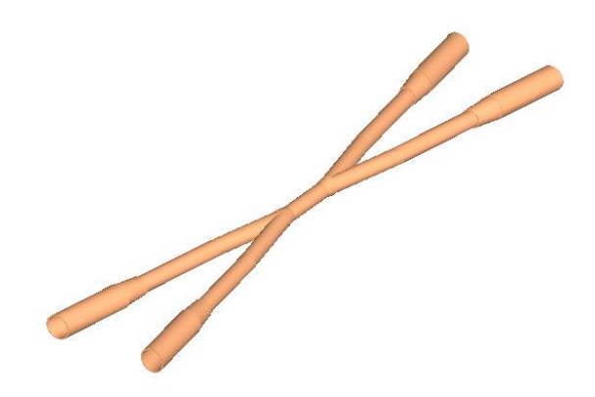
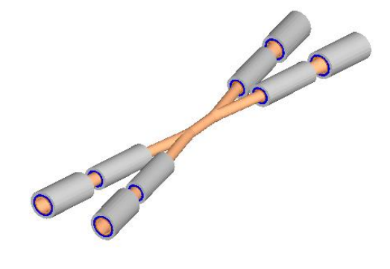
Update of Detector Simulation
Create a new beam pipe by Chengdong Fu according to the accelerator design

Slide 3
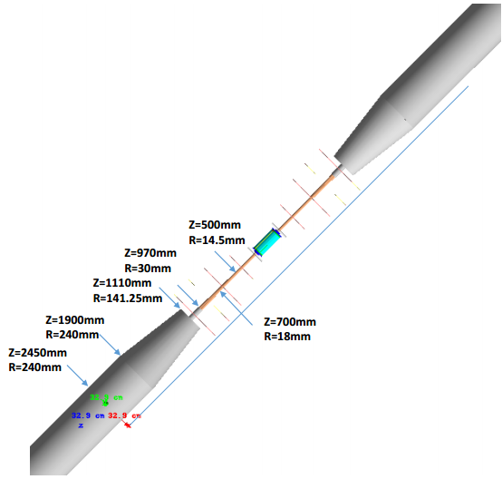
New model of IR

Slide 4
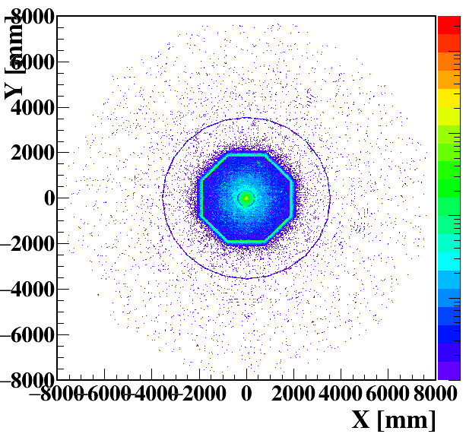
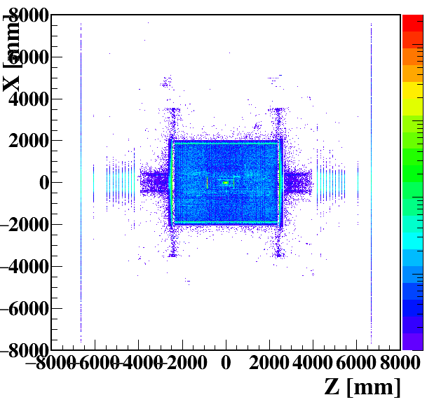
Detector Simulation of Beamstrahlung
Hit map of the whole detector

Slide 5
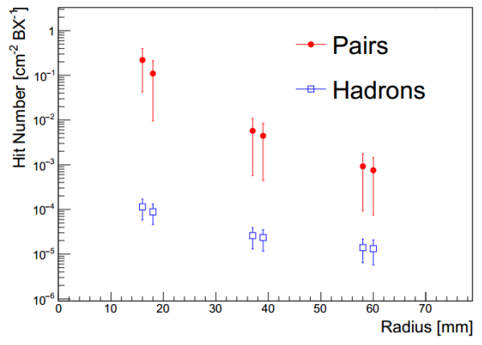
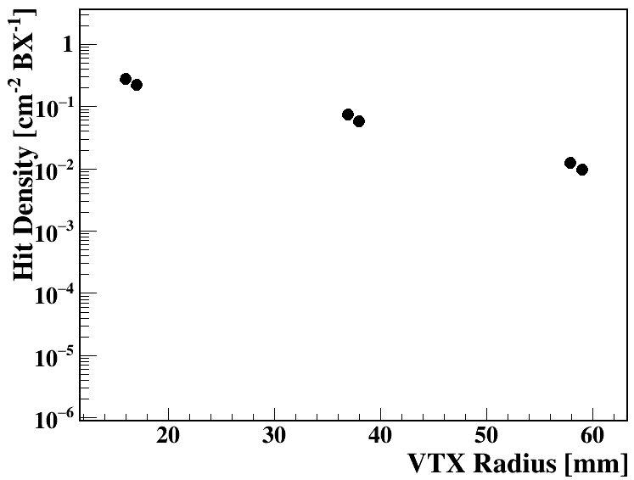
Hit Density at the Vertex Detector
Pairs
Single Ring, 3.5T
Double Ring, 3T
The hit density at outer layer of the VTX with magnetic field of 3 T is larger than that of 3.5 T

Slide 6
Summary
All of my documents can be found in the below website:
http://cepc.ihep.ac.cn/~cepc/cepc_twiki/index.php/Machine_Detector_Interface
Account: cepc
Password: cepc2014

