Slide 1
CEPC lattice design and DA optimization
Dou Wang, Yuan Zhang, Yiwei Wang, Huiping Geng,Chenghui Yu
2017.05.26

Slide 2
DA before optimization (lattice 1)
No damping
240 turns
With damping

Slide 4
DA after optimization (lattice 1)
No damping
240 turns
With damping

Slide 5
DA before optimization (lattice 2)
No damping
240 turns
With damping

Slide 6
DA after optimization (lattice 2)
No damping
240 turns
With damping

Slide 7
DA before optimization (lattice 3)
46 Knob: 8 IR sext + 22 IR Mult(k2) + 16 arc sextupoles
With damping
50 turns

Slide 8
DA after optimization (lattice 3)
With damping
50 turns

Slide 9
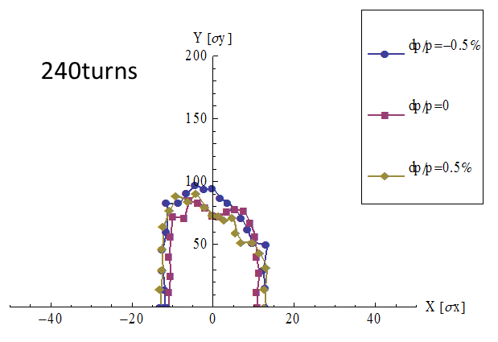

Slide 10
320turns

Slide 11
480turns

Slide 12
DA before optimization (lattice 4)
70 Knob: 8 IR sext + 4 IR multipoles(K1/K2/K3) + 18 IR Mult(k2) + 32 arc sextupoles
With damping
50 turns
200 turns

Slide 13
DA before optimization (lattice 4)
70 Knob: 8 IR sext + 4 IR multipoles(K1/K2/K3) + 18 IR Mult(k2) + 32 arc sextupoles
50 turns
Close K1
Close K2
K1 is the key of DA!

Slide 14
DA before optimization (lattice 4)
70 Knob: 8 IR sext + 4 IR multipoles(K1/K2/K3) + 18 IR Mult(k2) + 32 arc sextupoles
50 turns
Close K3
Close K2&K3

Slide 15
DA before optimization (lattice 4)
70 Knob: 8 IR sext + 4 IR multipoles(K1/K2/K3) + 18 IR Mult(k2) + 32 arc sextupoles
Close 22 multipoles except for K1

Slide 16
DA after optimization (lattice 4)
With damping
50 turns

Slide 17
DA before optimization (lattice 5)
70 Knob: 8 IR sext + 4 IR multipoles(K1/K2/K3) + 18 IR Mult(k2) + 32 arc sextupoles
With damping
200 turns

Slide 18
DA after optimization (lattice 5)
With damping
200 turns

Slide 19
Add multipole k1 to real quadrupole (lattice 5)
200 turns
Optics Distortion in IP : beata=0.1740689/ 0.0019829
working point=341.09925/341.22003

Slide 20
Add multipole k1 to real quadrupole (lattice 5)
200 turns
Optics Distortion in IP : beata=.17268262886877295/ .0019902450192472373
working point=341.099617/341.219991

Slide 21
Add multipole k1 to real quadrupole (lattice 5)
200 turns
Optics Distortion in IP : beata=.1724808175470621/ .0019924041029708082
working point=341.09961/341.219967

Slide 22
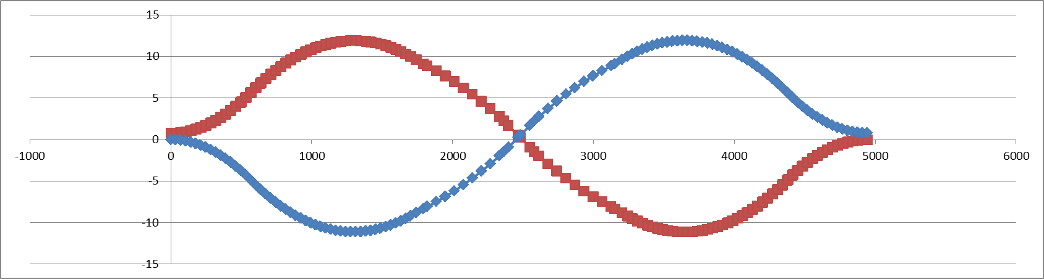
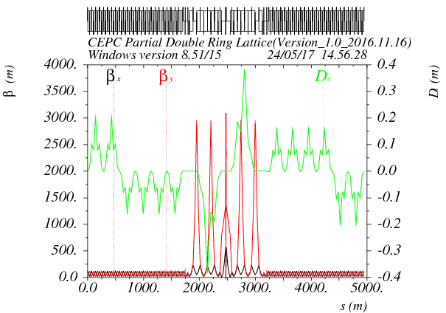
对撞区lattice及几何
SPPC
e-
e+
CEPC and SPPC is compatible in IP1 and IP3!

Slide 23
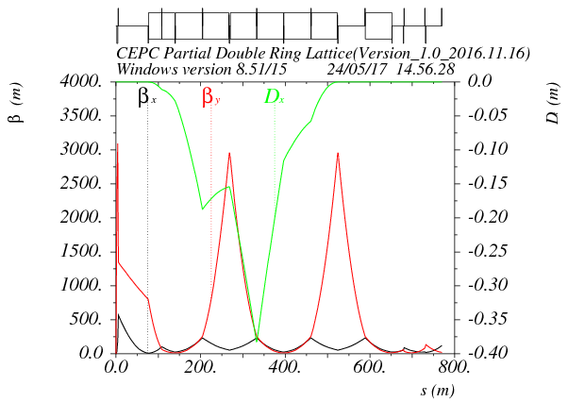
FFS lattice设计
Asymmetric dispersion
Shared sextupole for chromaticity correction and crab waist
Ec < 100 keV within 800m
Crab sextupole
Betax=0.171m
Betay=0.002m
L*=2.2m
K1(QD0)=150T/m

Slide 24
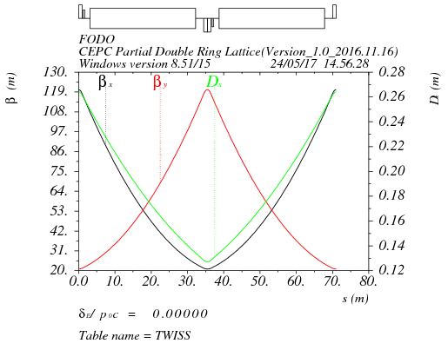
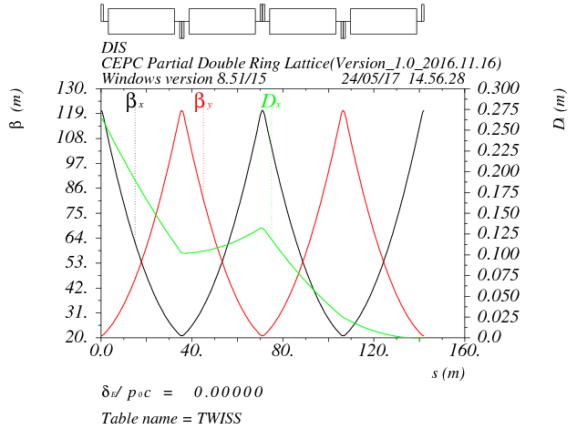
弧区lattice设计
90/90 FODO cell
Non-interleave sextupoles
Distance of two ring : 0.77 m

Slide 25
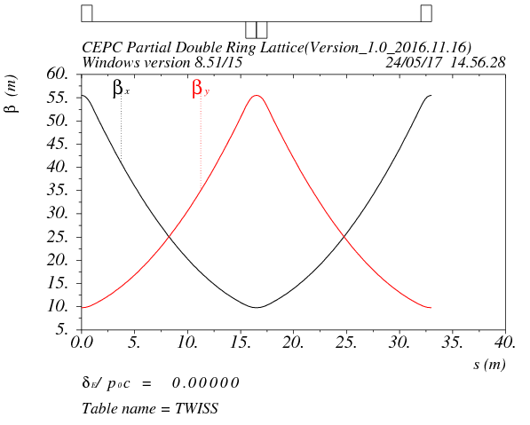
高频区lattice设计
90/90 FODO cell
Smaller beta than arc to suppress the multi-bunch instability (βmax: 55.5 m/βmin: 9.8 m)
Distance between quadrupole : 14.5m
Length of cryo-module: 12m

Slide 26
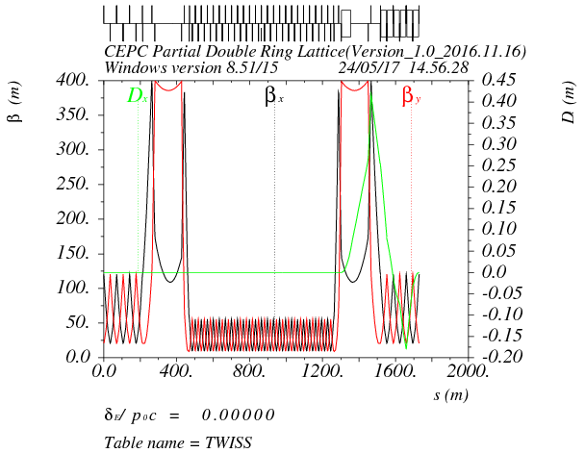
共享高频段lattice设计
Shared RF cavities for e- and e+ ring (Higgs)
Separator bending cancel that of dipoles for the beam of opposite direction
Δx=26cm at first quadrupole
Seperation at the end of seperator section: 0.77m
separator combined with a dipoles
beam
RF
RF

Slide 27
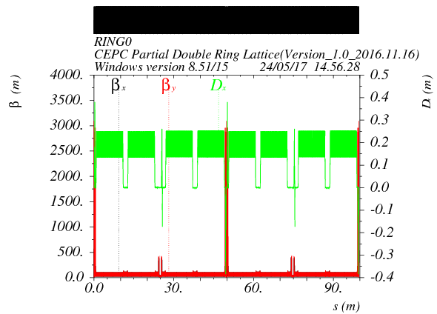
全环lattice
Circumference：99685m
Emittance from the real lattice：1.34nm

Slide 28
DA without optimization
With damping
2 fam sextupoles in arc
2 fam sextupoles in IR
(no sextupole in CCX)
200 turns tracking

