Slide 1
Information for workshop
Zhijun Liang

Slide 2
Travel to IHEP
You can get a taxi right outside the arrival terminals. It is about 40 km from the airport to IHEP. The fare should be about 150 RMB (about 25 USD) depending on time of day and traffic conditions.
Your flight number ?
Useful maps
http://english.ihep.cas.cn/doc/1775.html

Slide 3
Emergency contact
Zhijun Liang : 008618514028539
Manqi Ruan :
Joao Guimaraes da Costa : 008613693347476
Liu Bo: 008613406993990
Your phone number ?
Are you on roaming ?

Slide 4
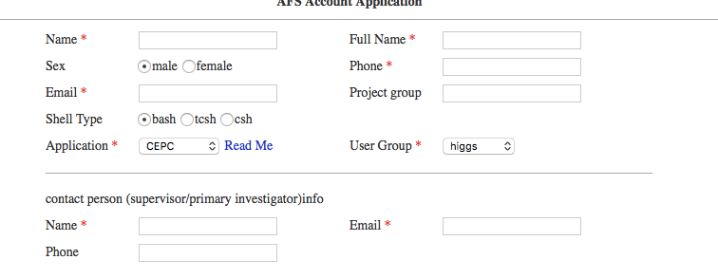
IHEP computing account
Need to apply for IHEP afs computing account
http://202.38.128.100:86/ccapply/userapplyaction.action

Slide 5
Accommodation
IHEP guest house
Manqi has reserved two rooms
http://english.ihep.cas.cn/doc/1709.html

Slide 6
Wifi inside IHEP
http://english.ihep.cas.cn/doc/2209.html
You can do Off-site registration before you arrive.

