Slide 1
IHEP PAPS SRF facility layout design
Feisi He
On behalf of colleagues in IHEP SRF group
Institute of High Energy Physics (IHEP)

Slide 2
Outline
Background
Brief introduction to the PAPS project
Future project that may need PAPS
The SRF facility
Layout and workflow
Labs for R&D purpose
Cryogenic system
Public service facilities

Slide 3
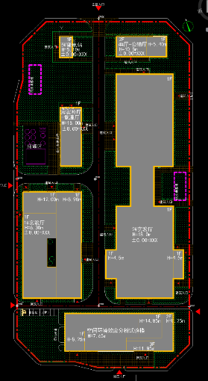
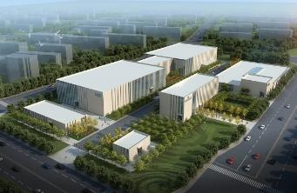
PAPS project overview
“Platform of Advanced Photon Source Technology R&D”, to provide infrastructure for construction of future project.
Budget: 500M CNY funded by Beijing Gov.
Construction: 2017.5-2020.6
Consist of 7 systems:
RF system
Cryogenic system
Magnet technology
Beam test
X-ray optics
X-ray detection
X-ray application

Slide 4
PAPS-RF system
The PAPS-RF system has two targets :
Build a SRF facility
Conduct R&D on cavities and ancillaries
The SRF facility is biased on mass production for SRF projects
Post-processing, clean assembly, VT/HT/conditioning of cavities, couplers, and cryomodules.
Compatible of 166MHz, 325MHz, 500MHz, 650MHz, and 1.3GHz
200-400 cavities (couplers) per year
~20 cryomodules per year
Support R&D on new material
and new technology
Total area of 4500 m²
Cryogenic system:
300W @ 2K
PAPS-RF
Testing
Clean assembly
Cavity VT
Labs
Cavity HT
CM conditioning
Coupler conditioning
Post processing
Microwave & LLRF
SC materials
Cavity R&D

Slide 5
Outline
Background
Brief introduction to the PAPS project
Future project that may need PAPS
The SRF facility
Layout and workflow
Labs for R&D purpose
Cryogenic system
Public service facilities

Slide 6
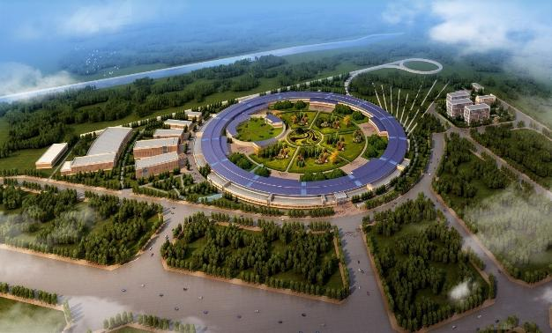
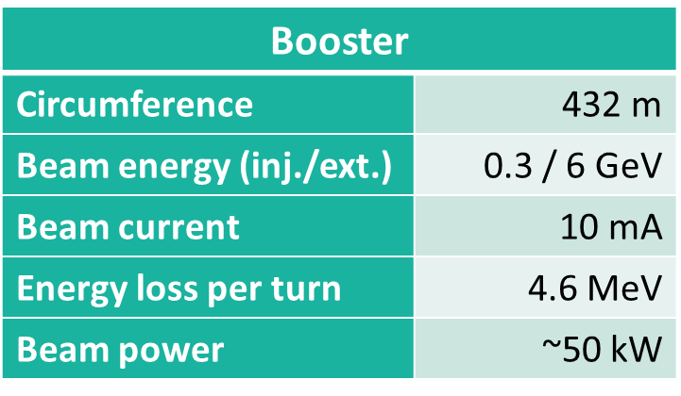
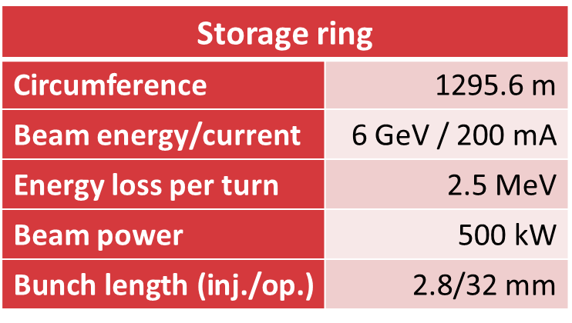
Future project: HEPS
High Energy Photon Source will be built in Beijing by IHEP from 2018 to 2024
Budget: 4.8B CNY

Slide 7
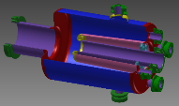
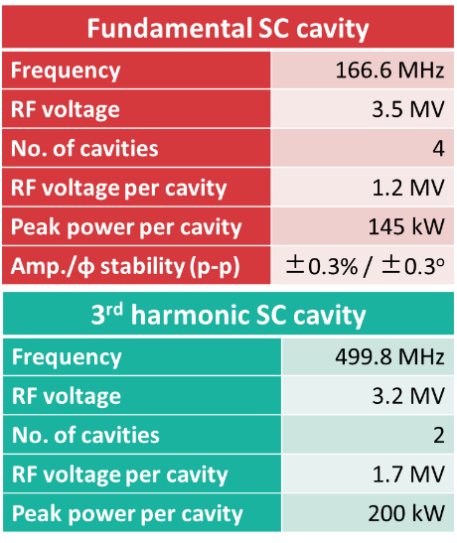
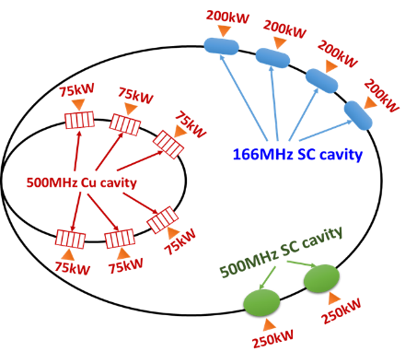
Future project: HEPS (2)
Solid-state amplifier: 166MHz, 200kW
500MHz, 75kW
Klystron: 500MHz, 250kW

Slide 8
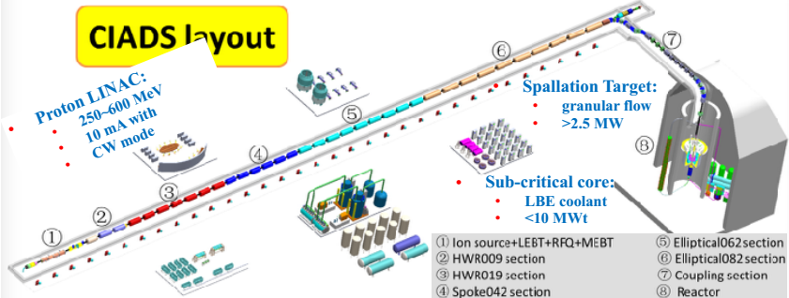
Future project: CIADS
Approved by Chinese government in Dec. 2015
Budget: >1.8B CNY
Proton CW linac > 250MeV
In collaboration of IMP, IHEP, and many other institutes

Slide 9
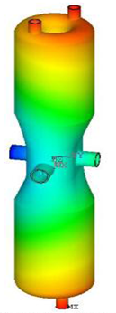
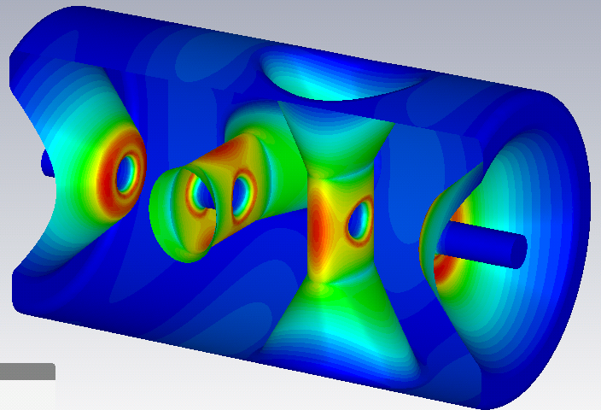
Future project: CIADS (2)
Current optics design:
HWR009
HWR019
56 of Double spoke β₀=0.42

Slide 10
Future project: Shanghai-XFEL
Approved with 10B CNY, to be built in 7 years
Dominated by Shanghai-Tech University and Sinap at Shanghai
8GeV CW Linac, with ~700 of 1.3GHz TESLA cavities
8 cavities in one cryomodule

Slide 11
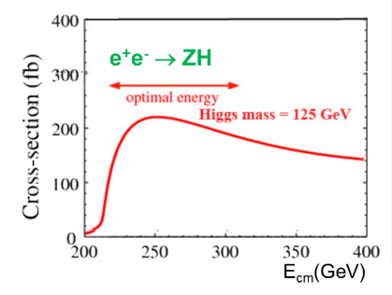
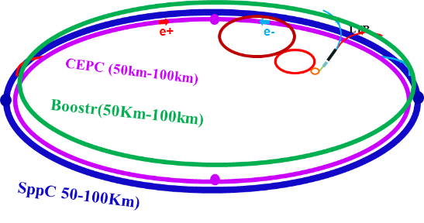
Future project: CEPC
Proposed by IHEP, pre-research in progress
Circular electron-positron collider at 2 x 120GeV
e+e- Higgs (Z) factory for precision measurement of the Higgs boson (and the Z boson)
Ecm~240GeV, luminosity ~2×10³⁴ cm⁻²s⁻¹, two detectors, 1M ZH events in 10yrs

Slide 12
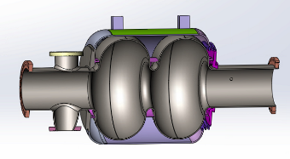
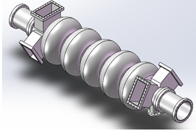
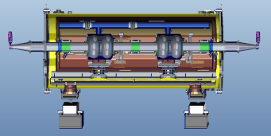
Future project: CEPC (2)
~600 of SRF 2-cell elliptical cavities at 650MHz needed. 2 or 6 cavities in one cryomodule.
5-cell cavities at 650MHz are possible according to optics design
Operation specification: Q₀>2e10@E_{acc}=16MV/m
VT specification: Q₀>4e10@E_{acc}=22MV/m

Slide 13
Outline
Background
Brief introduction to the PAPS project
Future project that may need PAPS
The SRF facility
Layout and workflow
Labs for R&D purpose
Cryogenic system
Public service facilities

Slide 14
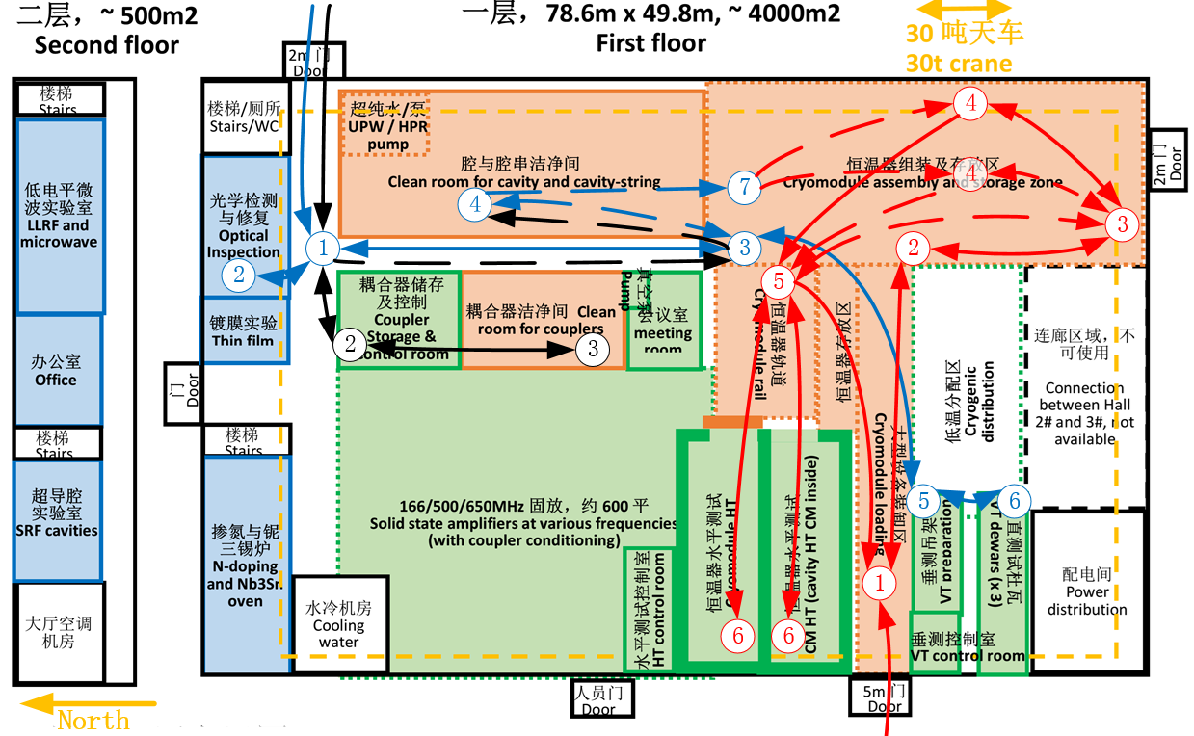
Layout of the SRF facility
3 VT dewars
2 HT caves
500m² CR
FPC aging in CR ISO7
Optic inspec.
Pre-tuning
Furnace
Nb₃Sn oven
Nb-Cu sputtering
T-mapping
Second sound
……
Blue lines: Cavity VT workflow
Black lines: FPC conditioning workflow
Red lines: CM assembly and test workflow

Slide 15
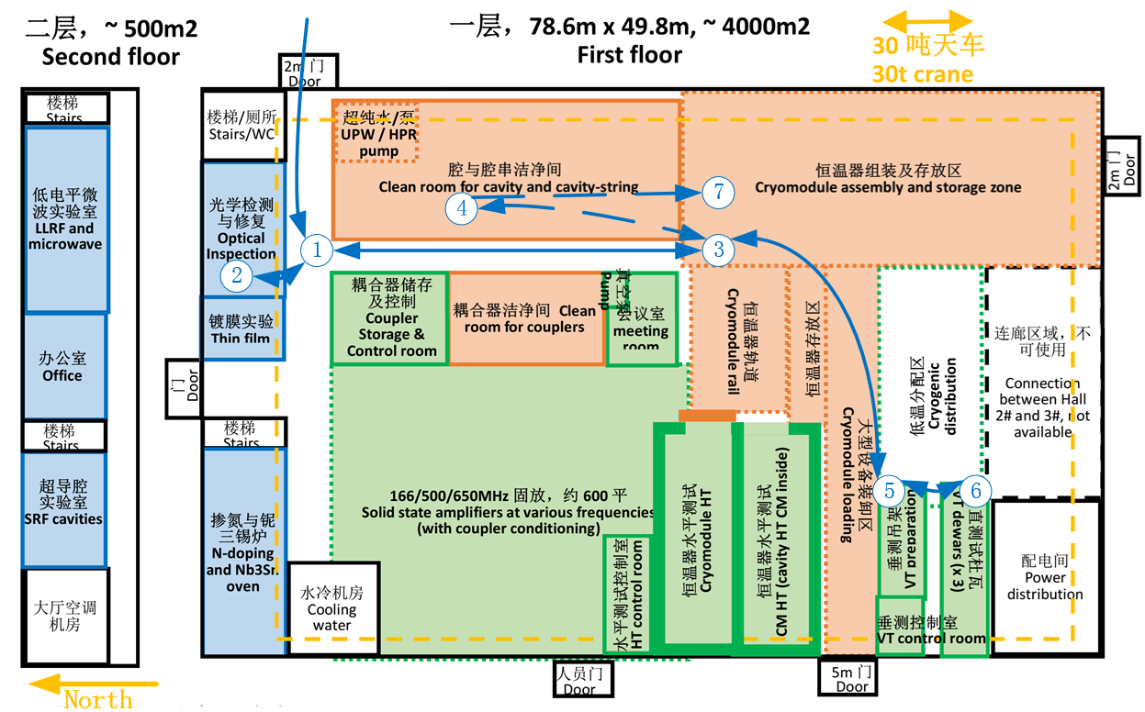
Workflow for vertical test
Compatible with 166/325/500/650/1300 MHz
Four 1.3GHz or two 650MHz cavities in one single test
1 VT/wk with HPR, or 2 VTs/wk with cavities ready to test
VT workflow:
② D1, validation
④ D2-5, HPR+dry
+assembly
⑤ D5-8, baking
+mounting
⑥ D8-12, Cool+VT
+Warm
⑤ D13, dismount

Slide 16
1
2
VT workflow
② Validation(1d)
④ HPR+dry+assembly (4d)
⑤ baking+mounting (3d)
⑥ Cool+VT+warm (4d)
⑤ Dismount (1d)
Notes:
② 频率/漏率检查
④ (HPR+洁净组装)
⑤ 上吊架
⑥ 吊入竖井垂测
⑤ 出杜瓦
④ (HPR+)腔串组装
或⑧ 实验/存放

Slide 17
1
2
3
4
VT workflow
② Validation (1d)
④ HPR+dry+assembly (4d)
⑤ baking+mounting (3d)
⑥ Cool+VT+warm (4d)
⑤ Dismount (1d)
Notes:
② 频率/漏率检查
④ (HPR+洁净组装)
⑤ 上吊架
⑥ 吊入竖井垂测
⑤ 出杜瓦
④ (HPR+)腔串组装
或⑧ 实验/存放

Slide 18
5
6
7
8
VT workflow
② Validation (1d)
④ HPR+dry+assembly (4d)
⑤ baking+mounting (3d)
⑥ Cool+VT+warm (4d)
⑤ Dismount (1d)
1
2
3
4
Notes:
② 频率/漏率检查
④ (HPR+洁净组装)
⑤ 上吊架
⑥ 吊入竖井垂测
⑤ 出杜瓦
④ (HPR+)腔串组装
或⑧ 实验/存放

Slide 19
VT workflow
② Validation (1d)
④ HPR+dry+assembly (4d)
⑤ baking+mounting (3d)
⑥ Cool+VT+warm (4d)
⑤ Dismount (1d)
5
1
6
2
7
3
8
4
Notes:
② 频率/漏率检查
④ (HPR+洁净组装)
⑤ 上吊架
⑥ 吊入竖井垂测
⑤ 出杜瓦
④ (HPR+)腔串组装
或⑧ 实验/存放

Slide 20
1
2
3
4
VT workflow
② Validation (1d)
④ HPR+dry+assembly (4d)
⑤ baking+mounting (3d)
⑥ Cool+VT+warm (4d)
⑤ Dismount (1d)
5
6
7
8
Notes:
② 频率/漏率检查
④ (HPR+洁净组装)
⑤ 上吊架
⑥ 吊入竖井垂测
⑤ 出杜瓦
④ (HPR+)腔串组装
或⑧ 实验/存放

Slide 21
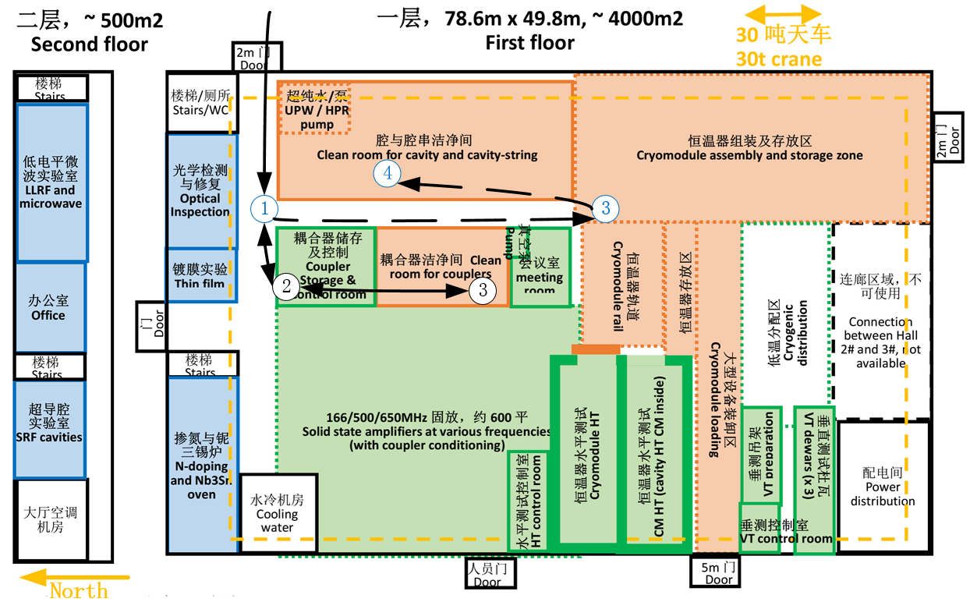
Workflow for FPC conditioning
Compatible with 166/325/500/650/1300 MHz single test stand
Upgradable for multiple test stand run at the same time
FPC workflow:
② D1-2, leak check
③ D3-10, cleaning
+assembly+bake
+conditioning
+disassembly
+Storage
Or④String assembly

Slide 22
FPC workflow
② Reception+Leak check+S11 (2d)
③ Cleaning+assembly+Conditioning +disassembly+Storage
Or ④ String assembly
Notes:
② 频率/漏率检查
④ (HPR+洁净组装)
⑤ 上吊架
⑥ 吊入竖井垂测
⑤ 出杜瓦
④ (HPR+)腔串组装
或⑧ 实验/存放

Slide 23
FPC workflow
② Reception+Leak check+S11
③ Cleaning+assembly+Conditioning +disassembly+Storage (8d)
Or ④ String assembly
Notes:
② 频率/漏率检查
④ (HPR+洁净组装)
⑤ 上吊架
⑥ 吊入竖井垂测
⑤ 出杜瓦
④ (HPR+)腔串组装
或⑧ 实验/存放

Slide 24
FPC workflow
② Reception+Leak check+S11
③ Cleaning+assembly+Conditioning +disassembly+Storage
Or ④ String assembly
Notes:
② 频率/漏率检查
④ (HPR+洁净组装)
⑤ 上吊架
⑥ 吊入竖井垂测
⑤ 出杜瓦
④ (HPR+)腔串组装
或⑧ 实验/存放

Slide 25
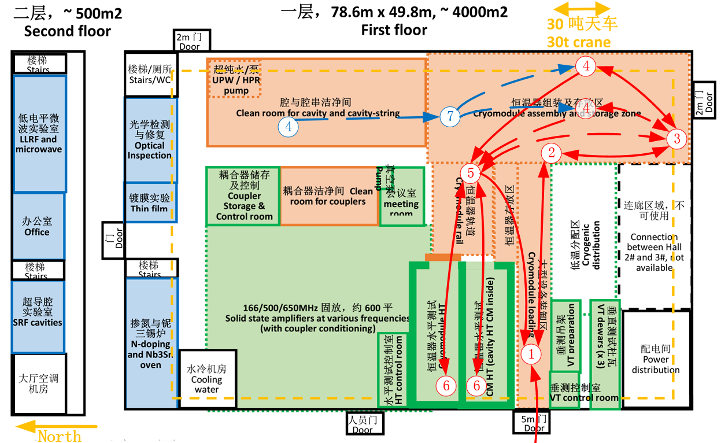
Workflow for CM assembly and test
Two shielding buckers with one cryostat for HT of single cavities at 166/500/650MHz
Upgradable for full test capacity of two CMs/week at a specific frequency
CM workflow:
①③ D0, storage
⑦ D1-15, Cold mass
assembly
④ D16-24, Cryomodule
assembly
⑤⑥ D25-44, HT
⑤① D45, shipment

Slide 26
1
2
3
4
1
2
3
4
5
6
7
8
CM workflow
①③ Storage (1d)
⑦ Cold mass assembly (15d)
④ CM assembly (9d)
⑤⑥ HT preparation, cool (10d)
⑥ HT, warm (10d)
①or③ Shipment or storage (1d)
Notes:
② 频率/漏率检查
④ (HPR+洁净组装)
⑤ 上吊架
⑥ 吊入竖井垂测
⑤ 出杜瓦
④ (HPR+)腔串组装
或⑧ 实验/存放

Slide 27
1
2
3
4
5
6
7
8
1
2
3
4
5
6
7
8
CM workflow
①③ Storage (1d)
⑦ Cold mass assembly (15d)
④ CM assembly (9d)
⑤⑥ HT preparation, cool (10d)
⑥ HT, warm (10d)
①or③ Shipment or storage (1d)
Notes:
② 频率/漏率检查
④ (HPR+洁净组装)
⑤ 上吊架
⑥ 吊入竖井垂测
⑤ 出杜瓦
④ (HPR+)腔串组装
或⑧ 实验/存放

Slide 28
1
2
3
4
5
6
7
8
1
2
3
4
5
6
7
8
CM workflow
①③ Storage (1d)
⑦ Cold mass assembly (15d)
④ CM assembly (9d)
⑤⑥ HT preparation, cool (10d)
⑥ HT, warm (10d)
①or③ Shipment or storage (1d)
Notes:
② 频率/漏率检查
④ (HPR+洁净组装)
⑤ 上吊架
⑥ 吊入竖井垂测
⑤ 出杜瓦
④ (HPR+)腔串组装
或⑧ 实验/存放

Slide 29
垂直测试动线
CM workflow
①③ Storage (1d)
⑦ Cold mass assembly (15d)
④ CM assembly (9d)
⑤⑥ HT preparation, cool (10d)
⑥ HT, warm (10d)
①or③ Shipment or storage (1d)
Notes:
② 频率/漏率检查
④ (HPR+洁净组装)
⑤ 上吊架
⑥ 吊入竖井垂测
⑤ 出杜瓦
④ (HPR+)腔串组装
或⑧ 实验/存放

Slide 30
垂直测试动线
CM workflow
①③ Storage (1d)
⑦ Cold mass assembly (15d)
④ CM assembly (9d)
⑤⑥ HT preparation, cool (10d)
⑥ HT, warm (10d)
①or③ Shipment or storage (1d)
Notes:
② 频率/漏率检查
④ (HPR+洁净组装)
⑤ 上吊架
⑥ 吊入竖井垂测
⑤ 出杜瓦
④ (HPR+)腔串组装
或⑧ 实验/存放

Slide 31
Outline
Background
Brief introduction to the PAPS project
Future project that may need PAPS
The SRF facility
Layout and workflow
Labs for R&D purpose
Cryogenic system
Public service facilities

Slide 32
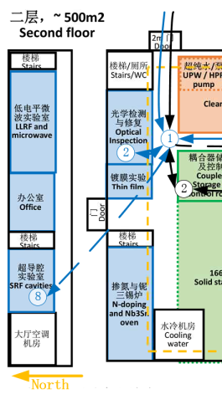
Labs for R&D purpose
Inspection and measurement
Optical inspection and grinding
Pre-tuning machine
New material and technology
Oven for high baking and N-infusion
Oven for Nb₃Sn treatment
Nb-Su sputtering
High precision measurement
T-mapping
Second sound
Vibration analysis
……

Slide 33
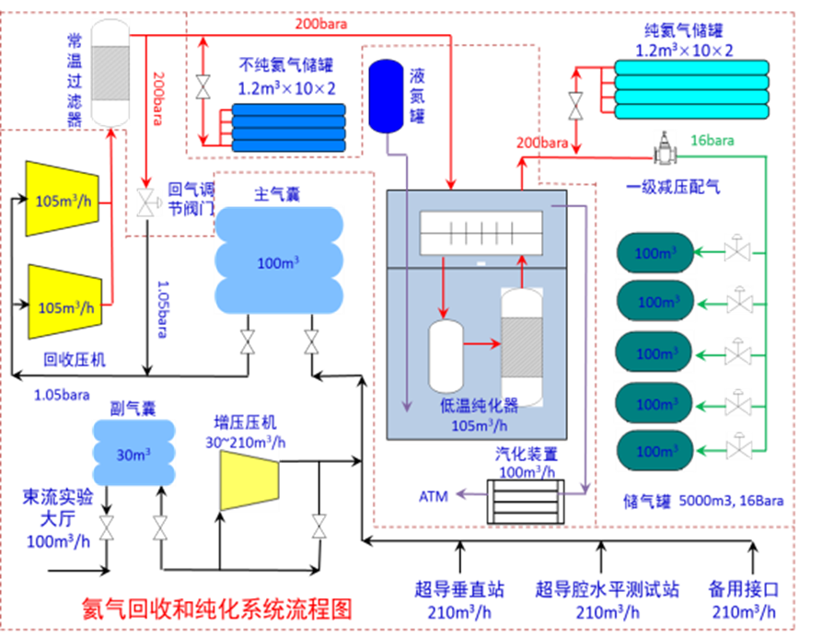
The cryogenic system
Cryogenic system
2.5KW@4.5K and 300W@2K LHe system
210m³/h gas recycle and 100m³/h gas purify capability

Slide 34
Function of the cryogenic system
VT dewars and HT CMs could be cooled, warmed, or tested separately. Cooling capacity is 100W for each.
Every two of the three VT dewars could be cooled or warmed at the same time; single test at the same time.
Each of the two HT CMs could be cooled or warmed at the same time; single test at the same time.

Slide 35
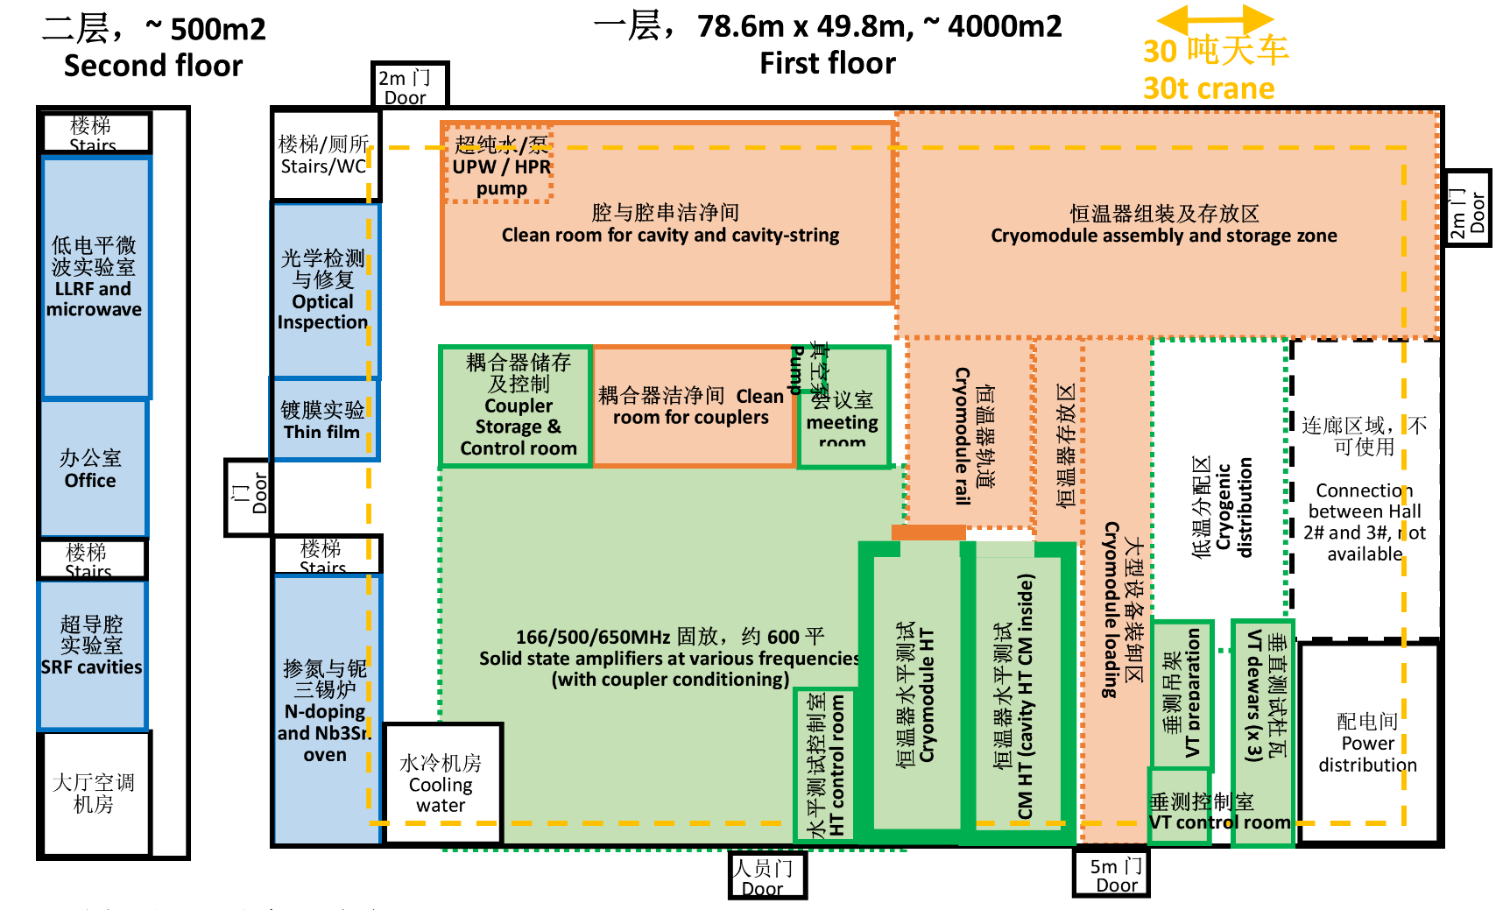
Compressed air and N₂ gas
5 bar compressed air for valve, gauges, pneumatic tool, blow.
5 bar N2 from LN, 0.5um pp filter to remove particles, 0.1um fiberglass filter to remove moisture.
是
Compressed air supply
Compressed air tank
Clean N2 supply
Notes:
N2: 0.05um，H20 <0.1ppm

Slide 36
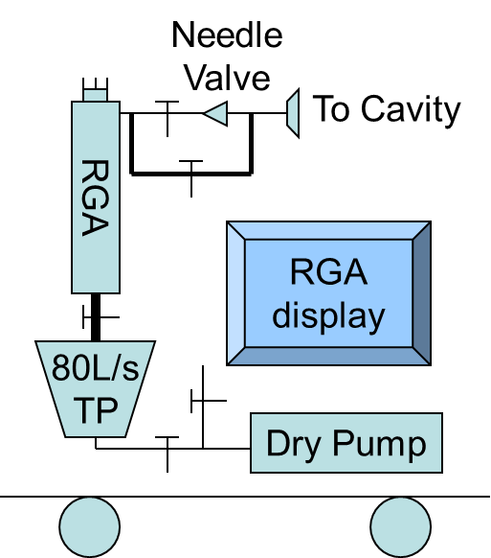
RF and vacuum equipment for general purpose
RF equipments | Quantity | Note
Signal generator | 2 | 9K--3GHz
Power meter | 2 | Dual channels
Power meter | 1 | Handheld
Oscilloscope | 1 | 1.5GHz
Oscilloscope | 2 | 100M,4 channels
Vector network analyzer | 1 | 2Hz--20GHz
Vector network analyzer | 1 | Handheld
Arbitrary wave generator | 3 | 30MHz
Frequency counter | 1 | 1.5GHz
Spectrum analyzer | 1 | 2Hz--6GHz
Vacuum equipments | Quantity | Note
Molecular pump unit | 1 | Oil-free, with garge
Leak detector | 2 | One for oil-free
Scroll pump | 1 | Oil-free
SPSV unit | 1 | MFC, 0.03um filter
PID Baking Controller | 2 | Up to 200C
RGA set | 1 | 1e-5 Pa to 1bar
Notes:
N2: 0.05um，H20 <0.1ppm

Slide 37
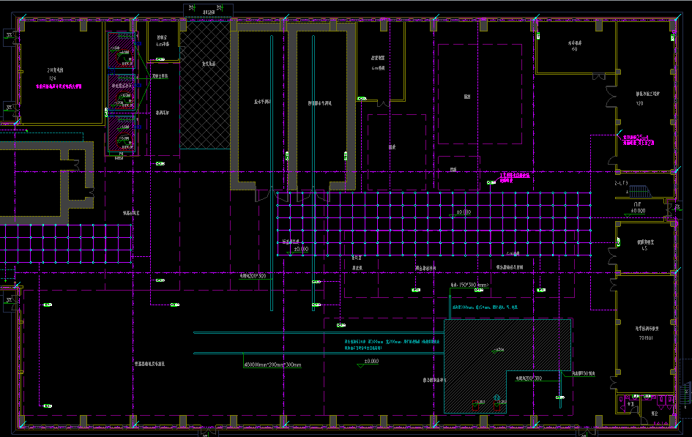
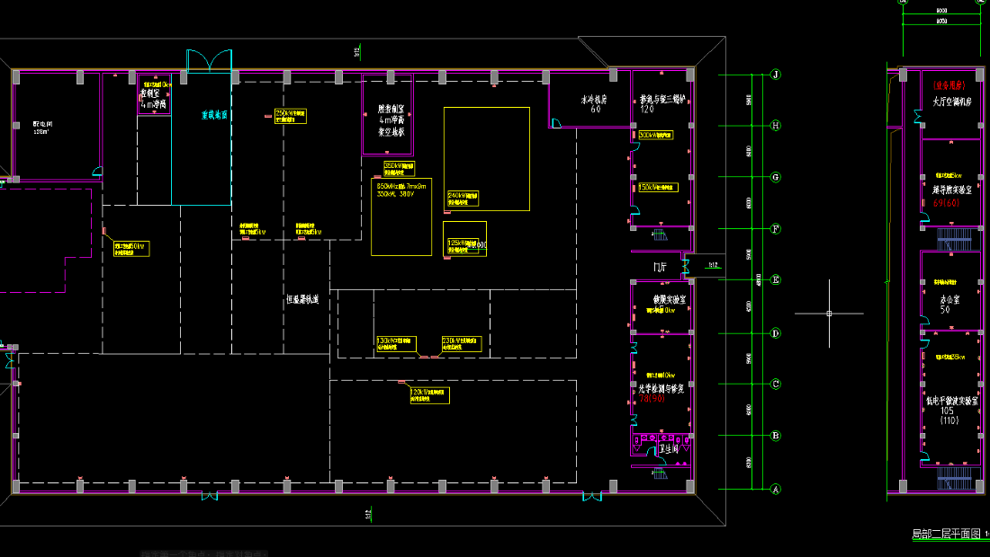
Public service facilities (2)
30 tons cranes to cover the whole hall, including the passageway of the second floor.
Gantry crane and manual folklift for light-weight pieces.
Total electric power about 800kW, with plugs and power and distribution ready; separate gound for control and high power
Notes:
N2: 0.05um，H20 <0.1ppm

Slide 38
Thanks for your attention!

