Slide 1


Cavity R&D Facilities
International Review on PAPS RF System
Song JIN
2017. 07. 14

Slide 2
Content
Cavity optical inspection and local grinding
Tuning equipment
N-doping furnace
Nb3Sn furnace
Nb/Cu coating system

Slide 3
1、Cavity optical inspection and local grinding system

Slide 4
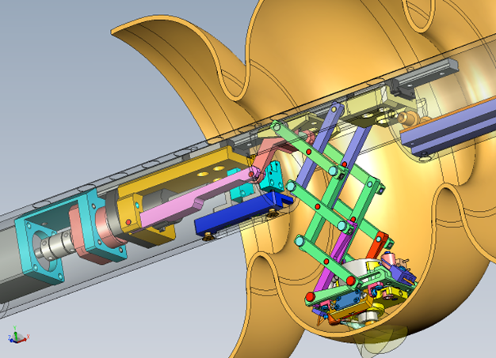
Optical Inspection and Grinding System
High resolution optical camera is a key tool to identify cavity defects. Local grinding is effective repairing tool for a cavity with a few defects.
  Kyoto Camera (CavCam) is one of the most successful and widely used cavity optical inspection systems.
  We will order a CavCam high resolution cavity camera combined with the local defect grinder of the latest version.

Slide 5
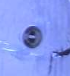
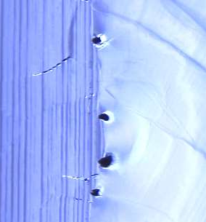
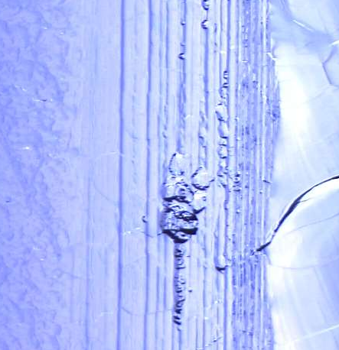
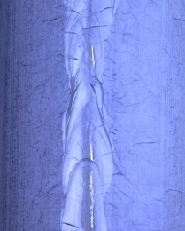
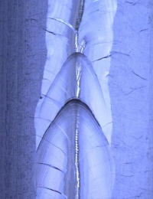
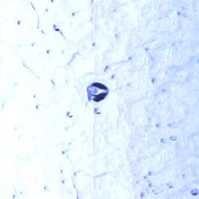
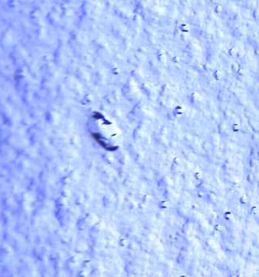
Example Images by Kyoto Camera
(IHEP TESLA cavity in KEK STF)
Cat-eyes
Trimming grooves
Etching pits
Undercuts
Weld irregularities
Bumps, scratches
Total: 4 ( 2 > 100 μm)
Diameter: 50 ~ 200 μm
Depth: 50 μm?
harmful or not?
Total: tens of
Diameter: < 200 μm
Depth: ?
Bumps after EP1
Narrow down
Numerous ( < 100 μm)
Material original or deep drawing induced pits,
Enlarged by EP
Weld spatters (very harm full)
Foreign inclusions (most harmful)

Slide 6
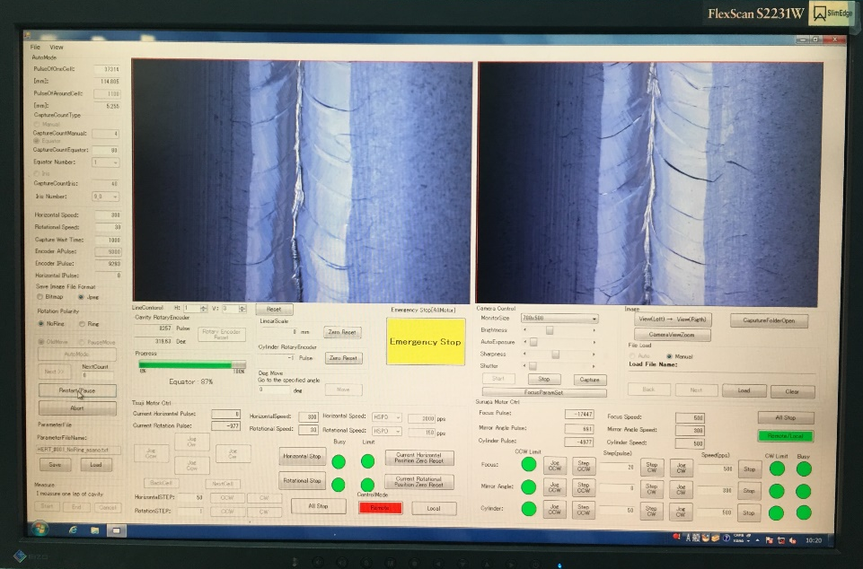
User Interface of Control Software

Slide 7
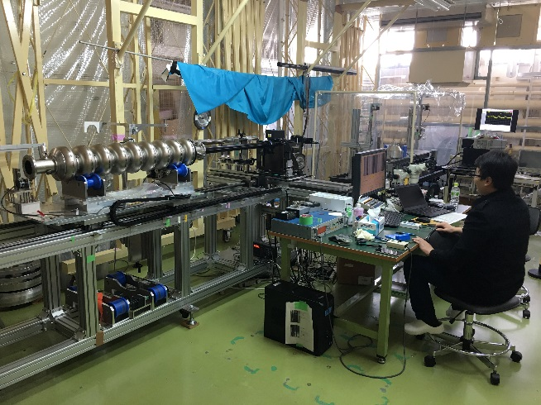
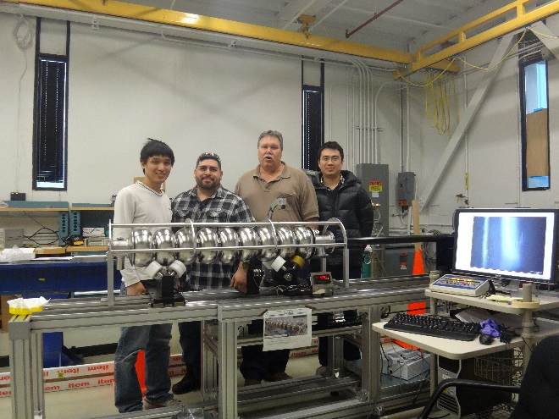
Kyoto Camera in the World
DESY
KEK
Three IHEP 9-cell cavities inspected by the Kyoto camera in KEK STF.
FNAL
One IHEP 9-cell cavity inspected by the Kyoto camera in FNAL.
CERN

Slide 8
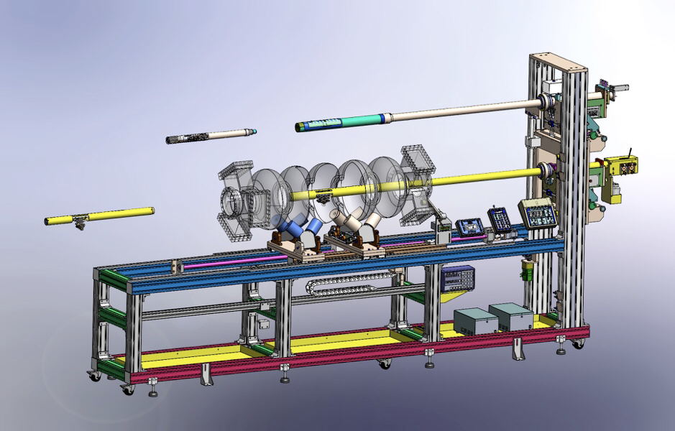
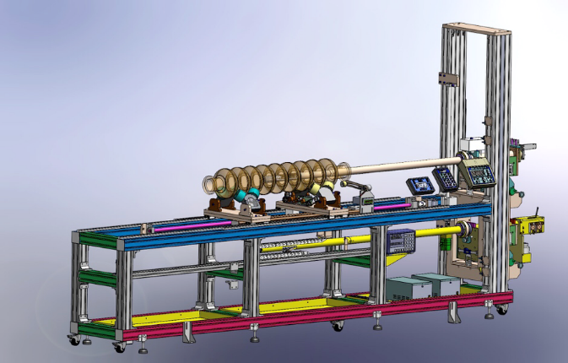
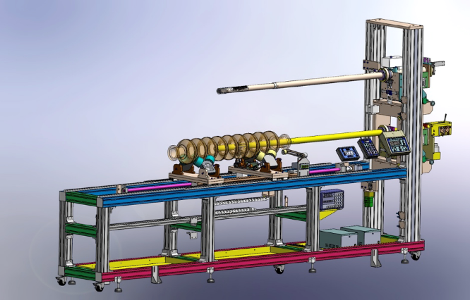
Combined CavCam and Local-Grinding Design for IHEP PAPS
650 MHz Inspection or Grinding
1.3 GHz Inspection
1.3 GHz Grinding
Switchable Inspection and Grinding of 650 MHz 1 to 5-cell cavity.
Extendable to 1.3 GHz 1 to 9-cell by changing camera head and grinder head.

Slide 9
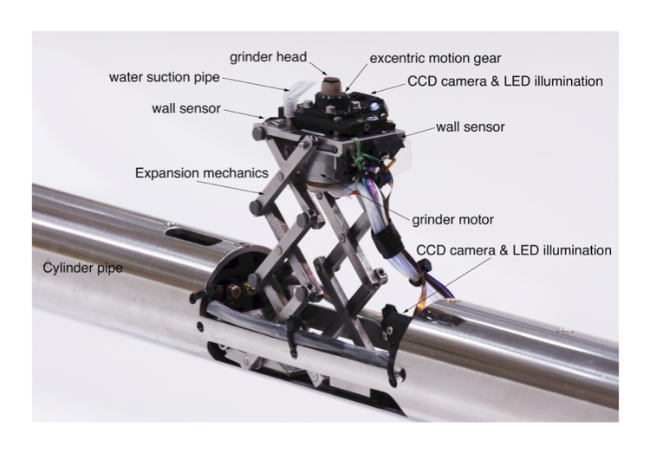
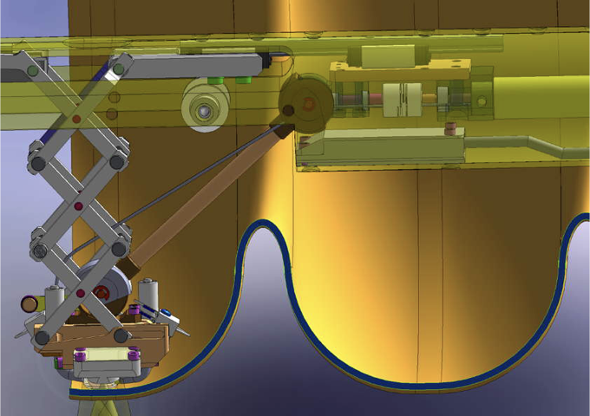
Grinding System

Slide 10
Main Features of the CavCam System
Inspection and grinding of the equator and iris area
Automated inspection (auto-photo, auto-focus etc.)
Resolution: < 5 μm / pixel
Independent brightness control of each illumination LED
Rotatable cavity and camera cylinder
External driving motor of the grinder
Collision-free of the grinder with proximity sensor
Easy operation and maintaining

Slide 11
2、Tuning Machine

Slide 12
Introduction
Tuning machine is the equipment to adjust the frequency, field flatness, eccentricity (straightness) and length of the multi-cell cavities to meet the target specifications.
Fully automatic tuning machine (FATM) is needed for the cavity mass-production at industry. We plan to make a machine for 1.3 GHz TESLA cavity in collaboration with related labs (other fund).
For the first tep, we will make a semi-automatic tuning machine (SATM) for 1.3 GHz TESLA cavity based on the DESY design, which is upgradable to FATM in the near future.

Slide 13
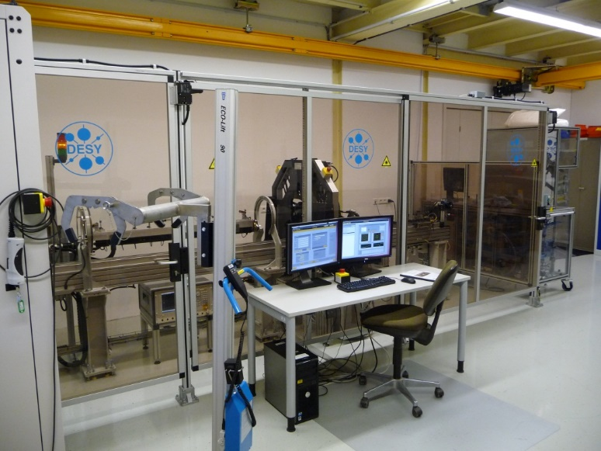
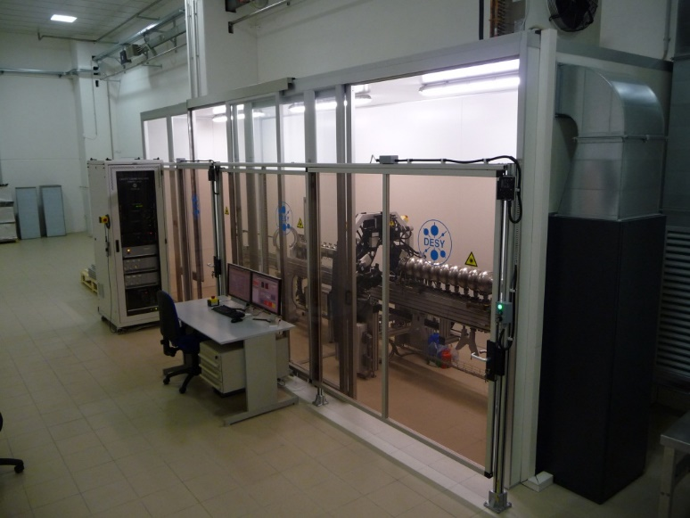
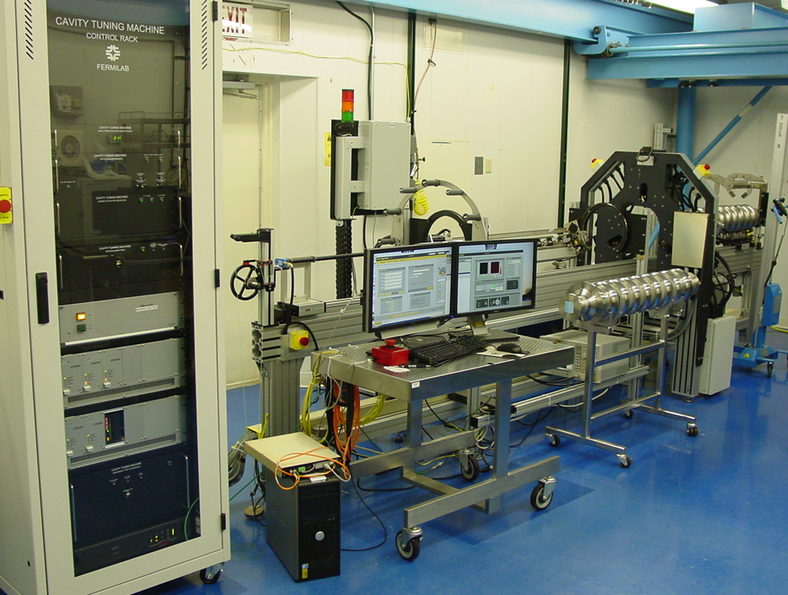
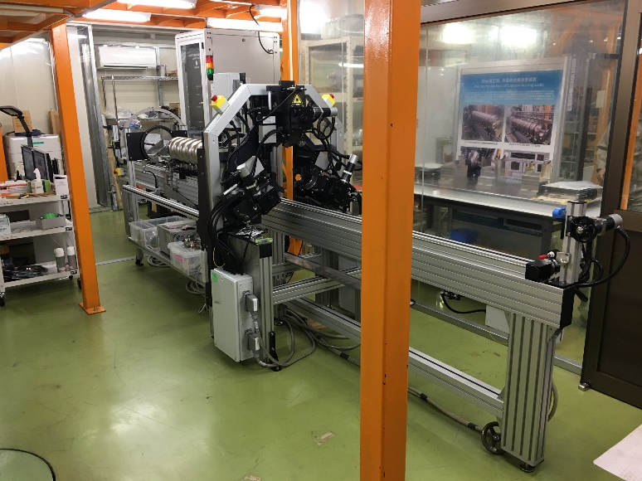
Fully Automatic Tuning Machine
DESY@RI
DESY@Zonon
FNAL
KEK

Slide 14
(courtesy of DESY)

Slide 15
Main Features of the Tuning Machine
Include:
Base Frame
Cavity Supporters and Train
Tuning Frame (vice jaws, sensors and actuators)
Bead-Pull System
Motors Control
Not include (upgrade in the future):
Cavity Alignment Tool (laser)
Eccentricity Measurement Device
Network Analyzer
Software
...

Slide 16
3、N-doping furnace

Slide 17
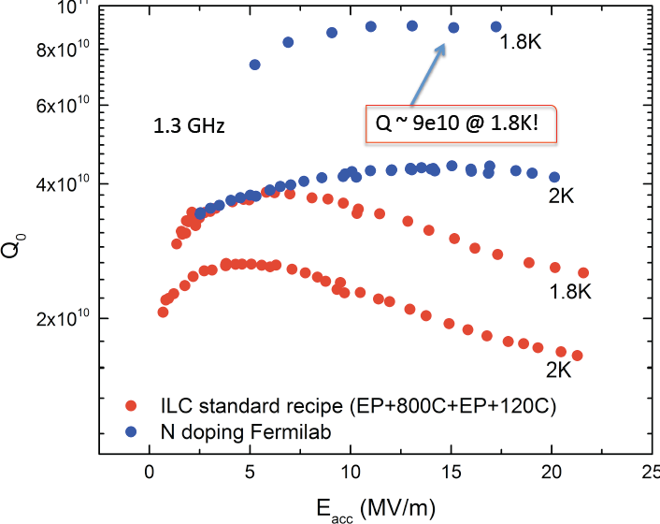
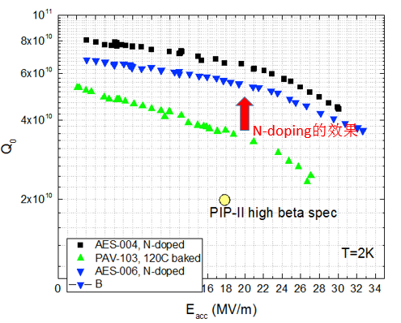
N-doping effects
Vertical test results of 1.3GHz single cell cavity (courtesy of FNAL)
Vertical test results of 650 MHz Single-Cell (β=0.92) cavity (courtesy of FNAL)

Slide 18
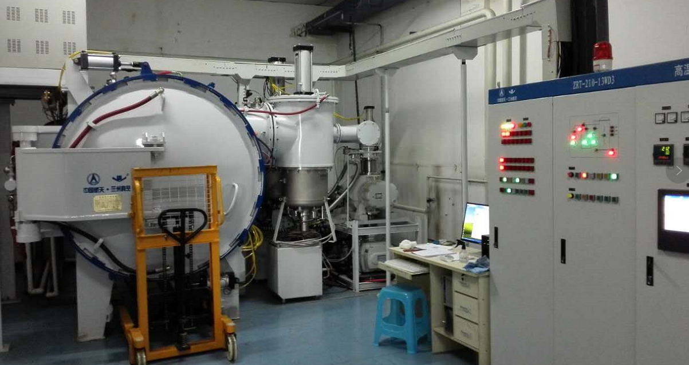
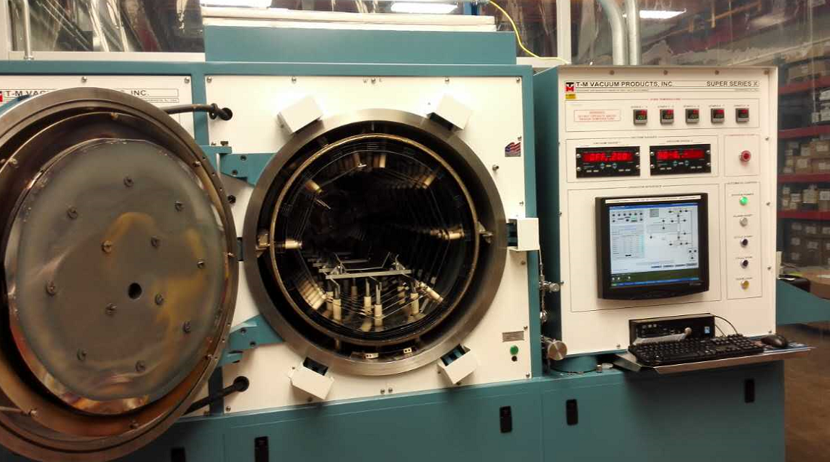
N-doping furnaces
N-doping Furnace at FNAL（made by T-M VACUUM）
N-doping Furnace at OTIC
(similar as ours, made by Lanzhou Vacuum）

Slide 19
Main parameters of design
Dimensions：7000L×6000W×3500H（mm）
Total electricity power：300 kW
Heating power：210 kW
Uniform temperature zone：1500*600*600 mm
Max temperature：1200 °C
Max Load: 500 kg
Ultra vacuum：<1e-4 Pa
Cooling：natural cooling with protective gas
Gas Injection ：4 ports for N₂, Ar, air and RGA
Mass flow controller: 0.1-100Pa

Slide 20
Main components of vacuum system
Oil-free pumping system: two COOLVAC10000 CL-V（DN500 ISO-K，N₂ pumping speed 10 000l/s) cryo-pumps by Leybold、one roots pump (1200L/S)、one screw pump.
All valves are pneumatic, which automatically shut as power off.
Vacuum pipe is made by stainless steel to keep clean.

Slide 21
Control system
PLC with Touch screen
Industrial Personal Computer with Labview
Main parameters such as mass flow, will be automatic controlled;
Data can be recorded, stored and transferred by internet
There’s also manual control system, which is independent from computer.

Slide 22
4、 Nb₃Sn furnace

Slide 23
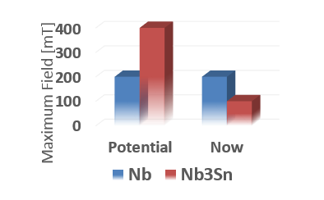
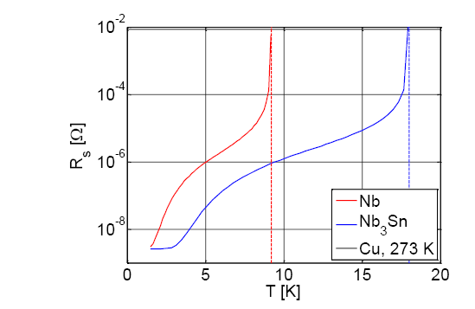
Advantages
Niobium cavity coating with Nb₃Sn can work at 4.2K, which save much cost than 2K.
Nb₃Sn is predicted to have 2 times higher magnetic field limit of niobium.

Slide 24
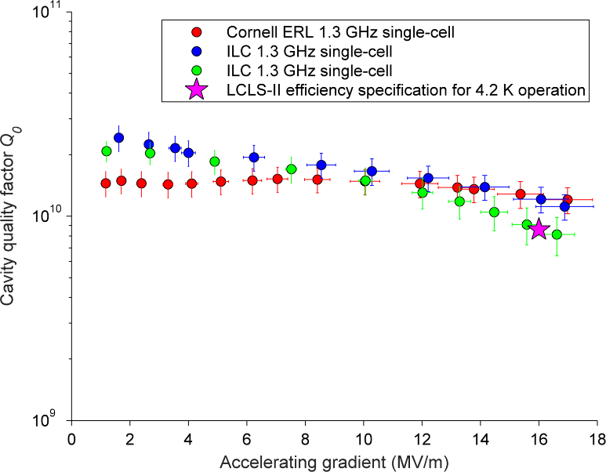
Economic benefits
Efficiency of 4.2K to 2K is about 5:1. Take PAPS Cryogenics system for example, the refrigerator (2500W@4.2K ≈ 500W@2K) costs 50 million Chinese Yuan, while the refrigerator (500W@4.2K) costs about 15 million Chinese Yuan.
1W@4.2K needs 300W electricity power. So the electricity power of PAPS cryogenics system (500W@2K) is ~750kW. If 4.2K, it’s ~150kW for 500W@4.2K.

Slide 25
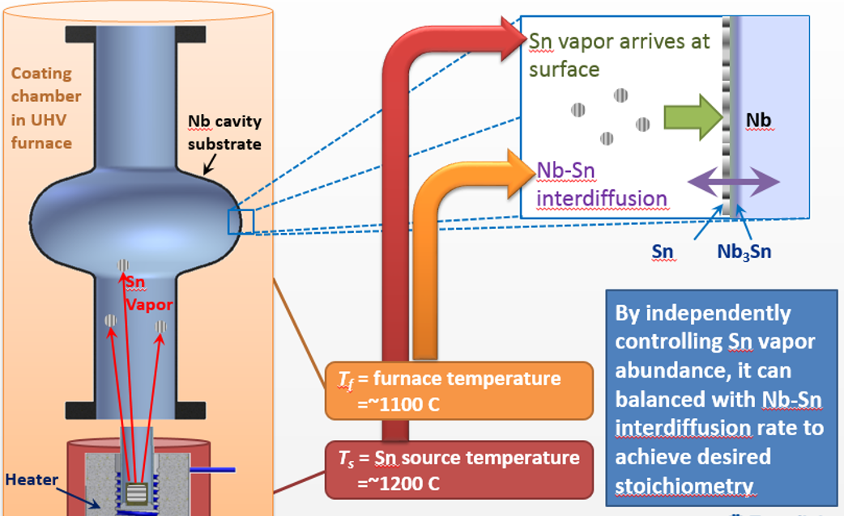
Schematic of Nb cavity coating with Nb₃Sn (courtesy of FNAL)

Slide 26
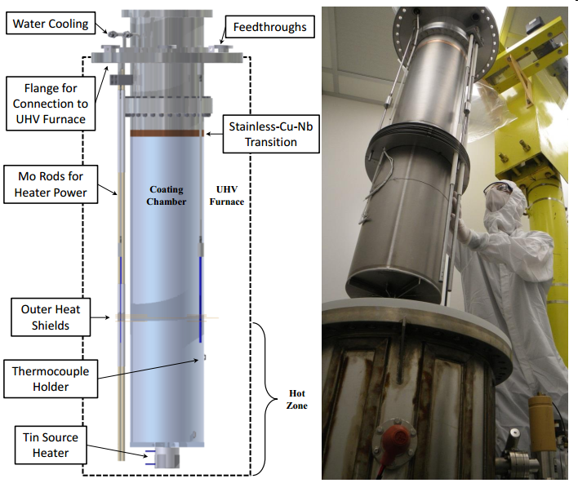
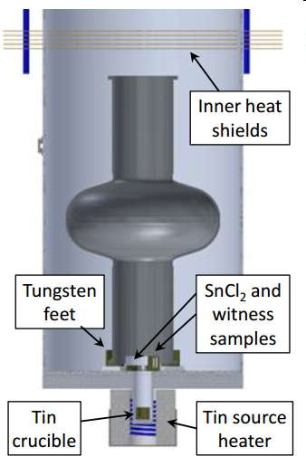
Cornell Nb₃Sn coating furnace

Slide 27
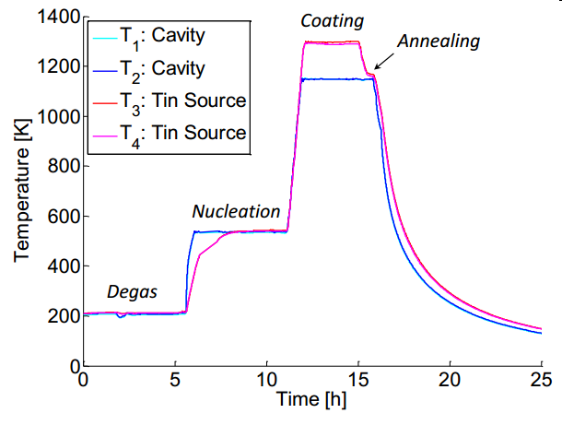
Cornell Nb₃Sn coating technique

Slide 28
Schematic of Nb3Sn Coating Furnace
  Furnace
    Working area:1000 × Φ 600 mm
    Maximum temperature
      Furnace area:1200℃
      Crucible:1300℃
  Vacuum
    Nb chamber
    Crucible material: Tungsten
    Oil free pumping system
    Ultimate vacuum：<1×10⁻⁴ Pa
  Temperature control
    The temperature at Nb chamber can be precisely controlled in the range of 1000~1300℃ with accuracy of ±1℃
Thermal sensor
G
Sn heater
TP
Turbo Pumps
Nb
chamber
Roots
Pumps
Heat shields
Screw
pumps
(Oil free)
G
Outer oven
Screw
pumps

Slide 29
5、Nb/Cu coating system

Slide 30
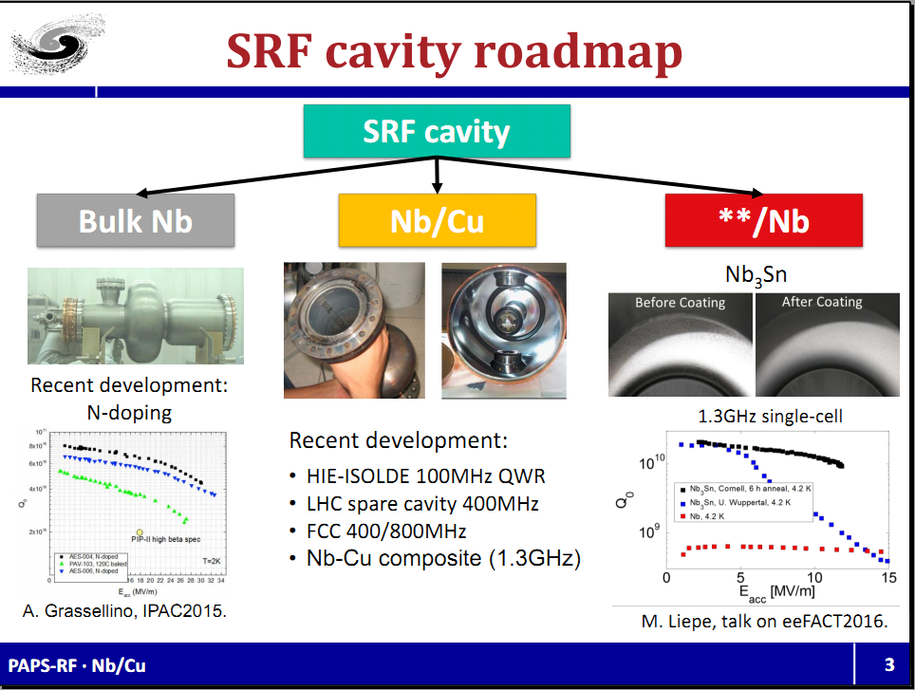
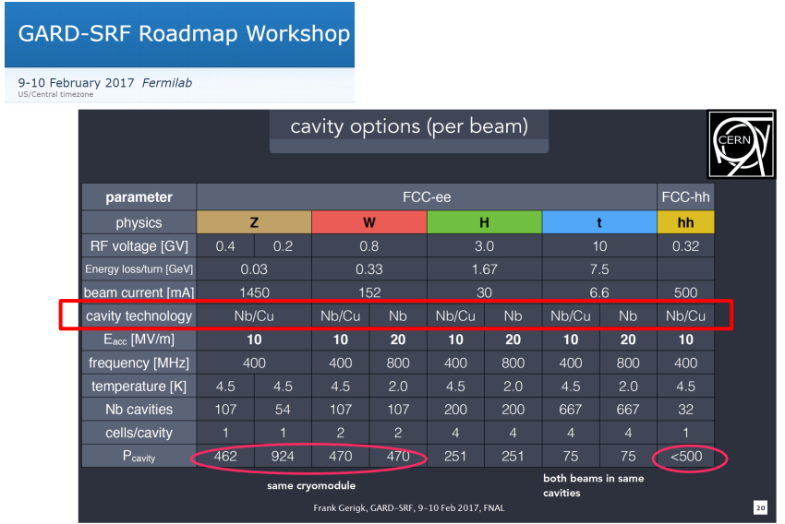
Introduction*
* P. Zhang, Status of Nb/Cu, Internal report at IHEP;

Slide 31
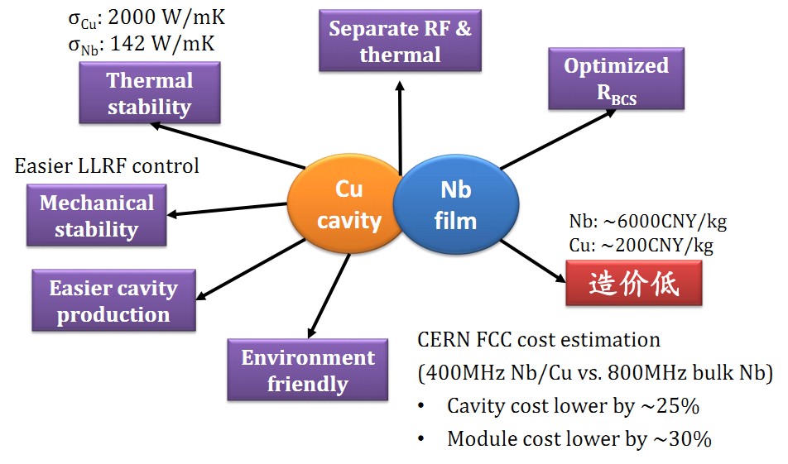
Benefit of Nb/Cu*
Low Cost
* P. Zhang, Status of Nb/Cu, Internal report at IHEP;

Slide 32
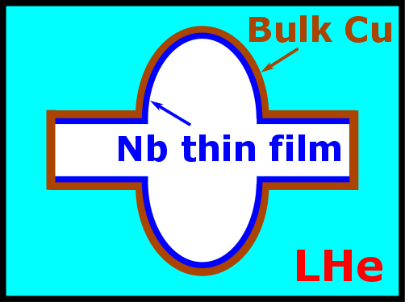
Nb/Cu
Cu substrate
- 1.3GHz (multiple VTs)
- 500MHz (eyes on HEPS HC)
Coating method
- DCMS
- HiPIMS (future)
Approach
- Samples
- Real cavity
SRF Cavity
Cu cavity
Nb thin film
SC

Slide 33
Thanks！

