Slide 1
STFC SRF test facility for ESS high beta cavities
UKRI
CryoOps Workshop at IHEP
June 6th 2018
Louis Bizel-Bizellot

Slide 2
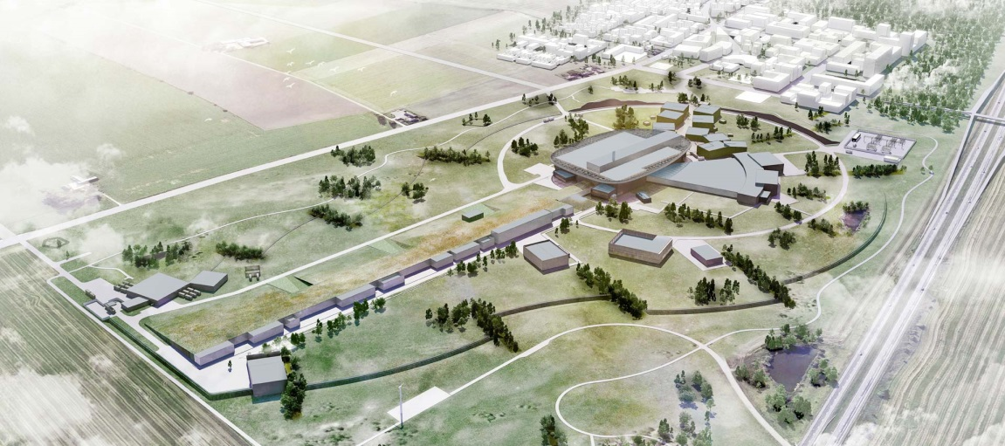
What is ESS ?
European Spallation Source
→ LINAC which accelerate proton toward a tungsten target generating neutrons.
→ 2.86 ms long proton pulse at 2 GeV at 14 Hz
→5 MW of average power with a DT = 4%
Currently under construction
User program for 2023
LINAC 100% functional in 2025

Slide 3
Hβ Cavity Project at STFC
Production + qualification
x 84 Hβ SRF cavities
Assembled into 21 cryo-module by CEA

Slide 4
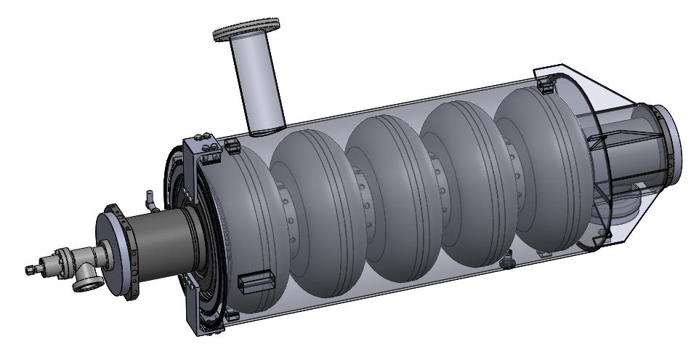
Hβ Cavity Project at STFC
Ti
x 84
Nb
Ø 460 mm
1550 mm

Slide 5
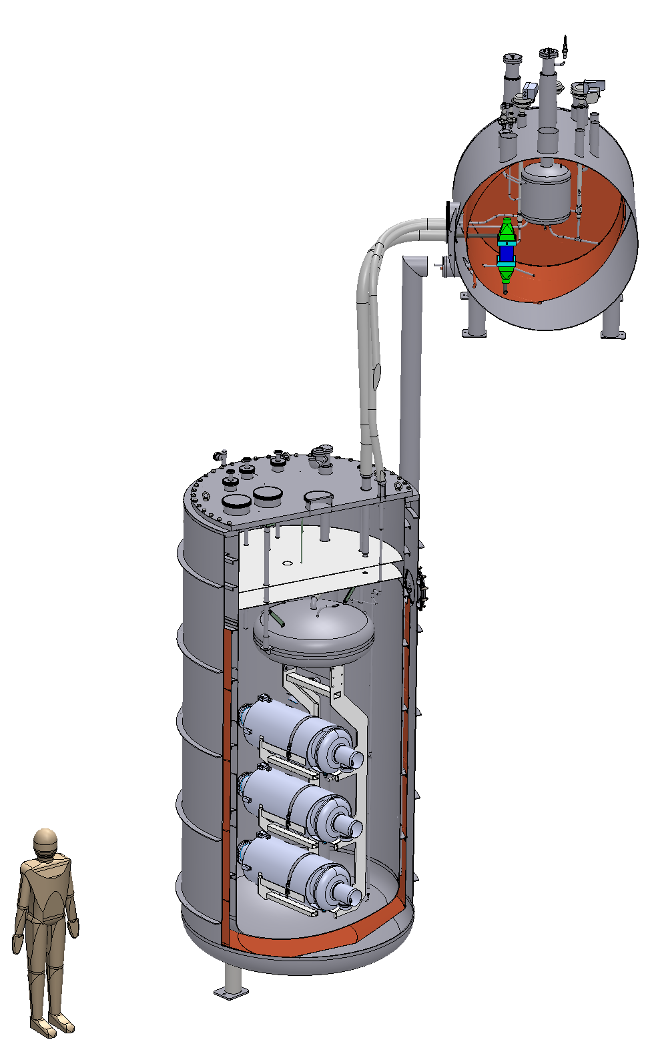
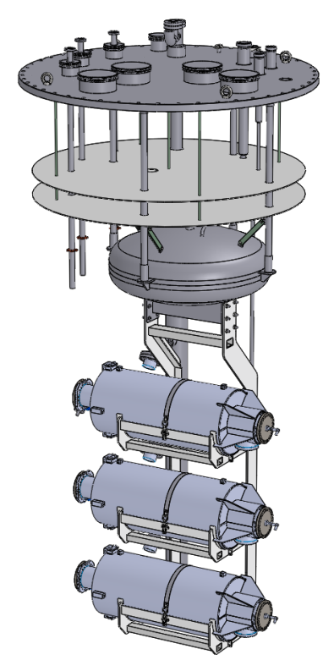
Hβ Cavity Project at STFC
Load 3 cavities
Helium connection
UHV connection
RF connection
1
2
3

Slide 6
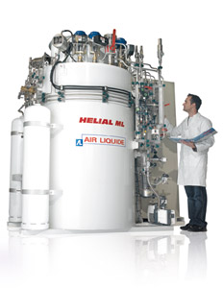
SRF cavity test – STFC facility
2K pumps
RF + Cryo Control center
2K box contains:
Cryogenic valves
2K heat exchanger
JT valve
Cryostat
Outside Ø = 2.2 m
Height = 4.25 m
4.2K LHe
50K GHe
Magnetic shield (µMetal) > 1 µT
Cryo-plant
Hélial 100
3 ESS high β cavities

Slide 7
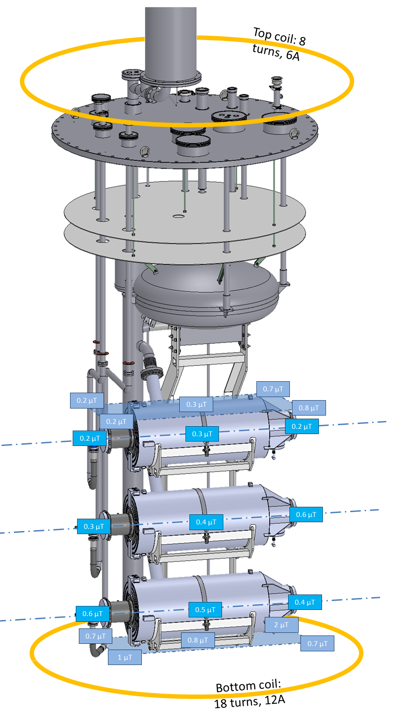
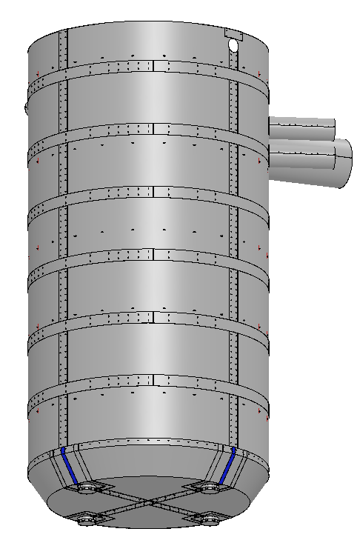
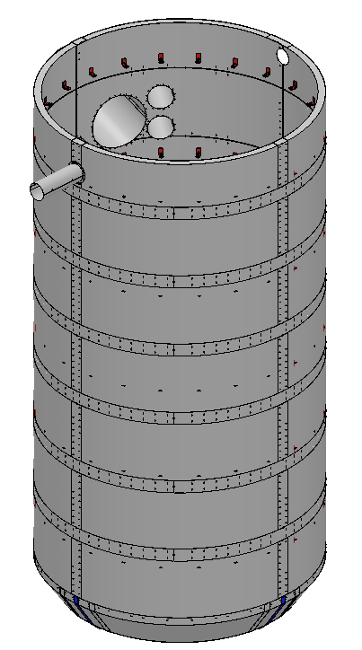
Magnetic shield

Slide 8
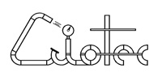
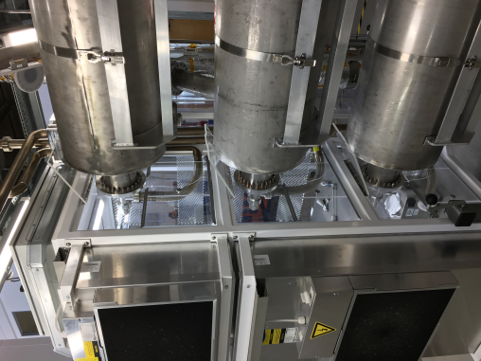
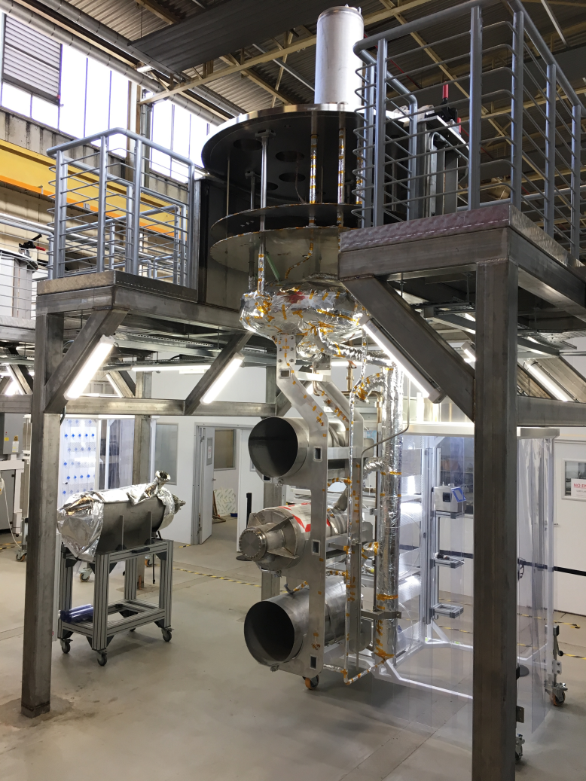
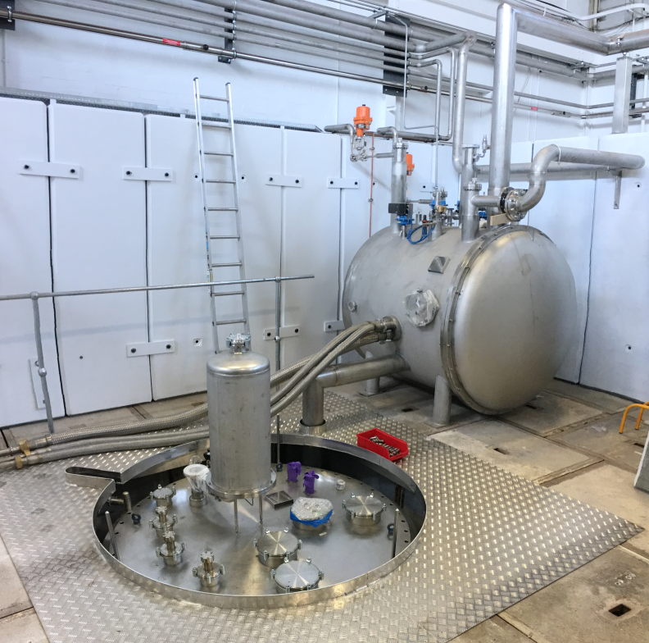
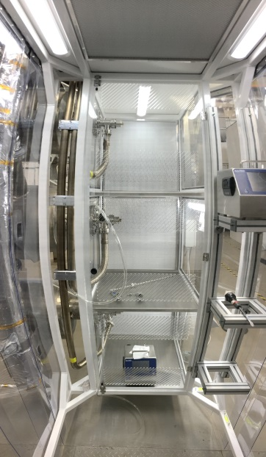
Cryostat – the facility
Cavity 1
Cavity 2
Cryostat
Cavity 3
Mobile cleanroom for UHV connection
Valve
box

Slide 9
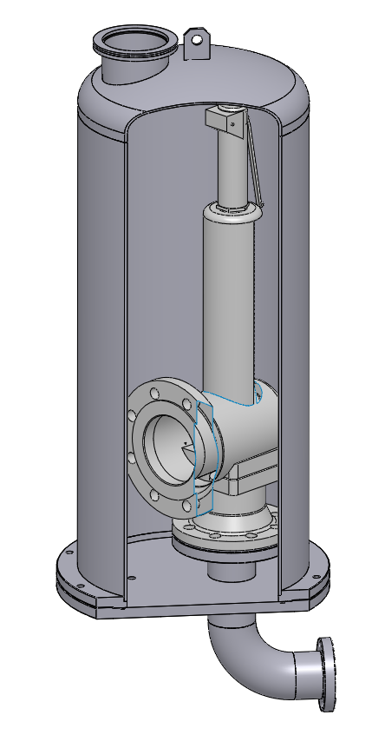
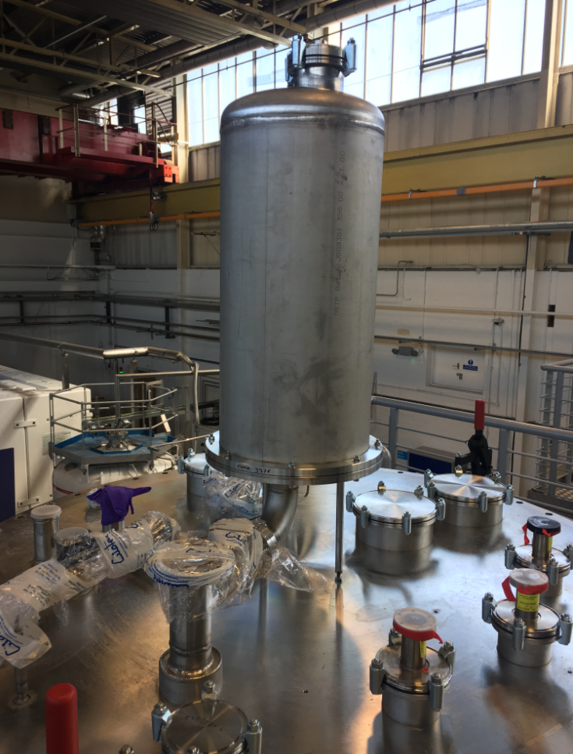
Safety considerations – PRV
1.1
bara
100 mbar GHe
Pressure relief valves
Low pressure helium guard (on 30 mbar circuit)
1.35
bara
Burst disk
1.45
bara
 | Loss of vacuum heat load | Ø safety valve required | Cross section burst disk required
Without MLI on cavities | 170 kW | 64 mm | 17680 mm²
With MLI on cavities | 42 kW | 32 mm | 4368 mm²

Slide 10
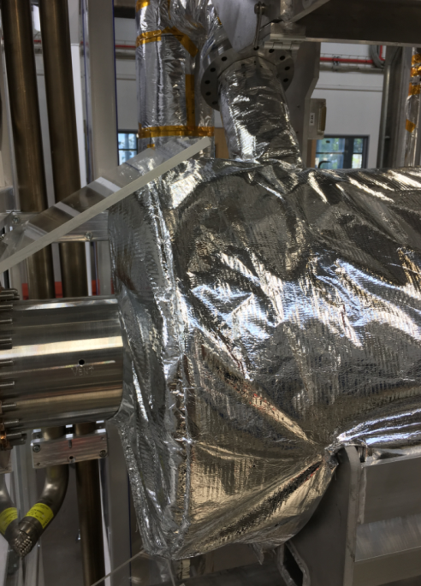
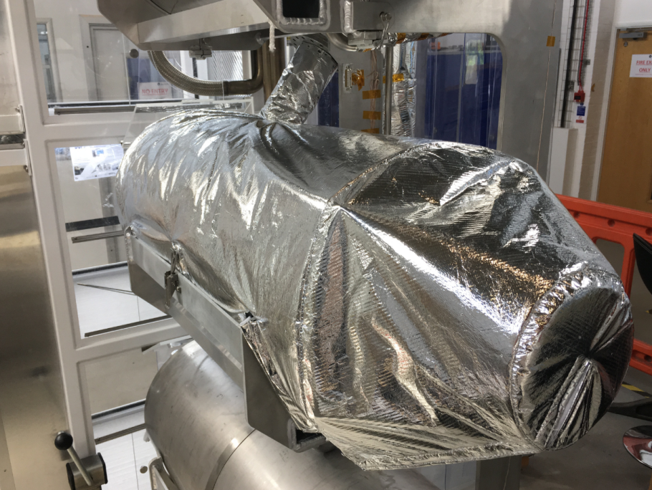
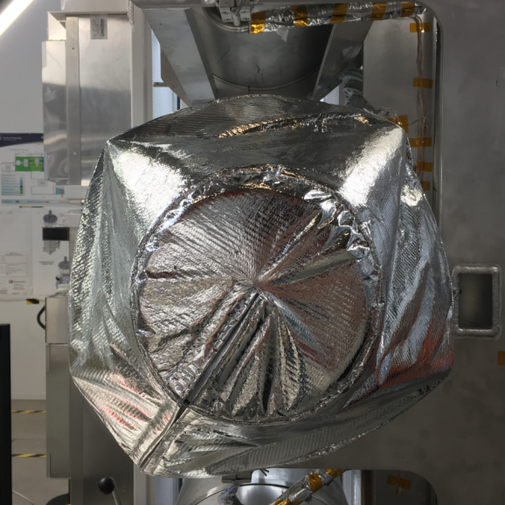
Safety Considerations
Multi-layer insulation ad-hoc suit design for repetitive installation. All in 1 piece

Slide 11
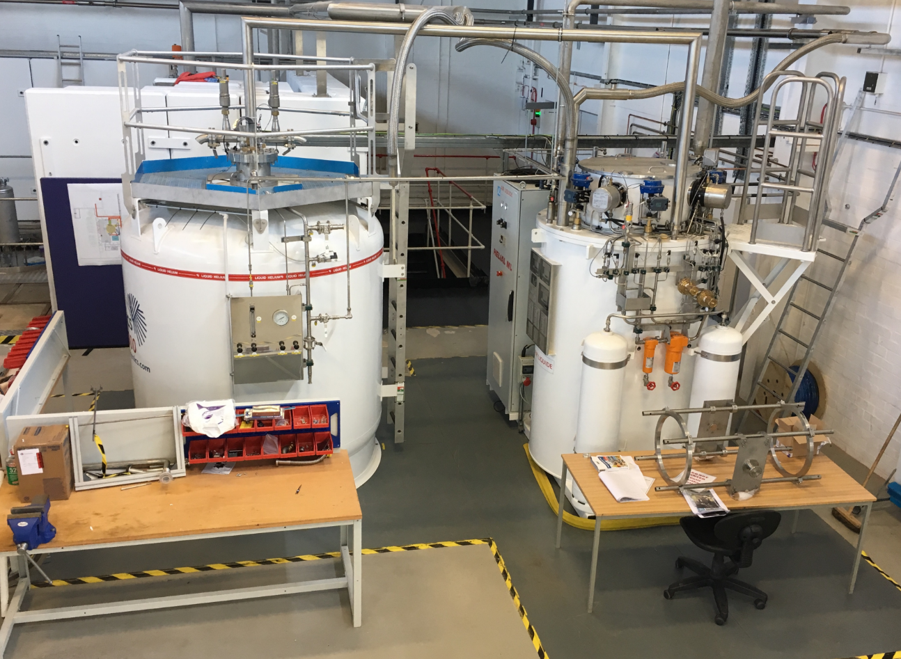
Cryoplant
Helium liquefier
100 ltrs/h liquefaction rate
+
50 K He gas for radiation shield
Liquid helium Dewar
3000 ltrs

Slide 12
Cryoplant – He & LN₂ storage
Gas bag
640 Nm³
Pure He
15 m³
Liquid N₂
400 Nm³
Recovery He
3000 ltrs
Liquid He
400 Nm³
Recovery He
16 bar
40 bar

Slide 13
Cryoplant – Storage issues
Cold box
Gas bag
Purifier
640 Nm³
Pure He
(40 m³ at 16 bar)
Use the recovery compressor
Doesn’t work bellow 20 bar
400 Nm³
Recovery He
Add-on for an extra compressor
20 m³ at 40 bar
400 Nm³
Recovery He
Dryer

Slide 14
Cryoplant – operation plan
Cool down 4.2K
LHe fill in
Cool down 2K
Operation
Warm up & re-liquefaction
Dewar LHe (ltrs)
Recovery He storage (bar)
Cryostat LHe (ltrs)
Pure He storage (bar)

Slide 15
Summary
AL Helial 100 fully commissioned and tested succesfully at Daresbury
Cryostat fully installed, commissioning on going
Improvement of the GHe management under study
Extra GHe storage solution under investigation
Thank you for your attention

