Slide 1
A Deemed University and autonomous Institute of the Department of Atomic Energy, Government of India
Operational Experience of Helium liquefier at TIFR, Mumbai, INDIA
K.V. Srinivasan
Low Temperature Facility,
Tata Institute of Fundamental Research, Mumbai, India
8th International Workshop on Cryogenics Operations
IHEP, Beijing, China, 2018 June 4—7
Email : kvsrini@tifr.res.in
Notes:
1

Slide 2
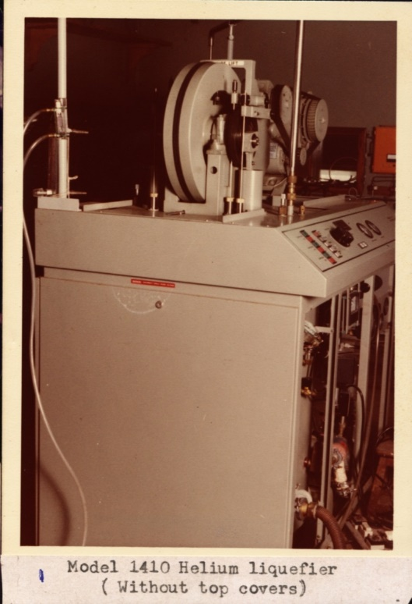
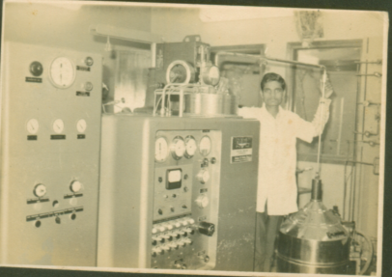
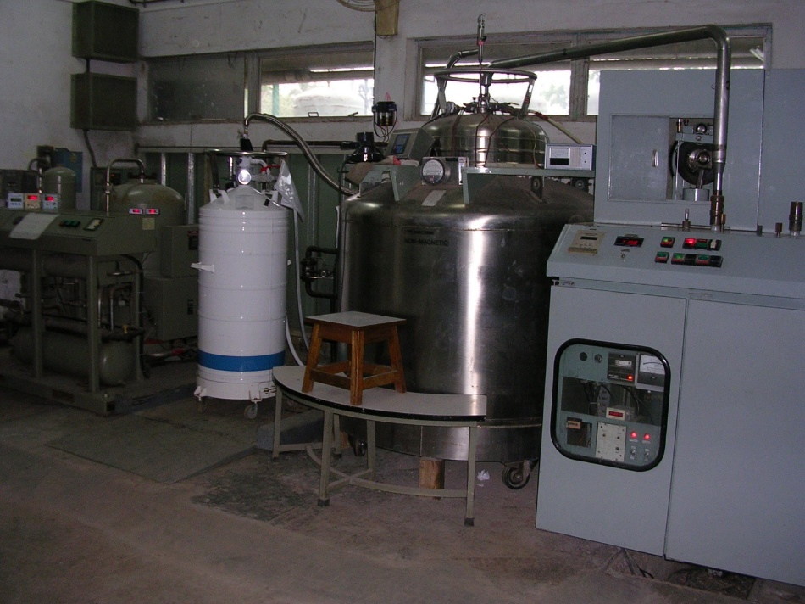
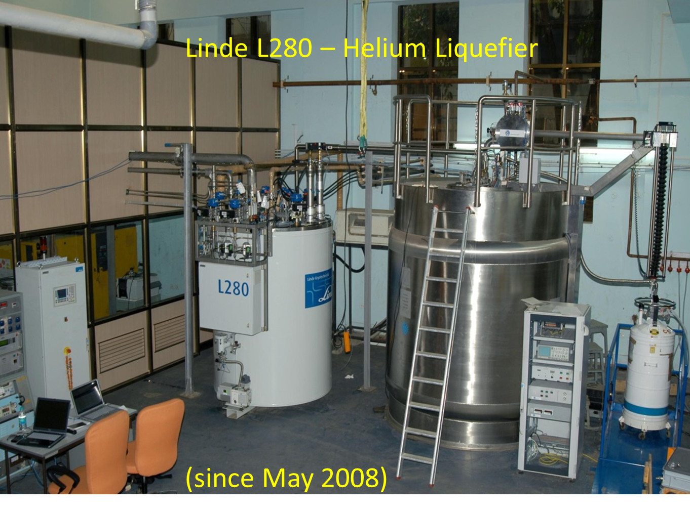
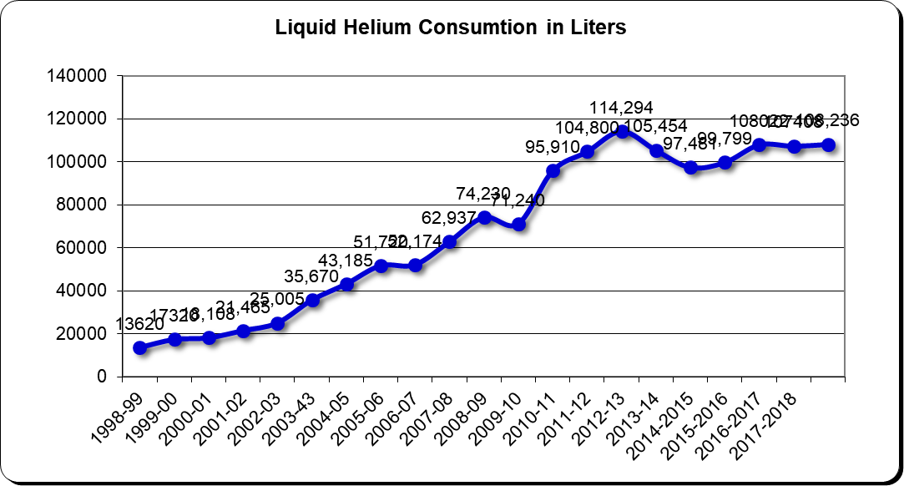
Liquid Helium at TIFR since 1962
ADL Collins Helium Liquefier
(1976 – 1989)
(1962 – 1976)
(1991 – 2008)
KOCH 140 Helium Liquefier

Slide 3
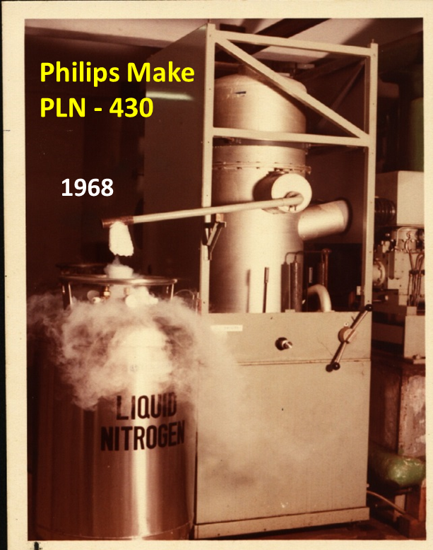
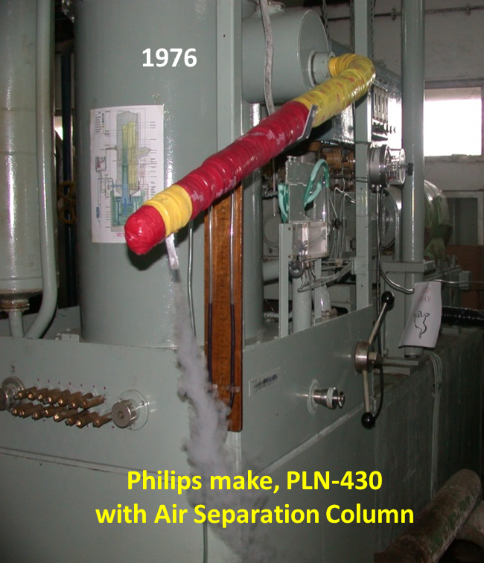
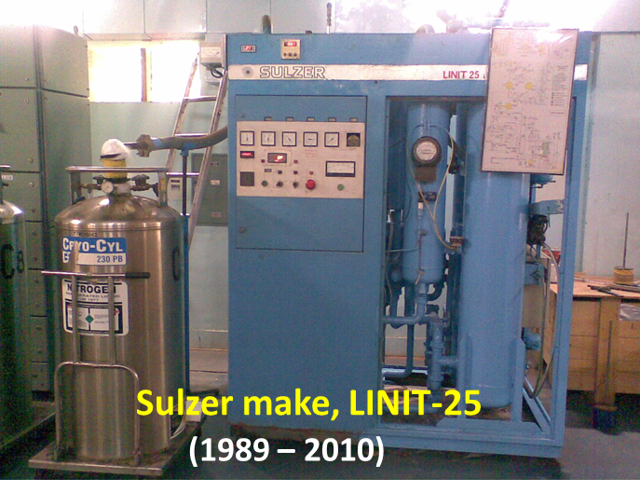
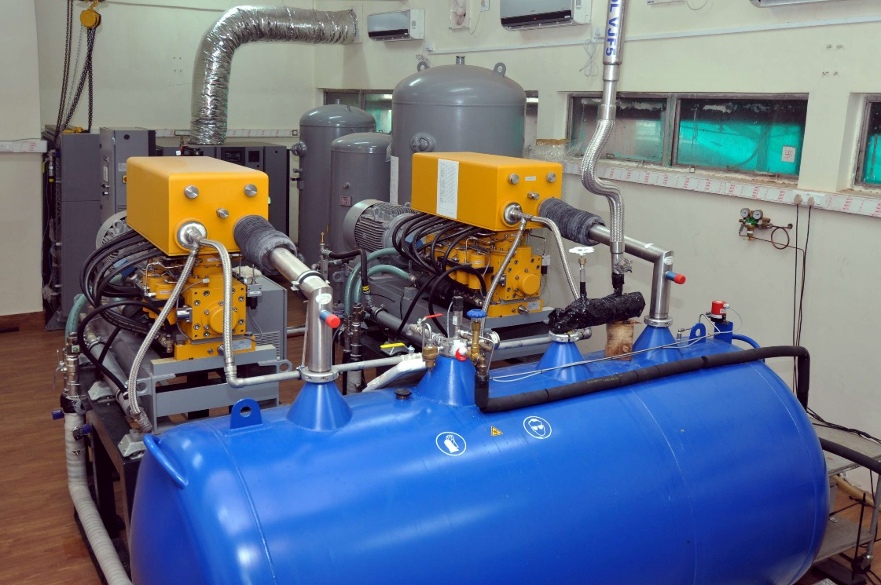
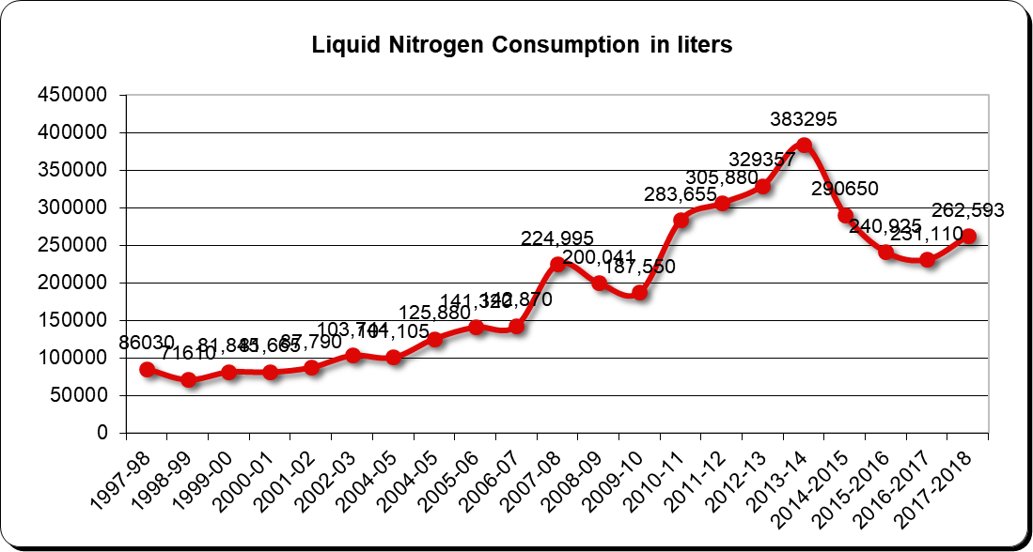
Liquid Nitrogen since 1968
Stirling make, STIRLIN-8
Since 2010

Slide 4
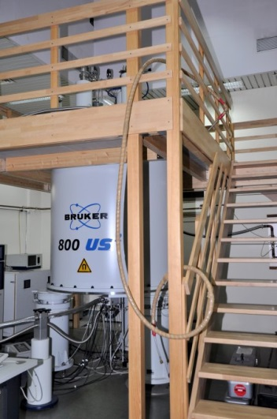
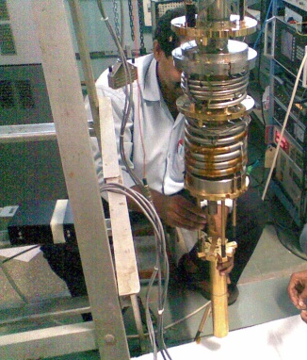
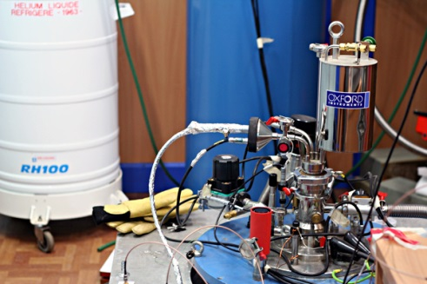
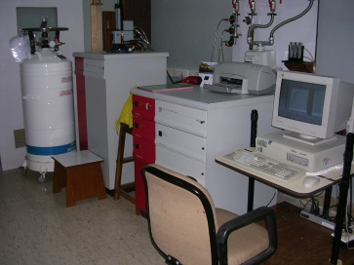
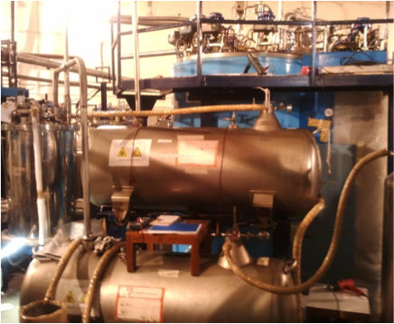
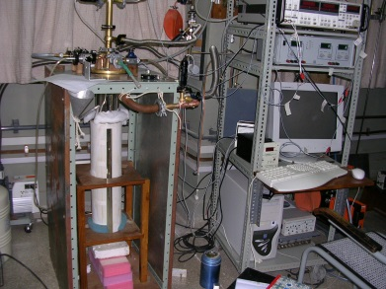
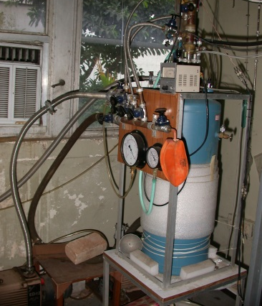
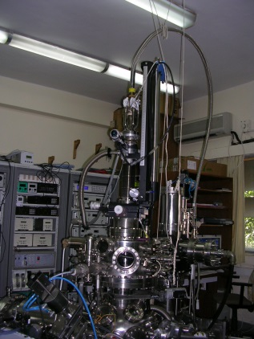
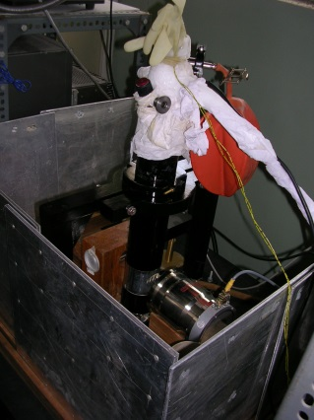
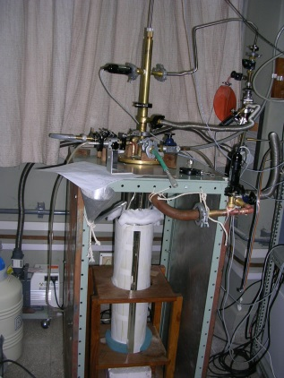
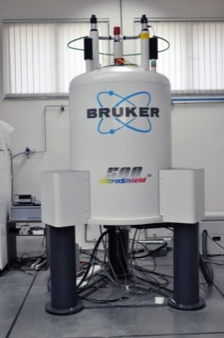
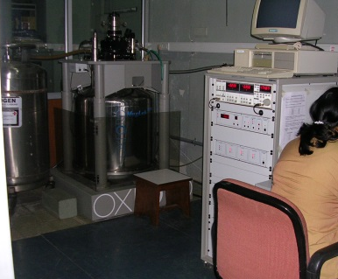
Cryo distribution
NMR spectrometers (four Nos.) Brüker 800 MHz; Brüker 700 MHz; Agilent 600 MHz; Brüker Avance 500 MHz
SQUID magnetometers (Four nos.)
Physical Property Measurement systems (PPMS) – Four Nos.
VSM magnetometer (Two Nos.)
Nano-electronics
Dilution milli-Kelvin refrigerator,
Adiabatic de-magnetization milli-Kelvin refrigerator,
Micro-kelvin refrigerator
Tunneling Point Spectroscopy,
Point Contact Spectroscopy and
Photo Electron Spectroscopy.
Mossbauer Experiments
Superconducting LINAC Booster (separately using TCF50 refrigerator)
Nuclear Atomic Physics / Beam hall experiments
In addition, about 16 other HOMEMADE experimental setups also make use of liquid helium.

Slide 5
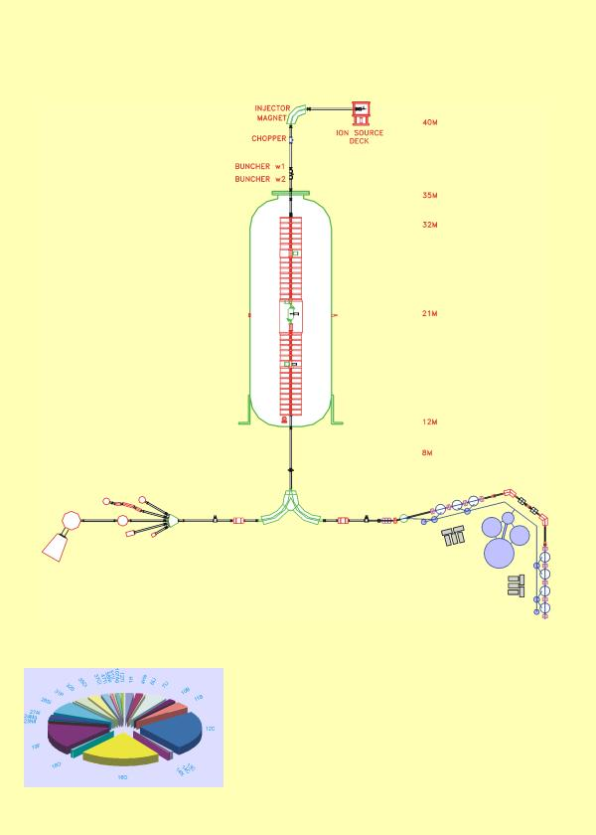
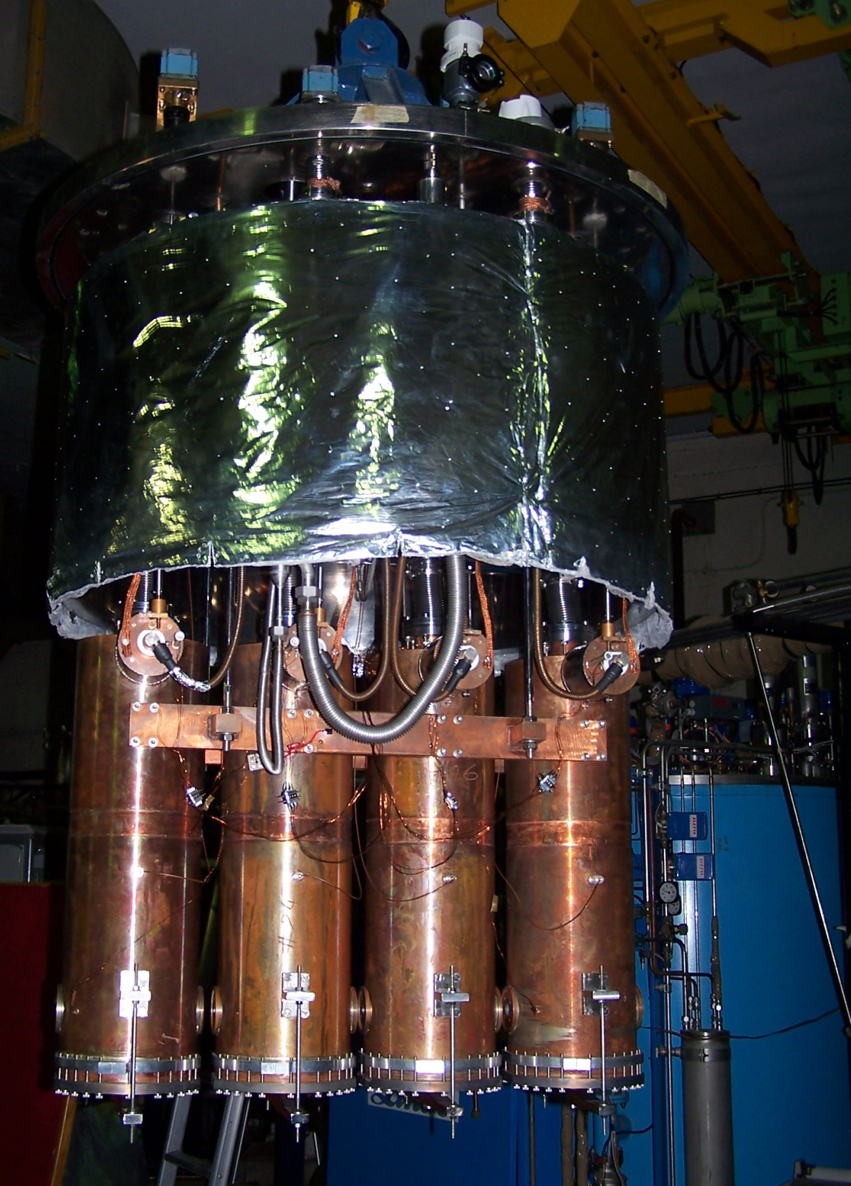

Slide 6
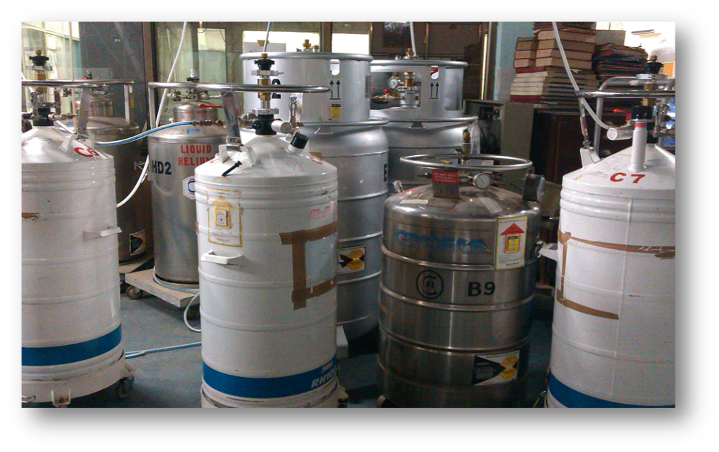
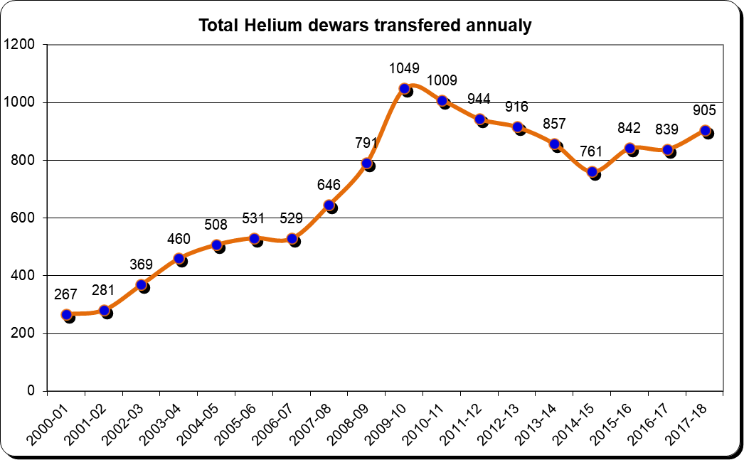
Cryogens dispensation pattern
Liquid Nitrogen | Liquid Helium
~70 dewars (85 to 300 liters capacity) | ~ 36 dewars (60 to 200 liters capacity)
Users: ~25 users | Users: ~45 users
Quantity supplied: 12,000 Ltrs per month | Quantity supplied: 9,000 Ltrs per month
Dewar transferred: 60 dewars per month | Dewar transferred: ~90 dewars per month

Slide 7
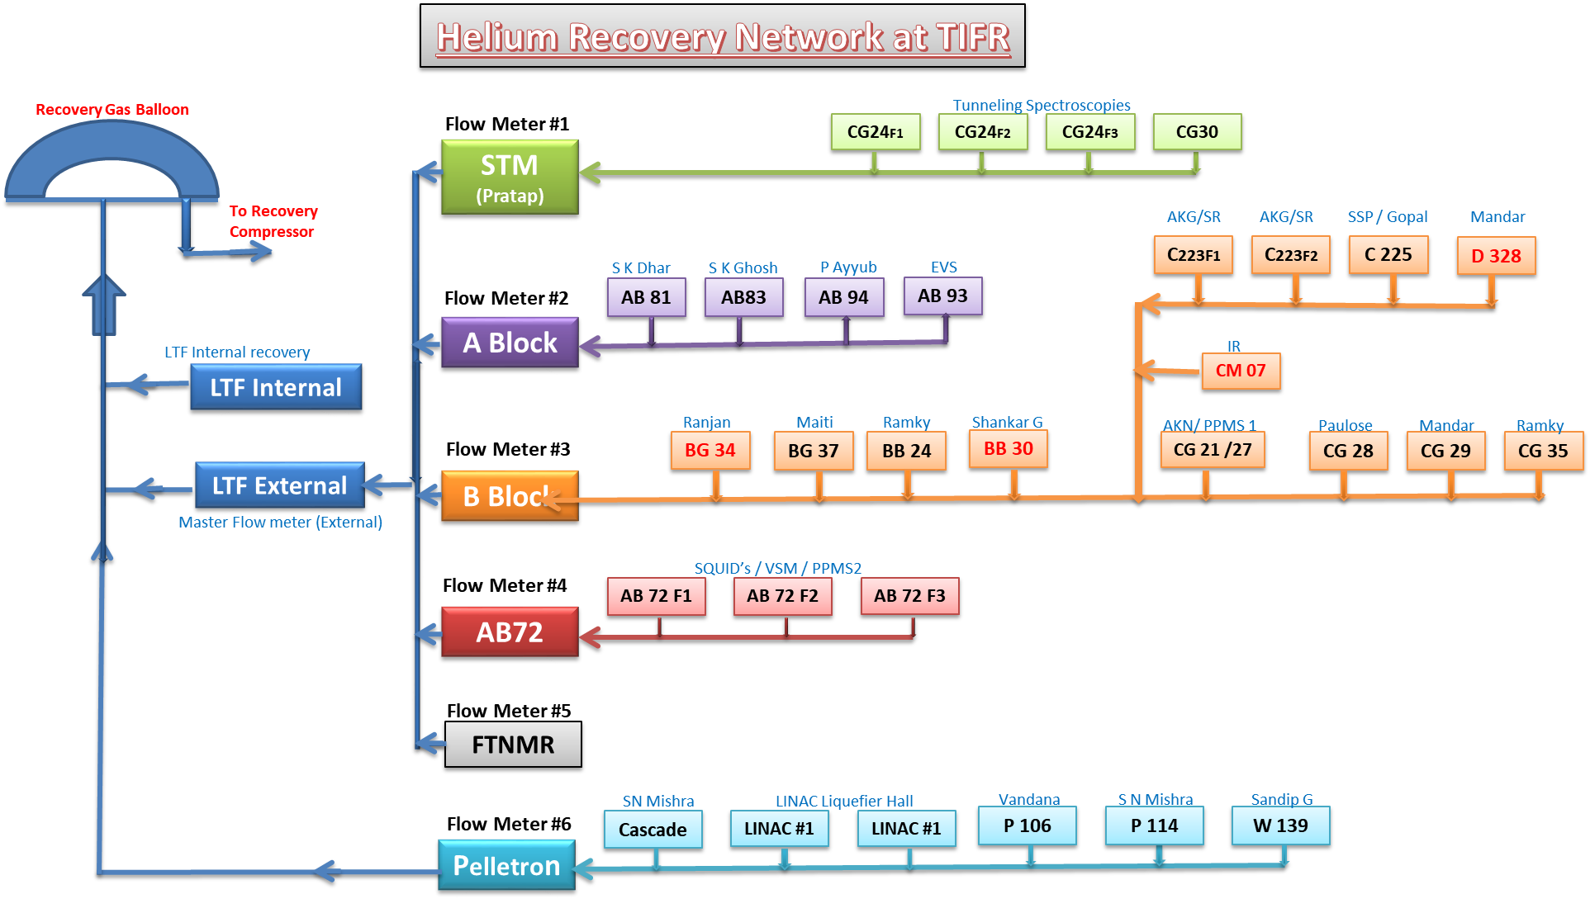
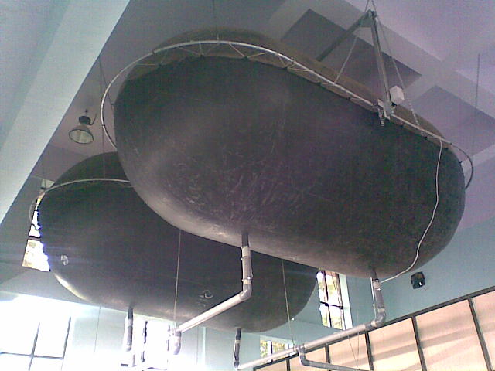
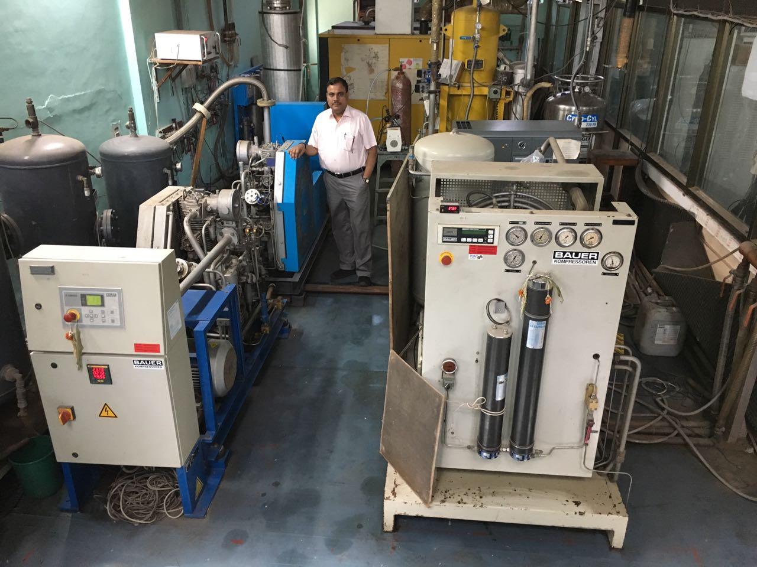
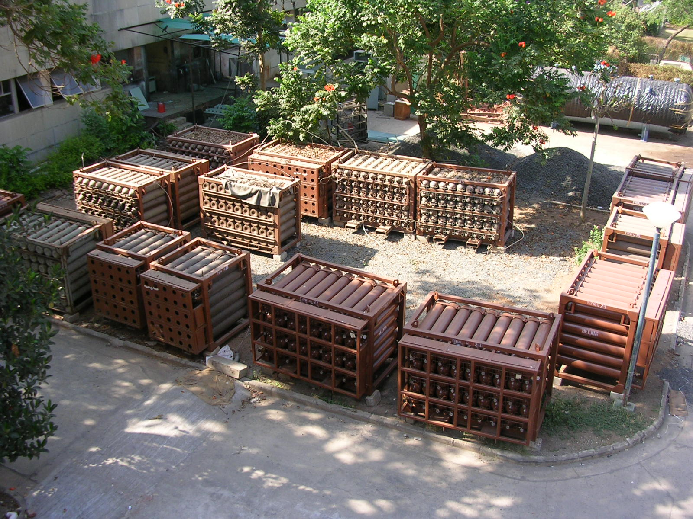
1.75 Km long

Slide 8
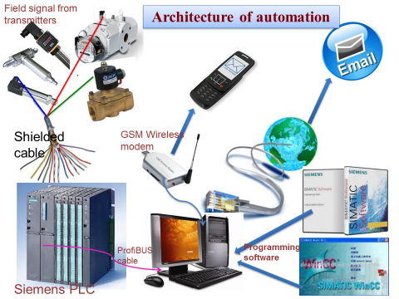
Automation of LTF Operation
Automation in
He plant operation
N2 plant operation
He gas management
Online order by USER
Cryogen Dispensation
Dewar tracking
Datalogging
Remote operation & control
Online monitoring
Trips & Alarm setting
E-logbook
Online report generation
Alarms by email
Alarms by SMS
CCTV surveillance
LTF operation is 100% automated and works as a paperless facility since 2008.
LTF is the largest cryogenic facility in India under R & D Sector.
First in India (@ automation front)

Slide 9
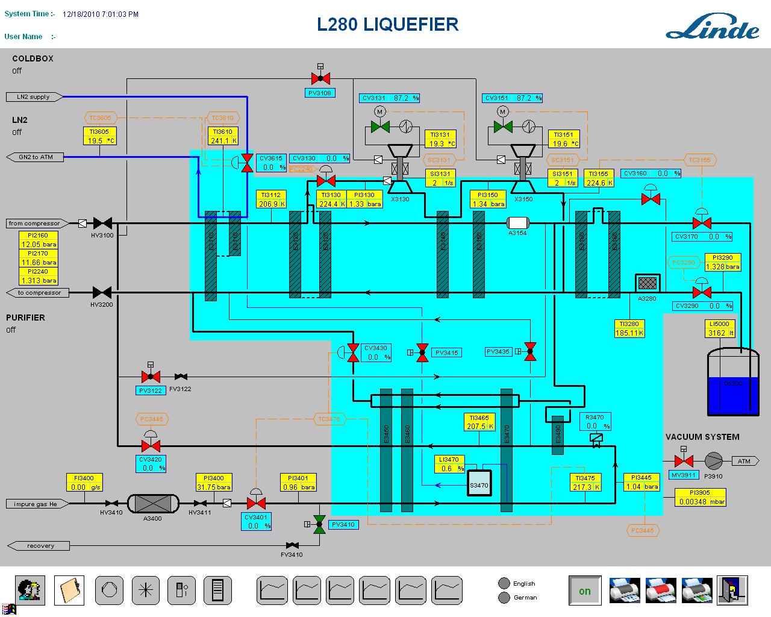
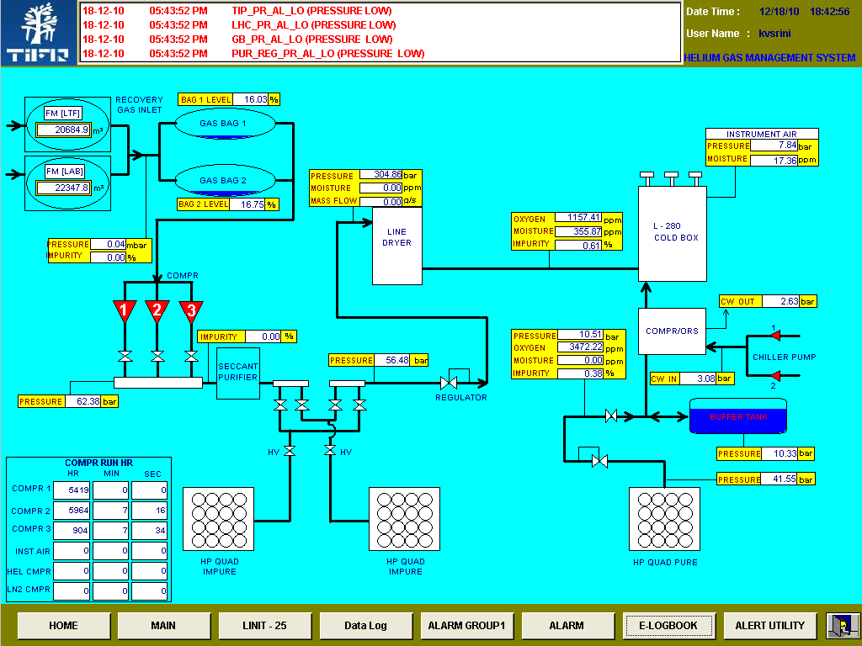
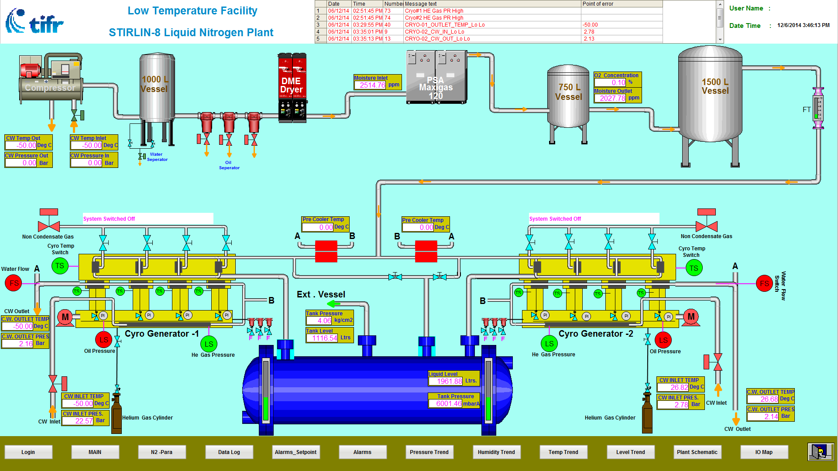
Graphical Process Visualization Screen [In-house Developed]
L280 Helium Liquefier (Linde Developed)
[Helium Gas Management System]
[Stirling Liq N2 Plant] First ever visualization screen made for this plant

Slide 10
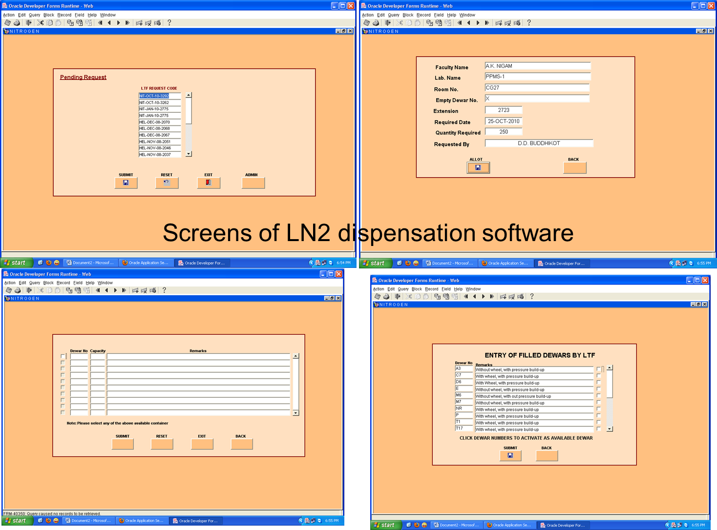
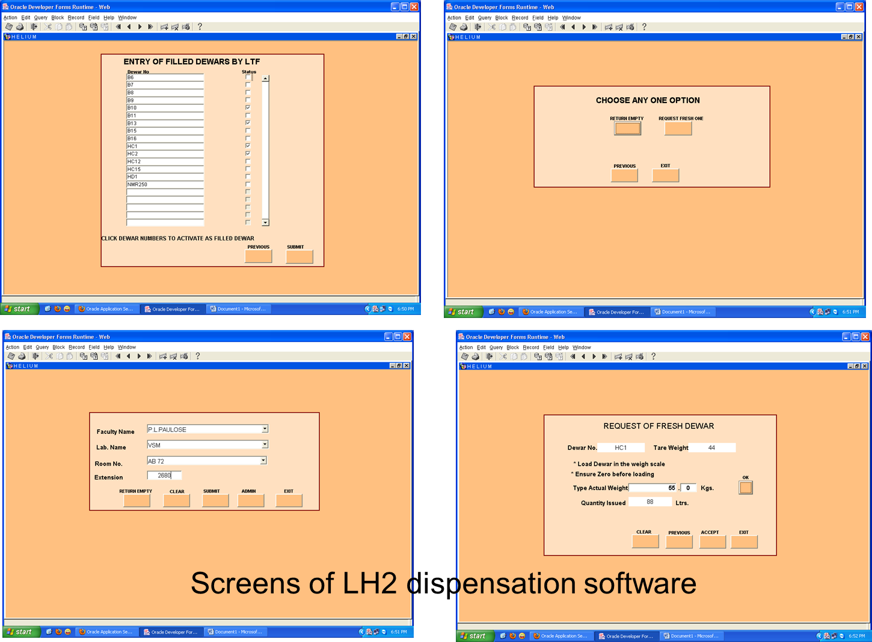
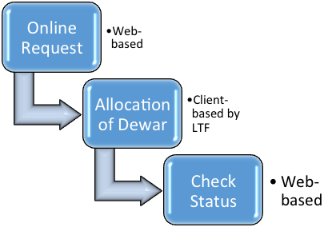
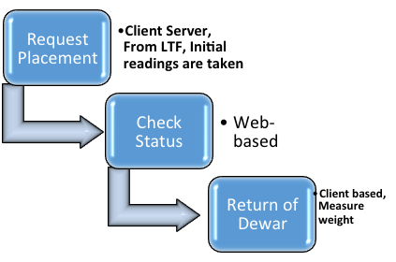
Web Based Dispensation System

Slide 11
Approach Objective
Helium liquefier/refrigerator is expected for an uninterrupted operation.
Either its is coupled to a massive accelerator based system (single user) or to an research facilities (to cater multiple and critical users). Problems remain the same
Interruption do happen (scheduled or breakdown maintenance, faults at plant component end, software end, utilities end., so on and so forth)
Bringing up the plant quickly (less down time) and efficiently approach the problem to avoid reoccurrence is an important task.

Slide 12
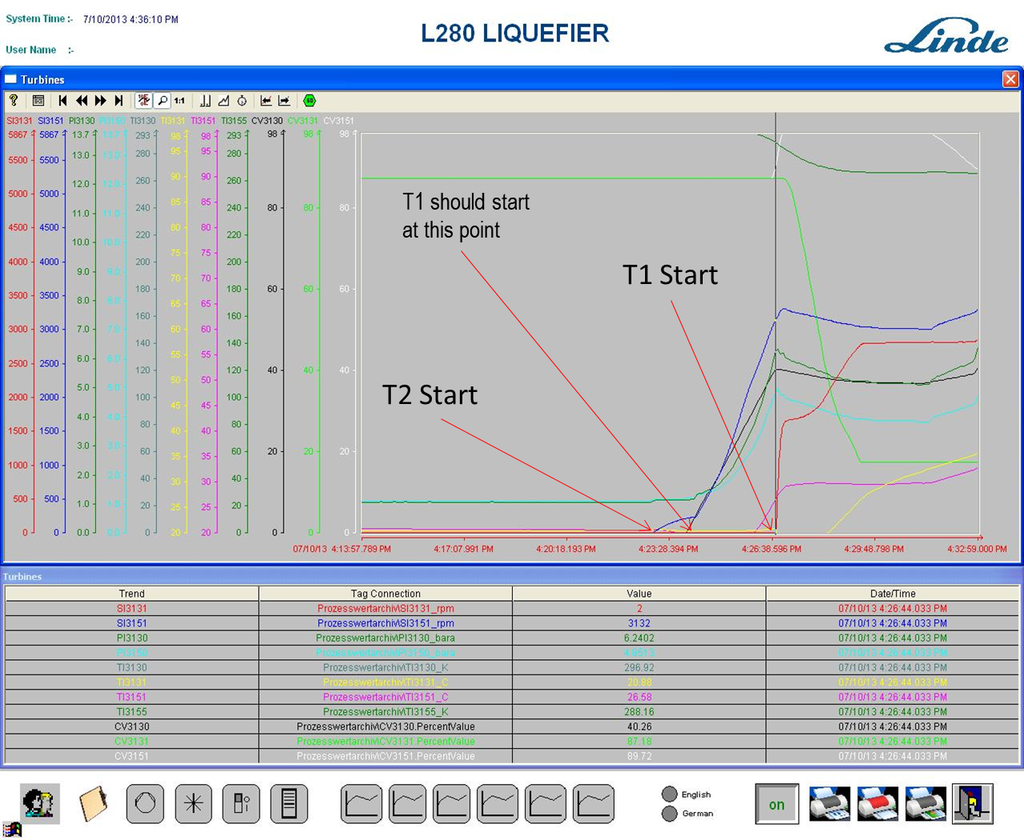
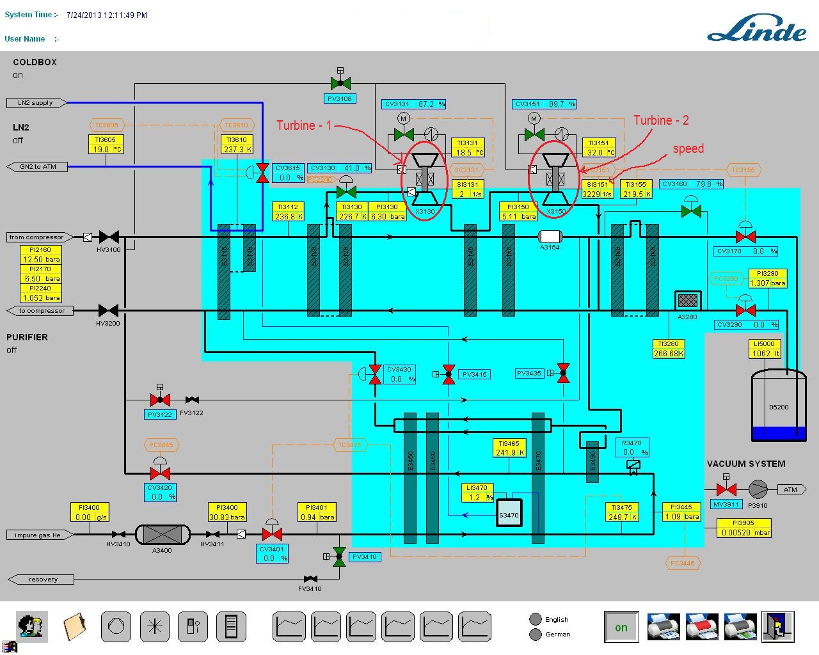
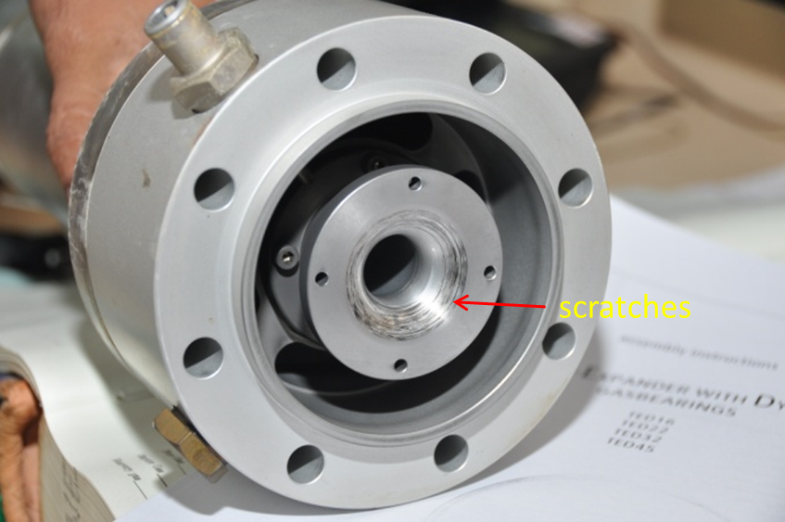
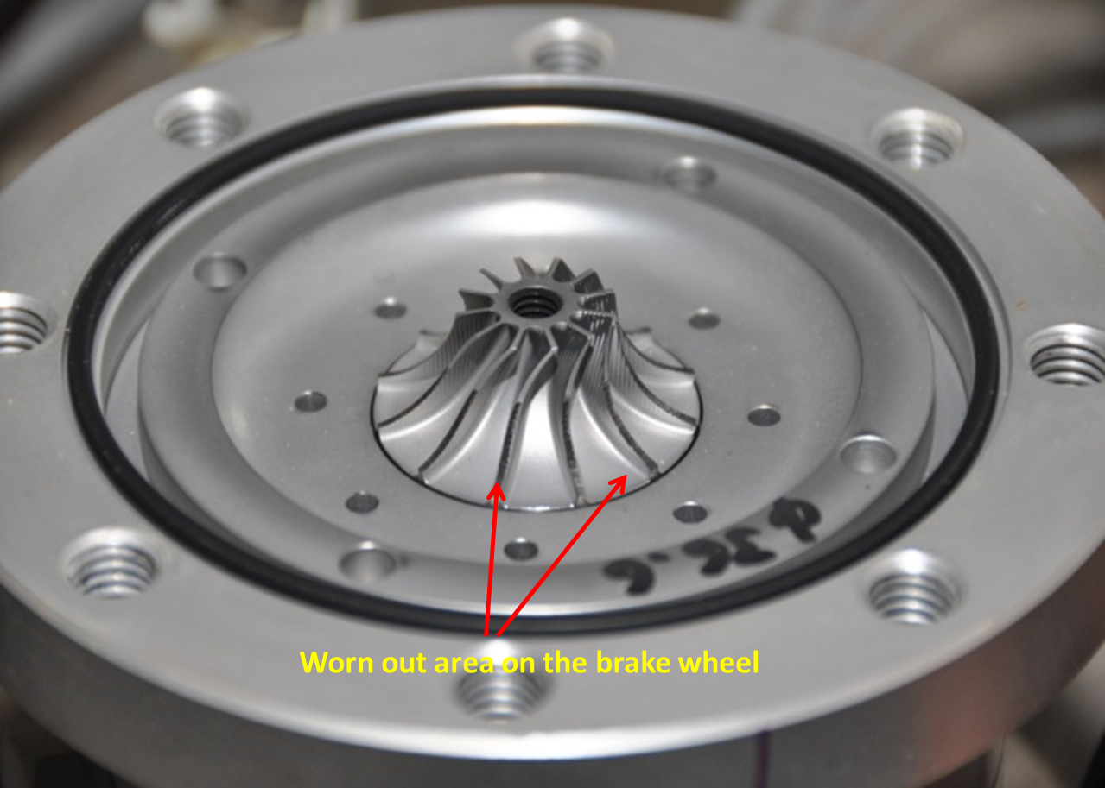
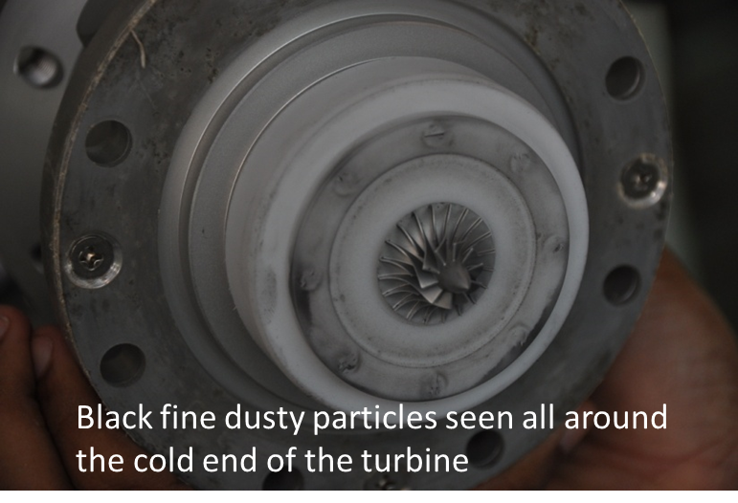
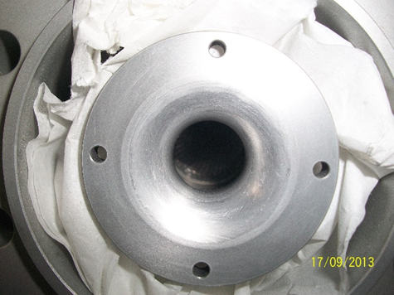
Problems encountered with 1st Stage Turbine
Unlike other plants, our ON/OFF cycle is quiet high, i.e., about 60/year, 90% of our operations are with recycled helium gas. So, systematic investigation is necessary
Brake Housing
Warm End
Cold End

Slide 13
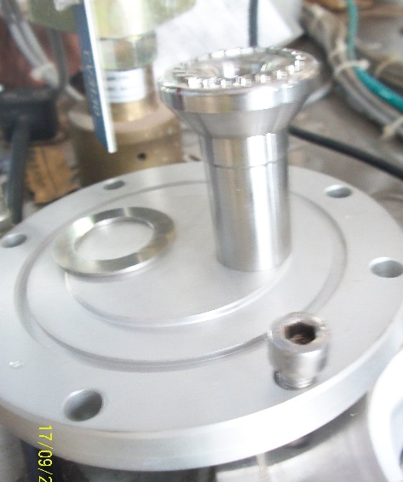
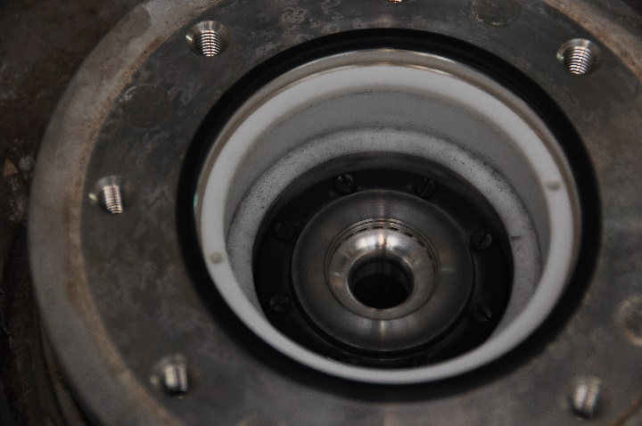
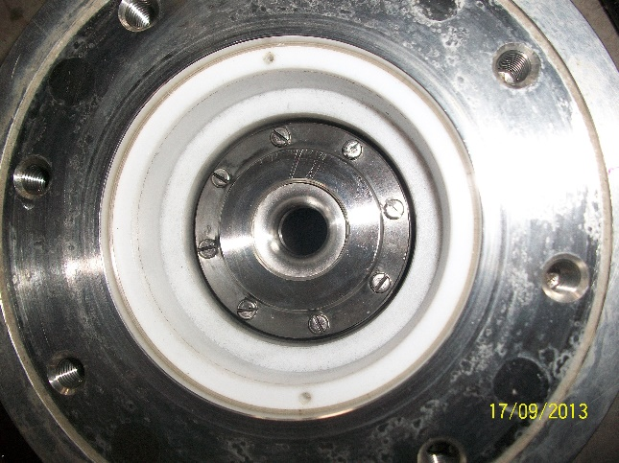
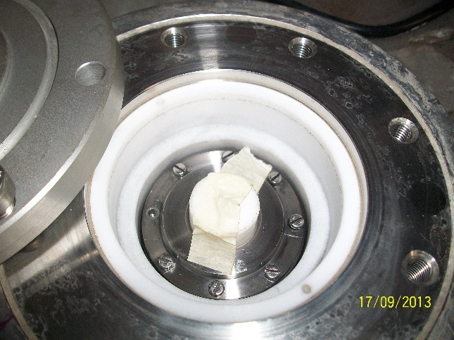
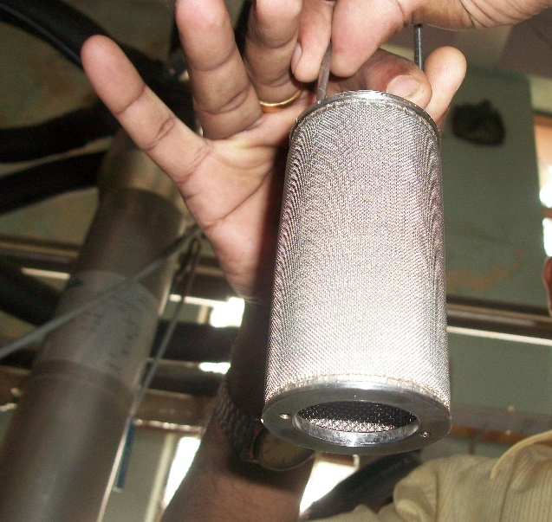
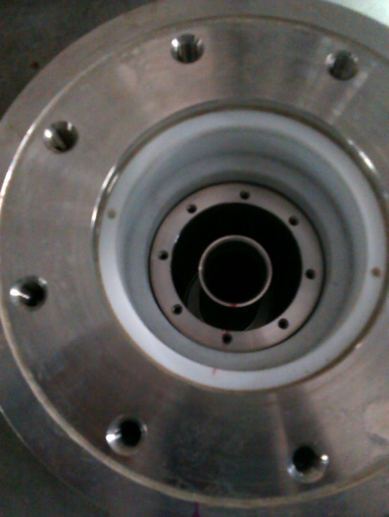
Problems encountered with 1st Stage Turbine
View after Diffuser and cap removal
Dismantling Turbine Diffuser cover plate [Enough care to avoid screws dropping into the coldbox HEX]
The dusty particles could be the impurity in the helium gas / rubbing of magnetic paddle bearing.
Linde recommended for the T1 replacement.
We once attempted to manually close the brake gas supply valve PV3108 (momentarily) when the T1 did not start & T2 speed reaches ~2000rps. This makes the T1 starts and immediately changed the PV3108 in auto mode. This worked for us.
Inspection of Turbine Inlet Filter
Cold box after inlet filter removal
Even though we thought of what could be its repercussion, but it is now about 3 years and plant operational performance is unaffected.
No traces of oil / dust appeared in the turbine inlet filter

Slide 14
L-280 Cryogenic Valve Replacement
After isolating the cold box we did not observe the pressure drop, hence valves in cold box could be leaking
These are the fours valves connects HP to LP side

Slide 15
Neck Frosting on the 5000Lit Mother Dewar
Observations / problem:-
Neck Frosting Occurs ONLY WHEN THE PLANT LIQUEFIES, the dewar pressure is normaly low (1.18bara) compared to the OFF condition (1.35 bara). Problem NOT belongs to pressure or Leakage. Suspected Vacuum level of RDT and dewar, but it was OK
Action:-One of the damper valves was closed by mistake, and this caused high evaporation during liquefaction.
Normally both the dampeners should be on-line to void pressure fluctuations and there by bumping/oscillations of He liquid in Dewar ( which may lead to more vaporization- there by increasing pressure in Dewar and also leading to Heat &Mass in-balance at cold end ) . 5KL dewar has two dampeners, For small dewars only one dampener

Slide 16
Warming up of 5KL Mother Dewar
Very recently, we experienced problems with the liquid helium produced internally which had an impact on the experimental setups of several groups. The contamination from the liquid helium would plug the capillaries / impedances of several experimental setups such as SQUIS’s, PPMS thus allowing not to go below 4.2K.
Choking occur some within less than an hour, some within weeks of operation. Problem reoccurred even after the system warmup/purging.
However, the performance of the liquefier was not affected at all.
The problem is noticed "worldwide“ by many research facilities having capillary based experimental setups. It is well presumed as hydrogen contamination in helium gas supply could be the culprit, even though there is not much technical data available on this H₂ contamination.
Very recently, we experienced problems with the liquid helium produced internally which had an impact on the experimental setups of several groups. The contamination from the liquid helium would plug the capillaries / impedances of several experimental setups such as SQUIS’s, PPMS thus allowing not to go below 4.2K.
Choking occur some within less than an hour, some within weeks of operation. Problem reoccurred even after the system warmup/purging.
However, the performance of the liquefier was not affected at all.
The problem is noticed "worldwide“ by many research facilities having capillary based experimental setups. It is well presumed as hydrogen contamination in helium gas supply could be the culprit, even though there is not much technical data available on this H₂ contamination.
We decided to probe the root cause by measuring the helium gas quality for its H₂ content at various sample
Hydrogen content of pure gas (bought out gas)
Hydrogen content of boil-off liquid helium
Hydrogen content of helium gas taken from the compressor discharge (after ORS)
Hydrogen content of gas taken (from HP line) just after the plant shutdown and when the cold box temperature is around 20K to 60K assuming it may vomits more hydrogen trapped in charcoal adsorber.
Very recently, we experienced problems with the liquid helium produced internally which had an impact on the experimental setups of several groups. The contamination from the liquid helium would plug the capillaries / impedances of several experimental setups such as SQUIS’s, PPMS thus allowing not to go below 4.2K.
Choking occur some within less than an hour, some within weeks of operation. Problem reoccurred even after the system warmup/purging.
However, the performance of the liquefier was not affected at all.
The problem is noticed "worldwide“ by many research facilities having capillary based experimental setups. It is well presumed as hydrogen contamination in helium gas supply could be the culprit, even though there is not much technical data available on this H₂ contamination.
We decided to probe the root cause by measuring the helium gas quality for its H₂ content at various sample
Hydrogen content of pure gas (bought out gas) [H₂ = <1 ppm]
Hydrogen content of boil-off liquid helium [H₂ = 2 to 3.9 ppm]
Hydrogen content of helium gas taken from the compressor discharge (after ORS) [H₂ = ~ 1 ppm]
Hydrogen content of gas taken (from HP line) just after the plant shutdown and when the cold box temperature is around 20K to 60K assuming it may vomits more hydrogen trapped in charcoal adsorber. [H₂ = 29 ppm]
Very recently, we experienced problems with the liquid helium produced internally which had an impact on the experimental setups of several groups. The contamination from the liquid helium would plug the capillaries / impedances of several experimental setups such as SQUIS’s, PPMS thus allowing not to go below 4.2K.
Choking occur some within less than an hour, some within weeks of operation. Problem reoccurred even after the system warmup/purging.
However, the performance of the liquefier was not affected at all.
The problem is noticed "worldwide“ by many research facilities having capillary based experimental setups. It is well presumed as hydrogen contamination in helium gas supply could be the culprit, even though there is not much technical data available on this H₂ contamination.
We decided to probe the root cause by measuring the helium gas quality for its H₂ content at various sample
Hydrogen content of pure gas (bought out gas)
Hydrogen content of boil-off liquid helium
Hydrogen content of helium gas taken from the compressor discharge (after ORS)
Hydrogen content of gas taken (from HP line) just after the plant shutdown and when the cold box temperature is around 20K to 60K assuming it may vomits more hydrogen trapped in charcoal adsorber.
Possibilities:
Quality of external gas supply could have heavily contaminated at some point [Not sure when ]
Heavy contamination (HC) in the helium recovery line. [Checked and cleaned all the possible line]
The main storage vessel could have gathered a “critical” amount of hydrogen over the years [our 5000 ltr storage vessel at 4.2K since 2008]
ACTION: WARMING UP AND FLUSHING OF 5KL LIQUID HELIUM dewar

Slide 17
Warming & Cleaning of 5KL Mother Dewar
Evacuation of Cold box
[HP & LP side]
Evacuation of 5KL Dewar through Lhe transfer siphon
Evacuation of 5KL Mother Dewar through the Dewar Vent port
Evacuation of ORS
Dewar successfully warmed upto 302K (3 days), purged/decontamination (3 days) and Re-liquefication (~50 hours)
Evacuation of Coaxial (RDT) helium siphon
Evacuation of Impure helium gas LINE DRIER
Evacuation of helium feed gas Compressor module

Slide 18
Extra Buffer in the Purifier Regeneration Outlet
High pressure rise whenever the regeneration is initiated during purifier operation. Sudden release of high pressure (~33 bar) cause the recovery flow integrator getting damaged. Added a 1 cu.m buffer tank and the regen out to this tank, which reduces the pressure to around 1-2 psig
Miscellaneous Improvements for Operational Convenience
Use of regulator port for transmitter
(avoids multiple adapter/connection]
Use of balloon to check the relief valve leakages
Valve tags for easy identifications

Slide 19
Major Preventive (24,000 hours) Maintenance of L280 Helium Liquefier
OST flange removal
Oil Removal System (ORS)
Adsorber tank bottom end fitted with heater
Compressor Module
Old charcoal being removed after bottom removal
Dismantling of oil coalescent filter flange
Heating & purging of ORS Charcoal Bed
Installation of Oil separator filter cartridge
Line drier top flange showing heavy contamination
Adsorber tank with temporary insulation pad
Sensor measuring the purge gas temperature at the outlet
Line Drier
Plus Cold box valves checking & entire plant decontamination
Oil micro-filter cartridge
Line drier top flange removal

Slide 20
Schematic of Charcoal adsorber drying process

Slide 21
Summary
Plant shutdown on Friday, 8th April 2016 at 1500hrs
Maintenance started on Saturday, 9th April 2016, 10AM
Maintenance - Charcoal Adsorber on Saturday, 9th April
Maintenance - Linde Drier on Saturday, 9th April
Maintenance - Compressor on Sunday, 10th April
Leak testing, purging, flushing & Evacuation 10th to 11th April
Testing of compressor & ORS in warmup mode – from 11th @ 5pm till 12th April 7am
Warmup mode of cold box - 12th April, 10 AM
Cooldown of coldbox started on 12th April, 3pm
Liquefaction started – 12th April, 8pm
Plant stopped on 15th April at 3pm after 73 hours of trouble free running.
Screen shot showing the smooth drop of plant impurity level after maintenance
Maintenance completed and plant restarted in just 72 hours

Slide 22
My Acknowledgements
Staff at Low Temperature Faculty, TIFR, Mumbai
Mr. K A Jaison Mr. Vijay Arolkar Mr. D G Purao
Mr. Bosco Augustine Mr. Arvind Hedukar Mr. D S Sandal (Retd)
& Prof. P L Paulose [ Chairman, LTF]
My Special Thanks to
Mr. Berg Hilmar [LKT, Swizz] & Mr. Anil Kumar [LKT, India]
Thanks

