Slide 1


OPERATION & MAINTENANCE RECORD
(KSTAR Helium Refrigeration System)
2018-06-05
Dong-Seong Park, Ph.D. (Principal Engineer),
on behalf of
Vacuum & Cryogenic Engineering Team
DEMO Technology Research Division
Advanced Technology Research Center

Slide 2
CONTENTS
1. INTRODUCTION
2. OPERATION SUMMARY
3. MAINTENANCE/REPAIR
4. SYSTEM MODIFICATION
5. SUMMARY

Slide 3
INTRODUCTION

Slide 4

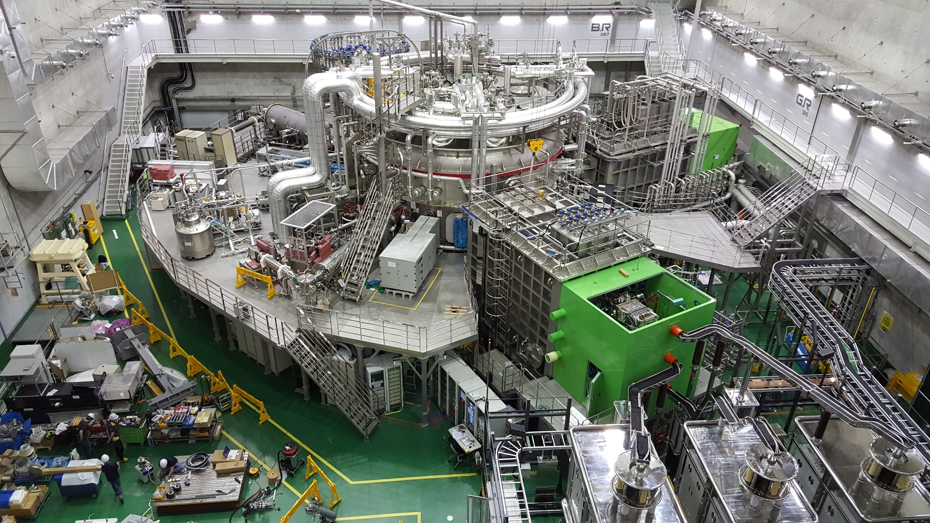
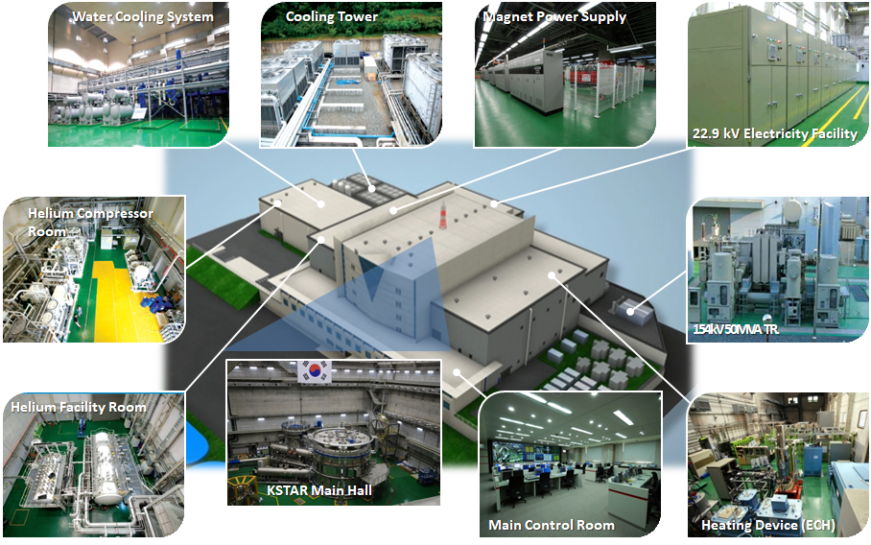
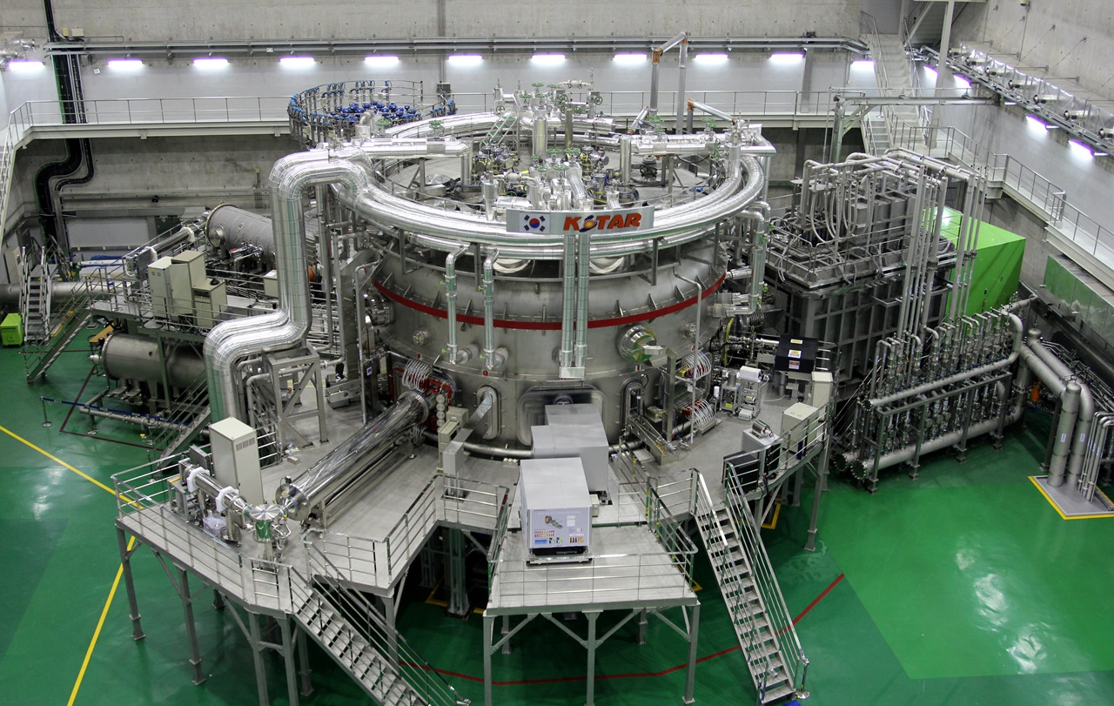
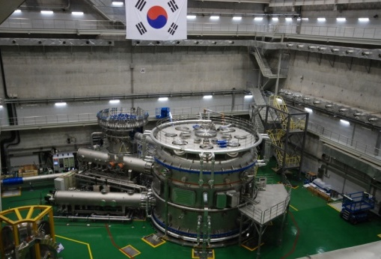
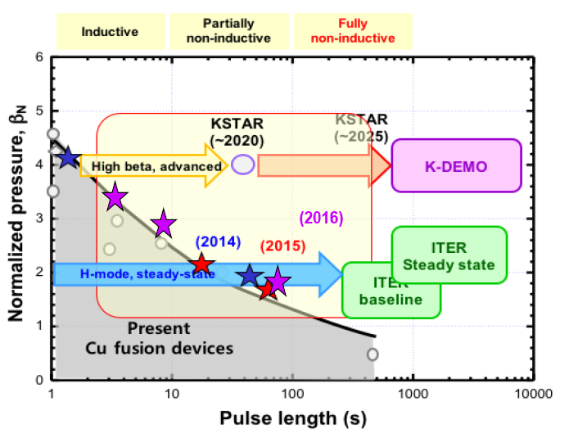
INTRODUCTION
Introduction
Mission of Program
Parameter | KSTAR | ITER
Major radius, R₀ Minor radius, a Elongation, κ Triangularity, δ Plasma volume Plasma surface area Plasma cross section Plasma shape Plasma current, I_{P} Toroidal field, B₀ Pulse length β_{N} Plasma fuel Superconductor Auxiliary heating /CD Cryogenics | 1.8 m 0.5 m 2.0 0.8 17.8 m³ 56 m² 1.6 m² DN, SN 2.0 MA 3.5 T 300 s 5.0 H, D Nb₃Sn, NbTi ~ 26 MW 9kW@4.5K 1kW@4.5K | 6.2 m 2.0 m 1.7 0.33 830 m³ 680 m² 22 m² SN 15 (17) MA 5.3 T 400 s ~2.0 H, D, T Nb₃Sn, NbTi 73 (110) MW 3*25 kW@4.5K 1MW LN2 Plant
Secondary helium distribution
- Korean Superconducting Tokamak Advanced Research
- Construct the superconducting tokamak
Vacuum Duct
- Exploit SC tokamak operation technologies
Steady state H-mode operation
KSTAR Tokamak
High performance operation modes
NBI-1 (5MW)
NBI-2 (6MW)
Under commissioning
Fueling system
Diagnosis Systems
KSTAR Main Hall-2011

Slide 5

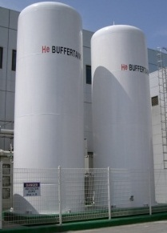
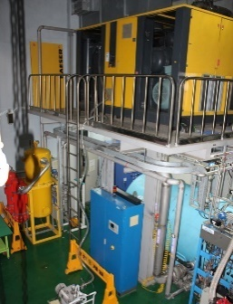
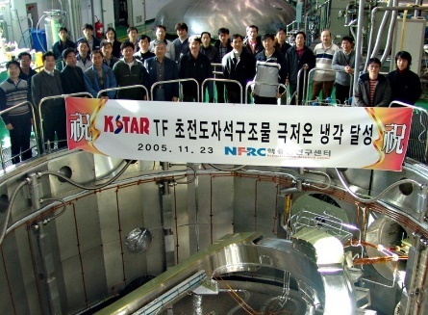
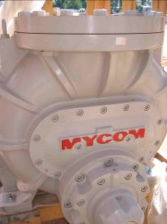
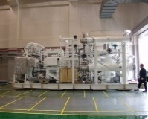
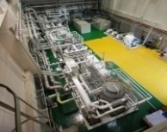
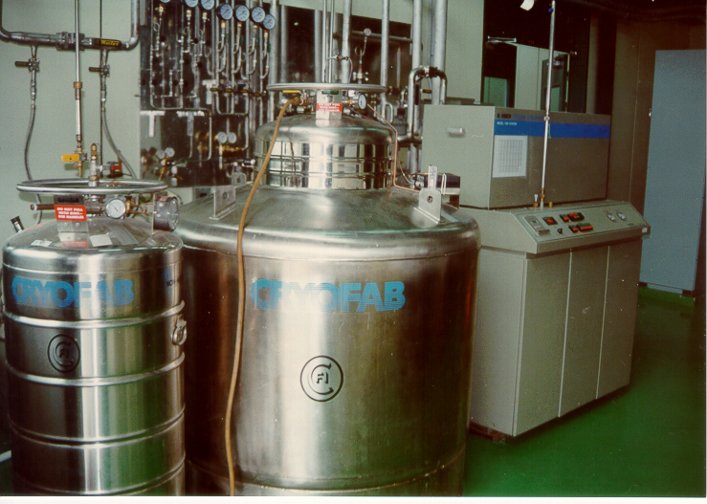
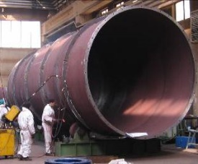
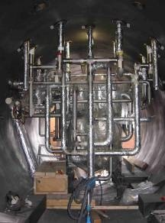
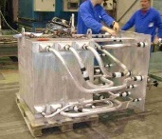
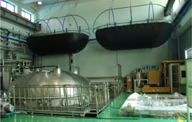
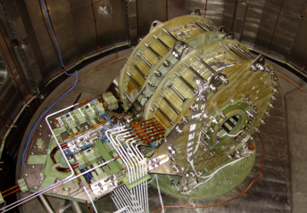
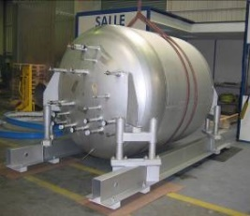
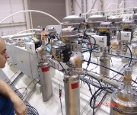
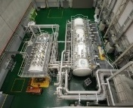
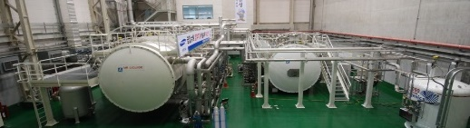
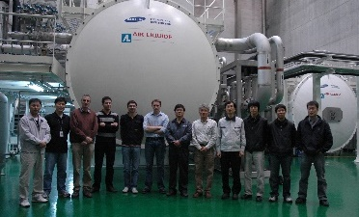
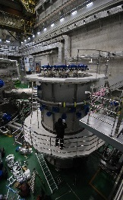
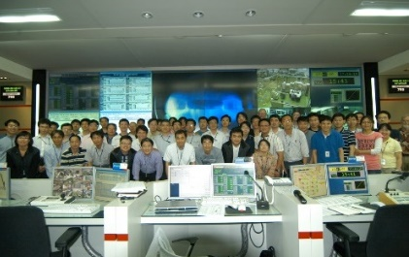
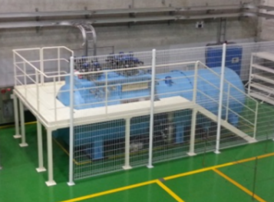
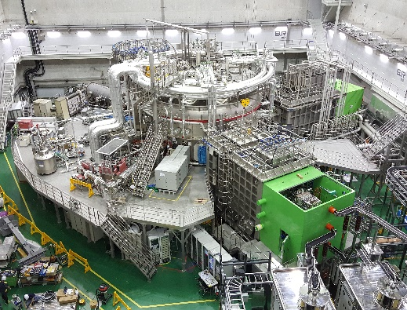
INTRODUCTION
History of Cryogenic Activity
1991
2002
2005
2006-2007
2008
2015
2017-Present

Slide 6
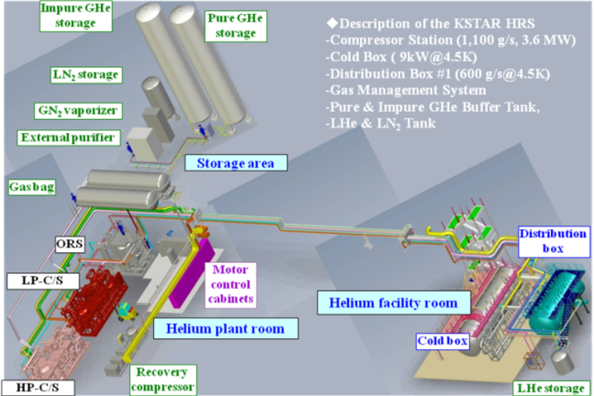
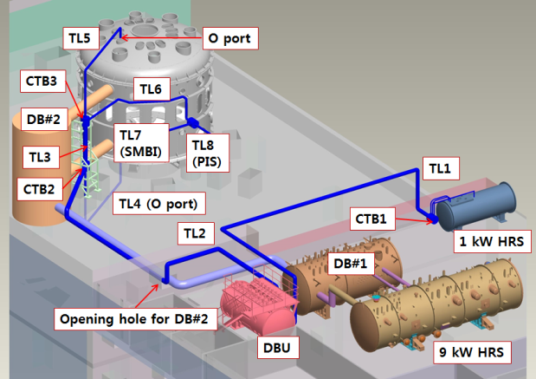
INTRODUCTION
Cryogenic System Configuration
HELIUM REFRIGERATION SYSTEM
(9kW@4.5K, Air Liquide Advanced Technologies, 2008)
HELIUM REFRIGERATOR
(1kW@4.5K, Linde Kryotechnik AG, 1st built 2002 & relocated/modified 2016)
HELIUM DISTRIBUTION SYSTEM
CURRENT LEAD SYSTEM
UPGRADED DISTRIBUTION SYSTEM
GAS MANAGEMENT SYSTEM#1
GAS MANAGEMENT SYSTEM#2
KSTAR TF & PF SC MAGNETS SYSTEM
KSTAR CURRENT LEAD
CPI
PIS
NBI-2
SMBI
LHE DEWAR
(R&D USERS)

Slide 7
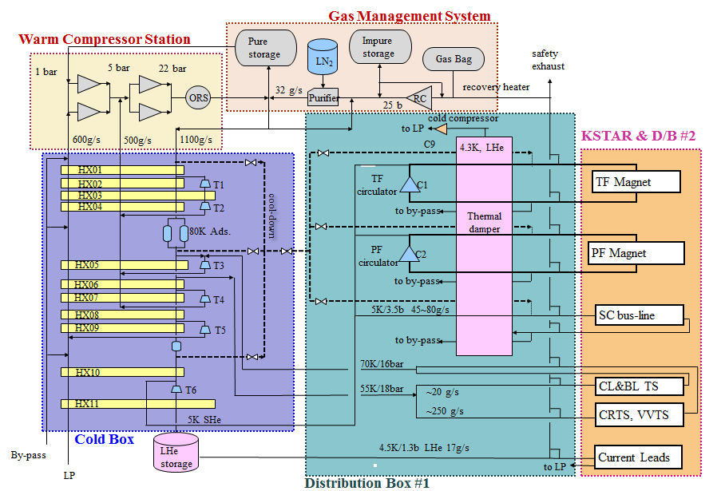
INTRODUCTION
Process Diagram of KSTAR Helium Circuit w/ 9kW@4.5K

Slide 8
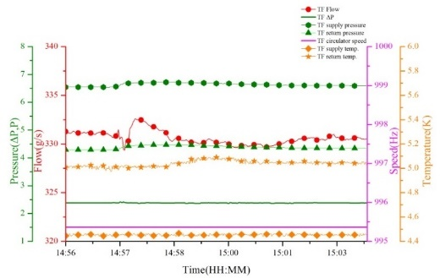
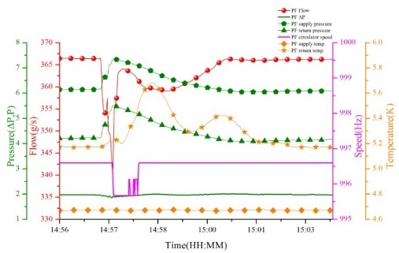
INTRODUCTION
SC magnet Cooling & Operation Trend
Thermal load handling of the KSTAR SC magnets
1.3 bar
4.2bar
4.5K
6.9bar
4.9K
 | TF Circulator | PF Circulator | Cold Comp.
Speed | 1,010 Hz | 1,010 Hz | ~235 Hz
dm/dt | 340 g/s | 372 g/s | ~300 g/s
△P | 2.4 bar | 2.0 bar | 0.2 bar
P_{inlet} | 6.6 bar | 6.2 bar | 1.1 bar
P_{outlet} | 4.2 bar | 4.2 bar | 1.3 bar
Bearing | Dynamic gas (Foil) |  | Ceramic ball
Cold compressor
SHe circulator
1.1 bar
4.3 K (1.1b) LHe
LHe supply
HX3
HX2
HX1
Thermal damper
4.2bar
5.5K
4.4bar
4.4K
4.4bar
5.5K
6.6bar
4.4K
Magnet str.
Magnet coil
Operation of TF Circuit
Operation of PF Circuit

Slide 9
OPERATION SUMMARY

Slide 10
OPERATION SUMMARY
Cryoplant Operation Plan
Annual operation program (2017)
300K
3,000~4,000 hr operational
annually
Maintenance &
Campaign preparation
Maintenance &
Campaign preparation
KSTAR Temp.
Cool-down
Warm-up
80K
KSTAR Operation
4.5K
1
2
3
4
5
6
7
8
9
10
11
12
Month
Daily operation scenario
TF coil charge
TF coil discharge
35 KA
20-25 shots per a day
TF Coil Current
0 KA
TF ramp-up
TF ramp-down
-35 KA
00
09
10
17
18
24

Slide 11
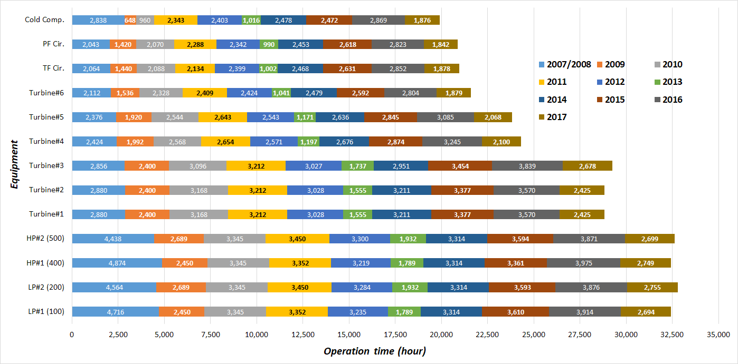
OPERATION SUMMARY
Plant Operation Times
2018

Slide 12
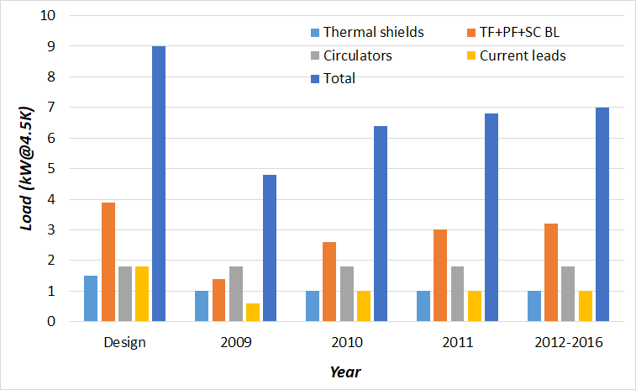
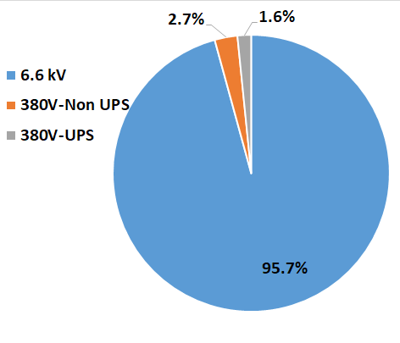
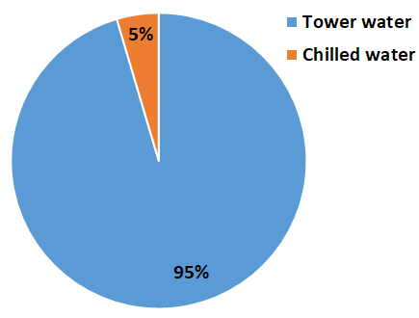
OPERATION SUMMARY
Thermal Load into KSTAR HRS
 | Thermal load (peak, kW@4.5K)
 | Design | ‘09 | ‘10 | ‘11 | ’12-’16
Thermal shields | 1.5 | ~1.0 | ~1.0 | ~1.0 | ~1.0
TF+PF+SC BL | 5.7 | ~1.4 | ~2.6 | ~3.0 | ~3.2
Circulators |  | ~1.8 | ~1.8 | ~1.8 | ~1.8
Current leads | 1.8 | ~0.6 | ~1.0 | ~1.0 | ~1.0
Total | 9.0 | ~4.8 | ~6.4 | ~6.8 | ~7.0
Utility Consumption
Items |  | Contents
Electricity | 6.6 kV | 3,600 kW consuming
 | 380V-Non UPS | 100 kW installed
 | 380V-UPS | 60 kW installed
Cooling water | Tower water | 520 m³/h (32°C/37°C)
 | Chilled water | 25 m³/h (22°C/27°C)
Instrument air | Compressed air | 44 Nm³/h @ 8 bar
 | GN₂ back-up | 650 Nm³/h @ 6 bar
Electricity
CWS

Slide 13
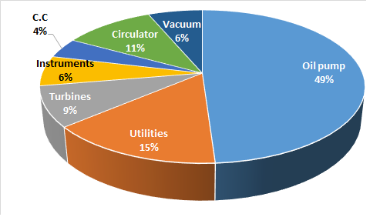
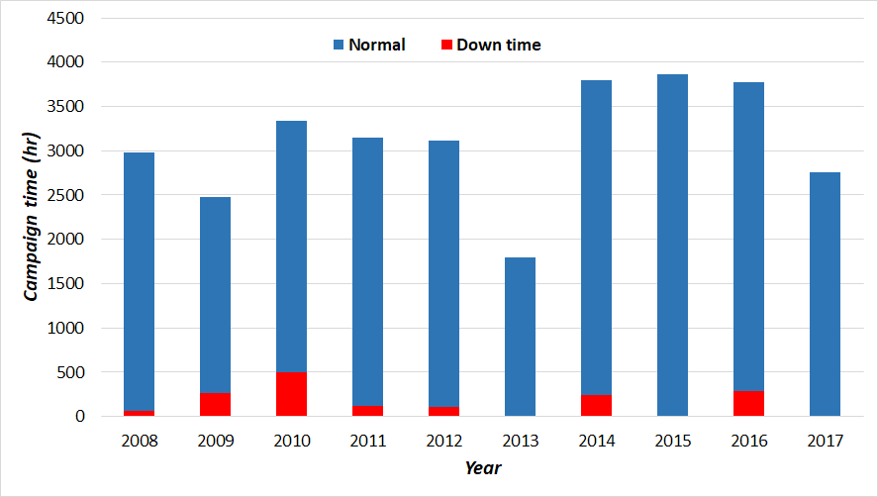
OPERATION SUMMARY
Failure Record
Items |  | Count | Consequences | Remarks
1 | Oil pump | 23 | Unless redundancy ⟶ ESD | will be discussed later
2 | Utility failure | 7 | HRS ESD | Incl. micro power-cut
3 | Turbines | 4 | Cool-down interrupted | Solved
4 | Instrumentation | 3 | Valves fault
5 | Cold compressor | 2 | TD temp./press. rising | Solved
6 | Circulator | 5 | SHe supply decreased | Solved
7 | Vacuum system | 3 | No impact (∵prompt repair) | Solved
Total |  | 47
Availability of the KSTAR HRS
Year | Reason of downtime
2008 | Oil pumps, electricity
2009 | T3
2010 | Oil pumps, electricity
2011 | Electricity, oil pumps
2012 | Electricity
2013 | None
2014 | T3 & UPS
2015 | Minors
2016 | Mechanical seal, Utilities failures, etc.
2017 | None
Availability≈95%

Slide 14
MAINTNANCE/REPAIR

Slide 15
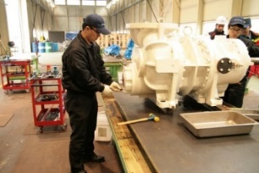
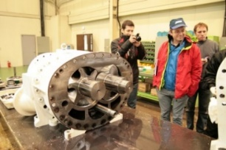
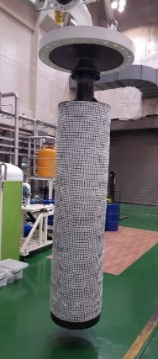
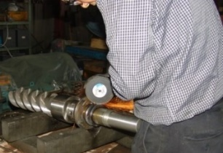
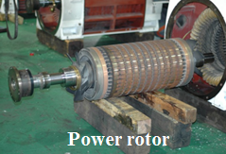
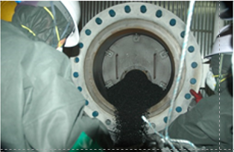
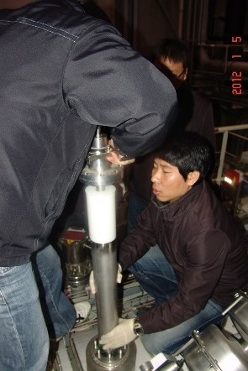
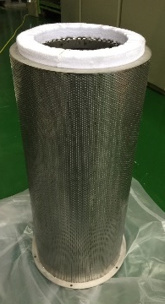
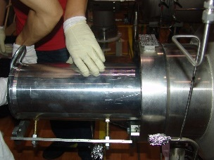
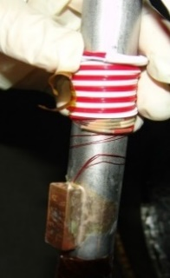
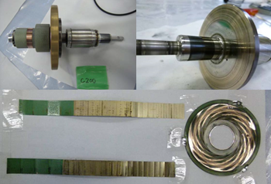
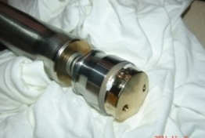
MAINTENANCE/REPAIR
Maintenance Schedule & Summary
Item |  | Service period | Remarks
Warm compression system (WCS) | Screw compressor | 20,000 hr | Manufacturer
 | Electric motor | 15,000 hr | Manufacturer
 | ORS coalescing filter | 10 years | NFRI
 | ORS charcoal | 5 years | NFRI
 | Charcoal dust filter | 3 years | NFRI
 | Oil pump | 1 year | NFRI
 | Oil filter | 5 years | NFRI
 | Motor control center | 2 years | NFRI
Cold Box (C/B) | Expander#1-#3 | 1 year | NFRI
 | Expander#4-#6 | 2 years | NFRI
 | Vacuum system | 1 year | NFRI
 | Cryogenic valves | 5 years | NFRI
Distribution Box (D/B) | Cold compressor | 5,000 hr | Manufacturer
 | TF SHe circulator | 10,000 hr | Manufacturer
 | PF SHe circulator | 5,000 hr | Manufacturer
 | Cryogenic valves | 5 years | NFRI
Instrument | T, P, m sensor | 1 year | NFRI
 | PLC & control | 1 year | NFRI

Slide 16
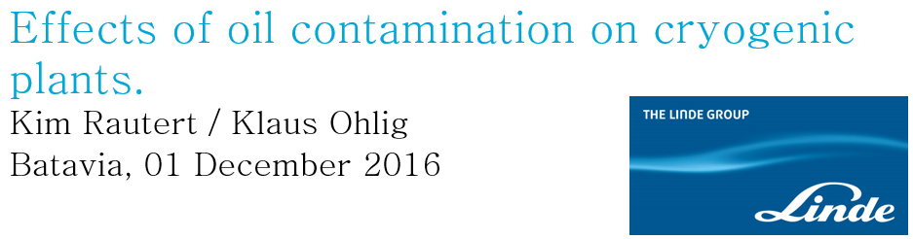



MAINTENANCE/REPAIR
Oil Removal System
Coalescing filter (2017)
- Oil contamination issues at the CRYO-OPS 2016/2014
26 October 2016
- Coalescers visual inspection
Item | Coalscer#1 | Coalscer#2 | Coalscer#3 | DCS | Remarks
Oil | Little wet | Dry, but little wet surface | Dry | Normal
Filter damage | No | No | No
Charcoal adsorber
- Activate charcoal exchange : 2009 & 2015
• Elapsed time ~2 weeks
• Utility
- GN₂ : 200,000 Nm³
- GHe : ~600 Nm³

Slide 17





MAINTENANCE/REPAIR
Cold Compressor
Failure trend@FY2010
 | 10/06, 13:00 | 10/07, 01:00 | 10/07, 13:00
Speed | 221 Hz | 172 Hz | 233 Hz
P_{Inlet} | 1.13 bar | 1.21 bar | 1.11 bar
P_{outlet} | 1.26 bar | 1.27 bar | 1.26 bar
Vibration | 4.57 μm | 20.41 μm | 11.52 μm
P_{LP_CS} | 1.05 bar | 1.05 bar | 1.05 bar
Vibration developing
Inspection at the manufacturer’s workshop
- Suspected root cause was grease dry-out due to vacuum (< 1 mbar) while P/F
New DL-2 Fluorine grease (IR)
Used DL-2 Fluorine grease (IR)
- Counter measures
1) Changed grease type from Fluorine base to Lithium base
2) Modify the conditioning procedure at lower vacuum (~100 mbar)

Slide 18
SYSTEM MODIFICATION

Slide 19



SYSTEM MODIFICATION
Major System Modification List
Items | Contents | Result | Remarks
C/B Sensor Upgrade (2017) | • Temp. sensors redundancy • Using Cernox CU sensors | - Better reliability of C/B operation w/ redundant sensors of temperature | Refer to the poster of Mr. Jae-Joon JOO for the details
Internal circuit modification (2014) | • Remove heat-leak sources • D/B#1 internal piping modification | - No more SHe circuit fluctuation is observed - Better stability of the cryoplant
Control System Upgrade (2011-2018) | • Establish the PLC redundancy • WinCC S/W upgrade | - Better reliability & scalability of the plant operation
 | • Realize the cool-down autonomy by using cool-down record of past years | - Better stability & less HR input while cool- down period - Demonstrates proper cool-down autonomy | Refer to the poster of Mr. Kyung-Mo MOON for the details
 | • SHe circuit pressure load handling | - Reduce pressure loss in the TF/PF circuit - Mitigate the pressure head in the PF circuit | Will be resented at the following slide
C/B sensor upgrade
Internal Circuit Modification
Cool-Down Autonomy

Slide 20


SYSTEM MODIFICATION
Pulsed (Pressure) Load Handling Control Logic
SHe venting
SHe filling
Real action movie
Cold
compressor
PF circulator
P
∆P
P
4.3 K (1.1b) LHe
Thermal damper
TF circulator (2011)
HX3
HX2
HX1
PF Magnet str.
PF Magnet coil
Control logic for entire SHe pressure handling
→ NFRI original logic
PF circulator (2011)
Control logic for pressure head mitigation in the circuit
→ Collaboration with ITER Organization

Slide 21
SUMMARY

Slide 22
SUMMARY
Operation
The KSTAR HRS has demonstrated sufficient cooling power with margin to cope with the
thermal load from KSTAR Tokamak
The KSTAR HRS has experienced 47 times of abnormal events while campaign period until now
The availability of system has been around 95% for past 30,000 hr operation
Maintenance/Repair
The cryoplant has been operated properly thanks to successful maintenance/repair activities
Most of maintenance/repair works are performed by NFRI that helps the flexibility of operation
Plant Modification
The activities of system/component modification increased the reliability & stability of plant

Slide 23
谢谢您的倾听!!!
THANK YOU FOR THE ATTENTION!!!
경청해 주셔서 감사합니다!!!

