Slide 1
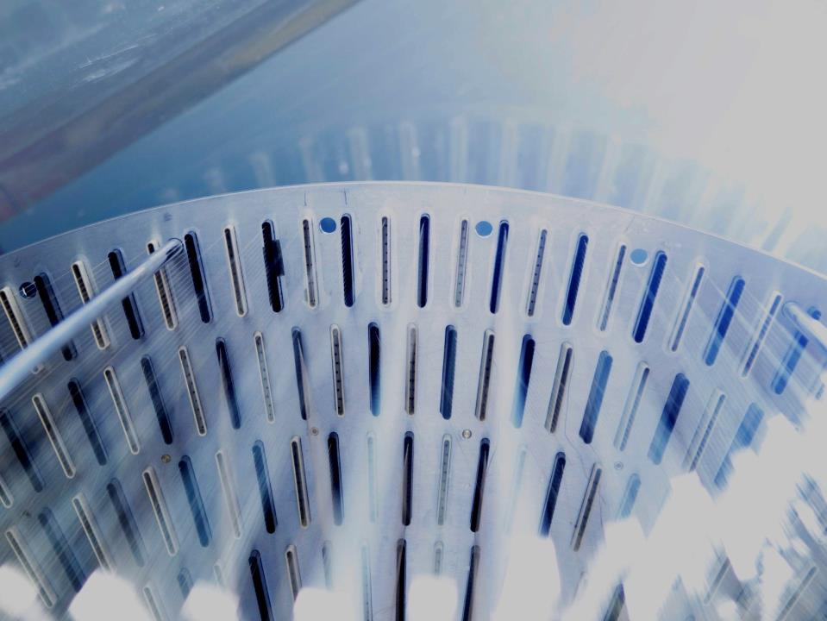



Canada's national laboratory
for particle and nuclear physics
and accelerator-based science
The Operational Experience of e-Linac Cryogenic System at TRIUMF
Presented by Alexey Koveshnikov
Cryogenic Group Leader
Workshop on Cryogenic Operations - 2018
Notes:
Hello Everybody. My name is Alexey Koveshnikov and I’m here to share some Operational Experience of e-Linac Cryogenic System at TRIUMF.

Slide 2
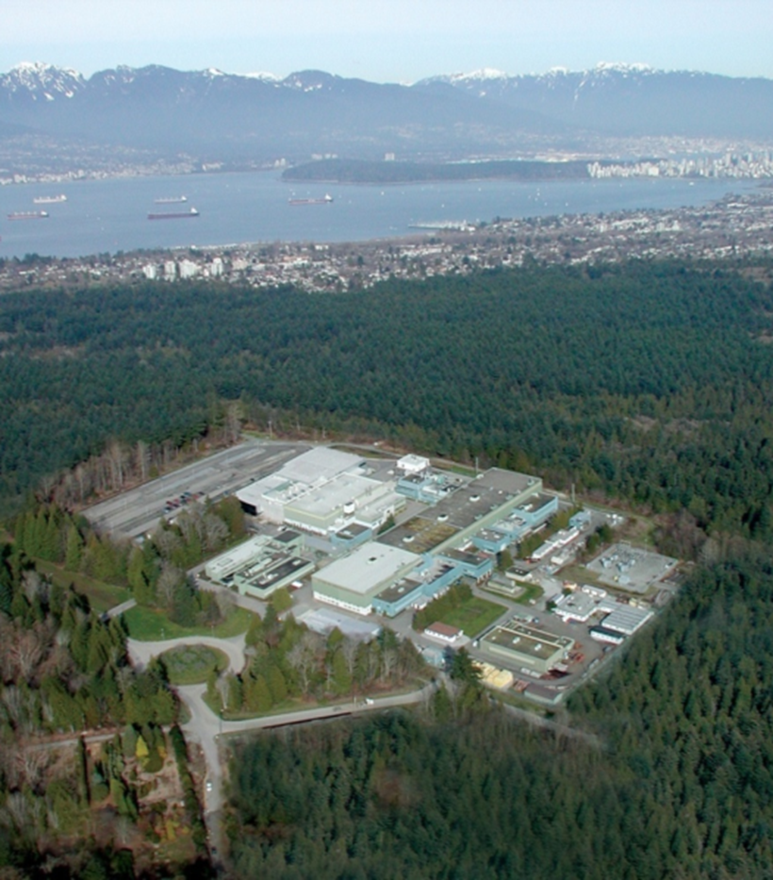

TRIUMF: Canada’s National Science Laboratory
TRIUMF Laboratory
founded 50 years ago as TRI-University Meson Facility
owned and operated by consortium of 20 Canadian universities
~ 500 scientists and staff, postdocs, students, visitors, etc.
research focus on rare isotopes, structure of matter, life science
Cryogenic Systems
SC Solenoid: Sulzer TCF200 Helium Refrigerator (currently off)
Cyclotron Cryopumping: Linde 1630 Helium Refrigerator
Helium Recovery Facility: Linde 1610 Helium Liquefier
ISAC-II SC Linac: two Linde TCF50 Helium Refrigerator
ARIEL SC Linac: Air Liquide HELIAL LL Helium Liquefier
June 05, 2018
A. Koveshnikov - Workshop on Cryogenic Operations, IHEP, Beijing, PRC
Notes:
TRIUMF is Canada’s National Lab in the field of Particle and Nuclear Physics and Accelerator Based Science.
It’s located in the woods of Pacific Spirit Reginal Park at the western tip of beautiful Vancouver, BC.

Slide 3
TRIUMF: Canada’s National Science Laboratory
TRIUMF Laboratory
founded 50 years ago as TRI-University Meson Facility
owned and operated by consortium of 20 Canadian universities
~ 500 scientists and staff, postdocs, students, visitors, etc.
research focus on rare isotopes, structure of matter, life science
Cryogenic Systems
SC Solenoid: Sulzer TCF200 Helium Refrigerator (currently off)
Cyclotron Cryopumping: Linde 1630 Helium Refrigerator
Helium Recovery Facility: Linde 1610 Helium Liquefier
ISAC-II SC Linac: two Linde TCF50 Helium Refrigerator
ARIEL SC Linac: Air Liquide HELIAL LL Helium Liquefier
June 05, 2018
A. Koveshnikov - Workshop on Cryogenic Operations, IHEP, Beijing, PRC
Notes:
Founded 50 years as TRI-University Meson Facility, nowadays it is run and operated by the consortium of 20 Canadian universities. There are around 500 researchers, staff, postdocs, students and visitors.
Main emphasis is on production of rare isotope beams (RIB) for the needs of physical sciences, material science and life sciences.
There are several Helium cryogenic facilities across the lab and I’ll be mostly talking about the latest one.

Slide 4
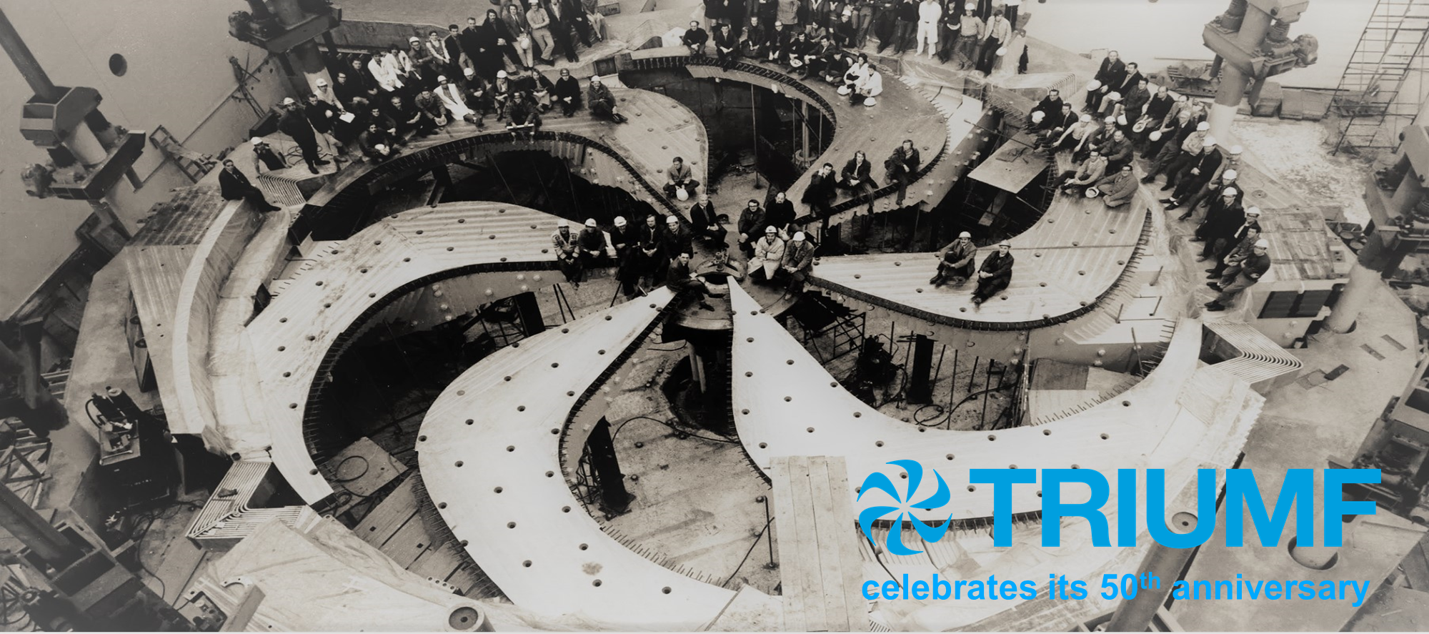
June 05, 2018
3
A. Koveshnikov - Workshop on Cryogenic Operations, IHEP, Beijing, PRC
Notes:
These year TRIUMF is celebrating its 50th anniversary. TRIUMF is home to the world largest (by size) Proton Cyclotron.

Slide 5
Rare Isotope Beam Facilities: ISAC-I and ISAC-II
June 05, 2018
5
A. Koveshnikov - Workshop on Cryogenic Operations, IHEP, Beijing, PRC
Notes:
The 500 MeV Cyclotron at TRIUMF was built in the 1st four years of the Lab existence and commissioned at 1972. It is the heart of the Lab for over more then 45 years.

Slide 6
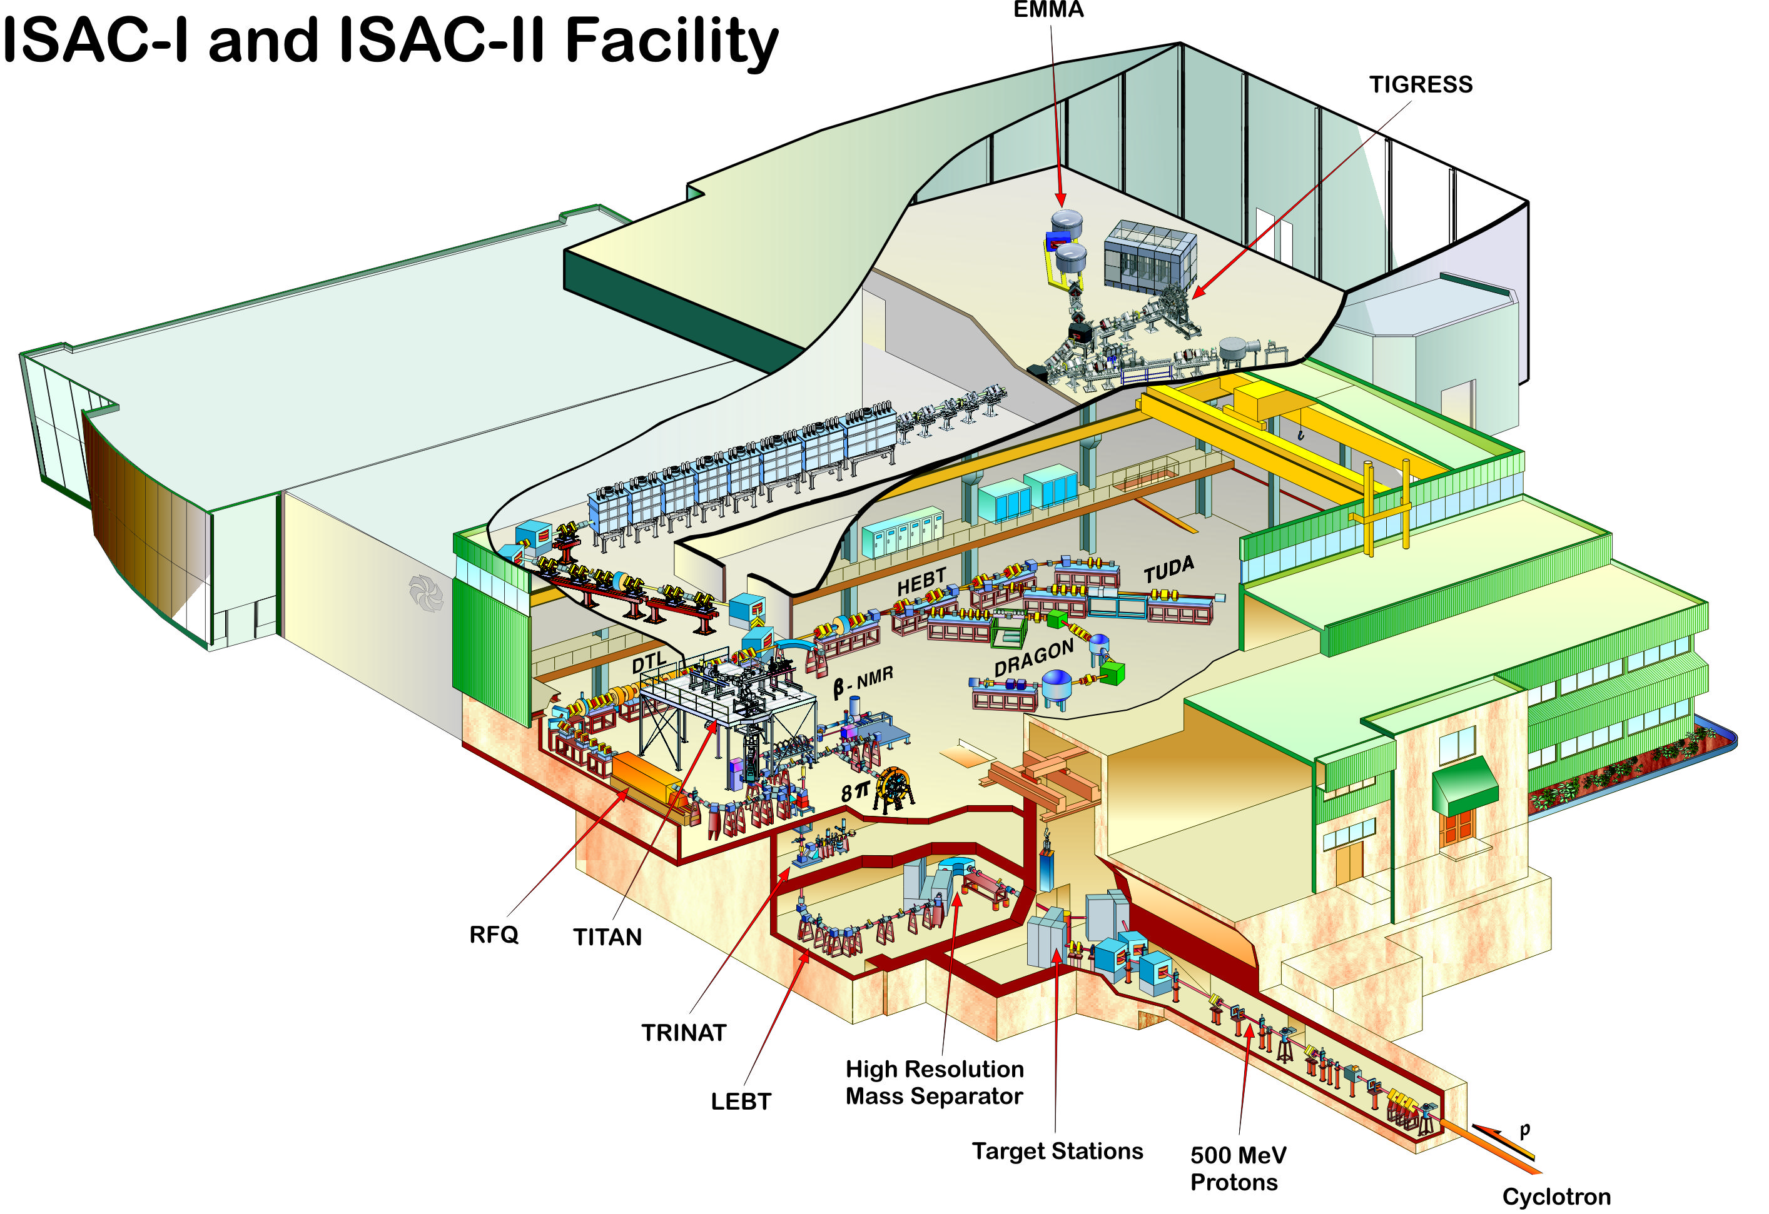
Rare Isotope Beam Facilities: ISAC-I and ISAC-II
ISAC-II
ISAC linac
ISAC-I
June 05, 2018
A. Koveshnikov - Workshop on Cryogenic Operations, IHEP, Beijing, PRC
5
Notes:
In 1990s the Lab was extended by building ISAC I and in 2000s ISAC II RIB experimental facilities.
But Cyclotron continued to serve as the sole driver for RIB production.
The proton beam from Cyclotron smash one of two targets. The extracted RIB is brought to ISAC I experimental hall for the following acceleration by RFQ and DTL and delivery to the end stations. Alternatively, RIB can be brought to ISAC II experimental hall after passing through SC RF heavy ion linac.

Slide 7
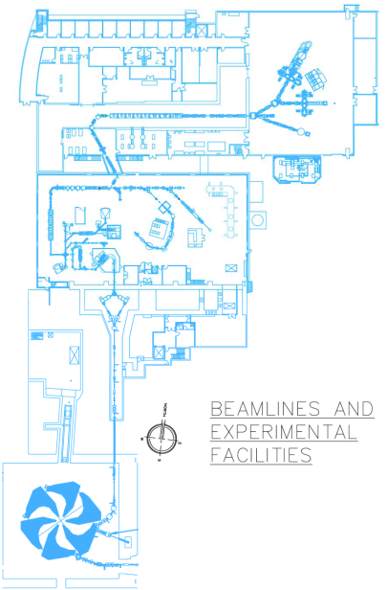

Rare Isotope Beam Facilities: ISAC-I and ISAC-II
TRIUMF’s Rare Isotope Beam facilities:
ISAC-I (low and medium energy facilities)
ISAC-II (high energy accelerated beams)
ISAC heavy ion SRF linear accelerator
Science program:
Nuclear Structure and Reactions
Nuclear Astrophysics
Materials Science
Life sciences
With many world class experiments in ISAC-I and ISAC-II areas, TRIUMF is only able to support a single user due to a single driver
520 MeV proton beam up to 100 μA (50 kW)
TRIUMF Cyclotron (commissioned in 1972)
June 05, 2018
4
A. Koveshnikov - Workshop on Cryogenic Operations, IHEP, Beijing, PRC
Notes:
To keep “heart pumping” Lab is going through the extensive Cyclotron refurbishment project.

Slide 8
Rare Isotope Beam Facilities: ARIEL Extension
Notes:
In order to overcome the bottleneck associated with single target driver and RIB infrastructure, TRIUMF has committed itself to a major facelift. The new Advanced Rare IsotopE Lab (ARIEL) was funded by CFI, NRC, Provinces of BC, AB, ON, MA, and QB starting 2010 and currently is under construction.

Slide 9
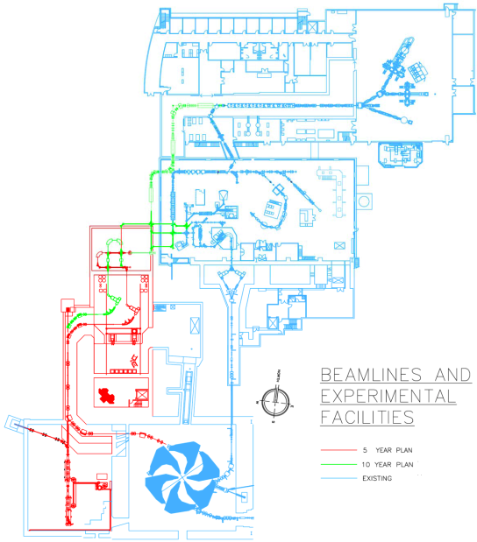
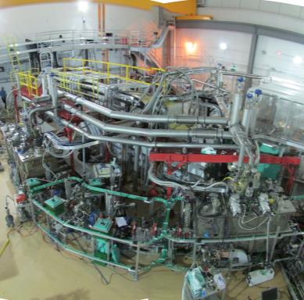
Rare Isotope Beam Facilities: ARIEL Extension
TRIUMF’s ARIEL Project:
allows rare isotope beams to be delivered to multiple experiments simultaneously
extra proton cyclotron driver beamline
complementary electron SRF linac driver 30 MeV, 10 mA (300 kW)
ISAC linac
ISAC-II
ISAC-I
L. Merminga et al., ARIEL: TRIUMF’s Rare IsotopE Laboratory, IPAC2011
Cyclotron
electron SRF linac
June 05, 2018
A. Koveshnikov - Workshop on Cryogenic Operations, IHEP, Beijing, PRC
6
Notes:
In addition to existing proton beamline to ISAC targets, the new alternative driver was built. The 30 MeV electron linac will send its beam to a convertor in order to produce intense cone of γ-radiation which in its turn will cause nuclear reaction in target via photofission.
An additional proton line will be also built out of Cyclotron to a new targets’ facility.
By accomplishing above goals, TRIUMF will triple the beam time available to experimentalists and provide high purity neutron reach Rare Isotope Beams to researchers.

Slide 10

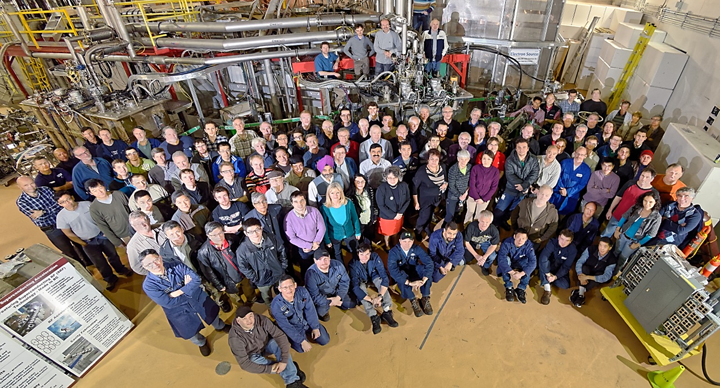

Notes:
So, following the steps of our Founding Fathers…
In 2014, the 1st phase of ARIEL project, the e-Linac accelerator was completed and since then went through testing and commissioning.

Slide 11
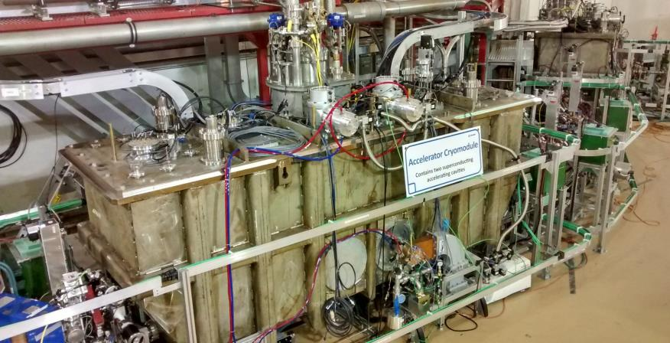
e-Linac: SRF Specification
30 MeV @ 10 mA (300 kW beam)
3 (5) elliptical 1.3 GHz SRF cavities
1 injector and 1(2) accelerator cryomodules (1 & 2(4) cavities)
Cryogenic requirements:
maintain SRF cavities @ 2 K
2 K load: 15.4 W / 28 W
4 K load: 5.7 W / 9.7 W
77K load: 162 W / 244 W
N. Muller et al., TRIUMF’s Injector and Accelerator Cryomodules, SRF2015
June 05, 2018
A. Koveshnikov - Workshop on Cryogenic Operations, IHEP, Beijing, PRC
8
Notes:
In order to deliver specified CW e-beam power the cryogenic system shall satisfy following parameters for each SRF CM. Please note, that requirement for the system leave a large room for the future expansion.

Slide 12
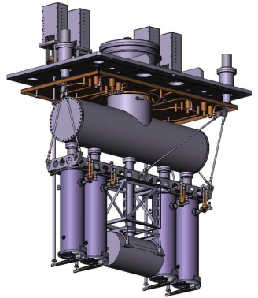
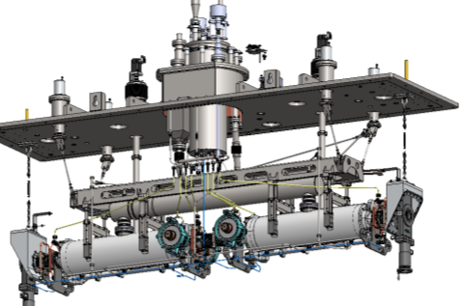
e-Linac: Cryomodules Design
utilize expertise with top-load design of ISAC cryomodules
80 K LN2 cooled thermal shields
few siphon driven LHe cooling loops for RF couplers
4 K to 2 K conversion onboard of each cryomodule
heat
exchanger
4K phase separator
2K reservoir
cavity bath
June 05, 2018
A. Koveshnikov - Workshop on Cryogenic Operations, IHEP, Beijing, PRC
9
Notes:
The major difference between ISAC II linac cryosystem and ARIEL e-linac is that ISAC cavities operate at 4.5K while ARIEL cavities were designed for 2K operation.
Still, we had heavily borrowed from the ISAC cryosystem design in order to reduce cost of R&D and to save those scarce resources that we have at our disposal. The major feature of the CM is a box top-load design which has proven itself at ISAC. Another advantage is that we could get “of-the shelf” 4K ColdBox and build rather simplistic LHe distribution system while performing 4K to 2K conversion on the board of each cryomodule.

Slide 13
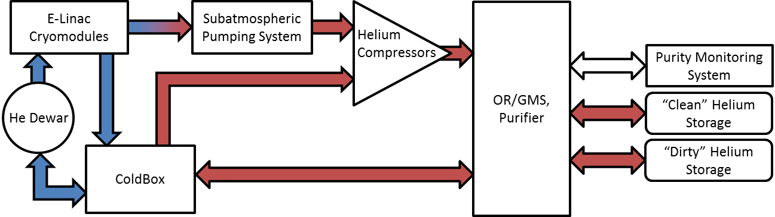
A. Koveshnikov et al., Integration and commissioning of the ARIEL e-linac cryogenic system at TRIUMF, ICEC 25 –ICMC 2014
e-Linac: Cryogenic System Architecture
accelerator
hall
compressor
building
Areas of special attention:
mitigation of impurities – enhanced ORS of compressors, welded joints of SA line, entire SA flow is passed through freeze-out purifier
failure scenarios (power, water, impurities) – recovery compressor and impure storage tank
integrated control system, safety interlocks and machine protection
Outstanding operational issues:
response of the control system to the failure scenarios – operator’s intervention is always required
large number of manually actuated control valves, ambiguity of the system state from controls point
June 05, 2018
A. Koveshnikov - Workshop on Cryogenic Operations, IHEP, Beijing, PRC
10
Notes:
The outline of e-linac Cryogenic System Architecture was reported at various meetings.
Just naming major subsystems: LHe cryoplant including ColdBox, “warm” and “cold” He storage, compressor station (main and recovery/purification compressors with GM and OR systems), He purifier, Subatmospheric pumping system, LHe distribution, CMs. Not to forget LN2 system.

Slide 14
e-Linac: Cryogenic System Architecture
Shut-off
Valve
Dewar
Cold Box
Ambient heater
Heat Exchanger
Future Extension
SA Pumps
Impure Helium Storage
Main Compressor
Recovery Compressor
Pure Helium Storage
Purifier
June 05, 2018
A. Koveshnikov - Workshop on Cryogenic Operations, IHEP, Beijing, PRC
11
Notes:
Schematically, the simplified PID is shown on this slide. Shaded greenish boxes indicate the future expansion, funding providing.

Slide 15
Cryogenic System – Compressors and Gas Management
Shut-off
Valve
Dewar
Cold Box
Ambient heater
Heat Exchanger
Future Extension
SA Pumps
Impure Helium Storage
Main Compressor
Recovery Compressor
Pure Helium Storage
Purifier
June 05, 2018
A. Koveshnikov - Workshop on Cryogenic Operations, IHEP, Beijing, PRC
12
Notes:
The “warm” part of the cryosystem is located ~50 m away and ~15 m above from the ColdBox and CMs

Slide 16
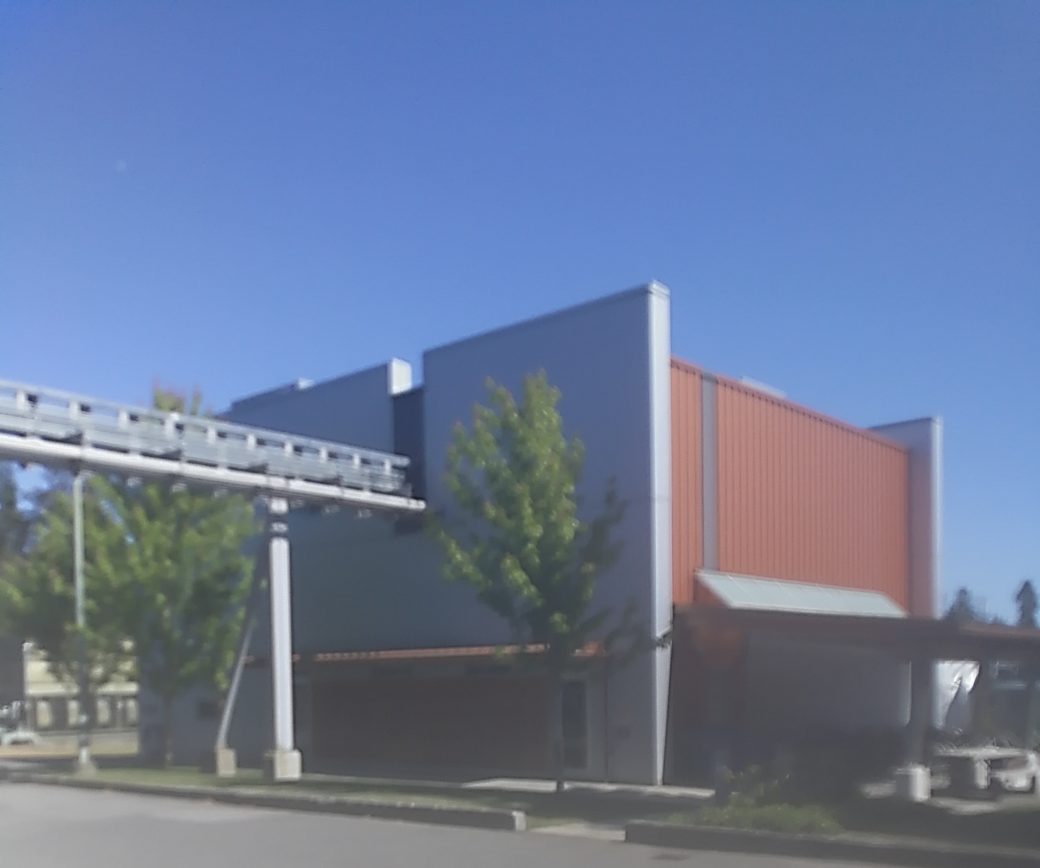
Cryogenic System – Compressors
Notes:
TRIUMF had to build a separate ARIEL compressor building to accommodate Compressors with OR and GM systems, He purifier and a sub-atmospheric pumps farm.

Slide 17
Cryogenic System – Compressors
Main compressor
KAESER FSD571SFC
discharge pressure: 14.2 bar(a)
mass flow rate: ≤112.4 g/s
power: 378 kW
water-cooled
Recovery compressor
KAESER CSD85
discharge pressure: 15 bar(a)
mass flow rate: ≤14.7 g/s
power: 57 kW (backed up with emergency diesel PG)
air-cooled
June 05, 2018
A. Koveshnikov - Workshop on Cryogenic Operations, IHEP, Beijing, PRC
13
Notes:
The above rendering shows 3D laser scan to produce “as built” documentation for compressor building.
The main compressor equipped with VFD and can handle up to 112 g/sec flow at 14.2 bara
And Recovery/Purification compressor can handle up to 14.7 g/sec at 15 bara.

Slide 18
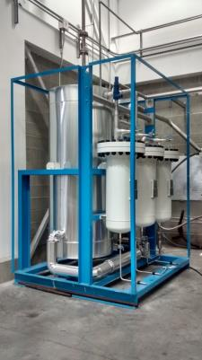
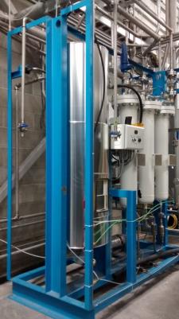
Cryogenic System – Oil Removal System
Oil removal system:
third additional coalescer to decrease risks of oil migration
high-temperature bakeable design of charcoal adsorber (150°C)
larger carbon bed of the adsorber
Operational experience:
no oil migration detected within 4 years of normal operation
still not enough runtime to validate the performance of ORS
Recovery compressor use-cases
nominal operation: pass SA flow through purification system without mixing with ColdBox process helium
power outage: collect helium boil-off vapors from cryomodules and dewar (implementation issues)
stand-by mode: circulation of helium inventory through purifier
purification mode: re-purification of contaminated helium from impure tank (for future extension)
June 05, 2018
A. Koveshnikov - Workshop on Cryogenic Operations, IHEP, Beijing, PRC
14
Notes:
Each compressor is equipped with a custom OR/GM system. Main features:
- 3 oil coallescers,
- increased size of the carbon bed,
- and bakeable to 150°C design of the carbon bed.

Slide 19
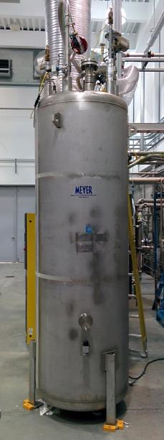
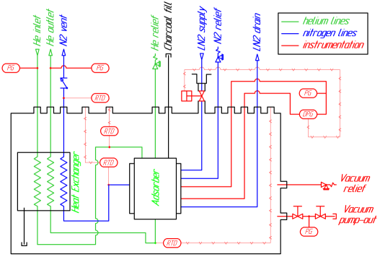
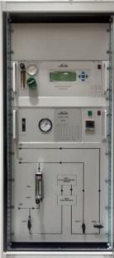
Cryogenic System – Helium Purifier
Stand-alone purifier:
designed by Fermilab, manufactured by Meyer Tools
specified for 60 g/s @ 25 bar, 10 ppm N2
Purity monitoring:
online monitoring with Linde MCD at compressors side (installed as a part of cryoplant)
water content monitor at coldbox side
interlocks for contaminated helium storage (future)
Linde MCD
June 05, 2018
A. Koveshnikov - Workshop on Cryogenic Operations, IHEP, Beijing, PRC
15
Notes:
The clearness of the helium supply, especially of subatmospheric stream is a quintessential for successful 2K operation.
The FNAL design He purifier was manufactured by Meyer Tools and installed at the end of 2015.
It has been operational for almost 2.5 years. But the detailed testing and commissioning of the purifier is still on the way.

Slide 20
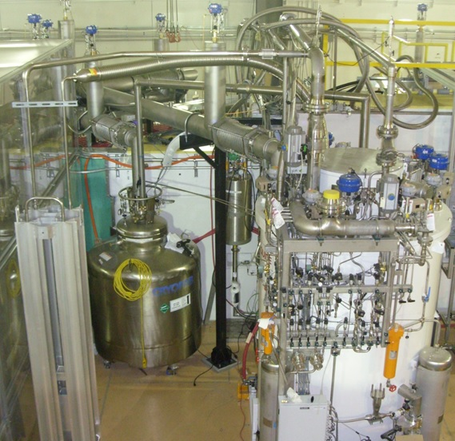
Cryogenic System – Helium Liquefier
Shut-off
Valve
Proportional
Valve
Pressure
Sensor
Dewar
Cold Box
Ambient heater
Flow
Sensor
Compressor,
Pump
Heat Exchanger
Future Extension
SA Pumps
Impure Helium Storage
Main Compressor
Recovery Compressor
Pure Helium Storage
Purifier
June 05, 2018
A. Koveshnikov - Workshop on Cryogenic Operations, IHEP, Beijing, PRC
16
Notes:
The He ColdBox is located at immediate vicinity of e-linac CMs at B2 level of Accelerator Building.

Slide 21
Helium Liquefier: Standard ~0.8 kW ColdBox
Notes:
It was supplied by ALAT at Q3 2013, installed and underwent through acceptance tests.

Slide 22
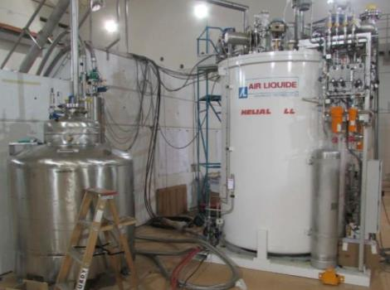
Helium Liquefier: Standard ~0.8 kW ColdBox
Lessons learned:
cooperation for better integration of control system – still an issue
instabilities of ColdBox operation (periodical turbine trips) – is under investigation with manufacturer
We didn’t master yet to automate the helium return during cooldown due to the temperature instabilities and turbine trips
Future work:
reimplementation of some of the control sequences
extra diagnostics (sensors, valve positioners)
G. Hodgson et al., Acceptance Tests and Commissioning of the ARIEL e-Linac Helium Cryoplant, Cryogenics 2014 (IIR)
ColdBox supplied by Air Liquide
Helium cryoplant requirements:
liquefaction w/ LN2: 288 L/h
refrigeration w/ LN2: 600 W
mixed w/ LN2: 240 L/h + 130 W
dewar pressure: ±2 mbar within 2 seconds, ±10 mbar in total
June 05, 2018
A. Koveshnikov - Workshop on Cryogenic Operations, IHEP, Beijing, PRC
17
Notes:
Acceptance test results exceeded our specifications. For example ColdBox has demonstrated liquefaction rate of 368 L/hr for ~1.5 hrs. Limited by the Dewar size and refrigeration power at 4.5 K over 830 W, limited by the immersed heater capacity.

Slide 23
Cryogenic System – Liquid Helium Distribution
Shut-off
Valve
Proportional
Valve
Pressure
Sensor
Dewar
Cold Box
Ambient heater
Flow
Sensor
Compressor,
Pump
Heat Exchanger
Future Extension
SA Pumps
Impure Helium Storage
Main Compressor
Recovery Compressor
Pure Helium Storage
Purifier
June 05, 2018
18
A. Koveshnikov - Workshop on Cryogenic Operations, IHEP, Beijing, PRC
23
Notes:
As it was mentioned before, designing LHe distribution System for e-linac we have modified existing ISAC II distribution.

Slide 24
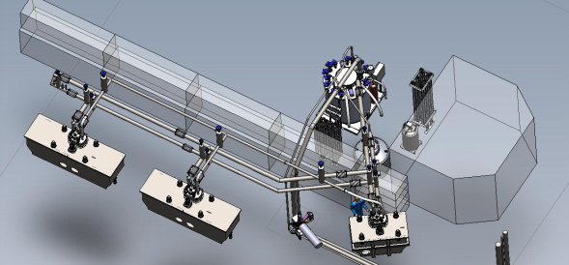
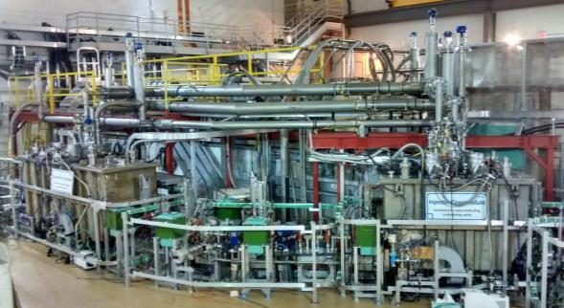
Liquid Helium Distribution
Modular design:
support operation of one to three cryomodules
frequent reinstallations of supply and return sections of cryomodules
accelerator hall access hatch is limited in size
Suppliers:
assembly: Cryotherm
cryogenic valves: WEKA
valve positioners: Siemens SIPART
Cryogenic process lines:
LHe supply: 12 mm, VCR
GHe return: 40 mm, Conflat flanges (CF)
LN2 shield: 12 mm, VCR
June 05, 2018
A. Koveshnikov - Workshop on Cryogenic Operations, IHEP, Beijing, PRC
19
Notes:
The major features: modular design, serviceable field joints, compression fittings (VCR and CF types) for supply and return lines. Major difference from ISAC design-LN2 shielded LHe withdraw from the Dewar and Cold He return to ColdBox as well as supply and return stingers for cryomodules – therefore reduced heatload on LHe distribution.

Slide 25
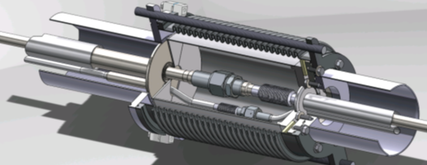
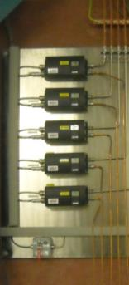
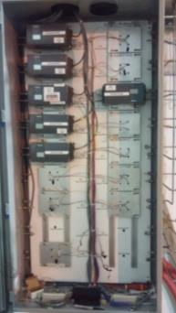
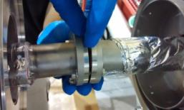
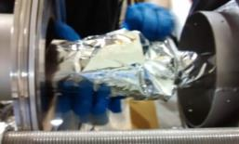
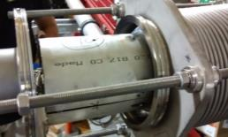
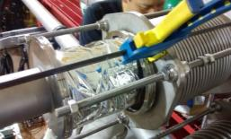
Liquid Helium Distribution
Installation and operation:
friendly design: ~2 hours assembly time per field joint (2 person job)
once observed: leaking VCR fitting, caused soft vacuum
Field joint design (supply side)
LHe line
Radiation protection of pneumatic valve positioners:
LN2 line
Assembly procedure (return side)
DESY
TRIUMF
June 05, 2018
A. Koveshnikov - Workshop on Cryogenic Operations, IHEP, Beijing, PRC
20
Notes:
Another difference – both LHe and LN2 process lines are inside of the field joint space.
Proportional valves position controllers are removed from the direct vicinity to CMs and placed behind the radiation protection wall.

Slide 26
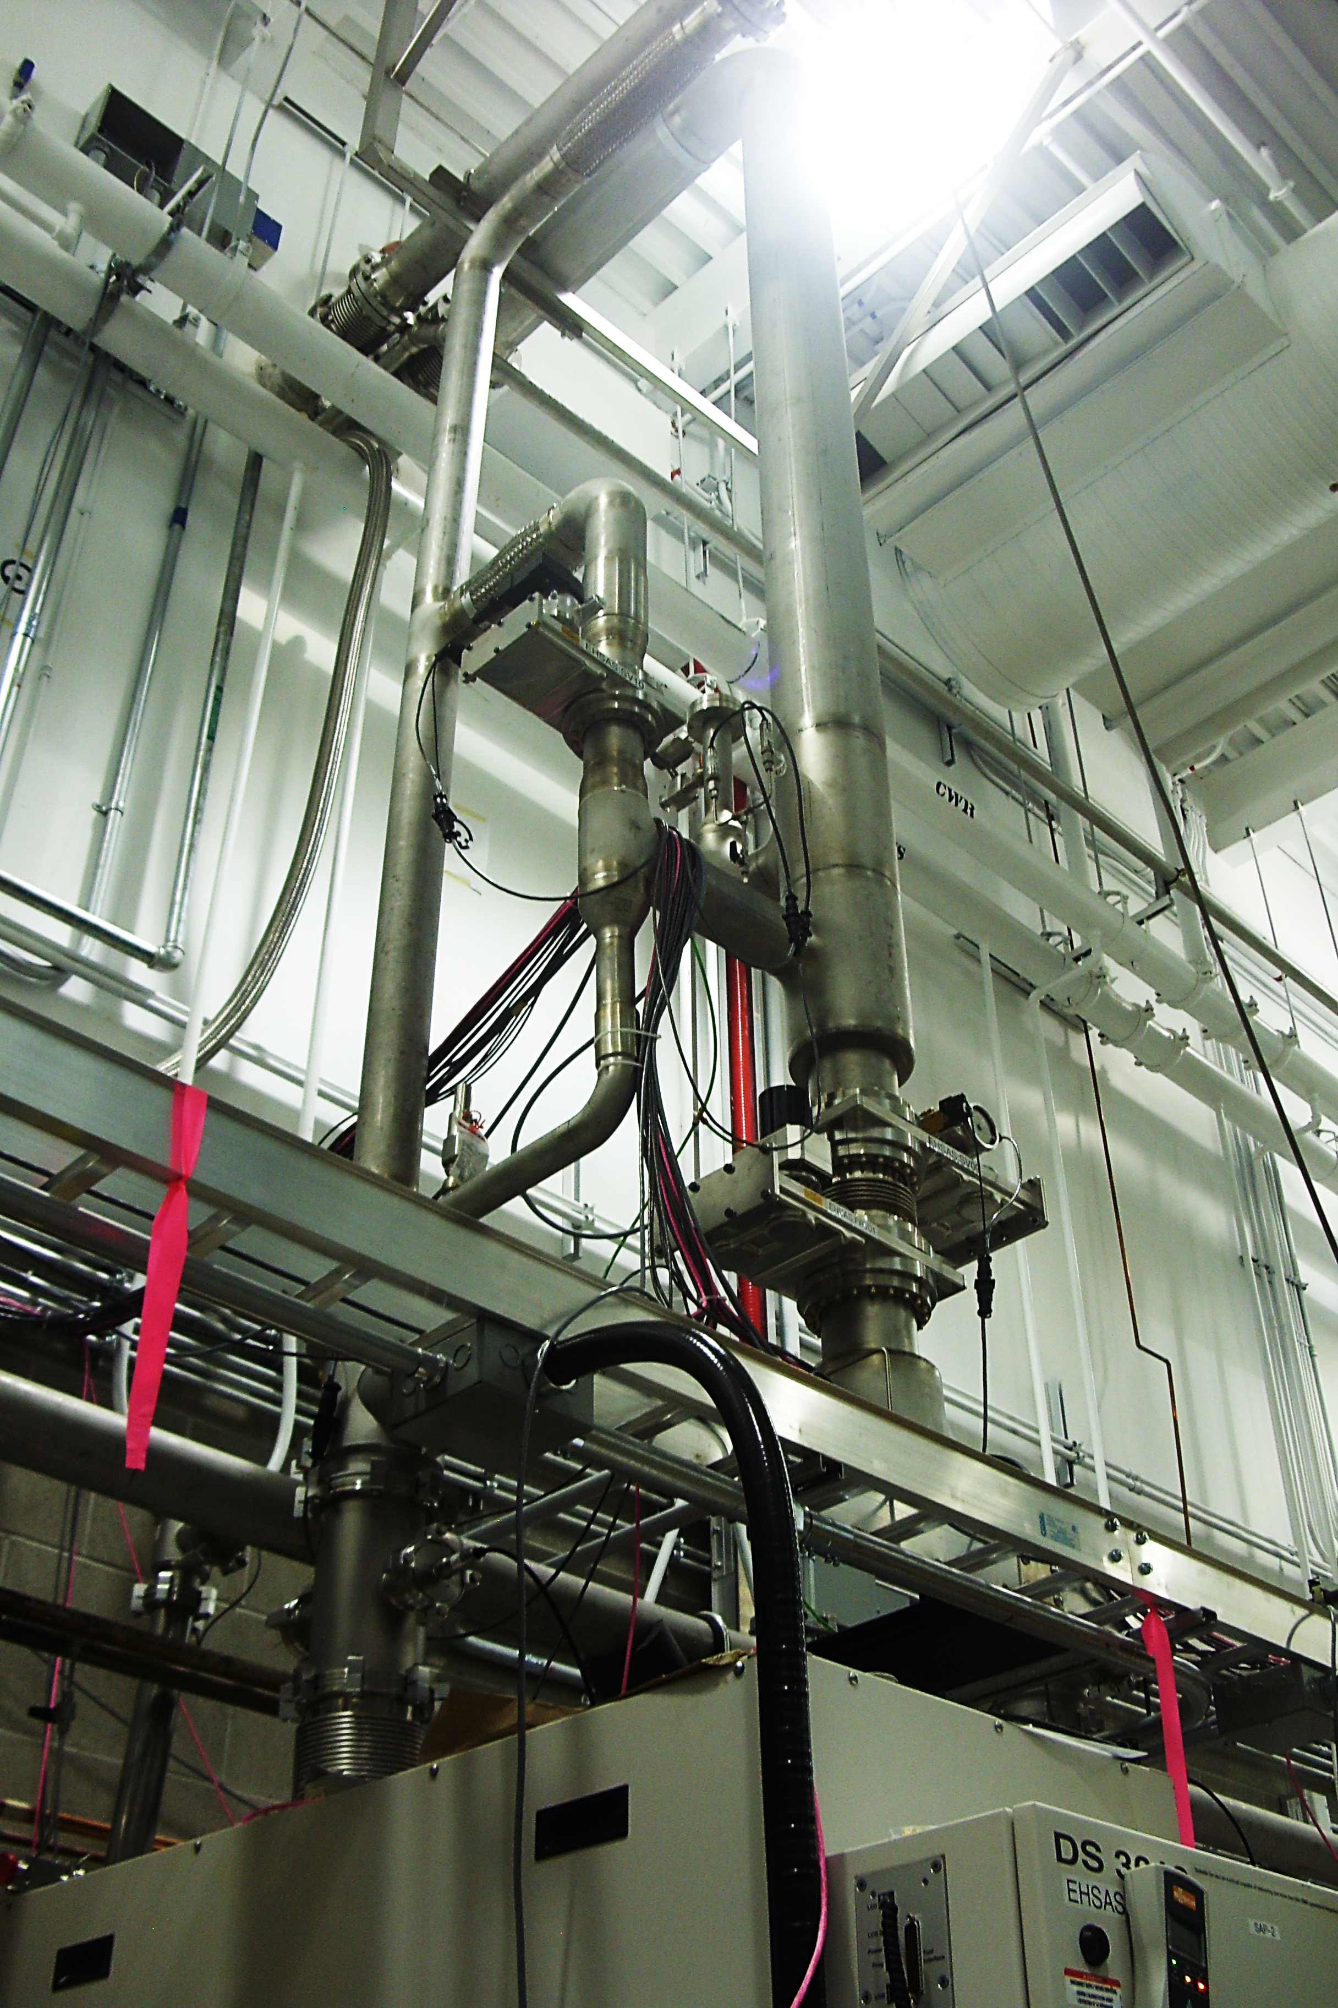
Cryogenic System – Sub-atmospheric Helium Return Line
Notes:
With subatmospheric system design we have tried to learn from the other labs experience with 2K systems, such as Daresbury, FNAL CM test stand, DESY, etc.

Slide 27
Cryogenic System – Sub-atmospheric Helium Return Line
Shut-off
Valve
Proportional
Valve
Pressure
Sensor
Dewar
Cold Box
Ambient heater
Flow
Sensor
Compressor,
Pump
Heat Exchanger
Future Extension
SA Pumps
Impure Helium Storage
Main Compressor
Recovery Compressor
Pure Helium Storage
Purifier
June 05, 2018
A. Koveshnikov - Workshop on Cryogenic Operations, IHEP, Beijing, PRC
21
Notes:
Simplified P&ID is shown in red box

Slide 28
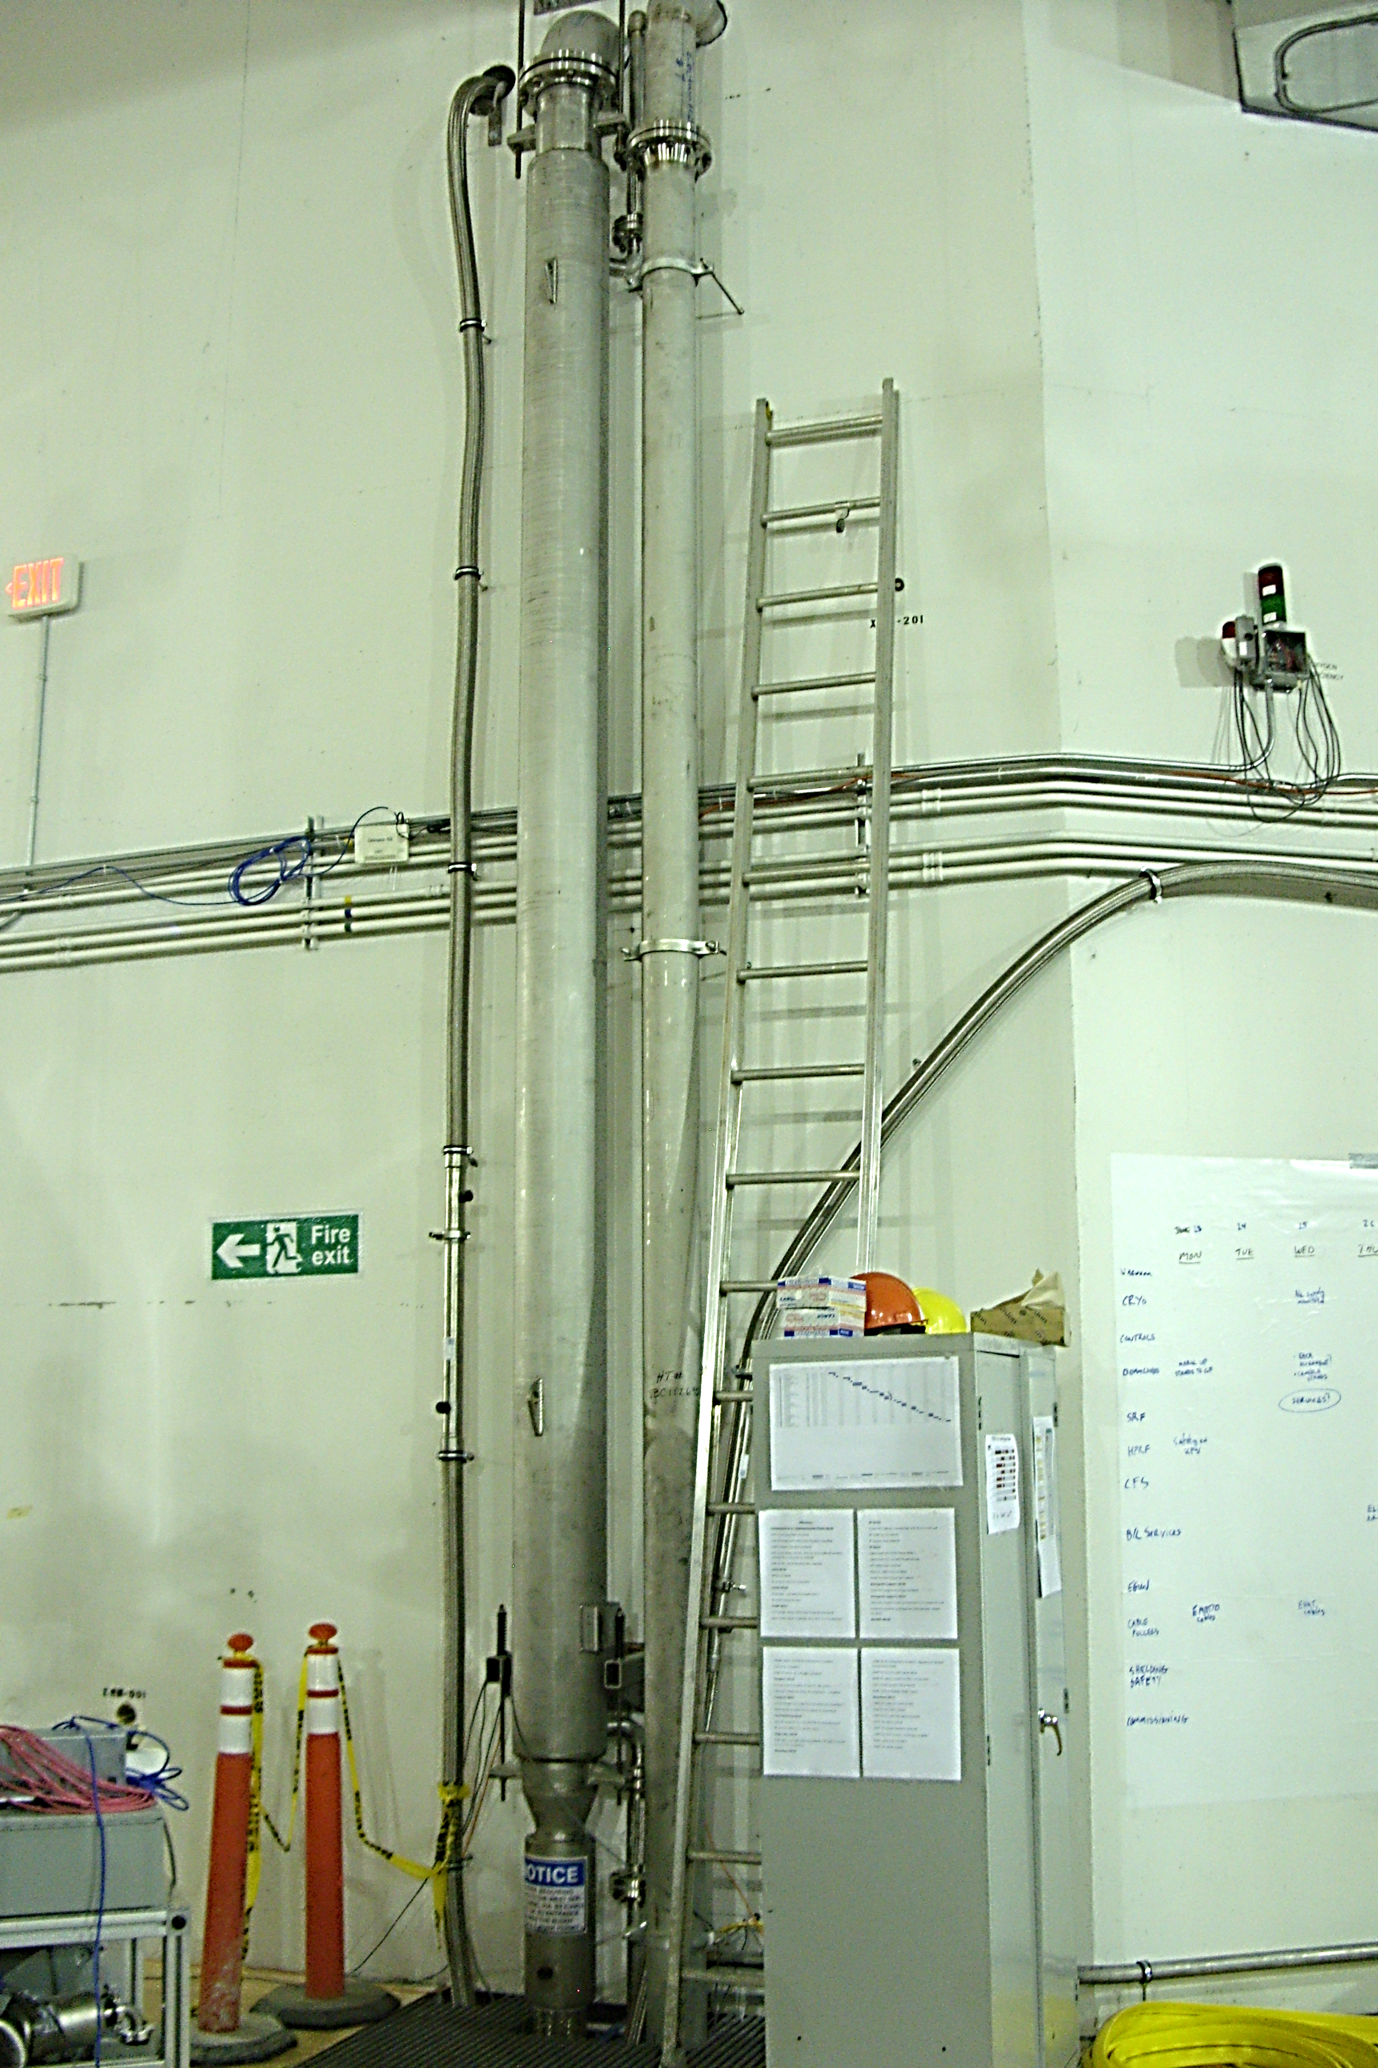
Sub-atmospheric Helium Return Line
Notes:
We have designed “passive” heating element for the cold subatmospheric return flow. And are proud it went very well from the 1st attempt.

Slide 29
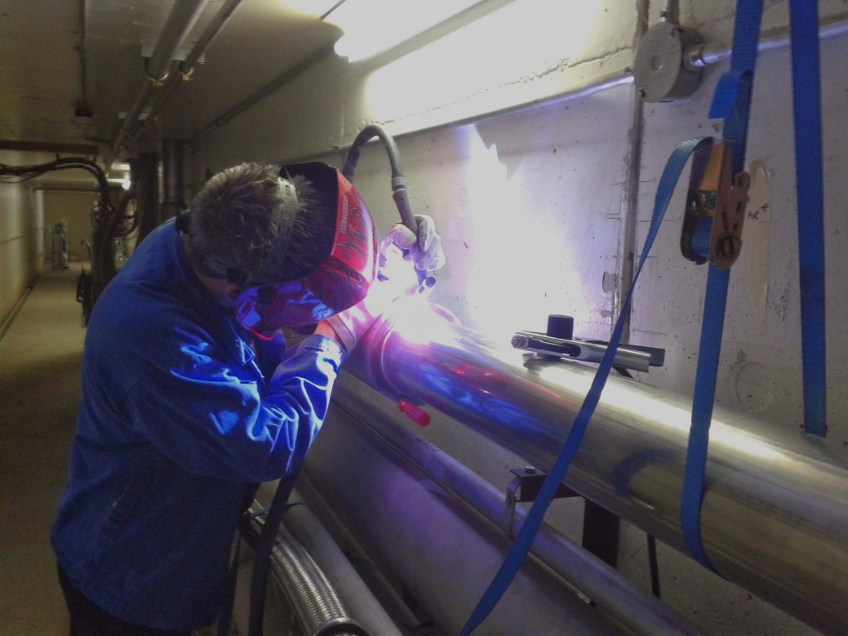
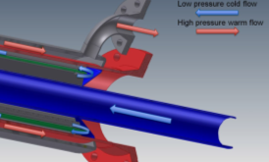
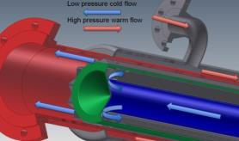
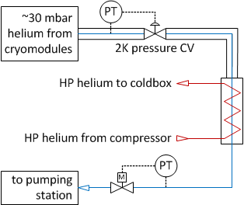
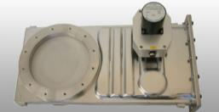
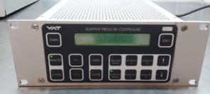
Sub-atmospheric Helium Return Line
hermetic welded cold joints
passive heater to minimize maintenance, some savings on power and LN2
2-stage pressure control to control suction of SA pumps
low resolution throttling valve is used to set pressure in the trunk
pre-pumping line is needed
1st stage pressure control in cavity bath
Passive heater utilizing HP helium stream
Cold piping constructed and installed by Demaco
2nd stage adaptive pressure controller (VAT)
June 05, 2018
A. Koveshnikov - Workshop on Cryogenic Operations, IHEP, Beijing, PRC
22
Notes:
The line consists of two parts: VI “cold” section, and ambient “warm” section.
The counterflow “Russian doll” triple–pass heatexhanger with a radial heat transfer inside from HP helium stream supplied by the main compressor on its way to the ColdBox. Heat is transferred to the cold helium gas at ~20 mBar and ~10K entering HX and close to ambient temperature exiting HXr. HXr is designed for the steady operation with flows ≤10 g/sec.
Redundant system of pressure control. Cold and warm throttling valves + an option to vary pumping speed via VFD.

Slide 30
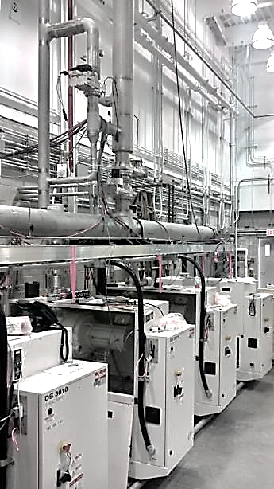
Cryogenic System – Sub-atmospheric Pumping Units
Notes:
Choice of subatmospheric pumps was not straightforward. We have learned both positive and negative lessons from various labs including BESSY, DESY EFEL modules test stand, FNAL CM test stand, etc.

Slide 31
Cryogenic System – Sub-atmospheric Pumping Units
Shut-off
Valve
Proportional
Valve
Pressure
Sensor
Dewar
Cold Box
Ambient heater
Flow
Sensor
Compressor,
Pump
Heat Exchanger
Future Extension
SA Pumps
Impure Helium Storage
Main Compressor
Recovery Compressor
Pure Helium Storage
Purifier
A. Koveshnikov - Workshop on Cryogenic Operations, IHEP, Beijing, PRC
June 05, 2018
23
Notes:
By weighting our options out we have decided on a modular parallel pumping scheme which allows expansion and provides certain level of redundancy.

Slide 32
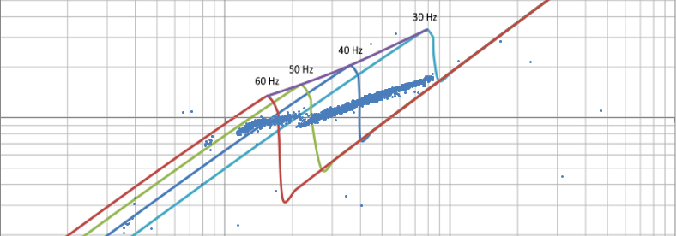
Sub-atmospheric Pumping Units
4 x Busch Combi DS3010-He
set of “Busch PANDA WZ2000” (Roots) and “Busch COBRA NS-0600 B” (screw pump)
VFD on the booster pump motor
sealed pumps, canned motors, no shaft leaks
own PLC, interlocks, start/stop procedures
automatic by-pass of booster pump
throughput
suction pressure
Issues and operational experience:
few controls issues resolved within four years in cooperation with Busch:
  automatic start-up/shut-down cycles
  flow control, purging cycle
  lots of PLC code bug fixes
highly sensitive to back-pressure, develop leaks when discharge >1.3 bar(a)
A. Koveshnikov - Workshop on Cryogenic Operations, IHEP, Beijing, PRC
24
June 05, 2018
32
Notes:
We got 4 BUSCH Combi DS3010-He units. Each consists of PANDA WZ2000 roots blower and Cobra NS0600B dry screw pumps. So far our experience is a mixed bag, we like the mechanical design of the dry pumps with water cooled canned motors. But we had our issues as well.

Slide 33
Future Work
Control System
automatic response to emergency situations (power/water outages)
automation of transition modes (cooldown, warm-up of CMs)
reimplementation of ColdBox logic within EPICS environment (in discussion)
Compression and gas management:
installation of impure tank (in discussion), gas management based on level of impurities
monitoring of the helium inventory, analysis of losses
Documentation and training of operators:
emergency response procedures, migrating some of the responsibilities
June 05, 2018
A. Koveshnikov - Workshop on Cryogenic Operations, IHEP, Beijing, PRC
25

Slide 34
Future Work
Control System
automatic response to emergency situations (power/water outages)
automation of some of the modes (cooldown, warm-up)
reimplementation of coldbox logic within EPICS environment (in discussion)
Compression and gas management:
installation of impure tank (in discussion), gas management based on level of impurities
monitoring of the helium inventory, analysis of losses
Documentation and training of operators:
emergency response procedures, migrating some of the responsibilities
June 05, 2018
A. Koveshnikov - Workshop on Cryogenic Operations, IHEP, Beijing, PRC
25

Slide 35
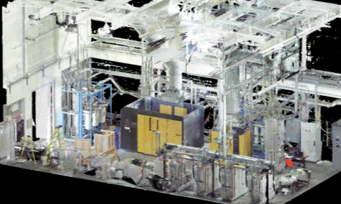
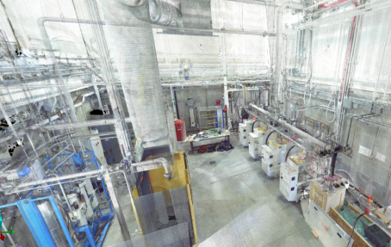
Future Work
Control System
automatic response to emergency situations (power/water outages)
automation of some of the modes (cooldown, warm-up)
reimplementation of coldbox logic within EPICS environment (in discussion)
Compression and gas management:
installation of impure tank (in discussion), gas management based on level of impurities
monitoring of the helium inventory, analysis of losses
Documentation and training of operators:
emergency response procedures, migrating some of the responsibilities
June 05, 2018
A. Koveshnikov - Workshop on Cryogenic Operations, IHEP, Beijing, PRC
25

Slide 36
Notes:
This work is a result of team work Vacuum and Cryogenics Groups as well as

Slide 37
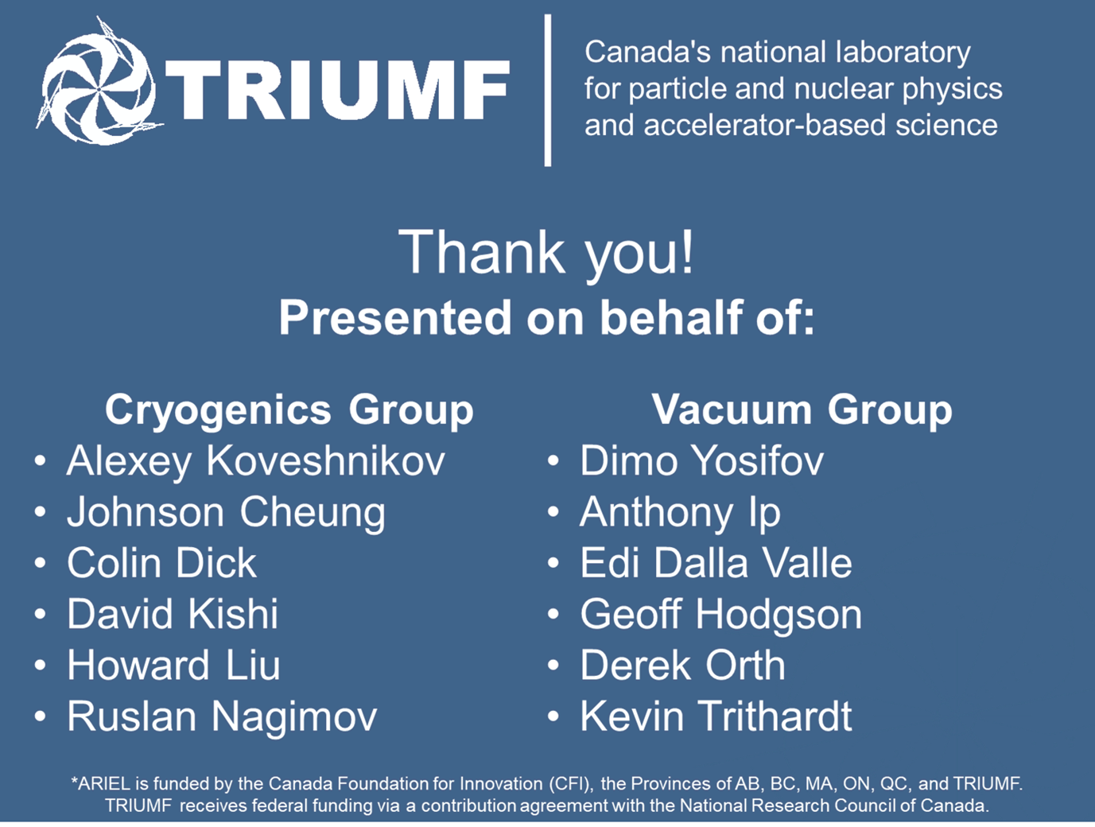
Notes:
Other good men and women of TRIUMF. Thank you for your attention.

