Slide 1
Experimental study of helium liquefier
Jiancheng TANG
Beijing Sinoscience Fullcryo Technology CO.,LTD.

Slide 2
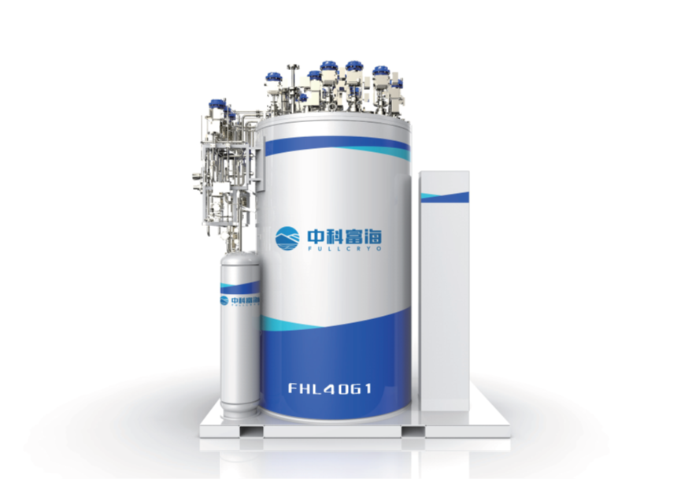
CONTENTS
1、Introduction
2、Flowchart of L40A
3、Test in laboratory
4、Operation for customer

Slide 3




1、Introduction
aims to promote the industrial application
of cryogenic technologies coming from TIPC
点击添加文本
点击添加文本
TIPC
FUHO Capital
government of Haidian District, Beijing
Professional Team
点击添加文本
Founded in August 2016 with a registered capital of RMB 131 million.
High-tech company based on the cryo-technologies coming from TIPC, CAS
Focus on Cryogenic Engineering
点击添加文本

Slide 4
1、Introduction
Milestone of cryogenic activities:
Initial helium liquefaction in 1959; small-scale production of helium liquefier in 1965 (30 W@4.5K)
Carried out the conceptual design of cryogenic fluid distribution valve boxes for "ITER" large-scale cryogenic system ; Participated in PKU-FEL 2K cryogenic system construction
Participated in "SSRF" cryogenic system construction in 2006 and acquired 1st prize in the 2013 National Scientific and Technological Progress Awards
Participated in "BEPC II“ cryogenic system construction in 2004 and acquired first prize in the 2016 National Scientific and Technological Progress Awards
200W@4.5K helium refrigerator for NFRI
1000L/h H2 liquefier for Pujiang Special Gas Co., Ltd
1000W@4.5K helium refrigerator ; 10000W@4.5K helium refrigerator
1959
1976
2008
2012
2013
2015
2016
2017
2018
2019
2020
Successfully developed helium cryogenic system of KM-4 space environment simulator and acquired the 1st prize of the National Scientific and Technological Progress Awards
2kW@20K helium refrigerator was successfully developed and applied in the aerospace field
40L/h helium liquefier was successfully developed
250W@4.5K helium refrigerator was successfully developed
2500W@4.5K & 500W@2K helium refrigerator
500W@4.5K helium refrigerator

Slide 5
1、Introduction
Company Business:
  Provide cryogenic products & cryogenic solutions for He refrigeration system, H₂ liquefier and other cryogenic applications.
Company Mission:
  Develop a cryogenic equipment manufacturing enterprise & cryogenic gas company which leads in the domestic and international markets.
  Company Goal:
  China's first cryogenic company with an output of 10 billion Yuan.
Erdos Basin
Helium extraction from LNG-BOG
Beijing
Headquarters
R&D center
Jiangsu Prov.
Gas Co.,Ltd.
Product Test center
H₂ liquefaction
demo Plants
Guangdong Prov.
Project service center
Cryo. Equi. Manufacturing base

Slide 6
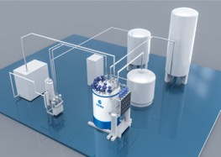
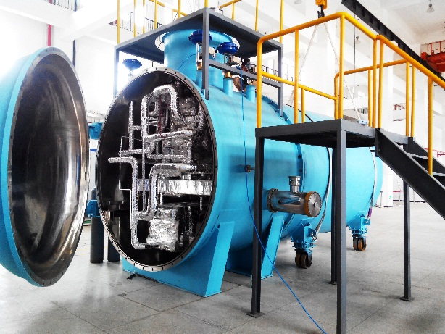
1、Introduction
Main Products and Services:
Large-scale cryogenic refrigerator (20K-2K)
Large-scale helium, neon and hydrogen liquefaction plant
Devices for extraction of pure helium from LNG boil-off gas(BOG)
Devices for separate and extraction of helium, neon and hydrogen isotopes from mixtures
Solutions for gas recovering , purification and liquefaction
Solutions for the use of liquid hydrogen, He and Ne
Contractor of cryogenic equipment and engineering for large-scale scientific projects
Contractor of liquid helium, liquid hydrogen storage, fueling and refueling equipment and project

Slide 7
1、Introduction
4.5K Helium liquefiers
Type | FHL-40 | FHL-70 | FHL-100 | FHL-140 | FHL-180 | FHL-240
Liquefaction Rate (with LN2 precooling) | 40 L/h | 70 L/h | 100 L/h | 140 L/h | 180 L/h | 240 L/h
Liquefaction Rate （w/o LN2 precooling） | 20 L/h | 35 L/h | 50 L/h | 70 L/h | 90 L/h | 120 L/h
4.5K Helium refrigerators
Type | FHR-40 | FHR-70 | FHR-100 | FHR-140 | FHR-180 | FHR-240
Cooling Power (with LN2 precooling) | 160W | 250 W | 320 W | 450 W | 580 W | 750 W
Cooling Power （w/o LN2 precooling） | 120W | 210 W | 240 W | 300 W | 400 W | 550 W
20K Helium refrigerators
Type | Small Scale | Medium Scale | Large Scale
Cooling Power | 500~1000W | 1000~2000 W | >2000 W

Slide 8
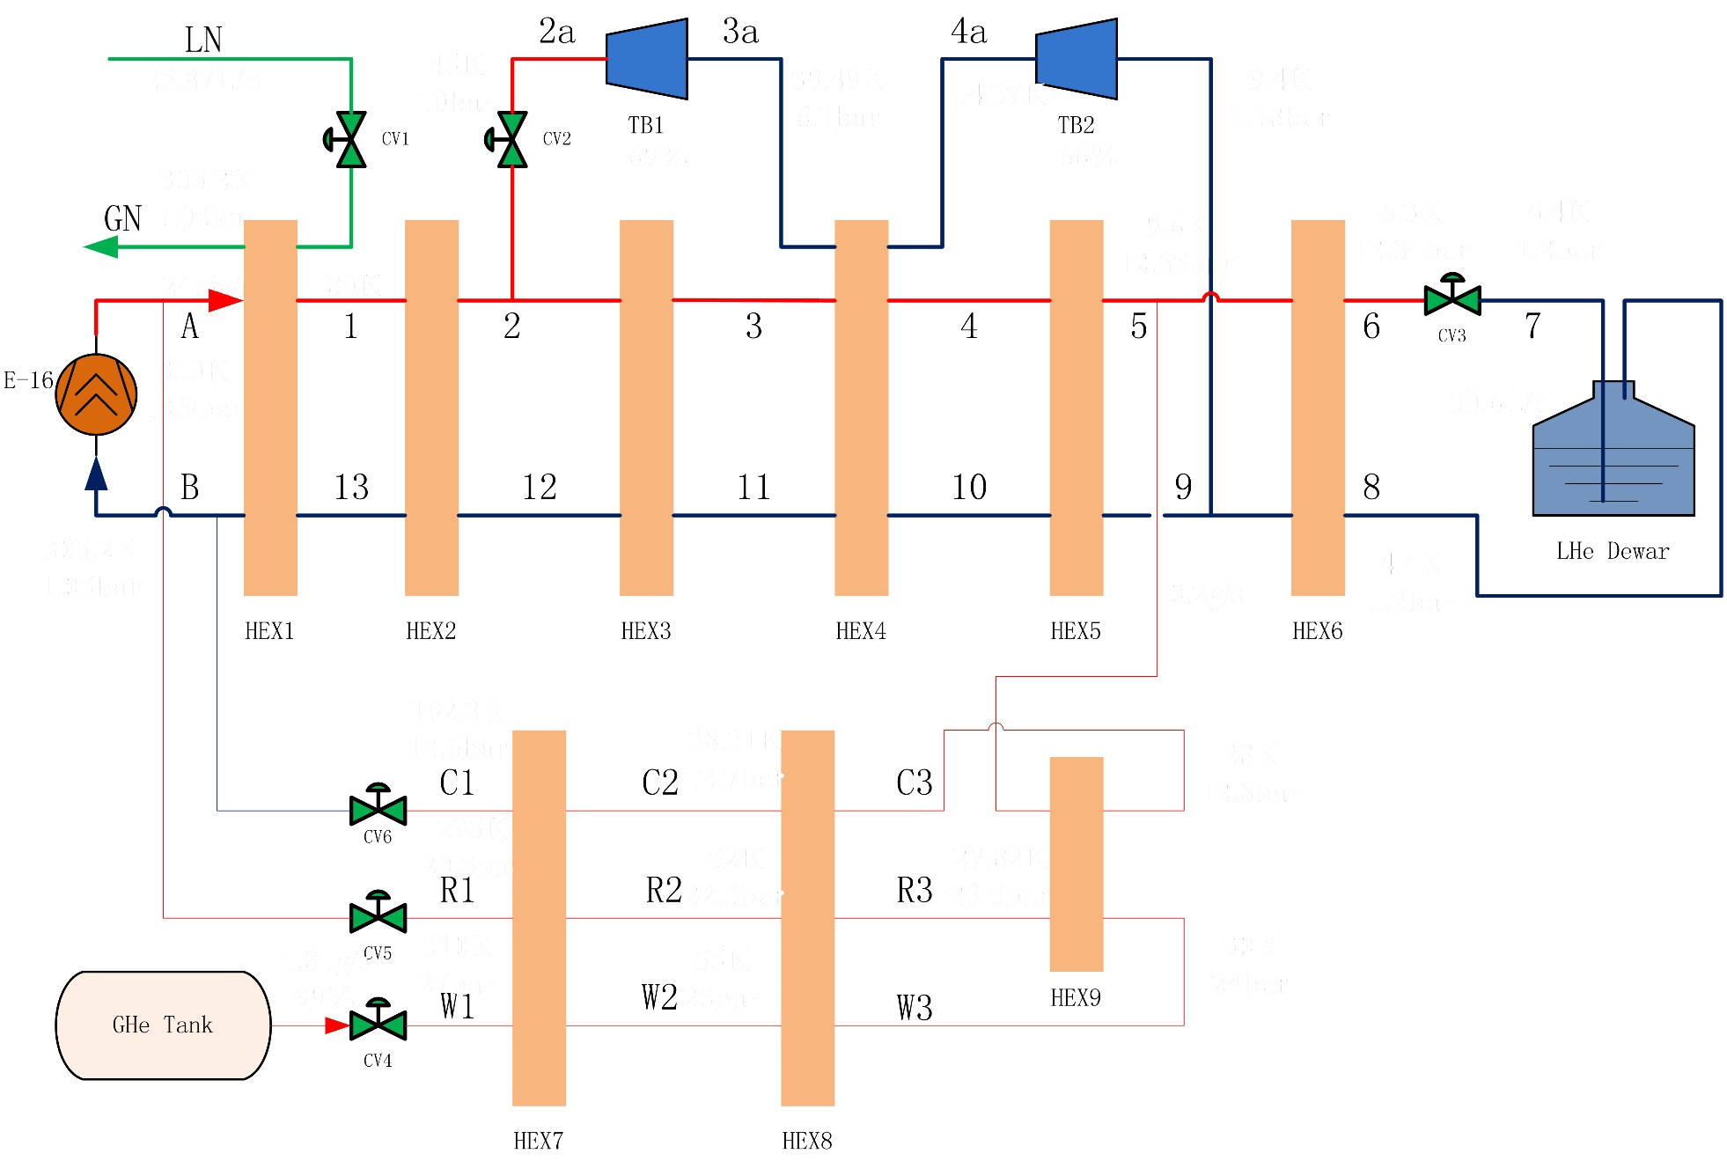
2、Flowchart of L40A

Slide 9
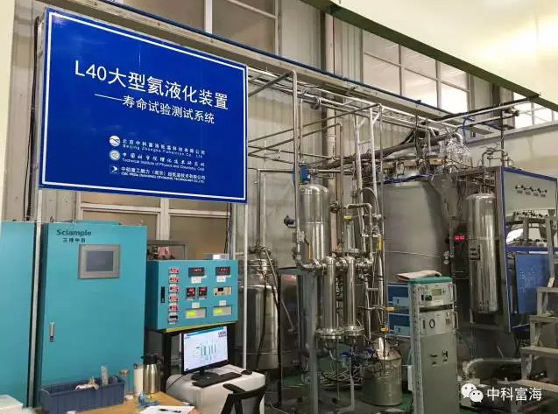
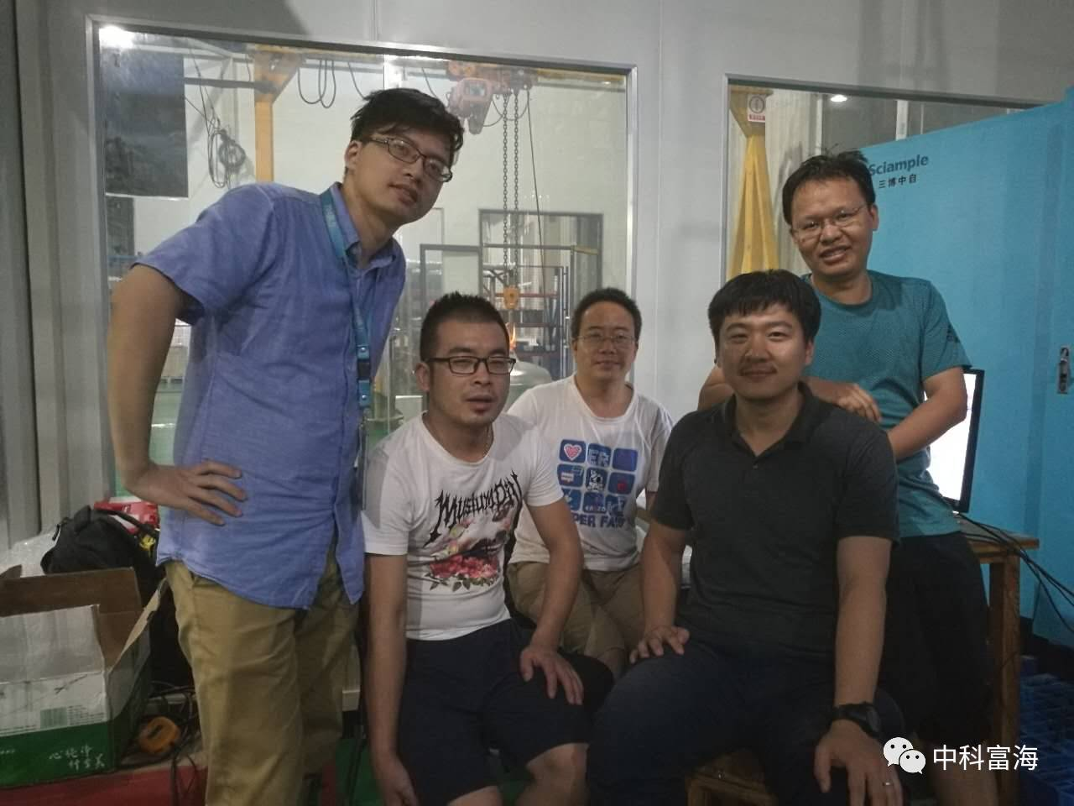
3、Test in laboratory
Lifetime test of liquefier
It was took a long-life and stability test from February 27th 2017 to March 29th 2017 in CSIC Pride (Nanjing) Cryogenic Technology Co., Ltd. The helium liquefier worked in refrigerate mode during the test. All of the equipment worked normally for a month. Two turbo-expanders operated at 220,000 rpm .

Slide 10
3、Test in laboratory
It took about 18 hours to cool down the liquefier with a 1000L dewar from 300K to 5K

Slide 11
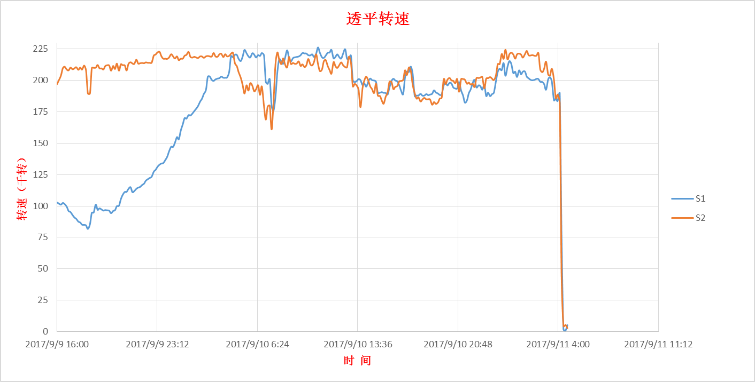
3、Test in laboratory
Turbo expander test

Slide 12
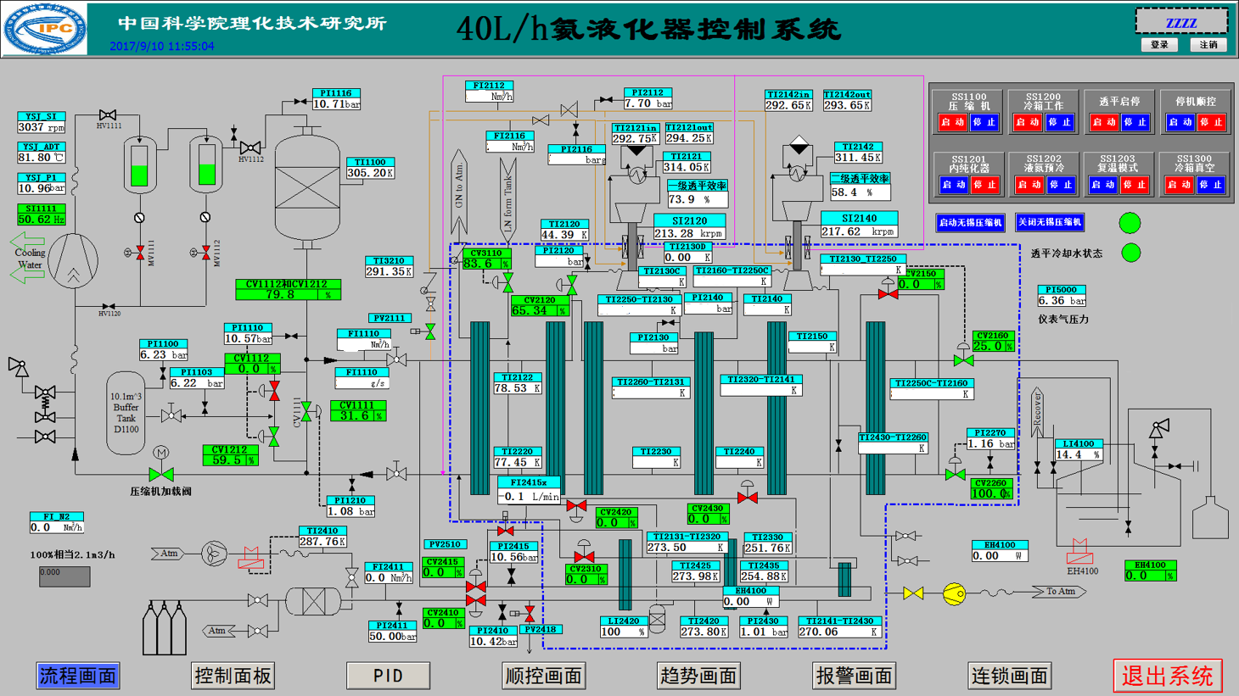
3、Test in laboratory
Liquefaction rate test
Calculated the liquefaction rate by the pressure decreasing of helium buffer.

Slide 13
3、Test in laboratory
Liquefaction rate test
Items | Flow rate（g/s） | High pressure (bara) | 1st turbine (krpm） | 2ed turbine (krpm） | Liquefaction rate（L/h）
Before upgrade | 30 | 10.5 | 219 | 212 | 32
Design | 29.5 | 12.9 | 222 | 225 | 40
After upgrade | 32.8 | 12.3 | 225 | 224 | 48

Slide 14
3、Test in laboratory
Purifier performance test
Pure Nitrogen
Pure Helium
impure Helium
Pure Nitrogen
Purity detector

Slide 15
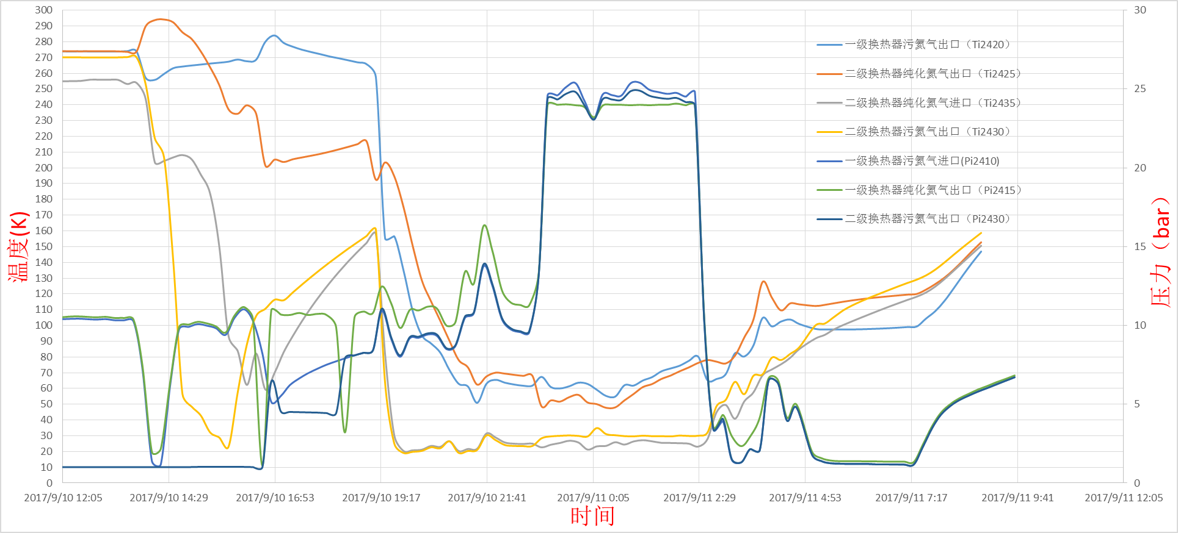
3、Test in laboratory
Purifier performance test

Slide 16
3、Test in laboratory
Purifier performance test
Purity | Flow rate of impure He NM³/h | PI2410 (bar) | PI2430 (bar) | Multy-component detector
 |  |  |  | N (ppm) | CxHx (ppm) | H2O (ppm)
99.1% | 38 | 25.39 | 24.88 | 0.5 | 0.3 | 1.3
98.5% | 39 | 25.39 | 24.88 | 0.5 | 0.3 | 1.3
97.1% | 38 | 25.01 | 24.59 | 0.5 | 0.3 | 1.3
96.1% | 30 | 24.67 | 24.32 | 0.5 | 0.3 | 1.2
94% | 29.5 | 24.54 | 24.25 | 0.5 | 0.3 | 1.2
93.2% | 27 | 24.58 | 24.05 | 0.5 | 0.3 | 1.2
92.1% | 23 | 24.36 | 23.97 | 0.5 | 0.3 | 1.2
89.1% | 14 | 25.3 | 23.94 | 0.5 | 0.3 | 1.0

Slide 17
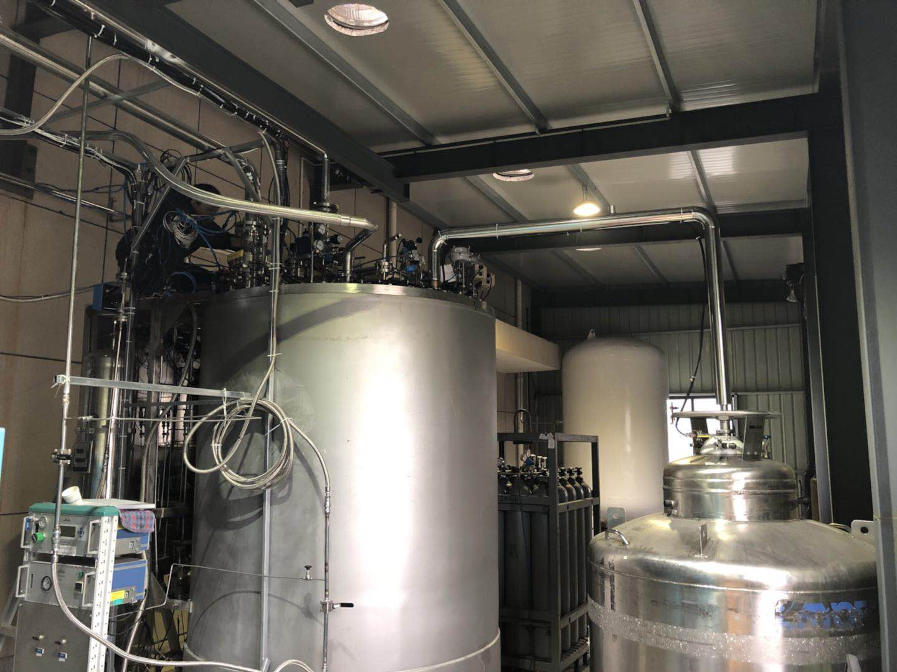
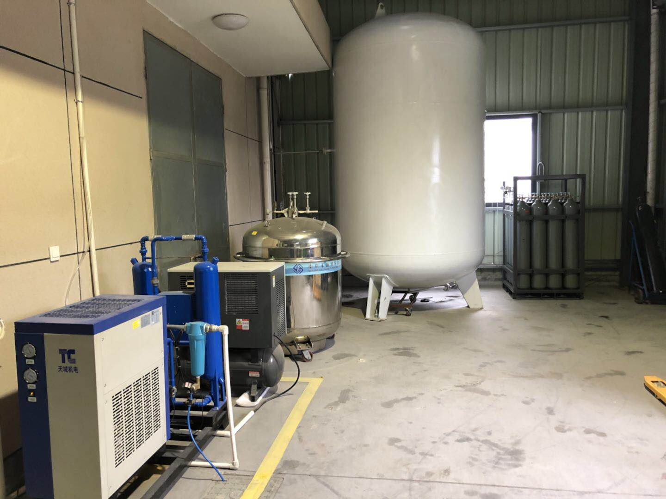
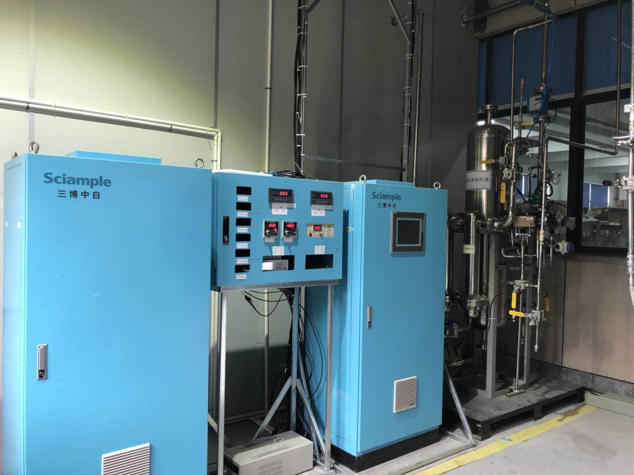
4、Operation for customer
The liquefier was delivered to Ningbo Jansen NMR Technology Co.,Ltd who use liquid helium for testing the MRI and recovering the helium gas caused by quench magnet.

Slide 18
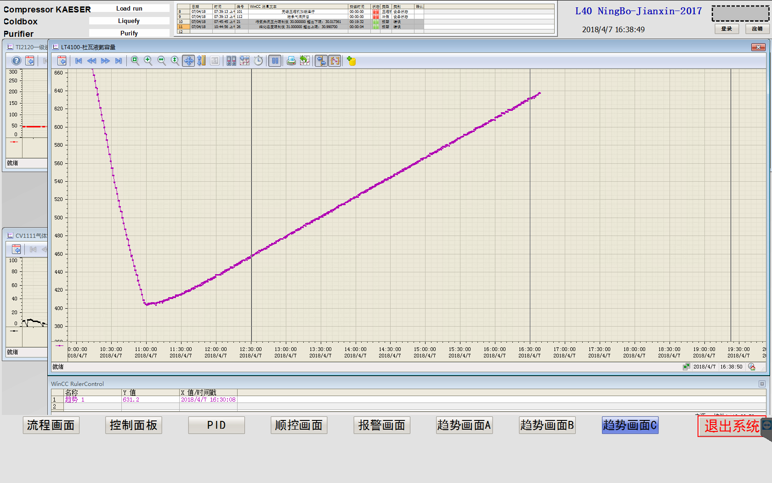
4、Operation for customer
The liquefaction rate is about 43.35L/h when the impure helium flow rate is about 12 Nm³/h.

Slide 19


Thank you
for you attention

