Slide 1
Cryogenic System at Peking University
Cryo-Ops 2018, Beijing, June 4-7
Jiankui Hao
On behalf of SRF Laboratory
Institute of Heavy Ion Physics
Peking University
The 8th International Workshop on Cryogenics Operations (Cryo-Ops 2018)
Beijing, June 4-7, 2018

Slide 2
Outline
Cryogenic System for Superconducting Injector and Accelerator
PKU Vertical Test System
Summary

Slide 3
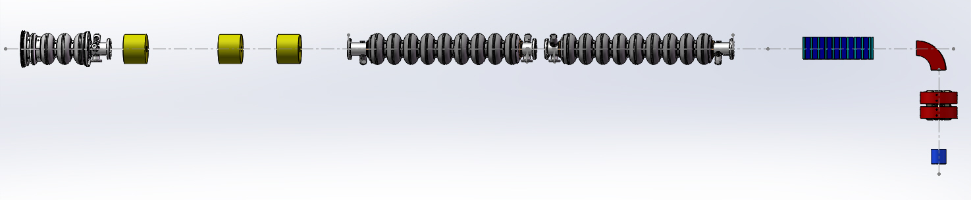
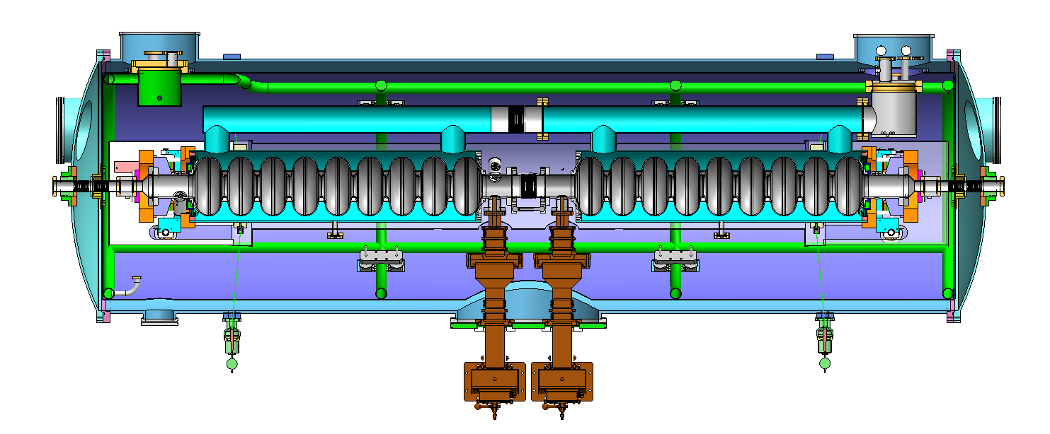
PKU SRF Accelerator for THz
3.5-cell DC-SRF Injector
2×9-cell Cryomodule
Undulator
SRF-based THz platform at PKU
1.3 GHz SRF cavities must run at 2 K

Slide 4
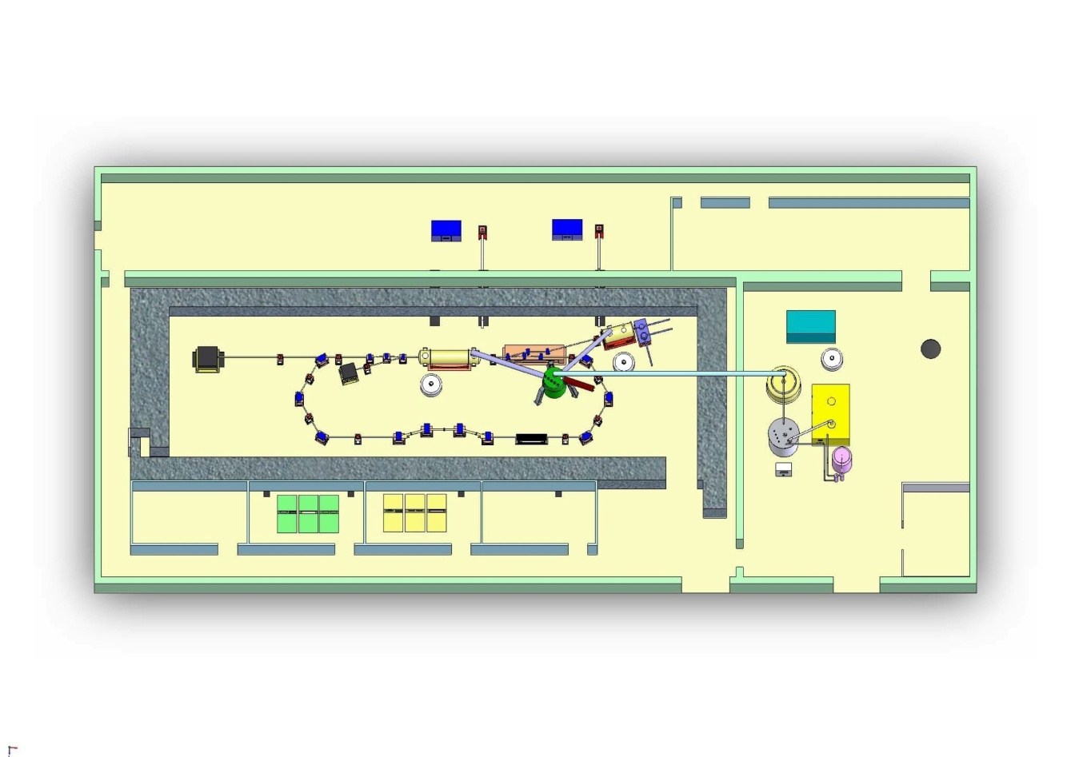
Layout of PKU SRF Laboratory
RF Power Laser
Cooling Water
Clean Room
Accelerator
Injector
2K
VTS
Undulator
Cryogenic System
Control Room

Slide 5
2K Cryogenic System
Design Parameters
Total Cooling Power （2K） | 57.5 W
Liquifaction rate （with LN precooling) | 120 L/h
Liquifaction rate （without LN precooling) | 70 L/h
2K pumping system | 3.2 g/s
Storage dewar | 2000 L
Pressure instability | within ±0.1 mbar
Liquid Helium level | within ±1 L
Helium buffer tank | 150 m³
Liquid Nitrogen tank | 30 m³
Cooling water | 180 kW
Cooling air | 15000 m³/h

Slide 6
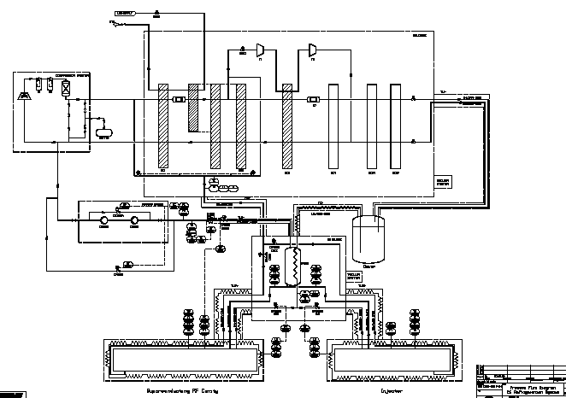
2K Cryogenic System at PKU
Compressor
Coldbox
TL
Dewar
2K Pumps
2K CBX
SCA
DC-SRF Injector
2K
2K

Slide 7
Components of 2K Cryogenic system
Compressor | KAESER DSD238, 40.7 g/s
Oil removal system | L140 standard
Liquefier/Coldbox | Linde L140
Control system | SIEMENS SIMATIC S7-300
LHe Dewar | 2000 L
2K Coldbox | 2 sleeves, recuperator heat exchanger
Gas heater | ~6 kW
2K pumps (2x) | RUTA WS2001FU/SV630BF/A, 3.2 g/s
Transfer Lines | TIPC
He gas buffer tank | 2 × 75 m³
Cooling water | 180 kW

Slide 8
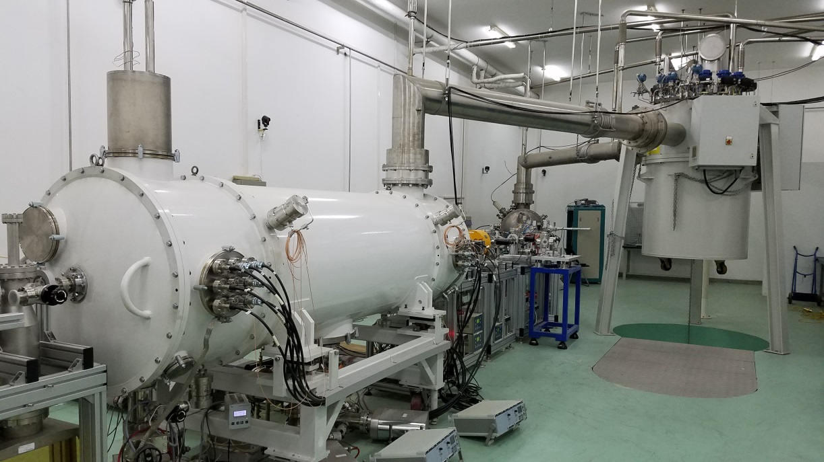
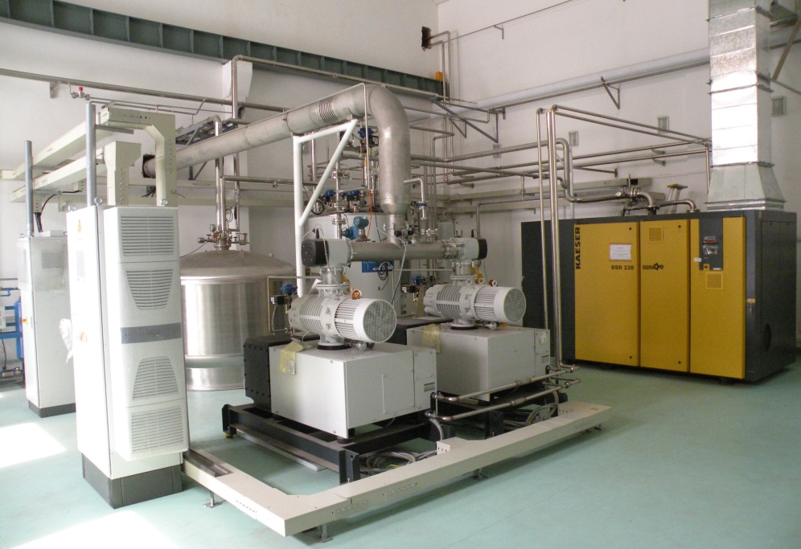
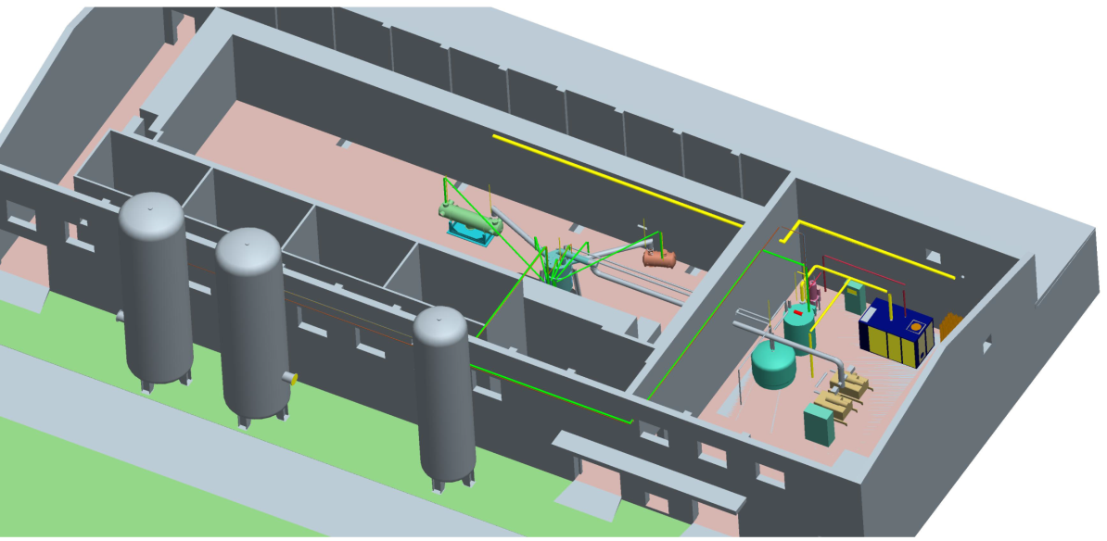
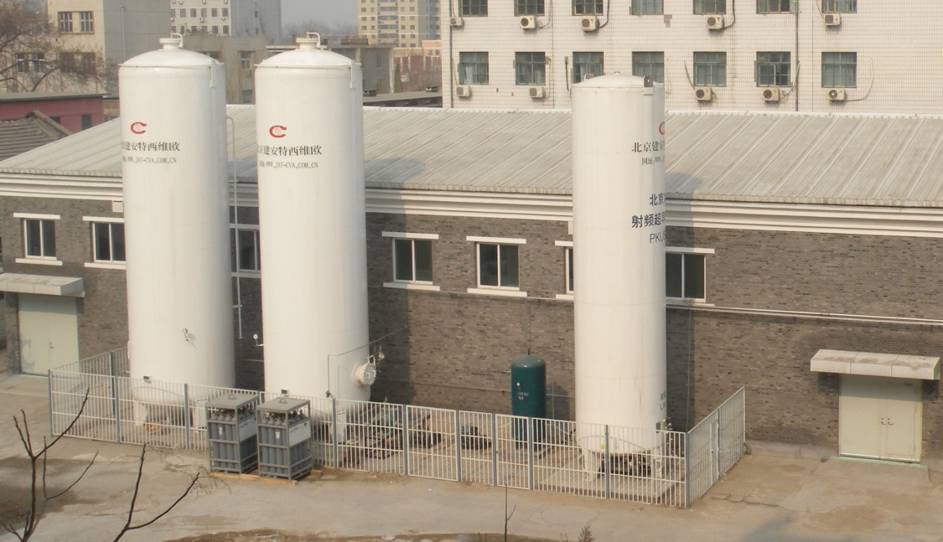
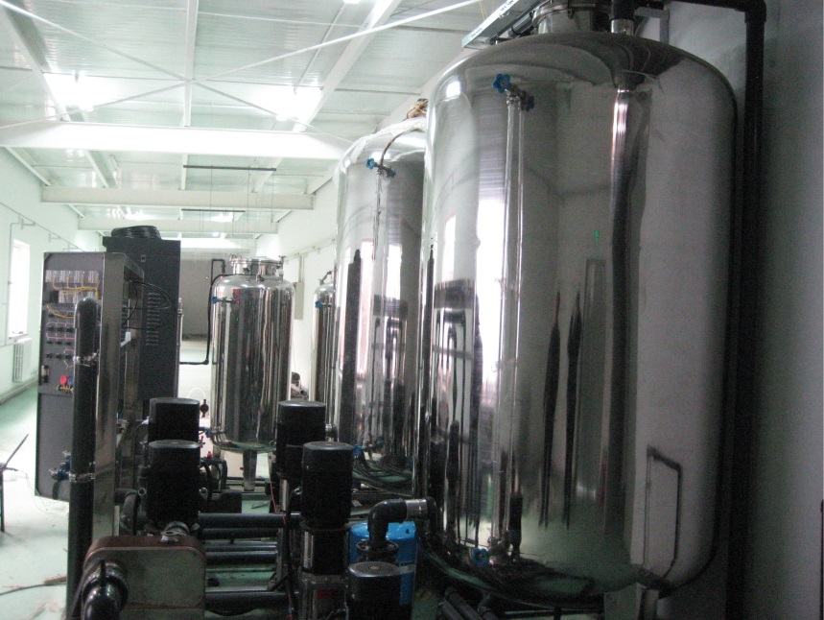
Layout of 2K Cryogenic System
Accelerator Hall
Cryogenic Hall
Buffer Tanks
Cooling Water

Slide 9
History
2005-2007, conception and design
2007, contract with Linde
2008-2009, installation
2010.03-06, commissioning of liquefier and 2K CBX
2010.07-10, commissioning with 2K transfer lines
2010.11-2011.06, commissioning with DC-SRF Injector
2011.06-2012.06, beam loading test with Injector
2013.08-2015.06, THz radiation with Injector
2015.07- now, THz radiation with DC-SRF Injector and 2×9 Accelerator

Slide 10
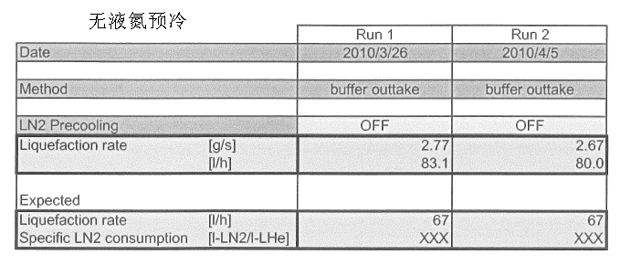
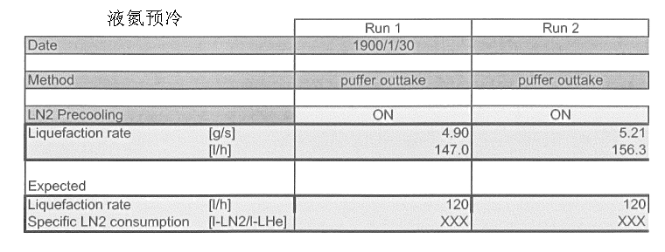
Commissioning
Liquefaction rate
  > 80 l/h w/o LN pre-cooling
  > 140 l/h with LN pre-cooling
2 K commissioning
  Cooling power at 2K:
  ~ 58-59 W

Slide 11
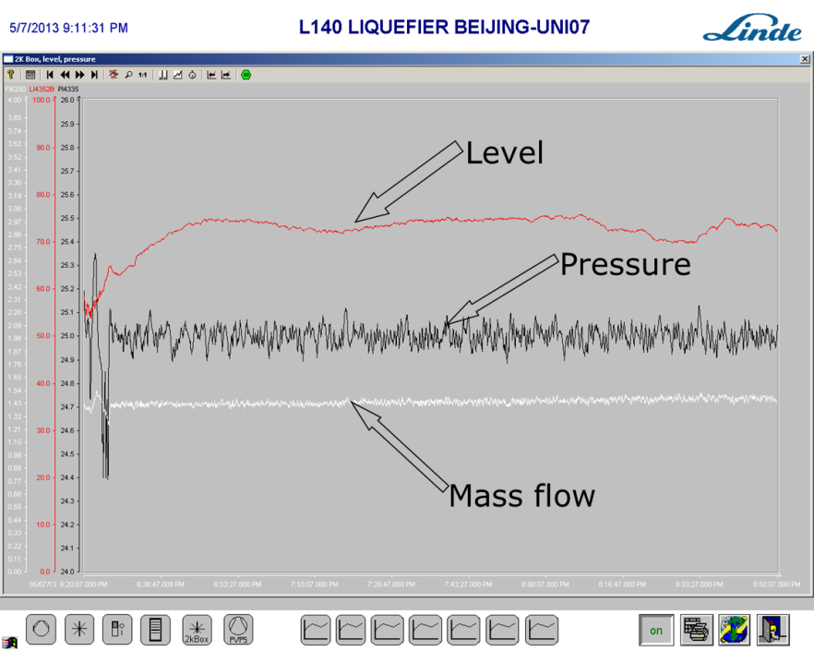
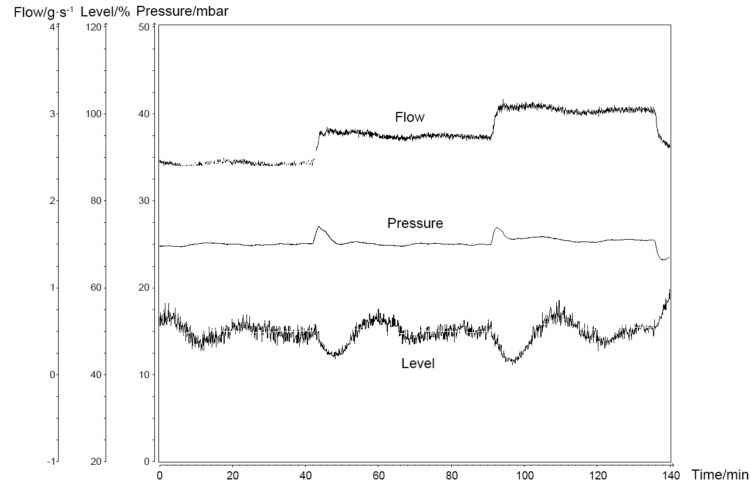
Commissioning
2 K commissioning
  Pressure instability:
  < ± 0.1 mbar
  Helium level: < ± 5%
Injector Eacc: 12MV/m
36W
44W
50W
Recovery from heat load change:
  ~10 min

Slide 12
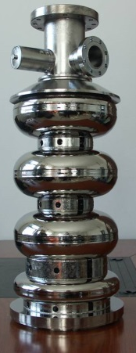
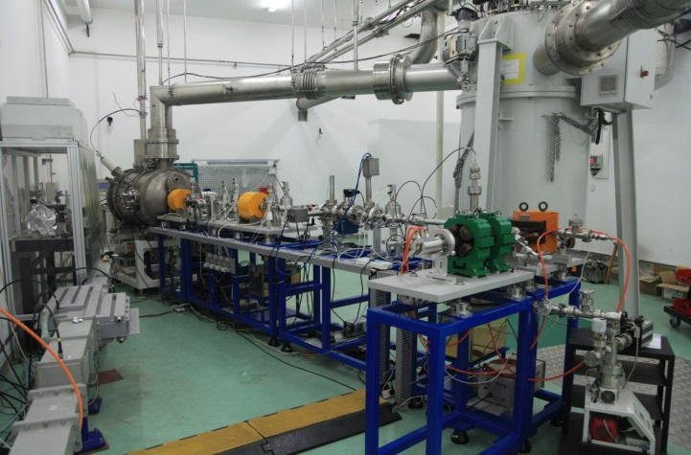
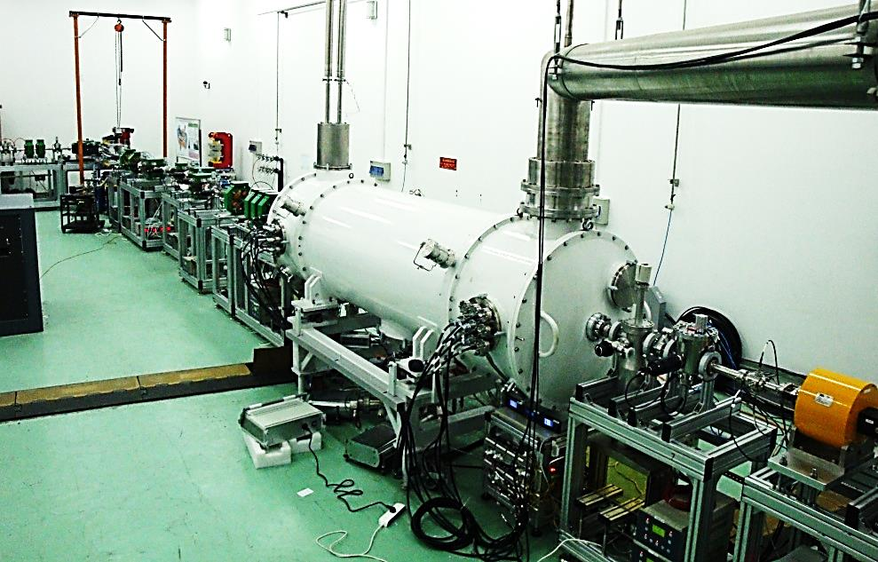
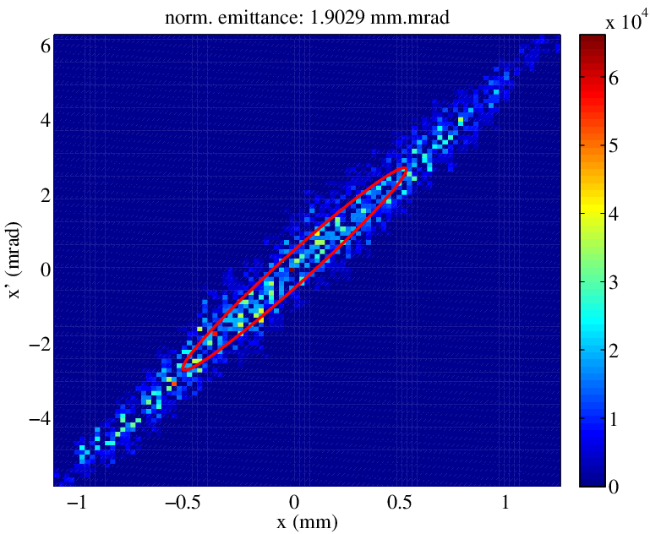
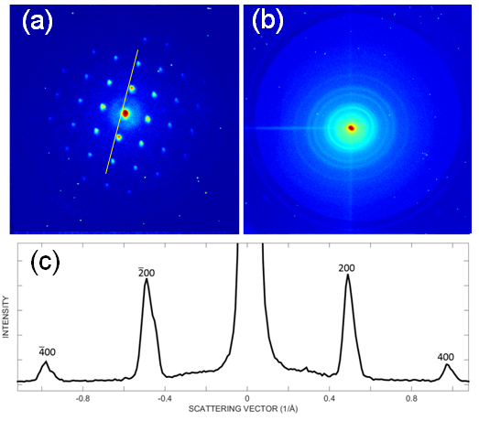
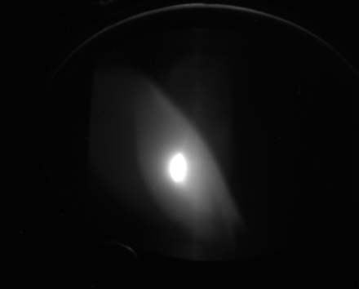
Stable electron beam loading at 2 K
DC-SRF injector with 3.5-cell cavity (since 2014)
Cryomodule with 2×9-cell cavities (since 2015)
10~20 MeV, Ave. current ~1mA (long macropulse)
Applications: UED, THz radiation

Slide 13
Outline
Cryogenic System for Superconducting Injector and Accelerator
PKU Vertical Test System
Summary

Slide 14
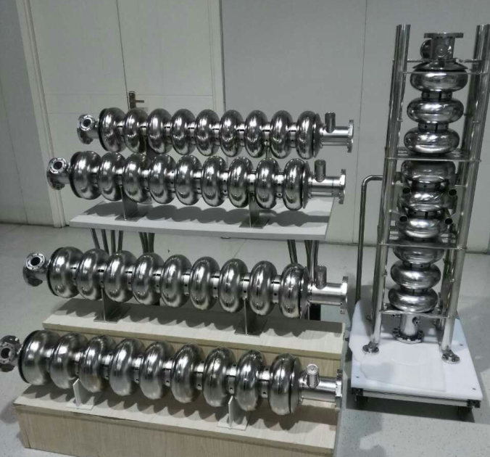
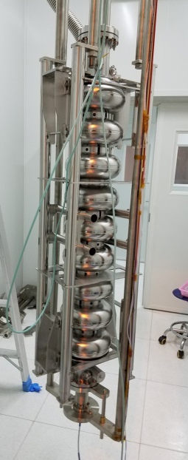
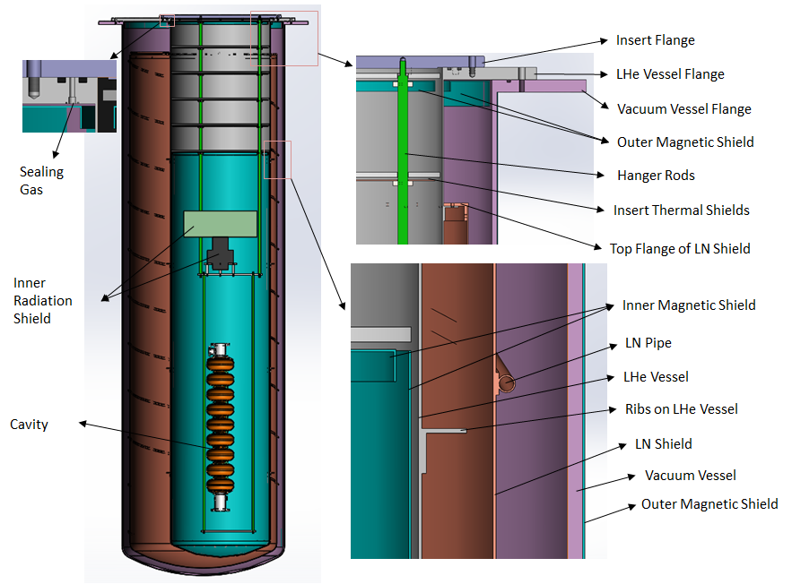
SRF researches for XFEL
Shanghai Soft XFEL Project
Tasks of PKU
Series researches of 9-cell superconducting cavities
  25～30 MV/m
Construction of SRF Facilities
  Vertical Test System (VTS)
  Surface treatment devices

Slide 15
Layout of PKU SRF Laboratory
RF Power Laser
Cooling Water
Clean Room
Accelerator
Injector
2K
VTS
Undulator
Cryogenic System
Control Room

Slide 16
Design of VTS
Components
  Cryostat
  Insert for cavities
  Magnetic shield
  Radiation Shield
  2K valve box
  Transfer lines
  2K pumping system
Capacity
  2 K temperature
  Static heat loss: < 18 W
  Heium mass flow (@25 mbar):
  10 g/s
  Cooling power:
  > 200 W @ 2 K

Slide 17
Process Flow Diagram

Slide 18
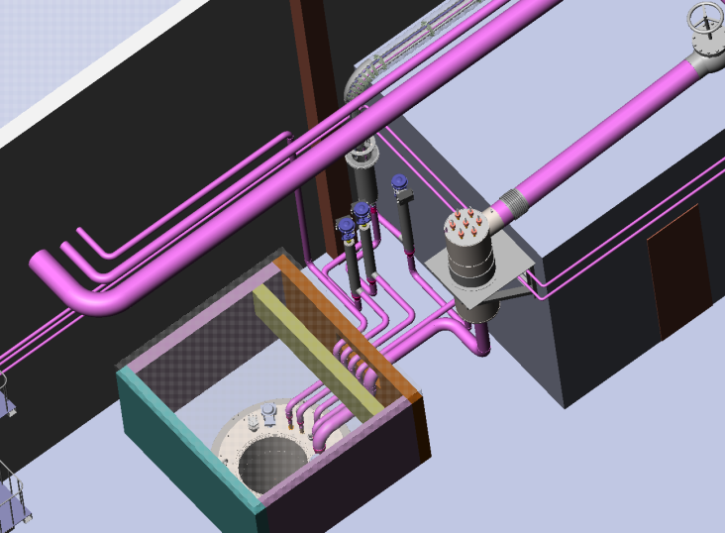
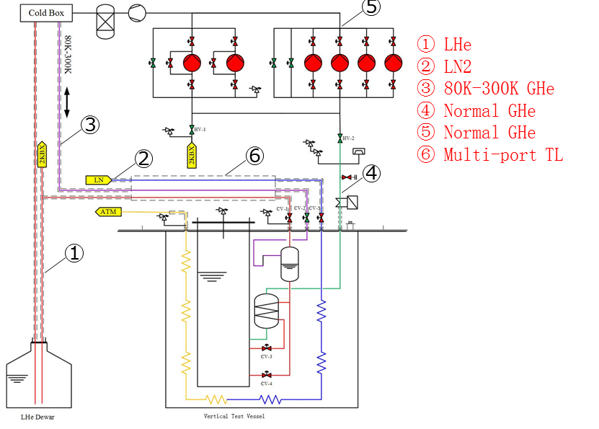
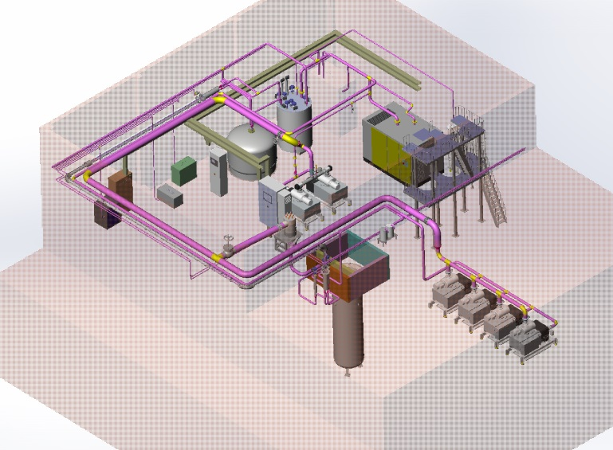
Design of PKU-VTS

Slide 19
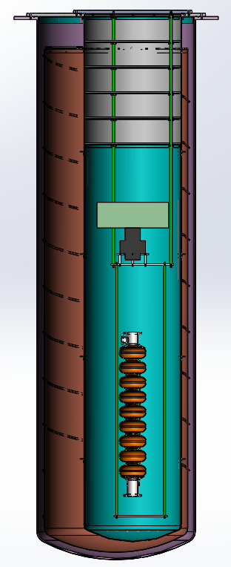
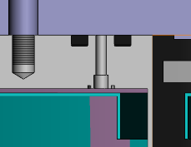
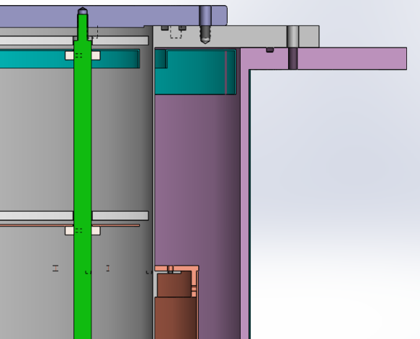
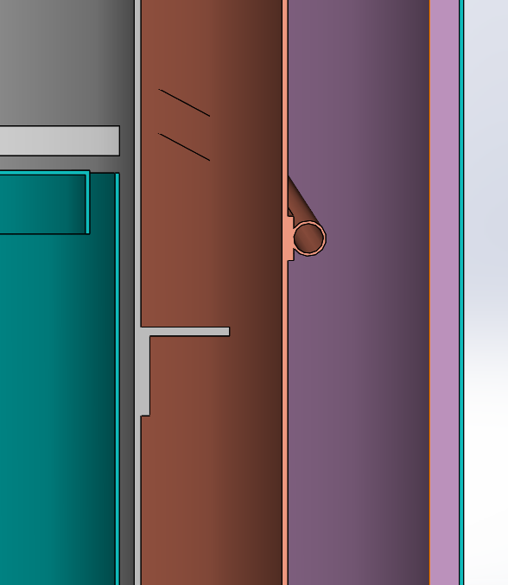
Cryostat and Insert
Insert Flange
LHe Vessel Flange
Vacuum Vessel Flange
Outer Magnetic Shield
Sealing Gas
Hanger Rods
Insert Thermal Shields
Top Flange of LN Shield
Inner Radiation Shield
Inner Magnetic Shield
LN Pipe
LHe Vessel
Ribs on LHe Vessel
Cavity
LN Shield
Vacuum Vessel
Outer Magnetic Shield

Slide 20
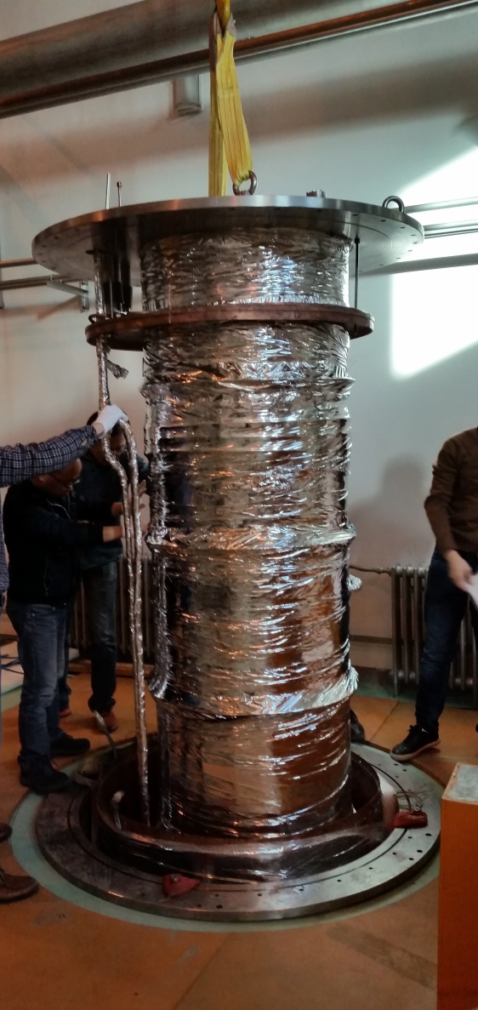
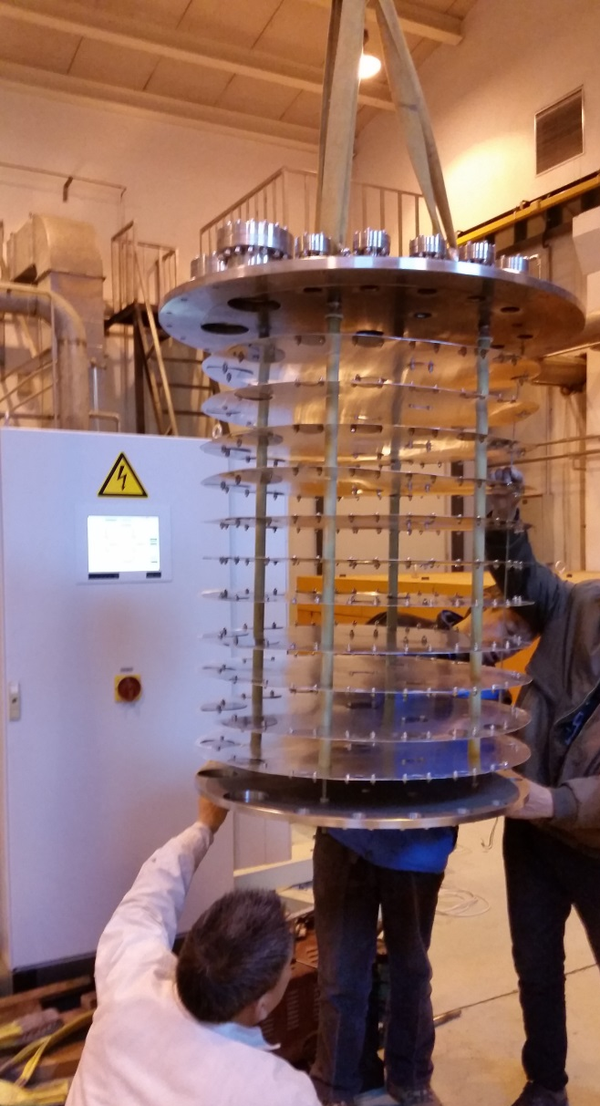
Cryostat and Insert

Slide 21
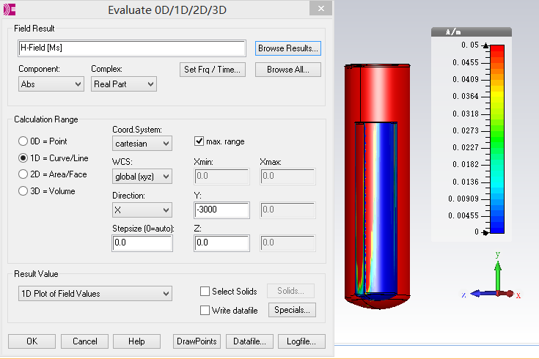
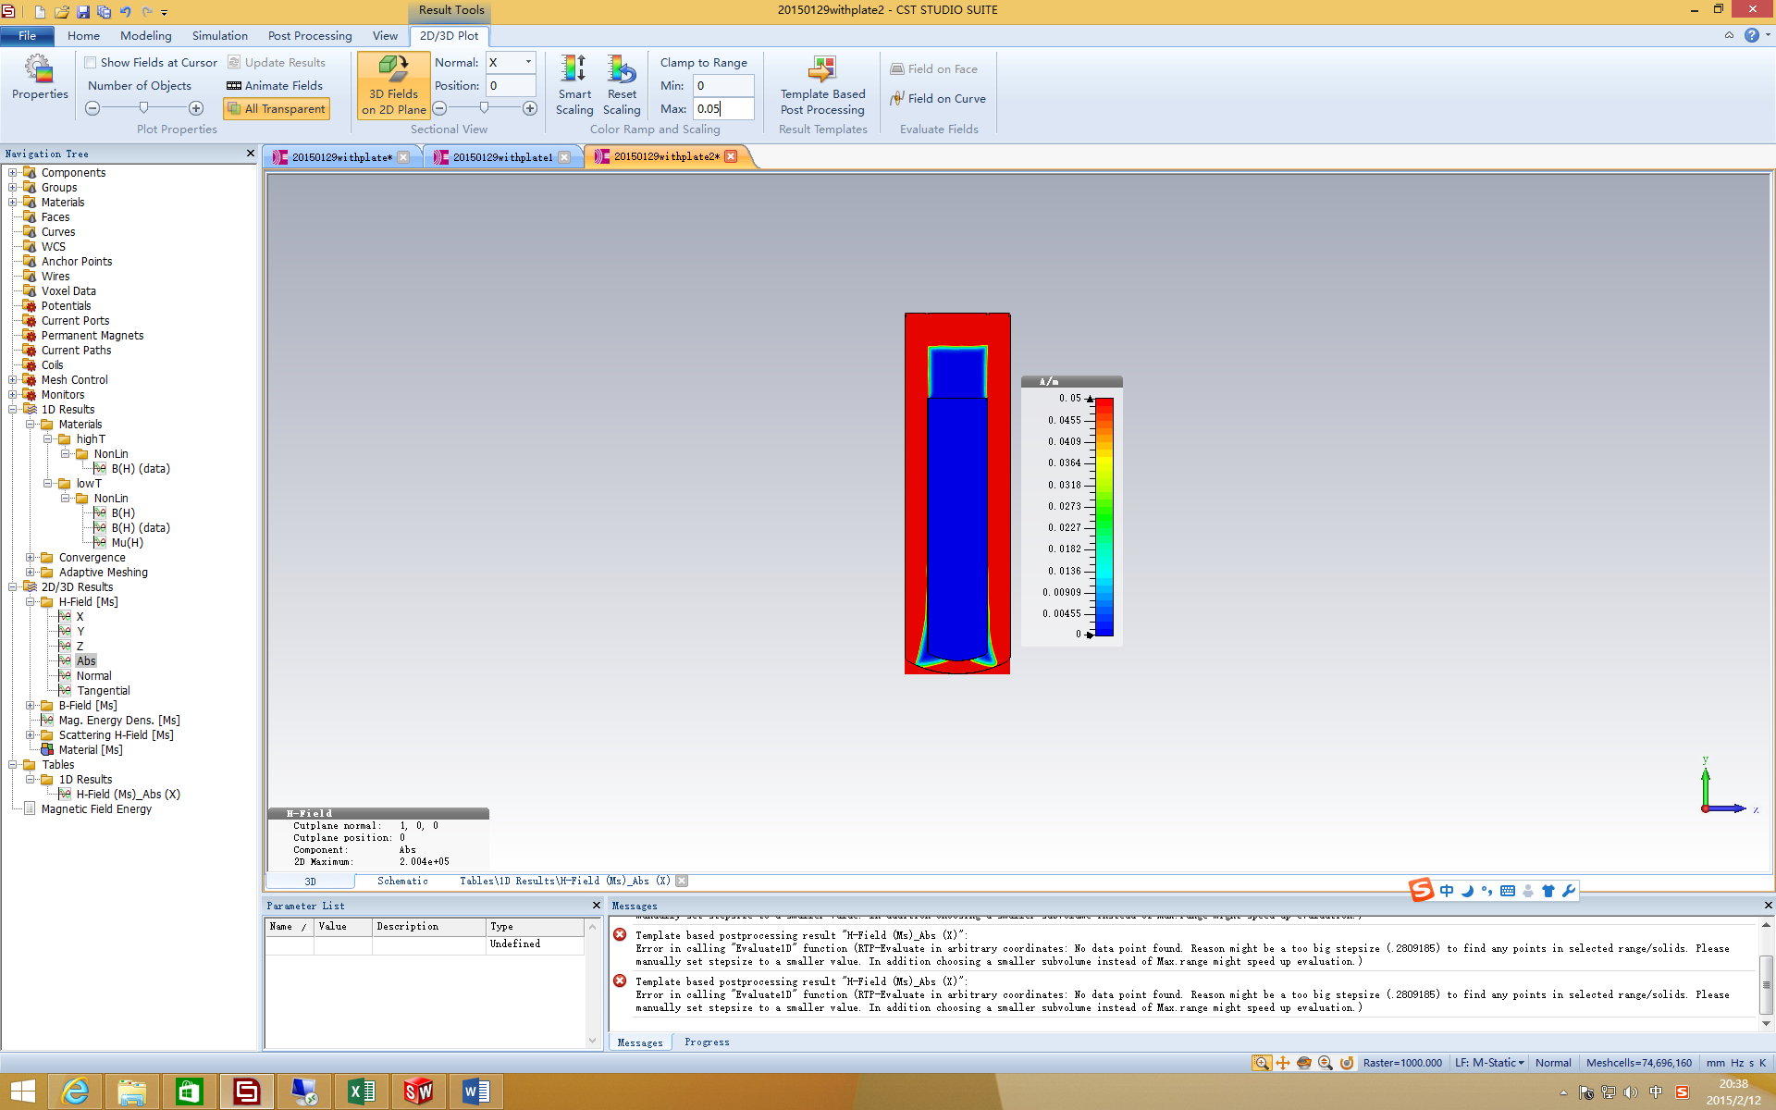
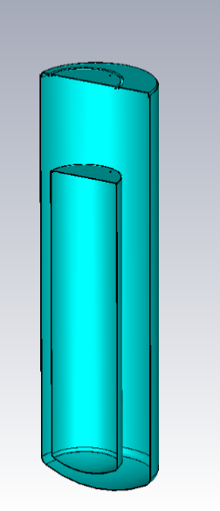
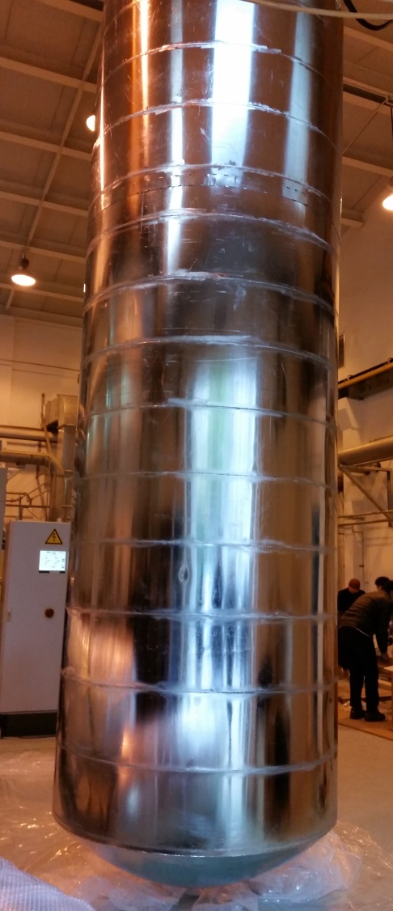
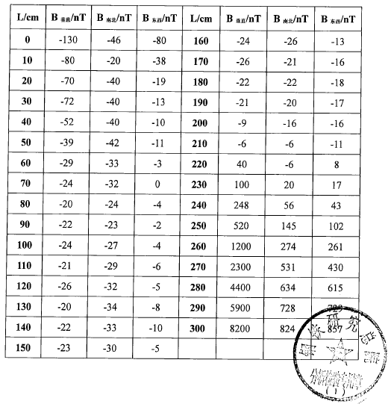
Magnetic shield
1J79 Alloy
Simulation (CST EM): < 1mGs
Measure: <2mGs

Slide 22
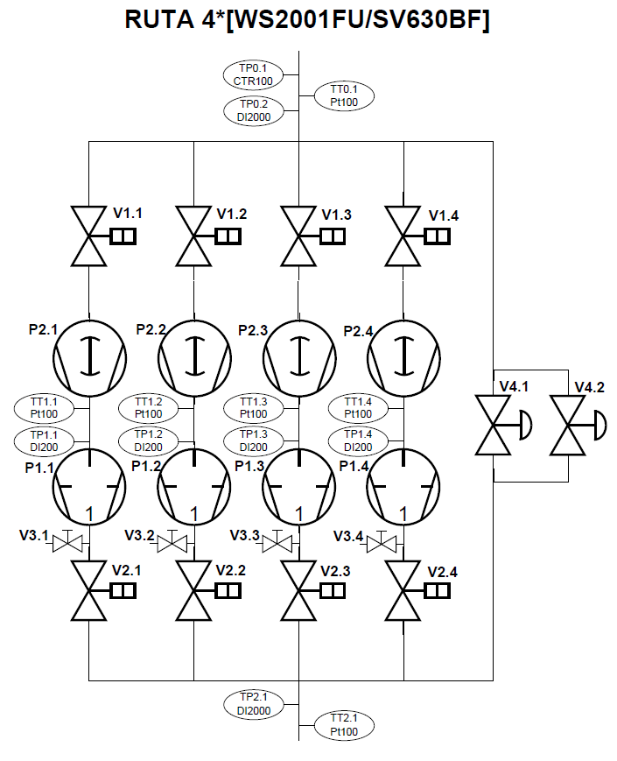
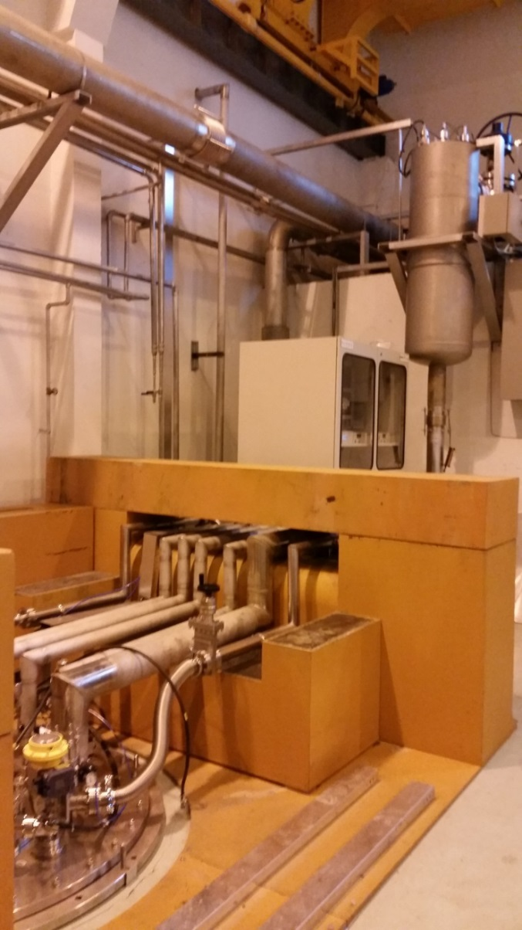
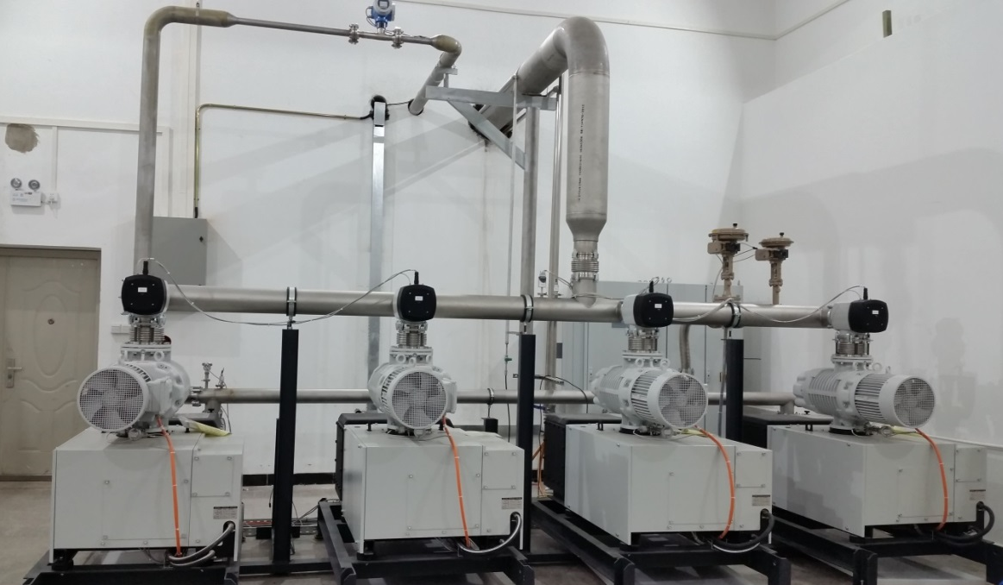
2K pumping & VTS
2K Pumping System
VTS
（2+4）RUTA WS2001FU/SV630BF/A
3.2 g/s for old pumps
6.8 g/s for new pumps

Slide 23
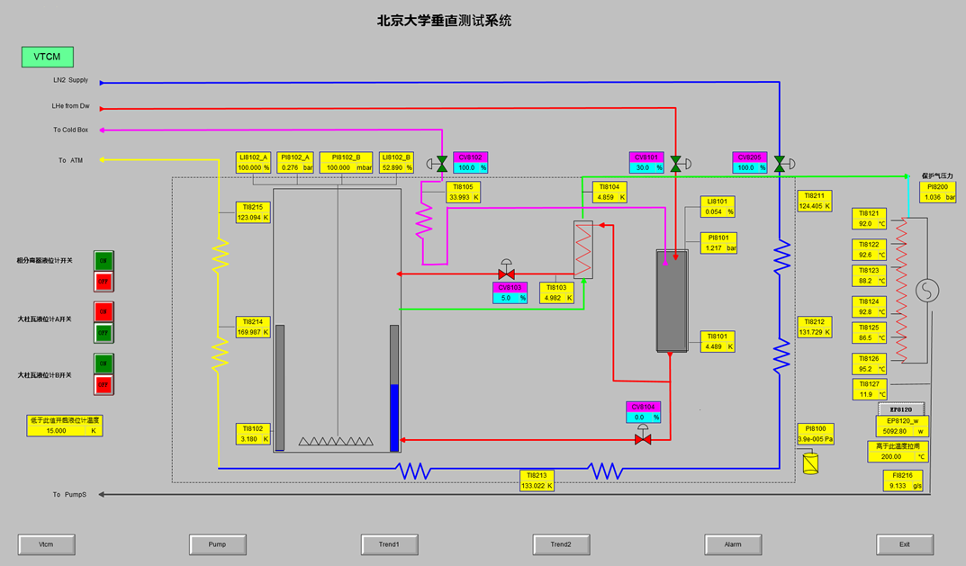
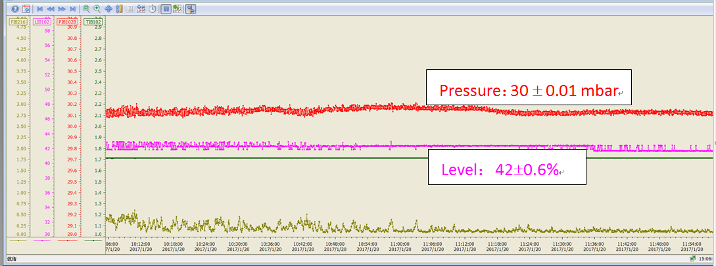
Commissioning（Jan. - March, 2017)
Heaters instead of cavity in cryostat
2K pumping system
VTS dewar & 2K box
Control system
Pressure：
30±0.1 mbar
Level:
42 ±0.6 %
Capacity:
210W @ 2K

Slide 24
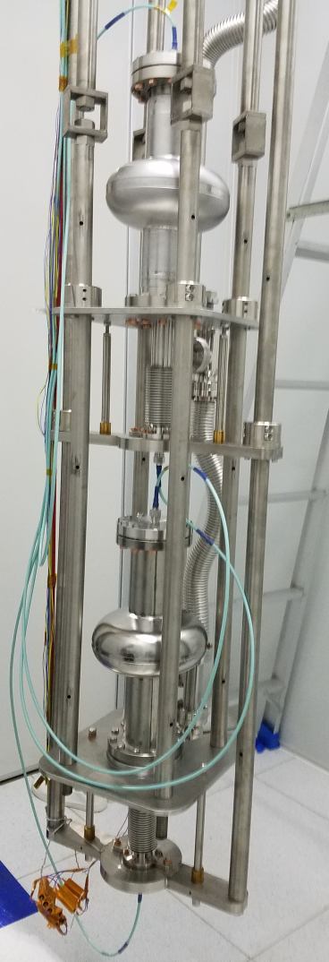
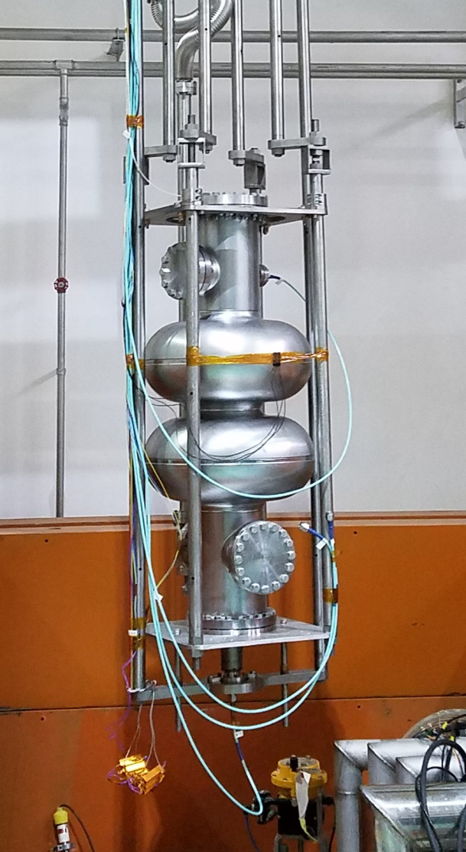
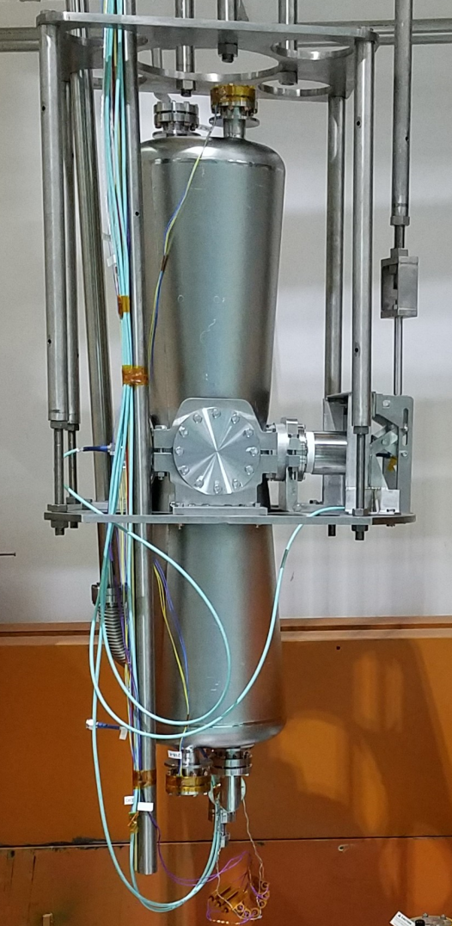
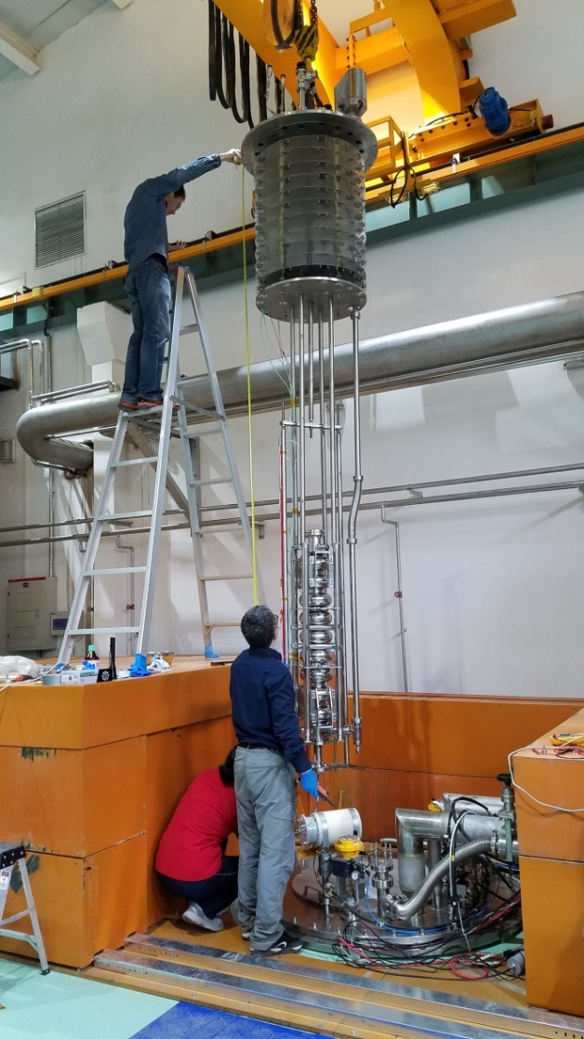
Vertical test of different cavities (since April 2017)
1.3 GHz single cell
650 MHz 2-cell
162.5 MHz HWR
1.3 GHz 9-cell

Slide 25
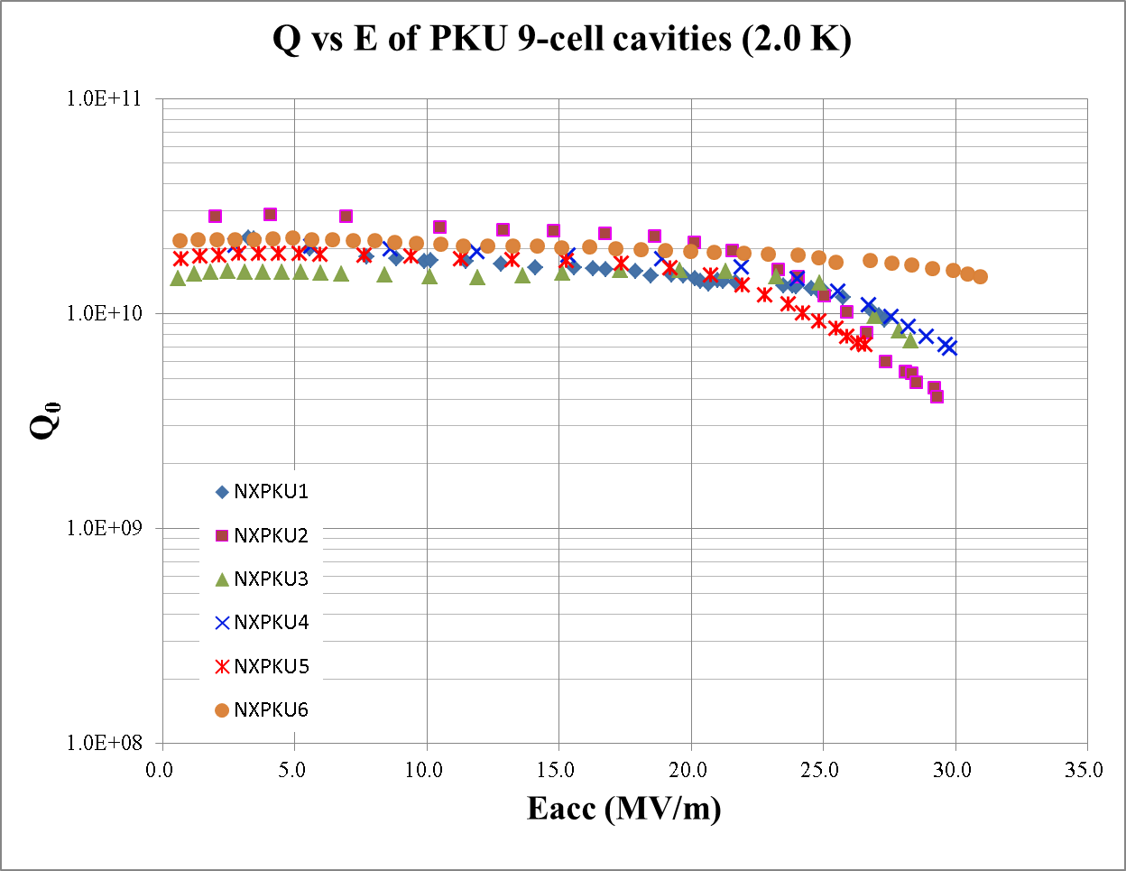
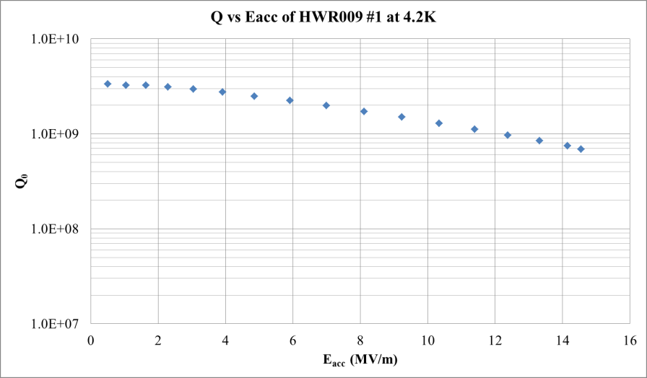
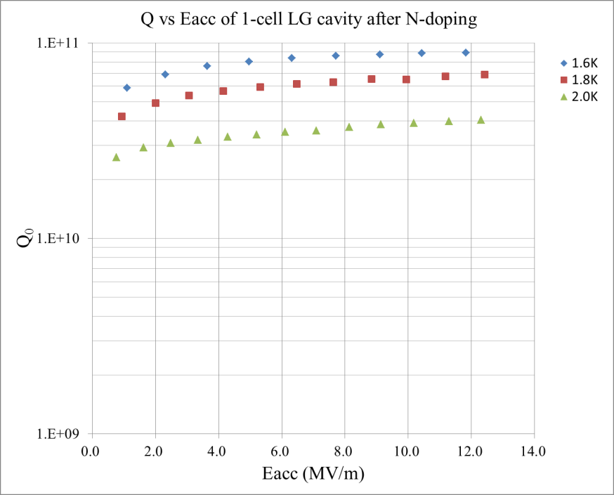
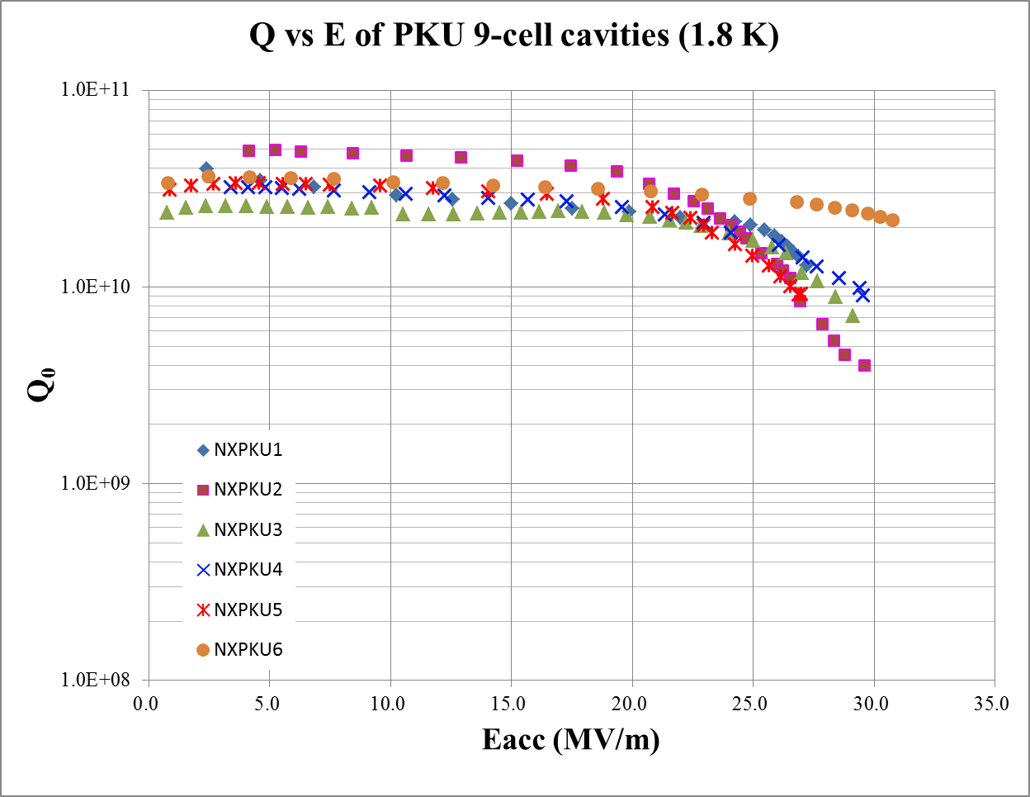
Vertical test (4.2K, 2.0K, 1.8K, 1.6K)

Slide 26
Summary
Stable operation of the first 2K cryogenic system in China is successful.
Electron beam loading experiments have been carried out based on the stable operation of cryogenic system.
Peking University Vertical Test System (PKU-VTS) is constructed, commissioned and operated successfully.
Various of cavities (9-cell 1.3 GHz, 1-cell 1.3 GHz, HWR, 2-cell 650 MHz) have been tested on PKU-VTS.

Slide 27
Cryo-Ops 2018, Beijing, June 4-7
Thank you for your attention!

