Slide 1
OPERATING STATUS OF BES
SUPERCONDUCTING MAGNET
Zhongxiu Liu

Slide 2
Outline
Brief introduction&Operating status
Faults
Aging Problems
Design of new valve box
Summary

Slide 3
Brief introduction&Operating status
BES superconducting magnet(SSM) is currently the largest single superconducting magnet manufactured in China. The normal working current of the magnet is 3369 A, and the yoke iron provides the circuit of magnetic field, which provides a constant magnetic field with a center field strength of 1 T and a certain degree of uniformity for the Beijing spectrometer, so that the charged particles are deflected in the magnetic field. By measuring the tracks of charged particles in the main drift chamber, the momentum of the particles is obtained to research the properties of the basic particles.
Normal Run was from 2008 to now. SSM run about seven months every year.

Slide 4
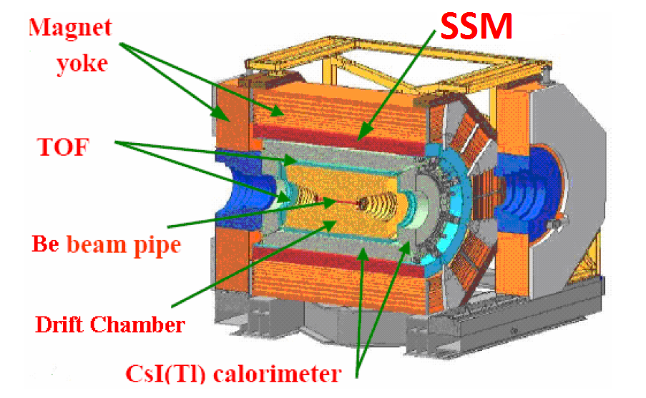
BES STRUCTURE

Slide 5
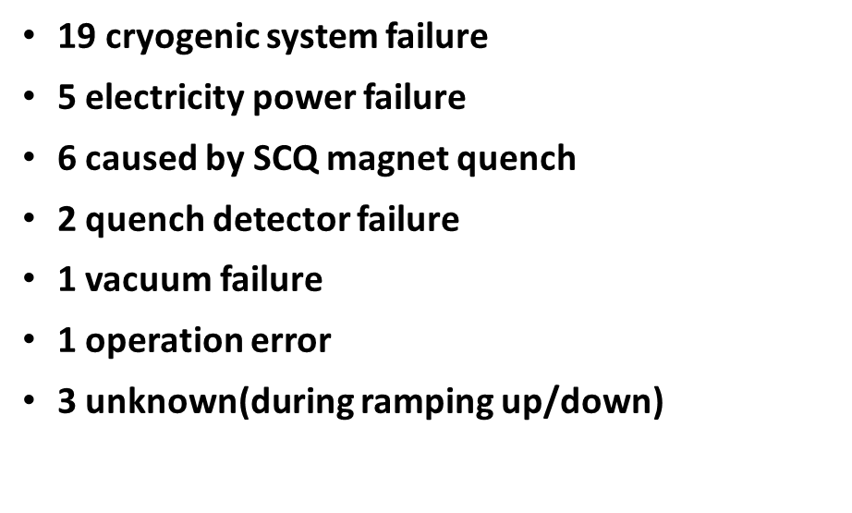
During the past ten years,there were total 37 quenches.

Slide 6
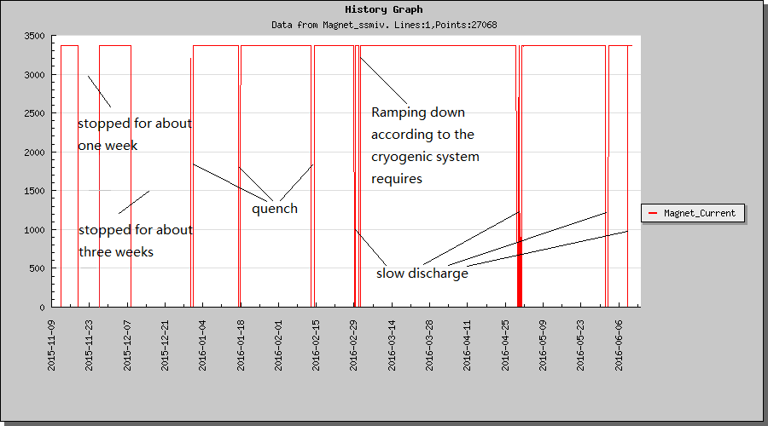
Current (2015 to 2016 run)

Slide 7
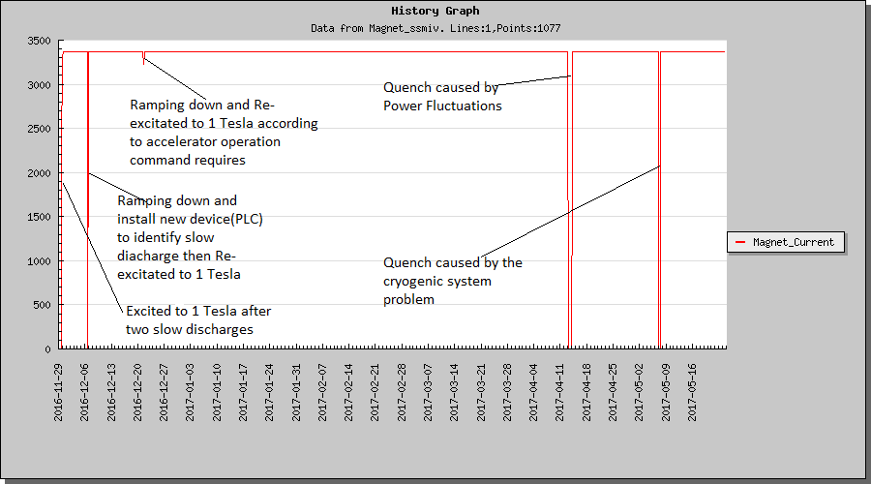
Current (2016 to 2017 run)

Slide 8
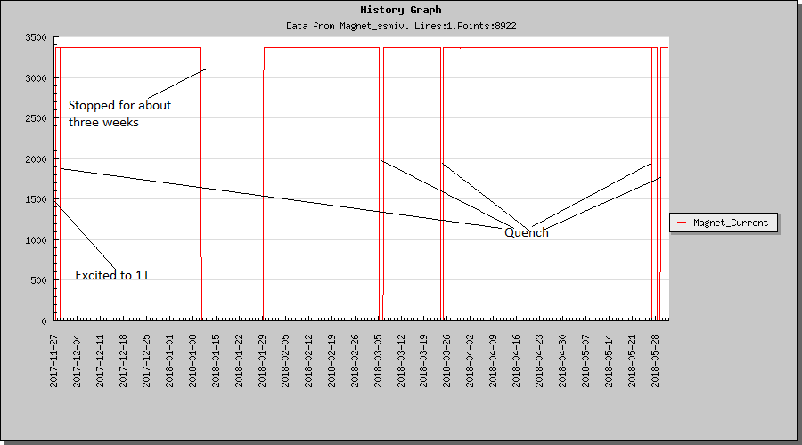
Current (2017 to 2018 run)

Slide 9
Faults
Qunech Detector
interlock PLC
Current lead A
No.32 signal line—I7
Slow discharge during exciting.
Two slow discharges during exciting,and first discharge caused to quench. The reason for the two slow discharges is due to the aging of the device inside the quench detector. We tackled problem as the right diagrammatic sketch.
Channel 1
Current lead B
No.32 signal line—I8
Channel 2
OMRON-PLC
OMRON-PLC
A-1
0
AD081
OC211
B-1
1
BES HALL
POWER CONTROLROOM

Slide 10
Aging Problems
Vacuum
Transition section in valve box
Design of new valve box

Slide 11
Aging Problem－－Vacuum
From 2010 to now, the vacuum value kept rising from 2.2×10⁻²Pa to 2.7×10⁻²Pa, even to 3.8×10⁻²Pa in 2016,and back to 2.7×10-2Pa ,it was
not stable within last few years.
It increased significantly under 20K. We believe that it should be liquid helium leaked .

Slide 12
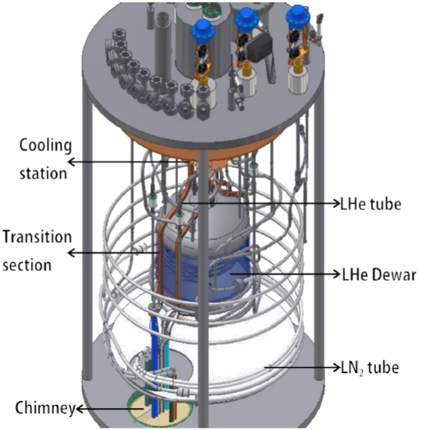
Aging Problem－－Transition section in valve box

Slide 13
Aging Problem－－Transition section in valve box
We worry about :
1.Temperature keep rising and out of control.
2.Burn the current transition section.
We did some experiments in Nov.12 2012 and adjusted warning threshold value of TSD-12 from 6.38 to 6.5

Slide 14
Aging Problem－－Bimetallic joints in valve box
There are some bimetal joints in valve box. Now we have no methods to check these bimetal joints, the reason that the vacuum became worse is perhaps those joints leaking.
It had been leaked from the first cooling.

Slide 15
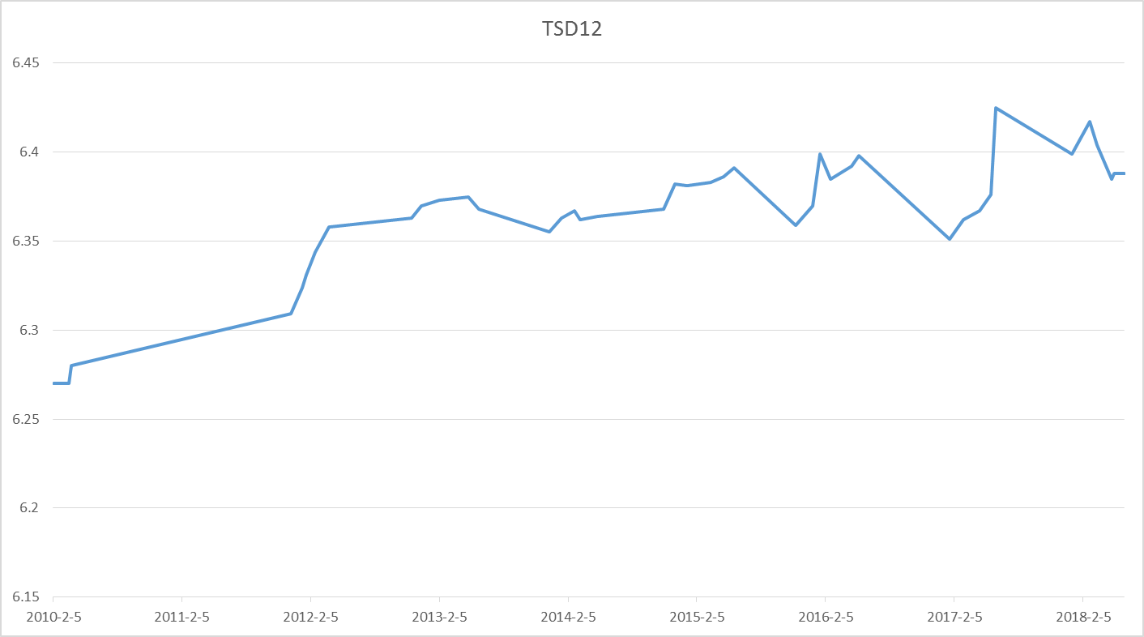
Aging Problem－－Transition section in valve box
From Feb.2010, the temperature of the transition section(TSD12) kept rising to 6.42K.

Slide 16
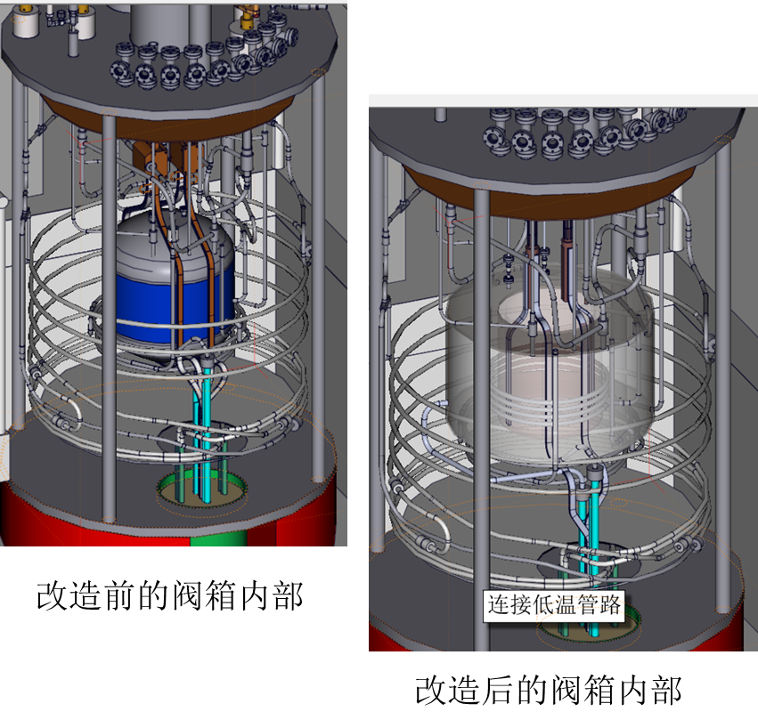
Design of new valve box---Requirements and technical improvements
Technical improvements:
HTS current leads instead of gas-cooled current lead
Optimize the cryogenic pipeline, reduce number of the bimetal joints, to improve the vacuum
Optimization of cooling structure of the transition section
Requirements：
Unchange the overall dimensions of the valve box
Unchange the position and mode of the joint with the cryogenic system
Unchange position of the joints with power bus
Overall heat leakage can not be increased
Inside structure of the existing valve box
Design of the new valve box

Slide 17
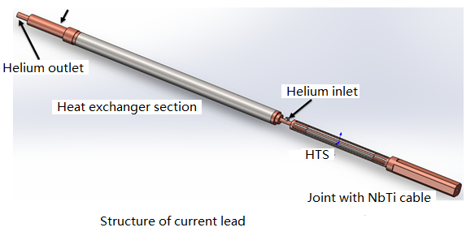
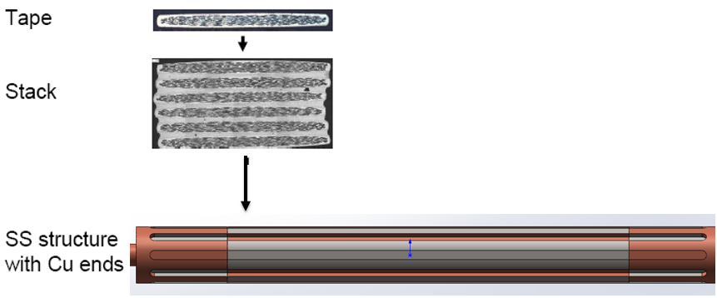
Design of new valve box- New current leads
Operating current: 3400A
Structure: binary current leads
Heat exchange section cooled by helium gas
Heat exchanger structure
HTS stack structure

Slide 18
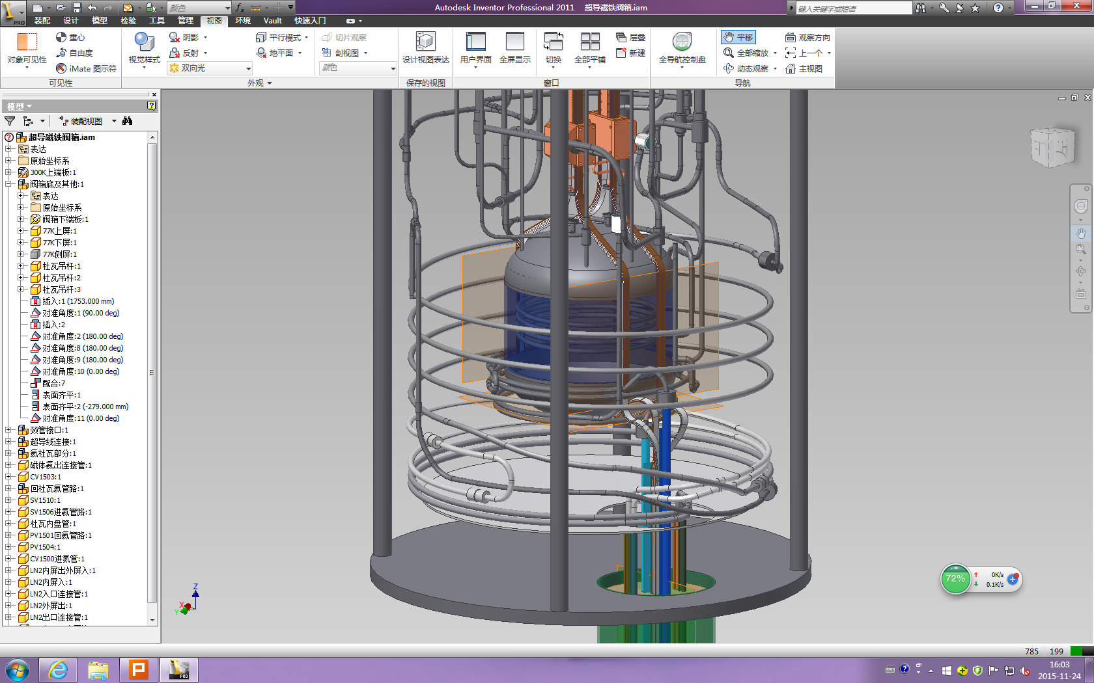
Design of new valve box- Cryogenic pipeline
Pipes from the coils are all aluminum tubes
There are several bimetal joints in the valve box, and these maybe the reason of the bad vacuum
Optimize the cryogenic pipeline:
1. Reduce number of the bimetal joints
2.Remove the cooling stations
Insulators
Bimetal joints
To improve the vacuum

Slide 19
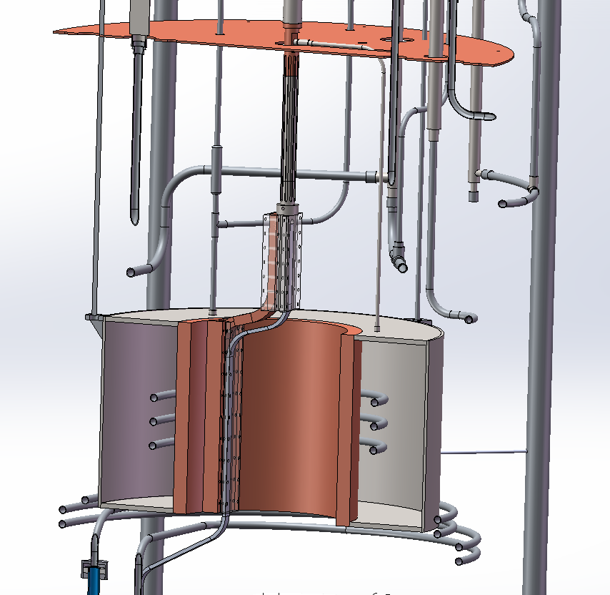
cooling structure of the transition section
Oxygen free copper material is selected for inner cylinder of the liquid helium Dewar.
The press plate and cooling plate will be pre-weld on the inner cylinder to ensure the better cooling effect.

Slide 20
Summary
In the past ten years,we got very important experience from SSM.
About vacuum and Transition section problem, we are making a new valve box,the design of new one has been completed.
Thanks!

