Slide 1


Cryogenic system for (SCLF) SHINE
Test facility
Zhengrong Ouyang, Shuhua Wang, Jiuce Sun, Lei Zhang, Lei Lei, Xiongzhong Deng
Notes:
Good Moring ladies and gentle man, it is my great pleasure to present the new project in front of many cryogenic experts here. My name is Jiuce Sun. Here are all the cryogenic stuff we got so far, a small group, not very well experienced but full of motivation and enthusiasm, That is why Your comments and suggestions are highly welcomed and appreciated. There is a slight change in the title of my talk. Instead of SCLF, difficult to pronounce and remember. a new project name SHINE has been adopted. What this new name stands for will be explained in the presentation later.

Slide 2
Outline
1. Introduction to SHINE facility
2. Cryogenic system for SHINE facility
  Conceptual design
  Preliminary layout
3. Cryogenic system for SHINE test facility
  Refrigerator process and layout
  Cryogenic distribution system
4. Summary
Notes:
In my presentation, the SHINE facility will be briefly introduced in the beginning, and afterwards I will talk a little bit about the conceptual design and preliminary layout of the cryogenic system for the SHINE facility. Next I will concentrate on the cryogenic system for the test facility within SHINE project.

Slide 3

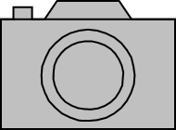
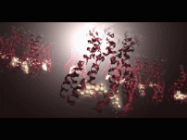
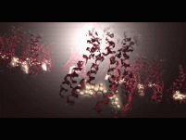
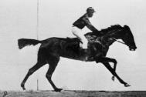


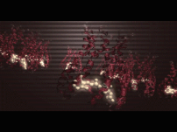
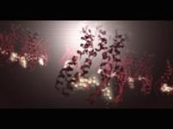
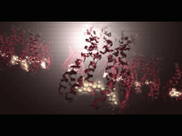

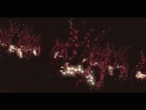

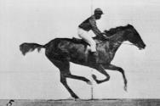
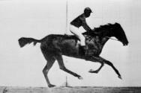
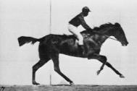
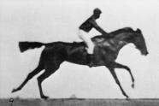

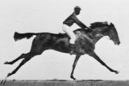
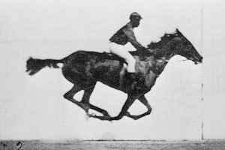

XFEL: X-ray free electron laser
European XFEL, 2017
Eadweard Muybridge, 1892
Notes:
SHINE is a kind of XFEL, which means X-ray free electron laser. And what is this. Technically speaking it is a camera which takes photos and videos. However, it is not an ordinary camera, in fact it is a much much more powerful tools. Take the European XFEL as example, It increases the spatial resolution down to molecule level and it could capture molecule movies regarding time resolution . That is why it is significant for the fundamental research and leads the international competition.

Slide 4
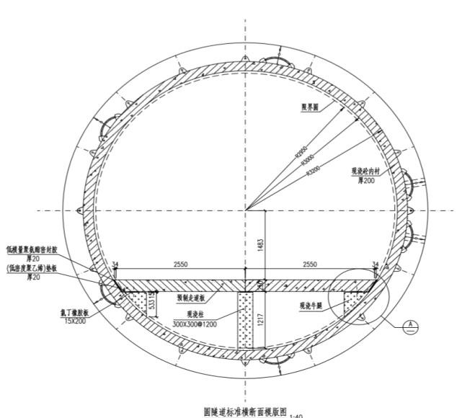
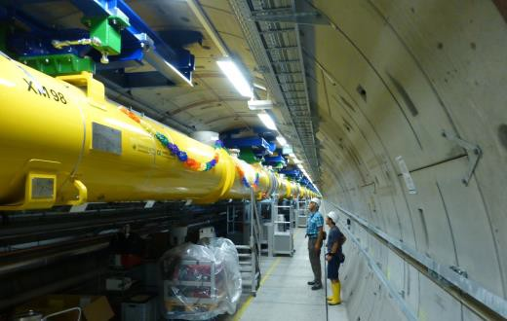
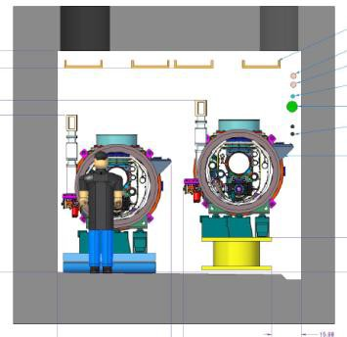
SHINE comparison
2.0m
>2.7m
2.0m
~1.
5m>1.2m
Shanghai XFEL
ITEM | European XFEL | LCLS-II（HE） | SHINE facility
RF mode | Pulsed | CW | CW
Power source | Klystron | SSA | SSA
Install | Single ac Tunnel | Tunnel + Gallery | Single ac Tunnel
2K heat load/CM | ~20w/CM | ~80w/CM | ~80w/CM
Tunnel slope | ~ | 0.5% | ~
N of modules | ~100 | ~35（+19） | ~75
2K capability | ~3kW | ~ 2 x 4kw | ~ 3x4 kw
Notes:
Last year, the European XFEL had been built and started the operation. It is a pulsed type and later on the LCLSII project plans to built a CW type with around 35 cryomodules in the beginning. The nominal 2K cooling capacity is two times 4 kW. The new SHINE projects intends to built also a CW type XFEL with more cryomodules and thus requires a higher 2K cooling capacity.

Slide 5
SHINE facility
Shanghai HIgh repetition rate XFEL aNd Extreme light facility
Notes:
OK, what does SHINE mean. The full name is Shanghai HIgh repetition rate XFEL aNd Extreme light facility .

Slide 6
SHINE facility
Shaft 1
Shaft 2 Shaft 3 Shaft 4
Shaft 5
8GeV CW Linac
BDS FELs
BLs
NEH
BLs
FEH
SHINE is a newly proposed MHz high rep-rate XFEL, based on an 8 GeV CW SRF linac;
This facility will be built in a 3.2 km long tunnel (30m underground) at Zhang-Jiang High Tech Park, across the SSRF campus in Shanghai;
This XFEL facility includes 3 undulator lines and ~10 experimental stations in phase one;
It can provide the XFEL radiation in the photon energy range of 0.2 -25 keV.
Notes:
Here is the rough schematic illustration of SHINE facility. Shine is a newly proposed High repetition rate XFEL, the Superconducting linac will be 1.3 km long and could reach 8GeV.
The entire SHINE facility will be 3.2 km long and built in 30 m underground tunnels at Shang Zhangjiang Hight Tech park.

Slide 7
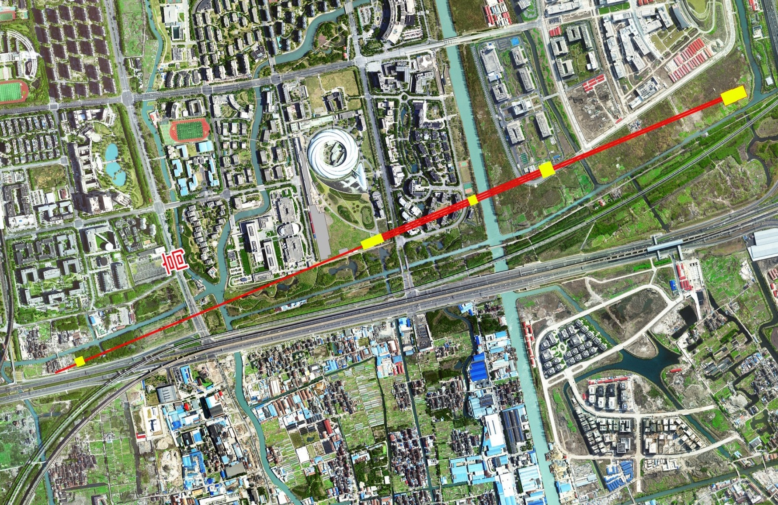
SHINE Layout
SULF
SEL
SSRF
SLEGS
SXFEL
SXFEL-γ
SHINE
E
N
S
W
Full-range (IR to γ) photon science facility cluster in Shanghai

Slide 8
SHINE Layout
Beamlines
Far Exp. Hall
Beamlines
2nd plant
Near Exp. Hall
Undulators
1st plant
SC Linac
E
Injector
N
S
W

Slide 9
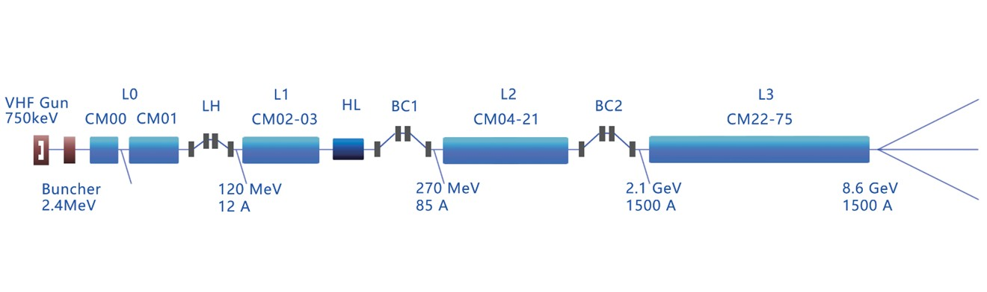
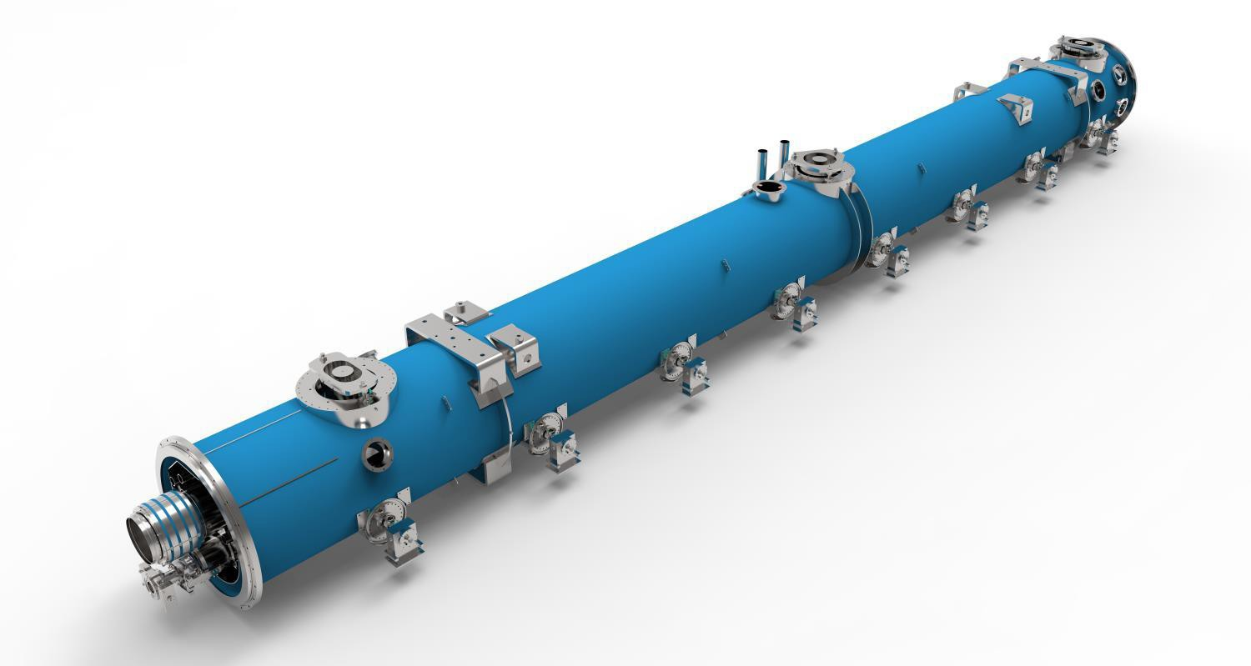
SHINE Superconducting (SC) Linac
Cryo-Modules: x 77
Parameter | value | unit
RF | 1.3 | GHz
Max.avg.RF CW gradient | 16 | MV/m
Max.RF gradient | 18 | MV/m
Active length of 9 cell cavity | 1.038 | m
Mean cavity quality factor | >2.7 | 10¹⁰
temperature | 2.0 | K
cavities | 8 | -
Heat load(dynamic) | 74.6 ~100 | W@2K
Heat load (static) | 6 | W@2K
pressure | 31 | mbar
Volume of helium | 184 | L
1.3 GHz Cryo-Modules: x 75
Cavities: 8
Length 12 m
Weight 8,000 kg
3.9 GHz Cryo-Modules: x 2
Cavities: 8
Length 6 m
Weight 4,000 kg

Slide 10
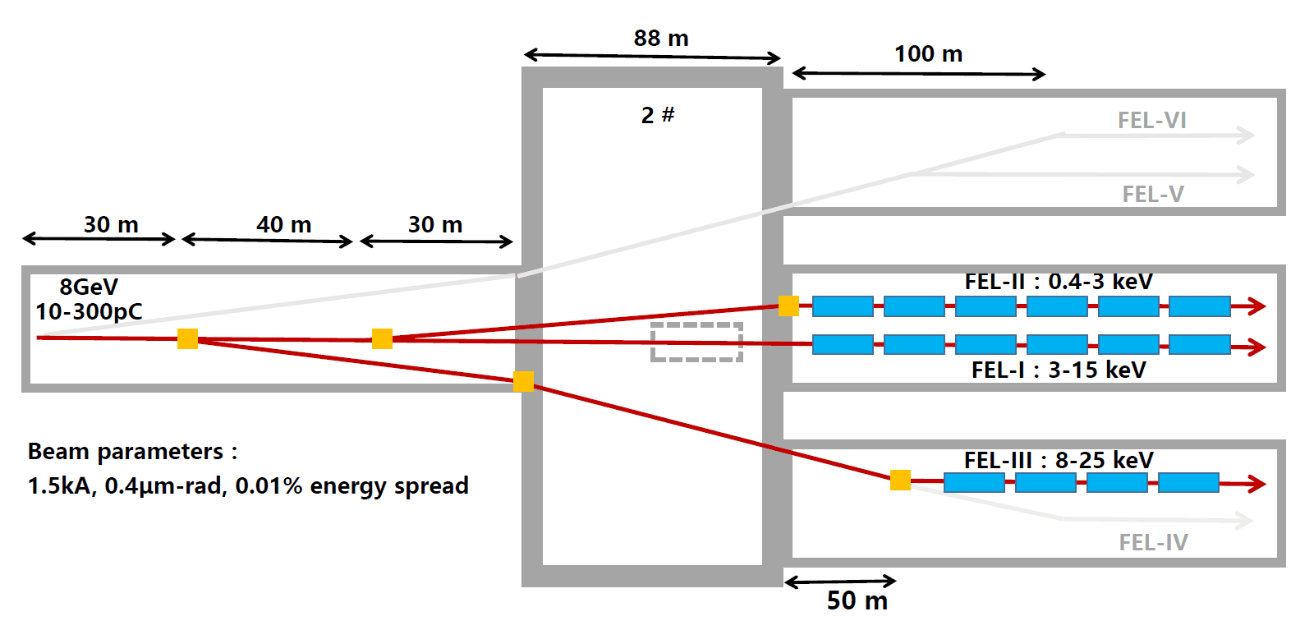
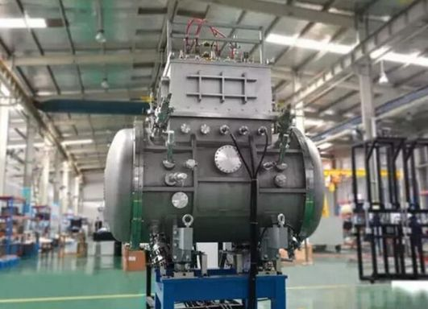
SHINE Superconducting (SC) Undulators
One of the Undulator lines plans to adopt SC type（4.5K)

Slide 11
Outline
1. Introduction to SHINE facility
2. Cryogenic system for SHINE facility
  Conceptual design
  Preliminary layout
3. Cryogenic system for SHINE test facility
  Refrigerator process and layout
  Cryogenic distribution system
4. Summary
Notes:
In my presentation, the SHINE facility will be briefly introduced in the beginning, and afterwards I will talk a little bit about the conceptual design and preliminary layout of the cryogenic system for the SHINE facility. Next I will concentrate on the cryogenic system for the test facility within SHINE project.

Slide 12
SHINE facility heat load
Item |  | 2K heat load（kW） | 4.5K Heat load（kW）
1.3GHz SRF Cavities | static | 0.75 | 1.575
 | dynamic | 6.075 | 0.375
 | total | 6.825 | 1.95
Undulator | static |  | 0.4
 | dynamic |  | 4
Distribution | Valve box | 1.0 | 1.0
 | Transfer line | 1.5 | 1.5
Total |  | 9.325 | 8.85
SHINE cryoplant capacity 12kW@2K == 4kW X 3

Slide 13

SHINE cryoplant layout
LN2 Storage
GHe Storage
LN2 Storage
GHe Storage
Purification system
Compressor system
Compressor system
Purification system
Compressor system
ORS
ORS
ORS
4.5 K
Cold box
4.5 K
Cold box
4.5 K
Cold box
LHe
Dewar
LHe
Dewar
LHe
Dewar
CP1
2 K
Cold box
2 K
Cold box
CP2
2 K
Cold box
CP3
Distribution
Box
Distribution
Box
Shaft 1
Shaft 2
L0 LH L1 BC1 L2(CM4-21) BC2 L3(CM22-CM51) BREAK L4(CM52-CM75)

Slide 14
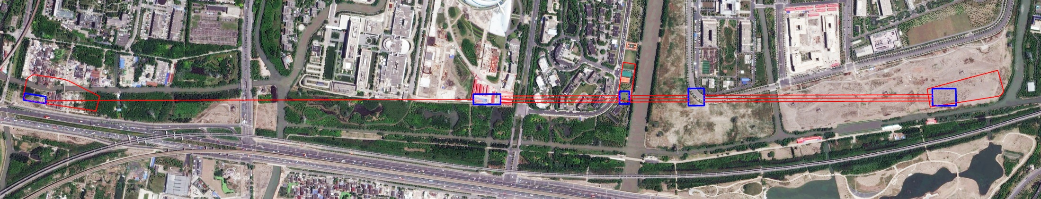
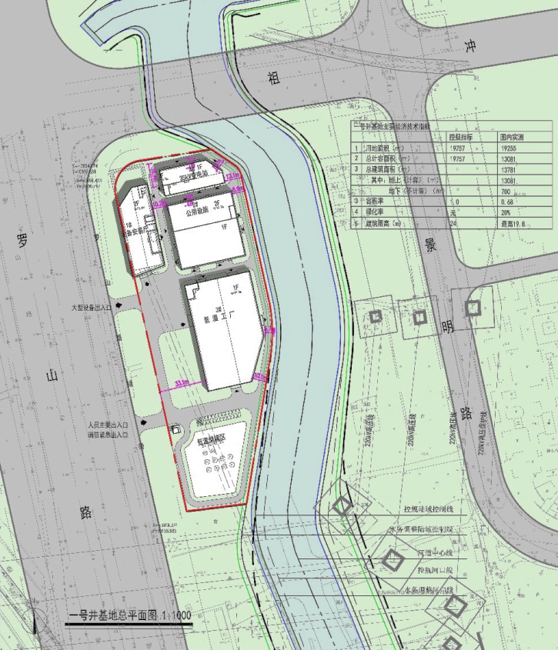
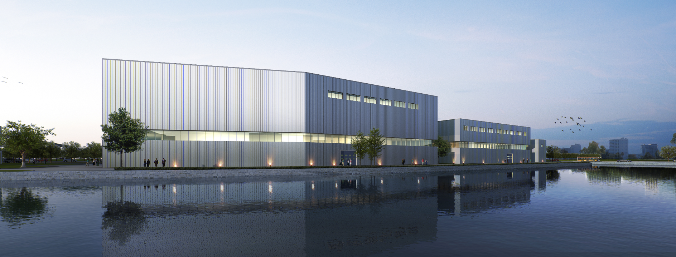
Cryoplants at No. 1 Shaft
GE R&D center
SSRF
1430m
3X400m
3X205m
3X760m
LuoShan Road
Shaft120X70
Shaft232X88
Shaft340X30
Shaft455X50
Shaft555X76
Two Cryoplants with 4kW@2K will be installed

Slide 15
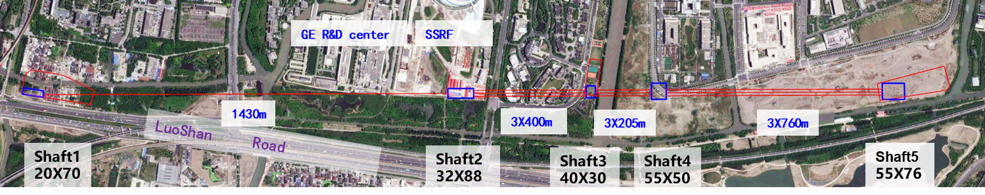
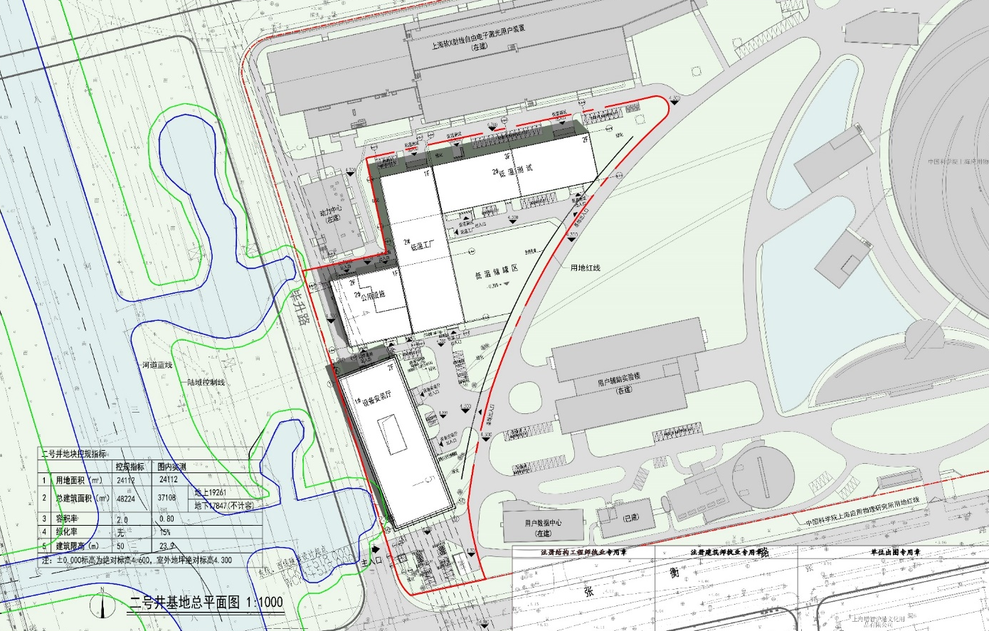
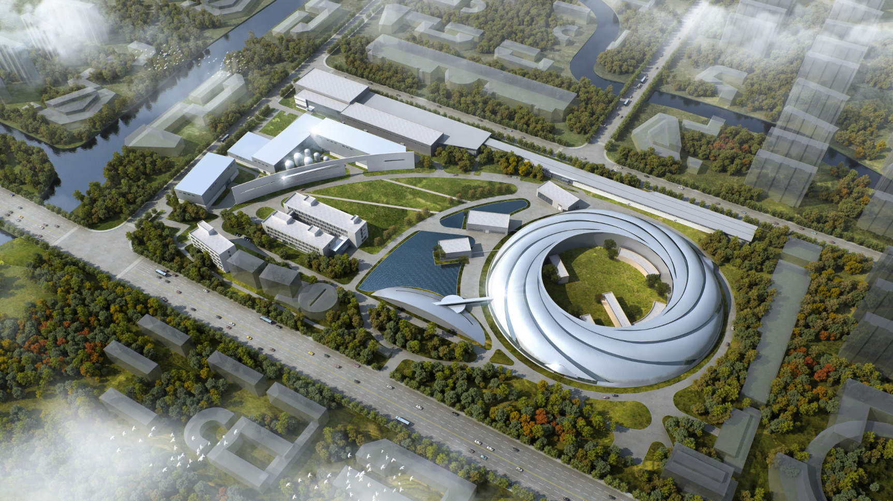
Cryoplant at No. 2 Shaft
One Cryoplant with 4kW@2K will be installed

Slide 16
Outline
1. Introduction to SHINE facility
2. Cryogenic system for SHINE facility
  Conceptual design
  Preliminary layout
3. Cryogenic system for SHINE test facility
  Refrigerator process and layout
  Cryogenic distribution system
4. Summary

Slide 17
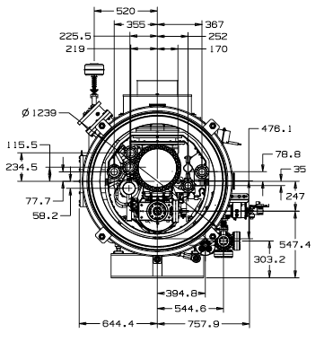
Cryogenic test facility
VTC: Vertical Test Cryostat
HTB: Horizontal Test Bench
UTC: Undulator Test Cryostat
CTC: Cavity Test Cryostat
GTC: General Test Cryostat
MTC: Magnet Test Cryostat
BTC: Backup Test Cryostat
VTC1
VTC2
HTB1
HTB2
UTC1
CTC1
GTC1
MTC1
VTC3
VTC4
HTB3
HTB4
UTC2
CTC2
BTC1
15
Test cryostats (benches)
CAVITIES:
- A: 4K, 3.00 bar
- B: 2K, 0.03 bar
3
Temperature
circuits
INTERCEPT:
- C: 4.5K, 3.0 bar
- D: 8K, 1.3 bar
SHIELDS:
- E: 35 K, 3.0 bar
- F: 55 K, 1.3 bar
17

Slide 18
Heat load requirements
Item | 2K heat load/W |  |  | 4.6K heat load/W |  |  | 35K heat load/W |  |  | Coolig type | Number
 | Normal | Max. | Min. | Normal | Max. | Min. | Normal | Max. | Min.
2K Horizontal | 110 | 250 | 10 | 40 | 50 | 15 | 210 | 260 | 130 | bath@2K | 1
 | 180 | 200 | 20 | 80 | 100 | 15 | 420 | 520 | 130 |  | 1
 | 90 | 100 | 10 | 40 | 50 | 15 | 210 | 260 | 130 |  | 2
1.5K-2K Vertical | / | 270 | 5 | / | / | / | / | 50 | / | bath@2K | 1
 | / | 140 | 5 | / | / | / | / | 50 | / |  | 3
2K Single Cavity | 20 | 50 | 10 | / | 30 | / | / | 200 | / | bath@2K | 2
2K SCM | / | 10 | 5 | / | 20 |  | / | 200 |  | bath@2K | 1
2K Heat Exchanger | 500 | / | / | / | / | / | 50 | / | / | bath@2K | 1
4.6K SCM | / | 15 | 8 | / | 20 | ？ | / | 200 | 150 | bath@4.6K | 1
4.5K SCU | / |  |  | / | 80 | 10 | / | 700 | 500 | forced flow | 2
Maximum capacity
Turn-down
Liquefaction
  1000W @2K
  350W @4.5K
  3750W @35K
  121.8 L/h
  350W @2K
  100W @4.5K
  1000W@35K
  970 L/h

Slide 19
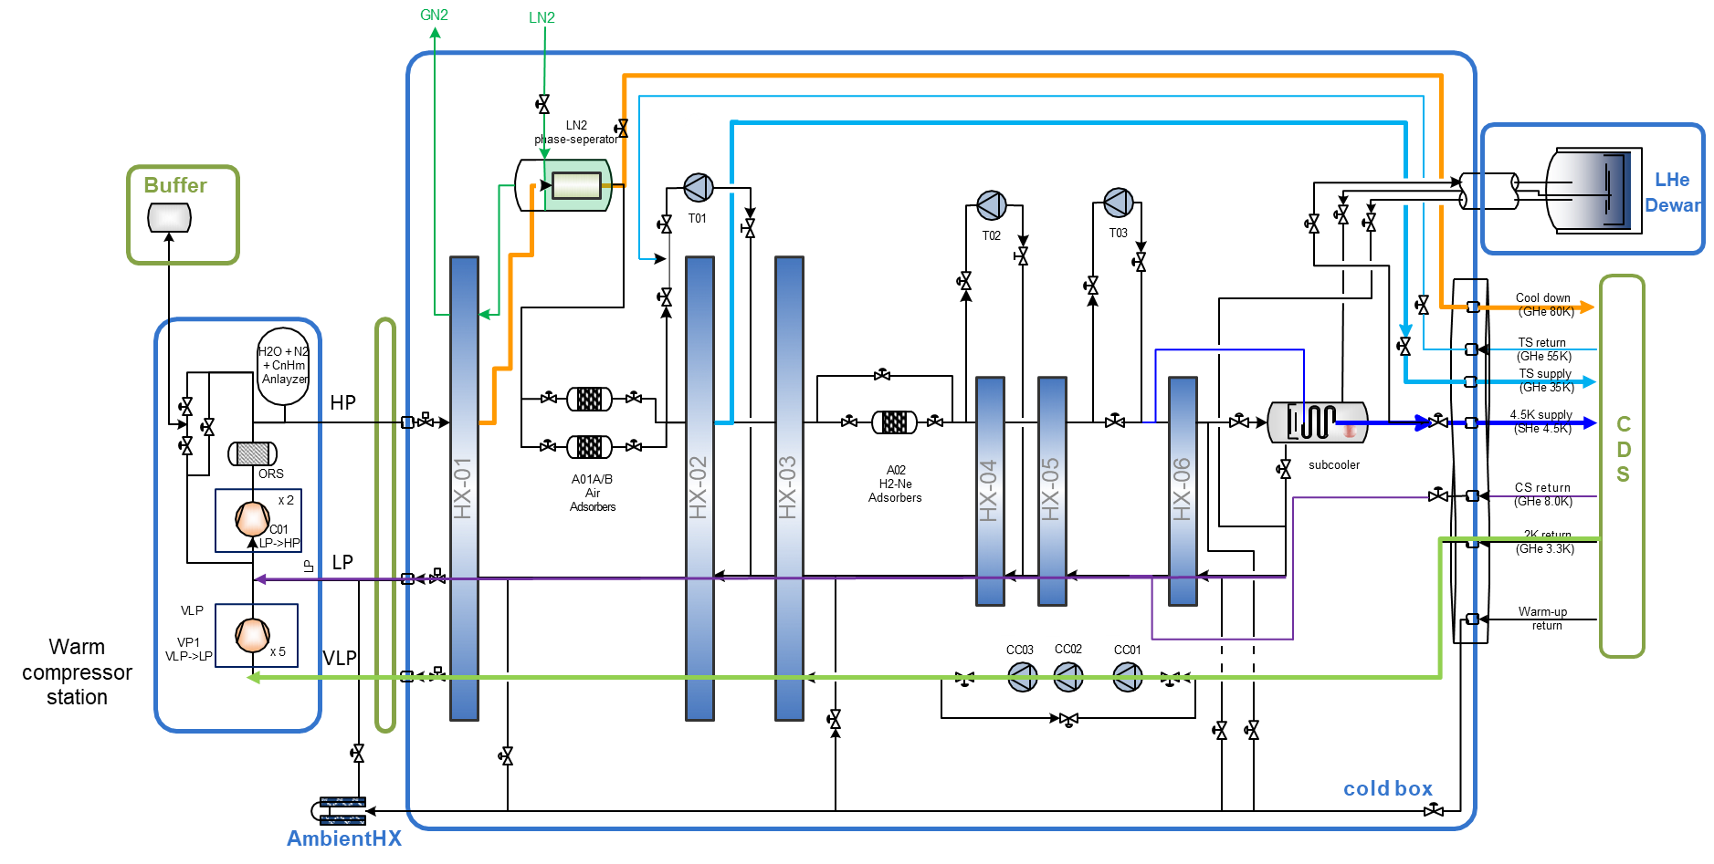
Cryoplant process for SHINE test facility
3 stages turbine
LN2 precooling
  All in one
  cold box
3 Temperature circuits
  2K loop
  5-8 K
  35-55K
3 stages cold compressor
5 VLP pumps

Slide 20












Process – Pressure circuits
GN2
LN2
LN2
phase-seperator
Buffer
LHe
Dewar
T01
T02
T03
Cool down
（GHe 80K）
TS return
(GHe 55K)
H2O + N2
+ CnHm
Anlayzer
TS supply
(GHe 35K)
HP
4.5K supply
(SHe 4.5K)
CDS
ORS
A02
H2-Ne
Adsorbers
subcooler
CS return
(GHe 8.0K)
x 2
HX-01
A01A/B
Air
Adsorbers
HX-02
HX-03
HX-04
HX-05
HX-06
C01 LP->HP
2K return
(GHe 3.3K)
LP
LP
Warm-up return
VLP
Warm
compressor
station
VP1
VLP->LP
x 5
VLP
CC03
CC02
CC01
Cold compressor
cold box
AmbientHX

Slide 21
Process – temperature circuits
GN2
LN2
LN2
phase-seperator
Buffer
LHe
Dewar
T01
T02
T03
Cool down
（GHe 80K)
TS return
(GHe 55K)
H2O + N2
+ CnHm
Anlayzer
TS supply
(GHe 35K)
HP
4.5K supply
(SHe 4.5K)
CDS
ORS
A02
H2-Ne
Adsorbers
subcooler
CS return
(GHe 8.0K)
x 2
HX-01
A01A/B
Air
Adsorbers
HX-02
HX-03
HX-04
HX-05
HX-06
C01 LP->HP
2K return
(GHe 3.3K)
LP
LP
Warm-up return
VLP
Warm compressor station
VP1
VLP->LP
x 5
VLP
CC03
CC02
CC01
cold box
AmbientHX

Slide 22
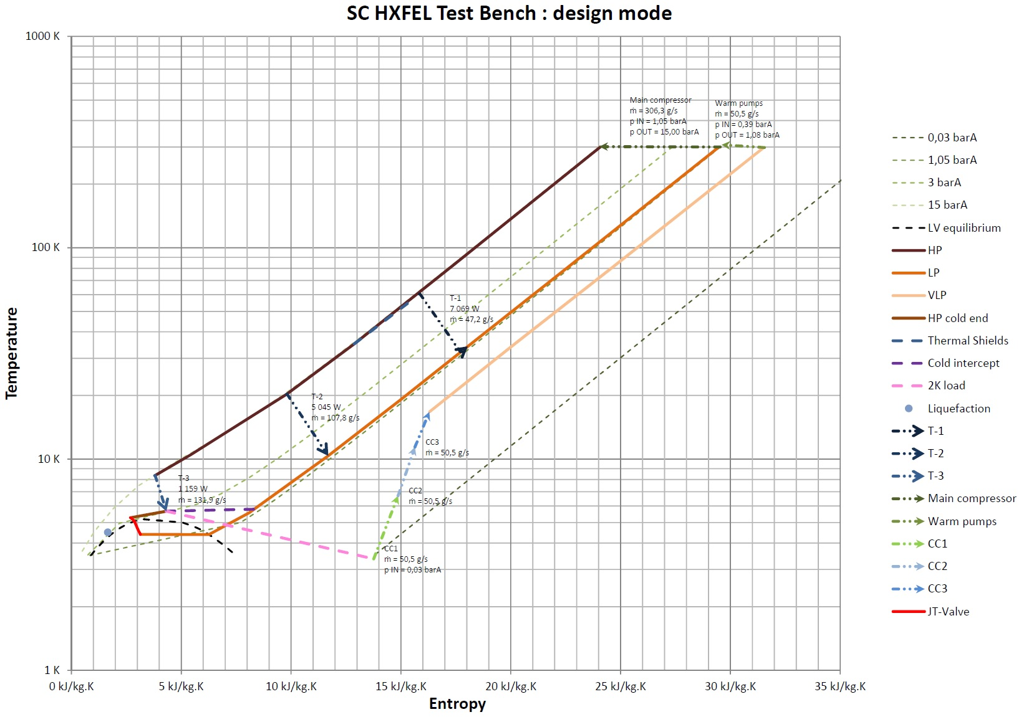
Process design – maximum capacity
Cooling capacity | 2K | 1000 | W
 | 4.5K | 350 | W
 | 35K | 3750 | W
 | LHe | 121.8 | L/h
Warm compressors | Suction pressure | 1.05 | bar
 | Discharge pressure | 15 | bar
 | mass flow | 303.2 | g/s
VLP Pumps | Suction pressure | 0.4 | bar
 | Discharge pressure | 1.05 | bar
 | mass flow | 50.5 | g/s
Cold compressors | Pressure to CC1 | 0.03 | bar
 | Pressure from CC3 | 0.48 | bar
 | mass flow | 50.5 | g/s

Slide 23
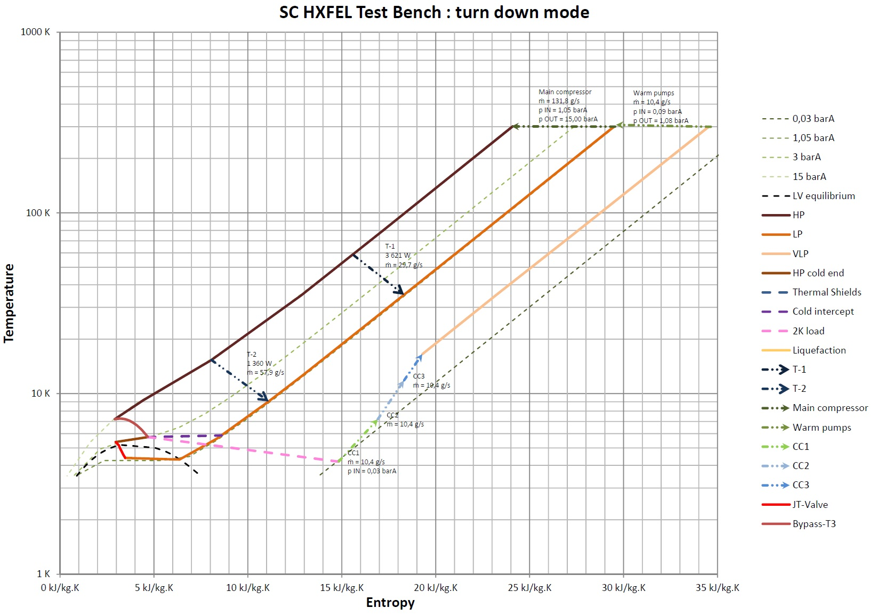
Process design – turn down mode
Cooling capacity | 2K | 350 | W
 | 4.5K | 100 | W
 | 35K | 1000 | W
 | LHe |  | L/h
Warm compressors | Suction pressure | 1.05 | bar
 | Discharge pressure | 13.4 | bar
 | mass flow | 196.1 | g/s
VLP Pumps | Suction pressure | 0.11 | bar
 | Discharge pressure | 1.1 | bar
 | mass flow | 17.2 | g/s
Cold compressors | Pressure to CC1 | 0.03 | bar
 | Pressure from CC3 | 0.14 | bar
 | mass flow | 17.2 | g/s

Slide 24
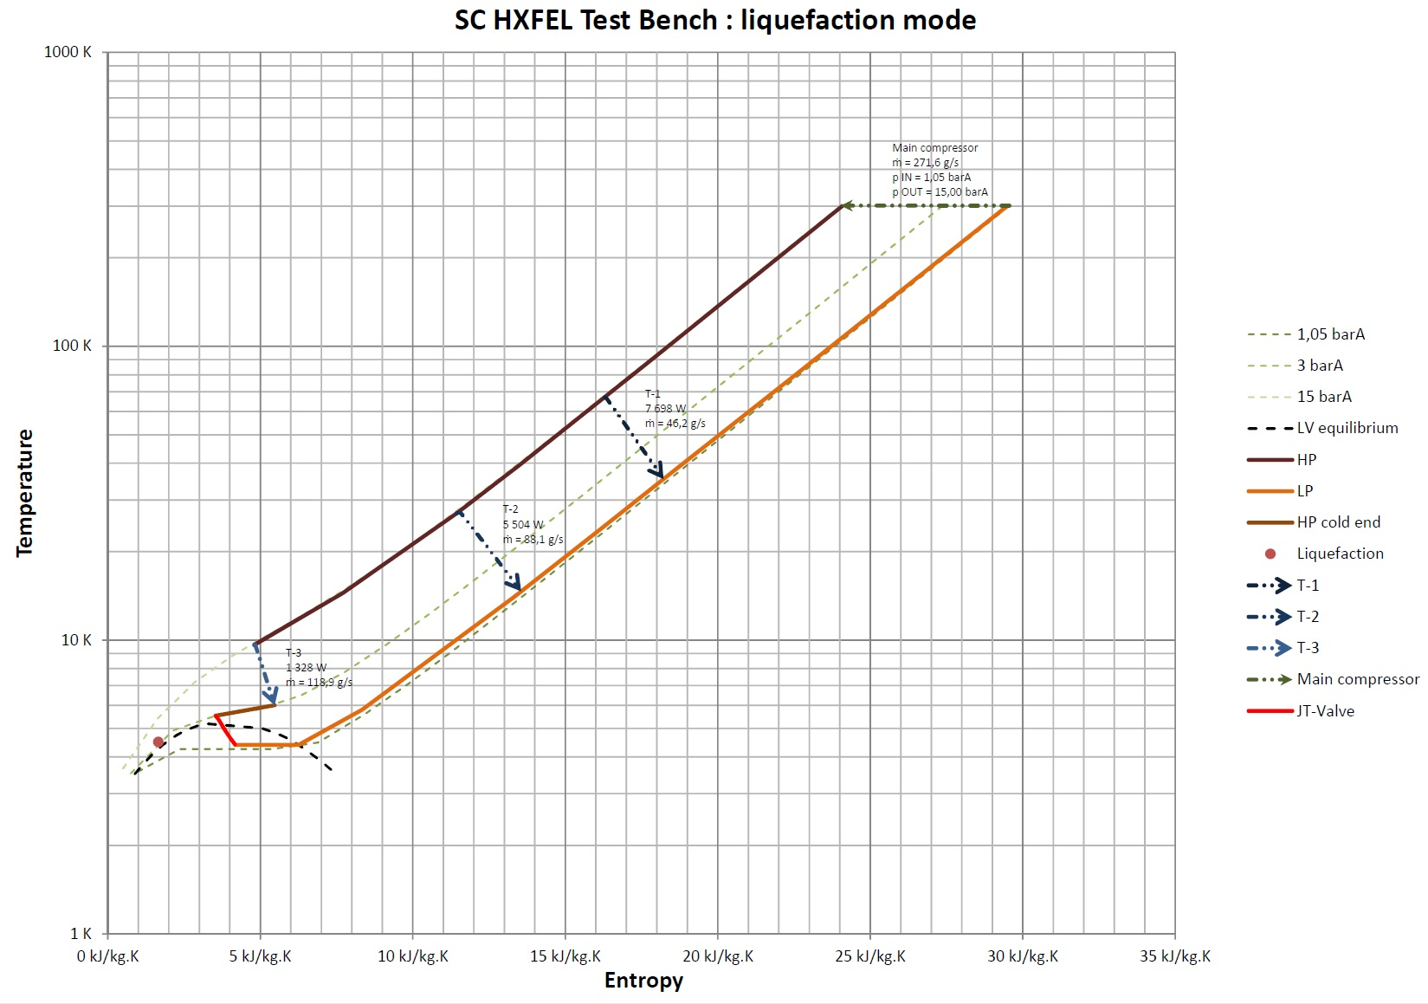
Process design – Liquefaction mode
Cooling capacity | 2K |  | W
 | 4.5K |  | W
 | 35K |  | W
 | LHe | 970 | L/h
Warm compressors | Suction pressure | 1.05 | bar
 | Discharge pressure | 15 | bar
 | mass flow | 256.4 | g/s
VLP Pumps | Suction pressure |  | bar
 | Discharge pressure |  | bar
 | mass flow |  | g/s
Cold compressors | Pressure to CC3 |  | bar
 | Pressure from CC1 |  | bar
 | mass flow |  | g/s

Slide 25
Process – test mode
GN2
LN2
Maximum capacity
Turn-down
Liquefaction
LN2
phase-seperator
EH01
  1000W @2K
  350W @4.5K
  3750W @35K
  121.8 L/h
  350W @2K
  100W @4.5K
  1000W@35K
  970 L/h
Buffer
LHe
Dewar
T01
T02
T03
Cool down
（GHe 80K）
TS return
(GHe 55K)
H2O + N2
+ CnHm
Anlayzer
TS supply
(GHe 35K)
subcooler
4.5K supply
(SHe 4.5K)
CDS
ORS
A02
H2-Ne
Adsorbers
EH02
CS return
(GHe 8.0K)
x 2
HX-01
A01A/B
Air
Adsorbers
HX-02
HX-03
HX-04
HX-05
HX-06
C01 LP->HP
2K return
(GHe 3.3K)
LP
EH03
Test heaters
2K / 4.5 K
Warm-up return
VLP
Warm compressor station
VP1
VLP->LP
x 5
CC03
CC02
CC01
cold box
AmbientHX

Slide 26
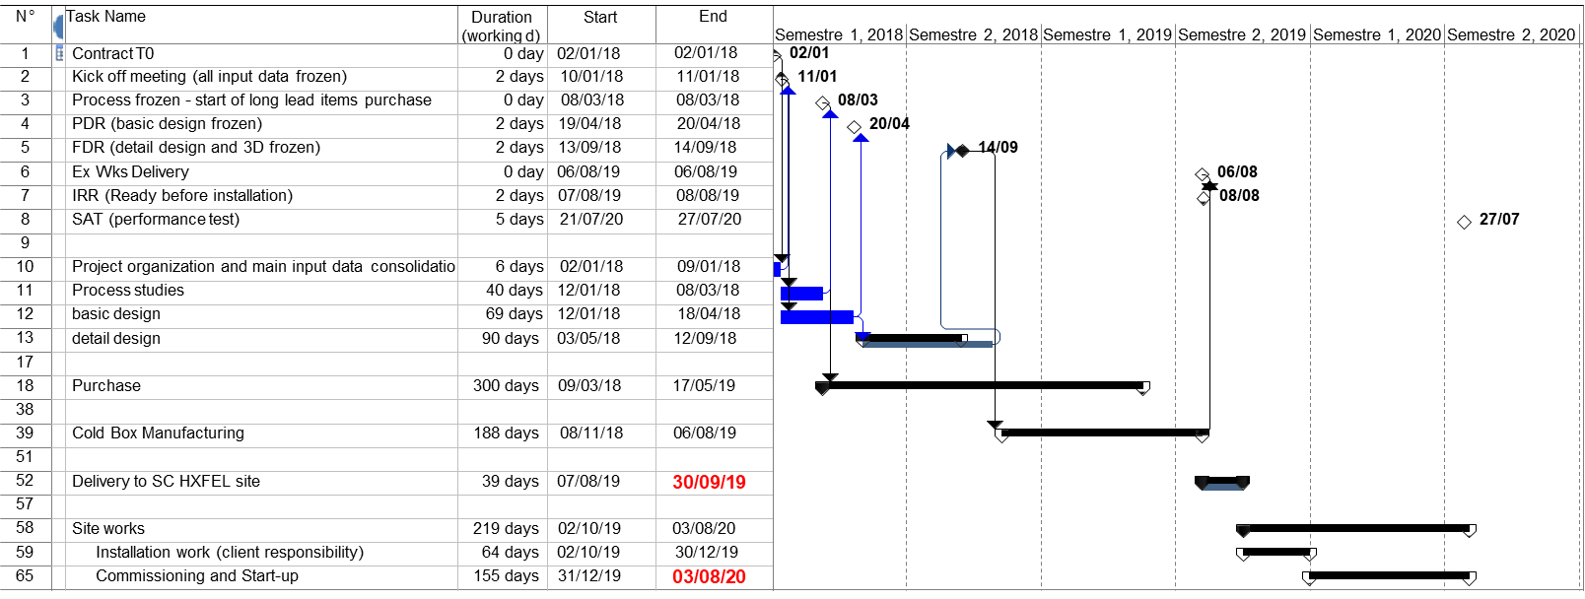
Cryoplant Schedule

Slide 27
Layout - Cryogenic test facility
Cryogenic transfer line
EVB1
Test Hall 1#
VTC1
VTC2
HTB1
HTB2
UTC1
CTC1
GTC1
MTC1
VTC: Vertical Test Cryostat
HTB: Horizontal Test Bench
UTC: Undulator Test Cryostat
CTC: Cavity Test Cryostat
GTC: General Test Cryostat
MTC: Magnet Test Cryostat
BTC: Backup Test Cryostat
EVB: End Valve Box
EVB2
Test Hall 2#
VTC3
VTC4
HTB3
HTB4
UTC2
CTC2
BTC2
So far, 15 test cryostats (benches) in total have been proposed

Slide 28
Layout - Cryoplant
EVB1
VTC1
VTC2
HTB1
HTB2
UTC1
CTC1
GTC1
MTC1
Test Hall 1#
Warm compressor
ORS
LHe Dewar
Recovery and Purification
EVB2
Warm compressor
Test Hall 2#
VTC3
VTC4
HTB3
HTB4
UTC2
CTC2
BTC2
VLP Pumps
Cold box
LN2 Dewar
GHe Storage
Cryofactory

Slide 29
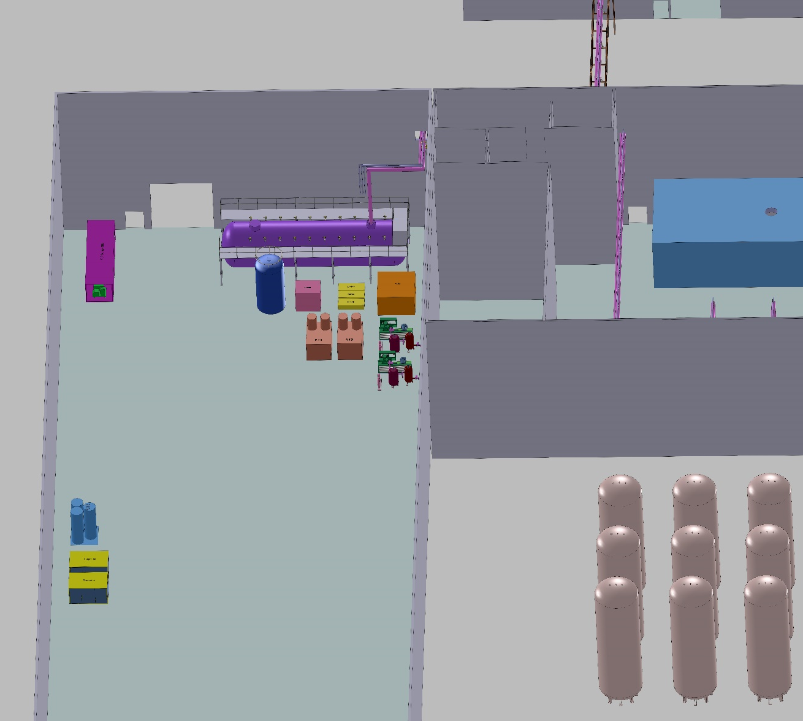
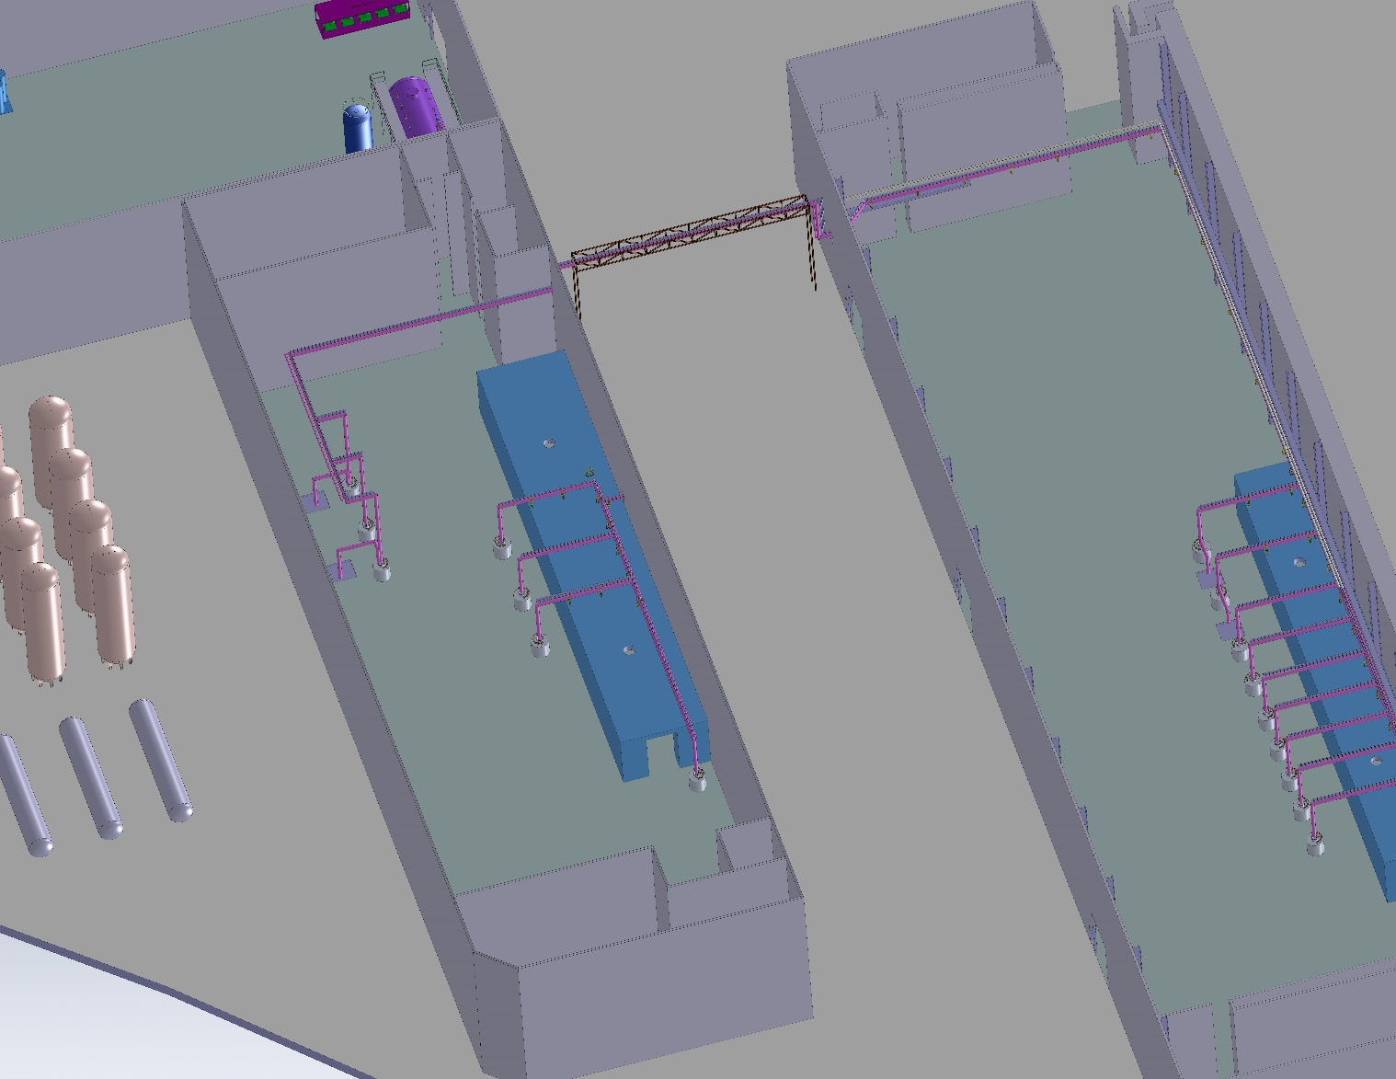
Cryogenic system preliminary layout
Transfer
Line
VLP pumps
Cold box
Transfer
Line
Dewar
Purifier
Recovery compressors
ORS
Valve boxes
Test Hall 2#
Warm compressors
Test Hall 1#
Helium Inventory

Slide 30
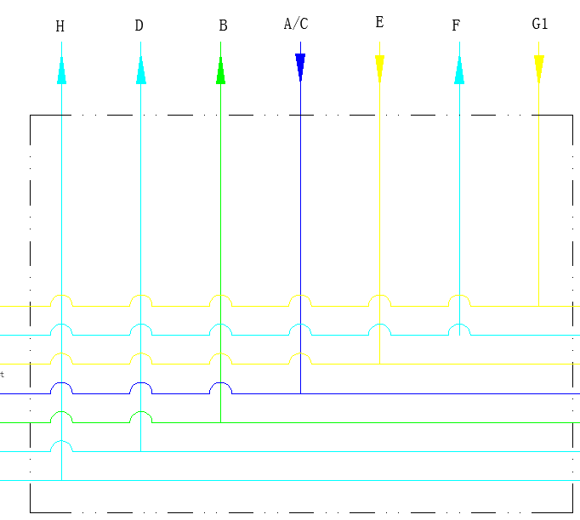
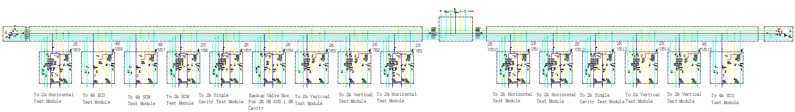
Cryogenic distribution system
From Cold Box
Pipe line | Pressure | Temperature
 | barA | K
A/C | 3 | 4.6
B | 0.0275 | 3.5
D | 1.3 | 8
E | 14.24 | 35
F | 13.74 | 55
G1 | 15 | 80
H | 1.3 | 4.6-300
Splitting Box
Multi-channel Transfer Lines
Multi-channel Transfer Lines
End Valve Box 1
End Valve Box 2
9 Valve Box
6 Valve Box

Slide 31
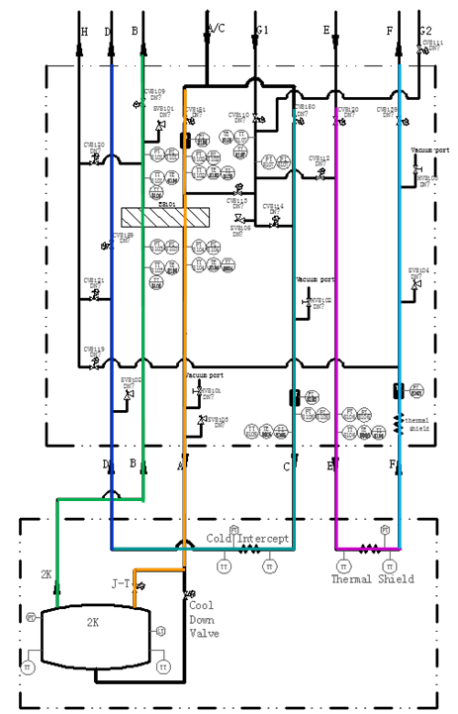
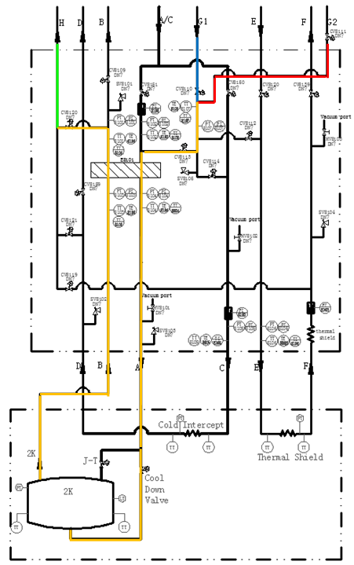
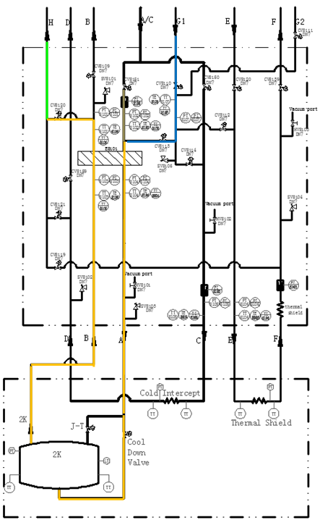
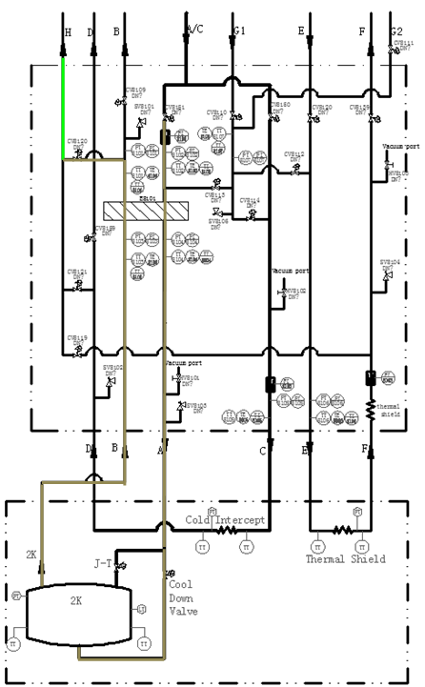
Cryogenic distribution system PFD
4.6K
35K
80K
300K
4.6K
80K
4.6K
300-80K
80-45K
45-4.6K
2K operation

Slide 32
Outline
1. Introduction to SHINE facility
2. Cryogenic system for SHINE facility
  Conceptual design
  Preliminary layout
3. Cryogenic system for SHINE test facility
  Refrigerator process and layout
  Cryogenic distribution system
4. Summary
Notes:
In my presentation, the SHINE facility will be briefly introduced in the beginning, and afterwards I will talk a little bit about the conceptual design and preliminary layout of the cryogenic system for the SHINE facility. Next I will concentrate on the cryogenic system for the test facility within SHINE project.

Slide 33
Summary
SHINE is a newly proposed MHz high rep-rate XFEL based on an 8 GeV CW SRF linac;
Three Cryoplants with 4kW@2K will be built for SHINE facility;
One cryoplant with 1kW@2K and corresponding distribution system is being built for SHINE test facility

Slide 34
Thank you!

Slide 35
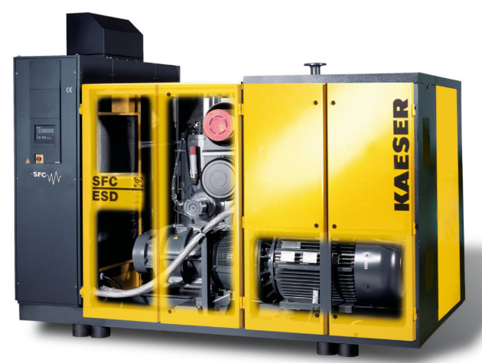
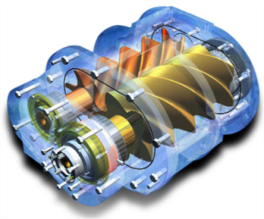
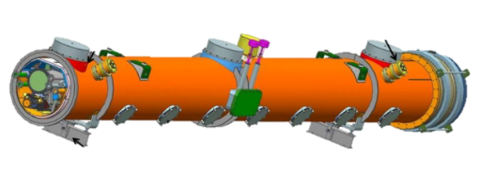
Key components – Warm compressor
0.4 bar
1.05 bar
15.0 bar
Comp. | Flow | Power
HP x2 | 303g/s | 1065kW
VLPx5 | 50.5g/s | 92.5kW
 |  | 1157.5kW
1
2
3
2 Kaeser skids HSD842 model
Oil-lubricated screw compressors
Each skid contains 2 screws
1 screw with VFD for optimized power consumption
Water cooled
35K Shield
4.5K Cold mass
Length | Wide | Height | Weight
m | m | m | kg
4.37 | 2.15 | 2.35 | 10100
3.57 | 2.15 | 2.35 | 8600
Notes:
By using a variable frequency driver (integrated in an additional cabinet beside the main compressor box, refer to above Figure 1), the compressor processed flow can be adjusted to the refrigeration need.

Slide 36
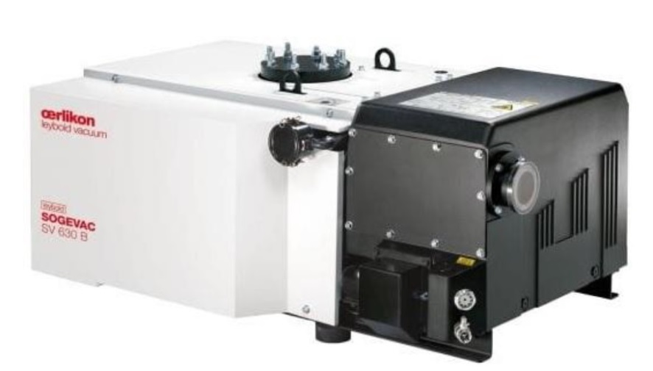
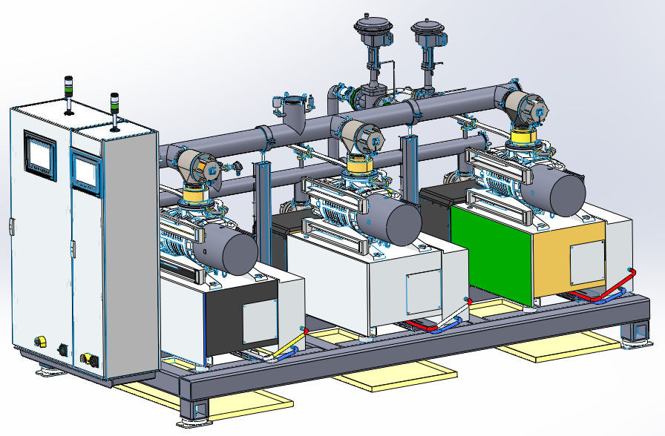
Key components – VLP pumps
Length | Wide | Height | Weight
m | m | m | kg
7.5 | 2.2 | 2.0 | 6500
0.4 bar
1.05 bar
15.0 bar
1
2
3
Comp. | Flow | Power
HP x2 | 303g/s | 1065kW
VLPx5 | 50.5g/s | 92.5kW
 |  | 1157.5kW
35K Shield
4.5K Cold mass

