Slide 1




The LHC Cryogenics Availability
Calculation Tool
8th International Workshop on Cryogenics Operation
4 – 7 June 2018
IHEP, CAS, Beijing, China
Laurent Delprat, Thomas Ytterdal
laurent.delprat@cern.ch

Slide 2
Introduction
Cryogenic conditions definition
Cryogenic availability calculation tool architecture
Statistics production
Conclusion – Perspectives
OUTLOOK

Slide 3
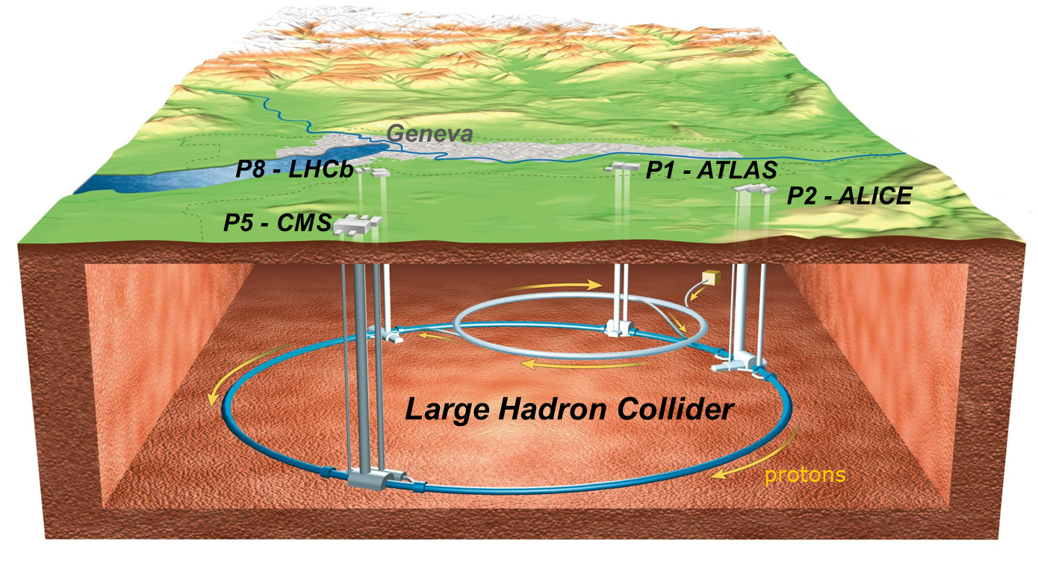
LHC Cryogenic System Architecture
HL
HL
B
P5
B
A
A
P4
P6
LL
A – upgraded ex-LEP cryo plant
B – new LHC cryogenic plant
LL
P3
LHC Cryogenics
P7
LL
LL – Low Load sector
HL – High Load sector
LL
circumference ➔ ~ 27 km,
constructed at ~ 100 m underground,
the accelerator ring inclination is 1.4 %
P2
P8
A
P18
A
P1
B
HL
HL
LHC cryogenics:
8 x 18 kW @ 4.5 K
1800 sc magnets
24 km & 20 kW @ 1.8 K
37 000 tons @ 1.9 K
130 tons of helium inventory
B
Compressor station
4.5 K refrigerator
Interconnection box
1.8 K pumping unit (cold compressor)
Notes:
Total for 8 sectors:
Compressors: 64
Turbines: 74
Cold Comp.: 28
Leads: 1’200
I/O signals: 60’000
PID loops: 4’000

Slide 4
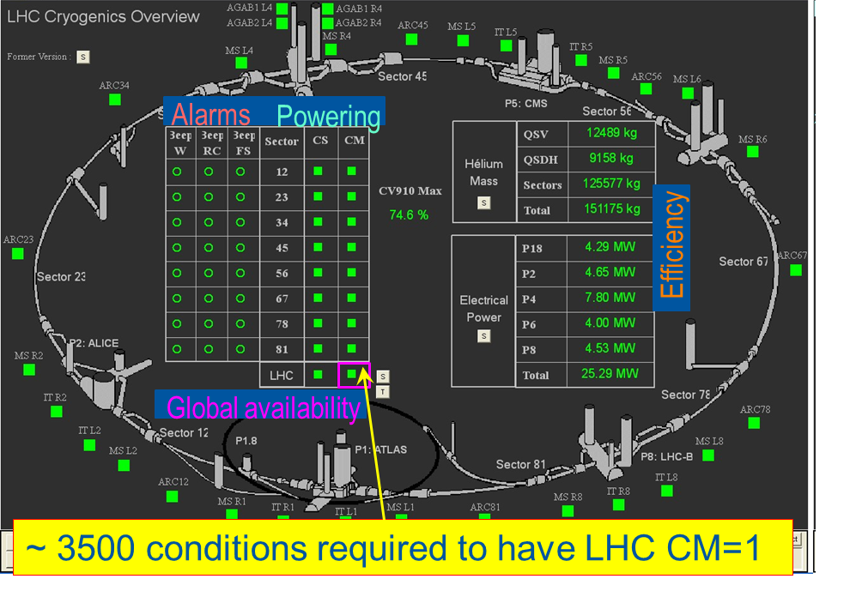
Cryogenic Conditions Definition
Set of cryogenic conditions:
to start powering (Cryo Start – CS)
to keep the magnets powered (Cryo Maintain – CM)…
… and in the end to allow for beams to circulate, and for physics production !
Notes:
Oral introduction of the slide: availability of cryogenics is compulsory for the beam to circulate and for the production of physics => we shall then define what is “Cryogenics Availability”.
What’s more, and not presented here, LHC Cryogenics is integrated in AFT_LHC (“Availability & Fault Tracking Tool of LHC) – refer to B. Todd presentation.

Slide 5
Example for magnet temperature
Set of cryogenic conditions:
to start powering (Cryo Start – CS)
to keep the magnets powered (Cryo Maintain – CM)
Availability impacted!
Magnet Temperature (K)
Loss of
cryo conditions
Diagnose,
Repair (if needed),
Restart
Cryo Maintain
2.15 K
Temperature drift
Temperature decrease
Cryo Start
2.05 K
Cryo conditions
back, towards nominal
Perturbation
Operation Temperature
1.90 K

Slide 6
How to calculate cryogenic availability
Set of cryogenic conditions:
to start powering (Cryo Start – CS)
to keep the magnets powered (Cryo Maintain – CM)
LHC operation schedule:
Beam start: Date D1
Beam end: Date D2
Technical stops: duration d (usually 2 to 3 times one week per year)
Due operation time: D = (D2 – D1) – d
Cryogenic downtime accounting
Cryo downtime: counted from CM lost to CS back = Dc
Does not take into account cryo faults originating from “Users” and “Technical Services”
Cryogenic Availability Calculation:
Cryogenic Availability: A = 1 – ( Dc / D )

Slide 7
Availability losses categorization

Slide 8
Current system for tracking LHC cryogenic availability
Built using Microsoft Excel
Precision down to 1 minute
Requires manual extract of data from timber
Tracks Cryo Maintain losses

Slide 9
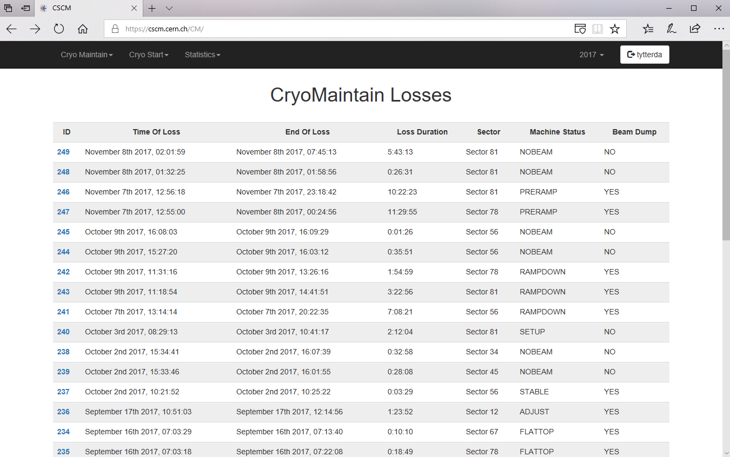






New system for tracking LHC cryogenic availability
Available at https://cscm.cern.ch
Notes:
Virtual machine in computing center
Python: programming language
Flask: Web framework for python
SQLAlchemy: used to communicate with database provided by the database on demand service at CERN
Bokeh: makes interactive javascript visualisations
Pandas and numpy: Mathematical libraries for python used for calculations

Slide 10
CALS - CERN Accelerator Logging Service
How to get the data
The CERN-wide Accelerator Logging Service was born out of the LHC Logging Project, which was launched in 2001. The service first became operational in late 2003, and has since become what is considered to be a mission-critical service.
PyTimber
Written in Python 2.7/3.4.
Use jpype to interface with the excellent native Java CALS API.
Notes:
CALS: data usually extracted using Timber
PyTimber: Python interface to get data from the CALS database. Also makes it possible to script extractions.
Next: workflow of script to extract data

Slide 11
Tool workflow
Wait 30min
Check for global CS loss
Wait 24h
Loss in progress
No loss
Check data
Fault in data
Log error
Save to DB
Data OK
Fault in data
Find Sector with CS loss
No CM loss
Check for global CM loss
CM loss
Check data
Data OK
Find Sector with CM loss
Check data
Fault in data or no data
Log error
Log error
Fault in data or no data
Check data
Timestamp Value
22-04-2017 10:14:01 0
22-04-2017 10:15:02 0
22-04-2017 10:17:05 1
Save to DB
Data OK
Timestamp Value
22-04-2018 10:14:01 0
22-04-2018 10:17:05 1
Save to DB
Data OK
Find subsector for CS loss
Find subsector for CM loss
Check data
Fault in data or no data
Log error
Log error
Fault in data or no data
Check data
Save to DB
Data OK
Fault in data or no data
Fault in data or no data
Data OK
Save to DB
Find equipment for CS loss
Check data
Data OK
Save to DB
Data OK
Check data
Find equipment for CM loss
Notes:
Workflow of script for collecting data
Data saved to database from the database on demand service at CERN
Values only stored on change, so repeating values is considered as an error
Block repeated throughout the script.

Slide 12
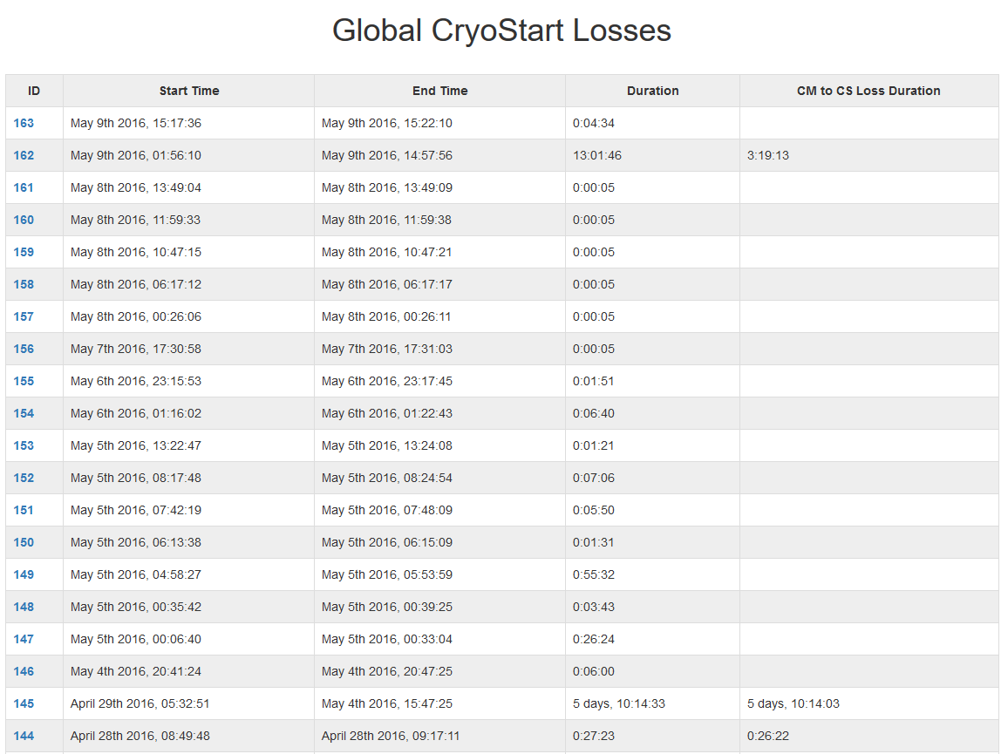
List of global Cryo Start losses
Notes:
List of global CS losses
Extra field filled if CM lost
Event 29th of April 2016: Weasel + 66kV transformer

Slide 13
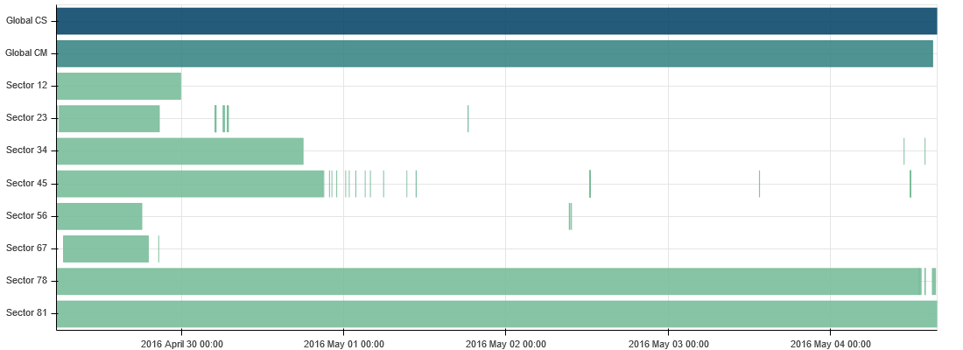

Visualising a global Cryo Start loss
Weasel in LHC Point 8
Notes:
Global CS loss + all underlying losses
A bit difficult to read x-axis, but zoom and hover tool available
Next: closer look at the details for Sector 81 (by clicking the bar on the plot)

Slide 14
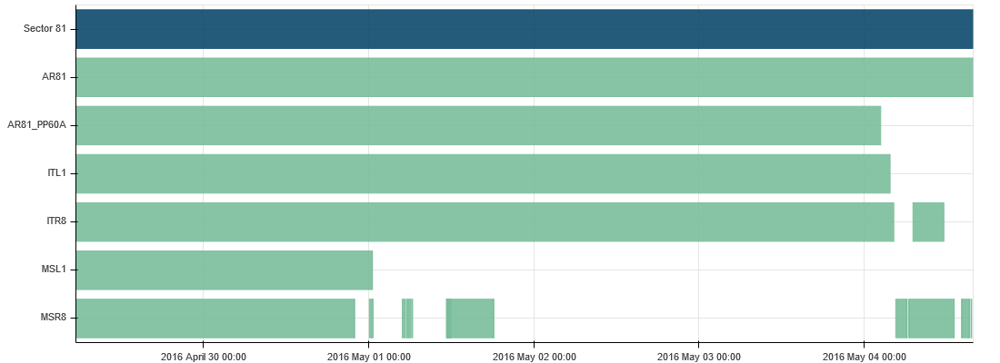
Visualising details for one sector
Notes:
Details for subsectors underlying the loss in Sector 81.
Next: Closer look at the loss in AR81

Slide 15
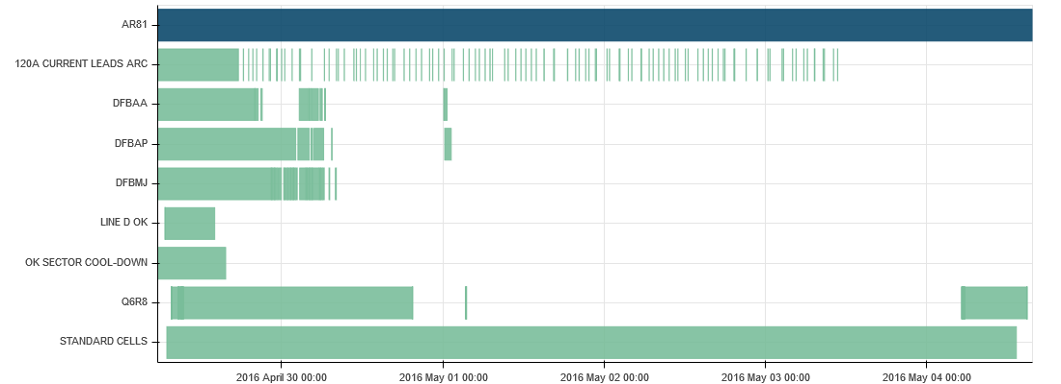
Visualising details for one subsector
Notes:
Details for all equipment losses underlying AR81
Conditions lost and regained several times during the period of the main loss
Next: Overview of how many times each equipment has been lost during the global loss

Slide 16

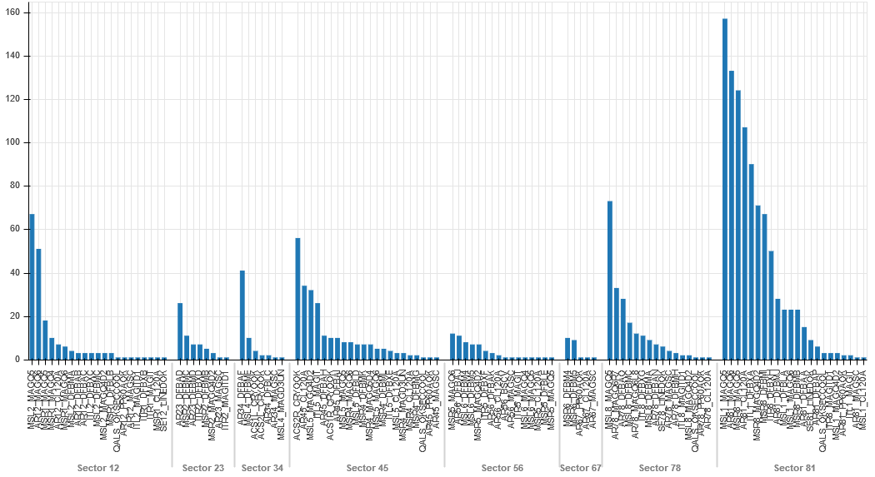
Summary of all equipment losses during the global loss
Notes:
Summary of which equipment have been lost, and how many times the condition have come and gone.
Zoom and hover tool available
Next: count all losses under the same global loss as one, and make an overview for the year.

Slide 17
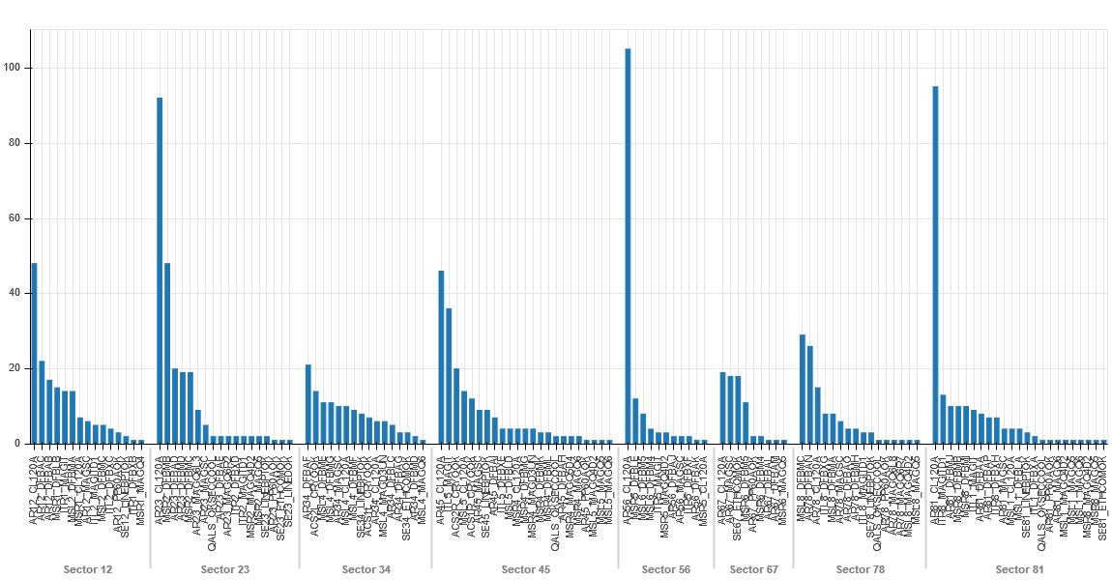
Summary of independent equipment losses in 2017
Notes:
All losses under a global loss counted as one
Can be used as an early warning system to determine where we need to improve to avoid losing conditions.
Zoom and hover tool available

Slide 18
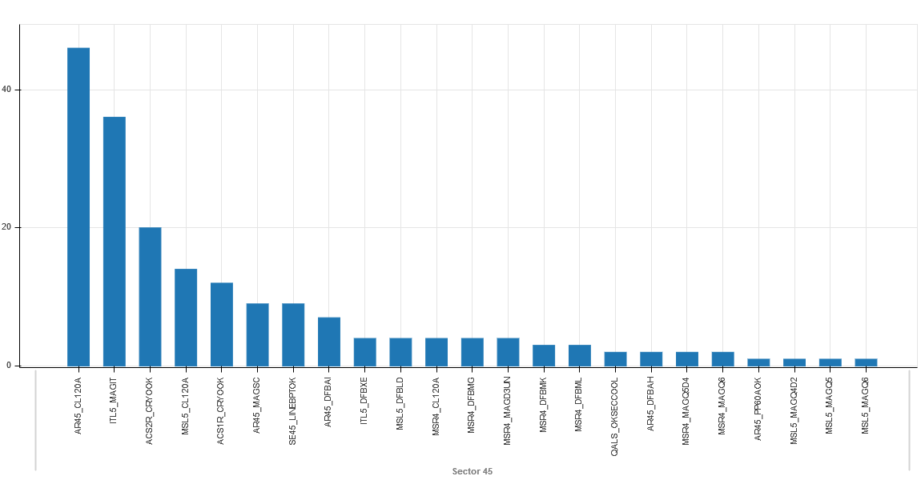
Independent equipment losses in 2017 – zoom
Notes:
Zoom of previous plot

Slide 19
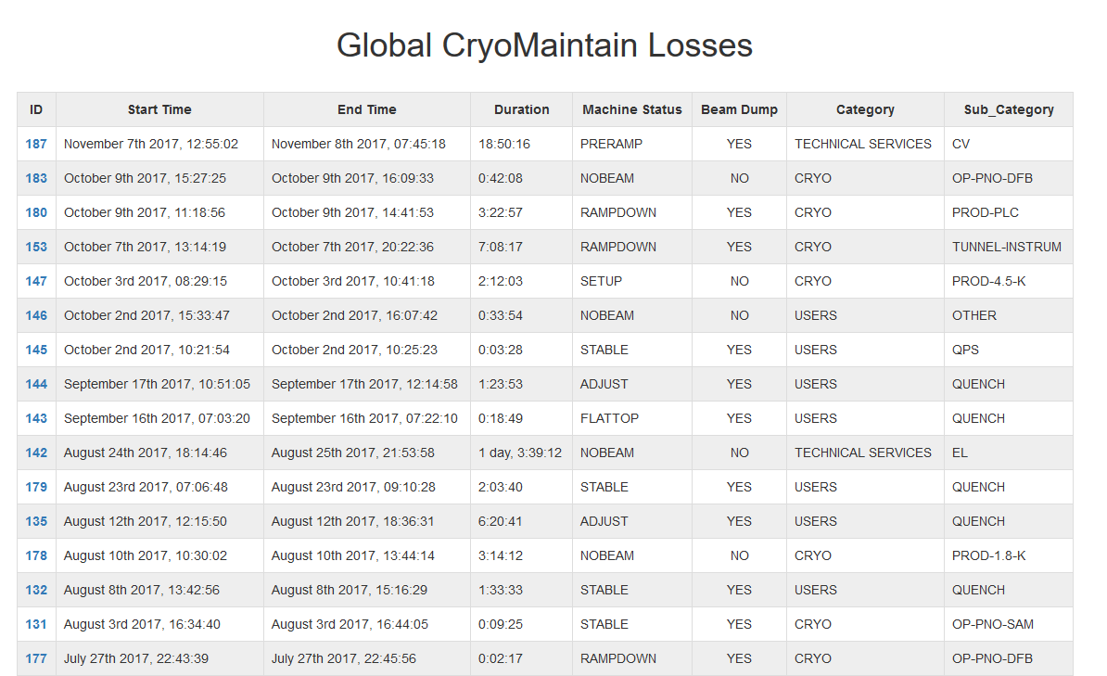
List of global Cryo Maintain Losses
Notes:
- List of Global CM losses with categorization and sub categories

Slide 20
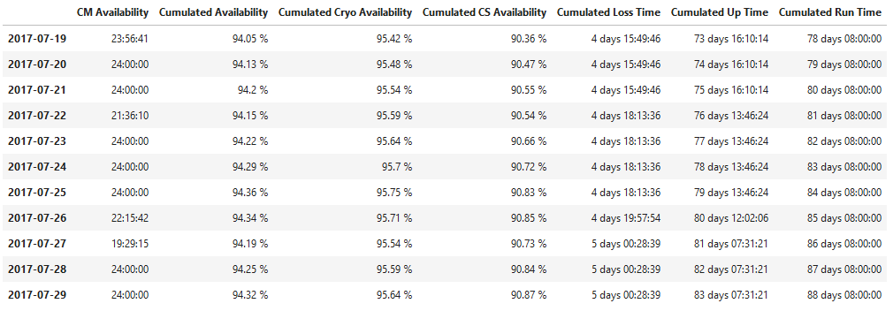
Calculating the availability
Notes:
Calculated availability
Daily CM, Cumulated CM availability, Cumulated Cryo, Cumulated CS

Slide 21
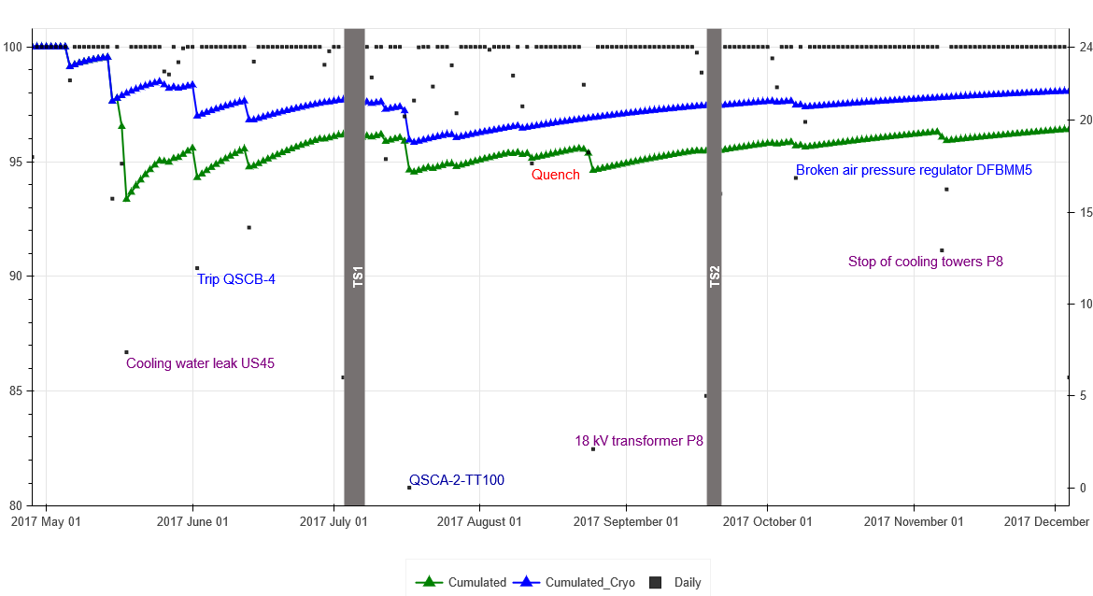
Yearly plot of the cumulated availability
Notes:
Yearly plot of the cumulated availability and daily availability
Comments can be added.

Slide 22
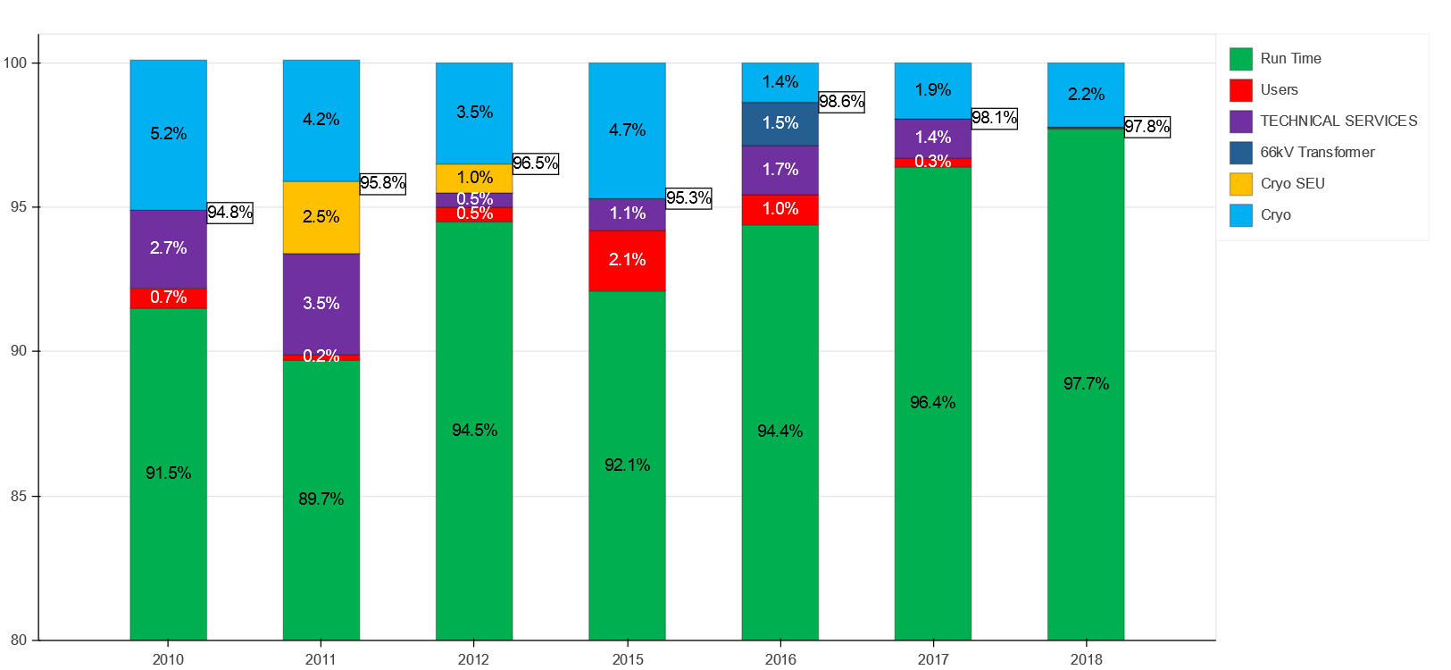
LHC Cryo availability summary
from Run 1 to Run 2
Notes:
- Summary of run time and CM categories since 2010

Slide 23
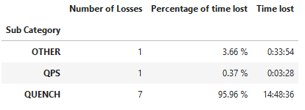
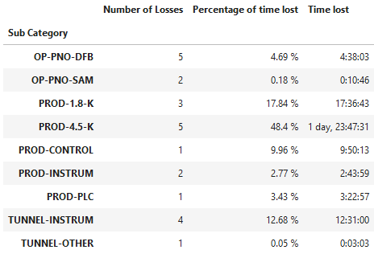
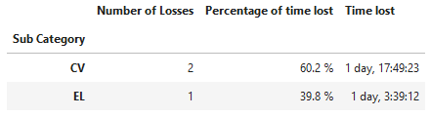
Grouping the data by category
CRYO
USERS
TECHNICAL SERVICES
Notes:
Grouped by category and sub category
Can be used to identify where we have lost the most time and what causes losses.
Can be used to signal to other departments where they need to put extra effort to reduce the cryo loss time due to their services.

Slide 24
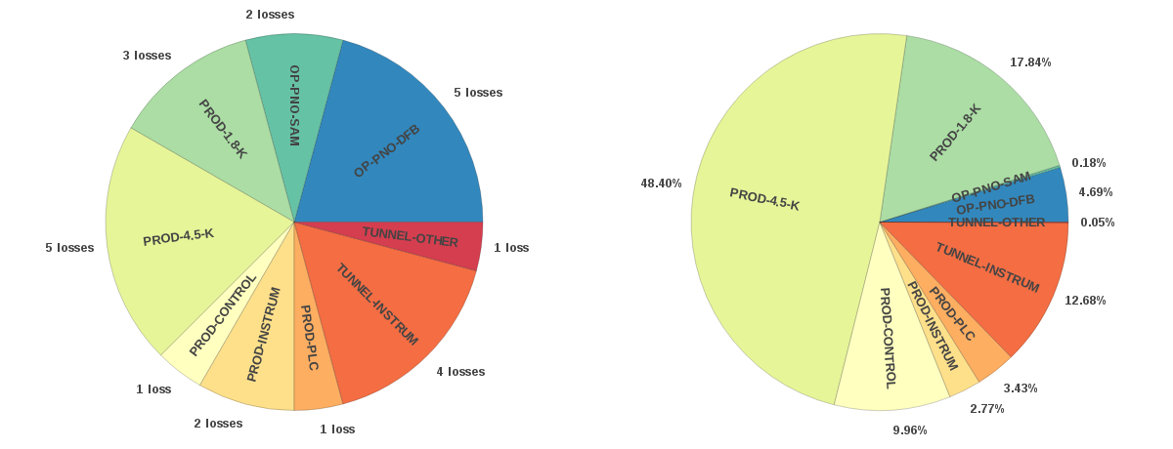
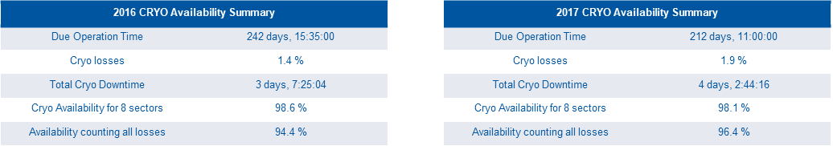
CryoMaintain Downtime Origins for 2017

Slide 25
Advantages of the new system
Easily available as a website
Precision down to 1 second
Automatically extracts data once a day
Less human interaction / chance of miscalculations
Tracks both Cryo Start and Cryo Maintain
Tracks all events during the loss of conditions

Slide 26
Conclusion – Perspectives
Run 1 operation used a fully manual tool for the calculation of availability
Run 2 operation started with the refurbishment of this old tool into a semi-automatized one, still giving some uncertainties in the results
Fully automatic calculation of the availability as well as online monitoring of the cryo start thresholds flips has been made possible with the implementation of this new tool
It will allow to use early-warning signals statistics for better anticipation and mitigation of failures when feasible
Thank you for your attention!
Questions ?

