Slide 1
Operation Present Status of the Upgraded Cryogenic System for EAST Tokamak
June 5,2018
Zhiwei Zhou, Qiyong Zhang* and EAST Cryogenic Team
Cryogenic Engineering and Technology Division
Institute of Plasma Physics, Chinese Academy of Sciences, P.O.Box 1126, Hefei, 230031, China

Slide 2
Outline
Introduction of EAST Tokamak & Cryogenic System
Upgrade of EAST Cryogenic System
Experimental Operation Present Status
Operational Performance after Upgrade
Conclusion and Perspective

Slide 3
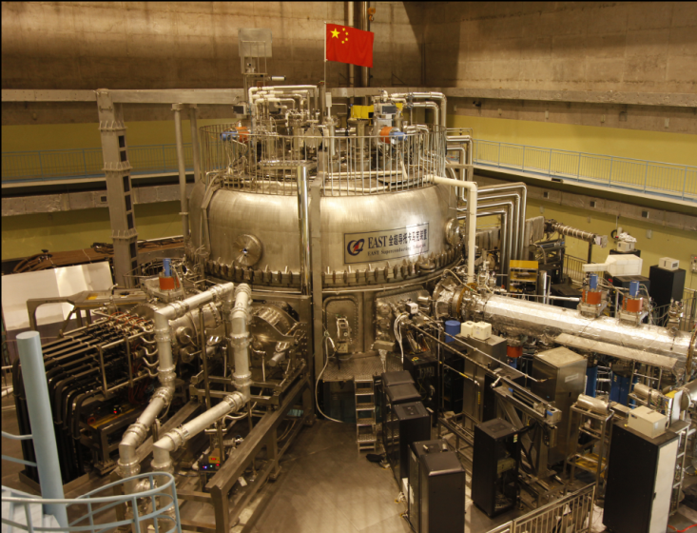
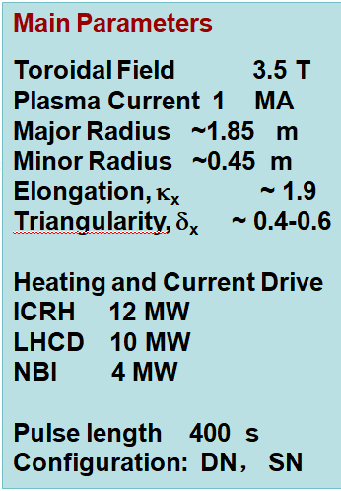
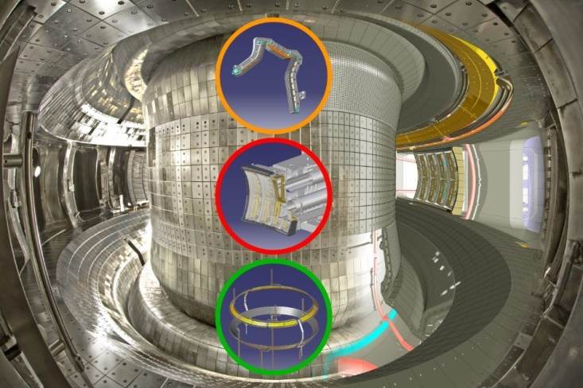
Introduction of EAST Tokamak
EAST (Experimental Advanced Superconducting Tokamak) is the first fully superconducting tokamak in the world——for future fusion reactor
Feb.-Mar. 2006
first engineering commissioning
second engineering commissioning and first plasma
Aug.-Oct. 2006
>50,000,000 ℃ plasma. 61s H model
2016
102s steady H model, new world record
2017

Slide 4
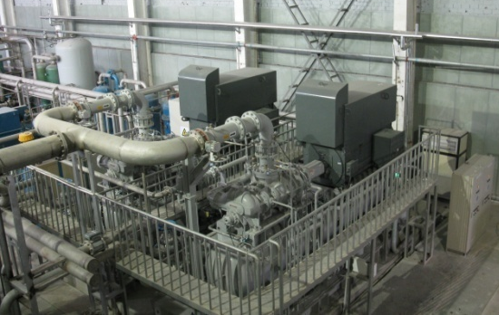
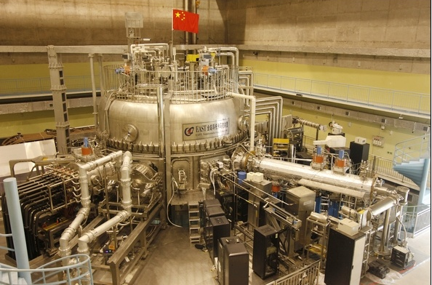
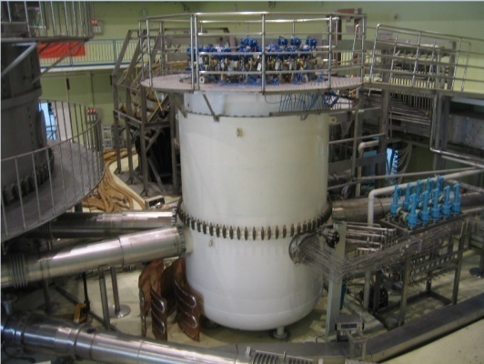
Cryogenic System for EAST Tokamak
Warm Compressor Station
ECS
One of Critical
Sub-systems
Cool-down
EAST Superconducting Tokamak
2kW/4.5K Helium Refrigerator
Cold Components
14 PF Coils， 16 TF Coils， TF Coil Cases，Thermal Shields(THS)
Buslines，13 pairs of HTS Current Leads (CL)
Built-in Cryopumps，NBI， Pellet Injection
Total cold mass
over 250 tons
Cryogenic distribution system

Slide 5
Timetable of EAST Cryogenic System
EAST cryogenic system was designed and constructed by CASIPP
1999
Start of the design of the cryogenic system
Jul. 2005
The helium refrigerator was commissioned successfully
Feb. 2006
The EAST tokamak was cooled down for the first time successfully
Aug. 2006
2nd Cool-down experiment, first plasma was got on Sept.26,2006
2012
Compressor system & Turbine TD upgrade
2015
Coldbox &Turbines & Control system upgrade, distribution system upgrade,11th Cool-down experiment
2018
14th Cool-down experiment in operation

Slide 6
Design Specification of ECS
Average heat loads :
960 W at 4.5 K and below
+ 12 kW ~ 30 kW at 80 K
+ 8.4 g/s LHe for current leads (not used now)
for cryopumps
Security factor: 1.5
Basic design capacity of refrigerator:
1050 W/3.5 K + 200 W/4.5 K
+ 13 g/s LHe + 12~30 kW/80 K
Equivalent refrigeration power :
2 kW/4.5 K

Slide 7
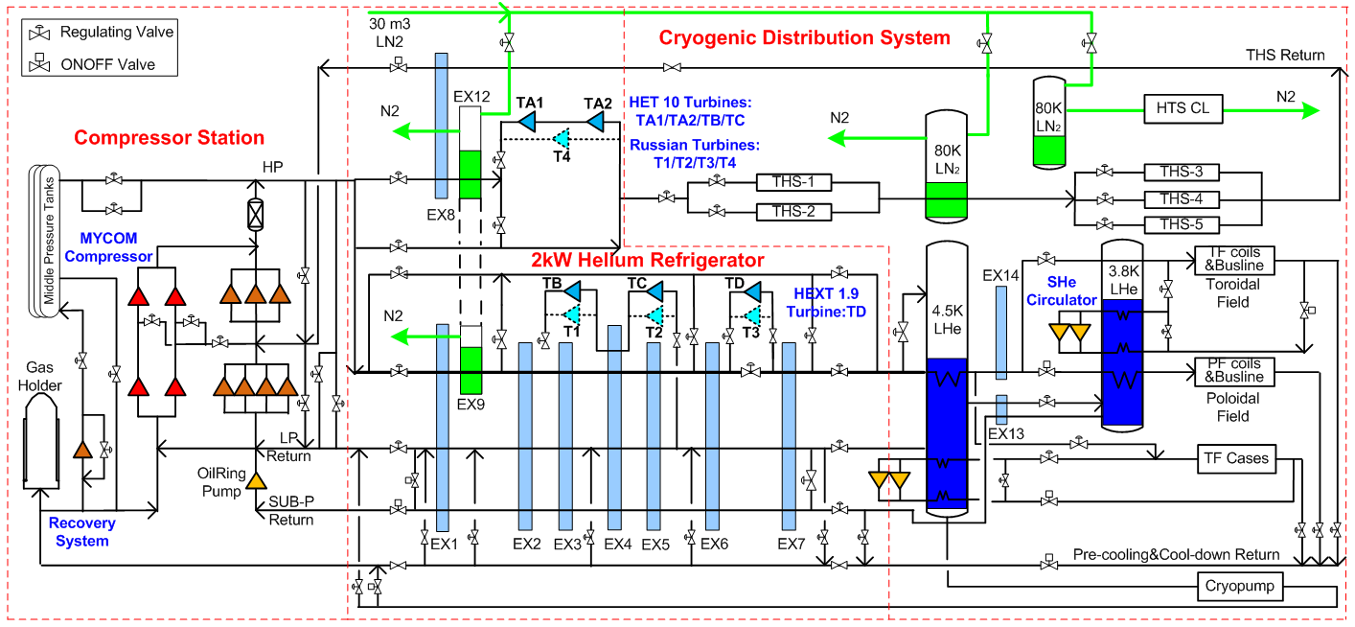
Process Flow of Upgraded ECS
Two refrigeration cycles with LN2 pre-cooling
Claude cycle with 3 turbines to produce refrigeration power at 4.5K for SC
Reverse-Brayton cycle with two turbine in series to produce refrigeration power at 80K for THS

Slide 8
Outline
Introduction of EAST Tokamak & Cryogenic System
Upgrade of EAST Cryogenic System
Experimental Operation Present Status
Operational Performance after Upgrade
Conclusion and Perspective

Slide 9
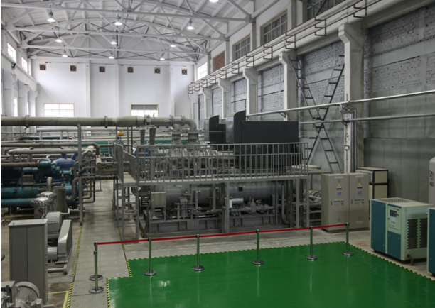
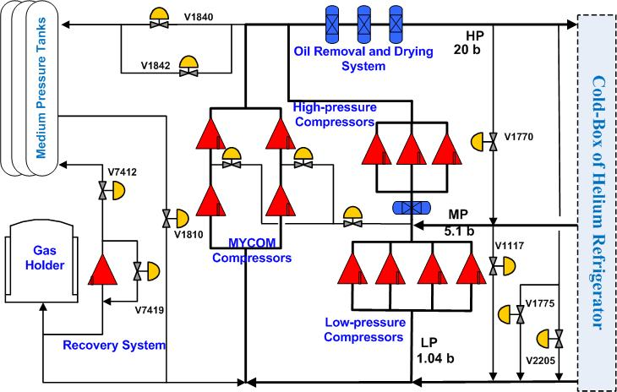
Compressor System Upgrade
New Compressor Station
Two new MYCOM oil injected screw compressors
Installed in parallel with 7 old compressors, which can used as spare on standby
Every set has two stages, creating a low, medium and high pressure
Mass flow rate: (LP) 135 g/s, (HP) 185 g/s, regulated by the slide valves
Pressure: (LP) 1.043 barA, (MP) 3~4.2 barA, (HP) 20 barA, controlled by 9 control valves

Slide 10
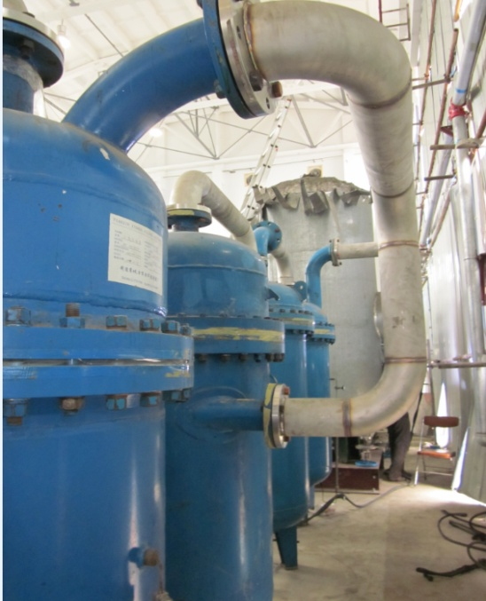
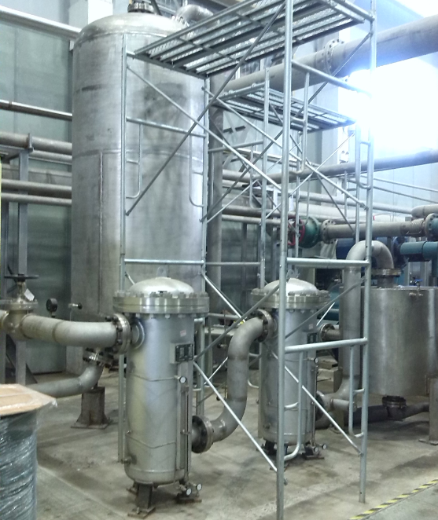
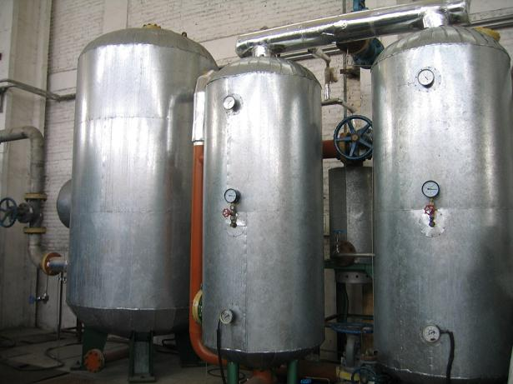
Helium Gas Purification System
Coalescers and Adsorbers
New Oil removal and purification system for MYCOM compressors
4 coalescers and an active carbon adsorber
One molecular sieve dryer and One dust filter
Final impurity content: H2O <1 ppm，N2 < 1 ppm，CxHy < 1 ppm，Oil < 10 ppb.

Slide 11
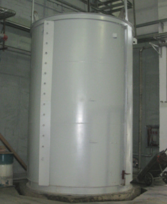
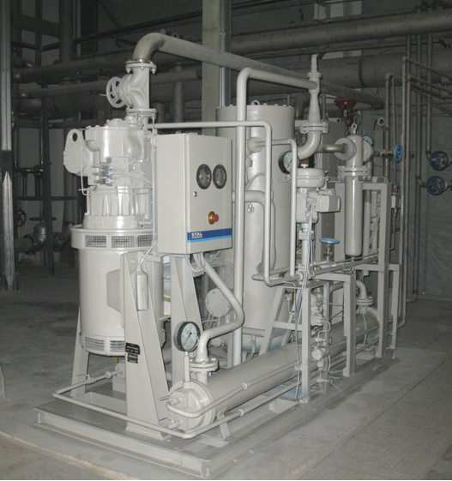
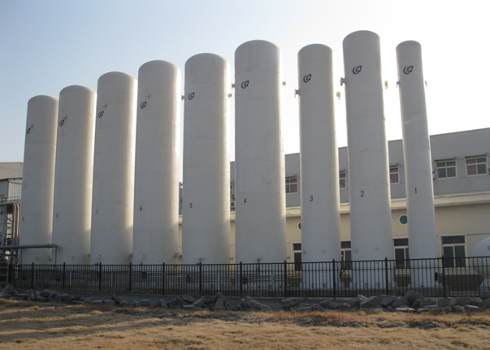
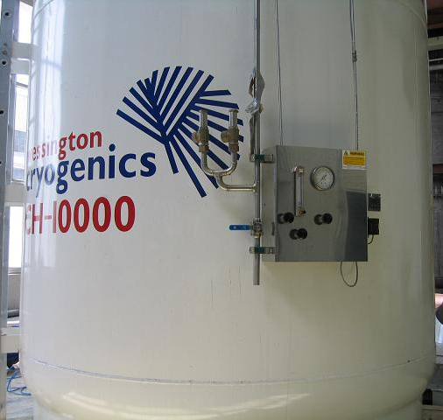
He/LN₂ Storage and Recovery System
Gas helium storage: 10000 Nm³
LN₂ storage: 2* 30 m³ , 0.8MPa
LHe storage: 10000 L
Impure GHe holder: 70 m³
Recovery compressor: 300 m³/h
Impure GHe Holder
Recovery Compressor
10000 Nm³ helium gas tanks
LN₂ Vessels
LHe Dewar

Slide 12
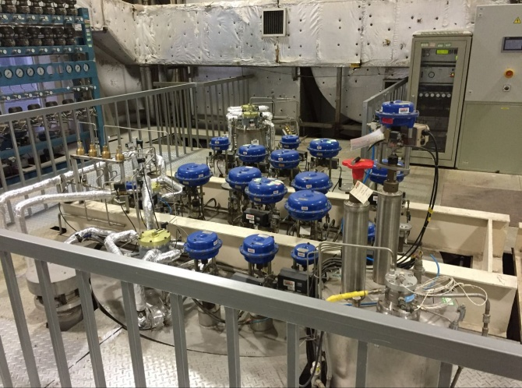
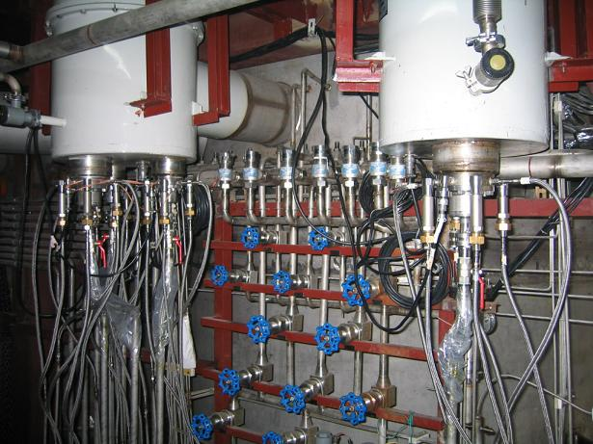
Cold Box Upgrade for New Turbines
2 kW@4.5 K helium refrigerator
A cold box and a valve box
High vacuum multilayer insulation: <10⁻³ Pa
8 aluminum plate-fin type heat exchangers
80K and 20K adsorbers
5 dynamic gas bearing turbines with eddy current brake replace Russian oil-gas hybrid bearing turbines
Cold Box
New Cold Box with new turbines
Cold Box of Russian Turbines
Cold Box and Valve Box

Slide 13
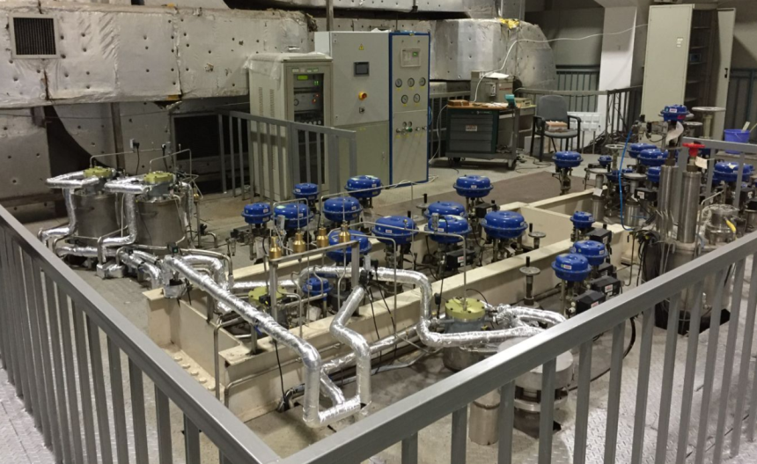
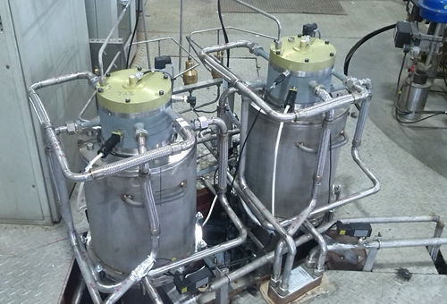
Turbine System Upgrade
T3 replaced with full dynamic gas bearing helium turbine TD
T4 replaced with two big break power gas bearing turbines TA1&TA2 in series
HET10: Fully dynamic radial gas bearings, but lower thrust gas bearing is static to increase thrust carrying capacity
TD
TA1+TA2
Turbine Expanders | TB | TC | TD | TA
 |  |  |  | TA1 TA2
Type | HET 10 | HET10 | HEXT 1.9 | HET 10 | HET10
Inlet pressure (barA) | 19.0 | 7.1 | 18.5 | 19.0 | 10.0
Outlet pressure (barA) | 7.5 | 1.25 | 4.5 | 10.0 | 4.0
Inlet temperature (K) | 43.5 | 18.9 | 7.6 | 80 | 66.1
Helium mass flow (g/s) | 98 | 98 | 147 | 110
Isothermal efficiency (%) | >= 75.5 | >= 77.0 | > 70.0 | >= 79.6
Cooling power (W) | 5333 | 3577 | 1100 | 8193+9057
Nominal Speed (rpm) | 187000 | 107500 | 120000 | 181000 | 161000
TB+TC
TA1+TA2

Slide 14
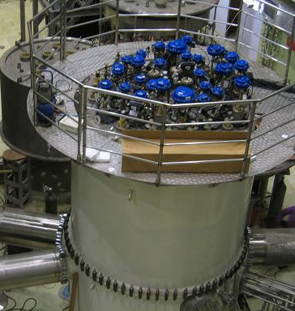
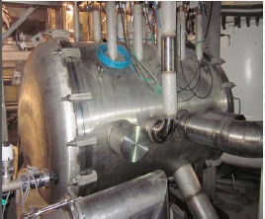
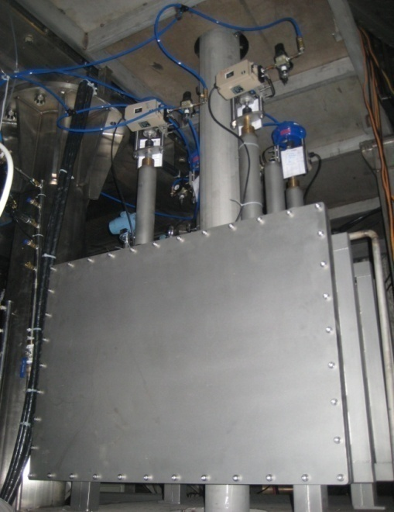
Distribution System Upgrade
New cryogenic distribution system construction for tow NBI cryopumps, built-in cryopumps
Reconstruction of cryogenic distribution system for pellet injection, HTS current leads, Buslines
Easy and stable operation
HTS CL
Distribution Valve Box
Cryopump Valve Box
NBI Valve Box

Slide 15
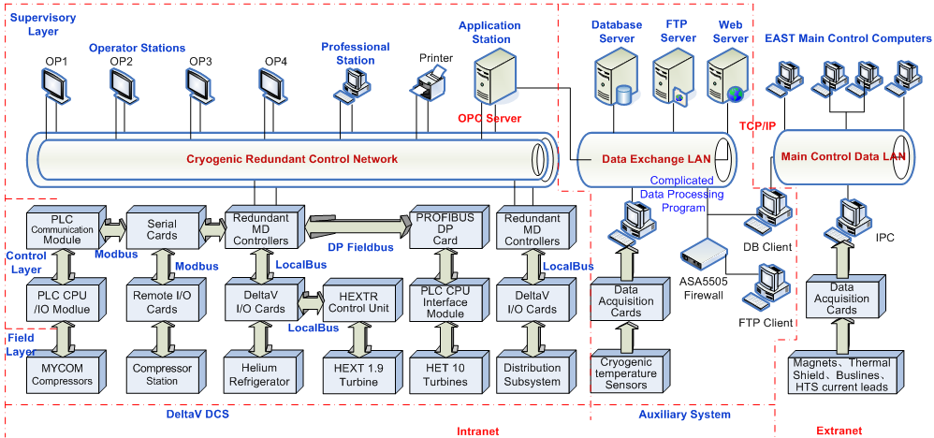
Cryogenic Control Network Upgrade
Upgraded DeltaV DCS: centralized supervisory, distributed control
Three-layer redundant control network and expands function through OPC protocol
New compressors and turbines PLC communicate with DCS through MODBUS/PROFIBUS DP protocol

Slide 16
Latest I/O List of ECS
I/O | MYCOM Compressors | Compressor Station | Helium Refrigerator | New Turbine | Distribution Subsystem | MagnetsTHS, HTS CL | Total
AI | 66 | 89 | 122 | 60 | 108 | 341 | 786
AO | 2 | 10 | 48 | 20 | 46 | 30 | 156
DI | 16 | 109 | 17 | 52 | 24 | / | 218
DO | 8 | 69 | 22 | 18 | 68 | / | 185
Total | 92 | 277 | 209 | 150 | 246 | 371 | 1345
Various process parameter types
Temperature, Pressure, Pressure difference, Mass flow rate, Liquid level, Rotation speed, Gas purity, Vacuum degree, Power, Displacement…
Various controlled parameters
17 pressure, 20 temperature, 6 liquid level, 19 flow rate, 8 rotation speed, 4 purity
~160 PID control loops for cryogenic process control

Slide 17
Outline
Introduction of EAST Tokamak & Cryogenic System
Upgrade of EAST Cryogenic System
Experimental Operation Present Status
Operational Performance after Upgrade
Conclusion and Perspective

Slide 18
Operation Timetable of ECS
Put into operation for 14 experiments since the first cool down in 2006
 | 1st | 2nd | 3rd | 4th | 5th | 6th | 7th | 8th | 9th | 10th | 11th | 12th | 13th | 14th
Start Cooling Date | 18th FEB, 2006 | 4th APR, 2006 | 26th DEC, 2006 | 5th JUN, 2008 | 12th FEB, 2009 | 22th FEB, 2010 | 20th AUG, 2010 | 30th JAN, 2012 | 31th MAY, 2014 | 7th MAY, 2015 | 11th DEC, 2015 | 10th AUG, 2016 | 2nd MAY, 2017 | 12th APR,2018
300~80K Pre-cooling Time | 11 | 11 | 11 | 11 | 13 | 15 | 10 | 12 | 12 | 14 | 14 | 18 | 16 | 15
80~4.5K Cool-down Time | 9 | 38 | 7 | 9 | 8 | 7 | 6 | 5 | 6 | 6 | 6 | 5 | 6 | 6
4.5K State Time | 18 | 31 | 28 | 57 | 50 | 79 | 113 | 148 | 138 | 73 | 131 | 140 | 71 | 28
Warm-up Time | 7 | 7 | 6 | 7 | 6 | 6 | 10 | 8 | 7 | 7 | 12 | 10 | 8 | …
Operation Time | 45 | 87 | 52 | 84 | 77 | 107 | 139 | 173 | 163 | 100 | 163 | 173 | 101 | 49
Total Operation Time | 1513 days till the end of MAY, 2018

Slide 19
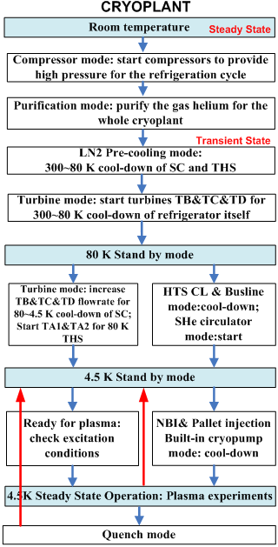
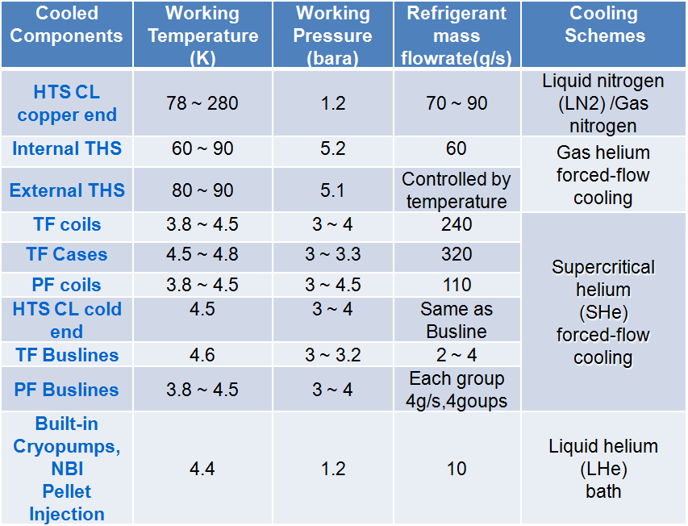
Cool-down Process & Operational Modes
Operation conditions of EAST cooled components
Cool-down Process
300 K ~ 80 K pre-cooling
80 K ~ 4.5 K cool-down

Slide 20
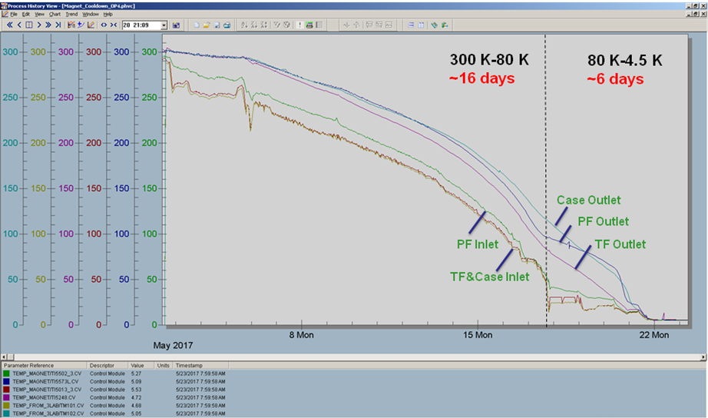
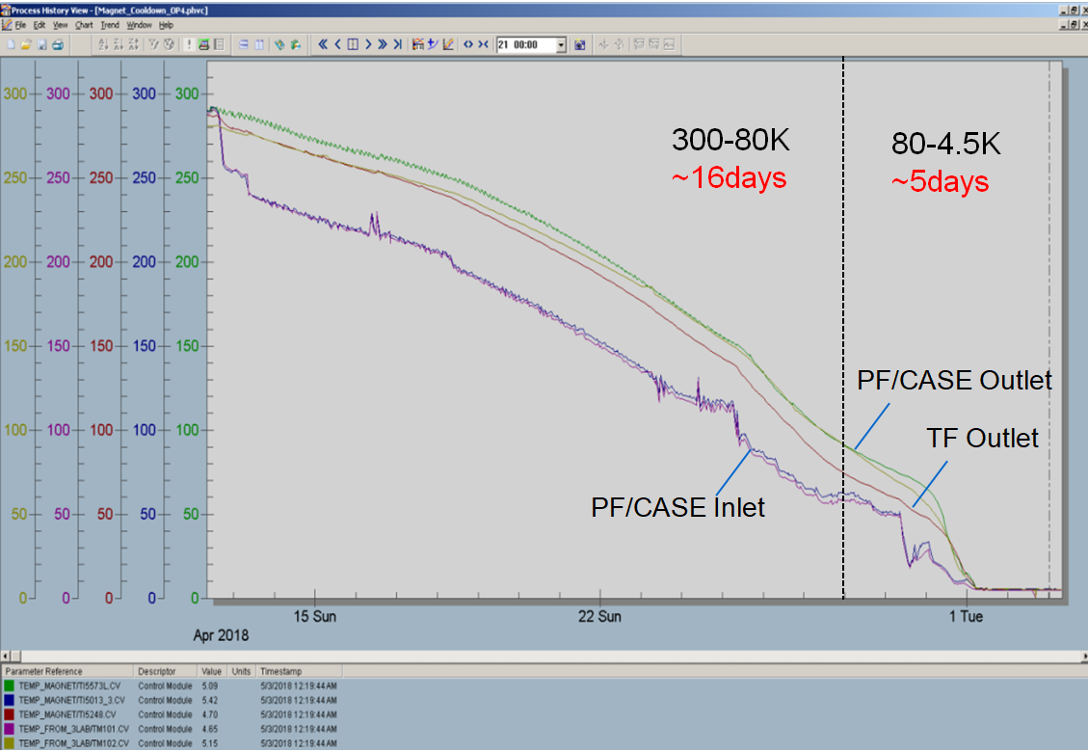
EAST Cool-down after Upgrade
300~80 K Pre-cooling
PF, TF, cases and THS cool-down simultaneously and automatically to maintain temperature gradients within 50K to avoid the destruction by heat stress
80~4.5 K cool-down
New turbines operate automatically after upgrade
4.5 K steady state operation
13th Cool-down
2017.5.2-2017.5.23
14th Cool-down
2018.4.12-2018.6.2

Slide 21
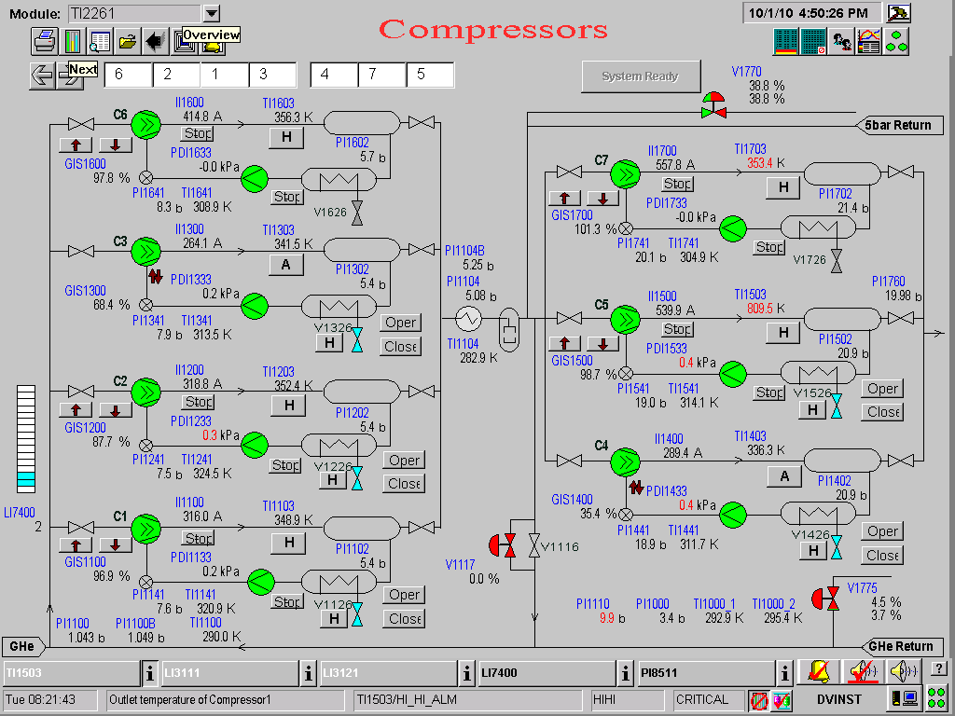
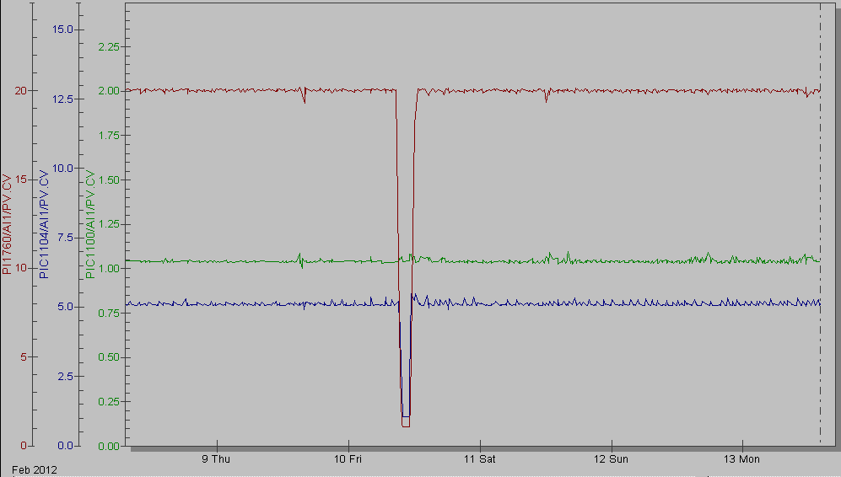
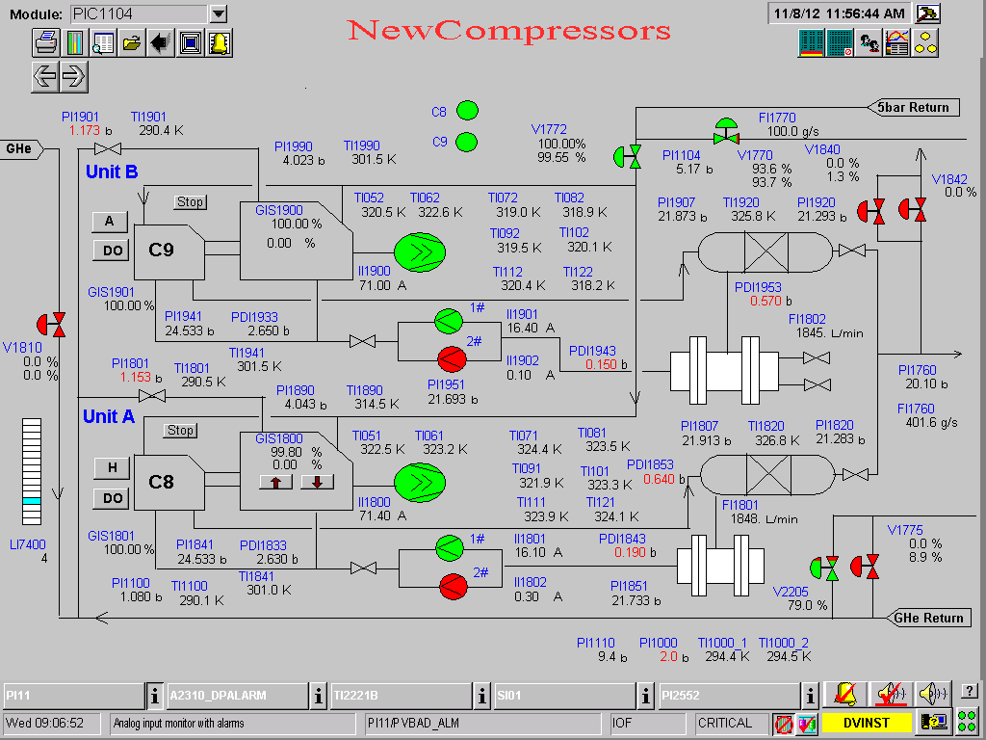
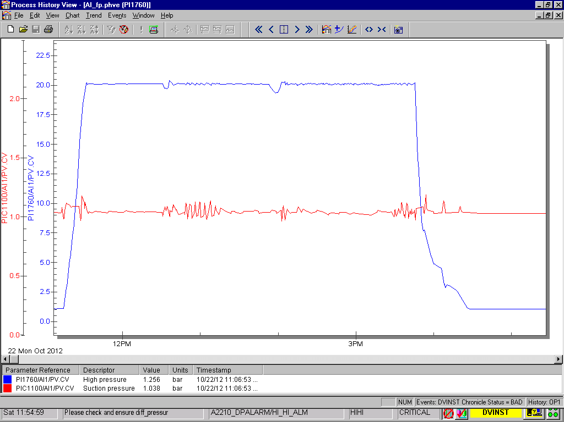
New Compressors Operation
Old screw compressors
HP=20± 0.04bar
MP=5.1± 0.03bar
LP=1.04± 0.01bar
Oil return pipe cracked，
stop the compressor to be fixed
New screw compressors commissioning
HP=20± 0.03bar
LP=1.04± 0.01bar
Complete the start process to reach nominal mass flow with half an hour
Page 21

Slide 22
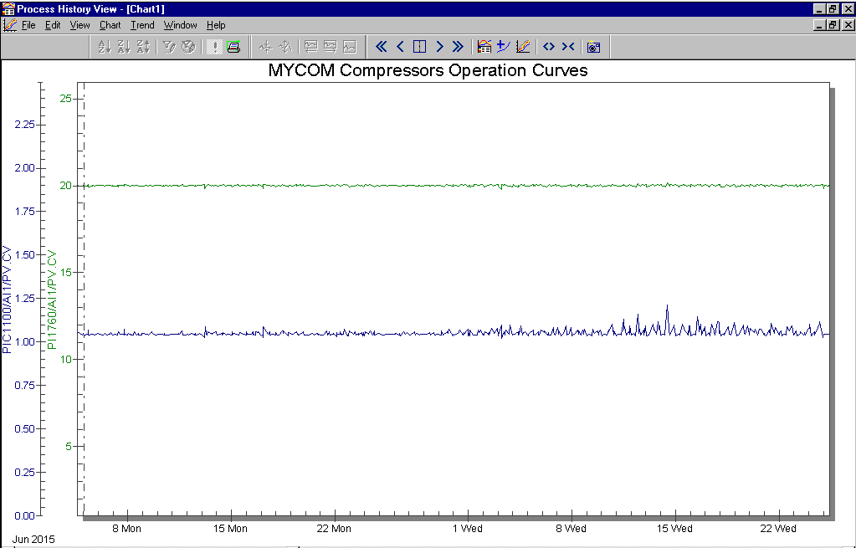
New Compressors Operation
HP=20± 0.03bar
Plasma operation
LP=1.04± 0.01bar
New compressors operated continuously over 2 months in automatic mode without any problem

Slide 23
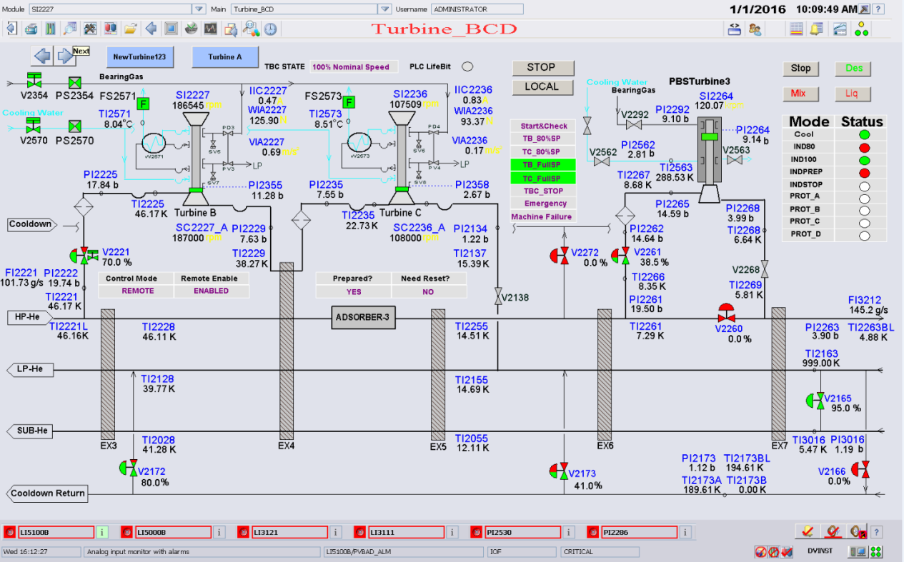
New Turbines TB&TC Operation
Big break power gas bearing helium turbine with eddy current brake
Operated with Rotor Cooling Circuit (RCC); total braking capacity can reach 10 kW
Cooling water pressure: >3barg; Gas bearing pressure: >5barg

Slide 24
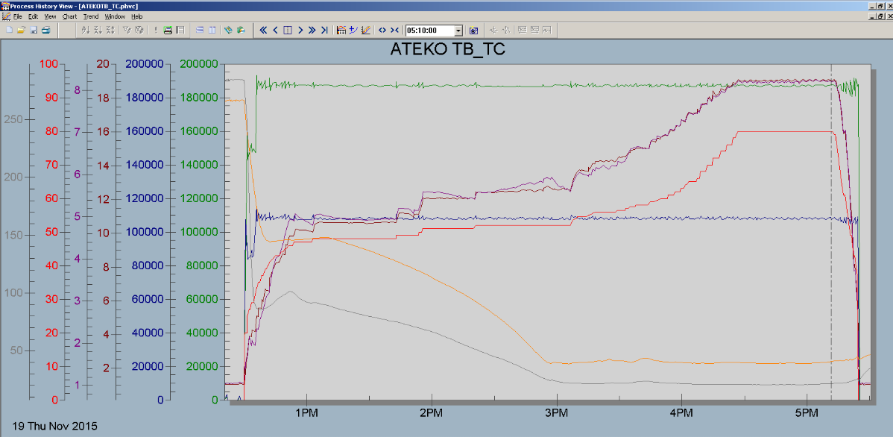
New Turbines TB&TC Operation
TB Rotation speed
Inlet pressure
TC Rotation speed
Inlet temperature
Start&Stop commissioning
Easy operation, fast and stable startup: 4 min
PLC control system control turbines’ automatic start/stop and protection

Slide 25
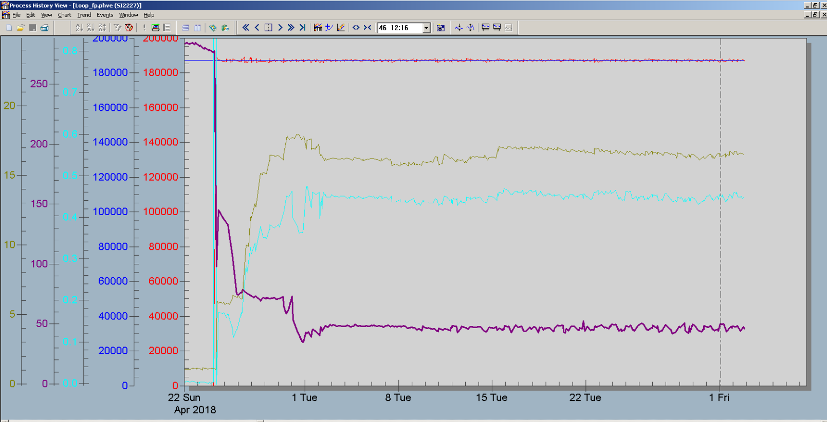
New Turbines TB&TC Operation
TB Rotation Speed:187000 rpm
Inlet pressure
Brake current
Plasma operation
Inlet temperature
Long term stable mechanical and control performance
Rotation speed control steadily in plasma operation

Slide 26
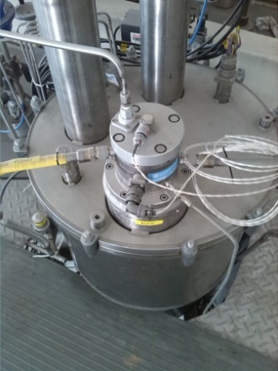
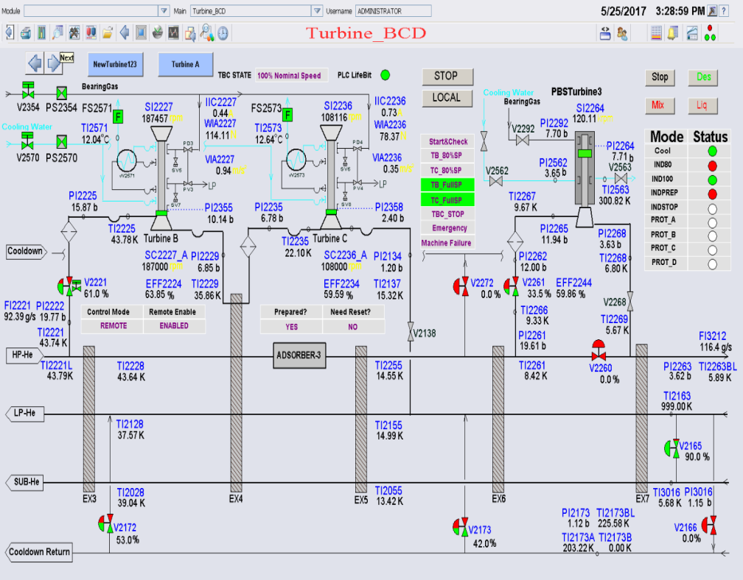
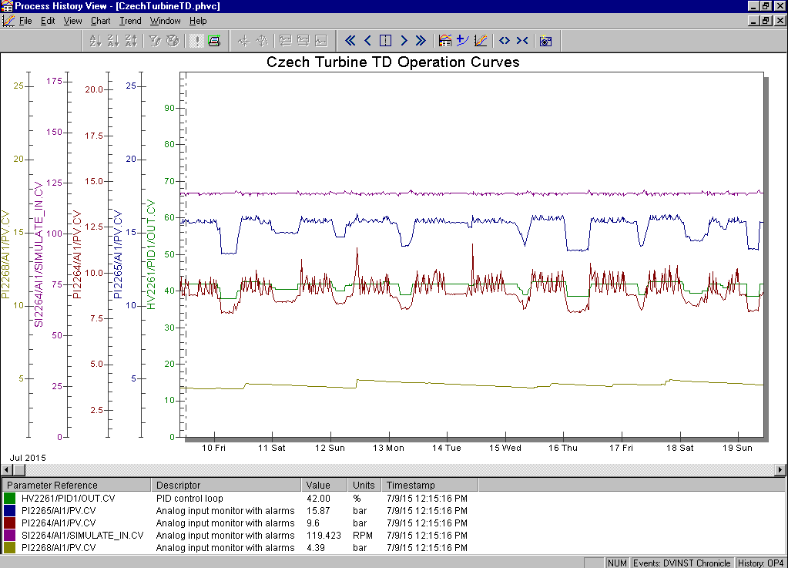
New Turbine TD Operation
Full dynamic gas bearing turbine with eddy current brake
Fast brake response
Easy operation, fast and stable startup: only 2 min
High automation degree
Long period stable operation for 5 cool-down experiments
Rotation Speed
Inlet and outlet pressure fluctuate during Charging period

Slide 27
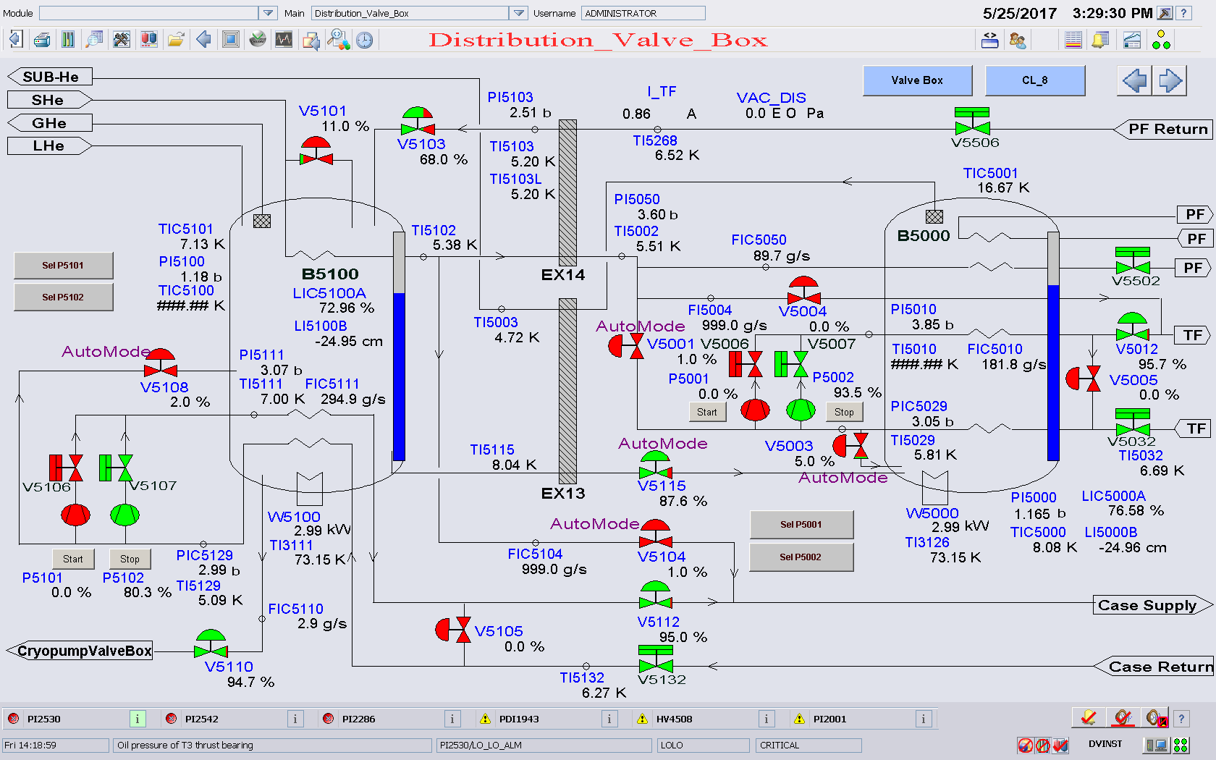
Distribution System Operation

Slide 28
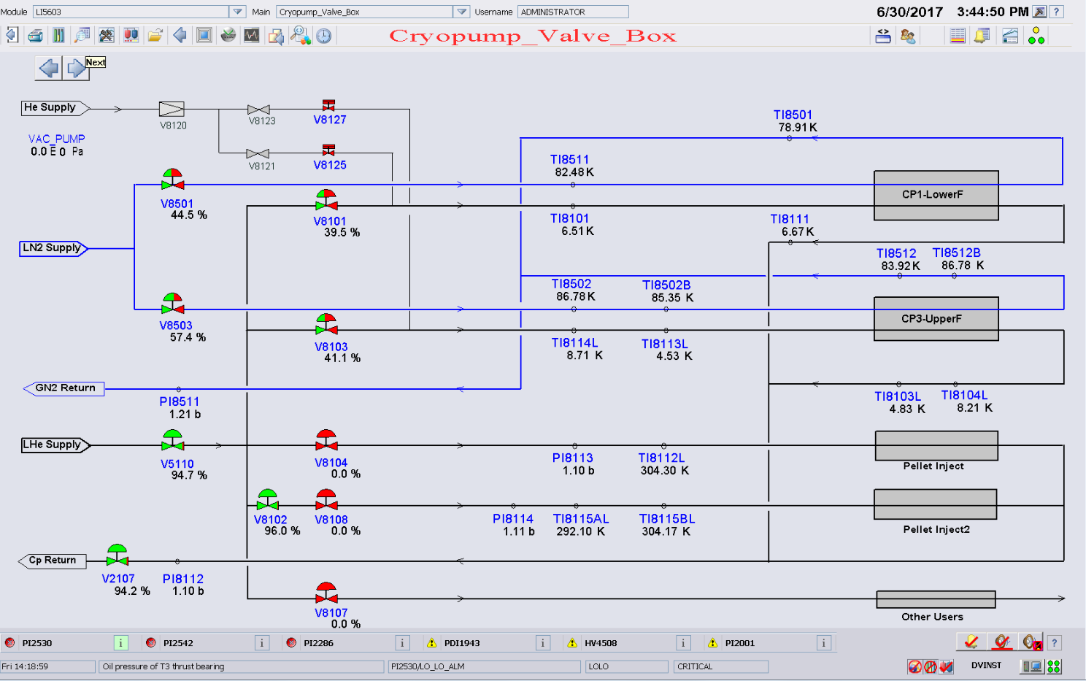
NBI and built-in Cryopumps Cooling
2 sets of NBI cryopumps and 2 sets of built-in cryopumps cool-down in the same time
EAST cryogenic system meets the cooling requirements of all thermal loads

Slide 29
ECS Performance after Upgrade
Abnormal events and faults (2006~2017)
Performance | Before Upgrade | After Upgrade
Power Supply Consumption | 2.2 MW | 1.54 MW
Fault Rate | 5% | 0%
Number of on duty （Automation） | 6 people | 3 people
Refrigeration Power | 2.3 KW | 2.4 KW
Turbines & Compressors fault stop happened before upgrade
Caused by mechanical failure; cannot be restarted in short time again
Never happened again after upgrade (2016-)
Stable operation after upgrade
Lower fault rate and helium gas leakage
Lower power supply consumption
Higher automation degree and refrigeration power

Slide 30
Conclusion and Perspective
Compressor system, turbine system, cryogenic distribution system and cryogenic control system have been upgraded and operated for latest three cool-down and plasma experiments since 2016, and been verified the long term stability , reliability and higher automation.
Proposal for higher reliability will be considered
The spare turbines on standby within cold box should be considered to allow resuming plasma operation in less than one day
The reparation spare for critical components as well as each type of instrumentation must be available on site
The vibration of new compressors should be monitored and analyzed for preventive maintenance
Spare recovery compressor should be arranged in parallel on standby in case of gas losses in emergency
Fully automatic control for the whole refrigerator, especially automatic control in case of emergent fault have been designed and will be tested in near future experiment.

Slide 31
Thanks for your attention！

