Slide 1
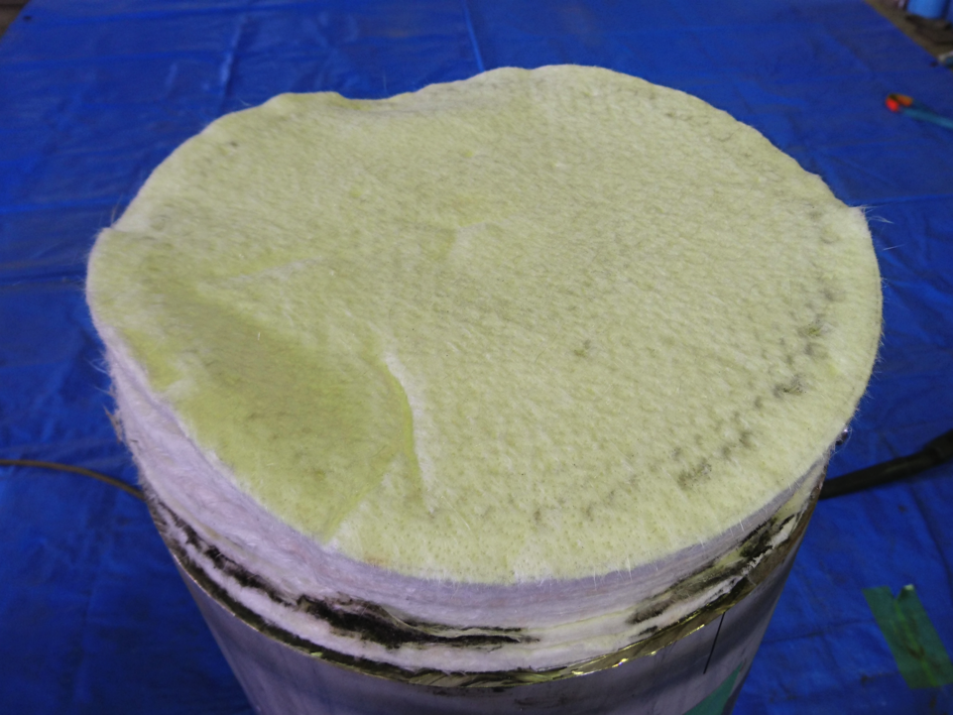

4-7 June 2018
IHEP
Performance degradation of helium refrigerator
for cryogenic hydrogen system at J-PARC
T. Aso, M. Teshigawara, S. Hasegawa, H. Muto, K. Aoyagi, H. Takada
J-PARC Center
Japan Atomic Energy Agency
Just dismantled ADS

Slide 2
Oil based troubles in other facilities
・Large amount of oil released from compressor
・Accumulated oil inside heat exchanger
(1) RIKEN: Cryogenic cooling system for SRC
Capacity: 620 W@4.5K
He flow: 140 g/sec
・Degradation of cooling power from 2005
It works well up to now
(2) CERN: CMS refrigerator
Capacity: 1.5 kW@4.5K
He flow: 220g/sec
(AIP Conf. Proc. 1218, pp.1410-1417, 2010)
Commissioning in 2004
・Amount of oil : ～2 kg
・Concentration : 750 ppm
2015 degradation
・Amount of oil : 375 g
・Concentration : <10 ppb
(Cryo-Ops 2016)
In our case, it occurred even small amount of oil accumulation.

Slide 3
Contents
Outline of J-PARC
Outline of cryogenic hydrogen system
Performance degradation of refrigerator
Investigations of cause
Measures for performance degradation
Consideration
Present status of pressure drop
Summary

Slide 4
1. Outline of high-intensity neutron source at J-PARC
J-PARC (Japan Proton Accelerator Research Complex)
Pacific ocean
50GeV Synchrotron
Hadron Experimental Facility
3GeV Synchrotron
Linac
Materials and Life Science Experimental Facility
300m
Spallation neutron source
→ Cold neutron
using by refrigerator
Neutrino Beams to Kamioka
Operation started since 2008
Current beam power is 500 kW

Slide 5
2. Outline of cryogenic hydrogen system
Cascade refrigeration system of helium and hydrogen for cooling neutrons
Hydrogen circulation system
Helium refrigerator Cold box
・Operation period: 60-100days/cycle, Current operating time : 50,000 hrs.
・1st ADS : Replacement at 12,000 hrs.
・2nd ADS : Pressure drop appeared at 18,000 hrs. since 2015.
→ Performance degradation
Hydrogen circulation system
Pressure | 1.5MPa
Temperature (moderator inlet) (moderator outlet) | 18K 21K
Flow rate | 180g/s
Helium refrigerator
Pressure | 1.6MPa
Flow rate | 270g/s
Capacity | 6kW at 17K

Slide 6
3. Performance degradation of refrigerator
Heat exchangers
ΔP1
Oct. 2015
Apr. 2015
Nov. 2015
Mar. 2015
Since 2015,
・Pressure drop increased with every operation.
・Pressure drop of ADS was 7-8 times larger than
one of heat exchangers.
・Outlet temperature of HX2 was also increased.
Finally, liquid hydrogen could not be generated.
・Pressure drop was reset by warm-up
Feb. 2015
Apr. 2014
Jan. 2015
Nov. 2014
ADS
ΔP2
Oct. 2015
Apr. 2015
Mar. 2015
Nov. 2015
Feb. 2015
Nov. 2014年
Jan. 2015
Apr. 2014
HX2 outlet temperature
T
Oct. 2015
Apr. 2015
Nov. 2015
Nov. 2014
Feb. 2015
Jan. 2015
Mar. 2015
Apr. 2014

Slide 7
4. Investigations of cause
(1) Impurity measurements by gas chromatograph
2015.1
Q-mass (2015.11)
almost < 1ppm
ADS: N₂ = 10-100ppm
Heat exchanger (HX1+HX2)
→within design value
Impurity concentration (ppm)
Remaining N₂ of active charcoal regeneration process
ＡＤＳ
Operating time of refrigerator （hrs)

Slide 8
4. Investigations of cause
(2) Impurity measurements by Q-mass
2016.1
He
After operation,
measured area partitioned by valves
ADS
Almost background → No impurity
HX
LP line
Background
Pressure (Pa)
N₂
CO₂
H₂O
Mass to charge ratio (m/z, a.m.u.)

Slide 9
4. Investigations of cause
(3) Oil concentration measurement by cold trap
・Cold trap extraction using liquid N₂
・Infrared spectroscopy analysis
2016
2017
2018
At outlet of OS-5
He flow rate
● 200g/s
・ ~10 ppb
・ Equivalent to
design value
○ 270g/s
Oil concentration (ppb)
Operating time of compressor (hrs)

Slide 10
4. Investigations of cause
(4) Observation of inlet of HX-1
No oil and contamination
Fiber scope
with ultra violet light
Fiber scope
with ultra violet light

Slide 11
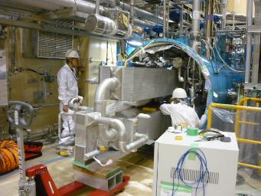
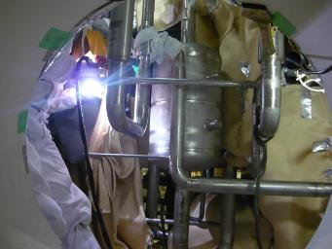
5. Measures for performance degradation
From results of the cause investigation,
・No impurities
・Low oil concentration (~10 ppb)
However, measures for oil accumulation
(1) Cleaning of inside heat exchangers
(2) ADS replacement
Heat exchanger removal from cold box, and cleaning by Freon
Replacement work in cold box

Slide 12
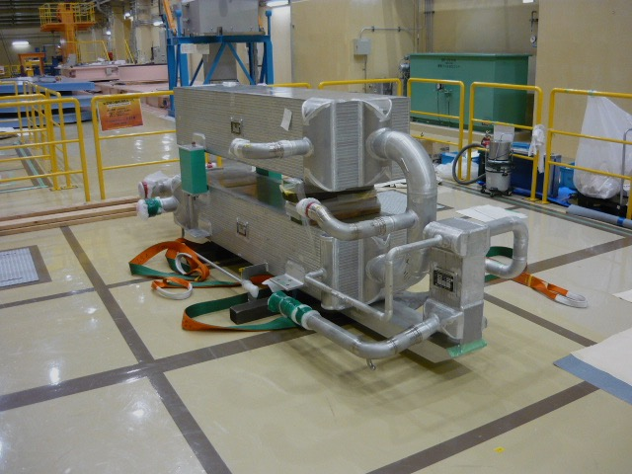
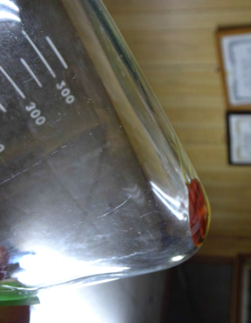
Measure of accumulated oil inside heat exchangers
・Circulation cleaning of Freon (AK-225G, 480 litters)
・Target：No.1 and 2 heat exchangers
・Non-volatile residue
HX-3
HX-1
HX-2
0.18g/350mL(AK-225G）
・Total oil collection: 95.1 g

Slide 13

Inlet
Felt
・Both sides of charcoal to hold it
・High siliceous glass fiber （12 mm thickness）
・8 layer laminated
Activated charcoal
・ Surface (3 mm^{t}) of upper felt was yellowed
・ Oil was accumulated in membranous form
Pressure drop
Outlet
( Oil freezes and disturbs He flow …)
Just after dismantled ADS (He inlet side)

Slide 14
Oil distribution in ADS
Area |  | Oil content (wt%) | Oil content (g) | Total (g)
Upstream Felt | 1 | 14±0.14 | 17.7 | 45.6
 | 2 | 8.8±0.20 | 11.1
 | 3 | 6.7±0.31 | 8.5
 | 4 | 4.4±0.01 | 5.6
 | 5 | 0.99±0.03 | 1.3
 | 6 | 0.63±0.04 | 0.8
 | 7 | 0.39±0.04 | 0.5
 | 8 | 0.09 | 0.1
Charcoal | Up. | 0.020±0.003 | 0.8 | 2.1
 | Mid. | 0.014±0.002 | 0.6
 | Lo. | 0.016±0.001 | 0.7
Downstream Felt | 1 | 0.16 | 0.2 | 0.3
 | 2 | 0.04 | 0.05
 | 3 | <0.01 | 0.01
 | 4 | <0.01 | 0.01
 | 5 | <0.01 | 0.01
 | 6 | <0.01 | 0.01
 | 7 | <0.01 | 0.01
 | 8 | <0.01 | 0.01
 |  |  | Total | 48.0
First ADS (g)
0.04
-
-
Example of RIKEN (g)
5.1
111.9
0.8
layer
He inlet
Upstream Felt
High siliceous glass fiber
Rock wool
Activated charcoal
95% of oil was trapped at upstream felt
Downstream Felt
・ADS accumulated oil : 48.0 g
・HX(95g) + ADS(48g) = 143 g
Comparable: ~10ppb x 20000hr
He outlet
Felt played a role of filter

Slide 15
Flowing element test of the felt
Element test was carried out to confirm the pressure drop due to the accumulated oil on the felt.
・Case: with/without oil case
・Flow; Nitrogen gas
Temperature: 150K
Pressure: 0.3MPa
Mass flow rate: 8.3-14.8 Nm³/h
・Cooling by liquid nitrogen
With oil case increased
differential pressure.

Slide 16
8. Consideration
・ ADS : Pressure drop occurred due to accumulated oil on surface of felt
・ HX :
・ Pressure drop at ADS was 7-8 times larger than that at HX.
・ Pressure drops occurred same time at ADS and HX.
→ We don’t understand
that large pressure drop of ADS affected on the performance of the HX.

Slide 17
7. Present status of pressure drop
HX1+HX2
2015.10-11
2012.4-6
2017.10-12
2018.1- ->
July
ADS
Performance has been recovered
2015.10-11
・No pressure drop increase
・No performance degradation
Pressure drop (kPa)
2012.4-6
2017.10-12
2018.1- ->
July
Operating time (days)

Slide 18
9. Summary
Although amount of oil accumulation at ADS and HX was small,
(Oil concentration in He was within design value,)
performance degradation of refrigerator was occurred.
Cause of large pressure drop at ADS was due to oil on surface of felt.
→ Improvement of ADS by changing felt
It’s under consideration whether large pressure drop at ADS affected performance degradation of HX.
We are still making effort to investigate the cause.
Thank you for your attention

