Slide 1
Potential NP on $B→π ℓ^{+}ℓ^{−}$
Seminar talk at UCAS
06/22/2017
Fanrong Xu
Jinan University

Slide 2
Track of $B→K^{∗}ℓ^{+}ℓ^{−}$

Slide 3
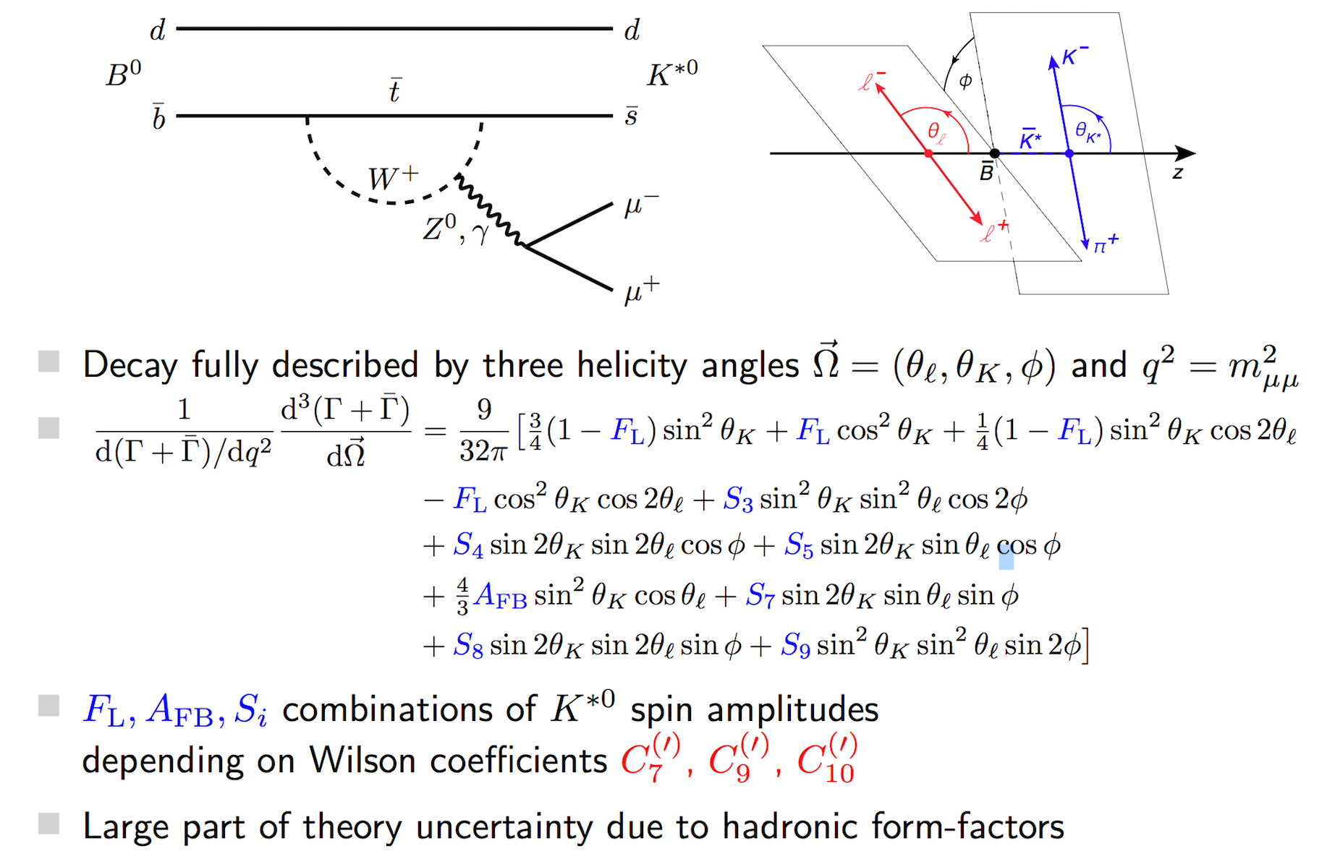

Slide 4
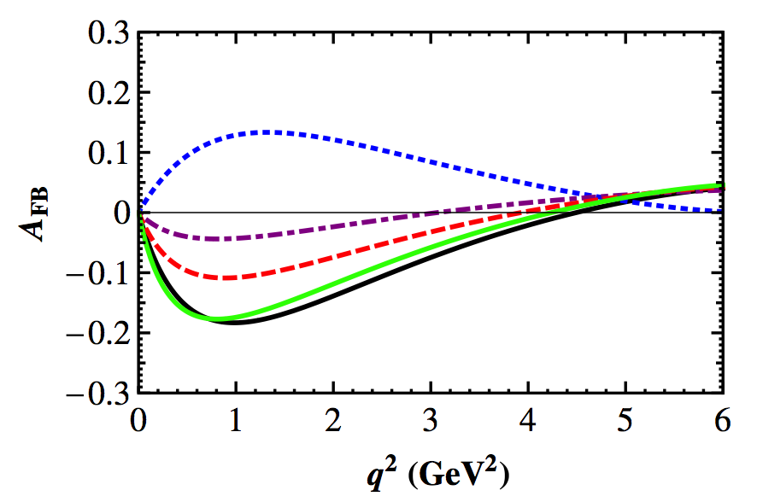
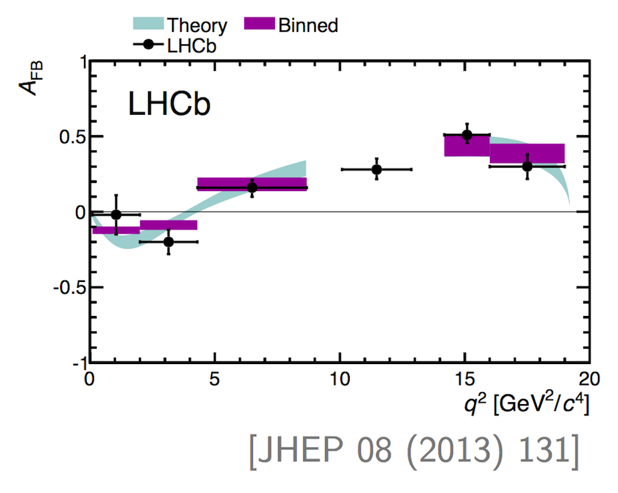
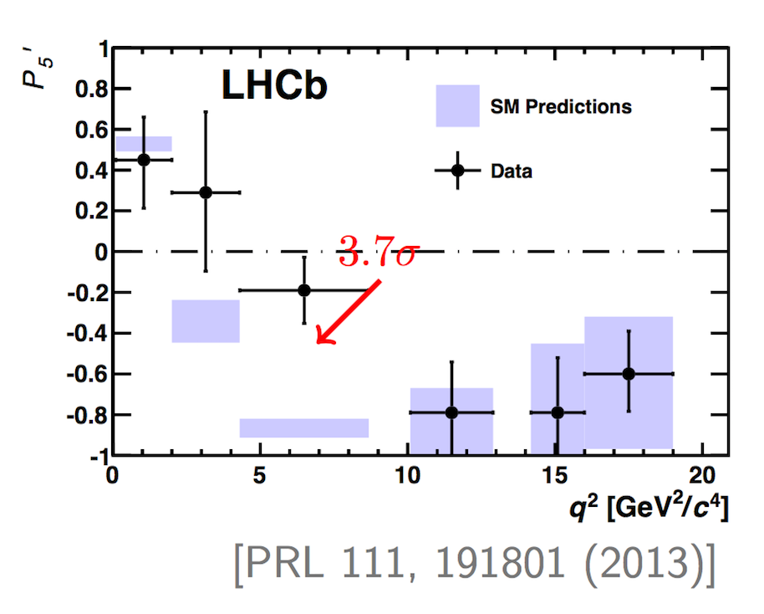
W.-S. Hou, M. Kohda FX, 2011

Slide 6
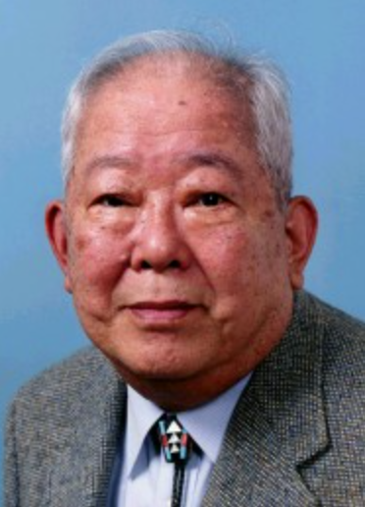
想的是A
看到的是B
做的是C

Slide 7
What will happen to $B→πℓ^{+}ℓ^{−}$

Slide 8
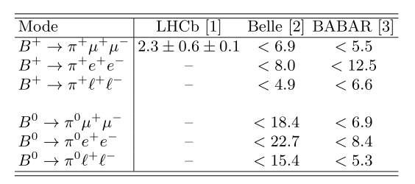
Experiments before 2013
657 million $B\overline{B}$ pair,
2008; (full: 772 million)
471 million $B\overline{B}$ pair,
full database, 2013
In unit ${10}^{−8}$
The “rarest decay” was observed by LHCb in 2012

Slide 9
Theory efforts
Theory before 2013
naïve factorization:
Song-Lu-Lu, Commun. Theor. Phys. 50, 096 (2008);
Wang-Wang-Xu-Yang, Phys. Rev. D 77, 014017 (2008);
Ali-Parkhomenko-Rusov, Phys. Rev. D 89, 094021 (2014).
pQCD:
Wang-Xiao, Phys. Rev. D 86, 114025 (2012);
QCDF:
Hou-Kohda-Xu, Phys. Rev. D 90, 013002 (2014).
(← Beneke-Feldman-(Seidel) in 2001 and 2005)
New Physics exploration
Leptoquark: S. Sahoo…
Majarano neutrino: Z.-G. Si
...

Slide 10
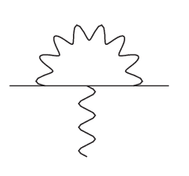
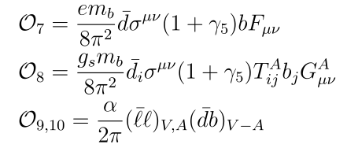
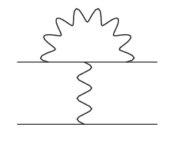
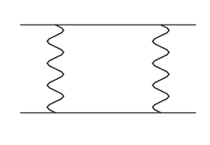
Effective Hamiltonian
We start from $b→d ℓ^{+}ℓ^{−}$ effective Hamiltonian
$CKM$
For $b→d ℓ^{+}ℓ^{−}$, $λ_{u}$ $\text{is} \text{comparable} \text{with} λ_{t} \text{in} \text{magnitude}\text{, }\text{and} \text{with} \text{a} \text{sizable} \text{phase} \text{difference}$

Slide 11
SD: Wilson coefficients
Initial condition: 2-loop matching at high energy
Evolution: 3-loop anomalous dimension matrix
Wilson coefficients at low energy scale
C.Bobeth et. al, 2000
P.Gambino et. al, 2003

Slide 12
Factorization
Approach 1: Naïve factorization
The three form factors are model dependent.
Approach 2: pQCD (Li-Sterman, 1992)
Advantage of pQCD: IR finite.
A recent study of NLO $B→π$ FF: Li-Sheng-Wang, PRD’12, leading to
pQCD study of $B→πℓ^{+}ℓ^{−}$: Wang-Xiao, PRD’12.

Slide 13
Factorization
Approach 3: QCDF (Beneke et.al. 1999)
The IR in hard kernel is supposed to be cancelled by soft FF.
The semi-leptonic processes, like $B→K^{∗}ℓ^{+}ℓ^{−}, B→K ℓ^{+}ℓ^{−}, B→ρ ℓ^{+}ℓ^{−}$,
have been studied by Beneke-Feldman-(Seidel) in 2001 and 2005.

Slide 14
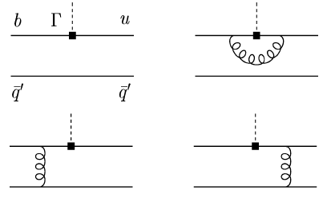
QCDF approach
Soft form factor in HQET/LEET
in which the number of form factors reduced to 1 with
Symmetry-breaking correction to FF (Beneke-Feldmann,2001)

Slide 15
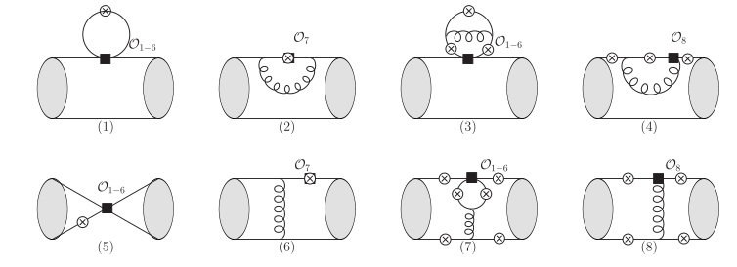
QCDF approach
Include “non-factorizable” contribution (Beneke et al, 2001)

Slide 16
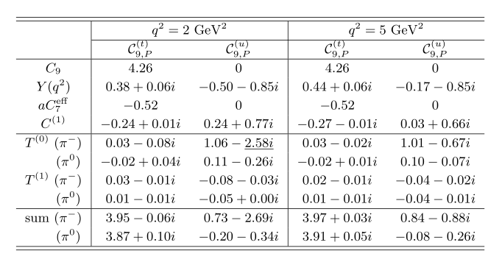
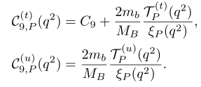
QCDF approach
Decay rates

Slide 17
Observables
Branching ratio of $B→π ℓ^{+} ℓ^{−}$
direct CP asymmetry and isospin asymmetry
(CP averaged)

Slide 18
Phenomenology

Slide 19
Input: hadronic parameters
Form factor model (Duplancic-Khodjamirian-Mannel-Melic-Offen, ‘08)
B meson light-cone distribution amplitude (Grozin-Neubert, ’97)
Pion meson LCDA in terms of Gegenbauer polynomials

Slide 20
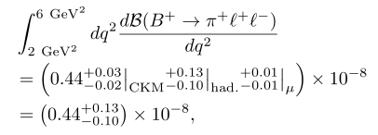
SM prediction
Branching ratio
Improved Branching ratio
Reduced error: $30\%→10\%$
LEET
free of resonance
error is dominated by had. uncertainty, especially
had. Error indeed reduced that guarantees the validity of CKM analysis

Slide 21
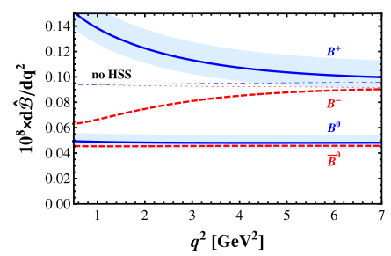
SM prediction
Branching ratio
naïve factorization, Ali et. al.

Slide 22
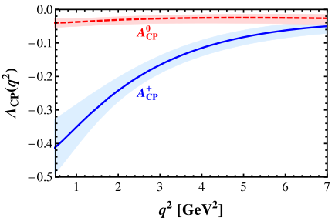
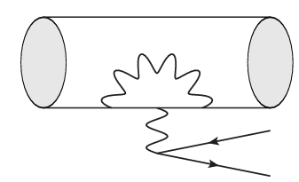
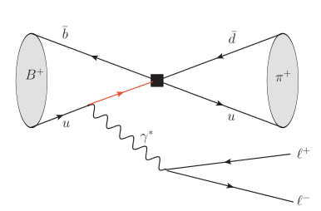
SM prediction
Direct CP asymmetry
The source of $A_{CP}$:
interference between strong phase and week phase

Slide 23
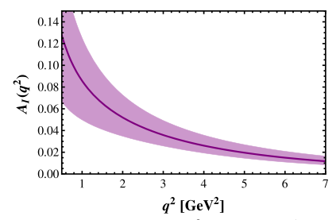
SM prediction
Isospin asymmetry
at low $q^{2}$ region, central value can be $10\%$, but theoretical error is also large; central value at (2,6) $GeV^{2}$ region is around $3\%$ with smaller error.
The measurement of isospin asymmetry depends on $B^{0}→π^{0}ℓ^{+}ℓ^{−}.$
Such small isospin asymmetry for a rare decay, is not easy to be measured.

Slide 24
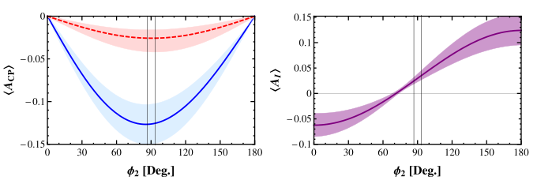
Implications for CKM parameters
The CKM angle $φ_{2}$ dependence
At the SM region from global fits, $A_{CP}$ reaches its maximum; isospin is small.
Using $A_{CP}$ to determine $φ_{2}$ is challenging because of larger error.

Slide 25
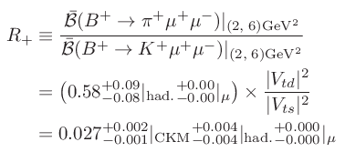
Implications for CKM parameters
The ratio between two CKM elements $V_{td}/V_{ts}$ in low $q^{2}$ region
The LHCb measured value at full $q^{2}$ region
with more data accumulated, $R_{+}$ at (2,6) ${GeV}^{2}$ can be measured, which provides a complementary check to $\frac{Δm_{B_{d}}}{Δm_{B_{s}}}.$

Slide 26
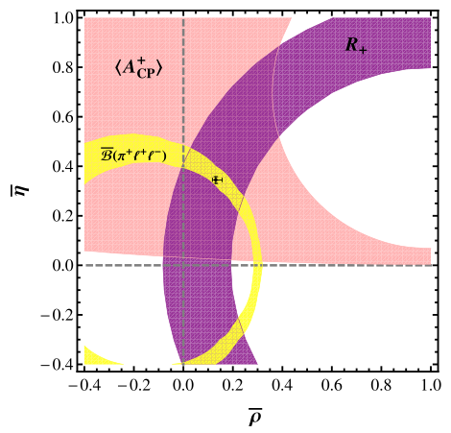
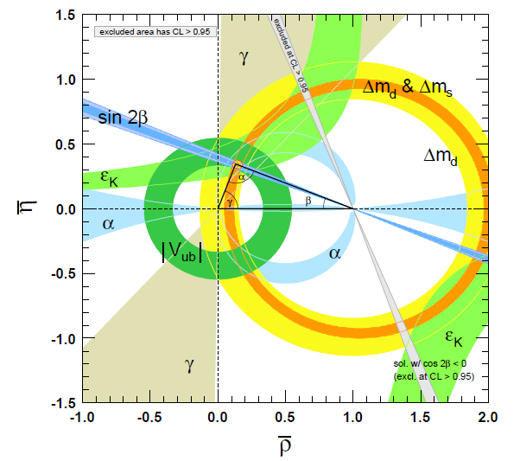
Implications for CKM parameters
The determination of $(\overline{ρ},\overline{η})$
We only rely on charged mode as neutral model is
challenging;
aim: LHC run 2 (2015-2017)

Slide 27
The latest experiment
Total and differential branching ratio is now available
$ℬ\left(B^{+}→π^{+}μ^{+}μ^{−}\right)=\left(1.83±0.24±0.05\right)×{10}^{−8}$
$A_{CP}\left(B^{+}→π^{+}μ^{+}μ^{−}\right)=−0.11±0.12±0.01$
--LHCb, JHEP 10 (2015) 034
More data required!

Slide 28
Summary
For the first time, we give a prediction for SM $B→π ℓ^{+}ℓ^{−}$ in QCDF approach, in the low lepton pair invariant energy region;
We predict there is a large direct CP asymmetry between charged mode decay, now it seems true.
Let’s see whether similar stories continue happening on $B→πℓ^{+}ℓ^{−}$, as on $B→K^{∗}ℓ^{+}ℓ^{−}.$

