Slide 1
FCC injector
FCC2017

Slide 2
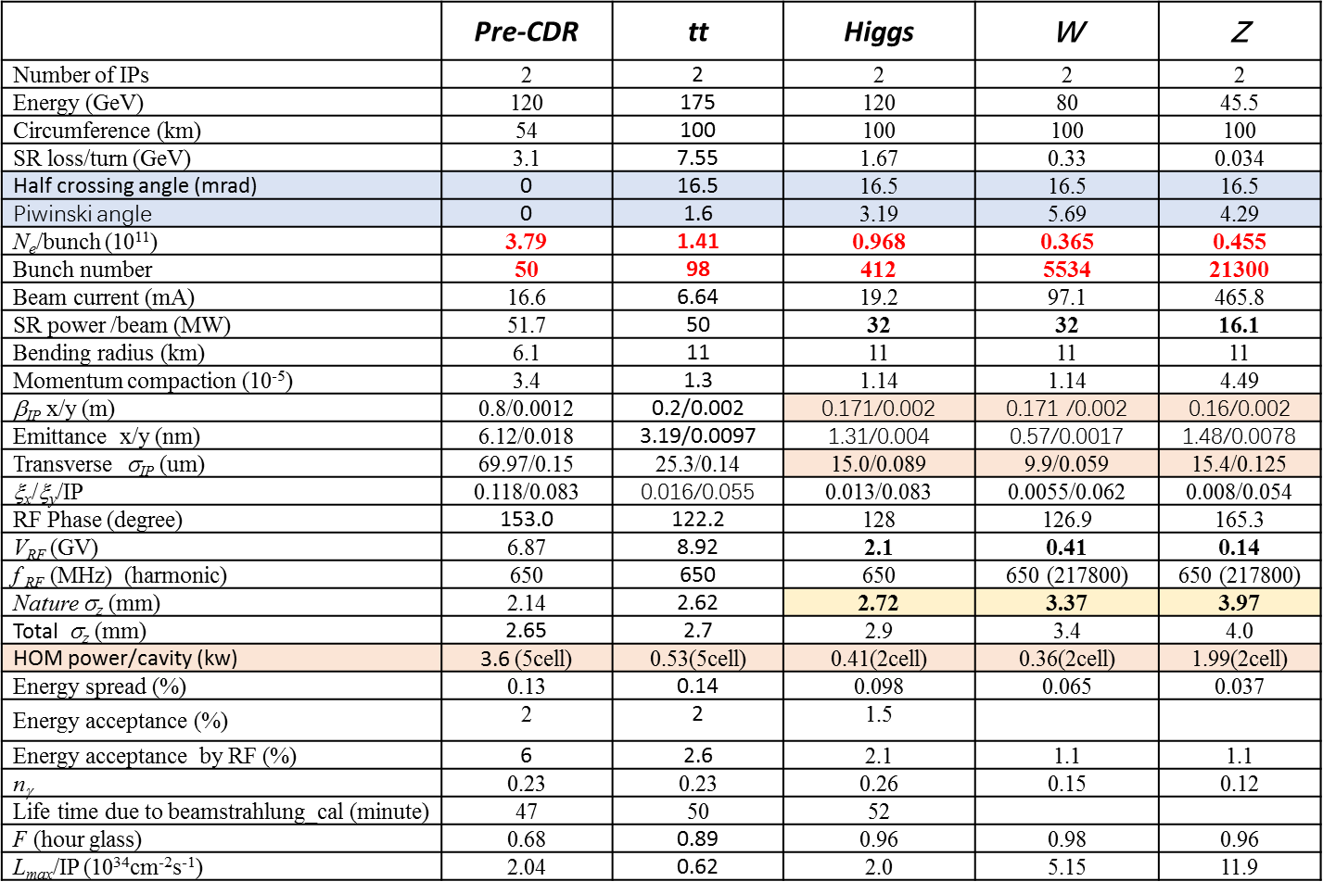

Slide 3
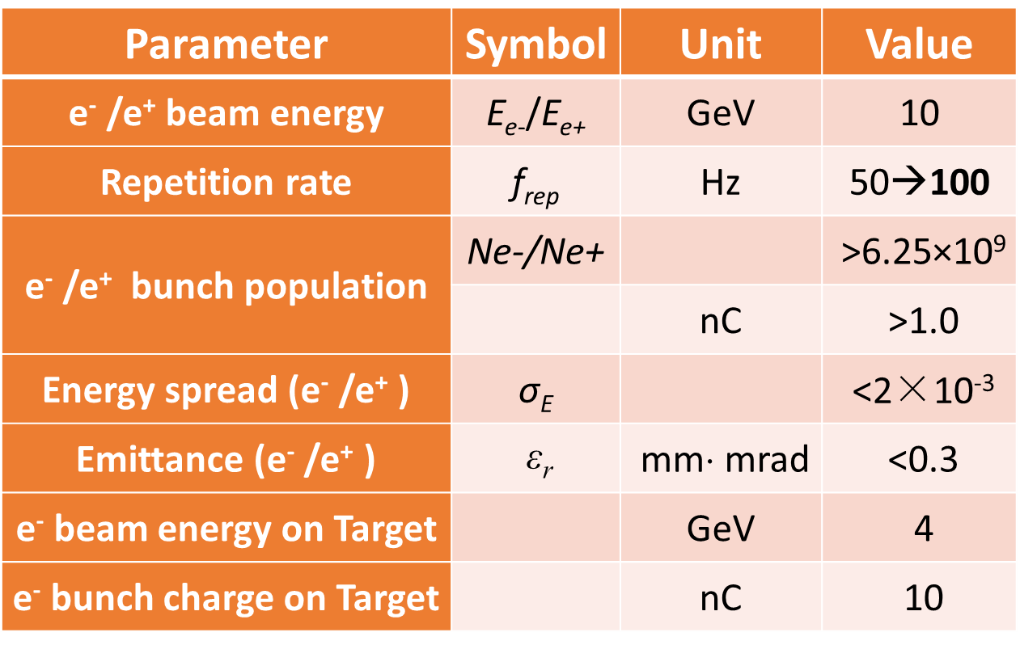

Slide 6
Linac Emittance Evolution

Slide 14
CPEC
Injection
Bunch charge
Scheme

