Slide 1
DA with different model
ZHANG, Yuan
2017-06-09

Slide 2
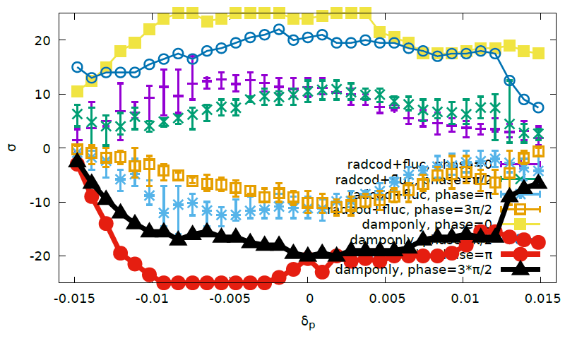
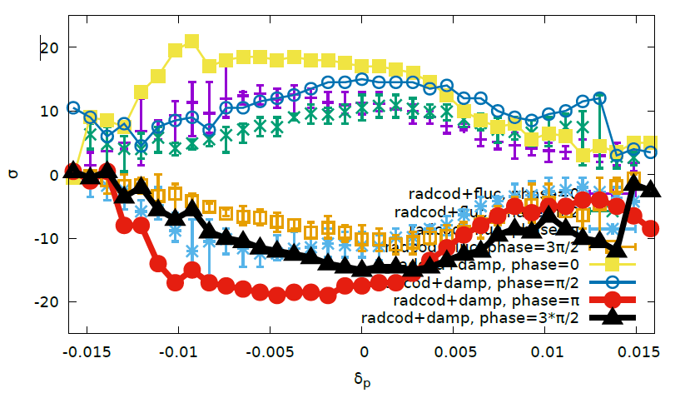
Optimize with DAMPONLY/NORADCOD
200turns
DAMPONLY/NORADCOD vs FLUC
RADCOD/DAMP vs FLUC
Notes:
MATCH-4-FILTER

Slide 3
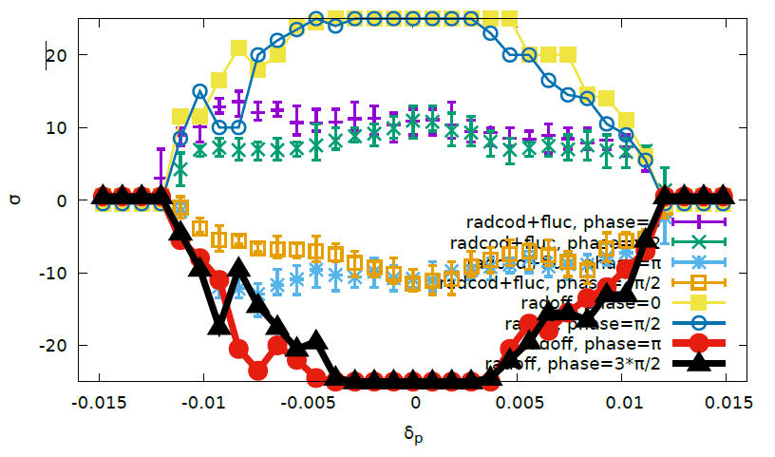
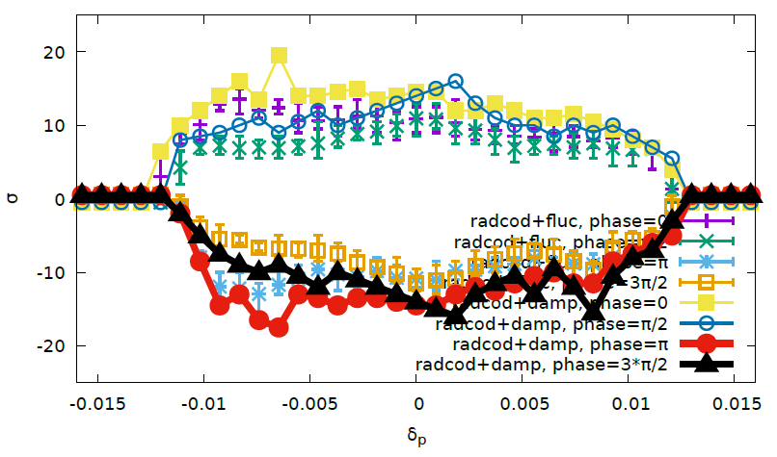
Optimize with RADOFF/RFSW
50turns
RADOFF vs FLUC
RADCOD/DAMP vs FLUC
Notes:
RADoff-2

Slide 4
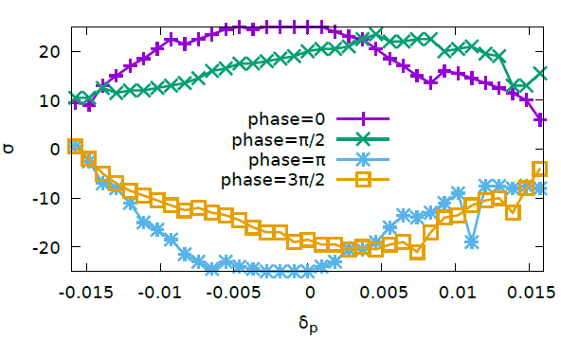
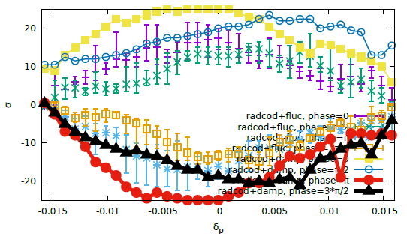
Optimize with RADCOD/TAPER/DAMPONLY
50turns
Errorbar: ten samples with FLUC
Notes:
Cmst-4-clip1

Slide 5
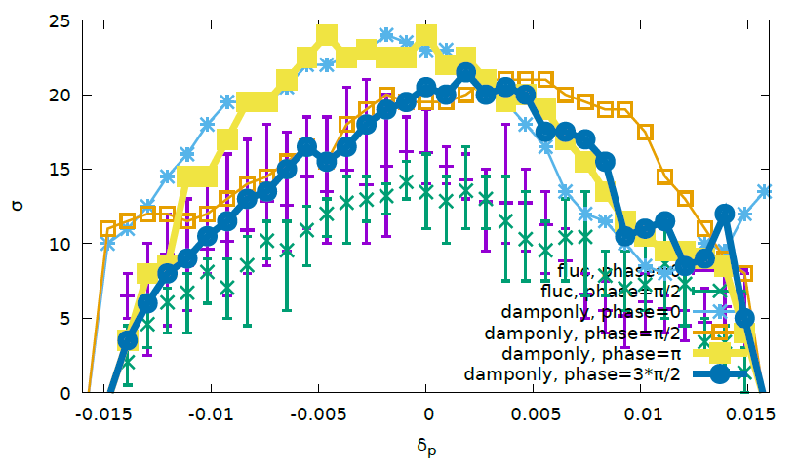
Optimize with RADCOD/TAPER/DAMPONLY(2)
50turns
Errorbar: ten samples with FLUC
Notes:
Cmst-2

Slide 6
Summary
RADCOD/TAPER/DAMPONLY is better for final FLUC model
The inscribed DA boundary of different initial coordinate determine the final DA with FLUC

Slide 7
memo

Slide 8
K. Oide

Slide 9
K. Oide

