Slide 1
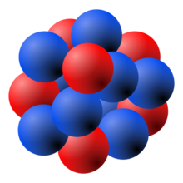
CRC 110 general meeting, Peking University, Aug. 29-31
Study of normal and hypernuclei with MDC-CDFT
Kun Wang Supervisor: Shan-Gui Zhou
Institute of Theoretical Physics, Chinese Academy of Sciences
2017/8/31

Slide 2
Outline
Introduction to MDC-CDFT
Study of superheavy toroidal nuclei
Study of isoscalar giant monopole resonances
Summary
1

Slide 3
Outline
Introduction to MDC-CDFT
Study of superheavy toroidal nuclei
Study of isoscalar giant monopole resonances
Summary
2

Slide 4
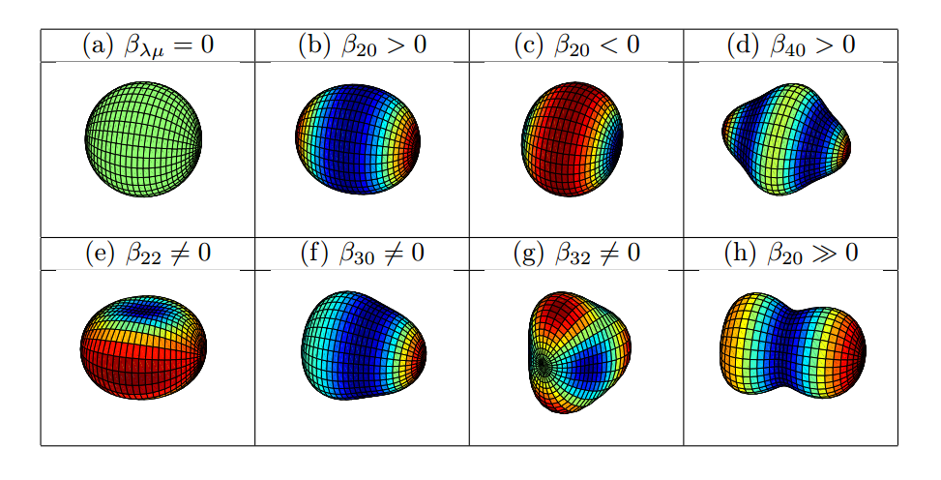
Nuclear shapes
Nuclear shapes:
Axial/non-axial
Reflection symmetry/asymmetry
Exotic shapes:
Tetrahedral
Triangle
Bubble
Toroidal
Courtesy by B.N. Lu
3

Slide 5
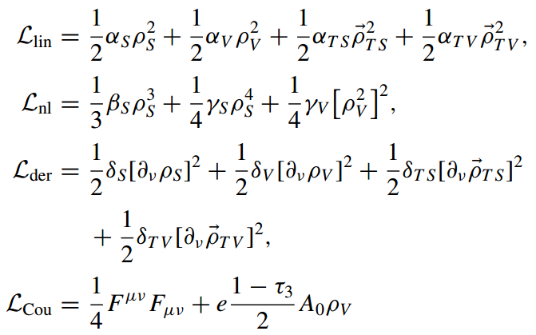
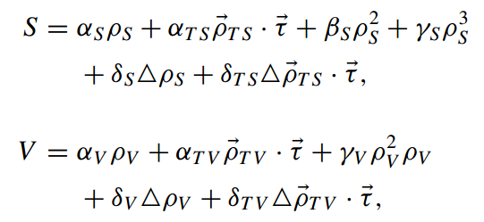
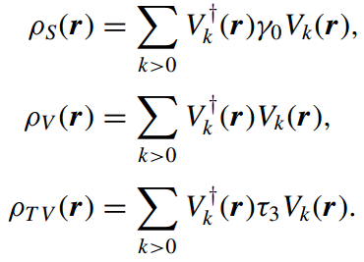
MDC-CDFT
Multidimensional constrained covariant density functional theory:
Non-linear point coupling:
with
B.N. Lu, E.G. Zhao and S.G.Zhou, Phys. Rev. C 85 (2012) 011301(R)
J. Zhao, B.N. Lu, E.G. Zhao and S.G. Zhou, Phys. Rev. C 86 (2012)
B.N. Lu, J. Zhao, E.G. Zhao and S.G. Zhou, Phys. Rev. C 89 (2014) 014323
J. Zhao, B.N. Lu, T. Niksic and D. Vretenar, Phys. Rev. C 92 (2015) 064315
S.G. Zhou, Phys. Scr. 91 (2016) 063008
J. Zhao, B.N.Lu, E.G. Zhao and S.G. Zhou, Phys. Rev. C 95 (2017) 014320
4

Slide 6
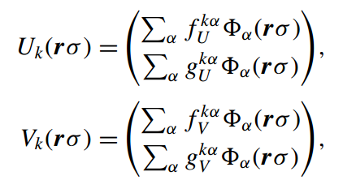
MDC-CDFT
MDC-RMF (Multidimensional constrained relativistic mean field model)
BCS:
MDC-RHB (Multidimensional constrained relativistic Hatree-Bogoliubov model)
Bogoliubov transformation:
Separable pairing force:
Y. Tian, Z.Y. Ma and P. Ring, Phys. Rev. C 80 (2009) 024313
5

Slide 7
Application of MDC-CDFT
Potential energy surfaces and fission barriers of actinides
B.N. Lu, E.G. Zhao, and S.G. Zhou, Phys. Rev. C 85 (2012) 011301(R)
B.N. Lu, J. Zhao, E.G. Zhao, and S.G. Zhou, EPJ Web Conf. 38 (2012) 05003
B.N. Lu, J. Zhao, E.G. Zhao, and S.G. Zhou, J. Phys: Conf. Ser. 492 (2014) 012014
B.N. Lu, J. Zhao, E.G. Zhao, and S.G. Zhou, Phys. Rev. C 89 (2014) 014323
B.N. Lu, J. Zhao, E.G. Zhao, and S.G. Zhou, Phys. Scr. 89 (2014) 054028
J. Zhao, B.N. Lu, D. Vretenar, E.G. Zhao, and S.G. Zhou, Phys. Rev. C 91 (2015) 014321
Spontaneous fission of several fermium isotopes
J. Zhao, B.N. Lu, T. Niksic, D. Vretenar, and S.G. Zhou, Phys. Rev. C 93 (2016) 044315
Y₃₂ correlations
J. Zhao, B.N. Lu, E.G. Zhao and S.G. Zhou, Phys. Rev. C 86 (2012) 057304
J. Zhao, B.N. Lu, E.G. Zhao and S.G. Zhou, Phys. Rev. C 95 (2017) 014320
Shapes of hypernuclei
B.N. Lu, E.G. Zhao, and S.G. Zhou, Phys. Rev. C 84 (2011) 014328
B.N. Lu, E. Hiyama, H. Sagawa, and S.G. Zhou, Phys. Rev. C 89 (2014) 044307
6

Slide 8
Outline
Introduction to MDC-CDFT
Study of superheavy toroidal nuclei
Study of isoscalar giant monopole resonances
Summary
7

Slide 9
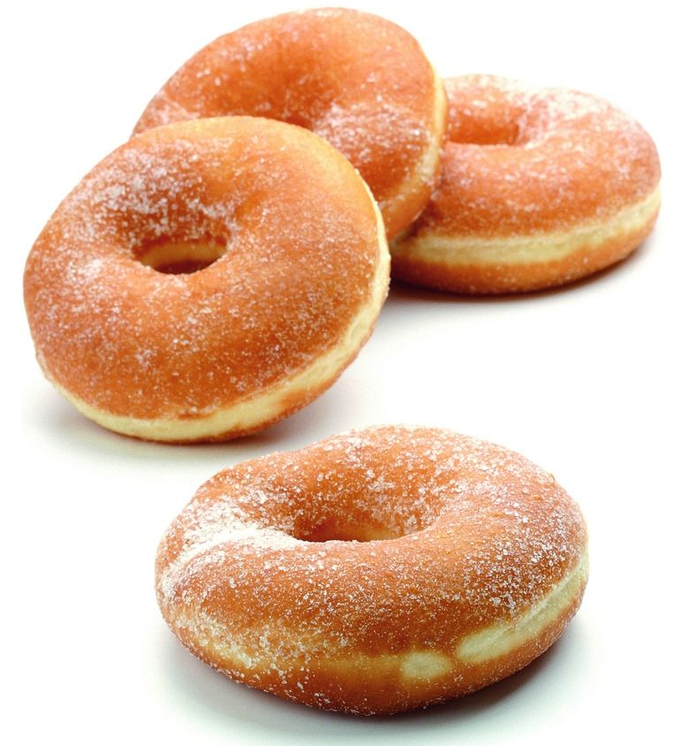
Why toroidal?
Proposed by J. A. Wheeler:
Bubble
Toroidal
Coulomb repulsion
Surface tension
Bubble/toroidal nuclei
C.Y. Wong, Ann. Phys. 77 (1973) 279
8

Slide 10
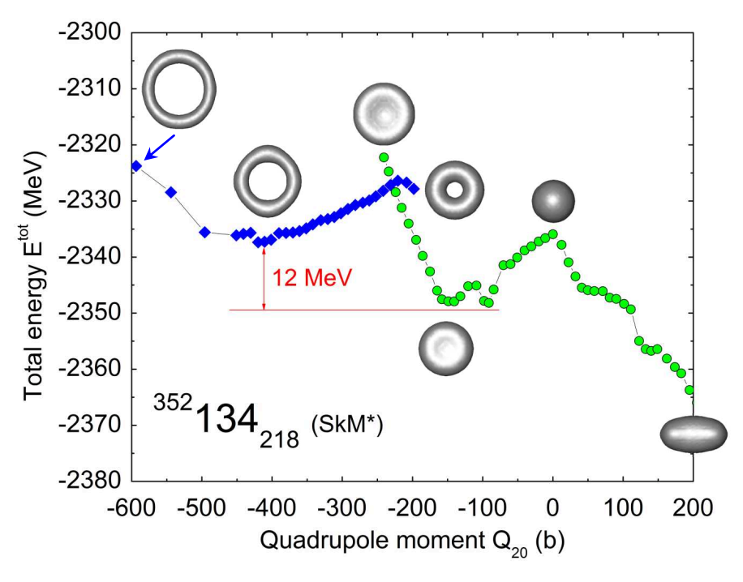
Toroidal nuclei in Skyrme-HF model
A. Staszczak, C.Y. Wong, Acta Phys. Pol. B 40 (2009) 753
9

Slide 11
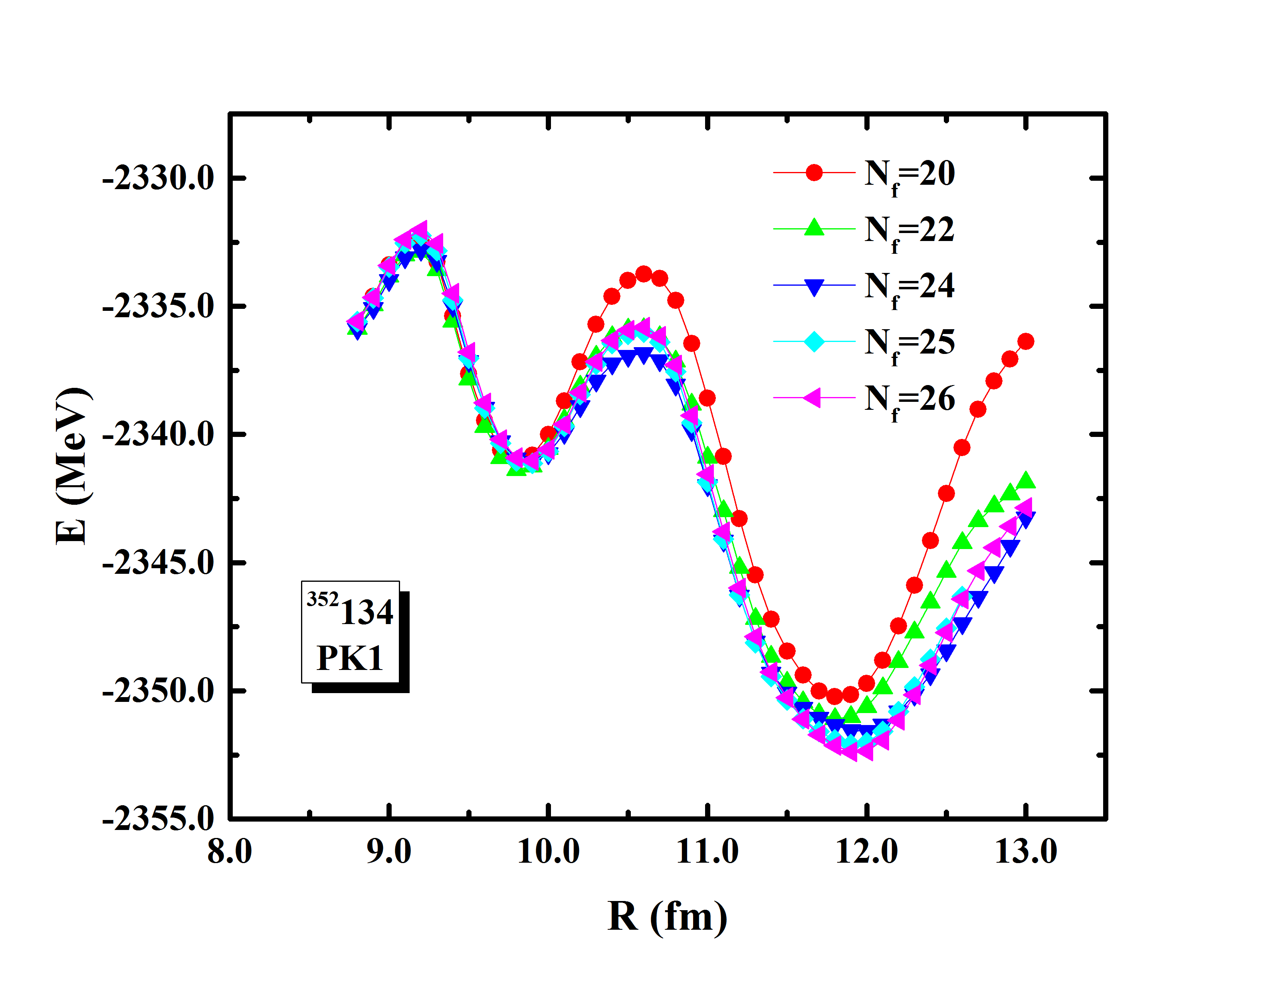
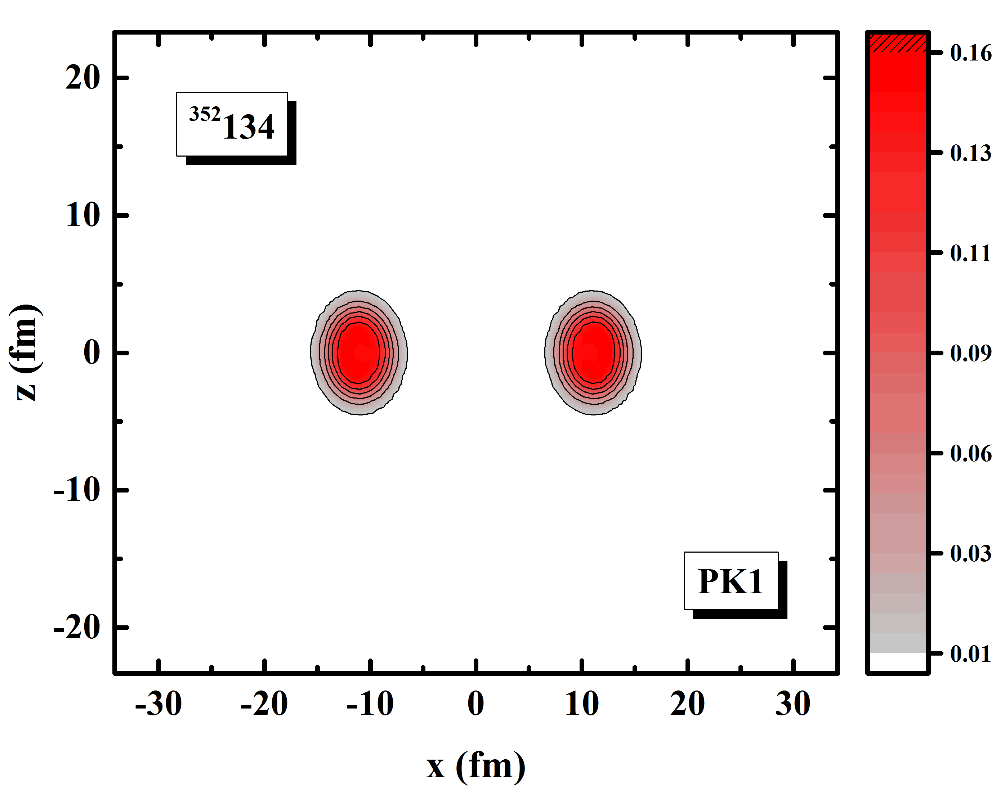
Toroidal nuclei in MDC-RMF
Radius constraint:
$$h^{′}=h+λr^{2}$$
$$E^{′}=E_{RMF}+λ\left\langle r^{2}\right\rangle$$
10

Slide 12
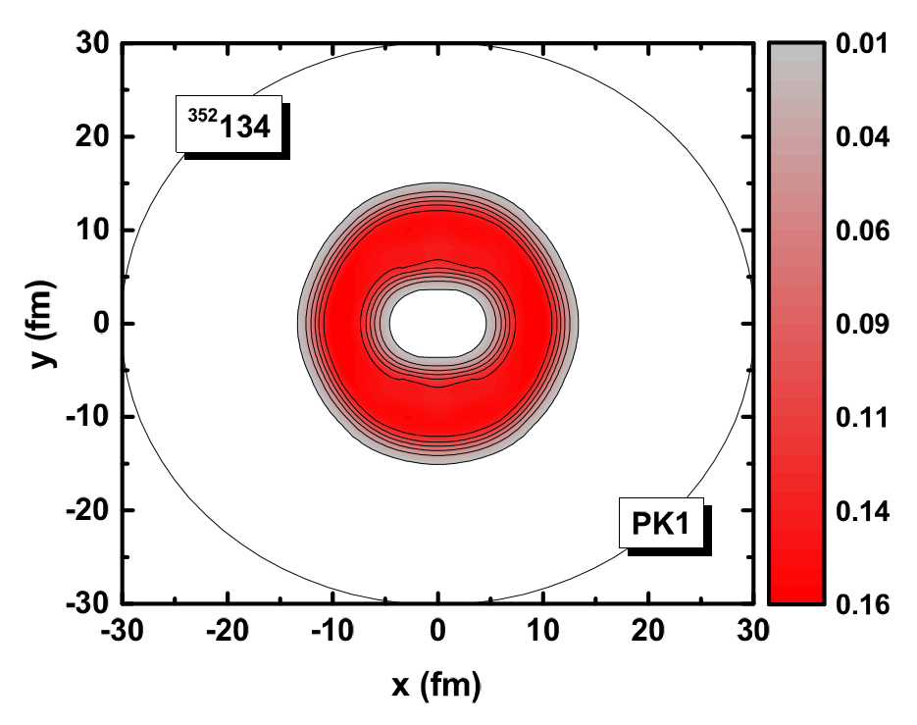
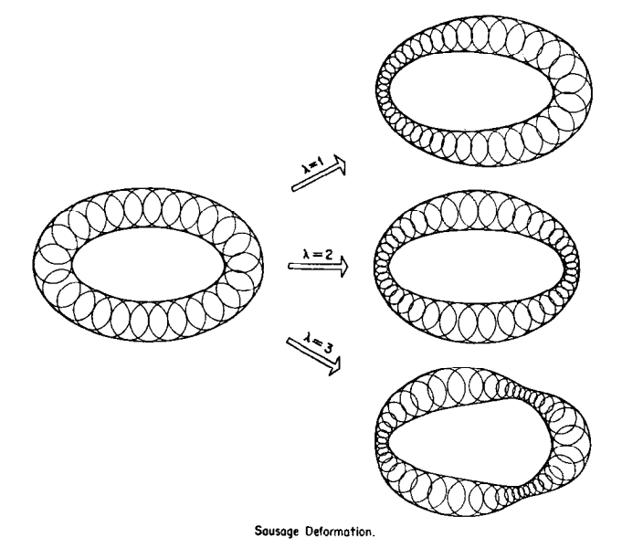
“Sausage” deformation
Symmetry | E (MeV)
Axially | −2326.19
Non-axially | −2333.68
C.Y. Wong, Ann. Phys. 77 (1973) 279
11

Slide 13
Outline
Introduction to MDC-CDFT
Study of superheavy toroidal nuclei
Study of isoscalar giant monopole resonances
Summary
12

Slide 14
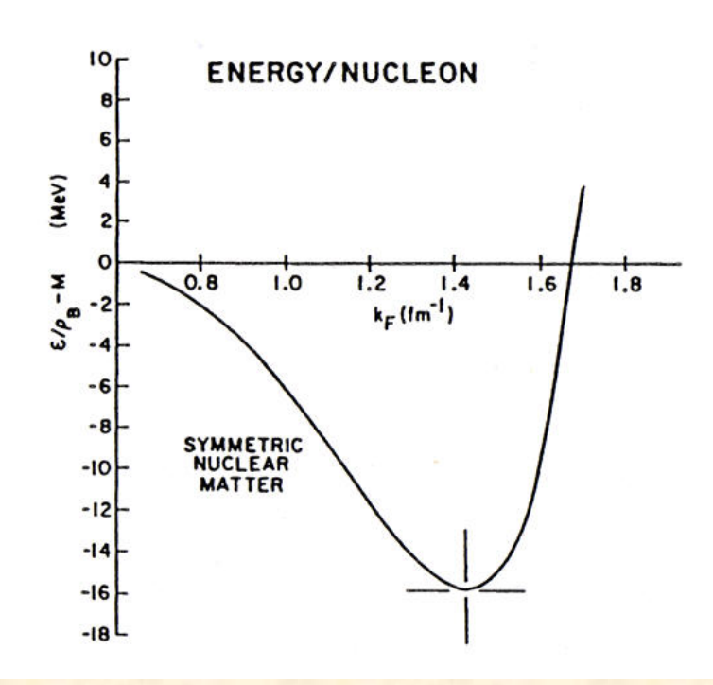
$K_{∞}$ in nuclear matter
Nuclear incompressibility is important for the study of:
Properties of nuclei
Supernova collapses
Neutron stars
Heavy-ion collisions
J.P. Blaizot, Phys. Rep. 64 (1980) 171
$$K_{∞}=K_{F}^{2}\frac{∂^{2}}{∂K_{F}^{2}}\left({E_{B}}/A\right)$$
From 2016.3.10 Umesh Garg’s talk at ITP
$$K_{F}={\left(\frac{3π^{2}}{2}ρ_{0}\right)}^{1/3}$$
EoS of the symmetric nuclear matter
13

Slide 15
$K_{A}$ and ISGMR energy in finite nuclei
Consider a nucleus which is vibrating in breathing mode, we expand its energy up to the 2nd order,
$$E=E_{G.S.}+\frac{1}{2}{AK}_{A}s^{2}+\frac{1}{6}K_{3}s^{3}+…$$
where
$$s=\frac{R{−R}_{G.S.}}{R_{G.S.}}$$
With harmonic approximation (small amplitude limit), $K_{A}$ writes
$$K_{A}={\left.\frac{1}{A}R^{2}\frac{d^{2}E}{dR^{2}}\right|}_{R=R_{G.S.}}$$
Knowing $K_{A}$, the ISGMR energy can be obtained as
$$E_{GMR}=\sqrt{\frac{{ℏ^{2}AK}_{A}}{MR_{G.S.}^{2}}}$$
J.P. Blaizot, Phys. Rep. 64 (1980) 171
14

Slide 16
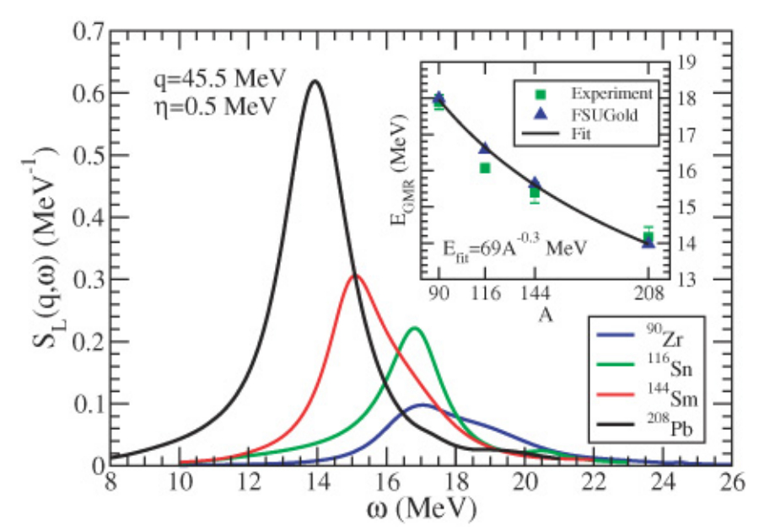
“Softness” of Sn or “hardness” of Pb
J. Li, G. Colo and J. Meng, Phys Rev. C 78 (2008) 064304
L. G. Cao, H. Sagawa and G. Colo, Phys. Rev. C 86 (2012) 054313
……
RPA
Pairing
Why is Sn so soft?
J. Piekarewicz, Phys. Rev. C 76 (2007) 031301
U. Garg et al., Nucl. Phys. A 788 (2007) 36c
15

Slide 17
Non-relativistic mass parameter
The non-relativistic mass parameter can be derived from the scaling method.
Scaling transformation on the solution of Schrodinger equation $ψ(r$):
$$r_{s}=ηr, s=\frac{η−1}{η}$$
Approximately, we write:
$$η=\frac{R_{G.S.}}{R}$$
From the continuity equation and with small amplitude approximation, the energy $E$ is written as,
$$E=E_{k}+E_{A}\left(η\right)=E_{A}+\frac{1}{2}MA\left\langle r^{2}\right\rangle {\left(\dot{s}\right)}^{2}+\frac{1}{2}AK_{A}s^{2}$$
This is the harmonic vibration of $s$.
$$ω=\sqrt{\frac{K_{A}}{B_{nr}}}=\sqrt{\frac{K_{A}}{MR_{G.S.}^{2}/A}} with B_{nr}= \frac{1}{A}MR_{G.S.}^{2}$$
$B_{nr}$ is the non-relativistic mass parameter.
J.P. Blaizot, Phys. Rep. 64 (1980) 171
Z.X. Wang, Nuclear Matter, Beijing: Peking University Press, 2014 (in Chinese)
16

Slide 18
Relativistic mass parameter
Lorentz boost on the constrained spinors,
$$ψ_{i}\left(x,t\right)=\frac{1}{\sqrt{γ}}\hat{S}\left(v\right)ψ_{i}\left(x,λ\right)$$
$$\hat{S}\left(v\right)=cosh\left(\frac{φ}{2}\right)+α⋅\frac{v}{\left|v\right|}sinh\left(\frac{φ}{2}\right)$$
$\hat{S}(v)$ is the Hermitian local Lorentz boost operator.
Use the continuity equation,
$$\dot{s}\frac{∂ρ(r,λ)}{∂s}+∇⋅\left[ρ\left(r,λ\right)v\left(r,t\right)\right]=0$$
The mass parameter of the monopole vibration is obtained as,
$$B_{rel}=A^{−1}\int{u^{2}\left(r\right)ℋ_{RMF}(r)d^{3}r}$$
Thus, $ω_{rel}=\sqrt{\frac{K_{A}}{B_{rel}}}$ is different from $ω=\sqrt{\frac{K_{A}}{MR_{G.S.}^{2}/A}}$ (derived from the non-relativistic scaling method).
T. Maruyama and T. Suzuki, Phys. Lett. B 219 (1989) 43
M.V. Stoitsov et al., J. Phys. G: Nucl. Part. Phys. 20 (1994) L149
17

Slide 19
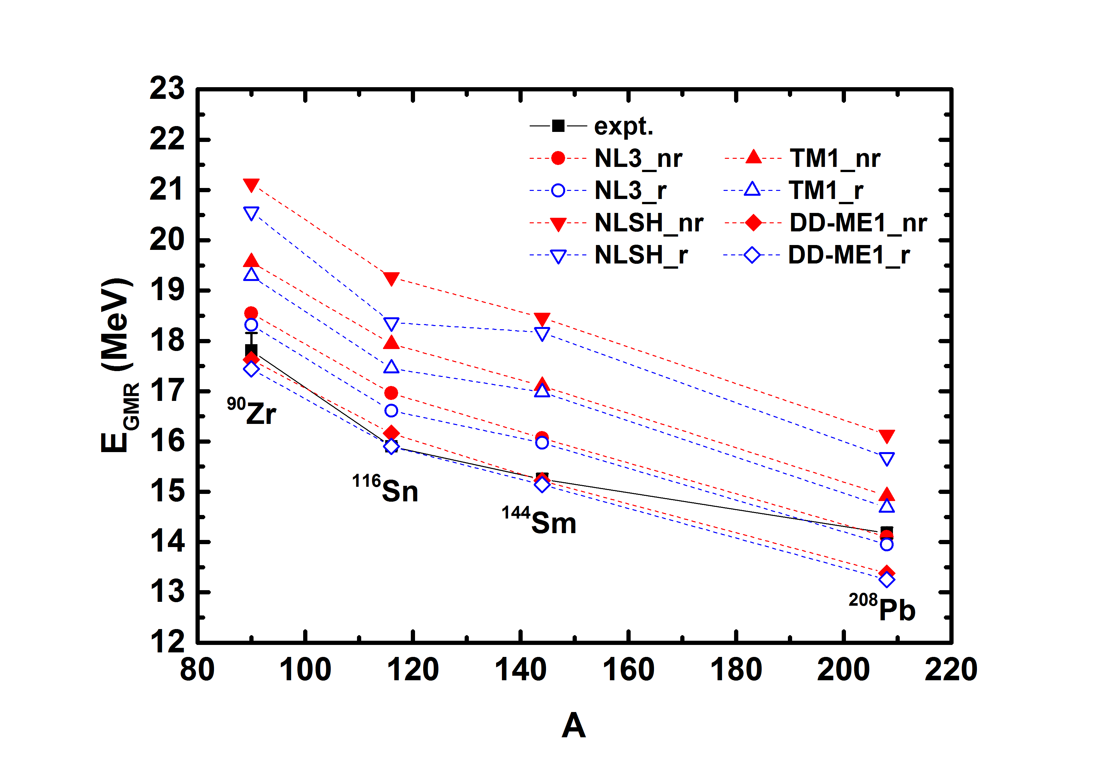
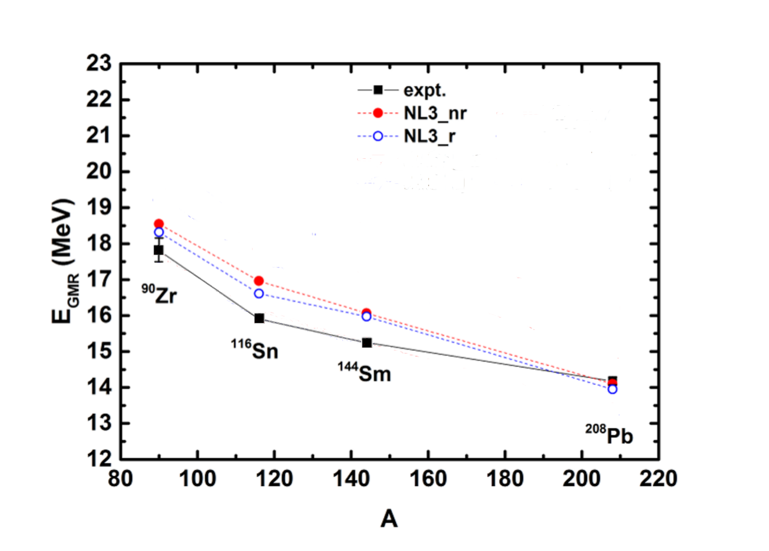
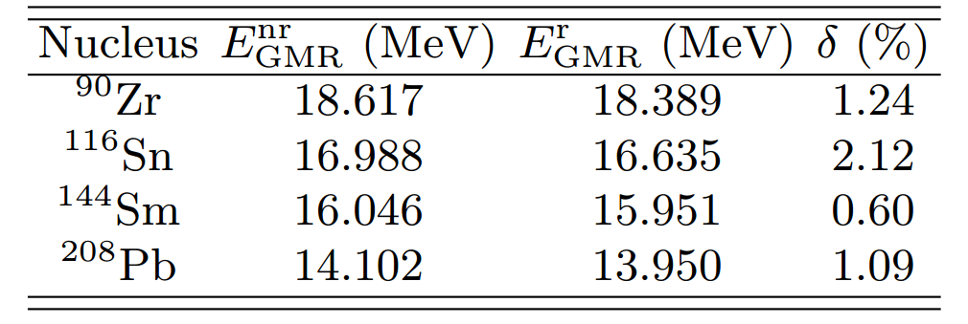
$E_{GMR}$ of several typical nuclei and Sn isotopes
Reductions of the ISGMR energies with the relativistic mass parameter:
The reduction for Sn is the largest!
The experimental values are taken from:
D.H. Youngblood et al., Phys. Rev. Lett. 82 (1999) 691
18

Slide 20
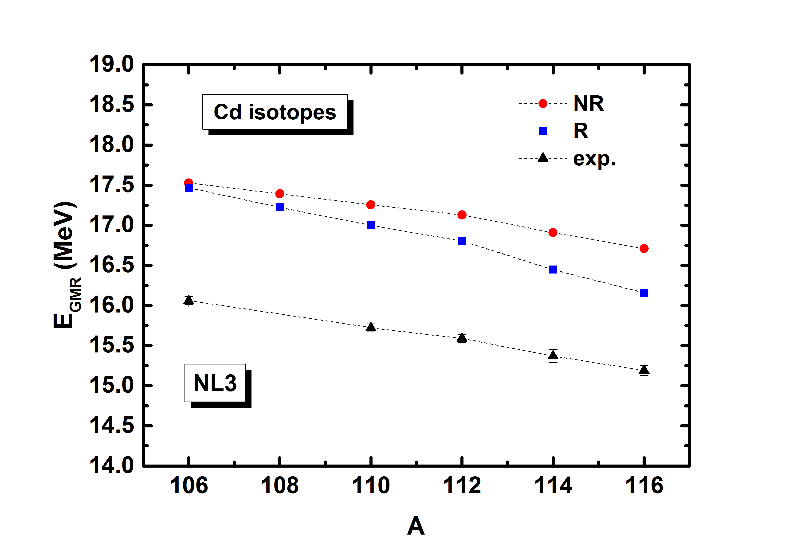
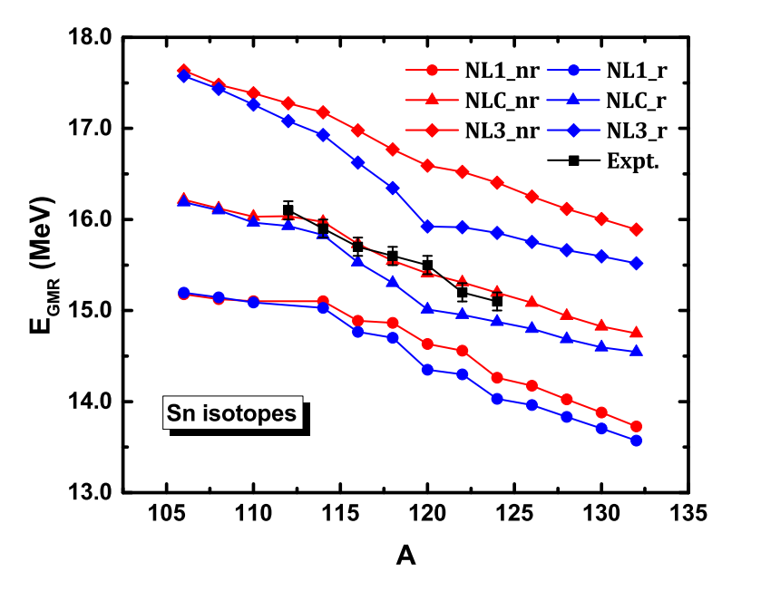
Sn and Cd isotopes
Experimental values from:
T. Li et al., Phys. Rev. Lett. 99 (2007) 162503
Softness for the open-shell nuclei
Cd isotopes: similar to Sn!
D. Patel et al., Phys. Lett. B 718 (2012) 447
19

Slide 21
Outline
Introduction to MDC-CDFT
Study of superheavy toroidal nuclei
Study of isoscalar giant monopole resonances
Summary
20

Slide 22
Summary
MDC-CDFT has been developed, which consists of two types of model: MDC-RMF model and MDC-RHB model . It has been used to study the potential energy surfaces and fission barriers of actinides, the spontaneous fission of several fermium isotopes, the Y₃₂ correlation, and shapes of hypernuclei.
By constraining the radius of the nucleus, we have studied the superheavy toroidal nucleus ³⁵²134 with MDC-RMF. The potential energy curve shows the toroidal minimum, the sausage deformation can also be reproduced.
We have studied the incompressibility and GMR of finite nuclei. The inclusion of relativistic mass parameter provides a possible explanation for the puzzle of softness of Sn or the hardness of Pb.
21

Slide 23
谢谢！
Thanks for your attention!
Kun Wang Supervisor: Shan-Gui Zhou
Institute of Theoretical Physics, Chinese Academy of Sciences
2017/8/31

