Slide 1
Effective field theory for triaxially deformed nuclei
Aug 28th – 31st, 2017, Bejing, China
CRC 110 general meeting of 2017
Qibo Chen
Physik-Department, Technische Universität Müchen,
and School of Physics, Peking University
Collaborators: Norbert Kaiser, Ulf-G. Meißner, Jie Meng
Reference: arXiv:1707.04353
Notes:
01. Good afternoon everyone. My name is Qibo Chen. First of all, thank you much for giving me this chance to introduce our recent work. The title of my talk is “Effective field theory for triaxially deformed nuclei”.

Slide 2
Outline
Introduction
Theoretical framework
Numerical details
Results and discussions
Summary and perspective

Slide 3
Outline
Introduction
Theoretical framework
Numerical details
Results and discussions
Summary and perspective

Slide 4
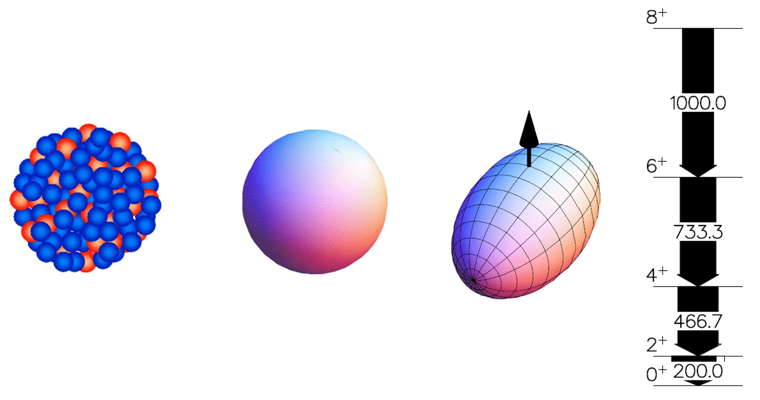
Deformation and rotation
Deformation and rotation:
Notes:
04. As a self-bound quantum many-body system, atomic nuclei can display different deformation. For a quantal system, rotation around a symmetry axis does not exist. Thus, the spherical nucleus does not have rotation. The concept of rotation is related to deformation, i.e. breaking of the spherical symmetry of the system. An ideal nuclear rotation spectra is shown here, which shows that the energy level is proportional I(I+1) rule.

Slide 5
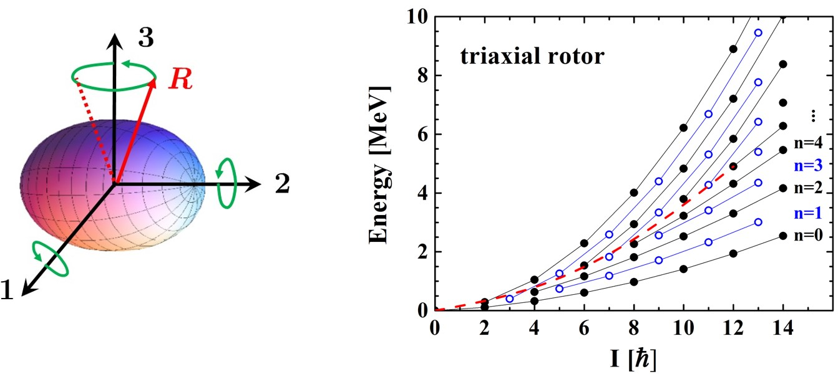
Deformation and rotation
Triaxial deformation and wobbling motion: Bohr&Mottelson1975book
Shi&Chen2015CPC
Notes:
05. If a nucleus is of triaxial deformation, the wobbling motion can happen. This is because the rotation around each axis is possible. Hence, the total spin of the nucleus does not align along any of the principal axes, but precesses and wobbles around one the axis with the largest moments of inertia. The energies of wobbling states, characterized by the wobbling phonon number $n$ together with total angular momentum $I$.

Slide 6
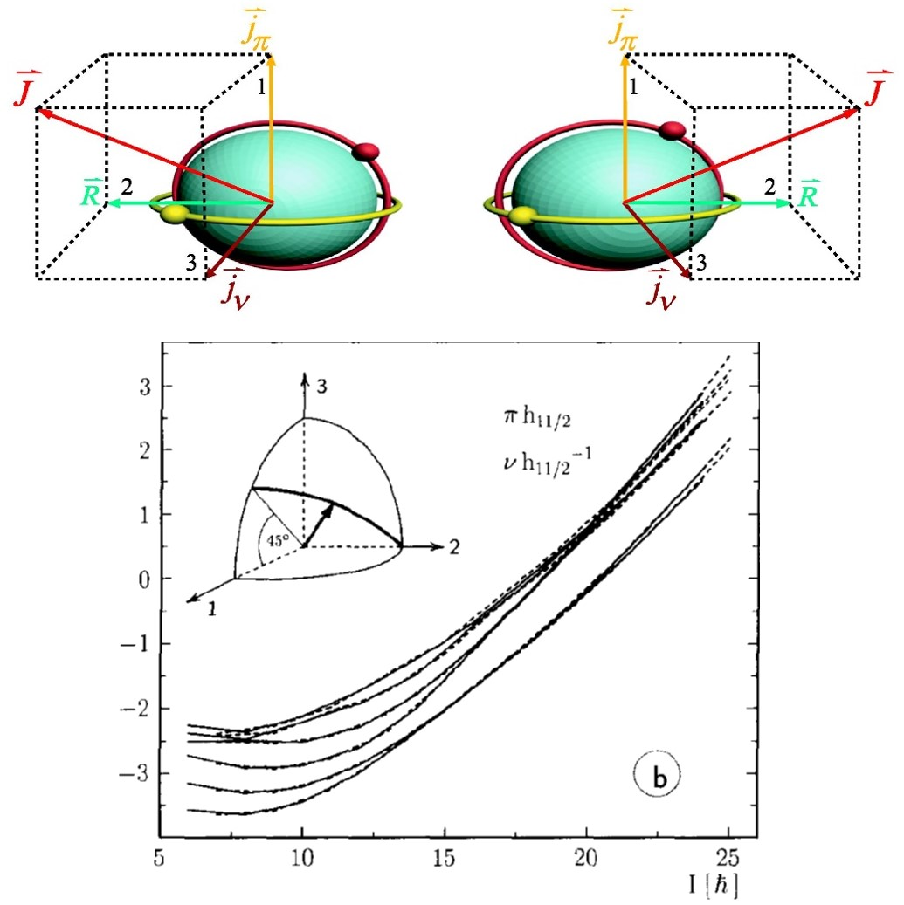
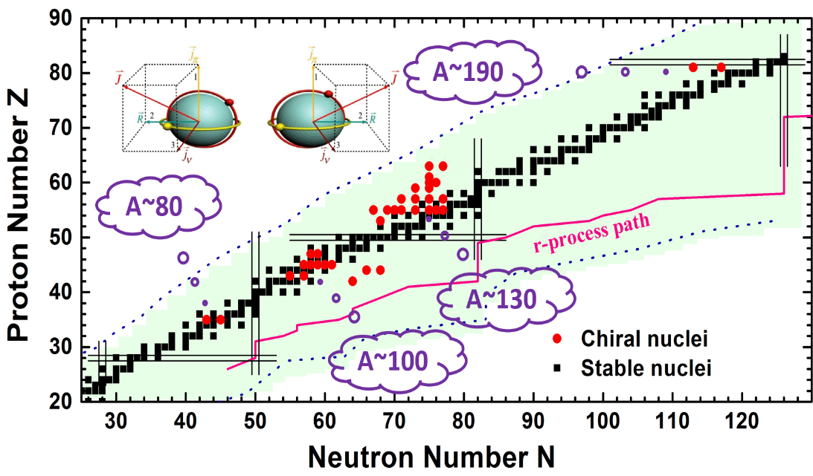
Deformation and rotation
Triaxial deformation and nuclear chirality: Frauendorf&Meng1997NPA
One of subjects in CRC110
B.7. Chiral Symmetry in Nuclear Physics
Chiral doublet bands predicted in 1997.
Notes:
06. If one particle and one hole is coupled to the triaxial rotor, the nuclear chirality is predicted. This is because the angular momenta of the rotor, the particle, and the hole are perpendicular to each other, and arranged to left handed or right handed systems. The chiral symmetry thus breaks in the body-fixed frame. In the laboratory frame, chiral symmetry is restored due to quantum tunneling. Its experimental signal is chiral doublet bands. They are a pair of nearly degenerated bands with the same parity.

Slide 7
Theoretical models
For even-even nuclei,
collective geometric model (e.g., Bohr Hamiltonian) Bohr&Mottelson1975book, Ring&Schuck1980book,
algebraic model (e.g., Interacting boson model (IBM)) Iachello&Arima1987book
For wobbling or chiral nuclei:
tilted axis cranking (TAC) approach Dimitrov2000PRL, Olbratorwski2004PRL
particle rotor model (PRM) Peng2003PRC, Zhang2007PRC, Qi2009PLB
TAC + random phase approximation Almehed2011PRC, Matsuzaki2002PRC, 2004PRCs, Shoji2009PTP
TAC + collective Hamiltonian Chen2013PRC, 2014PRC, 2016PRCs
Theories to systematically construct Hamiltonian for precise description of nuclear collective motion are still welcome.
Notes:
07. The descriptions of nuclear rotation is a long-stand interest. Many theoretical models are developed. For example, geometric model, algebra model, mean-field theory, or shell model. They have achieved many successes. However, they are difficult to extend systematically them, to gauge their limitations, or to compute results with reliable error estimates.
SO theories to systematically construct reliable Hamiltonian for precise description of nuclear rotation are highly welcome.

Slide 8
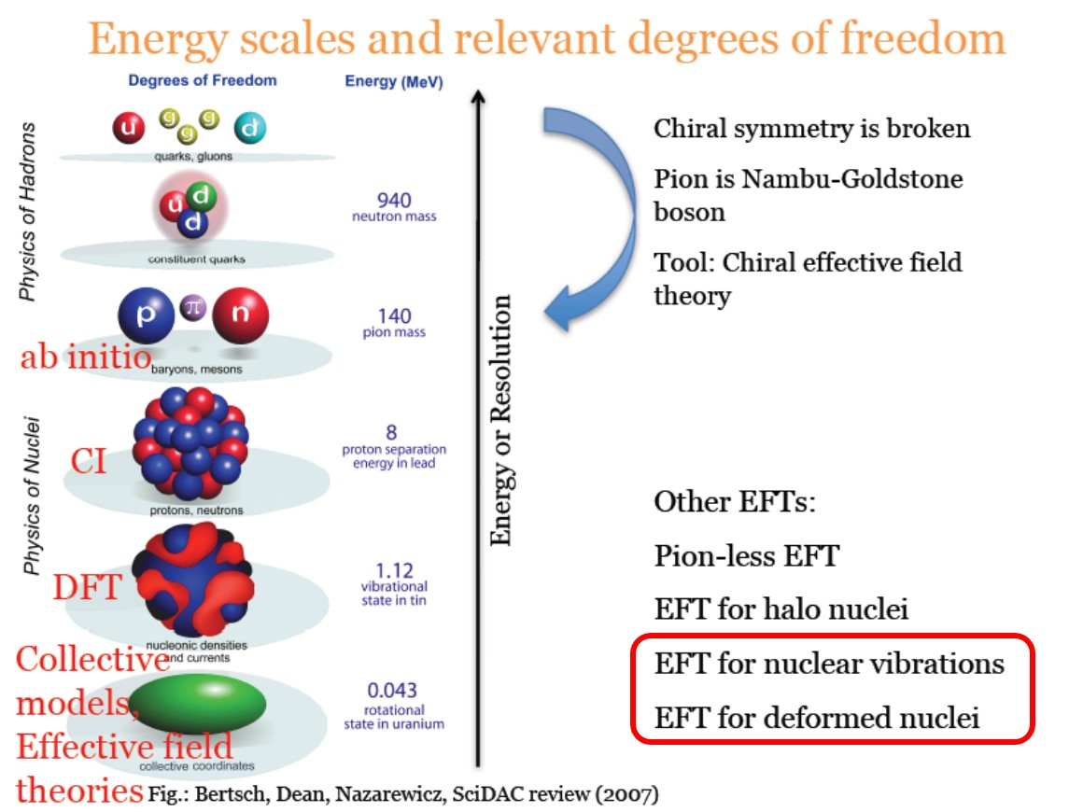
Effective field theory
Effective field theory (EFT) has enjoyed considerable popularity and success in nuclear physics.
Notes:
08. It is well known that effective field theory has enjoyed considerable popularity and success in nuclear physics. It is a theory based on symmetry principles alone and exploits a separation of scales for the systematic construction of Hamiltonian based on a power counting. For example, the chiral EFT is used to construct systematic the nuclear potentials. Halo EFT is used to describe the halo nuclei. Very recently, Papenbrock and his coauthors have extended EFT to describe the rotation and vibration of deformed nuclei.
The nuclear rotation or vibration are traditionally described by collective geometric model and algebraic model.

Slide 9
Motivation
EFT for deformed nuclei: Papenbrock2011NPA, 2014PRC, 2015JPG, 2016PS; J.L.Zhang2013PRC; Perez2015PRCs, 2016PRC
Provide a way to systematically construct Hamiltonian.
Allow one to estimate theoretical uncertainties.
Yield a consistent treatment of electromagnetic transition and Hamiltonian.
ONLY for axial deformed nuclei is constructed so far.
In this work
Generalize the EFT to triaxial nuclei and aim at chiral nuclei. As a first step, generalize to a rigid triaxial rotor, which is an essential part for the description of chiral nuclei.
Notes:
09. In contrast to the traditional model, EFT can solve the above-mentioned deficiencies. It allows one to estimate theoretical uncertainties. It can identify the breakdown scale that limits their applicability. It yields a consistent treatment of currents and Hamiltonian for the appropriate treatment of observables other than the energy.
We note that Papenbrock only deal with the axial nuclei. Therefore, we will generalized the EFT to triaxial nuclei and aim at investigating chiral nuclei.

Slide 10
Outline
Introduction
Theoretical framework
Numerical details
Results and discussions
Summary and perspective

Slide 11
Procedure
Within an EFT, one proceeds as follows:
Identify the relevant symmetries (and pattern of
spontaneous symmetry breaking).
Identify the relevant low-energy degree of freedom.
Identify a separation of scales and introduce a power
counting.
Parameterization of Nambu-Goldstone mode:
D₂ symmetry
Rotational motion, Euler angles $α, β, γ$
Vibration energy scale W is a large value.
Notes:
11. Within an EFT, one proceeds as follows.
(1) Identify the relevant symmetries (and pattern of spontaneous symmetry breaking). For example, for atomic nuclei, the Hamiltonian is invariant under rotations. The intrinsically triaxially deformed ground state is invariant under D_2 rotations.
(2) Identify the relevant low-energy degree of freedom. In our case, we only focus on the rotation motion. The Euler angles is the relevant degree of freedom.
(3) Identify (and exploit) a separation of scales and introduce a power counting. Since we freeze the degree of freedom of vibration, the vibration energy scale is a large value. For the rotational degree of freedom, the Euler angles is of order of unit, its velocity is the rotation energy scale.
(4) The Nambu-Goldstone modes lie in the coset space SO(3)/D2. The mode depend on the angles \theta and \phi (S^2 sphere), and are generated by a unitary transformation. The physics of this transformation is that U rotates the entire nucleus.

Slide 12
Effective Lagrangian
Nonlinear realization of NG modes: Weinberg1968PR, Coleman1969PR, Callan1969PR
Euler’s kinematical equations
Lagrangian:
Notes:
12. The effective Lagrangian of triaxial nuclei is built from invariants. These are constructed from element a_t^x, a_t^y, and a_t^z defined by the following formula. Here, the partial derivations are done for the angles \theta, \phi, and time t. From this equation, the elements can be obtained.
From this formula, the element can be calculated, which is combinations of the time derivatives of the \alpha, \beta, \gamma. In fact, these elements are the rotational frequencies.
Considering the time reversal, the leading order of Lagrangian can be obtained as the combinations of a_t^x, a_t^y, and a_t^z with the coefficients J_k, and these coefficients are the parameters that should be determined from the data.

Slide 13
Canonical momenta
Canonical momenta:
General velocity:
Notes:
13. The following procedure is standard. From the Lagrangian, we can calculate the canonical momenta, which are written as the combinations of the time derivatives of the \alpha, \beta, and \gamma.
From this equation, one can general velocities of \alpha, \beta, and \gamma.

Slide 14
Effective Hamiltonian
Effective Hamiltonian: by Lengenre transformation
Triaxial rotor model: Bohr&Mottelson1975
Notes:
14. With the above preparations, we can use Lengendre transformation to obtain the Hamiltonian.
In addition, we know the three components of angular momentum that expressed in terms of \alpha, \beta, \gamma. With these relations, we finally get the Hamiltonian rigid triaxial rotor. This Hamiltonian is very well known and it is the Hamiltonian of triaxial rigid rotor.
Now we have obtain the leading order term of rigid triaxial rotor. This is agreement with the classical textbook one. In the next step, we can calculate the next-leading-order terms.

Slide 15
Next-to-leading order
Next-to-leading order: (x/W)²
crossing terms are not included
Canonical momenta:
Notes:
15. At next-to-leading order (NLO), higher derivatives of the Namub-Goldstone modes appear, and we have to include terms of the size \xi^2. Namely, the forth order of a_t^x, a_t^y, and a_t^z. With the forth order considering, three more parameters are appeared in the Lagrangian. Here, the mixed terms are not included as M_k as well as J_k are defined with respect to the three principal axes.
From the Lagrangian, we obtain the canonical momenta. From the canonical momenta, we find the relationship between the angular momentum components and a_t^x, which are linked by the moments of inertia. With this relation and by Lengendre transformation, we obtain the Hamiltonian of triaxial rotor at next-to-leading order.

Slide 16
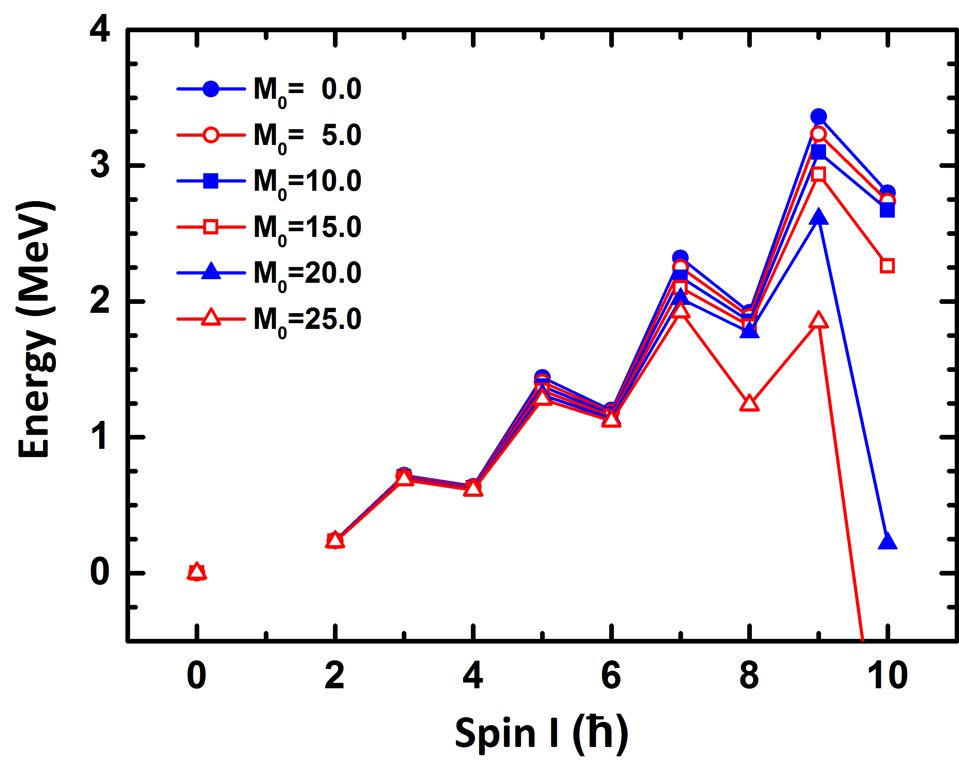
Impacts of NLO corrections
Assumptions:
By increasing M₀ (from 0 to 25 $ℏ4$/MeV³):
Energy decreases;
Sensitive at high spin region.
Notes:
16. With the obtained Hamiltonian of triaxial rotor at NLO, we first investigate the impacts of NLO terms. In the Hamiltonian, there are six moments of inertia. Here, we assume that they can be taken as irrotational flow type, so only three parameters are needed. In the first calculation, we fix the J_0 and \gamma, and change the value of M_0.
The obtained energy spectra are shown in this figure. One sees that with increasing M0, the energy eigenvalues decrease. This feature is due to the negative sign of HNLO. Because H_NLO contains the fourth power of spin, the impact of H_NLO for the high spin states is larger than those for the low spin states. In addition, if M_0 is very large (M0 ≥ 20 \hbar^4/MeV^3), the corrections from H_NLO lead to irregular energy spectra. In this case, the power counting is not longer obeyed, and the limits of the EFT are exceeded.

Slide 17
Outline
Introduction
Theoretical framework
Numerical details
Results and discussions
Summary and perspective

Slide 18
Numerical details
In the following, the newly developed EFT for the triaxial rotor is applied to describe the experimental ground state and g bands for the isotopes ¹⁰²Ru up to ¹¹²Ru.
Data are taken from National Nuclear Data Center (NNDC).
In TRM, moments of inertia are assumed to be of the irrotational type.
Strategy I: J₀ and M₀ are fitted to the experimental energies, g is taken from covariant density function theory (CDFT) calculations (Nf=12, PC-PK1). Zhao2010PRC
Strategy II: J₀, M₀, and g are all fitted to the experimental energies.
In five dimensional collective Hamiltonian (5DCH), both the collective potential and the inertial parameters are calculated by the constrained CDFT (Nf=12, PC-PK1). Niksic2011PPNP, Li2015JPG
Moments of inertia is adjusted to the data.
Notes:
18. In the following, the newly developed EFT for the triaxial rotor is applied to describe the experimental ground state and g bands for the isotopes 102Ru up to 112Ru (Ruthenium). These nuclei are demonstrated to be triaxial nucleus.
The data are taken from National Nuclear Data Center (NNDC).
In triaxial rotor model, the moments of inertia are assumed to be of the irrotational type. We will do two strategies of fitting. For the first one, J₀ and M₀ are fitted to the experimental energies, while \gamma is taken from CDFT calculations (Nf=12, PC-PK1). For the second one, J_0, M_0 and \gamma are all fitted to the data.
The obtained results will be compared to the five dimensional collective Hamiltonian, in which the collective potential and the inertial parameters are calculated with the constrained CDFT. The moment of inertia is also fitted to the data.

Slide 19
Outline
Introduction
Theoretical framework
Numerical details
Results and discussions
Summary and perspective

Slide 20
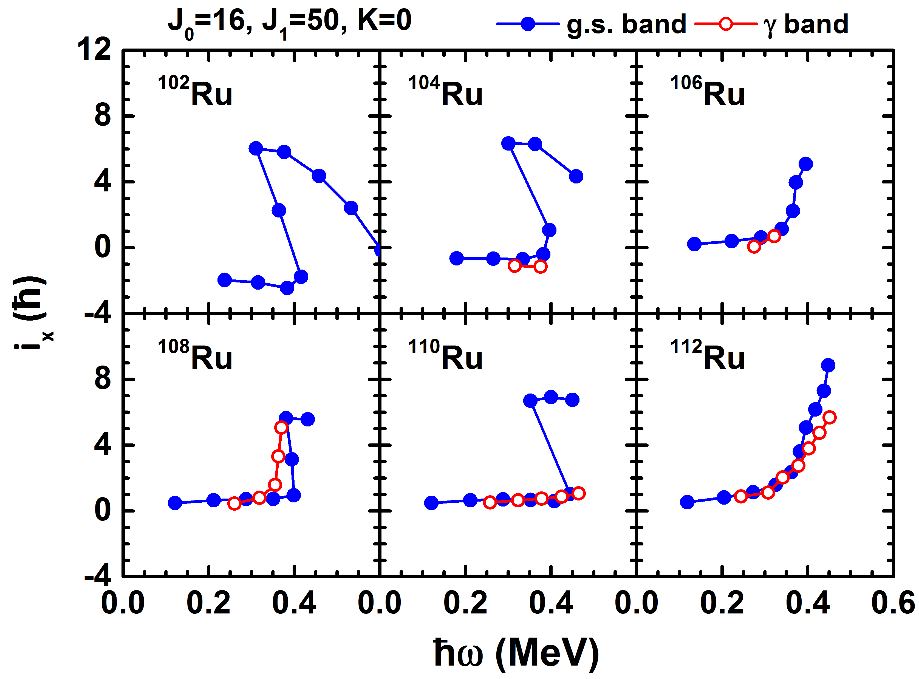
Quasiparticle alignment
First, we make a quasiparticle alignment analysis to identify which spin region TRM can be used.
No alignment are seen at I<10, where TRM can be used.
Notes:
20. Before performing the TRM calculations, we first study the quasi-particle alignment of the experimental energy spectra to establish the applicability of the triaxial rotor model. The quasi-particle alignment i_x is defined as the difference between the spin of the data and that of a reference rotor (with moment of inertia J0 + \omega^2 J1). Such an empirical study provides information about the spin at which a nucleon-pair breaks and thus the collective rotor model becomes inapplicable. The obtained results are shown in this figure. In all cases, the calculated alignments display a nearly constant behavior at low rotational frequency (corresponding to spins I ≤ 10) whereas a drastic increase sets in at higher rotational frequency. For this reason the range of applicability of the TRM and 5DCH Hamiltonians are restricted to the region with spins I ≤ 10. Therefore, we consider in the following only energy spectra in this low-spin region.

Slide 21
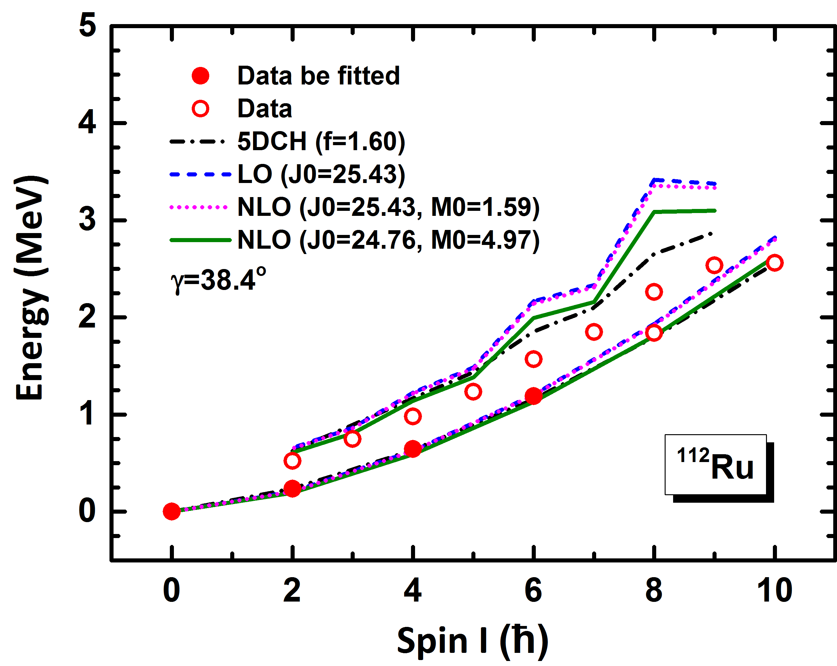
¹¹²Ru: Strategy I
112Ru
PES: CDFT, PC-PK1, Nf=12, g=38.4º
In TRM, ground state band is well described, and g-band is reasonable reproduced at low spin regions. For high spin regions, descriptions are not good as 5DCH.
Notes:
21. We will first show the results of the first strategy of fitting. To determine the triaxial deformation parameter of this nucleus, the triaxial relativistic mean field calculations are performed. The obtained potential energy surface is shown here. It shows the ground state of 102Ru has the deformation parameters \beta=0.26 and \gamma=38^\circ as well as moderate \gamma-softness.
With the given triaxial deformation parameter, the other moment of inertia parameters J_0 and M_0 are determined by fitting to the data. The results are shown here. One observes that both the LO and NLO calculations provide a reasonable description of the experimental data. In the LO calculations, the energies of ground states 8_1^+ and 10_1^+ are somewhat overestimated, and the description of the \gamma-band in high-spin region > 6\hbar is not as good as for low spins.
In the case of NLO calculation with $\mathcal{J}_0$ fixed, the obtained results are very similar to those at LO, since $\mathcal{M}_0$ is small and thus only small corrections are involved.
In the case where $\mathcal{J}_0$ and $\mathcal{M}_0$ are simultaneously fitted, the description of the data is somewhat improved. Nevertheless, there are still some deviations for the high-spin states in the $\gamma$ band.
By comparing with the 5DCH calculation, which reproduces better the ground state and $\gamma$ bands, one can attribute the deviations in the TRM to the neglect of the vibrational degrees of freedom. Consequently, in the future one should include systematically the vibrational degrees of freedom in the EFT.

Slide 22
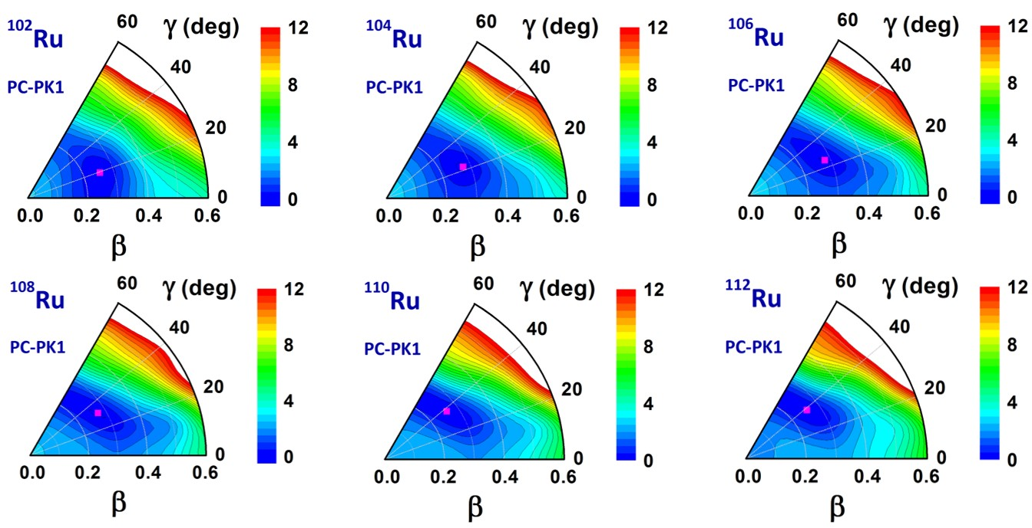
Potential energy surfaces
Similar calculations are carried out for other Ru isotopes.
Ground state deformation
Notes:
22. Similar calculations are carried out for other Ru isotopes. One observes that all potential energy surfaces possess a triaxially deformed minimum and they exhibit softness along the $\gamma$-direction. With increasing neutron number the $\gamma$-coordinate of the minimum becomes larger.

Slide 23
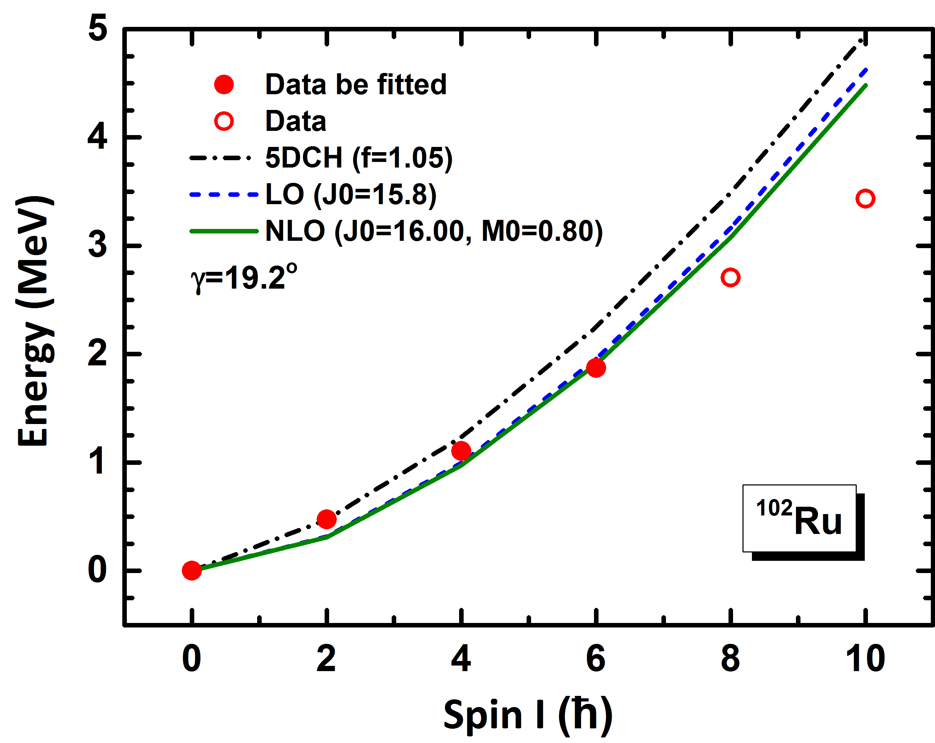
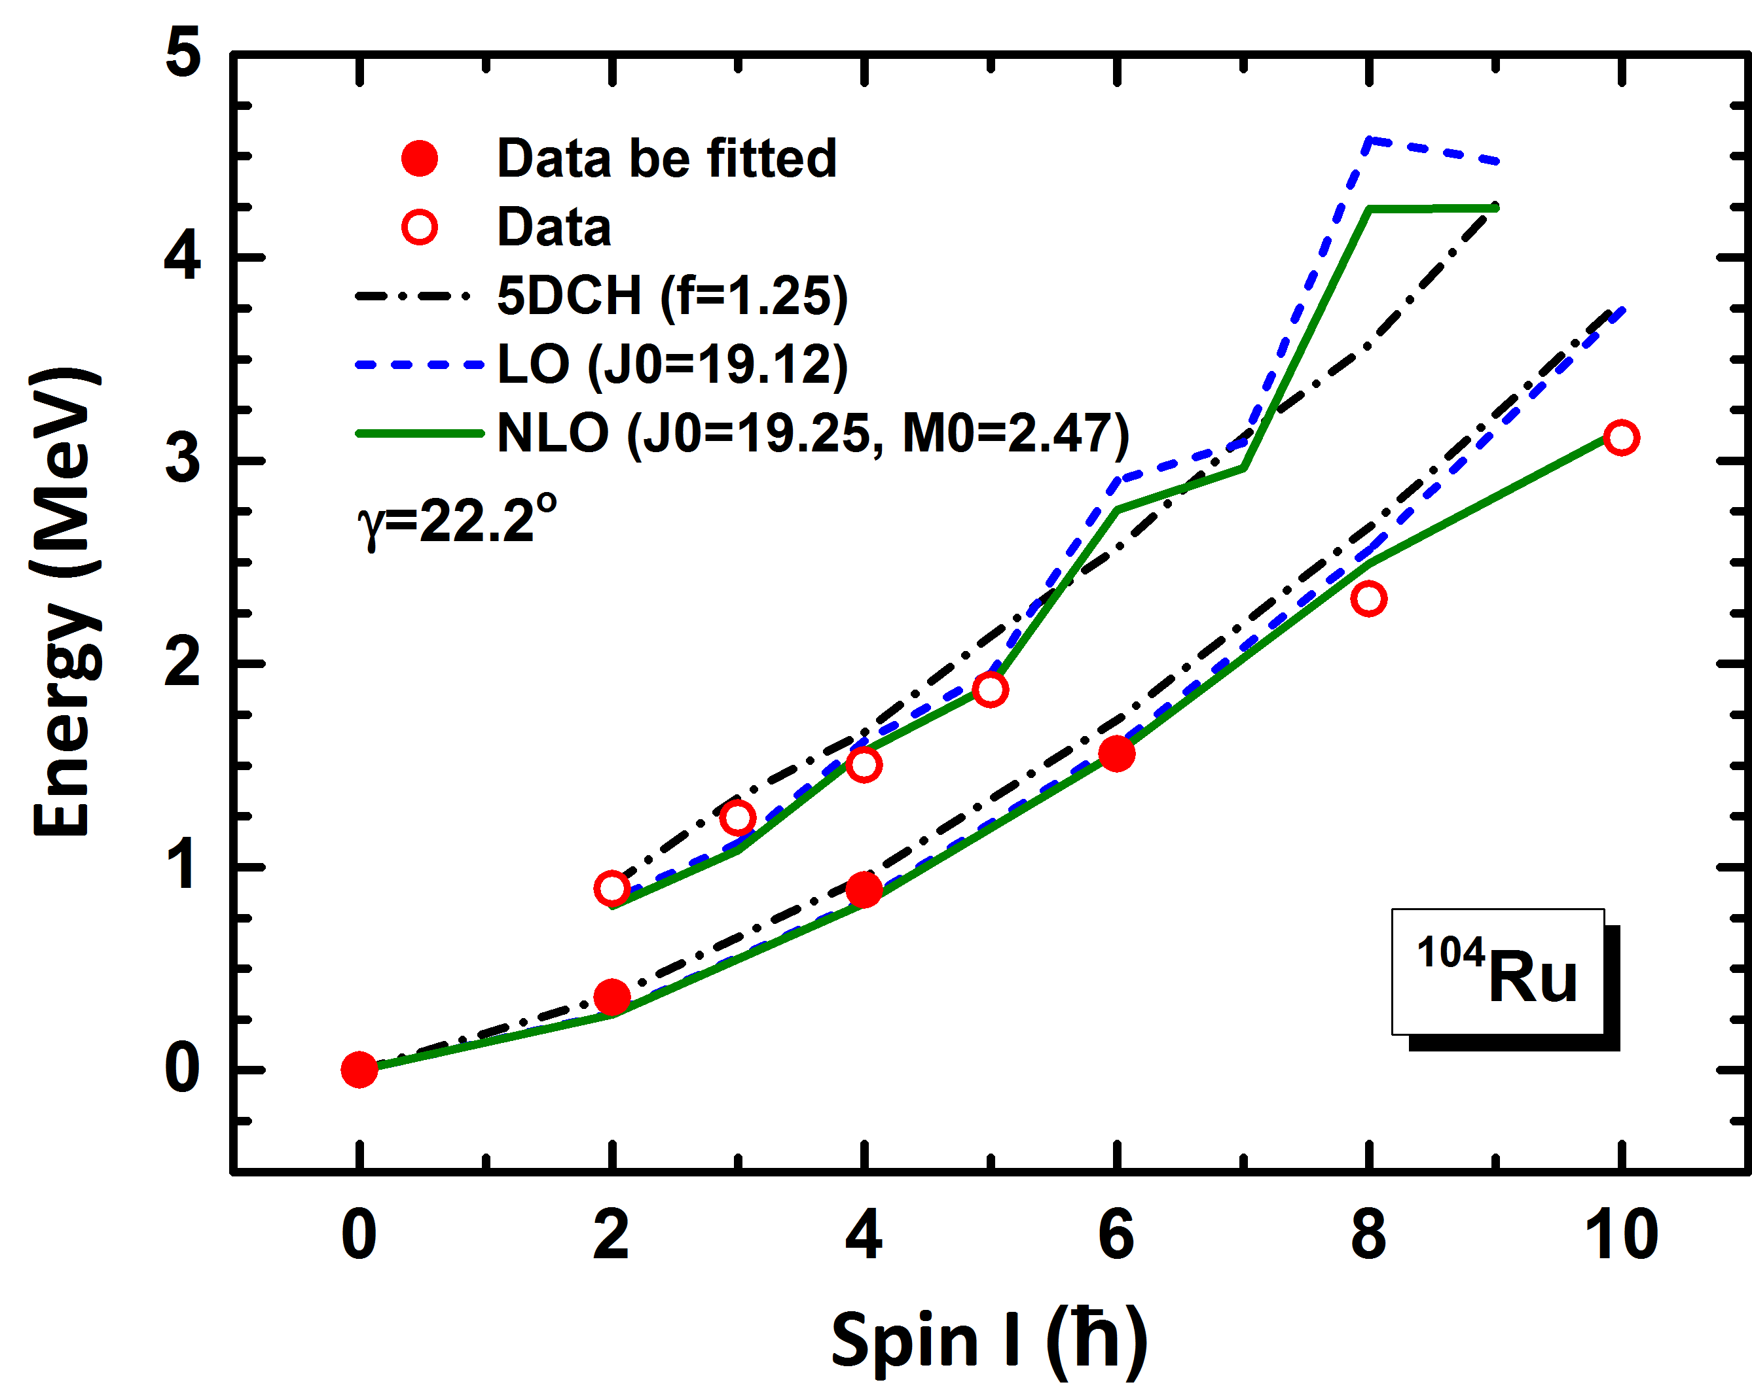
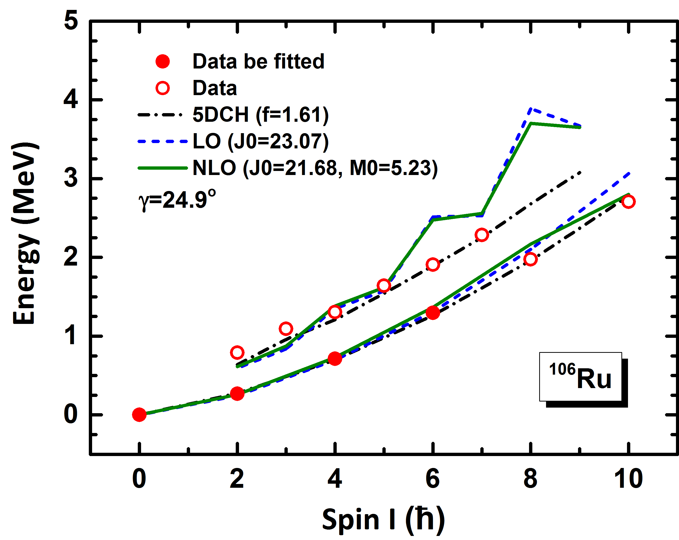
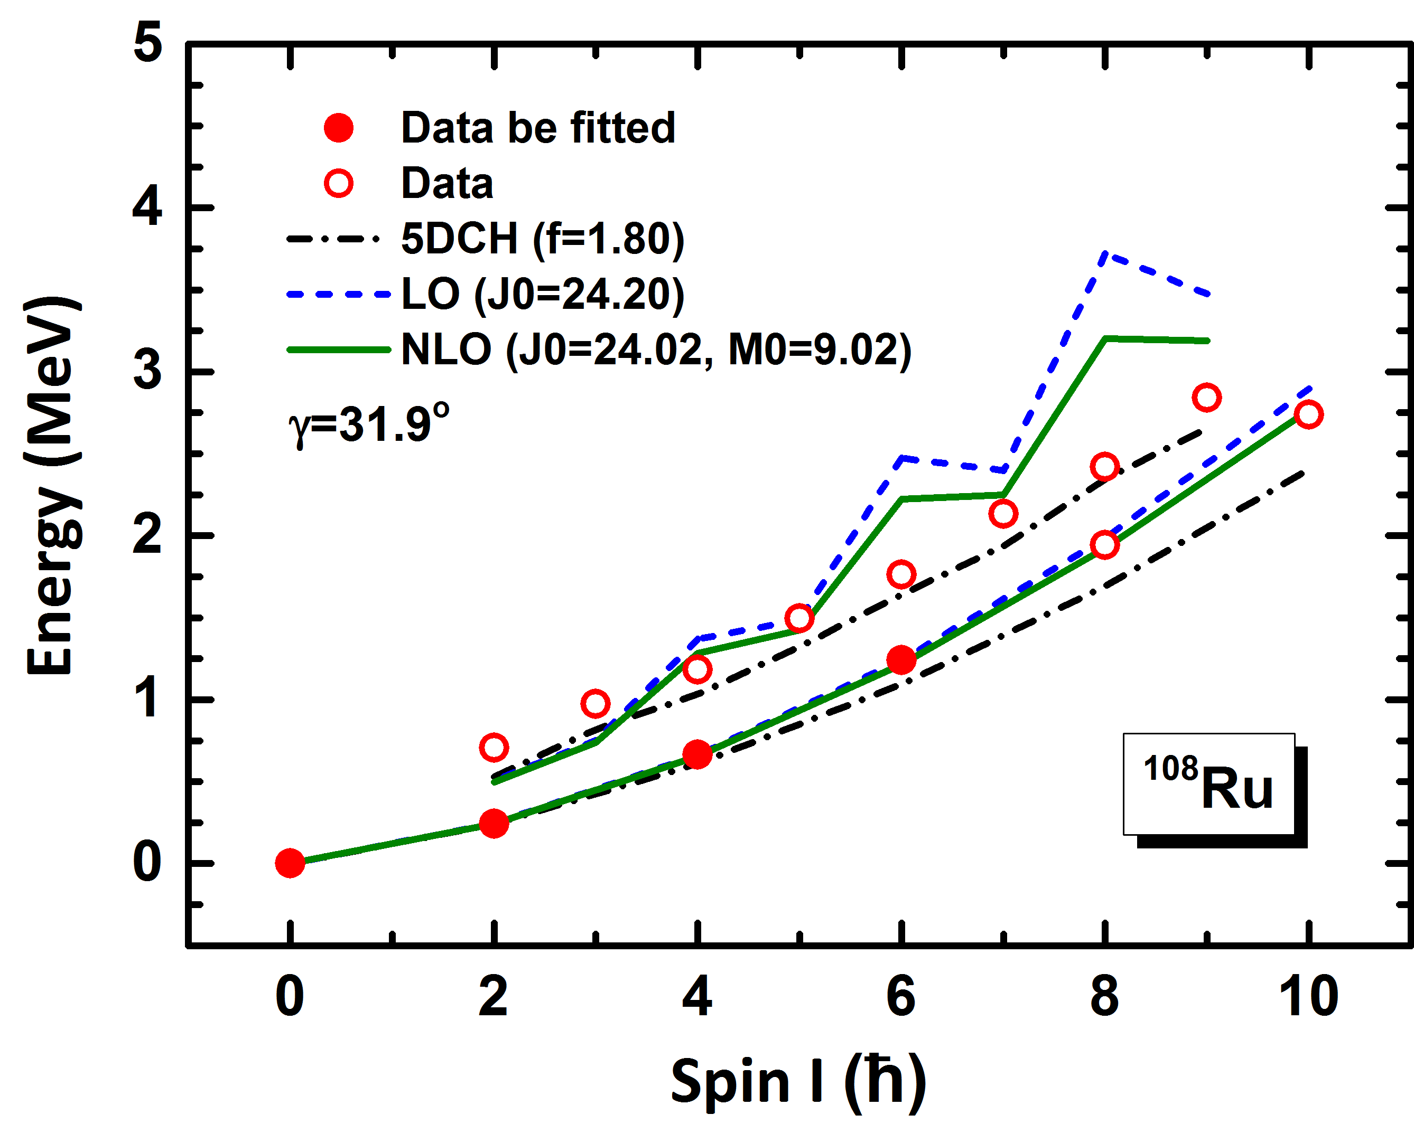
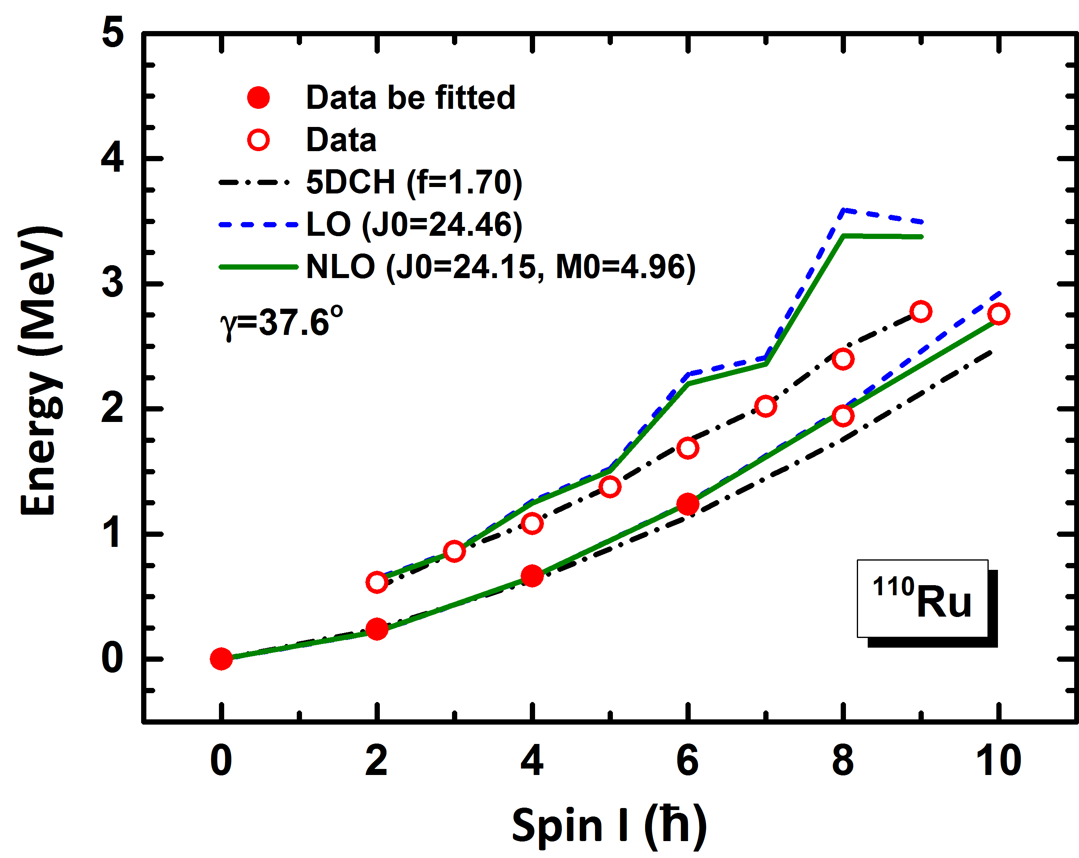
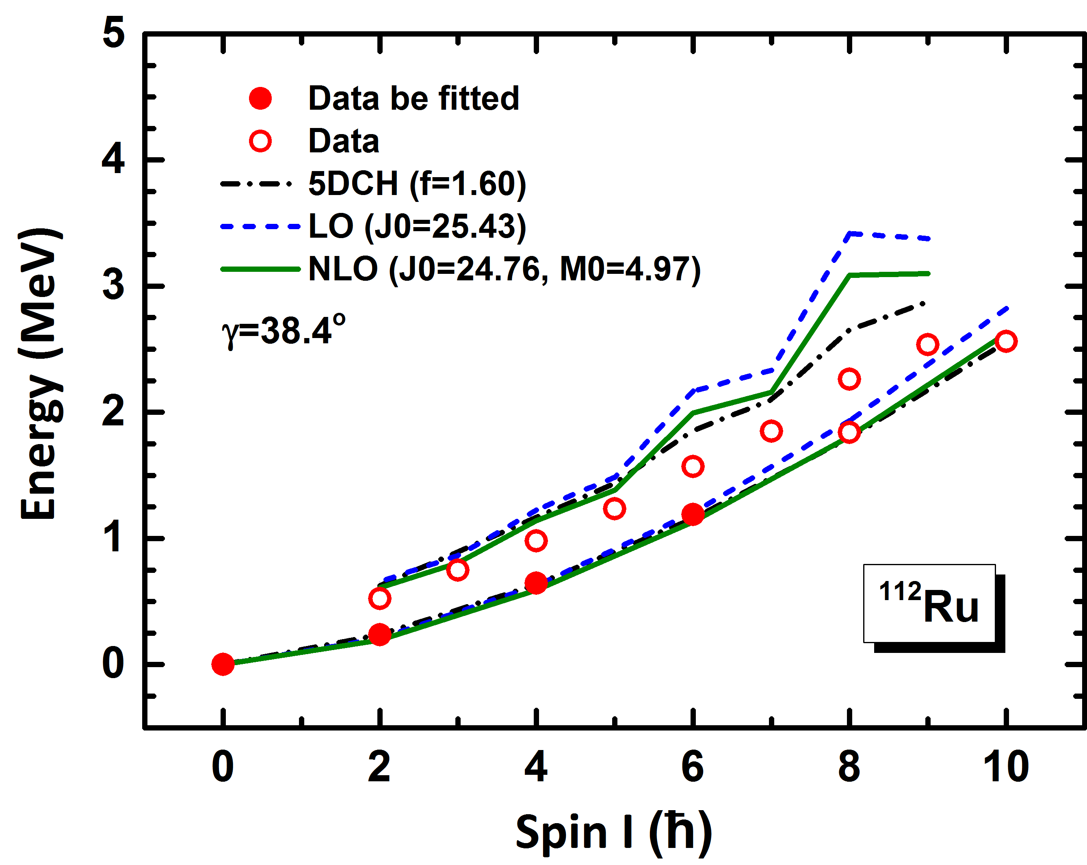
Energy spectra: Strategy I
Similar conclusions as ¹¹²Ru can be obtained.
Notes:
23. In this figure, the energy spectra of the ground state and $\gamma$ bands in the isotopes $^{102}$Ru up to $^{112}$Ru calculated at LO and NLO are shown in comparison to experimental data and results from the 5DCH Hamiltonian. We find similar results and draw the same conclusions for these lighter Ru isotopes as for $^{112}$Ru. Overall, the description at NLO is better than at LO, but there are still some deviations between the NLO results and the data for the high spin states in the $\gamma$ bands. Since the 5DCH results are in good agreement with the data, this points again towards the importance of including vibrational degrees of freedom in the EFT formulation.

Slide 24
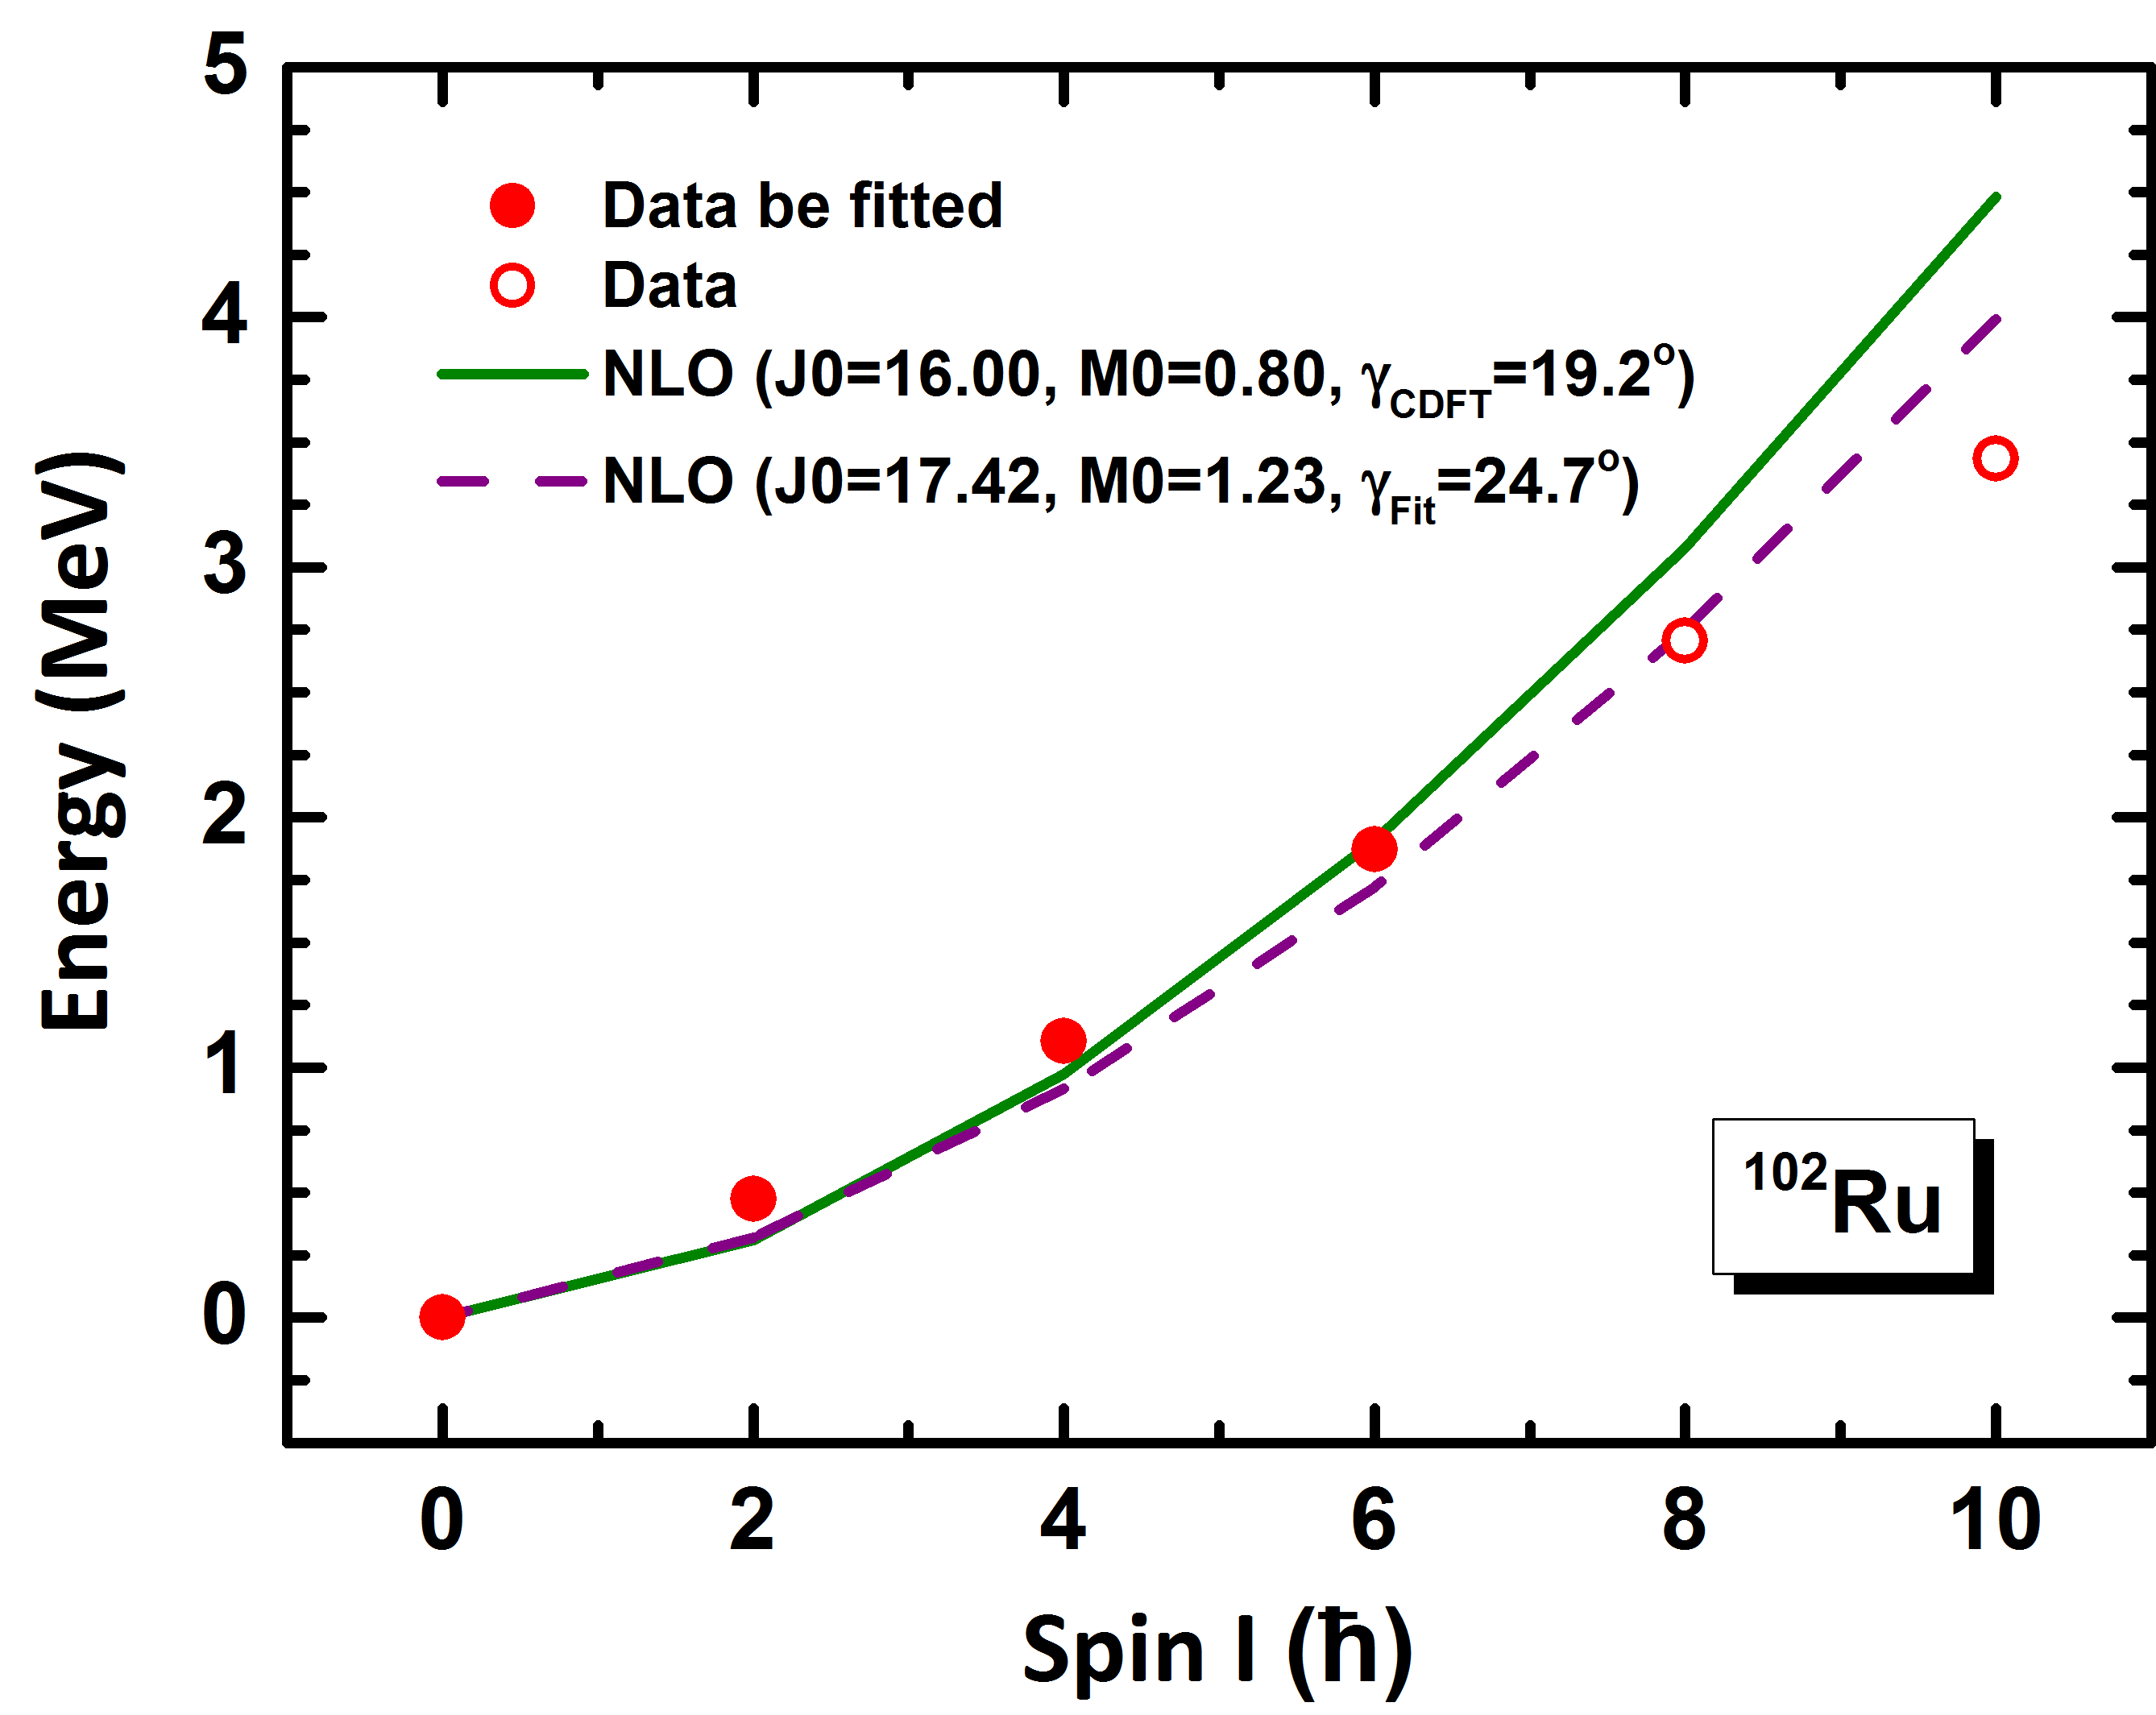
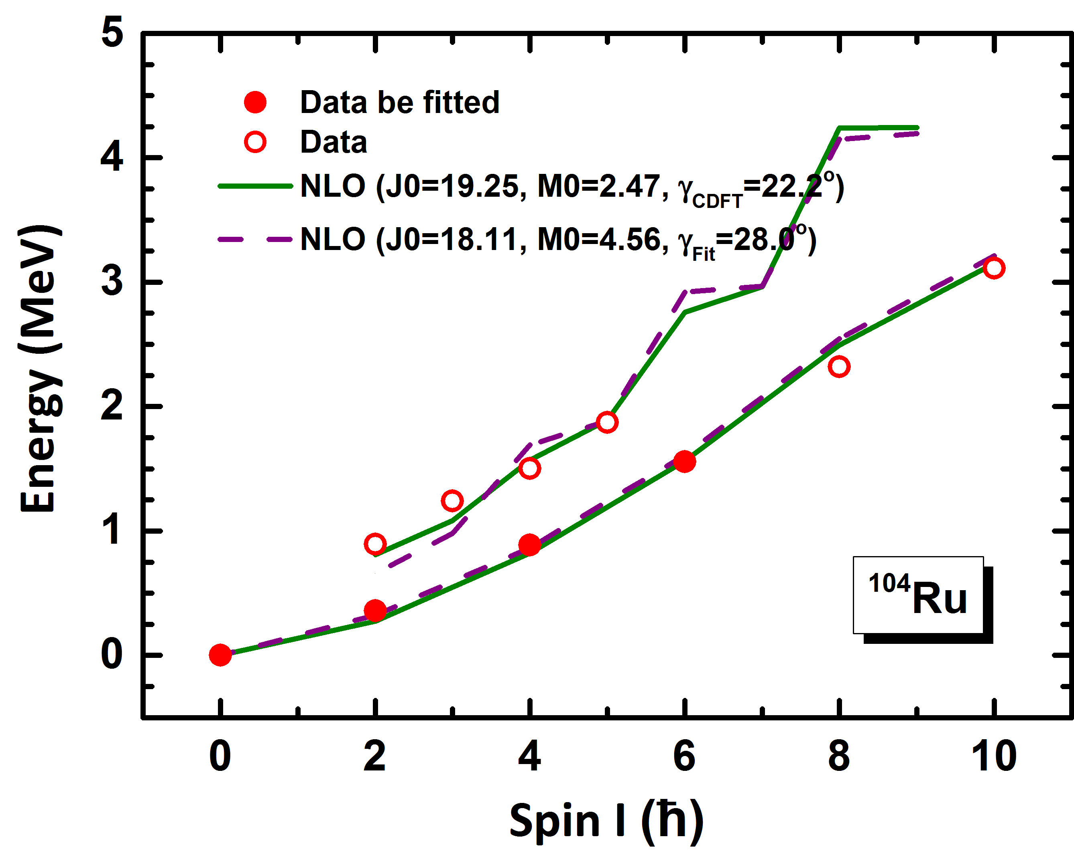
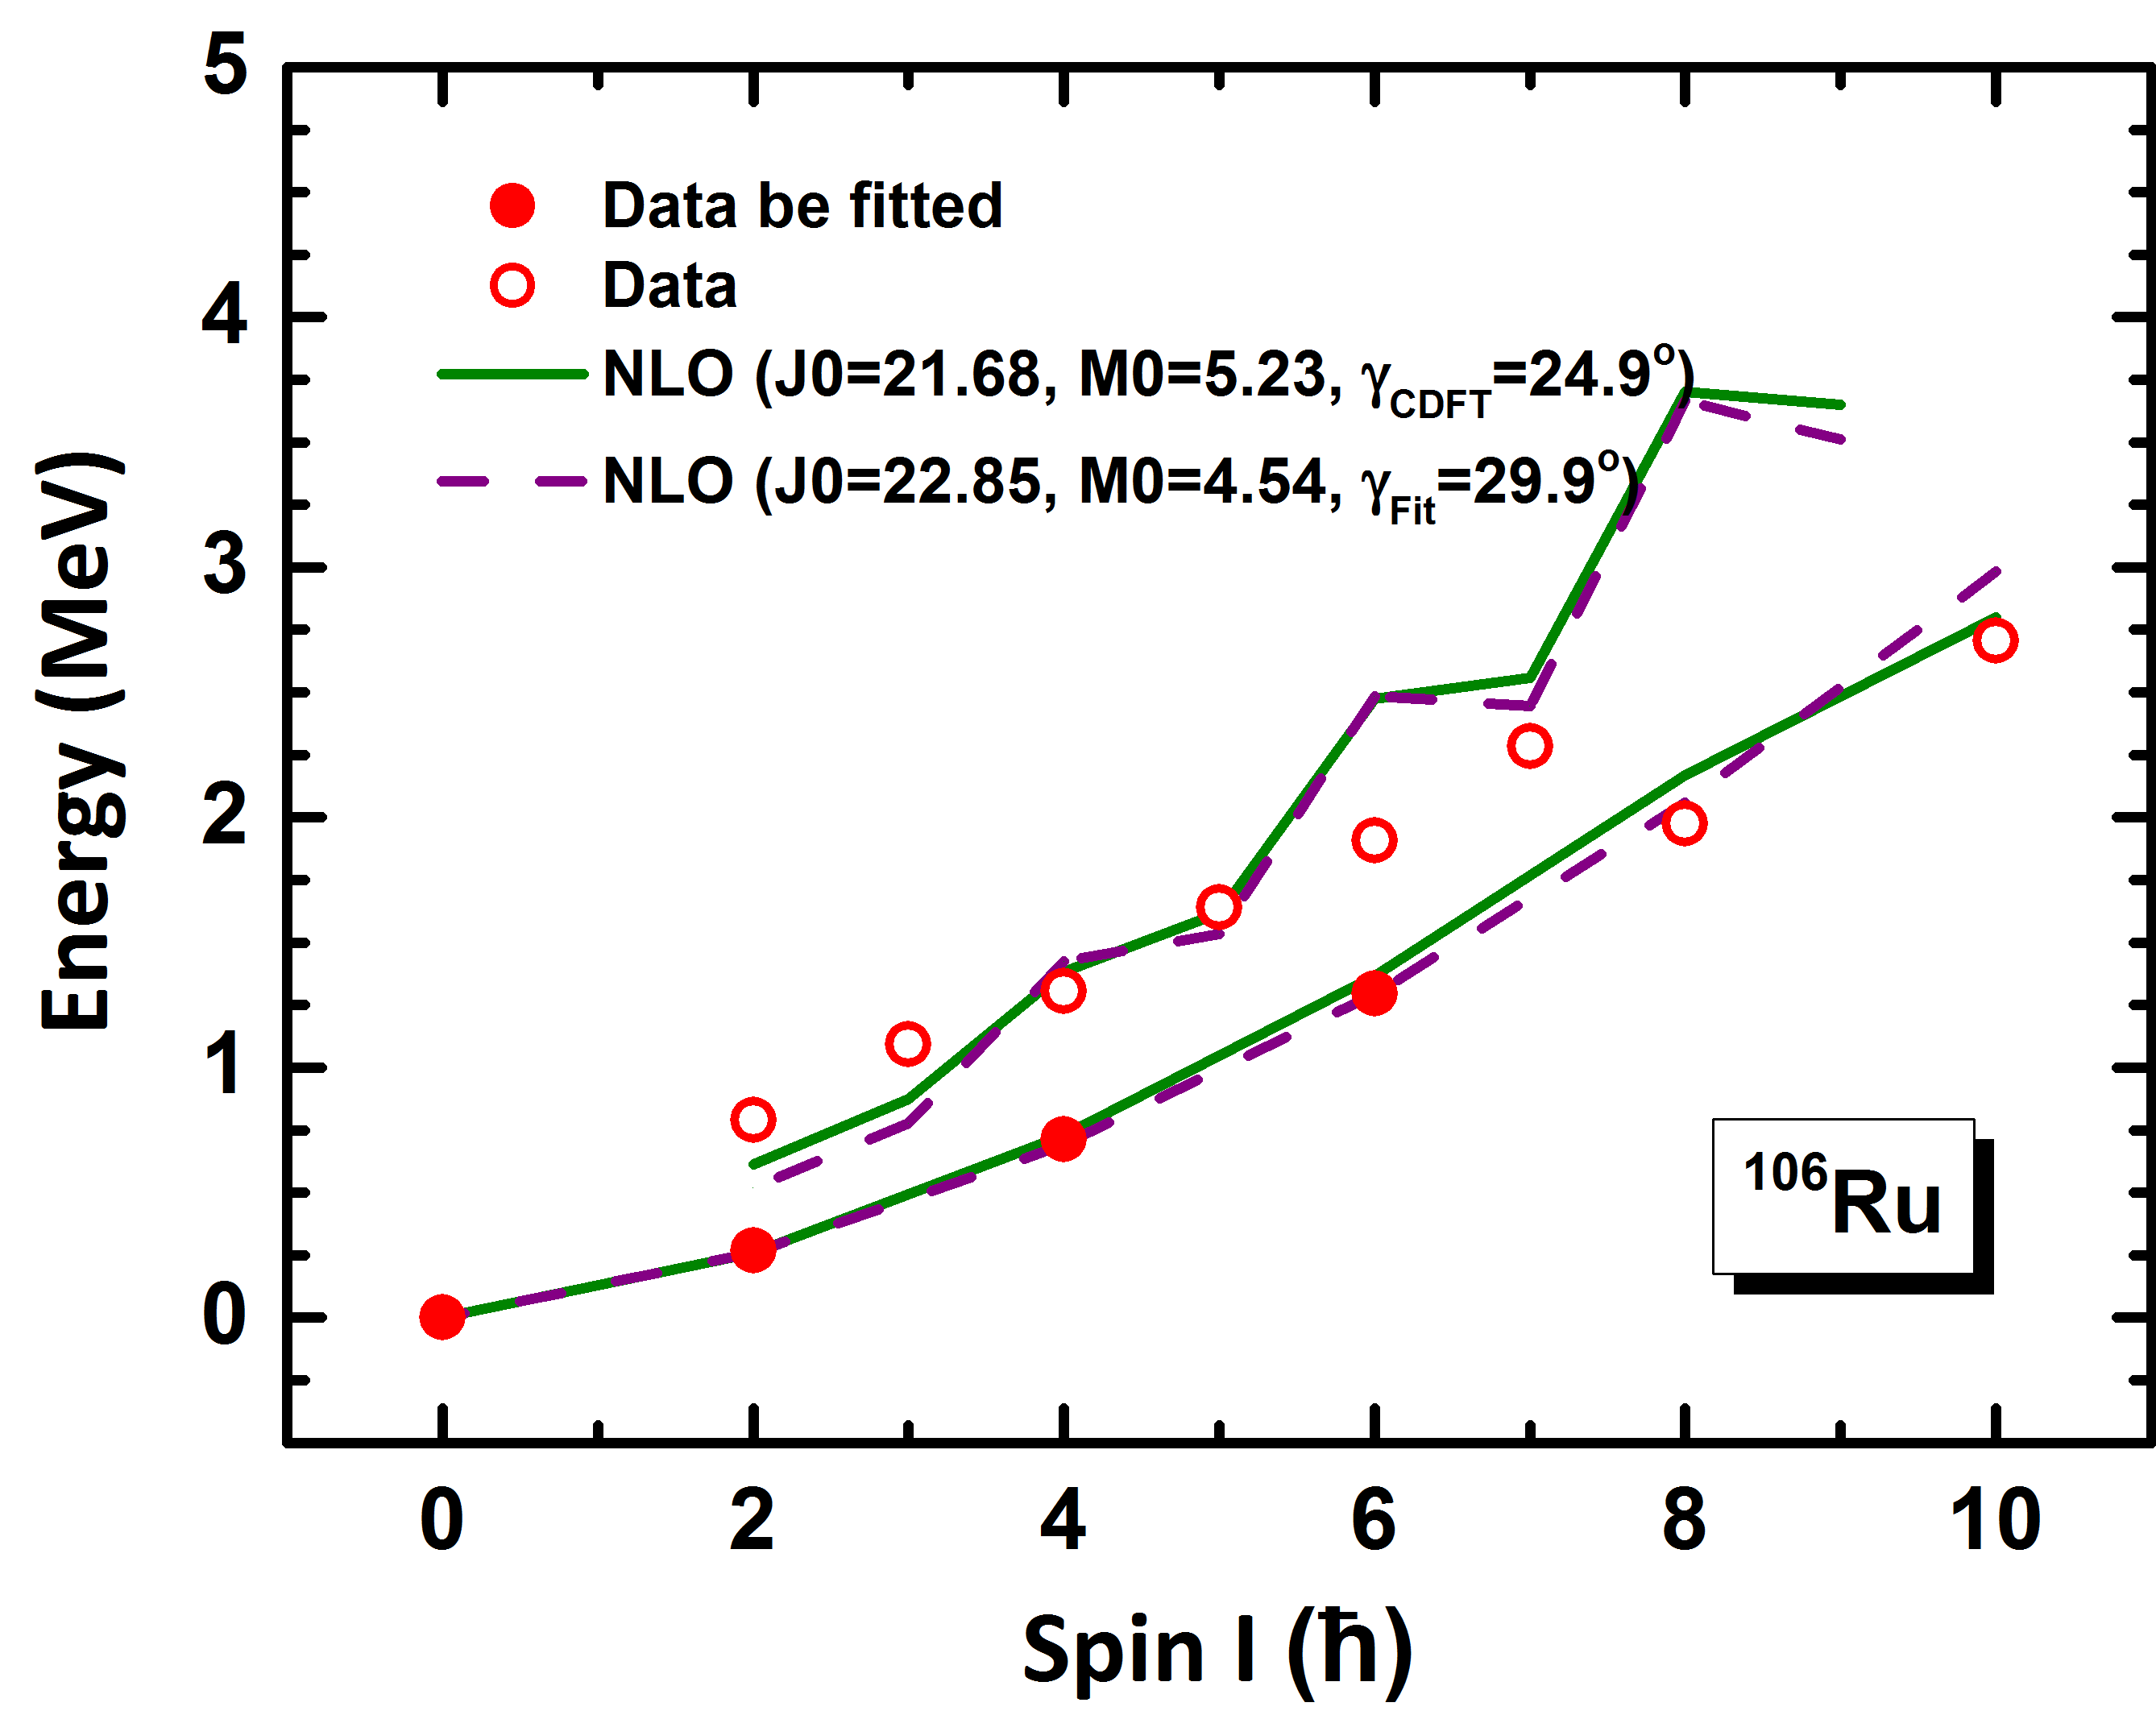
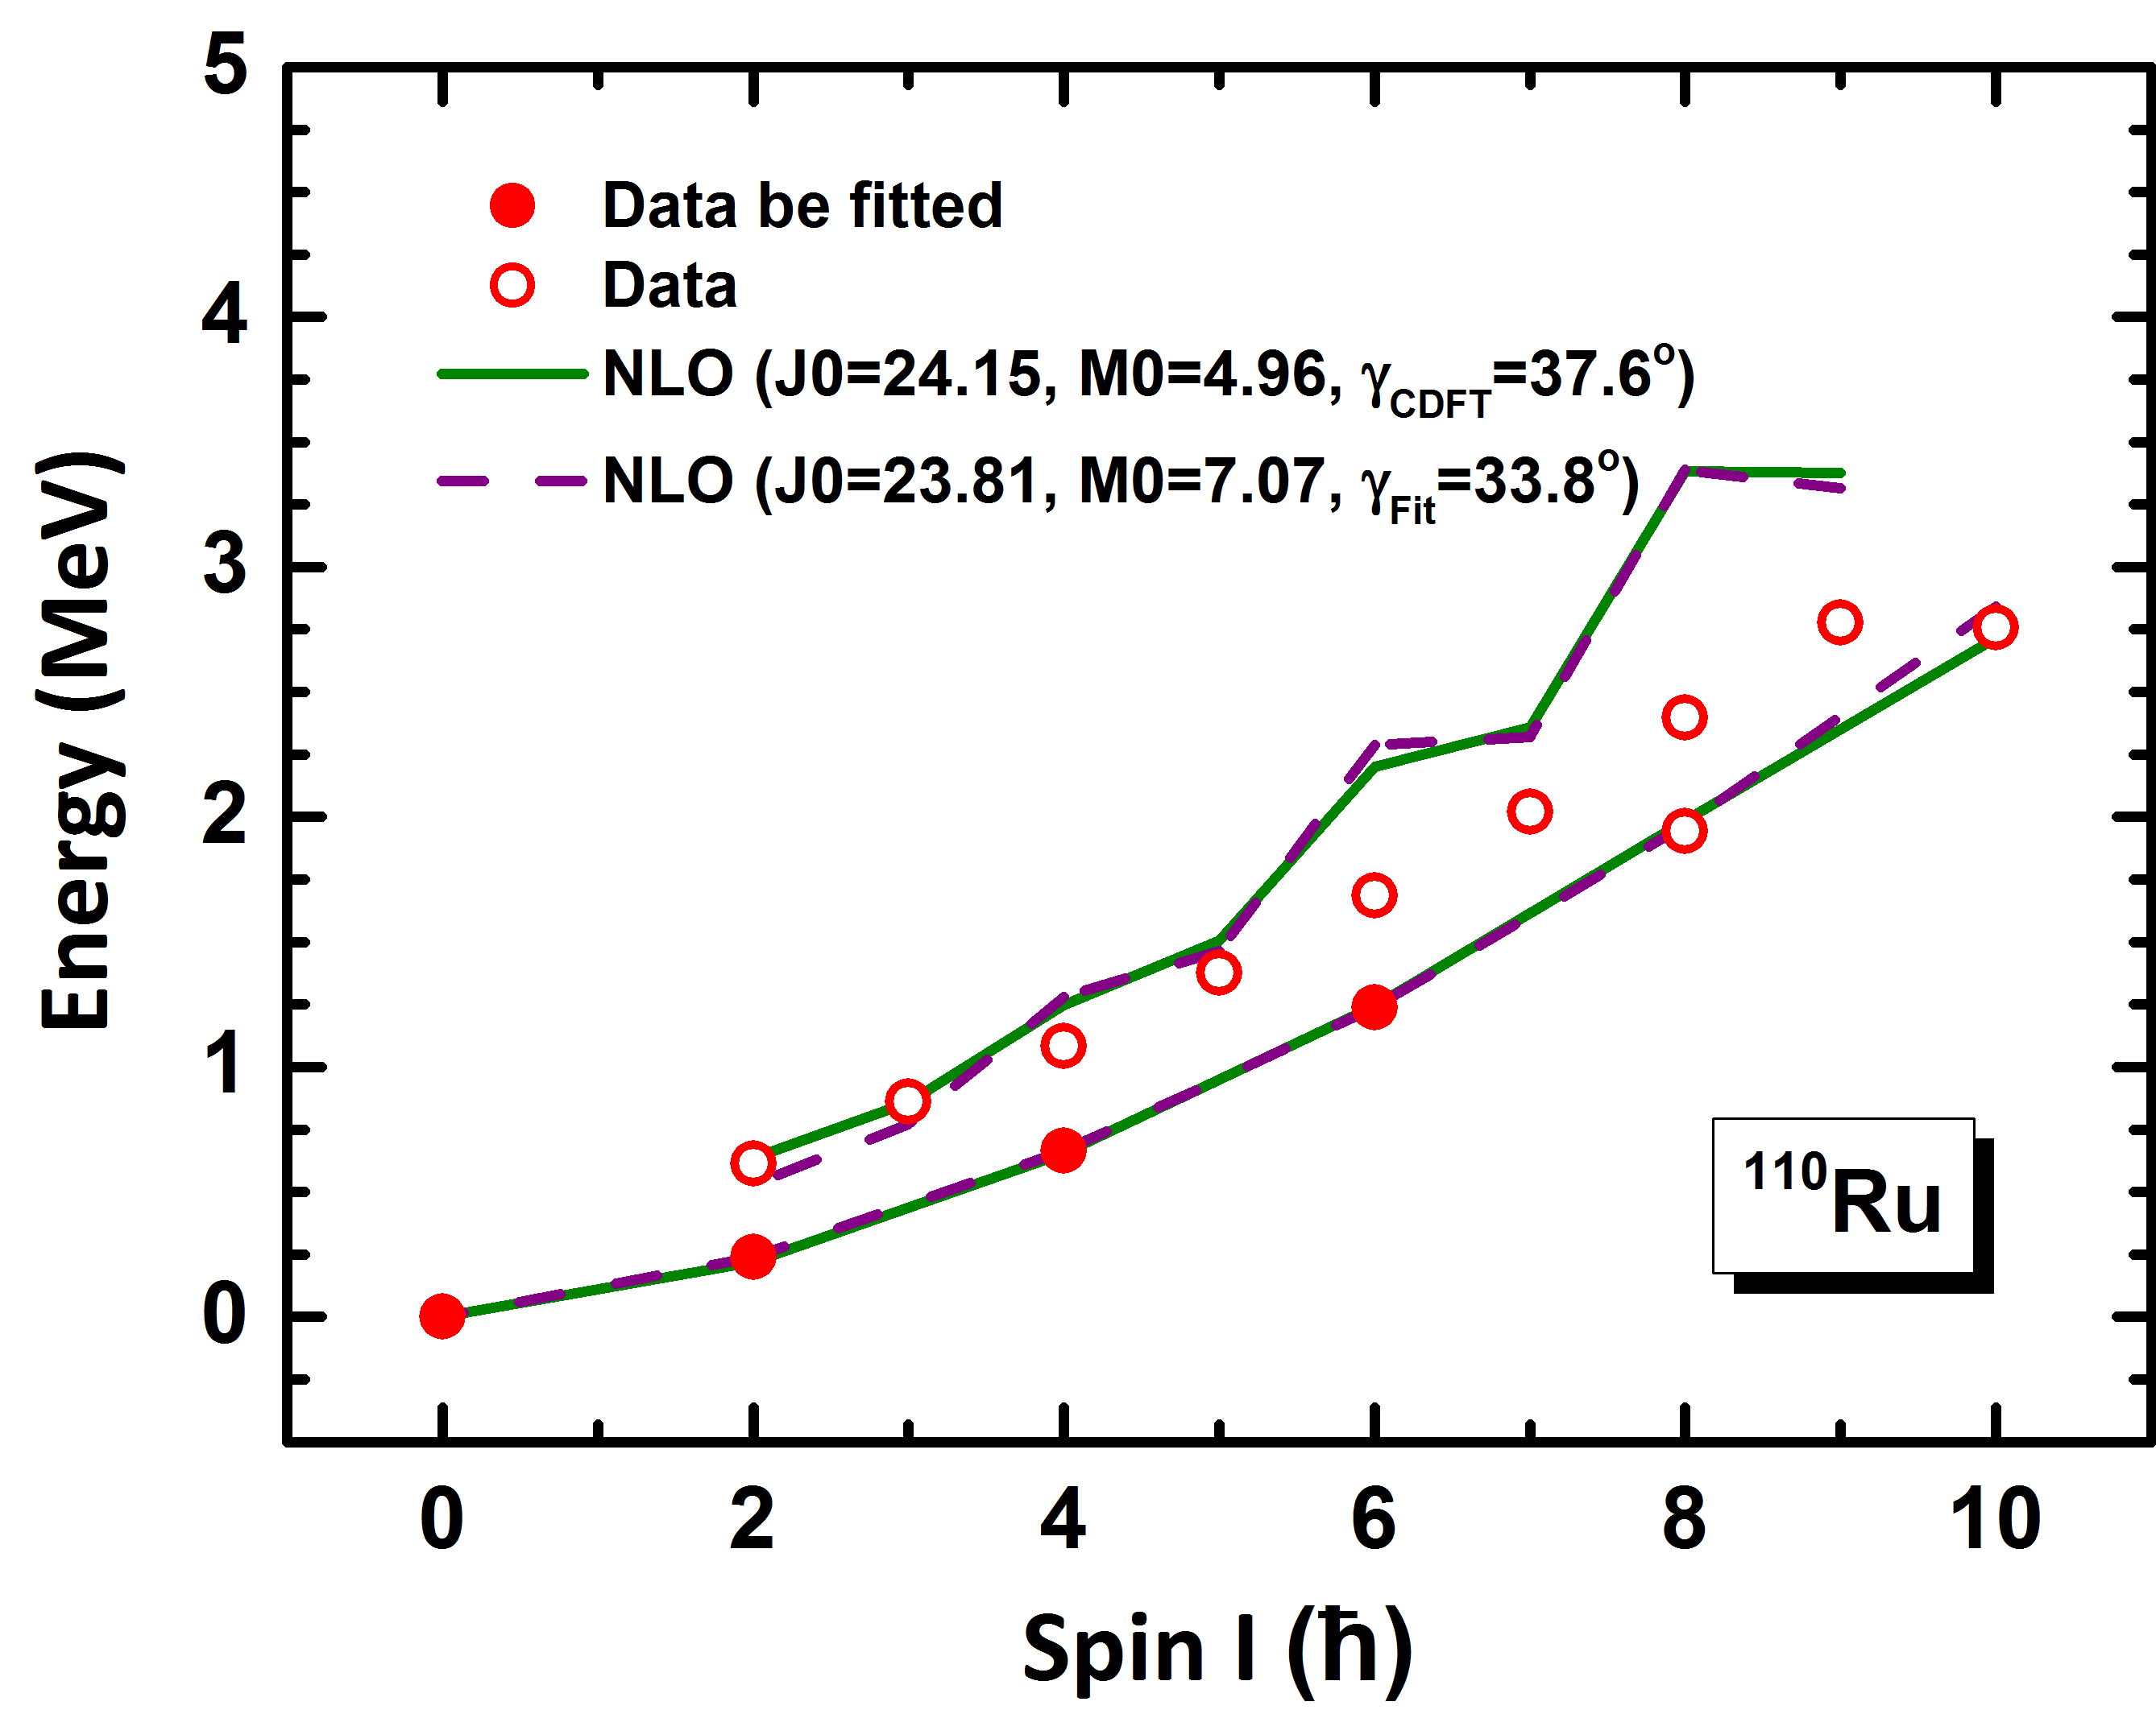
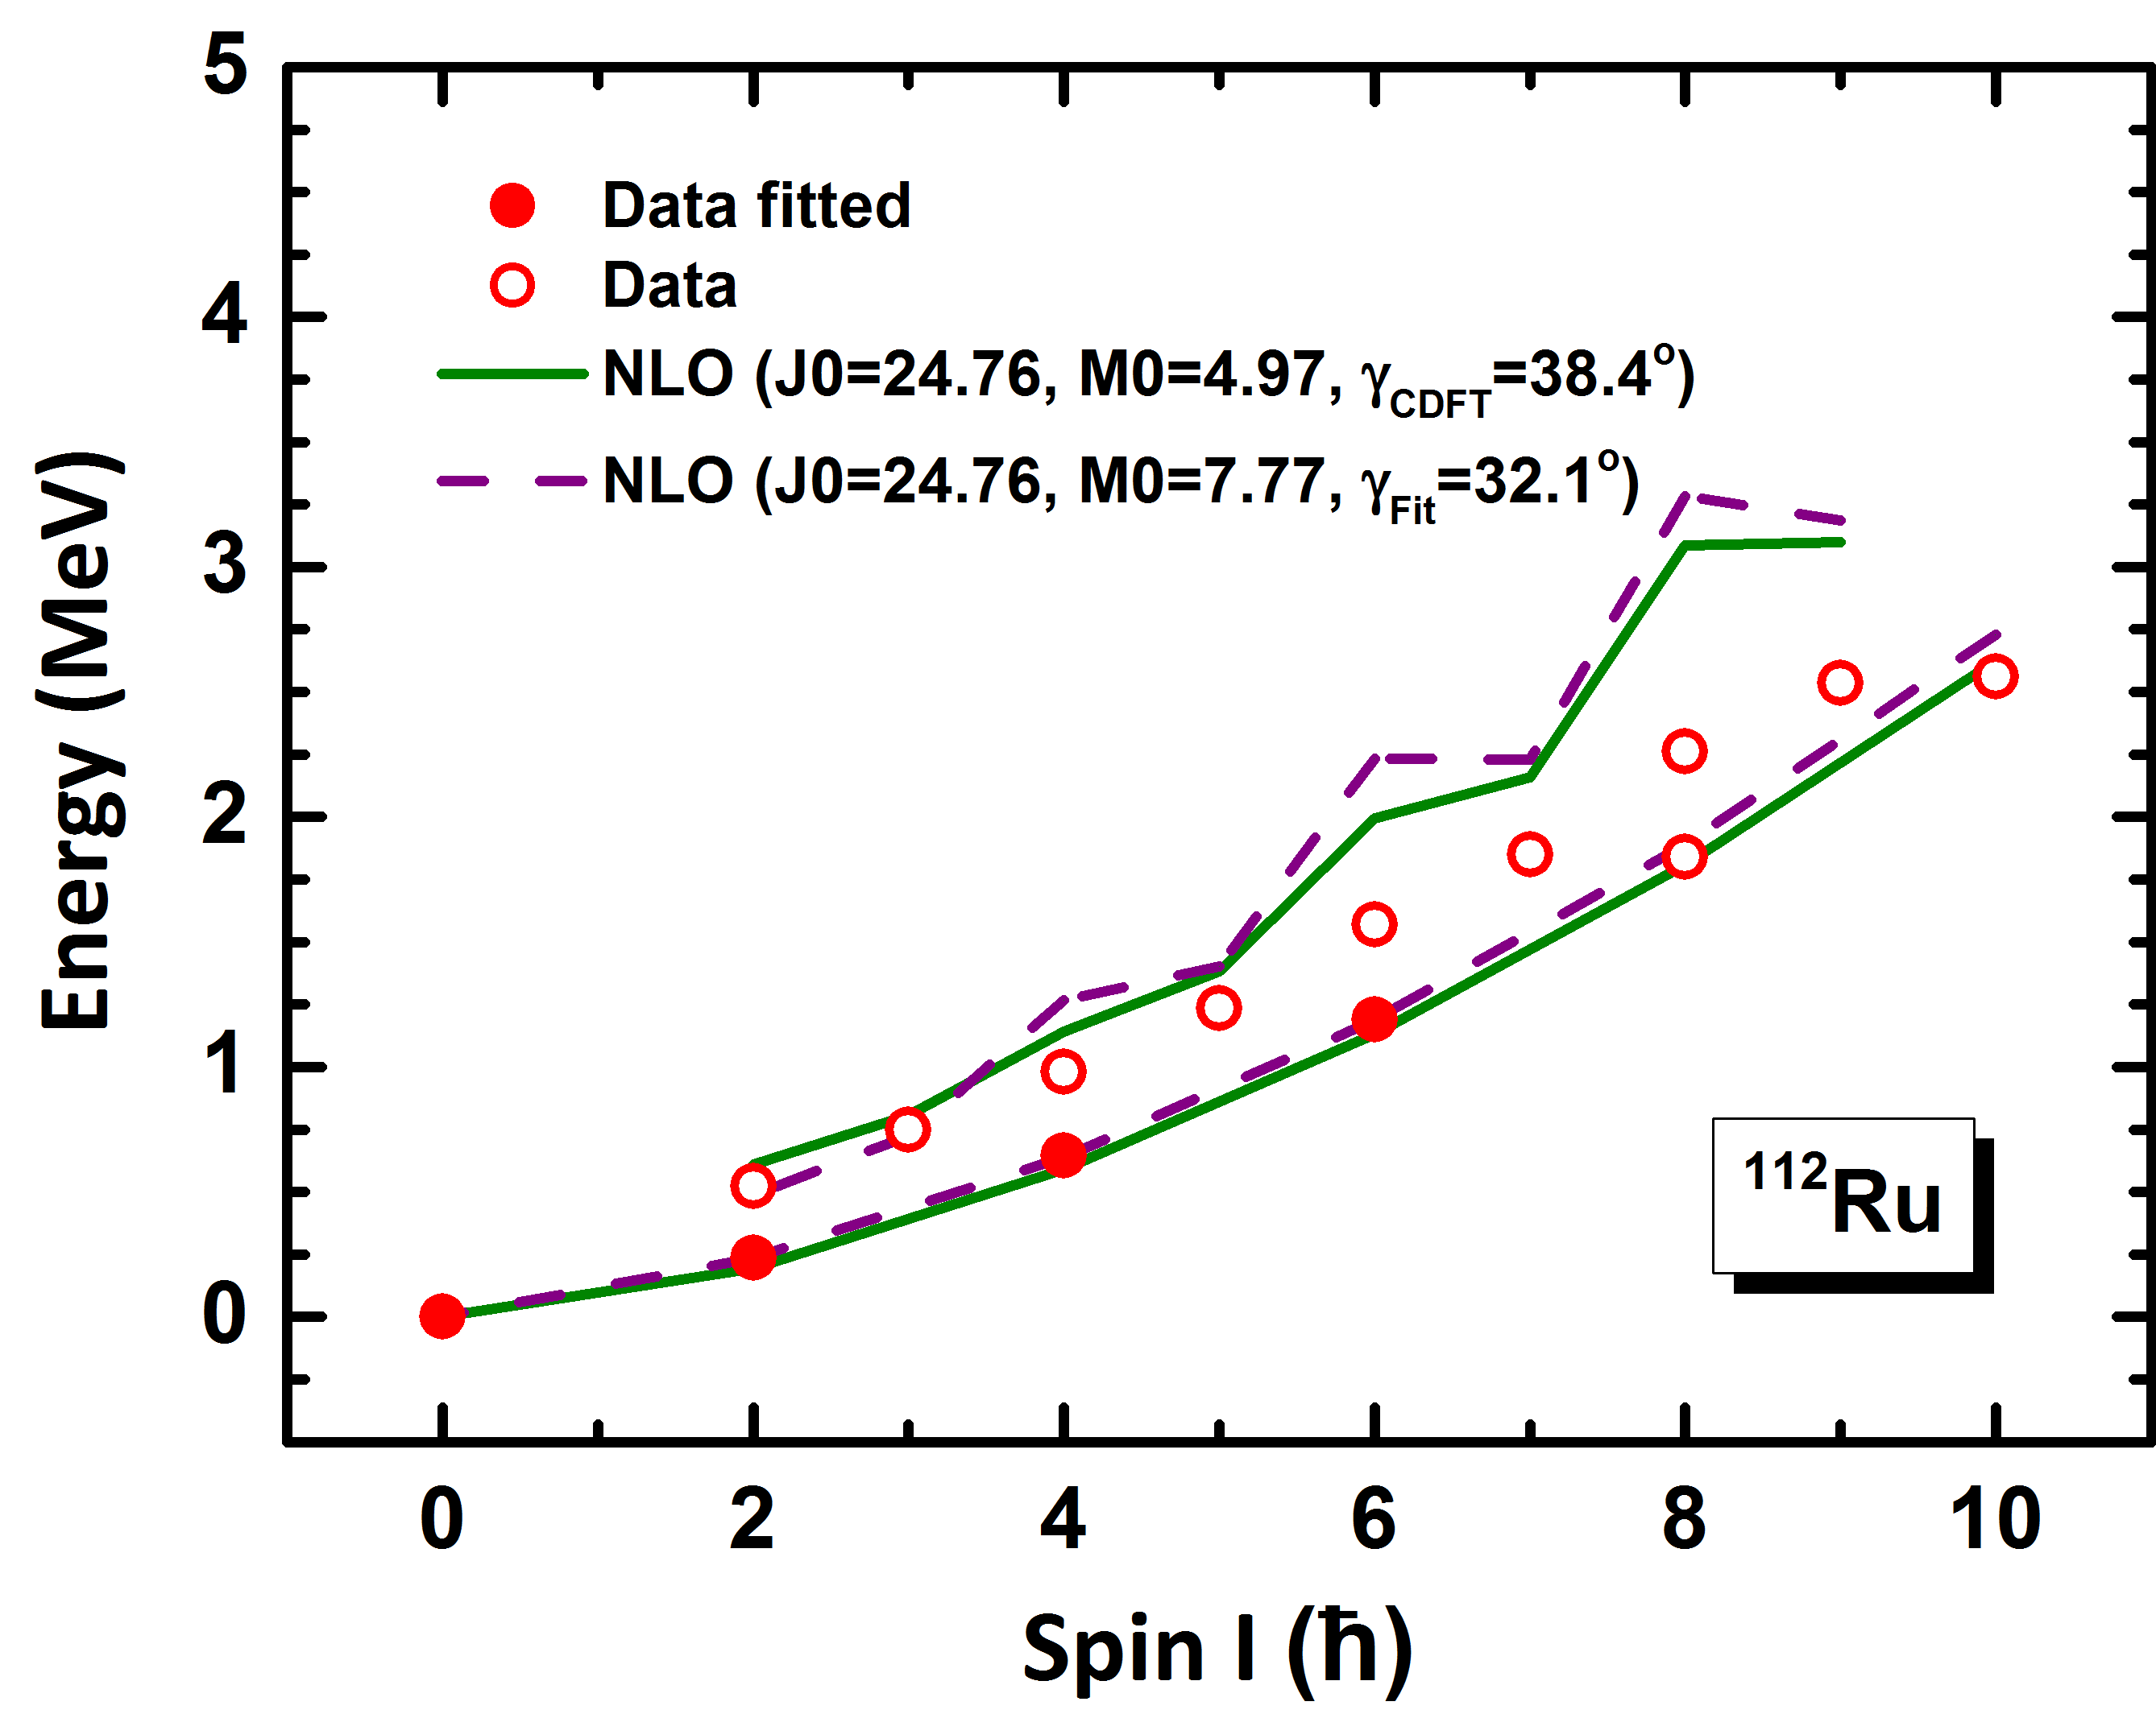
Energy spectra: Strategy II
g as well as J₀ and M₀ are all fitted by the data (spin~0, 2, 4, 6).
Notes:
25. Next, we consider the results of the genuine EFT approach, where all pertinent parameters are determined from a fit to data. The two sets of parameters are similar, but there some differences, most visible in the triaxial deformation parameter $\gamma$. It remains to be seen whether these differences persist if the vibrational degrees of freedom are included in the EFT formulation. The energies in the ground state and the $\gamma$ band at NLO are displayed in this figure for both fit strategies and the resulting description of all data turns out to be very similar in both approaches. It is comforting to see that the effective field theory without any external input works equally well as the (more microscopic) CDFT calculation.

Slide 25
Outline
Introduction
Theoretical framework
Numerical details
Results and discussions
Summary and perspective

Slide 26
Summary and perspective
The EFT for the collective rotational motion has been generalized to triaxially deformed nuclei (up to NLO order). Its applicability has been examined by describing the energy spectra of the ground state and g-bands of ¹⁰²⁻¹¹²Ru and by comparing to results by 5DCH.
It is found that the description at NLO is overall better than at LO. There are still some deviations between the NLO calculation and the data for high-spin states in the g-bands.
We also show that the EFT for collective nuclear rotation can be applied without referring to any microscopic input by comparing the results of two different fitting strategies.
In future, further generalize the EFT for triaxially deformed nuclei with odd mass number (for wobbling and chiral nuclei) and to include systematically the vibrational degrees of freedom.
Notes:
27. In this work, the effective field theory for the collective rotational motion has been generalized to triaxially deformed nuclei. The Hamiltonian of the triaxial rotor model has been constructed up to next-to-leading order in the EFT power counting. Taking the energy spectra of the ground state and $\gamma$ bands of the even isotopes $^{102}$Ru up to $^{112}$Ru as benchmarks, the applicability of the EFT has been examined by describing the pertinent data for spins $I\leq 10$ and by comparing to results obtained with a five-dimensional collective Hamiltonian. It is found that the description at NLO is overall better than at LO. Nevertheless, there are still some deviations between the NLO calculation and the data for high-spin states in the $\gamma$ bands. This point towards the importance of including vibrational degrees of freedom in the EFT formulation.
In addition, we have compared two strategies of fitting parameters. In the first strategy, $\gamma$ is taken from a CDFT calculation, and in the second strategy, $\gamma$ is also fitted to the data (the genuine EFT approach). The corresponding results show that the EFT for collective nuclear rotation can be applied without referring to any microscopic (model-dependent) input. We have found that the value of $\gamma$ as obtained in the second strategy is close to the one predicted by CDFT. This suggests that CDFT is a reliable microscopic approach to calculate ground state properties. Hence, we can (but need not) combine EFT and CDFT to describe the rotational spectra of deformed nuclei.
The results presented give us a strong motivation to further generalize the EFT for triaxially deformed nuclei with odd mass number and to include systematically the vibrational degrees of freedom.

