Slide 1
巧用 FPGA
Wu, Jinyuan
Fermilab
Oct, 2017

Slide 2
FPGA Applications:
FPGA devices are flexible and universal.
In addition to typical environments, FPGA devices are also used in satellite, the mu2e experiment, etc.
FPGA devices are good prototype platform for ASIC designs. Some good design practices are also true for ASIC designs.
The range of FPGA application is very likely to be broader than we can image.

Slide 3
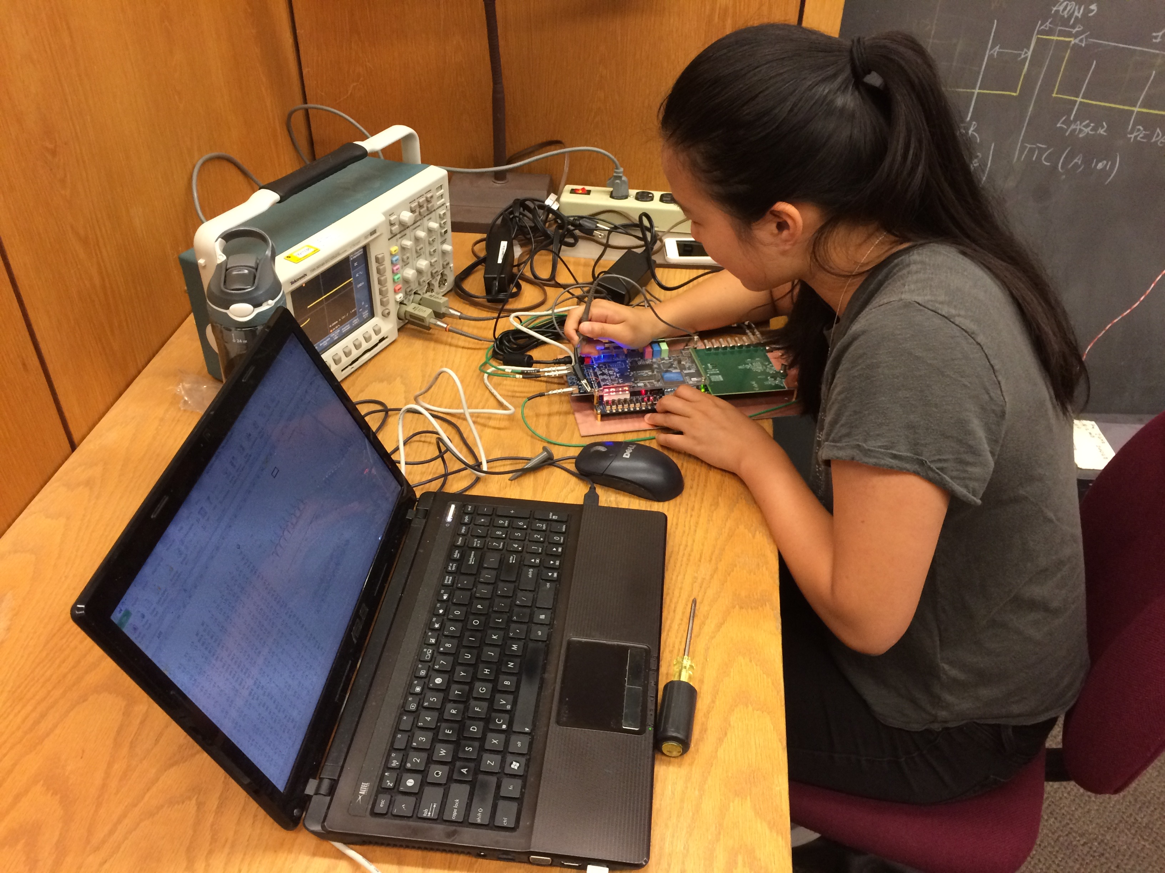
Threshold of FPGA Application
Good high school students can start basic application of the FPGA devices in a short amount of time.

Slide 4
Performance Degrading in CPU/GPU, ASIC & FPGA
Performance
Theoretical limit of current technology
Degrading
Due to
Design
Theoretical limit of
Older technology
Carefully designed FPGA may have better performance than typical ASIC.
Degrading
Due to
Structure
Degrading
Due to
Design
Degrading
Due to
Design
CPU/GPU
ASIC.
FPGA
Imperfect designs degrade performance of ICs, including CPU/GPU considerably.
ASIC devices are built using older technology and suffering similar design degrading.
FPGA internal structure causes extra performance degrading in addition to design degrading.
Design modification in FPGA is easier so that design degrading can be minimized.

Slide 5
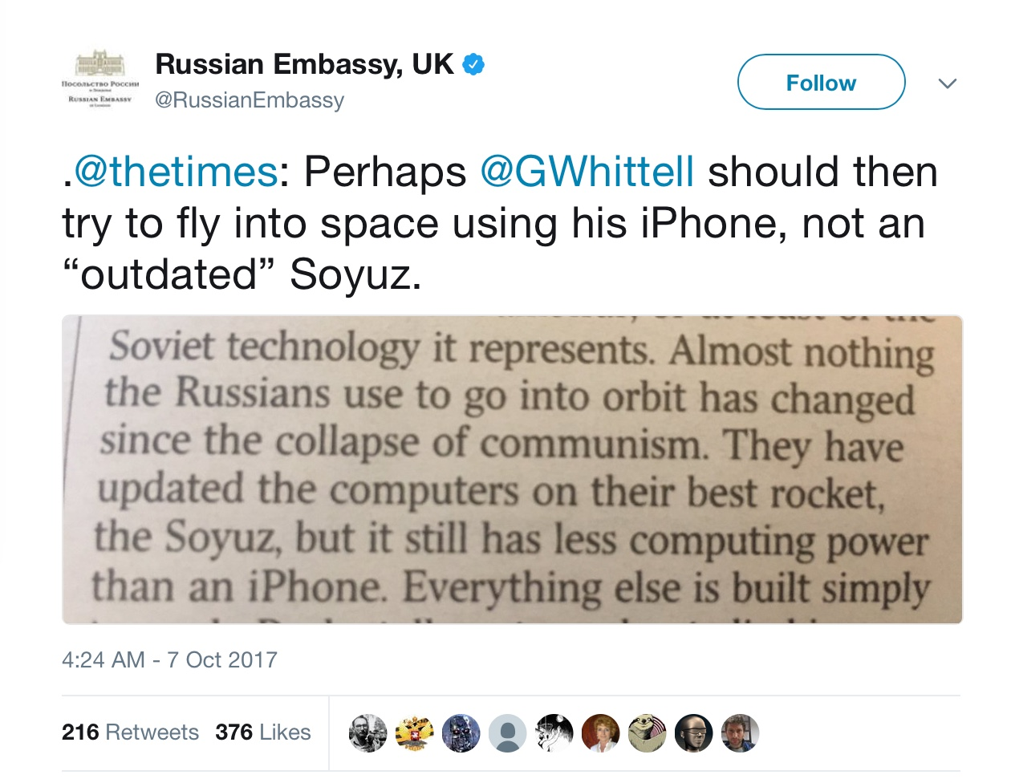
Soyuz vs iPhone
“Powerful” != Good Performance.

Slide 6
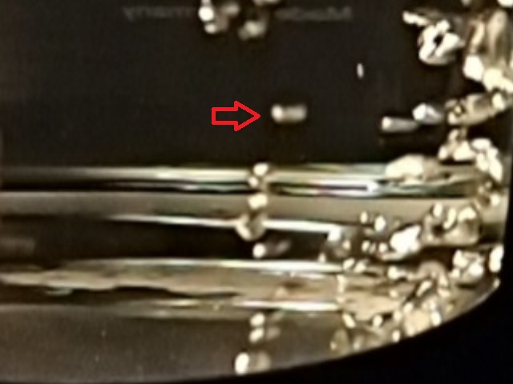
Considering for a Good FPGA Design:
System Reliability
Operating Frequency
Device Cost
Power Consumption

Slide 7
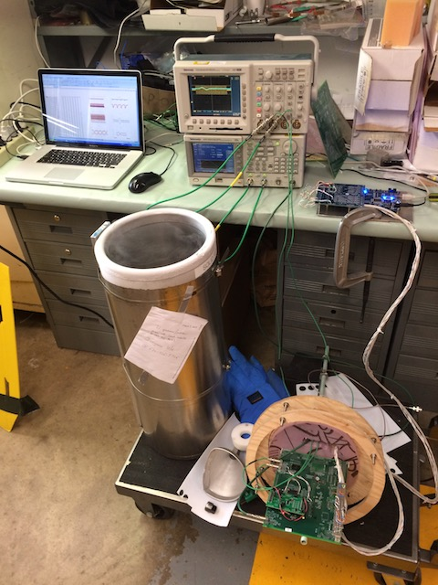
An FPGA Application Liquid Argon
Waveform digitization at 2 MSPS, 12-bit.
Operating at 77/87 K.
High reliability

Slide 8
Block Diagram
FPGA
DDR2/3
8B10B
Signal
Source
Shaper
TDC
Timing
CmdReg1a
Signal
Source
Shaper
PLL
C5
Decoder
TDC
V_{REF}
R
R
C
Clock & Command In
Data
Out
R1
The ramping reference voltage is generated from digital outputs of FPGA.
The differential receivers for the FPGA input are used as comparator.
TDC is implemented in the FPGA with approximately 125 ps bin width.
忘了画ADC？

Slide 9
Digitization of Analog Waveforms
FPGA
AMP &
Shaper
ADC
AMP &
Shaper
ADC
AMP &
Shaper
ADC
AMP &
Shaper
ADC
ADC chips cost and power consumption are relatively high.
The reliability of the ADC device is unknown.
什么ADC最可靠？没有ADC最可靠。

Slide 10
ADC Using FPGA
FPGA
AMP &
Shaper
ADC
AMP &
Shaper
ADC
AMP &
Shaper
ADC
Analog signals from AMP & Shapers are directly fed to FPGA pins.
FPGA outputs and passive RC network are used to generate ramping reference voltage V_{REF}.
The input voltages and V_{REF} are compared using FPGA differential input receivers.
The times of transitions representing input voltage values are digitized by TDC blocks in FPGA.
AMP &
Shaper
ADC
FPGA
AMP &
Shaper
TDC
AMP &
Shaper
TDC
AMP &
Shaper
TDC
AMP &
Shaper
TDC
V₁
V₁
V₃
V₂
V₃
V₂
V₄
V_{REF}
V₄
R1
R1
C
T₁
T₁
T₂
T₂
T₃
T₃
T₄
R2
T₄

Slide 11
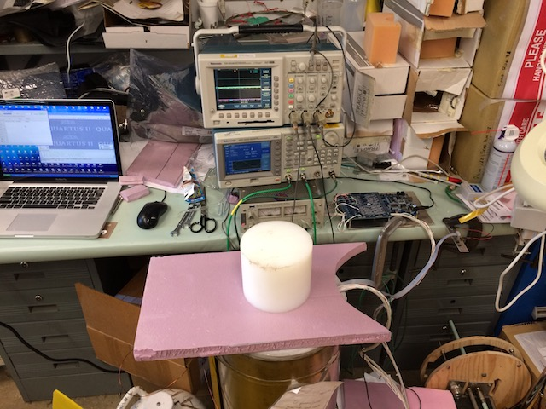
Testing
Various tests are performed in Fermilab, and more to do.

Slide 12
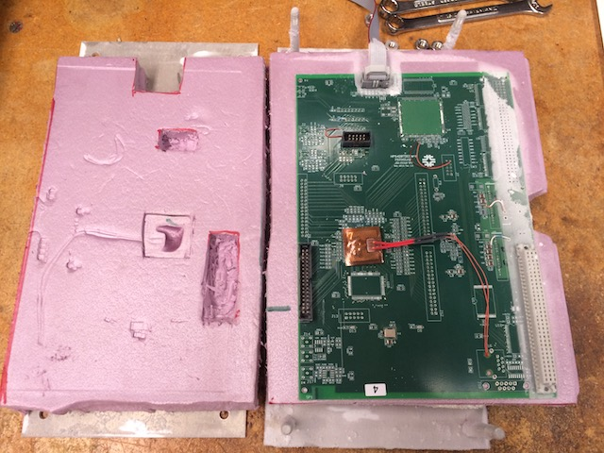
After Testing

Slide 13
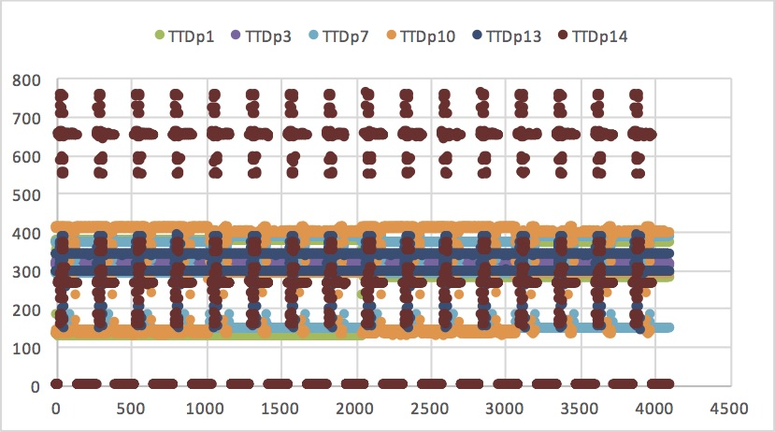
Raw Data
Data of several pulses from multiple channels when FPGA is in the LN.

Slide 14
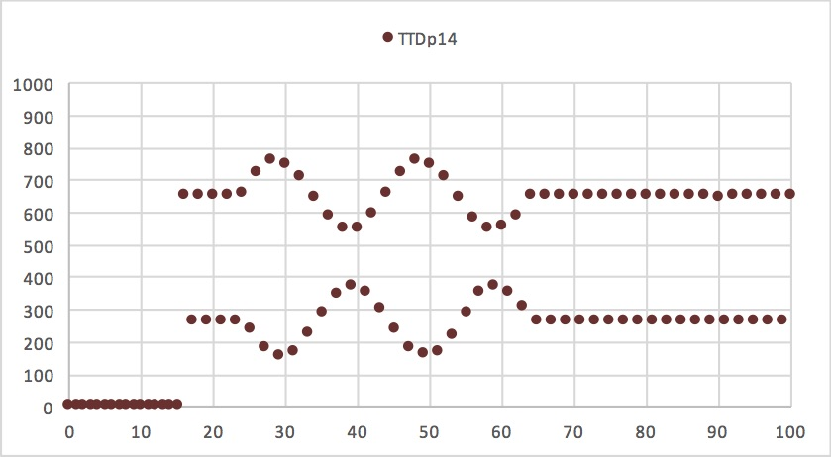
Digitized Waveform
Two periods of sine waves are digitized.

Slide 15
Good Design Practice:
Reduce Clock Frequency

Slide 16
Running Counter at Lower Frequency
Coarse
Time
Counter
Q[N-1]
Coarse
Time
Counter
Q[N-1]
CK400
CK200
Q[1]
Q[0]
Q[0]
CK400
A counter requires long propagation of signals in a carry chain.
If a counter with large number of bits running at very high frequency, there may not be enough time within a clock period to finish the propagation.
If is possible to run a counter for higher bit with a lower frequency clock while implement the lower bits at higher frequency.
The total power consumption is reduces when a counter is implemented this way.

Slide 17
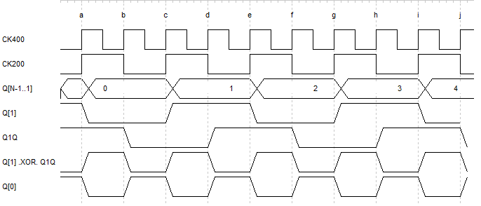
Detail Structure and Timing Diagram
Coarse
Time
Counter
Q[N-1]
The Q[1] and upper bits are in 200 MHz clock domain and only Q[0] is in 400 MHz clock domain.
It is also possible to run Q[2] and upper bits at 100 MHz clock domain.
CK200
Q[1]
Q[1]
Q1Q
Q[1] .XOR. Q1Q
D Q
D Q
Q[0]
CK400
CK400

Slide 18
Low-Power Design Practice: Clock Speed
250 MHz
62.5 MHz
IN0
Delay
Line &
Sampling
Register
Array
Data
Load/
Transfer
Register
Encoder
Buffer w/
Zero
Suppression
CK250
CK62
Load
Clock
Disable
Sequencer
The Sampling Register Arrays are clocked at 250 MHz.
All other stages are clocked at 62.5 MHz.
When a valid hit is sampled, the Sampling Register Array is disabled so that the registered pattern is stable for 64 ns.
The Data Load/Transfer Registers are enabled to load input 64 ns, so that a valid hit is guaranteed to be load once and only once.

Slide 19
DDR2/3 Operating Frequencies
FPGA
Writing:
250 M Hz
DDR2/3
Others: 62.5 M Hz
Clock & Command In
Data
Out
DDR2/3 memories support frequency change during operation.

Slide 20
Good Design Practice:
Data Compression

Slide 21
Raw PMT Hits

Slide 22
Slow Variation of Raw Data
U(n+1)
A
U(n+1)-U(n)
A-B
DFF
D
Q
B
More than 99% points differ from previous points by -1, 0 or +1.
Huffman Coding can be applied to the differences of the data points.

Slide 23
The Huffman Coding
The U(n+1)-U(n) value with highest probability is assigned to shortest code, i.e., single bit 1.
Values with lower probabilities are assigned with longer codes, e.g., 01, 001, 0001 etc.
Huffman coded words and regular words are distinguished by bit-15.
Regular ADC data for first point or when U(n+1)-U(n) is outside +-3
U(n+1)-U(n) | Code
-4 and others | Full 16 bits word
-3 | 000001
-2 | 0001
-1 | 01
0 | 1
+1 | 001
+2 | 00001
+3 | 0000001
0
0
ADC value (13-bit)
Huffman Coded
1
0
1
1
1
1
0
0
1
0
0
0
0
1
0
0
-1
0
0
0
+1
+2
Padding or
Continue to
Next Word
In this example, 6 differences of the data samples are packed in the 16-bit data word.

Slide 24
The Huffman Coding Block @ 1G samples/s
DV/PUSH
Encode
FIFO
R
R
4
0
1-0
R
R
5
1
2-1
INPUT
1Gs/s
R
R
6
2
3-2
R
R
R
7
3
4-3
1 GHz
250 MHz
The input data at 1 G samples/s is converted to 250 MHz clock domain.
The differences of 4 adjacent data pairs are calculated every clock cycles.
The encoder compose the differences into data stream and output.
The interface between the encoder and the FIFO should be 64 bits.
The DV/PUSH signal becomes valid every ~10 clock cycles.

Slide 25

Raw Hits, 1M Samples
The 1M samples = 1024 (PMT pulse samples) + 1023 x 1024 (background samples)
It looks like a 1KHz PMT pulses.
Each dot = 1 sample; Color = amplitude.

Slide 26

The Lossless Compression with Huffman Coding
The waveform can be accurately restored, but data volume reduced.
Each data point carries more information.

Slide 27

Dynamic Decimation + Huffman Coding
High frequency noise in background is filtered out.

Slide 28
Application
FPGA
FPGA
DDR3
MEM
2GB ?
DDR3
MEM
0.5GB?
Each 50 EURO per channel => 1 M EURO
Both size and bandwidth for MEM can be reduced.

Slide 29
Good Architecture:
Single Cable Support Digitizer

Slide 30
One Cable per Digitizer
Detector
Detector
Detector
Detector
Digitizer
Digitizer
Digitizer
Digitizer
Read Out Controller
Today, it is possible to build digitizer attaching to the detector module.
It is preferable and possible to minimize supporting cables to the digitizer.
Perhaps a CAT-5 cable with 8 conductors is a suitable choice of the supporting cable.
The interconnections between the Read Out Controller and the digitizer will need be carefully planned.

Slide 31
Interconnections of a Real Application
TDC FPGA
Only two pairs of fast signals are needed between TDC and the readout controller. (Extra wires in the cable can be used for JTAG or other FPGA reconfiguration signals.)
The Readout Controller sends 10 MHz clock pulses to drive the TDC.
Register setting and initialization commands are sent via pulse width modulation via the C5 Encoder and C5 Decoder.
Data from TDC FPGA is an 8B/10B stream.
It is decoded in the Readout Controller.
The encoder and decoders are based on over sampling scheme. No dedicated transceivers are needed.
8B10B
Timing
CmdReg1a
PLL
C5
Decoder
Clock & Command In
Data
Out
Readout Controller
C5 Encoder
(PWM)
10B8B

Slide 32
Sending Command In the Clock Line
Initialization
(Without Resetting
Scalars)
Command Valid
Init1x
TDC FPGA
8B10B
Reset
(With Resetting
Scalars)
Timing
CmdReg1a
A wide-narrow sequence is decoded as a initialization command without resetting scalars.
After a known latency, an initialization pulse is generated inside FPGA that resets the coarse time counter and a normal operation sequence is started.
The narrow-wide sequence can be reserved as resetting command that will reset scalars.
PLL
C5
Decoder
Clock & Command In
Data
Out
Readout Controller
C5 Encoder
(PWM)
10B8B

Slide 33
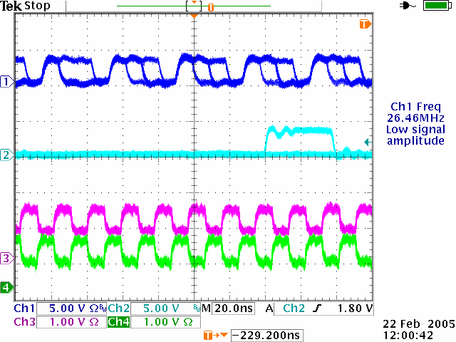
The Clock-Command Combined Carrier Coding (C5)
A data train contains 5 pulses and each pulse is transmitted in four unit time intervals, usually in four internal clock cycles at frequency f.
Information is carried with wide, normal and narrow pulses and the first pulse is always wide or narrow.
When not transmitting data, all pulses have normal width.
The data stream is DC balanced over 5 pulses suitable for AC coupled transmission.
All leading edges are evenly spread so that the pulse train can be used directly drive the receiver side logic or PLL.

Slide 34
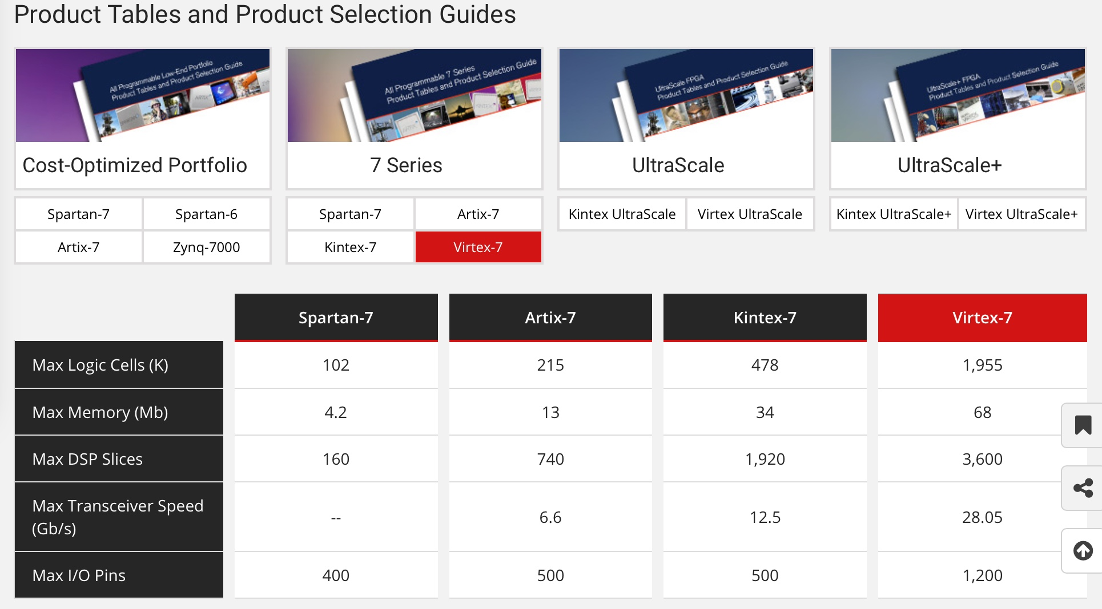
Transceivers in Powerful FPGA
In powerful FPGA, transceivers operate at 12, 28 Gb/s
不过，既不是不要钱，也不是不耗电。

Slide 35
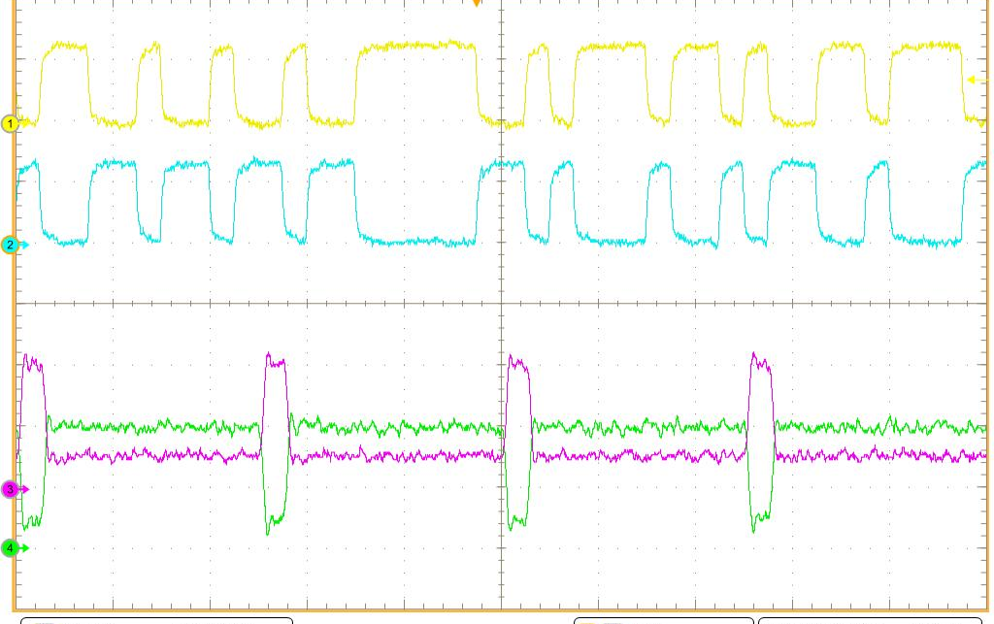
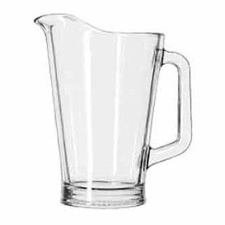
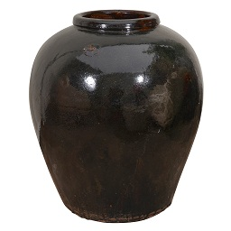
Data with Clock or Clock with Data?
8B/10B Stream
RX
Transceiver
Data
Recovered
Clock
The 8B/10B stream: Data with Clock.
The C5 pulse train: Clock with Data

Slide 36
Extra Reliability:
Common Timing Reference

Slide 37
Sending Timing Reference Across Modules
Detector
Detector
Detector
Detector
Digitizer
Digitizer
Digitizer
Digitizer
Read Out Controller
The common timing reference signals can be sent across modules.
Note that the signals are sent both ways alternatingly to cancel delays between modules.

Slide 38
Adding another TDC Channel in Digitizer
TL
TR
RA
RB
RC
RD
An extra TDC channel is added to the digitizer.
The TDC outputs are summed together.
The meantime of the signal edges is used as the common timing reference.
TDC
TDC
Σ
Σ
TDC
-
TDC
-
TDC
-
TDC
-
TDC
-
TDC
-
TDC
-
TDC
-

Slide 39
The Mean Times of All Channels
The mean of all leading edge times in a module is calculated.
The mean times of all channels represent an identical same time.

Slide 40
Is this a good design?
Clock Domain Transfer

Slide 41
A Design Seen
400 MHz
40 MHz

Slide 42
Fast Clock to Slow Clock
DV
DVQ
DV2Q
S
S=1, R=X; Q=1
TSeq0
R
S=0, R=0; Q unchanged
T1,T0
S=0, R=1; Q=0
TS
TQ
T2Q
E
400 MHz
400 MHz
40 MHz
TS
0
1
2
3
4
5
6
7
8
9
0
1
2
3
4
5
6
7
8
9
0
1
2
3
4
T1,T0
T
DV
TQ
(4,T)
DVQ
TSeq0
TSeq0
T2Q
(4,T)
DV2Q

Slide 43
Is this a good design?
Timing Uncertainty Confinement

Slide 44
Pipeline in FPGA
尽量不用PRN和CLRN口。
外来信号进D口，系统时钟进CK口，尽量不要调换。

Slide 45
A Common Implementation of ADC
Feeding CMP output to CK port of the register causes unnecessary challenges due to unconfined timing uncertainty:
Must use Gray Code Counter.
Must match propagation delays of all bits.
Register
+
CMP
-
☹
Register
+
CMP
-
Timing
Uncertainty
Gray
Code
Counter
f

Slide 46
An Improvement
Timing Uncertainty
+
CMP
-
Hold
☺
Binary
Counter
f
Feeding CMP output to D port of a FF reduces complexity:
The counter is regular binary counter.
No propagation delay matching is needed.

Slide 47
Doubling Digitizing Resolution
+
CMP
-
Hold
Binary
Counter
f
Confining timing uncertainty opens possibilities for further improvements:
Resolution or sampling rate can be doubled easily.
Improvements by a factor of 4, 8, 16, 32 etc. are possible.

Slide 48
Unnecessary Challenges
Unnecessary for
FPGA TDC
000
001
011
010
110
111
101
100
Gray
Code
Counter
Coarse
Time
Counter
Coarse
Time
Counter
Coarse
Time
Counter
In history, Gray code counters, double counters and dual registers + MUX are found in ASIC TDC coarse time counter schemes.
Theses are unnecessary if the TDC is designed appropriately.
In FPGA, a plain binary counter is sufficient.

Slide 49
Historical Implementation in ASIC TDC
DLL Clock Chain
Coarse
Time
Counter
c0
c1
HIT is used as CK input which creates unnecessary challenges.
HIT
Coarse
Time
Register
Encoder
Coarse
Time
Selection
Logic
Unnecessary Challenges = Extra Efforts + Reduced Performance
Deadtime is unavoidable.
Coarse time recording needs special care.
Two array + encoder sets are needed for raising edge and falling edge.
The register array must be reset for next event.
The encoder must be re-synchronized with system clock in order to interface with readout stage.

Slide 50
A Better Implementation
DLL Clock Chain
HIT is used as D input.
HIT
Multi-
Sampling
Register
Array
Clock
Domain
Transfer
16-bit Encoder with Registered Outputs
16-bit Encoder with Registered Outputs
Coarse
Time
Counter
OR + Register
DV
EG
T4..T0
TC
Deadtimeless operation is possible.
No special care is needed for coarse time.
Both raising and falling edges are digitized with a single array + encoder set.
No resetting is needed for the register array.
The output is synchronized with the system clock and is ready to interface with readout stage.

Slide 51
Summary
选便宜器件。
控制运行频率。
不自找麻烦。

Slide 52
The End
Thanks

Slide 53
Coarse Time Counter
Coarse
Time
Counter
Coarse
Time
HIT
Fine
Time
Encoder
Fine
Time
ENA
The timing uncertainty between HIT and CLK is confined in the sampling register array.
All the remaining logics are driven by the CLK signal.
No special cares such as Gray code counter is needed for coarse time counter.
CLK
Hit Detect Logic
Data
Valid

Slide 54
Improvement:
Cable Delay Monitoring

Slide 55
Cable Delay Variation
Detector
Detector
Detector
Detector
Digitizer
Digitizer
Digitizer
Digitizer
Read Out Controller
The cable length may vary as temperature change.
In some applications, it is necessary to monitor the cable delay for high precision timing measurement.

Slide 56
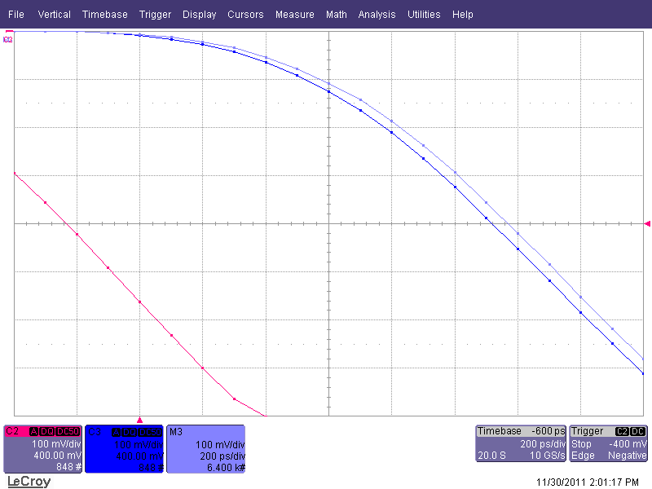
Cable Delay Variation Due to Temperature
25 ºC
50 ºC
The cable delay and fan-out channel timing character change with temperature.
In parallel scheme, it is not easy to control these variations.

Slide 57
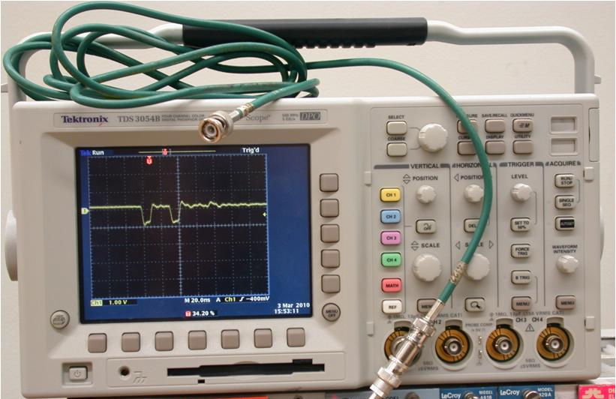
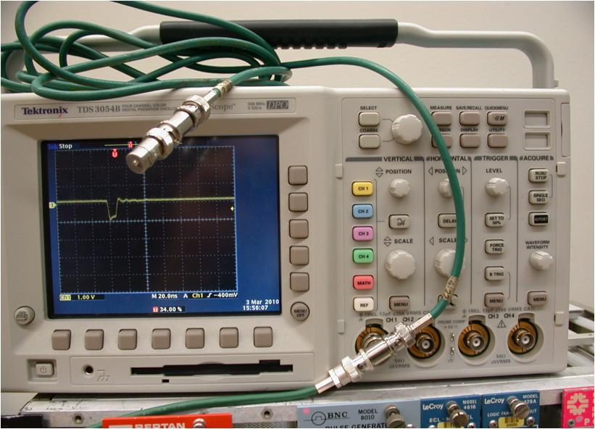
Signal Reflection in an Open Cable
Cables are usually terminated at the end to eliminate signal reflection.
An open cable causes a reflected waveform with same polarity as the transmission signal.

Slide 58
The CAKE Clocking: (Cable Automatic sKew Elimination)
w
R
TDC
d
V/4
Transmission
Reflection
Transmission
+Reflection
The clock pulses a driven through a cable to a high impedance receiver.
The pulses are reflected back to the sending side.
The transmission and reflection signals are added together to form a cake shaped-waveform.

Slide 59
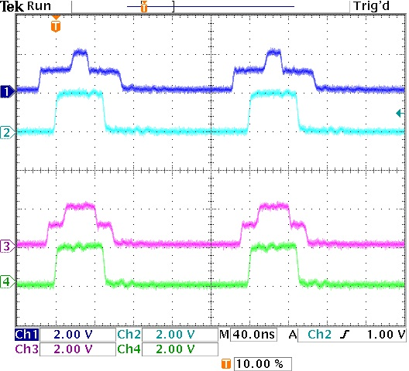
The CAKE Clocking Waveforms
w+2d_{A}
w
R
TDC
d_{A}
w+2d_{B}
V/4
R
d_{B}
TDC
V/4
The width of the cake base is (w+2d) and the cable length can be measured and monitored continuously based on TDC values collected from sending side only.

Slide 60
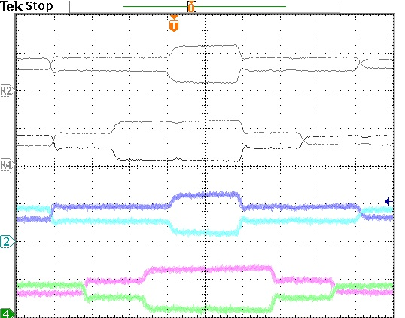
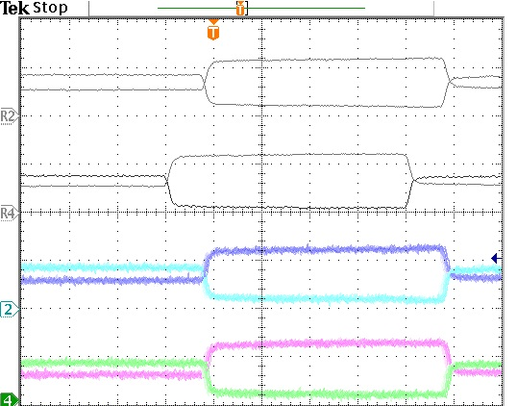
Test Results
Sending Side
Receiving Side
If the FPGA sends clock pulses at the same time, the clock edges at the receiving ends won’t be aligned due to cable length difference.
If the mean times of the cake-shaped pulses at the sending end are aligned, the clock edge at the receiving ends will be aligned.

Slide 61
Improvement:
Sending Clock to Several Modules

Slide 62
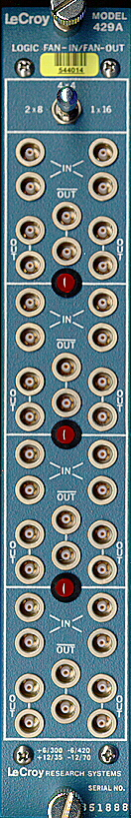
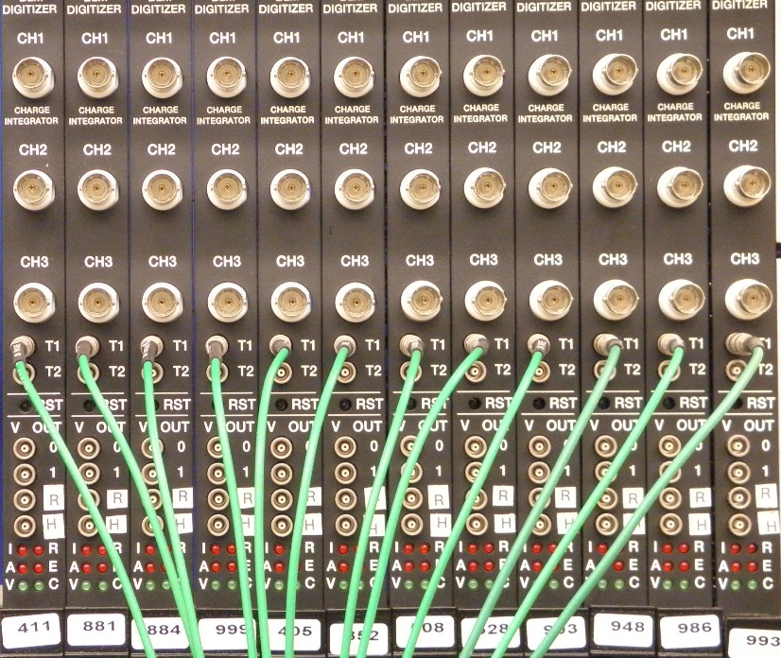
Clock Fan-Out: A Lot of Cables
Multiple copies of the clock signal are produced using a fan-out module.
Many copies of clock are to be generated so a dedicated fan-out module is needed.
Each module is fed with a clock signal via a cable.

Slide 63
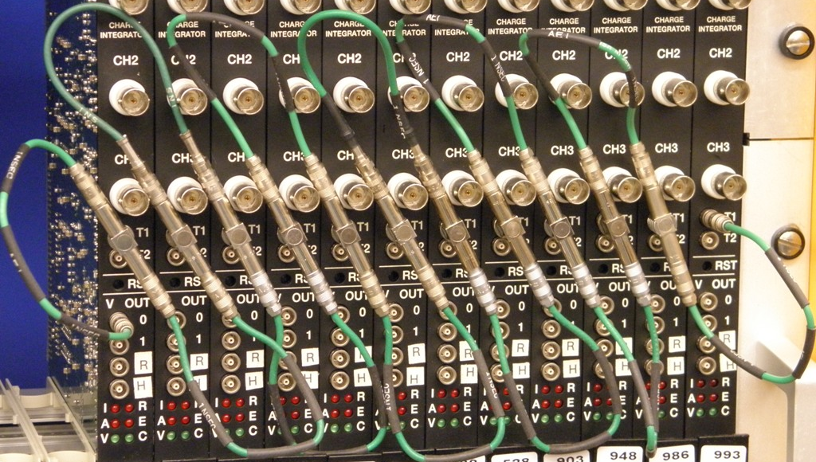
Multi-drop Clocking Scheme Using T Connectors
x
Cable segments are connected using T connectors to form a multi-drop cable assembly.
Clock driver can be absorbed into the same user module, eliminating a dedicated clock fan-out module.

Slide 64
The Trapezoidal Clocking in a Nut Shell
x
Transmitting
x
Reflecting
Sum
Trapezoidal-like pulses are fed into a transmission line and return back.
The ramps of two opposite traveling pulses are summed in cable.
An isochronous common crossing exists at each tap.

Slide 65
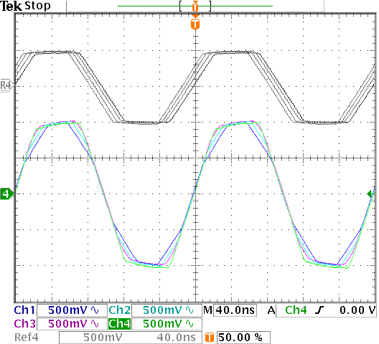
The Trapezoidal Clocking
With 50 Ω
Termination
Without 50 Ω
Termination
The 4 oscilloscope channels are connected with 3 cable segments (4 ns each).
When cable is terminated (Top traces), skews are seen.
When reflection is allowed, zero crossings become isochronous. (i.e., cable delays don’t matter)

