Slide 1
CEPC Software Management Proposal
Xianghu Zhao
July 3, 2017

Slide 2
Outline
Package Management
cepcenv Toolkit
Software Development and Release

Slide 3
Package Management

Slide 4
CEPC Software Package Category
Package category
  System
    Should be pre-installed before installation
  External
    Common libraries used by offline packages
    Will be installed before offline
  Offline
    Core CEPC software
External and offline packages could have multiple root directories
  Official and user development
  Reuse external

Slide 5
Package List
System
  git, svn, curl / wget
  gcc, python, java, CMake
  libraries
    libX11, libXpm, libXft, libXext
    openssl, pcre, libxml2
    mesa-libGL, mesa-libGLU
    …
External
  MySQL, xerces-c, GSL, QT
  geant4, ROOT, CLHEP, CERNLIB, FastJet
Offline
  LCIO, GEAR, CED, CondDBMySQL, ILCUTIL, DRUID
  FastJetClustering, MarlinFastJet
  KalTest, KalDet, GBL, LCCD, RAIDA
  MarlinUtil, Marlin, MarlinReco, MarlinTrk, MarlinTrkProcessors
  Clupatra, LCFIVertex, LCFIPlus, KiTrack, KiTrackMarlin
  Mokka
  …

Slide 6
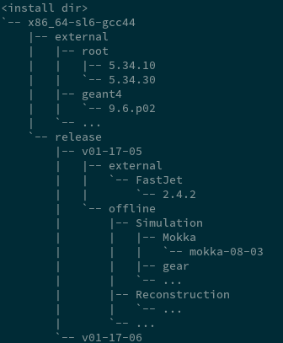
Directory Structure
Official release directory
  Could be selected in user profile or “cepcenv” command argument
  afs / cvmfs / user directory / …
User work directory
  User could develop new packages or modify already existed one
Directory structure
  <install dir>/<arch>-<os>-<compiler>/<release version>/

Slide 7
cepcenv

Slide 8
cepcenv
This toolkit could simplify the management of cepc offline software for both administrator and user
  Installation
  Environment variable
  Version selection
  Package management

Slide 9
cepcenv Command
cepcenv install <version>
  Install the specified release version
cepcenv list
  List all installed versions
cepcenv use <version>
  Select release version
cepcenv package-list
  List all active packages of the current release
cepcenv setup
…

Slide 10
Full Installation from Scratch
Install cepcenv with single command
  sh -c "$(curl -fsSL https://raw.githubusercontent.com/cepc/cepcenv/master/script/install.sh)"
cepcenv install --check <release-version>
cepcenv install <release-version> --root <root_dir> --os slc6 --arch x86_64
  Installation root directory specified in user profile or command argument

Slide 11
Setup Software Environment
Setup cepcenv environment
  source setup.sh
Default cepc software version is active automatically
Change version is easy (should be installed already)
  cepcenv use <new-version>
Change package version temporarily
  cepcenv package-use <version>
  Restore to default when newly logged in

Slide 12
Software Development and Release

Slide 13
How to Develop a Package
Version control with git
Each offline package corresponds to a project under github CEPC organization
Development procedure
  Fork the project from CEPC organization
  Create new branch and start development
  Commit changes
  Push to your own repository
  Create pull request
  The manager of the project accepts or denies the request
  The manager create release of the package

Slide 14
JUNO development procedure for reference

Slide 15
How to Create a New Release
Write release files in CepcRelease project
  Package dependency
  Package version
  Package parameters
Tag CepcRelease with version
All package versions should be fixed once the new version is released
  NEVER change the content of a specified version after release
  If bugs found, create a new patch release. The bugged release could be removed

Slide 16
JUNO software release procedure for reference

Slide 17
License
iLCSoft added GPL3.0 license recently
If package from iLCSoft is modified, it must be open sourced
Any software must also be open source and licensed under GPL3.0 if using iLCSoft

Slide 18
Discussion
iLCSoft has been already migrated to github
  Just use these repositories?
  Fork to CEPC organization?
How to define version if we are developing some packages which originated from iLCSoft?
  Do we need to merge new iLCSoft version?

Slide 19
Future Plan
Develop cepcenv toolkit
Migrate software to github
Provide detailed manual on release and development
Standardize the physics validation for each release

Slide 20
CEPC Jobs Status on Distributed Computing System

Slide 21
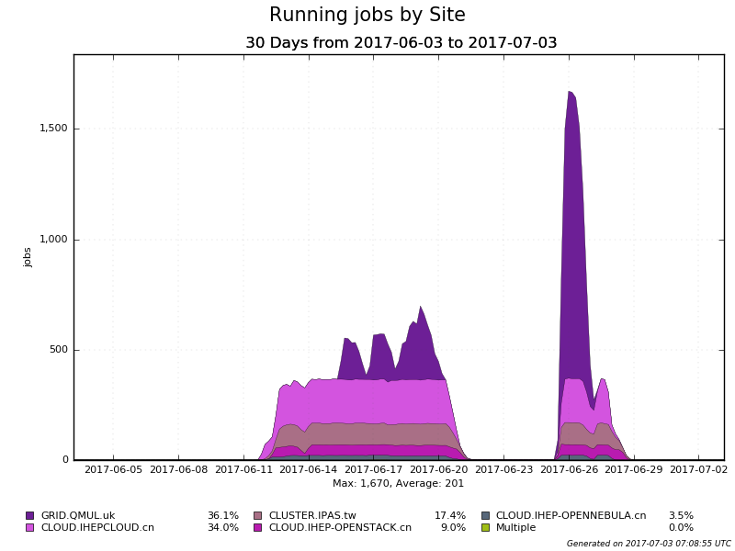
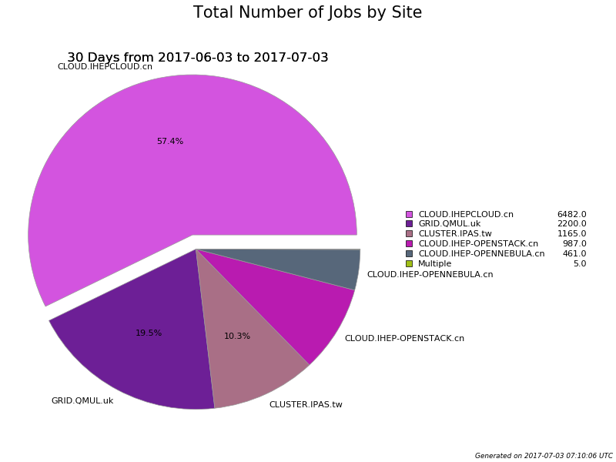
Recent Jobs
CEPC jobs

Slide 22
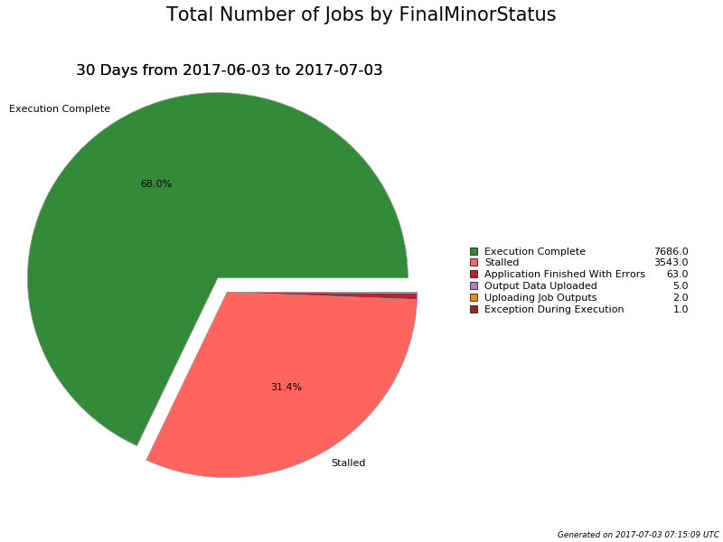
Most failed jobs caused by bug from submission script
Already fixed

Slide 23
Thanks!

