Slide 1
R&D on high performance RPC for the ATLAS Phase-II upgrade
Yongjie Sun
State Key Laboratory of Particle detection and electronics
Department of Modern Physics, USTC

Slide 2
outline
ATLAS Phase-II Muon Spectrometer upgrade
RPC trigger detector
  Requirements on performance
  The main challenges
  R&D on thin gap RPC
  Current progresses
Summary

Slide 3
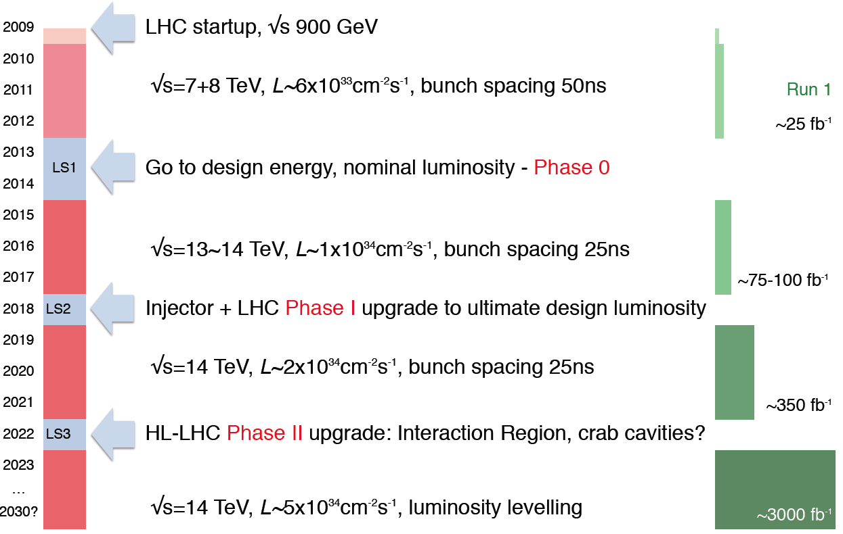
LHC to HL-LHC

Slide 4
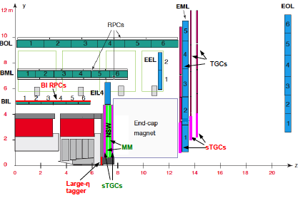
ATLAS Phase-II upgrade
Front-end and readout electronics
Thin gap muon trigger RPC
Inner tracker
（ITk）
High-η tagger

Slide 5
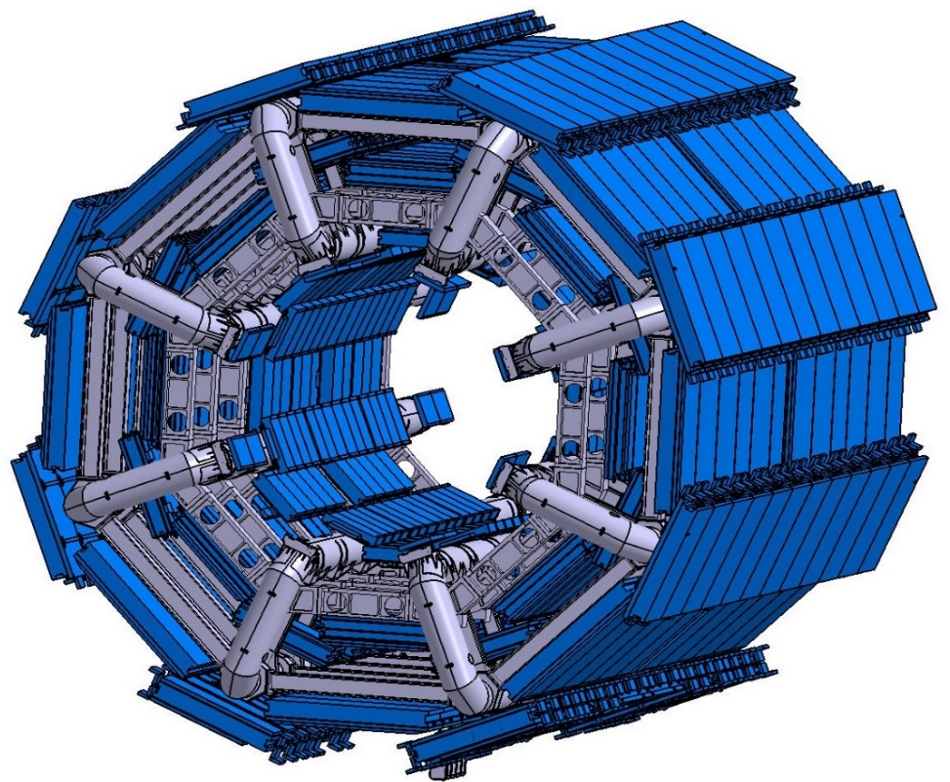

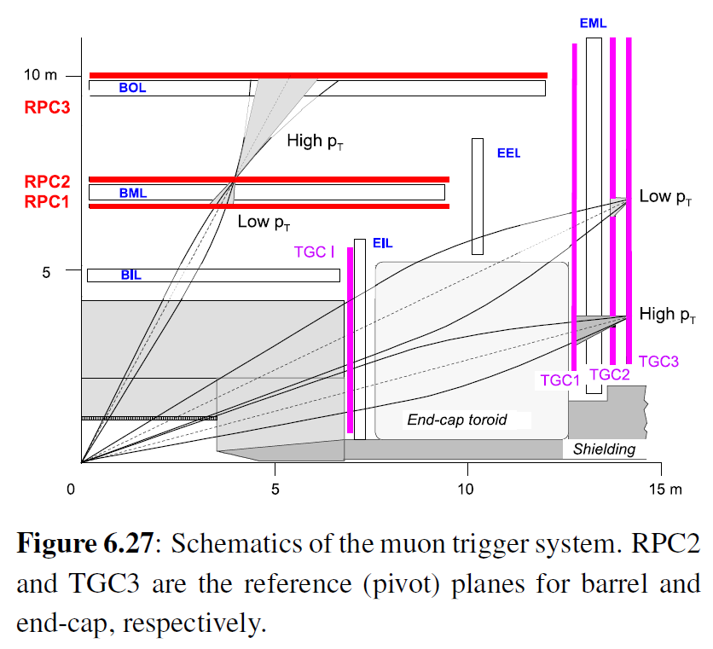
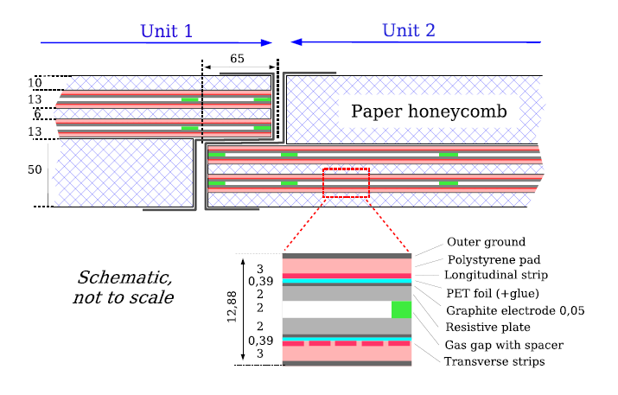
Current ATLAS RPC muon trigger system
6 layers RPC (BM and BO), measure η&φ position on each layer.
OUTER LAYER (BO) for High p_{T} trigger
MIDDLE LAYER (BM) for Low p_{T} trigger
NO RPC on INNER LAYER (BI)）

Slide 6
The main problems of current RPC
Longevity:
  Designed for work under 1×10³⁴ cm⁻²s⁻¹@14TeV for 10 years, corresponding to integrate charge of 0.3 C/cm²
  Reach the life time at HL-LHC
  Can only work under lower voltage with detection efficiency lost of 15%-35%
The rate capability:
  Under HL-LHC, the extrapolated rate on RPC will be an order of magnitude higher, ~300Hz/cm²
Basic solution:
  Add 3 BI RPC layers
  Rate: ~ kHz/cm², work 10 years for HL-LHC
  With higher spatial and time resolution
  for muon tracking and bunch crossing ID
  Close most of the acceptance holes
L=7×10³⁴cm⁻²s⁻¹@14TeV
Notes:
a limited geometrical acceptance, and an insufficient redundancy

Slide 7
The basic requirements
Higher rate capability: ~ kHz/cm²
Longer longevity: 10 years of HL-LHC
Higher spatial resolution: ~ mm
Higher time resolution: ~0.5ns
Current RPC detector:
2 mm gas gap, with avalanche mode
Work voltage: 4.8 kV/mm
Charge: 30 pC/count
Rate: 100 Hz/cm²
Time resolution: 1.1 ns
Strip pitch: 26-35 mm
FEE: GaAs technology
Gas component: Freon, Iso-butane, SF6
→ 1 mm
→ ~2.7 kV
→ 0.5 ns
→ Si BJT → SiGe
Notes:
Ga: gallium, As: arsenic, Silicon Bipolar Junction Transistors
Ge: germanium

Slide 8
Main challenges
More sensitive, high signal-to-noise ratio, fast, low power consumption Front End Electronics
New materials for a thinner and more rigid chamber structure
Increasing the signal-to-noise ratio by optimizing the gas gap and readout panel structure
Optimizing the detector parameters for maximizing spatial and time resolution, thus momentum resolution, and track-to-track separation.
Looking for new environment friendly gas mixture.

Slide 9
R&D on thin gap RPC
Supported by the MOST National key research and development program, USTC, SDU and SJTU started the R&D on thin gap RPC for ATLAS Phase-II upgrade.
Mainly focus on:
  New electrode material, gas gap structure, readout material and structure, working conditions.
  Join the FEE and readout electronics design.
  Simulation, design and test RPC prototypes, achieve the required performances.
  Built and test real size RPC detector.
  Establish the assembly and test procedure, quality control and assurance, get ready for the mass production

Slide 10
Main progresses
Thinner gas gap, thinner structure and very sensitive FEE introduces many problems for RPC operation.
  The gas ionization and avalanche process
  The signal induction
  Signal transport
  Impedance matching
  Shielding and GND connection
  Gas flow and mechanical problems
Simulation work already started together with the test of the BIS78 prototypes.

Slide 11
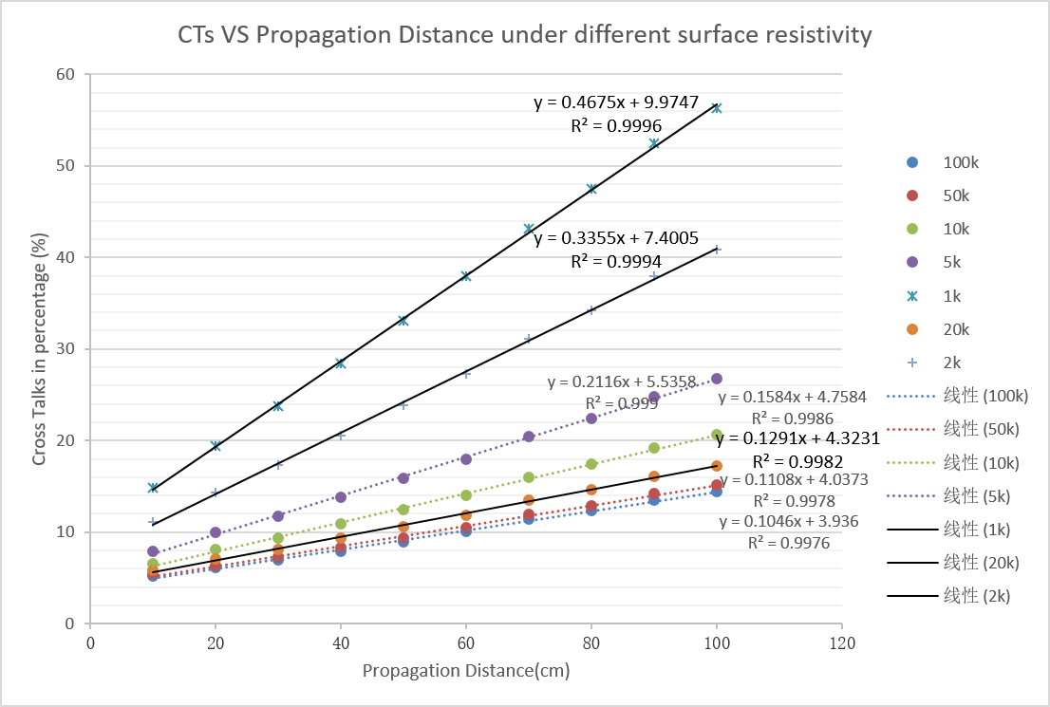
Simulation on cross-talk
Join the BIS78 assembly, beam test and data analysis.
Simulated the cross-talk observed from test results.
Simulation of signal propagation in RPC for Atlas Phase II Upgrade
--Xiangyu XIE
Relation between Cross Talk and propagation distance and HV layer resistivity

Slide 12
Prototype assembly and test
BIS78 similar gas gaps has been built with the same material, same technology.
RPC counter will be built for performance test.
The idea is to start from the BIS78-like technology and get comparable results, then start our own:
  Readout pattern R&D: material, new design…
  New gas mixture performance test.
  Optimize the assembling, shielding, mechanical structure….
  Built real size detector for phase-II upgrade

Slide 13
Summary
Supported by MOST, we take part in the ATLAS Phase-II muon trigger RPC upgrade.
Following the pilot work of Phase-I BIS78 upgrade, the simulation and prototype assembly has already started.
We will deeply explore any possibilities to extend the potential of RPC, fulfill the requirements of the upgrade.
Take the responsibility and make real contributions to the ATLAS collaboration.
Thank you!

