Slide 1
Simulation of Signal Propagation in RPC for Atlas Phase II Upgrade
Xiangyu Xie
on behalf of
ATLAS RPC Software Simulation Group(USTC, Roma II and INFN)
At Third CLHCP, Nanjing University

Slide 2
Outline
1. Motivation
2. Simulation method
3. Results
4. More functions
5. Conclusion

Slide 3
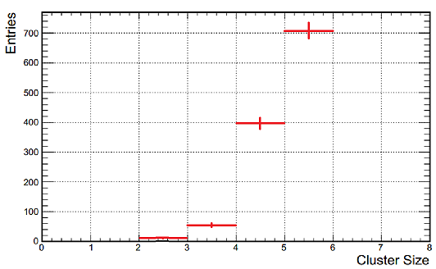
1. Background ——Too large cluster size
Prototype RPC with new readout panel and electronics has been made
Beam test shows it has larger cluster size than expect
→Too many strips have response to an event
Disadvantages:
Reduce online spatial resolution
Influence signal identification
Decay counting capability
Prototype CS is around 6,
While 3 is more acceptable

Slide 4
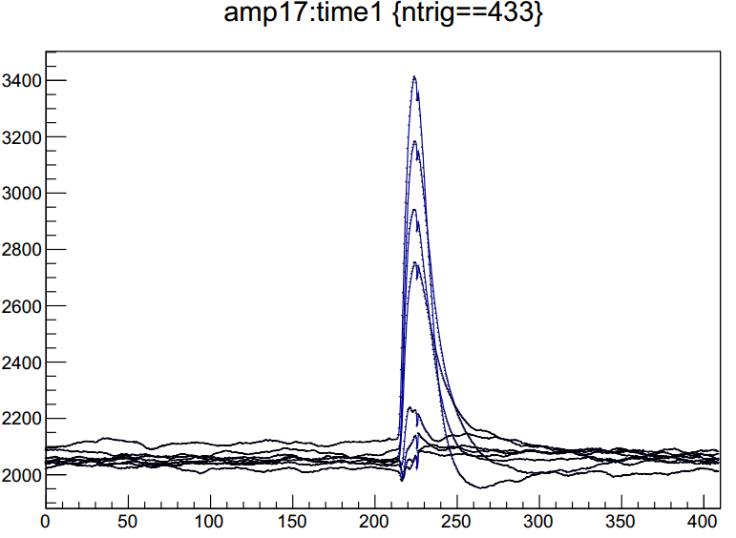
1. Background ——Readout Diagram
From readout diagram:
Besides the highest signal, three more strips have significant response.
Considering the 25mm-width-strip, this is not reasonable
These three strips’ signal could be called as ‘Crosstalk’ (CT).
Readout from prototype RPC

Slide 5
1. Background ——Targets
Find out how crosstalk comes by simulation
Give suggestions from simulation results
One more step forward…
Help design RPC with new structure

Slide 6
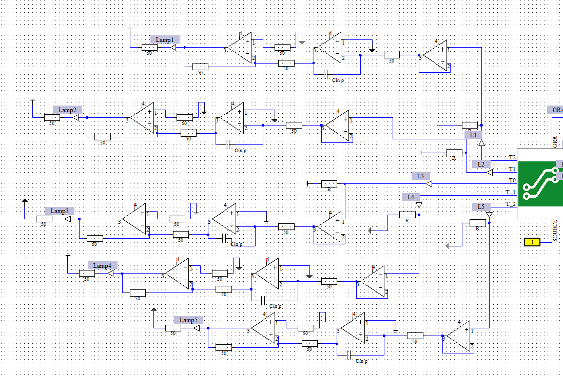
2. Simulation Method ——Simulation Tools
1/2:PCB Studio of CST SUITE
For physical modelling
The layer by layer structure of RPC ≈ PCB
Terminals (white points) connecting to Design Studio
Modeling half RPC for saving computing source
2/2:Design Studio of CST SUITE:
Accomplishing circuits
e.g. matching resistor, AMP
Set simulation task
Define signal
Top view of model (strip layer)
Model(Green block) with circuits

Slide 7
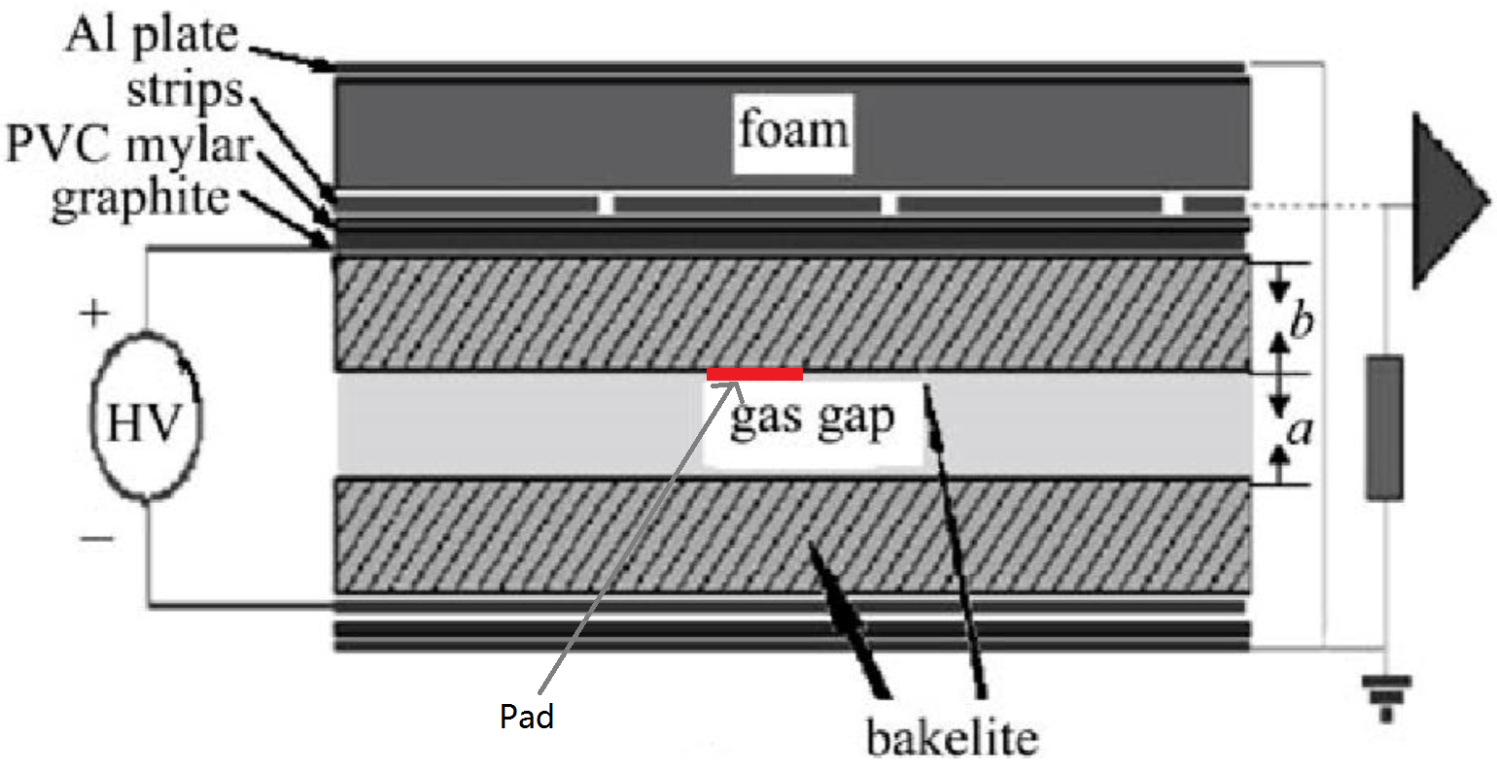
2. Simulation Method ——Simulation model
Top view of model (strip layer):
②
‘main strip’
①
③
③
① strips:
5 strips
25mm in width
2mm gap between strips
Terminated at both ends(white points)
② signal position:
Y axis: in the middle of strips3
X axis: variable
Z axis: under bakelite
Via a copper pad (D=2mm)
③ propagation distance:
Distance between signal position and terminal
Depending on signal’s
X-coordinate

Slide 8
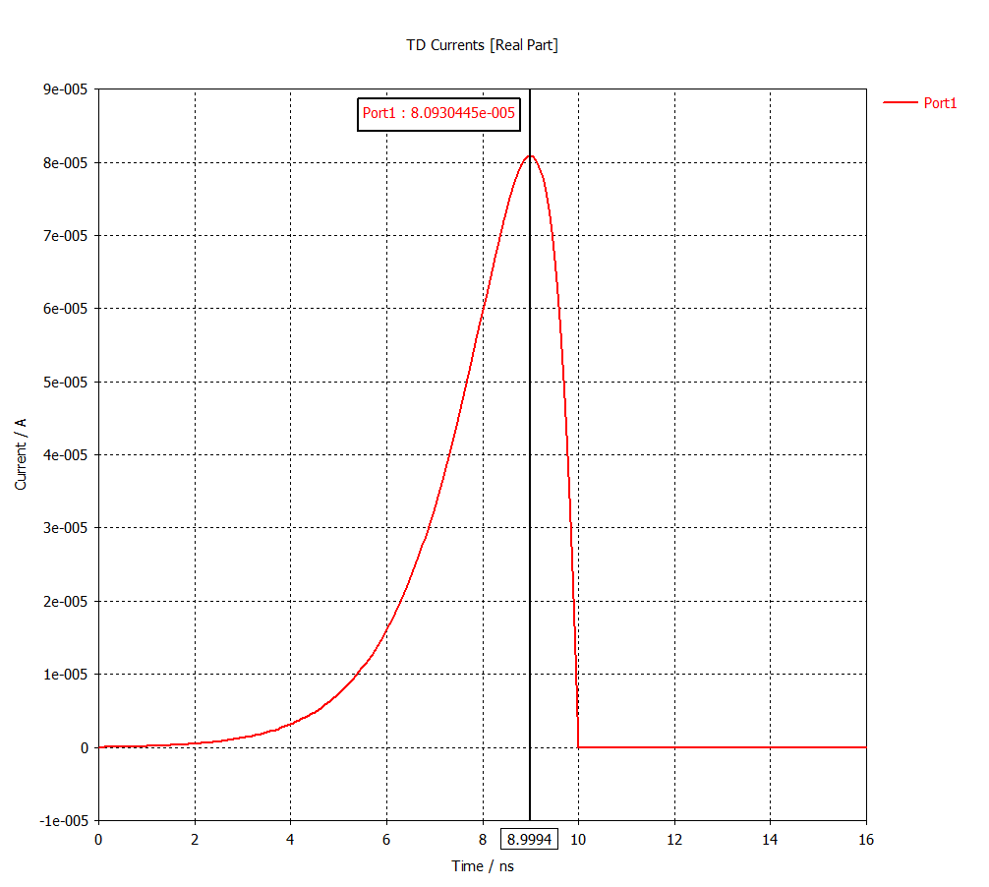
2. Simulation Method ——Simulation signal
Stimulate source: A current signal
Signal waveform:
I[t]=(gap-v*t)*e^(a*v*t)
Time of rise ≈ 4ns
Time of fall ≈ 1ns
(A simple assumption)
PS. The strength of signal doesn’t matter.

Slide 9
2. Simulation Method ——Method Reviews
Model
Transfer to simulation
Peripheral circuits
RPC
Current signal

Slide 10
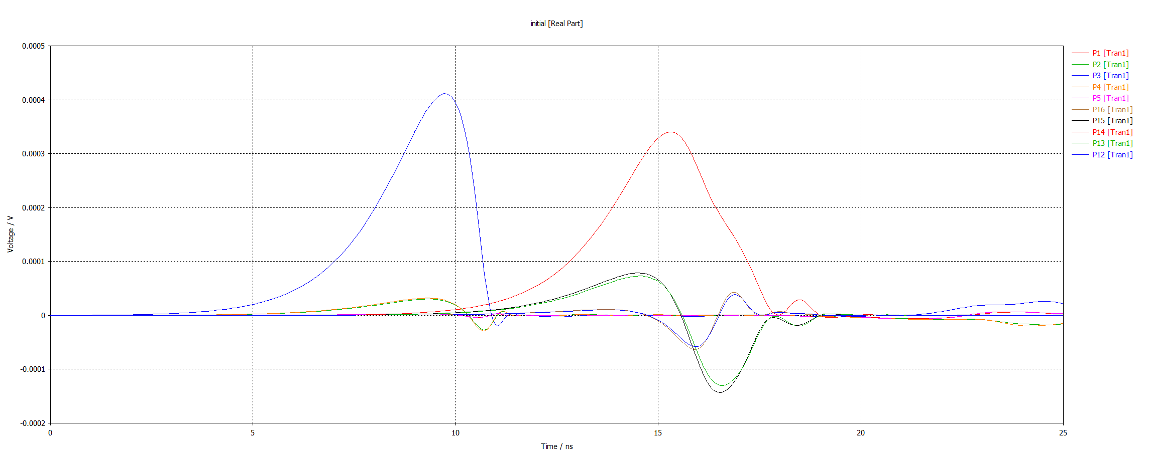
3. Simulation Results ——Two main causations of CT
1st causation: Strip-Strip Coupling
EM coupling
→ CT has bipolar waveform
→ like derivative of main signal
Relative to propagation distance
→ proportional relationship
（dispersion appears @90cm）
This kind of CT has bipolar waveform
Def. Cross talk = V_{max}(neighbor)/V_{max}(main) (%)
Five strips voltage readout (by matching resistors)
Model @propagation distance =10cm(left circle), 90cm(right circle)
Graphite@
100kΩ/SQ

Slide 11
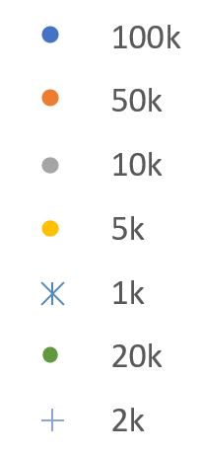
3. Simulation Results ——Two main causations of CT
1st causation: Strip-Strip Coupling
CT grow linearly with longer propagation distance
Lower graphite surface resistivity → Higher slope
PS. The value of slope is dependent on how fine the model is divided, but tendency not

Slide 12
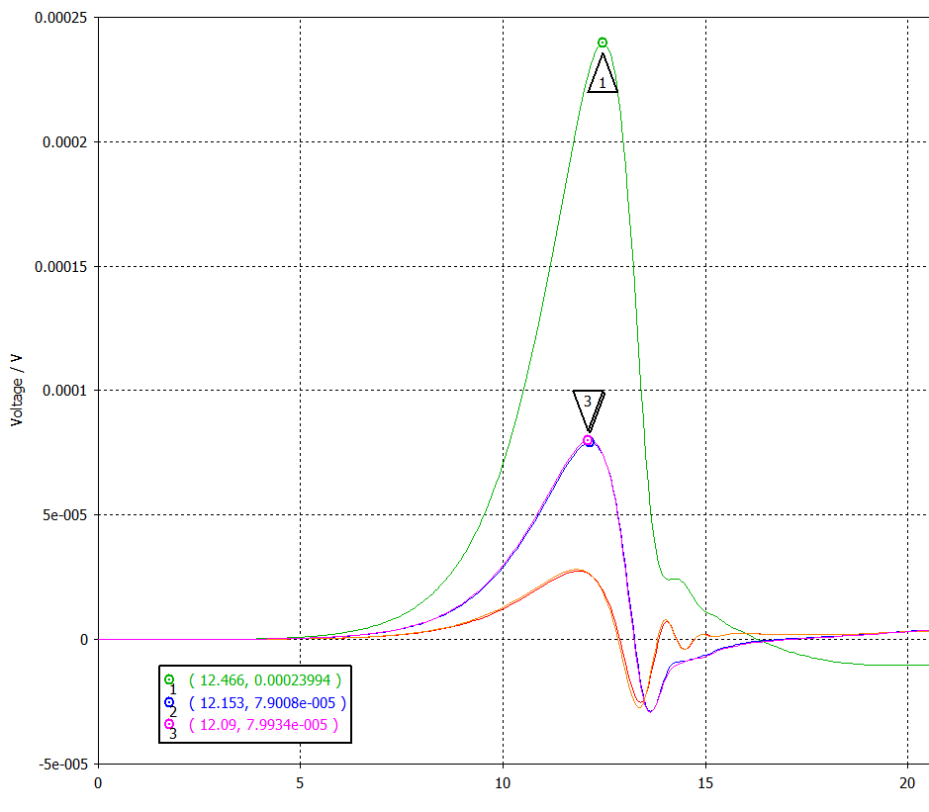
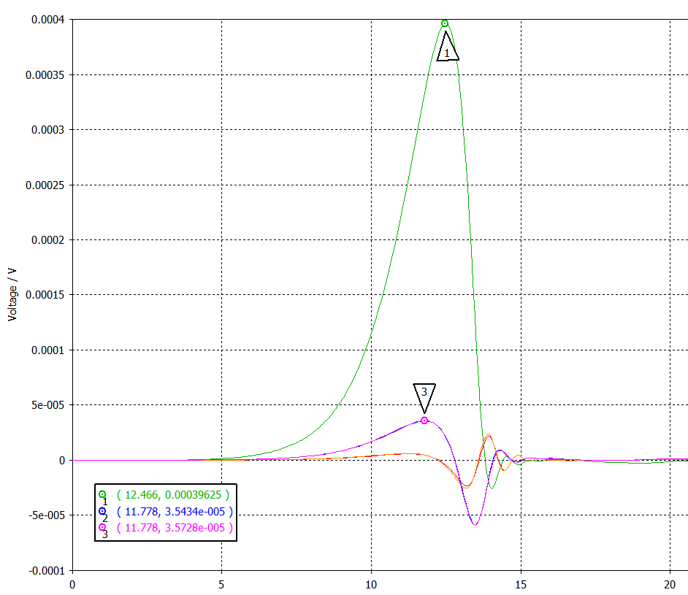
3. Simulation Results ——Two main causations of CT
2nd causation: surface resistivity of graphite
Low surface resistivity
→ CT’s positive part enhanced
→ larger CT
High surface resistivity
→ no such enhancement
Direct voltage readout (of matching R) over time(ns)
Graphite @ 1kΩ/SQ, Propagation distance=50cm
Direct voltage readout (of matching R) over time(ns)
Graphite @ 100kΩ/SQ, Propagation distance=50cm
This kind of CT has similar waveform
Graphite@
1kΩ/SQ
Graphite@
100kΩ/SQ

Slide 13
3. Simulation Results ——Two main causations of CT
2nd causation: surface resistivity of graphite
Graphite is ‘transparent’

Slide 14
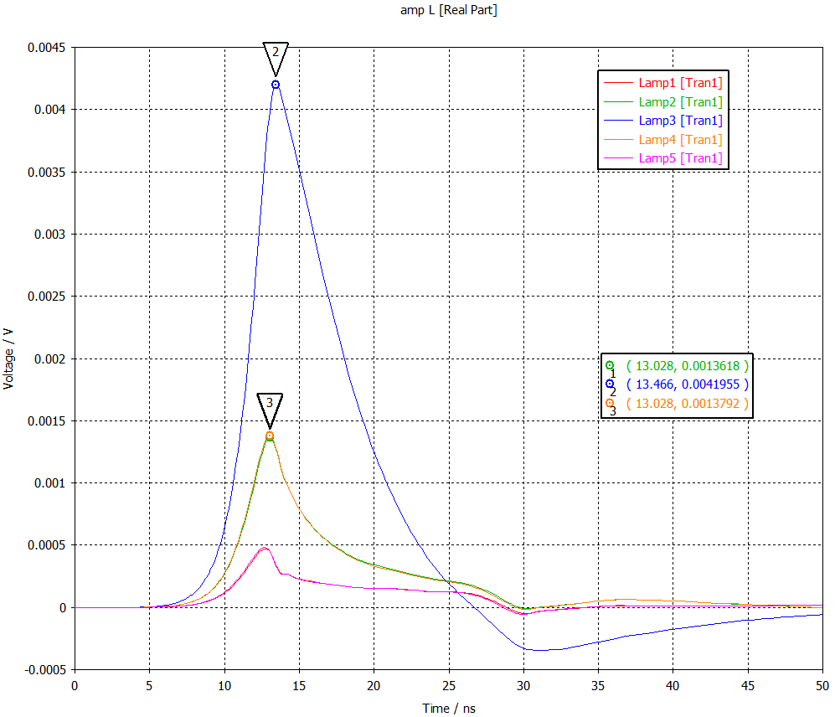
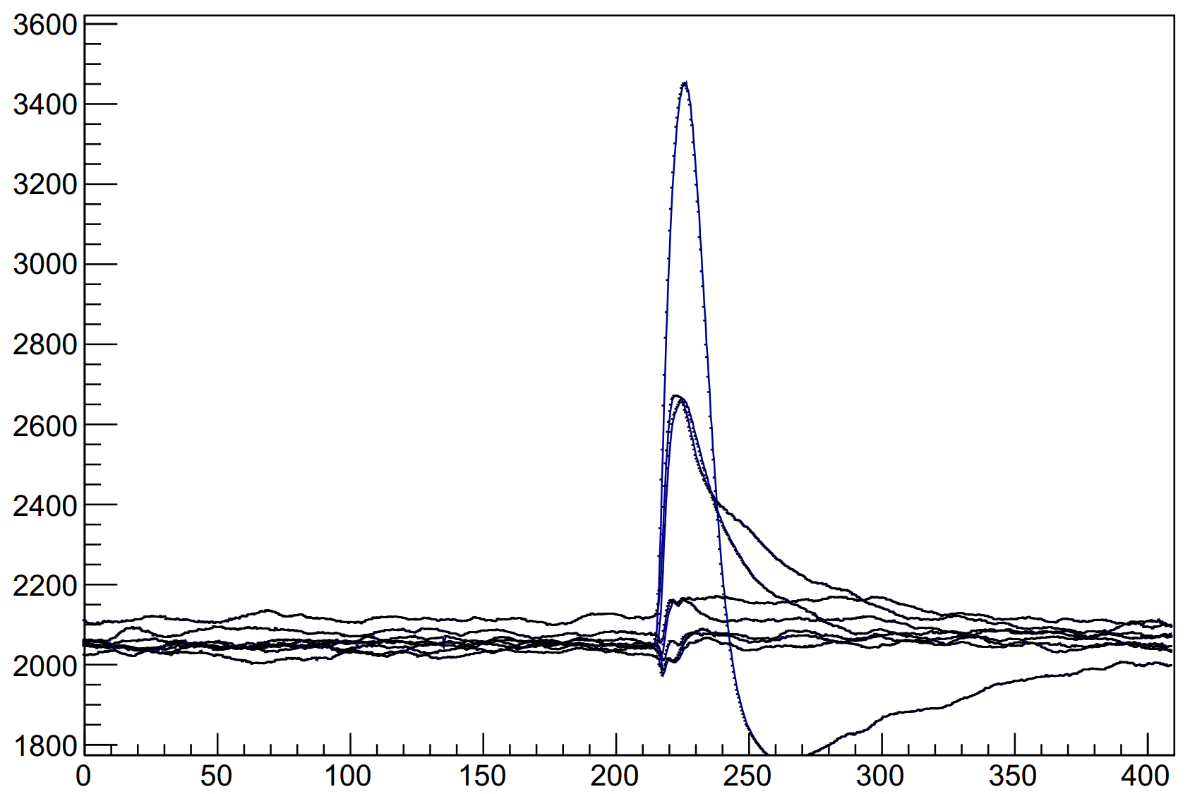
3. Simulations Results ——Comparing with prototype
Beam test results
Simulation integral results
Second neighbors have ‘steps’
Beam test: @120kΩ/SQ
Integral readout in simulation: @1kΩ/SQ
PS. Two diagrams have different time scale and amplifiers
Prototype RPC graphite surface resistivity isn’t high enough

Slide 15
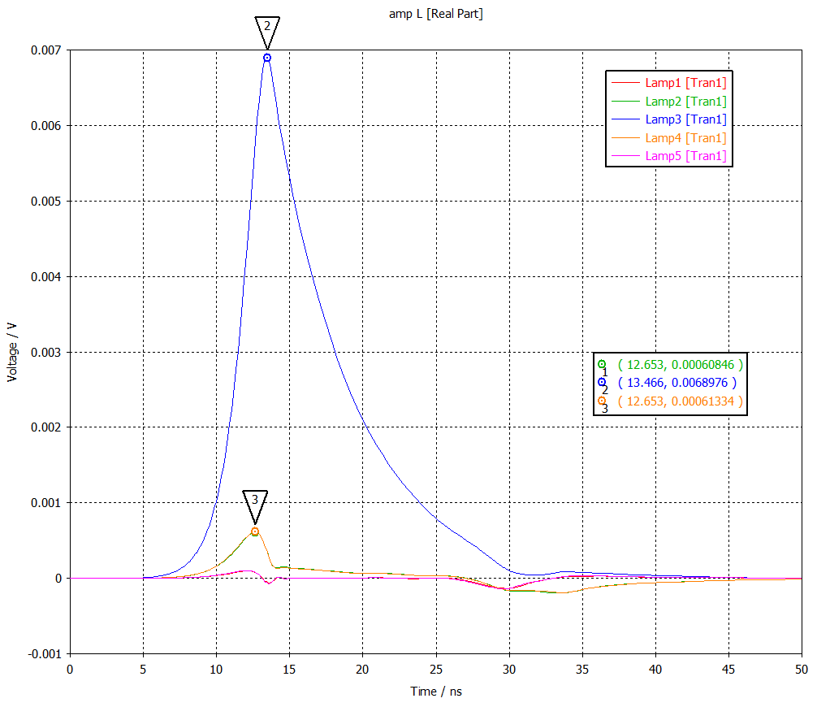
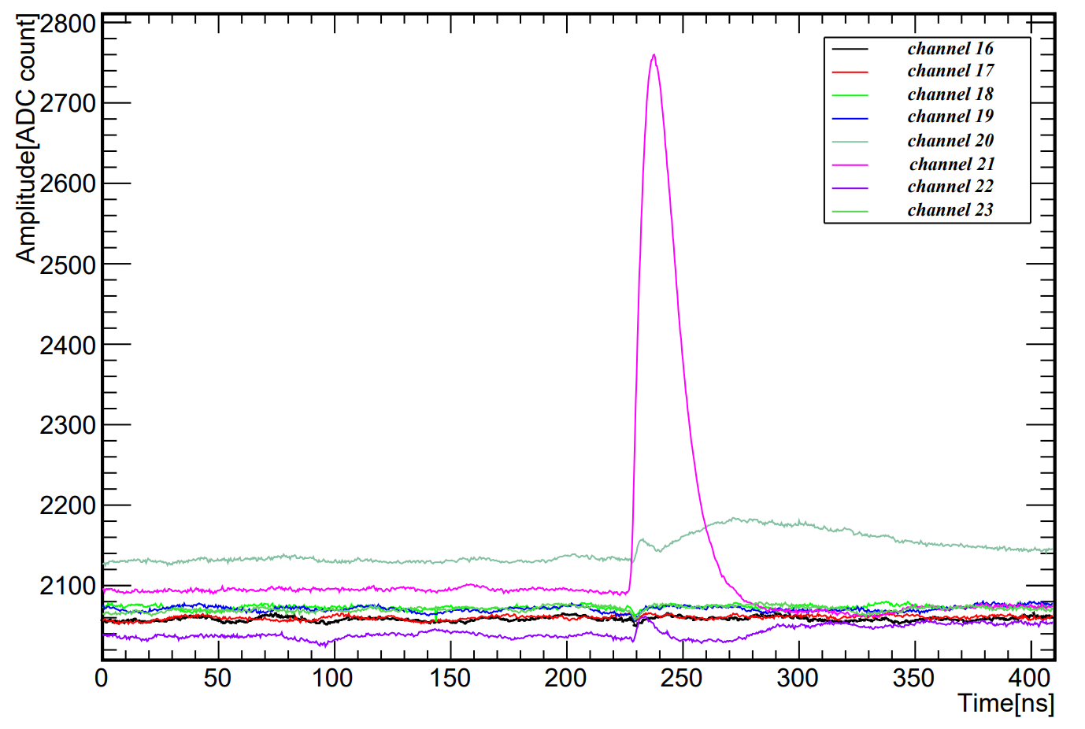
3. Simulations Results ——Comparing with second edition
Beam test results
Simulation integral results
Beam test: @620kΩ/SQ
Integral readout in simulation: @100kΩ/SQ
At ‘high’ surface resistivity, quite small CT with advanced peak time
Main discrepancy is the bias of surface resistivity

Slide 16
4. More functions ——1. grounded wires
Wires between strips
Under low graphite surface resistivity:
CT is dominated by graphite
Under high graphite surface resistivity:
Wires reduce about 1/3 CT
Wires won’t be effective in reducing CT caused by low graphite resistivity

Slide 17
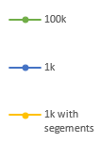
4. More functions ——2. segmented graphite
Graphite layer
Two 0.1mm-wide-segments under gaps between ‘main strip’ and neighbor strips
Graphite @1kΩ/SQ with segments better than graphite @100kΩ/SQ
Could help improve RPC counting capability

Slide 18
5. Conclusion
1. Problem comes:
Prototype RPC has large cluster size
2. Results:
Set up a new method to simulate RPC
Two main causations of CT have been found and fit beam teats readouts
New design could be simulated by this method
3. Future plan:
Improve model
Test existing applied material
Try new design RPC in USTC RPC lab.

Slide 19
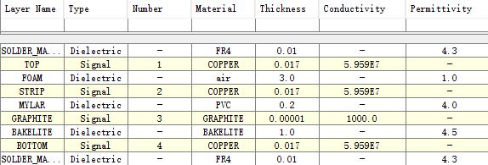
Back up
Stack up of model:

Slide 20
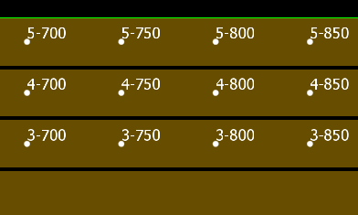
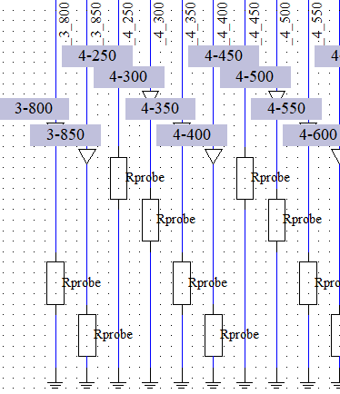
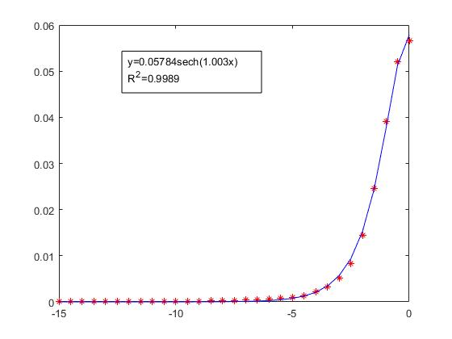
Bach up ——3. Ideal probes
An easy and clear way to observe signal propagation
Terminals on graphite(blue layer)
Terminals along strips
Connect to a tremendous resistor(10e20Ω) to monitor voltage
Voltage (V)
Y position(mm)
Graphite voltage distribution
Procession of signal transmission along strip

