Slide 1
Status Of The Experiments At LHC
Zhengguo Zhao
University of Science and Technology of China
12/27/2017, Nanjing University

Slide 2
Outline
LHC machine status
Data talking
Selected physics highlights
Programs of upgrade
Summary
Material based on talks from CLHC, November 2017

Slide 3

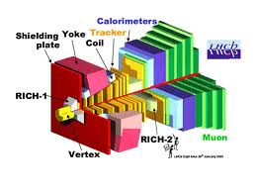

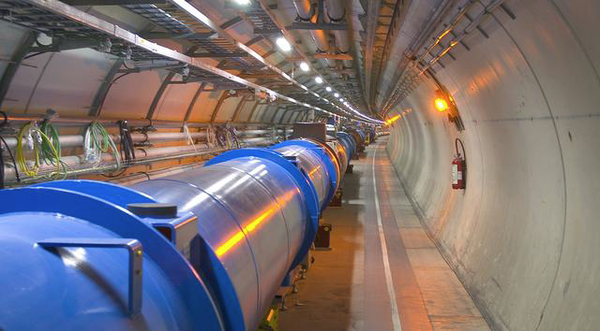

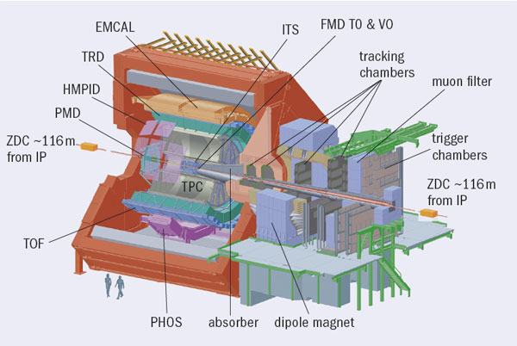
Experiments at Large Hadron Collider
Frontier of high energy physics in the next two decades
ATLAS
2800 Physicists
182 Institutions
40 countries
550 MCHF
CMS
2800 Physicists
184 Institutions
40 countries
550 MCHF
LHCb
1160 Physicists
69 Institutions
16 countries
75 MCHF
ALICE
1550 Physicists
151 Institutions
37 countries
150 MCHF
CMS
Tunnel circumference: 27 km
{p(TeV) = 0.3 B(T) R(km)]
Diameter: 3.8 m
Depth: 70 – 140 m
3
ATLAS

Slide 4
φ-η plane
H→ZZ*→2e2μ candidate
25 ns
N = L × σ(pp→x) = 10⁹ collision/s
Mostly low p_{T} events
Interesting high p_{T} events are rare
New physics rate ~ 10⁻⁽³⁻⁵⁾ Hz
Need a very power detector
z-axis
Notes:
Final object: leptons (e, μ, τ), γ, jets, Missing E_{T}

Slide 5
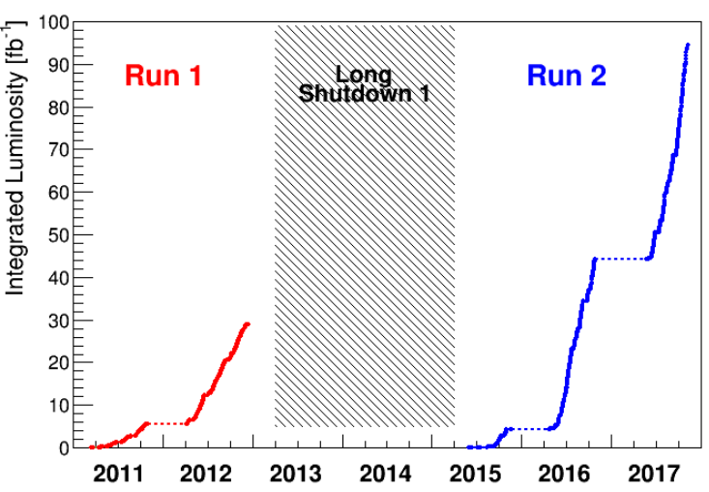
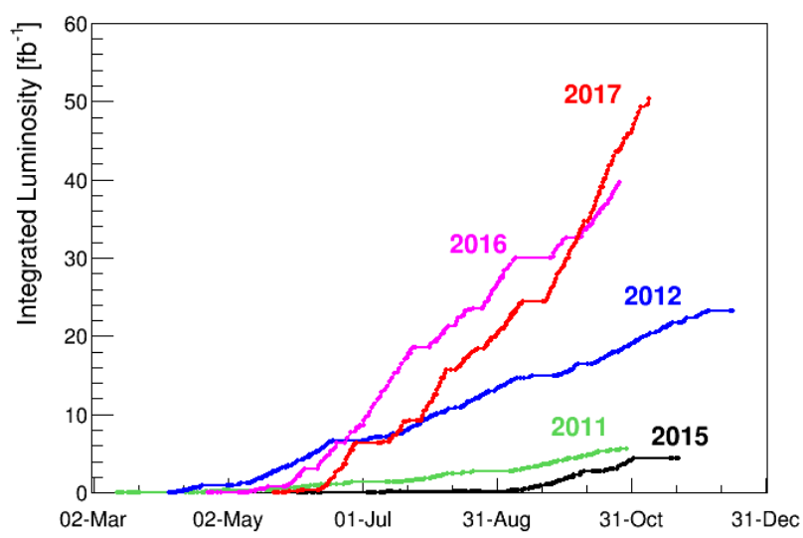
Luminosity Provided by LHC
~5 fb⁻¹ / week
~50 fb⁻¹ in 2017 for ATLAS/CMS.
~1.9 fb⁻¹ for LHCb and 172h 5 TeV data taking for ALICE
Best year so far!
95 fb⁻¹ produced in Run 2 for ATLAS/CMS
123 fb⁻¹ produced since start of LHC

Slide 6
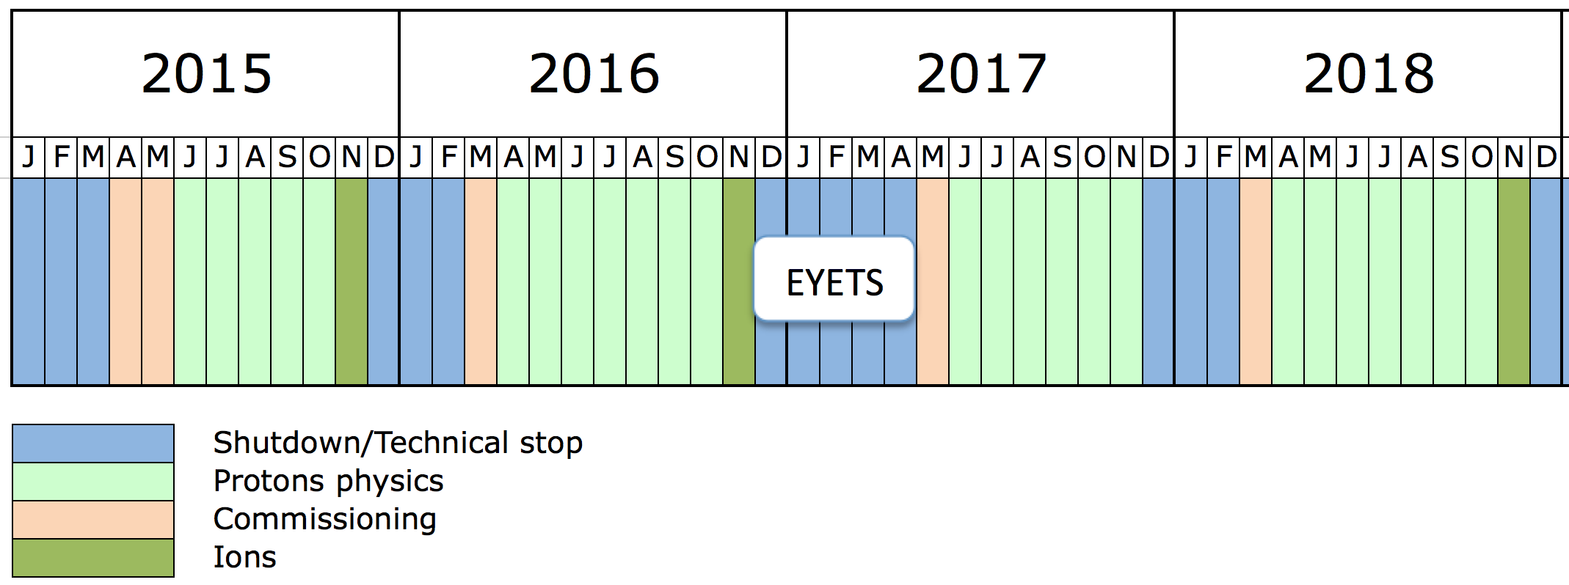
Outlook Of The Beam For 2018

Slide 7
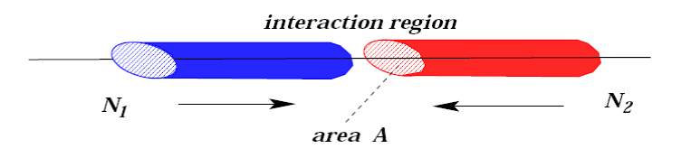
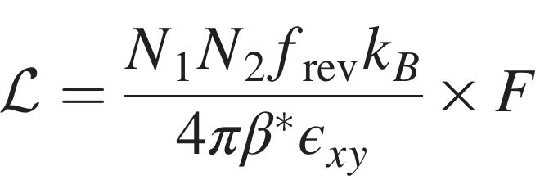
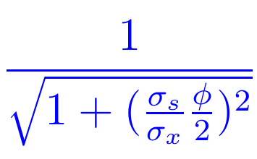
Ways to Improve Luminosity
Increased bunch intensities
Decreased crossing angle => larger F (geometric
reduction factor)
Beam area
Reduced β* (given by magnetic focussing)
Reduced emittance
Notes:
N1, N2: number of proton per bunch
f: beam crossing frequency
kB: number of bunch

Slide 8
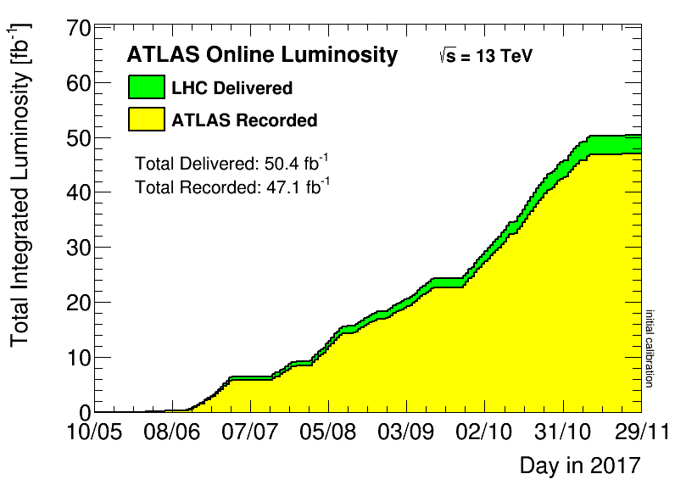
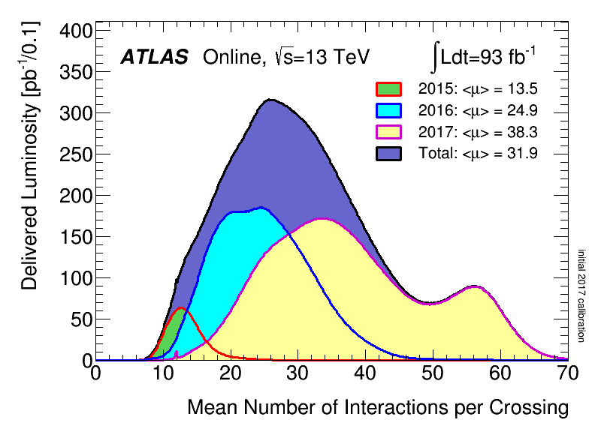
ATLAS Performance
Challenge condition: L reached 2x10³⁴ cm⁻²s⁻¹, μ up to 80.
Can handle μ~60 for 1.7x10³⁴ cm⁻²s⁻¹ and 80kHz level 1 rate.
Limitation is high-level trigger CPU, on the way to improve.

Slide 9
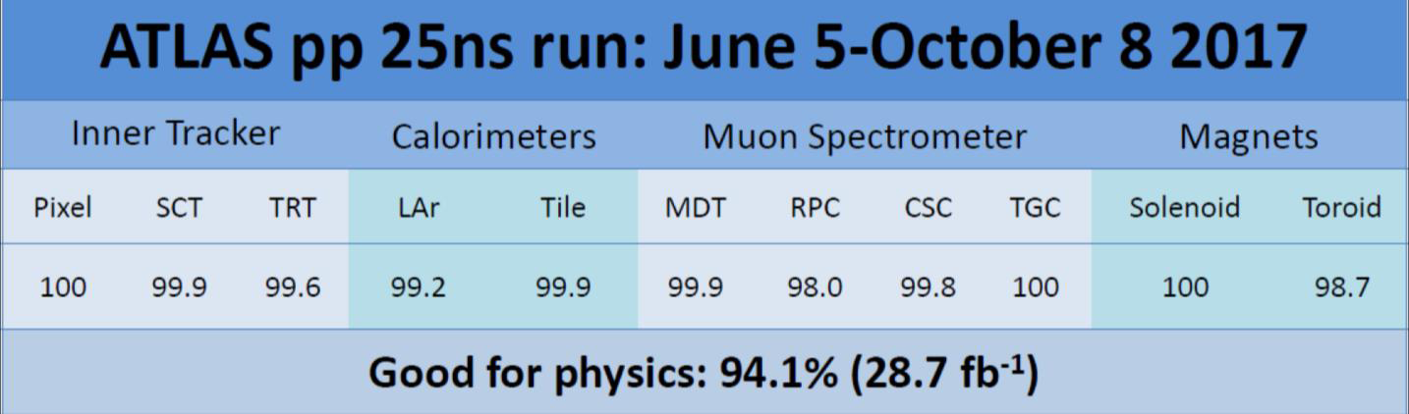
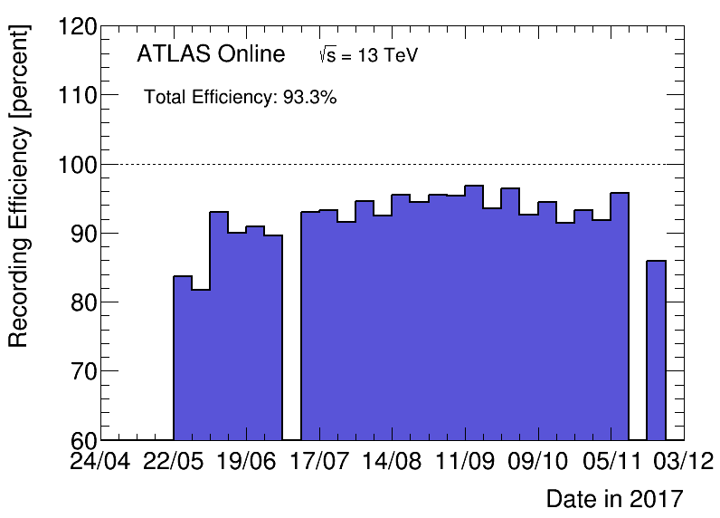
ATLAS Performance
High data taking efficiency: 93.3%
High data quality > 94%

Slide 10
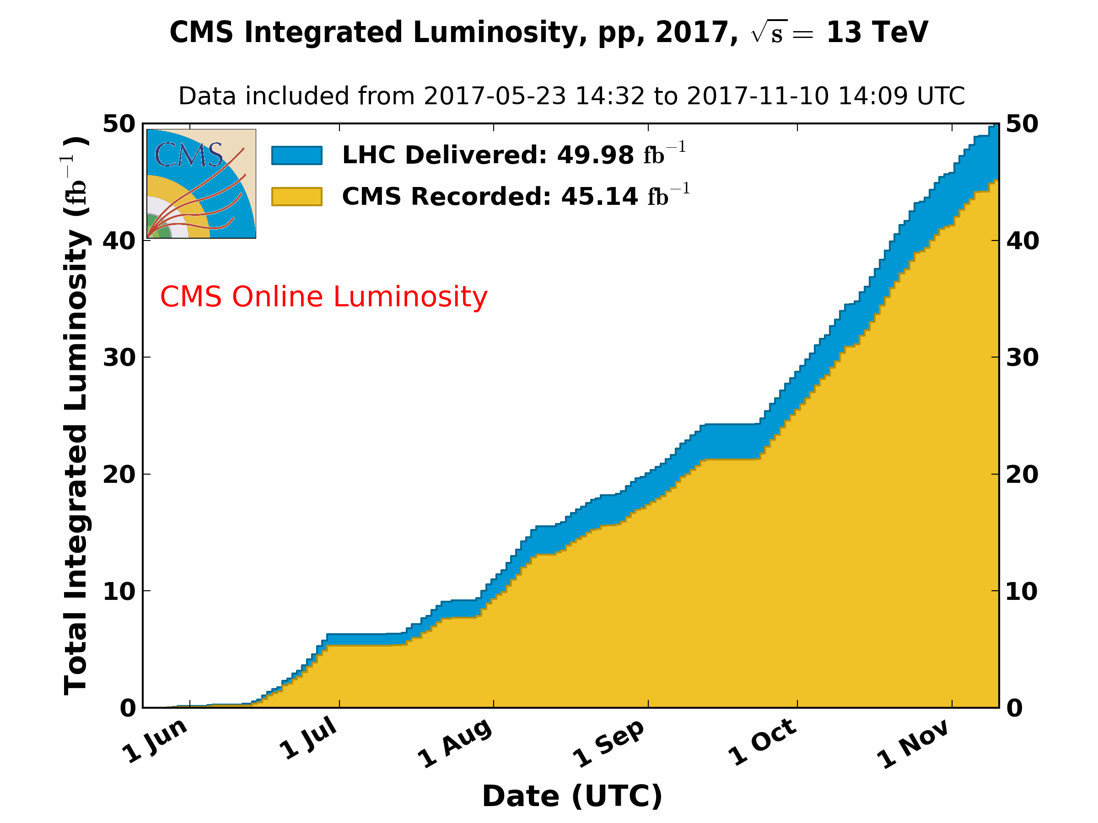
CMS Performance
2016 efficiency ~92%
Recorded/Delivered Luminosity per week (%)
Delivered Luminosity per week (5-1)
Integrated luminosity: recorded/delivered = 45.14/49.98=90.3%
~93% since August, though not so good before that.

Slide 11
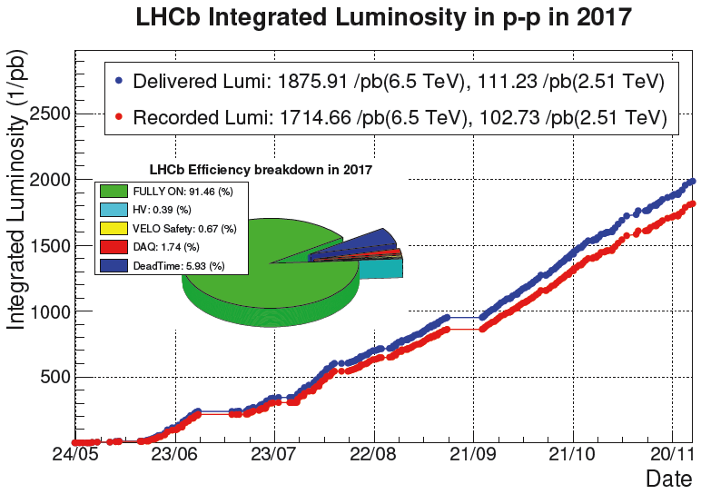
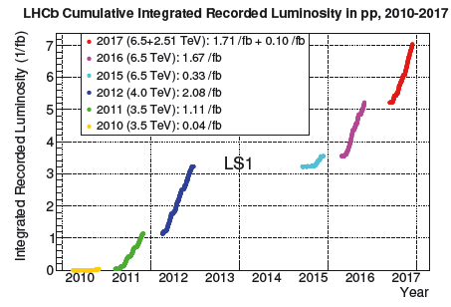
LHCb Data And Detector Performance
Reached target of 1.7 fb⁻¹ in 2017
Total integrated luminosity: ~7 fb⁻¹

Slide 12
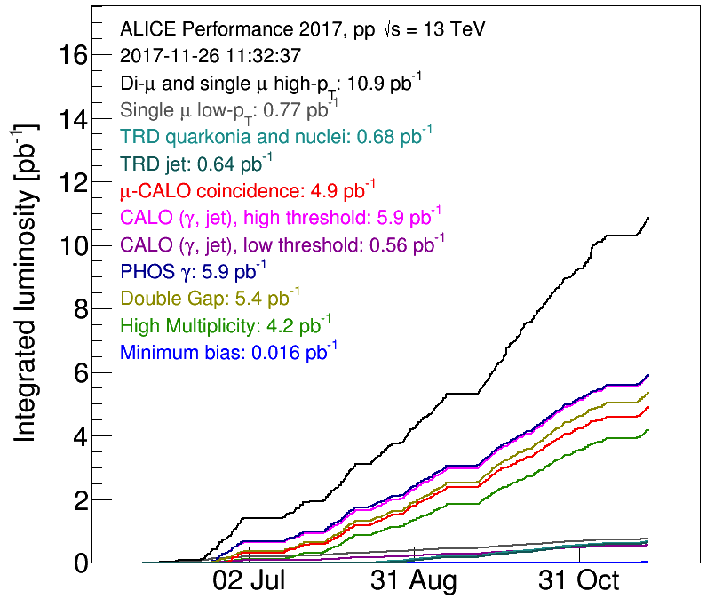
ALICE Data And Detector Performance
97.4% data-taking efficiency for Xe-Xe pilot run at 5.44 TeV

Slide 13
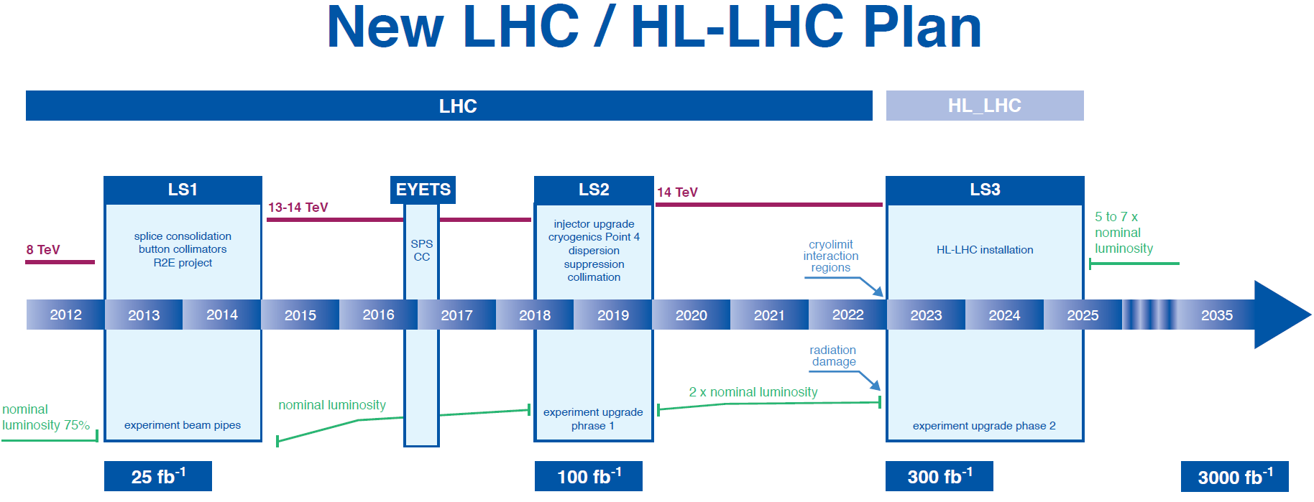
High statistics data to study Higgs boson property and
search for new phenomenon beyond SM.
LHC experiments are moving into upgraded stages
→ challenge to experts, new technology, management
as well as financial support.

Slide 14
Chinese Participation To Phase 2 Upgrade
(45 M from MOST)
1. ATLAS ITK silicon strip (IHEP, QHU)
- FE RO ASIC design
- Si strip model design and construction
- CMOS based Si strip property study
2. ATLAS μ spectrometer (USTC, SDU, SJTU)
- thin gap RPC trigger chamber
- large η μ detector (wGEM)
- MDT TDS
3. CMS endcap μ spectrometer and LHCb (PKU, QHU)
- GEM
- glass RPC
- LHCb SciFi system monitor and test
4. CMS endcap calorimeter and level-1 trigger (IHEP)
- HGC
- Level-1 trigger (μ track)
R&D and partial
mass production

Slide 15
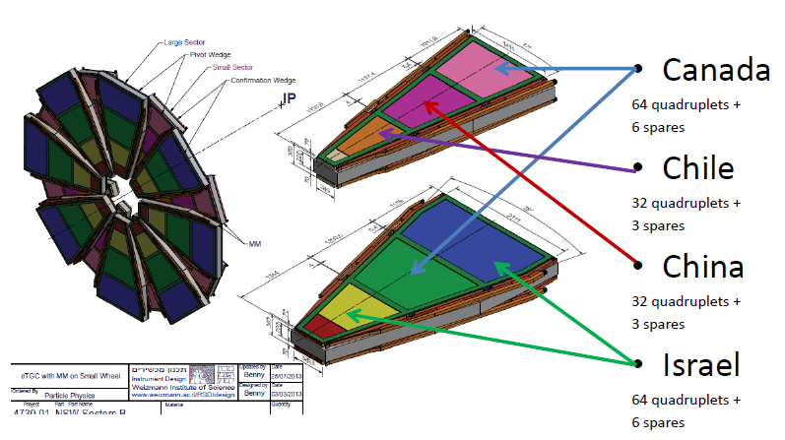
ATLAS Phase I : Muon NSW Project
(12 MRMB from NSFC)
SDU: 128 sTGC chambers
NSW(New Small Wheel)
USTC: FEB design and production
Muon 2/3 trigger coverage
Trigger rate 20 kHz
for 5×10³⁴ cm⁻²s⁻¹
Challenge:
High background ~15kHz/cm²
Spatial resolution ~100μm
Notes:
10 M RMB from NSFC

Slide 16
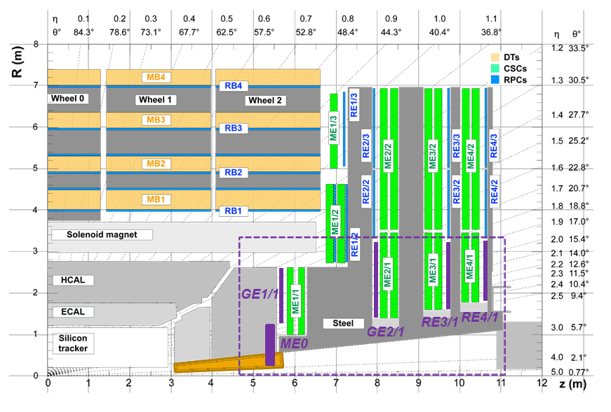
CMS Phase-1 Contribution From China
(0.7 MRMB from NSFC)
1/3 of CSC for ME4/2
CPPF(Concentrator, Preprocessor and Fan-out) system for MUON L1-trigger

Slide 17
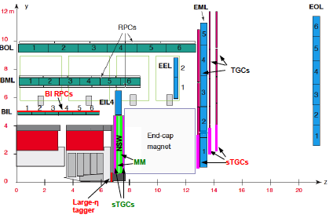
ATLAS Phase II Upgrade
Electronics of μ spectrometer (MDT)
μ spectrometer
trigger chamber
(thin gap RPC)
Inner tracker (Si strip)
Large η tagger (MGEM)

Slide 18
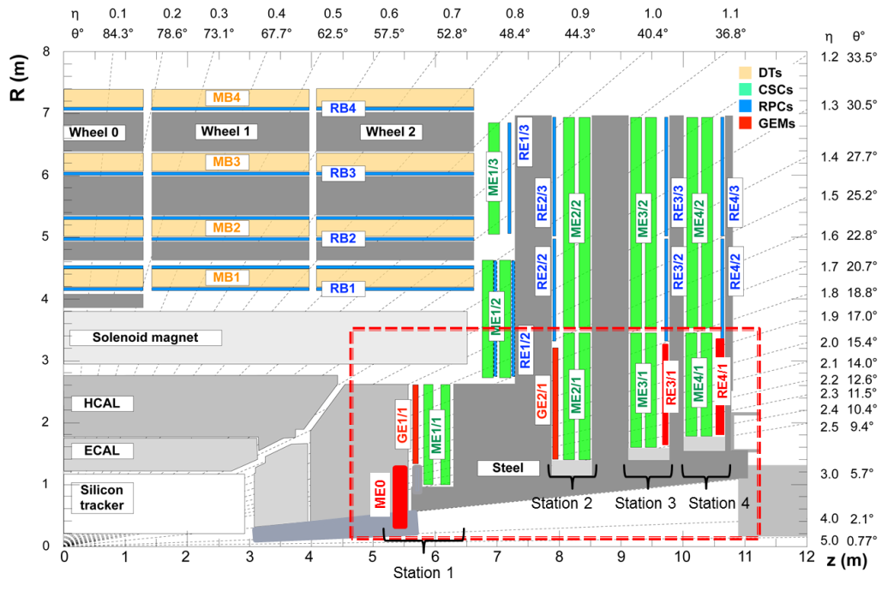
CMS Upgrade
Endcap calorimeter
(High granularity)
Endcap muon
trigger chamber
(Large area GEM)
Endcap muon
trigger chamber
(thin glass RPC)

Slide 19
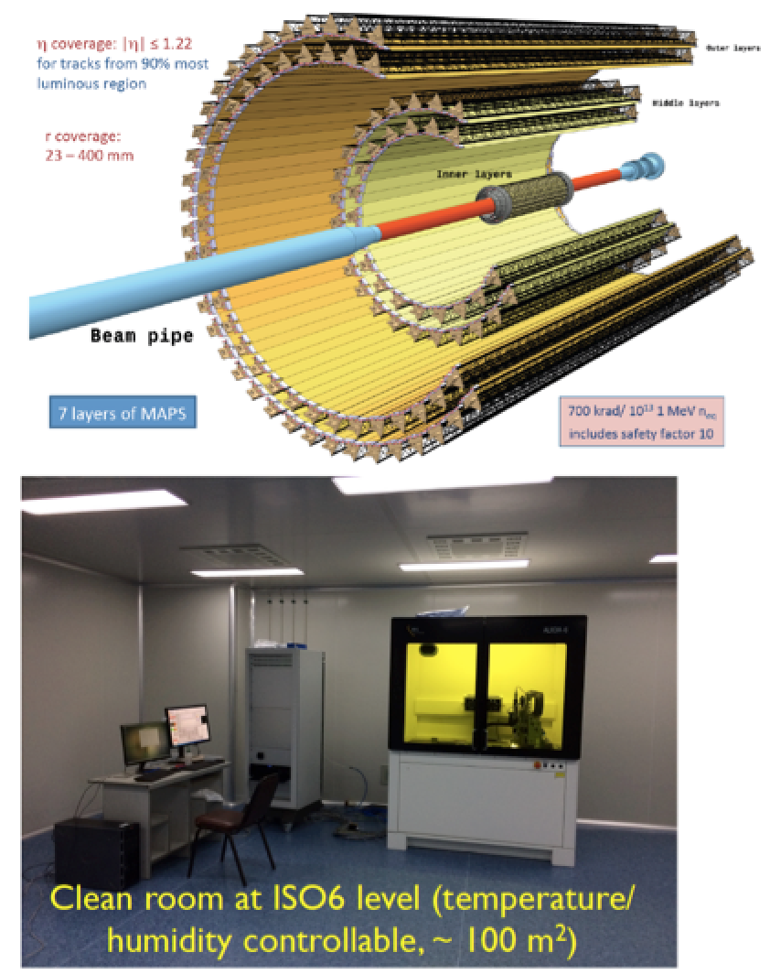
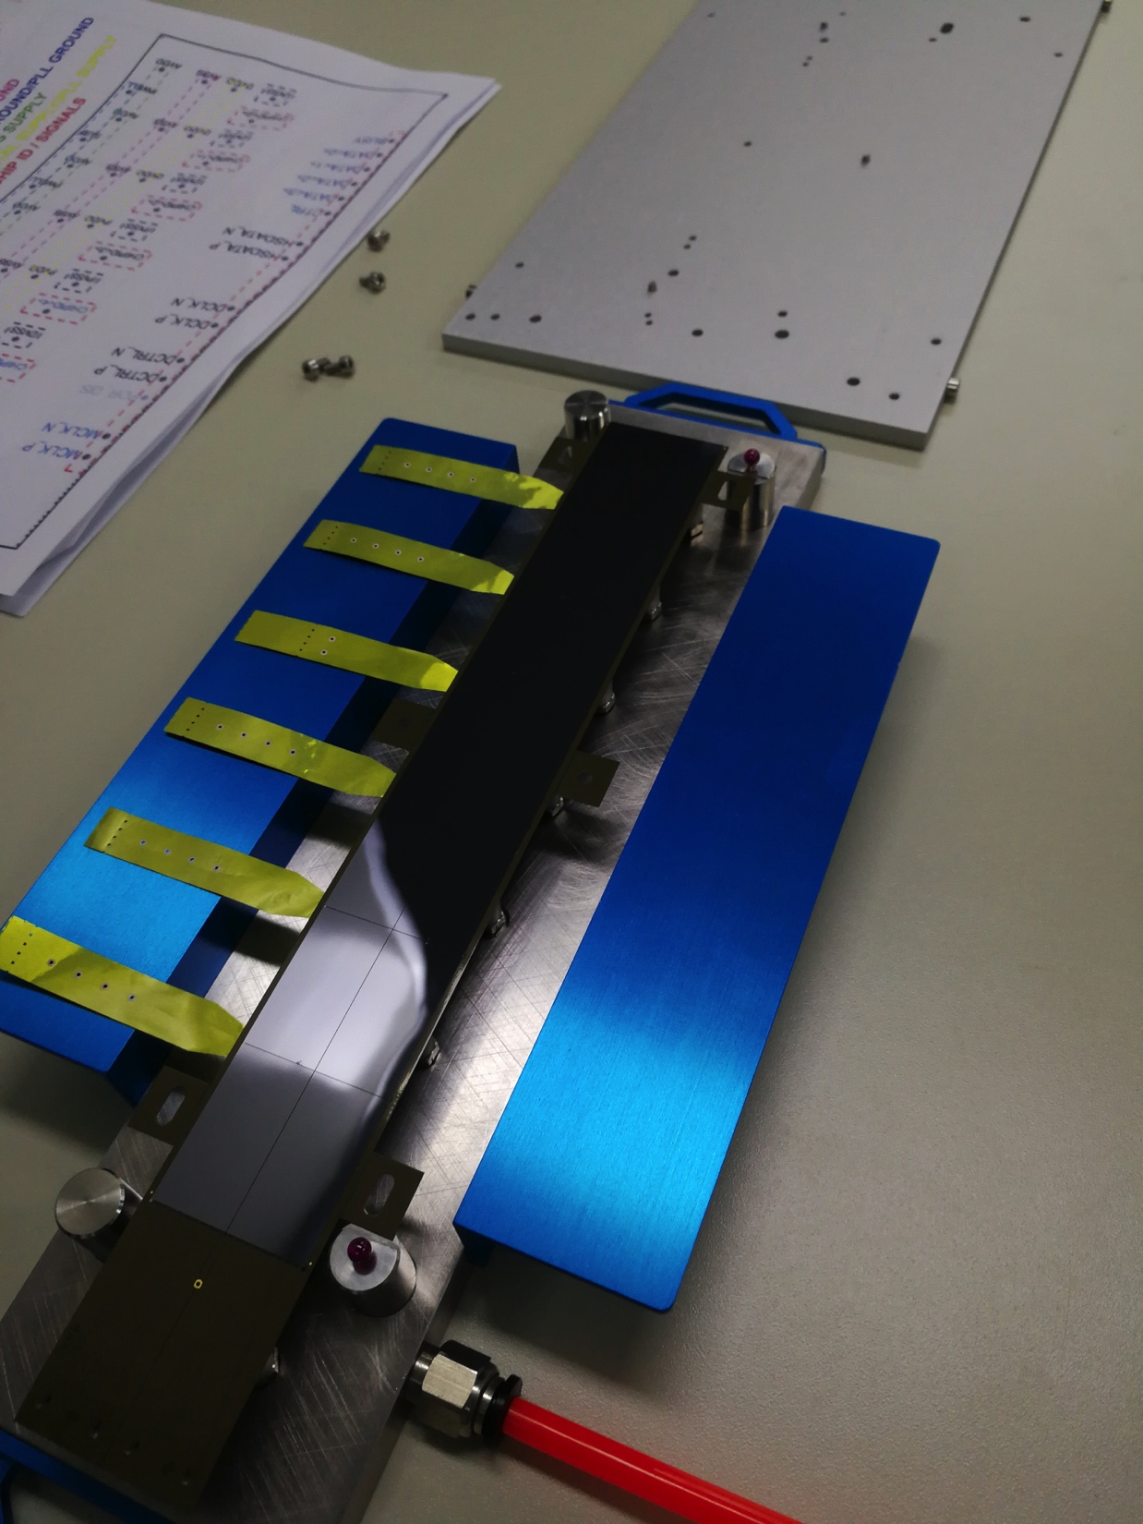
ALICE: Phase II Upgrade
Efforts on chip design (Wuhan/CCNU) on matrix readout architecture and pixel analog front-end
Assembly and test of 500 chips-modules (~1/5) of ITS upgrade detector
MOST approved 7.52 M RMB
ALICE ITS HIC Production at CCNU
19

Slide 20
Chinese Participation to LHC Experiments
Institution | ATLAS | CMS | ALICE | LHCb
Institute of High Energy Physics, CAS (IHEP) | 25 | 19
University of Science and Technology of China(USTC) | 21 |  | 3
Beijing University (PKU) |  | 8
Qinghua University (QHU) | 2 | 2 |  | 9
Shanghai Jiaotong University (SJTU) | 9
Shangdong University (SDU) | 8
Nanjing University (NJU) | 4
Beijing University of Aeronautics and Astronautics(BUAA) |  | 3
University of CAS (UCAS) |  |  |  | 7
Central China Normal University (CCNU) |  |  | 18 | 4
Shanghai Institute of Application Physics, CAS (SINAP) |  |  | 5
China Institute of Atomic Energy (CIAE) |  |  | 1
Wuhan University (WHU) |  |  |  | 2
Huazhong University of Science & Technology (HUST)
Hubei University of Technology (HBUT)
Total authors | 69 | 32 | 27 | 22

Slide 21
Resources to LHC Experiments
 | Construction and Commissioning | Upgrade | Physics Analysis | Position (Manpower, start fund)
NSFC | x | x | x | x
MOST | x | x | x
CAS | x |  |  | x
MOE |  |  |  | x
Government talent recruiting program |  |  |  | x
Institution |  |  |  | x

Slide 22
Approved Funds
Experiment | Physics |  | Phase I (NSFC) |  | Phase II (MOST)
 | NSFC | MOST | Task | M RMB | Task | M RMB
ATLAS | 9.98 |  | Muon Spectrometer (TGC, trigger electronics) | 10 | Tracking detector Si strip, RPC trigger chamber, MDC electronics, Large η | 25.85
CMS | 6.5 |  | L1 trigger | 8 | Endcap muon(GEM, MRPC), Endcap CAL, Trigger | 19.15
LHCb | ~4 |  |  |  | SciFiber readout electronic | 2
ALICE | ~4 |  | ECAL, PHOS | 11 (NSFC+MOE) | Inner tracking system | 8
~35 M for all 4 experiments
NSFC will support mass production of Phase II upgrade
MOST will continue support Phase II in 14th-5 year plan

Slide 23
Summary
Both LHC and the experiments on it are performed well in 2017. LHC provided 123 fb⁻¹ data in total.
Physics program and results are rich.
Challenge of the upgrade for both LHC and the detectors.
LHC experiments will be the frontier of energy frontier in the decades to come.
Chinese participation, as well as contributions to the LHC
experiments has been enhancing fast.
We are better organized, better supported by MOST and NSFC → It’s a time for us to have better performance and impressive impact to he LHC experiments.

Slide 24
Extra Slides

Slide 25
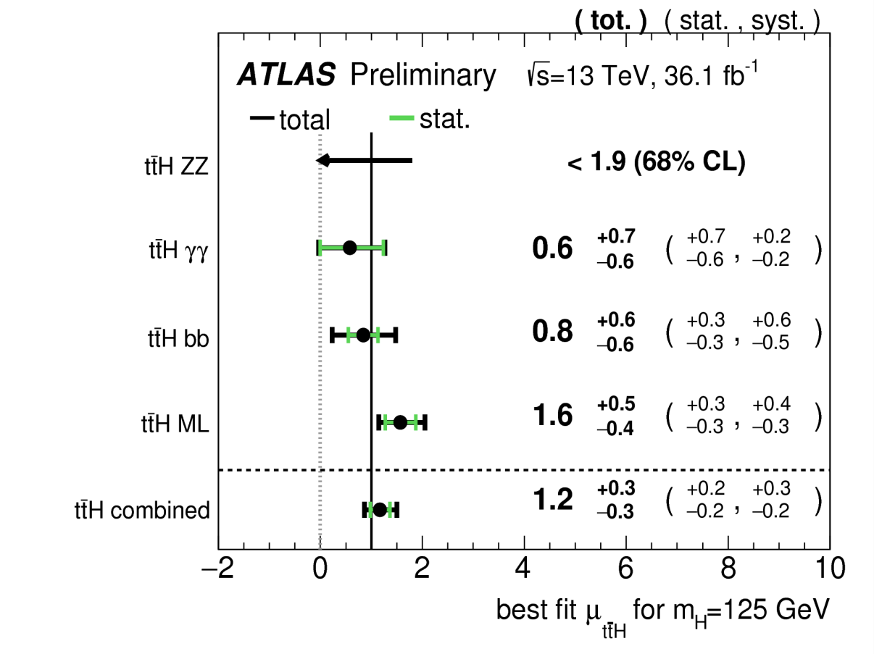
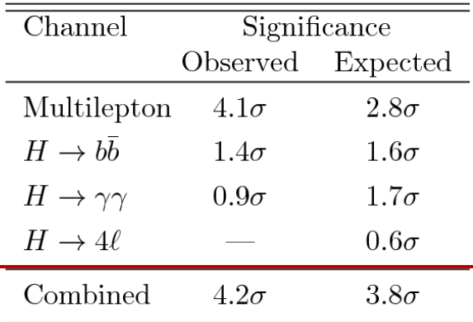


ATLAS: Evidence of ttH production
_

Slide 26
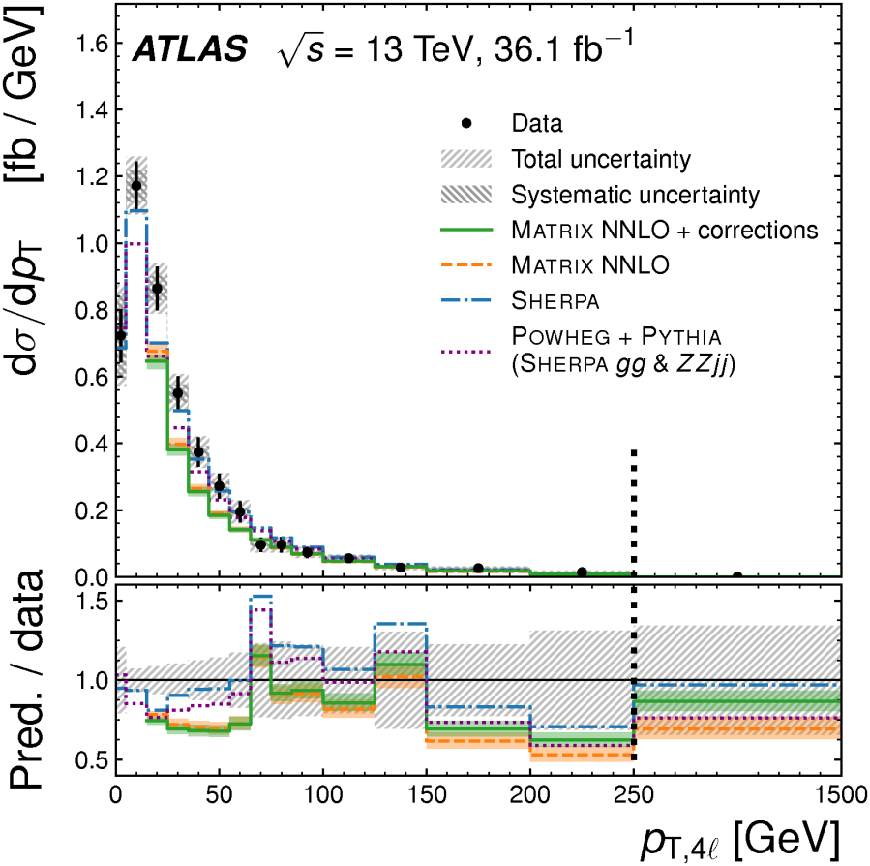
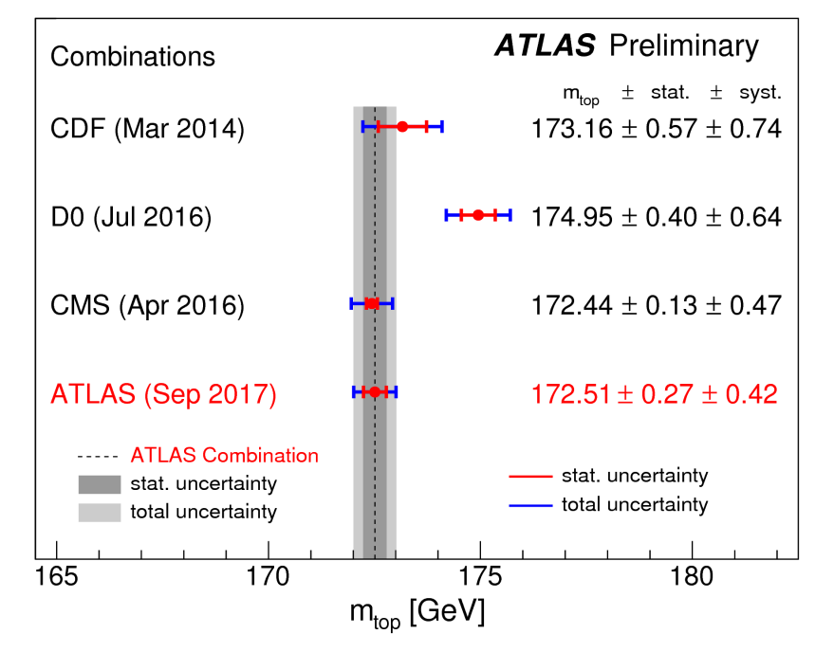
m_{t} pp→ZZ(4l) production
Provide data for global fits of EW parameters that used to test consistency of the SM.
σ_{inclusive} = 17.3± 0.6(stat.)±0.5(stst.)± 0.6(Lum.)
Test EW sector of SM at high energy
Integrated and differential cross sections
measured agree with NNLO predictions
Search for BSM neutral triple gauge couplings
→ no evidence found

Slide 27
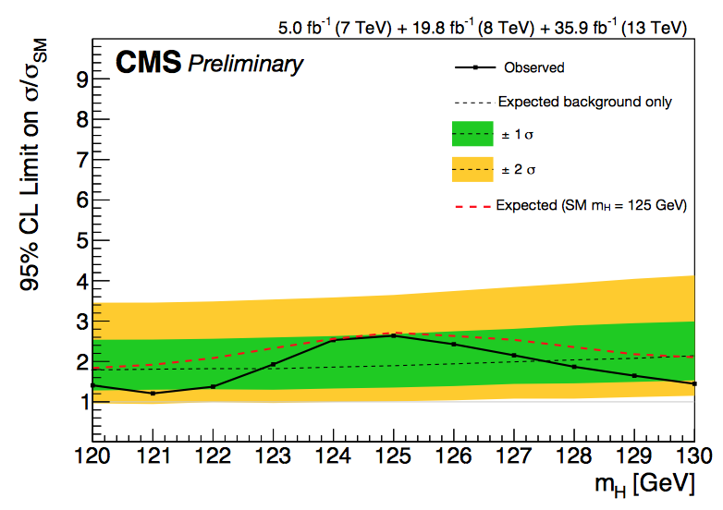
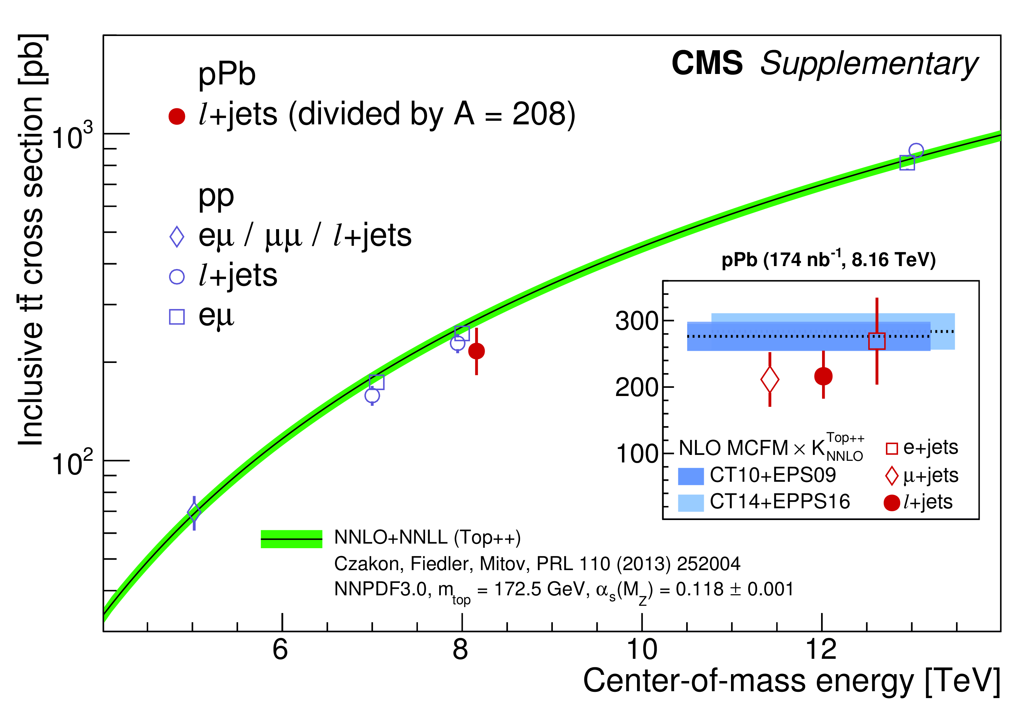
CMS: H→μμ and t production in pPb collision
Upper limit on obs. (exp.) prod. rate
2.64 (1.89) x SM at 95% CL
Upper limit on obs.(exp.) Br for H→μμ
5.7 (5.1) x 10⁻⁴ (7+8+13 TeV)
(5 TeV): 300pb⁻¹ of data
First observation in p-Pb collision
Consistent with the predictions from perturbative QCD NNLO.

Slide 28
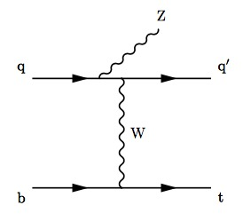
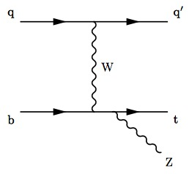
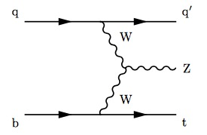
Evidence for tZq production
Rare SM process (~120 fb)
Probes both tZ and WWZ couplings
Evidence:
3.7𝜎 observed (3.1𝜎 expected)

Slide 29
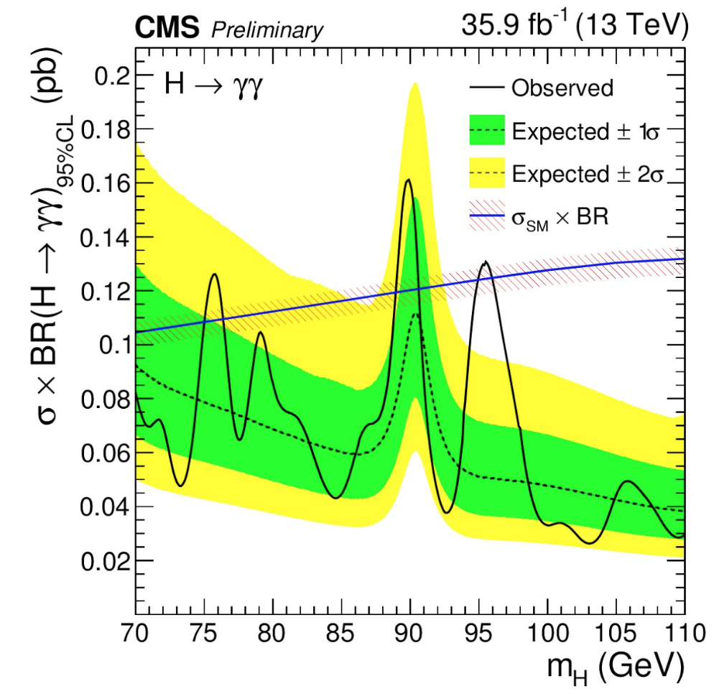
CMS: Low mass H→𝛾𝛾
Some BSM models (NMSSM, 2HDM) gives rise to several Higgs bosons, of which some could have m_{H} < 125 GeV
Results: No evidence observed
13 TeV: ~2.9𝜎 local (1.47𝜎 global) significance @ 95.3 GeV
8 TeV: ~2𝜎 local significance @ 97.6 GeV
Combined: ~2.8𝜎 local (1.3𝜎 global) significance @95.3 GeV

Slide 30
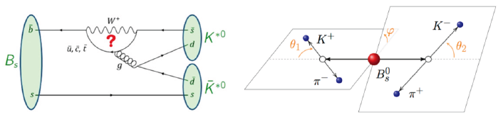
Measurement of φ_{s}^{dd} in B_{s}⁰→(K⁺π⁻)(K⁻π⁺) decays
_
Using 3 fb⁻¹ (7 + 8 TeV)
Time-dependent amplitude analysis
First measurement of the CP-violating phase φ_{s} using b→dds
φ_{s}^{dd} = -0.10 ± 0.13(stat) ± 0.13(syst) rad
Consistent with SM expectation (φ_{s}^{dd} ≈ 0 in SM) and with the corresponding result of φ_{s}^{ss}
φ_{s}^{ss} = -0.17 ± 0.15(stat) ± 0.03(syst) rad
First determination of the CP asymmetry of the (K⁺π⁻)(K⁻π⁺) final state.
_
_
_

Slide 31
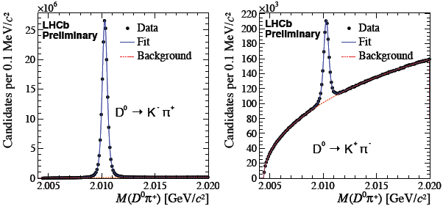
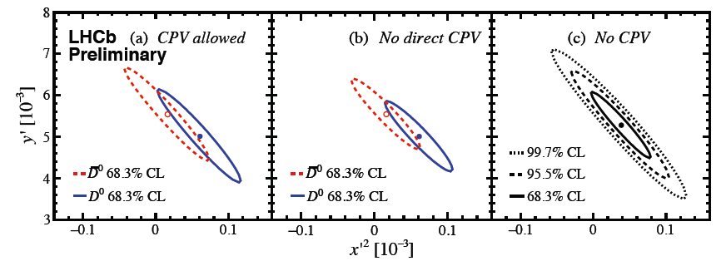
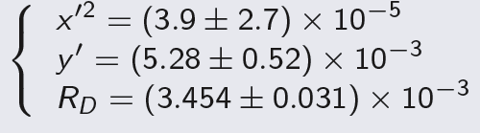
D⁰-D⁰ mixing and CPV in D⁰→K⁺π⁻ decays
_
_
Study D⁰-D⁰ oscillations using D^{*+}→D⁰(→K⁺π⁻)π⁺ decays
Using 5 fb⁻¹ (7+8+13 TeV)
For CP conservation:
For CPV, measurement performed separately for D⁰ and D⁰
  Direct CPV asymmetry A_{D} = (-0.1 ± 9.1) × 10⁻³
  Magnitude of the ratio of mixing parameters
  1.00 < |q/p| < 1.35 at 68:3% CL
No evidence yet for CP violation in charm mixing

Slide 32
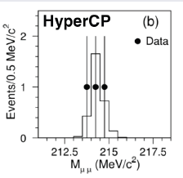

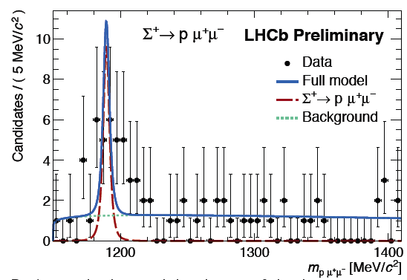
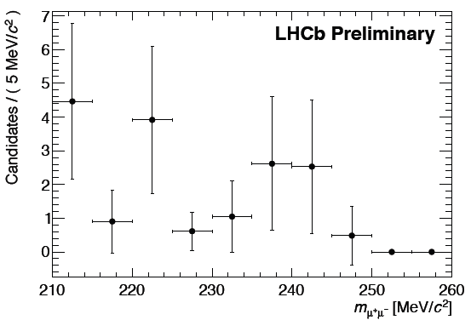
Search for the rare decay Σ⁺→pμ⁺μ⁻
Physics with s quark provides a unique & complementary probe to test SM wrt c and b quarks.
Using 3 fb⁻¹ (7+8 TeV)
Measured Br → consistent with SM
HyperCP results not confirmed with present data
- “Evidence for the decay Σ⁺→pμμ” PRL 94 021801
-

Slide 33
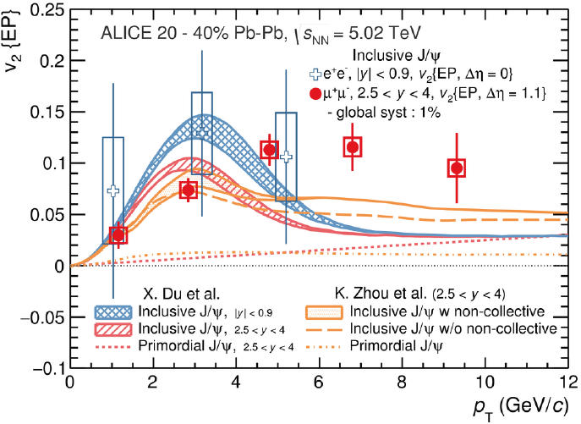
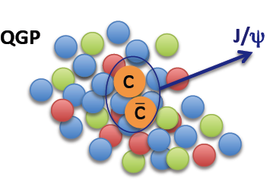
J/ψ elliptic flow in Pb-Pb collisions
arXiv:1709:05260, accepted by PRL
Evidence of J/ψ v2> 0 in the interval 4<p_{T}<6 GeV/c in semi-central collisions (significance 6.6σ)
Low p_{T} J/ψ are formed by recombinaon of the charm quarks in the medium
→charm quarks thermalize and flow with the medium
Notes:
Important observable to understand the properties of the created medium:
• Low pT: Sensi0vity to the thermaliza0on of the quarks in the medium
• High pT: Path length dependence of energy loss in the QGP

Slide 34
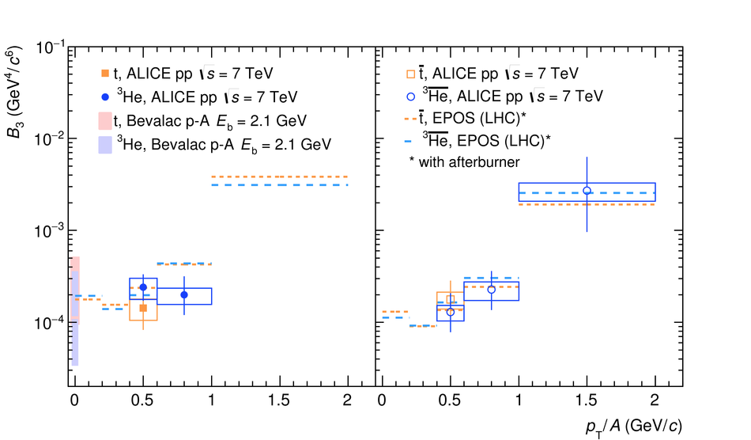
Triton and 3He spectra in pp collisions
Important for the study of of anti-nuclei production mechanisms
Interesting to cosmology: e.g. background for dark maker search
B₃ increases with p_{T}
B₃ well described by QCD-inspired generators when a coalescence-based aferburner is added

Slide 35
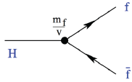
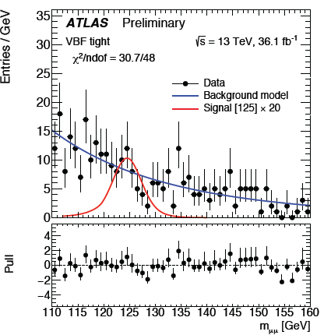
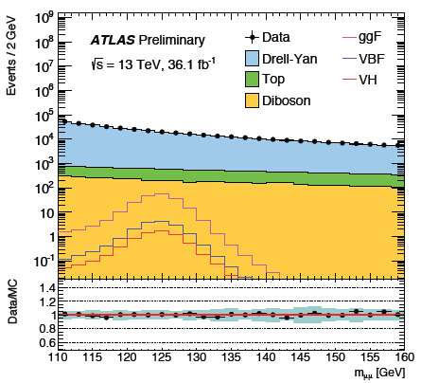
H→ μ⁺μ⁻
Small branching fraction, large D-Y background, high resolution
Probe Higgs couplings to second-generation fermions
 | Observed / expected upper limit at 95%CL | Signal strength
Run 2 (13 TeV) | 3.0 / 3.1 | -0.07 ± 1.5
Run 1+Run 2(7, 8, 13 TeV) | 2.7 / 2.8 | -0.13 ± 1.4

Slide 36
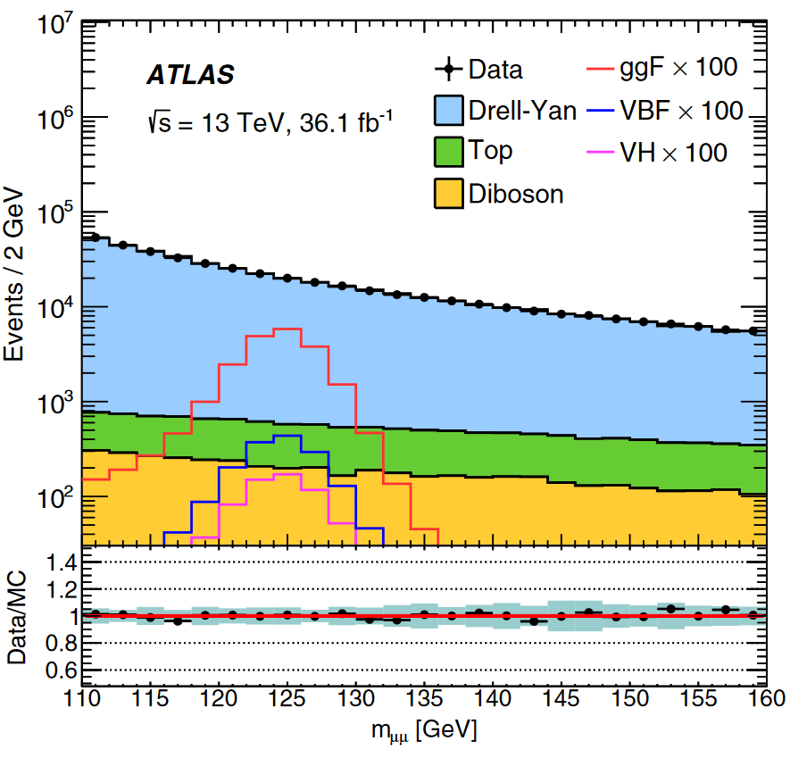
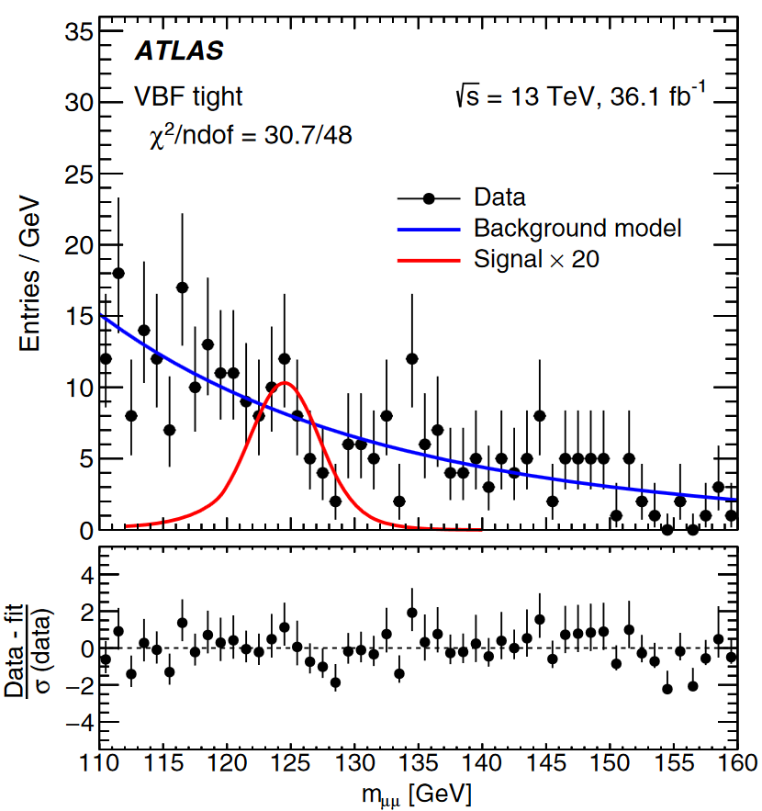
ATLAS: H→μμ
PRL 119 (2017)051802, editor’s suggestion

Slide 37
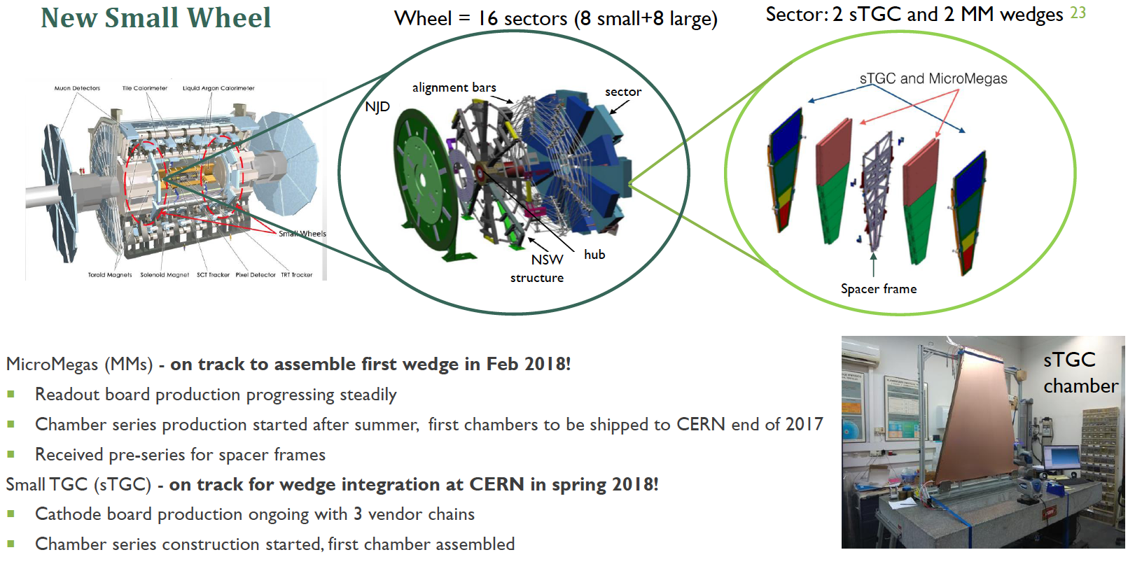

Slide 38



CCNU Activities on ALICE ITS Upgrade
New Inner Tracking System (ITS)
MAPS technology, 7 layers of pixel
Improved resolution, less material, faster readout
Physics goal: high-precision measurements of QGP properties.
20% ALICE/ITS OB HIC assembly & testing
Clean room was constructed and run in good status since November, 2016
Ground floor (vibration velocity RMS ~ 3 μm/s)
Temperature/humidity controllable
ISO6 clean level ~ 70 m² (2.6 m head room) +
ISO7 clean level ~ 20 m² (2.9 m head room)
Gas supply system
Pixel chip assembly & inspection machine (IBS ALICIA-6) and wire-bonding machine (F&K Delvotec G5 64000) installed
Pre-series production has been started, and the series production will start in Jan. 2018
ALICE ITS HIC Production @ CCNU
Dec. 17, 2017

Slide 39




CCNU Activities on ALICE ITS Upgrade
ALPIDE chips (dimension of 3cmx1.5cmx100μm) can be automatically aligned with positioning accuracy of better than 5 μm@3σ by the ALICIA machine.
The chip-FPC interconnections are realized with wire-bonding method, which is done fully automatically by the F&K G5 64000 machine with positioning accuracy ~ 5 μm@3σ (large working area).
R&D on chip-FPC interconnections technology, such as laser bonding, is ongoing.
Dec. 17, 2017

Slide 40



China built a supermodule of di-jet electromagnetic calorimeter and scalable readout unite (SRU) of PHOS/EMCAL/DCAL (10 M RMB)
measure di-jets

