Slide 1



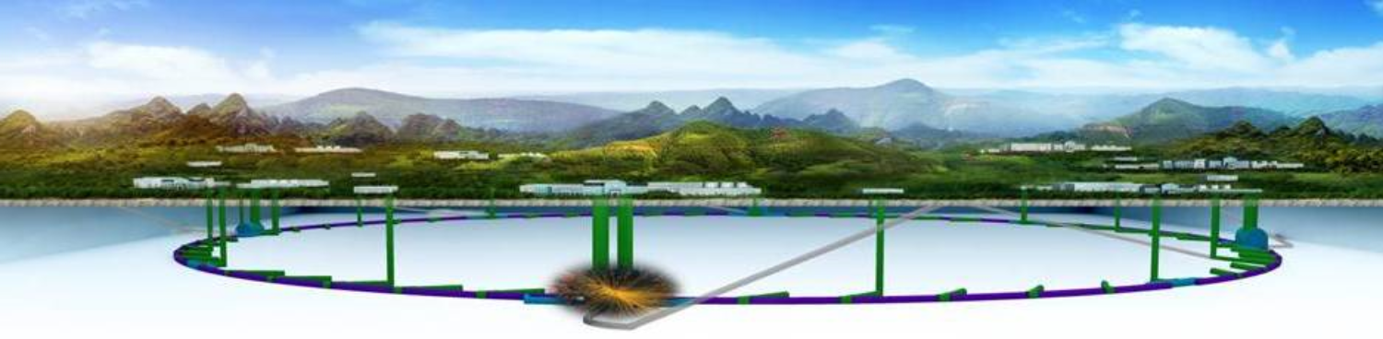
Overview & Objectives
XinChou Lou
Institute of High Energy Physics, Beijing
International Workshop on Circular Electron-Positron Collider

Slide 2
Outline
Overview
    Progress and updates
    Plan and goals
    Issues
Objectives
    This meeting
    Near future
Summary

Slide 3
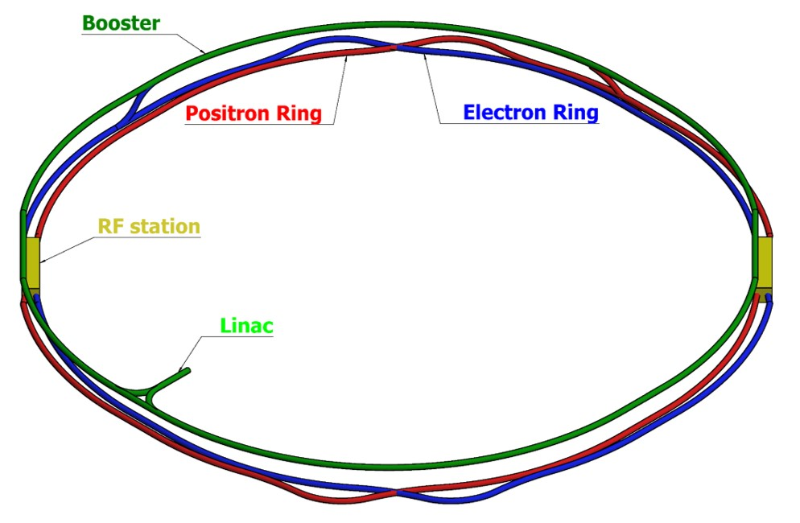
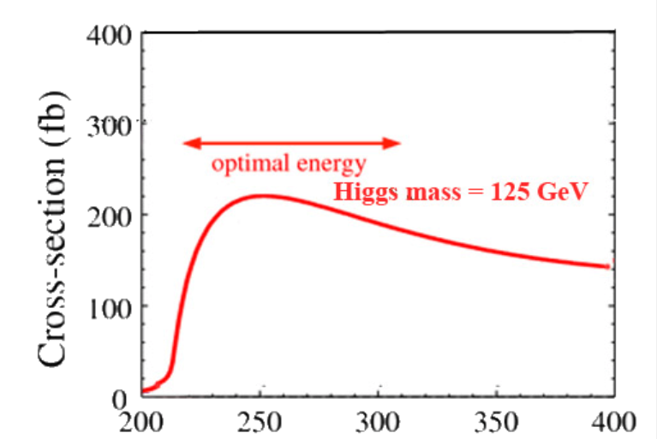
Reminder about the CEPC-SppC
e⁺e⁻ Higgs (Z) factory
E_{cm}≈240GeV, luminosity ~2×10³⁴ cm⁻²s⁻¹, 2IP，1M H in 10 years
at the Z-pole 10¹⁰Z bosons/yr
Precision measurement of the Higgs boson (and the Z boson)
Upgradable to pp collision with E_{cm} ≈ 50-100 TeV (with ep, HI options)
A discovery machine for BSM new physics
Higgs precision
1% or better
e⁺e⁻ → ZH
e⁺e⁻ Higgs (Z) factory
Ring length ~ 100km
BEPCII will likely complete its mission ~2020s;
CEPC – possible accelerator based particle physics program in China after BII
E_{cm}(GeV)

Slide 4
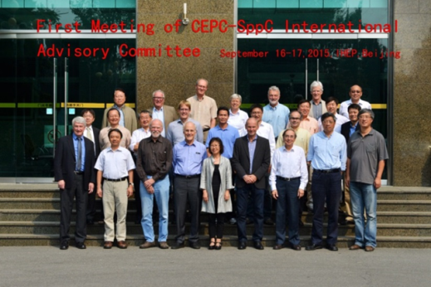
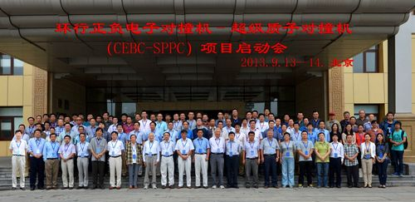
Current (temporary) CEPC Organization
Only for Chinese
Institutional Board
Y.N. GAO
J. GAO
IAC
Young-Kee Kim, ….
Since Sept.
2013
Steering Committee
Y.F. WANG (IHEP),….
Project Director
XC LOU
Q. QIN
N. XU
tasks：
Intl Relation– J GAO
PR – YN GAO
Conf. – J.Shan
CDR – XC Lou et al.
……
CDR Editors
theory LT Wang et al
accelerator W Chou et al
detector-simu. TC Chao et al
Theory
HJ HE(TH)
JP MA(ITP)
XG HE(SJTU)
Accelerator
J. GAO(IHEP)
CY Long(IHEP)
JY TANG(IHEP)
Detector
JoaoCosta(IHEP)
S. JIN(NJU)
YN GAO(TH)

Slide 5
at this workshop
International Advisory Committee
Young-Kee Kim, U. Chicago (Chair)
Barry Barish, Caltech
Hesheng Chen, IHEP
Michael Davier, LAL
Brian Foster, Oxford
Rohini Godbole, CHEP, Indian Institute of Science
David Gross, UC Santa Barbara
George Hou, Taiwan U.
Peter Jenni, CERN
Eugene Levichev, BINP
Lucie Linssen, CERN
Joe Lykken, Fermilab
Luciano Maiani, Sapienza University of Rome
Michelangelo Mangano, CERN
Hitoshi Murayama, UC Berkeley/IPMU
Katsunobu Oide, KEK
Robert Palmer, BNL
John Seeman, SLAC
Ian Shipsey, Oxford
Steinar Stapnes, CERN
Geoffrey Taylor, U. Melbourne
Henry Tye, IAS, HKUST
Yifang Wang, IHEP
Harry Weerts, ANL
Theory
•Qing-Hong Cao (PKU)
•Nathaniel Craig (UCSB)
•Hongjian He (SJTU)
•XiaoGang He (SJTU)
•JianPing Ma (ITP)
•Maxim Perelstein (Cornell U.)
•Tilman Plehn (Heidelberg U.)
•Matthew Reece (Harvard U.)
•German Valencia (Monash U,)
•Liantao Wang (Chicago U.)
Detector
•Patrizia Azzi (INFN Padova)
•Daniela Bortoletto (Oxford)
•Massimo Caccia (INFN)
•Joao Guimaraes da Costa (IHEP)
•Yaquan Fang (IHEP)
•Roberto Ferrari (INFN)
•Yuanning Gao (THU)
•Sasha Glazov (DESY)
•Imad Laktineh (IPNL)
•Jianbei Liu (USTC)
•Wang Meng (SDU)
•Soeren Prell (Iowa State U.)
•Manqi Ruan (IHEP)
•Charlie Young (SLAC)
Scientific Committee
CEPC accelerator
•Philip Bambade (LAL)
•Anton Bogomyagkov (BINP)
•Yunlong CHI (IHEP)
•Jie GAO (IHEP)
•Sergei Nikitin (BINP)
•Carlo Pagani (Milano U. & INFN-LASA)
•Guoxi Pei (IHEP)
•Chenhui YU (IHEP)
SppC accelerator
•Kazuhito Ohmi (KEK)
•Robert Palmer (BNL)
•Jingyu Tang (IHEP)
•Davide Tommasini (CERN)
•Qingjin Xu (IHEP)
Global contribution to this workshop

Slide 6
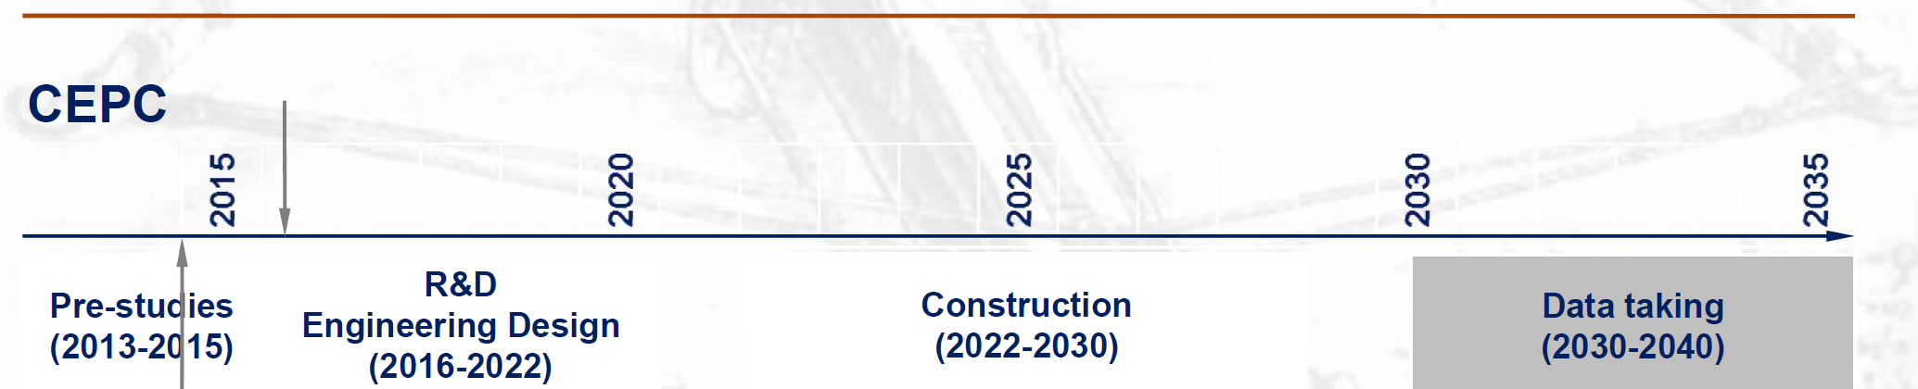
CEPC Schedule (ideal)
design issues
R&D items
preCDR
design, funding
R&D program
Intl. collabration
site study
seek approval, site decision
construction during 14th 5-
year plan
commissioning
CEPC data-taking starts before the LHC program ends
Possibly con-current with the ILC program

Slide 7
Baseline CEPC

Slide 8
Baseline CEPC
Baseline design & options for the Conceptual Design Report
circumference=100km，E_{cm}=240 GeV, power per beam≤30MW，design luminosity ~2×10³⁴cm⁻²s⁻¹ (240 GeV)
1×10³⁴cm⁻²s⁻¹ (91 GeV)
two layouts:
double ring as the default;
advanced local double ring as an option
two independent detectors
Benefits
mature technologies, Z+ZH program
high energy pp option beyond the Higgs(Z) factory
g synchrotron light source (?)

Slide 9
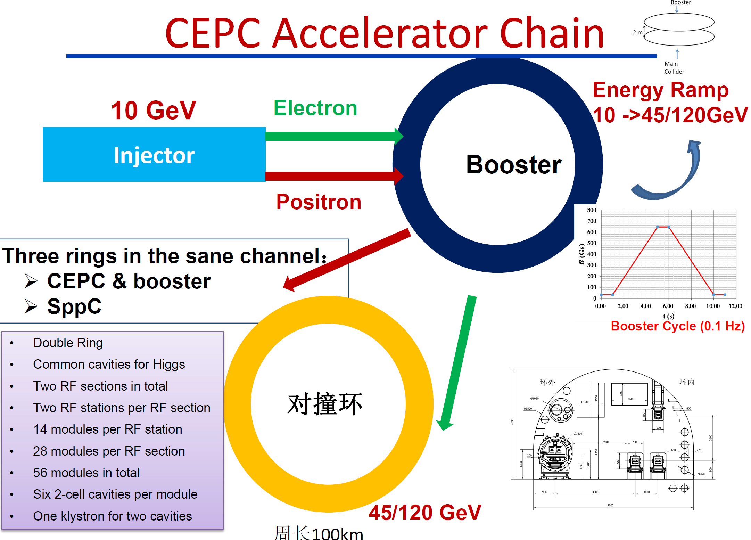

Slide 10
The Conceptual Design Report
    The CEPC accelerator design
    The CEPC detector design
    Theory and physics performance
CDR drafts by end of 2017, reviews and finalization in Spring 2018

Slide 11
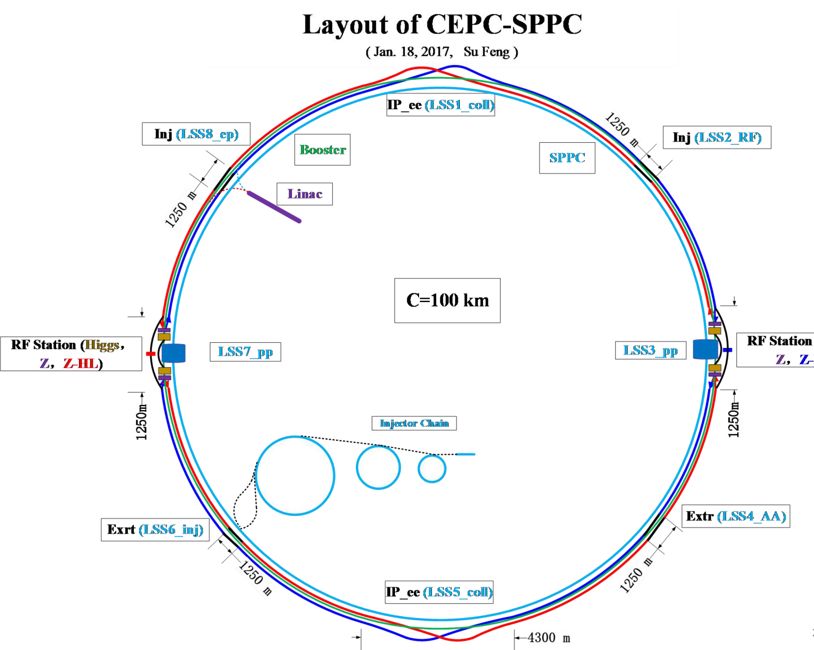
CDR 2017
Layout and hardware satisfying both the Z and the H programs
L =2×10³⁴cm⁻²s⁻¹ (at E_{cm}=240 GeV)
L =1×10³⁴cm⁻²s⁻¹ (at E_{cm}=91 GeV)

Slide 12
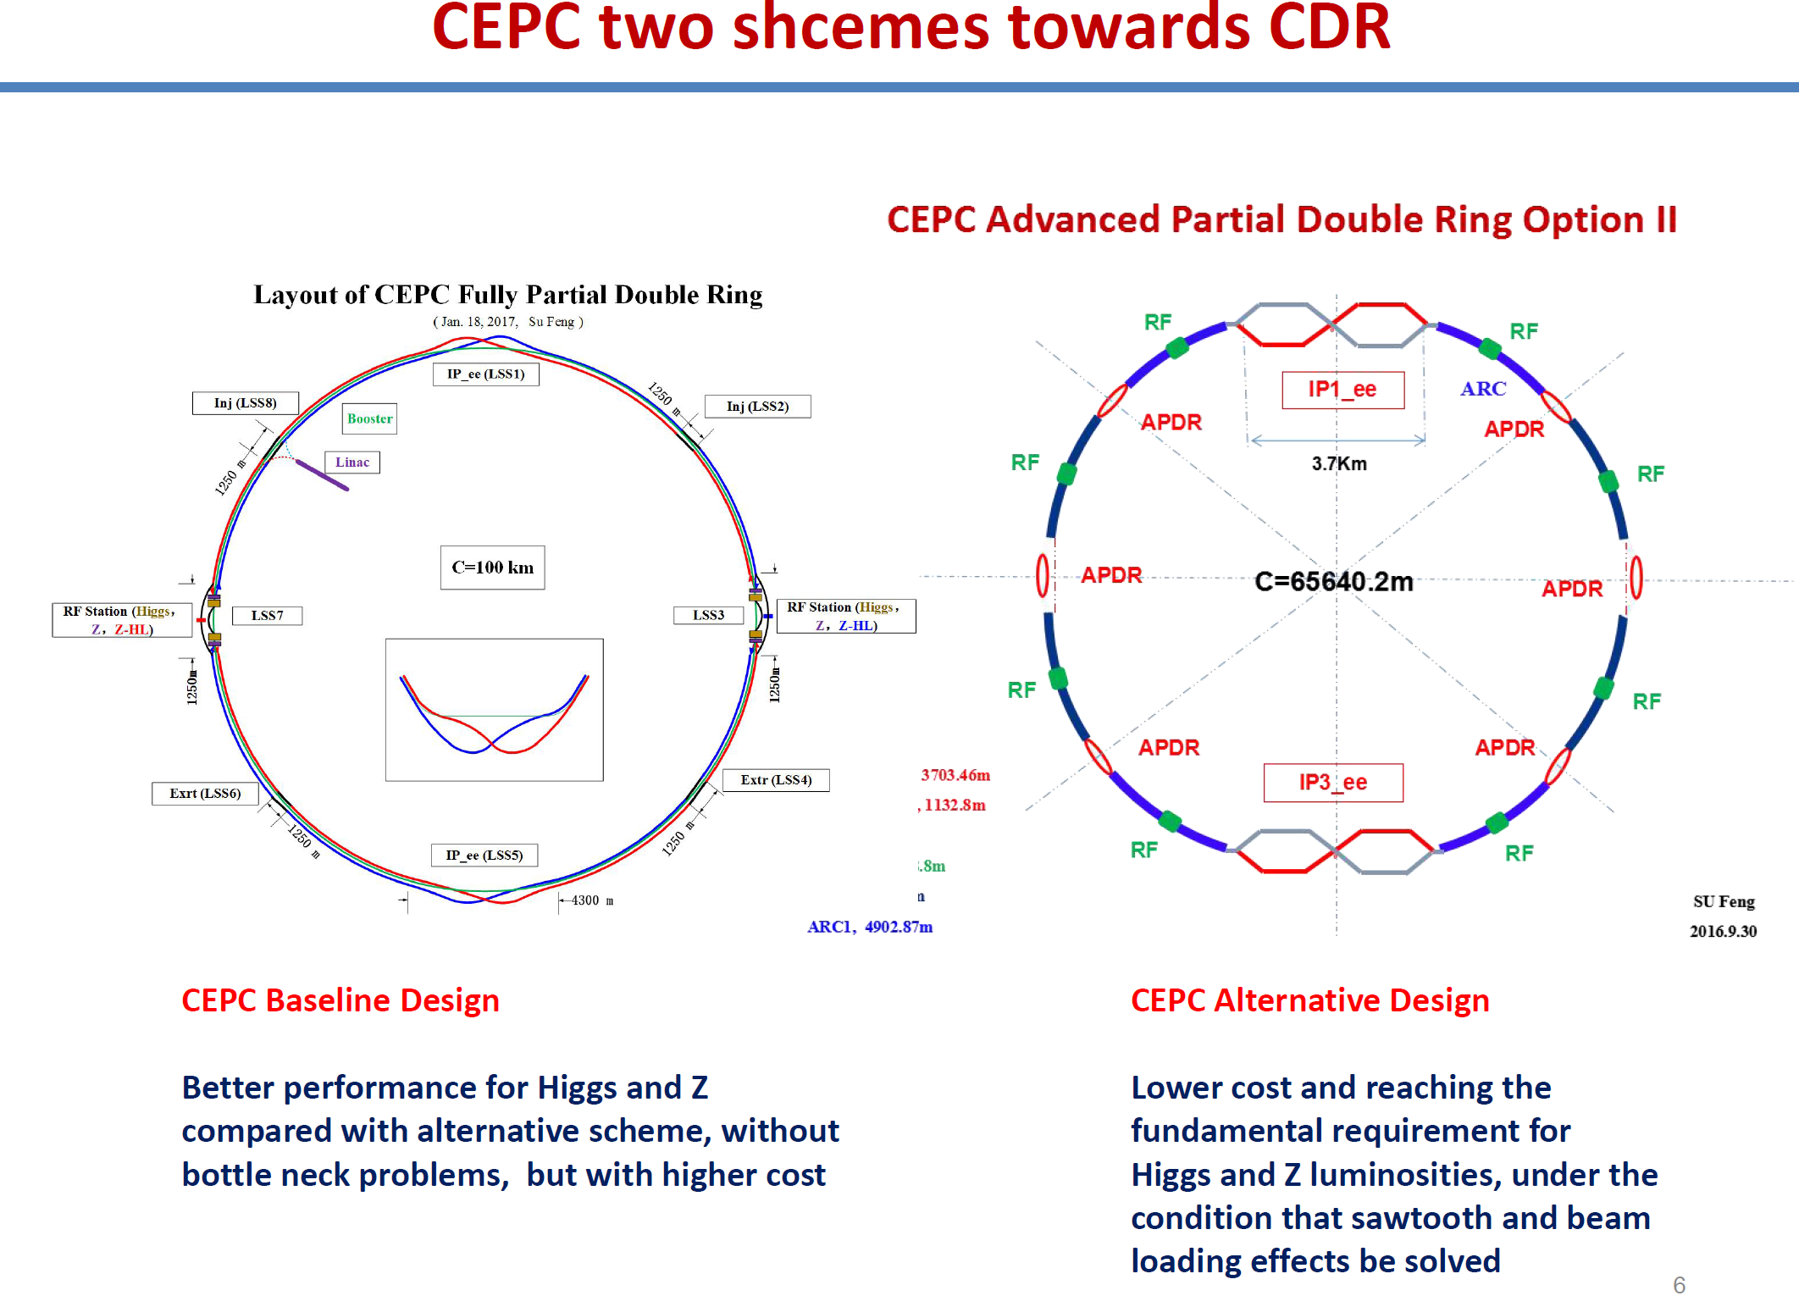

Slide 13
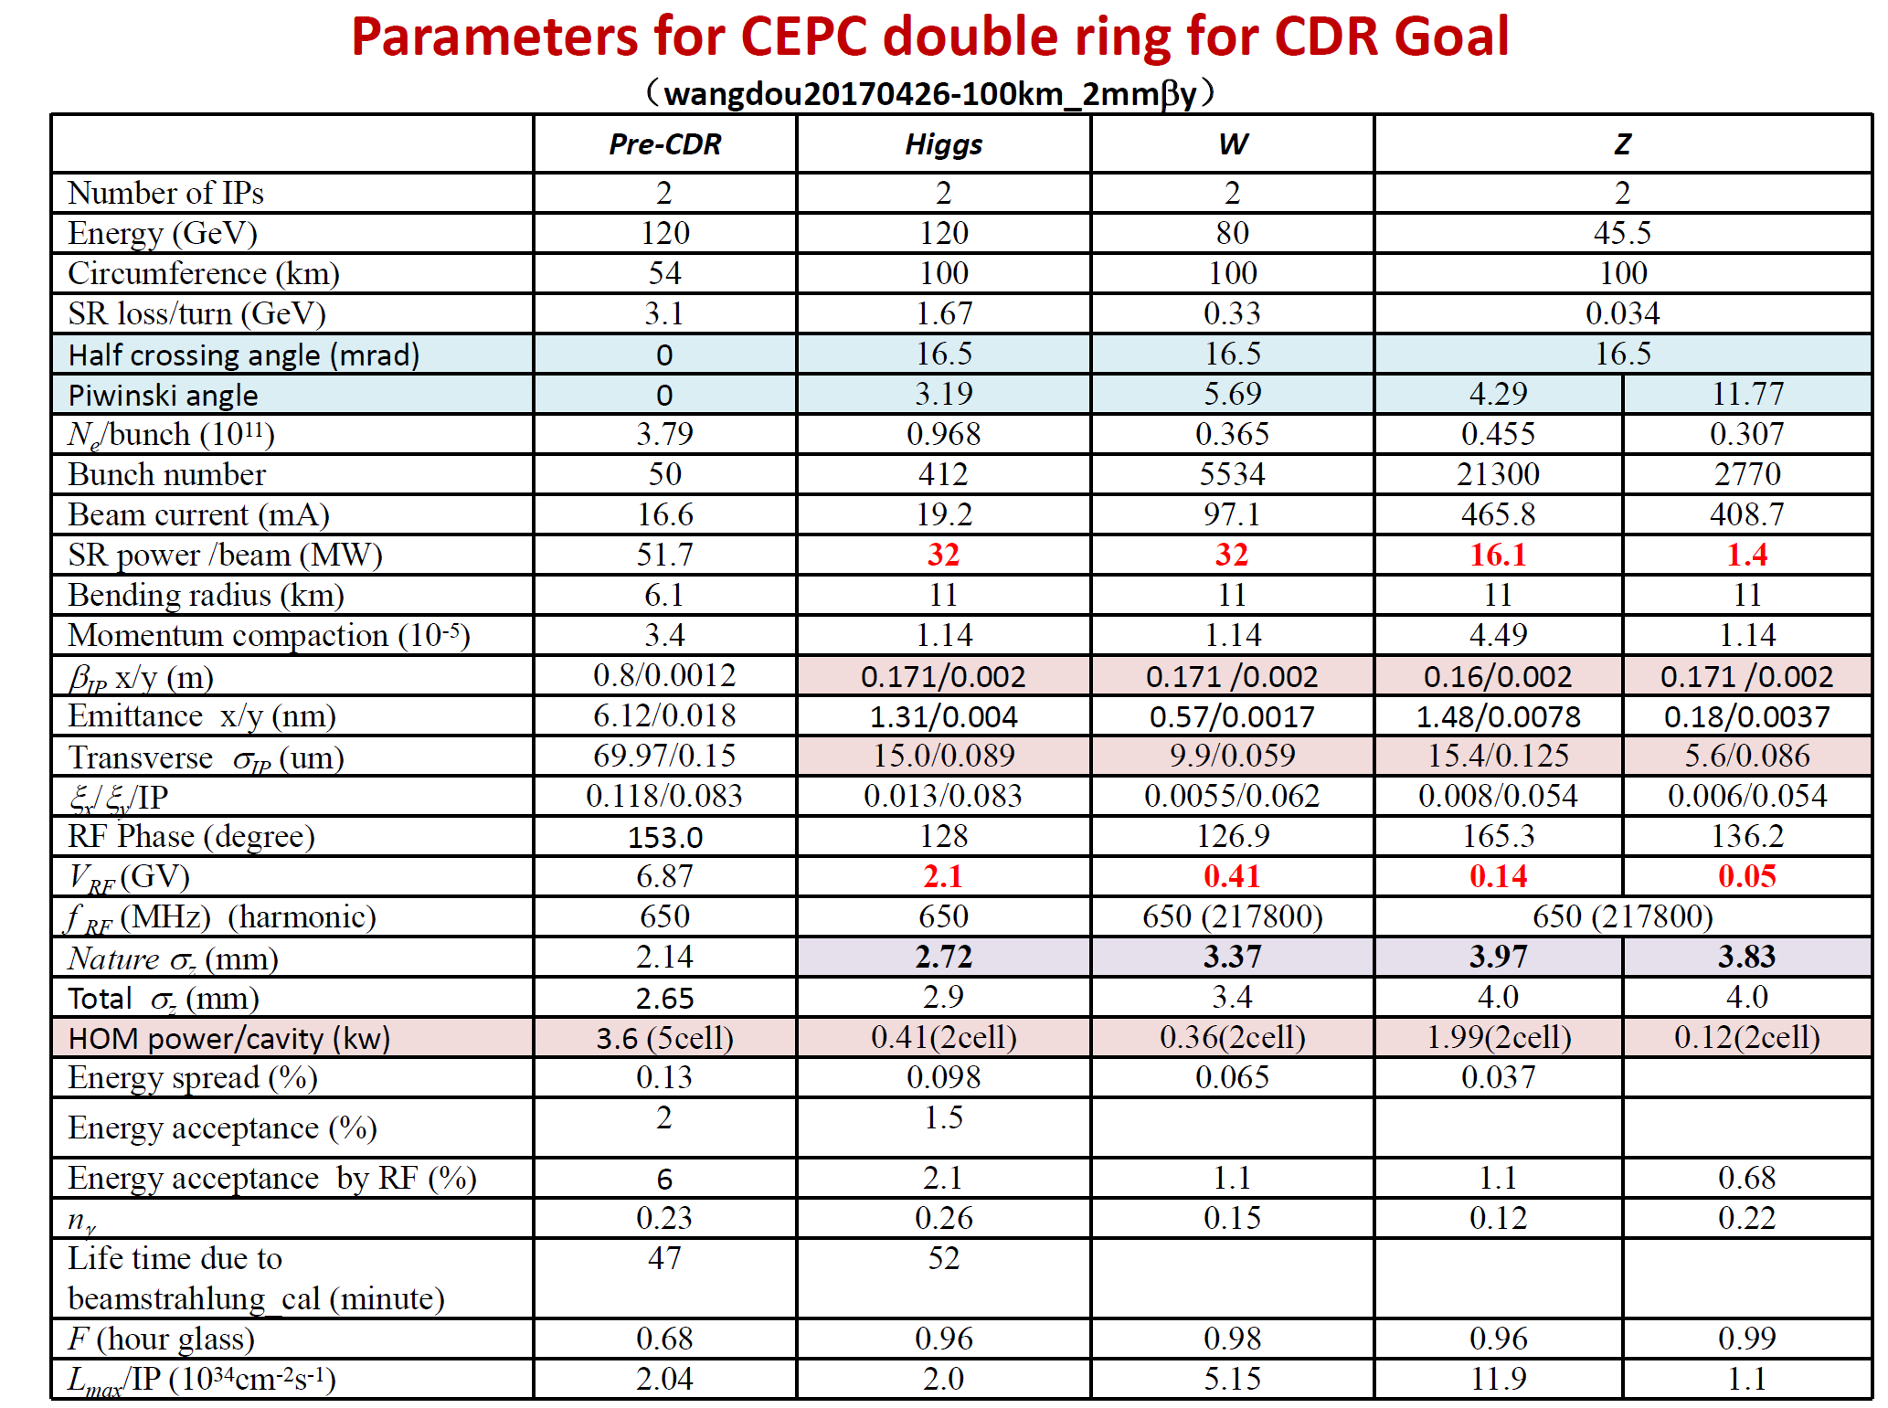
preliminary
Preliminary results shows co-existence of Z/H programs are possible
Reconfiguration of CEPC can lead to much better luminosity at the Z pole → Z factory

Slide 14
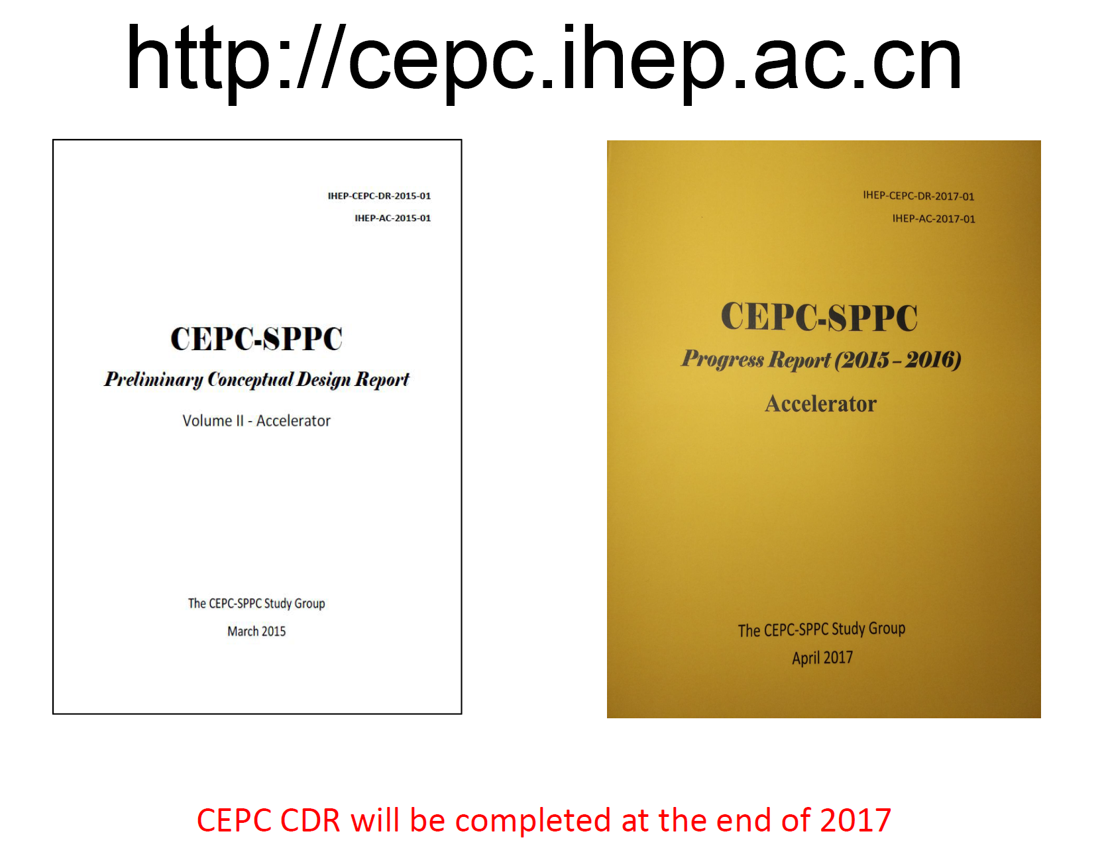
Progress report, along with the preCDR, is available at

Slide 15
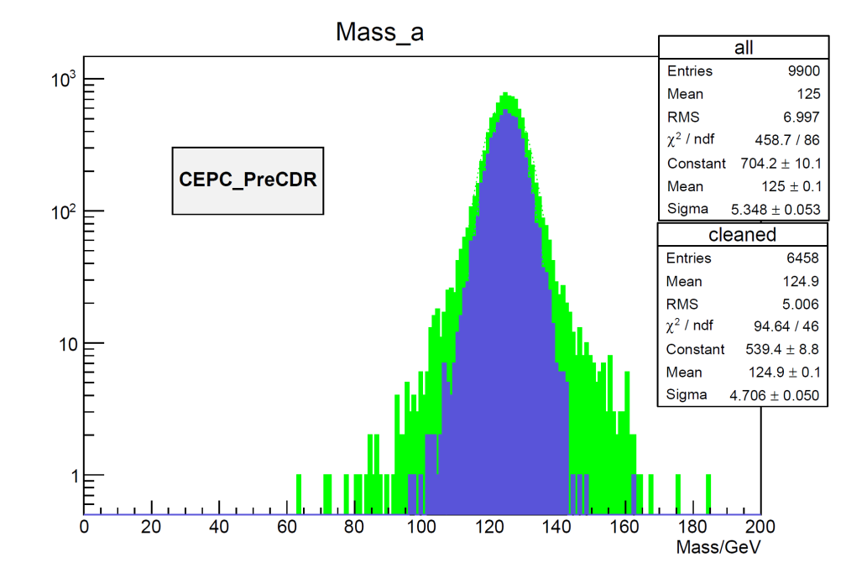
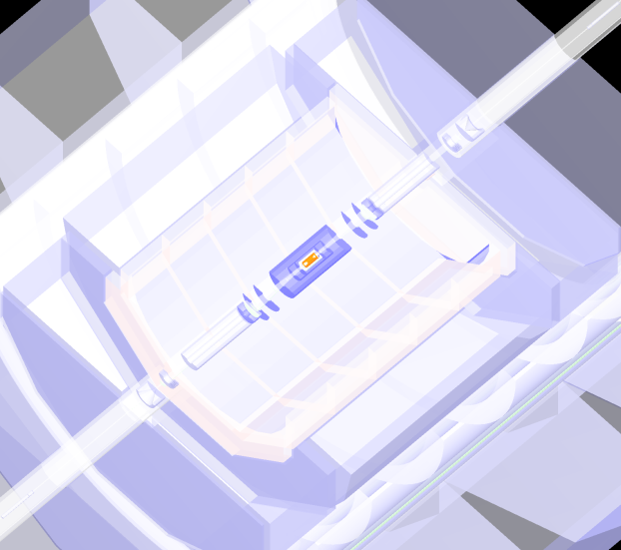
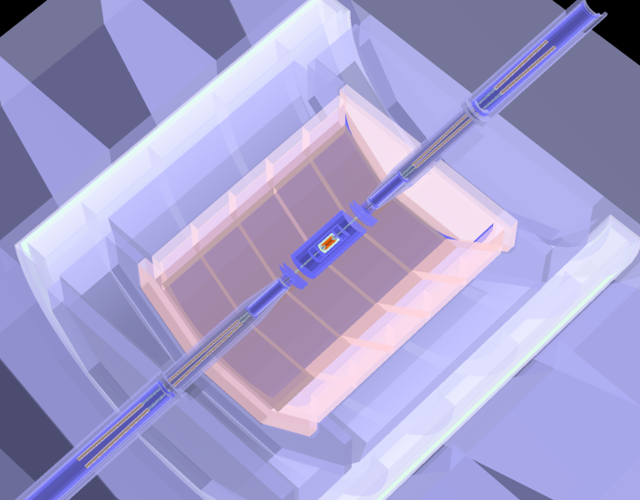
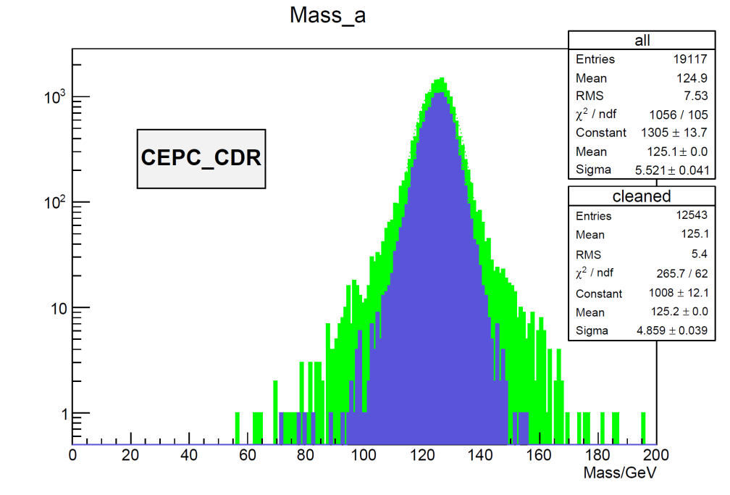
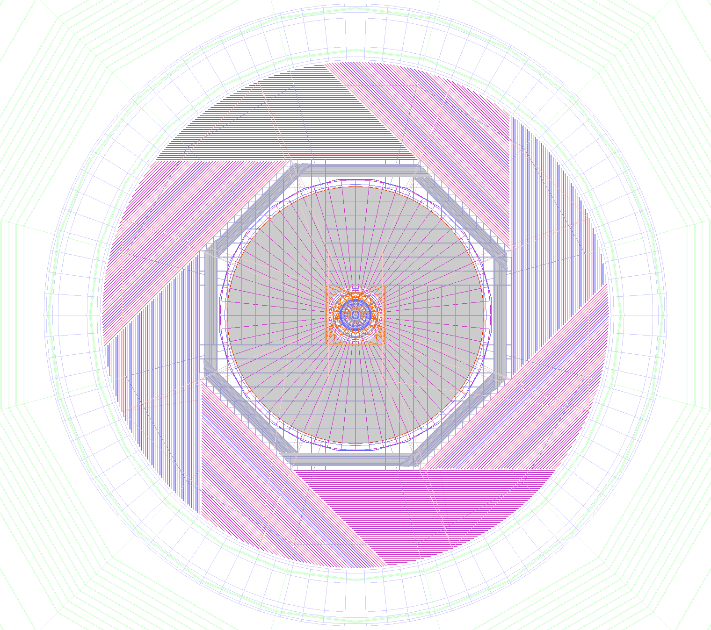
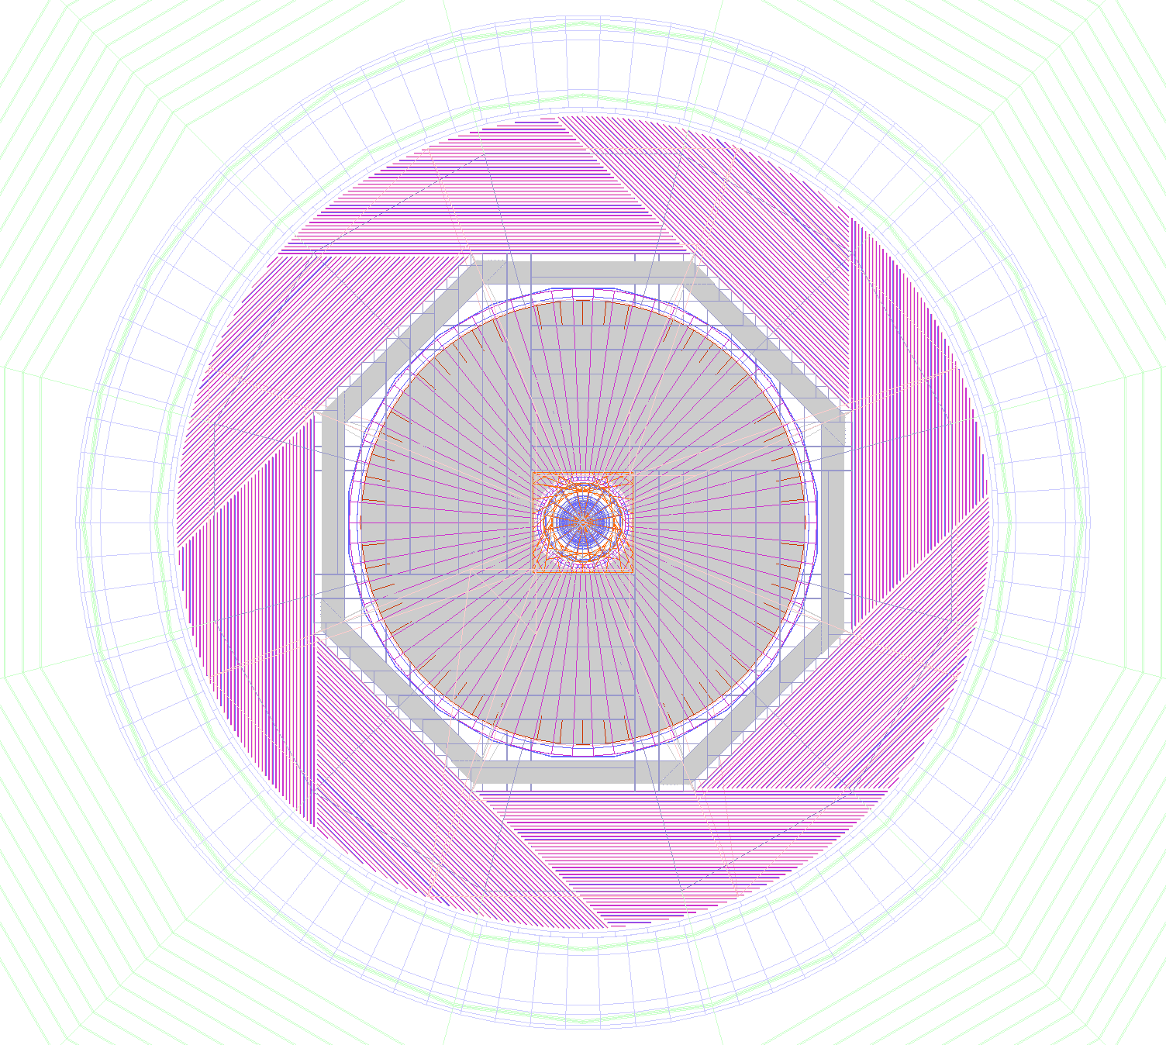
CEPC Detector: more compact & updated for CDR
preCDR (2015) CDR (2017)
H→gg events
σ_{DiJetMass}= 4.7GeV
σ_{JietMass}= 4.9 GeV
CDR CEPC detector:
Double ring geometry & MDI design implemented
HCAL reduced to 40 layers (from 48 in preCDR)
Di-Jet Mass (GeV)
No visible impact on
physics performance

Slide 16
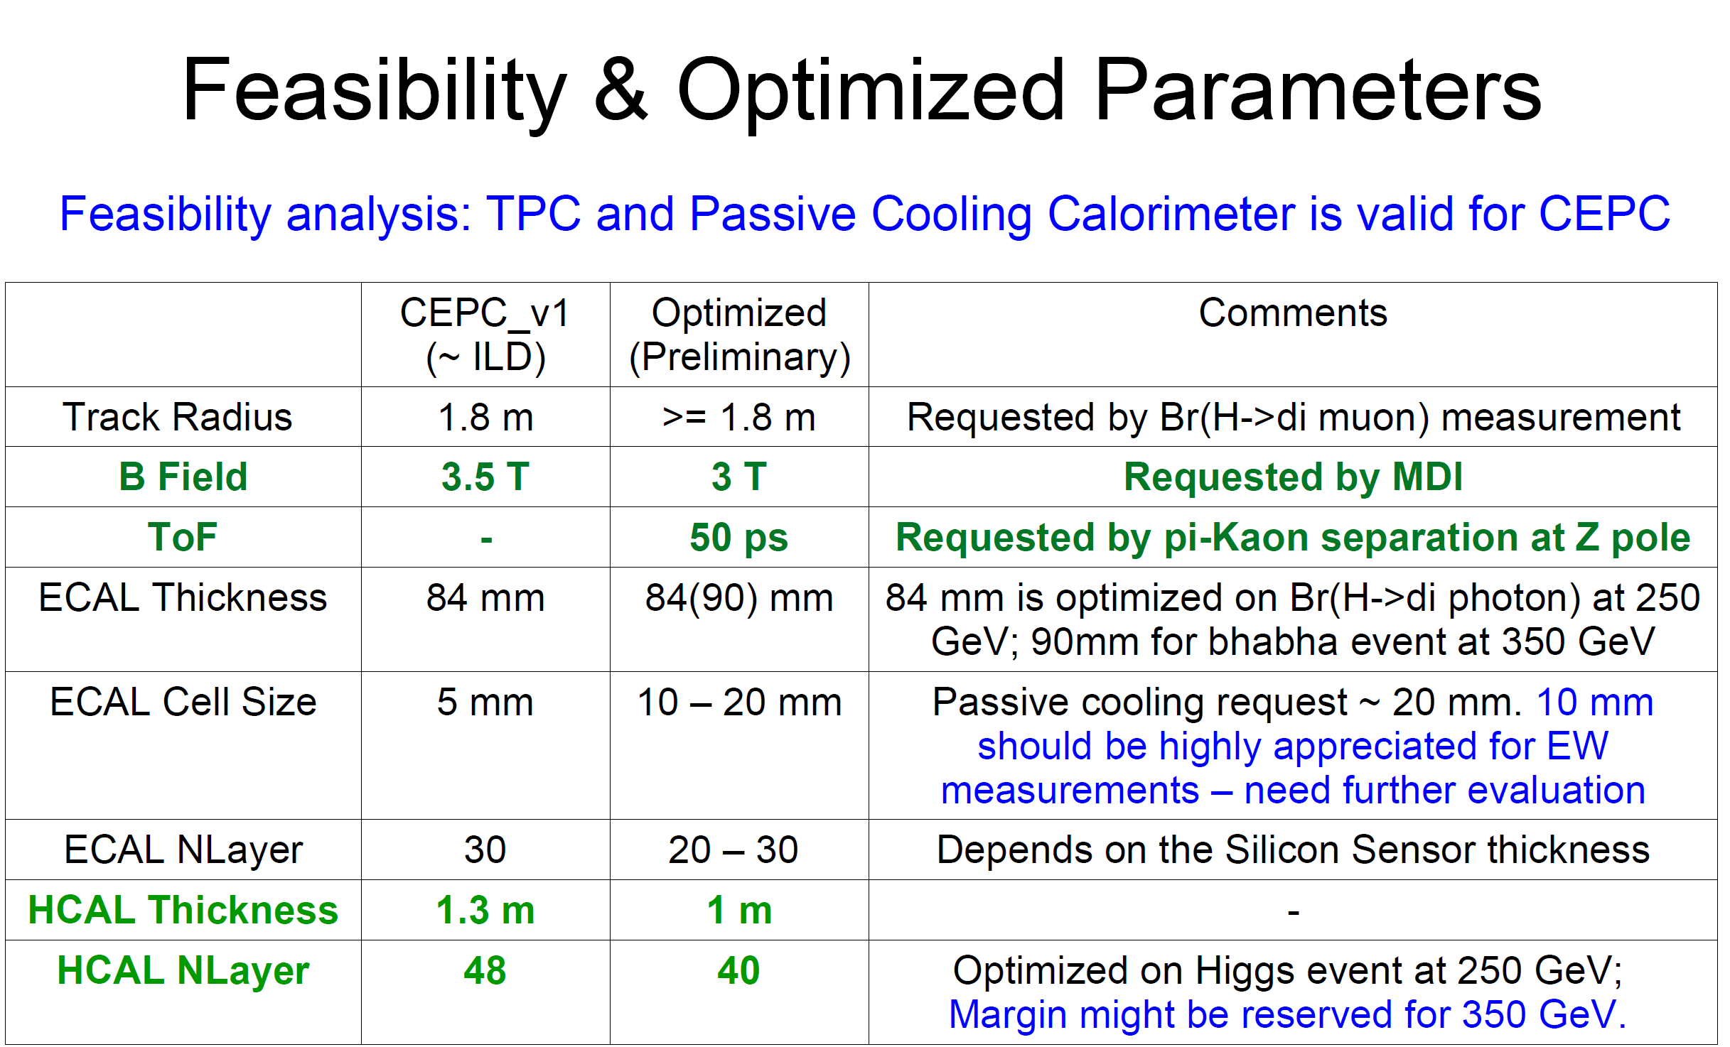
CEPC Detector: more compact & updated for CDR

Slide 17
Status and major development
    The R&D program
    Funding and support
    Site selection
    IAC and International collaboration
    Reach-out & engagement with the public

Slide 18
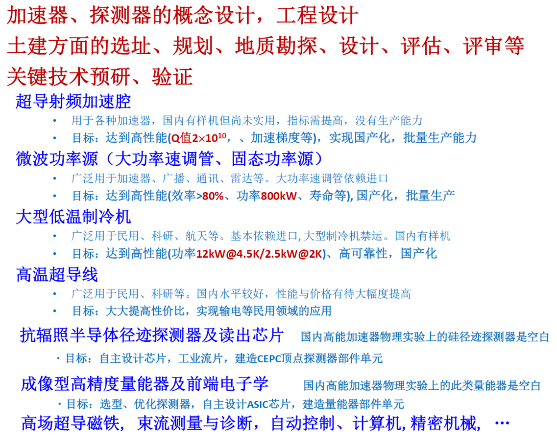
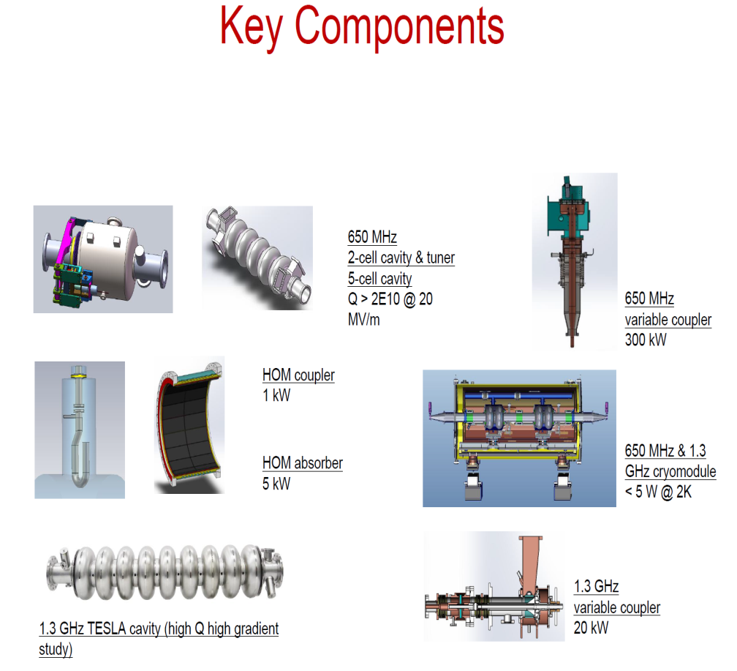
CEPC “R&D”
  preCDR identified: designs issues, site, key technologies and development plan
……
to learn, develop and master the processing and
production skills for making CEPC components;
enhance quality and cost-reduction of elements

Slide 19
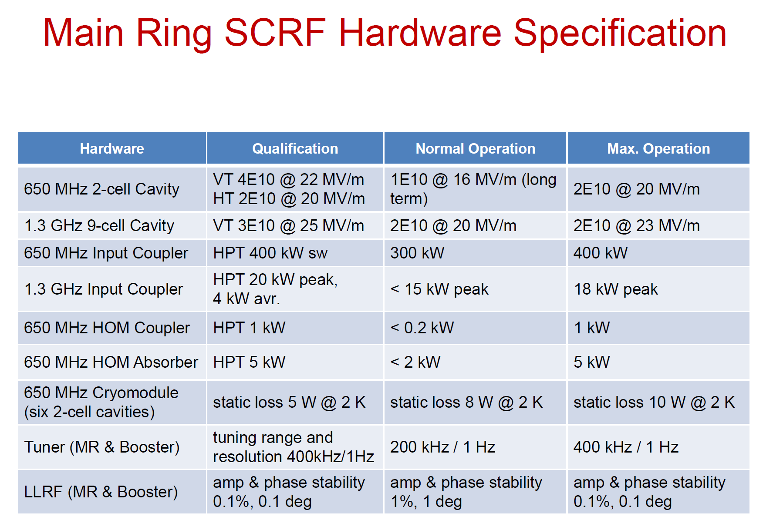
Main CEPC Ring SCRF Hardware Specification
benefit from the ILC development;
“R&D” will in turn contribute to the ILC construction

Slide 20
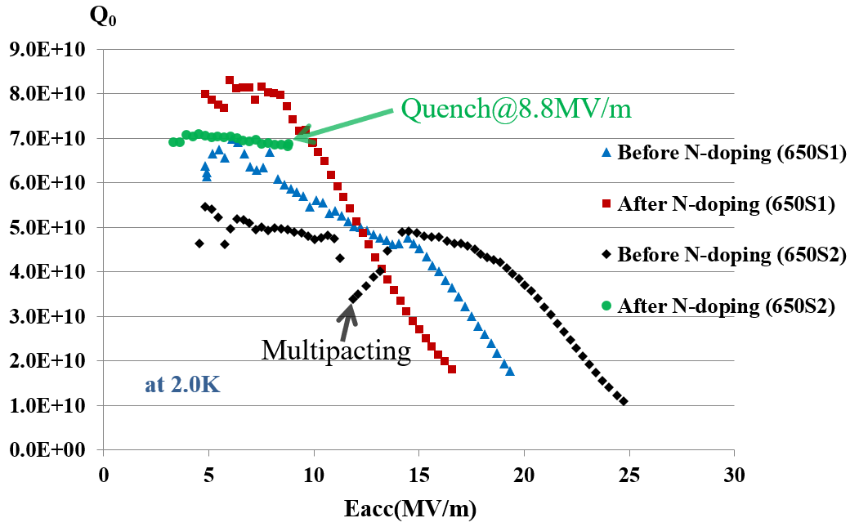
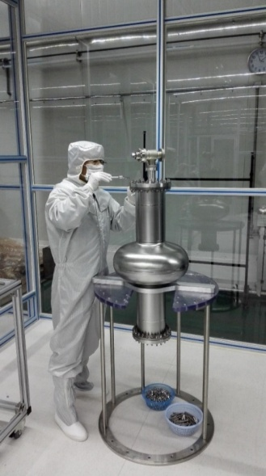
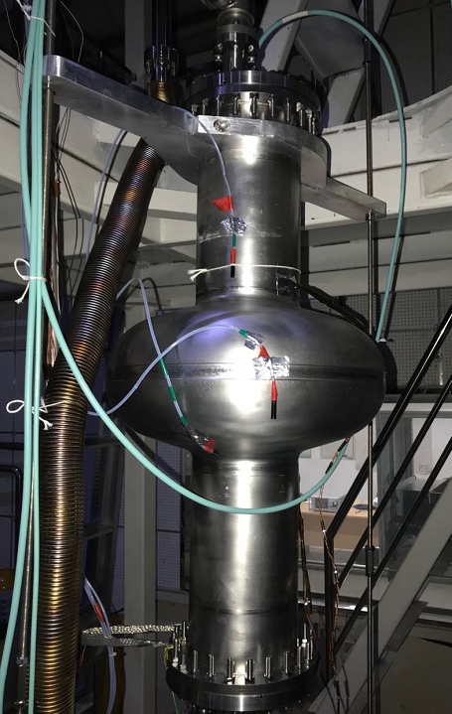
N-doping - vertical test of CEPC 650MHz single-cell cavities at IHEP
Post N-doping Q₀ increased obviously at low field for both cavities650S1: Q₀=7e10@Eacc=10MV/m. But Q₀ decreased quickly at high field (>10 MV/m).
  650S2: Quench at Q₀=6.9e10@Eacc=8.8MV/m.
Next, increase Q₀ at high field by improving N-doping technology.
CEPC 650MHz single-cell cavity for vertical test

Slide 21
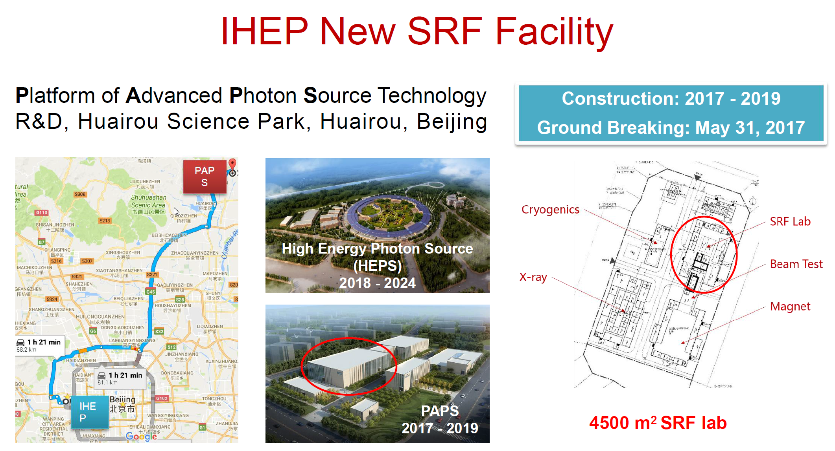
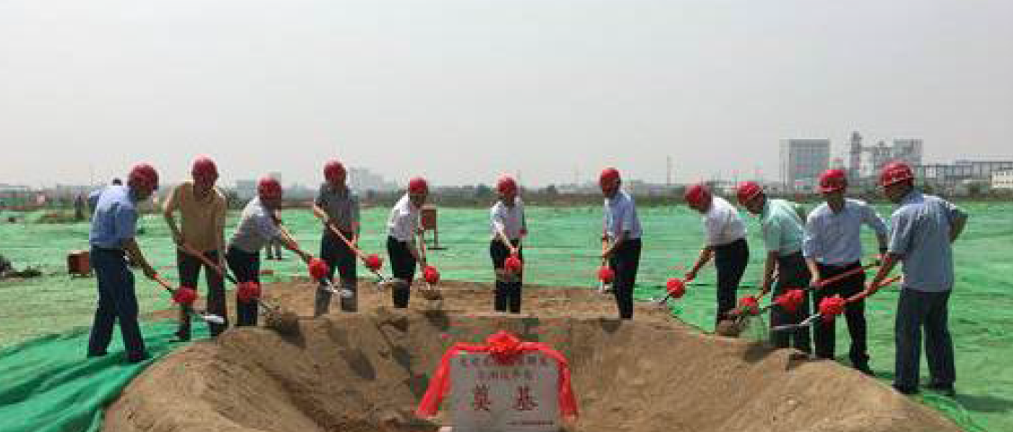
A New SRF Facility
500M RMB funded by city of Beijing
Construction: May 2017 – June 2020
Include RF system & cryogenic systems
magnet technology, beam test, etc.

Slide 22
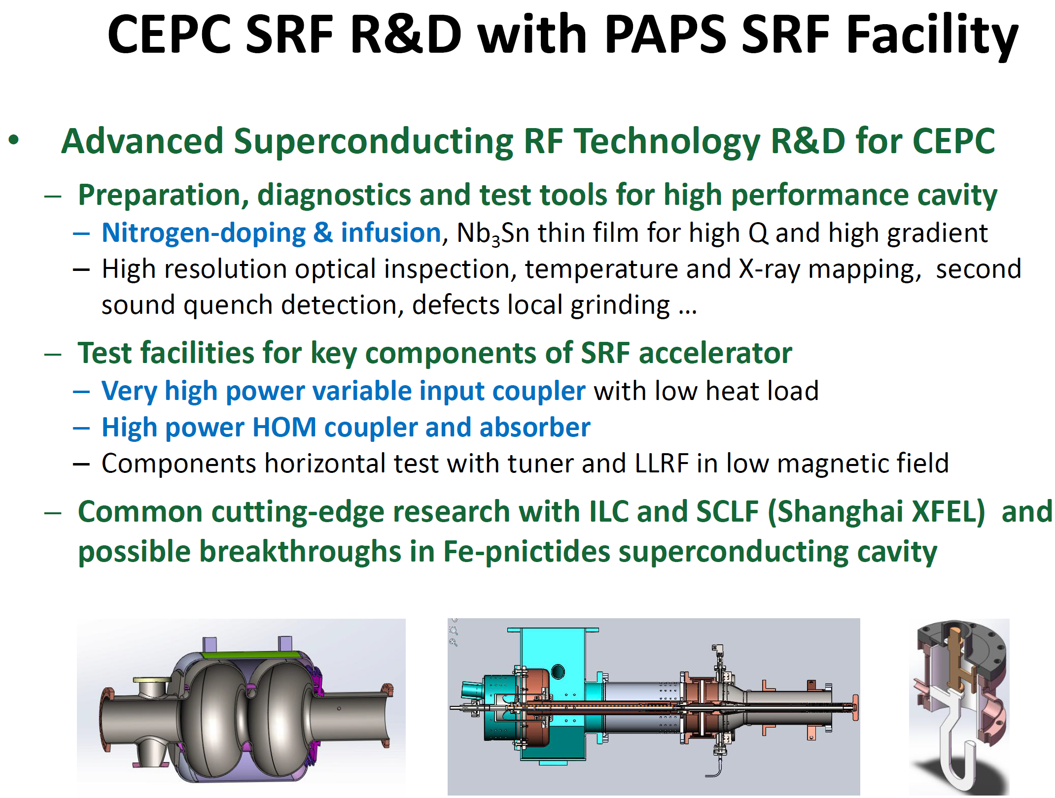
CEPC SRF R&D and Test at the PAPS Facility

Slide 23
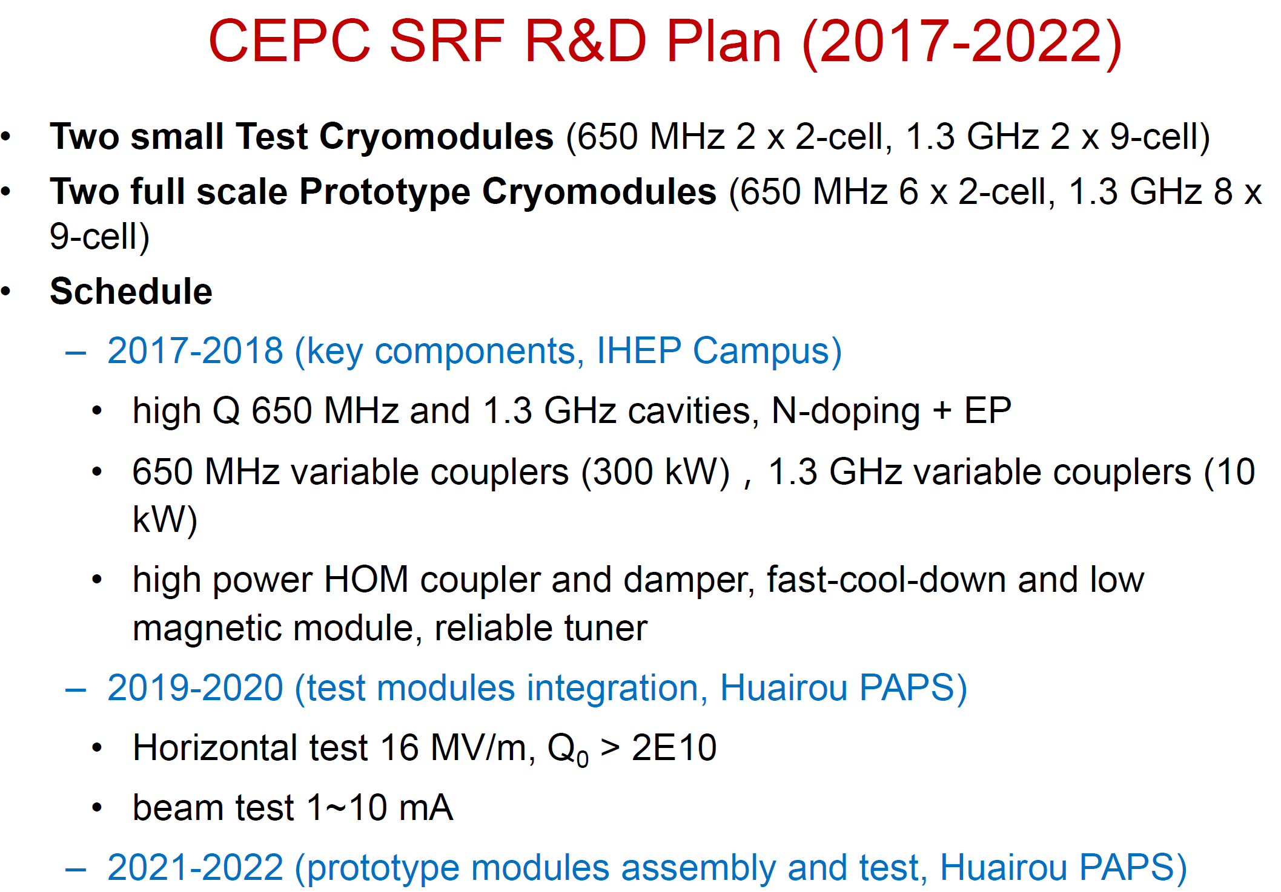
Cryomodule R&D and Test at the PAPS Facility

Slide 24
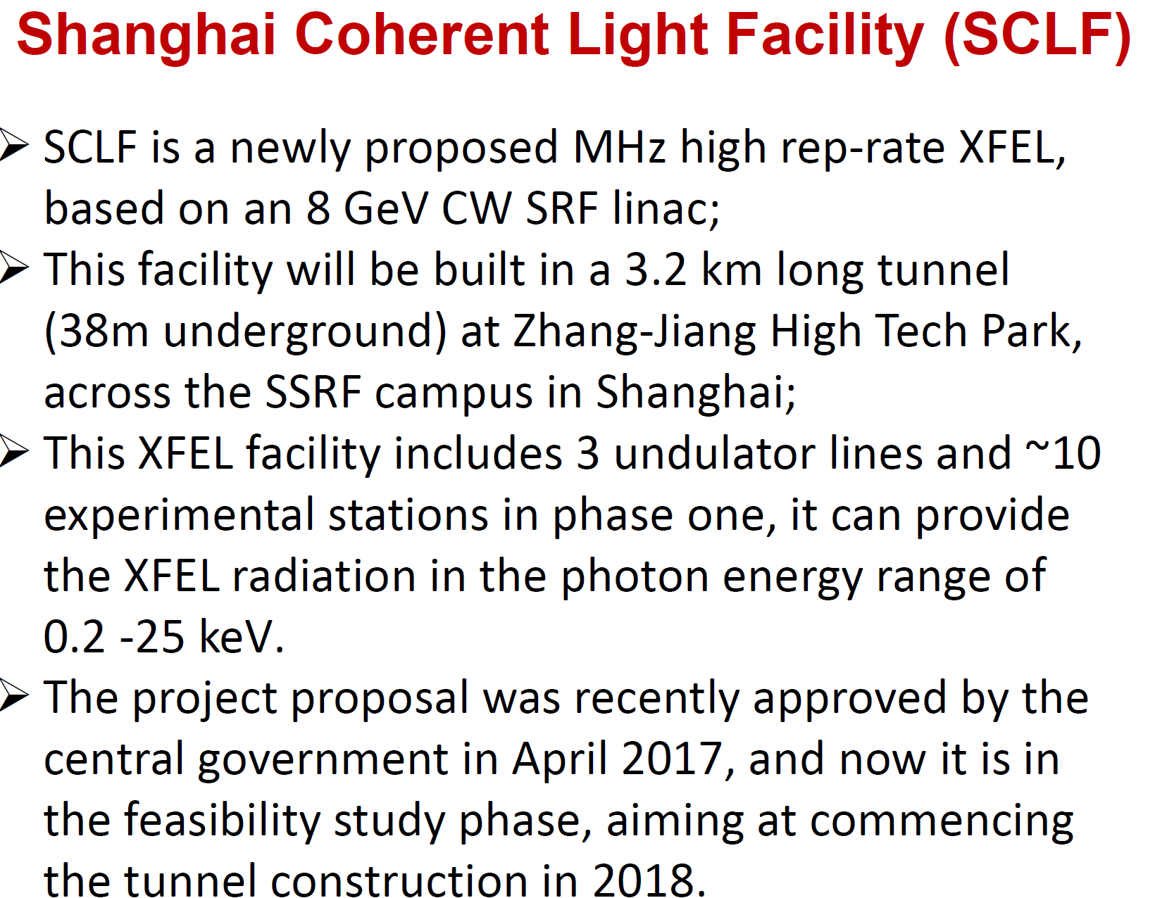
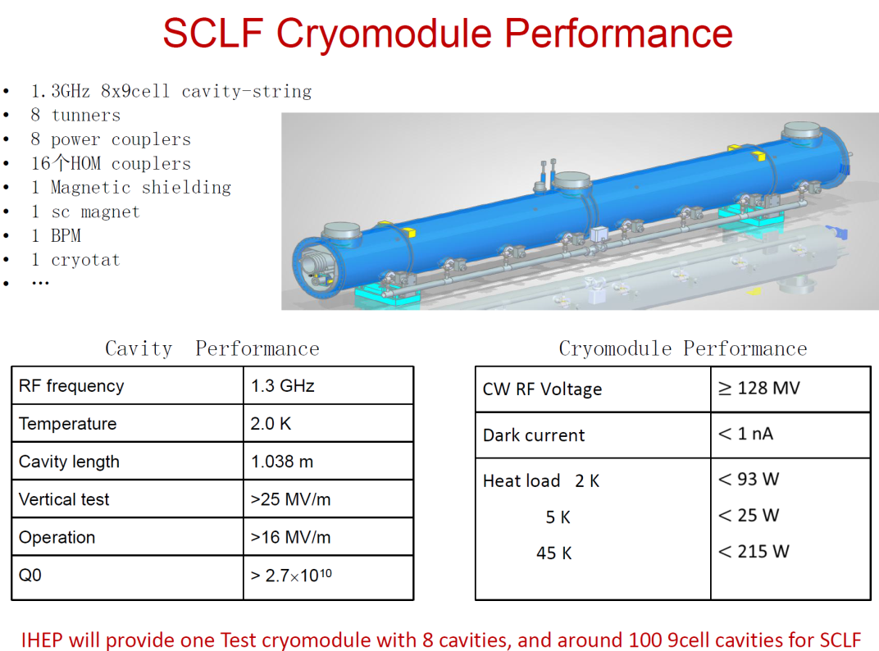
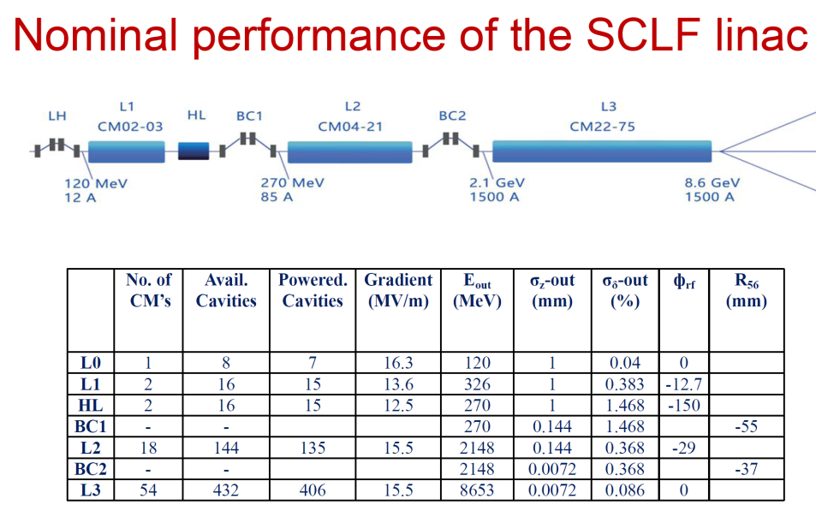
Cryomodule Development and Production for SCLF
IHEP will provide one test cryomodule (8-cavities),
and 100 9-cell cavities for SCLF
excellent exercise for CEPC

Slide 25
SPPC Design Scope (201701 version)
SppC Design Scope (201701 version)
Baseline design
  Tunnel circumference: 100 km
  Dipole magnet field: 12 T, iron-based HTS technology (IBS)
  Center of Mass energy: >70 TeV
  Injector chain: 2.1 TeV
Upgrading phase
  Dipole magnet field: 20 -24T, IBS technology
  Center of Mass energy: >125 TeV
  Injector chain: 4.2 TeV (adding a high-energy booster ring in the main tunnel in the place of the electron ring and booster)
Development of high-field superconducting magnet technology
  Starting to develop required HTS magnet technology before applicable iron-based wire is available
  ReBCO & Bi-2212 and LTS wires be used for model magnet studies and as an option for SPPC: stress management, quench protection, field quality control and fabrication methods
Top priority: reducing cost!
Instead of increasing field

Slide 26
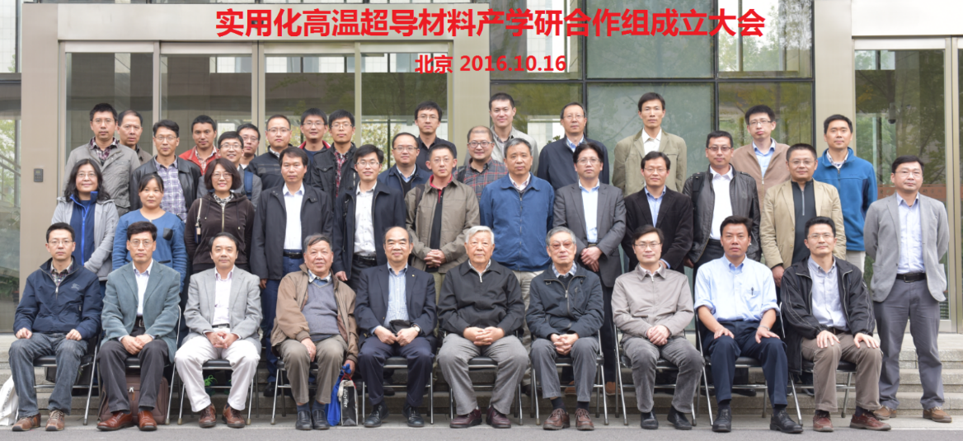
Collaboration on HTS
“Applied High Temperature Superconductor Collaboration (AHTSC)” was formed in Oct. 2016. with >13 related institutes & companies and 50 scientists & engineers to advance HTS R&D and Industrialization.
Goal：
1) To increase the J_{c} of IBS by 10 times, reduce the cost to 20 Rmb/kAm @ 12T &
4.2K in 10 years, and realize the industrialization of the conductor;
2) To reduce the cost of ReBCO and Bi-2212 conductors to 20 Rmb/kAm @ 12T &
4.2K in 10 years;
3) Realization and Industrialization of iron-based SRF technology.
Working groups：1) Fundamental science investigation; 2) IBS conductor R&D; 3) ReBCO conductor R&D; 4) Bi2212 conductor R&D; 5) performance evaluation; 6) Magnet and SRF technology.
Collaboration meetings: every 2~3 months.
Funded by CAS, more expected from MOST
执行委员会 (姓氏拼音排序)
陈仙辉 | 中国科技大学
蔡传兵 | 上海大学/ 上创超导
李贻杰 | 上海交通大学/ 上海超导
马衍伟 | 中科院电工研究所
王贻芳 | 中科院高能物理所
张平祥 | 西北有色院
周兴江 | 中科院物理研究所
顾问委员会 (姓氏拼音排序)
甘子钊 | 北京大学
李言荣 | 电子科技大学
林良真 | 中科院电工研究所
万元熙 | 中国科学技术大学
吴茂昆 | 台湾中研院
薛其坤 | 清华大学
张裕恒 | 中国科学技术大学
赵忠贤 | 中科院物理研究所
周廉 | 西北有色院

Slide 27
R&D Funding

Slide 28
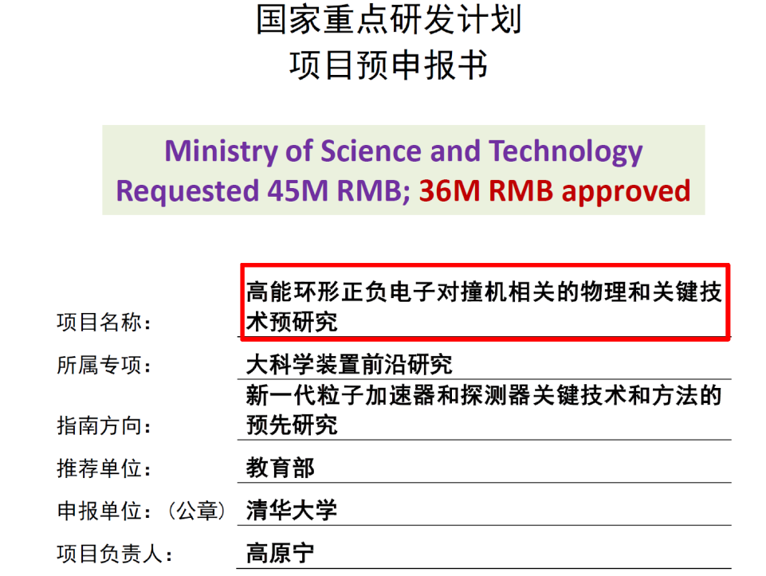
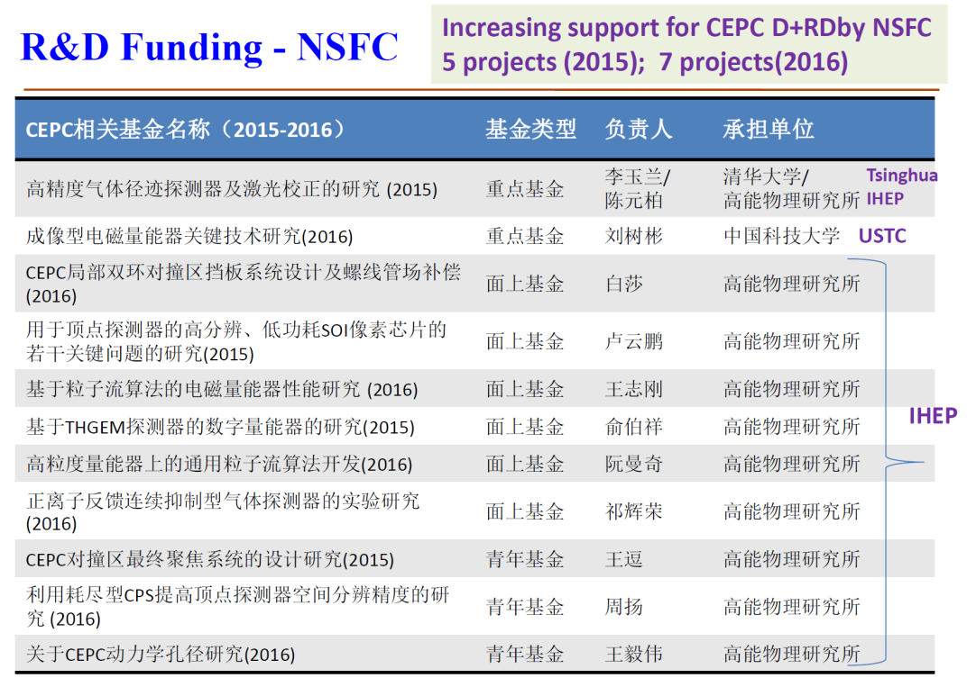
CEPC Funding
FY 2016
  HEP seed money
  11 M RMB/3 years (2015-2017)
~60M RMB CAS-Beijing fund, talent program
~500M RMB Beijing fund (light source)
year 2017 funding request (45M) to MOST and other agencies under preparation
funding needs for carrying out CEPC design and
R&D should be fully met by end of 2018

Slide 29
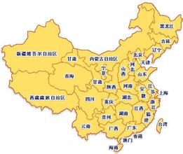

CEPC Site Exploration
1) QingHuangDao, Hebei（completed preCDR）
2) Huangling, Shaanxi（2017.1 signed contract to exp.）
3) ShenShan, Guangdong, （completed in August, 2016)

Slide 30
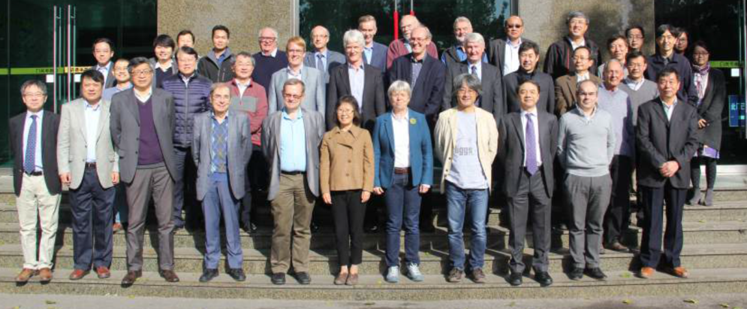
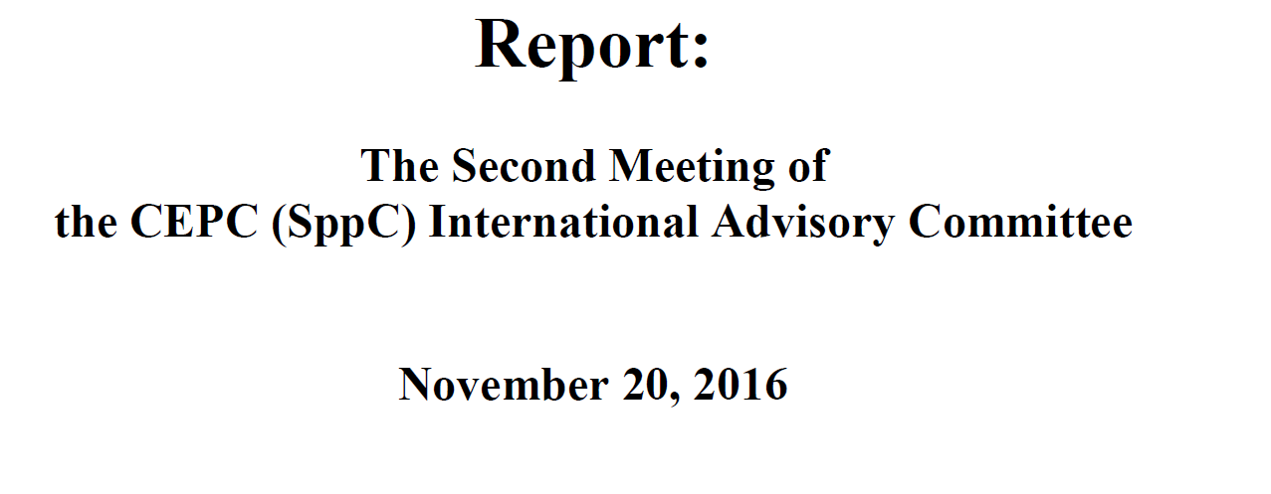
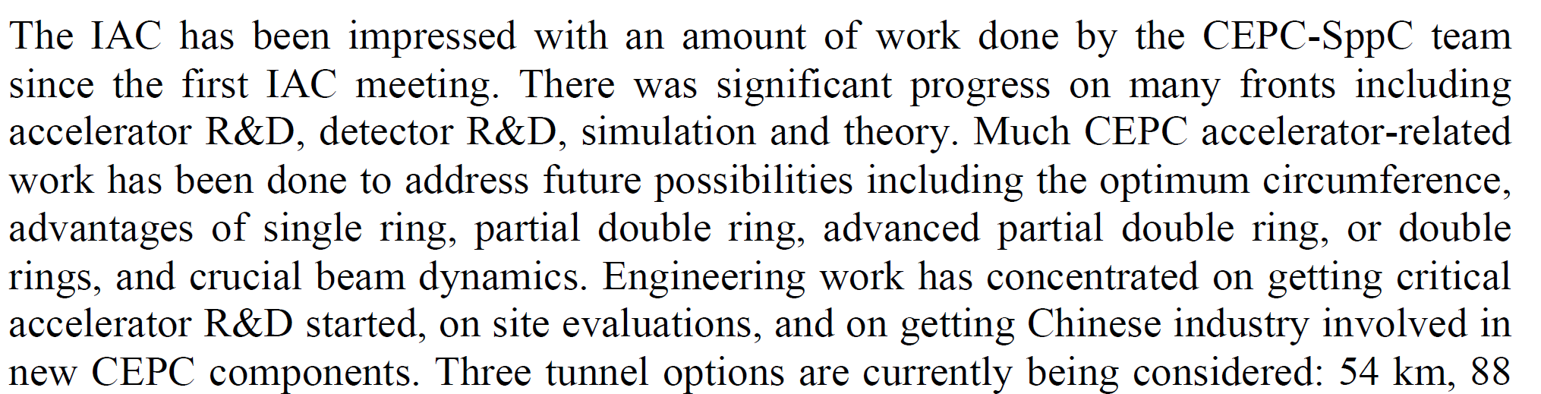
CEPC International Advisory Committee

Slide 31
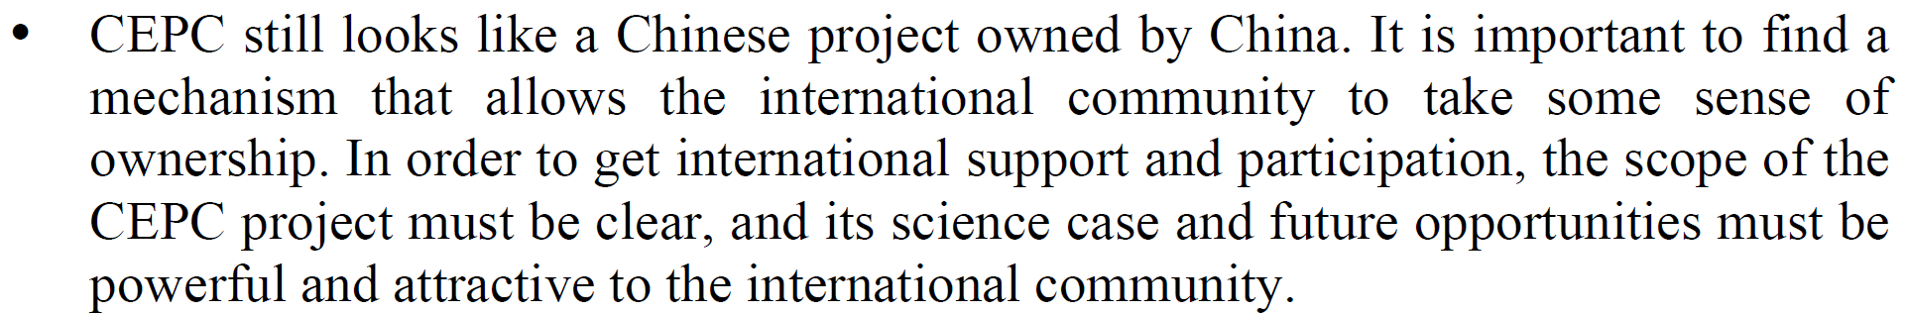
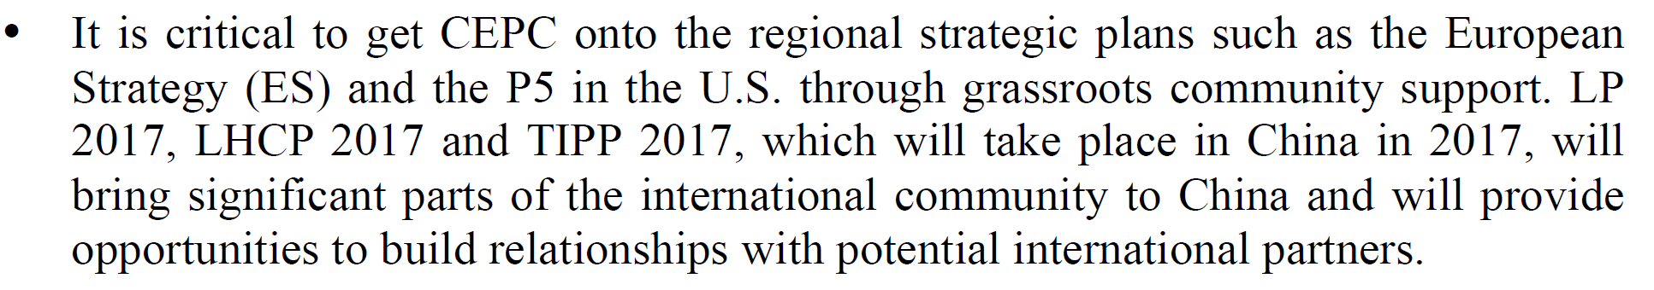
CEPC International Collaboration
MOU， joint research，established collab. with ILC-TPC, HL-LHC， …

Slide 32
CEPC Outreach, PR and Communication
Colloqiuia and outreach in Chinese universities
北京大学，中国科大，浙江大学，中山大学，山东大学，武汉大学
国科大，华中师大，清华，交大，南大， 复旦，…
  Fragrant Hill Meeting on CEPC
  social media& news
  CEPC Web revamp
  ……

Slide 33
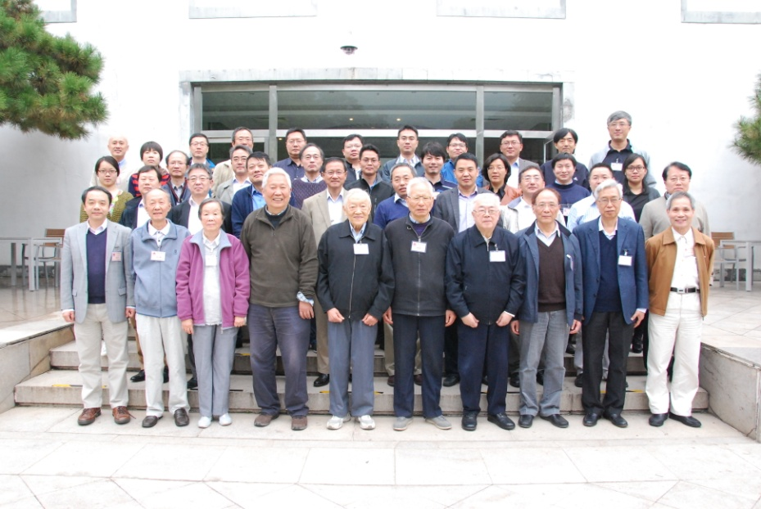
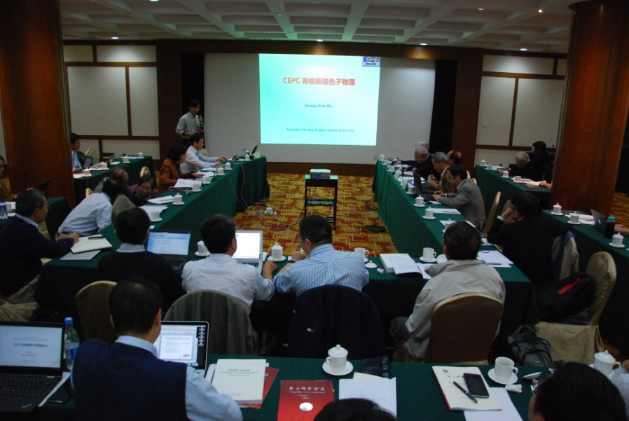
Fragrant Hill Meeting on CEPC
香山科学会议
高能环形正负电子对撞机-中国发起的大型国际科学实验
A forum to discuss and plan for major projects of national significance
October 18-19, 2016
会议主题：Meeting Theme: CEPC
高能环形正负电子对撞机-中国发起的大型国际科学实验
中心议题：Focused Discussions
CEPC科学意义、物理目标、发展潜力 Science
CEPC预研究，和加速器、探测器、实验室建设 CDR, R&D
对社会发展的牵引作用和国际合作 Impact and Intl. Collab.
CEPC方案，时间表和论证 Plan, Timetable, Approval Process
consensus on R&D program, …

Slide 34
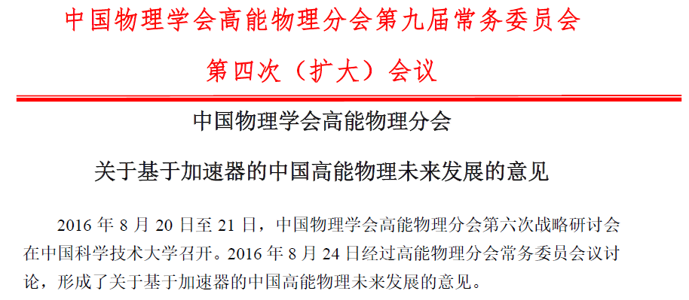
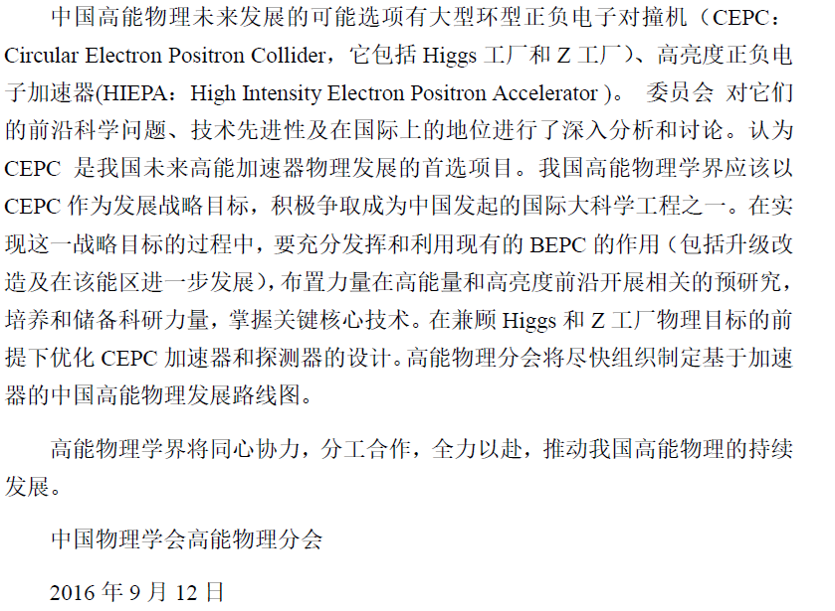
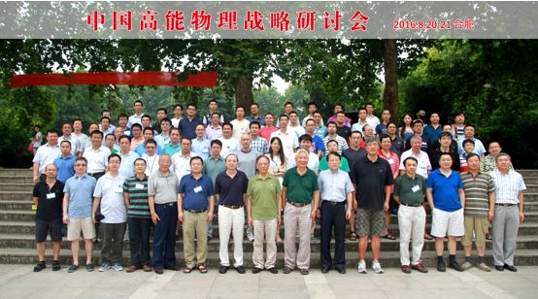
大型环形正负电子对撞机
中国物理协会高能物理分会达成共识
The HEP division of the Chinese Physical
Society reached a consensus in August, 2016
that placed CEPC as the top priority accelerator
based program for the future and endorsed
CEPC design and R&D
Notes:
覆盖比BEPCII更宽能区

Slide 35
Objectives
Conceptual Design Report a major push
Organization and global collaboration
R&D
Preparation for the realization of CEPC

Slide 36
Focuses
CDR chapters available (parallel sessions), good time to contribute to the CDR
informal CEPC, SppC accelerator mini reviews (Nov. 4-5) at IHEP
informal detector-simu mini review (Nov. 10) at IHEP
Organization
members & conveners of working groups
domestic advisory committee (on China related issues)
R&D
    design and performance study
    Prototyping
    infrastructure
Preparation for the realization of CEPC
project management (IAC meeting)
industrial support and preparation (industrial consortium)
international collaboration and support
site exploration and design
funding agency, government support
……

Slide 37
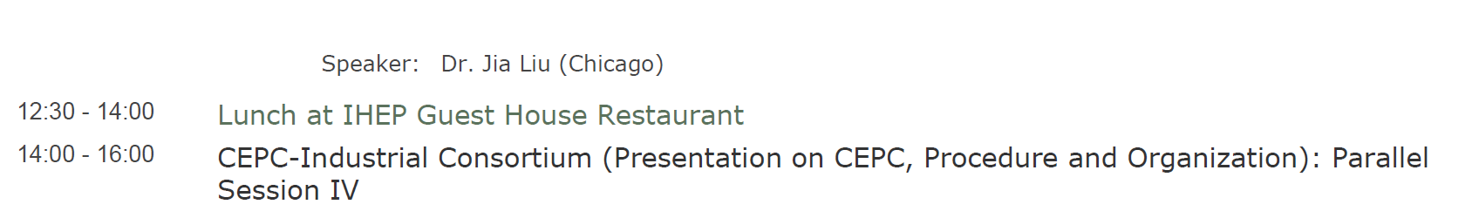
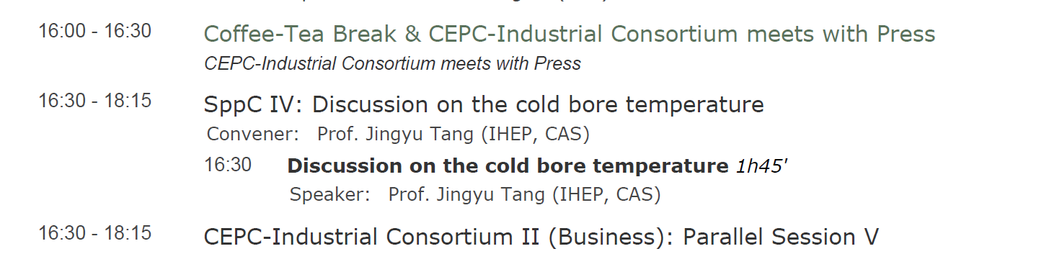
Focuses
Industrial Consortium (A214)
Nov. 7
Next workshop on CEPC
April 5-7, 2018 at Sun Yat-Sen University University, Guangzhou, China
http://indico.ihep.ac.cn/event/7388/

Slide 38
Summary
CEPC CDR is progressing
Design + R&D funding needs are largely met with various sources; people are hard working on DRD
Build a stronger CEPC team w. intl. collab. & participation
For the very long future, economic HTS magnet program is being explored in China with a carefully constructed consortium
Infrastructure, experience and engineering proficiency gained through current projects (light source, CSNS, etc.) helpful for the CEPC
Upon successfully completing the DRD program, we expect to make the case to the national government for building CEPC (~5 years from now)

