Slide 1
CEPC 650MHz Cavity HOM Absorber Research
Fanbo Meng
Accelerator Center, IHEP
2017. 04. 19
CEPC workshop, CCNU, Wuhan

Slide 2
Outline
1
Absorbing material selection
Material test
Structure optimization and absorbing efficiency
Brazing experiment
Absorber design method
Cooperation details

Slide 3
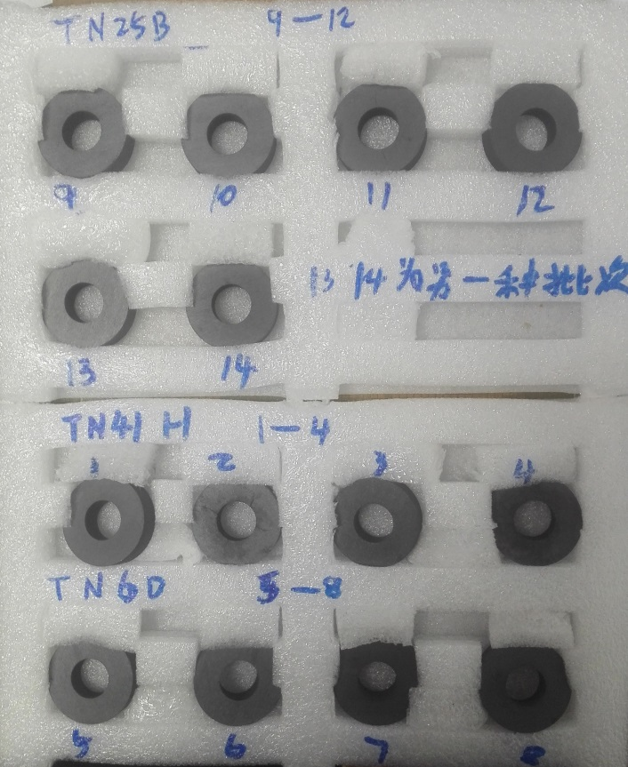
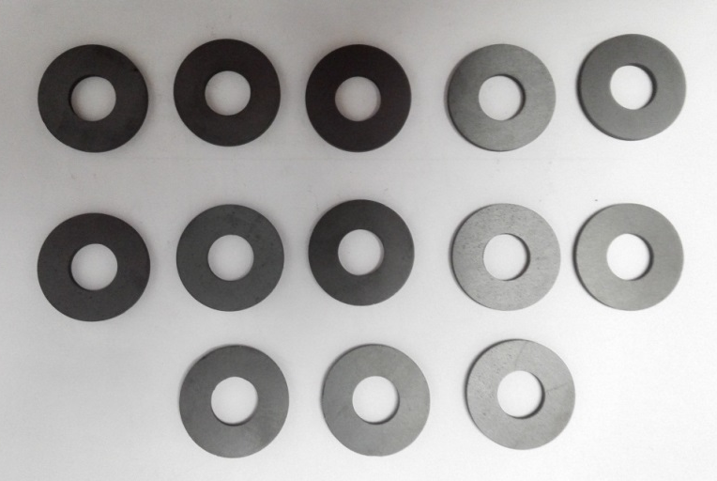
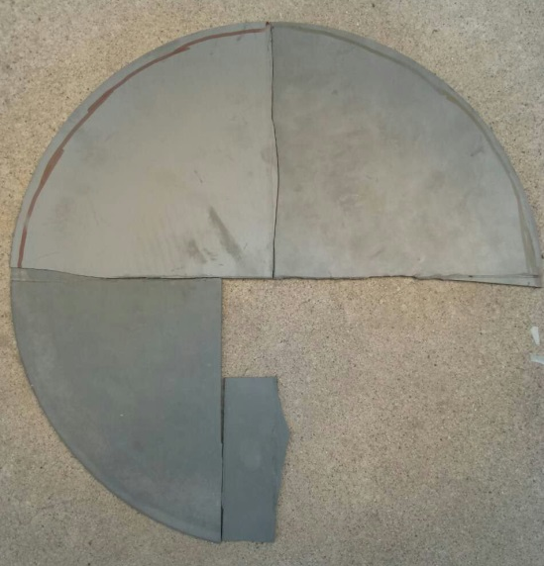
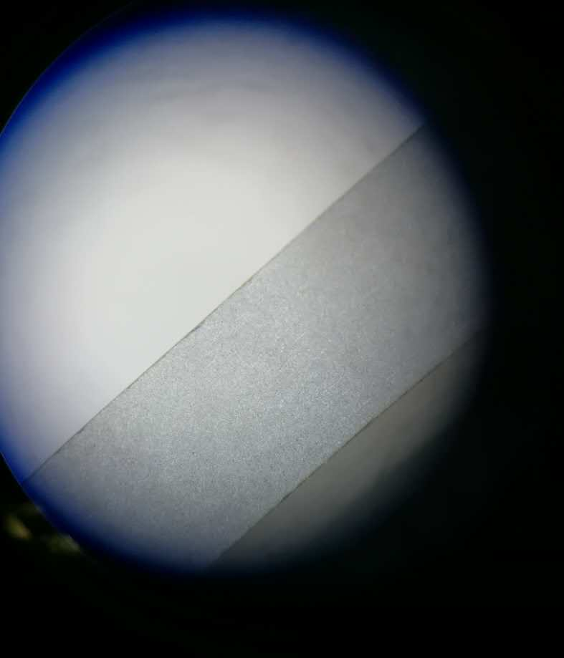
Absorbing material selection
HIP material
Mature ferrite
New ferrite
Selection criterion:
Absorbing capability
Mature technology
Suitable Material：
Mature ferrite
AlN+SiC composite
AlN+SiC composite

Slide 4
Material absorbing capability test system
To select the material, we need a absorbing capability test system.
7
Test method:
DUT port
DUT
Test port
fixture
fixture
Cable with N type connector
Agilent VNA
Use SOLT method to calibrate cable
Use TRL method to calibrate fixture
Use S parameter on DUT port to compute the $ε$ and $μ$ of sample with transmission and reflection theory

Slide 5
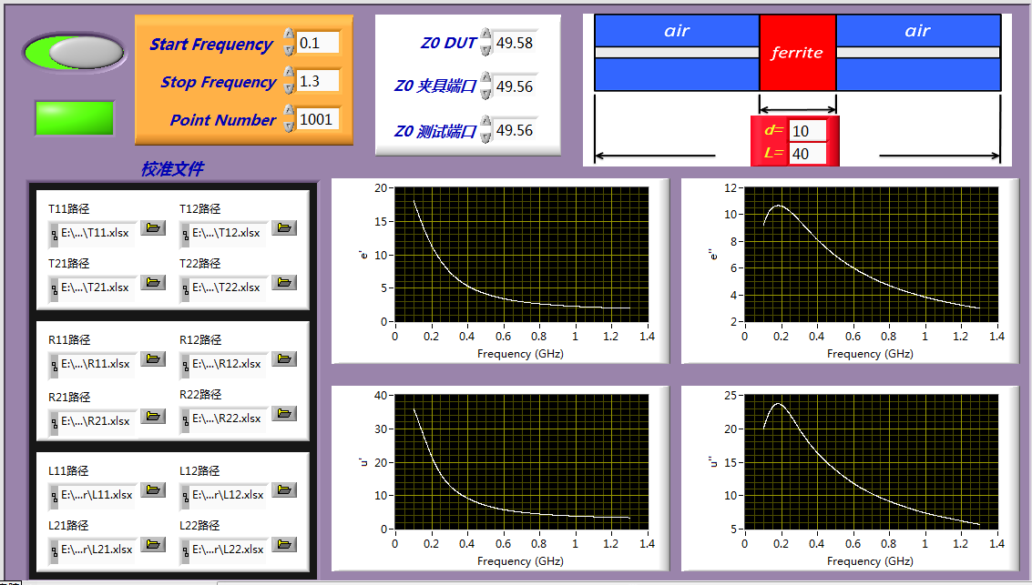
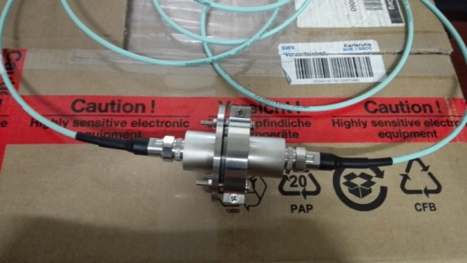
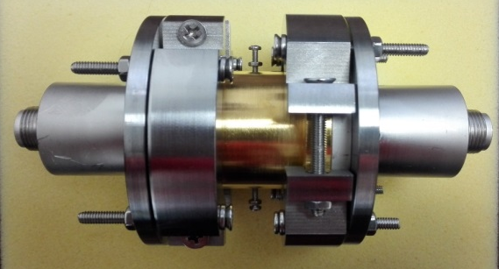
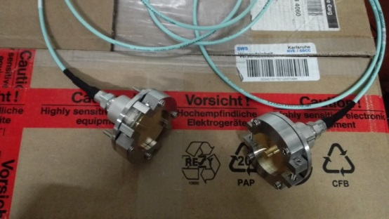
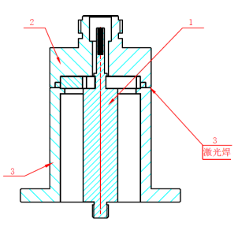
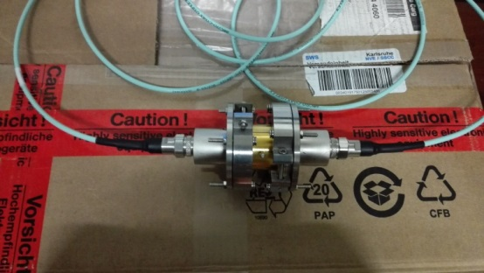
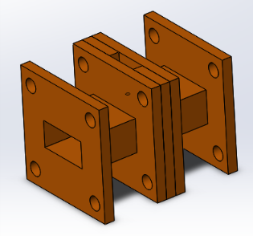
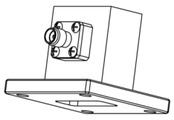
Material absorbing capability test system
Work frequency :
TRL calibration
finished
T state
0~5.6GHz
Coaxial fixture
R state
upgrade
0~9GHz
Waveguide fixture
L state
8.5~18GHz
upgrading

Slide 6
Material absorbing capability test system
9
Verification of test accuracy:
Test result of air

Slide 7
Material absorbing capability test system
10
Test results of mature ferrite:

Slide 8
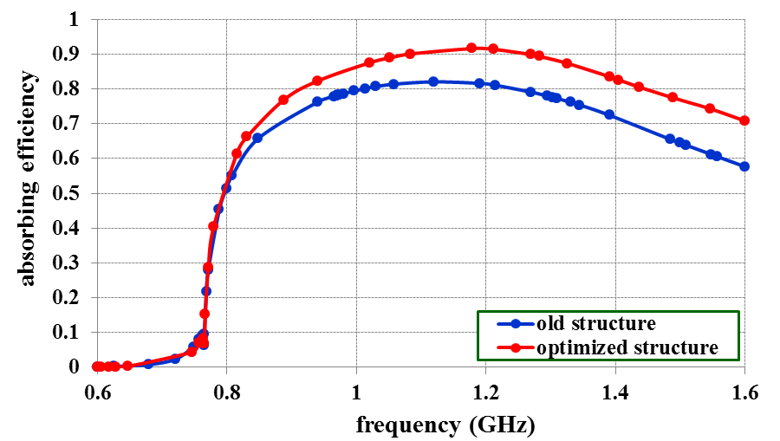
The structure and absorbing efficiency
The brick shape ferrite will cause impedance mismatch, increasing the reflection
Optimize the special structure and ferrite size to lower the reflection, then increasing the absorbing efficiency
Ideal structure
Optimized structure
Conclusion:
Base on the same material, optimizing the damper structure is a effective method to make a balance between the fabrication cost and absorbing efficiency

Slide 9
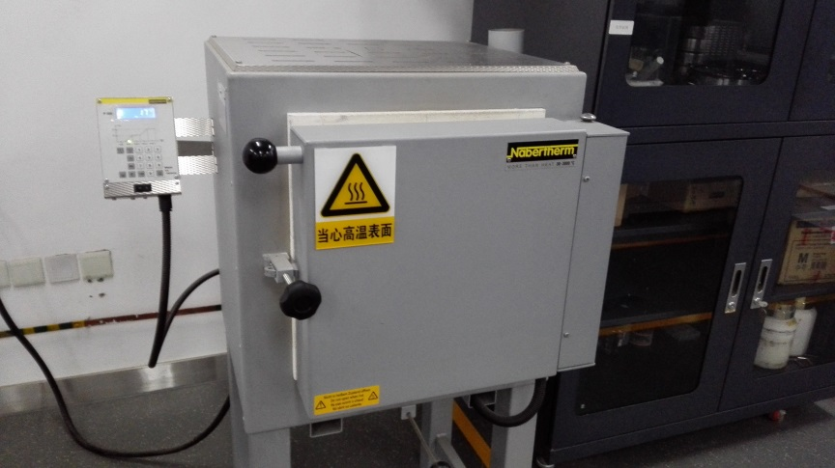
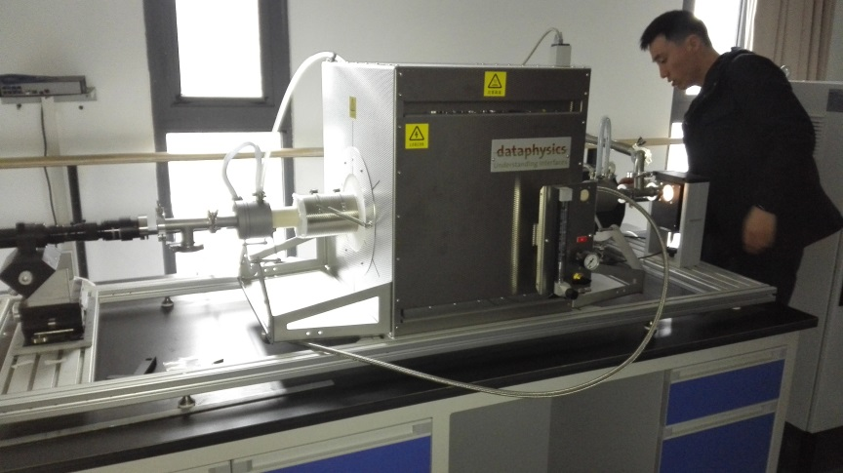
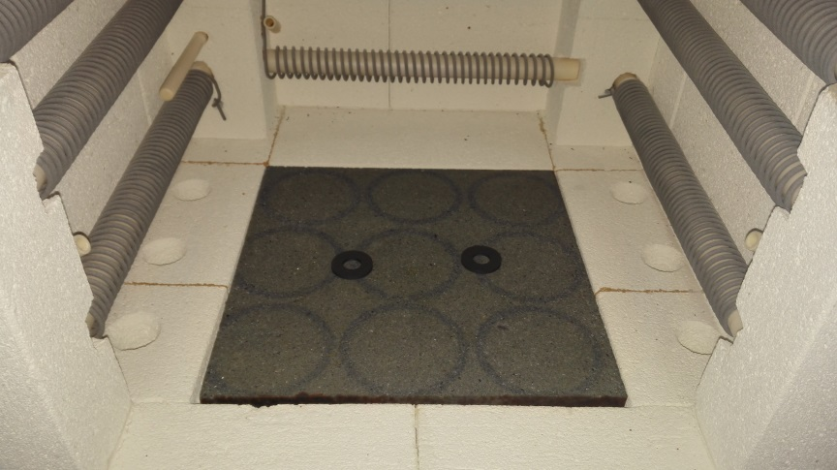
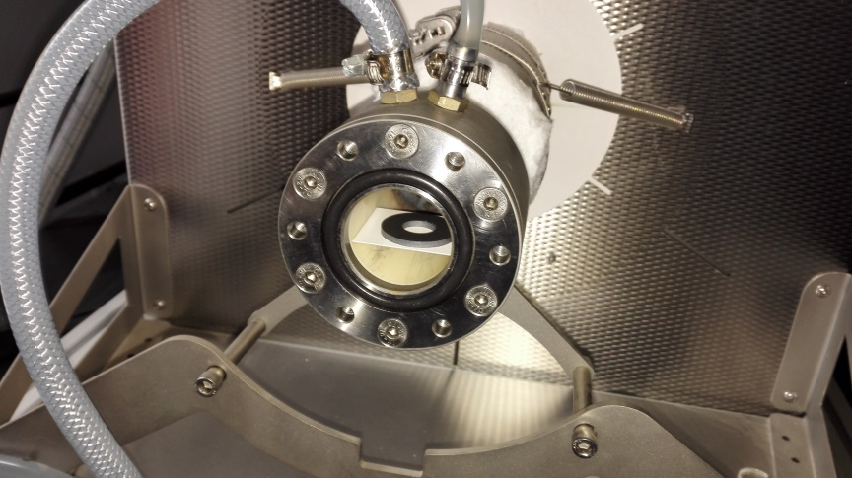
Brazing experiment
11
1st experiment:
Check the ferrite property variation after high temperature heating.
Metallization temperature
Brazing experiment

Slide 10
Brazing experiment
12
Data change before and after brazing experiment:
u” is more important for microwave absorptivity.
The u” change before and after brazing experiment is less than 5% ( including the test error between two test ).
The brazing process does not change the performance of ferrite obviously.

Slide 11
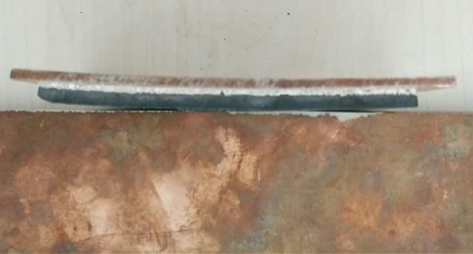
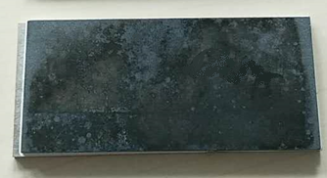
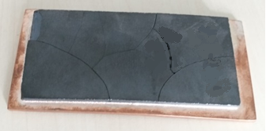
Brazing experiment
2nd experiment:
Braze ferrite on the copper plate
Failing brazing
Successful brazing

Slide 12
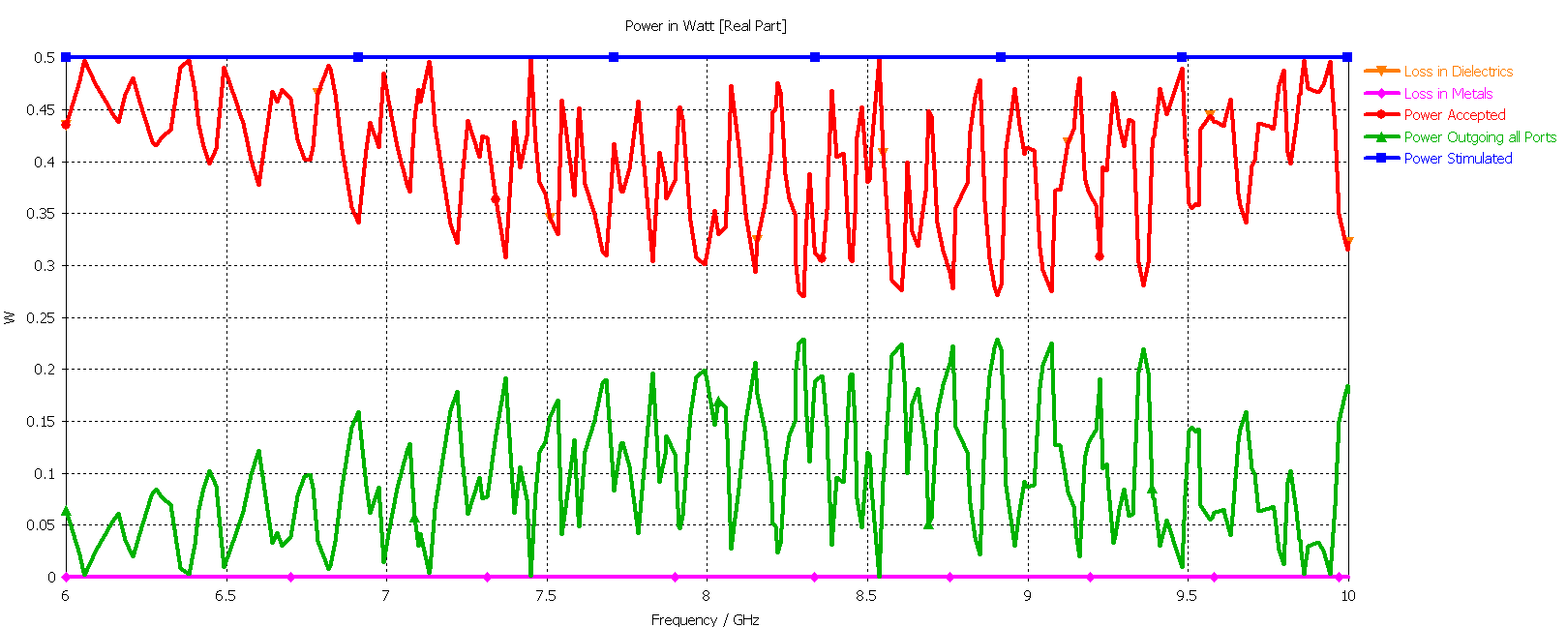
Brazing experiment
$$P_{loss}=\frac{1}{2}ωε_{0}ε^{′′}\iiint{{\left|\overset{⃑}{E}\right|}^{2}dV}$$
Loss is proportional to frequency
High frequency, long wave, low reflection
频率 （GHz） | $$ε^{′}$$ | $$ε^{′}′$$
8.5 | 15 | 3.75
11 | 15 | 3.75
In Ku band, though the $ε^{′}′$ may decrease, the absorbing efficiency will not decrease too much.
50%

Slide 13
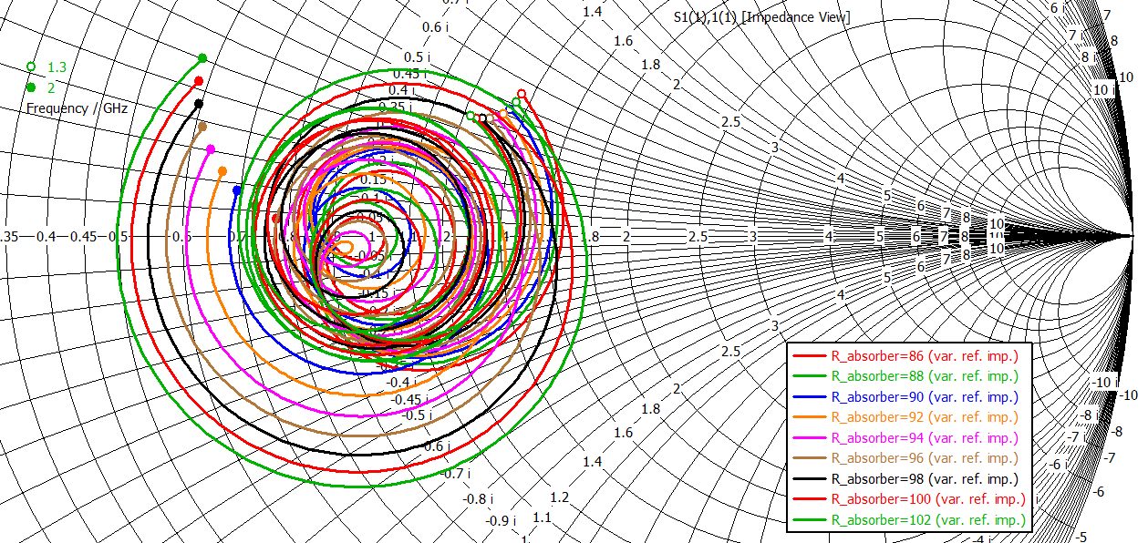
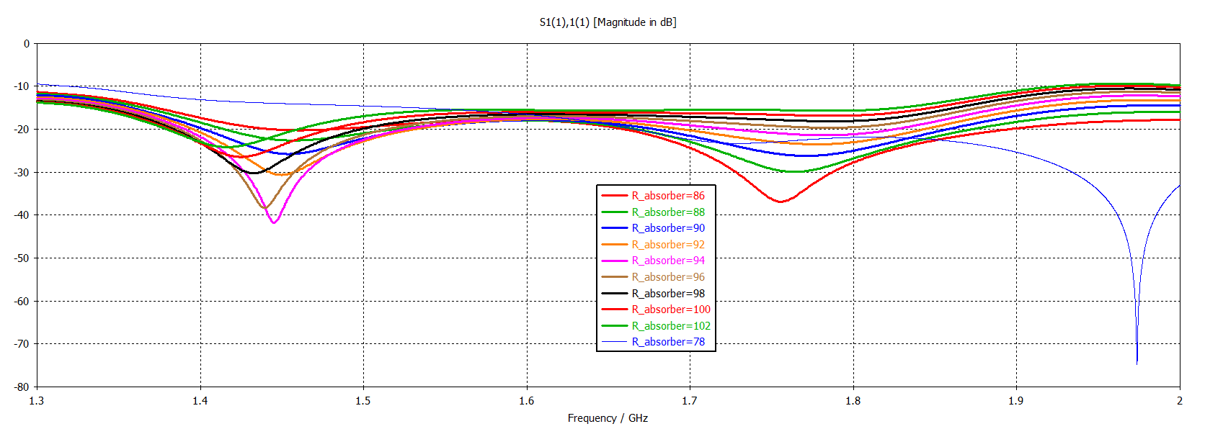
HOM absorber design method
1st step
15
Optimize the HOM absorber + taper:
Treat the HOM absorber + taper as a matched load
Separately design the HOM absorber + taper
Lower the S11 of this structure
Make the S11 trace around the origin of Smith Chart
Increase the design efficiency
HOM absorber + taper model
S11 in dB
S11 in Smith Chart

Slide 14
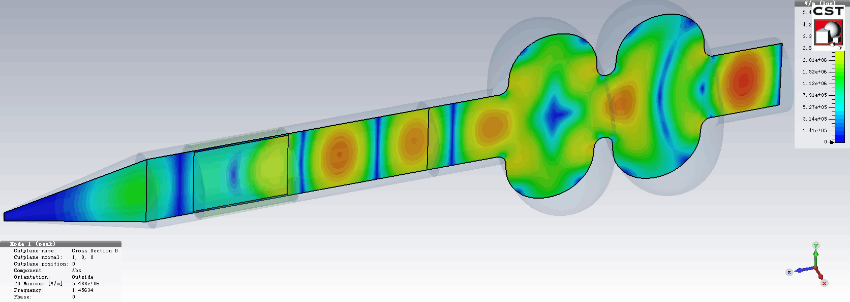
HOM absorber design method
2nd step
16
Integral simulation of “cavity + HOM absorber + taper”:
Simulate the real HOM absorbing situation
Focus on monopole and dipole mode above 1.4GHz
absorber
Cavity + HOM absorber + taper model
TM111 mode E field, f=1.456GHz, Ql=56.7
Need further simulation for higher mode
Use the wakefield method to calculate impedance with absorber directly in PIC solver

Slide 15
Cooperation details
17
Some new absorbing materials, such as SiC or AlN
Material test, such as $ε$, $μ$, thermal conductivity, electric conductivity, outgassing rate
Some new RF structure to increase the absorbing efficiency

Slide 16
18
Thank you for your attention!!

