Slide 1
EP system development at IHEP
Song JIN
6th IHEP-KEK SCRF Collaboration Meeting,
IHEP, July 15th, 2017

Slide 2
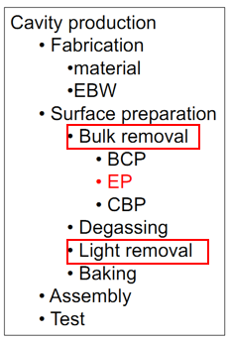
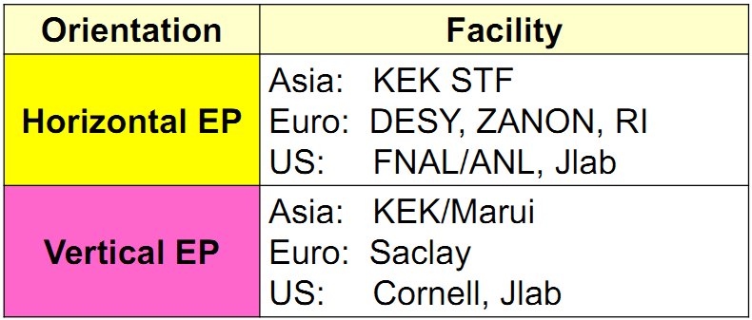
Introduction
EP as a critical technology for SRF cavity surface treatment was widely accepted and developed in the world.
High accelerating field, e.g. ILC, XFEL;
High Q₀ studies, e.g. N-doping cavity for LCLS-II;

Slide 3
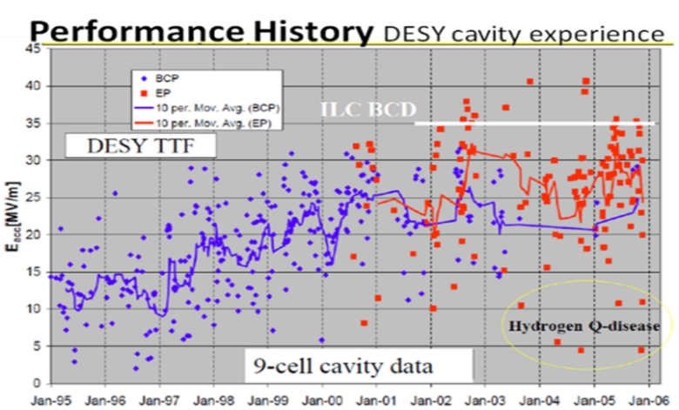
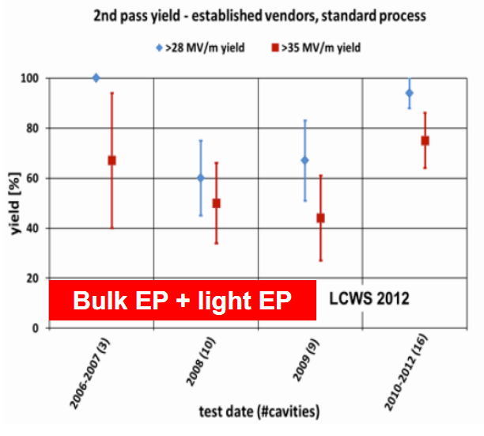
Effect of EP on 1.3GHz cavities

Slide 4
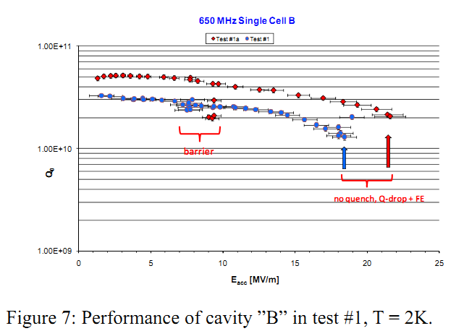
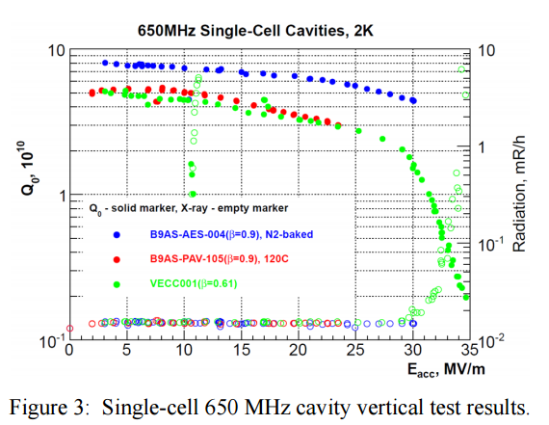
Effect of EP on 650MHz cavities
Recent years, due to N-doping development, the EP results on lower frequency cavity like 650MHz can be found. However, the directly comparing between EP and BCP on lower frequency cavities is not too much.
Here, we just take two 650MHz single cavities for example. EP can improve accelerating grandient and Q0
Besides, EP is also critical for N-doping technology.
图：红色为JLab BCP 处理后的650MHz单cell超导腔的2K下的垂测结果
图：红色和绿色曲线为Fermilab（ANL）EP处理过的两支650MHz 单cell超导腔在2K下的结果
Notes:
对于BCP和EP在频率较低超导腔的研究，如650MHz和500MHz超导腔，目前并不是太多。左图和右图分别为JLab和FermiLab（ANL）650MHz单Cell超导腔的垂测结果。其中Jlab超导腔为BCP处理，Fermilab超导腔为EP处理。可以看到，经BCP处理后，JLab的超导腔加速梯度为23MV/m，而EP处理后Fermilab的超导腔达到了30MV/m以上；在23MV/m时，超导腔的品质因子，则前者为2E10，后者为3E10。
对于500MHz， KEKB和BEPC II 的超导腔研制的标准流程，均为EP处理。BEPCII 备用腔则采用了BCP。但时间较早，十几年前，所以可比性不太大。

Slide 5
We would also like to build a EP system for future projects such as ILC, CEPC, Shanghai XFEL and so on.
CEPC Cavities
Cavity | Vertical test | Horizontal test
650 MHz 2-cell Cavity | 4E10 @ 22 MV/m | 2E10 @16 MV/m
1.3 GHz 9-cell Cavity | 3E10 @ 25 MV/m | 2E10 @ 20 MV/m

Slide 6
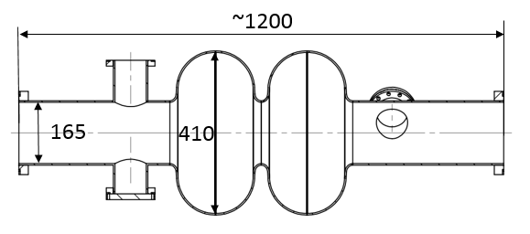
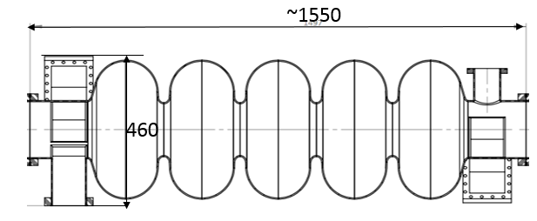
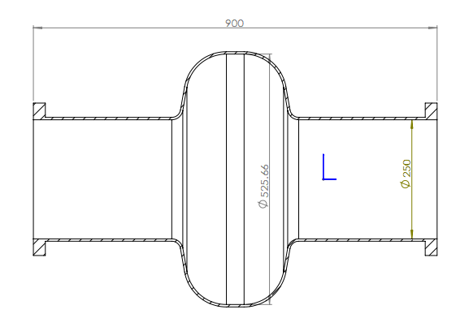
Capability requirements of EP system
At this stage, we would like a horizontal EP facility.
Main purpose is for elliptical SRF Nb cavities, compatible for 1.3GHz, 650MHz 5-cell, and 500MHz cavities.
It can realize three function: Pre-EP, Bulk EP, and fresh EP
900
170
530
220

Slide 7
Main components for EP system
Main parts of EP systems need to fabricate
Flow scheme/plumbing
Mechanical/structural
Controls/data logging
Infrastructure
Shared equipment and infrastructure:
DI water of 2MΩ.cm
Ultrasonic cleaning
HPR
Waste treatment facilities

Slide 8
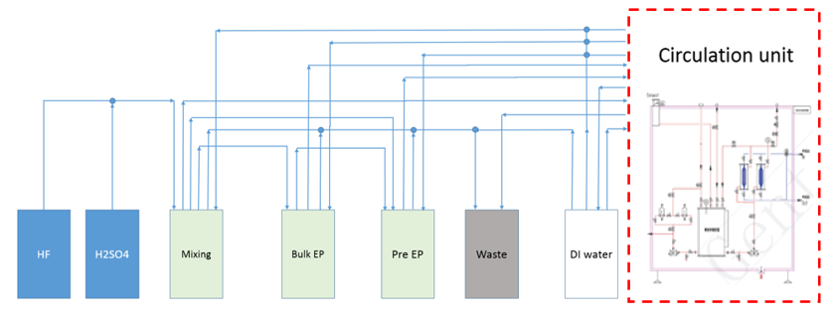
Flow scheme/plumbing
Acid mixing and storage unit
Acid mixing unit
Storage
Circulation unit
3) Circulation: acid level ~60% of the cavity volume
4) Cooling unit: mixing acid and EP process
5) Hydrogen gas dilution for maximum H2 rate of 7L/min.

Slide 9
Requirements
Program | Acid mixing and storage | Circulation unit
Functions | 可实现溶液的配制，可实现各单元对超导后处理的溶液供给、各单元间的溶液循环、管路的清洗和废酸的排放；可实现自动控制和数据获取；溶液排除后，无管路残留积液 | Similar
Material | 接液部分均满足高洁净品质；系统阀门及管路材质：PFA/PVDF；设备部分采用PP外壳做包板，金属骨架作支撑，所有外露金属需包覆； | Similar
Flow rate | 溶液配制速度≥50L/hour，供液流量≥20L/min, Pneumatic Pump | 工艺循环流量≥70L/min for 650MHz；工艺循环流量≥25L/min 1.3GHz; magnetic pump
Acid/ mixing | 配液精度±1%；配酸时温度≤35℃（室温25℃）；cooling 10kW | ≤20℃±0.5℃@15L/min, cooling 20kW; filter with 0.2μm;
Container Volumes | 去离子水储箱：2500L，材质：进口PP； 新酸配置容器：200L，材质：进口PVDF； 深度抛光容器：500L，材质：进口PVDF； 预处理容器：200L，材质：进口PVDF； 废液收集容器：500L，材质：进口PVDF | Buffer container 1: 500L Buffer container 2: 200L
Leaking check | 系统管路充入0.12MPa的氮气正压，半小时内压力降低小于千分之二 | Hydrogen pumping: air filter 0.3μm

Slide 10
Mechanical/structural
Main functions:
Rotation along the axial direction: ≥ 10RPM
Switchable from horizontal to vertical cathode assembly, electrolyte draining, water rinsing: 0~95º
Cathode and assembly machine: assembly at vertical direction
Electric connections and cavity jigs (500MHz single cell)
Power Supply：direct current，variable to 1000A and 50V.
Cavity outside cooling:
by water with more than 20 water pipes;
The water flow of each pipe can be controlled separately.
Rotation sealing
Vibration

Slide 11
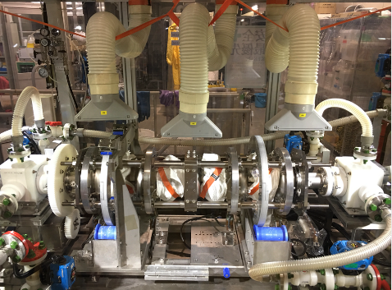
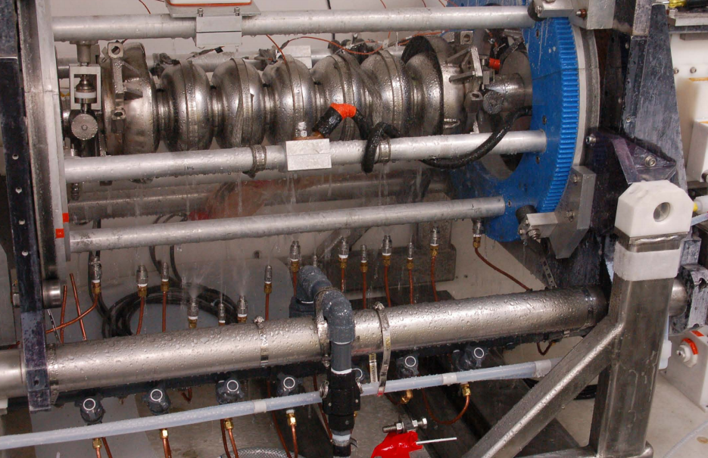
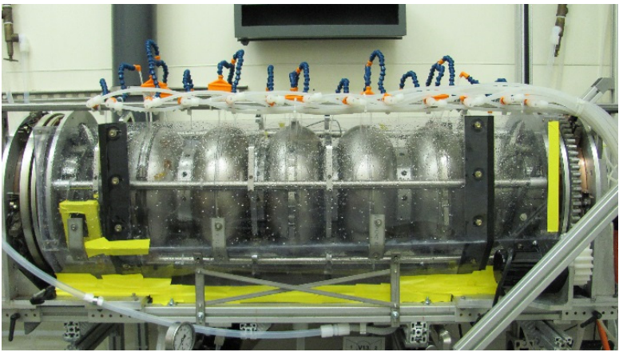
Cooling
Cooling at KEK
Cooling at JLab
Cooling at ANL

Slide 12
Controls/Data Logging
Controls
Leaking check
Air Pumping for H2 or nitrogen purge
Filter/mix acid
Rotate cavity
Fill/overflow cavity
Sweep voltage
Start polishing
Stop polishing
Tilt to vertical and drain
Rinse to Resistivity and drain
Tilt to horizontal
Data logging
Current with voltage
Voltage and current with time
Rotation speed
Flow rate
Temperatures：
Inlet and outlet of the cavity；
Three points on cathode surface
Outer Surface of the cavity;
All the containers;
Level of solution at various container；
Resistivity
Rinsing
cavity outside cooling
Hydrogen concentration ；

Slide 13
Infrastructure needs to prepare
Two Chillers:10kW and 20kW
Clean and constant temperature environment
Easily dismountable cabinet for the main part of EP system
Gas monitors: HF, Hydrogen, Oxygen
Shower area and device , first-aid medicine
Area: 8m*8m*5m(high) (DIW not included )

Slide 14
EP System Features
Processing horizontally while rotating
Draining vertically for the electrolyte and rinse water
Straight aluminum cathode with electrolyte fill ports located at cell centers
Tooling variable up to about 2 m cavity length and 1m for diameter
Maximum flow rate can be 70L/min
Direct current power supply rated at 50 volts and 1000 amperes
An onboard 20kW heat exchanger for EP process
Chillers for electrolyte temperature control (20kW and 10kW )
Automated controls – programmable logic controller by both PLC/ touch screen and a on line Industrial Personal Computer

Slide 15
Schedule
 | 2017 |  |  |  |  |  |  | 2018
Task | To Jun. | July. | Aug. | Sep. | Oct. | Nov. | Dec. | Jan. | Feb. | Mar. | Apr.
Concept
Administration
Supplier survey 1
Design 1
Fabrication 1
Supplier survey 2
Design 2
Fabrication 2
purchase
Assembly
Commissioning

Slide 16
Thank you!

