Slide 1
Achievement of Stable Pulsed Operation at 36 MV/m in STF-2 Cryomodule at KEK
Preliminary version
E. Kako, T. Shishido, K. Umemori, T. Kubo, T. Konomi, G. Park, T. Saeki, T. Dohmae, M. Egi, Kirk
T. Matsumoto, T. Miura, T. Takenaka, H. Nakai, Y. Kojima, K. Hara, T. Honma, K. Nakanishi, H. Shimizu
Kirk

Slide 2
Outline
History of STF-2 project
Construction of STF-2 cryomodule
Performance for each item
Accelerating gradient
X-rays
Heat load
Lorentz detuning
Consideration of degradation
Last V.T. → 2nd Cool-down test
2nd Cool-down test → 3rd Cool-down test
Vector-sum operation @31 MV/m
Summary

Slide 3
Outline
History of STF-2 project
Construction of STF-2 cryomodule
Performance for each item
Accelerating gradient
X-rays
Heat load
Lorentz detuning
Consideration of degradation
Last V.T. → 2nd Cool-down test
2nd Cool-down test → 3rd Cool-down test
Vector-sum operation @31 MV/m
Summary

Slide 4
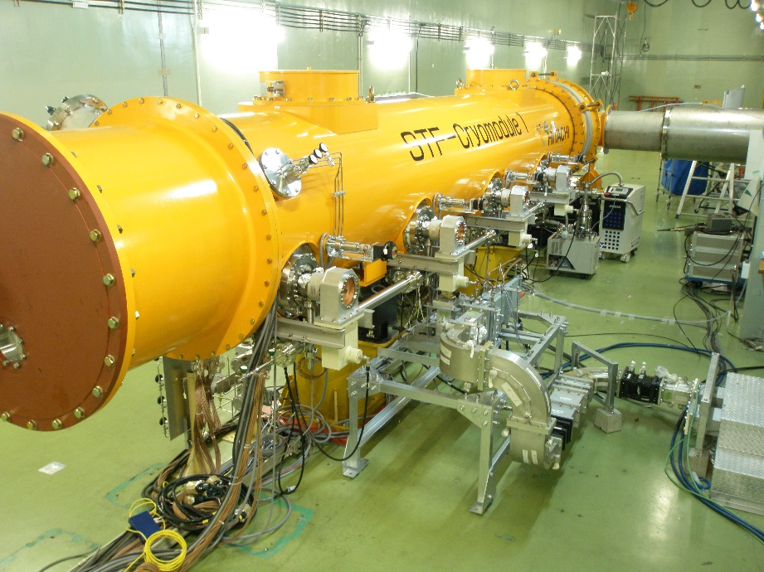
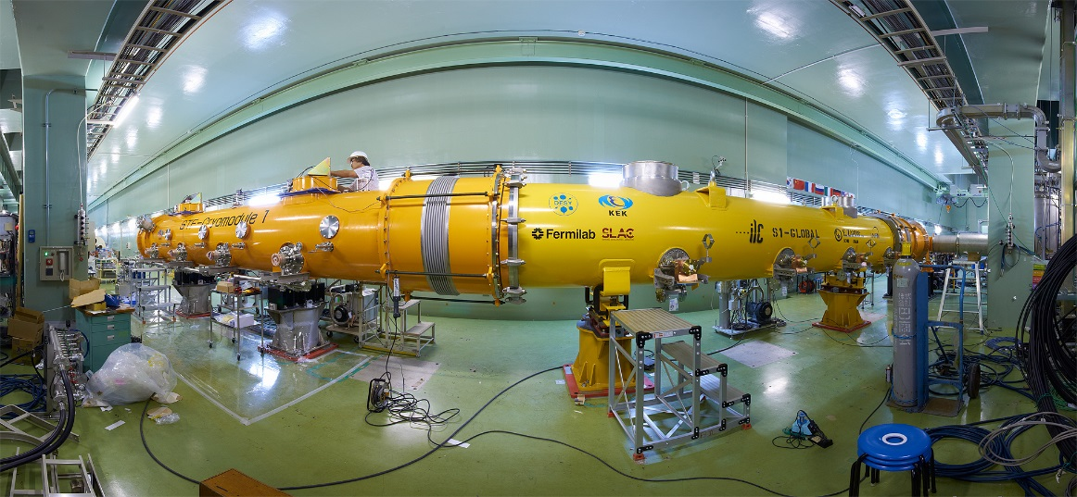
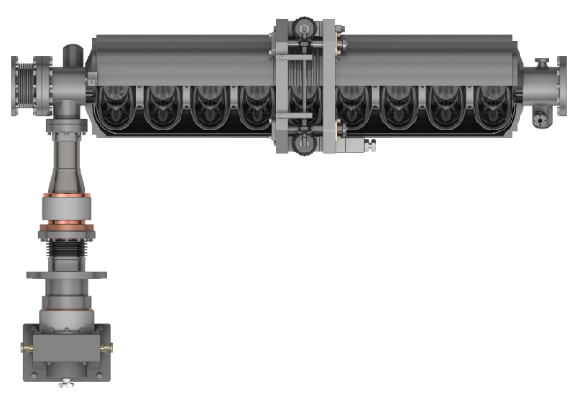
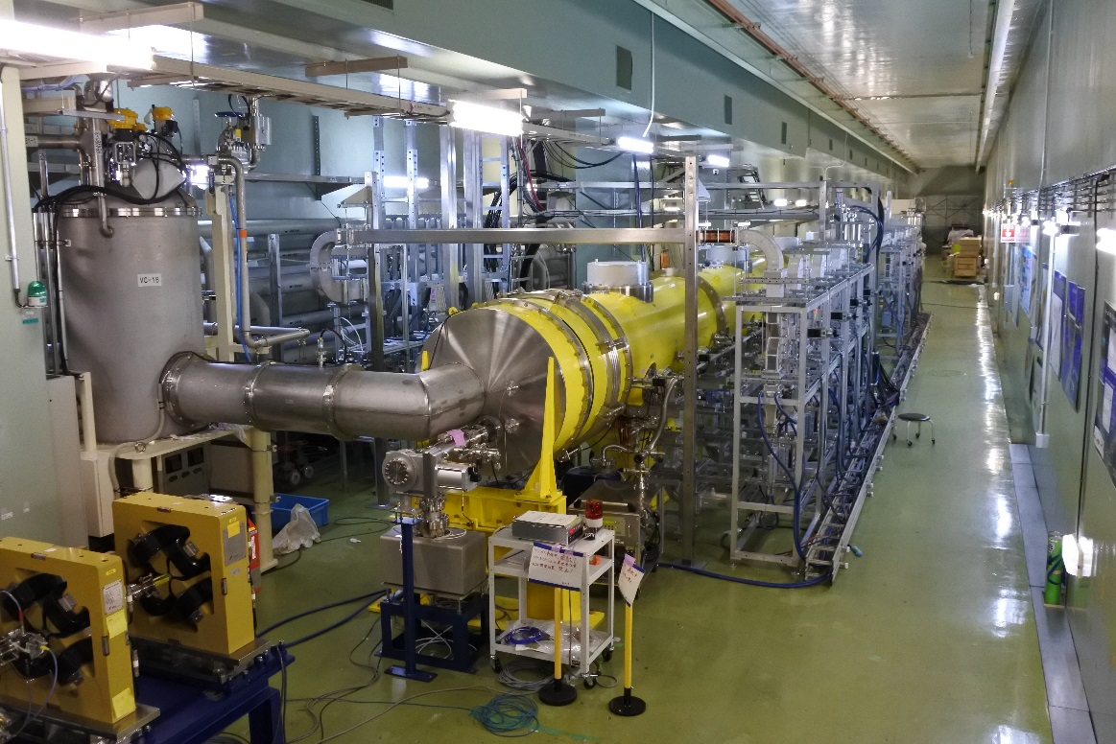
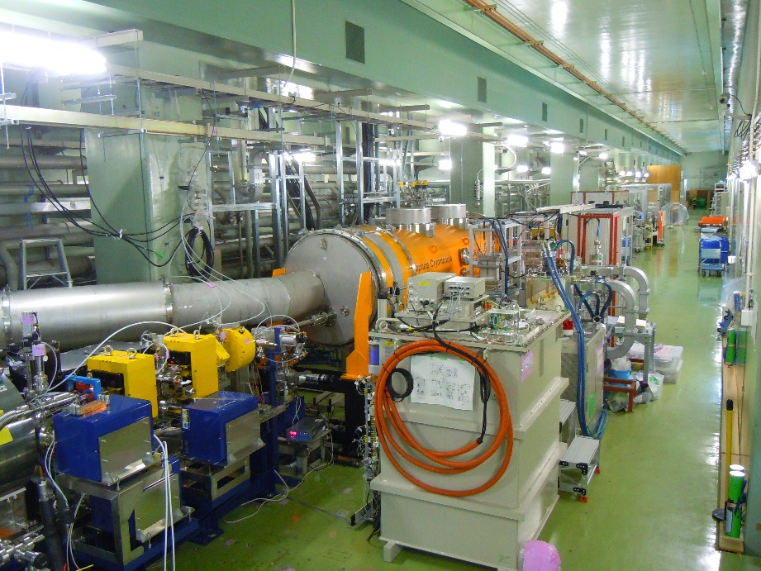
STF Cryomodules
STF-1 (4 cavities) in 2008
S1-Global (4+4 cavities) in 2010
4 cavities per batch
Proc. in SRF11
Proc. in SRF09
STF Cavity Package
STF-2 (12 cavities) in 2014~
Quantum Beam (2 cavities) in 2012
Capture CM in STF-2 accelerator
Proc. in IPAC12
Proc. in IPAC16

Slide 5
Brief History for STF-2 Cryomodule
Date | Content
2011 ~ 2013 | V.T. for 12 cavities / RF conditioning for 12 couplers
Jun/2013 | Cleaning up STF tunnel
Jul/2013 ~ Apr/2014 | Cavity string assembly (three times)
Oct/2013 ~ Jan/2014 | Module assembly (CM1/CM2a)
Jul/2014 | Complete certification for High pressure Gas Code
Oct/2014 ~ Dec/2014 | 1st cool-down / low power test
Apr/2015 ~ Jul/2015 | 5MW Klystron / Single waveguide system completed
Jul/2015 ~ Sep/2015 | Coupler conditioning at room temperature
Oct/2015 ~ Dec/2015 | 2nd cool-down / high power test (cavity performance check)
Jan/2016 ~ Jul/2016 | Multi-beam Klystron & Waveguide system completed
Jul/2016 ~ Sep/2016 | Coupler conditioning at room temperature
Sep/2016 ~ Nov/2016 | 3rd cool-down / LFD, Q₀ measurement, 8 Cavities Operation & LLRF study
2017 | No plan for cool-down test
F.Y. 2018 | 4th cool-down test (?)
F.Y. 2018 ~ | Beamline construction / Beam operation starts (?)

Slide 6
Outline
History of STF-2 project
Construction of STF-2 cryomodule
Performance for each item
Accelerating gradient
X-rays
Heat load
Lorentz detuning
Consideration of degradation
Last V.T. → 2nd Cool-down test
2nd Cool-down test → 3rd Cool-down test
Vector-sum operation @31 MV/m
Summary

Slide 7
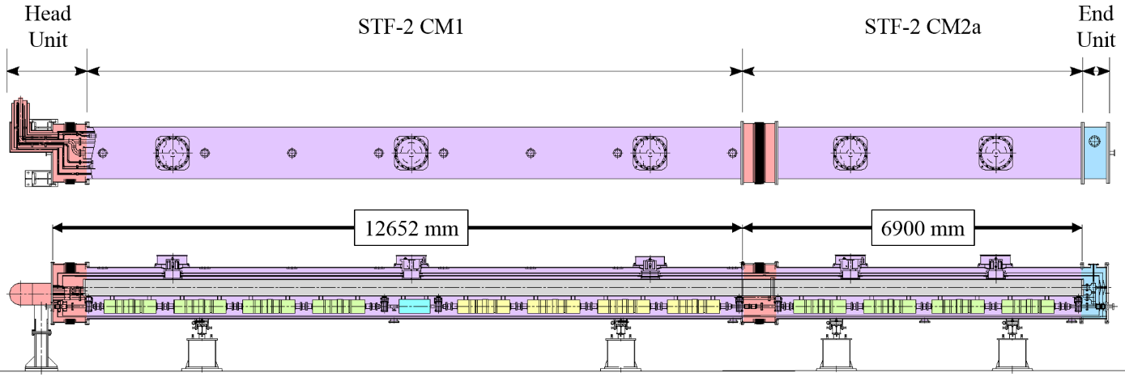
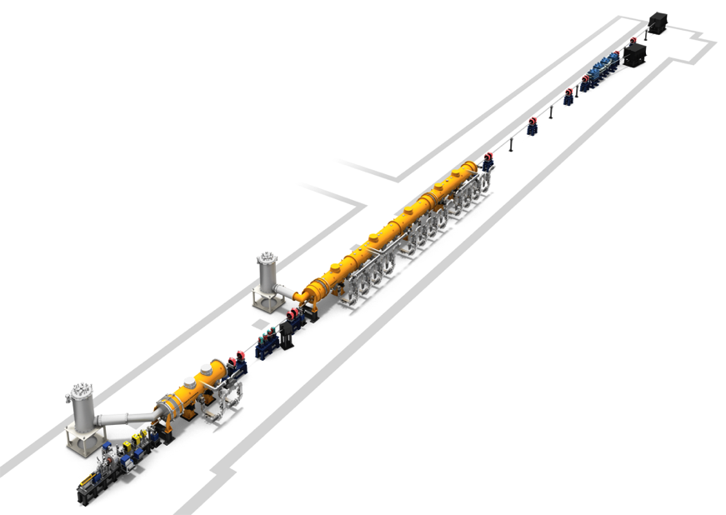
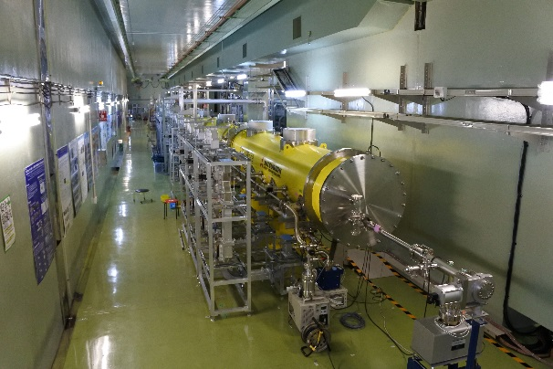
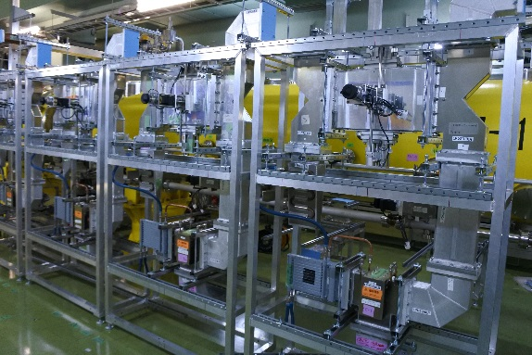
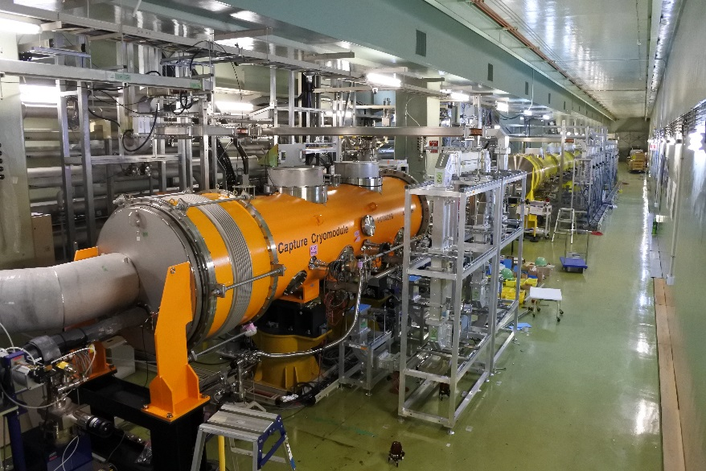
STF-2 Accelerator Layout
To be constructed
Cold box
CM1 + CM2a
(Twelve cavities)
Waveguide system
View from downstream
To be constructed
Cold box
Capture CM
(Two cavities)
Chicane
RF Gun
View from upstream

Slide 8
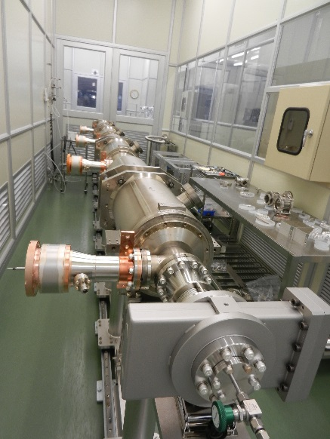
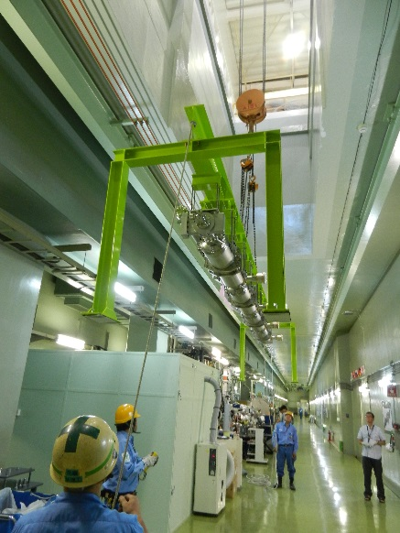
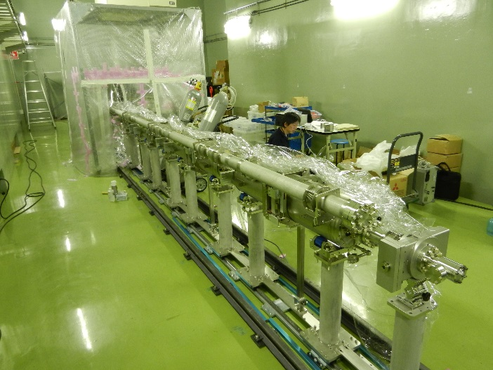
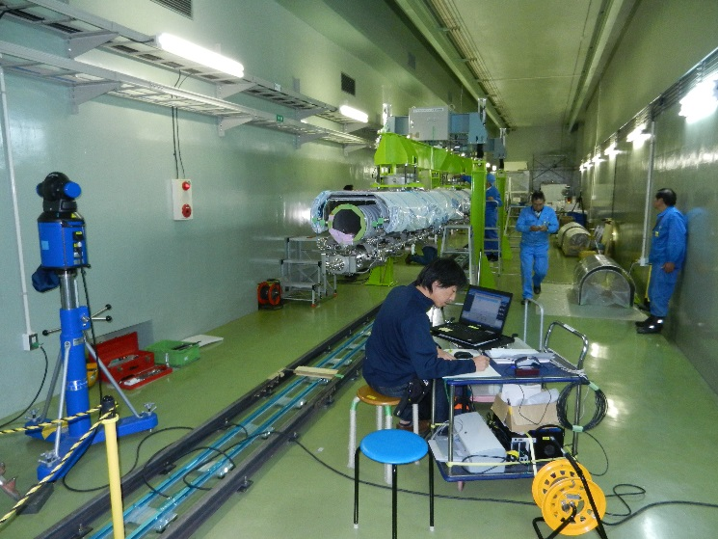
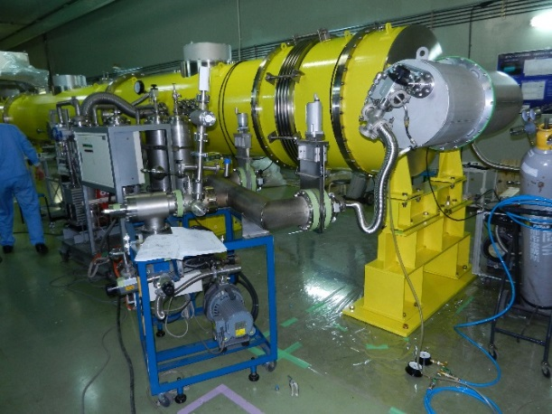
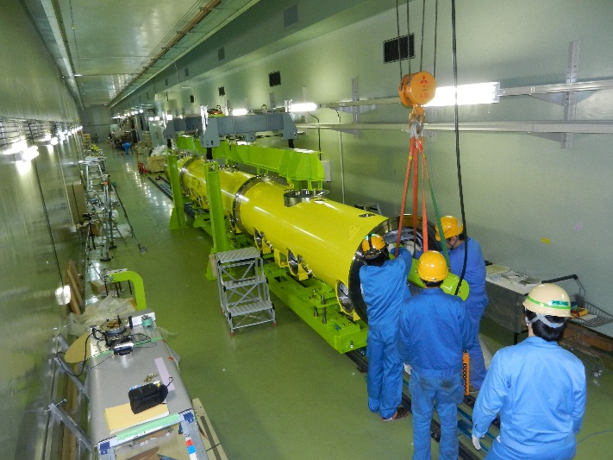
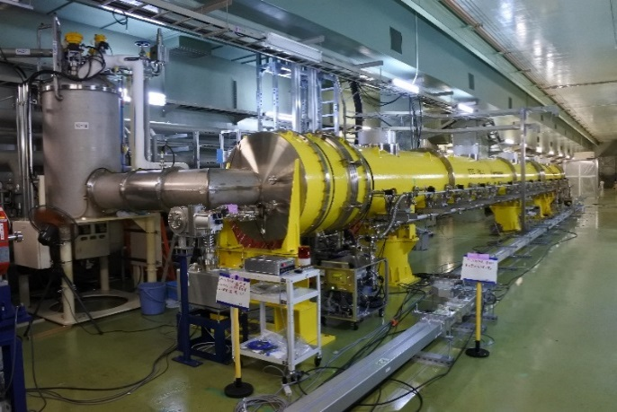
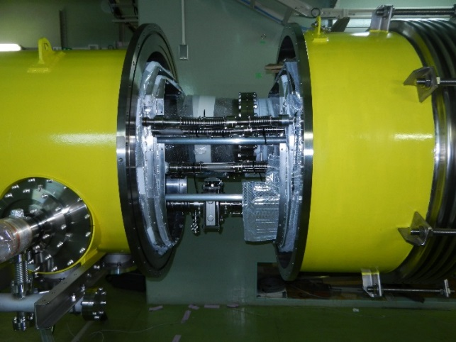
Construction of STF-2 Cryomodule
Cavity string
Installation into tunnel
Beampipe connection between cavity strings
Alignment
(laser tracker)
Pumping/leak check
Construction completed after HPG certification
Cryomodule connection
Installation into cryo-vessel

Slide 9
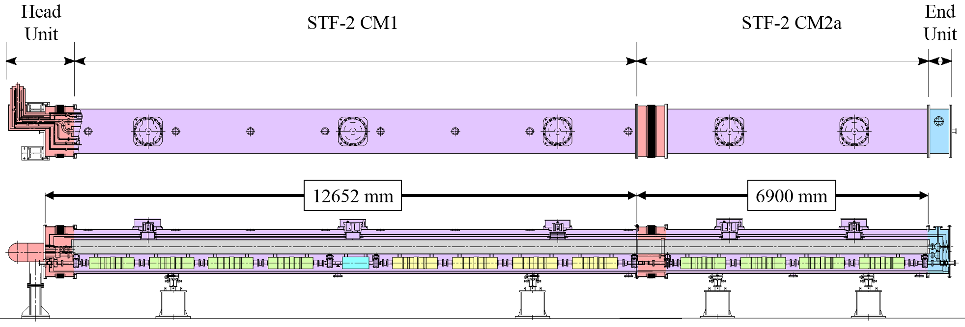
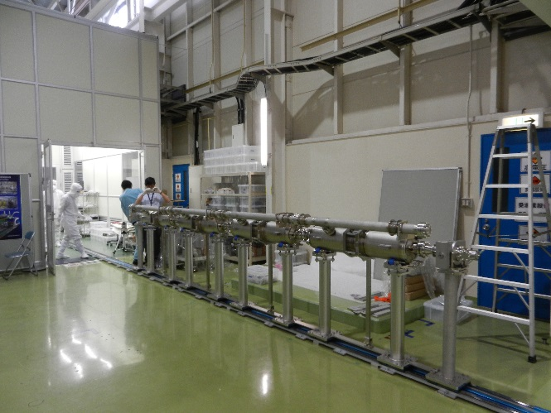
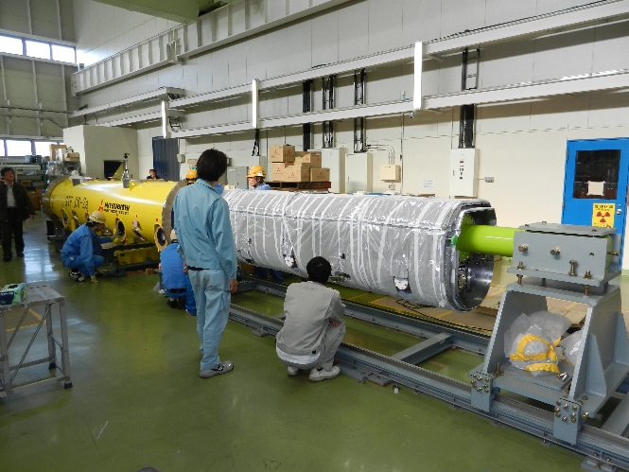
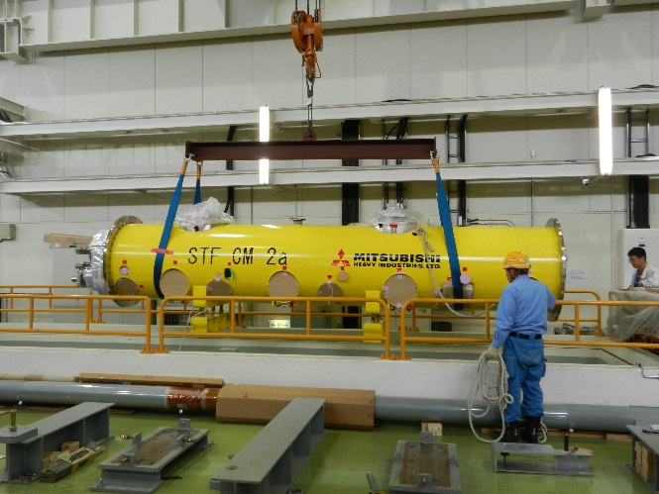
Complicated situation in CM construction
1+1/2 cryomodule
1/3 cryo-vessel
1/3 cryo-vessel
1/3 cryo-vessel
1/2 cryo-vessel
Three cavity strings (4+4+4=12)
Four cryo-vessels (1/3+1/3+1/3+1/2=1.5)
five support posts (3+2=5)
constructed in tunnel
constructed on ground floor
CM2a was constructed by the same way as S1-Global
Four cavities per string
Construction of half-size cryomodule
Tunnel hatch for half-size cryomodule

Slide 10
Outline
History of STF-2 project
Construction of STF-2 cryomodule
Performance for each item
Accelerating gradient
X-rays
Heat load
Lorentz detuning
Consideration of degradation
Last V.T. → 2nd Cool-down test
2nd Cool-down test → 3rd Cool-down test
Vector-sum operation @31 MV/m
Summary

Slide 11
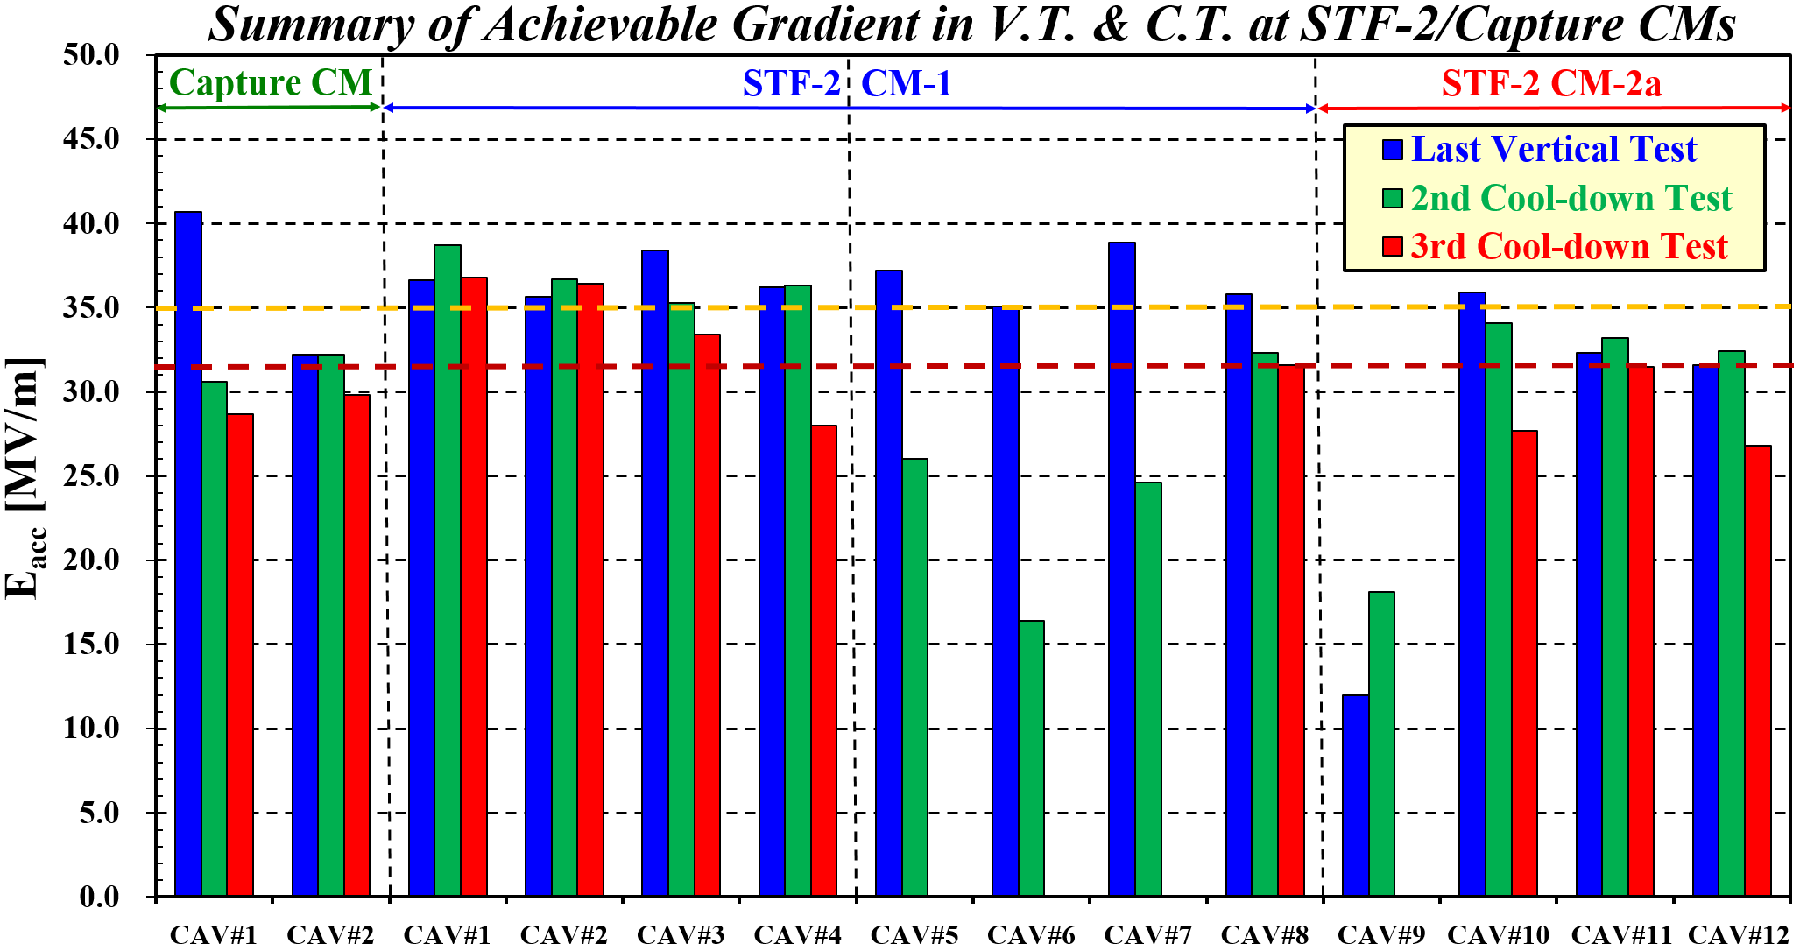
Summary of Cavity Performance
Not measured in 3rd C.T.
K_{t} for CAV#1 and #8 was never changed!
Significantly degraded in 3rd C.T.

Slide 12
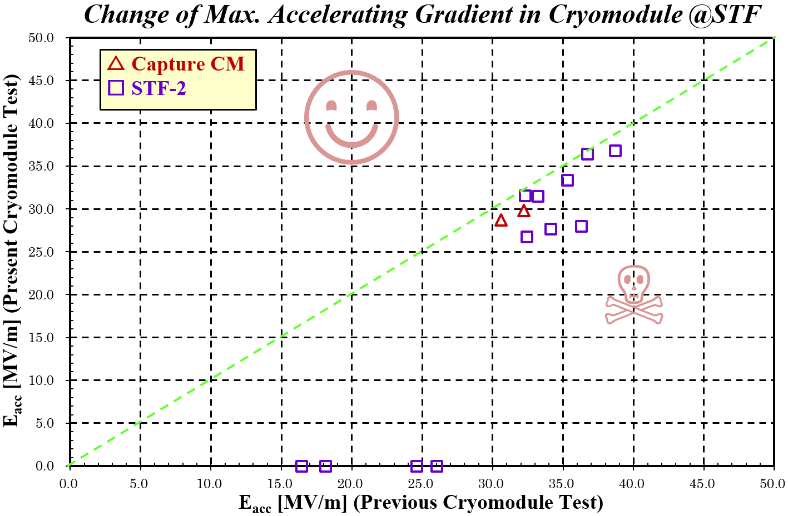
Change of Cavity Performance in STF-2
All measured cavities in Capture/STF-2 CMs had performance degradation again!
There maybe some risk for performance degradation in higher gradient operation.
Uniformly degraded!
3rd cooldown test
RF conditioning by short pulse should be tried again!
Not measured cavities in 3rd C.T.
2nd cooldown test

Slide 13
Outline
History of STF-2 project
Construction of STF-2 cryomodule
Performance for each item
Accelerating gradient
X-rays
Heat load
Lorentz detuning
Consideration of degradation
Last V.T. → 2nd Cool-down test
2nd Cool-down test → 3rd Cool-down test
Vector-sum operation @31 MV/m
Summary

Slide 14
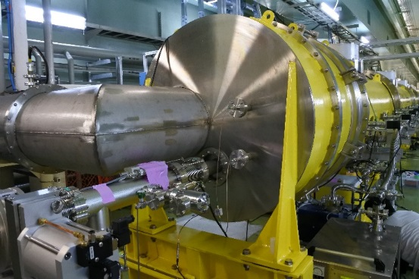
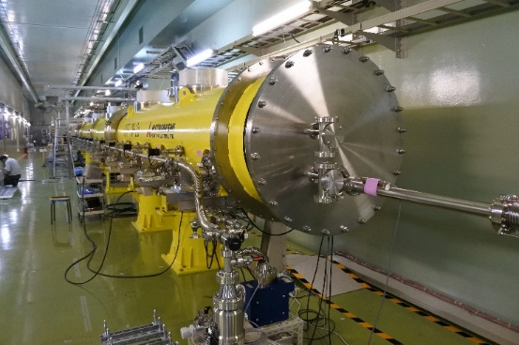
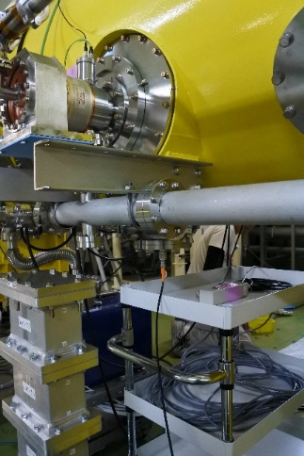
Positions of radiation detector
upstream
downstream
cavity
upstream
downstream
We can move these detectors
to below each cavity
cavity

Slide 15
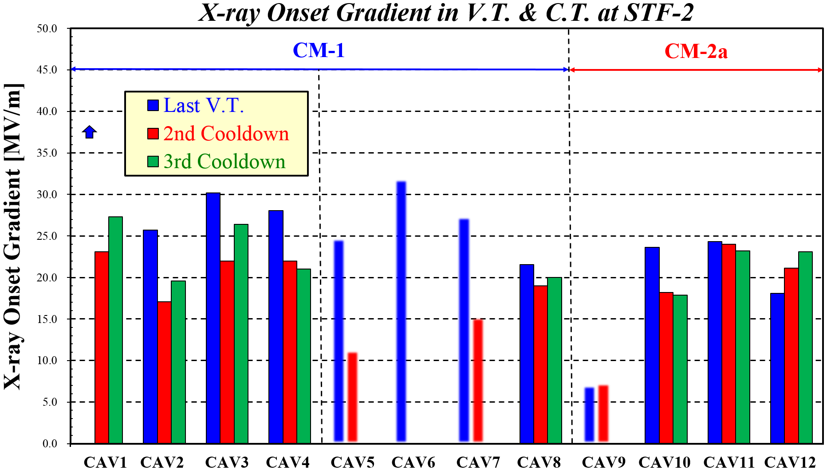
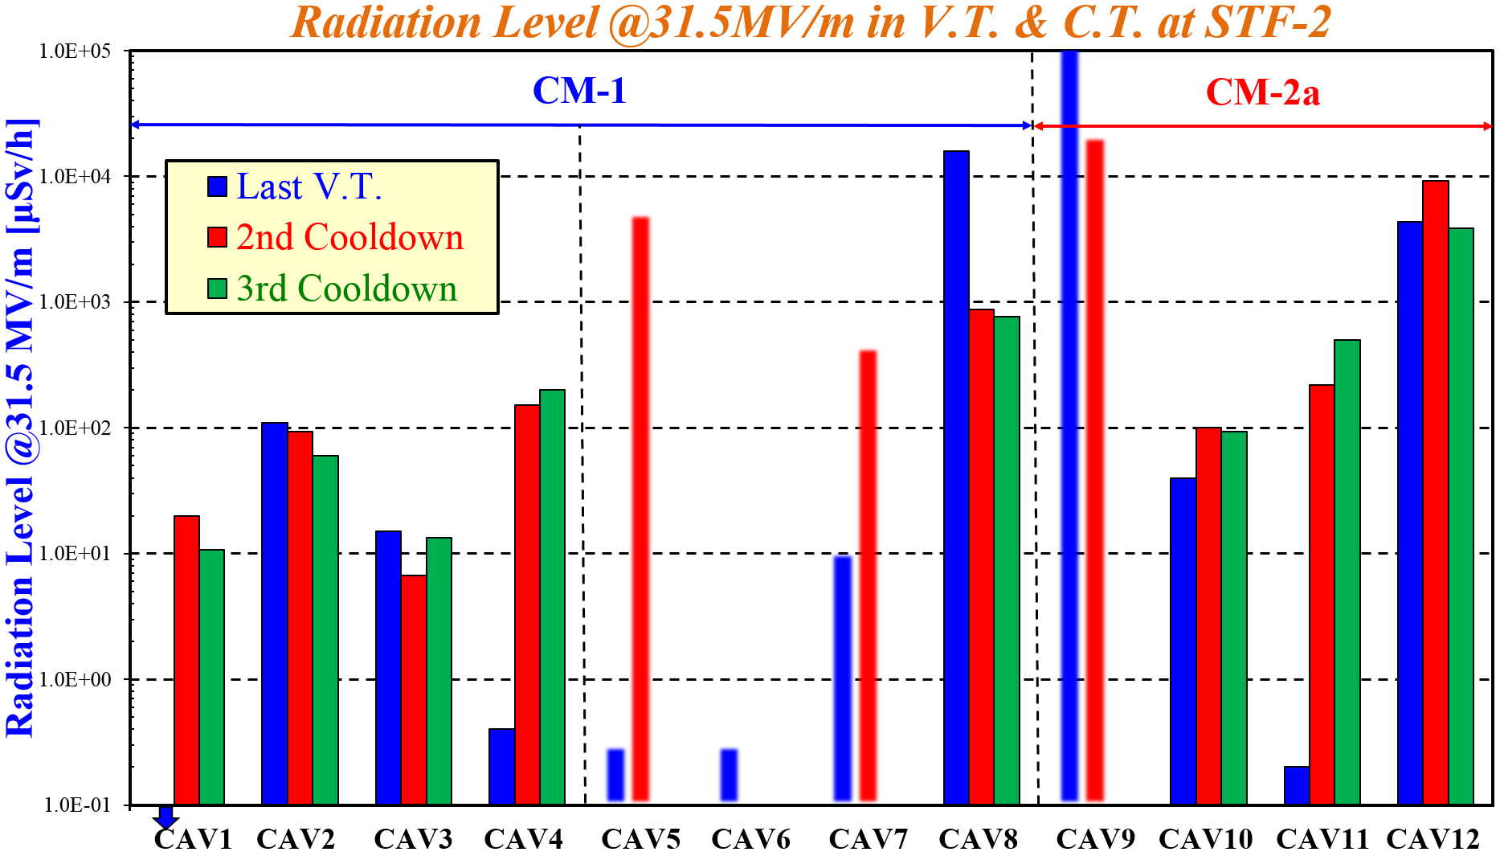
X-rays measurement
CAV5, 6, 7, and 9 not tested in 3rd cooldown
CAV1 had no x-rays in last V.T.
A little bit higher gradient in 3rd test as resulting from RF conditioning
Onset Gradient
CAV5, 6, 7, and 9 not reached 31.5 MV/m in 2nd cooldown
CAV10 and 12 not reached 31.5 MV/m in 3rd cooldown
Almost same level between 2nd and 3rd test
X-rays @31.5MV/m

Slide 16
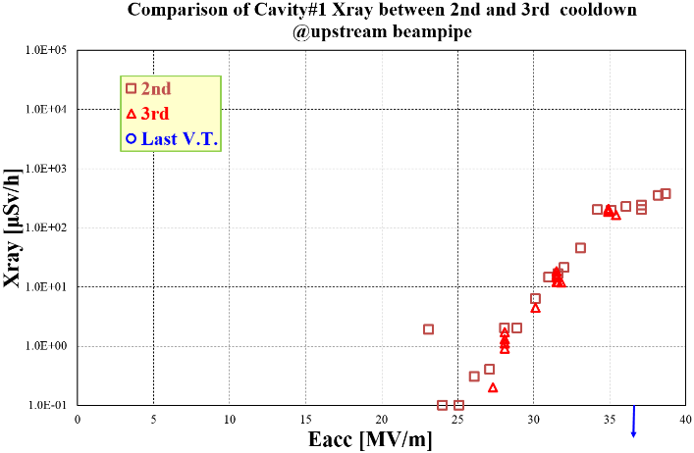
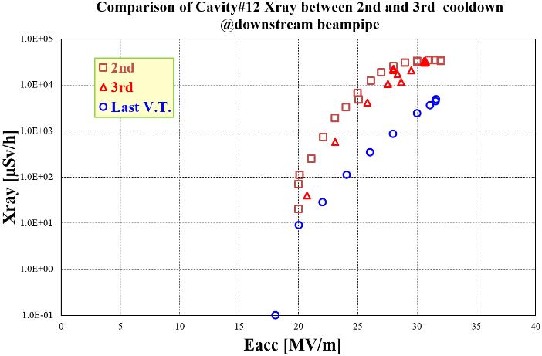
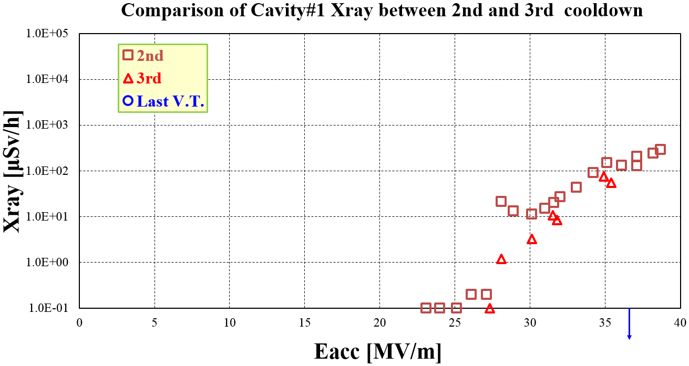
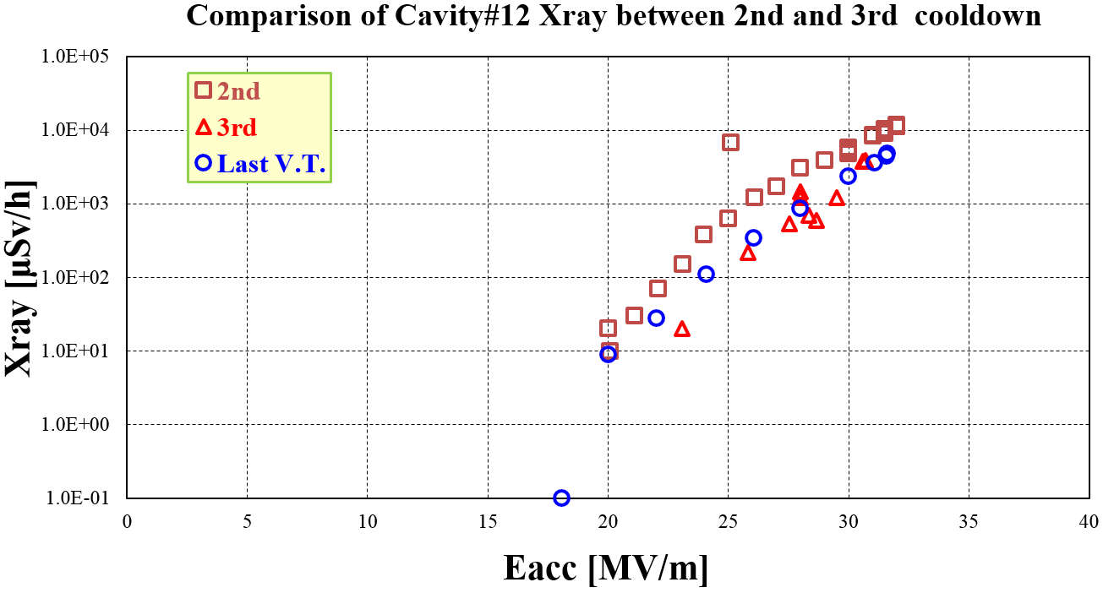
X-rays comparison for both-end cavities
upstream
downstream
Same radiation level between 2nd and 3rd cooldown test!
upstream
downstream
below CAV1
below CAV12
below CAV1
below CAV12

Slide 17
Outline
History of STF-2 project
Construction of STF-2 cryomodule
Performance for each item
Accelerating gradient
X-rays
Heat load
Lorentz detuning
Consideration of degradation
Last V.T. → 2nd Cool-down test
2nd Cool-down test → 3rd Cool-down test
Vector-sum operation @31 MV/m
Summary

Slide 18
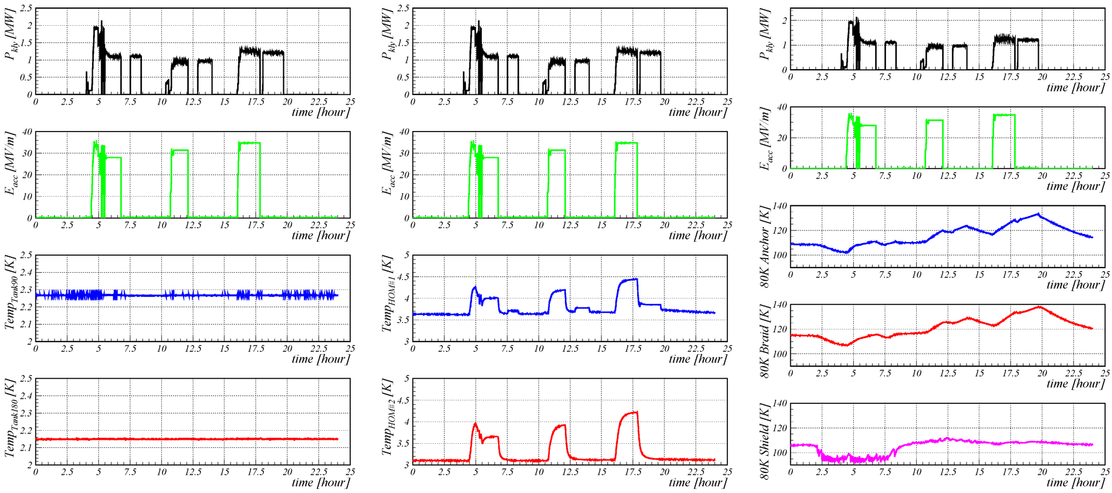
Trend graph during the heat load measurement
Measurement cycle: dynamic heat load → detuned heat load → static heat load
Heat load in cavity
Heat load in coupler

Slide 19
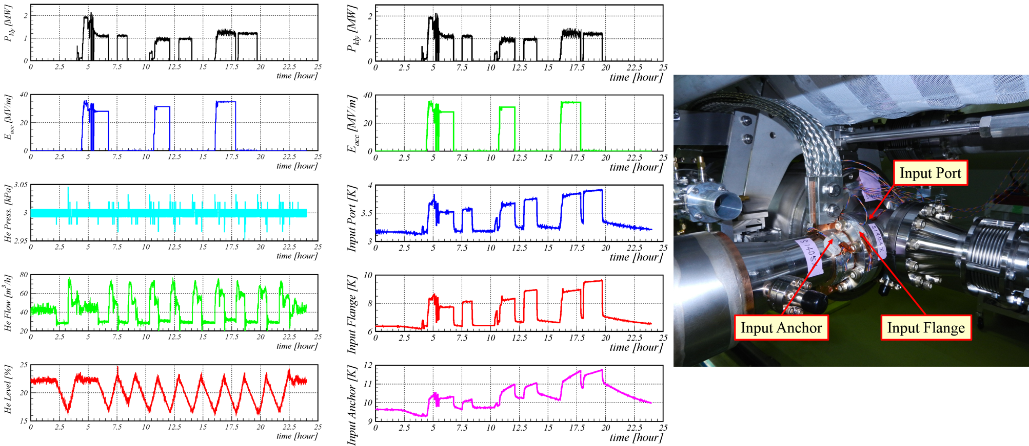
Trend graph during the heat load measurement
We can estimate the heat load from the helium mass flow rate.
The heating around the power coupler did not disappear by the next day.

Slide 20
Error Estimation in Q₀ Measurement
Reproducibility of Static Heat Load
0.36 [W] on average for 28 times measurements
Distribution of Helium Mass Flow
3.9% on maximum for every heat load measurement
Stability in Accelerating Gradient for Flat-top of Pulse
0.05% (very stable)
Stability in RF Duty Factor
0.85% (stable)
Latent Heat of Vaporization
Negligible small
Helium Mass Flow Meter
±0.3% according to spec. sheet
Calibrated by heater in STF-2

Slide 21
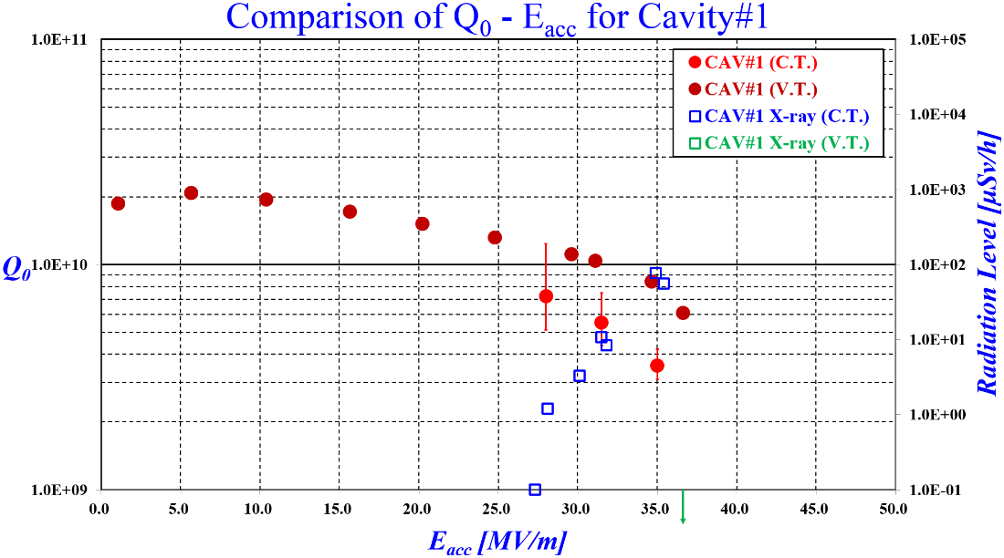
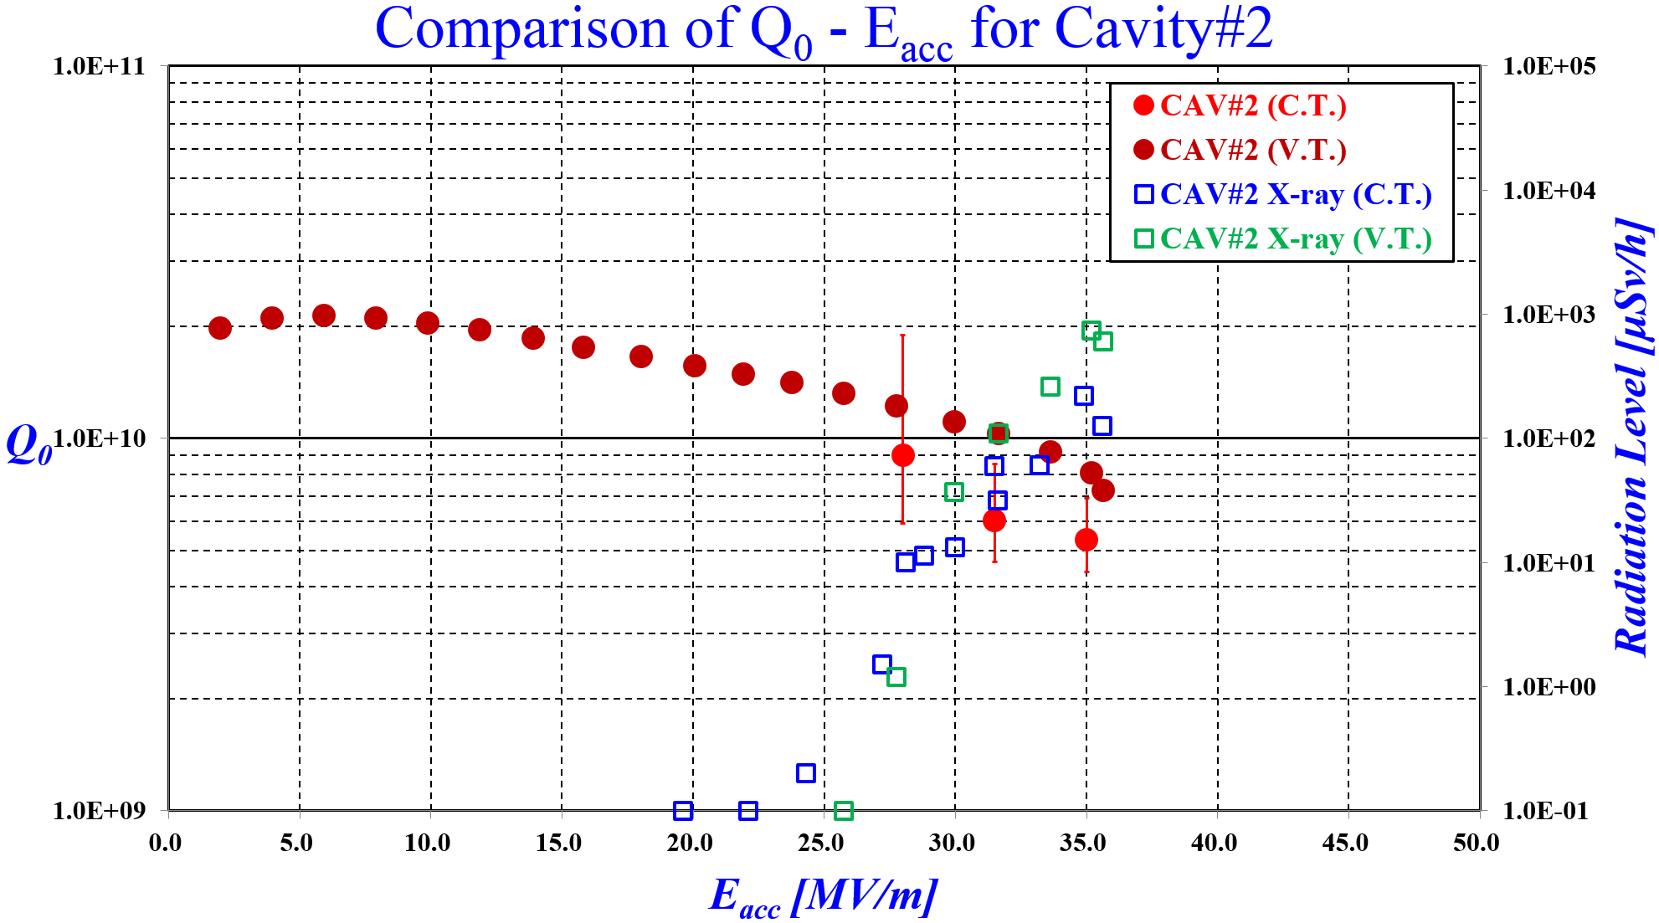
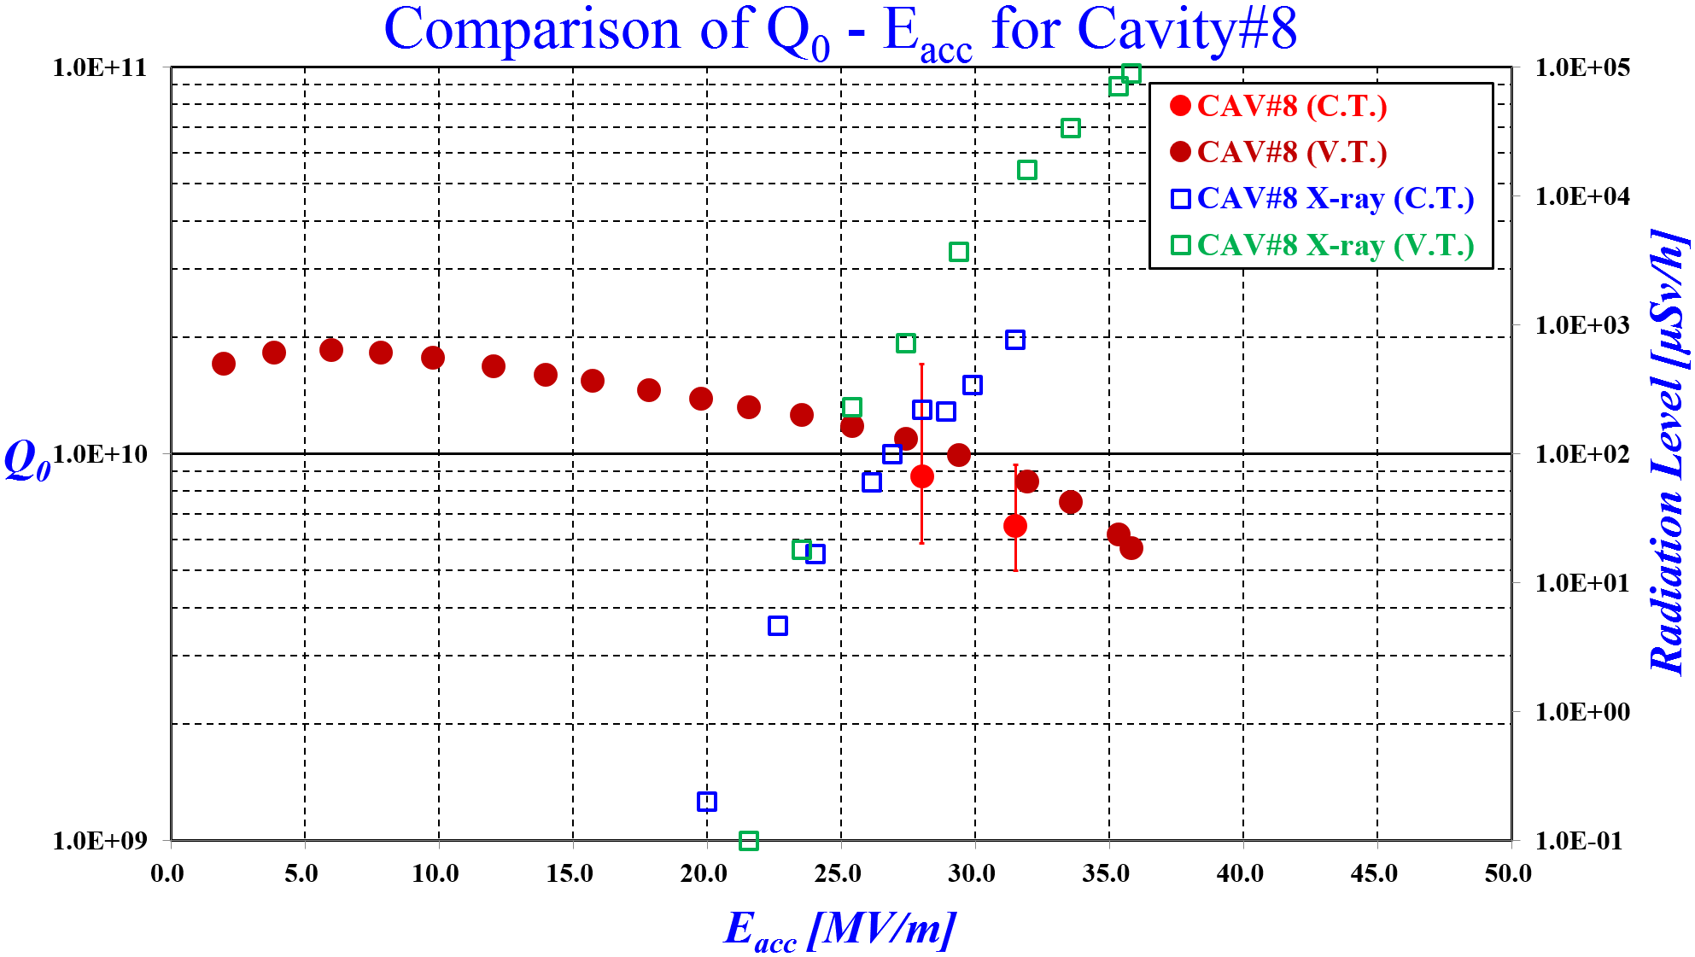
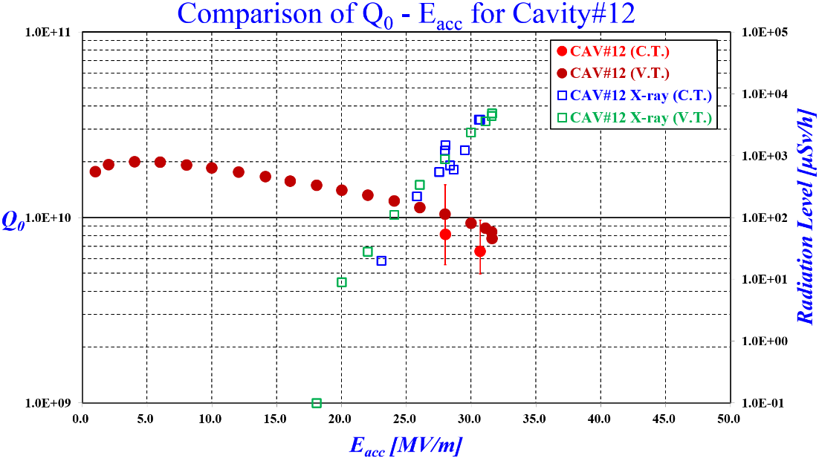
Comparison of Q₀ – E_{acc} and X-rays
Cavity #1
Cavity #2
The both results are contradictory!
Cavity #8
Heater is used as calibration
Q₀ is estimated from helium mass flow
Cavity #12
Heavy field emission
Lower Q₀ may depend on cooldown rate (@LCWS2016) → Will be tried in next cool-down test

Slide 22
Outline
History of STF-2 project
Construction of STF-2 cryomodule
Performance for each item
Accelerating gradient
X-rays
Heat load
Lorentz detuning
Consideration of degradation
Last V.T. → 2nd Cool-down test
2nd Cool-down test → 3rd Cool-down test
Vector-sum operation @31 MV/m
Summary

Slide 23
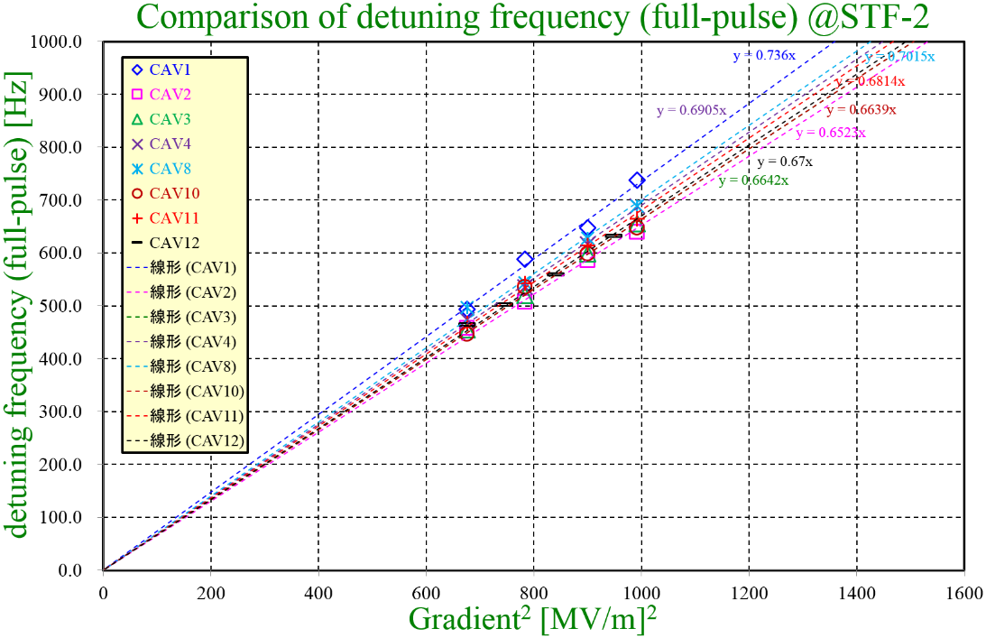
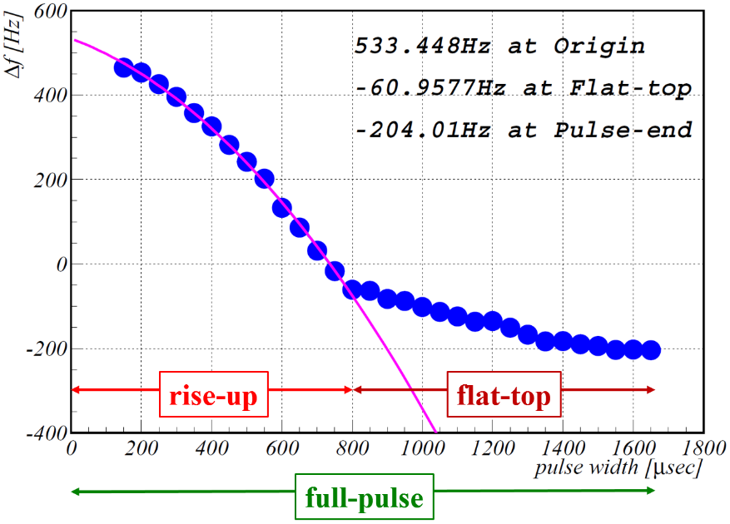
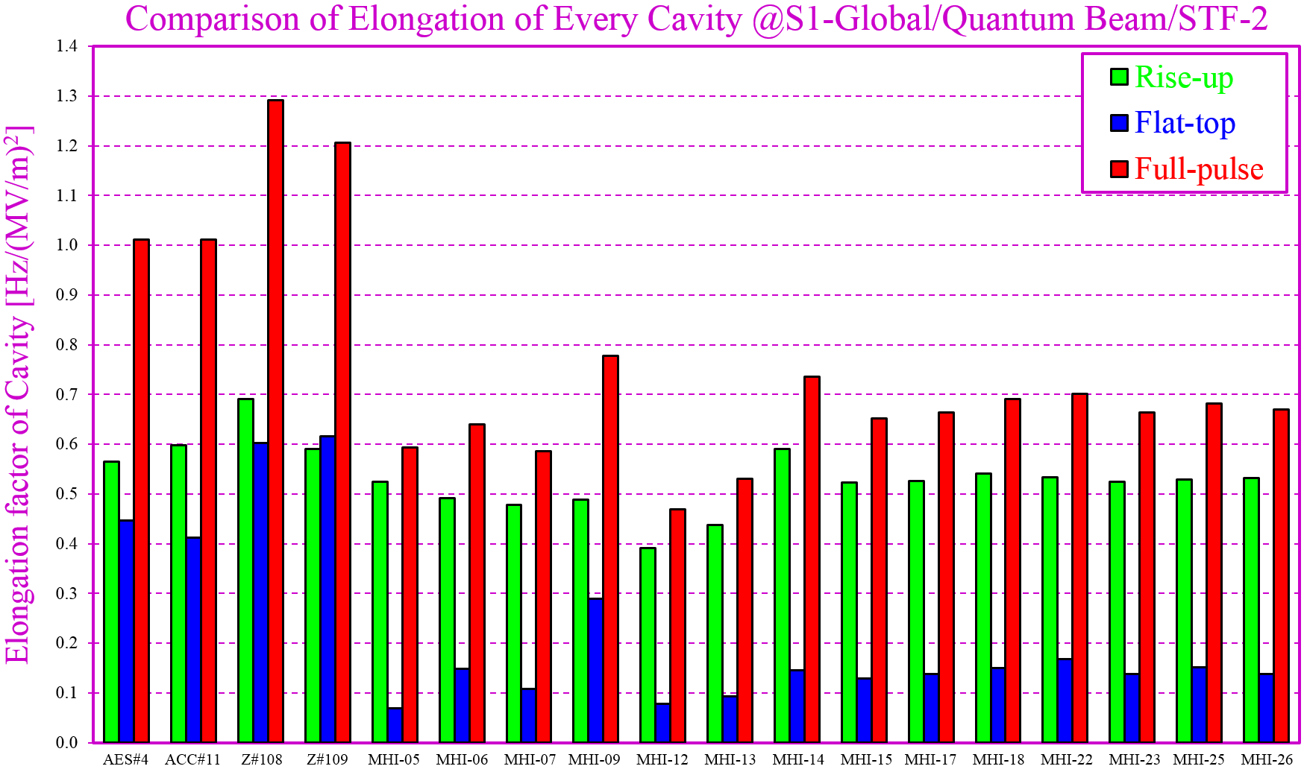
Result of Lorentz Detuning Measurement
Thicker titanium end plate
The STF cavity has more stiffness than TESLA cavity.
Capture CM
S1-Global
STF-2

Slide 24
Outline
History of STF-2 project
Construction of STF-2 cryomodule
Performance for each item
Accelerating gradient
X-rays
Heat load
Lorentz detuning
Consideration of degradation
Last V.T. → 2nd Cool-down test
2nd Cool-down test → 3rd Cool-down test
Vector-sum operation @31 MV/m
Summary

Slide 25
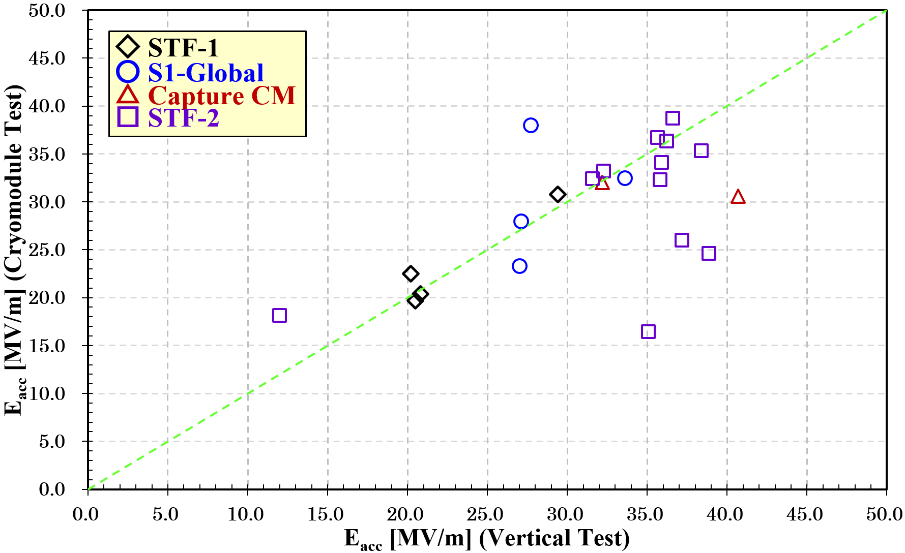
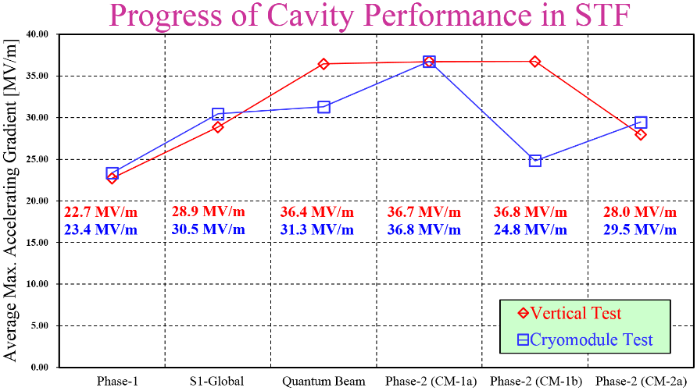
Performance Degradation
Statistics for cavity performance;
Above 31.5 MV/m: 11 cavities
Degradation: 4 cavities
Three types of performance limit;
One cavity: Quench w/o F.E.
Two cavities: F.E. Quench
One cavity: Quench by enormous heat loss
Three degraded cavities in STF-2 are connected in series.
→ Common cause for degradation
Q₀ measurement is not done yet in STF-2.
It will start from this autumn.
Heavy F.E. in V.T.
22 cavities in 6 cavity strings
Statistics for cavity string (four cavities per batch);
Four cavity strings: No degradation
Quantum Beam: Degradation, but around ILC spec.
CM-1b in STF-2: Significant degradation

Slide 26
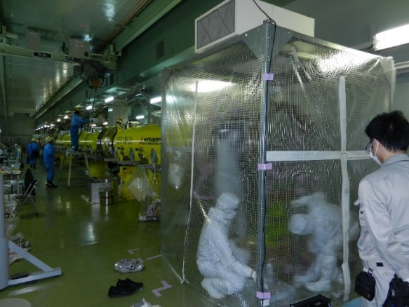
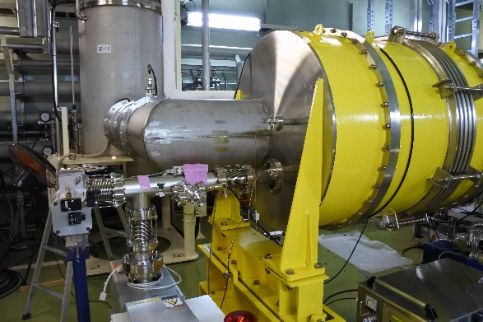
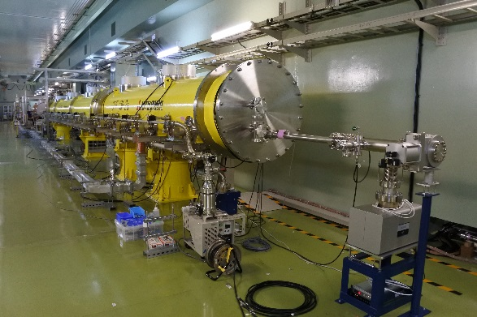
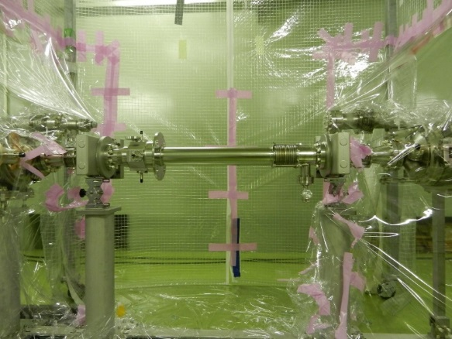
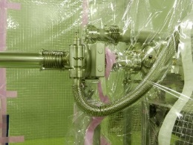
Cavity string/Beam pipe connection in clean booth
Local clean booth
Ion pump
Ion pump
Three degraded cavities in series
Use of simply local clean booth
Local clean booth was used for four beampipe connection parts
Exchange of metal valve near cavity string #2
Metal valve was a little bit bigger, disturbed thermal shield attachment
Extra Argon gas purging at gate valve opened
Usually, when gate valve opens, both sides should be under vacuum
but, we had to do Argon gas purging for the both sides
due to complicated process of cryomodule assembly
A little bit bigger metal valve

Slide 27
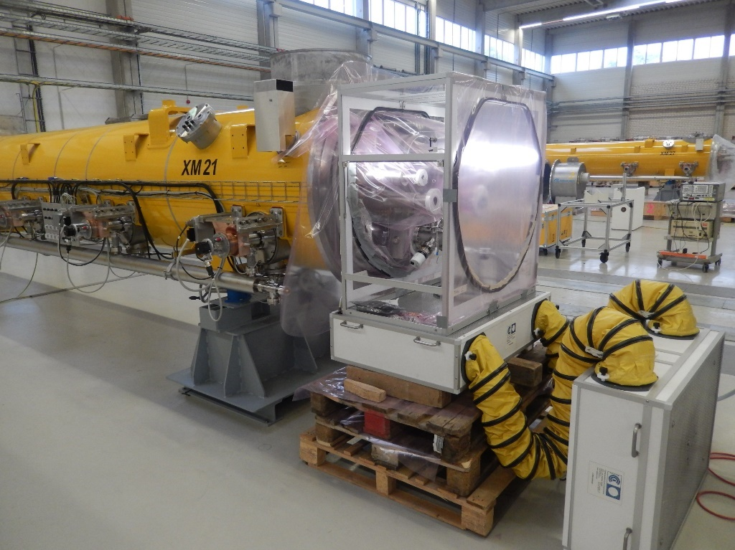
Improvement of clean room items
Particle counter
Slow pumping unit
Local clean booth
Many experiences in EU-XFEL
High quality local clean booth
High quality particle counter
Slow pumping system
Will be introduced in 2017(?)
Local clean booth

Slide 28
Outline
History of STF-2 project
Construction of STF-2 cryomodule
Performance for each item
Accelerating gradient
X-rays
Heat load
Lorentz detuning
Consideration of degradation
Last V.T. → 2nd Cool-down test
2nd Cool-down test → 3rd Cool-down test
Vector-sum operation @31 MV/m
Summary

Slide 29
RF System changed from 2015 to 2016
Single Cavity Operation in 2015
8 Cavities Operation in 2016
800kW Klystron
(Distributed RF System)
10MW Multi-beam Klystron
Klystron
Waveguide
Circulator
LLRF modules

Slide 30
Too High Forward Power distributed
After optimization of LLRF control, forward power was drastically reduced!
Bump in RF filling disappeared after parameter optimization!
Max. level changed from 400 to 260kW.
We have never observed strange phenomena in vacuum level during this operation.
Red: Gradient
Blue: Forward Power
Green: Reflect Power

Slide 31
Earthquake? (Unbelievable, but…)
In E-XFEL, G-shock sensor has been used for cryomodule transportation. Max. recorded shock was 6G! But, they observed no performance change in cryomodule test. In STF, data logging by G-shock sensor may be necessary.
Date | Magnitude | Level in Tsukuba city
11/Mar/2011 14:46 | M7.9 | Level 6
14/Mar/2012 21:05 | M6.1 | Level 4
28/Jan/2013 3:41 | M4.9 | Level 3
20/Sep/2013 2:25 | M5.9 | Level 3
10/Nov/2013 7:37 | M5.5 | Level 4
31/Dec/2013 10:03 | M5.4 | Level 3
16/Sep/2014 12:28 | M5.6 | Level 4
25/May/2015 14:28 | M5.5 | Level 4
12/Sep/2015 5:49 | M5.2 | Level 3
16/May/2016 21:23 | M5.5 | Level 4
27/Jul/2016 23:47 | M5.4 | Level 3
22/Nov/2016 5:59 | M7.4 | Level 4
28/Dec/2016 21:38 | M6.3 | Level 4
1st cooldown test in STF-2 CM
2nd cooldown test in STF-2 CM
3rd cooldown test in STF-2 CM

Slide 32
Outline
History of STF-2 project
Construction of STF-2 cryomodule
Performance for each item
Accelerating gradient
X-rays
Heat load
Lorentz detuning
Consideration of degradation
Last V.T. → 2nd Cool-down test
2nd Cool-down test → 3rd Cool-down test
Vector-sum operation @31 MV/m
Summary

Slide 33
Vector-sum Operation with 8 Cavities
E_{acc} @flat-top
φ
E_{acc}
E_{acc} @end
φ @end
E_{acc} distribution

Slide 34
Vector-sum Operation with 8 Cavities
Each pulse for 8 cavities
Trend graph of Ave. E_{acc} and Δf
during vector-sum operation
35.9 MV/m
35.7 MV/m
31.8 MV/m
28.3 MV/m
30 min
30.6 MV/m
27.3 MV/m
30.1 MV/m
27.8 MV/m
30.9 MV/m ± 0.02 MV/m
They satisfy the ILC specification!
46Hz ± 1.8Hz

Slide 35
Outline
History of STF-2 project
Construction of STF-2 cryomodule
Performance for each item
Accelerating gradient
X-rays
Heat load
Lorentz detuning
Consideration of degradation
Last V.T. → 2nd Cool-down test
2nd Cool-down test → 3rd Cool-down test
Vector-sum operation @31 MV/m
Summary

Slide 36
Summary for STF-2 Cryomodule
STF-2 Cryomodule was constructed, installed and tested since 2013
Cavity string assembly in clean room was completely done
Construction and alignment work were completely done
Passed HPC without problem
Cooldown tests have been done totally three times
2nd cooldown test in F.Y. 2015
Performance check by single cavity operation
Eight cavities achieved above 31.5 MV/m
Three significantly degraded cavities by heavy field emission/enormous heat load
Necessary for improving quality of local clean booth, pumping system, and assembly work
3rd cooldown test in F.Y. 2016
Performance check by 8 cavities operation
“More” degraded cavities during testing cryomodule (first observation in STF)
Uniformly lower Q₀-value, irrespective of field emission (cooldown rate?)
There maybe some risk for performance degradation in higher gradient operation

Slide 37
Items in 4th Cooldown Test
Change of cool-down method (like FNAL)
Re-check cavity performance and x-rays including k_{t}
More Precise Heat Load Measurement for Cavity
Disconnected Capture CM
Disconnected Q-Magnet
Precise Heat Load Measurement at Power Coupler
Microphonic Measurement during high gradient operation

Slide 38
Toward next steps…
Waveguide/Circulator system will be added for remaining four cavities
Beamline construction will be done
Beam dump will be constructed
RF Gun / Laser system will be reconstructed
LLRF modules will be more added
DAQ/Monitoring system will be updated
12 (STF-2 CMs) + 2 (Injector CM) Cavities operation will be done
Beam commissioning will be done
Final goal for STF-2

Slide 39
Thank you very much for your attention!
I will “more” improve my slide in SRF2017.
青磁茶碗 銘馬蝗絆

Slide 40
Back-up slides

Slide 41
Performance in Vertical Test
ILC spec.: 35 MV/m ± 20%
Q₀ vs. E_{acc} Curve
8 cavities in STF-2 CM1 achieved above 35 MV/m
Average gradient: 36.8 MV/m
After MHI-23, mass-production scheme was used
Workers, EBW machine, EBW method were changed
HIT-02 achieved around 41 MV/m
EBW was done in MIRAPRO
TOS-02 (w/o HOM couplers) achieved around 36 MV/m
EBW was done in TOSEI
MHI-C (mass-production type) achieved around 37 MV/m
Accelerating Gradient
Mass-production scheme
Average Gradient
Capture CM: 36.5 MV/m
↓
STF-2 CM1: 36.7 MV/m
↓
STF-2 CM2a: 28.0 MV/m
↓
STF-2 CM2b: 29.2 MV/m
Capture CM
Mass-production
scheme
STF-2 CM1
STF-2 CM2a
STF-2 CM2b

Slide 42
Accelerating gradient in Last V.T.
9 cavities: > 35 MV/m
11 cavities: > 28 MV/m

Slide 43
Method of RF Conditioning in 2K
Cavity conditioning is done very carefully as monitoring
HOM heating, unusual RF output from HOM, and X-rays.
When heating, unusual output or x-rays appear,
we have to keep the gradient level for a while.
After processing out, we can go to next level.
RF parameters in STF-2
Q_{L} : 5.0 x 10⁶
Filling time : 900μsec
Flat-top : 800(100)μsec
Total width : 1700μsec
Temp. sensor at HOM coupler
Summary of cavity conditioning time in 2K
Conditioning time was too short?

Slide 44
Various clean booths in DESY
There are totally eight kinds of clean booth in the following figures.
DESY people uses clean booth optimized for each location of cavity/cryomodule.

Slide 45
Cavity performance in CM1/CM2a
Module # | CM1 |  |  |  |  |  |  |  | CM2a
String # | 1 |  |  |  | 2 |  |  |  | 3
Cavity # | 1 | 2 | 3 | 4 | 5 | 6 | 7 | 8 | 9 | 10 | 11 | 12
Cavity name | MHI-14 | MHI-15 | MHI-17 | MHI-18 | MHI-19 | MHI-20 | MHI-21 | MHI-22 | MHI-24 | MHI-23 | MHI-25 | MHI-26
E_{acc} @Last V.T. [MV/m] | >36.6 (power limit) | 35.7 (Cell#1 Quench) | >38.4 (power limit) | >36.2 (power limit) | 37.2 (Cell#1 Quench) | >35.1 (power limit) | >38.9 (power limit) | >35.8 (power limit) | >12.0 (admin. stop) | 35.9 (Cell#3 Quench) | 32.3 (Cell#1 Quench) | 31.6 (Cell#1 Quench)
E_{acc} @2nd cooldown test (short pulse) [MV/m] | >38.6 (admin. stop) | 36.8 (Quench) | 35.2 (Quench) | >36.1 (P_{f} max.) | 26.6 (Quench) | 20.0 (Quench) | 25.0 (Quench) | >36.2 (admin. stop) | >18.0 (admin. stop) | 33.6 (Quench) | 32.1 (Quench) | 31.5 (Quench)
E_{acc} @2nd cooldown test (full pulse) [MV/m] | >38.7 (admin. stop) | 36.7 (Quench) | 35.3 (Quench) | >36.3 (admin. stop) | >26.0 (admin. stop) | 16.4 (Quench) | 24.6 (Quench) | >32.3 (admin. stop) | >18.1 (admin. stop) | 34.1 (Quench) | 33.2 (Quench) | 32.4 (Quench)
E_{acc} @3rd cooldown test (full pulse) [MV/m] | >36.8 (admin. stop) | 36.4 (Quench) | 33.4 (Quench) | 35.4→28.0 (Quench) |  |  |  | 31.6 (Quench) |  | 31.5→27.7 (Quench) | 31.5 (Quench) | 30.8→26.8 (Quench)
モジュール試験では8空洞が31.5 MV/mに到達した。
25 MV/m以上にすると9空洞が到達したことになる。

Slide 46
Cavity performance in Capture CM
Module # | Capture
String # | 1
Cavity # | 1 | 2
Cavity name | MHI-12 | MHI-13
E_{acc} @Last V.T. [MV/m] | >40.7 (power limit) | 32.2 (Cell#2 Quench, Heavy F.E.)
E_{acc} in 2012 (600μs) [MV/m] | 35.3 (Quench) | 32.5 (Quench)
E_{acc} in 2012 (1500μs) [MV/m] | 30.6 (Quench) | 32.2 (Quench)
E_{acc} in 2016 (1650μs) [MV/m] | 28.7 (Quench) | 29.8 (Quench)
Capture CMについては、31.5 MV/m以上は1空洞で、25 MV/mだと両空洞ともに到達している。

Slide 47
Radiation Level at Last V.T. in STF-2
※ MHI-14(CAV1)のみ放射線は無かった
※ MHI-24(CAV9)は４回測定したが、状況が改善しなかったためそのままモジュールに組み込んだ

Slide 48
Comparison of radiation level in STF-2 CM
2nd Cooldown Test in 2015
3rd Cooldown Test in 2016
空洞直下で測定した放射線量の結果(ただしCavity#10以降は固定)。
去年と今年の放射線量の比較を示す。今年は８空洞のみの運転である。
全体的に放射線量に変化は見られない。むしろ若干下がっている。
エージングの効果か、測定場所の微妙な違いによるものか。
ただし、放射線量はQ₀測定時のもので、8空洞運転時には評価していない
（空洞性能劣化後の放射線は測定していない）
MAR-781/-782

Slide 49
Comparison of radiation level in STF-2 CM
2nd Cooldown Test in 2015
3rd Cooldown Test in 2016
空洞直下で測定した放射線量の結果(ただしCavity#10以降は固定)。
去年と今年の放射線量の比較を示す。今年は８空洞のみの運転である。
全体的に放射線量に変化は見られない。むしろ若干下がっている。
エージングの効果か、測定場所の微妙な違いによるものか。
ただし、放射線量はQ₀測定時のもので、8空洞運転時には評価していない
（空洞性能劣化後の放射線は測定していない）
MAR-781/-782

Slide 50
Comparison of radiation level in STF-2 CM
Cavity #1
Cavity #2
放射線量は去年と同じかむしろ下がっているように見える
エージングの効果かあるいは測定位置の微妙な違いによるものか
Cavity #3
Cavity #4

Slide 51
Comparison of radiation level in STF-2 CM
Cavity #8
Cavity #10
放射線量は去年と同じかむしろ下がっているように見える
エージングの効果かあるいは測定位置の微妙な違いによるものか
Cavity #11
Cavity #12

Slide 52
Comparison of radiation level in STF-2 CM
Cavity #1
@below CM
Cavity #1
@beampipe
モジュール両端にある空洞のみビームパイプに取り付けられたモニターでも比較してみたが、去年と特に変わっていなかった。
モジュール両端のモニターの取り付け位置は変わっていないため放射線量も変わっていないものと思われる。
Cavity #12
@below CM
Cavity #12
@beampipe

Slide 53
Neutron/Gamma detectors added later…
upstream
downstream
Radiation center in KEK measured neutron and gamma.
And, they analyzed the energy spectrum by NaI.
The detailed result will be presented in next LCWS/SRF?
Energy spectrum in 8 cavities operation
T. Sanami / T. Oyama
Highest sensitivity!

Slide 54
Helium Flow to Q₀ Estimation
Assumption; Helium temperature (2.0 [K]) estimated from helium gas pressure (3 [kPa])
Volume of Ideal gas per mol: 22.4 [ℓ/mol]
Molecular weight of helium: 4.0 [g/mol]
Latent heat of vaporization: 93.0 [J/mol] = 23.3 [J/g] = 4.2 [J/ℓ]
Observation; Helium flow: 30.0 [m³/h], Helium pressure: 2.99 [kPa], Helium temperature: 1.70 [K],
Helium temperature at mass flow meter: 23 [℃]
E_{acc}: 28.0, 31.5, 35.0 [MV/m]
Dissipated Heat Load including Static Heat Load (example); 30.0 [m³/h] x 4.2 [J/ℓ] = 35 [W=J/s]
RF Duty Factor: 0.81-0.86 % (from Pulse Analysis) Not constant!
Formula for Q₀ Estimation ; E_{acc} = 30.8 x Sqrt(P₀ x Q₀)
Contents to be considered; Stability in Static Heat Load: Main Systematic Error
Stability in Accelerating Gradient: To be checked by Pulse Analysis
Precise RF Duty Factor: To be checked by Pulse Analysis
Precise Latent Heat of Vaporization: To be estimated by HEPAK code
† Ohuchi-san estimated Heat Load by HEPAK in STF-1 Cryomodule
‡ Nakai-san got HEPAK recently, and we can use it for this analysis
Helium Pressure in Return Line: Not measured yet, but to be monitored
Specification for Helium Mass Flow Meter: Dependence on Temperature (±0.3%)

Slide 55
Comparison of Q₀ – E_{acc} Curve in STF-2 CMs
中心値が一様に下がっているように見えるが、放射線量を見るとそれほど出ているようにも見えないので、まだ理解できていない効果があるものと思われる。

Slide 56
Comparison of Q₀ – E_{acc} Curve in STF-2 CMs
中心値が一様に下がっているように見えるが、放射線量を見るとそれほど出ているようにも見えないので、まだ理解できていない効果があるものと思われる。

Slide 57
Summary of Static Heat Load
Static Heat Load / module @2K [W]
Real Data |  | TDR
Capture CM | STF-2 CM | SUM | Coupler | Support
10.5 (9.2) | 23.0 | 1.32 | 0.17 | 0.60
※ TDRの数値はVol. 3, Part II, pp.46 にあるTable 3.9より引用
† Static Heat Loadに含まれるものは、サポートポスト、カプラ、マグネットなどである
TDRとの相違点は、空洞(カプラ)台数、サポートポストの数、4極電磁石、ケーブル本数など
参考値: Static Heat Load / module @2K [W]
S1-Global | PXFEL 1 | PXFEL 2 | PXFEL 3 | XM-3 | Calculated
7.2 | 9.9 | 5.9 | 6.4 | 6.4 | 2.0
※ S1-Globalの値はS1-Global Reportより、E-XFELの値はSRF2013のプロシーディングより引用
※ STF-2モジュールのStatic heat loadはおおよそ10W程度と予想している（次回冷却試験にて確認）
※ E-XFELの100モジュールの結果は諸事情により開示不可

Slide 58
Summary of Static Heat Load
Static Heat Load / module @2K [W]
Real Data |  | TDR
Capture CM | STF-2 CM | SUM | Coupler | Support
10.5 (9.2) | 23.0 | 1.32 | 0.17 | 0.60
※ TDRの数値はVol. 3, Part II, pp.46 にあるTable 3.9より引用
† Static Heat Loadに含まれるものは、サポートポスト、カプラ、マグネットなどである
今回の測定と比較できるところ
(HOM absorberは含まれていない)

Slide 59
Difference in Copper Plating
Module | CM1 |  |  |  |  |  |  |  | CM2a
Coupler # | 1 | 2 | 3 | 4 | 5 | 6 | 7 | 8 | 9 | 10 | 11 | 12
Cold coupler
Copper plating [μm] | 20 (inner) | 20 | 20 | 20 | 20 | 20 | 20 | 20 | 25 | 25 | 25 | 25
 | 3 (outer) | 3 | 3 | 3 | 5 | 5 | 5 | 5 | 10 | 10 | 10 | 10
Warm coupler
Copper plating [μm] | 10 (inner) | 10 | 10 | 10 | 20 | 20 | 20 | 20 | 25 | 25 | 25 | 25
 | 10 (outer) | 10 | 10 | 10 | 20 | 20 | 20 | 20 | 25 | 25 | 25 | 25
Gold strike plating
Nickel strike plating
外導体の銅鍍金厚が10μmであるということはp.36に明記されている。

Slide 60
Temperature Status @Power Coupler
Input Port
Input Anchor
Input Flange
Coupler #8の温度計はノイズがひどいため
精確に測定されていない可能性あり
鍍金厚みの違いははっきり見えなかった

Slide 61
Simultaneous Operation with 8 Cavities
Run 1
Run 2
Run 3
30 min
11/25に行った８空洞同時運転の３回のRunの結果を示す。
それぞれ上から最大加速勾配、平均加速勾配、加速勾配のばらつき、離調周波数、
の８空洞平均である。Run 3が平均加速勾配が最も高いものである。

Slide 62
Simultaneous Operation with 8 Cavities
Run 1
Run 2
Run 3
前ページの結果で、平均加速勾配と離調周波数のヒストグラムを取ったものである。
Run 3では、平均加速勾配のふらつきは0.02MV/mで、
離調周波数の平均値は46Hzで、ふらつきは1.8Hzであることがわかる。

Slide 63
Cell Taper
13 deg. → 10 deg.
TTF Cavity
Magnetic shield
Beam Tube
φ78 → φ84
STF Baseline Cavity
Thick Titanium Baseplate,
Thick Nb Beam Tube & Thick Nb End-cell
Input Port
φ40 → φ60
STF Baseline Cavity
TTF Cavity
Stiffness of Cavity Sys. 72 kN/mm 22 kN/mm
Lorentz Detuning Δ f = - 150 Hz Δ f = - 500 Hz
at flat-top
Estimation
at 31.5 MV/m

Slide 64
Specification of Tuner/Piezo in STF-2
Tuner type | Slide-jack
# of Tuner/Piezo | 12
Attachment Position | Center (String 1, 3) / End (String 2)
Frequency range | ~530kHz
Cavity expansion | ~2.2mm
Piezo Max. voltage | 1000V (500V@opr.)
Frequency range | >200Hz
Tuner
Piezo
center type
end type

Slide 65
Replacement of Piezo in Cryomodule
After this trouble, we replaced Piezo.

Slide 66
Alignment work for STF-2 CMs
Cat’s eye
S. Araki
Stand for cat’s eye near cavity
Laser tracking system
Courtesy of S. Araki

Slide 67
Result of cavity alignment
CM1 Horizontal
CM2a Horizontal
ILC spec.
16 points are measured for 8 cavities
Alignment result satisfied the ILC specification!
CM1 Vertical
CM2a Vertical
ILC spec.
Courtesy of S. Araki

Slide 68
Result of cryomodule alignment
Horizontal
5 points are measured for 5 support posts
ILC spec.
Vertical
ILC spec.
Alignment result satisfied the ILC specification!
Courtesy of S. Araki

Slide 69
1+1/2 Gas Return Pipe
Full-size gas return pipe
Half-size gas return pipe

Slide 70
Construction of STF-2 CM1①
Lining two cavity strings on rail
Cavity string installation
Attachment of thermal shield
Leveling gas return pipe

Slide 71
Construction of STF-2 CM1②
Q-magnet attachment
(collaboration with FNAL)
Attachment of thermal shield
Installation into cryo-vessel
Carrying cryo-vessels

Slide 72
Construction of STF-2 CM1③
Putting CM2a along beamline
Adjustment of position
Putting CM1 along beamline
Construction finished
Connecting CM1 and CM2a
Integrated leak check

Slide 73
Change of K_{t} in STF
During jointing helium tank after V.T., these cavities in STF-2 were deformed?

