Slide 1
Superconducting Accelerator for ERL based FEL EUV light source at KEK/Japan
Hiroshi Sakai, Kensei Umemori, Taro Konomi,
Takayuki Kubo, Eiji Kako (KEK),
Masaru Sawamura(QST), Tomoko Ota(Toshiba)
Introduction for high-power EUV Light source
Learn from cERL cryomodule
EUV main linac cavity & cryomodule design
Development for EUV main linac cavity
Summary
6th IHEP-KEK meeting. (2017.Jul.15)

Slide 2
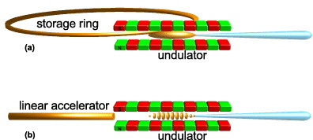
Introduction
10-kW class EUV sources are required in the future for Next Generation Lithography
In order to realize 10-kW class EUV light source, ERL-FEL is the most promising light source (High repetition rate (≦1.3 GHz) and high current linac system).
Breakthrough for EUV light by using FEL (with ERL)
X-ray pulse duration ~ 50 ps
Micro-bunching -> SASE lasing → high peak power
X-ray pulse duration ~ 10 fs
LPP of 13.5nm
250W level now
Need breakthrough for higher EUV light (>1kW)
G. Dattoli et al., NIM-A (2001)
In case of normal conducting accelerator,
The repetition rate of FEL is less than 100Hz
→ High repetition with SC cavity is needed for kW laser

Slide 3
EUV/X-ray FELs
High power
Low power
 | LCLS | SACLA | FLASH | Euro-XFEL | LCLSII | EUV-FEL
Type of linac | Normal conducting |  | Super conducting
Operation mode | Pulse |  | Long pulse |  | CW
Country | US | Japan | Germany | Germany | US | -------
ERL scheme | No | No | No | No | No | Yes
Repetition rate | 120 | 30～60 | <5000 | <27000 | 1M | 162.5M
Beam energy （MeV) | 14300 | 6000～8000 | 1250 | 17500 | 4000 | 800
Wavelength(nm) | 0.15 | 0.08 | 4.2-52 | 0.05 | ~0.3 | 13.5
Pulse energy(mJ) | ~10 | ~10 | <0.5 | ~10 | ~1 | ~0.1
Average Power （W) | ~1 | ~1 | <0.6 | ~100 | ~1000 | >10000
Beam dump power （W) | ~1.5k | ~0.5k | ~6k | ~0.5M | ~1M | ~0.1M
Status | Operation 2009 | Operation 2011 | Operation 2004 | Construction 2017 | Construction 2020 | Planning
ERL helps to make high power CW FEL and reduce the beam dump power (important in future)

Slide 4
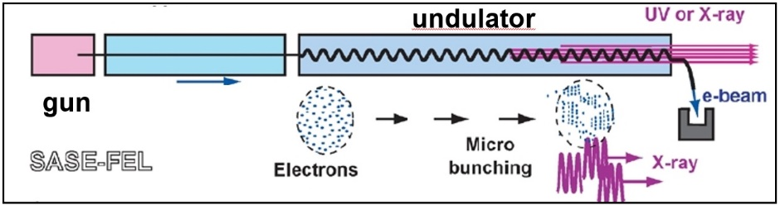
Design Concept for high repetition high current EUV-FEL
EUV Source (ERL)
Target : 10kW power @ 13.5 nm, (800 MeV, 10mA)
Use available technology (based on SASE-FEL) without too much development
Make ERL scheme by cERL designs, technologies and operational experiences
p
2nd turn
p
1st turn
2nd turn
1st turn
p
bunch
t
t
t
t
RF field
t
Beam Dump
Energy recovery by SRF cavity
Injector
Main Superconducting Linac
Bunch decompressor
Bunch compressor
SASE-FEL is an available technology now
2nd Arc
R₅₆ < 0, T₅₆₆ < 0
R₅₆ > 0, T₅₆₆ > 0
1st Arc + Chicane
Undulator（for FEL)
FEL light
p
p
t
t
Energy recovery is needed for accelerating more than 10 mA to reduce beam dump and save RF power.
This operational experience with high current is studied in Compact ERL (cERL) at KEK

Slide 5
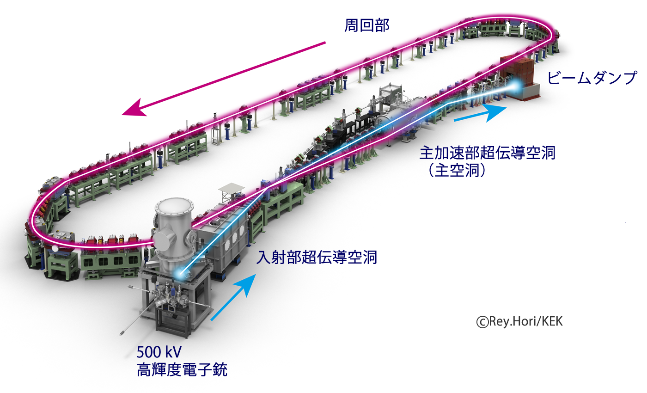
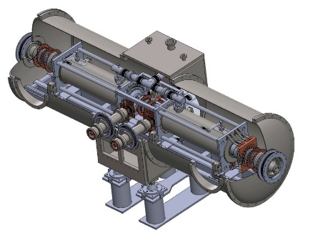
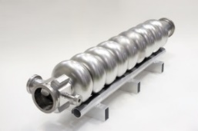
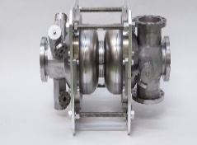
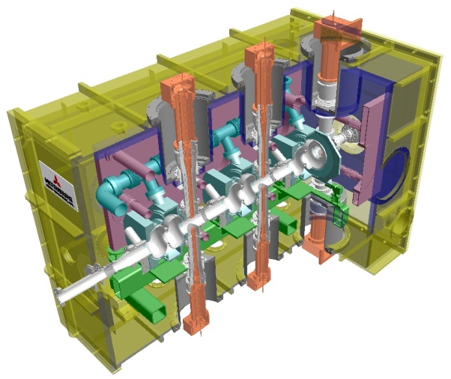
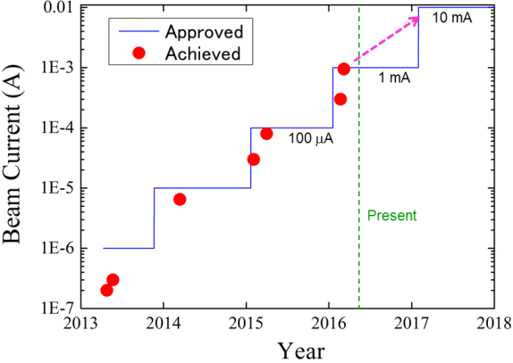
Learn from Comact ERL (cERL) in KEK (cERL cryomodules)
Main linac module
See details by [K.Umemori ;”Long operational experience with beam in Compact-ERL cryomodules” .SRF2017]
HOM damped (for 100mA circulation to suppress HOM-BBU in design)
9-cell cavity (ERL-model2)× 2
Compact ERL Layout
Recirculation (return) loop
20MeV
RF frequency: 1.3 GHz
Input power : 20kW CW (SW)
E_{acc}: 8.6 MV/m（operational）
Unloaded-Q: Q₀ > 1×10¹⁰
Injector diagnostic line
Dump
Main-linac
Cryostat
Two 9-cell SC cavities
HOM absorber
Merger
Tuner
Injector-linac
Photocathode DC gun
(Not SRF Gun)
3MeV
Input couplers
e-
Requirement was satisfied at V.T. Heavy F.E was met @9-10MV/m after string assembly.
Injector module
2-cell Cavity
Tuner
E.Kako MOPB097
SRF2017
2-cell cavity × 3
Double coupler
Cryostat
RF frequency: 1.3 GHz
Input power :
10kW/coupler (10mA, 5MeV)
180kW/coupler (100mA, 10MeV)
E_{acc}: 7.6MV/m（5MeV）
15MV/m (10MeV)
Unloaded-Q: Q₀ > 1×10¹⁰
Success 1mA operation
100% Energy recovery
without HOM-BBU.
Input Coupler
e-
HOM Coupler &
RF Feedthrough
Requirement was satisfied at V.T and for initial 10mA requirement .
Operated from 2013. Current increased.

Slide 6
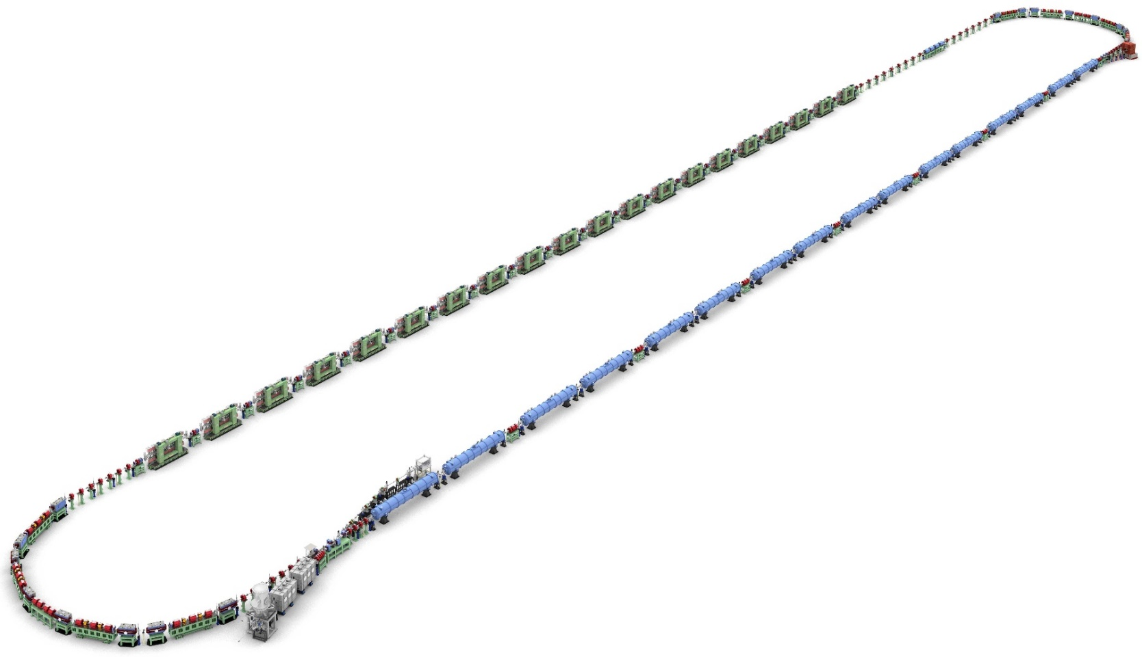
EUV-FEL Design
Parameter | Specification
Wavelength | 13.5 nm
Output power | 10 kW
Bunch chare | 60 pC
Beam energy | 800 MeV
Accelerating gradient | 12.5 MV/m (main linac)
Number of SRF cavity | 9-cell cavity×64
Beam repetition | 162.5 MHz
Beam current | 9.75 mA
Presented by Norio NAKAMURA
ERL2015（https://www.bnl.gov/erl2015/ ）
Bunch compressed
1st Arc
Chicane
~200 m
Beam Dump
Design strategy (main linac)
Epeak/Eacc is 1.5 times reduced from cERL cavity to overcome field emission.
8.6 MV/m → 12.5MV/m
10MeV, 10mA
800MeV, 10mA
Undulators(FEL)
Main Linac
Acceleration/Deceleration
to 800MeV/10MeV
Energy recovery of
790MV x 10mA ～ 8MW
Injector Diagnostic Line
10kW FEL
output
Energy recovery
Is needed.
2nd Arc
Merger
Injector Linac
~20 m
Gun
10MeV, 10mA
decompressed

Slide 7
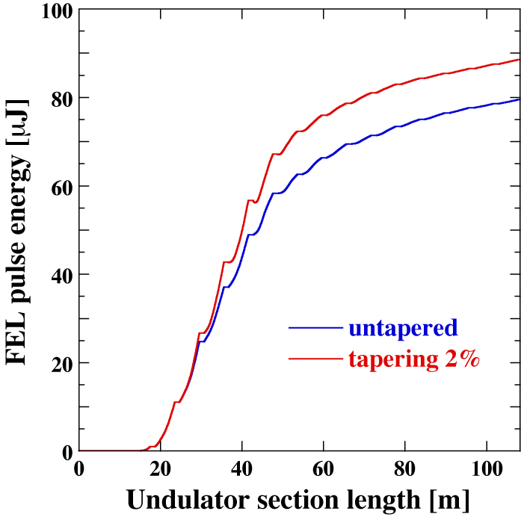
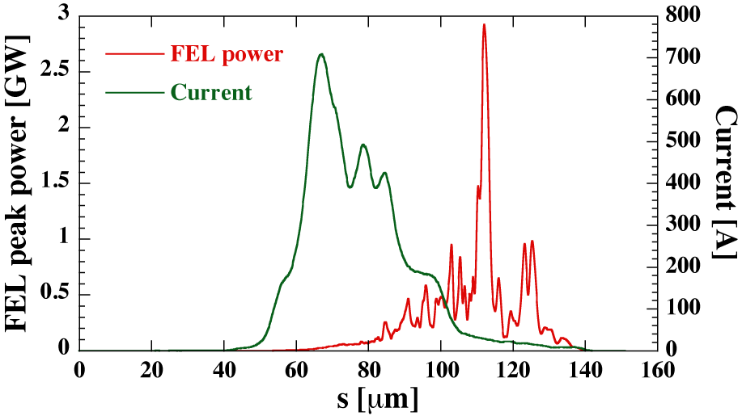
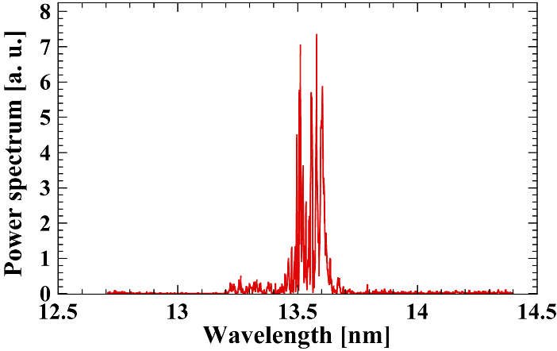
FEL Performance by simulation
Electron beam parameters: E=800 MeV, Q_{b}=60 pC, f_{b}=162.5/325 MHz
Helical undulator parameters: K=1.652, λ_{u}=28 mm, L_{u}=4.9 m(18 units), L_{g}=1.12 m
Bunch compression scheme: 1st Arc(DBA), R₅₆=0.3115 m
88.5μJ
79.5 μJ
FEL power without tapering: 12.9/25.8 kW @ 9.75/19.5 mA
FEL power with 2% tapering: 14.4/28.8 kW @ 9.75/19.5 mA
10 kW class high power EUV light source is NOT just a dream!

Slide 8
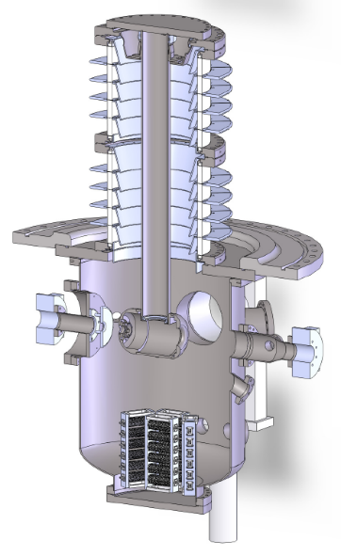
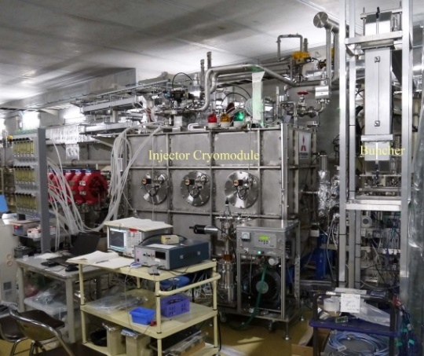
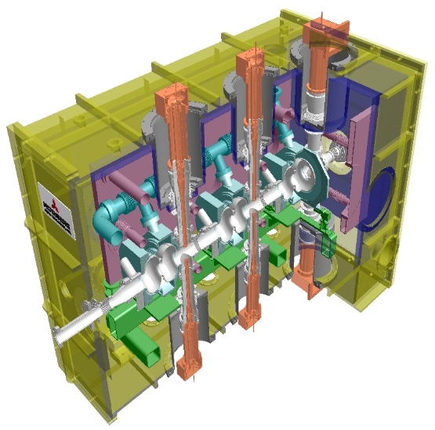
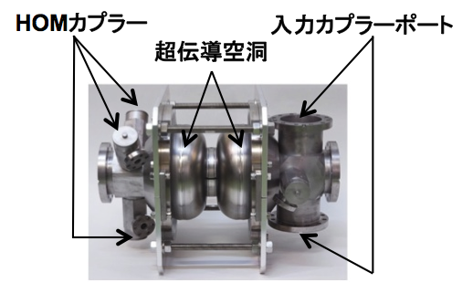
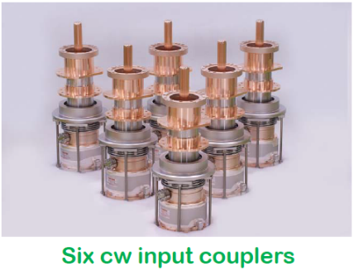
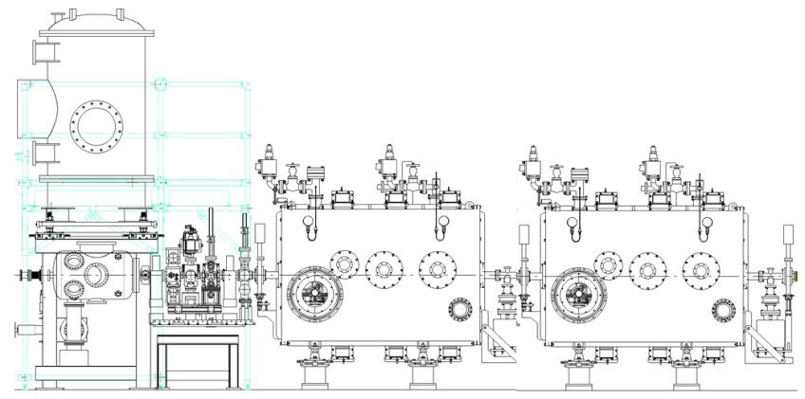

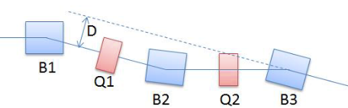
Injector & Merger Design
ref. E.Kako “MOPB097” poster in SRF2017
Cryomodule design
Segmented
ceramic duct
Vacuum Vessel
5K Duct
5K Panel
5K Panel
80K Shield
Electron
beam
2K He Jacket
2K Gas
Return Pipe
5K Support
Anode
(0V)
80K Base-plate
Cathode
(-500kV)
cERL Injector cryomodule
e⁻
Input Coupler
2-cell Cavity
Ti chamber
NEG pump
HOM coupler
Input coupler
HOM Coupler
Photocathode DC gun
cavity cells
Solenoid magnets
Buncher cavity
2-cell SC cavity
B : Bending magnets（θ=15°, ρ=1m）
Q : Quadrupole magnet
recirculation loop
injection point
electron beam
E_{inj}~10.5 MeV
Injector section (side view)
matching section
Merger section (top view)
Injector part of cERL will be used for EUV-FEL light source.

Slide 9
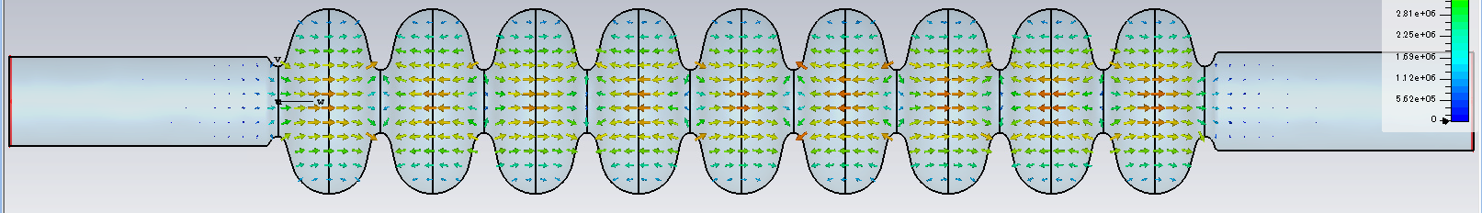
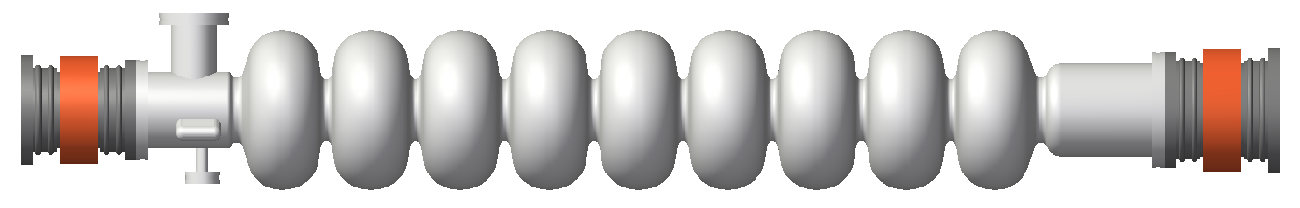
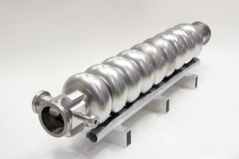
Design of Main Linac Cavity
How to overcome field emission
EUV cavity – TESLA-type 9-cell cavity + Large beam pipes(100φ & 110φ)
Only end cell was modified to match the impedance to beam pipe.
EUV cavity
φ100
HOM
φ70
φ110
HOM damper
HOM damper
cERL cavity (Model 2) – HOM damped cavity for 100mA operation
φ80
HOM damper
HOM damper
Parameters for acceleration mode
 | ERL Model 2 | EUV |  | ERL Model 2 | EUV
Frequency | 1300 MHz | 1300 MHz | Iris diameter | 80 mm | 70 mm
R_{sh}/Q | 897 Ω | ~1000 Ω | Q_{o}×R_{s} | 289 Ω | ～270 Ω
E_{p}/E_{acc} | 3.0 | ~ 2.0 | H_{p}/E_{acc} | 42.5 Oe/(MV/m) | ～42.0 Oe/(MV/m)
From cERL stable beam operation of 8.6 MV/m in 3 years with less trip ratio.
Stable operation at 12.5 MV/m seems achievable due to reduced E_{p}/E_{acc}.

Slide 10
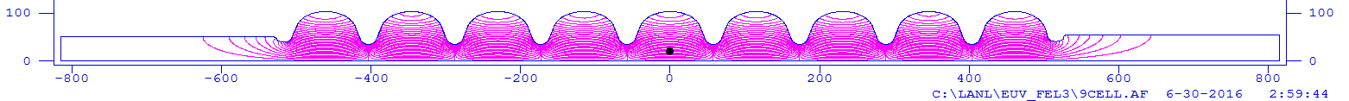
Detailed calculated parameters of EUV main linac cavity
Ep/Eacc is 2.0 because the center cell is TESLA shape.
EUV monopole HOM is lower than cERL because the cERL was optimized for dipole HOMs
Acc.
Cavity Parameters | KEK-EUV | KEK-cERL | TESLA
Frequency (MHz) | 1300 | 1300 | 1300
Iris diameter (mm) | 70 | 80 | 70
R/Q (Ω) | 1009 | 897 | 1036
G (Ω) | 269 | 289 | 270
Ep/Eacc | 2.0 | 3.0 | 2.0
Hp/Eacc (mT/(MV/m)) | 4.23 | 4.25 | 4.26
BBU limit | >190 mA | ~600 mA | ~10 mA
Calc by
Superfish
Norio NAKAMURA
ERL2015（https://www.bnl.gov/erl2015/ ）
Monopole HOM
Dipole HOM
Calc by
MW-Stdio
(cERL case
calc by
MAFIA)
EUV cavity satisfied our requirement of 10 mA beam operation by keeping Ep/Eacc ~ 2.
Notes:
Here shows summary of EUV cavity parameters.
Ep/Eacc is 2.0 because the center cell is TESLA shape.
Bottom figures show the comparison of EUV cavity and ERL cavity.
Monopole HOM impedance of EUV cavity is lower than that of ERL cavity because the ERL cavity is optimized to the dipole modes.
There are may dots of EUV HOMs. The reason is beam pipe length was changed to search the maximum Impedance.

Slide 11
Concepts of EUV main linac cryomodule
Cold Box
Room Temp.
Support
80K Shield
5K Shield
2K Return Pipe & Cavity Support
80K
80K
80K
80K
80K
80K
80K
80K
80K
80K
HOM Damper
Input Coupler
2K gas out
2K in
Damper
HOM antenna &BPM
5K in
2K 2-Phase
5K out
Cable
Tuner
80K out
W/C line
Tuner
80K in
2K 2-Phase
5K
80K
300K
Tuning Shaft
Tuning Shaft
Input Coupler
EUV module consists 4 cavities and the design based on STF and ERL module.
Coupler position is opposite direction each cavity, because the beam pipe sizes are different.
Input coupler and tuner are same type of ERL and STF.
HOM damper needs new development.
Notes:
This is the concept of the module. We doesn’t design the detail.
This module consists 4+4 cavities and the design based on ILC module.
The difference is cold box and input coupler position.
Coupler position is opposite direction every one cavity, because the beam pipe sizes are different by upstream and downstream of the cavity.
Cold box is center of the module.

Slide 12

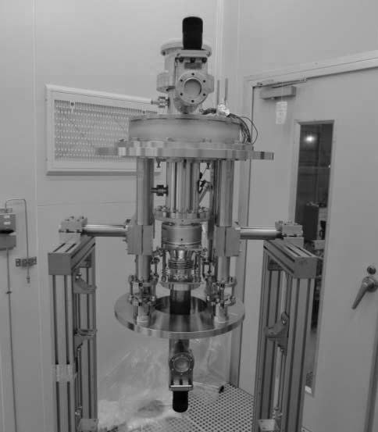
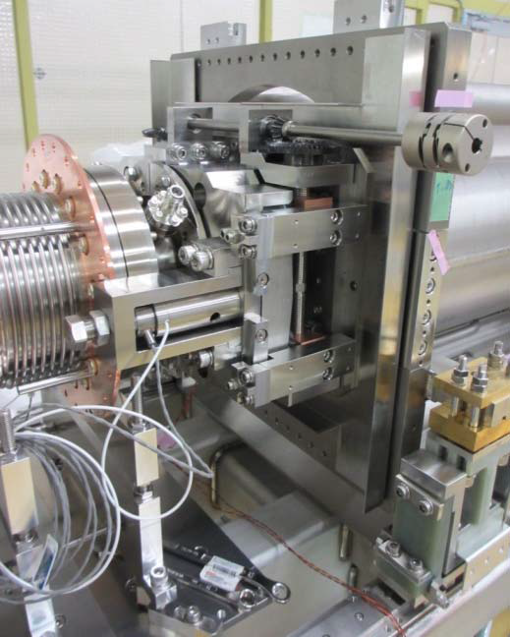
Detailed and Modified from cERL main linac cryomodule
Input coupler
cERL main linac coupler is working well up to CW 15 kW power (double windows)
Qext=2x10⁷ require 4~5 kW input power for Eacc=12.5 MV/m
We could apply for EUV main linac cavity by using cERL main linac coupler.
Frequency tuner
Rough tuning by Slide-Jack tuner controlled by motor
  Full stroke 3mm (~1MHz)
Fine tuning by piezo tuner
  Precision <nm
Working very well at cERL and STF
Apply for EUV
cERL Input coupler
cERL Tuner

Slide 13
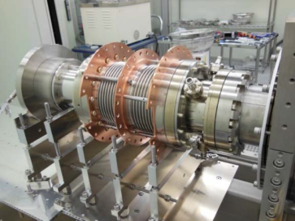
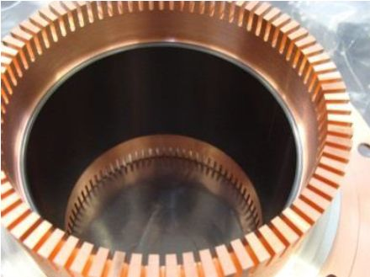
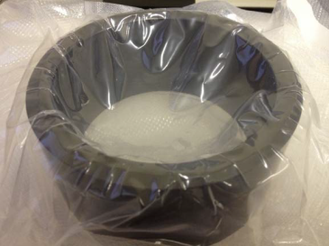
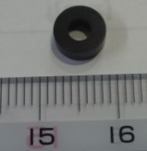
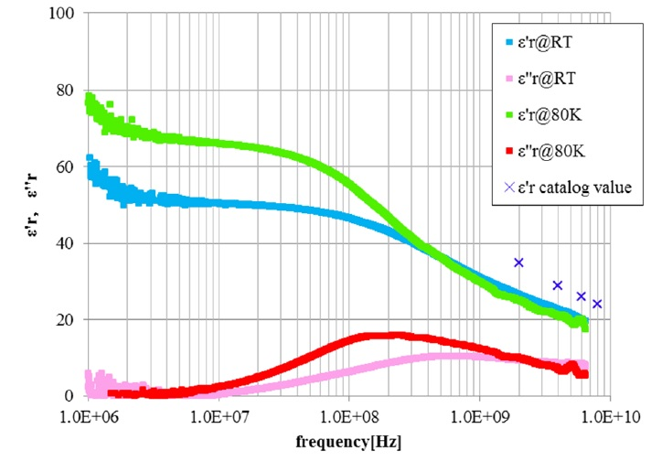
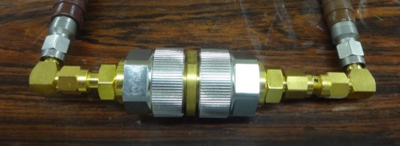
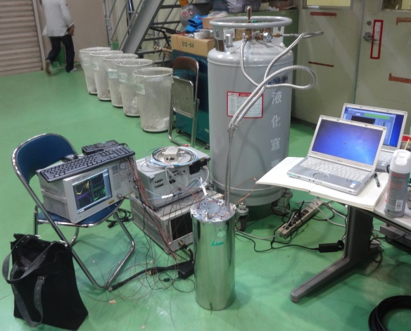
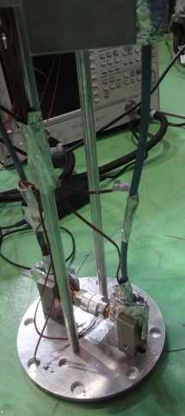
Test of HOM damper for EUV cavity
cERL HOM damper
cERL HOM absorber (ferrite) has cracks during cool down and not bakable ⇒ not good for SRF usage.
AlN (Sienna Tec. : STL-150D) is a candidate for absorber.
⇒ AlN is already tested at Jlab and DESY
We started the measurement of RF parameter @ low temperature, outgassing and testing the brazing.
HIP ferrite
change
AlN ring
RF parameter measurement @ 80K
AlN sample
Cool to
80K
Little difference of epsilon of AlN between R.T and 80 K
We have enough absorption by using AlN material @80K.
Notes:
We considered AlN RF absorber is the strongest candidate for HOM damper material.
Sienna Tec STL-150D is used at CEBAF and Euro-XFEL.
We started the RF parameter and outgassing measurement and brazing test.
Here is the result of RF parameters of AlN.
RF parameters are measured by Nicolson-Loss method. 80K data was taken in nitrogen gas atmosphere. Test sample and RF cables did not touch liquid nitrogen.
Room temperature data agrees well with the Sienna tec. Data.
80K tangent delta keeps high value at high frequency. We will try to take more high frequency data.
This picture is the test piece of the HOM damper. AlN cylinder was brazed in the copper cylinder which has the comb pattern.
This is the ultrasonic testing in the water bath. Yellow line area shows the AlN. Blue waves show the echo waveform from yellow circle. Point A is outside of AlN. It has the second peak at 73 ns. This means the boundary of copper and water reflects the ultrasonic wave. On the other hand, Point B is inside of AlN, It does not have second peak around 73 ns. Copper and AlN is touched. The color of scanning image shows the echo height. We can see the touched point is not white. It is gray. It suggest the joint strength is poor.
We tried thermal test. Unfortunately, AlN cylinder came off after first 80K thermal cycle.
Copper cylinder has slightly taper to insert the brazing material. We suspect angle of copper taper and AlN taper was different.
Or, AlN was metalized by Mo-Mn method. We skipped Nickel plating which was strongly recommended by Sienna tec.
Now we tries to search the best condition of metalizing.

Slide 14

Outgassing rate of AlN ring
Outgassing rate of AlN ring was measured after 48h x150 ºC baking.
After 1000h, outgassing rate is lower than 10⁻⁸ Pa*m³/s/m²
Surface area 0.020724
AlN ring
1day
cERL damper is not bakeable.
So water rinse is not allowed.
AlN (STL-150D) damper is bakeable and easy for cleaning.
It is enough for installation inside the cryomodule
~ Measured by Shinji Terui (KEK)

Slide 15
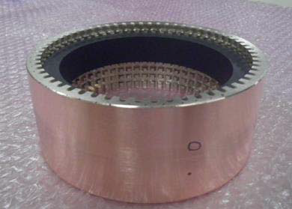
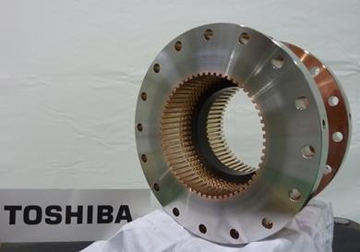
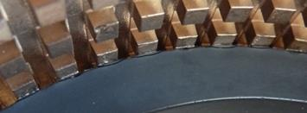
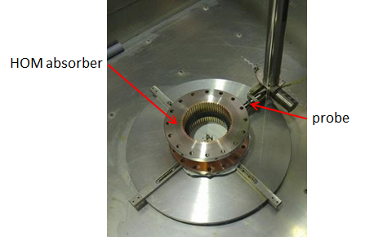
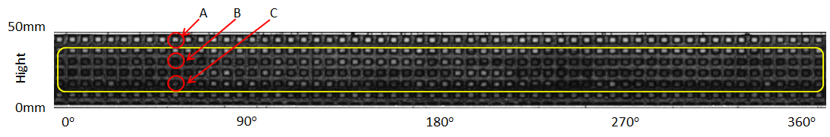
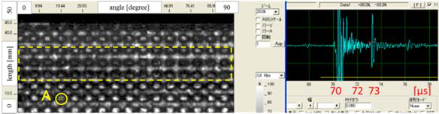
Brazing test of AlN based HOM damper prototype
Two AlN cylinder were brazed in the copper cylinder which has the comb pattern.
Brazed by Silver at 750 degree under Hydrogen Furnace.
We tried thermal test. Unfortunately, AlN cylinder is broken after first 80K thermal cycle.
Ultrasonic testing in the water bath was done after brazing. AlN ring of 2nd prototype much tighter connected than that of 1st one. But not all area of AlN ring was connected.
We need to search more tighter brazing condition including thermal cycle.
1st : Test piece of brazing
2nd : HOM damper prototype
Same brazing condition but shape was optimized to fit AlN at center position.
Ultra sonic test
Crack
to 80K
2nd prototype is tighter connected. 60% area connected but not perfect.
Connection was not tight and crack occurred under cooling to 80 K (but very fast (1 hour) ).
T. Ota et al. , “Development of HOM absorbers for CW Superconducting cavities in Energy Recovery LINAC” (SRF2017))

Slide 16
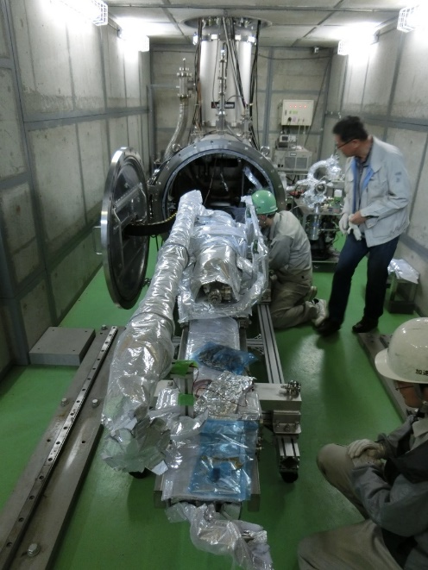
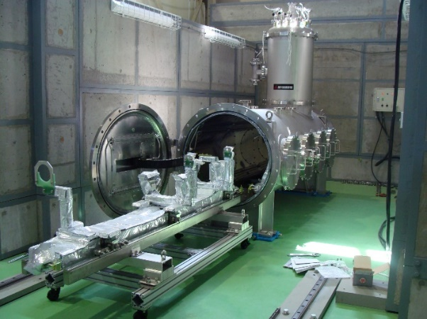
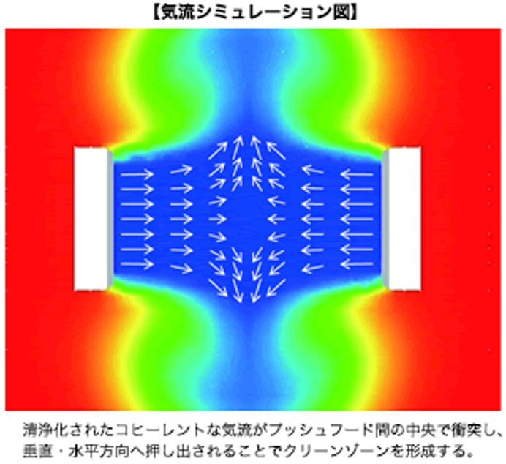
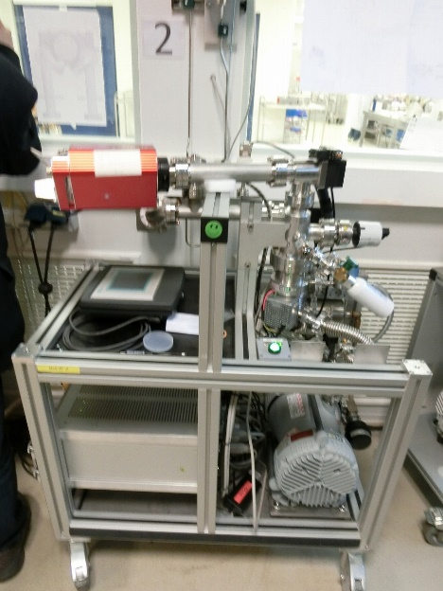
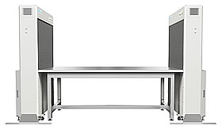
For reliable operation after assembly work
Horizontal test stand was build and already carried out high power test in KEK .
Toward the reliable operation,
We made the horizontal test stand for testing the performance after cryomodule assembly including HOM damper, input coupler, tuner and magnetic shield.
Furthermore, now we try to establish the local clean boose and slow pumping system in this horizontal test standto overcome field emission after string assembly.
For making very clean local boose
Slow pumping system
Open clean bench
KOACH (ISO class 1)

Slide 17
EUV-FEL Light Source Study Group for Industrialization
since 2015
By all Japan association to realize EUV-FEL light source

Slide 18
Summary
EUV-FEL-ERL is promising to open the era to the highest EUV light source and can make more than 10 kW@ 13.5nm EUV light in design.
We learned that most severe problem is field emission on long beam operation.
EUV cavity has been designing by including cERL beam operation experience for EUV-ERL/FEL accelerator.
  Cavity based on KEK-cERL +TESLA cavity to reduce Epk/Eacc.
⇒TESLA center cell + beam line damper with modified end-cell & beam pipe
  This designed cavity could make 10 mA beam operated without HOM BBU instability and large HOM heat load with 12.5 MV/m accelerating field by extrapolated from cERL operation.
Cryomodule has been designing based on STF+ERL cryomodule.
HOM damper was newly developed for EUV cavity. We found AlN material is suitable for our cryomodule HOM damper on RF parameters and outgassing. Unfortunately, we did not find good brazing condition.
For a reliable cryomodule operation, we made horizontal test stand for study of more reliable string assembly work to prevent the dust coming into the cavity.
We also do the nitrogen doping/infusion work for future high-Q operation. (See poster; T. Konomi, et, al., “Trial of Nitrogen Infusion and doping by using J-PARC Furnace”, THPB021 SRF2017 poster )
Finally, all Japan association with KEK promote to build EUV-FEL light source.
Notes:
This is the summary of my talk
EUV cavity has been designing for EUV-ERL/FEL accelerator.
Cryomodule has been designing based on ILC cryomodule. Detail design will be started because the cavity and damper parameters are decided.
EUV cavity design is based on ERL cavity. It consists of TESLA shape center cell and beam line damper.
Maximum impedance of Dipole HOM is 3x104. BBU limit is 10times higher than EUV operation current.
And Maximum impedance of Monopole HOMs is 5x10 4th. This HOM power is lower than 20W and Total loss will be lower than 100W.
That’s all
Thank you.

Slide 19
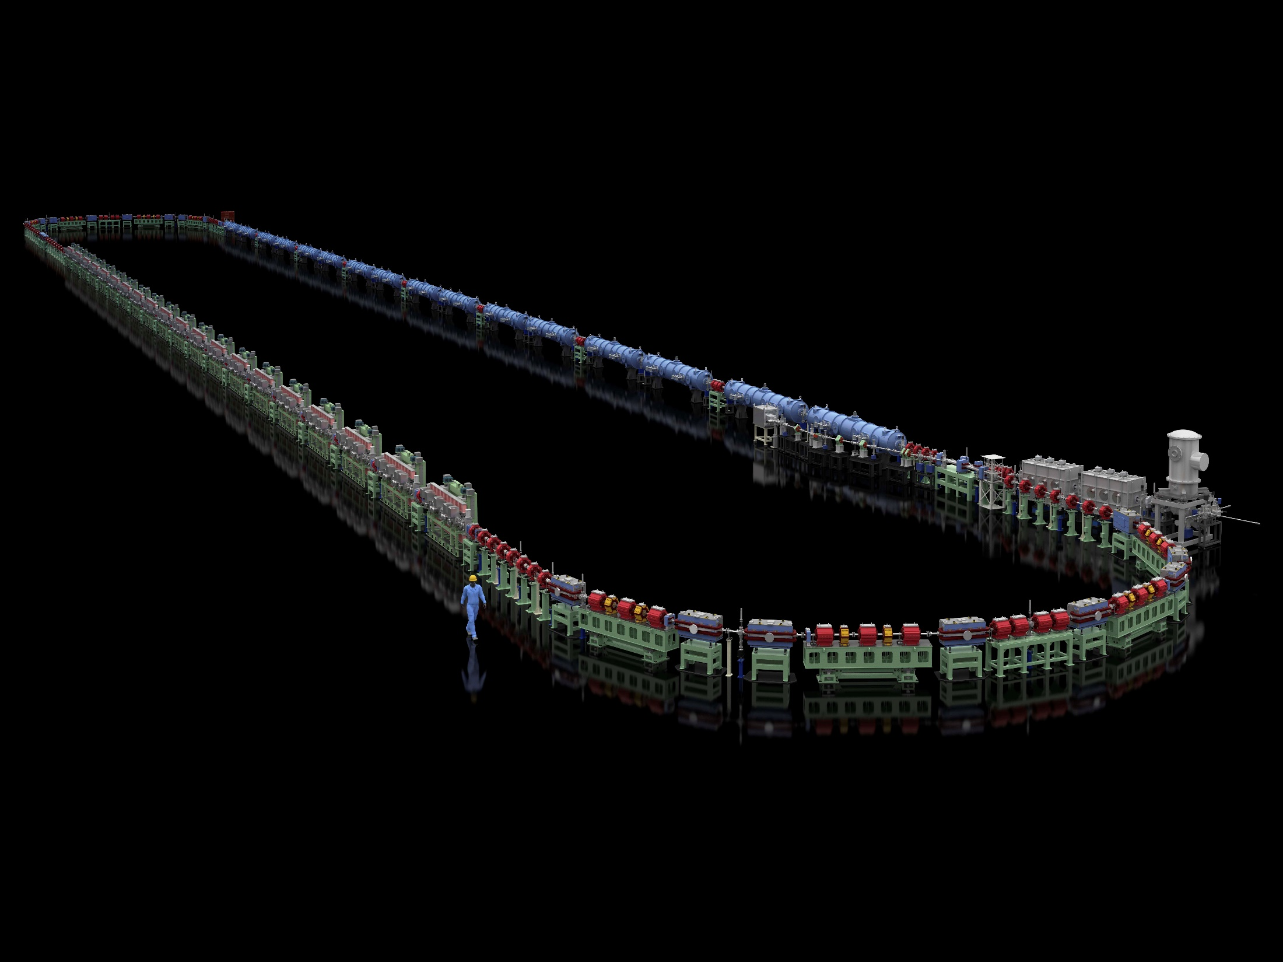
Thank you for your attention!

Slide 20
backup

Slide 21
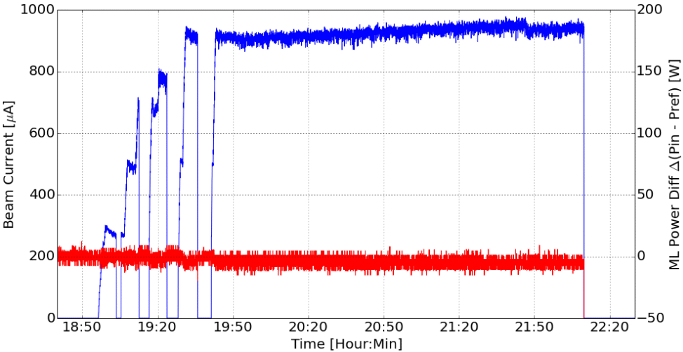
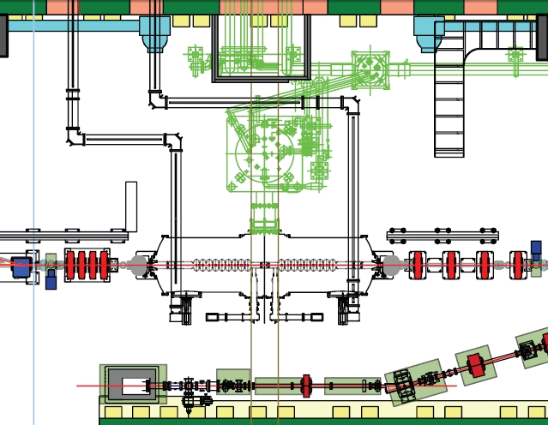
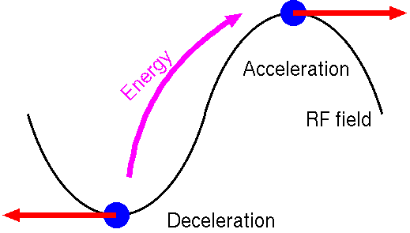
Successful ~ 1mA CW beam operation with energy recovery at cERL by using KEK ERL-model-2 cavity
beam current :
CW 0.9 mA at 8th/Mar/2016.
Beam current (CW)
Energy Recovery is almost 100.0% (error +-0.03%)
Δptotal=Δ(Pin1+Pin2-Pref1-Pref2)
No HOM-BBU
was observed.
17.14 MV x 900 uA = 15.4 kW :
KEK ERL-model-2 cavity
1) Large beampipe + HOM absorbers (not HOM coupler)
2) Optimize cell shape for ERL operation from TESLA
Main linac
（lower）ML2
8.57MV
（upper） ML1
8.57MV
e-
HOM absorber
():TESLA cavity
HOM absorber
Frequency | 1300 MHz | Gradient | 28 MV/m measured VT
Q0 | 1e+10 | Coupling | 3.8 % (1.9%)
R_{sh}/Q | 897 Ω (1007Ω) | HOM BBU | 600mA (10mA)
E_{p}/E_{acc} | 3.0 (2.0) | H_{p}/E_{acc} | 42.5 Oe/(MV/m)
Pref
Pin

