Slide 1
“Ver. 0”
for KEK-IHEP meeting at Beijing
July 15

Slide 2
A unified theory of
surface resistance and the residual resistance of SRF cavities at low temperatures
20min
Takayuki Kubo and Alex Gurevich
KEK / SOKENDAI
Tsukuba, Japan
Old Dominion University, Department of Physics and Center for Accelerator Science,
Norfolk, VA 23529, USA
#17H04839
Supported by NSF under grant # 100492-010

Slide 3
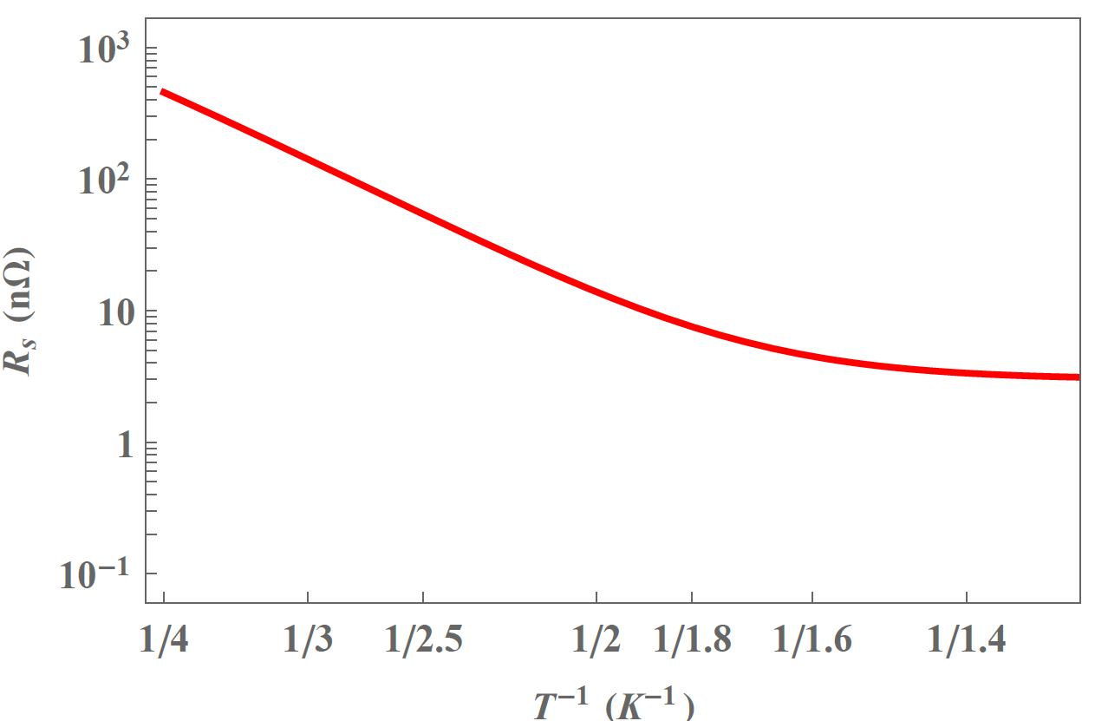
Surface resistance of Nb cavity
Typical behavior of
Nb cavities

Slide 4
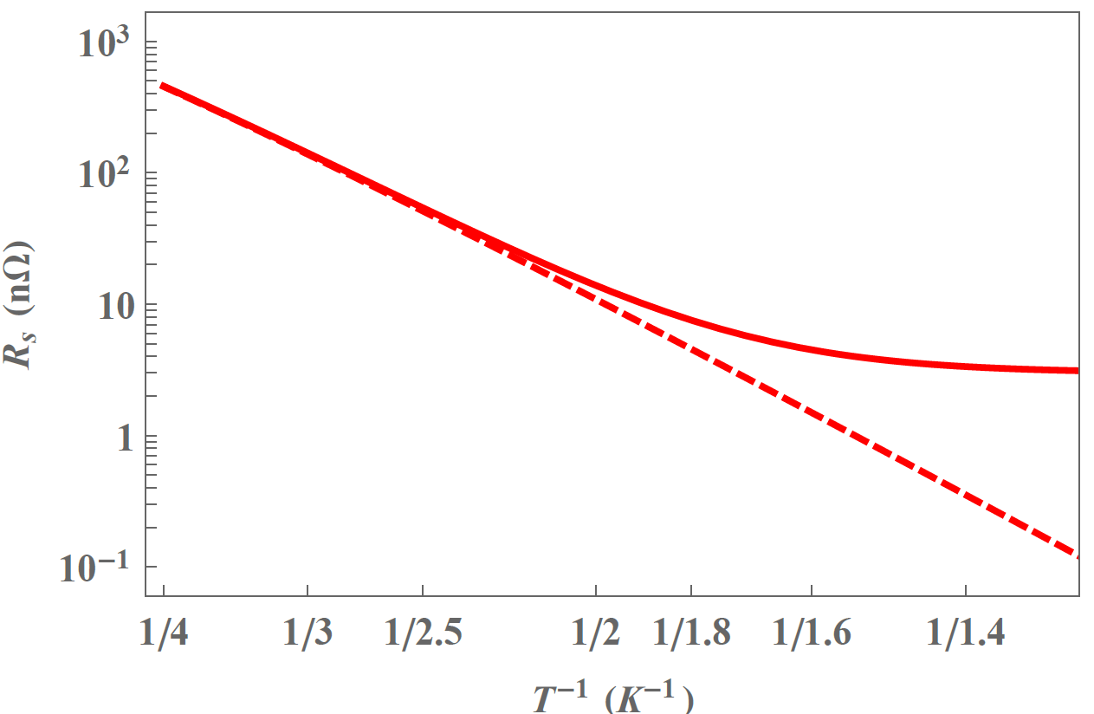
Surface resistance of Nb cavity
Typical behavior of
Nb cavities
Mattis-Bardeen
$$R_{MB}\sim e^{−\frac{∆}{k_{B}T}}$$
D. C. Mattis and J. Bardeen, Phys. Rev. 111, 412 (1958).

Slide 5
Surface resistance of Nb cavity
Typical behavior of
Nb cavities
Mattis-Bardeen
Residual
resistance
$$R_{res}$$
$$R_{MB}\sim e^{−\frac{∆}{k_{B}T}}$$
D. C. Mattis and J. Bardeen, Phys. Rev. 111, 412 (1958).

Slide 6
To explain this shift,
we have summed different contributions so far
$R_{MB}$ : Mattis-Bardeen surface resistance

Slide 7
To explain this shift,
we have summed different contributions so far
$R_{MB}$ : Mattis-Bardeen surface resistance
$R_{others}$ : other than the above
Damaged layer
Metallic sub-oxide
Subgap states
Dielectric losses
_{etc}
$R_{flux}$ : trapped flux contribution
A. Gurevich and G. Ciovati, Phys. Rev. B 87, 054502 (2013).

Slide 8
To explain this shift,
we have summed different contributions so far
$R_{MB}$ : Mattis-Bardeen surface resistance
$R_{others}$ : others
Damaged layer
Metallic sub-oxide
Subgap states
Dielectric losses
_{etc}
$R_{flux}$ : trapped flux contribution
A. Gurevich and G. Ciovati, Phys. Rev. B 87, 054502 (2013).

Slide 9
To explain this shift,
we have summed different contributions so far
$R_{MB}$
$R_{others}$
Damaged layer
Metallic sub-oxide
Subgap states
Dielectric losses
_{etc}
$R_{flux}$
R_{s} = R_{MB} +R_{flux} + …

Slide 10
Today, R_{flux} can be substantially reduced by cooling down a cavity with a large temperature gradient.
A. Romanenko, et al., Appl. Phys. Lett. 105, 234103 (2014).
S. Posen et al., J. Appl. Phys. 119, 213903 (2016)
S. Huang, T. Kubo, and R. Geng, Phys. Rev. Accel. Beams 19, 082001 (2016)
$R_{MB}$
$R_{others}$
Damaged layer
Metallic sub-oxide
Subgap states
Dielectric losses
_{etc}
$R_{flux}$
R_{s} = R_{MB} +R_{flux} + …

Slide 11
Today, R_{flux} can be substantially reduced by cooling down a cavity with a large temperature gradient.
A. Romanenko, et al., Appl. Phys. Lett. 105, 234103 (2014).
S. Posen et al., J. Appl. Phys. 119, 213903 (2016)
S. Huang, T. Kubo, and R. Geng, Phys. Rev. Accel. Beams 19, 082001 (2016)
$R_{MB}$
$R_{others}$
Damaged layer
Metallic sub-oxide
Subgap states
Dielectric losses
_{etc}
$R_{flux}$
R_{s} = R_{MB} +R_{flux} + …
Understanding this part is becoming important more and more!

Slide 12
We incorporate these effects based on the BCS theory.
$R_{MB}$
$R_{others}$
Damaged layer
Metallic sub-oxide
Subgap states
Dielectric losses
_{etc}
$R_{flux}$
3min

Slide 13
We will obtain a theory that unifies R_{MB} and the effects of real material.
$R_{MB}$
$R_{others}$
Damaged layer
Metallic sub-oxide
Subgap states
Dielectric losses
_{etc}
$R_{flux}$
R_{unified}
R_{s}=R_{unified}+R_{flux}+ …
3min

Slide 14
The unified theory will be a basis of microscopic understanding on surface processing technologies:
Provides us with clues to understanding what makes the differences of the low field R_{s} among

Slide 15
The unified theory will be a basis of microscopic understanding on surface processing technologies:
Provides us with clues to understanding what makes the differences of the low field R_{s} among
EP only

Slide 16
The unified theory will be a basis of microscopic understanding on surface processing technologies:
Provides us with clues to understanding what makes the differences of the low field R_{s} among
EP only
EP + 120℃ baking

Slide 17
The unified theory will be a basis of microscopic understanding on surface processing technologies:
Provides us with clues to understanding what makes the differences of the low field R_{s} among
EP only
EP + 120℃ baking
Nitrogen doping

Slide 18
The unified theory will be a basis of microscopic understanding on surface processing technologies:
Provides us with clues to understanding what makes the differences of the low field R_{s} among
EP only
EP + 120℃ baking
Nitrogen doping
Nitrogen infusion
Etc

Slide 19
The unified theory will be a basis of microscopic understanding on surface processing technologies:
Provides us with clues to understanding what makes the differences of the low field R_{s} among
EP only
EP + 120℃ baking
Nitrogen doping
Nitrogen infusion
Etc
and tells how to engineer the surface to tune R_{s}

Slide 20
The unified theory will be a basis of microscopic understanding on surface processing technologies:
It should be noted that
we do not propose
“a new BCS” or “new MB”:
we incorporate
the realistic surface and bulk broadening of the gap peaks
based on the BCS theory.
Provides us with clues to understanding what makes the differences of the low field R_{s} among
EP only
EP + 120℃ baking
Nitrogen doping
Nitrogen infusion
Etc
and tells how to engineer the surface to tune R_{s}

Slide 21
Overview

Slide 22
Strategy
If we start from
BCS model of
SC with an idealized surface

Slide 23
Strategy
If we start from
BCS model of
SC with an idealized surface
Mattis-Bardeen

Slide 24
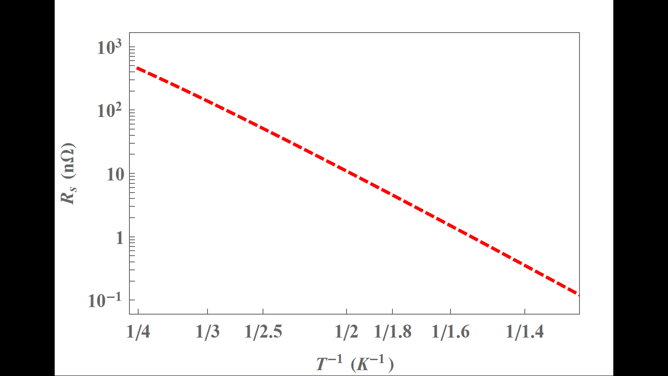
Strategy
If we start from
BCS model of
SC with an idealized surface
$$R_{MB}\sim e^{−\frac{∆}{k_{B}T}}$$
Mattis-Bardeen

Slide 25
Strategy
If we start from
BCS model of
SC with an idealized surface
$$R_{MB}\sim e^{−\frac{∆}{k_{B}T}}$$
Mattis-Bardeen
Fails

Slide 26
Strategy
If we start from
We start from
BCS model of
SC with an idealized surface
BCS model of
a more realistic SC
Mattis-Bardeen
Fails

Slide 27
Strategy
If we start from
We start from
BCS model of
SC with an idealized surface
BCS model of
a more realistic SC
A theory beyond the Mattis-Bardeen
Mattis-Bardeen
Fails

Slide 28
Strategy
If we start from
We start from
BCS model of
SC with an idealized surface
BCS model of
a more realistic SC
A theory beyond the Mattis-Bardeen
Mattis-Bardeen
Fails
Would contain R_{res} and
lead us to deeper understanding on R_{s}

Slide 29
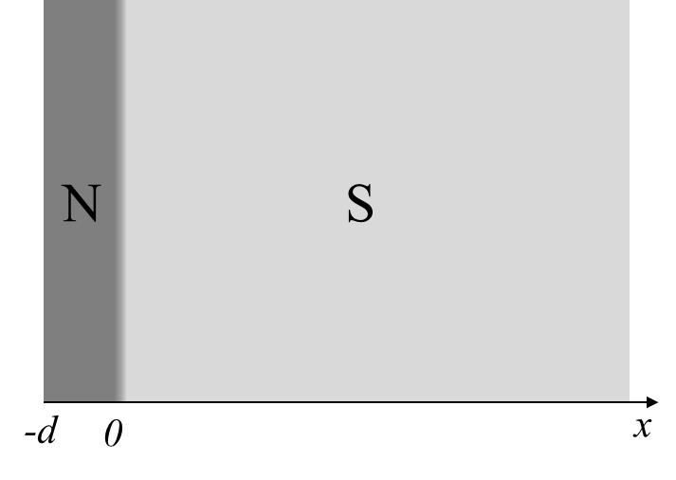
“More realistic” SC

Slide 30
“More realistic” SC
bulk superconductor
(e.g., Nb)

Slide 31
“More realistic” SC
normal conductor with thickness d<<ξ
(e.g., damaged Nb or
metallic sub-oxide with a few nm thickness)
bulk superconductor
(e.g., Nb)

Slide 32
“More realistic” SC
normal conductor with thickness d<<ξ
(e.g., damaged Nb or
metallic sub-oxide with a few nm thickness)
Proximity
effect
bulk superconductor
(e.g., Nb)

Slide 33
“More realistic” SC
Main physical parameters

Slide 34
“More realistic” SC
Main physical parameters
$$d$$
Normal layer thickness

Slide 35
“More realistic” SC
Main physical parameters
$$d$$
Normal layer thickness
Normal conductance
for N layer
$$σ_{n}^{N}$$
Normal conductance
for SC region
$$σ_{n}^{S}$$

Slide 36
“More realistic” SC
Main physical parameters
$$d$$
Normal layer thickness
Normal conductance
for N layer
$$σ_{n}^{N}$$
Interface
resistance
$$R_{B}$$
Normal conductance
for SC region
$$σ_{n}^{S}$$

Slide 37
Theoretical tool
We use the quasiclassical theory in the diffusive limit.
Usadel equation

Slide 38
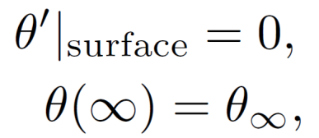
Theoretical tool
We use the quasiclassical theory in the diffusive limit.
Usadel equation
Self-consistency condition
Boundary conditions
K. D. Usadel, Phys. Rev. Lett. 25, 507 (1970).
M. Yu. Kuprianov and V. F. Lukichev, Sov. Phys. JETP 67, 1163 (1988).
where

Slide 39
Theoretical tool
We use the quasiclassical theory in the diffusive limit.
Usadel equation
Self-consistency condition
Boundary conditions
K. D. Usadel, Phys. Rev. Lett. 25, 507 (1970).
M. Yu. Kuprianov and V. F. Lukichev, Sov. Phys. JETP 67, 1163 (1988).
where
Normal and anomalous
Quasiclassical Matsubara Green functions
T. Matsubara, Prog. Theor. Phys. 14, 351 (1955).

Slide 40
Theoretical tool
We use the quasiclassical theory in the diffusive limit.
Usadel equation
Self-consistency condition
Boundary conditions
K. D. Usadel, Phys. Rev. Lett. 25, 507 (1970).
M. Yu. Kuprianov and V. F. Lukichev, Sov. Phys. JETP 67, 1163 (1988).
where
Normal and anomalous
Quasiclassical Matsubara Green functions
T. Matsubara, Prog. Theor. Phys. 14, 351 (1955).
Retarded normal and anomalous
Quasiclassical Green functions

Slide 41
Theoretical tool
We use the quasiclassical theory in the diffusive limit.
Usadel equation
Self-consistency condition
Boundary conditions
K. D. Usadel, Phys. Rev. Lett. 25, 507 (1970).
M. Yu. Kuprianov and V. F. Lukichev, Sov. Phys. JETP 67, 1163 (1988).
where
Normal and anomalous
Quasiclassical Matsubara Green functions
T. Matsubara, Prog. Theor. Phys. 14, 351 (1955).
Retarded normal and anomalous
Quasiclassical Green functions
+2.5min
->5.5min
Physical quantities: Density of states and surface resistance

Slide 42
Results

Slide 43
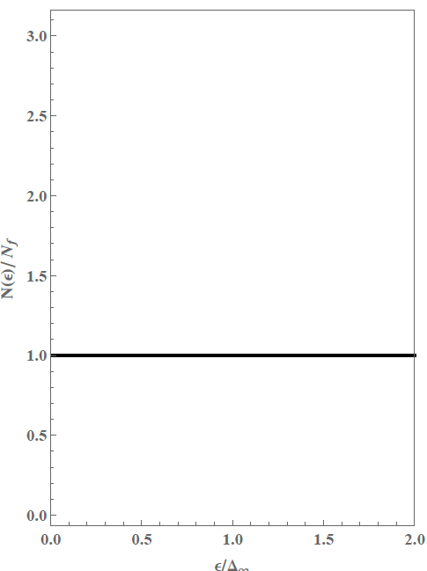
Density of states: n=Re[G^{R}]
DOS of Normal conductor

Slide 44
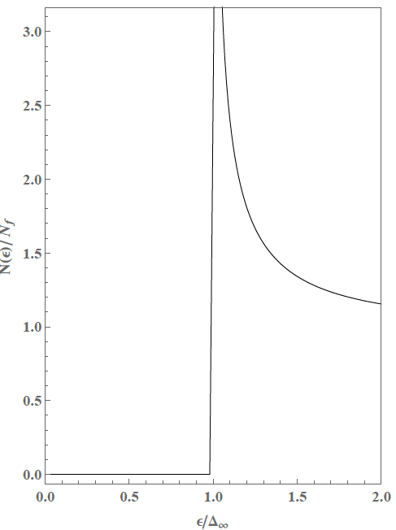
Density of states: n=Re[G^{R}]
DOS of Normal conductor
DOS of BCS superconductor

Slide 45
DOS of
Normal conductor
DOS of
BCS superconductor
Normal
conductor
BCS
superconductor

Slide 46
DOS of
Normal conductor
DOS of
BCS superconductor
Normal
conductor
BCS
superconductor
N-side DOS
S-side DOS
?
?

Slide 47
The proximity effect depends on the boundary parameters
$$α≡γ\frac{d}{ξ_{N}}$$
$$β≡γ_{B}\frac{d}{ξ_{N}}$$
Conductance ratio
between N and S
Barrier between N and S
N-side DOS
S-side DOS
?
?

Slide 48
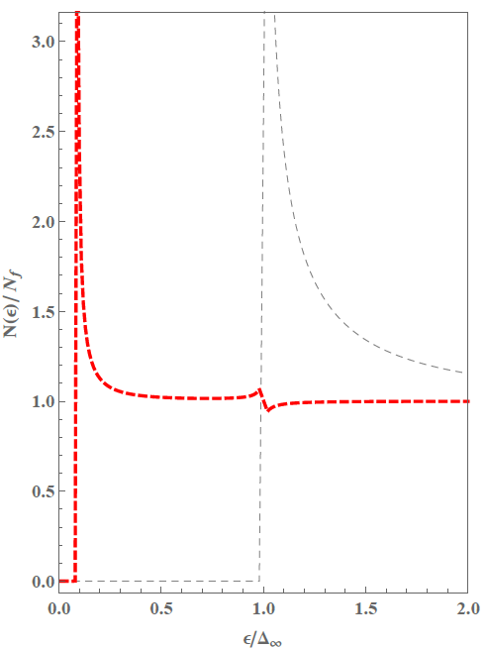
N-side
DOS
S-side
DOS
$$α≡γ\frac{d}{ξ_{N}}=0.05$$
$$β≡γ_{B}\frac{d}{ξ_{N}}=10$$
minigap

Slide 49
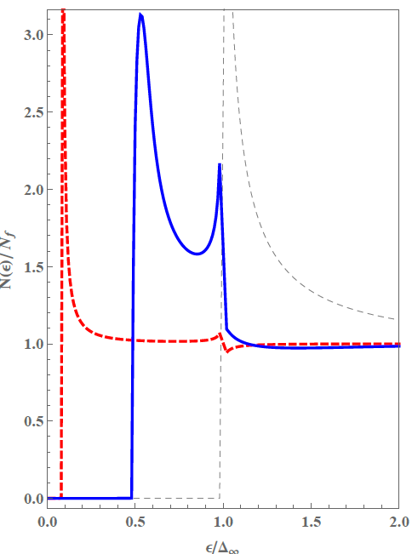
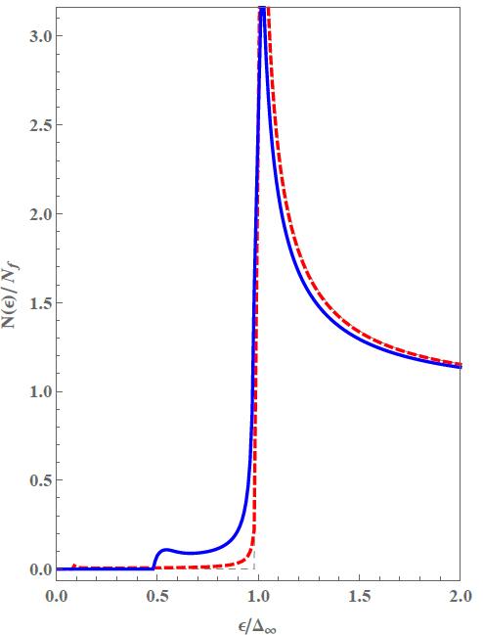
N-side
DOS
S-side
DOS
$$α≡γ\frac{d}{ξ_{N}}=0.05$$
$$β≡γ_{B}\frac{d}{ξ_{N}}=1$$
minigap

Slide 50
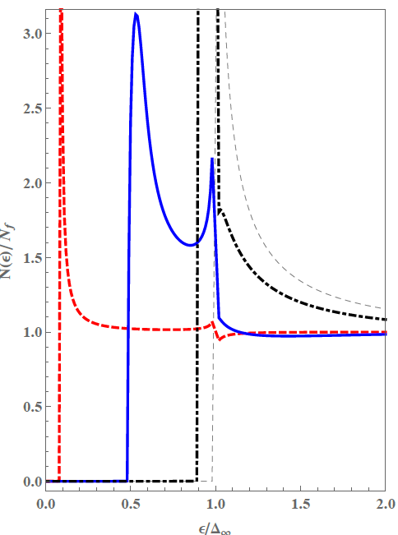
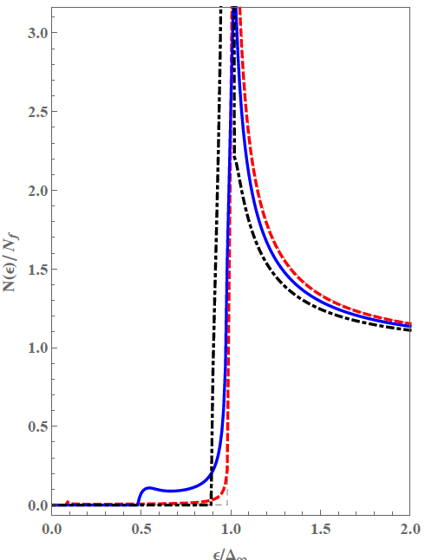
N-side
DOS
S-side
DOS
$$α≡γ\frac{d}{ξ_{N}}=0.05$$
$$β≡γ_{B}\frac{d}{ξ_{N}}=0.1$$
minigap

Slide 51
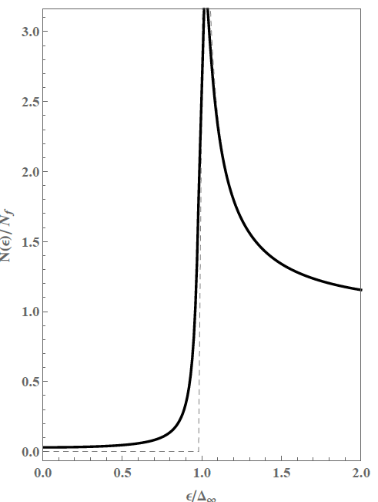
So far, we have neglected the bulk DOS broadening (due to an inlelastic scattering, magnetic impurities, random inhomogeneities of the BCS pairing constant etc).
Further realistic results can be obtained by introducing a finite DOS broadening parameter Γ
(Isolated)
Normal
conductor
(Isolated)
Superconductor
with Γ=0.03

Slide 52
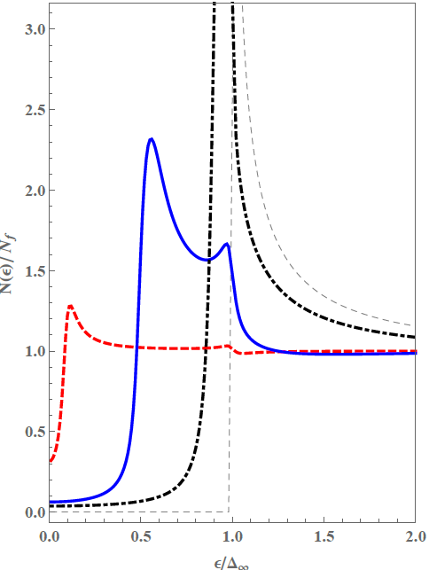
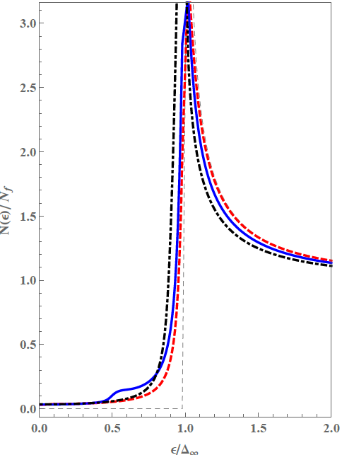
N-side
DOS
S-side
DOS
β=0.1
$$α=0.05$$
β=1
$$β=10, 1, 0.1$$
Γ=0.03
β=10
Minigap with
subgap states
+4min
=>9.5min

Slide 53
Surface resistance
Now we can calculate the surface resistance of the proximity coupled NS system taking the minigap induced at the N layer into account.
microwave

Slide 54
Surface resistance
Now we can calculate the surface resistance of the proximity coupled NS system taking the minigap induced at the N layer into account.
microwave
Quasiparticles
Quasiparticles
gap
minigap

Slide 55
Surface resistance
General
formula
A. Gurevich, Phys. Rev. Lett.
A. Gurevich, Supercond. Sci. Technol. 30, 034004 (2017).
microwave
Quasiparticles
Quasiparticles
gap
minigap

Slide 56
Surface resistance
Approximate formula
(for α<<1 and Γ→0)
N layer
contribution
Bulk S
contribution
microwave
Quasiparticles
Quasiparticles
gap
minigap

Slide 57
Surface resistance
Approximate formula
(for α<<1 and Γ→0)
N layer
contribution
Bulk S
contribution
The first term is tiny due to its small thickness and small normal-conductivity.

Slide 58
Surface resistance
Approximate formula
(for α<<1 and Γ→0)
N layer
contribution
Bulk S
contribution
The first term is tiny due to its small thickness and small normal-conductivity.
As T decreases, the second term decreases rapidly rather than the first term due to its large gap.

Slide 59
Surface resistance
Approximate formula
(for α<<1 and Γ→0)
N layer
contribution
Bulk S
contribution
The first term is tiny due to its small thickness and small normal-conductivity.
As T decreases, the second term decreases rapidly rather than the first term due to its large gap.
At a low temperature, the first term becomes dominant, which looks like the residual resistance.

Slide 60
Surface resistance
Approximate formula
(for α<<1 and Γ→0)
N layer
contribution
Bulk S
contribution
$$\log{R_{s}}$$
We will have
N layer
contribution
$$\frac{1}{T}$$
Bulk S contribution

Slide 61
Surface resistance
Approximate formula
(for α<<1 and Γ→0)
N layer
contribution
Bulk S
contribution
$$\log{R_{s}}$$
We will have
$$\frac{1}{T}$$

Slide 62
Surface resistance
Approximate formula
(for α<<1 and Γ→0)
$$\log{R_{s}}$$
We will have
$$\frac{1}{T}$$

Slide 63
Surface resistance
As the DOS broadening parameter increases, the subgap state contribution pushes up the residual resistance.
Approximate formula (for finite Γ)
$$\log{R_{s}}$$
pushed up
$$\frac{1}{T}$$

Slide 64
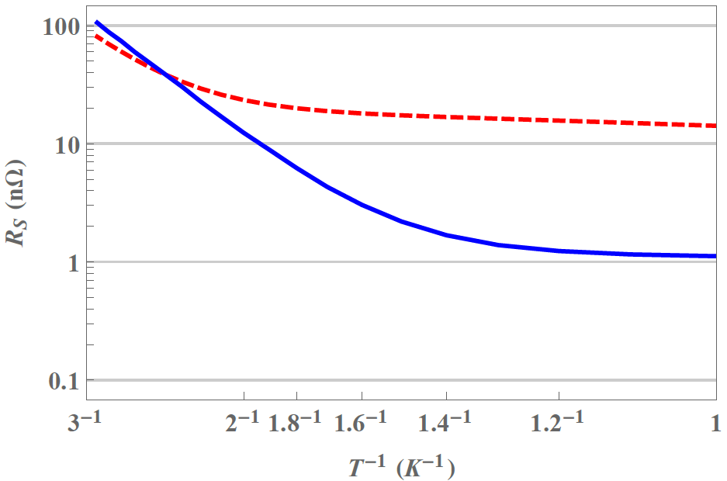
Surface resistance: example
β=10
β=0.1
α=0.1
Γ=0.03

Slide 65
Surface resistance: example
β=10
Residual resistance!
β=0.1
α=0.1
Γ=0.03

Slide 66
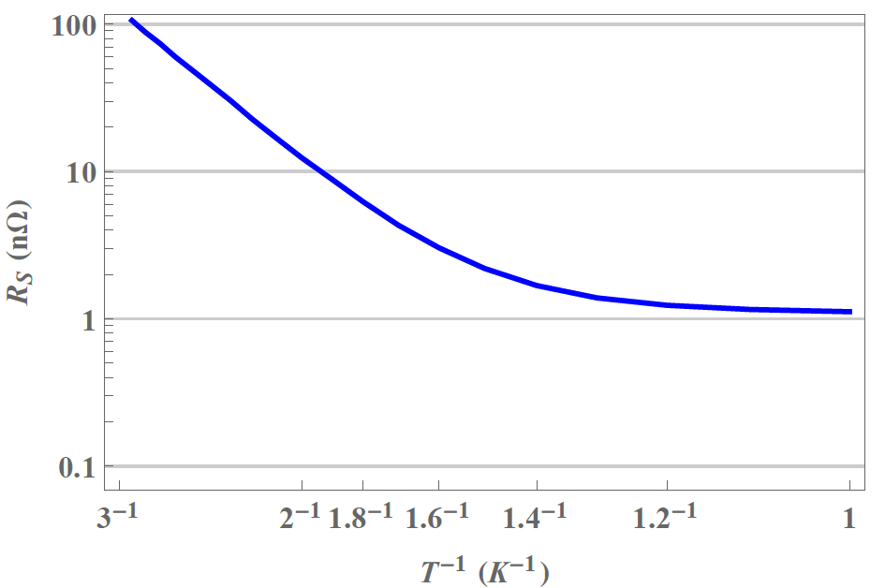
Surface resistance: example
In particular, this yields a realistic R_{s} and
β=0.1
α=0.1
Γ=0.03

Slide 67
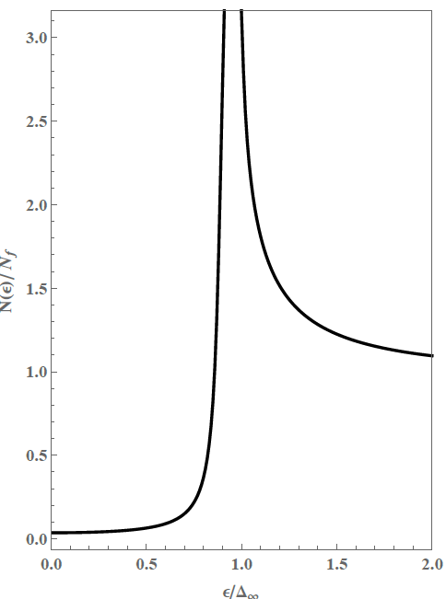
Surface resistance: example
A realistic DOS at the top layer
Note that this is N layer DOS!
β=0.1
α=0.1
Γ=0.03

Slide 68
Tune the surface layer
towards higher Q at 2K

Slide 69
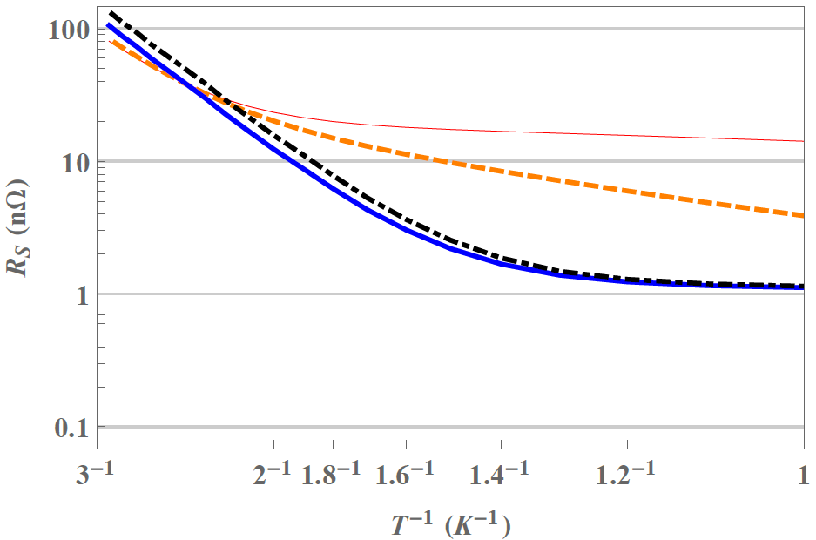
β=3
β=10
β=0.01
β=0.1
α=0.1
Γ=0.03

Slide 70
At $T≃2K$
β=3
β=10
β=0.01
β=0.1
α=0.1
Γ=0.03

Slide 71
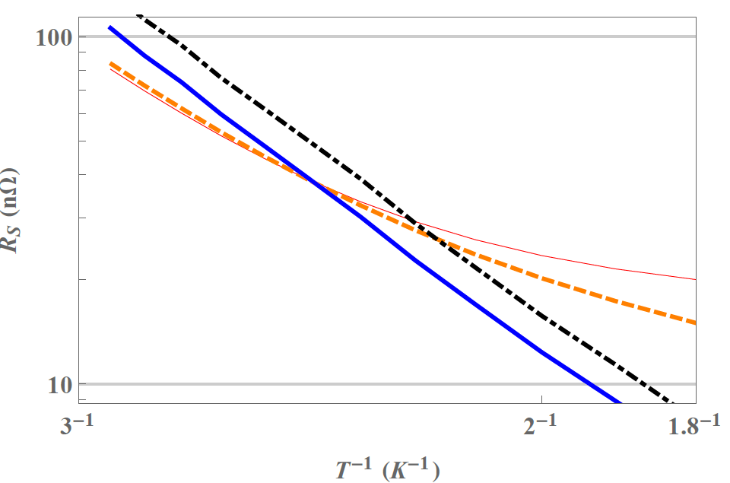
β=0.01
β=0.1
β=3
β=10

Slide 72
β=0.01
β=0.1
β=3
β=10

Slide 73
β=0.01
β=0.1
β=3
β=10
A larger β induce a broaden DOS peak, so we have a smaller R_{s}!
A. Gurevich, Phys. Rev. Lett.
A. Gurevich, Supercond. Sci. Technol. 30, 034004 (2017).

Slide 74
β=0.01
β=0.1
β=3
As T decreases, the order changes due to the minigap induced residual resistance
β=10

Slide 75
β=0.01
β=0.1
β=3
β=10
We have the optimum!

Slide 76
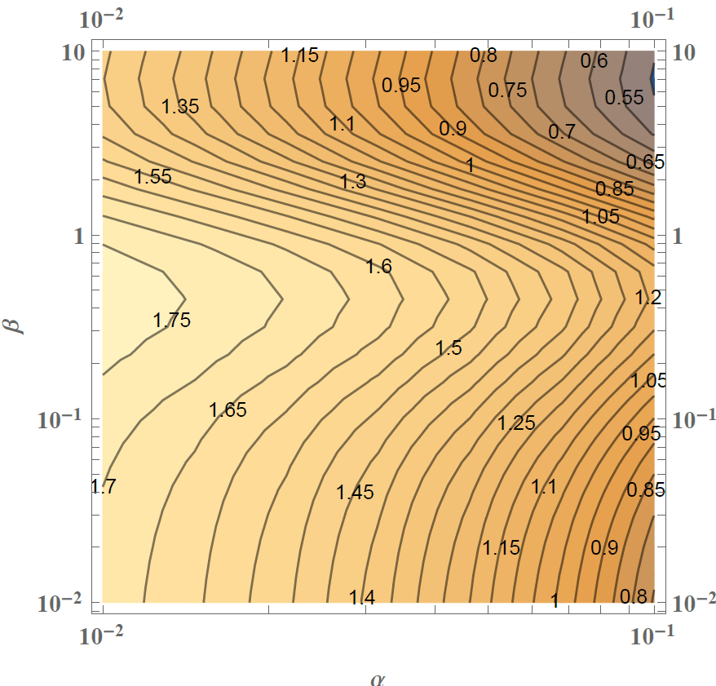
We can tune R_{s}
by varying α and β.
α
β
$$\frac{Q_{0}}{Q_{0}^{MB}}=\frac{R_{MB}}{R_{s}}$$
$=\frac{I_{MB}}{I_{N}+I_{S}}$
T=2K
Γ=0.03

Slide 77
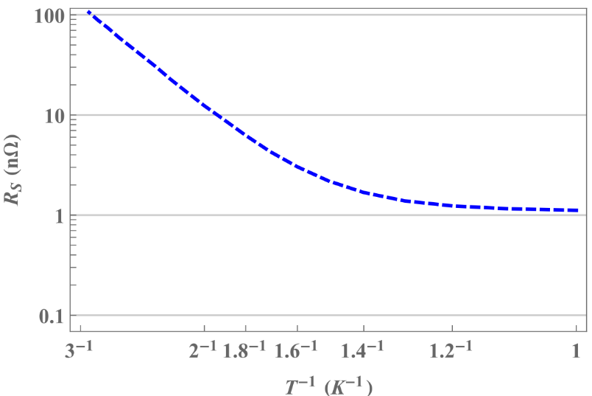
Decreases N layer thickness
and increases surface barrier
Q=2.2×10¹⁰
Q=1.6×10¹¹
Γ=0.03

Slide 78
Decreases N layer thickness
and increases surface barrier
Q=2.2×10¹⁰
Q=1.6×10¹¹
Γ=0.03

Slide 79
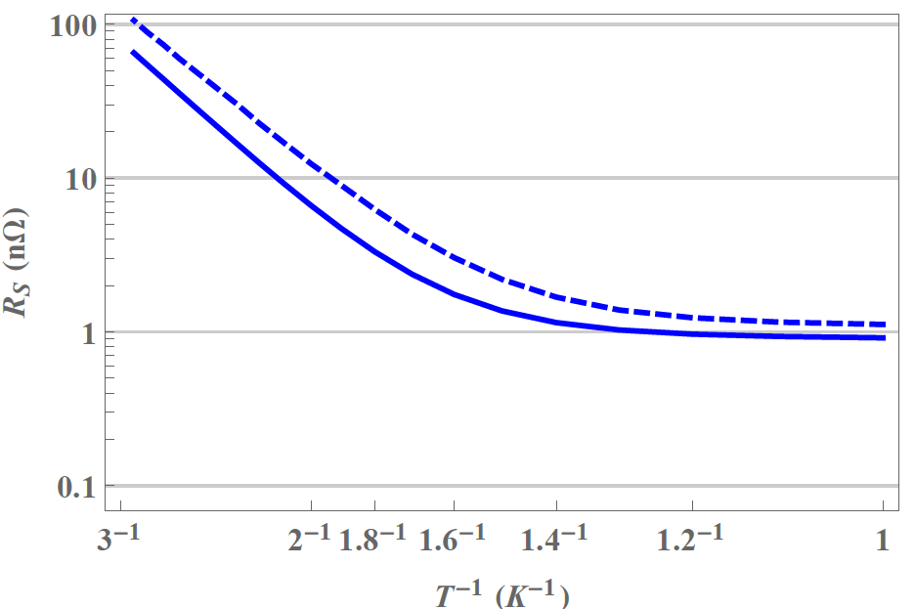
Decreases N layer thickness
and increases surface barrier
Q=2.2×10¹⁰
Q=4.1×10¹⁰
Q=1.6×10¹¹
Q=2.4×10¹¹
Γ=0.03

Slide 80
The differences between the 2 curves are analogous to those between ILC recipe and N-dope! Remind the residual resistance (without flux) is known to be smaller in N-doped cavity than ILC recipe.
Q=2.2×10¹⁰
Q=4.1×10¹⁰
Q=1.6×10¹¹
Q=2.4×10¹¹
Γ=0.03

Slide 81
Summary
We developed a unified theory of surface resistance and residual resistance
The theory incorporates the effects of the surface normal layer or damaged layer and mechanism which produce finite density of subgap states in the bulk.
The theory incorporates both the conventional MB contribution and the residual resistance.
The NS coupling affects not only residual resistance but also surface resistance at T~2K.
We showed tuning R_{s} by optimizing the thickness of metallic suboxide layer and the interface resistance.

Slide 82
Tune the surface
based on the unified theory!
$R_{MB}$
$R_{others}$
Damaged layer
Metallic sub-oxide
Subgap states
Dielectric losses
_{etc}
$R_{flux}$
$R_{MB}$
$R_{others}$
Damaged layer
Metallic sub-oxide
Subgap states
Dielectric losses
_{etc}
$R_{flux}$
R_{unified}
R_{unified}
R_{s}
R_{s}

Slide 83
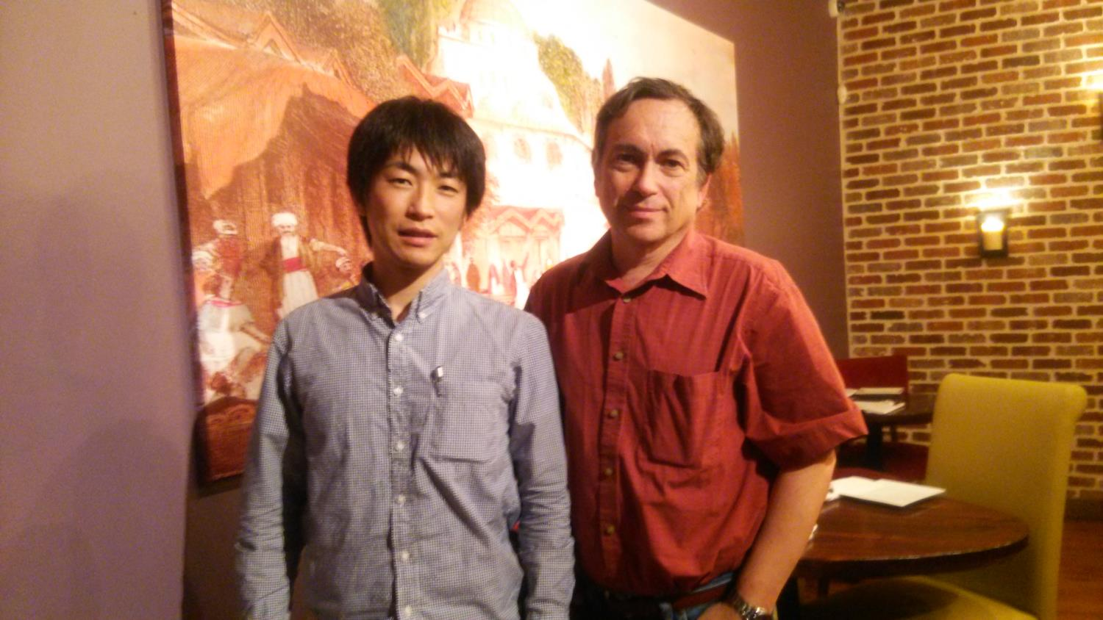
Thanks!
Oct. 2016
@Norfolk

