Slide 1

CEPC SRF System Design
Jiyuan Zhai
On behalf of CEPC SRF Study Team
6th IHEP-KEK SCRF Collaboration Meeting, Beijing, 15 July 2017

Slide 2
Outline
CEPC introduction
RF system design and parameters
RF transient and instability
R&D plan and status
Collaboration

Slide 3
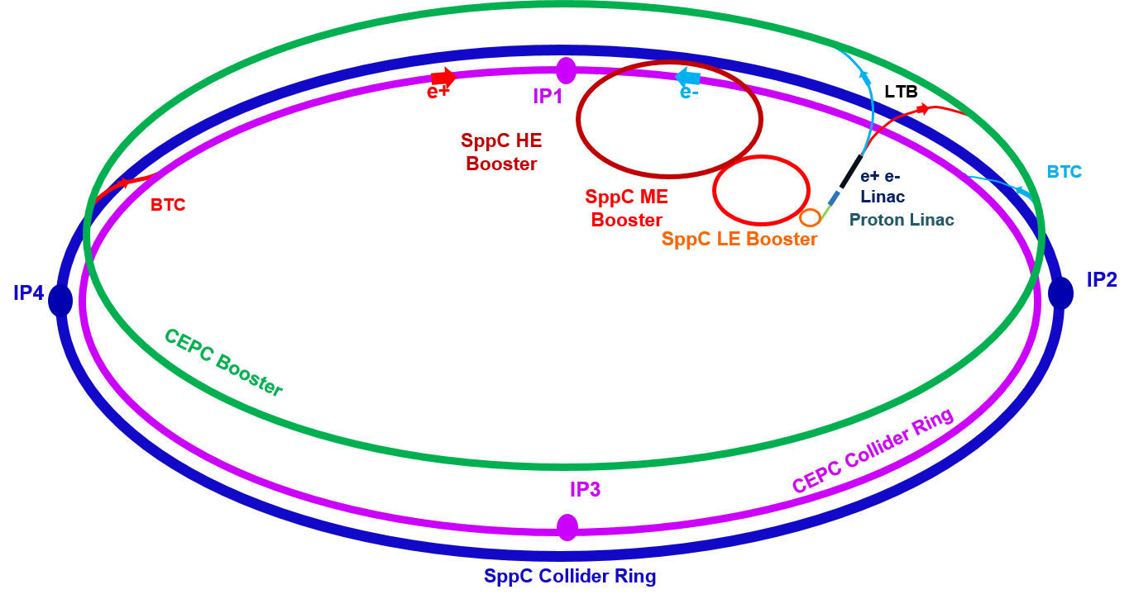
CEPC-SPPC Project
Circumference: 100 km
CEPC Beam Energy: 45.5 – 120 GeV
SPPC Beam Energy: 35 - 50 TeV
CEPC SR Power < 100 MW

Slide 4
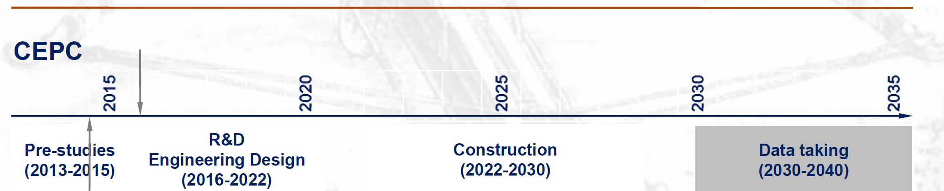
CEPC Schedule (ideal)
CEPC data-taking starts before the LHC program ends around 2035
Earlier than the FCC-ee
possibly concurrent, but advantageous and complimentary to the ILC

Slide 5
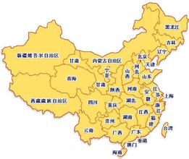

CEPC Site Exploration
1) QingHuangDao, Hebei（completed preCDR）
2) Huangling, Shaanxi（2017.1 signed contract to exp.）
3) ShenShan, Guangdong, （completed in August, 2016)

Slide 6
Physics Goals of CEPC
Electron-positron collider (45.5, 80, 120 GeV)
  Higgs Factory
    Precision study of Higgs (m_{H}, J^{PC}, couplings)
    Looking for hints of new physics
    Luminosity > 2.0×10³⁴ cm⁻²s⁻¹
  Z & W factory
    Precision test of standard model
    Rare decays
    Luminosity > 1.0×10³⁴ cm⁻²s⁻¹
  Flavor factory: b, c, t and QCD studies

Slide 7
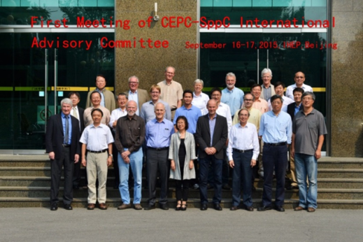
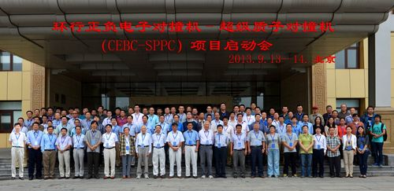
CEPC Organization
Institute Board
Y.N. GAO
J. GAO
IAC
Young-Kee Kim, ….
Since Sept.
2013
Steering Committee
Y.F. WANG (IHEP),….
ProjectDirector
XC LOU
Q. QIN
N. XU
分工：
Intl Relation– J GAO
PR – YN GAO
Conf. – J.Shan
CDR – XC Lou et al.
……
CDR Editors
theory LT Wang
accelerator W Chou
detector-simu TC Chao
CH YU (AC Physics)
Theory
HJ HE(TH)
JP MA(ITP)
XG HE(SJTU)
Accelerator
J. GAO(IHEP)
CY Long(IHEP)
JY TANG(IHEP)
Detector
JoaoCosta(IHEP)
S. JIN(NJU)
YN GAO(TH)

Slide 8
Machine Parameters of CEPC Main Ring
 | Higgs Wang Dou 20170607 | W Wang Dou 20170306 | Z Wang Dou 20170607 | Z-high lumi Wang Dou 20170306
Number of IPs | 2 | 2 | 2 | 2
Energy (GeV) | 120 | 80 | 45.5 | 45.5
SR loss/turn (GeV) | 1.67 | 0.33 | 0.034 | 0.034
Half crossing angle (mrad) | 16.5 | 16.5 | 16.5 | 16.5
Piwinski angle | 3.19 | 5.69 | 11.8 | 4.29
N_{e}/bunch (10¹¹) | 0.968 | 0.365 | 0.22 | 0.455
Bunch number | 412 | 5534 | 5100 | 21300
Beam current (mA) | 19.2 | 97.1 | 53.9 | 465.8
SR power /beam (MW) | 32 | 32 | 1.9 | 16.1
Bending radius (km) | 11 | 11 | 11 | 11
Momentum compaction (10⁻⁵) | 1.14 | 1.14 | 1.14 | 4.49
β_{IP} x/y (m) | 0.171/0.002 | 0.171 /0.002 | 0.171 /0.002 | 0.16/0.002
Emittance x/y (nm) | 1.31/0.004 | 0.57/0.0017 | 0.18/0.0037 | 1.48/0.0078
Transverse σ_{IP} (um) | 15.0/0.089 | 9.9/0.059 | 5.6/0.086 | 15.4/0.125
ξ_{x}/ξ_{y}/IP | 0.013/0.083 | 0.0055/0.062 | 0.004/0.039 | 0.008/0.054
RF Phase (degree) | 128 | 126.9 | 135 | 165.3
V_{RF} (GV) | 2.1 | 0.41 | 0.049 | 0.14
f _{RF} (MHz) (harmonic) | 650 | 650 (217800) | 650 | 650 (217800)
Nature σ_{z} (mm) | 2.72 | 3.37 | 3.9 | 3.97
Total σ_{z} (mm) | 2.9 | 3.4 | 4.0 | 4.0
HOM power/cavity (kw) | 0.41(2cell) | 0.36(2cell) | 0.11(2cell) | 1.99(2cell)
Energy spread (%) | 0.098 | 0.065 | 0.037 | 0.037
Energy acceptance (%) | 1.5 | / | / | /
Energy acceptance by RF (%) | 2.1 | 1.1 | 0.65 | 1.1
n_{γ} | 0.26 | 0.15 | 0.16 | 0.12
Life time due to beamstrahlung (min) | 52 | / | / | /
F (hour glass) | 0.96 | 0.98 | 0.99 | 0.96
L_{max}/IP (10³⁴cm⁻²s⁻¹) | 2.0 | 5.15 | 1.03 | 11.9

Slide 9
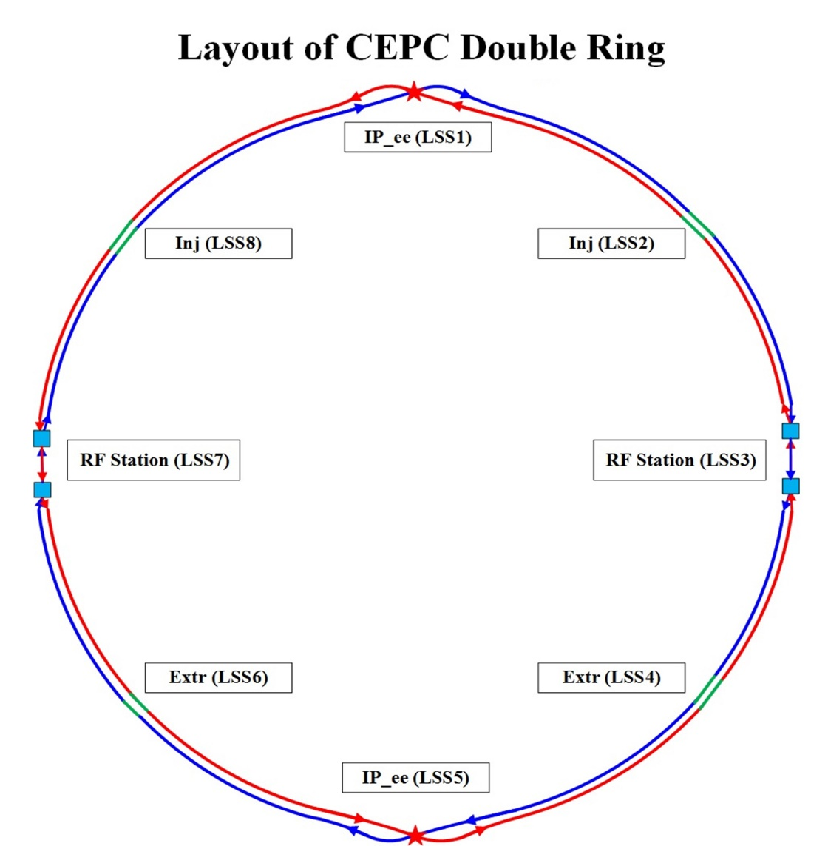
CEPC Man Ring Layout
Double Ring
Common cavities for Higgs
Two RF sections in total
Two RF stations per RF section
14 modules per RF station
28 modules per RF section
56 modules in total
Six 2-cell cavities per module
One klystron for two cavities

Slide 10
Luminosity Upgrade (RF related)
HL-H:
SR power 32 MW → 50 MW
Increase bunch number → higher input power per cavity
HL-Z:
SR power 16 MW → 50 MW
limited by the HOM power per cavity (2 kW), input coupler power per cavity (400 kW) and beam loading, and bunch spacing requirement from detector (> 10 ns) → KEKB/BEPCII type cavity
HE:
Add high gradient, high Q 5-cell cavities (two ring shared)

Slide 11
From Pre-CDR to CDR
Circumference: 54 km → 100 km
Ring type: Single Ring (pretzel, head-on) → Partial Double Ring (1+1 bunch train, crab waist) → Advanced Partial Double Ring (4 + 4 bunch trains; alternative) → Double Ring (baseline)
RF System: high RF voltage (5-cell), high HOM power, uniform fill, low lumi. Z → low RF voltage (2-cell), modest HOM power, bunch train gap, heavy beam loading (high lumi. Z)

Slide 12

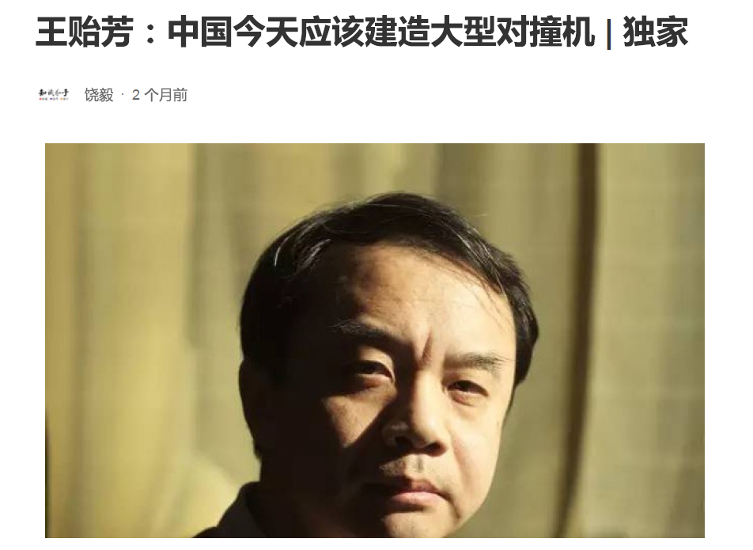

An Unexpected National Debate on CEPC-SppC
China should not build CEPC
2016-09-05
China should go with CEPC
Like the SSC – endless cost
Use the money for environment, education, health, etc.
CEPC takes money from other fields of science
CEPC-SppC uncover SUSY is groundless
HEP achievement has no benefit (past 70 yrs,
future 30, 50 years) to people’s life
IHEP is not more significant than 1% or at best 2% in
the world’s HEP community; CEPC will be foreign dominated,
will not bring Nobel prize to Chinese
Worthy focuses: A. new accelerator principles, B. marvelous
geometry.
point by point rebuttal
widely read in the social media

Slide 13

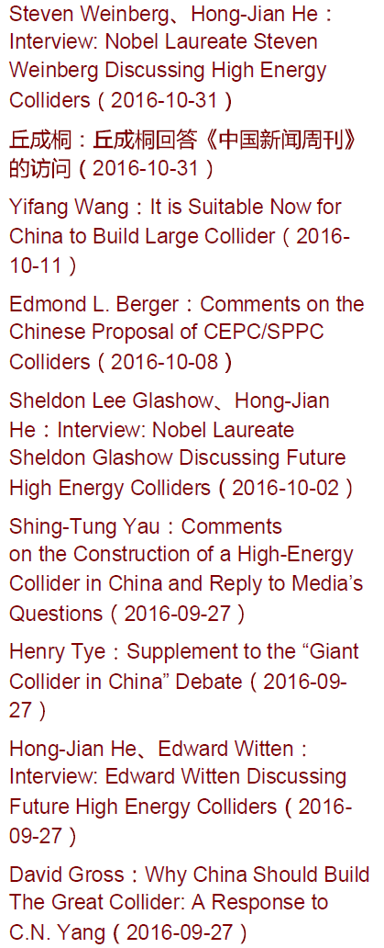
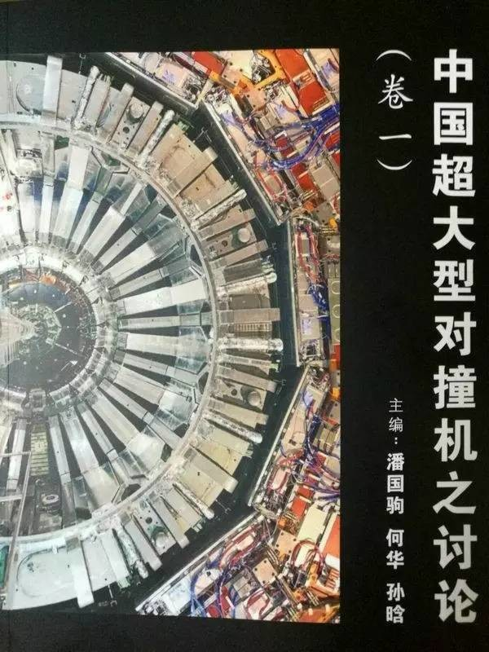
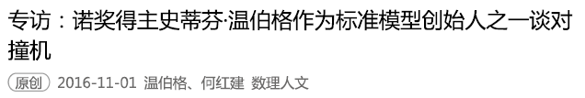
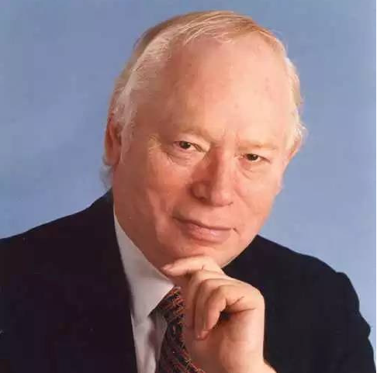
An Unexpected National-Global Debate on CEPC-SppC

Slide 14
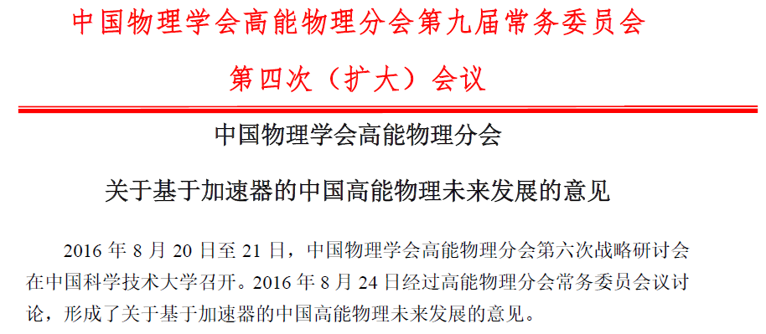
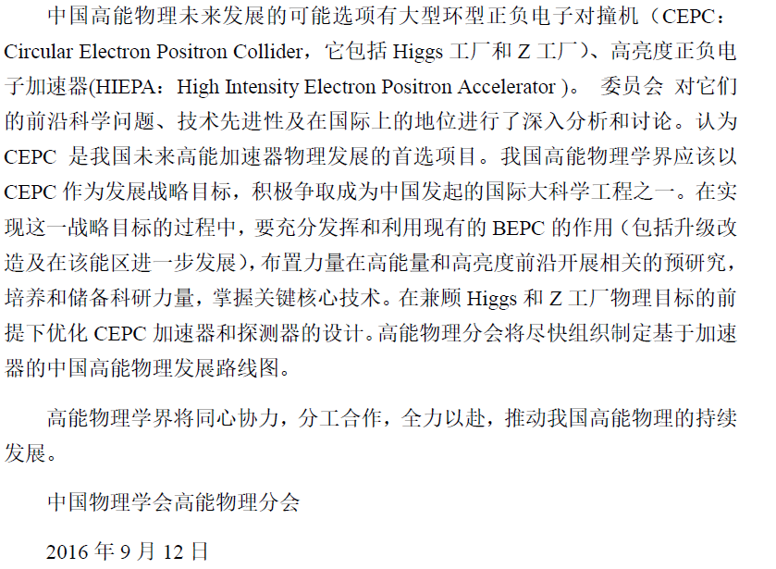
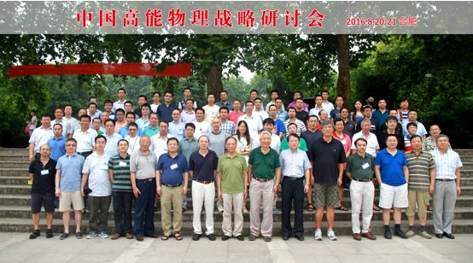
大型环形正负电子对撞机
中国物理协会高能物理分会达成共识
The HEP division of the Chinese Physical
Society reached a consensus in August, 2016
that placed CEPC as the top priority accelerator
based program for the future and endorsed
CEPC design and R&D
Notes:
覆盖比BEPCII更宽能区

Slide 15
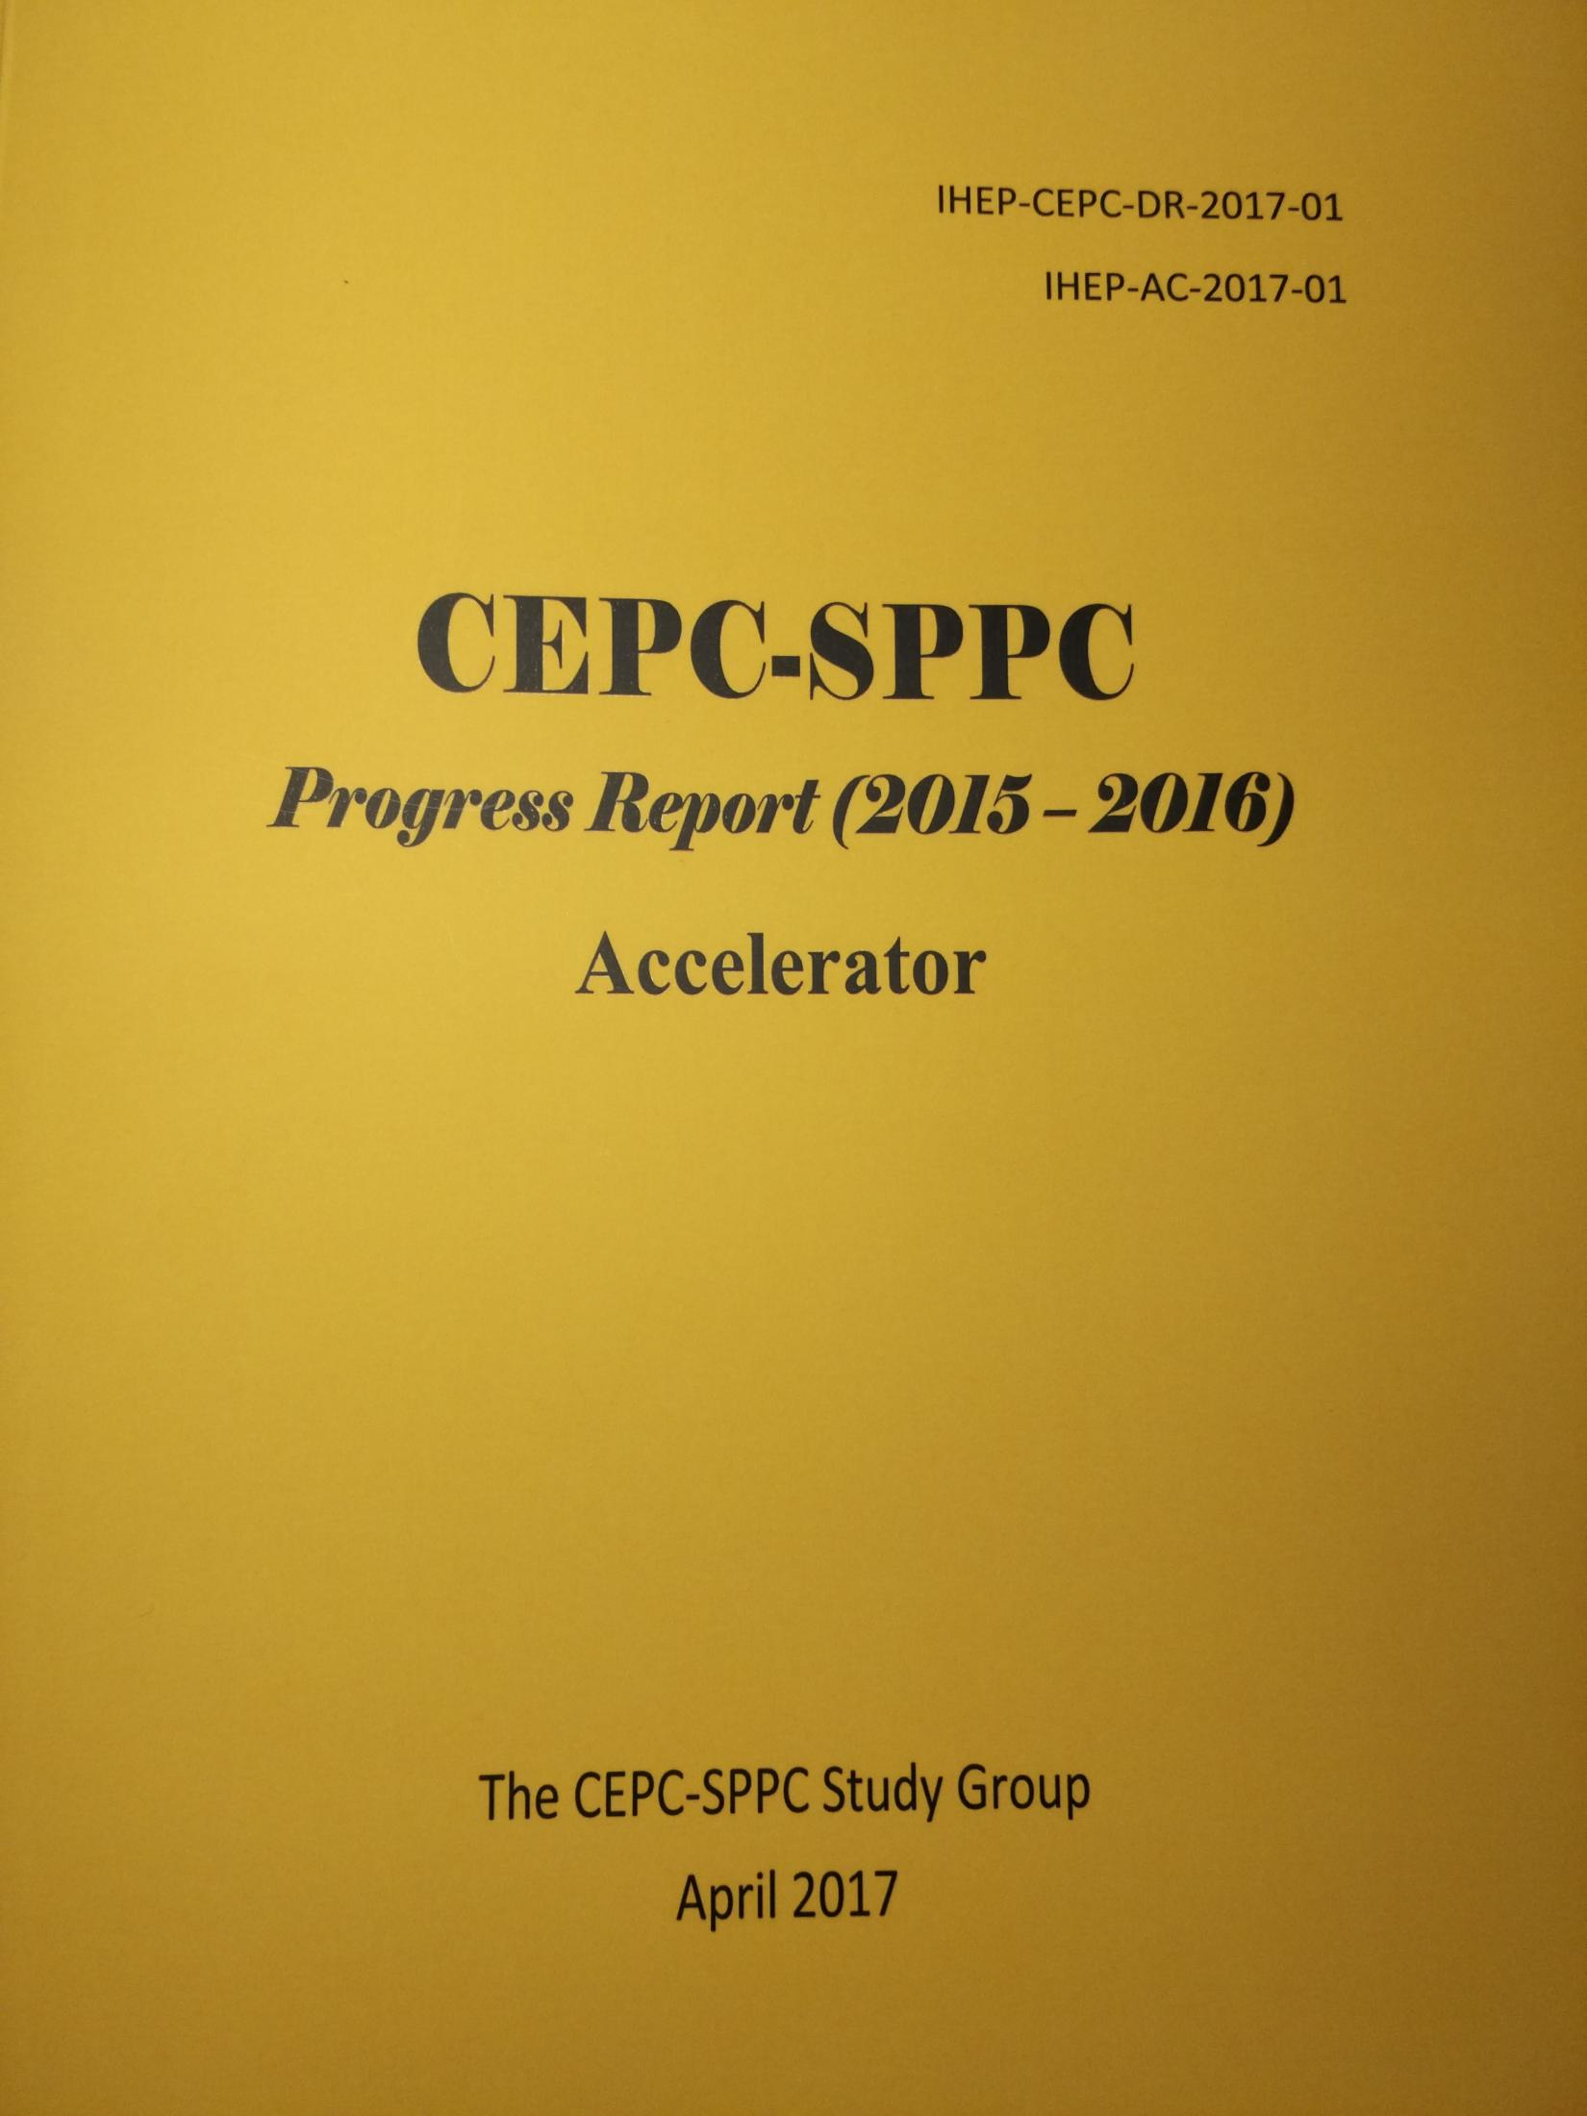
http://cepc.ihep.ac.cn

Slide 16
Outline
CEPC introduction
RF system design and parameters
RF transient and instability
R&D plan and status

Slide 17
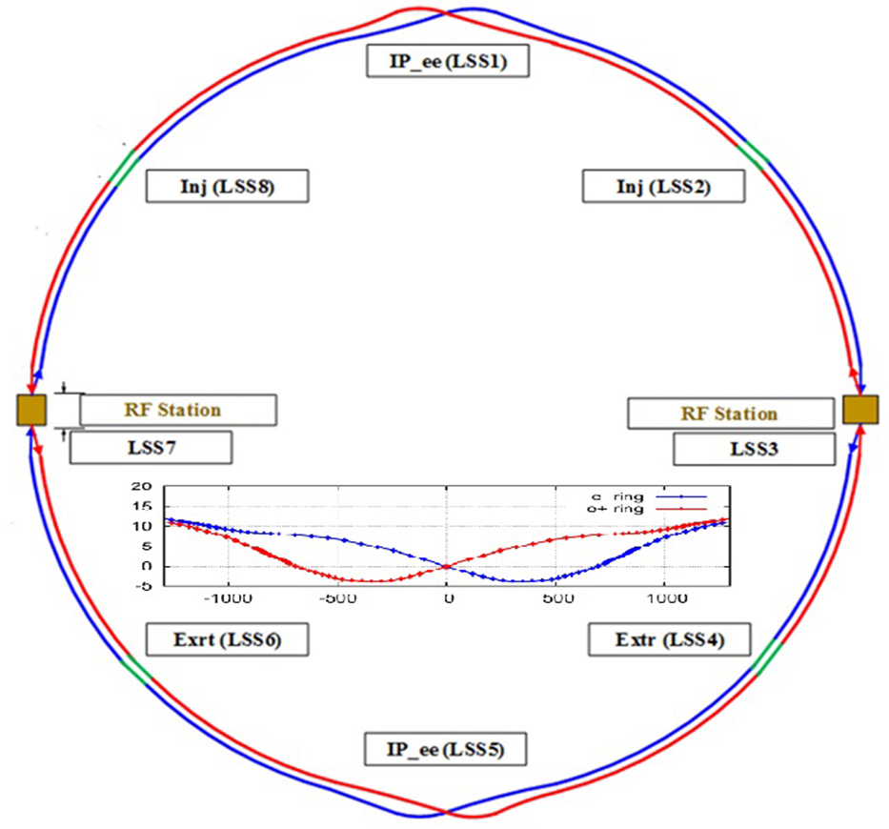
CEPC SRF Layout (one RF section)
H: high RF voltage, low current
W & Z: low RF voltage, high current
Park (detune) the unused cavities for W & Z operation (or use lattice by-pass, or push the unused cavities off-line for Z).
H: shared cavities for two rings (half fill). W & Z: separate cavities for two rings (“uniform” fill). Fewer cavities for H, lower current seen by the W & Z cavity, lower impedance for W & Z.

Slide 18
CEPC Main Ring SRF Parameters
Zhai Jiyuan 20170706. 100 km, H common cavities. Main Ring parameter: Wang Dou 20170607 & 20170306 | H | W | Z | Z-HL
Luminosity / IP [10³⁴ cm⁻²s⁻¹] | 2 | 5 | 1 | 12
SR power / beam [MW] | 32 | 32 | 1.9 | 16
RF frequency [MHz] | 650 | 650 | 650 | 650
RF voltage [GV] | 2.1 | 0.41 | 0.049 | 0.14
Beam current / beam [mA] | 19.2 | 97.1 | 54 | 466
Bunch charge [nC] | 15.5 | 5.8 | 3.5 | 7.3
Bunch length [mm] | 2.9 | 3.4 | 4.0 | 4.0
Cell number / cavity | 2 | 2 | 2 | 2
Cavity number in use (total) | 336 | 192 | 24 | 96
Gradient [MV/m] | 13.6 | 9.3 | 8.9 | 6.3
Input power / cavity [kW] | 190 | 333 | 158 | 335
Cavity number / klystron | 2 | 2 | 2 | 2
Klystron power [kW] | 800 | 800 | 800 | 800
Klystron number | 168 | 96 | 12 | 48
HOM power / cavity [kW] | 0.4 | 0.3 | 0.1 | 1.8
Cavity number / cryomodule | 6 | 6 | 6 | 6
Cryomodule number in use (total) | 56 | 32 | 4 | 16
Q₀ at operating gradient | 1E+10 | 1E+10 | 1E+10 | 1E+10
Optimal Q_{L} | 9.6E+05 | 2.6E+05 | 4.9E+05 | 1.2E+05

Slide 19
CEPC Main Ring SRF Parameters (1)
ZJ20170410 Main Ring parameter: WD20170306 | H | W | Z-HL
Luminosity / IP [10³⁴ cm⁻²s⁻¹] | 2 | 5 | 12
SR power / beam [MW] | 32 | 32 | 16
RF voltage [GV] | 2.1 | 0.41 | 0.14
Beam current / beam [mA] | 19.2 | 97.1 | 466
Bunch charge [nC] | 15.5 | 5.8 | 7.3
Bunch length [mm] | 2.9 | 3.4 | 4
Cavity number in use / beam (650 MHz 2-cell) | 336 | 96 | 48
Gradient [MV/m] (with margin for HV-H) | 14 | 9.3 | 6.3
Input power / cavity [kW] (with margin for HL-H) | 190 | 333 | 335
Klystron power [kW] (2 cavities / klystron) | 800 | 800 | 800
HOM power / cavity [kW] | 0.4 | 0.3 | 1.8
Cryomodule number (6 cavities / module) | 56 | 32 | 16
Q₀ @ 2 K at operating gradient (long term) | 1E10 | 1E10 | 1E10
Total wall loss @ 4.5 K eq. [kW] | 23 | 6 | 1
No staging (except super-Z and higher energy).
Same RF cavity for H, W, Z.
No cavity push-pull.
Challenging input power, low heat load, input coupler short to reduce module diameter
Cavity acceptance Q₀ > 4E10 (N-doping), Module horizontal test > 2E10 (clean assembly and magnetic hygiene)

Slide 20
CEPC Main Ring SRF Parameters (2)
ZJ20170410 Main Ring machine parameter: WD20170306 | H | W | Z-HL
Optimal Q_{L} | 1.0E6 | 2.7E5 | 1.2E5
Relative optimal Q_{L} (to H) | 1.0 | 0.1 | 0.12
Extra power (if fixed optimal coupling for H) | 0 | 209 % | 155 %
Cavity bandwidth [kHz] | 0.7 | 2.4 | 5.3
Optimal detuning [kHz] | 0.2 | 0.9 | 10.5
Cavity time constant [μs] | 488 | 130 | 60
Cavity stored energy [J] | 46 | 22 | 10
Max relative voltage drop for 1 % beam gap | 0.9 % | 3.3 % | 23.2 %
Max phase shift for 1 % beam gap [deg] | 0.8 | 3.2 | 13.7
Max relative voltage drop for 4+4 APDR | 10 % | 77 % | decelerate
Max bunch train phase shift for 4+4 APDR [deg] | 9.8 | 74 | decelerate
Variable coupler needed for W&Z, and even for Higgs itself to save power.
Heavy beam loading → damp acceleration mode CBI instability during injection and top-up operation
Even 1 % beam gap will have large bunch phase shift → change fill pattern from one long gap to many small gaps
Alternative APDR (4+4 trains) scheme may not work unless phase shift corrected by beat cavity or other method.

Slide 21
CEPC Booster SRF Parameters (preliminary)
ZJ20170410. 10 GeV injection. Booster machine parameter: CX20170401 | H | W | Z-HL
Extraction beam energy [GeV] | 120 | 80 | 45.5
Bunch charge [nC] | 0.77 | 0.2 | 0.3
Beam current [mA] | 0.37 | 0.33 | 0.96
Extraction RF voltage [GV] | 2.8 | 1 | 0.4
Extraction bunch length [mm] | 4.7 | 2.8 | 1
Cavity number in use (1.3 GHz TESLA 9-cell) | 160 | 64 | 32
Gradient [MV/m] | 16.9 | 15.1 | 12.0
Q_{L} | 2E+07 | 2E+07 | 2E+07
Cavity bandwidth [Hz] | 65 | 65 | 65
Input power per cavity [kW] (remained detuning 10 Hz) | 5.8 | 4.0 | 2.5
SSA power [kW] (one cavity per SSA) | 10 | 10 | 10
HOM power per cavity [W] | 0.4 | 0.2 | 1.6
Cryomodule number in use (8 cavities per module) | 20 | 8 | 4
Q₀ @ 2 K at operating gradient (long term) | 2E+10 | 2E+10 | 2E+10
Total wall loss @ 4.5 K eq. [kW] (assume CW) | 8.4 | 2.7 | 0.9
Narrow bandwidth, microphonics
Voltage ramp 12 times in 1 s
LLRF challenge

Slide 22
Outline
CEPC introduction
RF system design and parameters
RF transient and instability
R&D plan and status

Slide 23

Beam Gap Transient
Phase shift caused by beam gap in DR or APDR
  A bunch extracts cavity stored energy when passing through, and power source will recover the cavity voltage when the next bunch comes. When the bunch spacing is much smaller, cavity stored energy and voltage will drop continuously due to lack of power. The latter bunch will move towards voltage peak by auto-phasing, resulting in less longitudinal focusing, smaller energy acceptance, lifetime and luminosity, and possible other dynamical problem. Small phase shift can be estimated by (K. Bane, etc., EPAC96):
Correction methods
  Increase cavity stored energy (less cell number, higher RF voltage, low RF freq)
  More uniform distribution (increase bunch train number or length)
  Pulsed power (power source hardware limit and low RF-to-beam efficiency)
  Beat cavity (small frequency shift of part of RF sources and cavities, beating)
$$Δθ_{1N}≈\frac{−2kq}{V_{c0}\sin{φ_{0}}}\left[\frac{T_{t}T_{g}/T_{b}}{T/N_{t}}\right]≈\frac{−2kI_{0}T_{g}}{V_{c0}\sin{φ_{0}}}≈\frac{−2kqN}{V_{c0}\sin{φ_{0}}}$$
Max phase variation proportional to number of bunches in a bunch train, or number of bunch trains (for fixed total bunch number) or the gap length.
Refer to talks in the CEPC-SPPC Workshop, Apr. and Sept. 2016
http://indico.ihep.ac.cn/event/5277/session/9/contribution/45/material/slides/
http://indico.ihep.ac.cn/event/6149/session/2/contribution/55/material/slides/
Phase shift not trivial for double ring W & Z with 1 % ~ 5 % gap to mitigate ion-trapping and fast beam ion instability (FBII) → Cure by using many short bunch trains. APDR phase shift → Cure by beat cavity

Slide 24
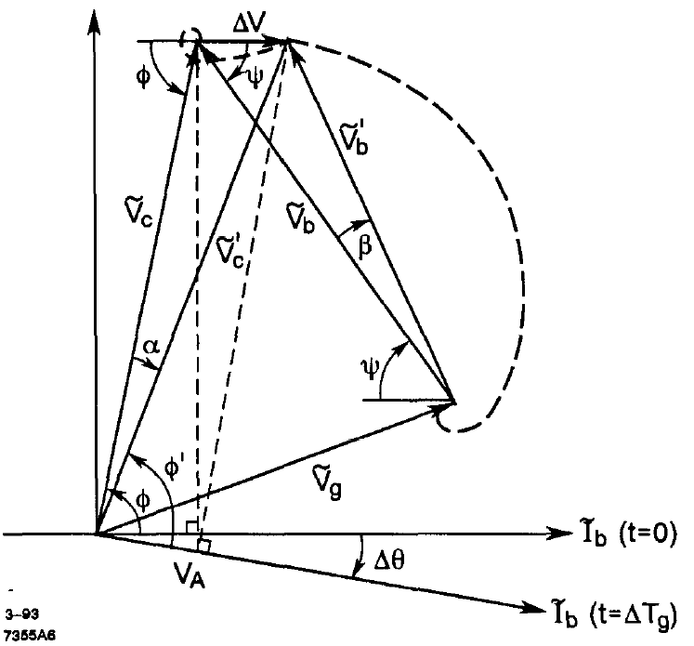
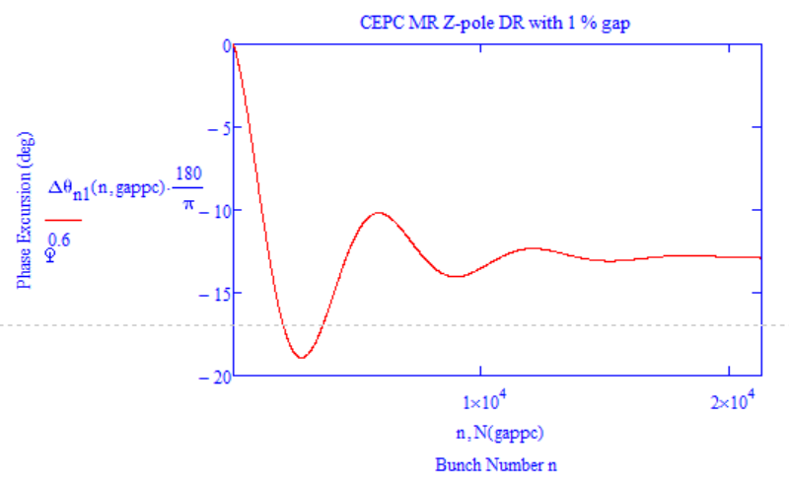
Phase Shift of Z-pole Beam Gap
1% long gap：
Same with Wilson formula.
Bane’s formula (plot by Haipeng Wang’s Mathcad code)
1065 trains, 20 bunches each (T_{g} = 195.7 ns, T_{b} = 6.15 ns)
P.B. Wilson. SLAC-PUB-6062,1993

Slide 25
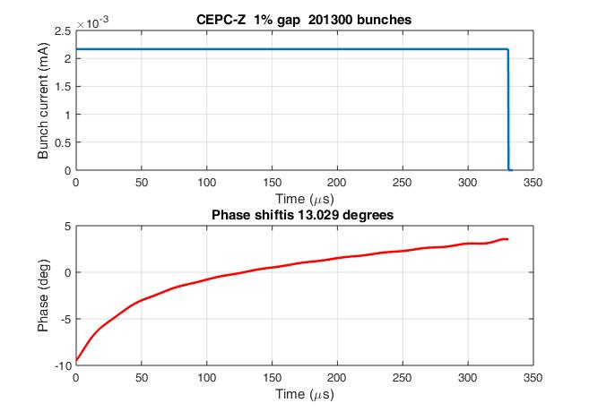
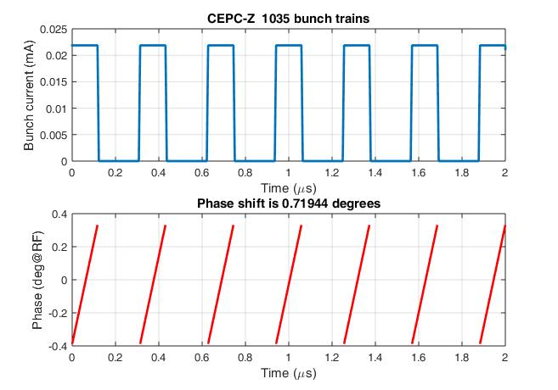
Transient Simulation with Transfer Functions
Pedersen Model
1% long gap
1065 trains, 20 bunches each (T_{g} = 195.7 ns, T_{b} = 6.15 ns)
Based on Dmitry Teytelman’s MATLAB code

Slide 26
5 % Gap
T. Kobayashi (KEK)

Slide 27
5 % Gap
T. Kobayashi (KEK)

Slide 28
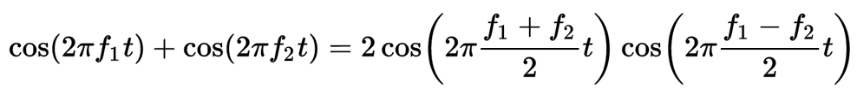
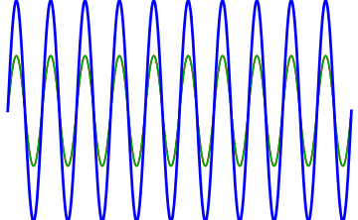
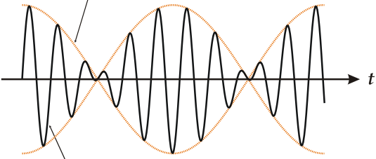
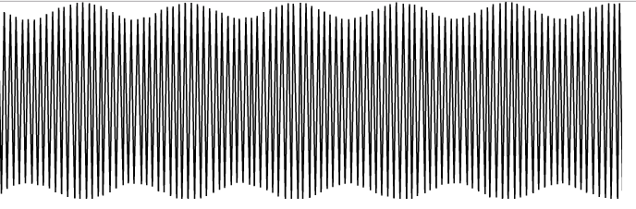


Phase Compensation with Beat Cavity
Tune freq of some RF sources and cavities slightly different from the normal RF sources (650 MHz) and cavities (optimal detuning) – beating
Use linear part of beat wave to compensate voltage and phase variation due to beam loading (non-linearity increases with train length, max. half-fill of the ring)
Higher order beats are more effective but more non-linear
Number of beat cavities:
$$f_{DF}=f_{RF}±mN_{t}f_{rev}$$
$$N_{BFCm}=\frac{∆V_{RF }}{{2V}_{BFC }sin(mN_{t}ω_{rev}T_{t})}$$
K. Kubo etc. Compensation of bunch position shift using sub-RF cavity in a damping ring, PAC93
electron bunch train
positron
bunch train
bunch train freq = train # x revolution freq = beat freq / m

Slide 29
APDR Phase Correction with Beat Cavity
Machine Parameter： wangdou20160918/23（Circumference 61 km） | H Low Power | H High Lumi | W | Z | Z 1-cell
Bunch charge (nC) | 32 | 32 | 18.6 | 12.5 | 12.5
Bunch number (one beam) | 70 | 107 | 400 | 1100 | 1100
Bunch spacing (ns) [bunch train length < 3.2 km] | 152.3 | 98.5 | 26.2 | 9.2 | 9.2
Cavity voltage (MV) | 7.4 | 7.3 | 3.9 | 3.7 | 3.7
Synchrotron phase (deg) | 123 | 122 | 128 | 146 | 146
PDR 1+1 max voltage drop | 11 % | 18 % | 72 % | 140 % | 70 %
PDR 1+1 max phase shift (deg) | 12 | 19 | 67 | / | 49
PDR 3rd order beat cavity# (29 kHz) | 33 | 51 | 83 | 28 | 14
APDR 4+4 max voltage drop | 3 % | 4 % | 18 % | 35 % | 18 %
APDR 4+4 max phase shift (deg) | 3 | 4.8 | 16.7 | 24.2 | 12.1
APDR 2nd order beat cavity# (79 kHz) | 10 | 16 | 27 | 9 | 4

Slide 30
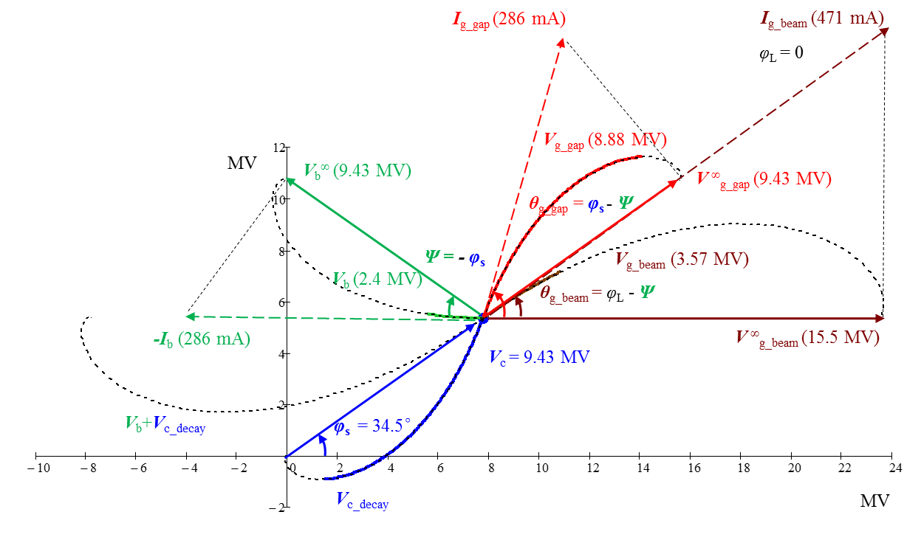
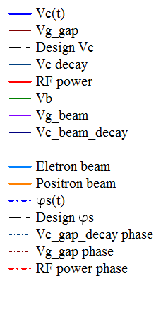
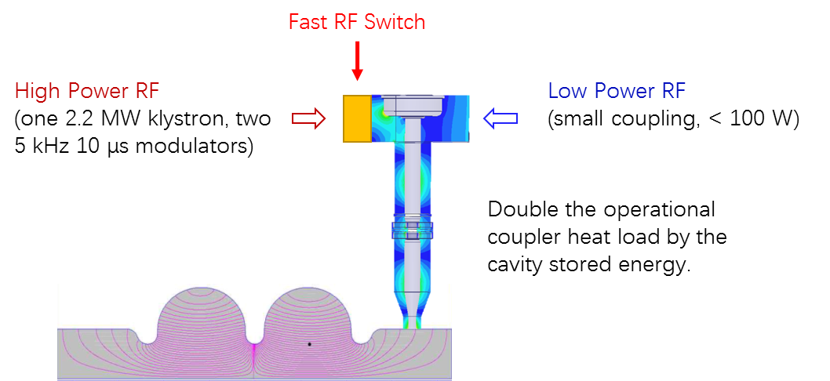
Pulsed Power Correction
Constant amplitude and phase of the cavity voltage.
To avoid complicated Lorentz force detuning correction in ring.

Slide 31
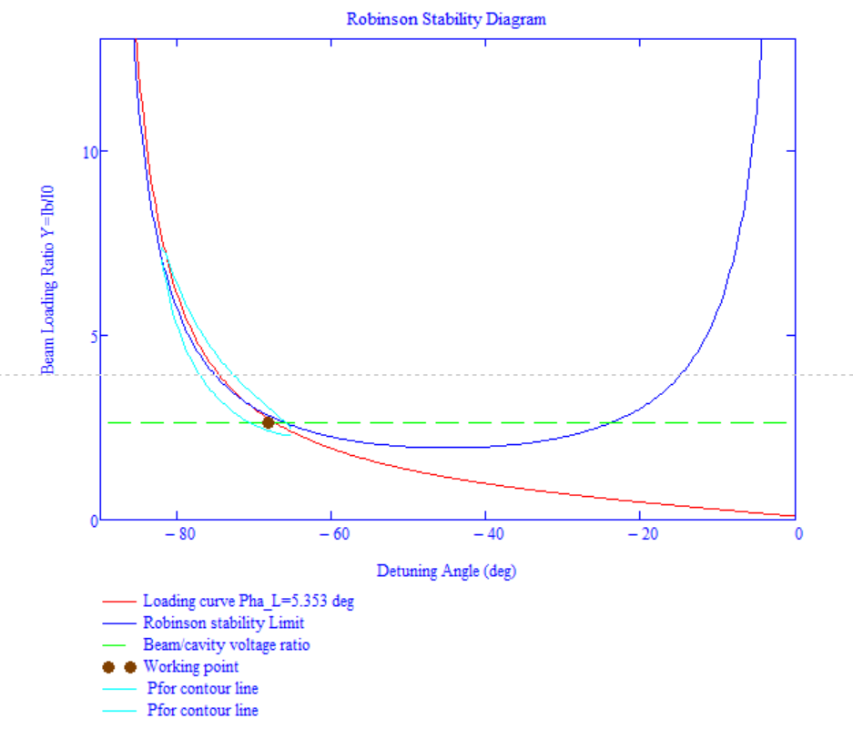
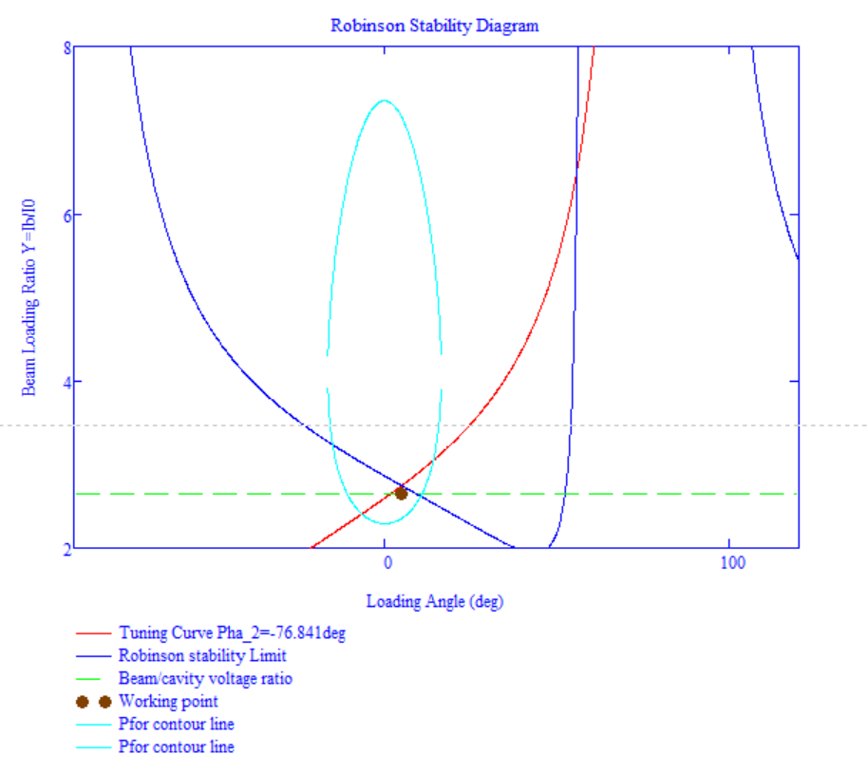
Robinson Stability (CEPC DR Z mode)
by Haipeng Wang’s Mathcad code
Fast direct feedback (group delay 2 us, loop gain 22).
~ 10 % more power to have Robinson stable operation of high current Z-pole.

Slide 32
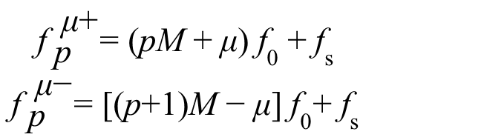
Fundamental Mode Instability of Z-pole
Fundamental mode CBI of Z-pole due to large circumference (small revolution frequency, low RF voltage) and high current (large cavity bandwidth and detuning, input coupler power limit).
For M bunches, there are M coupled-bunch modes, the phase shift between adjacent bunches for mode number n:
n = 0, 1, 2, ... M-1
CBI growth rate :
$$\begin{matrix}{\text{f}}_{ \text{p}}^{ \text{μ}\text{+}}\text{=} \text{(}\text{pM} \text{+} \text{μ}\text{)} {\text{f}}_{\text{0}} \text{+} {\text{f}}_{\text{s}} \\ {\text{f}}_{ \text{p}}^{ \text{μ}\text{−}}\text{=} \text{[(}\text{p}\text{+1)}\text{M} \text{−} \text{μ}\text{]} {\text{f}}_{\text{0}}\text{+} {\text{f}}_{\text{s}}\end{matrix}$$
Kouki Hirosawa. PASJ2016 TPU012

Slide 33
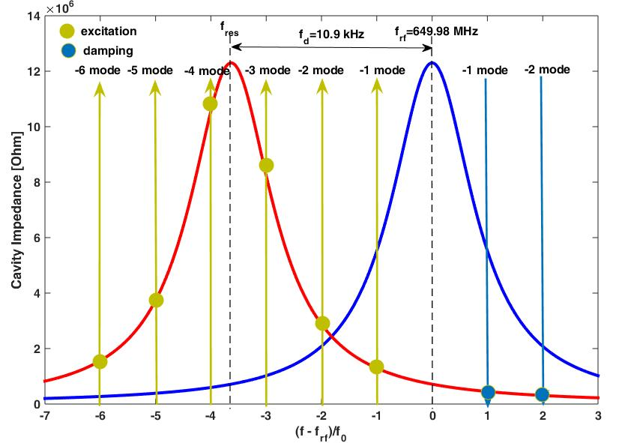
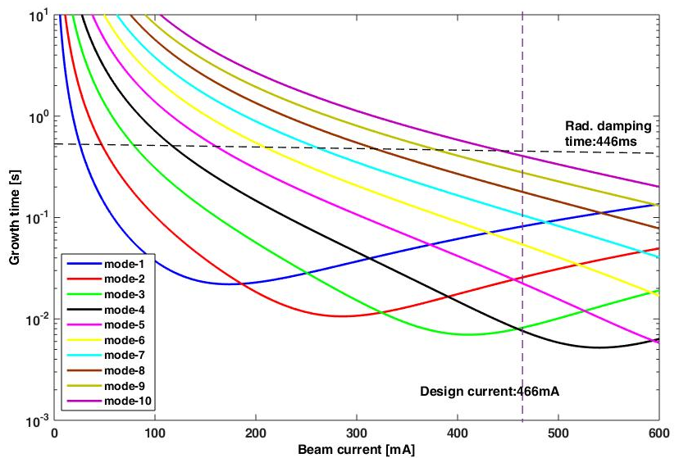
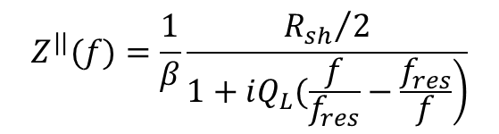
Fundamental Mode Instability of Z-pole
Longitudinal coupling-impedance
Cavity resonance frequency
$$Z^{||}(f)=\frac{1}{β}\frac{{R_{sh}}/2}{\left.1+iQ_{L}(\frac{f}{f_{res}}−\frac{f_{res}}{f}\right)}$$
Optimal detuning
Cavity acceleration mode impedance and beam spectrum of CEPC Z-pole mode
Growth time of CBI due to acceleration mode of CEPC Z operation (10 modes to be damped)

Slide 34
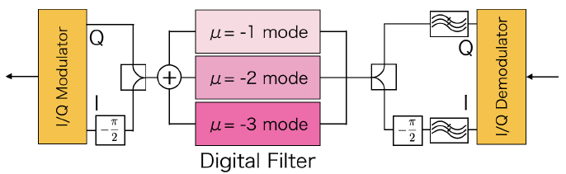
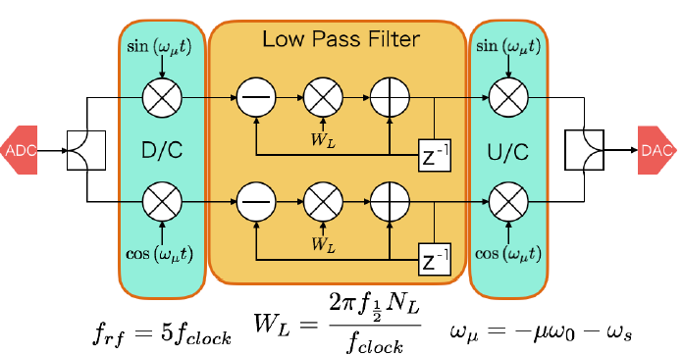
Fundamental Mode Instability of Z-pole
Use the mode by mode damper system with digital filters to suppress (SuperKEKB)
Damper system for SuperKEKB:
Kouki Hirosawa. Development of a coupled bunch instability damper caused by the acceleration mode for SuperKEKB. PASJ2016 TPU012
Functional block diagram of digital filter for SuperKEKB

Slide 35
Main Ring HOM CBI and Feedback
Machine parameter: wangdou20170222 | H | W | Z
Cavity number (total) | 336 | 240 | 96
Beam feedback time [ms] | 3.3 | 3.3 | 3.3
Average beta_x,y in RF cavity [m] | 30 | 30 | 30
Qe limit | 1×10⁴ | 1×10⁴ | 1×10⁴
H cavity 336, W&Z cavity 168, with feedback, Ib limit [mA] | 580.14 | 1547.05 | 673.07
Lmax / IP [10³⁴ cm⁻²s⁻¹] | 60.19 | 81.59 | 17.23
Unused cavity off-line for W&Z, with feedback, Ib limit [mA] | 580.14 | 2165.87 | 2355.75
Lmax / IP [10³⁴ cm⁻²s⁻¹] | 60.19 | 114.23 | 60.29
H, W, Z all 336 cavities, with feedback, Ib limit [mA] | 580.14 | 386.76 | 168.27
Lmax / IP [10³⁴ cm⁻²s⁻¹] | 60.19 | 20.40 | 4.31
H cavity 336, W&Z cavity 168, without feedback, Ib limit [mA] | 39.94 | 31.57 | 3.25
Lmax / IP [10³⁴ cm⁻²s⁻¹] | 4.14 | 1.66 | 0.08
Unused cavity off-line for W&Z, without feedback, Ib limit [mA] | 39.94 | 44.19 | 11.38
Lmax / IP [10³⁴ cm⁻²s⁻¹] | 4.14 | 2.33 | 0.29
SR power limit [MW] | 50 | 50 | 50
Ib limit from SR power limit [mA] | 29.9 | 151.1 | 1470.6
Lmax/IP limit from SR power limit [10³⁴ cm⁻²s⁻¹] | 3.1 | 8 | 37.6
HOM Qe limit ~ 1×10⁴ (including frequency spread)
Beam feedback time ~ 3.3 ms (damping time: 5 turns and margin)
Average beta_x,y in RF cavity ~ 30 m

Slide 36
Cavity HOM Frequency Spread
Cavity fabrication and tuning will make small HOM frequency spread, this will result in an “effective” quality factor Q.
Red: σ_{fR}=0
Blue: σ_{fR}=1 MHz
f_{R} = 1.16554 GHz, Q = 1.10×10⁵, 336 RF cavities

Slide 37
Main Ring Cavity Impedance
Cut off
Cut off
TM011
TM021
TM120/hybrid
TM020
TM111/TE121
TM012
TE111/TM110
H: 336 cavity, W & Z: 168 cavity
Feedback: 3.3 ms, Transverse beta: 30 m
Impedance of all the modes below the threshold if HOM frequency spread included
Further optimize coupler RF design

Slide 38
CEPC Booster HOM CBI Instability and Feedback
Modes | f (GHz) | R/Q (Ω) | Q_{ext} measured | CBI Growth Time (ms)
 |  |  |  | H-extraction | W-extraction | Z-extraction
TM011 | 2.45 | 156 | 5.90E+04 | 3758 | 2157 | 363
TM012 | 3.845 | 44 | 2.40E+05 | 2087 | 1198 | 202
TE111 | 1.739 | 4283 | 3.40E+03 | 6159 | 4594 | 906
TM110 | 1.874 | 2293 | 5.00E+04 | 782 | 583 | 115
TM111 | 2.577 | 4336 | 5.00E+04 | 414 | 309 | 61
TE121 | 3.087 | 196 | 4.40E+04 | 10400 | 7757 | 1530
 |  |  |  | H-injection | W-injection | Z-injection
TM011 | 2.45 | 156 | 5.90E+04 | 313 | 270 | 80
TM012 | 3.845 | 44 | 2.40E+05 | 174 | 150 | 44
TE111 | 1.739 | 4283 | 3.40E+03 | 513 | 574 | 199
TM110 | 1.874 | 2293 | 5.00E+04 | 65 | 73 | 25
TM111 | 2.577 | 4336 | 5.00E+04 | 34 | 39 | 13
TE121 | 3.087 | 196 | 4.40E+04 | 867 | 970 | 336
All larger than beam feedback time limit ~ 3.3 ms (5 turns and margin)
Cavity HOM frequency spread will have more margin
Average beta_x,y in RF cavity ~ 30 m

Slide 39
Outline
CEPC introduction
RF system design and parameters
RF transient and instability
R&D plan and status

Slide 40
CEPC SRF R&D Plan (2017-2022)
Two small Test Cryomodules (650 MHz 2 x 2-cell, 1.3 GHz 2 x 9-cell)
Two full scale Prototype Cryomodules (650 MHz 6 x 2-cell, 1.3 GHz 8 x 9-cell)
Schedule
  2017-2018 (key components, IHEP Campus)
    high Q 650 MHz and 1.3 GHz cavities, N-doping + EP
    650 MHz variable couplers (300 kW)，1.3 GHz variable couplers (10 kW)
    high power HOM coupler and damper, fast-cool-down and low magnetic module, reliable tuner
  2019-2020 (test modules integration, Huairou PAPS)
    Horizontal test 16 MV/m, Q₀ > 2E10
    beam test 1~10 mA
  2021-2022 (prototype modules assembly and test, Huairou PAPS)

Slide 41
Hardware Specification
Hardware | Qualification | Normal Operation | Max. Operation
650 MHz 2-cell Cavity | VT 4E10 @ 22 MV/m HT 2E10 @ 20 MV/m | 1E10 @ 16 MV/m (long term) | 2E10 @ 20 MV/m
1.3 GHz 9-cell Cavity | VT 3E10 @ 25 MV/m | 2E10 @ 20 MV/m | 2E10 @ 23 MV/m
650 MHz Input Coupler | HPT 400 kW sw | 300 kW | 400 kW
1.3 GHz Input Coupler | HPT 20 kW peak, 4 kW avr. | < 15 kW peak | 18 kW peak
650 MHz HOM Coupler | HPT 1 kW | < 0.2 kW | 1 kW
650 MHz HOM Absorber | HPT 5 kW | < 2 kW | 5 kW
650 MHz Cryomodule (six 2-cell cavities) | static loss 5 W @ 2 K | static loss 8 W @ 2 K | static loss 10 W @ 2 K
Tuner (MR & Booster) | tuning range and resolution 400kHz/1Hz | 200 kHz / 1 Hz | 400 kHz / 1 Hz
LLRF (MR & Booster) | amp & phase stability 0.1%, 0.1 deg | amp & phase stability 1%, 1 deg | amp & phase stability 0.1%, 0.1 deg

Slide 42
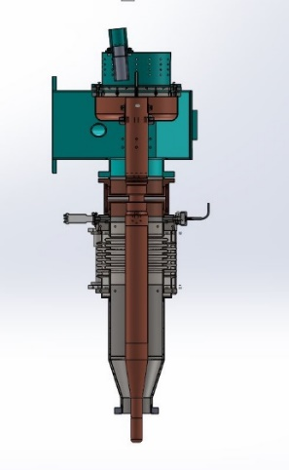
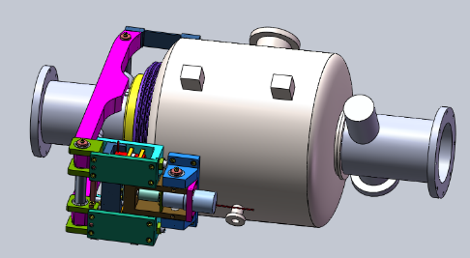
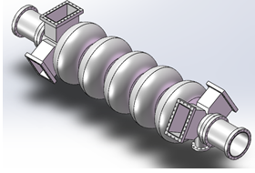
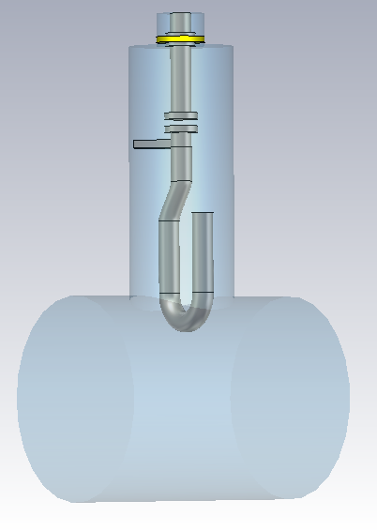
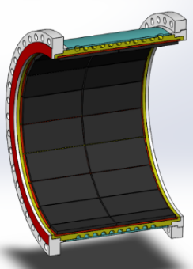
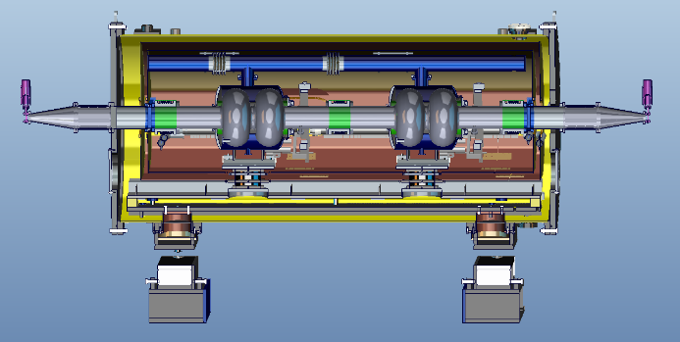
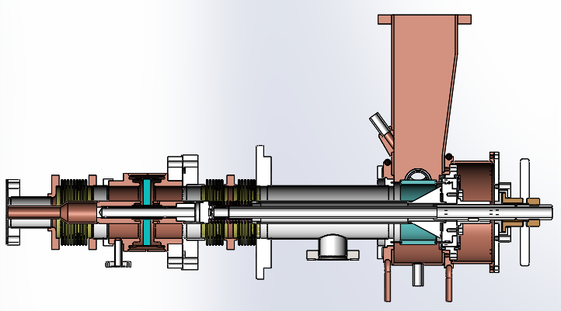
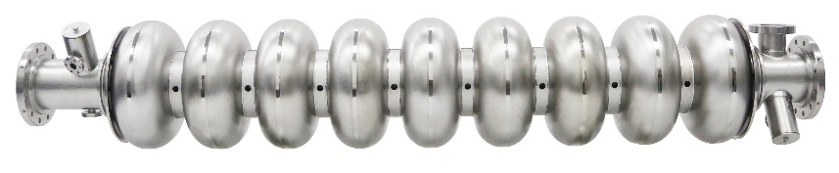
Key Components
650 MHz
2-cell cavity & tuner
5-cell cavity
Q > 2E10 @ 20 MV/m
650 MHz
variable coupler
300 kW
HOM coupler
1 kW
HOM absorber
5 kW
650 MHz & 1.3 GHz cryomodule
< 5 W @ 2K
1.3 GHz
variable coupler
20 kW
1.3 GHz TESLA cavity (high Q high gradient study)

Slide 43
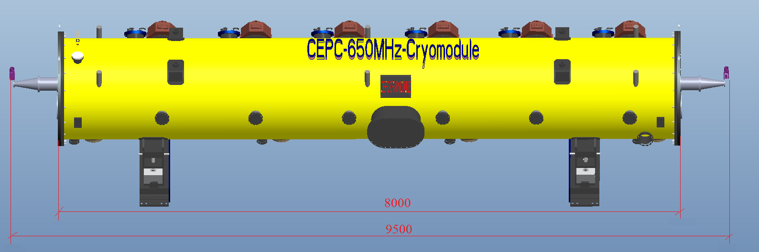
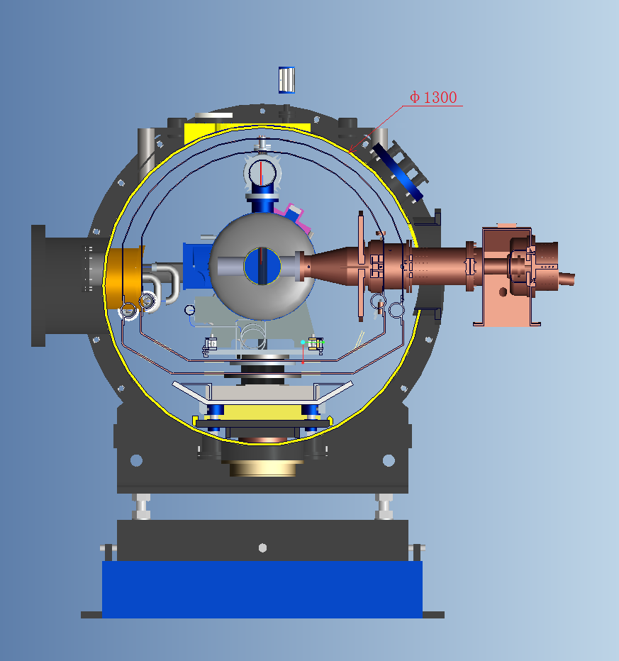
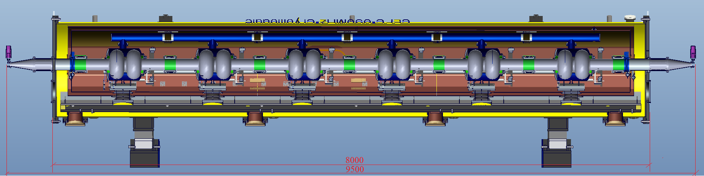
CEPC MR 650 MHz Cryomodule
Operating at 2 Kelvin of superfluid helium.
Six 2-cell 650 MHz superconducting cavities, six high power couplers, six mechanical tuner and two RT HOM absorbers, et al.
Fast cool-down capability. Static heat load budget of whole cryomodule is 5 W at 2 K.

Slide 44
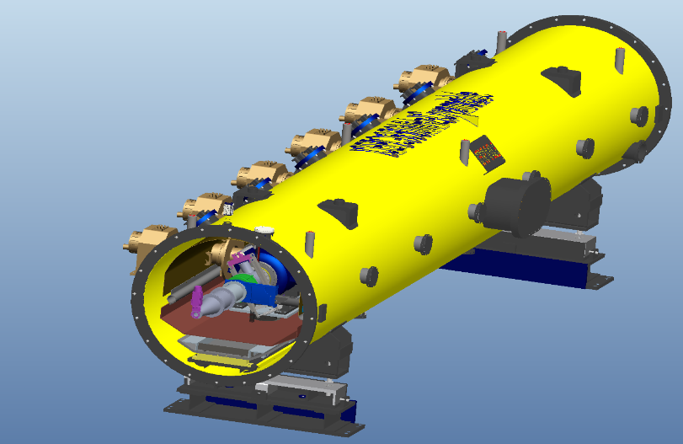
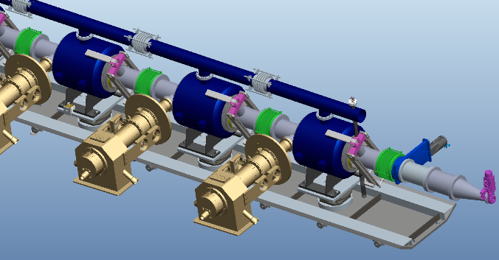
CEPC MR 650 MHz Cryomodule
Overall length (flange to flange, m) | 9.5
Inner diameter of vacuum vessel (m) | 1.3
Beamline height from floor (m) | 1.5
Overall weight (t) | 16
Cryo-system working pressure (mbar) | 31
Cryo-system working temperature (K) | 2
Cryo-system pressure stability at 2 K (mbar) | 0.1
Diameter of 2-phase pipe, mm | 114
2 K heat exchange | 1
Number of JT valve | 1
Number of cavities | 6
Number of coupler | 6
HOM absorber | 2
Number of 200-POST | 6

Slide 45
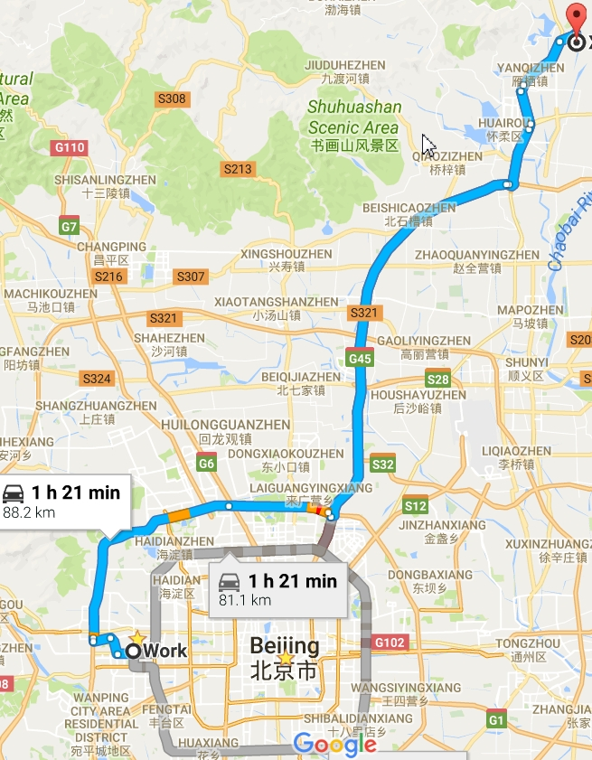
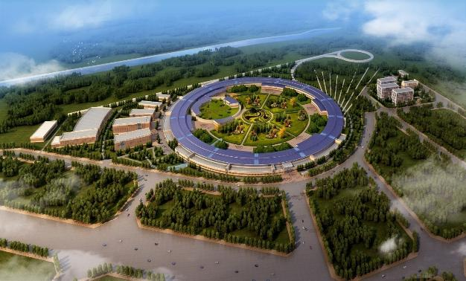


IHEP New SRF Facility
Platform of Advanced Photon Source Technology R&D, Huairou Science Park, Huairou, Beijing
Construction: 2017 - 2019
Ground Breaking: May 31, 2017
PAPS
High Energy Photon Source (HEPS)
2018 - 2024
IHEP
PAPS
2017 - 2019
4500 m² SRF lab

Slide 46


PAPS Beam Test System
CW 1 ~ 10 mA
15 ~ 30 MeV
DC photo cathode gun
1.3 GHz test module
650 MHz test module

Slide 47




Chinese SRF Industry and Opportunities
  Niobium: OTIC (EXFEL 35% 7 t, FRIB 50% 5 t, LCLS-II 50% 5.6 t …)
  Cavity: OTIC, HERT, HIT, BIAM…
Coupler: HERT (ILC, CADS, RISP …), JNT …
Cryomodule: WXCX (EXFEL 60% 60, LCLS-II 100% 33, FRIB), HFJN …
CIADS, HIAF, SCLF, HEPS … more than 1000 cavities needed in next 5 years for China

Slide 48
Summary and Outlook
Baseline layout and parameters for CEPC RF system established (~ 500 cavities in total: 336 main ring 650 MHz 2-cell cavities and 160 booster 1.3 GHz 9-cell cavities). Complete CDR in the end of 2017.
Key physics issues and component design progressing well. Prototype demonstration next year. Extensive CEPC SRF technology R&D planned and launched, with support of large PAPS SRF facility.
Ramp up CEPC SRF industrialization and international collaboration.

