Slide 1
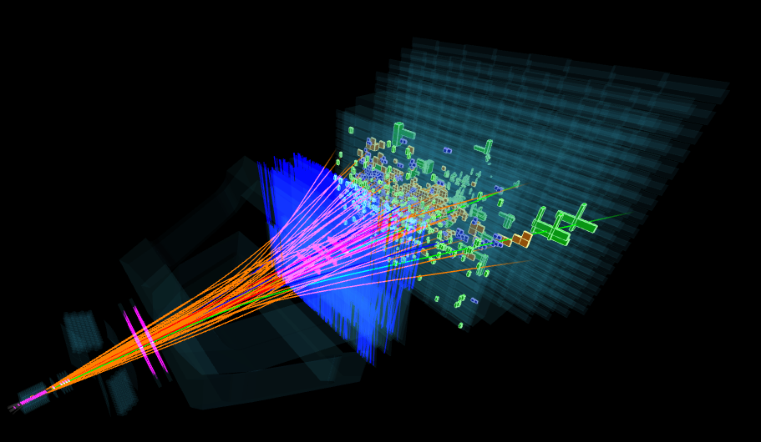
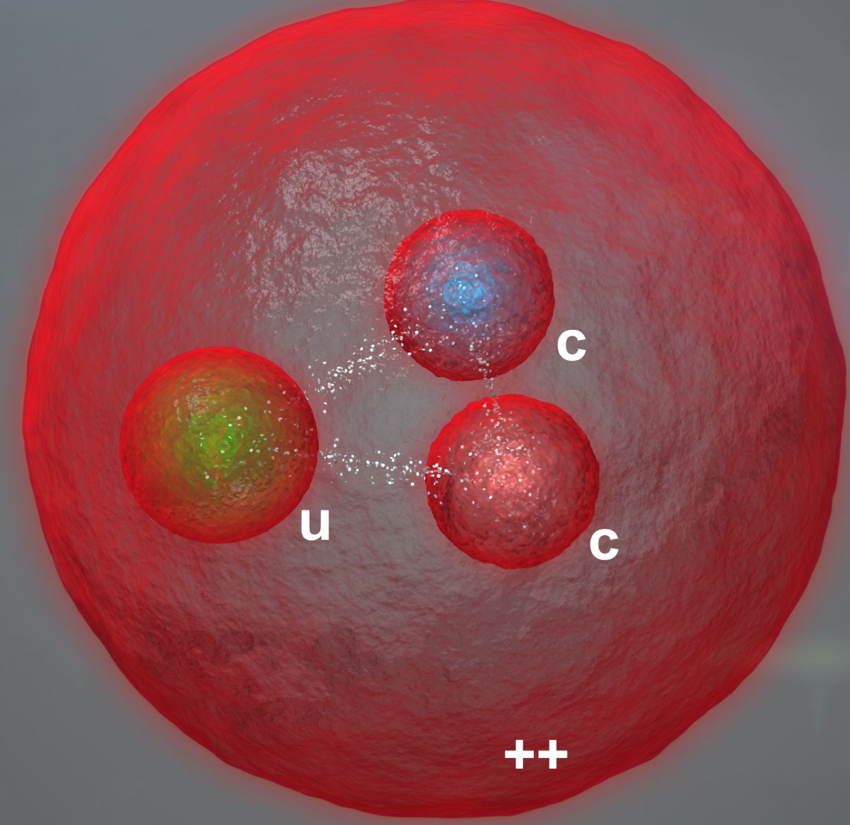
Observation of the doubly charmed baryon $Ξ_{cc}^{++}$
Zhenwei Yang (杨振伟)
Center for High Energy Physics, Tsinghua University
for the LHCb collaborations
EPD seminar, 14 July 2017, IHEP

Slide 2
Outline
Introduction
LHCb detector
Observation of the $Ξ_{cc}^{++}$ baryon
Prospects and summary
[arXiv:1707.16021]

Slide 3
Standard Model of particle physics
Task of particle physics is to investigate
the fundamental constituents (elementary particles) of the Universe and,
the interactions between them (the forces)
Efforts so far lead to the Standard Model
力的媒介
基本组元
上帝粒子

Slide 4
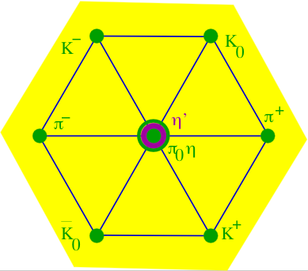
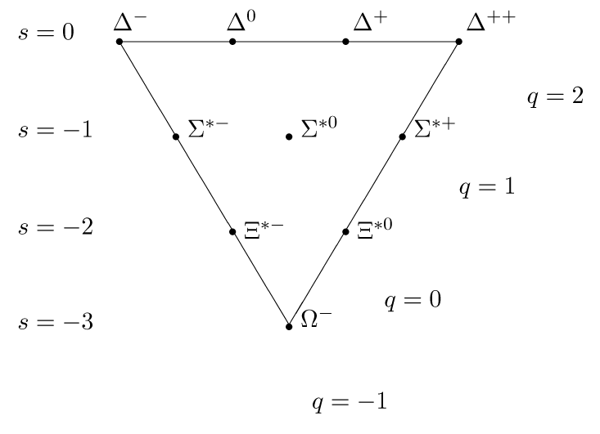
Quark model: a revolution
Many milestones in the history of particle physics
The quark model proposed by M. Gell-Mann and G. Zweig is among those highly recognized
It revolutionized our understanding of the structure of matter that interacting strongly

Slide 5
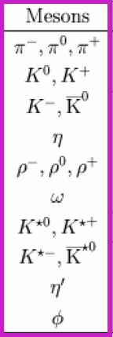
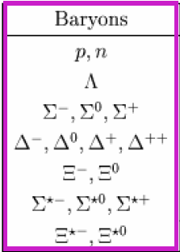
Proliferated particle zoo
All these particles cannot be elementary ……
➔ Quark Model
…… I have heard it said that « the finder of a new elementary particle used to be rewarded by a Nobel Prize, but such a discovery now ought to be punished by a $10,000 fine ». —— Lamb 1955

Slide 6
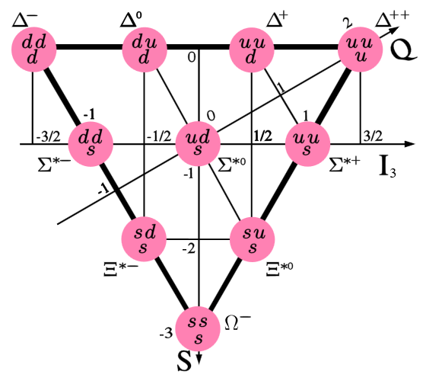
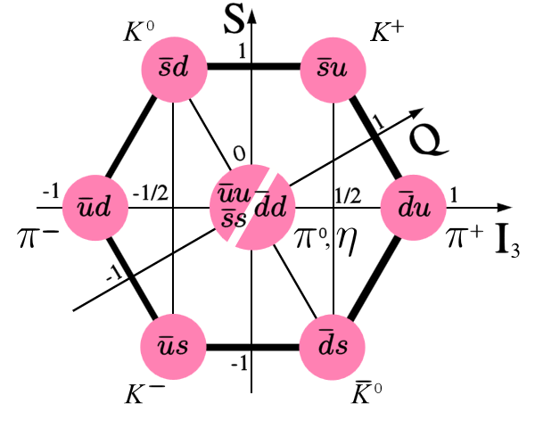
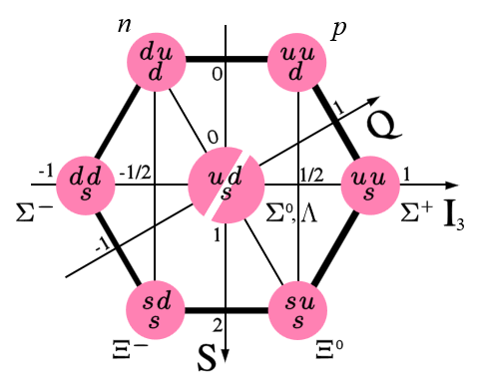
SU(3) quark model
Hadrons are composed of (invisible) quarks ($u, d, s$)
Mesons $(q\overline{q}′)$ and baryons $(qq^{′}q′′)$ are SU(3) multiplets
$$u$$
$$d$$
$$s$$
Numerous hadrons are well classified, and predictions confirmed
Baryons
$Ω^{−}$: 1969
Baryons
Mesons

Slide 7
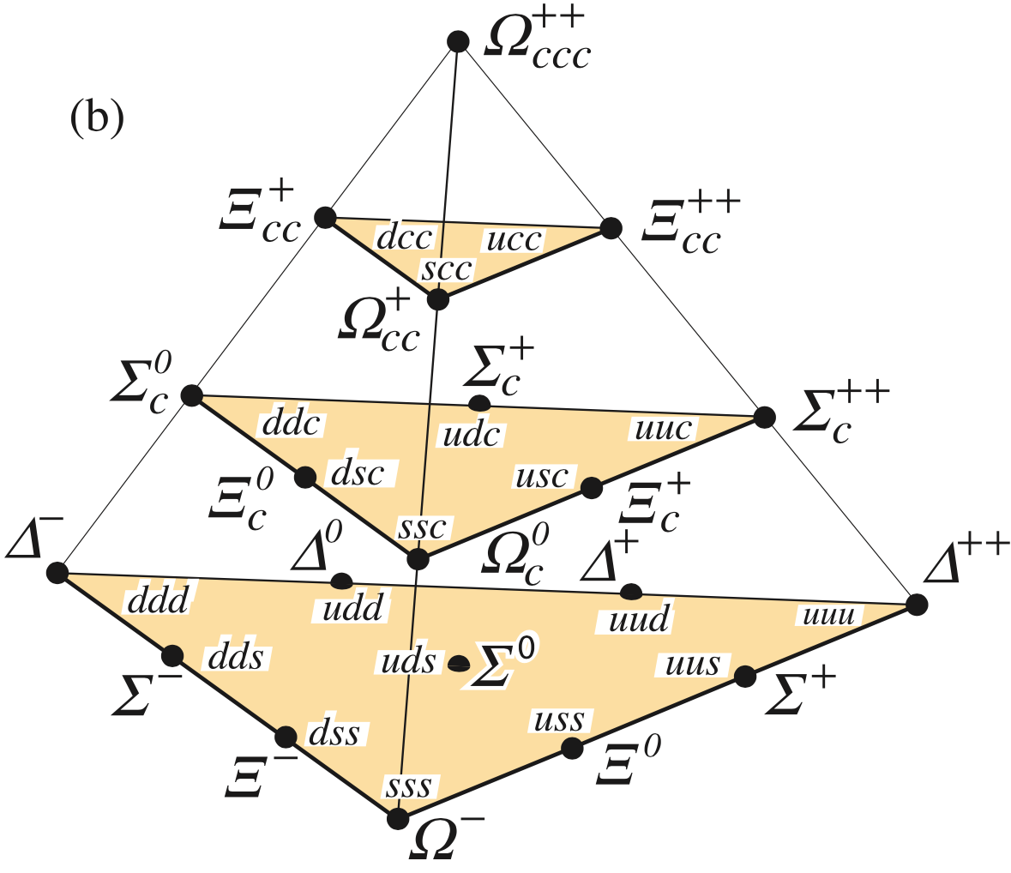
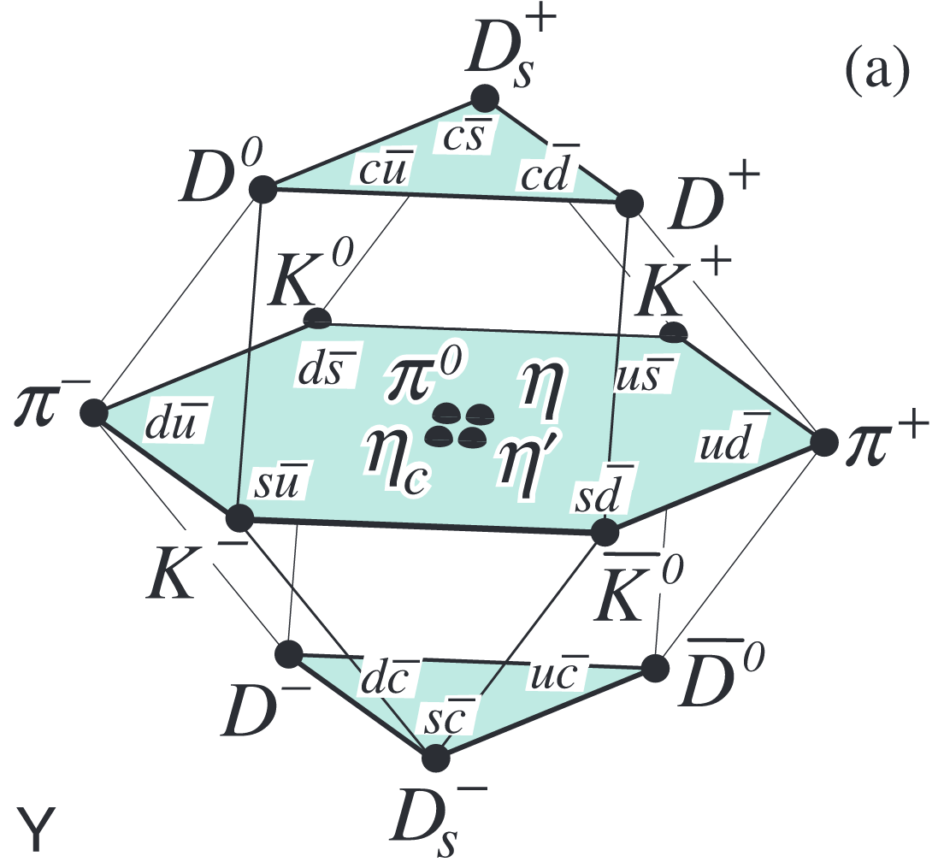
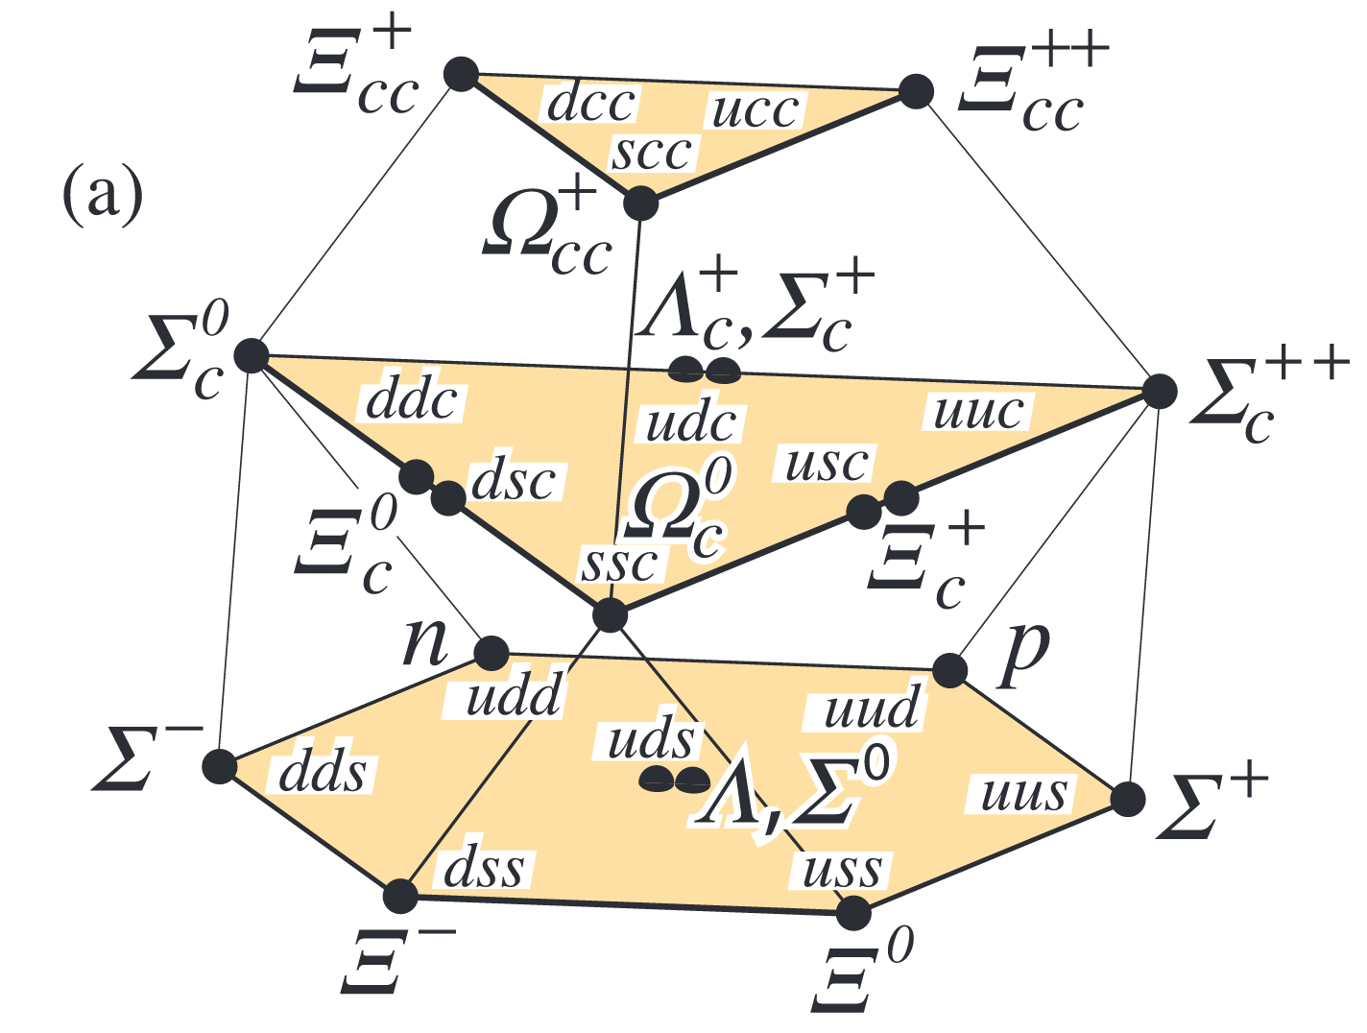
SU(4) quark model
$$J^{P}={\frac{3}{2}}^{+}$$
Baryons
When extended to $(u, d, s, c)$ quarks, hadrons form SU(4) multiplets
All $C=0$ and $C=1$ ground states observed
Three $C=2$ baryons $J^{P}=1/2^{+}$ or $3/2^{+}$
Isospin doublet: $Ξ_{cc}^{+}(ccd)$ and $Ξ_{cc}^{++}(ccu)$
Isospin singlet: $Ω_{cc}^{+}(ccs)$
$$J^{P}={\frac{1}{2}}^{+}$$
Baryons
Mesons
PDG
PDG

Slide 8
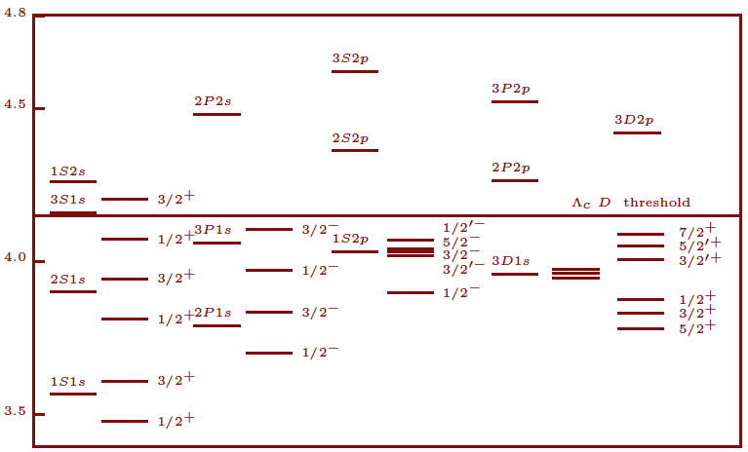
Spectroscopy
Spectroscopy: collecting and sorting energy levels
An indispensable procedure to elucidate the underlying dynamics of complex phenomena
Study of hadron spectroscopy can reveal properties of strong interactions between quarks

Slide 9
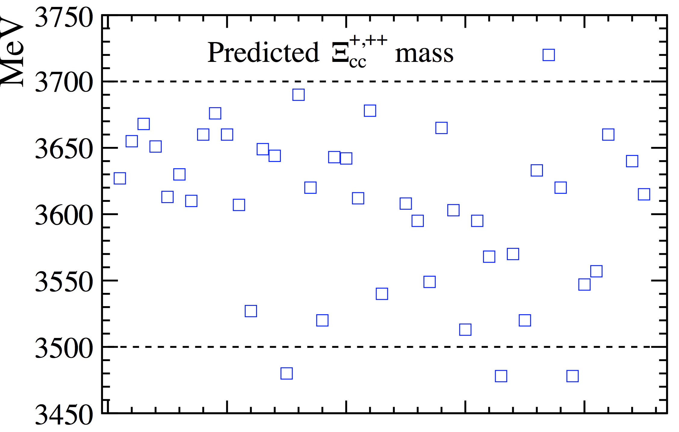
Theoretical calculations of $Ξ_{cc}$
Many models calculated the masses: (non-)relativistic QCD potential models, QCD sum rules, bag model …
$m\left(Ξ_{cc}^{+,++}\right)∈\left(3.5, 3.7\right) GeV$, $m\left(Ω_{cc}^{+}\right)≈m\left(Ξ_{cc}\right)+0.1 GeV$
Mass splitting between $Ξ_{cc}^{+}$ and $Ξ_{cc}^{++}$: a few MeV
Lattice QCD:
Lifetime: ${τ(Ξ}_{cc}^{++})≫τ(Ξ_{cc}^{+})$
$τ\left(Ξ_{cc}^{++}\right)∈(200−700)$ fs
$τ\left(Ξ_{cc}^{+}\right)∈\left(50−250\right) fs$
$M\left(Ξ_{cc}\right)≈3.6$ GeV, $M\left(Ω_{cc}^{+}\right)≈3.7$ GeV
HQET: two charm quarks considered as a heavy diquark, doubly heavy baryon similar to a heavy meson $Qq$
$$q$$
diquark
$$c$$
$$c$$

Slide 10
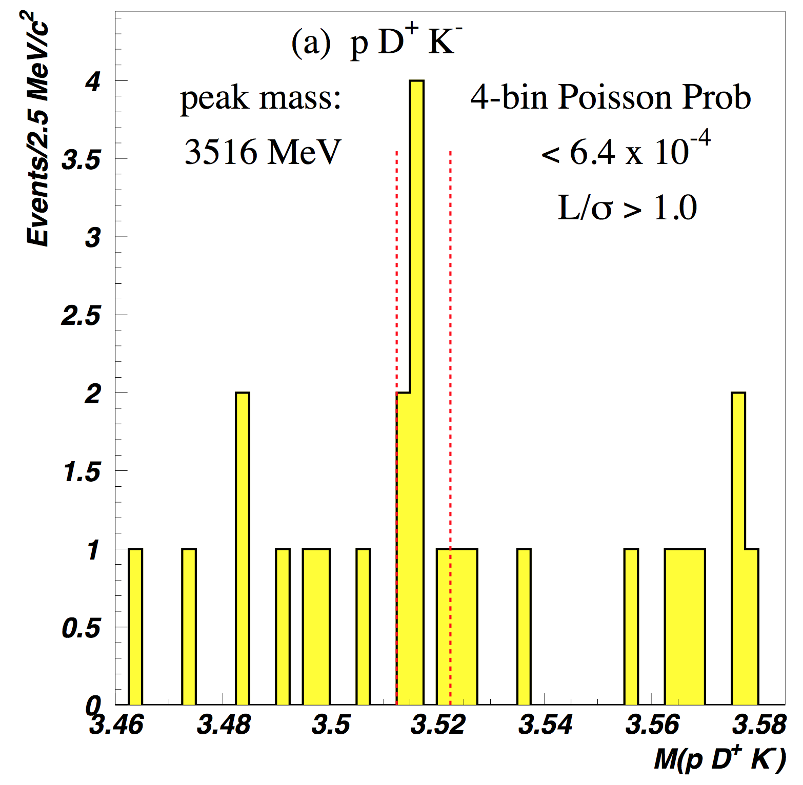
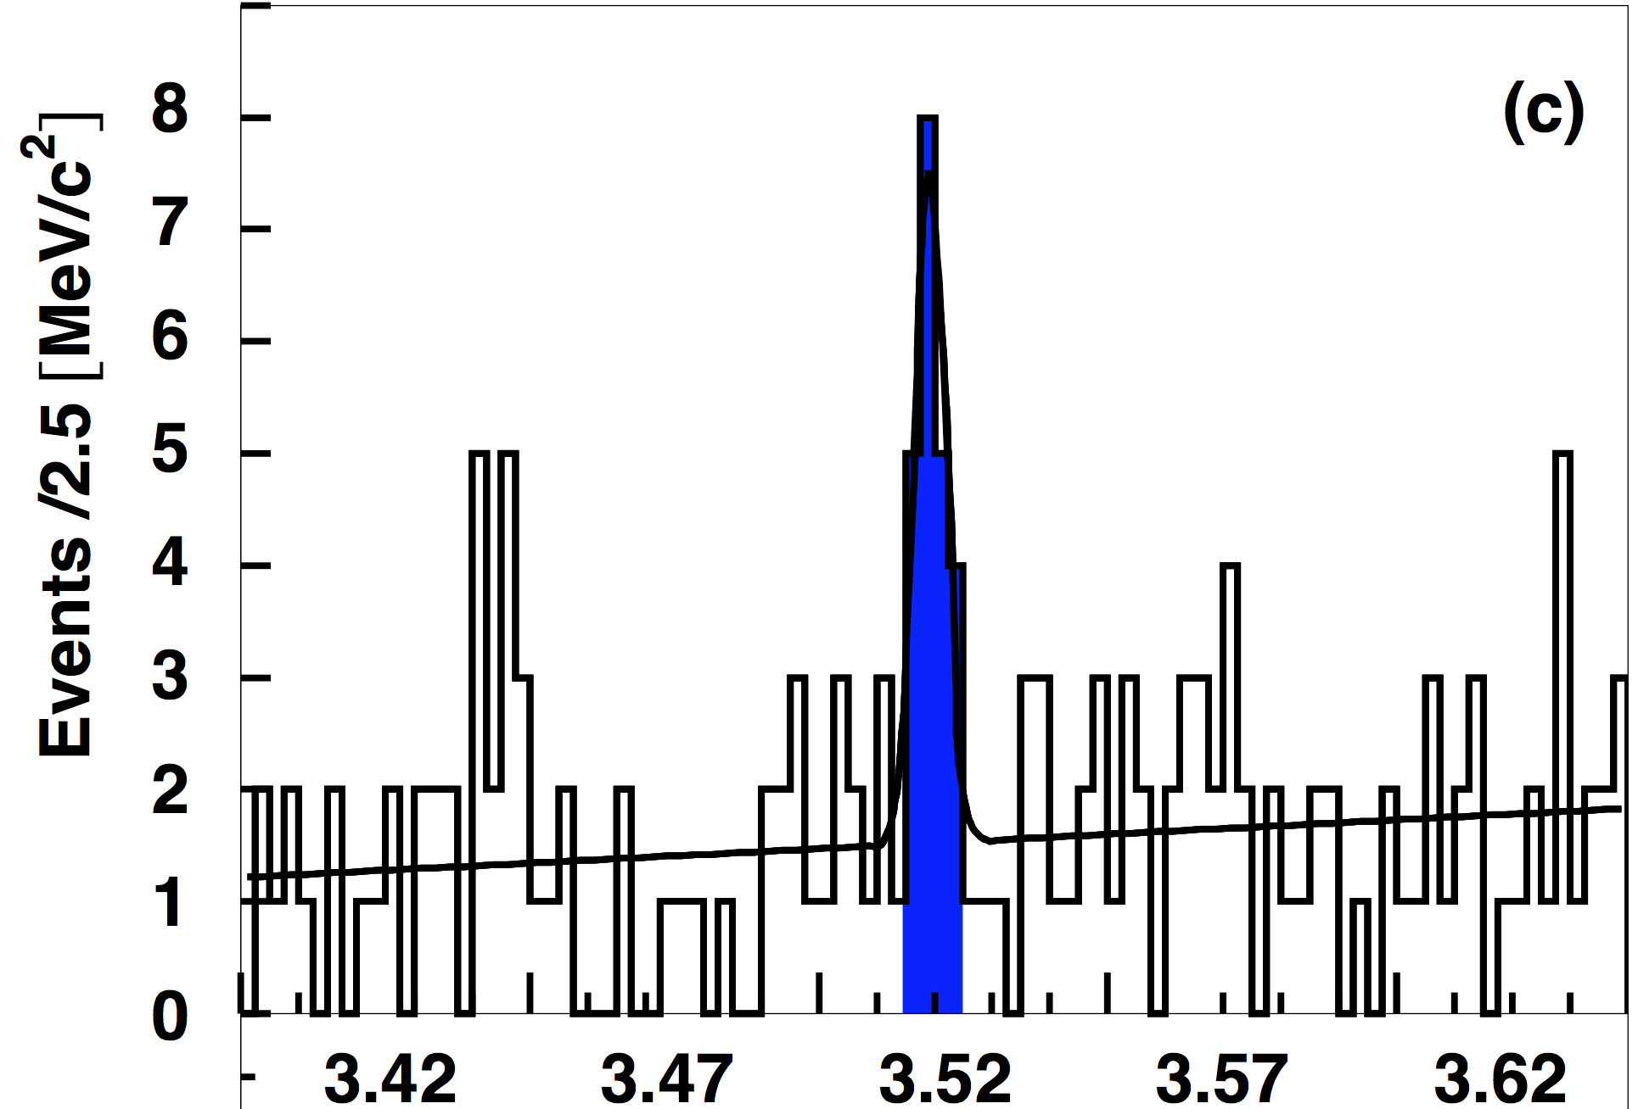
Experimental results
SELEX (Fermilab E781) collides high energy hyperon beams ($Σ^{−},p$) with targets, dedicated to study charm baryons
Observed $Ξ_{cc}^{+}$ in $Ξ_{cc}^{+}→Λ_{c}^{+}K^{−}π^{+}$ and $Ξ_{cc}^{+}→pD^{+}π^{−}$ decays
Signal yields: $15.9 (Λ_{c}^{+}K^{−}π^{+})$ and $5.62 (pD^{+}π^{−})$
Short lifetime: $τ\left(Ξ_{cc}^{+}\right)<33$ fs @90% CL, but not zero
Large production: $R=\frac{σ\left(Ξ_{cc}^{+}\right)×BF(Ξ_{cc}^{+}→Λ_{c}^{+}K^{−}π^{+})}{σ(Λ_{c}^{+})}∼20\%$
Mass (combined): $3518.7±1.7$ MeV
$$Ξ_{cc}^{+}→pD^{+}π^{−}$$
PLB 628 (2005) 18
$$Ξ_{cc}^{+}→Λ_{c}^{+}K^{−}π^{+}$$
PRL 89 (2002) 112001

Slide 11
Experimental results (cont.)
SELEX (Fermilab E781) collides high energy hyperon beams ($Σ^{−},p$) with targets, dedicated to study charm baryons
Observed $Ξ_{cc}^{+}$ in $Ξ_{cc}^{+}→Λ_{c}^{+}K^{−}π^{+}$ and $Ξ_{cc}^{+}→pD^{+}π^{−}$ decays
Signal yields: $15.9 (Λ_{c}^{+}K^{−}π^{+})$ and $5.62 (pD^{+}π^{−})$
Short lifetime: $τ\left(Ξ_{cc}^{+}\right)<33$ fs @90% CL, but not zero
Large production: $R=\frac{σ\left(Ξ_{cc}^{+}\right)×BF(Ξ_{cc}^{+}→Λ_{c}^{+}K^{−}π^{+})}{σ(Λ_{c}^{+})}∼20\%$
Mass (combined): $3518.7±1.7$ MeV
$$Ξ_{cc}^{+}→pD^{+}π^{−}$$
PLB 628 (2005) 18
$$Ξ_{cc}^{+}→Λ_{c}^{+}K^{−}π^{+}$$
PRL 89 (2002) 112001
No evidence observed by FOCUS, BaBar, Belle, and LHCb

Slide 12
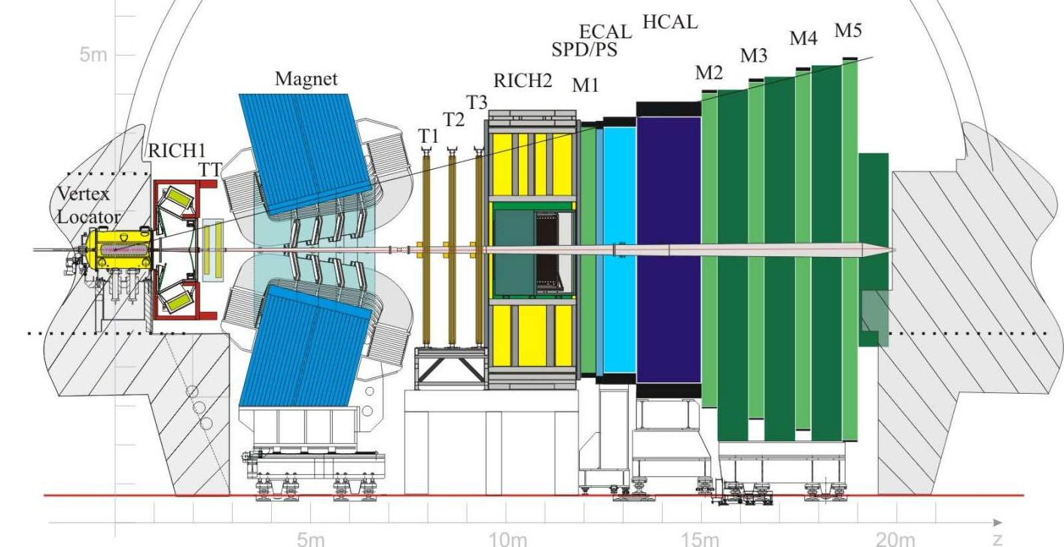
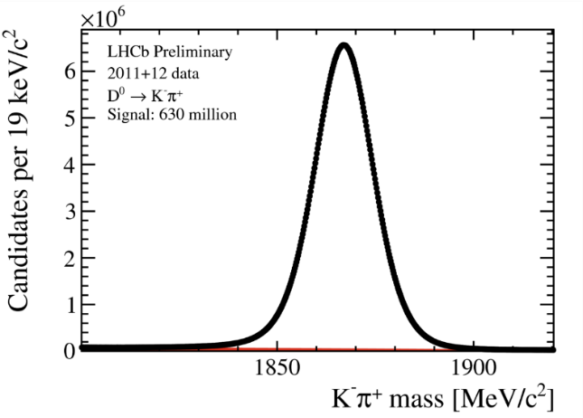
The LHCb detector
JINST 3 (2008) S08005
IJMPA 30 (2015) 1530022
Designed for precision measurements in $b,c$ flavor sectors
Acceptance: $2<η<5$
250 mrad
Powerful
hadron PID!
1) precise vertex 2) precise tracking 3) powerful hadron ID

Slide 13
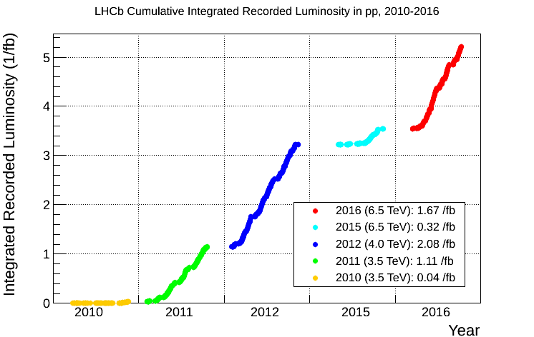
LHCb data taking
Run I: 1. fb⁻¹ at 7 TeV (2011) + 2. fb⁻¹ at 8 TeV (2012)
Run II: 0.3 fb⁻¹ (2015) + 1.7 fb⁻¹ (2016) at 13 TeV
Run-II: $2 fb^{−1}$
Run-I: $3 fb^{−1}$
Data taking efficiency $>90\%$

Slide 14
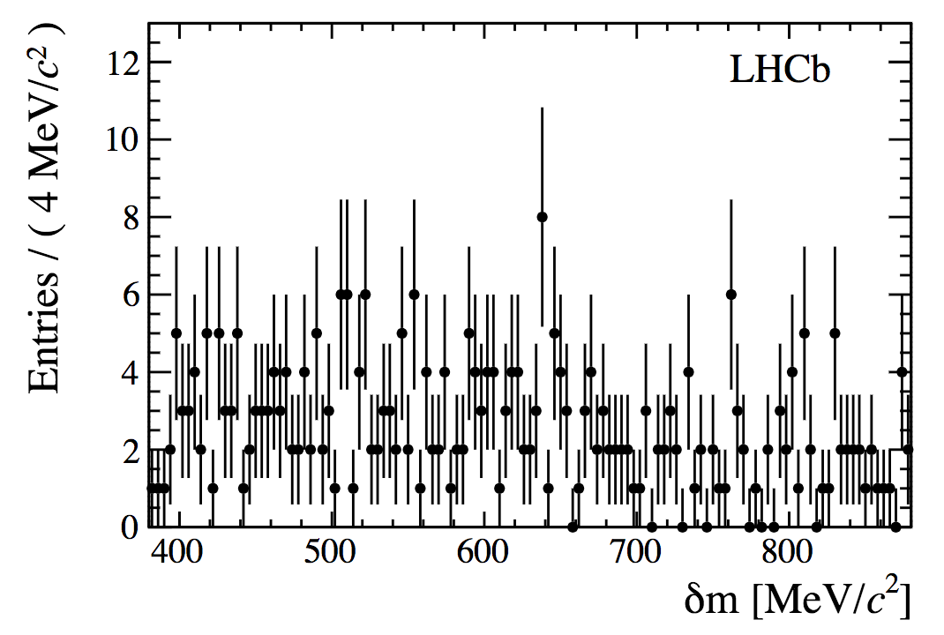
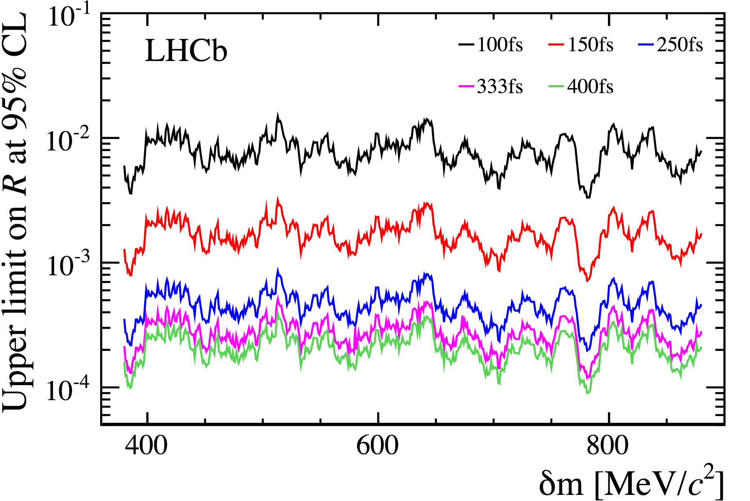
Search for $Ξ_{cc}$ at LHCb
JHEP 12 (2013) 090
Search for $Ξ_{cc}^{+}→Λ_{c}^{+}K^{−}π^{+}$ at 7 TeV, $𝓛=0.65 fb^{−1}$
$N\left(Λ_{c}^{+}\right)≈0.8$ M, requiring high-$p_{T}$
No significant peaking structure observed in the range $[3.3, 3.8]$ GeV
Experiment sensitivity strongly depends on the $Ξ_{cc}^{+}$ lifetime
$R≡\frac{σ\left(Ξ_{cc}^{+}\right)×BF(Ξ_{cc}^{+}→Λ_{c}^{+}K^{−}π^{+})}{σ(Λ_{c}^{+})}$ $<0.013$ for $τ=100$ fs,
$<3.3×{10}^{−4}$ for $τ=400$ fs @95%
Increased by ~40 from 100 fs to 400 fs
SELEX $Ξ_{cc}^{+}$
SELEX $Ξ_{cc}^{+}$
$$δm=m\left({\left[pK^{−}π^{+}\right]}_{Λ_{c}^{+}}K^{−}π^{+}\right)−m\left({\left[pK^{−}π^{+}\right]}_{Λ_{c}^{+}}\right)−m(K^{−})−m(π^{+})$$

Slide 15
Search for $Ξ_{cc}$ at LHCb (cont.)
Tsinghua started the work in 2010, collaborating with two UK groups
Two NSFC fundings dedicated to doubly heavy baryons
Implementing GenXicc [C.-H. Chang et al] to LHCb software
PhD thesis of the search for $Ξ_{cc}^{+}→Λ_{c}^{+}K^{−}π^{+}$
Planned in 2014 to make a full search using full Run-I data
Both $Ξ_{cc}^{+}$ and $Ξ_{cc}^{++}$, and more decay modes
No progress due to lack of MC (tech. issue) and students
Analysis restarted in the summer 2016
Checking MC samples, studying selections, still focusing on $Ξ_{cc}^{+}$
In a seminar by F.-S. Yu in UCAS in Dec. 2016 (invited by Jibo), $Ξ_{cc}^{++}→Λ_{c}^{+}K^{−}π^{+}π^{+}$ is labelled as the most promising channel
Owing to longer lifetime of $Ξ_{cc}^{++}$ and the large branching fraction

Slide 16
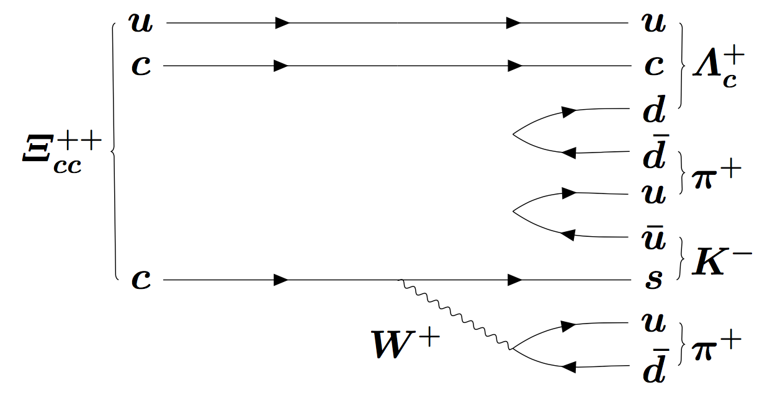
Search for the $Ξ_{cc}^{++}→Λ_{c}^{+}K^{−}π^{+}π^{+}$
Longer lifetime expected than $Ξ_{cc}^{+}$ ➔ higher sensitivity at LHCb
Decay: $Ξ_{cc}^{++}→Λ_{c}^{+}(→pK^{−}π^{+})K^{−}π^{+}π^{+}$, branching fraction ~10%
F.-S. Yu, arXiv:1703.09086
Data sample: LHCb Run-II at $\sqrt{s}=13$ TeV, $\sim 1.7$ fb⁻¹
Dedicated exclusive trigger ensuring high efficiency, full event reconstruction at trigger level
Run-I data (2012) also analyzed for cross-check
$$Ξ_{cc}^{++}→Λ_{c}^{+}K^{−}π^{+}π^{+}$$

Slide 17
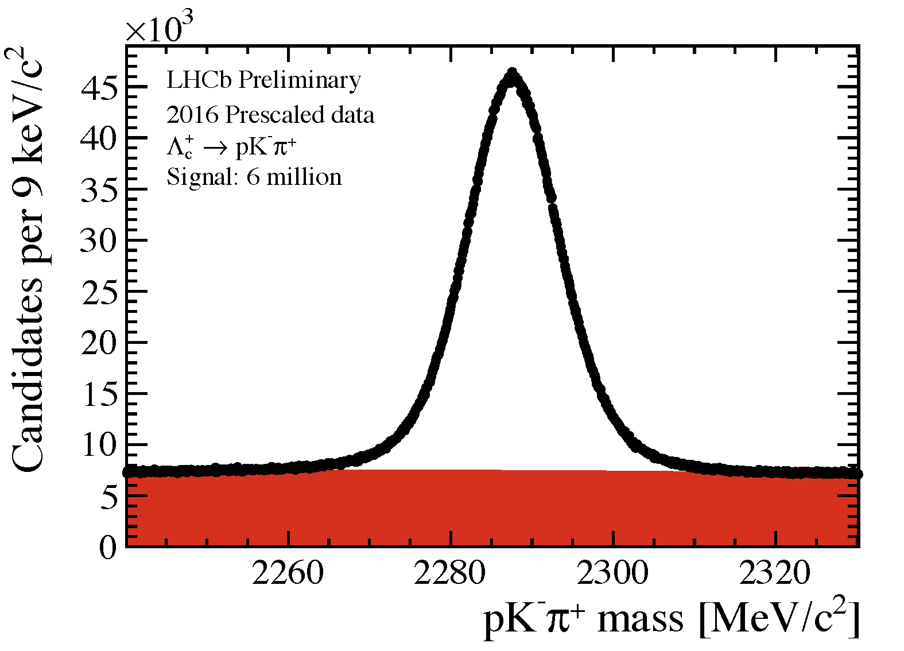
Preselections
Huge hadronic background expected
Online selection to select clean $Λ_{c}^{+}→pK^{−}π^{+}$ and reasonably reject $Ξ_{cc}^{++}$ background
Tracks with good track-fit quality, good PID, and away from PV
Good vertices, large decay length significance, large $p_{T}$
Clone tracks removed
Loose offline preselection to remove obvious background
Background strongly suppressed
$${Ξ_{cc}^{++}→K^{−}π^{+}π^{+}Λ}_{c}^{+}\left(→pK^{−}π^{+}\right)$$
$10\%$ data for plot
$$Ξ_{cc}^{++}$$
$$Λ_{c}^{+}$$
Primary Vertex
(PV)
$τ\left(Λ_{c}^{+}\right)≈200$ fs
$σ_{τ}\sim 45$ fs
$60$ M fully reconstructed
$Λ_{c}^{+}→pK^{−}π^{+}$ signal decays

Slide 18
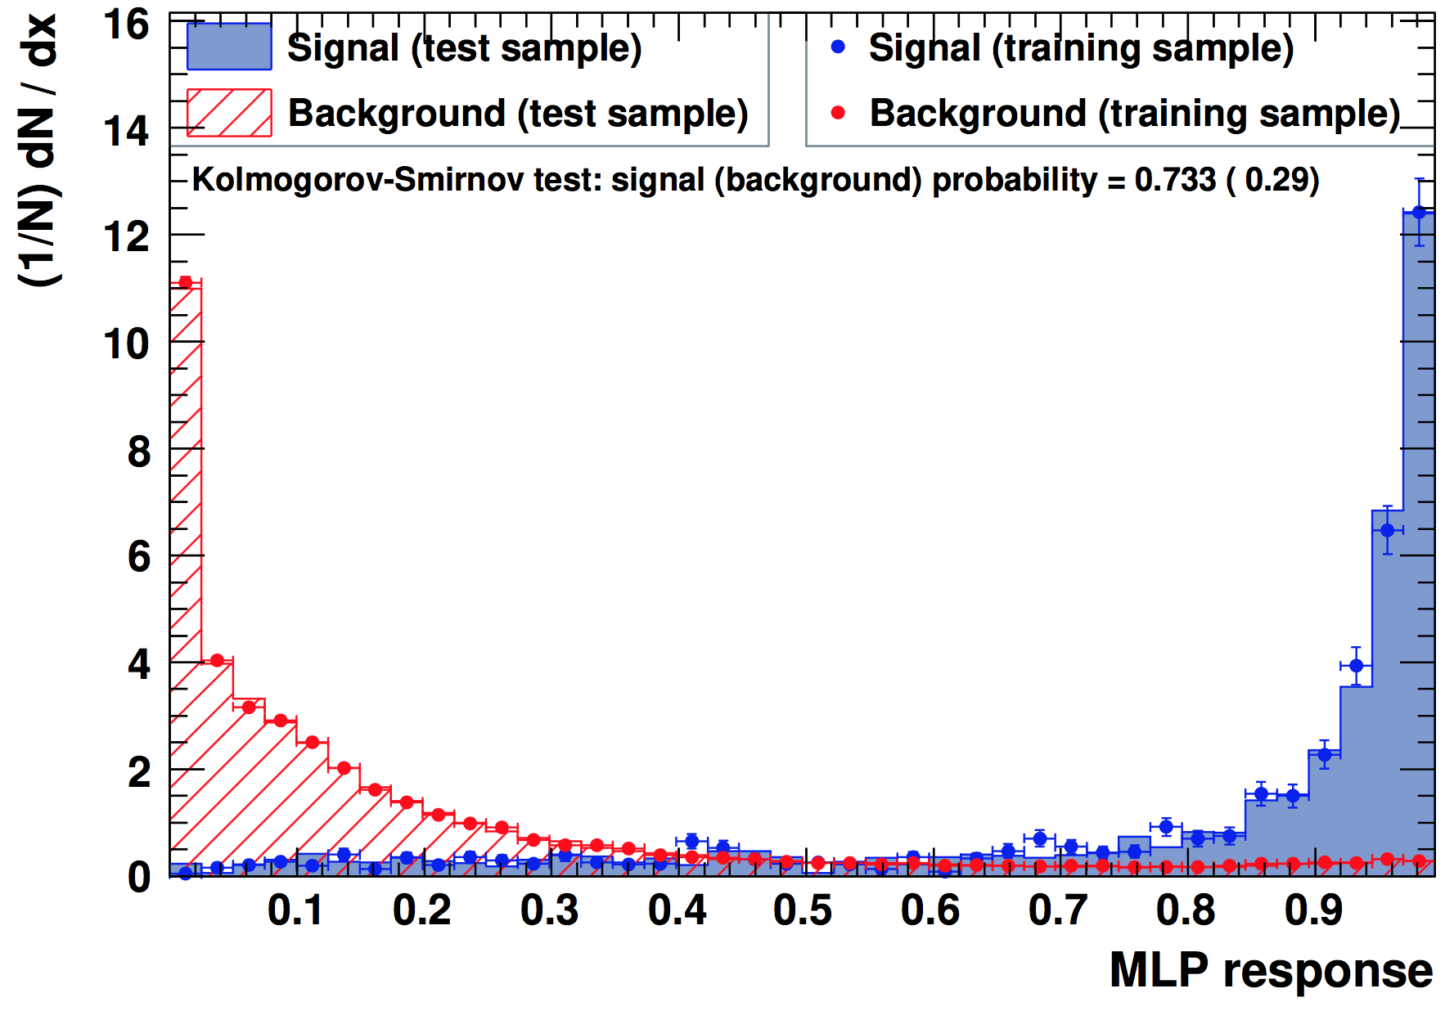
Multivariate analysis
MVA used to further suppress background
10 kinematic and topological variables as input
In the training and optimization
signals from simulation
Background from wrong-sign (WS) control sample ($Λ_{c}^{+}K^{−}π^{+}π^{−}$)
$${Ξ_{cc}^{++}→K^{−}π^{+}π^{+}Λ}_{c}^{+}\left(→pK^{−}π^{+}\right)$$
$$Ξ_{cc}^{++}$$
$$Λ_{c}^{+}$$
PV
FoM $F(t)≡{ε(t)}/{\left(\frac{a}{2}+\sqrt{B\left(t\right)}\right)}$ used to optimise the MVA cut
$t$: a given MVA cut
$ε\left(t\right):$ signal efficiency
$B\left(t\right)$: expected number of background in the signal region
$a=5$ aiming at a discovery
MVA selector

Slide 19
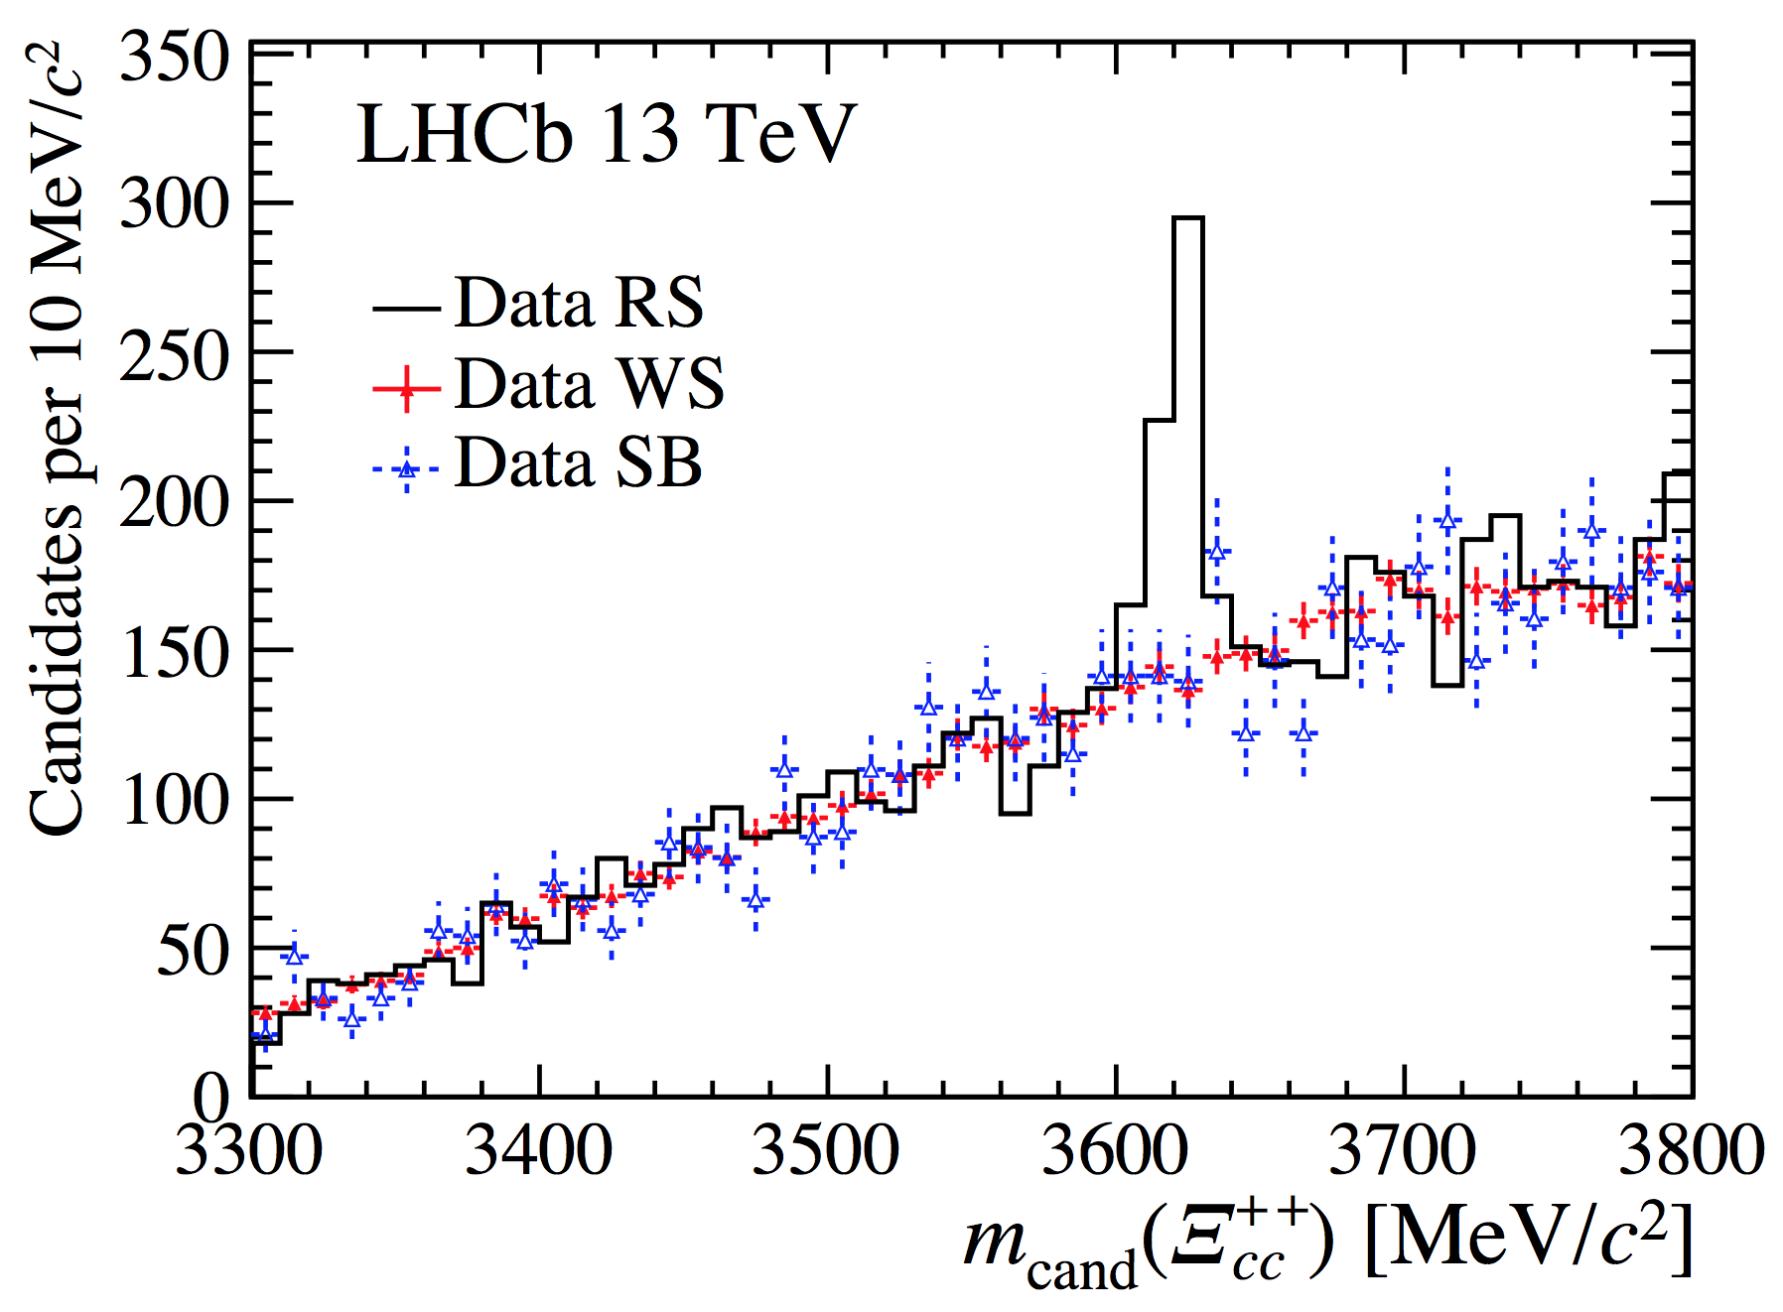
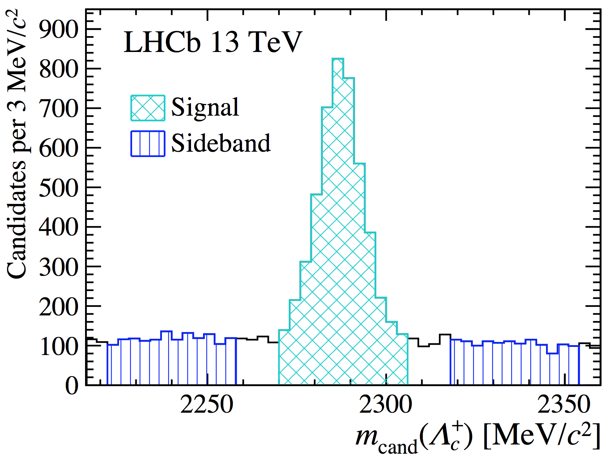
Mass spectrum after selection
arXiv: 1707.01621
A significant structure in right sign (RS) combinations at around $3620 MeV/c^{2}$
Not present in wrong sign (WS) combinations
Not observed for $Λ_{c}^{+}$ sidebands candidates
Distributions similar except the peak in RS
A significant peak!

Slide 20
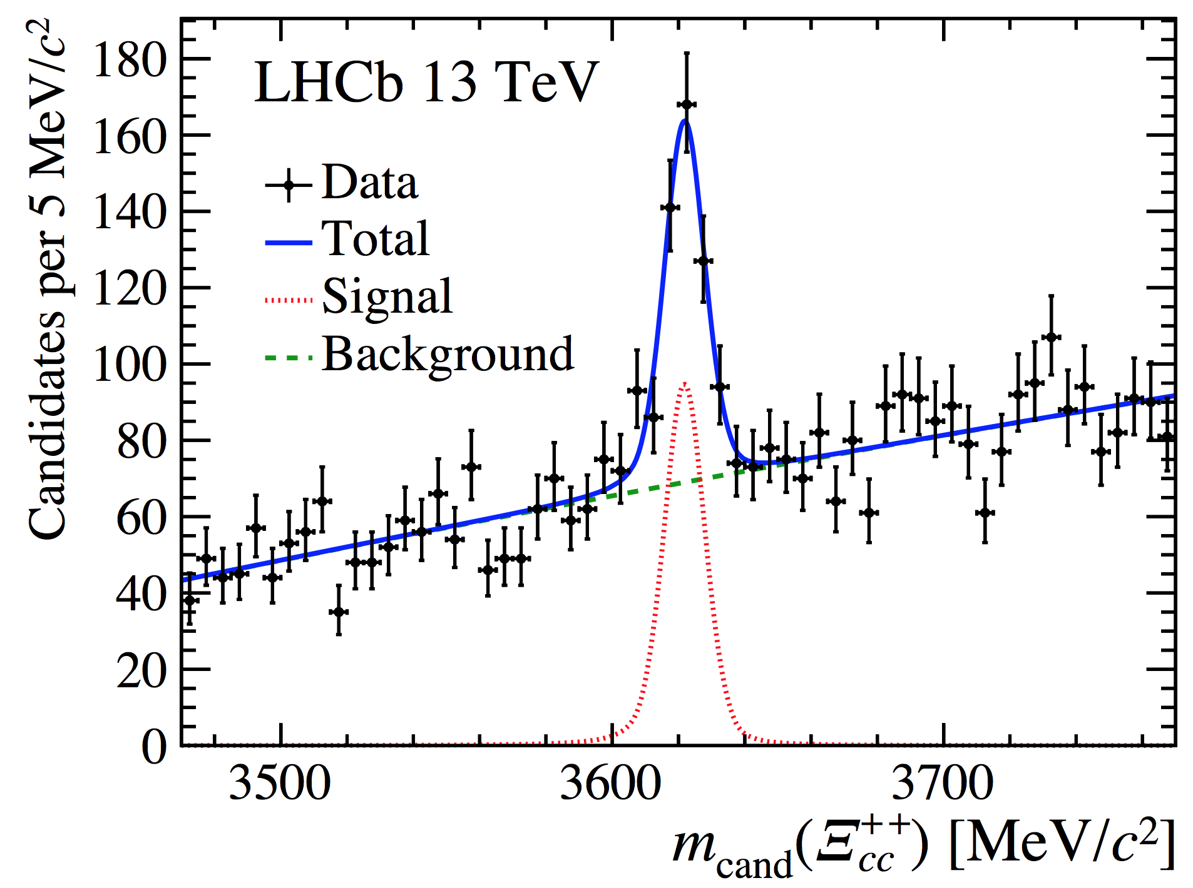
Fit to the peak structure
arXiv: 1707.01621
$$m_{cand}(Ξ_{cc}^{++})=m\left(Λ_{c}^{+}K^{−}π^{+}π^{+}\right)−m_{cand}\left(Λ_{c}^{+}\right)+m_{PDG}\left(Λ_{c}^{+}\right)$$
Default fit range: $3620±150 MeV/c^{2}$
Signal: DSCB function + Gaussian
Mass, yield and overall resolution free, others fixed to simulation
Bkg: 2nd order Chebychev
All parameters free
$$N_{sig}=313±33$$
$$m=3621.80±0.72 MeV/c^{2}$$
$$σ=6.63±0.82 MeV/c^{2}$$
Mass resolution consistent with simulation
Local statistical significance above 12$σ$

Slide 21
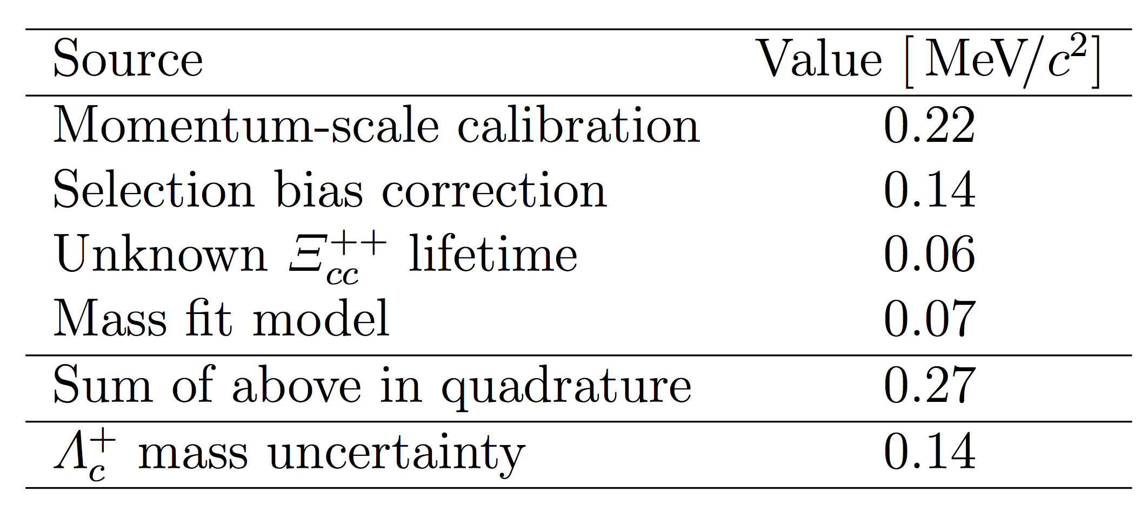
Mass result
arXiv: 1707.01621
After corrections to biases due to selection and final-state radiation
$m\left(Ξ_{cc}^{++}\right)=3621.40±0.72(stat)±0.27(syst)±0.14(Λ_{c}^{+})$ MeV
$m\left(Ξ_{cc}^{++}\right)−m(Λ_{c}^{+})=1134.94±0.72(stat)±0.27(syst)$ MeV
Value consistent with many theoretical calculations
Systematic uncertainties

Slide 22
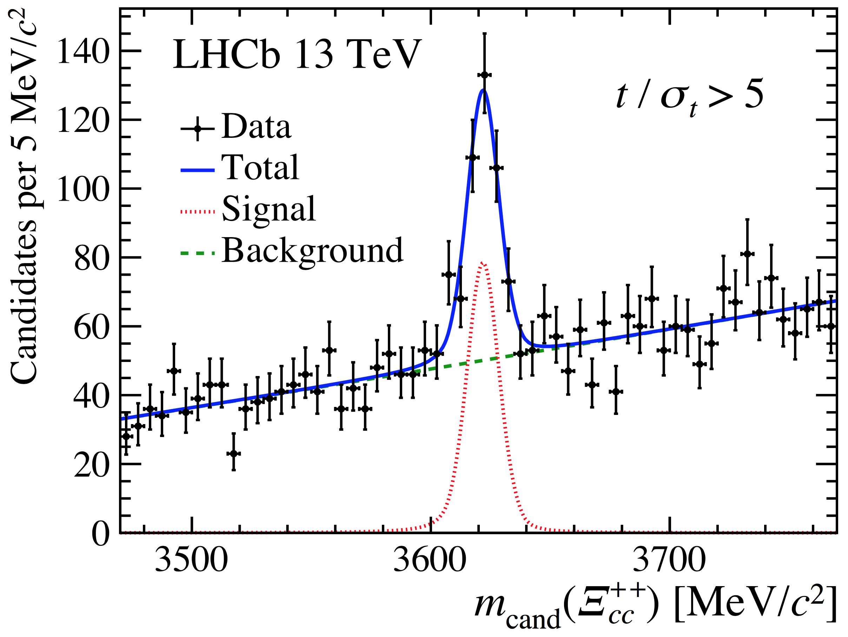
Signal properties: weakly decay
arXiv: 1707.01621
Peaking structure remains significant $(>12σ)$ after requiring minimum decay time, $t>5σ_{t}$
Indeed a weak decay!

Slide 23
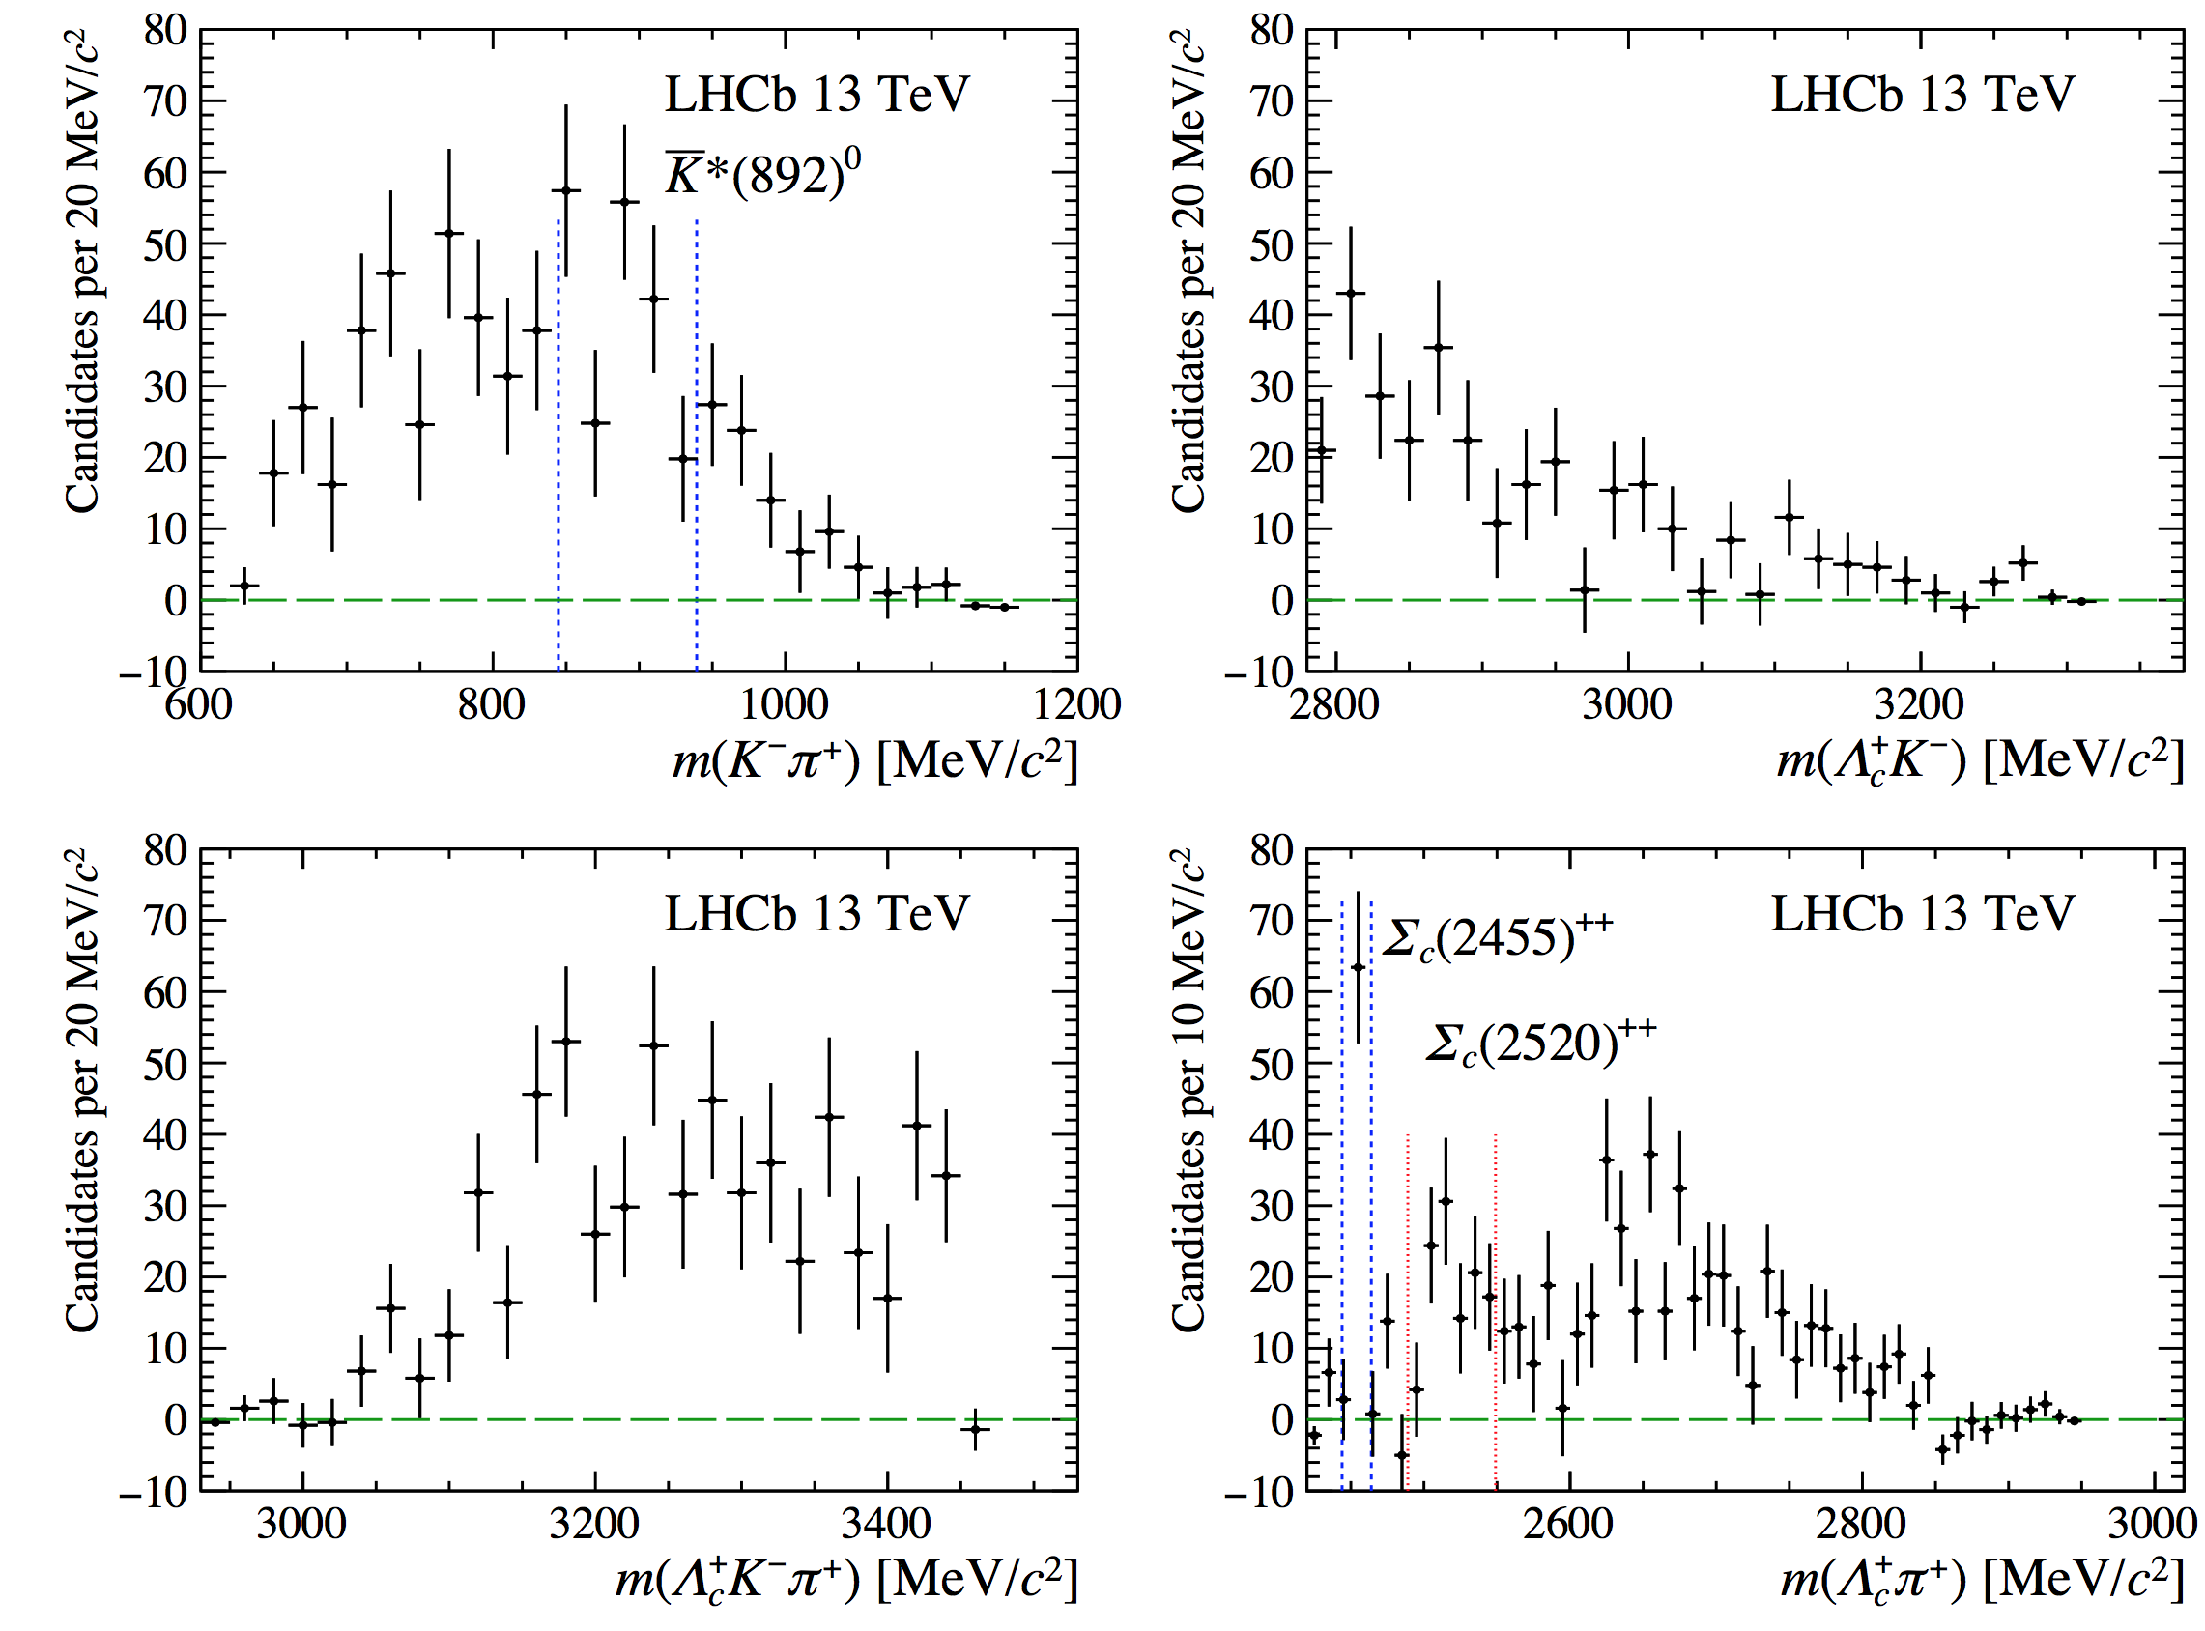
Signal properties: intermediate resonances
${\overline{K}}^{∗}{\left(892\right)}^{0}, Σ_{c}{\left(2455\right)}^{++}, Σ_{c}{\left(2520\right)}^{++}$
arXiv: 1707.01621
$$Σ_{c}{\left(2455\right)}^{++}$$
$$Σ_{c}{\left(2520\right)}^{++}$$
$${\overline{K}}^{∗}{\left(892\right)}^{0}$$

Slide 24
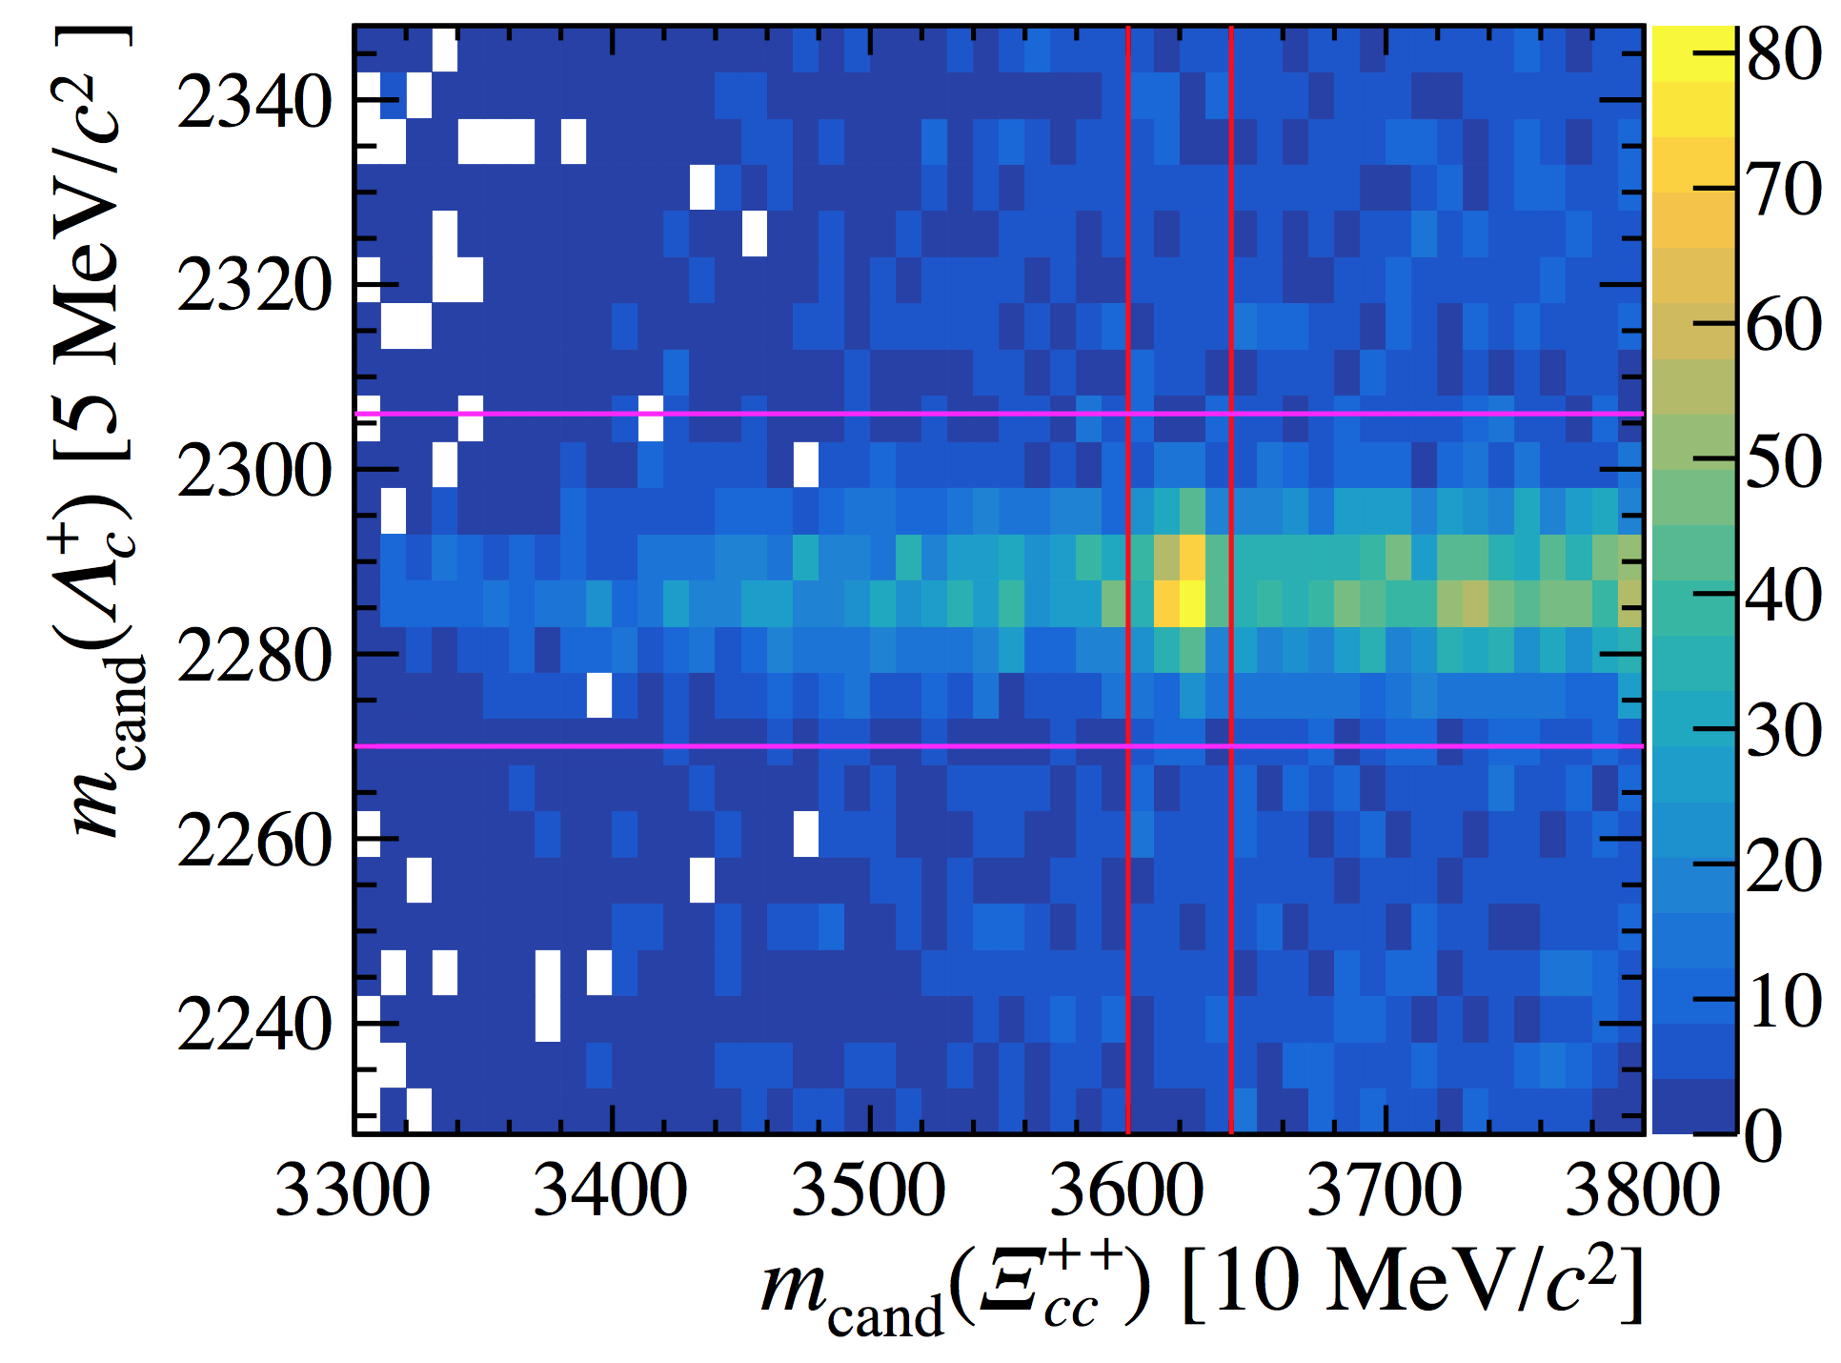
More checks: 2D mass distribution
arXiv: 1707.01621
Signal candidates only present in $Λ_{c}^{+}$ signal region

Slide 25
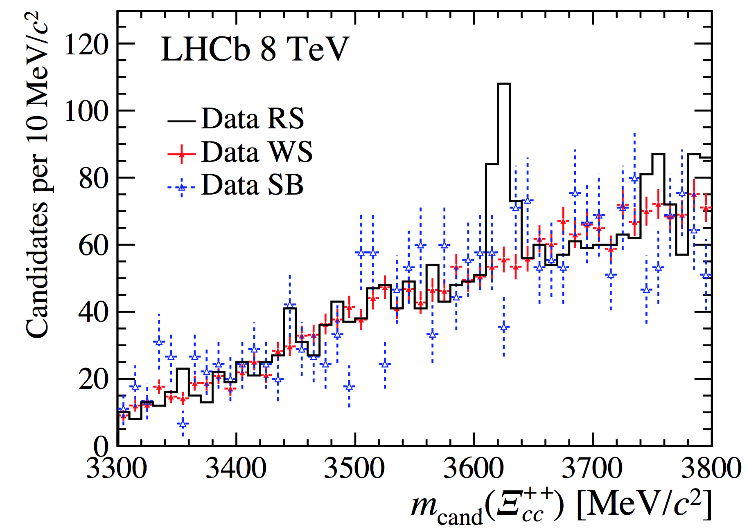
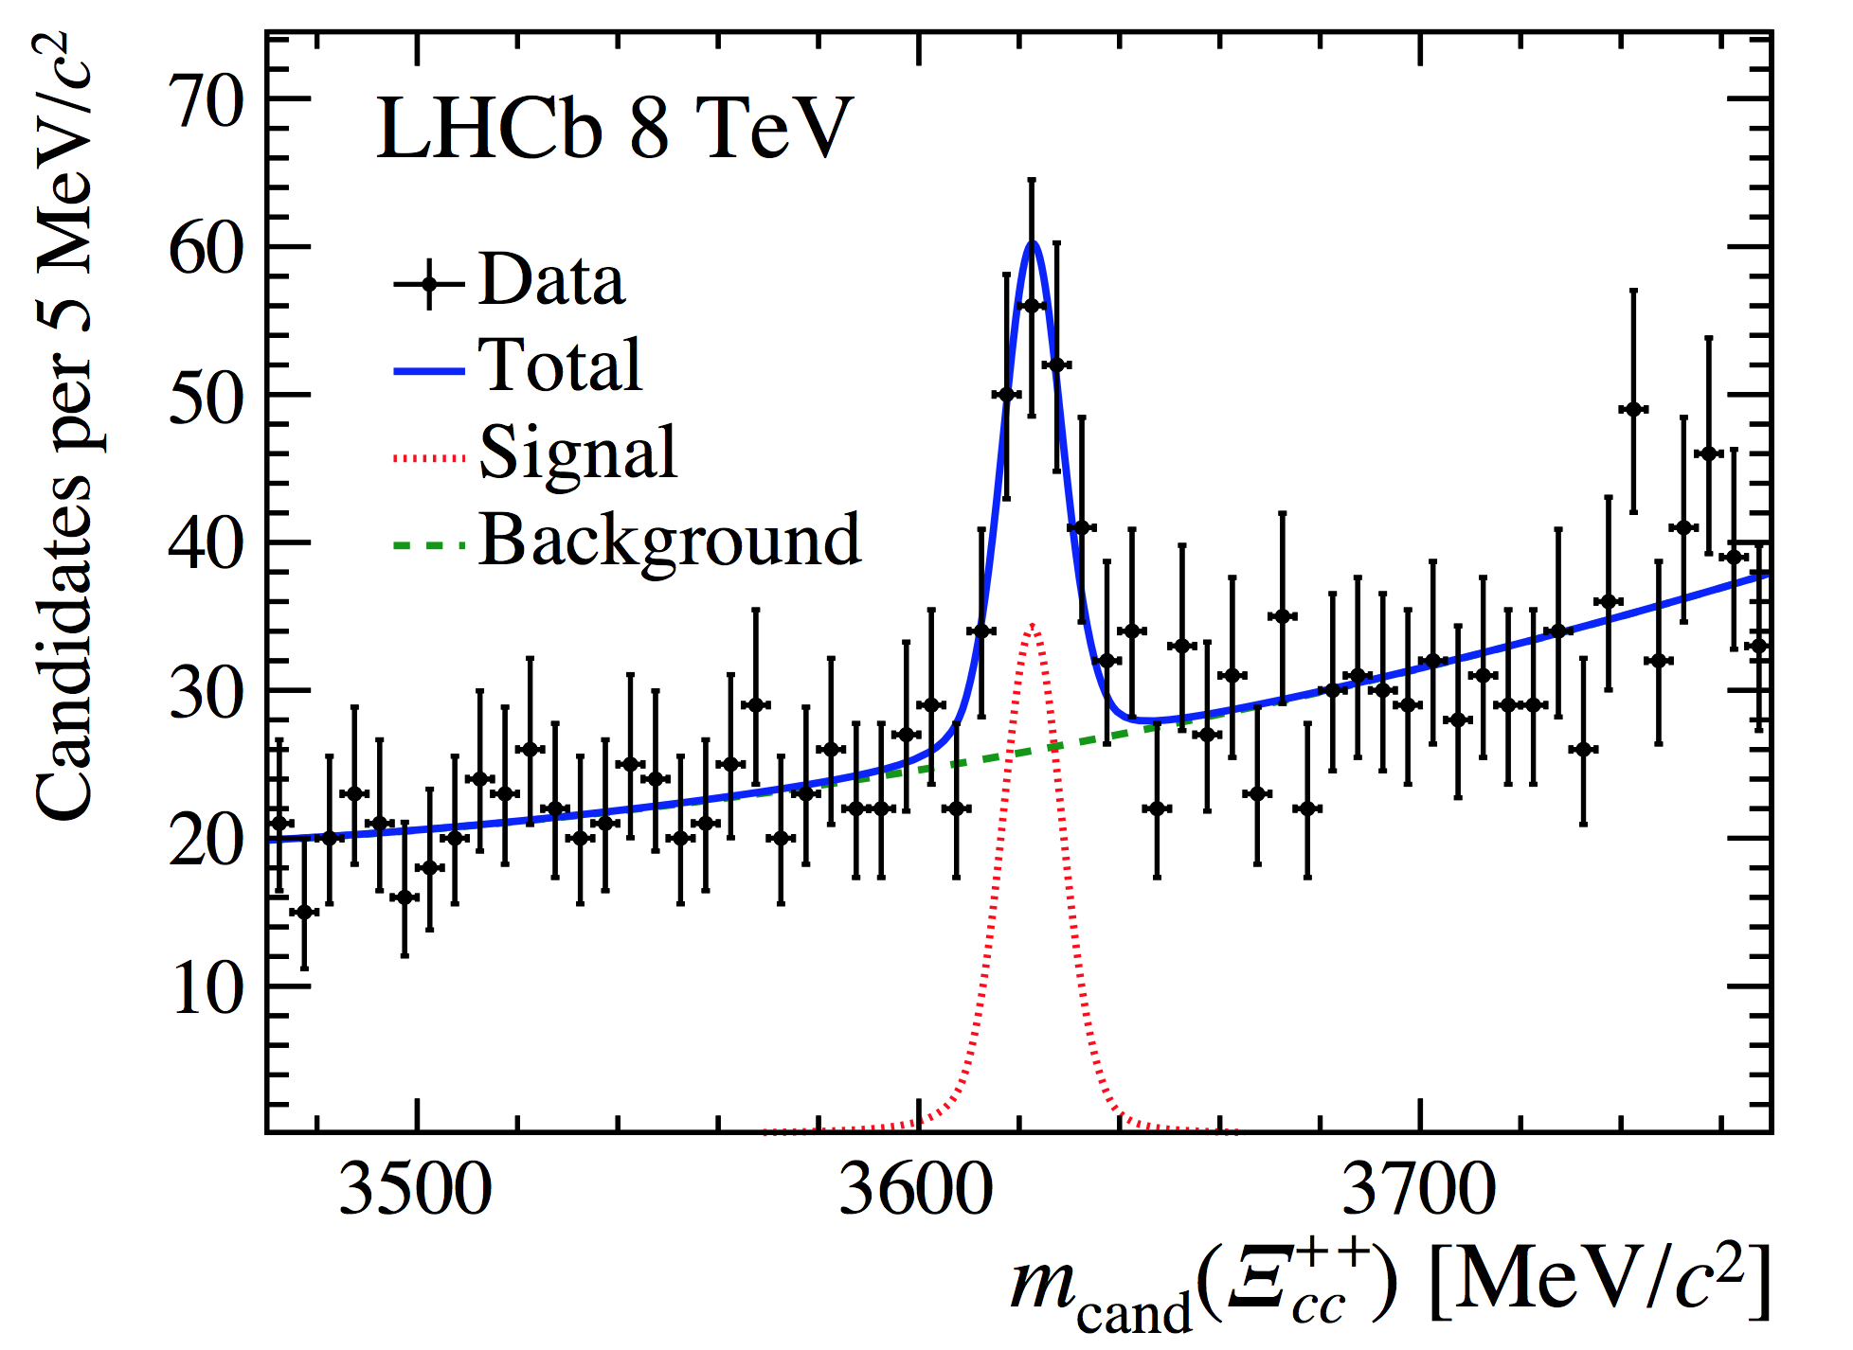
More tests: Run-I data
arXiv: 1707.01621
Signal peak presents in Run-I data sample with significance above $7σ$
$$N\left(Ξ_{cc}^{++}→Λ_{c}^{+}K^{−}π^{+}π^{+}\right)=113±21$$
Resolution: $6.6±1.4$ MeV
$δM\left(run I, run II\right)=0.8±1.4$ MeV
Consistent between two samples

Slide 26
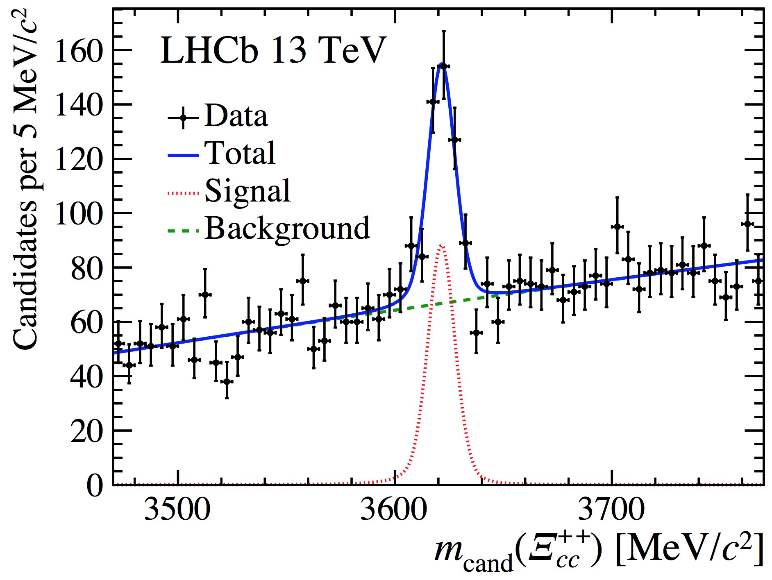
More checks: others
arXiv: 1707.01621
Multiple candidates: not creating fake narrow structure
Checking combinations of tracks from $Λ_{c}^{+}$ and $Ξ_{cc}^{++}$: not peaking
MVA efficiency as a function of mass: very smooth
Varying MVA selector cut: structure stays significant
Varying particle ID selections: no peaking structure emerging in WS combinations, structure stays in RS sample
Cut-based
selection
Using a cut based selection instead of using MVA, requiring good vertex fit quality, $Ξ_{cc}^{++}$ vertex displaced and tracks are not produced from PV: peak significance $>12σ$

Slide 27
Comparion with SELEX
arXiv: 1707.01621
Large mass difference, inconsistent with being isospin partners $m(Ξ_{cc}^{++})LHCb − m(Ξ_{cc}^{+})SELEX =103±2 MeV/c^{2}$
Production: $N(Ξ_{cc})/N(Λ_{c}^{+})$ much smaller in the LHCb result
SELEX $Ξ_{cc}^{+}$

Slide 28
Prospects
A long list of programs
Measuring the $Ξ_{cc}^{++}$ lifetime, relative production cross-section
Confirming its spin-parity: $½^{+}$
Searching for $Ξ_{cc}^{++}$ with more channels: $Ξ_{c}^{+}π^{+}$, $Λ_{c}^{+}π^{+}$, $pD^{+}K^{−}π^{+}$, ……
Searching for its isospin partner $Ξ_{cc}^{+}$ in a larger sample than the previous measurement
Searching for $Ω_{cc}^{+}$
The excited states?
Doubly heavy baryons with bottom quark: $Ξ_{bc}$, $Ω_{bc}, Ξ_{bb}$ …
New systems for CP violations?

Slide 29
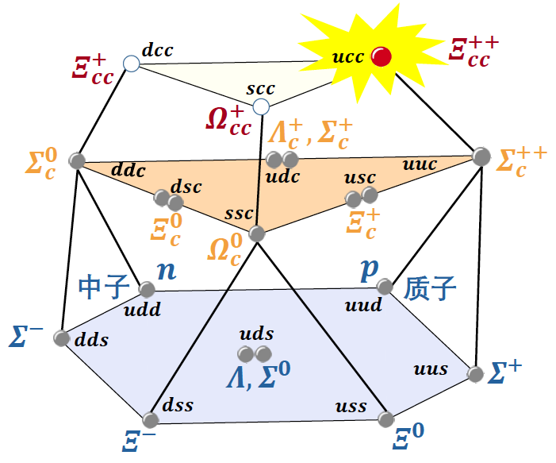
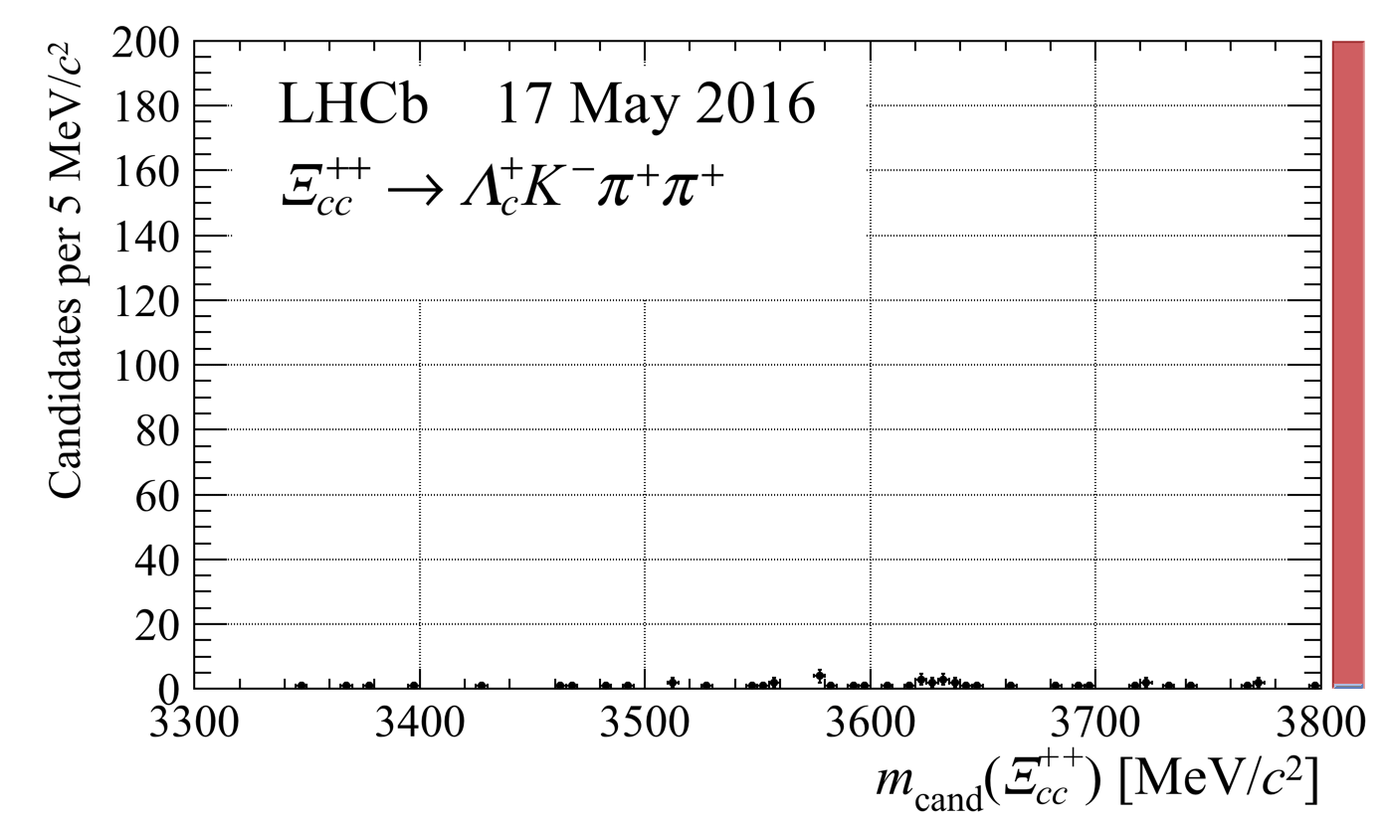
Summary
arXiv: 1707.01621
“The LHCb experiment is charmed to announce observation of a new particle with two heavy quarks” (CERN press release) (LHCb实验粲然宣布发现双粲重子)
Mass $m=3621.40±0.78 MeV/c^{2}$, inconsistent with the $Ξ_{cc}^{+}$ reported by SELEX being its isospin partner
New window opened for charm/bottom hadron spectroscopy studies
Thank you!
清兮粲兮，双粲迷人兮

Slide 30
Backup slides

Slide 31
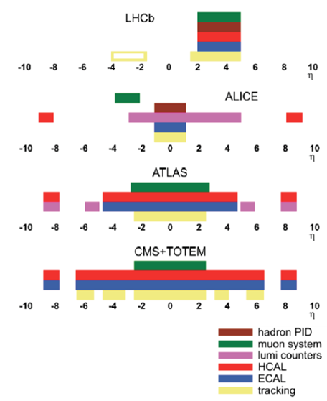
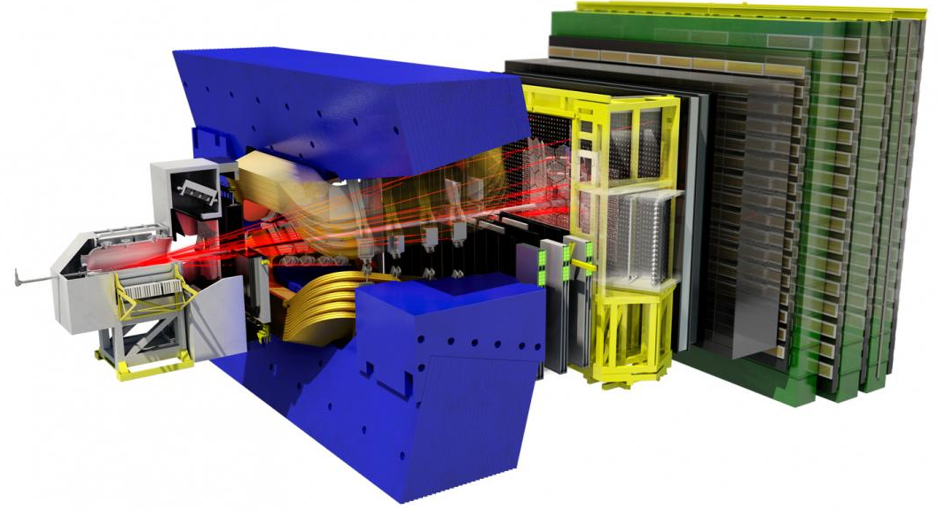
LHC detectors and coverage

Slide 32
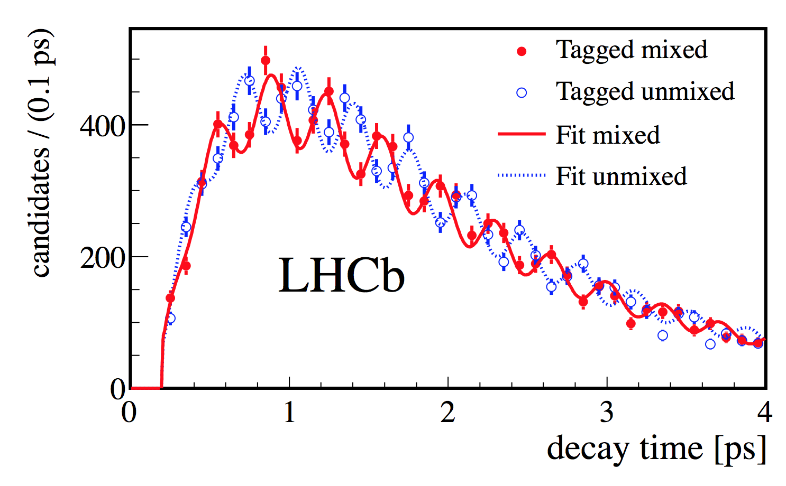
The LHCb detector
JINST 3 (2008) S08005
IJMPA 30 (2015) 1530022
Vertex Locator (vertex reconstruction)
Impact parameter resolution: $20μm$
Decay time resolution: $45 fs$ $(τ_{B}\sim 1.5 ps)$
$B_{s}^{0}−{\overline{B}}_{s}^{0}$ oscillation
250 mrad
$pp$ collision
point
New J. Phys. 15 (2013) 053021
Tracking system
(particle reconstruction)
$ε\left(Tracking\right)\sim 96\%$
${δp}/p\sim$0.5%-1% (5-200 GeV)
$σ\left(m_{B→hh}\right)≈22 MeV$
Magnet
Bending power: 4 Tm

Slide 33
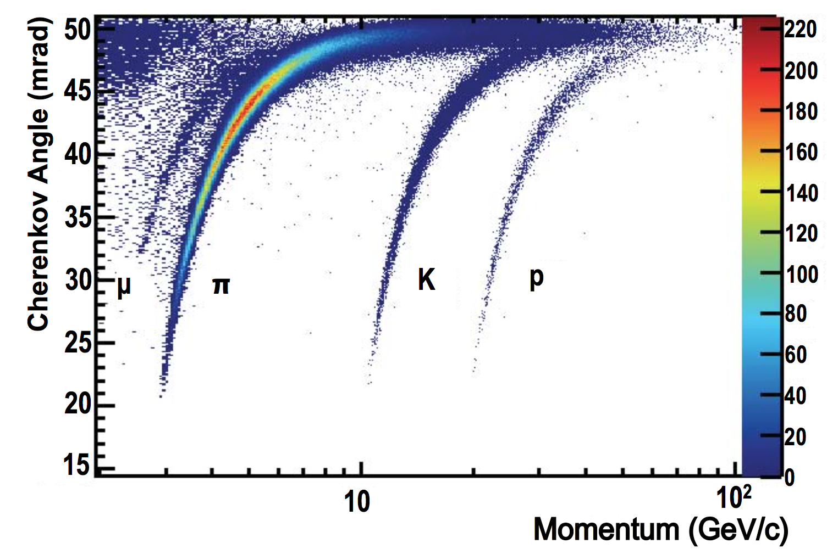
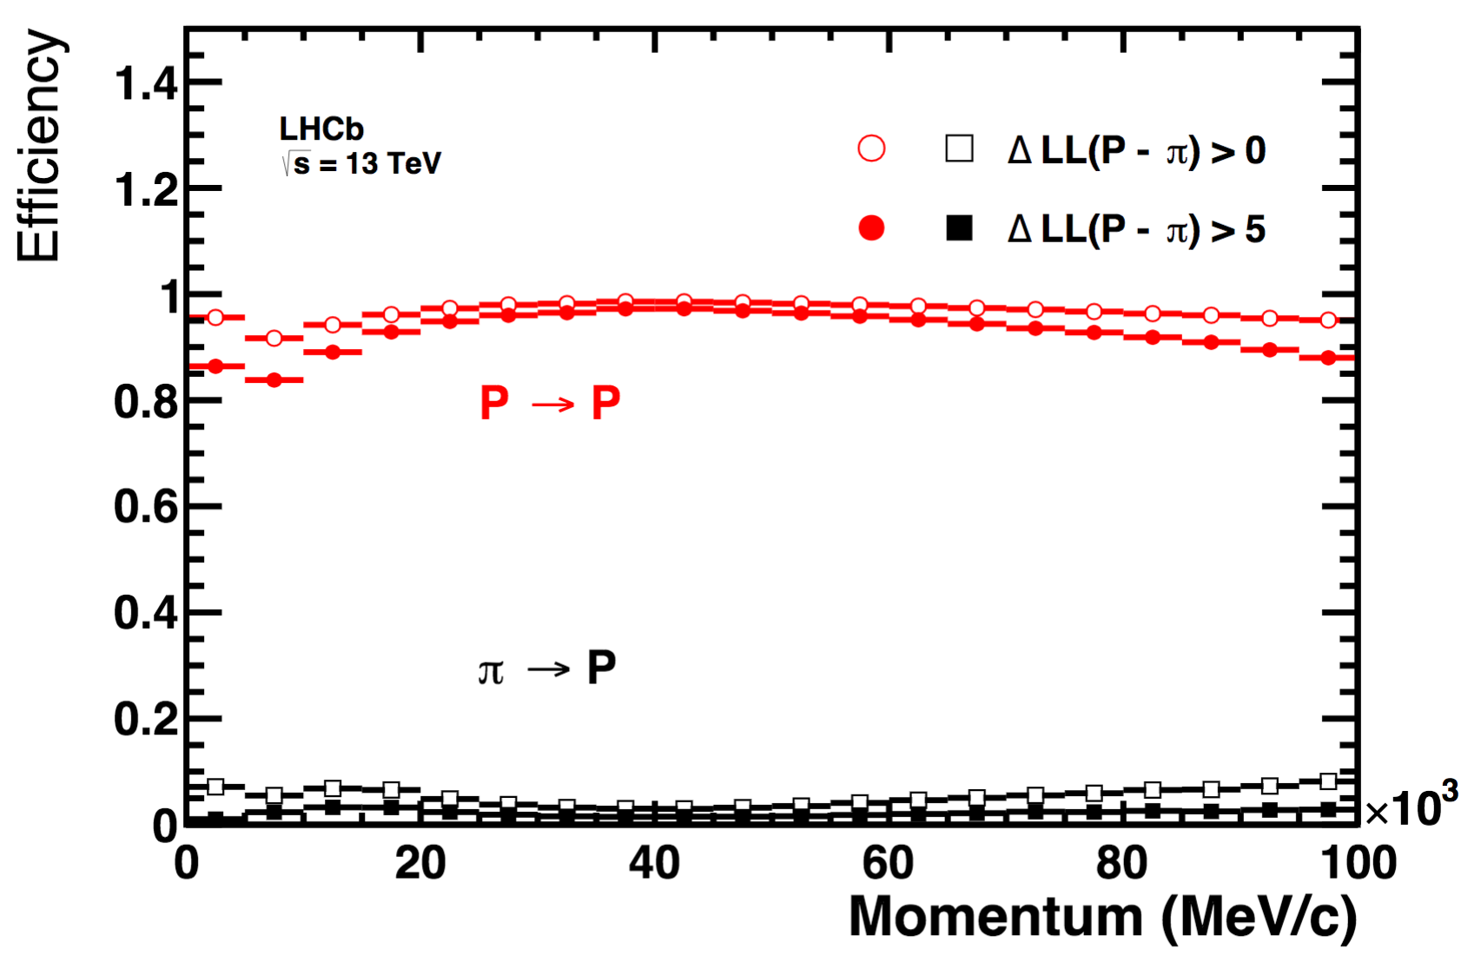
The LHCb detector
JINST 3 (2008) S08005
IJMPA 30 (2015) 1530022
RICH detectors ($K/π/p$ separation)
$ε\left(K→K\right)\sim 95\%$
Mis-ID $ε\left(π→K\right)\sim 5\%$
250 mrad

Slide 34
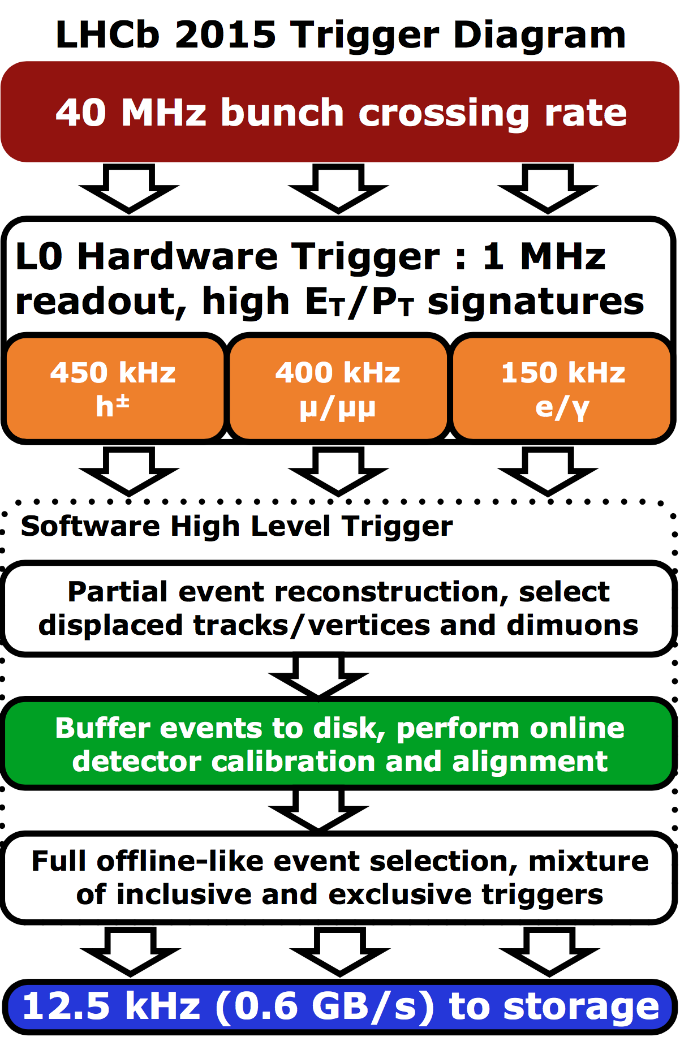
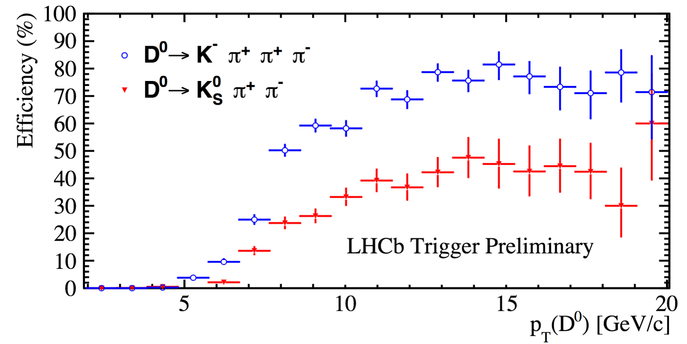
Trigger
Comput. Phys. Commun. 208 35-42
Int. J. Mod. Phys. A 30, 1530022 (2015)
Run II Turbo stream:
Candidates reconstructed at trigger level saved for offline analyses directly
High trigger efficiency for hadronic channels
, PID

Slide 35
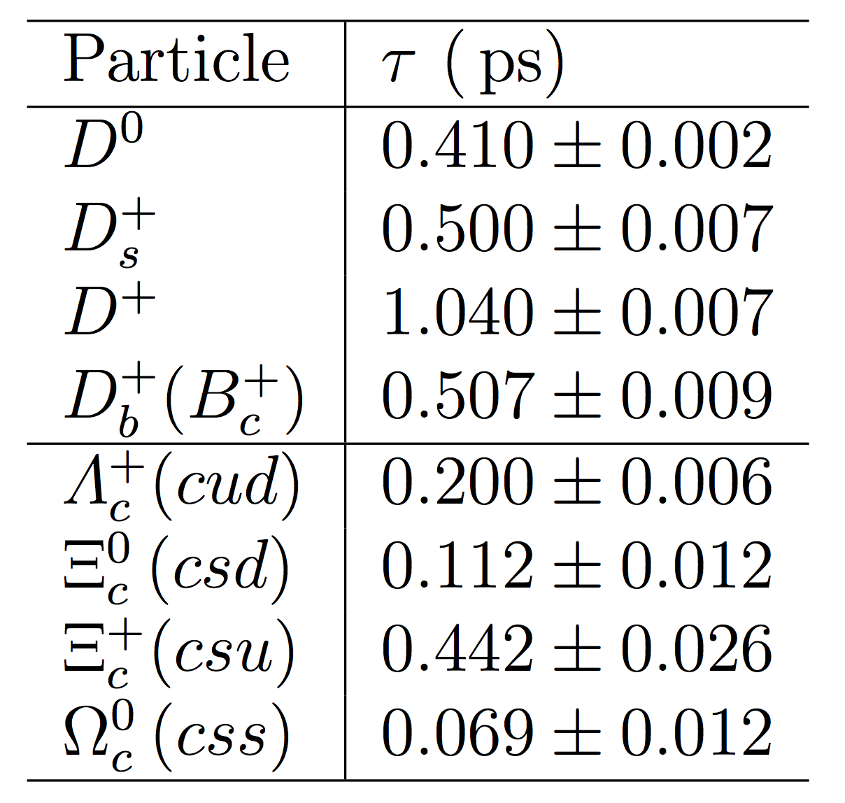
Lifetimes of ½⁺ states
PDG
Spectator model predicts almost equal lifetimes
True for bottom hadrons: $1.5 ps ±10\%$
True for charm semi-leptonic decay width:
$Γ\left(H_{c}→lν_{l}X\right)=\frac{Br(H_{c}→lν_{l}X)}{τ_{H_{c}}}≈ 0.3 ps^{−1}$
But charm hadron lifetimes known to vary a lot
Explained by non-spectator decays and Pauli interference, qualitatively
Destructive/constructive interference ($Γ_{s}^{−/+}$): $cuq/csq→suq/ssq(u\overline{d})$
$W$-exchange process (enhancement): $cdq→suq$
$Γ\left(Ξ_{c}^{0}:W+Γ_{s}^{+}\right)>Γ\left(Λ_{c}^{+}:W+Γ_{s}^{−}\right)>Γ(Ξ_{c}^{+}:Γ_{s}^{+−})$
Expectation: ${τ(Ξ}_{cc}^{++}(ccu))≫τ(Ξ_{cc}^{+}(ccd))$
Calculations give $τ\left(Ξ_{cc}^{++}\right)∈[ 200−700]$ fs
$$ps$$
$$c$$
$$s$$
$$c$$
$$s$$
Spectator ($Γ_{s}$)
$$d$$
$$w^{∗}(u\overline{d})$$
$W$-exchange ($W$)
$$d$$
$$w^{∗}$$
$$u$$
$u$/s
$$u/s$$
$$u$$
$$u$$
Refs.[5, 6, 12 49-52]

Slide 36
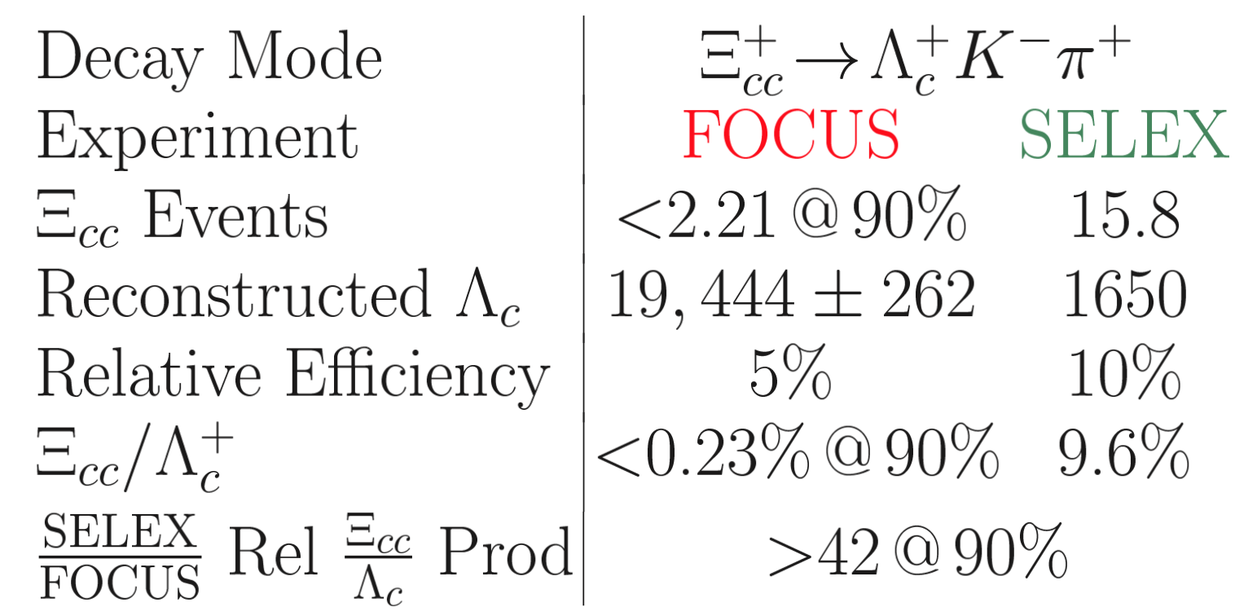
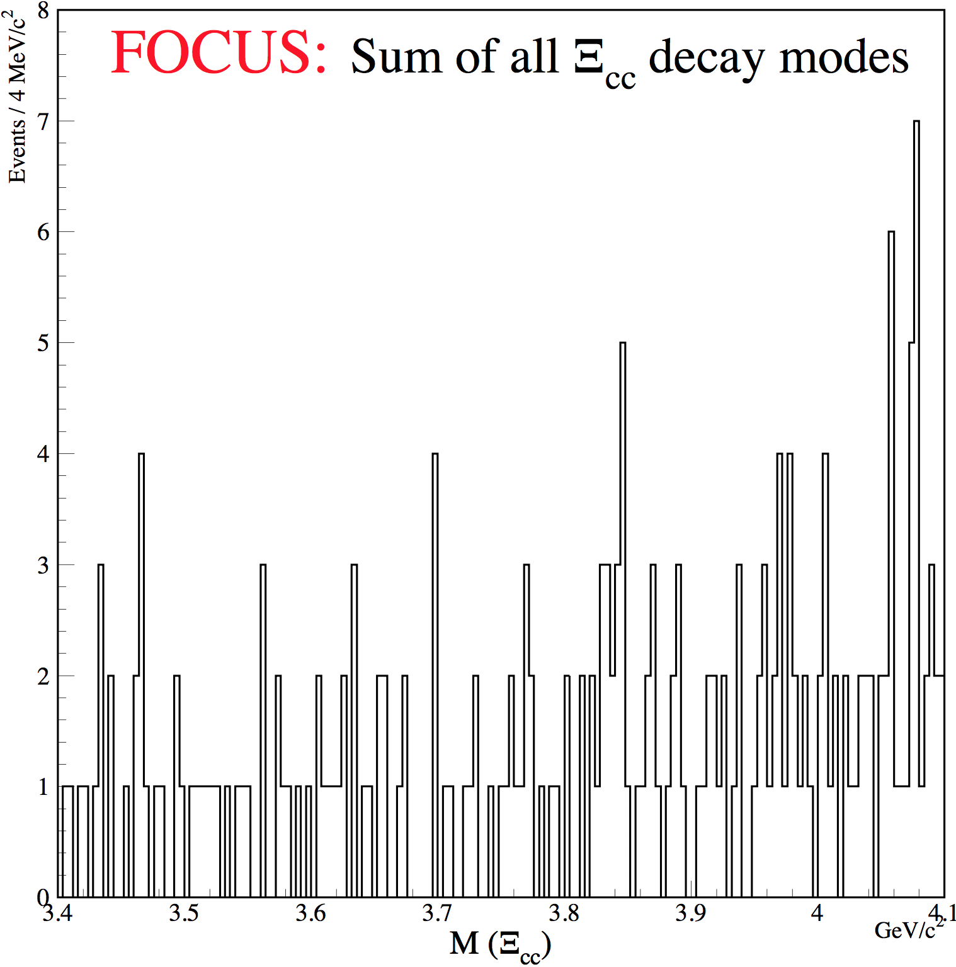
Studies of $Ξ_{cc}$ by FOCUS
FOCUS (Fermilab E831) studies charm hadrons produced in photon-nuclear fixed target collisions
FOCUS didn’t confirm $Ξ_{cc}^{+}$ observed by SELEX in $Λ_{c}^{+}K^{−}π^{+}$decay
Nucl. Phys. Proc. Suppl. 115 (2003) 33
SELEX $Ξ_{cc}^{+}$
Other modes also studied: $Ξ_{cc}^{+}→Λ_{c}^{+}X,$ $D^{0}X$ $D^{+}X$, no SELEX-like signal peak observed

Slide 37
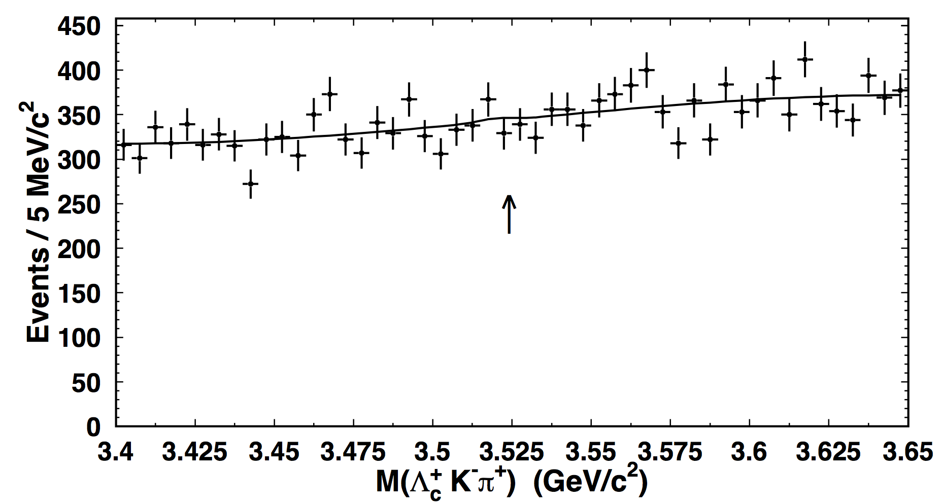
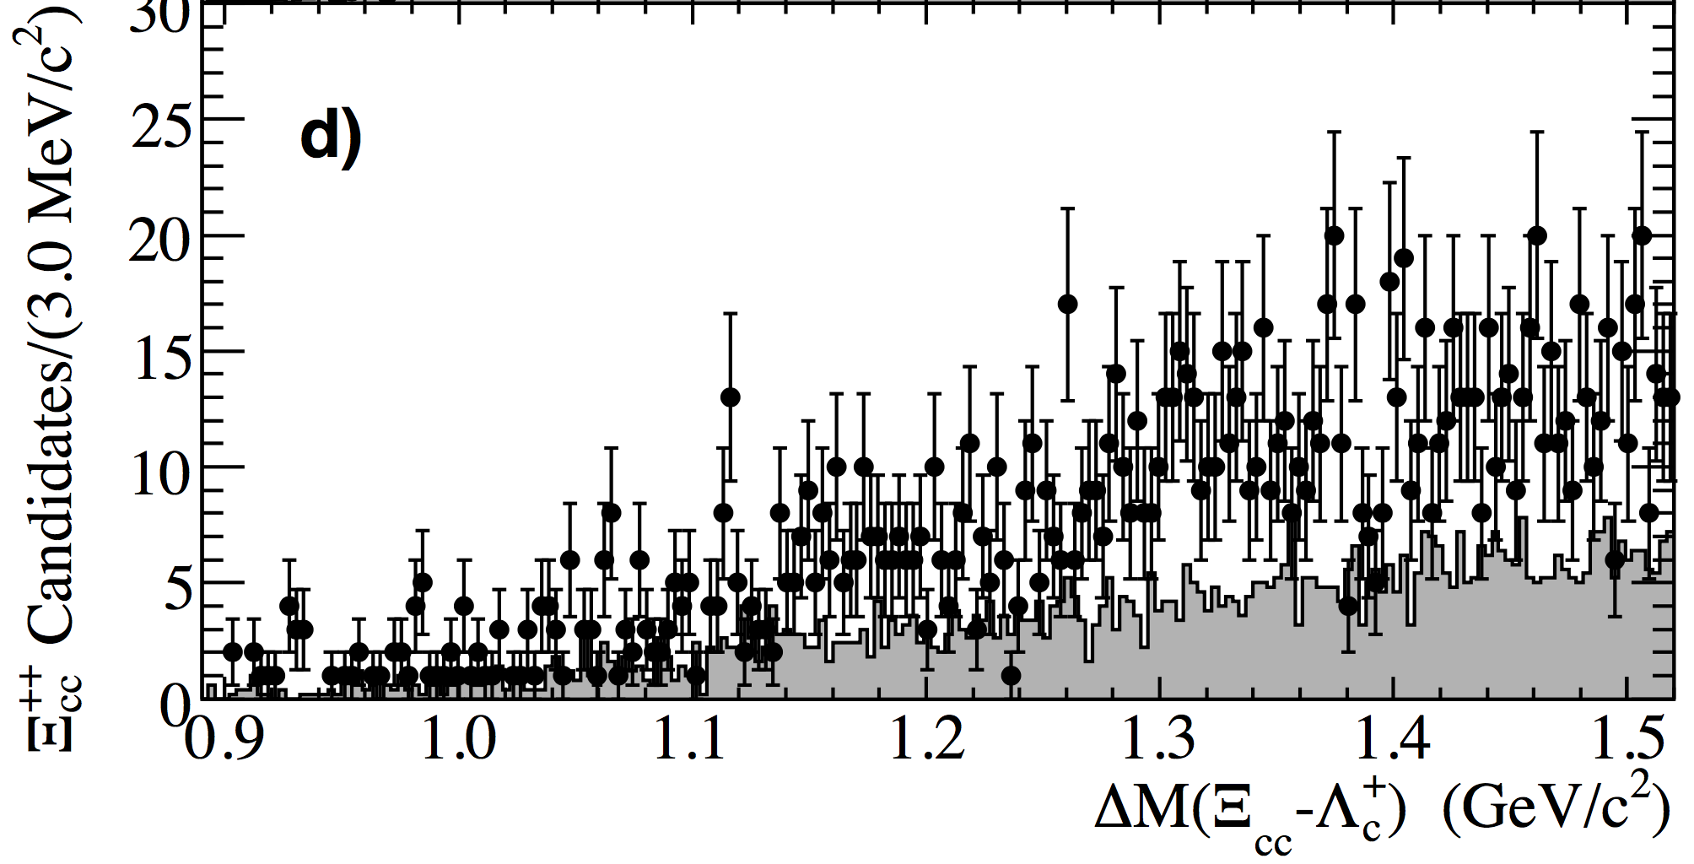
Studies of $Ξ_{cc}$ by BaBar and Belle
$e^{+}e^{−}$ colliders working at $Υ(4S)$ mass $\sqrt{s}=10.58$ GeV
Large $Λ_{c}^{+}$ yields: $≈0.6$ M at BaBar, $≈0.8$ M at Belle
SELEX-like $Ξ_{cc}^{+}$ signal not confirmed in $Ξ_{cc}^{+}→Λ_{c}^{+}K^{−}π^{+}$ decays
$R=\frac{σ\left(Ξ_{cc}^{+}\right)×BF(Ξ_{cc}^{+}→Λ_{c}^{+}K^{−}π^{+})}{σ(Λ_{c}^{+})}<$ $2.7×{10}^{−4}$ (BaBar) $1.5×{10}^{−4}$ (Belle) @ 95% CL
BaBar: PRD 74 (2006) 011103
Belle: PRL 97 (2006) 162001
SELEX $Ξ_{cc}^{+}$
SELEX $Ξ_{cc}^{+}$
$ΔM(Ξ_{cc}^{+}−Λ_{c}^{+})$ GeV/c²
$M(Λ_{c}^{+}K^{−}π^{+})$ GeV/c²

