Slide 1
A new method study the improvement of the resolution of reconstructed heavy nuclei spectrum
Litao Zhao
Liaoning University&IHEP
2017.9.21-2017.9.23
Weihai ShanDong

Slide 2
Outline
The state of comic rays measurements
Characteristics of DC-light
Simulation and analysis
Summary and prospect

Slide 3
The state of comic rays measurements
Measurements of energy spectrum for individual elements are very important to resolve the questions of the origin and the acceleration of cosmic rays.
energy<100TeV，space experiments
PAMELA、ATIC、CREAM、RUNJOB
advantage ：Precise measurements of individual elements of comic rays
disadvantage ： limited collection area（$\sim {1m}^{2}$） 、limited measuring time
energy>100TeV，ground-based arrays experiments
ARGO-YBJ、 Tibet Asγ
advantage： larger effective area、longer measuring time
disadvantage :
the uncertainty of energy calibration
the uncertainty of resolution of energy
dependent highly on the hadronic interaction models.
Independent on the hadronic interaction models?

Slide 4
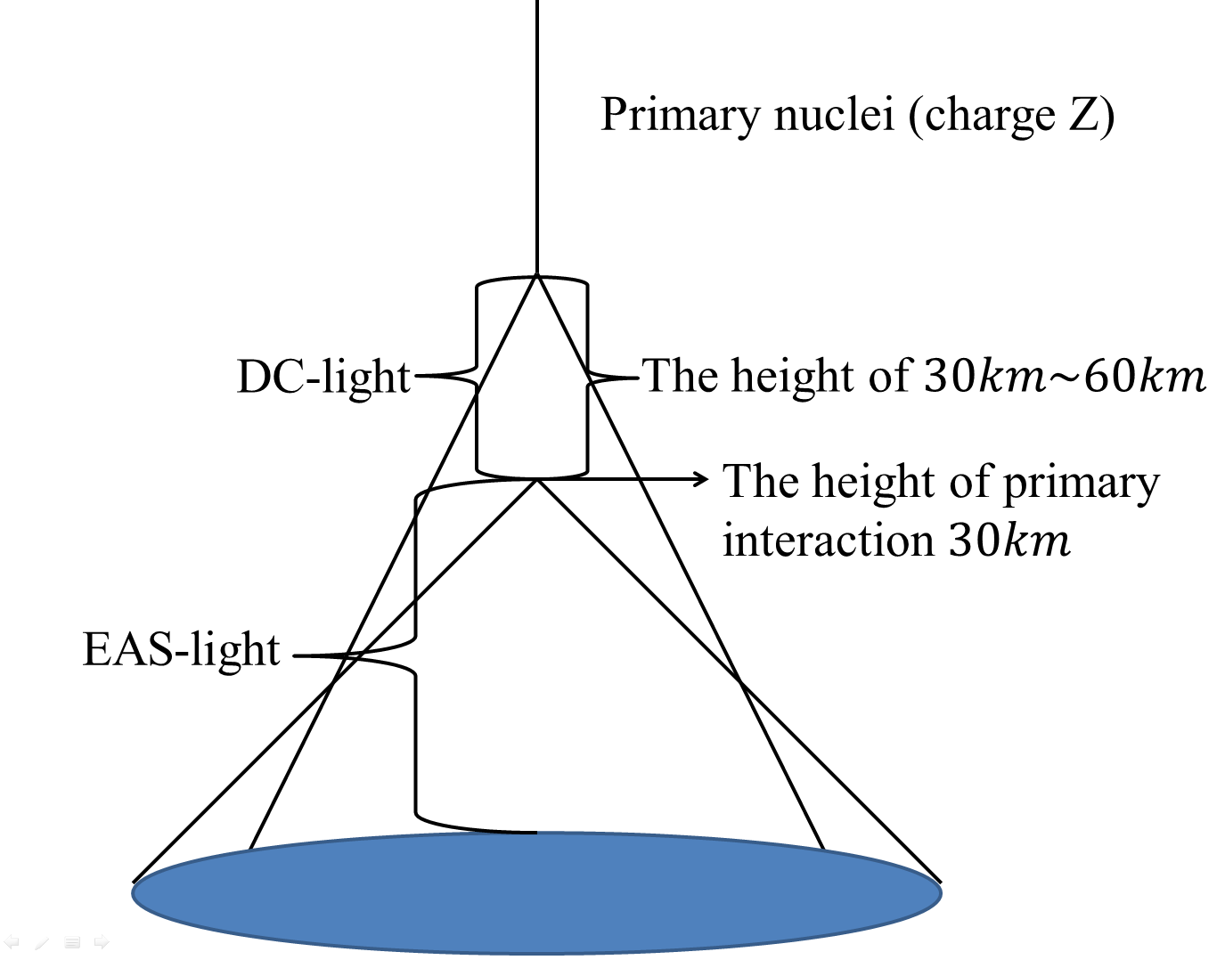
Characteristics of DC-light
DC-light: is emitted by the primary incoming nucleus prior to its first interaction with the atmosphere.
Radiation Height: 30km～ 60km
The radius of light cone:100m
The angle of Cherenkov photons :
${ 0.1}^{°}\sim {0.3}^{°}$
Intensity of Cherenkov photons : weaker
EAS-light :is emitted by the secondary particles in
the shower
Radiation Height: lower 30km
The radius of light cone: wider
The angle of Cherenkov photons :$>{ 0.4}^{°}$
Intensity of Cherenkov photons : stronger
Challenge :Discern the DC-light against the EAS-light.

Slide 5
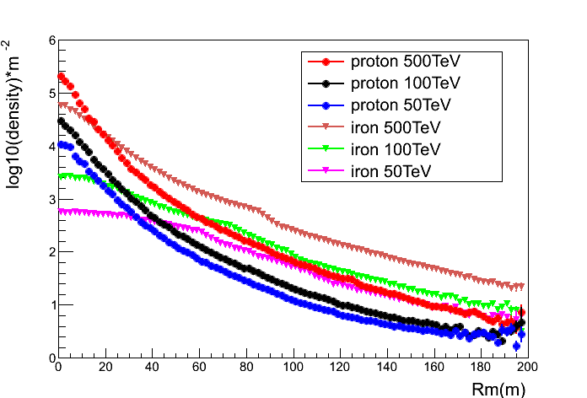
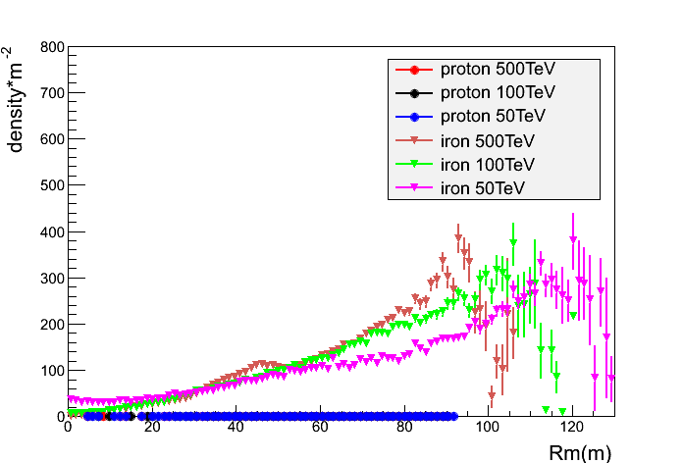
Characteristics of DC-light
EAS-light increases approximately linearly with the primary energy of cosmic rays. DC-light is emitted by primary cosmic rays must exceed the Cherenkov threshold , independent of the energy of cosmic rays .
DC-light is proportional to square charge of primary particle.
DC-light to EAS-light ratio is increase with the distance to the core position and decrease with energy.
The different fragmentation process case large fluctuations under the range of Rm 90m～120m.
EAS-light
DC-light

Slide 6
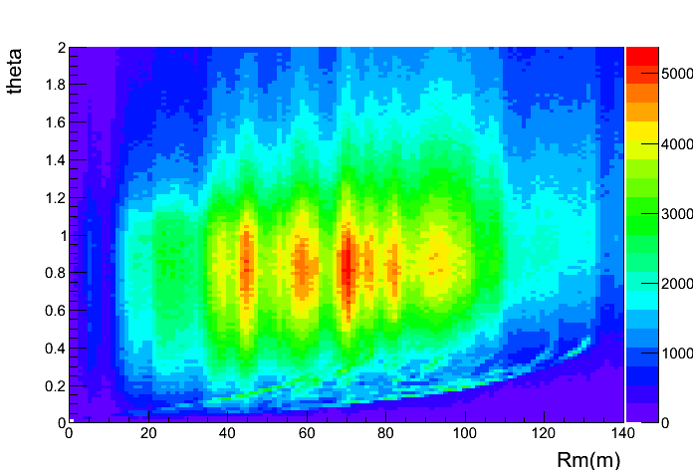
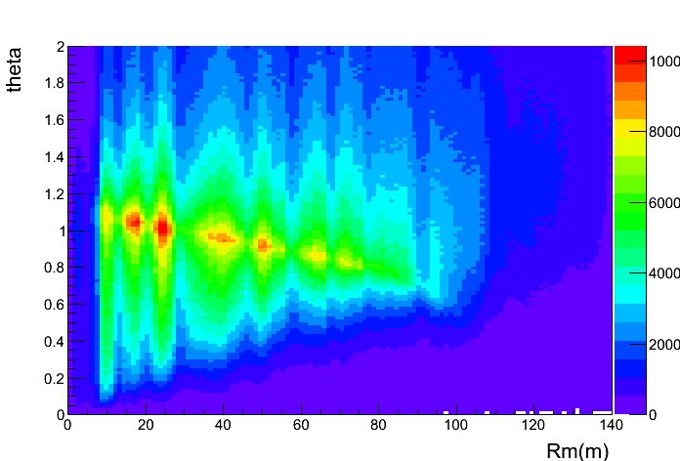
Characteristics of DC-light
iron
proton
Simulated of emitted angle of DC-light and EAS-light relative to parameter Rm.
The significantly difference of the two plots is the right plot has filamentary structure under the main structure, which is contributed by DC-light.
The DC-light can be detected by the Cherenkov telescopes which can detect the photons with highly direction resolution.
R$=\frac{I_{dir}}{I_{cog}}$
discriminate the iron events from cosmic rays

Slide 7
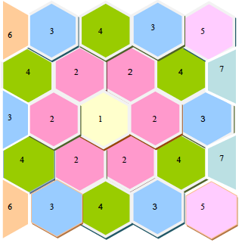
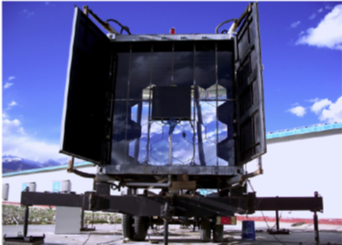
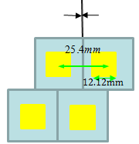
Simulation and analysis
introductions of WFCTA
reflector mirrors
spherical aluminized mirror:25
the area of mirrors :5.29$m^{2}$
radius of curvature：5800mm
Camera
array: $32×32$
the resolution of pixel: ${0.5}^{°}$
the total field view:${14}^{°}×{16}^{°}$
focal length: 2870mm
Winston Cone

Slide 8
Simulation and analysis
simulation
The set of events
software :CORSIKA;
Nuclei :iron, proton;
The number of events: QGSJET-II 314400 , EPOS LHC 232800
The zenith of events :${18}^{°}\sim {38}^{°}$;
The azimuth of events:${35}^{°}\sim {55}^{°}$;
range of energy :30TeV～500TeV;
Index of energy spectrum:-2;
The sample area: 300m× 300m.
The set of WFCTA
The zenith of telescopes:${28}^{°}$;
The azimuth of telescopes:${45}^{°}$;
The events number is normalized to the expectation of H$\ddot{o}$rdanel model.

Slide 9
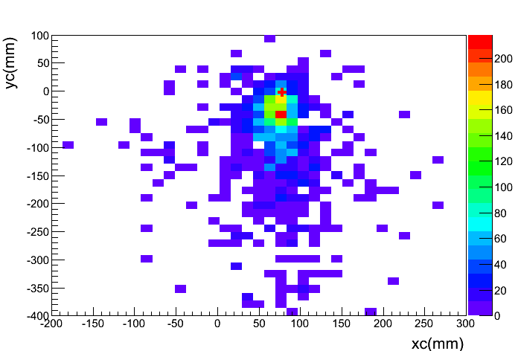
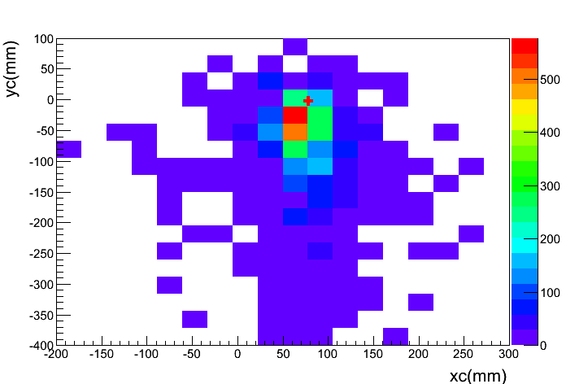
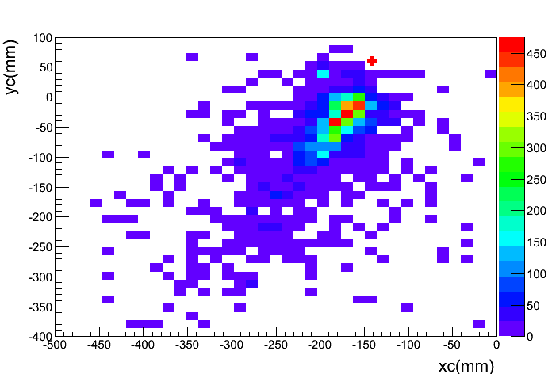
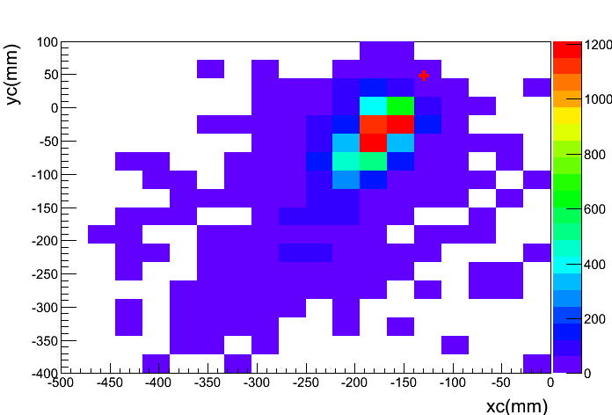
Simulation and analysis
select iron events by the DC-light
New array with 64$×$64 and the pixel resolution ${0.25}^{°}$are simulated.
iron
The new array of pixel
The set of WFCTA
proton
The difficulty of selecting the DC-light pixel against the much larger background of Cherenkov light that use the parameter of R is increased with the pixel size

Slide 10
Simulation and analysis
select iron events by the DC-light
reconstructed of Rp (WCDA)
shower core reconstruction resolution: 5m
arriving direction reconstruction resolution : ${0.1}^{°}$
The resolution of the reconstructed Rp is nearly 3.3m
First selection of events
were sampled for the process of select iron events
30% events are survived
QGSJET-II：94682
EPOS LHC:69992
Rp :0m$\sim 100m$
Second selection of events
abs(MeanX)<300mm, abs(MeanY)<300mm
Dist>0 , Dist<200mm
Length/Width<7 , Length/Width>0
Rp>50m,Rp<100
R>0,R<2
10% events are survived
QGSJET-II：33389
EPOS LHC: 22306

Slide 11
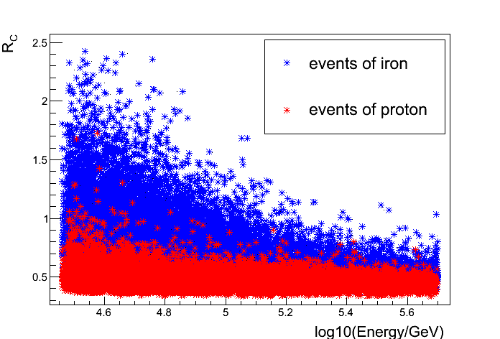
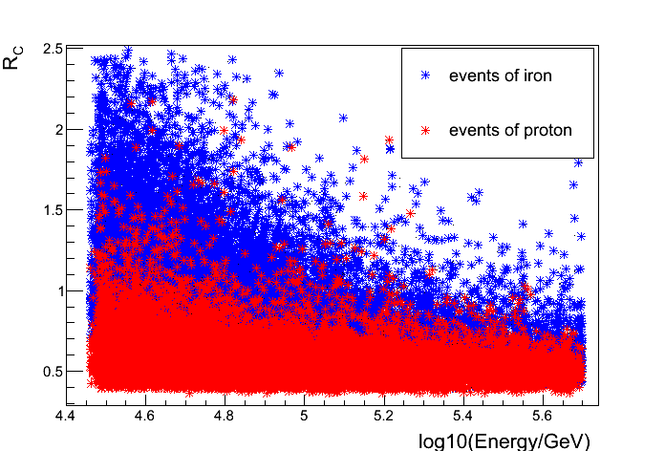
Simulation and analysis
select iron events by the DC-light
Rp :0m$\sim 100m$
The new array of pixel
The set of WFCTA
$R_{C}$ indicates the R after Rp correction
As the energy increase, the difficulty of selecting iron events that use the parameter of R is increased.
The camera of the pixel size ${0.25}^{°}$is better than the camera of WFCTA at the whole energy range.

Slide 12
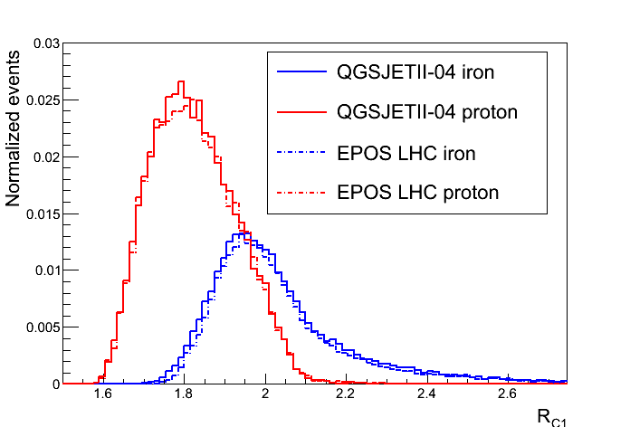
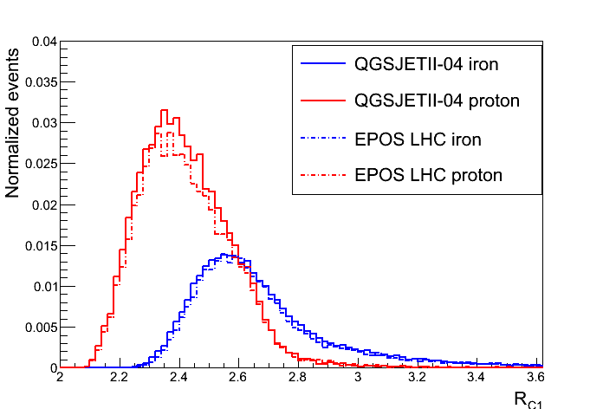
Simulation and analysis
select iron events by the DC-light
One-dimensional distribution of $R_{C1}$
Rp :0m$\sim 100m$
$R_{C1}$=1.92
$R_{C1}$=2.64
The new array of pixel
The set of WFCTA
$R_{C1}$indicates the R after Rp and energy correction
Purity：$>$80%

Slide 13
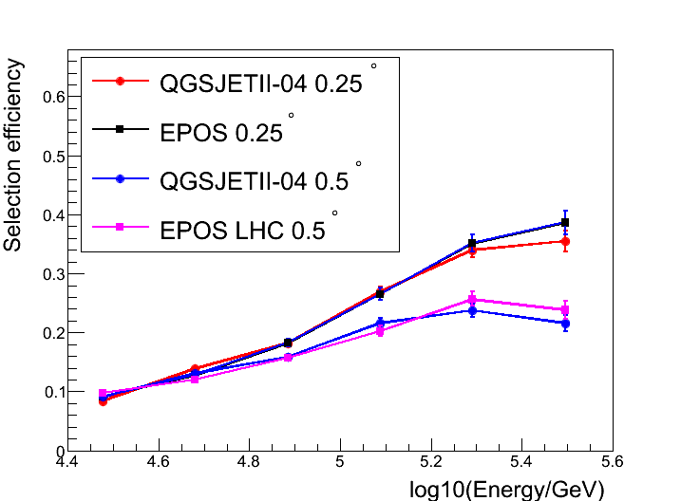
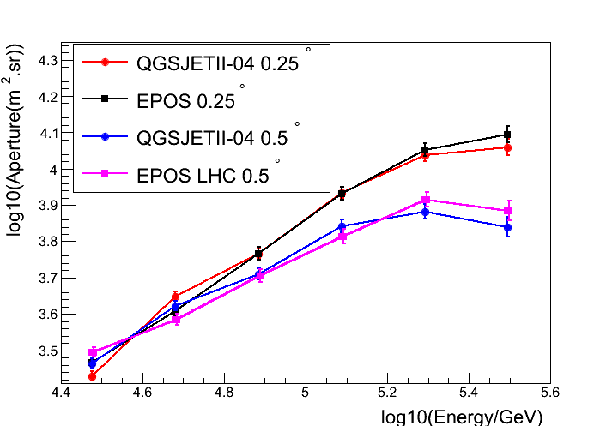
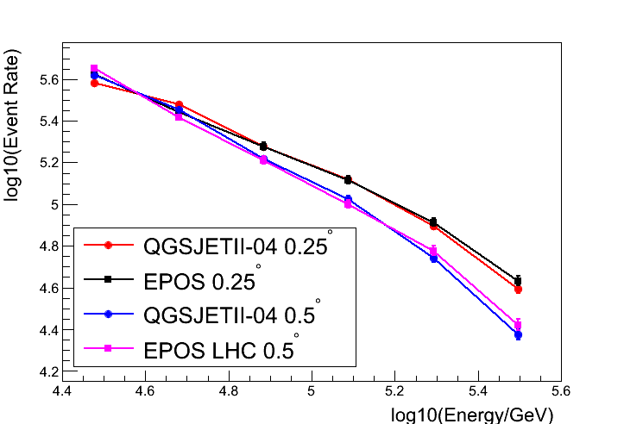
Simulation and analysis
Duty cycle :15%
energy bins width: 0.2
select iron events by the DC-light
The err in each energy bin is at the range of 3%$\sim 6$%
Selection efficiency
Aperture
Event rate
The selection method by parameter R is independent of hadronic interaction models.
Along with the rise of energy, the trigger efficiency is getting smaller influence on the selection process of iron events, and the advantages of small pixel size of telescope camera has become obvious.

Slide 14
Simulation and analysis
improvement of selection efficiency by the DC-light
Hillas Parameters
Length and Width are the second moments of the light distribution along the major and minor axes of the image.
The Dist is the angular distance between arrival direction of the
shower and the center of gravity (COG) of the image.
The depth of the shower maximum ($X_{max}$) of iron should be about
70 $g/{{cm}^{2}}$higher than that of proton with the same energies.
So the parameters of Dist and Length/Width also can be used MVA in the process of discrimination of iron events.

Slide 15
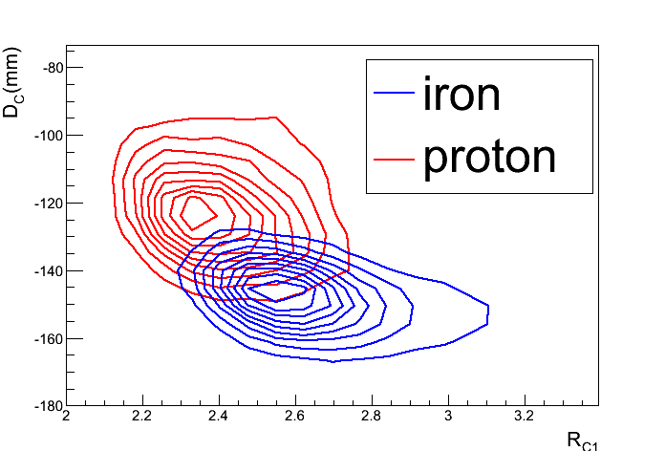
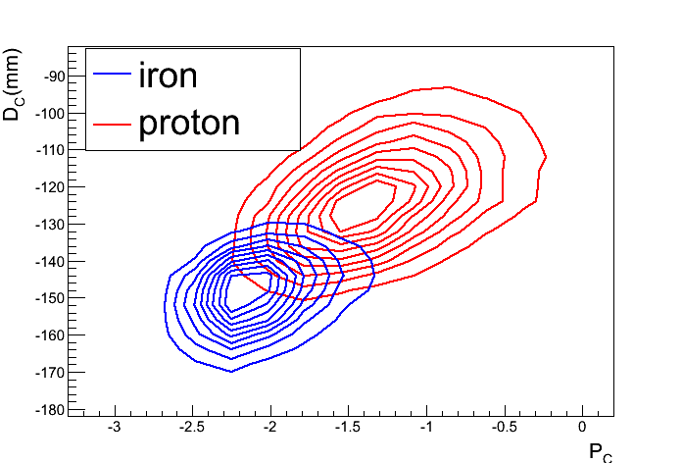
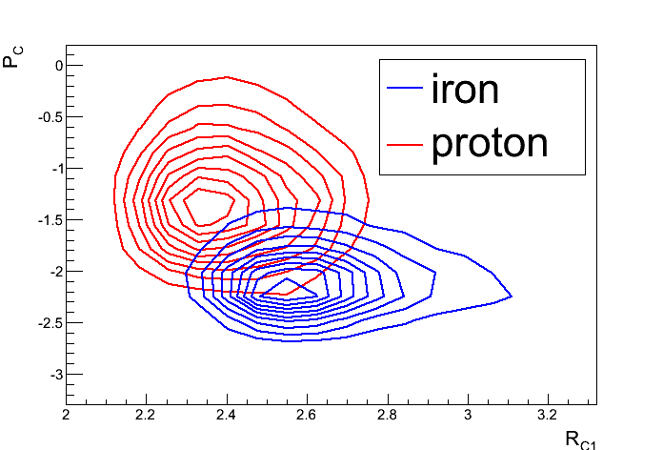
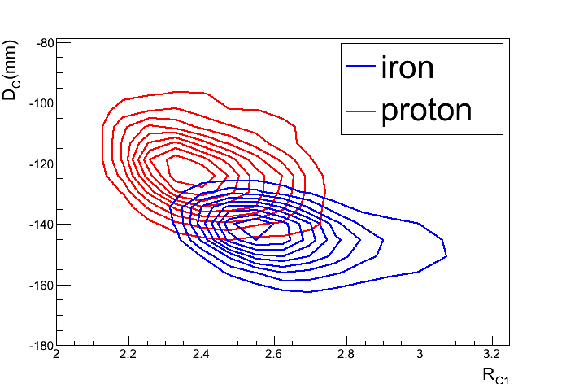
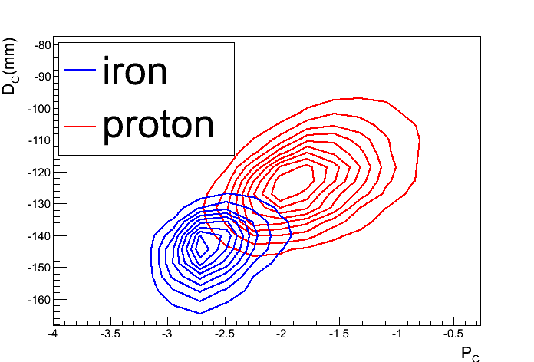
Simulation and analysis
Improvement of selection efficiency by the DC-light
QGSJET-II
$R_{C1}$、 $D_{C}$、 $P_{C}$ indicates the Rp and energy correction for R、Dist、Length/Width, respectively .
Three parameters has a satisfactory performance in the process of discriminate iron events
EPOS LHC

Slide 16
Simulation and analysis
improvement of selection efficiency by the DC-light
Purity: $>$80%
MVA
Two parameters ：Length /Width、Dist 。
Three parameters：Length /Width 、Dist、R。
The cuts values $R_{C1}$、 $D_{C}$、and $P_{C}$of in a select sample of iron showers for different hadronic interaction models and steps.
parameters | Models | DIST | LENGTH /WIDTH | R
Two parameters | QGSJET-II | -140$\sim −180$ | -3$\sim −1.98$
 | EPOS LHC | -138$\sim −180$ | -3.5$\sim −2.38$
Three parameters | QGSJET-II | -140$\sim −180$ | -3~−1.98 | 2.89$\sim 3.2$
 | EPOS LHC | -138$\sim −180$ | -3.5$\sim −2.34$ | 2.70$\sim 3.2$

Slide 17
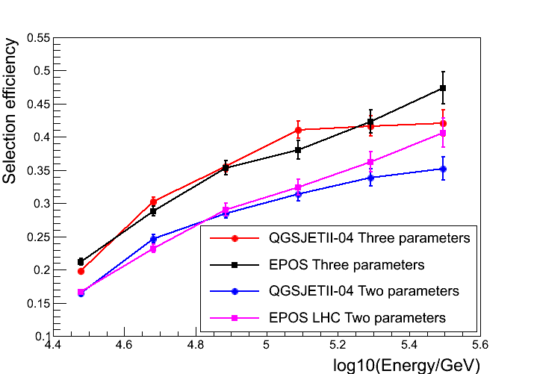
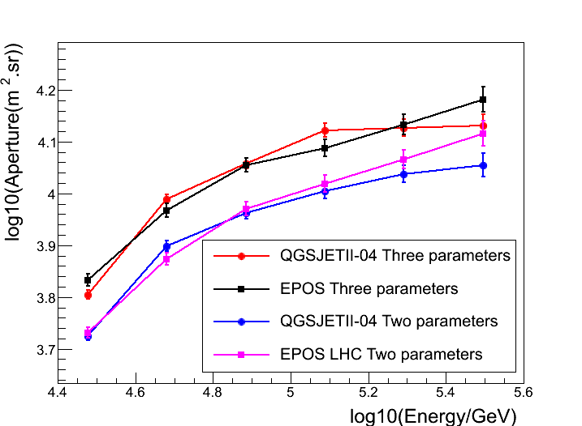
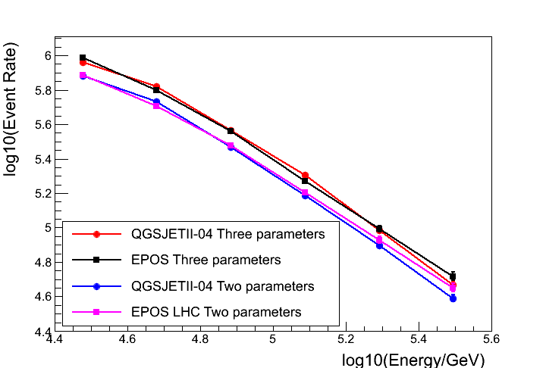
Simulation and analysis
improvement of selection efficiency by the DC-light
Duty cycle :15%
energy bins width: 0.2
The err in each energy bin is at the range of 2.5%$\sim 5$%
Selection efficiency
Aperture
Event rate
The improvement of selection efficiency in each energy bin is independent of hadronic interaction models.
The event rate of iron obtained by R, Dist and Length/Width is 27% higher than that obtained only by the Dist and Length/Width.

Slide 18
Simulation and analysis
purity
the contamination from other nuclei
Selection of iron events
80%
nuclei
contamination
iron
MgAlSi&He&CNO
50%
The contamination from the MgAlSi and helium bring a negative effect to the final result.
Selection of heavy events
purity
contamination
80%
78%
Heavy nuclei
Proton&He&CNO
proton
The method of DC-light could help achieve the better performance in the process of select heavy nuclei.

Slide 19
Summary and Prospect
Summary
Compared the parameters of Length /Width and Dist , the R is independent of hadronic interaction models. In addition , the R improve significantly of selection efficiency of iron events in the process of MVA. In the near future, this method could be applied to the LHAASO project, and will improves the resolution of reconstructed heavy nuclei spectrum.

Slide 20
Summary and Prospect
Prospect
DC-light methods combine with 1221 muon detectors of LHAAASO will help us to check the hadronic interaction model.
Future improvements of the DC-light technique could extend the energy range of the measurement to energy of 1 PeV. HESS could not check the fact , and it can be checked by LHAASO in the future.
A small pixel size array in the telescope camera will improved separation power of the DC-light from the EAS-light.
Extra separation power is also be achieved by time structure of the DC-light.

Slide 21
Thanks for your listening

