Slide 1
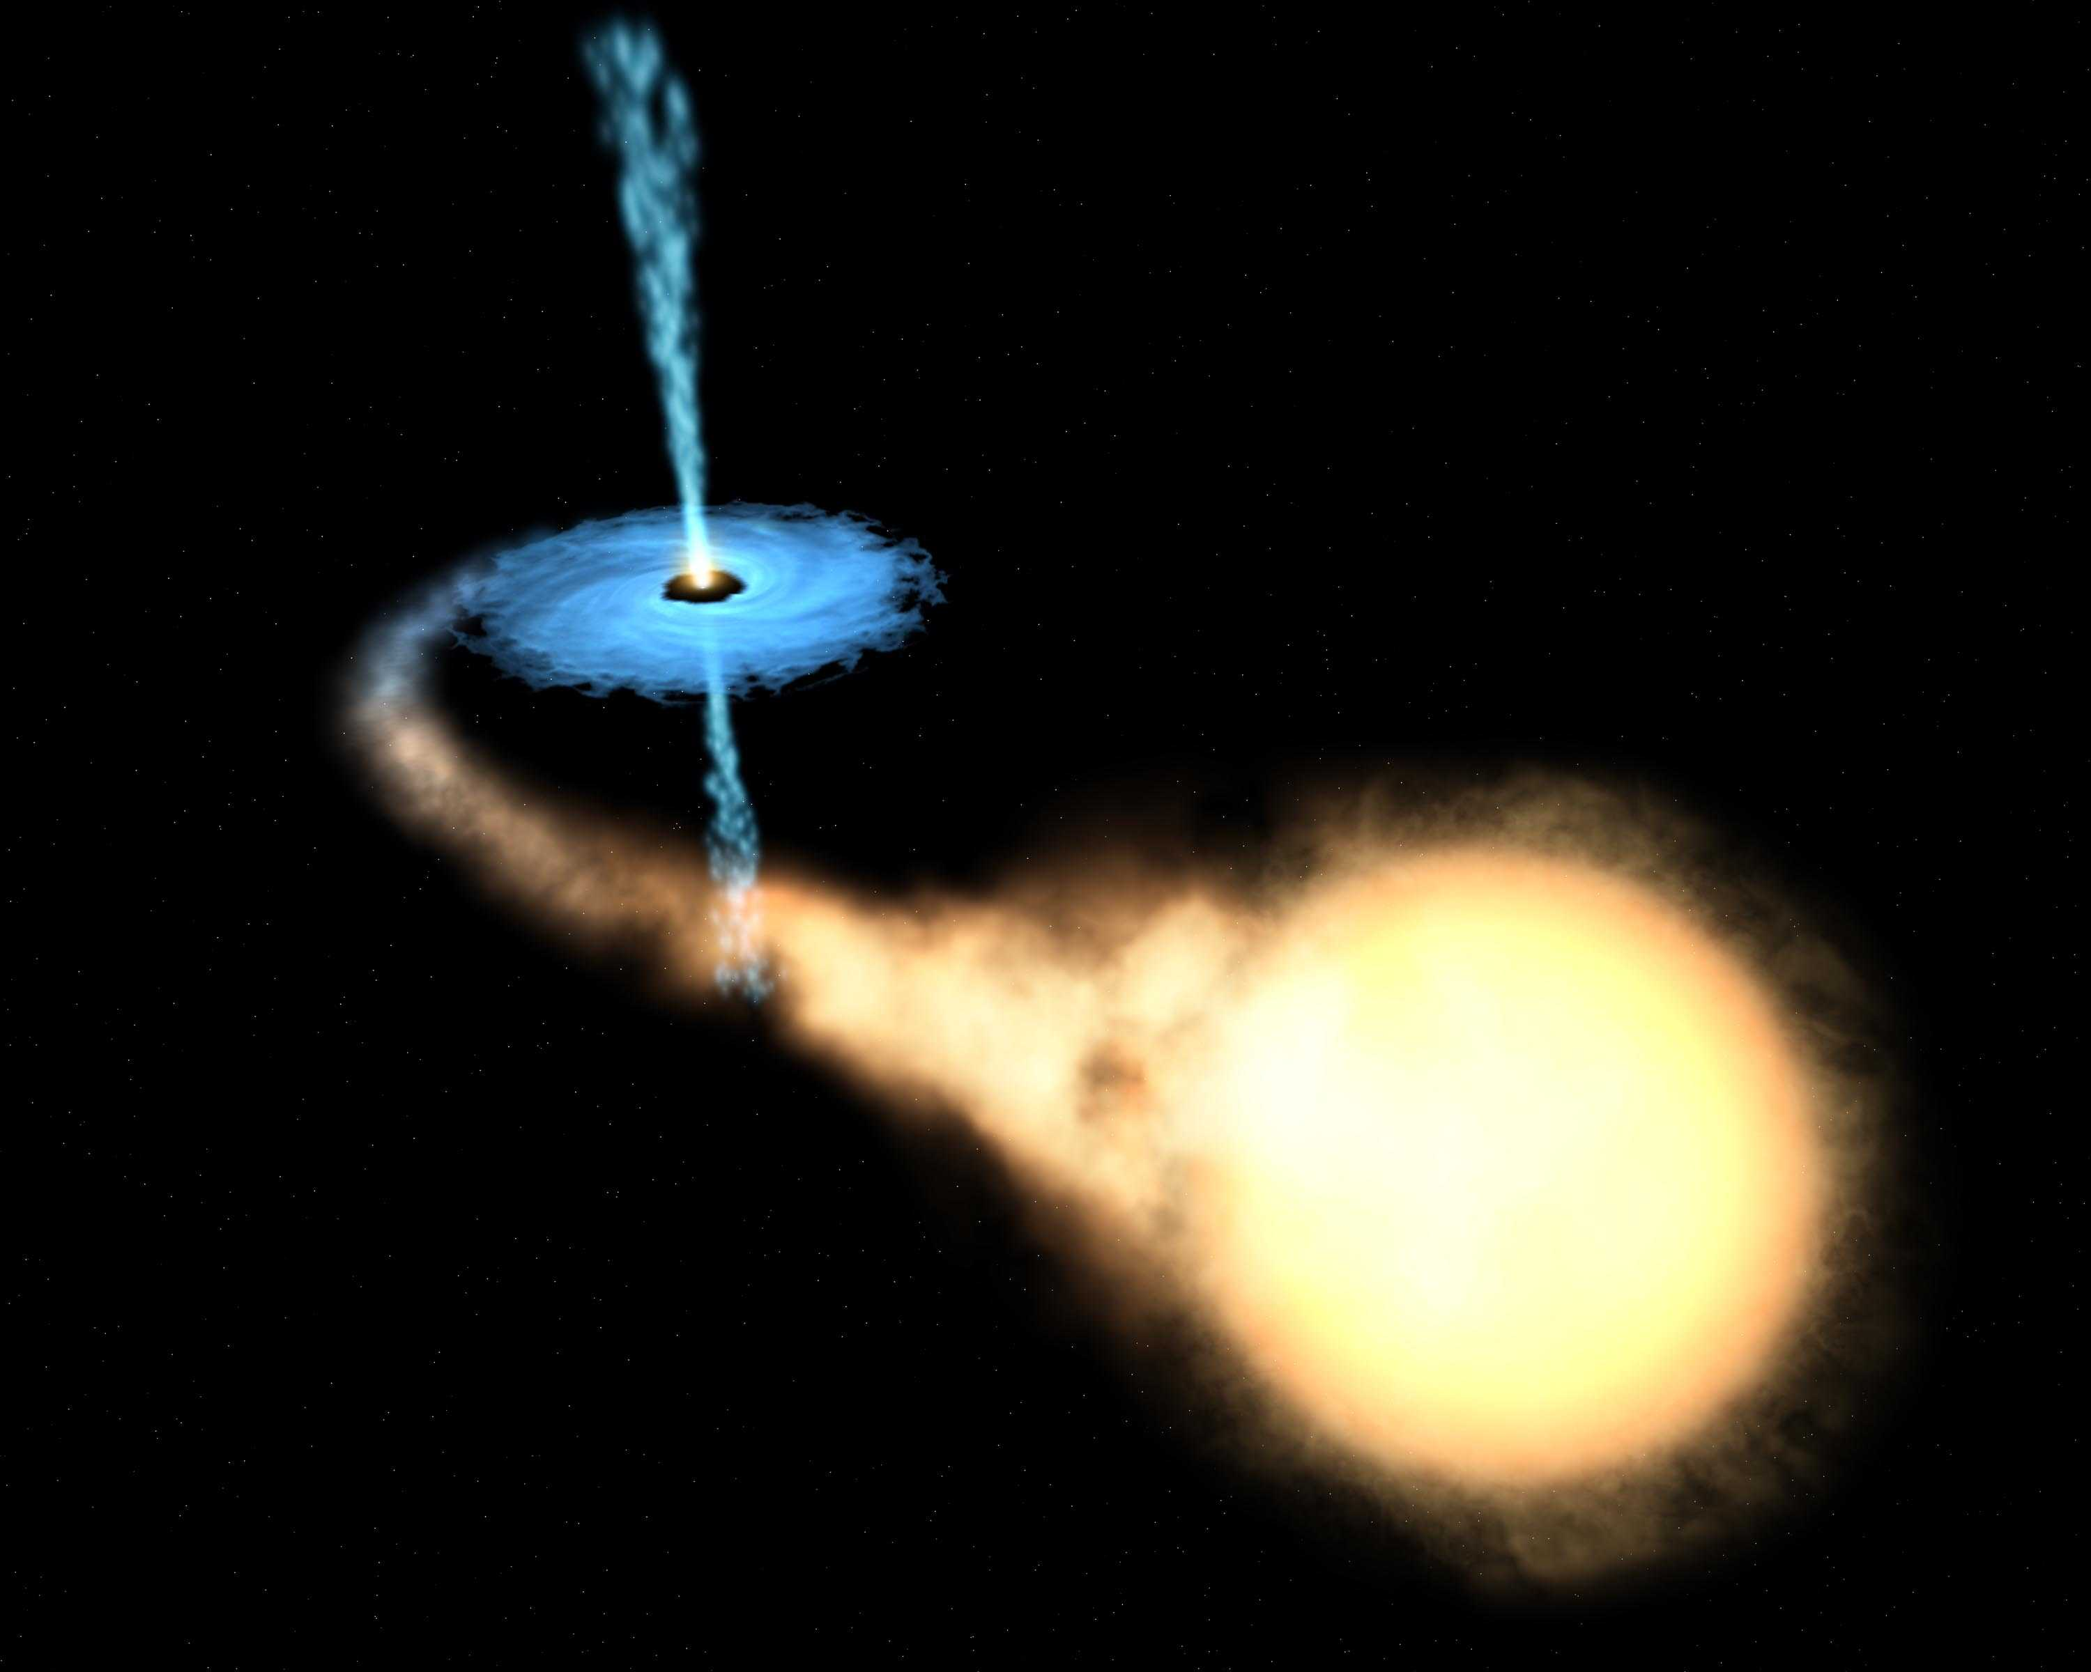
对伽玛射线双星的高能观测研究
王仲翔
(合作者: 邢祎, J. Takata,周佳能,童思敏)
上海天文台
威海, 2017/09/21

Slide 2
费米研究工作
对脉冲星系统的认证研究
脉冲星双星系统中高能辐射
对超新星遗迹的观测认证
对AGN的多能段观测研究
对伽玛射线双星的观测研究

Slide 3
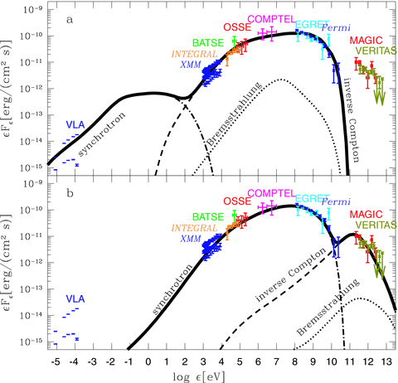
伽玛射线双星
High-mass X-ray binaries while with the emission peak at gamma-rays
Contain an O/B massive companion
Binary orbits highly eccentric
Observable at multi-wavelengths, from radio to TeV
Variable sources
Showing different phenomena, which reflect underlying physical processes
Emission peaks at gamma-rays
SED of LSI +61d303 (Zdziarski et al. 2010)

Slide 4
Two possible scenarios
Key question: whether they are rotation powered (a young pulsar as the primary) or accretion powered?
(Dubus 2013)

Slide 5
 | Orbital period (d) | Eccentricity | Companion type | Companion mass (Sun) | Distance (kpc)
PSR B1259-63 | 1236.7 | 0.87 | O9.5Ve | 31 | 2.3
LS 5039 | 3.9 | 0.35 | O6.5V | 23 | 2.9
LSI +61d303 | 26.5 | 0.54 | BoVe | 12 | 2.0
HESS J0632+057 | 315 | 0.83 | BoVpe | 16 | 1.6
1FGL J1018.6-5856 | 16.6 |  | O6V | 31 | 5.4
CXOU J053600.0-673507 (in LMC; candidate) | 10.3 |  | O5III |  | 50
PSR J2032+4127 (candidate) | 17670(48 years) | 0.989 | Be | 15 | 1.4-1.7
Known as a pulsar (47.8 ms) system

Slide 6
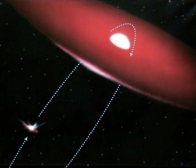
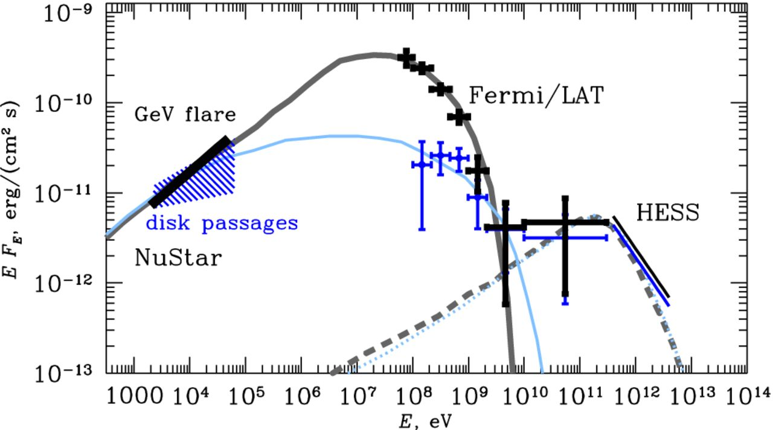
PSR B1259-63/LS 2883 at periastron
PSR B1259-63/LS 2883 ：orbital period 3.4 yr, e=0.87
GeV flare during the 2014 periastron passage, likely explained by synchrotron radiation
Chernyakova et al. (2015 )
Notes:
Ｘ射线双星特别是大质量Ｘ射线双星在伽玛射线研究的早期就被认为是可能伽玛射线源，但直到近十年通过地面ＴｅＶ和费米ＧｅＶ的观测才明确确认了几颗具有甚高能和高能的Ｘ射线双星源。它们基本上是变源，对于大质量双星在近星点附近有显著辐射增强现象。这里是谭柏轩关于这个双星的一项工作：在过了近星点后有ＧｅＶ耀变，而ＧｅＶ辐射和同时的Ｘ射线很可能是由同一批高能电子同步辐射所产生。我们计划对Ｘ射线双星做具体的费米数据搜寻，了解它们整体情况，回答诸如为什么有些有很显著的辐射而另一些却没有，造成这种区别的具体物理条件是什么等等问题。

Slide 7
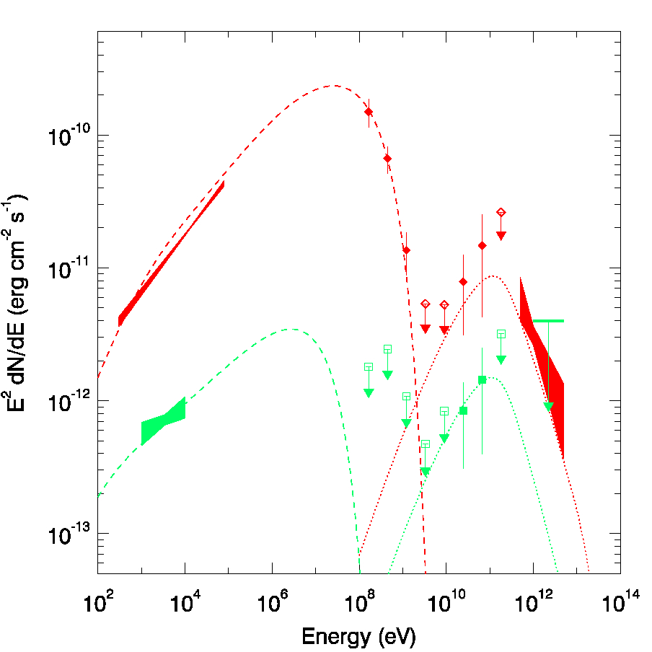
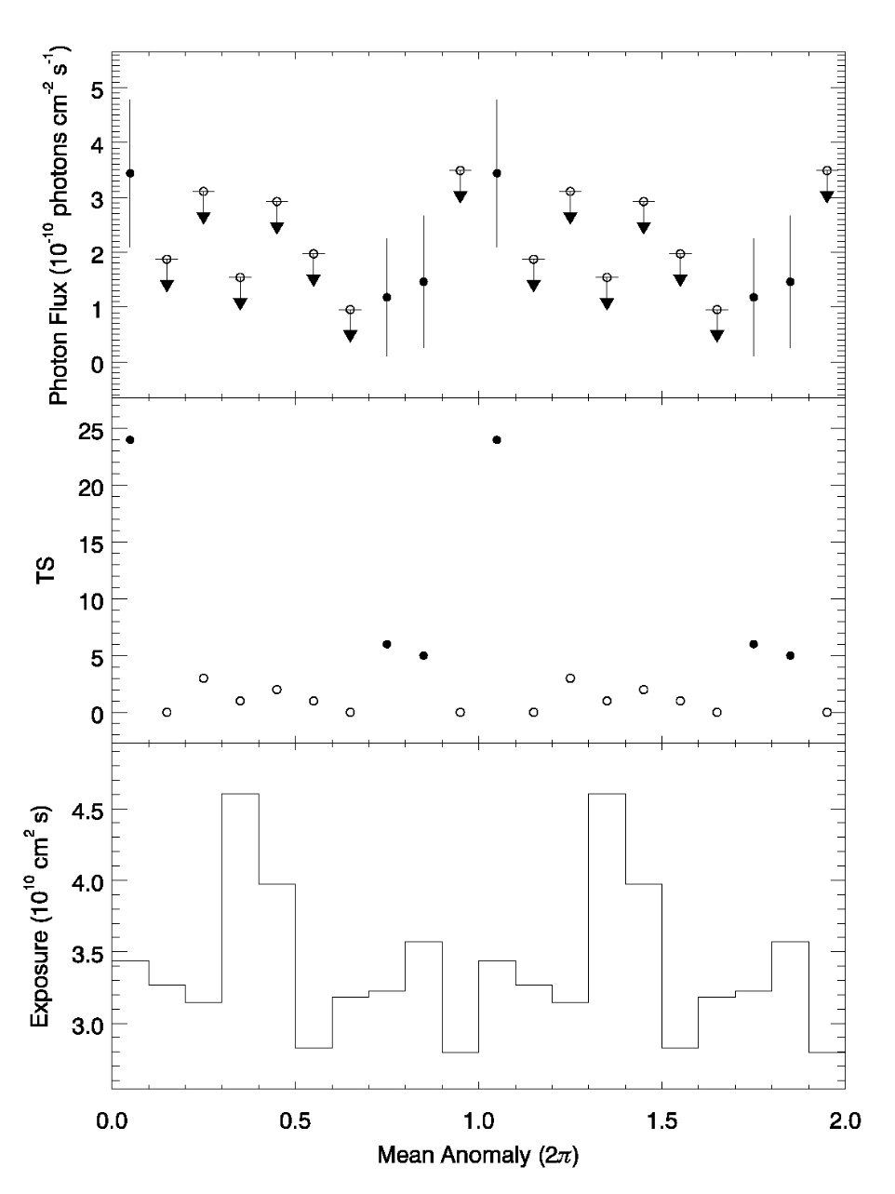
PSR B1259-63/LS2883高能辐射的发现
红色：近星点耀变能谱
绿色：宁静态能谱
流量
探测显著度
在后半周轨道具有高能5-300 GeV辐射，产生于脉冲星星风和大质量伴星星风的相互作用
我们首次在观测上证认出即使在宁静态，中子星和大质量伴星相互作用一直存在
（Xing, Wang, Takata 2016, ApJ)

Slide 8
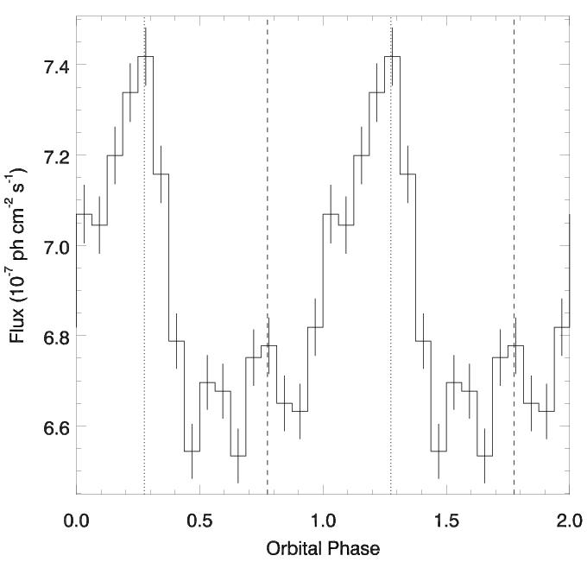
LSI +61d303
Porb=26.5 d, e=0.54
Emission peaks at gamma-rays
Fermi/LAT 0.1-300 GeV orbital light curve.
Periastron at orbital phase 0.275
SED of LSI +61d303 (Zdziarski et al. 2010)

Slide 9
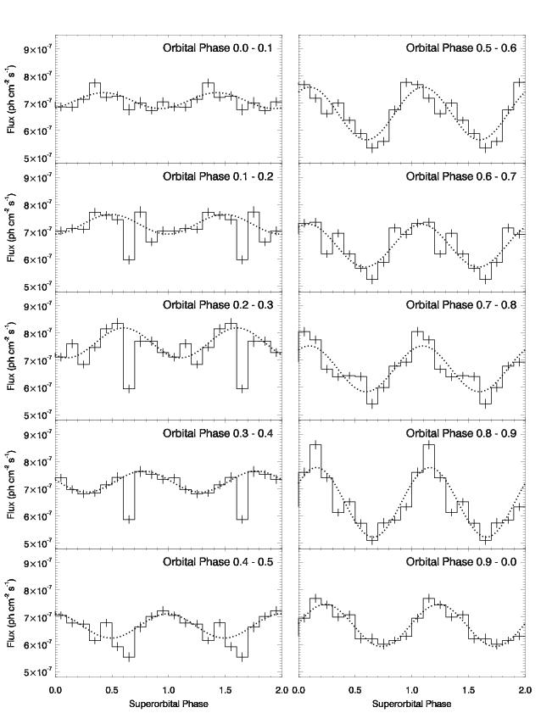
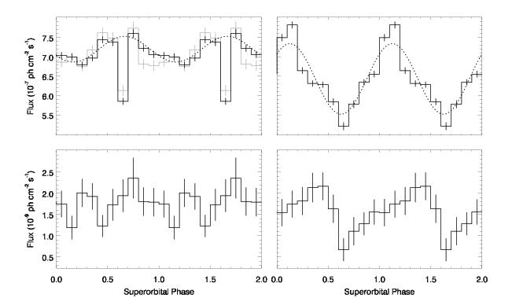
A dip appears most significantly during orbital phase 0.135-0.435 and energy<5.5 GeV
Superorbital modulation:
Pso=1667 days

Slide 10
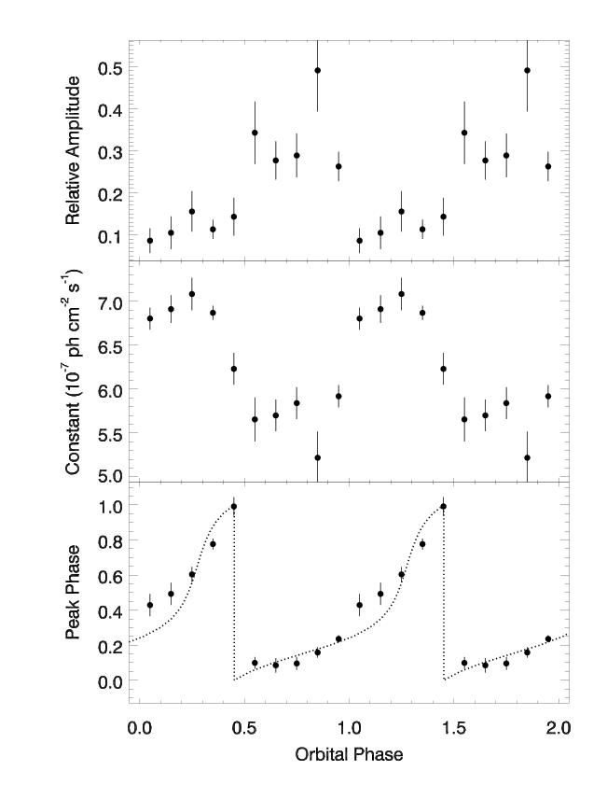
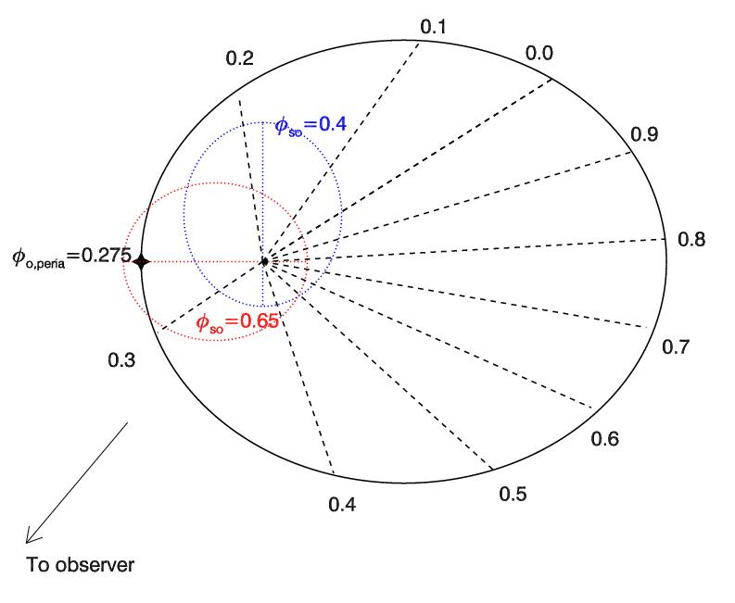
We
We fit the superorbital light curves with a sinusoid
The circumstellar disk is eccentric, and when at SO phase 0.65, the compact star is inside the disk, causing the dip;
The direction of the major axis points to the high-density region, giving rise to the SO modulation peak
(Xing, Wang, Takata 2017)

Slide 11
TeV 辐射特征
红色：近星点耀变能谱
绿色：宁静态能谱
在TeV能段存在着一个高能成分，部分可以由Fermi所探测到，来自逆康普顿过程

Slide 12
 | Orbital period (d) | Eccentricity | Companion type | Companion mass (Sun) | Distance (kpc) | TeV spectrum | TeV flux (10^-12) | TeV variability
PSR B1259-63 | 1236.7 | 0.87 | O9.5Ve | 31 | 2.3 | 2.7 | 3 （HESS） | Periastron Peak
LS 5039 | 3.9 | 0.35 | O6.5V | 23 | 2.9 | 2.1 | 10 （HESS） | Orbital peak at infe
LSI +61d303 | 26.5 | 0.54 | BoVe | 12 | 2.0 | 2.4 | 1-8 (Magic/Veritas) | Orbital/superorbital
HESS J0632+057 | 315 | 0.83 | BoVpe | 16 | 1.6 | 2.5 | 0.6 (HESS/Veritas) | Orbital, peak at 0.3
1FGL J1018.6-5856 | 16.6 |  | O6V | 31 | 5.4
CXOU J053600.0-673507 (in LMC; candidate) | 10.3 |  | O5III |  | 50
PSR J2032+4127 (candidate) | 17670(48 years) | 0.989 | Be | 15 | 1.4-1.7
TeV detection and properties

Slide 13
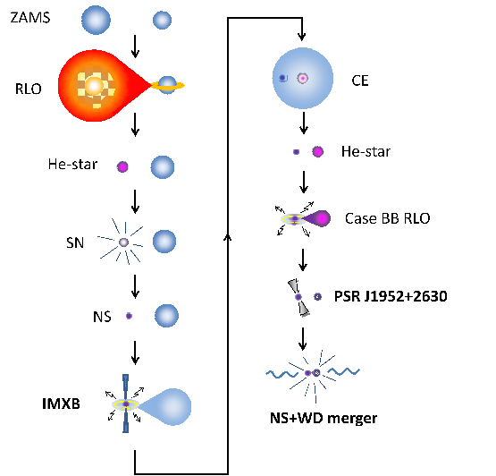
双星演化
从密近双星演化的推算,处于脉冲星生成的阶段,在银河系应有20-30颗此类大质量双星系统

Slide 14
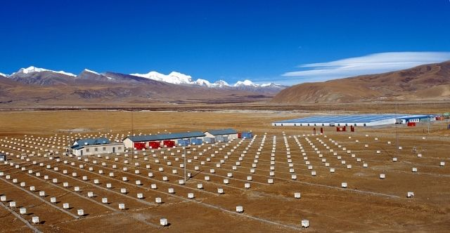
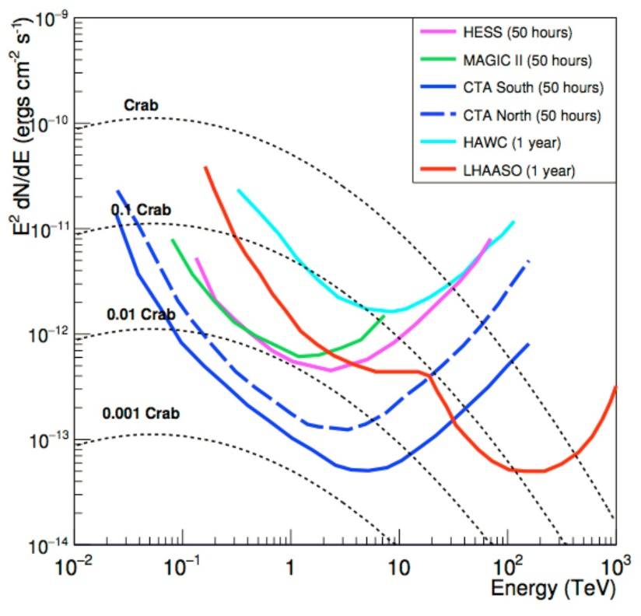
Summary
Gamma-ray binaries are remarkable sources in the sky
Around TeV or beyond, they are possibly detectable with LHAASO and to be studied in detail
We also expect to find new gamma-ray binaries with LHAASO
LHAASO’s sensitivity range

Slide 15
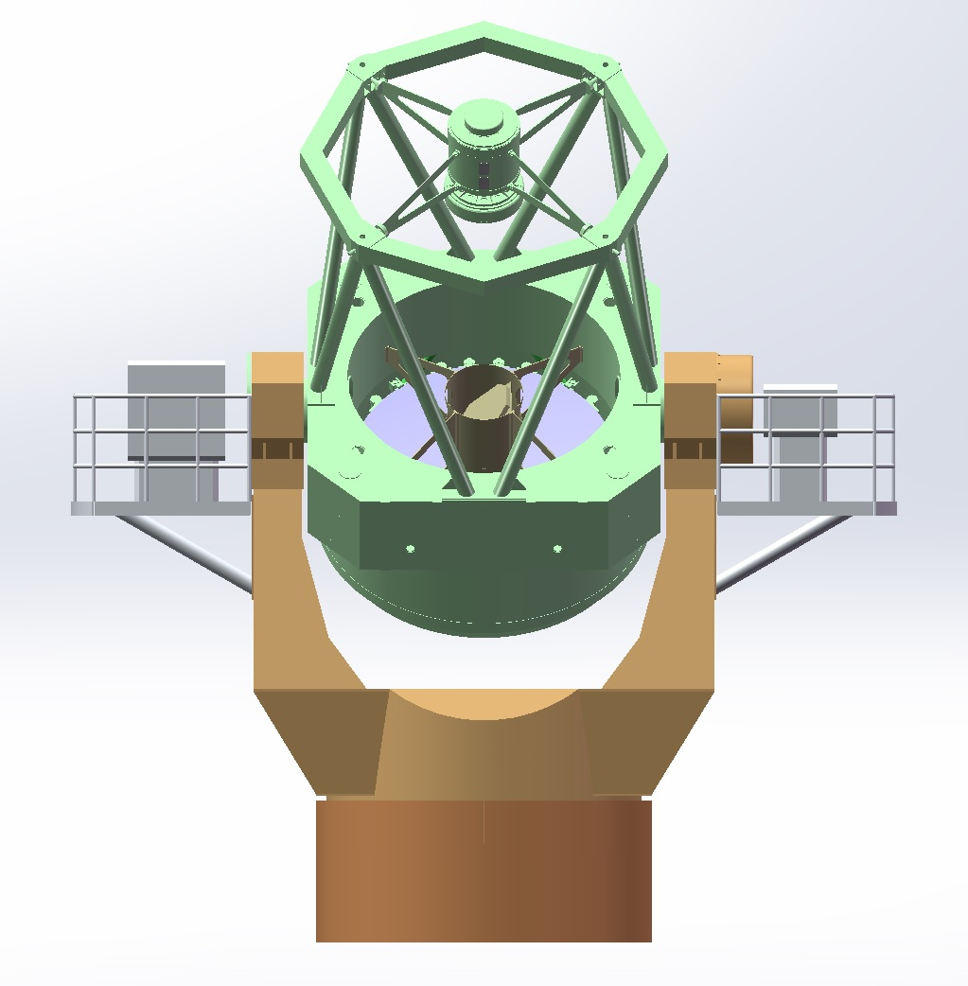
筹建中的上海台望远镜初步方案
口径2米级通用型望远镜
有两个耐焦，分别配置IFU和多通道成像仪，从事对近邻星系和宇宙中变源的观测:
比如X射线双星,超新星,AGN,TDE,伽玛暴,引力波源对应体
卡焦可自由配置不同仪器满足不同的观测需求
谢谢!
IFU
多通道成像仪
智利的优势:
覆盖南天，中国本土望远镜所缺少的
晴夜数比例高，达85%
视宁度优质，0.6-0.9角秒

