Slide 1
TeV未知源的联合观测证认
崔晓红、田文武、朱辉、张孟飞、吴丹、单素素
国家天文台
2017.9.21
LHAASO合作组会议， 威海， 9.21-9.23 @2017

Slide 2
Outline
TeV catalog and UNID
Galactic source identification
Extra-galactic sources
Survey crossing

Slide 3
Outline
TeV catalog and UNID
Galactic source identification
Extra-galactic sources
Survey crossing

Slide 4
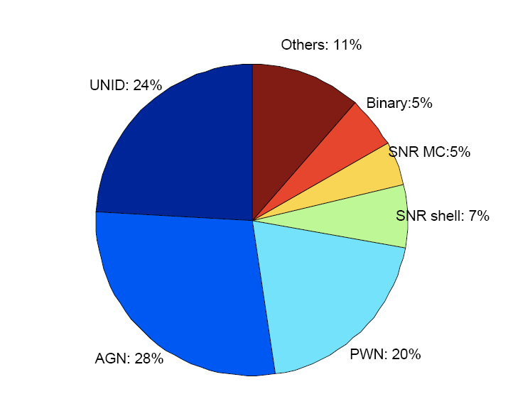
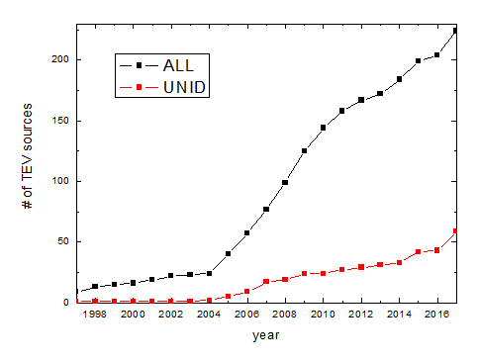
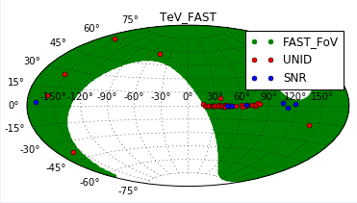
TeV catalog
tevcat.uchicago.edu/
1987.4-2017.8：224

Slide 5
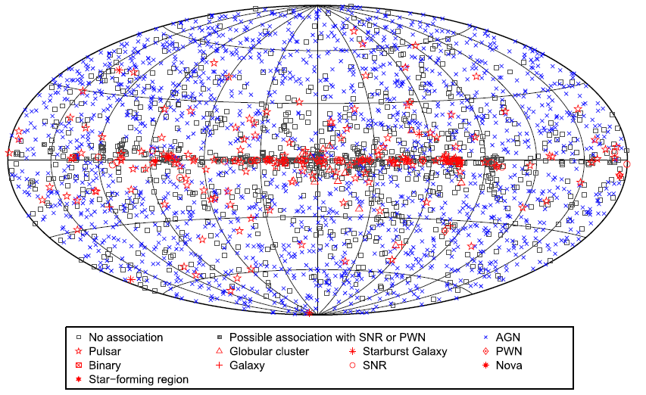
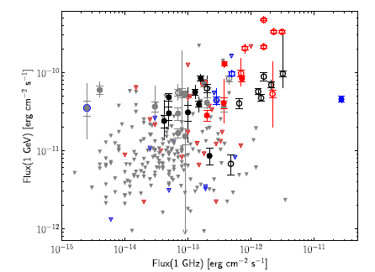
Fermi-LAT Catalog
Third Source Catalog 3033：1010
(Acero+ 2015)
Fermi First SNR Cat.:
30 likely, 14 marginal, 245 flux upper limits
(Acero+ 2016)

Slide 6
Outline
TeV catalog and UNID
Galactic source identification
Extra-galactic sources
Survey crossing

Slide 7
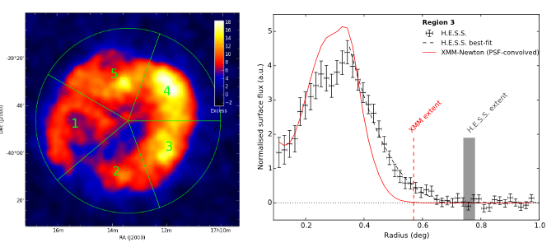
Supernova remnant
CO clumps
Hoischen+ 2017
Left: H.E.S.S.VHE γ-ray image of RX J1713.7-3946 ; Right: Radial profile of γ-ray (black) and X-ray (red)
(de Naurois 2017a)
CO intensity map (Su+ 2017)

Slide 8
Pulsar Wind Nebula (PWN)
(de Naurois 2017b)

Slide 9
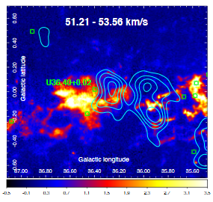
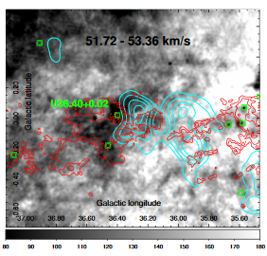
Pulsar complex
CO line emission in HII region U36.40+0.02
Phase folded distribution of Vela Pulsar
(de Naurois 2017a)
HI line emissions
(Aleksic+2014)

Slide 10
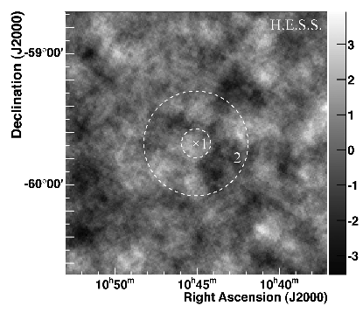
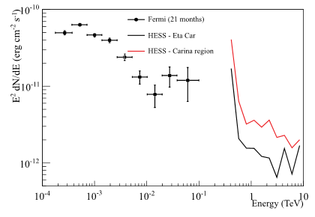
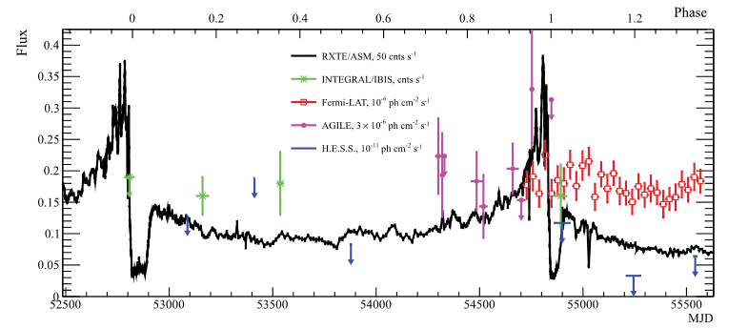
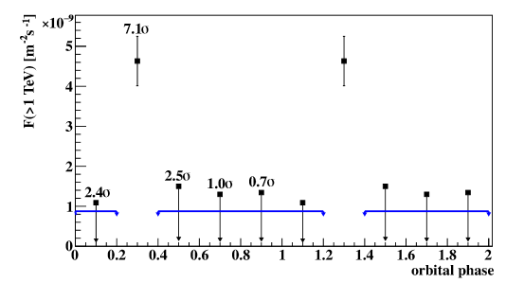
Binary
H.E.S.S. excess maps for the on-peak (left panel) and off-peak (right panel) regions of the orbit.
Left: Significance map of the 2◦×2◦ region Right: upper limits from Hess
Folded TeV γ-ray light curve
Binary system LMC P3 (Komin+ 2017)
Eta Carinae (H.E.S.S. Collaboration 2017)

Slide 11
Outline
TeV catalog and UNID
Galactic source identification
Extra-galactic sources
Survey crossing

Slide 12
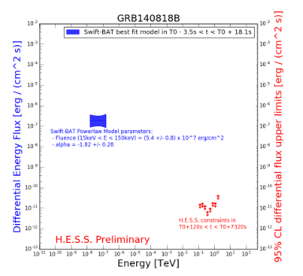
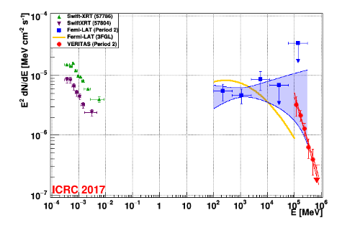
Quasar OJ 287
Preliminary spectra of PKS 0736+017 from Fermi-LAT (blue) & H.E.S.S. (red) (Cerruti+ 2017)
Significance sky map from VERITAS
Spectral energy distribution
(O'Brien+ 2017)
Upper limits from H.E.S.S. (red) and the best fit spectral model for the Fermi-GBM detection (Taylor+ 2017)

Slide 13
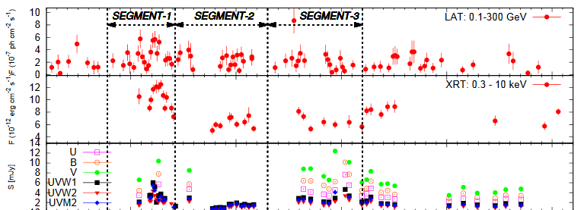
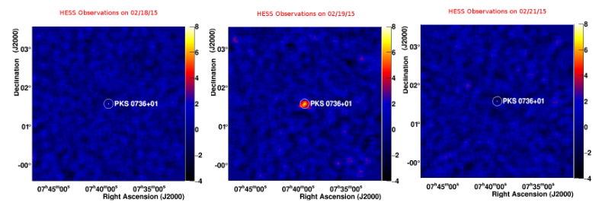
PKS 0736+017 : a new quasar in the VHE sky
Blazar OJ 287
Multi-wavelength light curves of from γ-rays to radio (Kushwaha+2017)
Fermi-LAT light-curve above 100 MeV
H.E.S.S. significance map for 2.18,19, and 21
(Cerruti+2016)

Slide 14
Outline
TeV catalog and UNID
Galactic source identification
Extra-galactic sources
Survey crossing

Slide 15
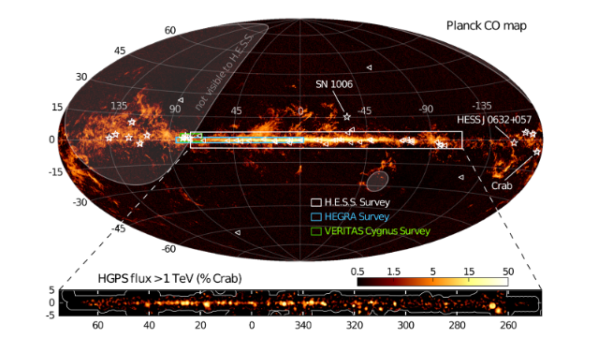
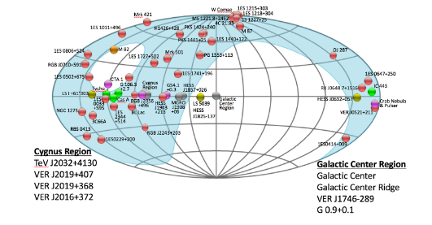
Survey crossing
Planck CO Map with 1FHL sources (triangles) and the 15 known Galactic TeV sources (white stars) outside the HGPS region
(de Naurois+ 2017a)
The VERITAS sky catalog in Galactic coordinates. Red circles: AGN; Blue region: VERITAS sky in normal observing modes
(Benbow+ 2017)
Notes:
http://tevcat.uchicago.edu/?mode=1&showsrc=284, 对已知有更多的了解，对未知有更多可能了解的方法。

