Slide 1
Mdc-7-13 PPJS

Slide 2
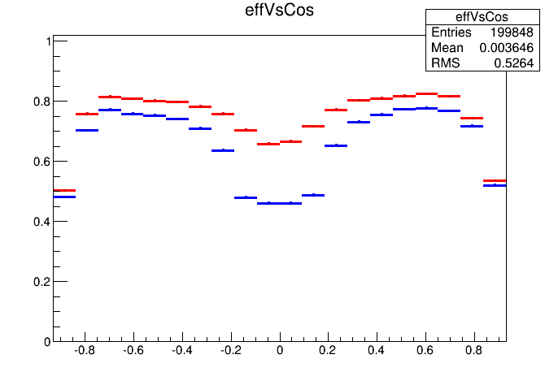
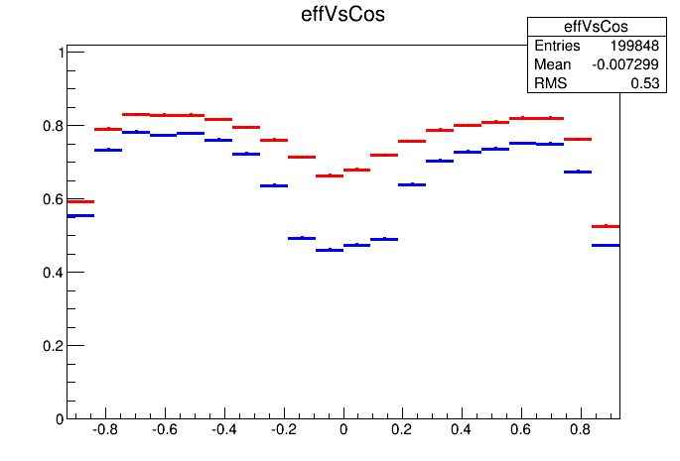
50~120MeV single pi-,pi+ Pattsf+ New Hough VS Pattsf
Pion-
Pion+
Pattsf+New Hough vs Pattsf
Pattsf+New Hough vs Pattsf
0.74292-0.652936 = 9%
0.729344-0.653156= 7.6%
Bug accur when do the don’t consider positive charge in stereo hit z-s calculation
Have fixed this bug

Slide 3
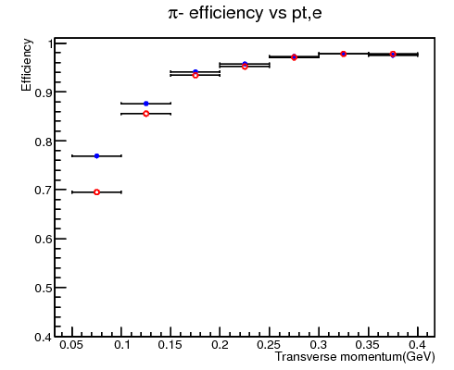
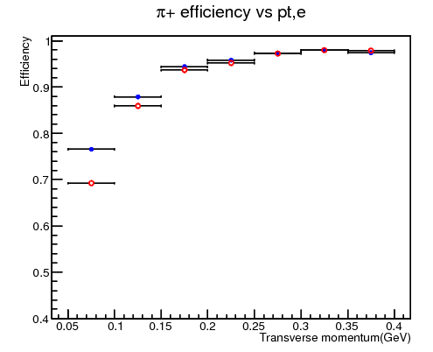
Tracking efficiency of data
Ψ(2s) ->J/ Ψ π ⁺ π ⁻ , J/ Ψ ->l⁺ l⁻
500w MC events
7.5% update in 50~100MeV

Slide 4
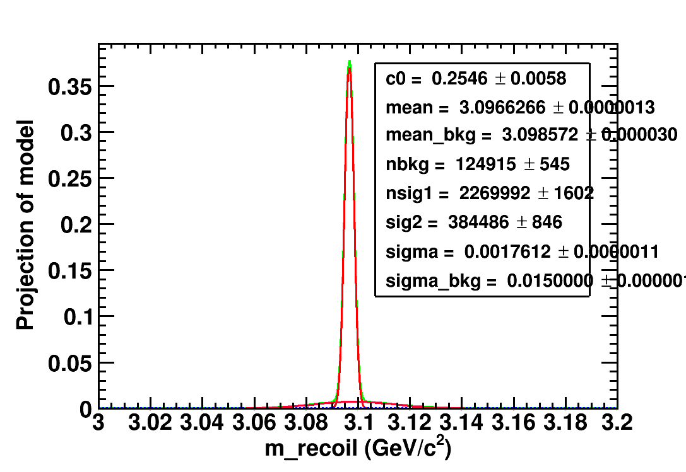
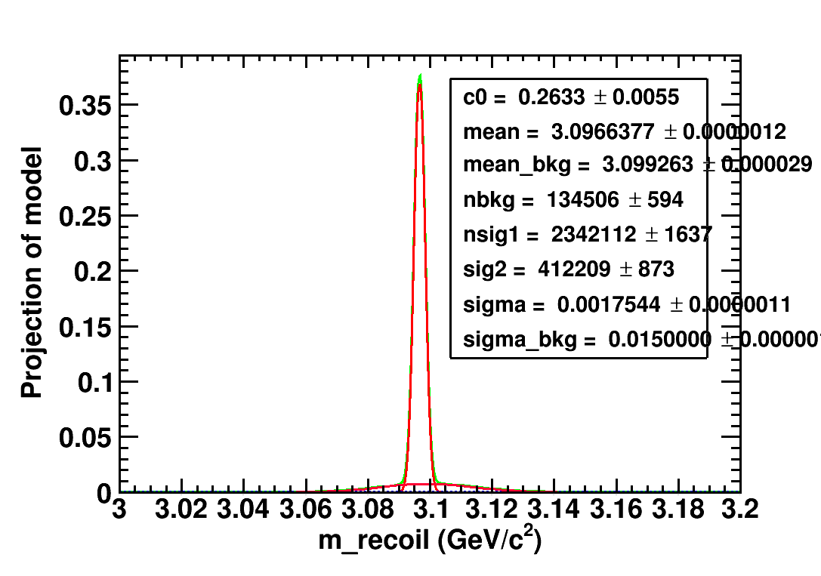
J/ Ψ recoil mass
PATTSF
PATTSF+HOUGH
Sig by mass fit : 2269992+384486 = 2654478
Signal by 4c : 2118834
signal/sqrt(signal+bkg) : 159.2
Sig hough mass fit : 2342112+412209 = 2754321
Signal by 4c : 2199417
signal/sqrt(signal+bkg):162.1
By mass fit : 3.76% oldversion(1.7%)
By 4C : 3.79%

Slide 5
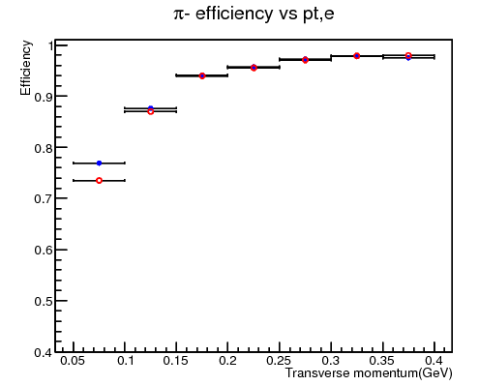
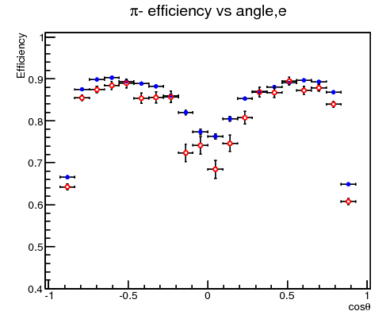
New version compared with old version
3.4% update with old Hough Version (0~100MeV)

Slide 6
 | Tracking eff (50~120MeV) | Signal by mass fit(compare with pattsf) | Ntrack = 5
PATTSF | 74.3% |  | 0.12%
PATTSF+OLDHOUGH | 77.6% | 1.7% | 0.18%
PATTSF+NEWHOUGH | 80.3% | 3.76% | 0.49%

