Slide 1
Higgs combination toward CDR
ZhangKaili
IHEP
2017-07-12

Slide 2
Outline
Motivation
Model introduction
Brief look of individual analysis
Fit Result of $Δ\left(Br∗σ\right)$ and $κ$

Slide 3
Combination: motivation
Old individual analysis
Correlations between channels not taken into account
Treat ZH backgrounds wrongly
One channel’s ZH bkg is another channel’s signal, should combine together.
Systematic uncertainties are difficult to address
Combination measurement
Uniformed, simultaneous fit framework
Can easily include necessary correlations/uncertainties
Extensibility for making different assumptions

Slide 4
Fit techniques
Workspace: container of likelihood model and data.
Input: invariant/recoil mass spectrum, b/c/g template
POI(parameter of interest): $σ∗Br$, Higgs coupling $κ$
NP(nuisance parameter): function & constrains in model besides POI
represents uncertainties
correlated NP share the same name
currently set $Δσ=0.5\%, ΔLumi=0.1\%$
more NP can be introduced in the future.
PDF for fit:
signal: CB ball + Gaussian;
bkg: 2rd poly exp
Algorithm:
Minuit2 + Minimize
Currently, with MC sample,
we can fit Asimov data to get
estimated precisions of
$σ∗Br$, $Br$, and $κ$ of CEPC.
All the result are consistent with pre_CDR’s result.
In the future with real data,
we can directly use this framework to get these pois’ value and uncertainties.

Slide 5
Fit techniques
For each channel (like eeqq, $μμττ$)
Input observables from MC sample.
Build Combine S+B Pdf Tot=N_{bb}*Pdf+N_{cc}*Pdf_{cc}+……+N_{bkg}*Pdf_{bkg}
Add $μ$s on evnets number N_{bb，}could be:
When measure $σ∗Br$, N_{bb}= N_{bb_SM}* $μ$_{bb}
When measure $Br$, N_{bb}= N_{bb_SM}* $μ$_{bb} *$σ(ZH)(0.5\%)$
When measure $κ$, N_{bb}= N_{bb_SM}* $κ_{z}^{2}$ * $κ_{b}^{2}$
Different channel share the same $μ$s. eebb, mmbb, qqbb, vvbb……
Use Combine pdf to make Asimov data No fluctuation made (Unlike ToyMC test)
Simultaneous fit combine pdf to Asimov Data with different asumptions.
pdf shape is fixed all the time.
ZH bkg events, like ZZ events in WW channel, will contribute to $μ_{ZZ}$.
If no specific channels known, will only contribute to $μ_{global} or κ_{z}$

Slide 6
Channels Table (now 36)
*H->ee/$eμ$ not listed due to no certain ratio.
*nn/qq+$ττ$ without bkg.
*H->zz->vvvv is tagged H->invisible.
Signal |  | Observed | Who takes charge | Last update |  | Signal |  | Observed | Who takes charge | Last update
Z | H |  |  |  |  | Z | H
H->qq |  |  |  |  |  | H->WW
ee | bb | 7466 | Baiyu | 2017.7 |  | μμ | μvμv | 52 | Libo | 2017.4
 | cc | 343 |  |  |  |  | evev | 36
 | gg | 1039 |  |  |  |  | evμv | 105
μμ | bb | 10575 |  |  |  |  | evqq | 663
 | cc | 538 |  |  |  |  | μvqq | 717
 | gg | 1556 |  |  |  | ee | μvμv | 44
qq | bb | 176734 |  |  |  |  | evev | 22
 | cc | 8268 |  |  |  |  | evμv | 81
 | gg | 25279 |  |  |  |  | evqq | 612
vv | bb | 70443 |  |  |  |  | μvqq | 684
 | cc | 3054 |  |  |  | vv | qqqq | 9022
 | gg | 9585
H→γγ |  |  |  |  |  | H->ZZ
ll | γγ | 93 | Feng | 2015 |  | vv | μμjj | 190 | Yuqian | 2016.9
vv |  | 309 |  |  |  | μμ | vvjj | 209
qq |  | 822 | Yitian | 2017.4 |  | ee | vvjj | 72
H→ll |  |  |  |  |  | H->Invisible
μμ | ττ | 2067 | Dan | 2017.7 |  | qq | vvvv | 202 | MoXin | 2017.7
qq |  | 36024 |  |  |  | ee |  | 12
nn |  | 12478 |  |  |  | μμ |  | 22
Inc. | μμ | 47 | Zhenwei | 2016.8
Observed=tagged signal after cutflow and in asimov fit range.
All events are normalized to 5ab⁻¹.

Slide 7
Individual analysis intro

Slide 8
$$bb/cc/gg$$
$$B_{likeness}=\frac{b_{j1}b_{j2}}{b_{j1}b_{j2}+(1−b_{j1})(1−b_{j2})}$$
Higgs ~70% to dijets bb/cc/gg
Flavor tagging algorithm
Baiyu, Liboyang’s template fit
$Z→ee μμ qq vv, H→$ $bb/cc/gg$ are studies.
2D fit, with dijets’ b/c likeness
In $Z→ee μμ qq vv$, Tot=bb+cc+gg+bkg_{zh}+bkg_{sm}.
Build individual pdf by MC, then fit to determine fraction.
In Baiyu’s result, also, the shape of bkg is fixed.
Which means we have a wonderful understanding with bkg, which may be more suitable for CEPC.
Baiyu’s | μ_bb | μ_cc | μ_gg | Pre_CDR | μ_bb | μ_cc | μ_gg
eeH | 1.2% | 14.4% | 7.8% | eeH | 1.1% | 14.6% | 5.6%
mmH | 1.1% | 12.8% | 6.9% | mmH | 0.9% | 12.6% | 3.8%
qqH | 0.4% | 8.0% | 5.2% | qqH | 0.4% | 3.0% | 2.6%
vvH | 0.4% | 3.8% | 1.6% | vvH | 0.45% | 3.2% | 2.8%
Combined | 0.3% | 3.2% | 1.6% | Combined | 0.28% | 2.2% | 1.6%
Pre_CDR, $v\overline{v}H$, $\overline{q}qH$ results are extrapolated from ILC studies.
It seems Pre_CDR‘s result too optimistic.

Slide 9
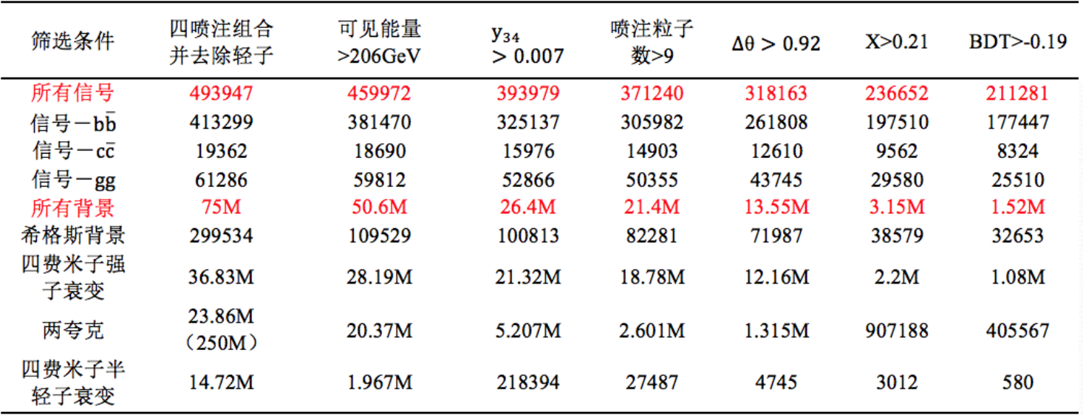
A cut flow on qqqq
huge bkg events (1520000)
will reduce the performance.
if bkg is float, the precision can be worse in qqqq:
(0.96%, 12.1%, 18.9%)

Slide 10
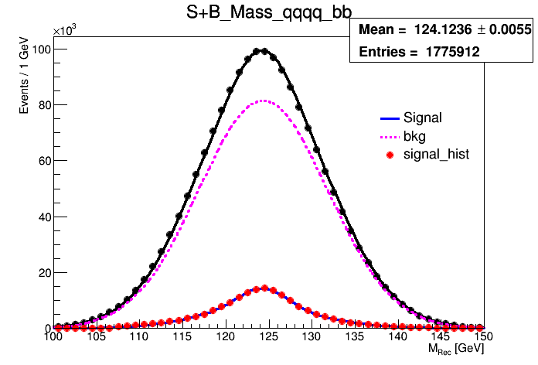
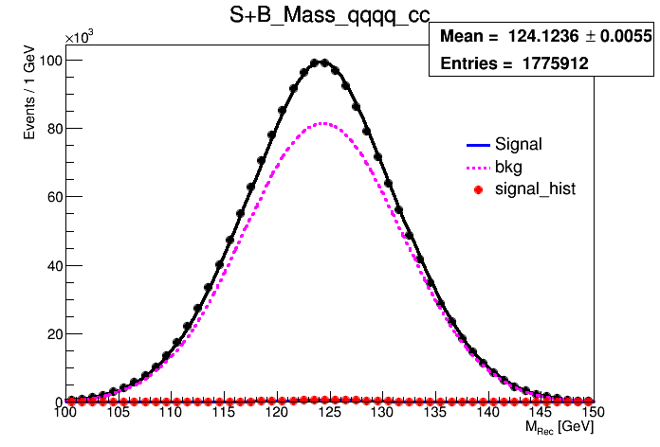
My attempt, $bb/cc/gg$
 | CDR | Old sample | Current | Baiyu’s
$$bb$$ | 0.28% | 0.25% | 1.53% | 0.3%
$$cc$$ | 2.2% | 2.70% | 38.0% | 3.2%
$$gg$$ | 1.6% | 1.17% | 7.9% | 1.6%
Now, we can use either mass spectrum or template as observables.
In old sample, bb/cc/gg is separated(which is not realistic.) and bkg is not complete.
Now in a single channel, as bb/bkg large, cc/gg events limited,
qqbb 170000, qqcc 8000, and bkg ~1520000.
the fit is unstable/ performance is vary poor now.
Fixing……
Other channels not influenced.
In theory this result is all the same with Baiyu’s result.
Black line&dot: Asimov s+b pdf&data
Blue line: signal pdf
Red dot: signal mc sample
Ping dash: SM bkg

Slide 11
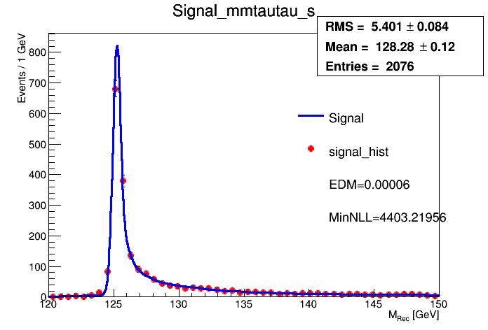
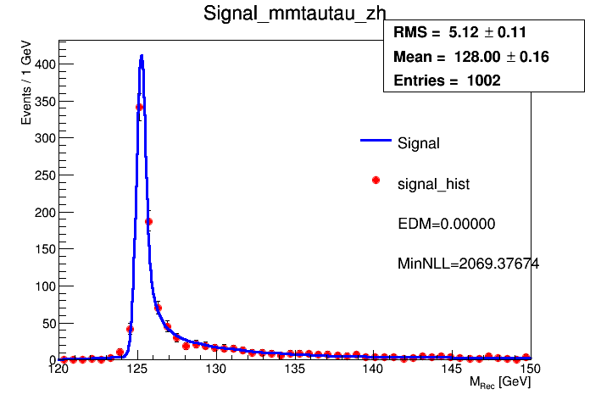
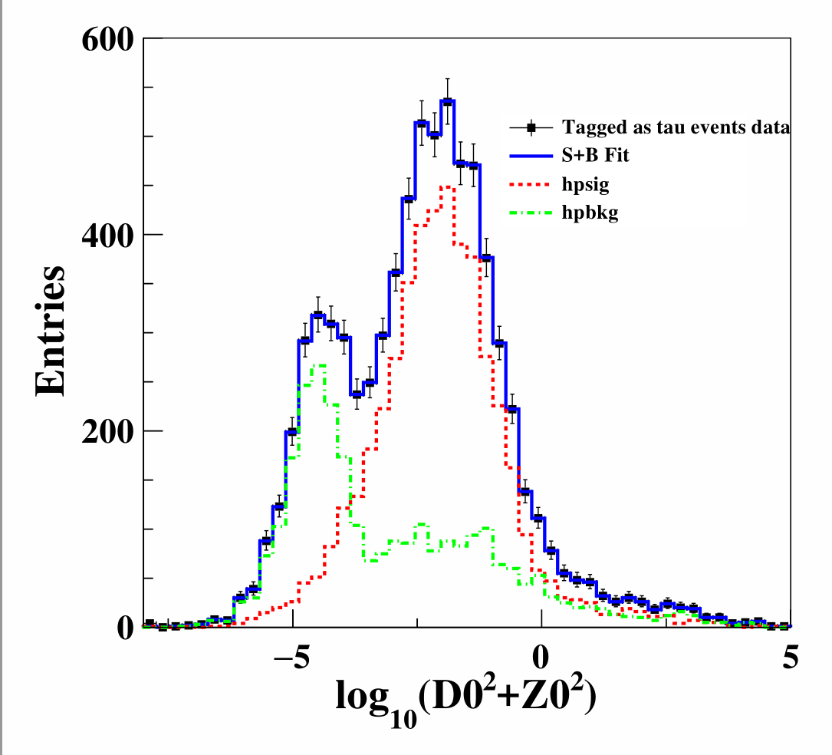
$$ττ$$
 | CDR | Currently
$$ττ$$ | 1.2% | 0.74% (overestimated)
Pre_CDR concludes the precision result but no description.
Signal and ZH events(Main WW) share the same shape
Dan use $\log_{10}{(D_{0}^{2}+Z_{0}^{2})}$ fit to separate signal
Distance from beam spot
Determine the ratio, then use ratio to produce signal sample.
Currently,
qqtt channel’s bkg not ready and some bugs in vvtt’s bkg.
So bkg not included; this 0.74% can be overestimated.

Slide 12
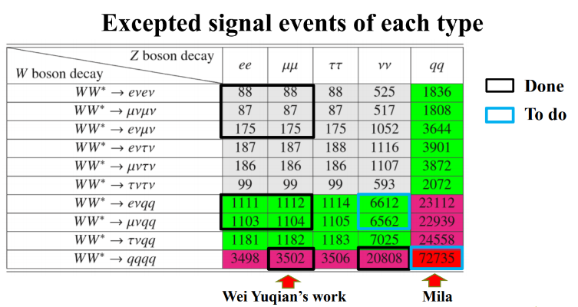
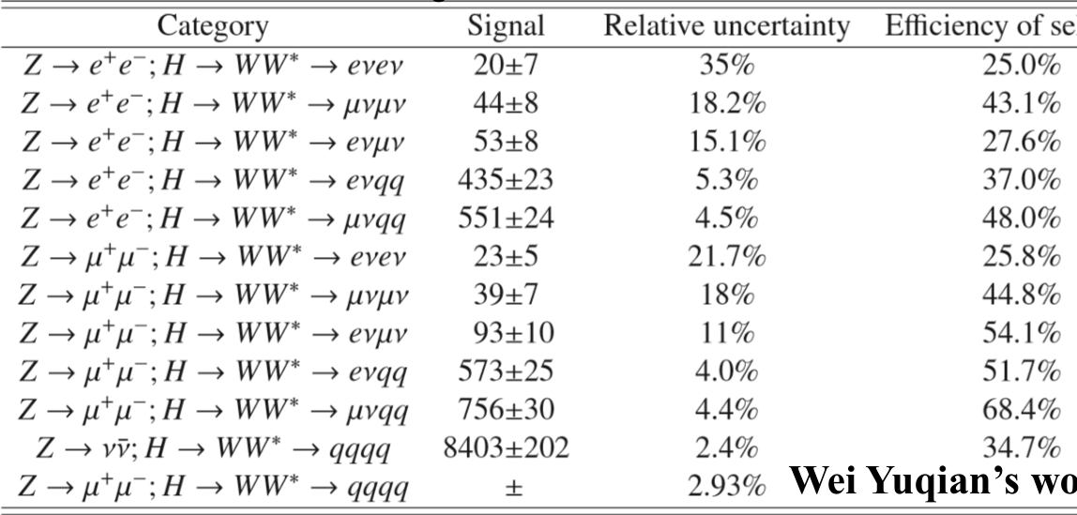
WW
 | CDR | Manqi’s | Mine
$$WW$$ | 1.5% | 1.0% | 1.24%
Pre_CDR’s result contains:
Currently have 11 channels of WW (with box)
Data entry is different with Pre_CDRs’.
Others are undergoing
Libo’s summary

Slide 13
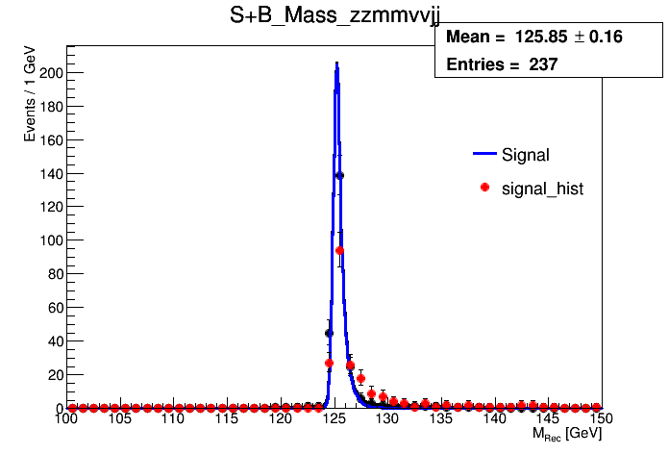
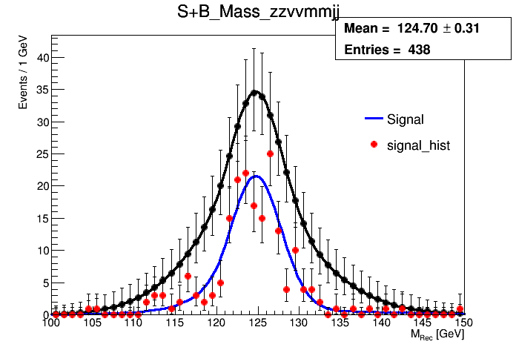
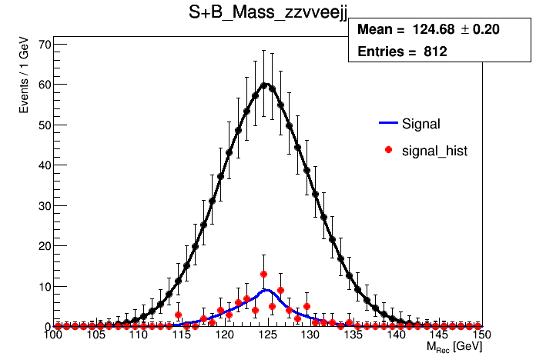
ZZ
 | CDR | Mine
$$ZZ$$ | 4.3% | 5.41%
3 final Z, one off-shell.
Pre_CDR’s result from extrapolating the FCC-ee.
Now has 3 channels clear and easy to study
Others are rather difficult; undergoing by Yuqian.
μμ | vvjj
vv | μμjj
ee | vvjj

Slide 14
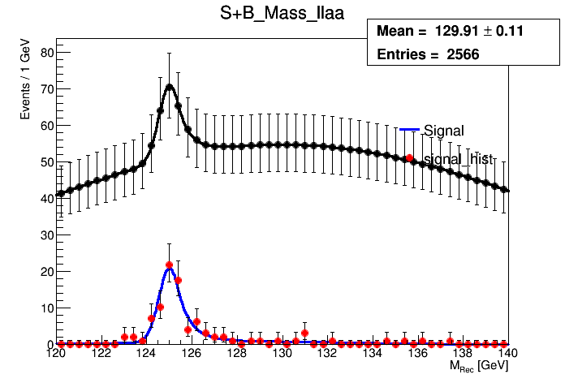
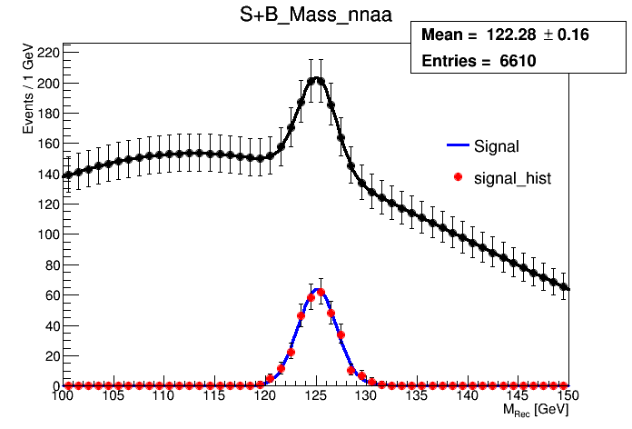
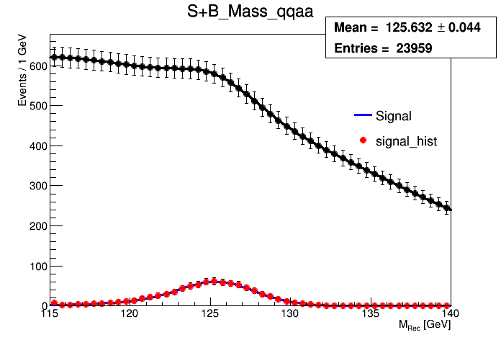
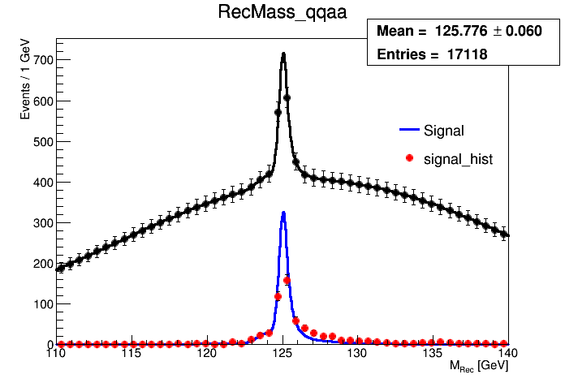
$$γγ$$
 | CDR | Mine
$$ZZ$$ | 9.0% | 7.38%
Z | H | Mine | CDR
ll | γγ | 90 | 62+56
vv |  | 328 | 339
qq |  | 828 | 582
3 channels of $γγ$ ($ll,vv,qq+γγ$, lepton=$μ, τ$)
Pre_CDR assume ECAL’s resolution $\sim \frac{16\%}{\sqrt{E}}⨁{1}\%$, then to 9%.
llrr, vvrr are fast simulated by Feng in 2015, and now outdated.
qqrr updated by Yitian in 2017.4.
Awaiting update.
Signal events comparison
Old plot for qqrr,
totally different.
New plot for qqrr

Slide 15
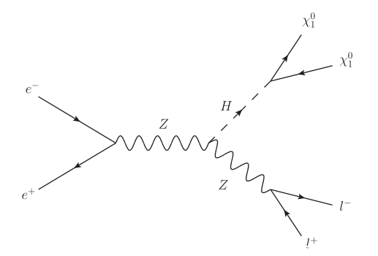
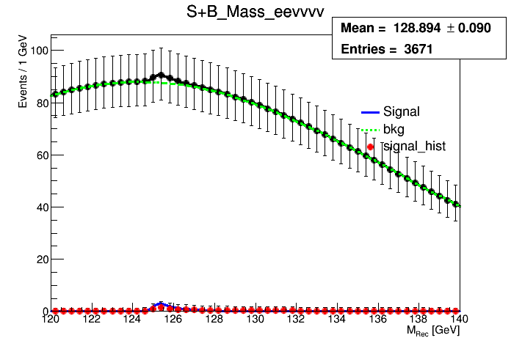
$$H→invisible$$
 | CDR | Mine
$$invisible$$ | 0.14% | \
In pre_CDR, plan to search exotic decay
SUSY $H→χ_{1}χ_{1}$ assume $σ=$200 fb.
In this case, extrapolated from ILC studies, precision is 0.14%
Here, treat H->ZZ->vvvv as invisible.
3 channels analyzed by Moxin, Z->ee/mumu/qq
As large bkg, my precision of $μ$ is ~14.5%.
The Br precision is 0.18% (in pre_CDR it’s 0.28%)

Slide 16
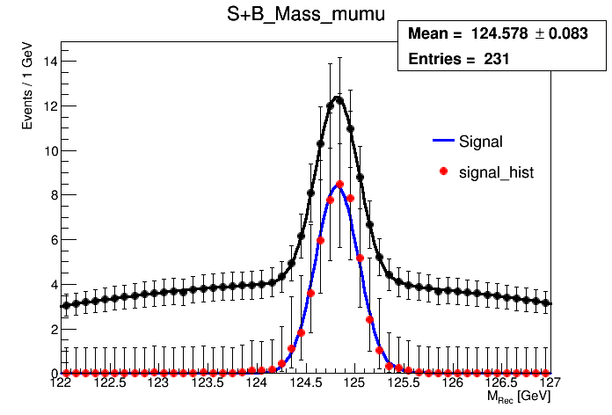
$μμ$ and other rare decays
 | CDR | Mine
$$μμ$$ | 17% | 14.50%
$μμ$ process, the Z decay is inclusive
performance benchmark for the tracking system design
$Zγ,eμ, ee$ process are studied.
Since low stats and no clear ratio, not taken into fit model.

Slide 17
$Δ\left(Br∗σ\right)$ fit Result
bb/cc/gg use Baiyu’s result
 | PreCDR | $$σ\left(ZH\right)∗Br$$ |  | PreCDR for $ΔBr$ | Fit result for $ΔBr$
$$σ(ZH)$$ | 0.51% | set to 0.50%
$$Δ(Br∗σ)$$ | 0.28% | 0.17% |  |  | 0.54%
$$σ\left(ZH\right)∗Br(H→bb)$$ | 0.28% | 0.30% |  | 0.57% | 0.57%
$$σ\left(ZH\right)∗Br(H→cc)$$ | 2.2% | 3.20% |  | 2.3% | 1.80%
$$σ\left(ZH\right)∗Br(H→gg)$$ | 1.6% | 1.60% |  | 1.7% | 1.06%
$$σ\left(ZH\right)∗Br(H→WW)$$ | 1.5% | 1.24% |  | 1.6% | 1.35%
$$σ\left(ZH\right)∗Br(H→ZZ)$$ | 4.3% | 5.41% |  | 4.3% | 5.42%
$$σ\left(ZH\right)∗Br(H→ττ)$$ | 1.2% | 0.74% |  | 1.3% | 1.00%
$$σ\left(ZH\right)∗Br(H→γγ)$$ | 9.0% | 7.38% |  | 9.0% | 7.38%
$$σ\left(ZH\right)∗Br(H→μμ)$$ | 17% | 14.65% |  | 17% | 14.65%
$$Br(H→inv.)$$ | \ | \ |  | 0.28% | 0.18%

Slide 18
$κ$ framework
Define as the ratio of the coupling to SM expects.
In CEPC, $κ$ occurs on three places:
For Production, as now only ZH sample, $κ_{Z}^{2}$;
For Partial decay, no top quark $κ_{t}$ like: $κ_{Z}^{2}$, $κ_{W}^{2}$, $κ_{b}^{2}$, $κ_{c}^{2}$, $κ_{g}^{2}$, $κ_{τ}^{2}$, $κ_{γ}^{2}, κ_{μ}^{2}$, $κ_{Inv}^{2}……$
For Total width $Γ_{H}.$ $Γ_{H}=Γ_{SM}+Γ_{BSM}$ for exotic decays.
$κ$ framework varies for different assumptions.
Here our fit, as sample limited, we set:
$Γ_{BSM}=0$
Assume $Γ_{H}$ constant currently
So set 9 $κ:κ_{Z}^{2}$, $κ_{W}^{2}$, $κ_{b}^{2}$, $κ_{c}^{2}$, $κ_{g}^{2}$, $κ_{τ}^{2}$, $κ_{γ}^{2}, κ_{μ}^{2}$, $κ_{Inv}^{2}$

Slide 19
$κ$: current precision result
$$κ$$ | 9 | 8 | 7
$$κ_{b}$$ | 1.22% | 1.22% | 1.22%
$$κ_{c}$$ | 1.77% | 1.77% | 1.77%
$$κ_{g}$$ | 1.29% | 1.29% | 1.29%
$$κ_{γ}$$ | 4.01% | 4.02% | 4.00%
$$κ_{τ}$$ | 1.28% | 1.28% | 1.16%
$$κ_{μ}$$ | 8.11% | 8.11%
$$κ_{inv(H→vvvv)}$$ | 12.99%
$$κ_{Z}$$ | 0.93% | 0.93% | 0.90%
$$κ_{W}$$ | 1.13% | 1.14% | 1.10%
9: Assume $Γ_{H}$ constant.
8: Assume no invisible decay. set $κ_{inv}=1$
7: Assume lepton universality ${κ_{l}=κ}_{τ}=κ_{μ}$
These simplification little affect the precision.

Slide 20
$κ$: comparison to pre_CDR
10 $κ$ | My fit | Pre_CDR | 7 $κ$ | My fit | Pre_CDR
$$κ_{b}$$ | 1.22% | 1.3% | $$κ_{b}$$ | 1.22% | 1.2%
$$κ_{c}$$ | 1.77% | 1.7% | $$κ_{c}$$ | 1.77% | 1.6%
$$κ_{g}$$ | 1.29% | 1.5% | $$κ_{g}$$ | 1.29% | 1.5%
$$κ_{γ}$$ | 4.01% | 4.7% | $$κ_{γ}$$ | 4.00% | 4.7%
$$κ_{τ}$$ | 1.28% | 1.4% | $κ_{μ}$=$κ_{τ}$ | 1.16% | 1.3%
$$κ_{μ}$$ | 8.11% | 8.6%
$${Br}_{inv}$$ | 12.99%
$$κ_{Z}$$ | 0.93% | 0.26% | $$κ_{Z}$$ | 0.90% | 0.16%
$$κ_{W}$$ | 1.13% | 1.2% | $$κ_{W}$$ | 1.10% | 1.2%
$$Γ_{H}$$ | / | 2.8%
Pre_CDR’s result from Michael Peskin’s codes, totally theoretic calculation.
(most stats. dependent)
Mine from MC sample.
The fit didn’t consider $Δσ\left(ZH\right)=0.5\%$, which contributes a lot to $κ_{Z}.$
(and only $κ_{Z}$, so others are consistent.)
So there are a big gap.

Slide 21
Add pseudo data
Since now data incomplete, bad result for $κ_{z}$
If we reuse some MC sample
Ensure out total $σ\left(ZH\right)=0.5\%$
Contribute to $κ_{z}$ and $μ_{global}$
Then $κ_{z}$ could be 0.12%
$μ_{global}=0.11\%,$ other unchanged;

Slide 22
$κ$: other assumptions
$$κ$$ | 2
$$κ_{V}$$ | 0.11%
$$κ_{f}$$ | 0.18%
$κ$, only $κ_{V}$ Boson and $κ_{f}$ Fermi:
Means the ratio $\frac{g}{g_{SM}}$ for each Boson/Fermi are equal.
Introducing other colliders’ results in
Resolutions like $κ_{γ}^{2}=1.59κ_{W}^{2}+0.07κ_{t}^{2}−0.66κ_{W}κ_{t}$ can be added;

Slide 23
To dos
Can do a lot to improve this model in the future:
Fix template issues.
Use different assumptions to complete $κ.$
Introduce NPs to describe uncertainties.
Profile likelihood ratio? 2-D Contour? ……

Slide 24
Thanks for your attention!

Slide 25
Manqi’s summary on LHEP 2017

