Slide 1
CEPC Injector
Linac beam dynamics
CEPC regular meeting
2017/6/16
C. Meng ,Y. Chi, G. Pei, J. Zhang, X. Li, S. Pei, J. Gao
Institute of High Energy Physics, CAS, Beijing

Slide 2
Introduction
Main parameters of CEPC Linac
Parameter | Symbol | Unit | Value
e⁻ /e⁺ beam energy | E_{e-}/E_{e+} | GeV | 10
Repetition rate | f_{rep} | Hz | 50→100
e⁻ /e⁺ bunch population | Ne-/Ne+ |  | >6.25×10⁹
 |  | nC | >1.0
Energy spread (e⁻ /e⁺ ) | σ_{E} |  | <2×10⁻³
Emittance (e⁻ /e⁺ ) | ε_{r} | mm⋅ mrad | <0.3
e⁻ beam energy on Target |  | GeV | 4
e⁻ bunch charge on Target |  | nC | 10
Linac goal
  Simple and reliable
  High availability
  Linac is “inexistent” for collider Running
  Always providing beams to meet the requirements

Slide 3
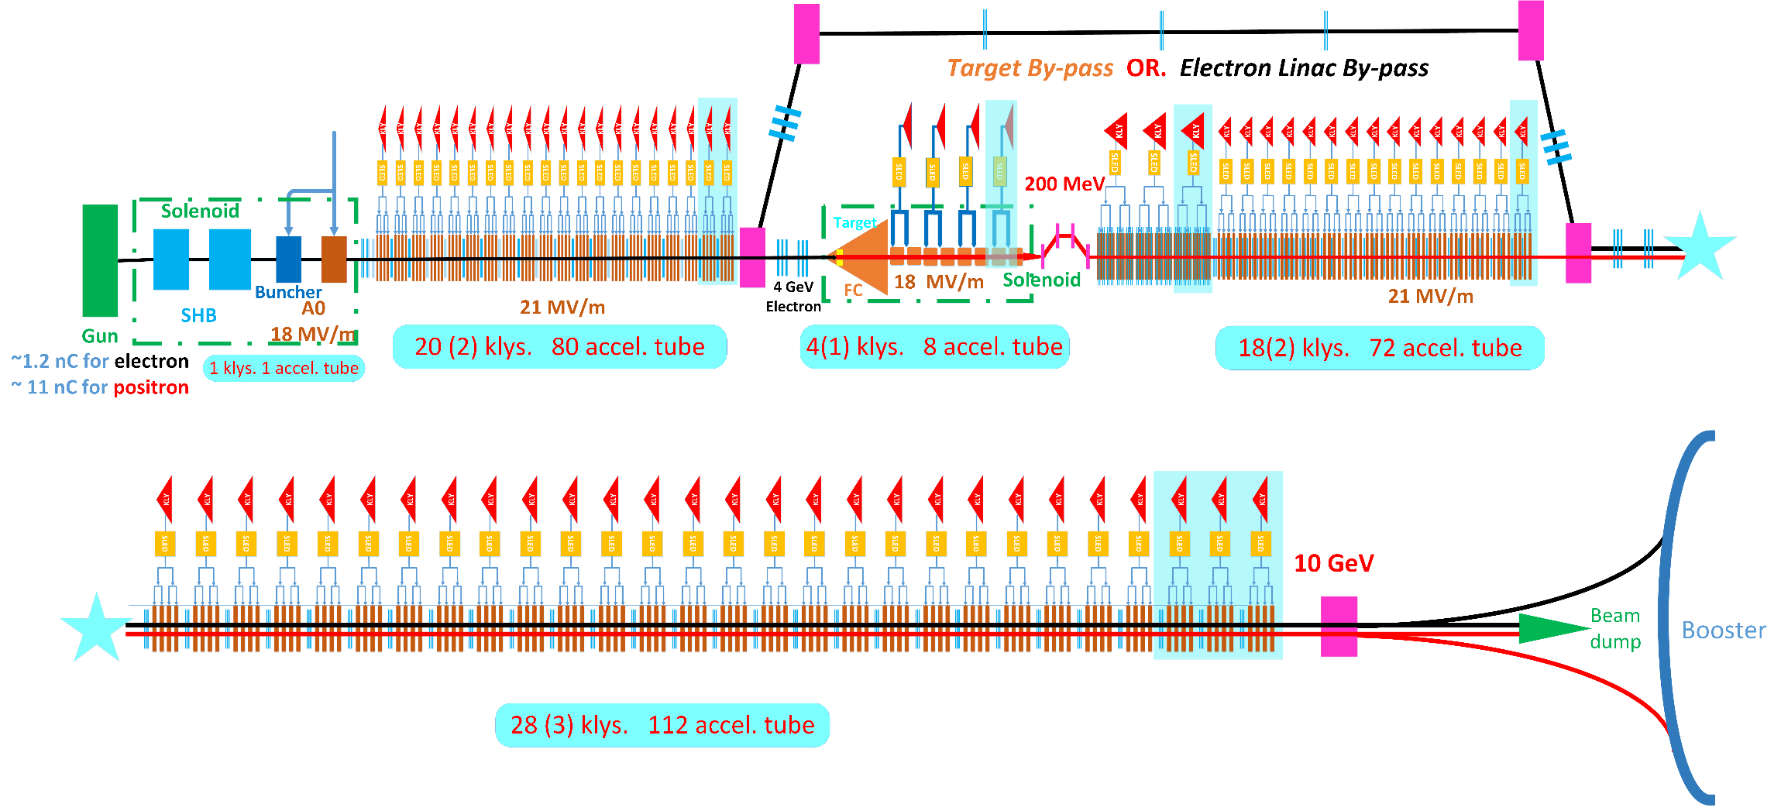
Introduction
Layout of Linac (II)
LTB 10.0 GeV
S-band accelerating tube
2856.75 MHz

Slide 4
Linac design
Main elements
Type | No. | Value
KLY | 71 | 80 MW
S-band Acc. Tube | 1 | 18 MV/m
 | 265 | 21 MV/m
S-band LAS Acc. Tube | 8 | 18 MV/m
SHB | 2 | 142.8375/571.35 MHz
Buncher | 1 | 2856.75 MHz
Solenoid | ~25 m | 0.5 T
Quadrupole Larger Aperture | 48 | r ~40 mm
Quadrupole | 213+~30 (ELBP) | r ~20 mm
Dipole | ~ 10

Slide 5
Linac design
Beam dynamics results (I)
Positron linac
3.2 nC
10 GeV

Slide 6
Linac design
Beam dynamics results (II)
Positron linac
3.2 nC
10 GeV
Beam loss

Slide 7
Linac design
Beam dynamics results (III)
Electron linac
10 nC
4 GeV
Small beam size for positron production
  0.5 mm

Slide 8
Linac design
Errors study
Simulation condition
  10k particles
  100 seeds
  Dynamic errors:
    Quadrupole transverse alignment：2 μm、5 μm、10 μm
    Uniform distribution
Simulation results
  If rms beam obit (dynamic) <0.1 mm, the dynamic alignment <2 μm
  If rms beam obit (dynamic) <0.2 mm, the dynamic alignment <5 μm

Slide 9
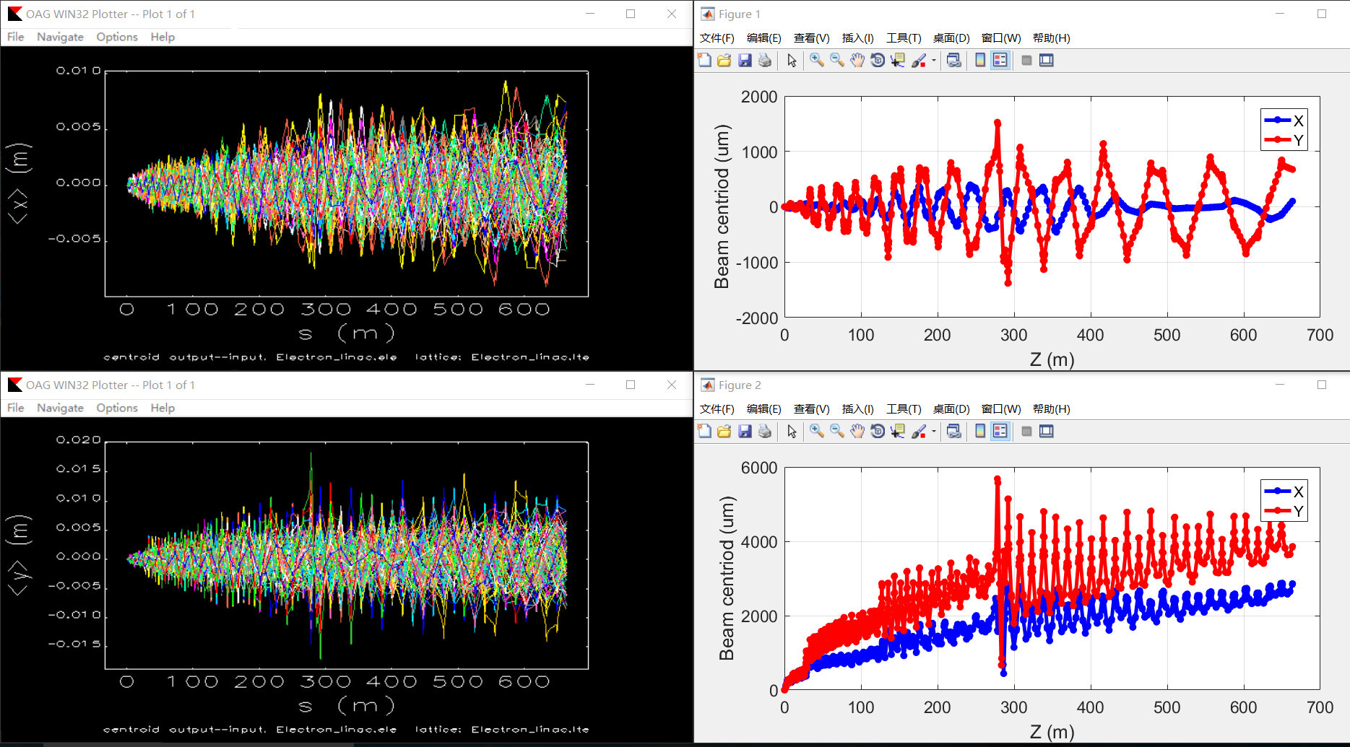
Linac design
Errors study
Simulation condition
  10k particles
  100 seeds
  Dynamic errors:
    Quadrupole transverse alignment：0.1 mm
    Uniform distribution

Slide 10
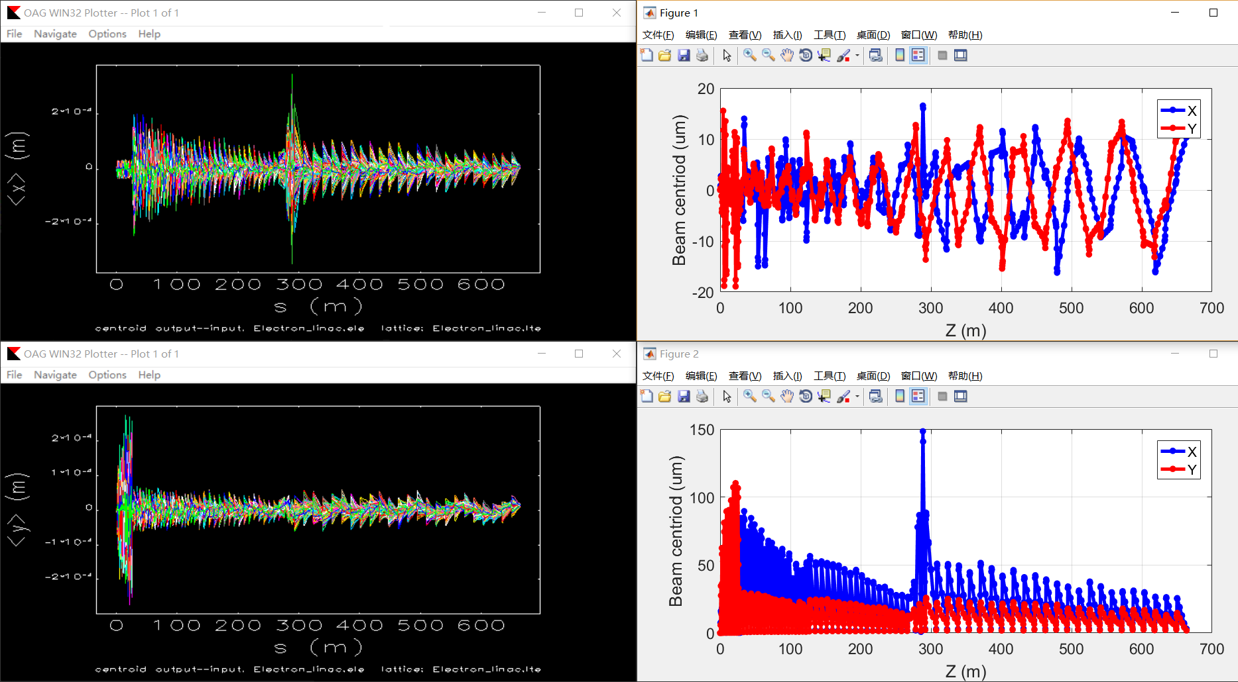
Linac design
With correction

Slide 11
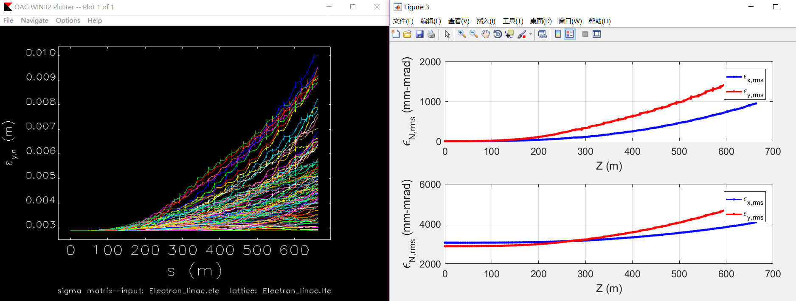
Emittance without correction

Slide 12
Emittance with correction

