Slide 1


Groove阻性微结构探测器的性能测量
陈石
中国科学院大学(UCAS)
第七届全国先进气体探测器研讨会
2017

Slide 2
Outline
DMD difficulties in MPGD
Groove concept
Measurement
Conclusion

Slide 3
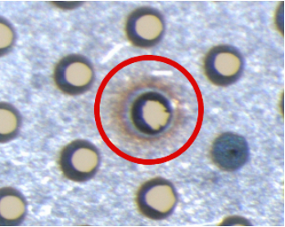
Difficulty I: Discharge
High rate，Stability @HEP
MPGD, without charge saturation in wire vicinity —— high rate capability
Occasional discharge & relatively low dynamic range
HIP events(highly Ionizing particles)
MIP@RICH
Nuclear action product @MIP
Damage the electrodes / electronics
解决方法：用阻性层做保护

Slide 4
Difficulty II: Manufacture difficulty
50mmx50mm 11700 holes
300mmx300mm ~10h
1000mmx500mm 2x10⁶ holes 2days
Abrasion of drills
解决方法：激光打孔、化学腐蚀

Slide 5
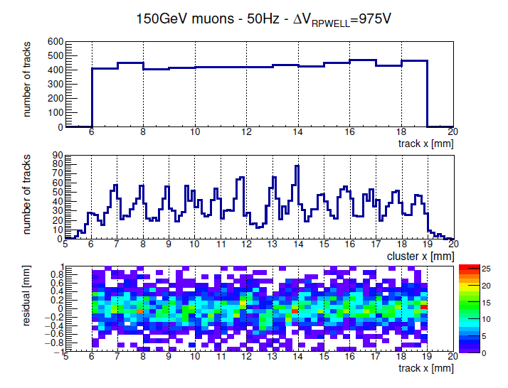
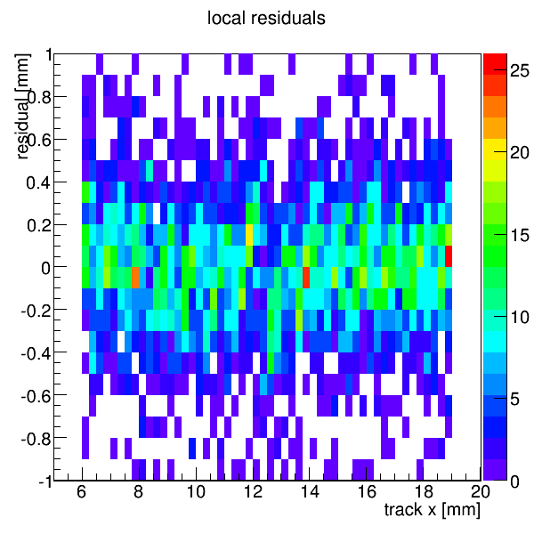

Difficulty III: Distortion
Distortion 与孔结构存在关联
在CERN-SPS H2上测量结果，
上：束流telescope提供tracker事例位置(50um RMS)
中：重建事例位置
下：重建位置的偏移
https://arxiv.org/abs/1707.00125

Slide 6
DMD Difficulty in MPGD
Discharge
Mamufacture
Distortion
the Groove concept
@Weizmann Institute of Science, Israel
for resolving these DMD problems

Slide 7
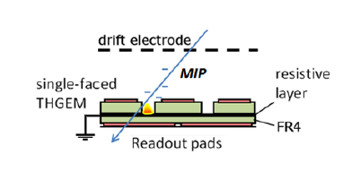
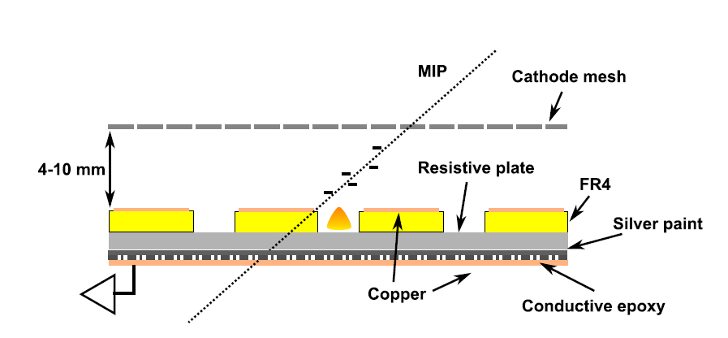
Groove Concept I
Resistive layer
Resistive plate
Groove: Resistivity, Multiplicity

Slide 8
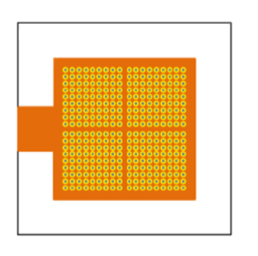
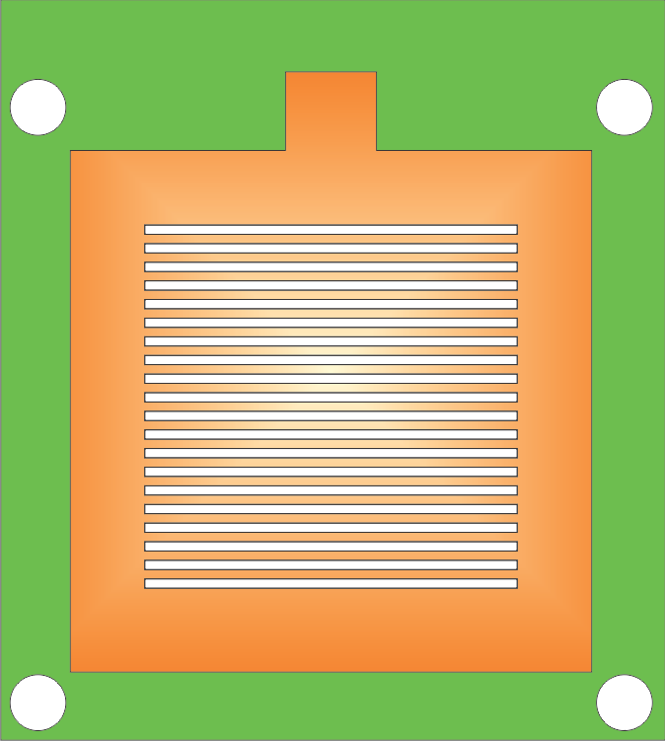
Groove Concept II
holes -> grooves

Slide 9
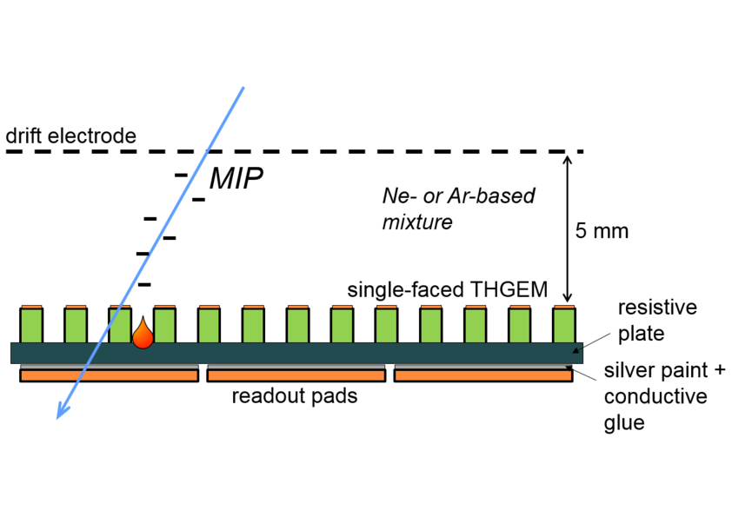
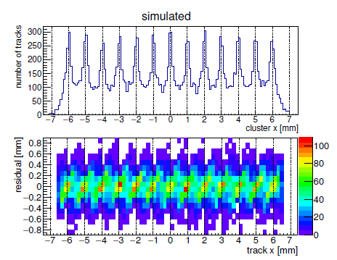
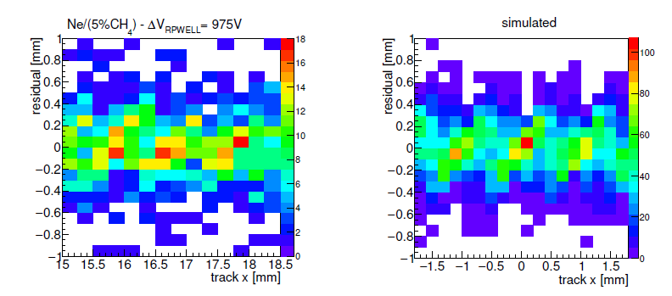
Groove Concept III
模拟对照实验结果表明，孔型结构MPGD，漂移区电场使得原初电离电子向孔中心汇聚，导致distortion

Slide 10
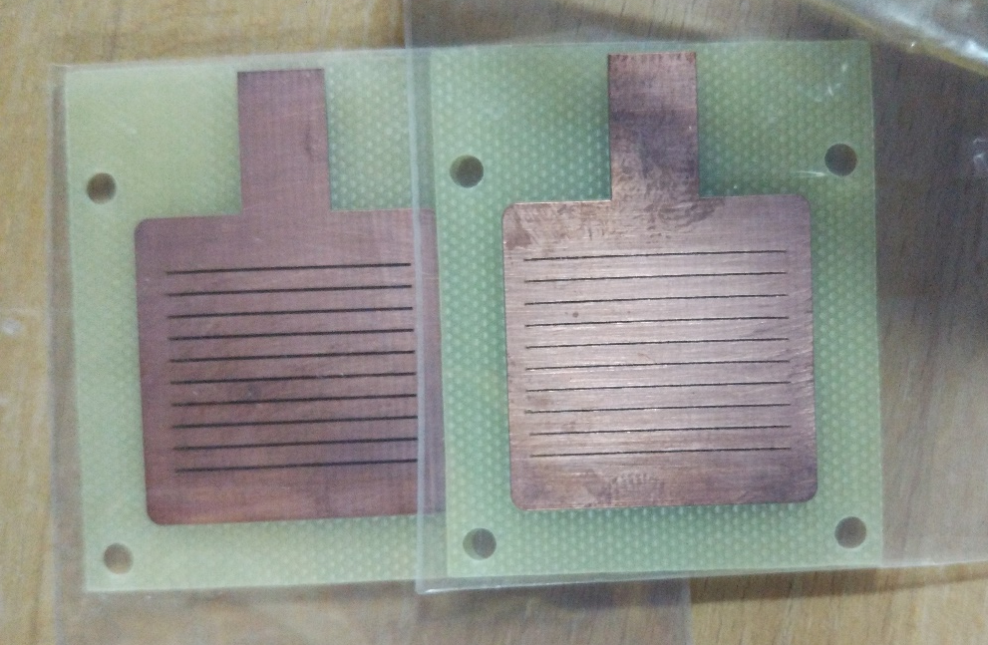
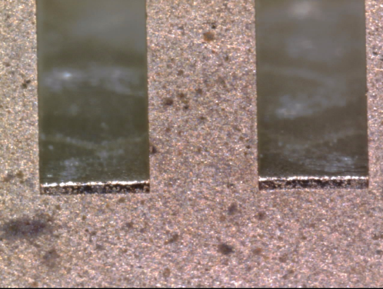
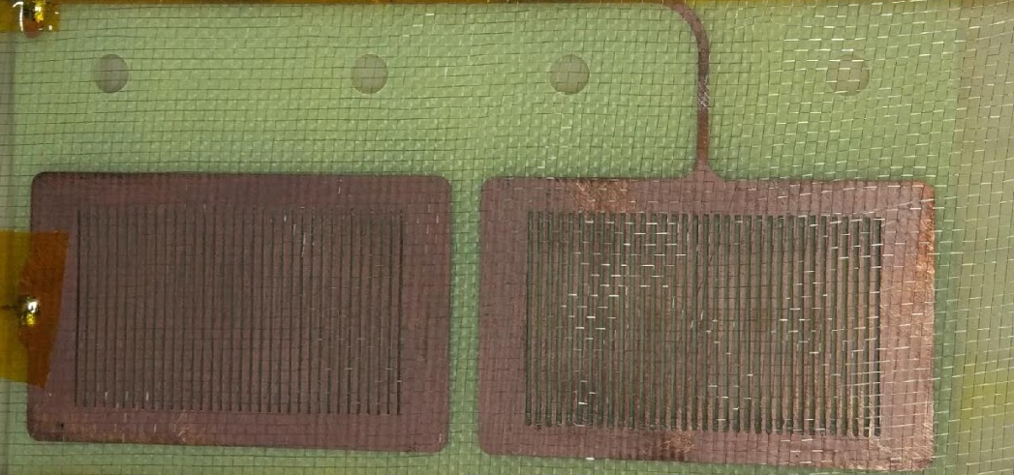
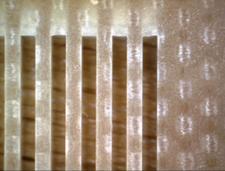
Manufacture a Groove
copper
FR4

Slide 11
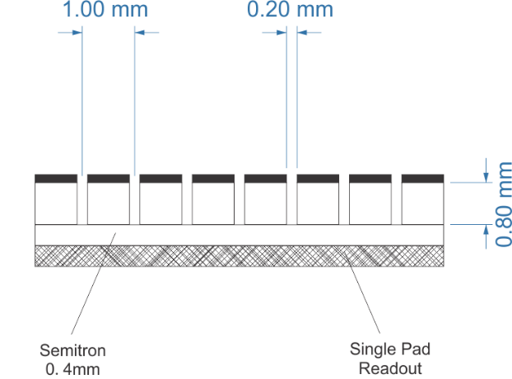
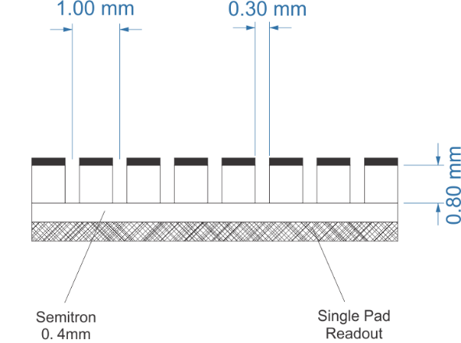
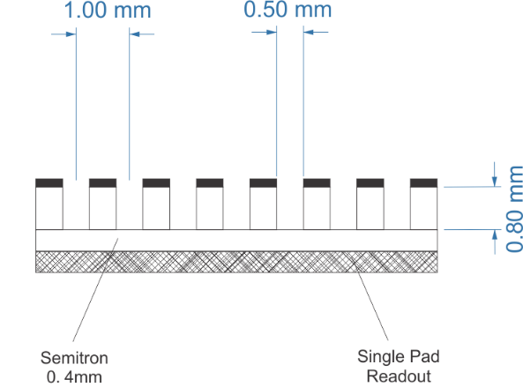
Experiment Setup
d = 0.2, 0.3, 0.5 mm (groove width)
a = 1 mm (groove pitch)
t = 0.8 mm (thickness)
FR4 0.8mm +Semitron 0.4mm
Semitron ESD 225 2×10⁹Ωcm
Couple the resistive plate to anode via silver painting

Slide 12
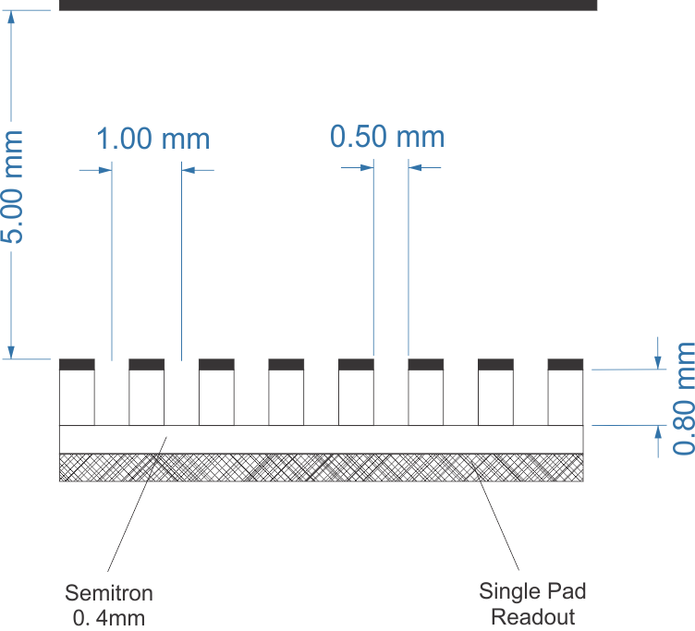
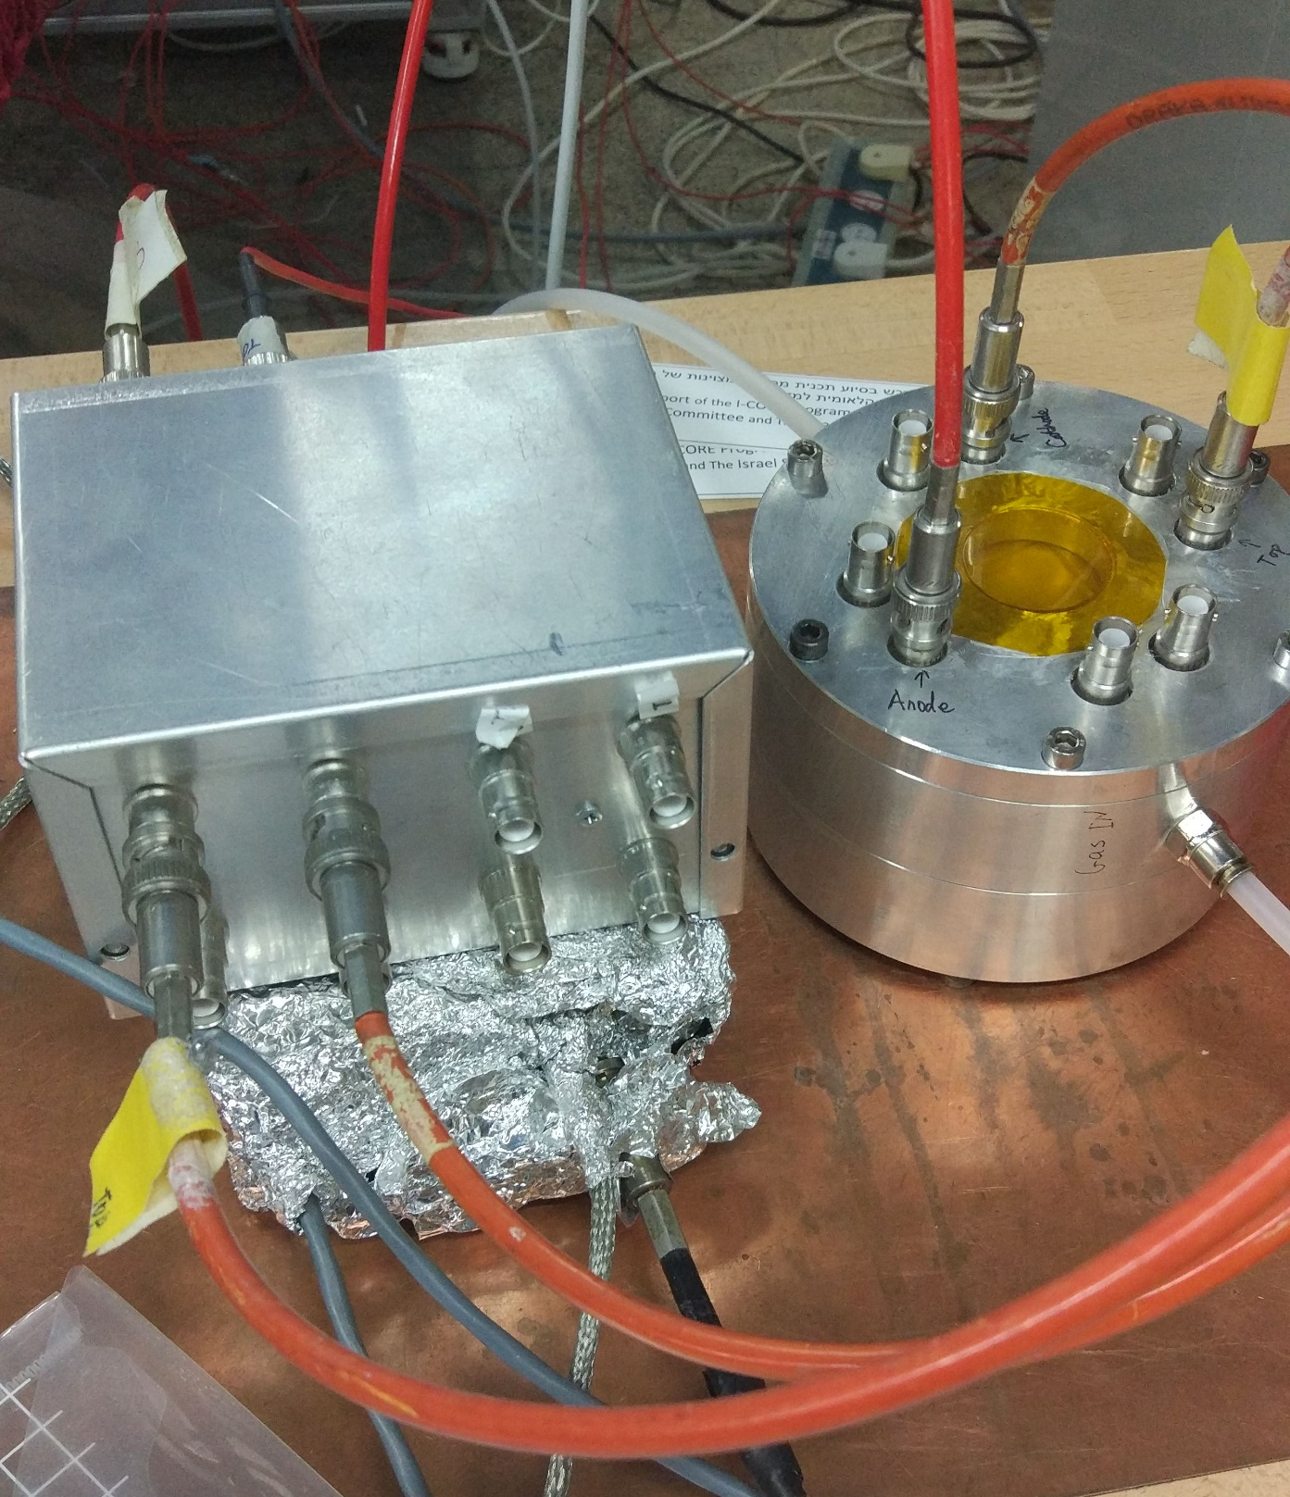
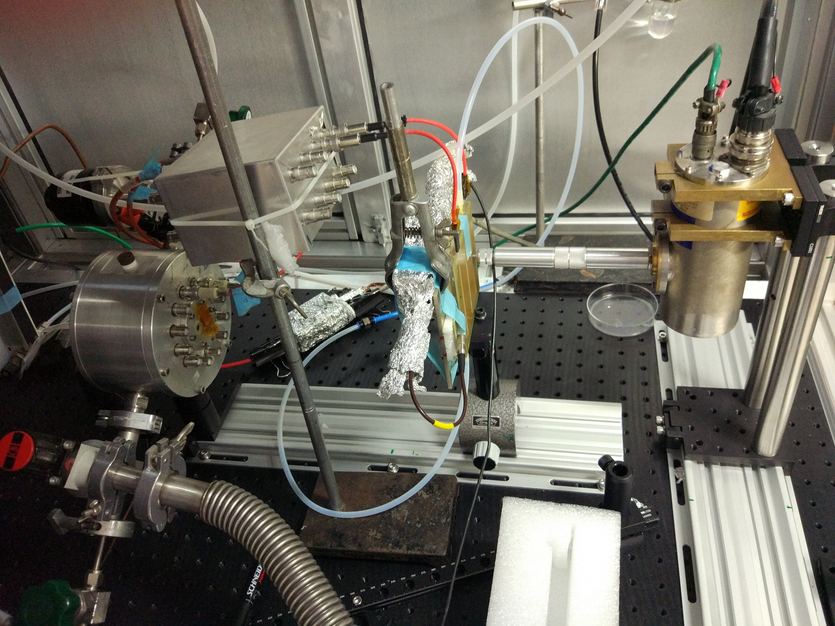
Pre amplifier：CAEN1422(ch4)
Linear amplifier: ORTEC 572A
MCA: AMPTEK 8000A
Collimator: d=0.5mm,1mm
Window: Mylar
Drift Field: 0.5kV/cm

Slide 13
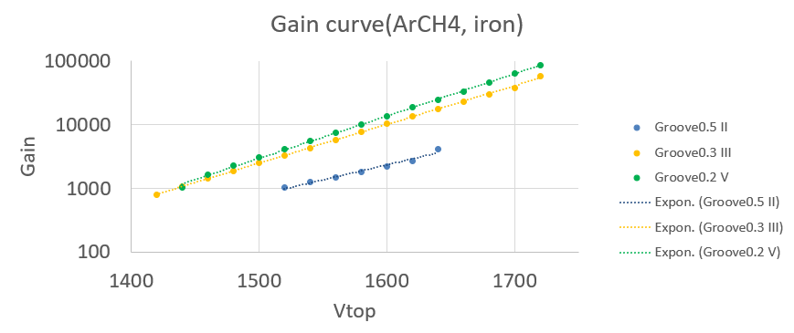
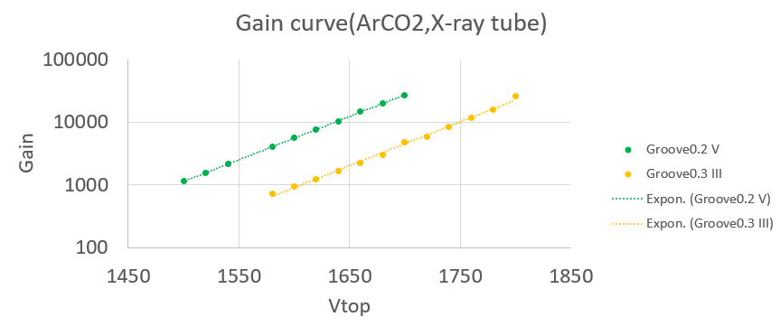
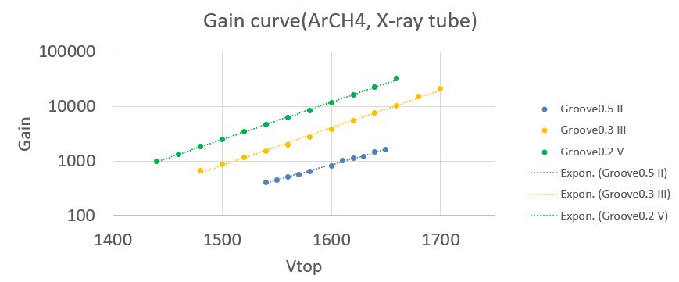
Result of Gain
不同气体中，Groove均能稳定工作在10⁴增益下
（Rate :6kHz/mm2 Cu-tube: 8.04keV)
2.7x10⁴ @ArCO₂(93%+7%) (discharge-free: 1.5x10⁴)
3.2x10⁴ @ArCH₄(95%+5%) (discharge-free:1.2x10⁴)
5.3x10⁴ @NeCH₄(95%+5%) (discharge-free:3.5x10⁴)
⁵⁵Fe下（Rate：50Hz/mm2)获得更高增益
8.5x10⁴ @ArCH₄(95%+5%) (discharge-free:2.5x10⁴)
电压相同，Groove越窄，增益越高

Slide 14
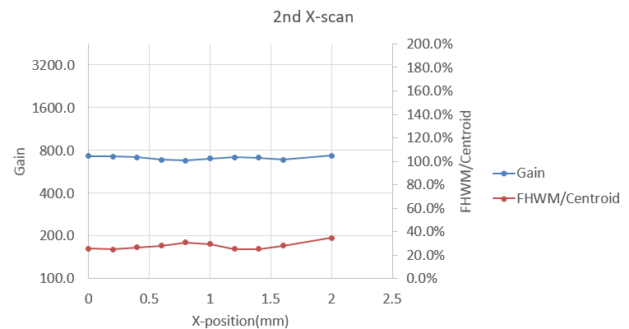
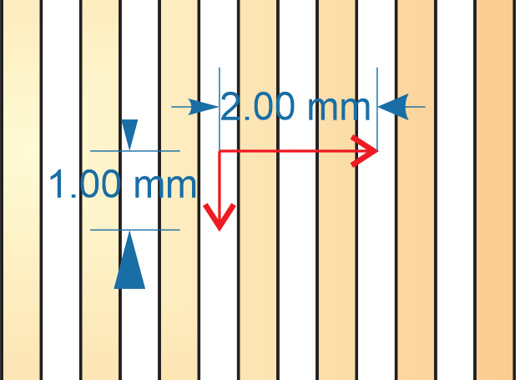
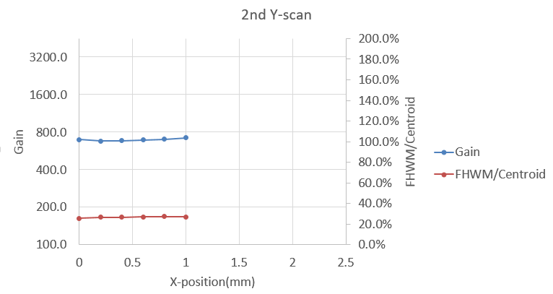
Result of Uniformity
X-Scan:
move across grooves;
x=0mm→2mm
step:0.2mm
Y-Scan:
move along the groove
y=0mm→1mm
step: 0.2mm
The gain uniformity ~4.5%
(max-min)/(2*average)
The gain uniformity ~3%
(max-min)/(2*average)

Slide 15
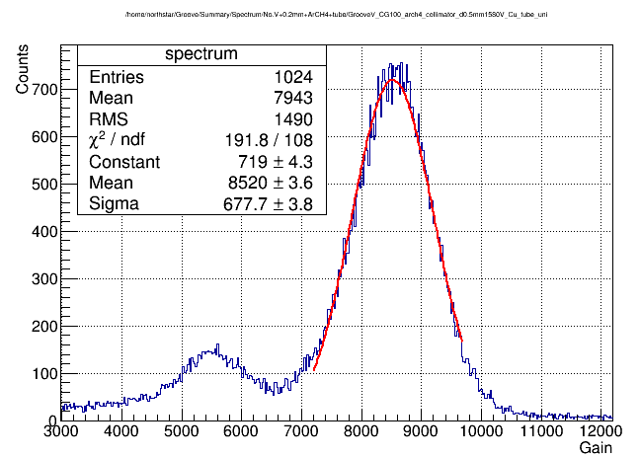
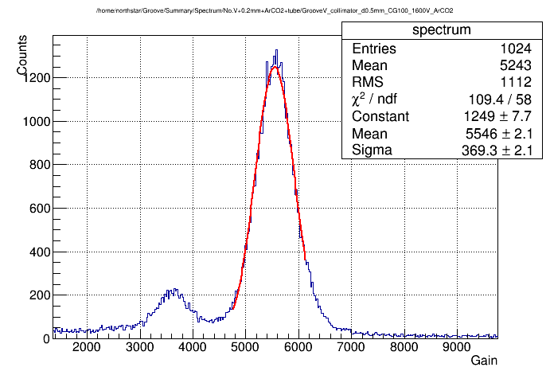
Result of Energy Resolution
Groove 0.2mm
ArCH4
FHWM/Centroid=18.7%
Groove 0.2mm
ArCO2
FHWM/Centroid=15.6%

Slide 16
Conclusion
DMD difficulties can be solved in Groove concept
Gain 8.5x10⁴ was achieved in Argon mixture
Gain uniformity ~4.5% across the groove
~ 3% along the groove
Energy Resolution 15.6% was achieved
Friendly for large area （manufacture&check）

Slide 17
Thank you!

Slide 18
Backup
RPWELL 计数率vs增益
Multiplicity RWELL vs RPWELL
增益到电荷量

Slide 19
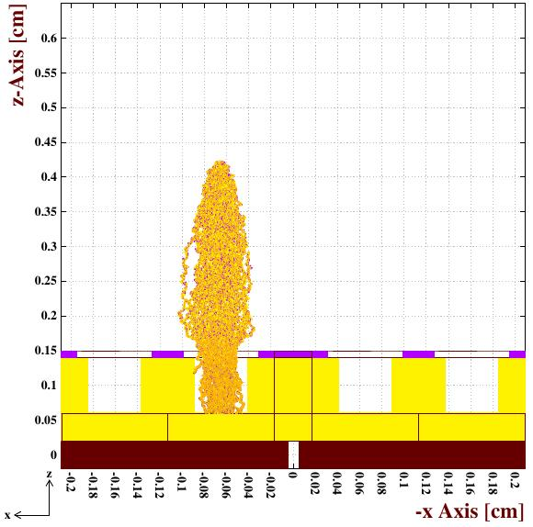
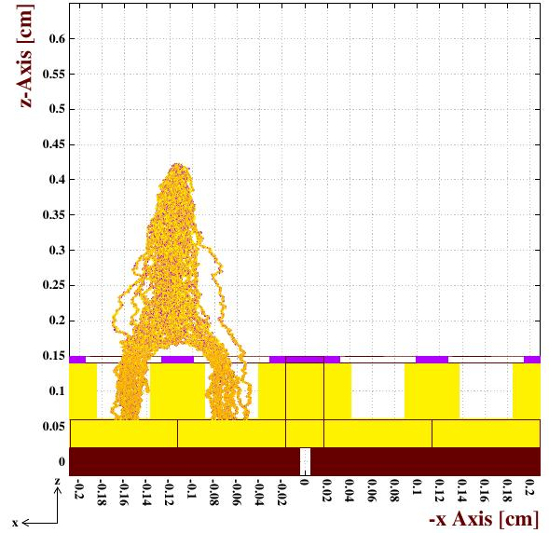
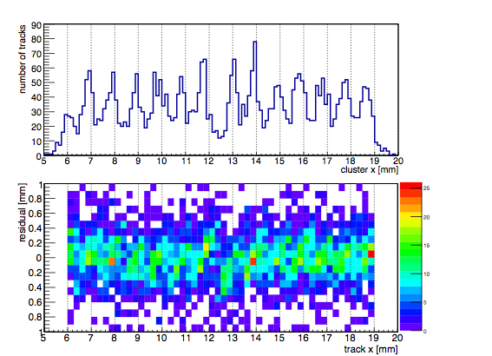
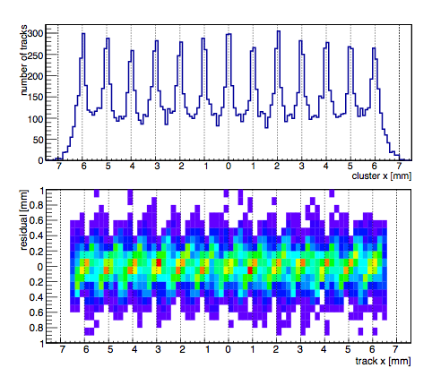
Localization in RPWELL
In THGEM/RPWELL, the primary charge is focused in the middle of the holes and can be distributed among few holes, typically one or two.
The holes pattern causes residuals when the particle is not passing through the hole center or in the middle between two holes.
data
simulate
In beam measurement of RPWELL, residual was observed.
Residual: $∆x=x_{cluster}−x_{track}$ (Y-axis in the plots)
The position resolution in data & simulation result.
RMS: ~200um

