Slide 1
Neutrino Detector
-- Principle and Design
Jun Cao
Institute of High Energy Physics, Beijing
Nov.15, 2017, Nanning

Slide 2
反应堆中微子探测原理
大亚湾探测器设计
其它中微子探测器原理简介

Slide 3
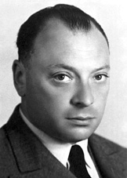
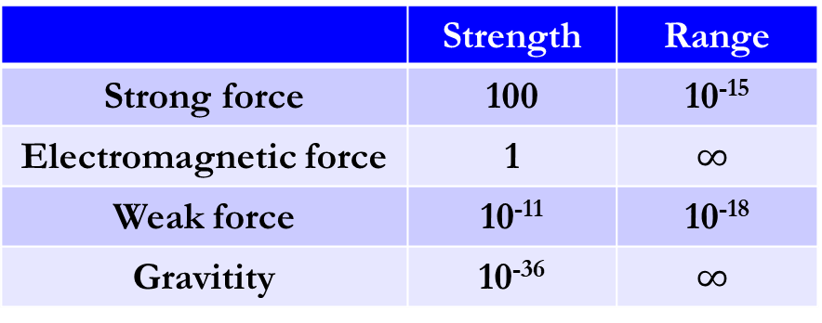
Detecting a Neutrino
"I have done a terrible thing. I have postulated
a particle that cannot be detected." -- Puali
 | Strength | Range
Strong force | 100 | 10⁻¹⁵
Electromagnetic force | 1 | $$∞$$
Weak force | 10⁻¹¹ | 10⁻¹⁸
Gravitity | 10⁻³⁶ | $$∞$$
Wolfgang Pauli
The lesson of the work was clear: It is easy to shield out the noise men make, but impossible to shut out the cosmos. -- Cowan
Neutrino
  no charge
  Almost no reaction with matter
  We can only observe a neutrino after it reacts with matter and produces (finally) a charged particle

Slide 4
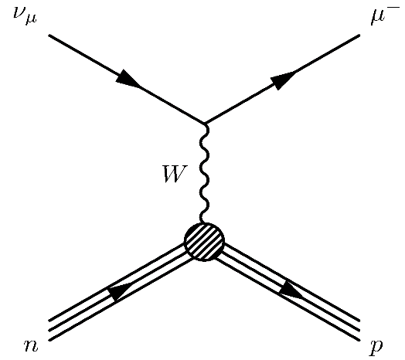
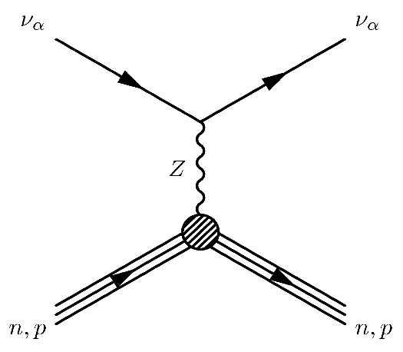
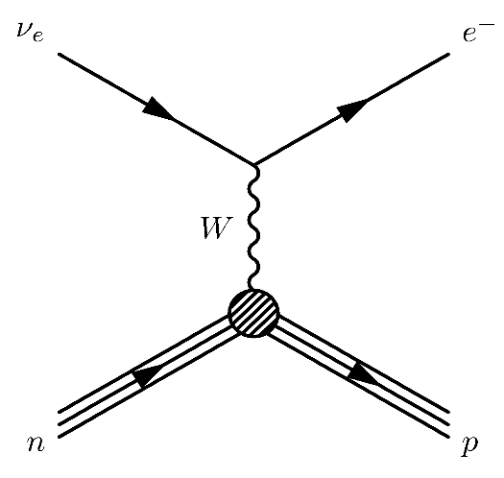
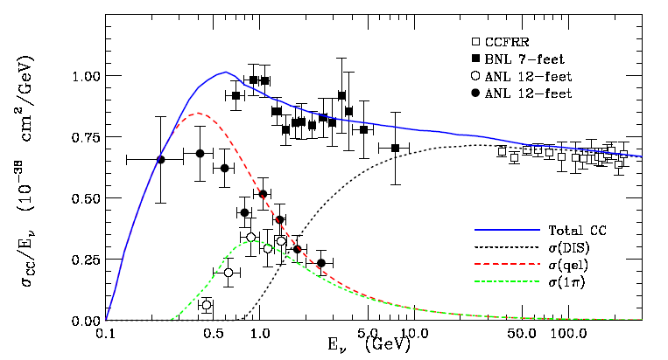
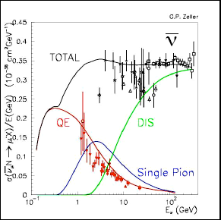
Typical Reactions (1)
ν_{μ} CC Event
NC Event
ν_{e} CC Event
Total ν_{μ} CC cross section
Accelerator neutrino, Atmospheric neutrino
Why anti-nu has less events than nu in accelerator exp.?

Slide 5
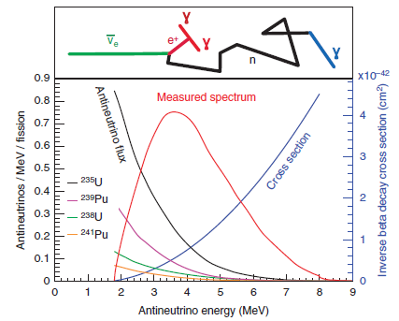
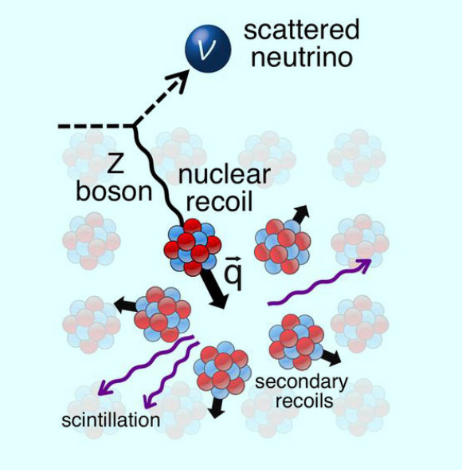
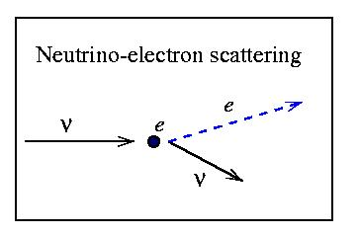
Typical Reactions (2)
Neutrino coherent scattering (SNS, reactor?)
Reactor neutrino
Solar neutrino
Solar, reactor, etc

Slide 6
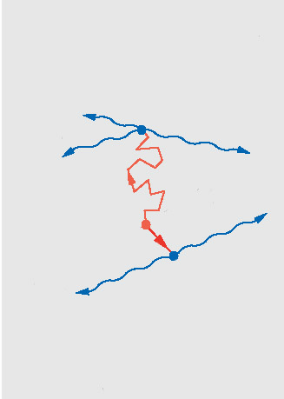


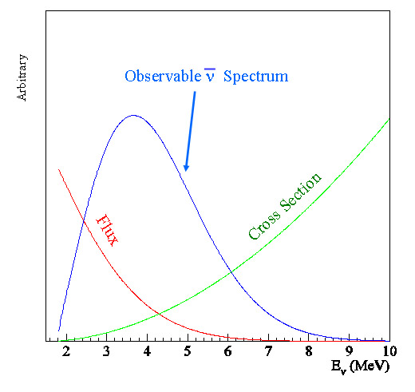
Detecting with Liquid Scintillator
Detecting reactor neutrinos with a liquid scintillator
As an example of a complete experiment
PMT
UV-vis photon
n
neutrino
positron
Gd-LS
LS
Mineral Oil

Slide 7
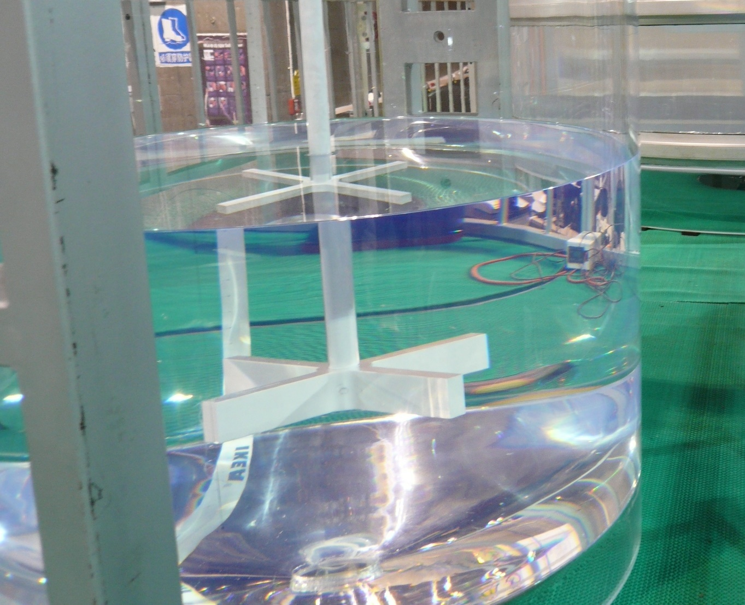
Liquid Scintillator

Slide 8
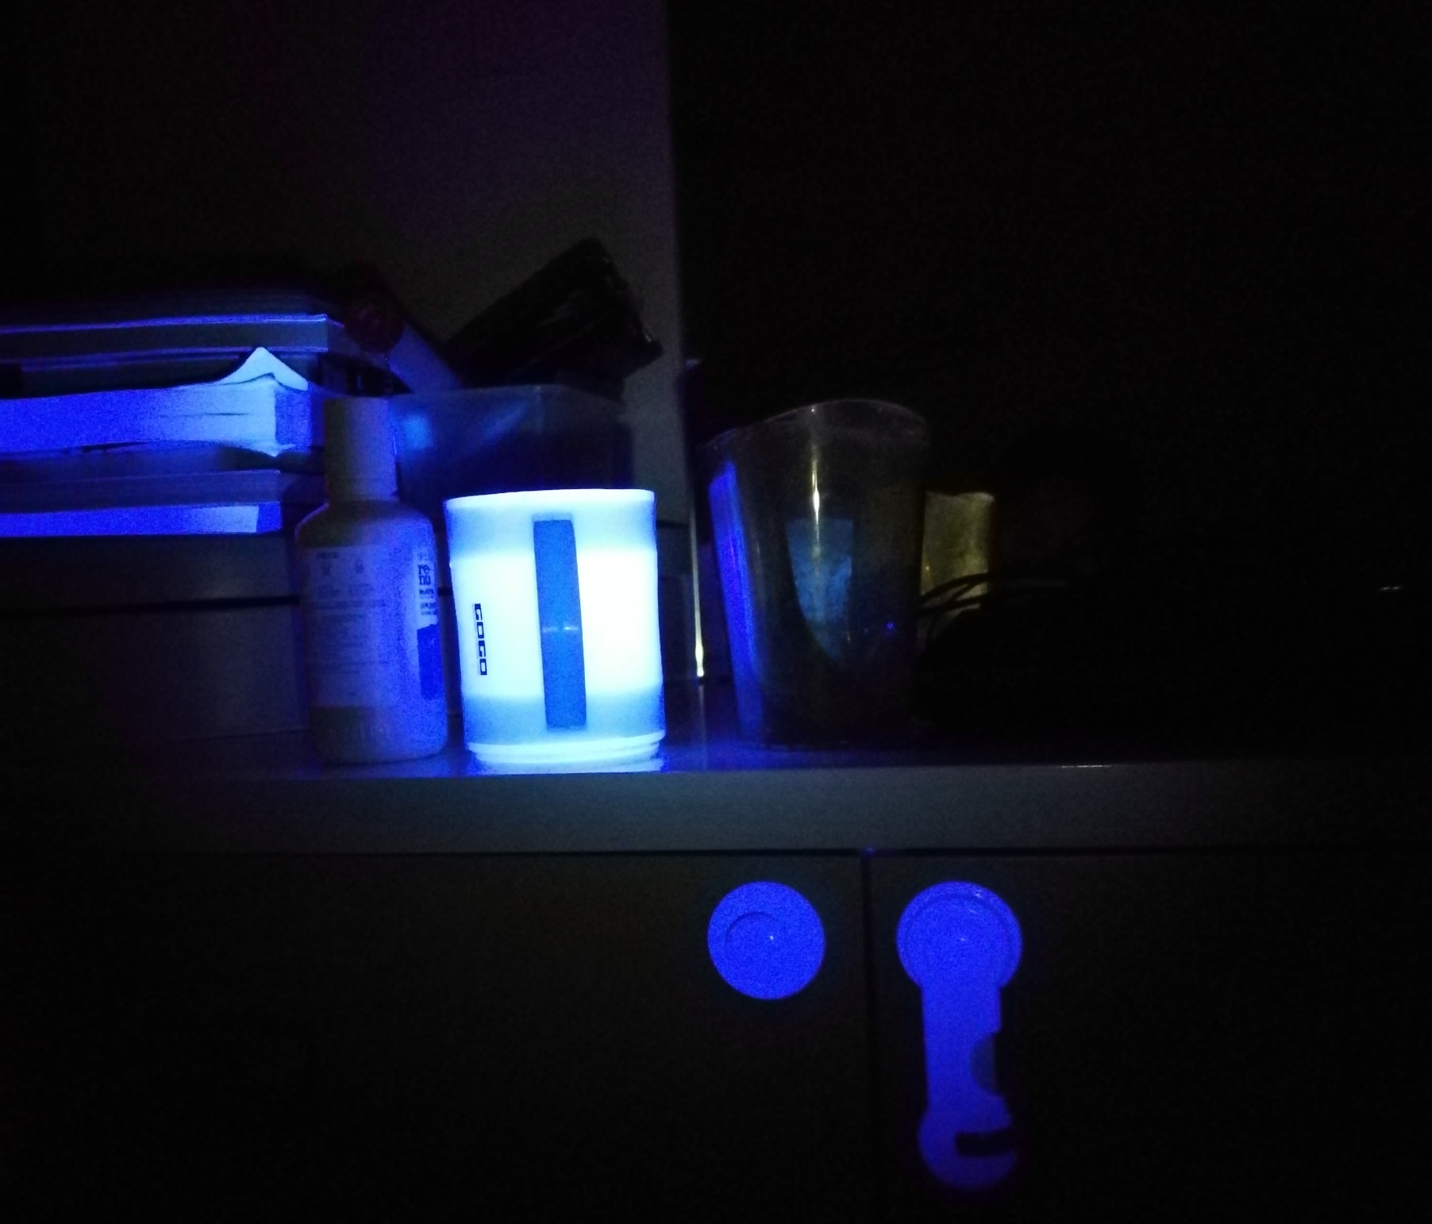
Scintillation light
Expose my room with a UV flashlight:
Some plastic
Bleached paper
Washed clothes

Slide 9
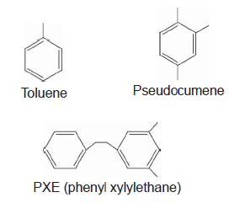
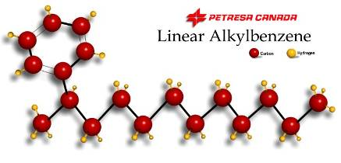

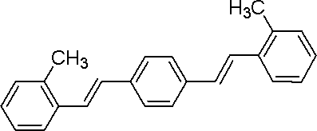
Make a Liquid Scintillator
Easier than making a cocktail
Solvent
  Aromatic compounds, e.g. Pseudocumene , Mesitylene, Xylene(PX), Toluene, PXE, DIN, LAB
  Solvent itself has very low light yield
Fluor (1-5 g/L)
  PPO、PBD、TP、PMP
(Optional) Wavelength Shifter (0~15 mg/L）
  bis-MSB、POPOP、BBQ
  Match PMT response, shifting photon wavelength to transparent region
Very difficult to make good LS

Slide 10
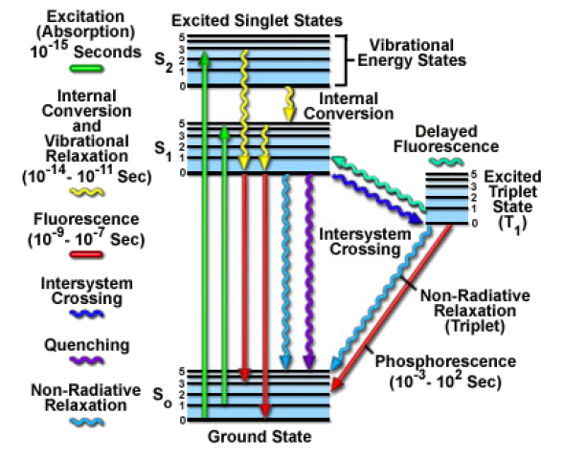
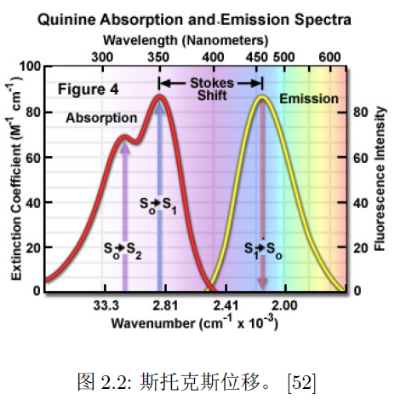
Molecule Energy Level
Energy level of pi bond, S0 is ground state, S1, S2 are excited single states, T1 is excited triplet state
Due to Stokes shift (found in 1852) scintillation light can transmit in itself.

Slide 11
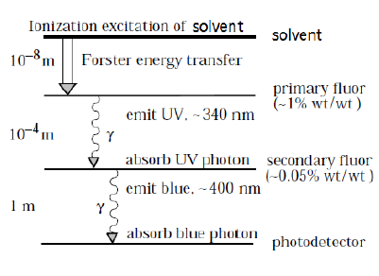
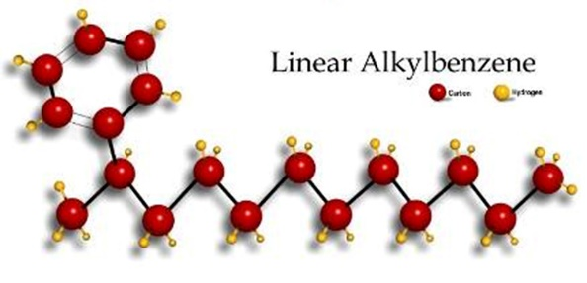
Energy Transfer in LS
Excitation by Ionization
Resonance
Absorption and re-emisson of UV light
Binary LS (w/o wl shifter)
Ternary LS
What happens when exciting with UV light?

Slide 12
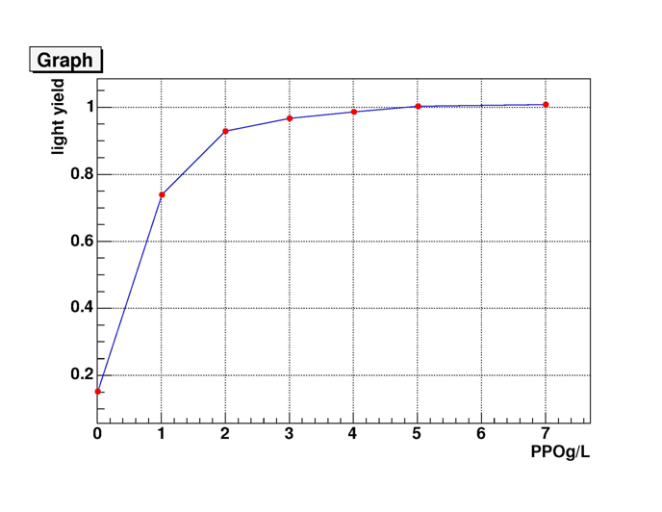
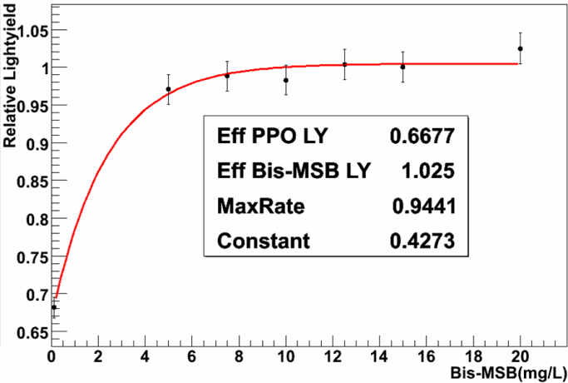
Light Yield vs PPO (Bis-MSB) Concentration
Light yield versus PPO concentration
Light yield versus bis-MSB concentration
LAB solvent, measured w/ small cell. Light yield may be impacted by cell size, due to absorption reemission process
Concentration Quenching

Slide 13
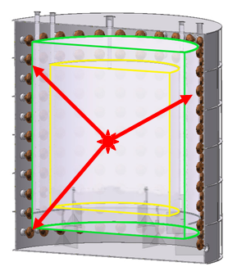
Attenuation, absorption, scattering
L=2~3 m (Tap water)，50% light absorbed in DYB detector
L=10m ：20% light absorbed in DYB
Mie, Raman, absorb&re-emit…
Absorption: the molecular are heated by incident light.
Rayleigh scattering: scatter off the bound electrons of molecular.
Attenuation: also noted as extinction length.

Slide 14
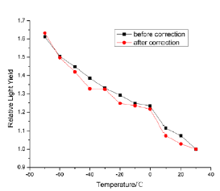
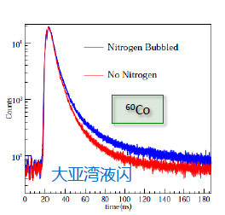
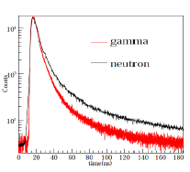
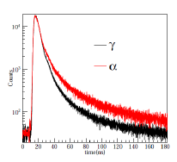
Quenching
Energy quenching
Thermal Quenching
Oxygen quenching
11%
Pulse shape

Slide 15
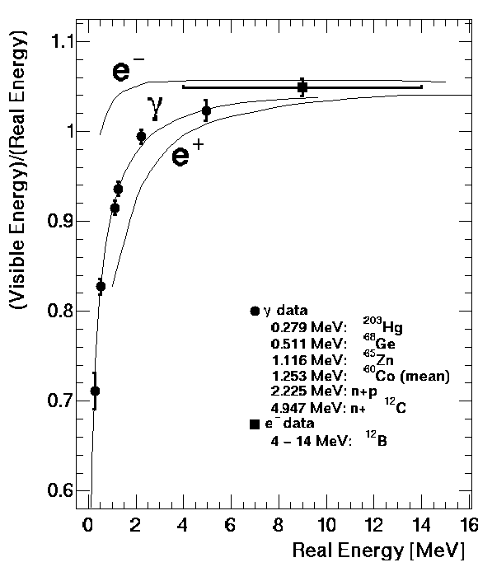
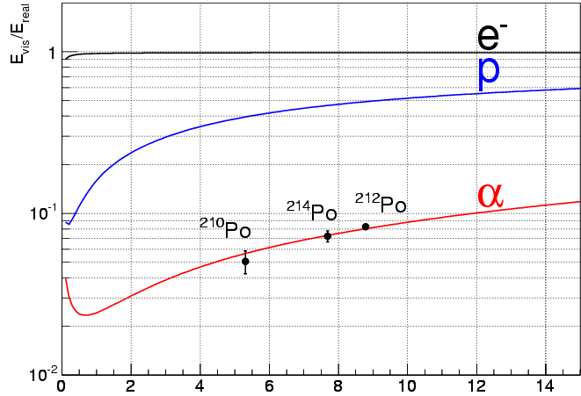
Non-linearity due to energy quenching

Slide 16
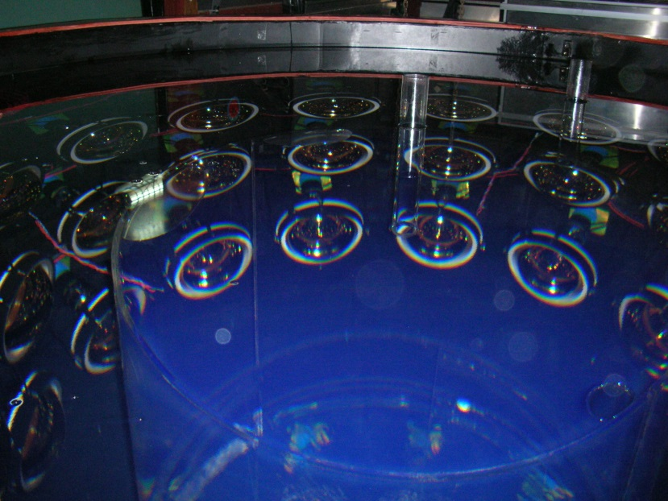
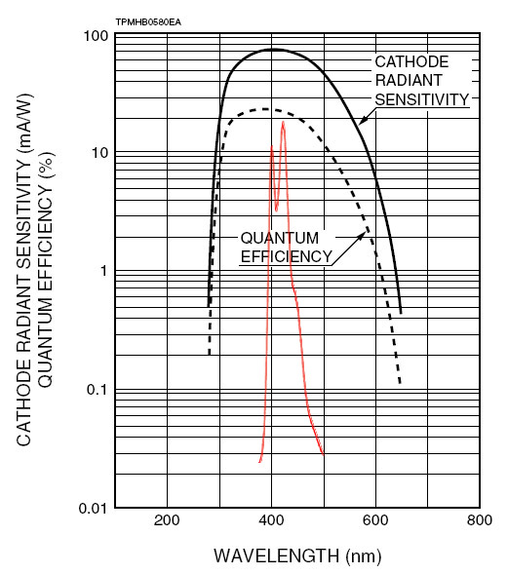
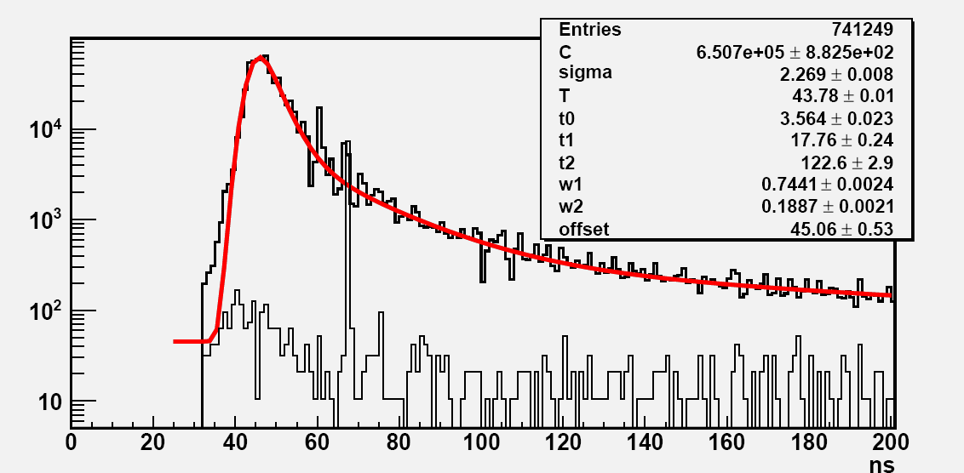
Daya Bay Liquid Scintillator
LS: ~ 10 k photons/MeV (NaI 40 k photons/MeV), isotropic
Recipe: LAB + 3g/L PPO + 15mg/L bis-MSB (+0.1% Gd)
Daya Bay photoelectron yield: 163 p.e./MeV
10 k photon/MeV (?)
Attenuated: 70%
PMT photocathode coverage: 12%
PMT quantum efficiency: ~ 20%
1.68% ➔ 168 p.e./ MeV

Slide 17
Summary of DYB LS
Light Yield: ~ 10, 000 photon/MeV
Emission Spectrum (bis-MSB): 380-500 nm
Attenuation Length 15m@430nm (incl. Rayleigh)
Absorption spectrum
Absorption re-emission
Decay time: 3 ns + 10 ns + 150 ns
Oxygen Quenching: light yield increase ~11% after N2 bubbling
Temperature eff.: Light yield increase 70% from 20 ℃ to -75 ℃
PID with pulse shape

Slide 18
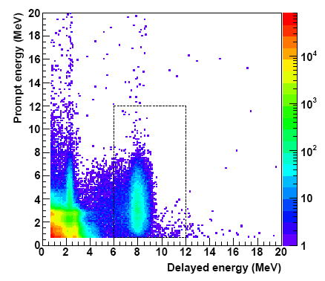
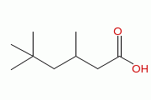
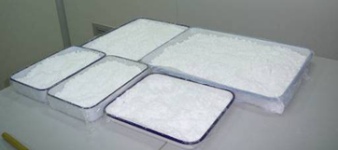
Doping with Gadolinium
Increase n-capture E from 2.2 to 8 MeV
Gd has the largest n-capture xsec.
Challenging of dissolving metal into organic liquid
phosphors, β-diketones, or carboxylates
GdCl3 + carboxylic acid (TMHA)
  0.1% Gd by mass
Doping with Li (alpha)
Doping with Te (0vbb)
…

Slide 19
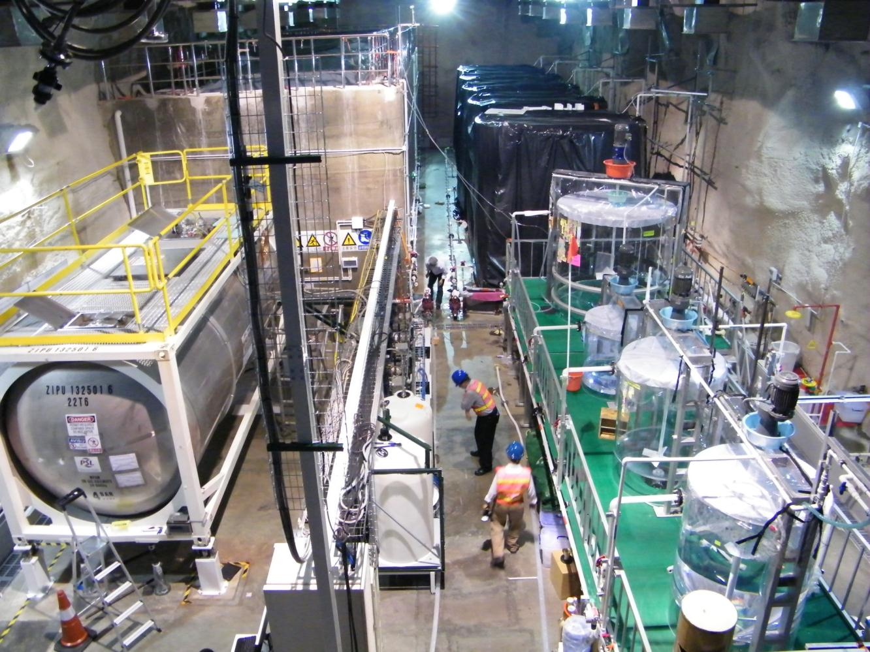
Liquid Scintillator Hall
Mineral Oil
185 ton 0.1% Gd-LS
Liquid Scintillator
Filling Equipment
LS mixing equipment
ISO tank equiped with load cell. Target mass errorr ~0.1%

Slide 20
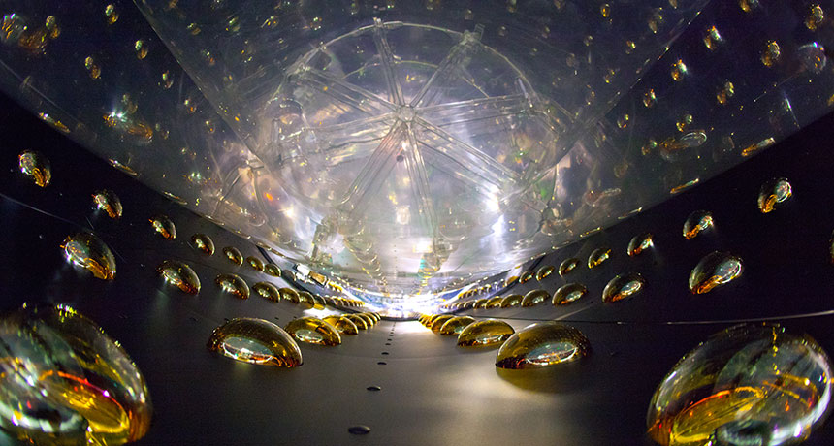
Photomultiplier Tube (PMT)
APOD

Slide 21
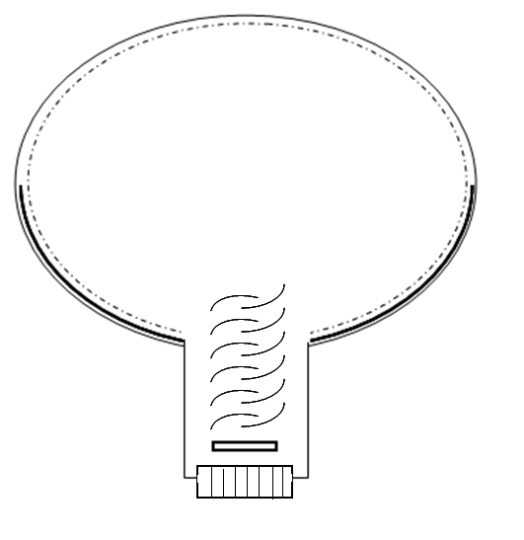
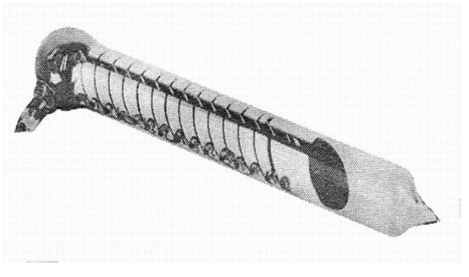

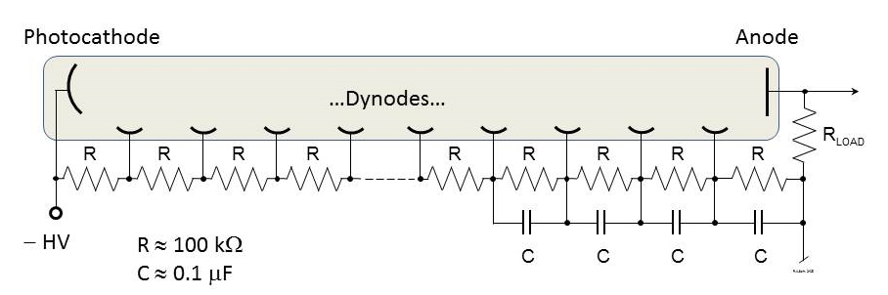
Dynode PMT
Glass bulb
The first PMT in the world in 1933
“Kubetsky’s tube”
Photocathode
Photoelectrons (p.e.)
Al reflective coating
Quantum Eff.
(QE) : ~20%
Collection Eff.
(CE): 60-90%
Dynode
Anode
voltage divider
Signal
DE= QE * CE ~ 12-30%

Slide 22
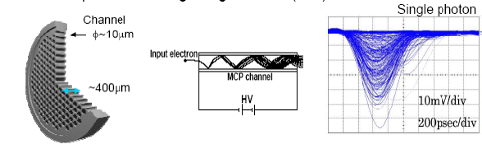
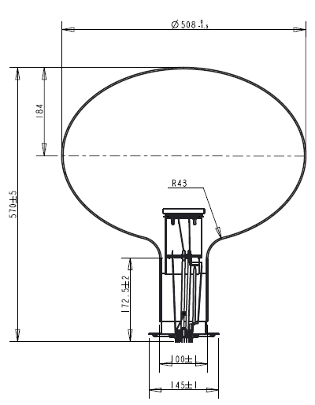
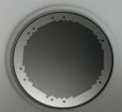
Micro Channel Plate (MCP)
MCP-PMT

Slide 23
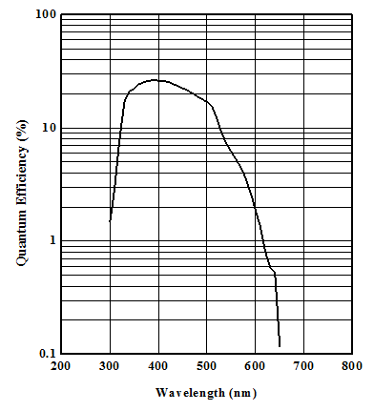
QE of the Photocathode
Overlay w/ LS emission spectrum
Photocathode Sensitivity

Slide 24
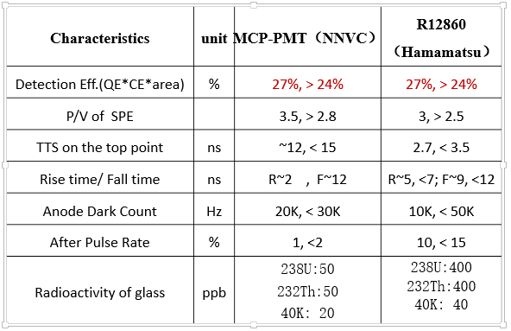
Performance of the 20-inch PMTs
JUNO Specification

Slide 25
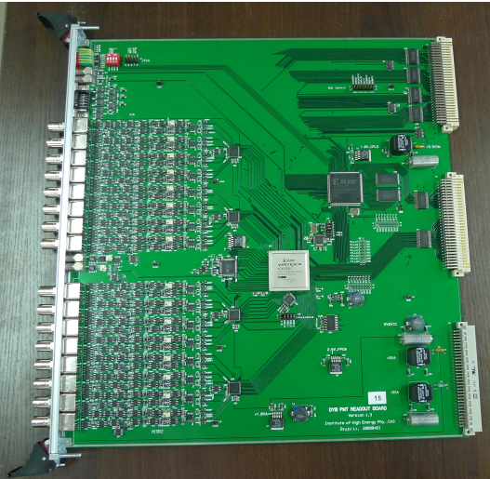
Electronics Readout

Slide 26
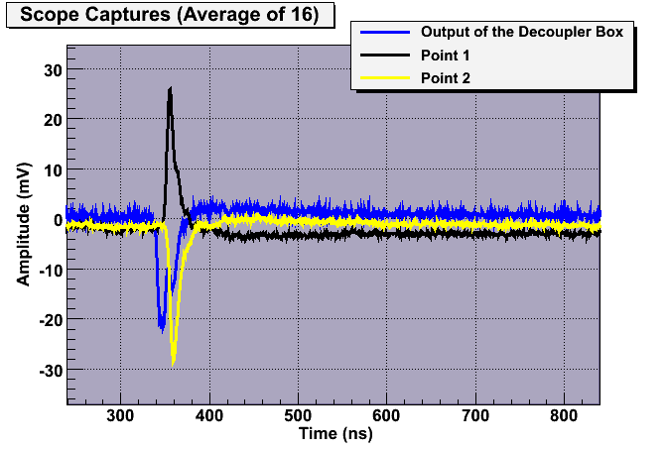
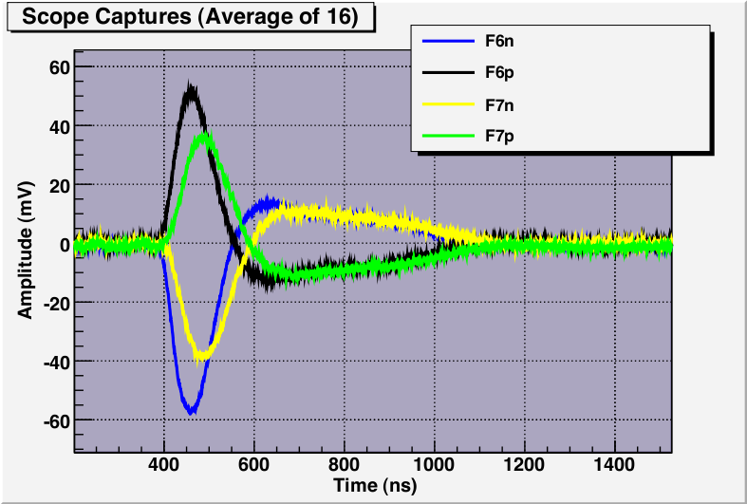
Charge Measurement (Q)
green - shaper out
yellow - shaper out
blue - input to FEE
Using CR-(RC)⁴ shaping + Peak finding
Analog → Digital signal (ADC)
FPAG: Field Programmable Gate Array, online algorithm to process signals

Slide 27
Timing Measurement (T)
Multi-phase clock method
Determine the timing with the rising edge
FPGA-Based clock, precision (RMS) 0.78ns
Can measure multiple hits

Slide 28
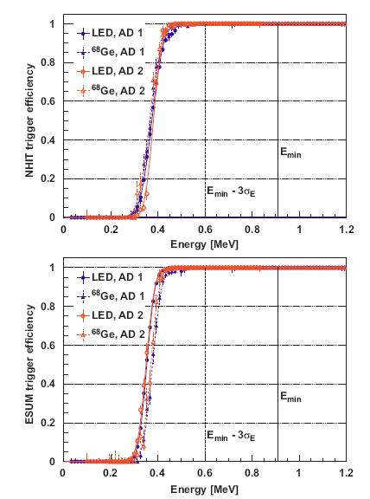

Trigger
To ignore noise (PMT dark noise and electronics noise) and low energy events. PMT dark noise: 1–10 kHz at room temperature for 8-in PMT
  NHIT (# PMT fired in 100 ns)
  ESUM (total p.e.)
FEE send info to trigger board，
logic decision online,
read out data from FEE buffer to
DAQ, or override in the buffer

Slide 29

Natural Radioactivity

Slide 30
Natural Radiation
Natural radiation is everywhere, born w/ the Earth
  ²³⁸U → ²²²Rn
  ²³²Th
  ⁴⁰K
1 Bq = 1 decay per second
  Human body has ~ 5000 Bq K-40
  1 kg rock (granite) ~ 150 Bq
  1 kg Uranium ~ 12,000,000 Bq
  1 kg Co-60 = ? Bq
Cosmogenic radiation: ¹⁴C, neutron, and many
Artificial radiation, e.g.
  ⁶⁰Co (In stainless steel, for industry and research)
  ¹³⁷Cs (N bomb test, for research)
In rock, mud, air, sea water

Slide 31

Three kinds of radiation:
α particle: can not penetrate a paper
β particle (electron): cm
γ ray: attenuation length = 20 cm water, or one order per 50 cm water

Slide 32


Gamma spectrum of DYB granite
γ Energy < 2.6 MeV (Tl-208)
Granite has high radiation in all kinds of rock. Radiation of Daya Bay granite is 3 times higher than world average
10 ppm U
30 ppm Th
5 ppm K40
ppb to Bq conversion
  1 ppb 40K = 258.4 mBq/kg
  1 ppb 238U = 12.4 mBq/kg
  1 ppb 232Th = 4.0 mBq/kg

Slide 33
Where the radioactivities come from?
Rock
  8.8ppm U, 28.7ppm Th, 4.5ppm K
  Almost 0 after 2.5m water shielding
Liquid scintillator
  Radon (product of U238 decay, emitted from rock)
  Contamination, additives
  Liquid scintillator need cover with N2
PMT glass, can not contact with LS directly (oil shielding); use low background glass
Stainless steel tank: need low bkg steel.
Avoid aluminum, glass components in detector
All detector material need radio-assay
Assembly of detector in clean room (10,000 class)

Slide 34

Use water to shield gamma from rock
w/o water, DYB detector will see 1,000,000 Hz from rock
w/ 2.5m water, rate lowers to 200 Hz (almost 0 from rock)

Slide 35
Estimate the Shielding Power
MeV γ deposit energy in matter via Compton scattering on electron. Therefore, attenuation is proportional to electron density, thus matter density (almost independent of material)
“mass attenuation coefficient”
attenuation length ~ 20 cm water. Reduce 1 order/50 cm.
What’s the shielding power of DYB water pool?
 | γs (>1 MeV) | E (MeV) | mass attenuation coefficient in oil(cm²/g) | mass attenuation coefficient in steel(cm²/g)
1 Bq U | 0.82 | 1.5 | 0.0575 | 0.0486
1 Bq Th | 0.88 | 2 | 0.0493 | 0.0425
1 Bq K | 0.105 | 1.5 | 0.0575 | 0.0486
1 Bq Co | 2 | 1.17+1.33 | 0.0493 | 0.0425

Slide 36

Final natural radiation bkg in DYB
W/o enough shielding, we can’t see any neutrino:
Imaging how to find 0.002 neutrinos in 1,000,000 backgrounds
Why DYB use Gd-LS? Why JUNO won’t dope Gd in LS?

Slide 37

Cosmic Muon
The lesson of the work was clear: It is easy to shield out the noise men make, but impossible to shut out the cosmos. -- Cowan

Slide 38


Cosmic Muon
μ Flux on surface ~ 200Hz/m²
Minimum ionization muon:
~200 MeV/m.w.e.
(meter-water-equivalent)

Slide 39


Muon Tomography

Slide 40

Muon Flux
Muon on surface: Gaisser formula
Modified Gaisser formula
More precise flux need simulation (Earth Magnetic field)

Slide 41




Muon Energy Loss
Continuous process —— Ionization energy loss
Minimum ionization muon: ~200MeV/m.w.e.
Discrete process ——Bremsstrahlung, pair production, hadron process, important for high energy muon
Minimum muon energy to pass x_{min} thick rock
ε=500GeV, the energy at which the continuous process has equal contribution to discrete process

Slide 42




Propagate Muon to Underground Lab
Mount map of Daya Bay area
  1×2 km high precision (1m)
  3×4 km 1:5000 map (5m)
  10×10 km SRTM map
Muon propagation software:
MUSIC, FLUKA
Rock density：~2.6 g/cm³
Muons at Daya Bay Lab

Slide 43




Muon Simulation
Far
 | DYB | LA | Mid | Far
Elevation (m) | 93 | 100 | 208 | 324
Flux (Hz/m²) | 0.88 | 0.69 | 0.17 | 0.039
Mean Energy (GeV) | 57 | 58 | 97 | 142
Muon rate at surface ~200Hz/m²
Mid
LingAo II
Daya Bay
LingAo

Slide 44


Spallation Neutron
muon Spallation
Gamma-N
Muon capture on nuclei can produce neutron
Cosmogenic neutron is one of the most important bkg
Neutron yield
(when matter density is 1 g/cm3, number of neutron produced for each muon passing 1 cm path → neutron’s sea)
Neutron density at Daya Bay near (far) site
0.03 (0.001) neutron/m³/sec
Y.F. Wang et al

Slide 45




Muon capture on nuclei
Stopping muon: μ → e+ν, Michel’s e, lifetime 2.19703 μs
Form a μ－ molecule, then decay μ－→e－+‾ν, or capture on nuclei.

Slide 46



Cosmogenic Longlived Isotopes
Hard to remove by muon veto
The most important bkg in DYB: He8/Li9 with a delayed neutron

Slide 47


Daya Bay Detectors
3 layers separated by Acrylic Vessels
μ
RPC
Water Cherenkov
Neutron

Slide 48



靶质量
根据物理目标确定靶质量（探测器大小）：80吨
  中微子事例率低，统计量很关键
假定系统误差和本底
物理目标：三年测量sin²2θ₁₃到好于0.01 （90%置信度)

Slide 49




多模块、远近相对测量
参数 | 相对误差 | 远近相对测量
反应截面 | 1.9% | 0
总质子数 | 0.8% | 0.02%
探测效率 | 1.5% | 0.2%
反应堆功率 | 0.7% | ~ 0.1%
每裂变能量 | 0.6% | 0
CHOOZ合计 | 2.75% | ~0.2%
多模块：
  0.2%的系统误差需要验证(side-by-side)
  多模块统计性地减少系统误差 $1/{\sqrt{N}}$
  80吨/4=20吨

Slide 50


三层探测器
法国CHOOZ：Gd-LS + LS，外层LS用来收集n-Gd伽马能量 → PMT泡在LS中，本底高
日本KamLAND：LS + Oil，液袋有放射性 → 需要Fiducial volume cut，误差大
新一代反应堆中微子实验：三层 Gd-LS + LS + Oil
20吨
?
?

Slide 51




Gamma Catcher
外层LS用来减少n-Gd 8MeV峰的伽马能量逃逸
两层:
Eff. ~ 73%
Error ~ 0.4%
20 ton LS
20 ton Gd-LS
三层:
Eff. ~ 92%
Error ~ 0.2%
The most important error!

Slide 52



Gamma Catcher
6 MeV
45cm gamma catcher
GEANT energy
Recon.
Neutron Energy (MeV)
Neutron energy cut eff. 92%
Error ~0.2% (Suppose 1% energy scale error）
Energy Resolution | 10%/sqrt(E) | 7%/sqrt(E) | Geant E
6MeV | 92.03% | 92.05% | 92.08%
5.94MeV | 92.23% | 92.23% | 92.25%
6.06MeV | 91.79% | 91.85% | 91.89%
δEff. | -0.24% | -0.20% | -0.19%
 | +0.20% | +0.18% | +0.17%
能量精度

Slide 53


Positron Eff.
Chooz 1.3MeV, error 0.8%（bad LS)
KamLAND 2.6MeV, error 0.26%
Positron Eff. 99.6%
Error ~ 0.05% (suppose 2% energy scale error）
Daya Bay
Chooz
必须做低本底探测器
白油屏蔽层

Slide 54


屏蔽层
矿物油（白油）~50cm
  使光源远离PMT
  屏蔽PMT玻璃、钢罐的放射性
III
低本底玻璃PMT：~10Hz
钢罐（低本底钢、低本底焊条）：~30Hz
实际起作用的是PMT距光源20cm + PMT自身高度
= 50 cm

Slide 55


# of PMTs
Tech. Spec.: ~ 5% energy resolution @ 8 MeV
200 PMTs/module → 10% effective coverage w/ reflection
→ ~ 100 p.e./MeV
7000 * 0.6 * 0.22 * 0.8 * 10% = 74 + scattered photon
We chose a “cheap” design
 | Wall Area (m²) | #PMT 10% coverage
No Ref. | 102 | 360
Reflection | 58 + 32×10% | 215
Vertex ~ 14 cm

Slide 56

中心探测器尺寸优化
 | Gd-LS | LS | Oil | Eff.
Daya Bay | 310x310 cm 23.25 m³ 20 ton | 400x400 cm 26.7 m³ 23 ton Thick 45 cm | 500x500 cm M³ 37 ton Thick 50 cm | $$\frac{20 ton}{80 ton}$$
RENO | 280x320 cm 18.7 m³ 16.1 ton | 400x440 cm 33.2 m³ 28.5 ton Thick 60 cm | 540x580 cm 76.5 m³ 64.2 ton Thick 70 cm | $$\frac{16 ton}{109 ton}$$
Double Chooz | 230x240 cm 10.3 m³ 8 ton | 340x357 cm 22.6 m³ 17.5 ton Thick 55 cm | 552x567 cm 114 m³ 88 ton Thick 105 cm | $$\frac{8 ton}{113.5 ton}$$
 | PMT | Coverage | pe yield | pe yield/Coverage
Daya Bay | 192 8" | ~6% | 163 pe/MeV | 1.77
RENO | 354 10" | ~15% | 230 pe/MeV | 1
Double Chooz | 390 10" | ~16% | 200 pe/MeV | 0.81

Slide 57

Assembly of Antineutrino Detector

Slide 58



水屏蔽层大小
阻挡岩石天然放射性
阻挡岩石中子
探测宇宙线
Fast Neutron
Not Vetoed muon
Vetoed muon
n
n

Slide 59


2004年的设计
用2米厚的纯水做屏蔽层，搭建成“水房子”，然后在水房子内放置探测器模块。
探测器模块: 高~4米，直径~4.5米
内部充满液体闪烁体和矿物油
全重约50吨，运输时可将液体抽空，容器约重5吨。
近端实验室：2模块
远端实验室：4~8模块

Slide 60


实际设计

Slide 61

Filled Water Pool

Slide 62

氮气密封罩（10米 X 16米）
40/52米长密封拉链

Slide 63



Energy Calibration
LED (PMT gain，timing)
Ge68 (positron threshold 1.022 MeV)
Co60 (2.506 MeV) + Am-C (neutron)
R=1.7725 m
R=1.35m
R=0
Ge68: 15 Hz
0.511x2 MeV
Am-C：
0.5 Hz
Co60: 100 Hz
1.173 + 1.332 MeV

Slide 64




Neutrino Selections
0.7-12 MeV
6-12 MeV
Prompt candidate
Delayed candidate
Reactor Neutrinos
(Prompt)
Neutrons (Delayed )
Correlated Events in 1-200 μs

Slide 65







Various Neutrino Sources
Sun
Earth
Big Bang
Supernova
Atmosphere
Reactor
Accelerator

Slide 66

Neutrino Sources
arXiv:1111.0507

Slide 67






Neutrino Detectors
… … …

Slide 68
Atm. and Solar Neutrino

Slide 69


Super-Kamiokande: Water Cherenkov
50 kt water Cherenkov
22.5 kt fiducial volume
11146 20” PMT
1885 8” PMT
1000 m underground

Slide 70





History of Super-Kamiokande
1996 | 1997 | 1998 | 1999 | 2000 | 2001 | 2002 | 2003 | 2004 | 2005 | 2006 | 2007 | 2008 | 2009 | 2010
SK-I
SK-II
SK-III
SK-IV
SK-I
Acrylic (front)
+ FRP (back)
SK-II
SK-III
SK-IV
11146 ID PMTs
(40% coverage)
5182 ID PMTs
(19% coverage)
11129 ID PMTs
(40% coverage)
Electronics
Upgrade
Energy
Threshold
(Total energy)
(Kinetic energy)
7.0 MeV
~6.5 MeV
5.0 MeV
~4.5 MeV
5.0 MeV
~4.5 MeV
< 4.0 MeV
<~3.5 MeV

Slide 71


Cherenkov Light

Slide 72


Slide 73


Cherenkov Ring in SK detector

Slide 74
Neutrino detection
Charged particles:
Cerenkov rings
Charged interactions:
ν_{μ}+ N ◊ μ + N’ + x
ν_{e}+ N ◊ e + N’ + x
Neutral interactions:
ν_{μ}+ N ◊ ν_{μ} + N’ + x
ν_{e}+ N ◊ ν_{e} + N’ + x
Elastic scattering:
ν_{x} + e → ν_{x} + e
FC
PC
Stopping muons
Through-going muons

Slide 75

Particle Identification (PID)

Slide 76




Future Atmospheric Exp.
INO
Hyper-K
260 kton each
PINGU
KM3NET-ORCA

Slide 77


Homestake experiment
1949 L. Albarez: neutrino detection by ν_{e} + ³⁷Cl → ³⁷Ar + e⁻
Proposed by J.Bahcall & R. Davis
Experiment by R. Davis since 1964
Overburden: 1500 m
E_{th}>817 keV, sensitive to ⁸B and ⁷Be
615t tetrachloroethylene
Extract and count Ar every 3 months
Detected 2000 neutrino in 30 years
Solar Neutrino Problem

Slide 78


GALLEX & SAGE
Proposed by V.A. Kuzmin and G.T. Zatsepin in 1966
SAGE in Baksan (1990~):
  60t Metallic Ga
GALLEX in Gran SASSO(1991~)
  60t GaCl3
Chemical extraction of ⁷¹Ge

Slide 79

The SNO Detector

Slide 80
Neutrino Detection in SNO
Charged-Current (CC)
ν_{e}
ν_{e} + d e⁻ + p + p
Ee~E_{ν}, ~isotropic
Neutral-Current (NC)
ν_{x}= ν_{e}+ν_{μ}+ ν_{τ}
ν_{x} + d ν_{x} + n + p
n + d → t + γ , E_{g} = 6.25 MeV
Elastic Scattering (ES)
ν_{x} + e⁻ ν_{x} + e⁻
Forward Peaking
ν_{x}= ν_{e}+(ν_{μ}+ ν_{τ})/6

Slide 81

Borexino Detector
278t target liq. Scint.
890t buffer liq.
2214 PMT
2100t water shielding

Slide 82
Accelerator Neutrino

Slide 83


Neutrinos at the Main Injector(NUMI)
120 GeV proton beam from the main Injector on graphite target, power ~ 310 kW
Produced hadrons, mainly pi and K, will decay to neutrinos

Slide 84
Detection
ν_{μ} CC Event
NC Event
ν_{e} CC Event
Total ν_{μ} CC cross section

Slide 85

US Accelerator Neutrinos
NOvA
MINOS
DUNE

Slide 86

MiniBooNE
1000 ton mineral oil, Cherenkov light in oil, 1000 8-in PMTs

Slide 87

MINOS Detectors
Dave Wark
Imperial College/RAL

Slide 88



Slide 89



Slide 90






PID
ν_{μ} CC Event
ν_{μ} CC Event
ν_{e} CC Event
NC Event
ν_{e} CC Event
NC Event
UZ
VZ
3.5m
1.8m
2.3m
long μ track & hadronic activity at vertex
short event, often diffuse
short, with typical EM shower profile

Slide 91


Slide 92


CNGS and OPERA
Direct approval of ν_{μ} ◊ ν_{τ} oscillation
ν_{μ}
ν_{τ} ?
Signature of
τ appearance
Plastic base
1 mm
τ
ν
Pb
Emulsion layers

Slide 93


Slide 94


Slide 95



Future Accelerator Exp.
DUNE/LBNF
DUNE
T2HK

Slide 96



Liquid Argon Detector

Slide 97


Neutrinoless Double Beta Decay
Exploring nature of v’s mass
Are neutrinos Dirac or Majorana particles?

Slide 98







NLDBD Experiments
¹³⁰Te
⁸²Se
(¹³⁰Te, ¹¹⁶Cd, ⁴⁸Ca, ⁹⁶Zr, ¹⁵⁰Nd, ¹⁰⁰Mo)
¹³⁰Te
⁷⁶Ge
LUCIFER, ……
¹³⁶Xe

Slide 99




Time Projection Chamber (TPC)
Energy meas. → Combine Light and Ionization
-8 kV
EXO
Avalanche Photo Diodes
Liquid TPC:
Single Phase
Dual Phases

Slide 100


The EXO-200 Detector
High purity
Heat transfer fluid
HFE7000
> 50 cm
25 mm ea
1.37 mm
> 25 cm
VETO PANELS
G.Gratta 2013

Slide 101

G.Gratta 2013

Slide 102


V
U
V
U
Side 1 Side 2
A two-site Compton
scattering event.
All scintillation light arrives at
the same time, indicating that
the two energy depositions
are simultaneous.
The scintillation light is
Brighter and more localized
on Side 1 where the
scattering occurs
G.Gratta 2013

Slide 103


IceCube

Slide 104



Ice drilling with hot water
Hot water heaters
-50 m
-55 C
-2450 m
-25 C

Slide 105


Distinguish Neutrinos from Different Sources
Super-K: solar ν, atm. ν, acc. ν from J-Parc
JUNO: reactor ν, geo-ν, solar ν, atmospheric ν, supernova ν, DSNB
Fit Spectrum
Energy range
ν and anti- ν
Acc. ν beam timing
Supernova in 10 s
Sun has a direction
Inevitably, some bkgs
reactor-ν
geo-ν

Slide 107



Dark Blue Water

Slide 108

SuperK,SNO
Homestake
Gallex/SAGE
Borexino

Slide 109


