Slide 1
Abnormal threshold anomaly in exotic nuclear systems and its significances
Chengjian Lin
China Institute of Atomic Energy, P. O. Box 275(10), Beijing 102413
1st workshop on applications of high energy Circular Electron-Positron Collider (CEPC) synchrotron radiation source
第一届CEPC同步辐射光源应用研讨会
（6-8 Dec, 2017, IHEP, Beijing）

Slide 2
Outline
I. Introduction
II. Experimental Procedure
III. Results and Discussions
IV. Summary
CEPC-γ CJLin@ciae.ac.cn 1

Slide 3
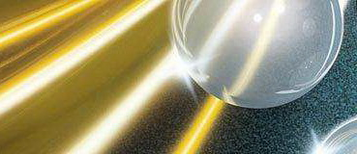
Optical Model Potential
A successful model to explain the experimental data on scattering and reaction is the optical model, which resembles the case of light scattered by an opaque glass sphere.
phenomenological potential, independent on energy.
A basic task in nuclear reaction study is to understand the nuclear interaction potential.
Optical Model Potential (OMP):
U = V(r) + iW(r)
attractive absorptive
Cf: 1) S. Fernbach, R. Serber, and T. B. Taylor, Phys. Rev. 73, 1352 (1949).
2) H. Feshbach, “The optical model and its justification”, Ann. Rev. Nucl. Sci. 8, 49 (1958).
CEPC-γ CJLin@ciae.ac.cn 2

Slide 4
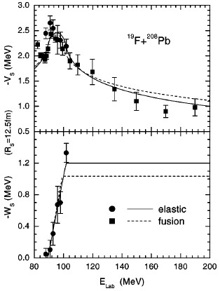
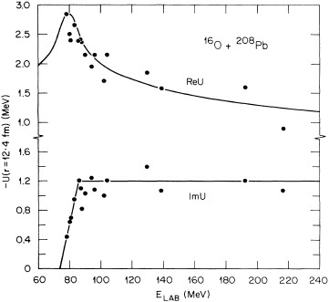
Threshold Anomaly
A universal phenomenon within the Coulomb barrier energy region
tightly-bound nuclear systems
Anomaly
Space Time
Nonlocality
Dispersion relation
Dynamic polarization potential:
C.J. Lin et al., PRC 63, 064606 (2001).
Threshold
Dispersion relation
(results from the causality)
Cf: 1) M. A. Nagarajan, C. C. Mahaux, and G. R. Satchler, Phys. Rev. Lett. 54, 1136 (1985).
2) C. Mahaux, H. Ngo, and G. R. Satchler, Nucl. Phys. A449, 354 (1986).
3) G. R. Satchler, Phys. Rep. 199, 147 (1991).
CEPC-γ CJLin@ciae.ac.cn 3

Slide 5
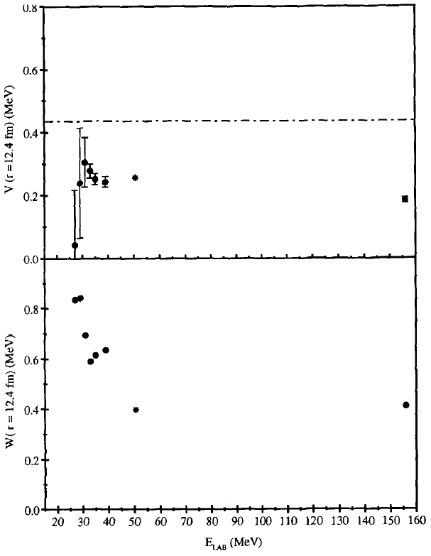
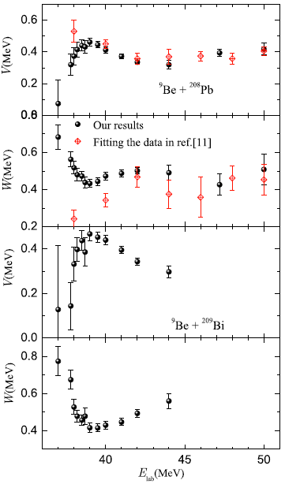
Abnormal Threshold Anomaly
For weakly-bound nuclear systems: ^{6,7}Li, ⁹Be and RNB induced reactions
⁶Li+²⁰⁸Pb
⁹Be+²⁰⁸Pb
decrease
Reason?
Dispersion relation?
increase
⁹Be+²⁰⁹Bi
JPG 371, 075108 (2010).
Nucl. Phys. A571, 326 (1994).
Breakup Threshold Anomaly -- M. S. Hussein et al., Phys. Rev. C 73, 044610 (2006).
CEPC-γ CJLin@ciae.ac.cn 4

Slide 6
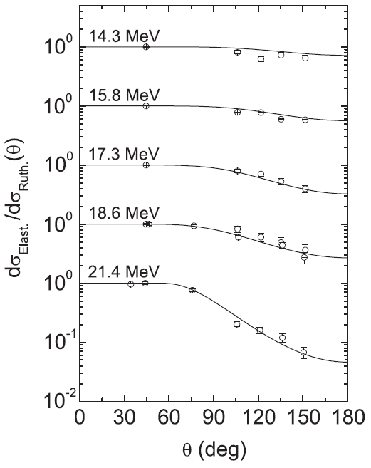
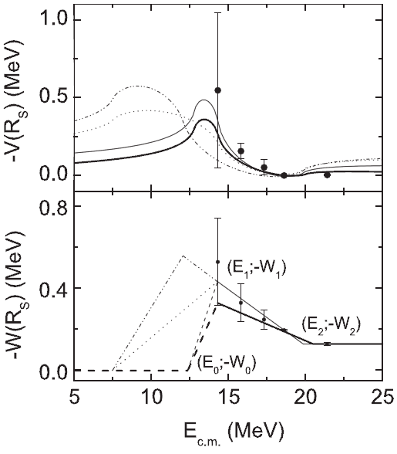
Extraction -- Elastic
OMPs are usually extracted by fitting the angular distributions of elastic scattering.
⁶He+²⁰⁹Bi
Δθ =6 -11°
ΔE=1.2 -1.5 MeV
★ Rather difficult to extract an effective OMP at energy below the barrier.
Cf: 1) E.F. Aguilera et al., PRL 84, 5058 (2000); PRC 63, 061603R (2001).
2) A. R. Garcia et al., Phys. Rev. C 76, 067603 (2007).
CEPC-γ CJLin@ciae.ac.cn 5

Slide 7
Extraction -- Transfer
We proposed to extract the OMPs through transfer reactions.
x
x
+
A
+
A
b
b
a = b+x
B = A+x
Transfer reaction A(a,b)B
elastic scatting cross sections
In the DWBA calculation,
Transition amplitude:
4 wave functions are needed,
two bound states: b+x & A+x (single-particle potential model)
two scattering states: incoming & outgoing (optical potentials)
Cf: C. J. Lin et al., AIP Conf. Proc. 853, 81 (2006).
CEPC-γ CJLin@ciae.ac.cn 6

Slide 8
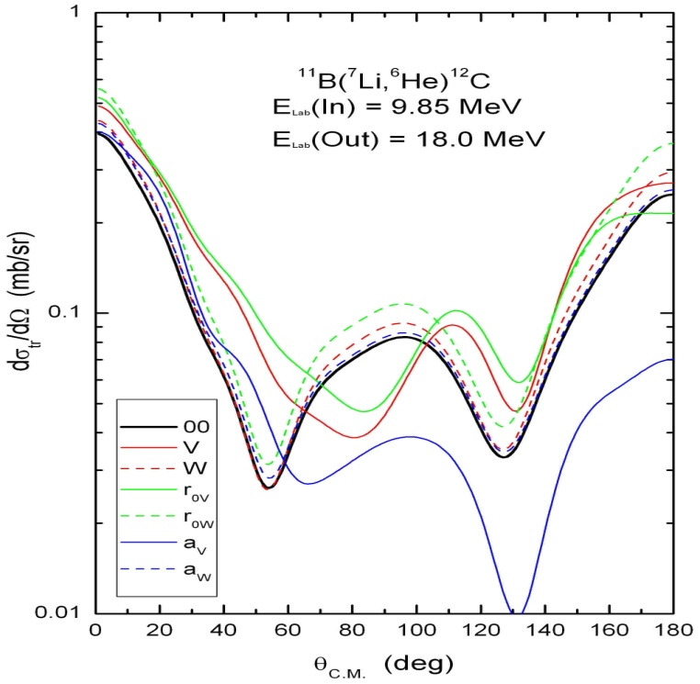
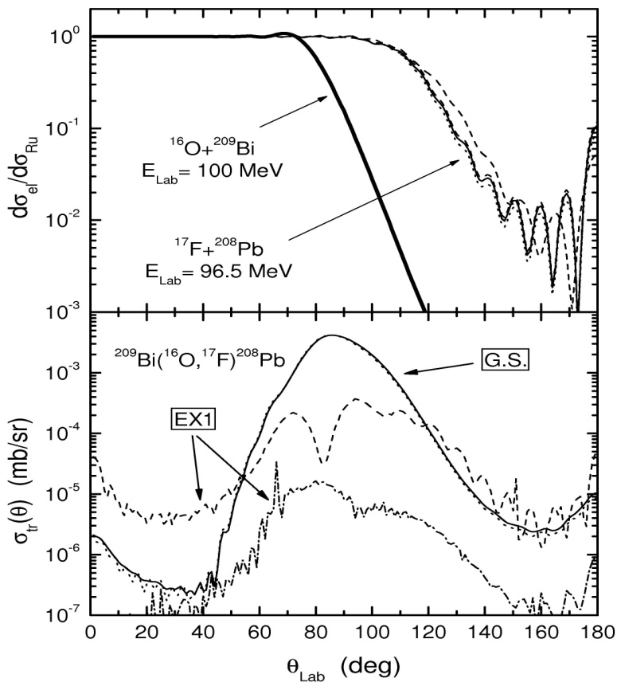
Systematic study
Proposed：C. J. Lin et al., AIP Conf. Proc. 853, 81 (2006), presented at the FUSION06.
¹⁶O(¹⁴N,¹³C)¹⁷F：Chin. Phys. Lett. 25, 4237 (2008).
¹¹B(⁷Li,⁶He)¹²C：Chin. Phys. Lett. 26, 022503 (2009). Phys. Rev. C 87, 047601 (2013).
²⁰⁸Pb(⁷Li,⁶He)²⁰⁹Bi：Phys. Rev. C 89, 044615 (2014), Il Nuovo Cimento C 39, 367 (2016), Chin. Phys. Lett. 31 (9), 092401 (2014), Phys. Rev. C 96, 044615 (2017).
⁶³Cu(⁷Li,⁶He)⁶⁴Zn：Phys. Rev. C 95, 034616 (2017).
★Referee: “Data on the scattering of ⁶He with various targets are of interest to assess the role of the weak binding and halo nature of the ⁶He nucleus in reaction processes.”
10% changed
halo
no halo
Sensitivity test
Effects of halo structure
CEPC-γ CJLin@ciae.ac.cn 7

Slide 9
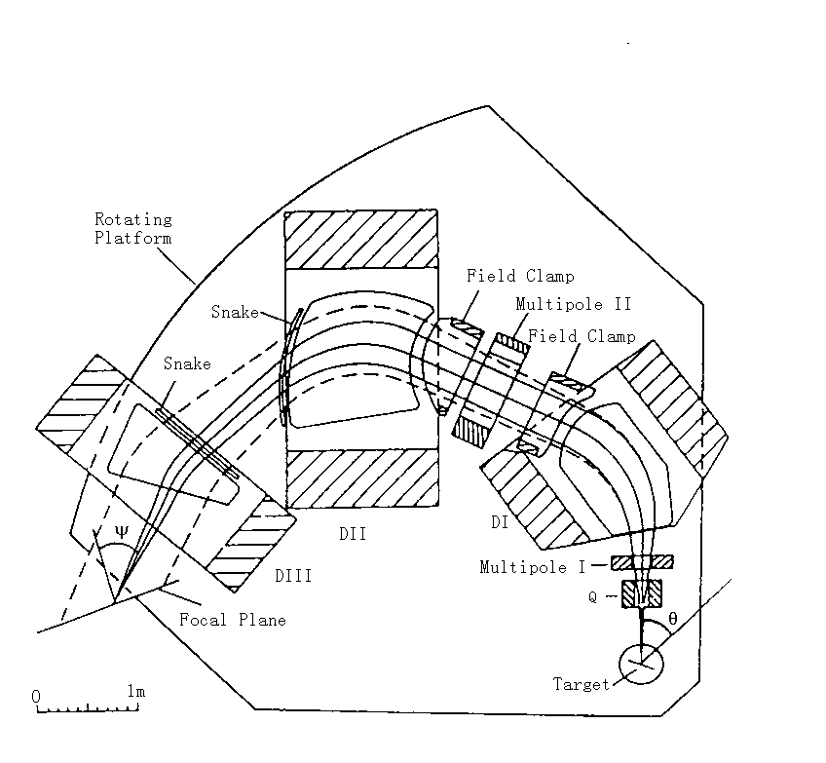
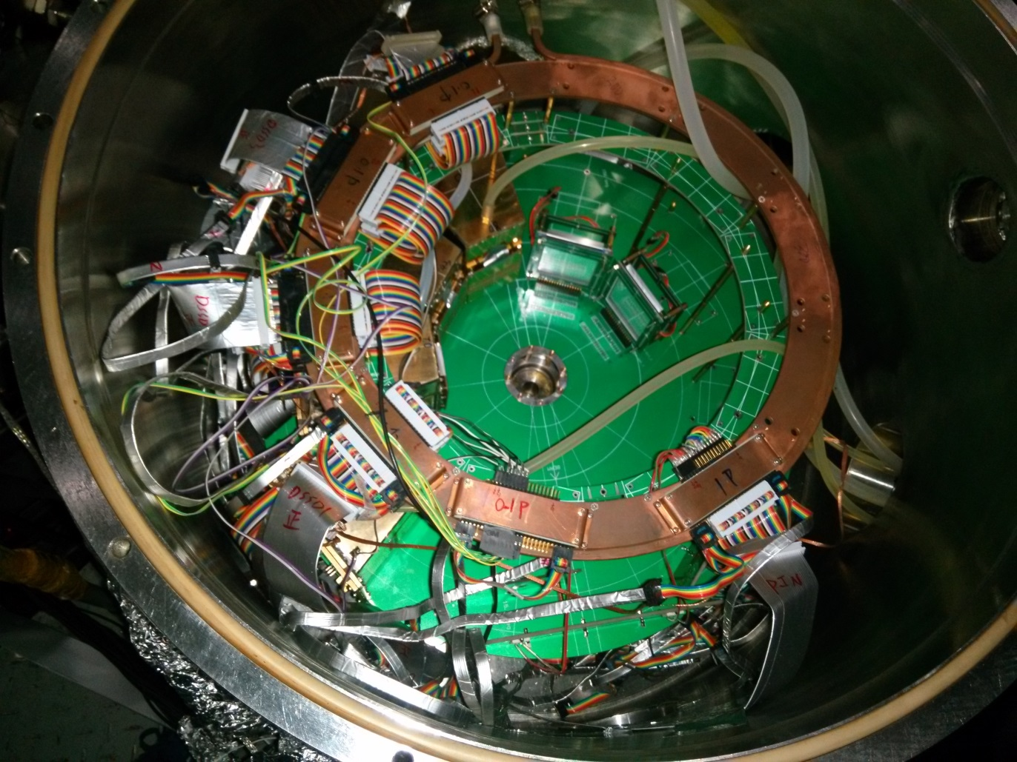
²⁰⁸Pb(⁷Li,⁶He)²⁰⁹Bi Exps
Two experiments have been done at HI-13 tandem accelerator @ CIAE
Exp1: E_{beam} = 42.55, 37.55, 32.55, 28.55, 25.67 MeV – high energies 【2004.8】
Exp2: E_{beam} = 28.55, 25.67, 24.3, 21.2 MeV -- low energies 【2016.4】
Angular distributions of both elastic scattering and transfer were measured.
Exp1 – R20
Exp2 – R60
2 Telescopes: SSSD(20μm) + DSSD(60μm) + QSD(100μm)
7 Si(Au)s
⁷Li
Monitor (±10°)
F.cup
Target
3 ΔE-Es
150°,160°,170°
Q3D (-20°-140°)
Focal Plane
CEPC-γ CJLin@ciae.ac.cn 8

Slide 10
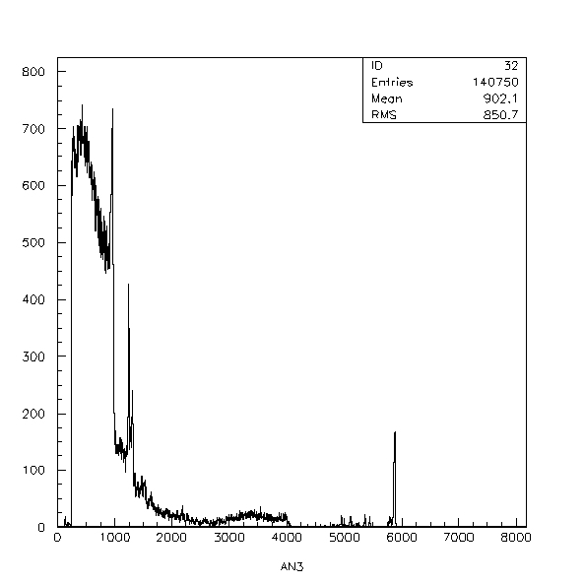
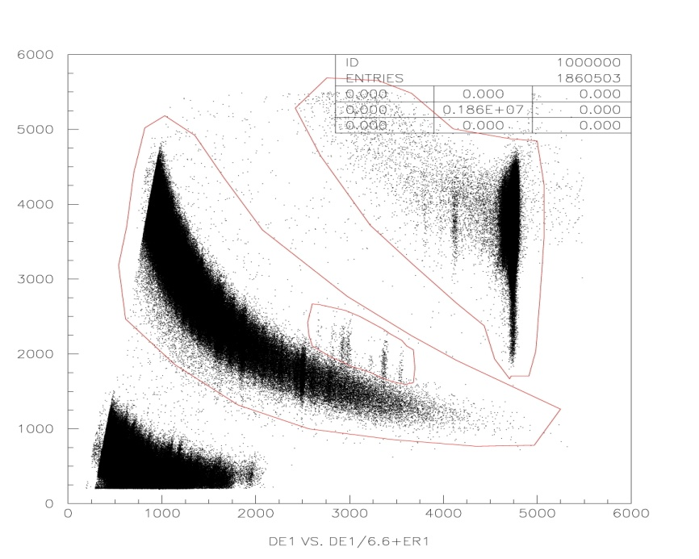
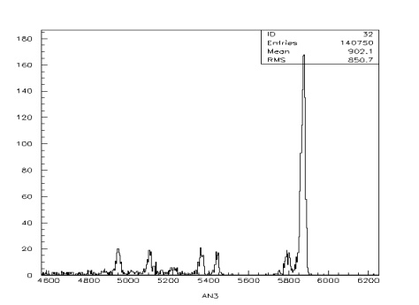
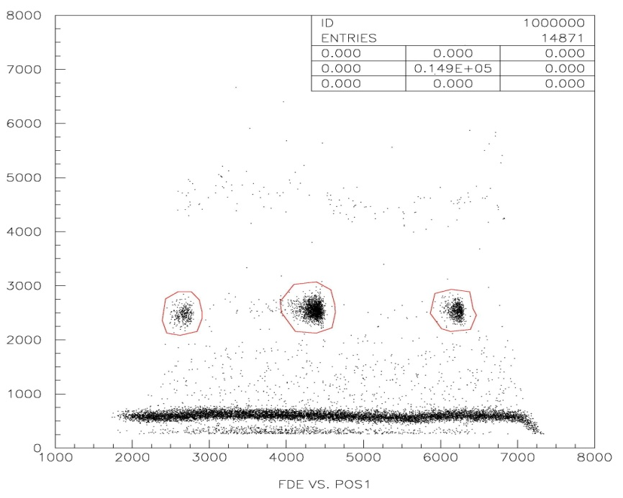
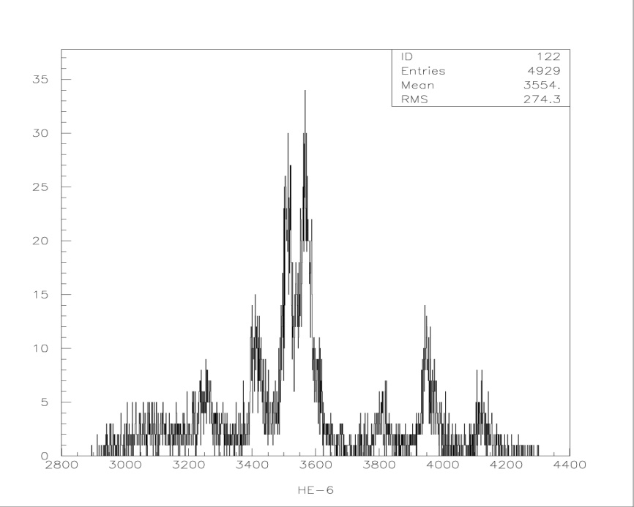
Exp1 spectrums
Focal Plane
ΔE-E telescope
⁷Li
3.95 MeV
4.63 MeV
2.62 MeV
0.48 MeV
5.65 MeV
3.20 MeV
2.83 MeV
⁶He
3.12 MeV
²⁰⁹Bi(Ex2)
²⁰⁹Bi(Ex1)
3.63 MeV
G.S.
0.90 MeV
⁶He
4.44 MeV
1.61 MeV
CEPC-γ CJLin@ciae.ac.cn 9

Slide 11
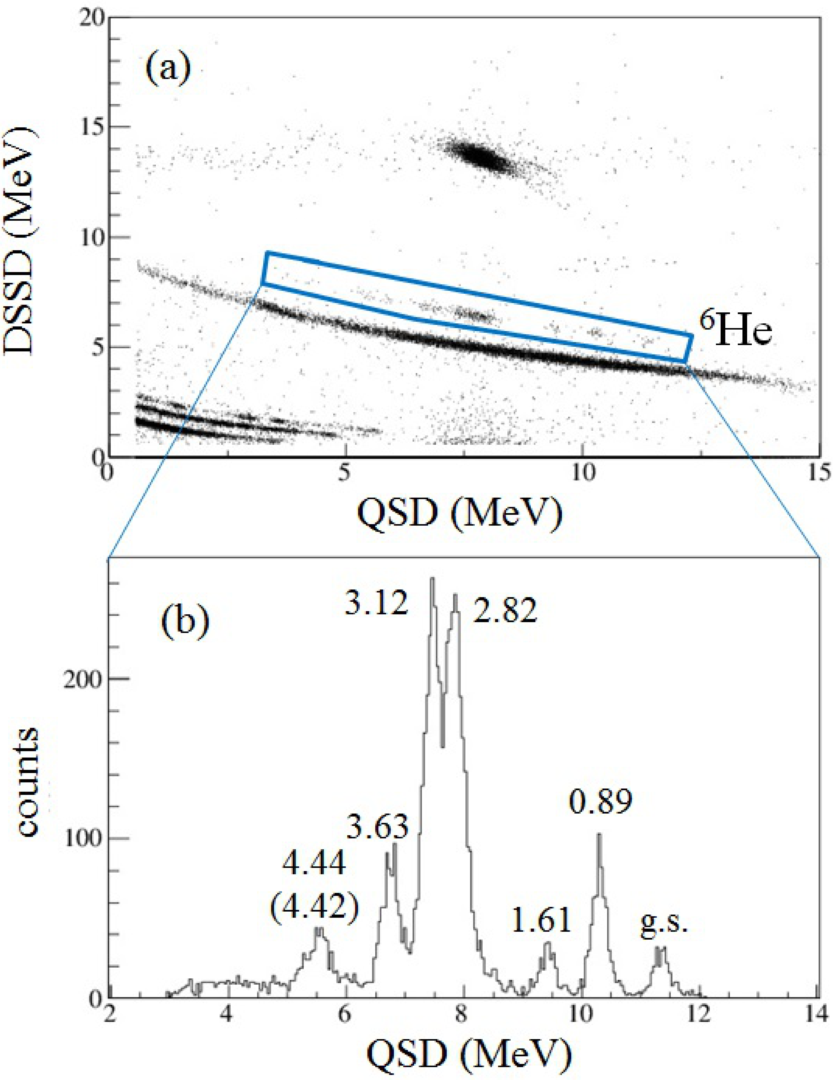
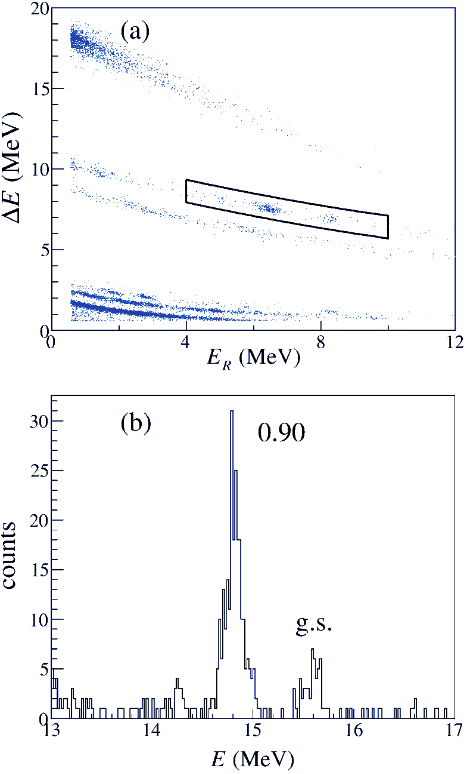
Exp2 spectrums
28.55 MeV
24.30 MeV
⁶He
Single-particle states
S-factors are well known
CEPC-γ CJLin@ciae.ac.cn 10

Slide 12
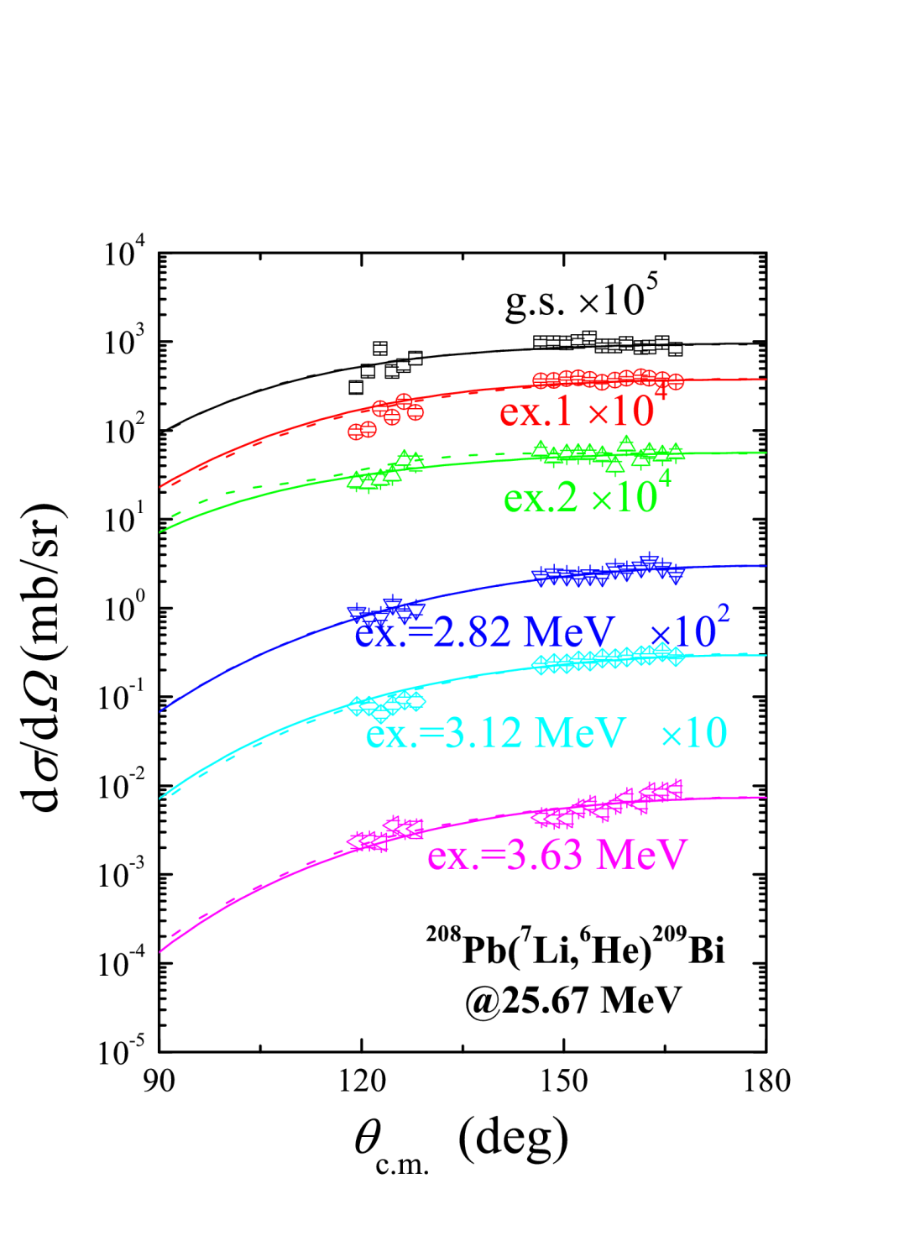
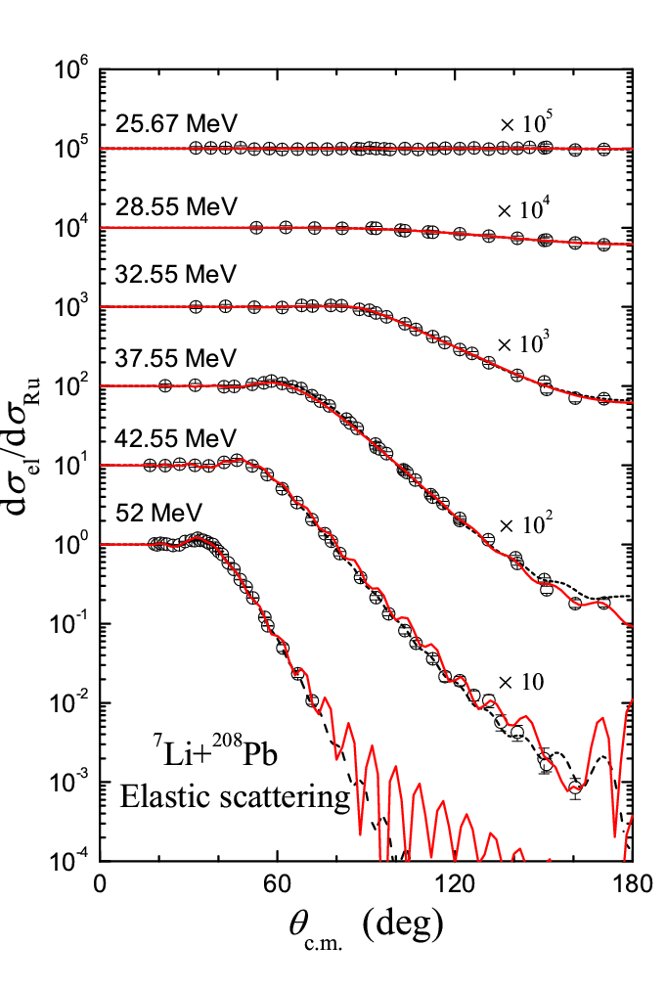
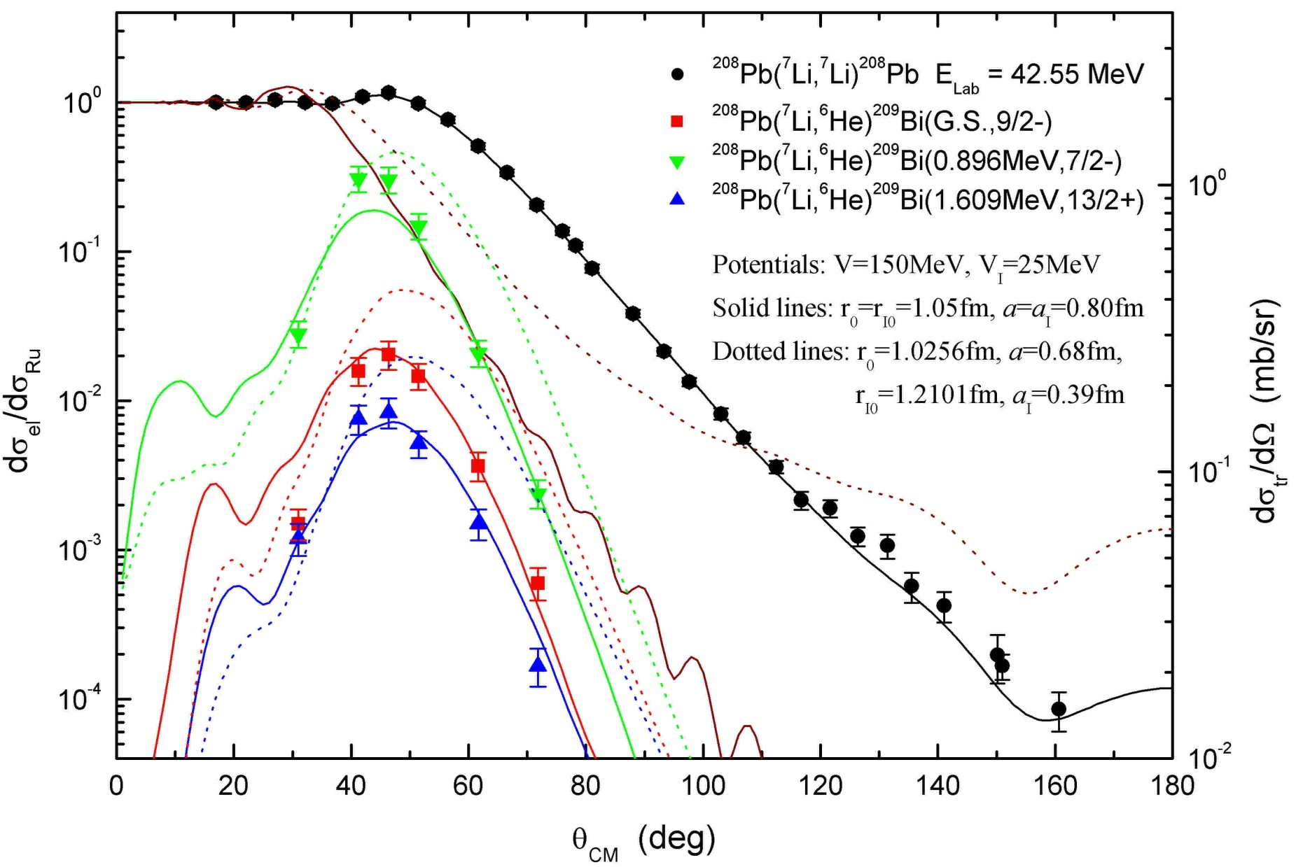
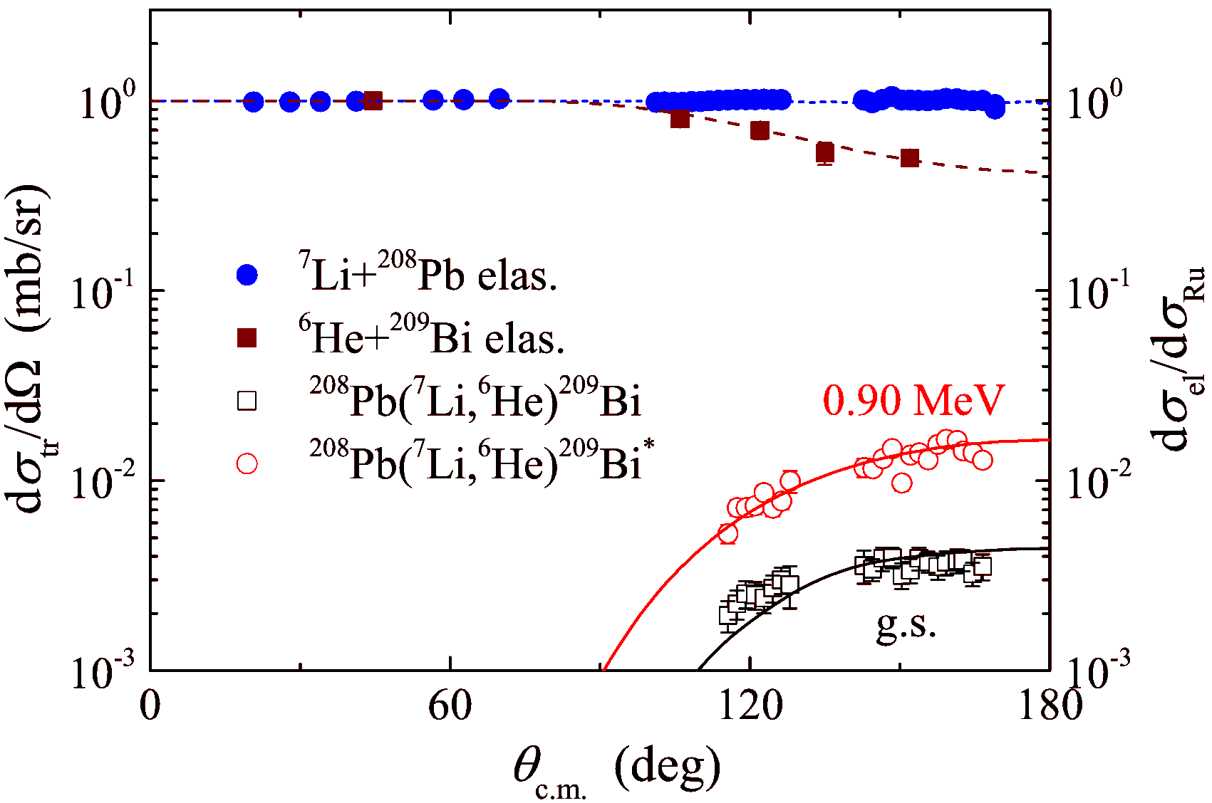
Analyses
DWBA & CRC analyses
42.55 MeV
24.30 MeV
CEPC-γ CJLin@ciae.ac.cn 11

Slide 13
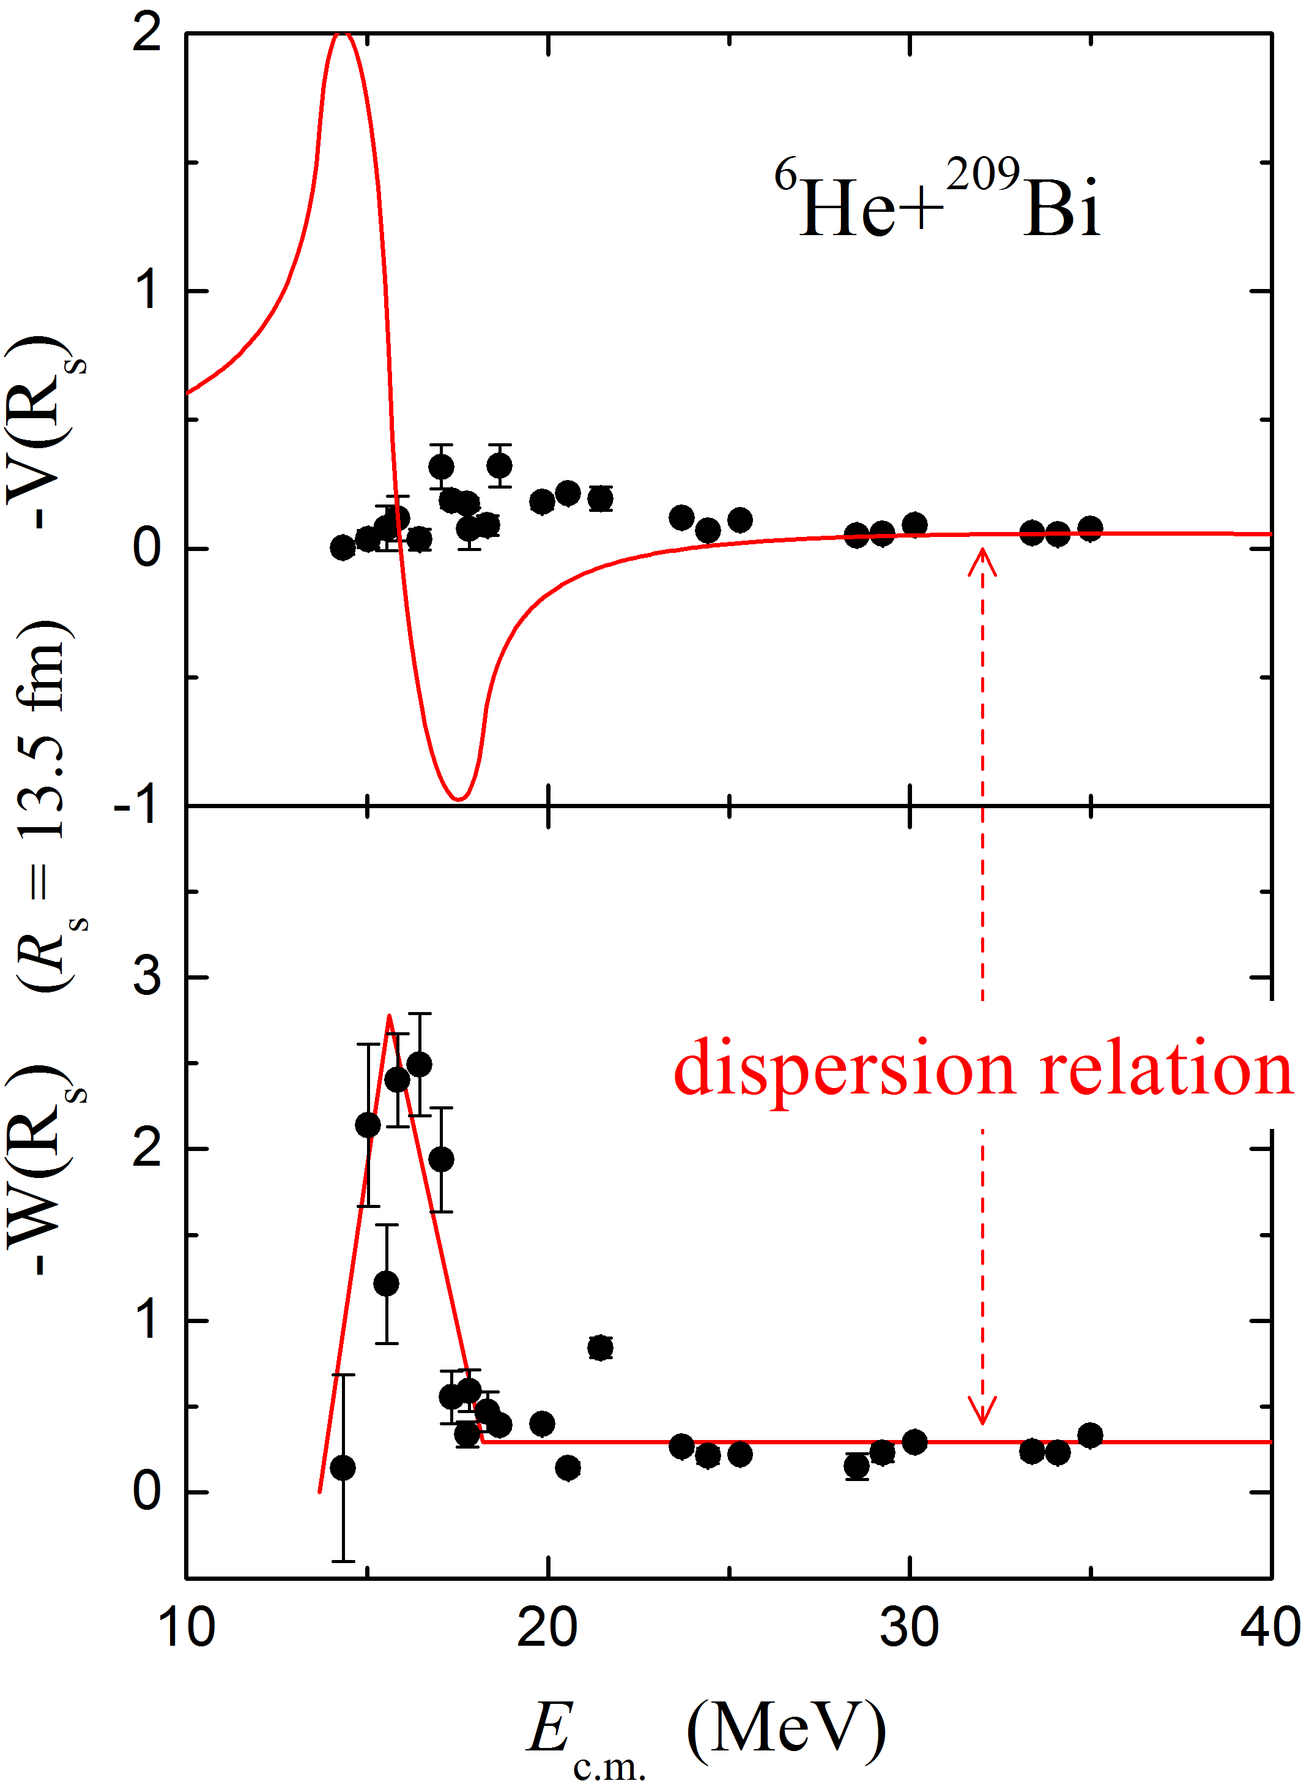
Results
★ OMPs of the ⁶He+²⁰⁹Bi system are determined precisely for the first time;
★ The decreasing trend in the imaginary part is observed, and the threshold energy is about 13.73 MeV (~0.68V_{B});
★ The behavior of real part looks normal, i.e. like a bell shape around the barrier;
★ The dispersion relation does NOT hold in this system.
preliminary
L. Yang, C.J. Lin*, H.M. Jia et al., Phys. Rev. Lett. 119, 042503 (2017);
Phys. Rev. C 96, 044615 (2017).
CEPC-γ CJLin@ciae.ac.cn 12

Slide 14
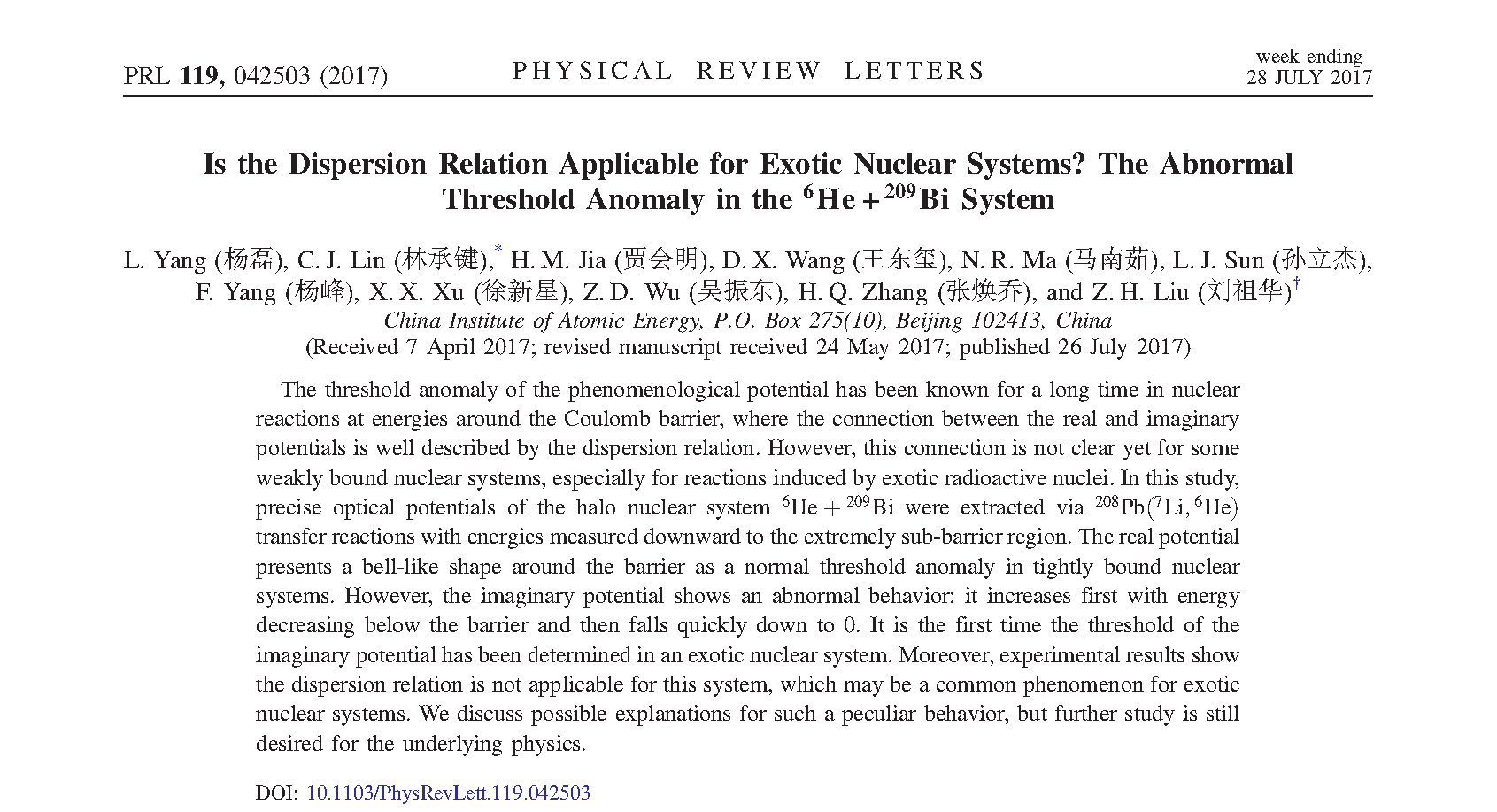
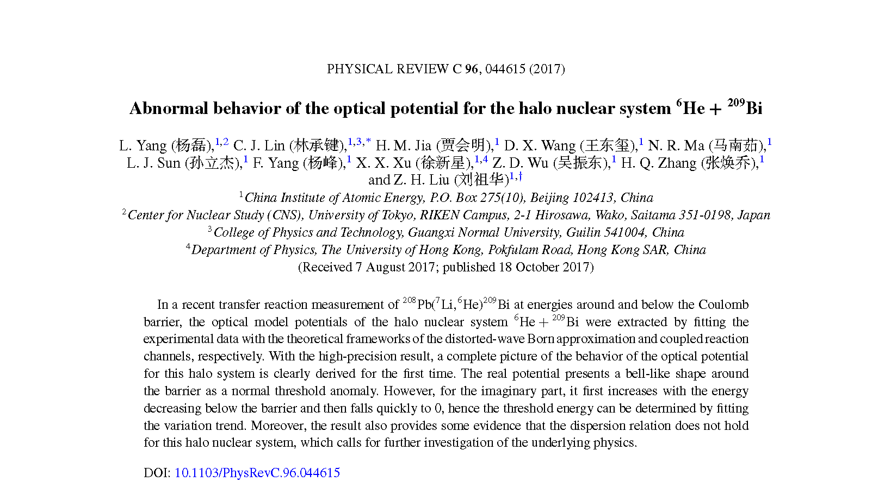
Publishing
CEPC-γ CJLin@ciae.ac.cn 13

Slide 15
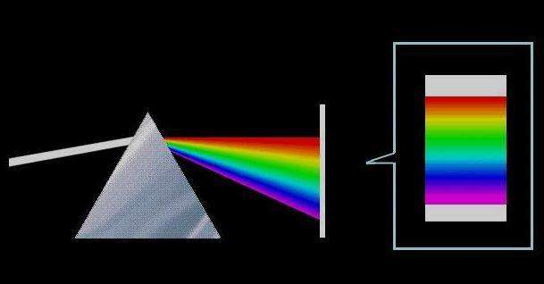
Discussion
The Dispersion Relation is not Applicable for Exotic Nuclear Systems.
A serious problem!
★ Dispersion relation results from Causality;
★ Connecting real part and imaginary part;
★ Any wave, like microscopic particle, should obey this rule when it pass through a media.
CEPC-γ CJLin@ciae.ac.cn 14

Slide 16
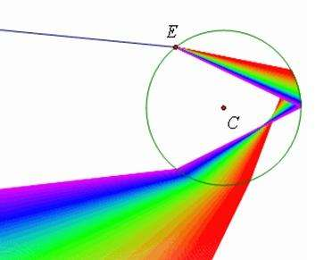
The K-K Relation
Causality → Dispersion Relation:
The Kramers-Kronig relation
wikipedia : The Kramers-Kronig relations are bidirectional mathematical relations, connecting the real and imaginary parts of any complex function that is analytic in the upper half-plane. These relations are often used to calculate the real part from the imaginary part (or vice versa) of response functions in physical systems because for stable systems causality implies the analyticity condition is satisfied, and conversely, analyticity implies causality of the corresponding stable physical system.
cf: J. S. Toll, Phys. Rev. 104, 1760 (1956).
+
CEPC-γ CJLin@ciae.ac.cn 15

Slide 17
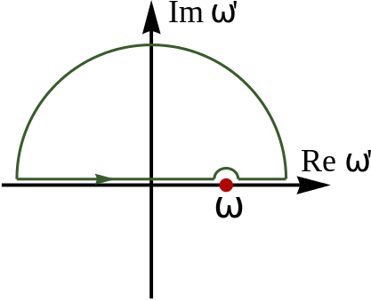
The Cauchy integral
Weakly-bound system: infinity poles
• Stable system:
finite poles in the real axis
• Tightly-bound nuclear system:
finite bound states in the real axis
[cf: C. Mahaux et al., NPA 449, 354 (1986).]
• Weakly-bound exotic nuclear system:
infinity states (continuum) …
in the real axis ?
The Cauchy integral theorem
-- Cauchy’s residue theorem
+
CEPC-γ CJLin@ciae.ac.cn 16

Slide 18
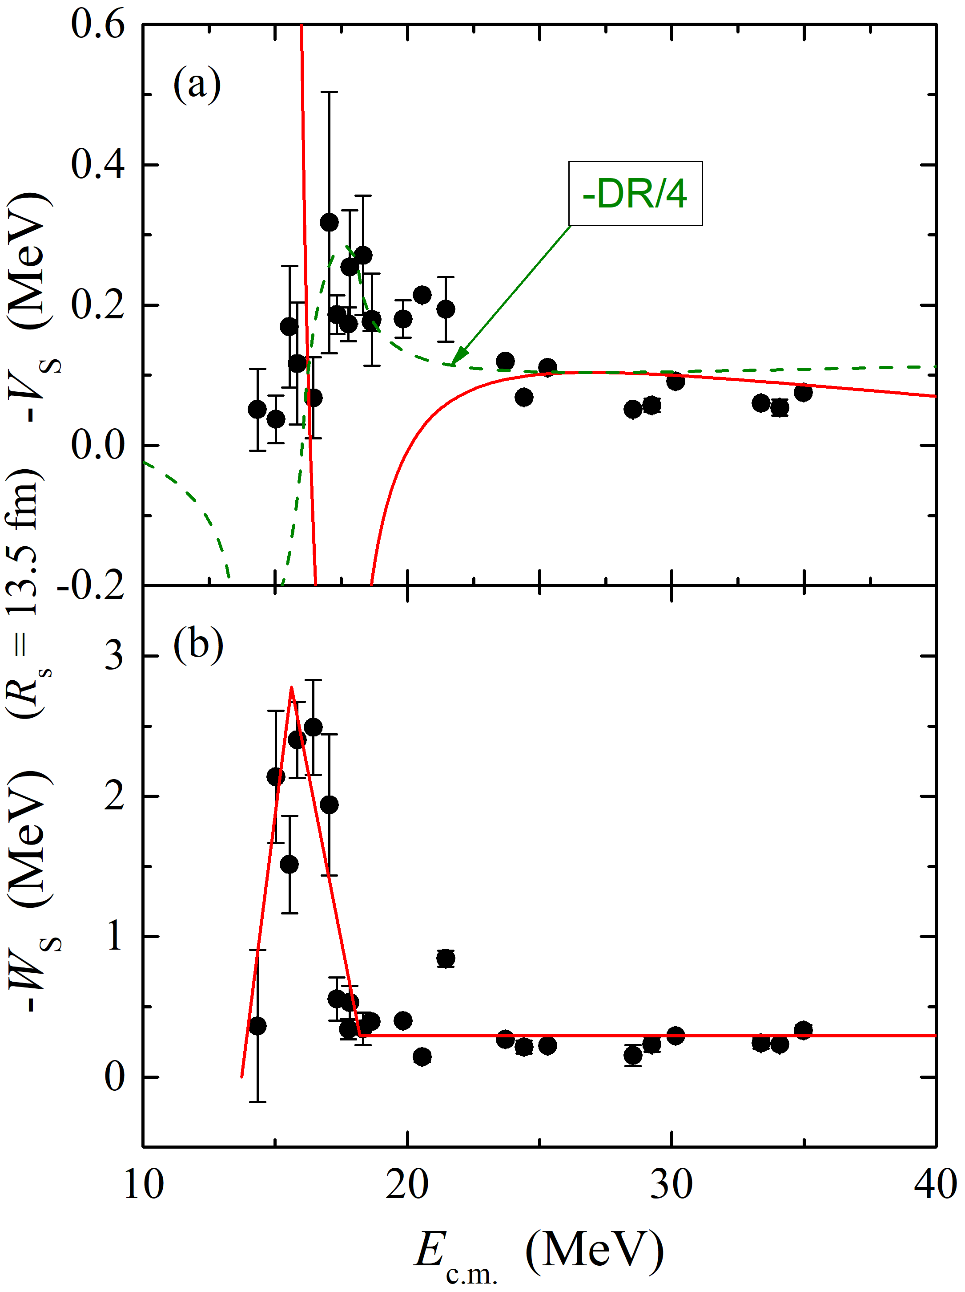
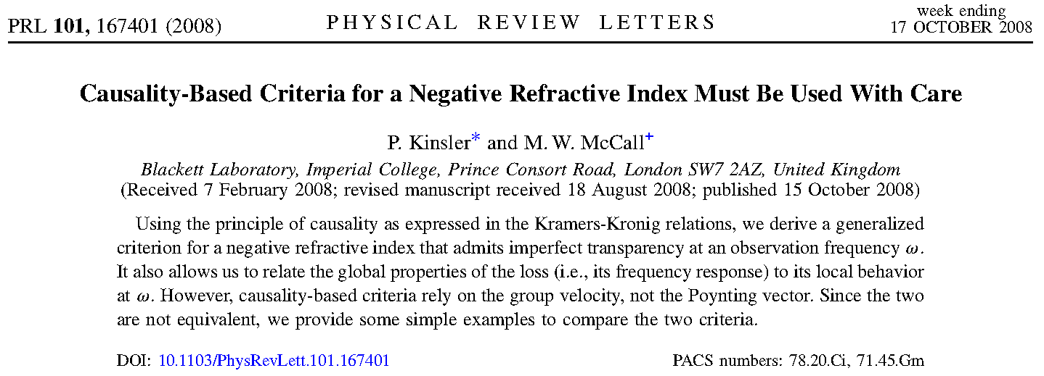
Negative Index of Refraction
The nature of the material:
Experimental Verification of a Negative Index of Refraction, R. A. Shelby, D. R. Smith, and S. Schultz, Science 292, 77 (2001).
CEPC-γ CJLin@ciae.ac.cn 17

Slide 19
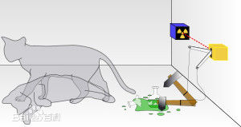
Locality & Non-locality
OMP: local
Wave functions: non-local
Schrödinger equation
Energy dependence on the equivalent local potential
The fundamental quantum mechanics:
Quantum state (non-local) v.s. Measurement (local)
Schrödinger’s cat
CEPC-γ CJLin@ciae.ac.cn 18

Slide 20
On the CEPC-γ source
Applications on:
Nuclear reaction: photon-induced fission…
Nuclear structure: giant resonance …
Nuclear data: …
Nuclear astrophysics: (γ,n), (γ,p), (γ,a) … ↔ (n,γ), (p,γ), (α,γ)…
Nuclear material: radiation effects …
CEPC-γ CJLin@ciae.ac.cn 19

Slide 21
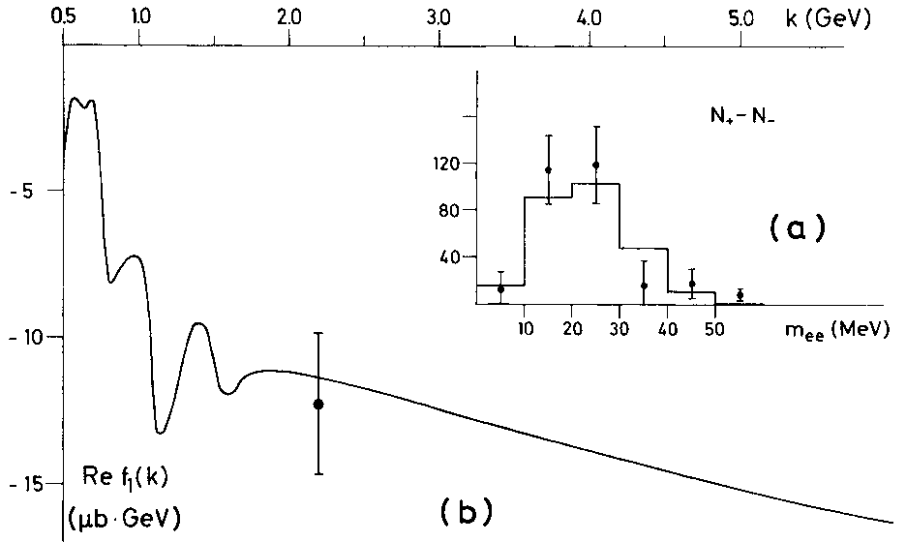
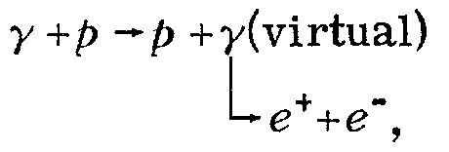
On the CEPC-γ source
2.2 GeV
γ + N → ?
100 MeV γ, λ ≈ 12.4 fm
PRL 30, 328(1973).
CEPC-γ CJLin@ciae.ac.cn 20

Slide 22
Summary
Transfer reactions are employed to extract the OMPs of exotic nuclear systems in the exiting channels.
Advantage: 1) stable beam; 2) high-quality data; 3) precise OPs. 4) good for sub-barrier energy, where the absolute C.S. sections provide extra constraints on OMP.
OMPs of the ⁶He+²⁰⁹Bi system have been determined precisely, showing: 1) the threshold energy. (~0.68 V_{B}). 2) an abnormal TA behavior.
The dispersion relation does not hold for the exotic systems.
CEPC-γ CJLin@ciae.ac.cn 21

Slide 23
Thanks !
China Institute of Atomic Energy

