Slide 1

Photodisintegration reaction measurement: a probe of p-process for nuclear astrophysics
● Introduction
● Photodisintegration
● Experimental methods
● Works by Beihang group
Liuchun He, Bao-Hua Sun, Li-Hua Zhu, Jian-Wei Zhao, Meng Wang, Kang Wang
School of Physics and Nuclear Energy Engineering, Beihang University

Slide 2
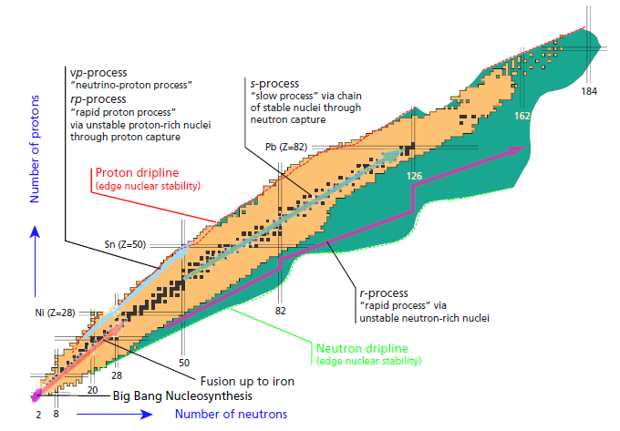
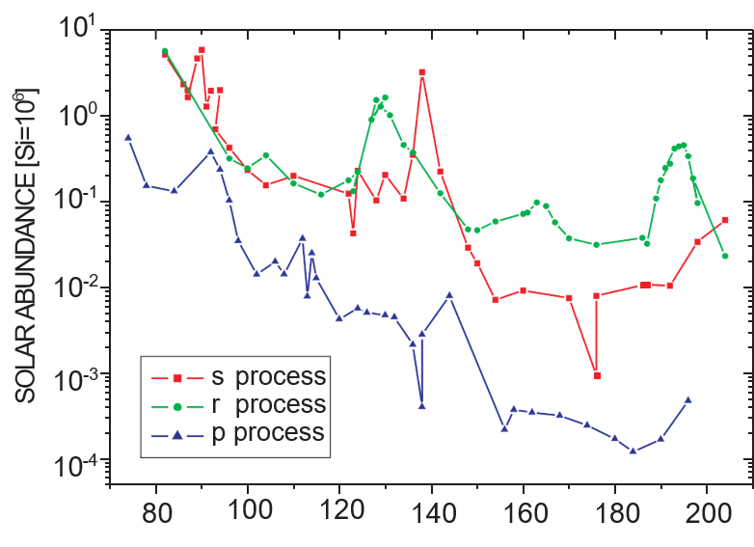
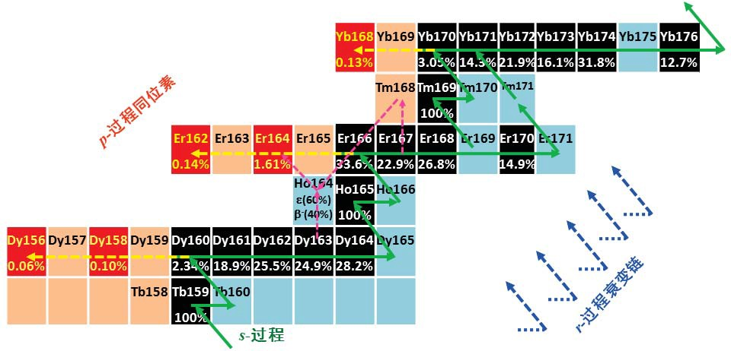
Introduction
γ-process in massive stars
p-process
“γ-process”
r-process
“rapid process” via
unstable neutron-rich nuclei
Neutron dripline
(edge nuclear stablility)
Notes:
对于稳定的核素，它们的比结合能在⁵⁶Fe处达到了最大值^{[3,4]}，铁以上的元素不能再通过类似氢燃烧，氦燃烧^{[1]}等方式随恒星的演变熔合产生，并且随着元素质子数的增加，原子核内越来越大的库伦位垒导致了带电粒子的俘获反应越来越困难，此时，中性粒子的俘获反应开始起主导作用。各种模型研究表明，元素中的大部分（约99％）原子核主要是通过慢中子俘获过程（s-过程: slow neutron-capture process）^{[5,6]}和快中子俘获过程（r-过程: rapid neutron-capture process）^{[7]}来合成的。
然而，还有一些天然存在的丰质子同位素不在这些中子俘获过程的路径上，它们无法通过s-过程或r-过程来合成，这些元素被称为 p-原子核，如图 1中的^{156,158}Dy、^{162,164}Er和¹⁶⁸Yb等。核素图上从元素硒(Se)到汞(Hg)的质量区域，大约30多个这样的 p-原子核^{[8-10]}。与其它稳定同位素相比，p-原子核含有的中子 数较少，与通过s-过程和r-过程产生的同位素相比，它们的同位素丰度和太阳系丰度都极低，见图2。产生它们的天体环境、核合成机制都还不清楚，与其相关的核反应数据也非常缺乏，是当前天体物理核合成研究的重要热点问题之一。
在 II 型超新星^{[11,12]}和Ia型超新星^{[13]}中发生的$γ$-过程（光 致蜕变反应），热核燃烧期间中子星表面发生的rp-过程（质子俘获反应）^{[14]}，或中微子驱动II型超新星的$ν$p-过程(中微子俘获反应)^{[14]}，等等。
为了使反应能在恒星演化的时间尺度上发生，温度一般不能低于1.5×10⁹开尔文，而为了保证重元素不会被大量的光致裂变反应而过度侵蚀，一般也不能超过3.5×10⁹开尔文。这样就给p-过程提供三种限制条件：足够丰度的种子核，足够高的温度，以及时间尺度足够短的热过程。
About 99% of the heavy elements are produced during the s and r processes
However, a small fraction of neutron-deficient nuclei are bypassed by these neutron-capture processes.
The approximately 35 proton-rich nuclei in the mass region between Se (Selenium [səˈlēnēəm]) and Hg (Mercury [ˈmərkyərē]) are believed to be produced by a variety of different processes, usually summarized as the p process.
Among others, astrophysical processes producing the p nuclei are the γ process in type II supernovae and type Ia supernovae, the rp process during thermonuclear burning on a neutron-star surface, or the νp process in neutrino driven winds of type II supernovae. Lighter p nuclei are also efficiently produced in type Ia supernoave.

Slide 3
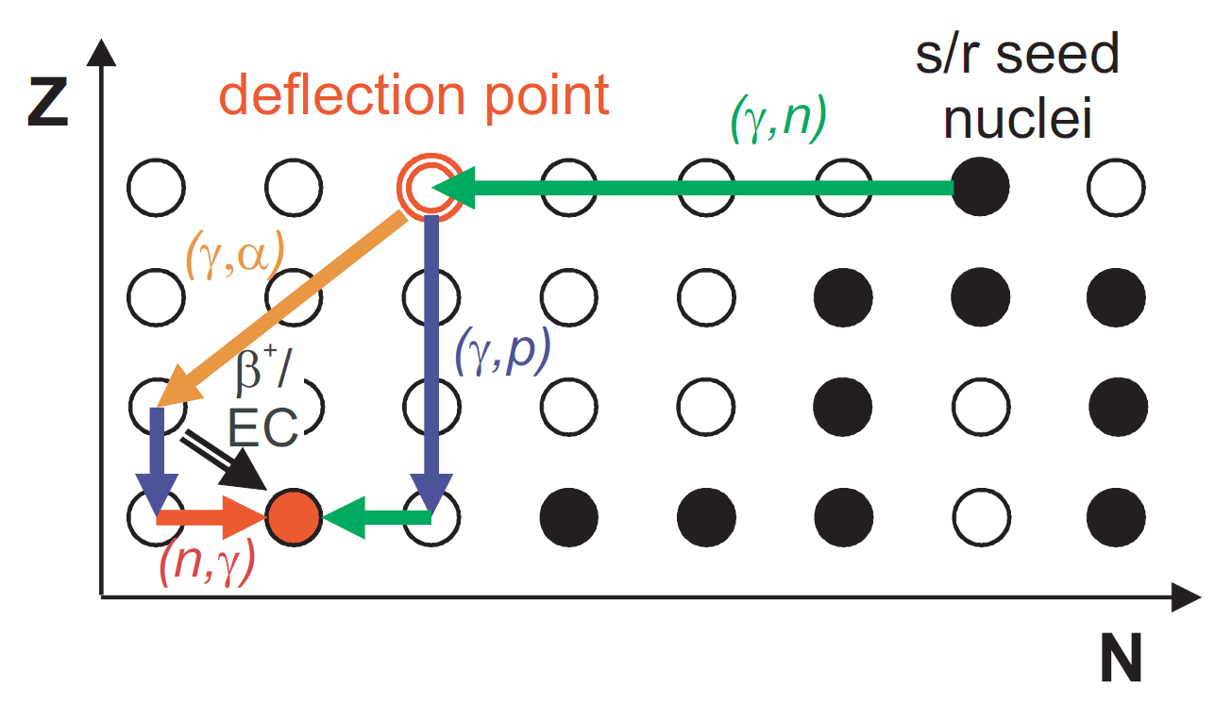
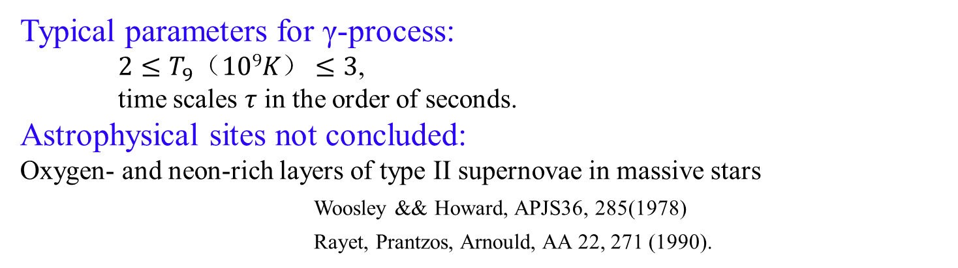
Introduction
Typical parameters for γ-process:
$2≤T_{9}（109K）≤3$,
time scales $τ$ in the order of seconds.
Astrophysical sites not concluded:
Oxygen- and neon-rich layers of type II supernovae in massive stars
Woosley && Howard, APJS36, 285(1978)
Rayet, Prantzos, Arnould, AA 22, 271 (1990).
~ 2000 isotopes ~ 20000 reactions
(mainly unstable nuclei)
Not possible to measure all the reaction rates in the laboratory.
Statistical Hauser-Feshbach model
Rare experiment data at A>130
Notes:
II型超新星爆发中的富氢壳层可能是p-过程发生的地点，这也是恒星演化的最后阶段^{[12]}。
为了使反应能在恒星演化的时间尺度上发生，温度一般不能低于1.5×10⁹开尔文，而为了保证重元素不会被大量的光致裂变反应而过度侵蚀，一般也不能超过3.5×10⁹开尔文。这样就给p-过程提供三种限制条件：足够丰度的种子核，足够高的温度，以及时间尺度足够短的热过程。
为了解决 p-原子核的起源之谜，必须将天体物理和核物理方面的研究与各种来自恒星光谱、陨石样品和核实验的大量“观测”信息相结合，将核天体物理模型与天文观测进行比较。p-过程主要涵盖了大量的光致裂变反应(γ,n)、(γ,p)、(γ,α)，也涉及了一部分的质子，中子，α粒子的俘获反应，且它们的质心能量应该远小于1MeV或者小于对应带电核的库仑位垒；而一部分弱相互作用，如β衰变、正负电子俘获、（反）中微子俘获也可能在特定情况下参与到p-过程中。为此，要对p-过程建立系统的可靠的网络方程模型进行计算，则需要同时考虑到质量数A≤210的约2000个核素相关的20000个反应，且主要涉及不稳定原子核的反应数据[17]。
实验上获得天体物理核合成网络中的所有原子核的反应数据是不可能的。其原因除了涉及不稳定核外，还有天体环境对应的能量较低，在较低能量下的核反应截面一般都非常低，实验本身有很大的困难。因此，天体物理对应能量的核反应实验数据一般很少，而关于p-原子核的实验数据就更加稀少。
Up to current knowledge, the majority of the p nuclei are produced by photodisintegration reactions during the γ process within O/Ne burning layers of core-collapse supernovae. When the shock-front passes the O/Ne (Neon) layer, temperatures of 2 GK T 3.5 GK are reached, allowing the partial photodisintegration of preexisting seed nuclei. The γ –process starts with sequences of (γ ,n) reactions. At some point, the (γ ,n) reactions will start to compete with (γ ,p) and (γ ,α) reactions as well as β decays, leading to deflections in the γ -process path. The reaction rates in the γ –process reaction network, which includes thousands of reactions on mainly unstable nuclei, are calculated within the scope of the Hauser-Feshbach (HF) statistical model. In order to obtain reliable model predictions, it is important to put the nuclear-physics input parameters entering these calculations on a firm basis. These nuclear-physics input parameters include nuclear level densities and γ -ray strength functions, which determine the γ width. Moreover, the particle+nucleus optical-model potentials (OMP) are needed to describe the particle widths for protons, neutrons, and α-particles. These parameters can, to some extent, be experimentally tested by laboratory experiments.

Slide 4
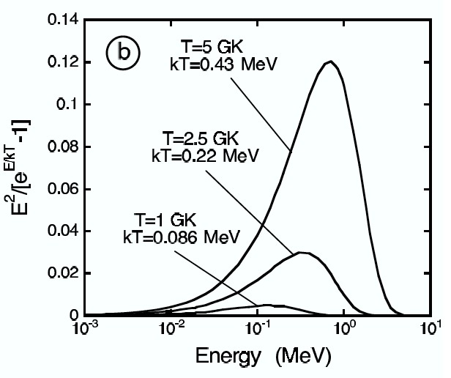
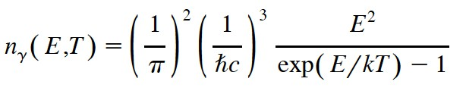

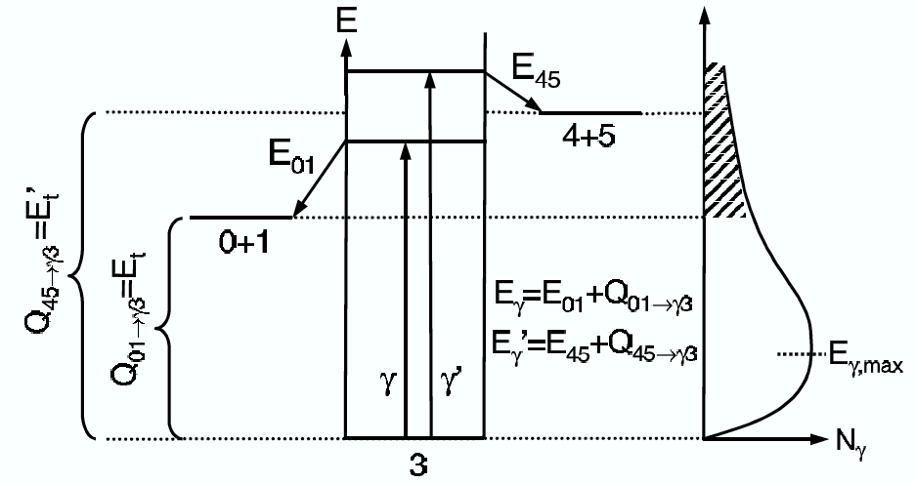
Photodisintegration
The energy distribution of a thermal photon bath at a temperature T is given by the Planck distribution
700
349
140
Number of γ-rays at energy E per unit of volume and energy interval
In a photon-induced reaction B(γ,x) A, the distribution leads to a temperature dependent decay rate λ(T) of the initial nucleus B:
γ-flux
Cross section of the γ-induced reaction
The larger threshold energy, the smaller λ(T)
threshold
$3+γ→0+1$ or $3+γ→4+5$

Slide 5
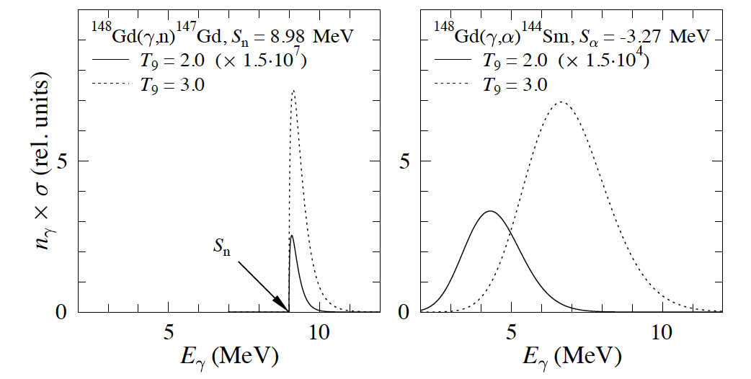

At temperature of astrophysical interests
Utsunomiya et al., NPA 2006
1-2 MeV
Gamow window for (γ,n) (left panel) and (γ,α) reactions (right panel) on the ground state of the target nucleus ¹⁴⁸Gd.
Note the temperature dependence of the position of the Gamow window when the emitted particle is charged as well as the significant changes of the vertical scales in both panels when T₉ goes from 2 to 3.

Slide 6
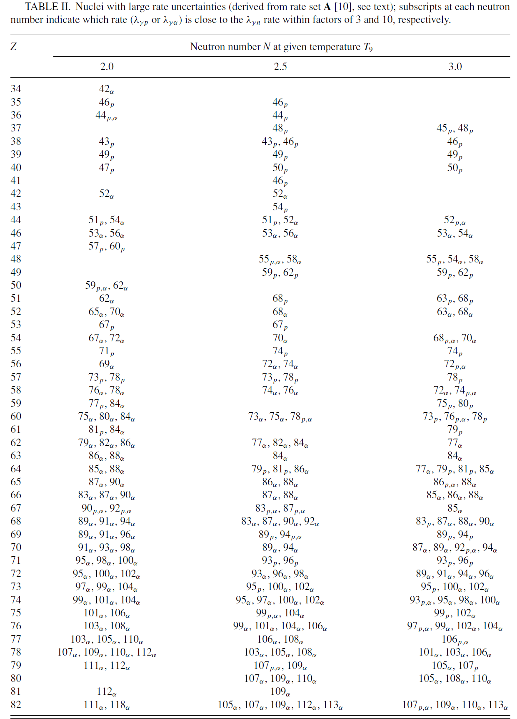
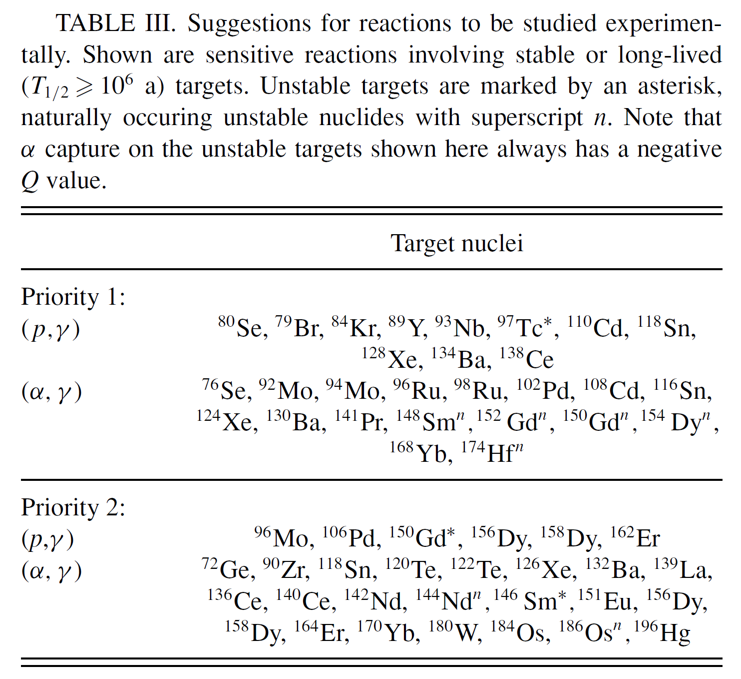
Suggestions for reactions to be studied experimentally
Thomas Rauscher, PRC, 73, 015804 (2006)
Notes:
A well-known deficiency in the model is the underproduction of the Mo-Ru region, but the region 151 A 167 is also underproduced, even in recent calculations [3].
In this work the sensitivity of the location of the γ process path to reaction rates is investigated, showing which nuclei should be preferred in experimental studies.
表左：产率具有较大误差的核素，下角标表示与（g,n）反应产率接近的反应。
表右：优先进行实验研究的核素。

Slide 7
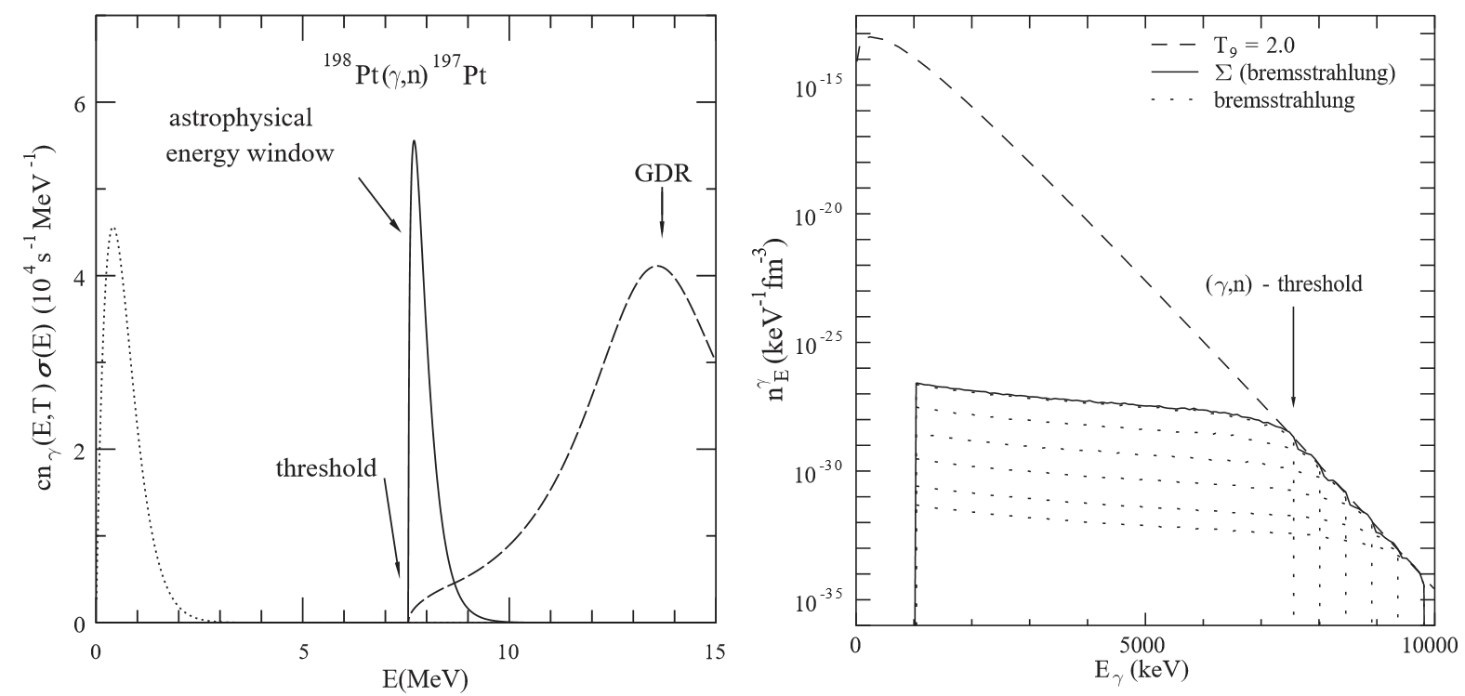
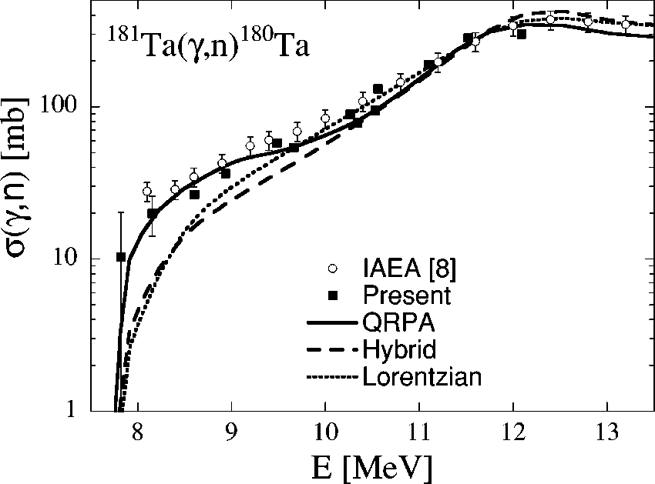
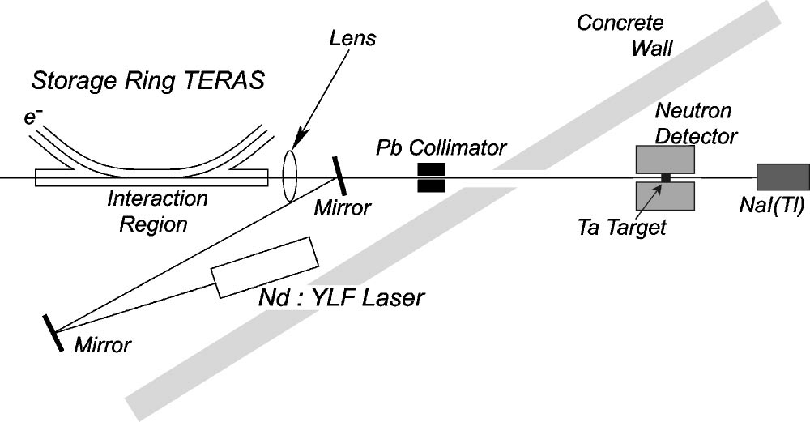
Experiment method
Direct determination of reaction rates
Bremsstrahlung-induced activation
Continuous energy distribution photons
Superposition method
Approximate satisfactorily a black-body Planck spectrum
Laser Compton backscattering
Physics Reports 384 (2003) 1–84_3
Quasi-monochromatic γ-rays
PHYSICAL REVIEW C 67, 015807 (2003)

Slide 8
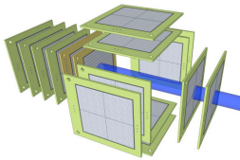
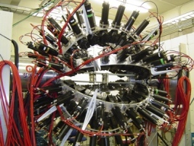
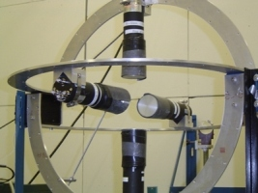
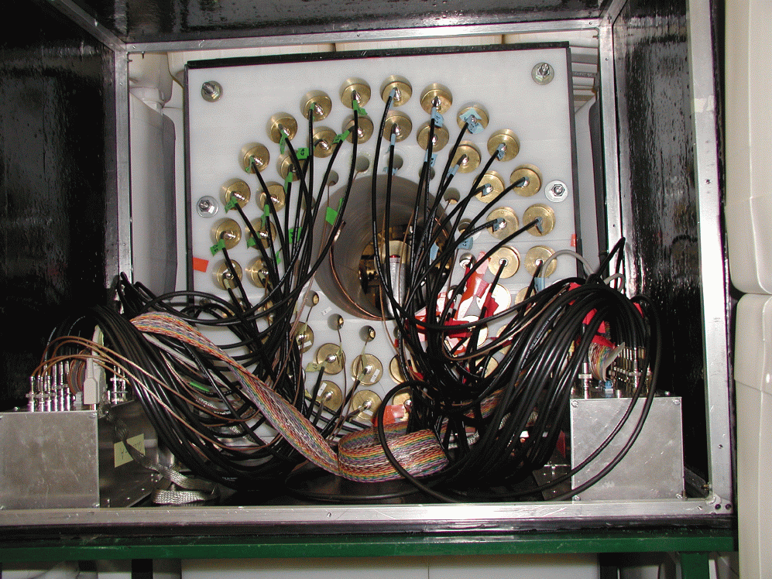
Detectors for (γ,X)
Time Projection Chamber：
Silicon detector：
Neutron detectors：
3He
BF3
liquid scintillating detectors
Li-loaded glass detectors

Slide 9
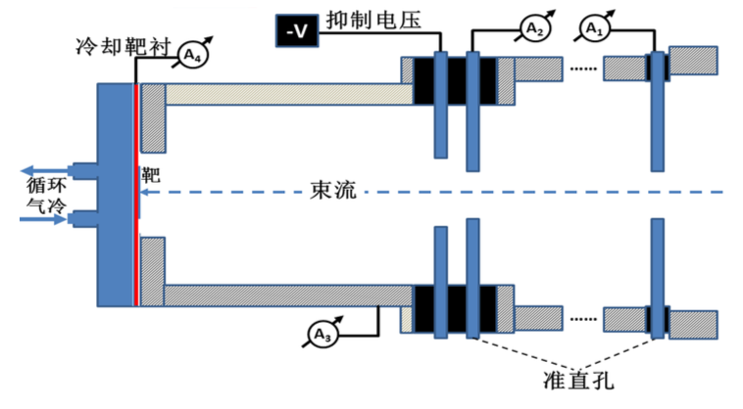
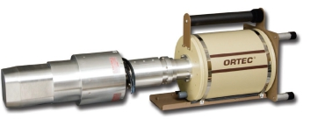
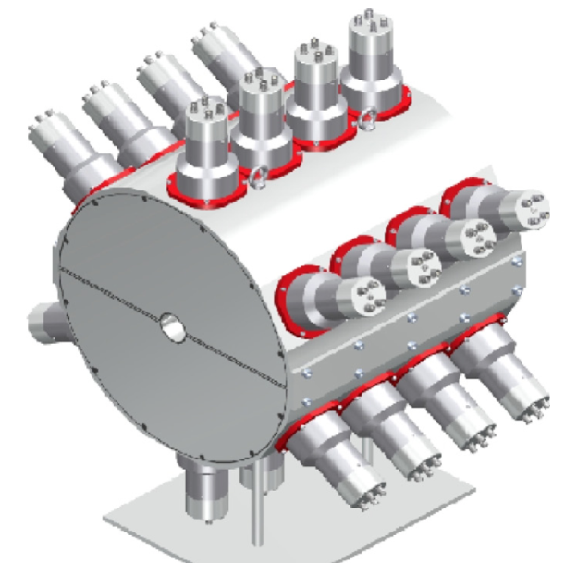
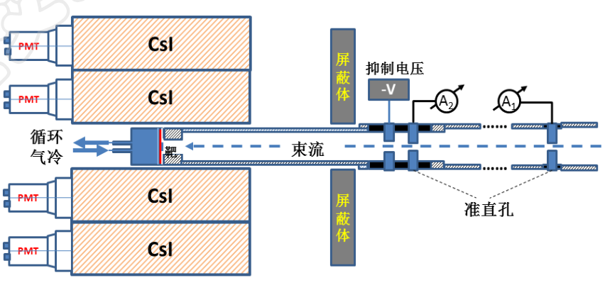
Experiment method (Inverse reactions )
Inverse reactions (p, γ), (n, γ), (α, γ)
Activation method：A (x, γ) B → Radioactive γ-rays measurements
Suitable T_{1/2} of B
Low background
In beam measurements: A (x, γ) B → in-beam γ-rays measurements
High detector efficiency

Slide 10
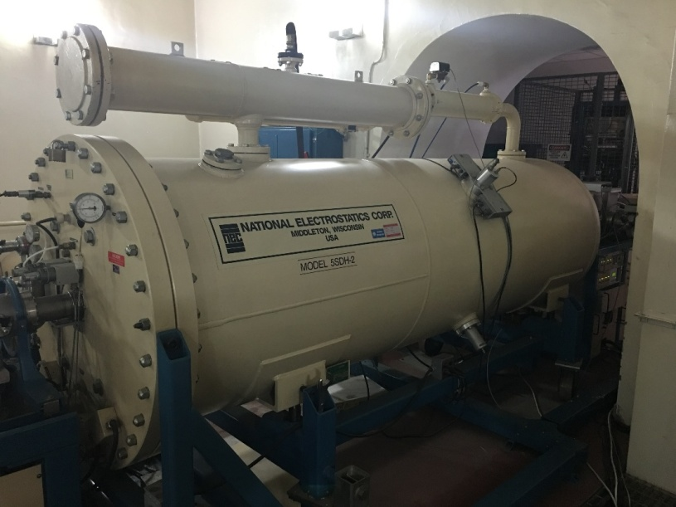
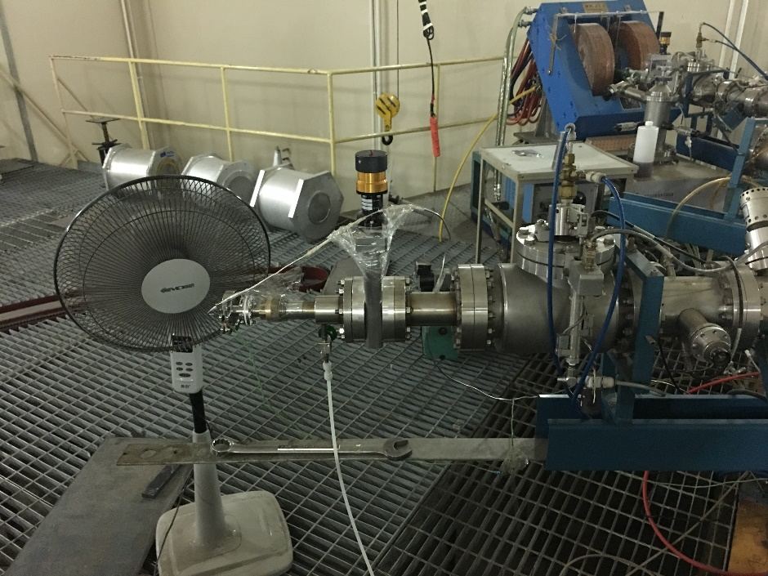
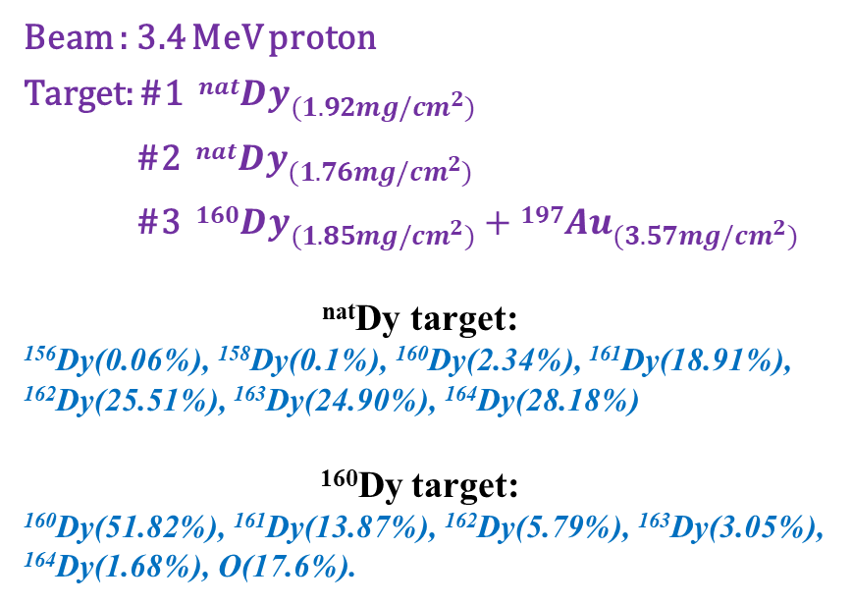
Experimental setup @ CIAE
Beam : 3.4 MeV proton
Target: #1 $nat{Dy}_{(1.92mg/cm^{2})}$
#2 $nat{Dy}_{(1.76mg/cm^{2})}$
#3 $160{Dy}_{(1.85mg/cm^{2})}+197{Au}_{(3.57mg/cm^{2})}$
^{nat}Dy target:
¹⁵⁶Dy(0.06%), ¹⁵⁸Dy(0.1%), ¹⁶⁰Dy(2.34%), ¹⁶¹Dy(18.91%), ¹⁶²Dy(25.51%), ¹⁶³Dy(24.90%), ¹⁶⁴Dy(28.18%)
¹⁶⁰Dy target:
¹⁶⁰Dy(51.82%), ¹⁶¹Dy(13.87%), ¹⁶²Dy(5.79%), ¹⁶³Dy(3.05%), ¹⁶⁴Dy(1.68%), O(17.6%).
Target | Beam time | Waiting time | Measured time
#1 | 41min 41s | 10min 18s | 55min 11s
#2 | 40min 36s | 7min 20s | 1h 05min 13s
#3 | 37min 54s | 12min 16s | 15h 21min 37s
Notes:
改表格

Slide 11
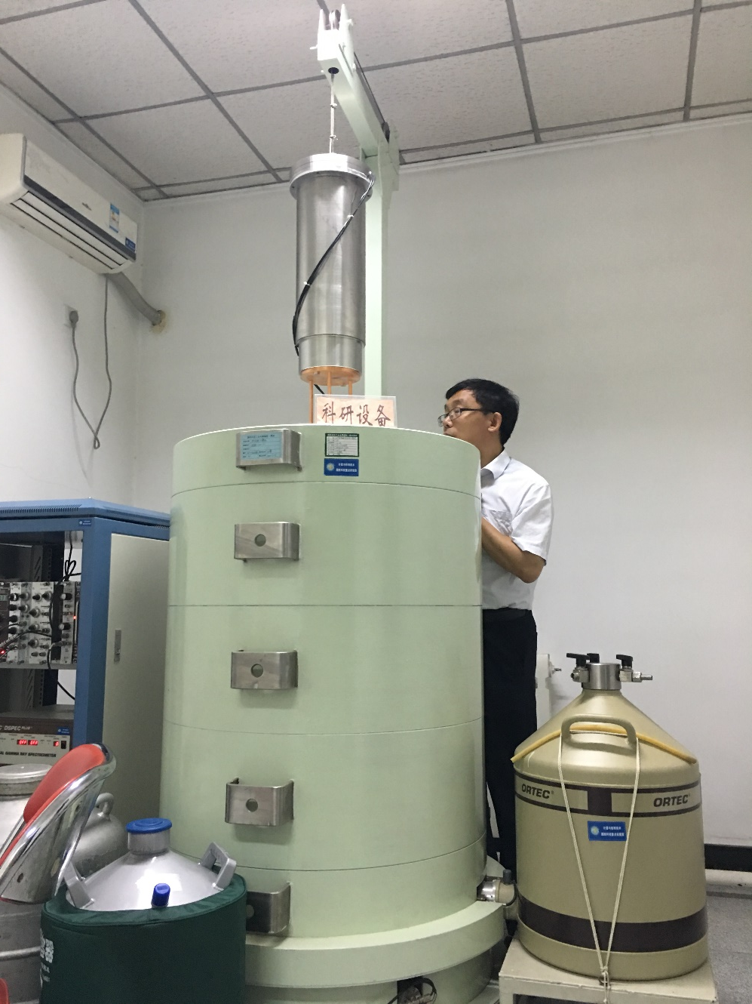
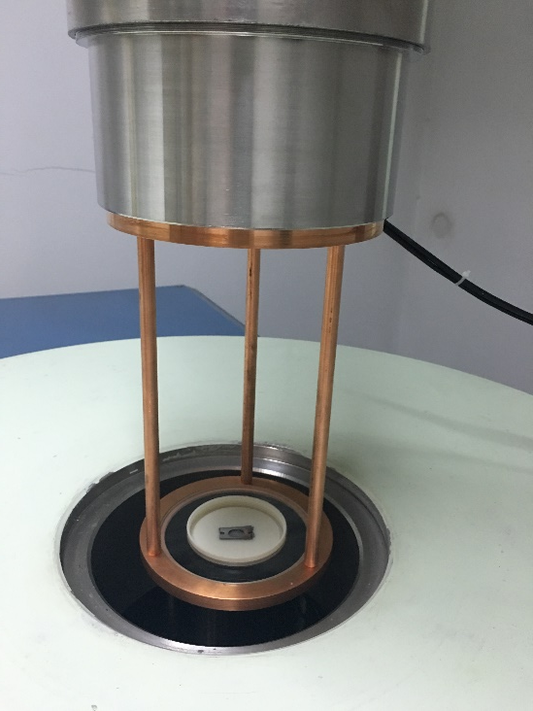
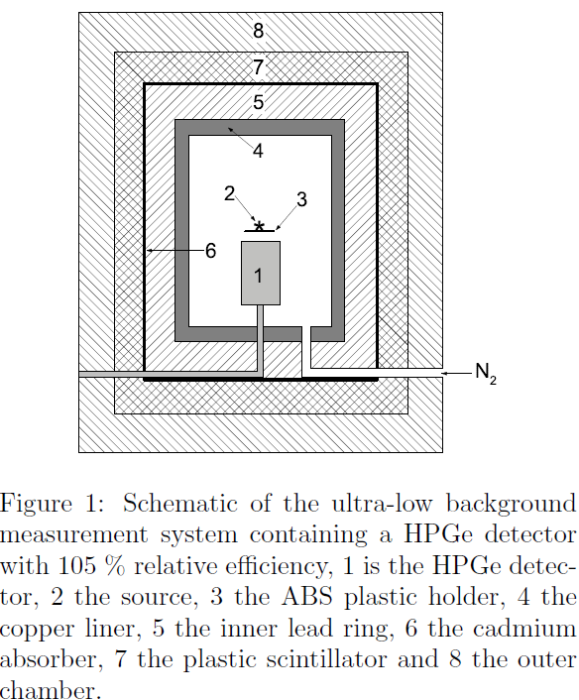
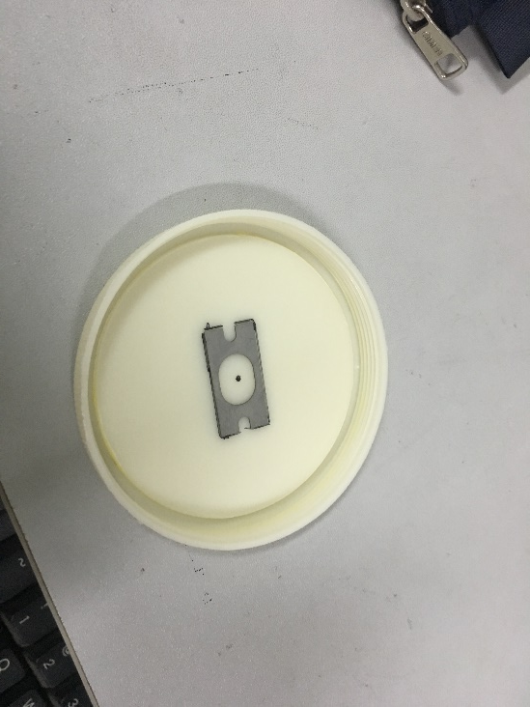
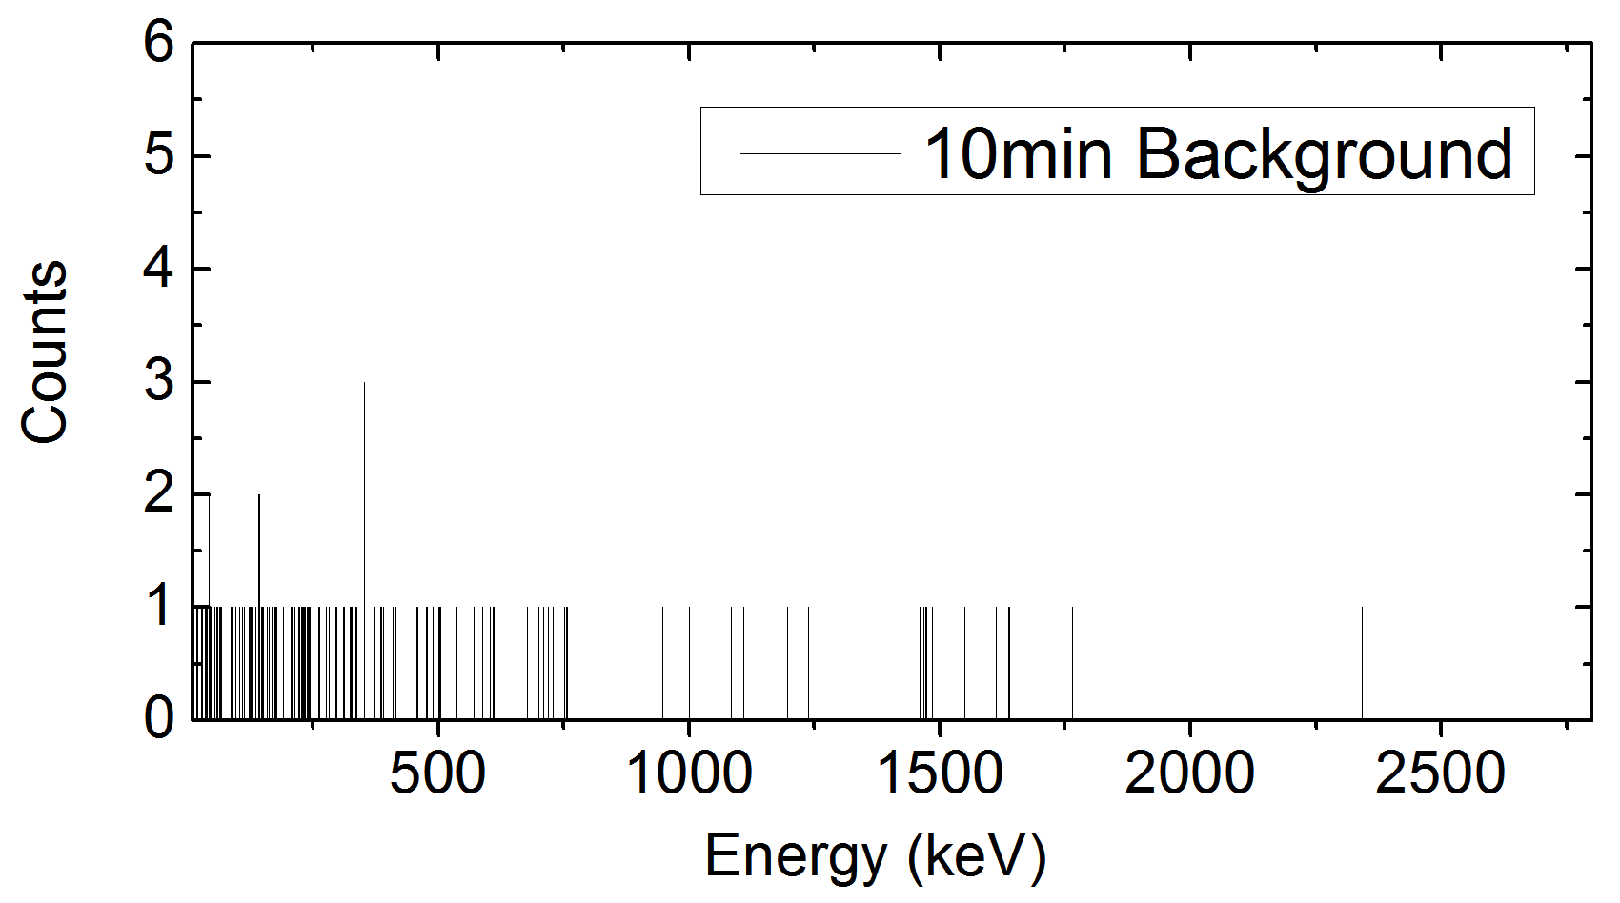
Experimental setup @ CIAE
HPGe detector with 105% relative efficiency, Source is 22.1 mm away from the detector surface.
Background: 0.1/s

Slide 12
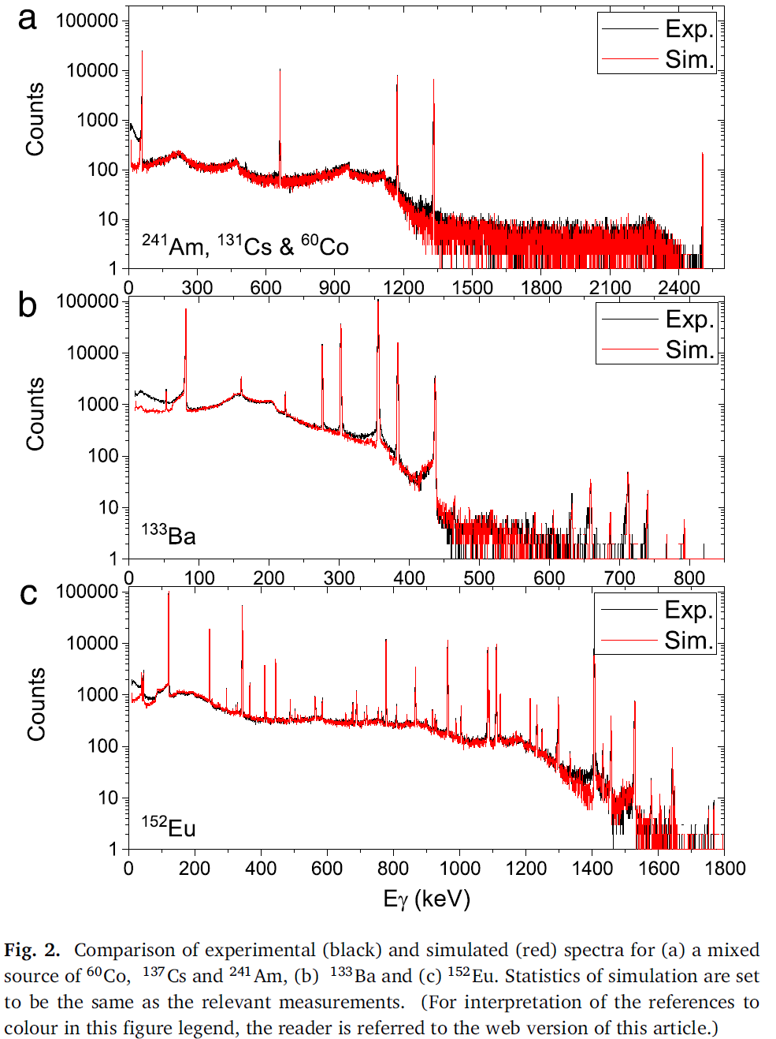
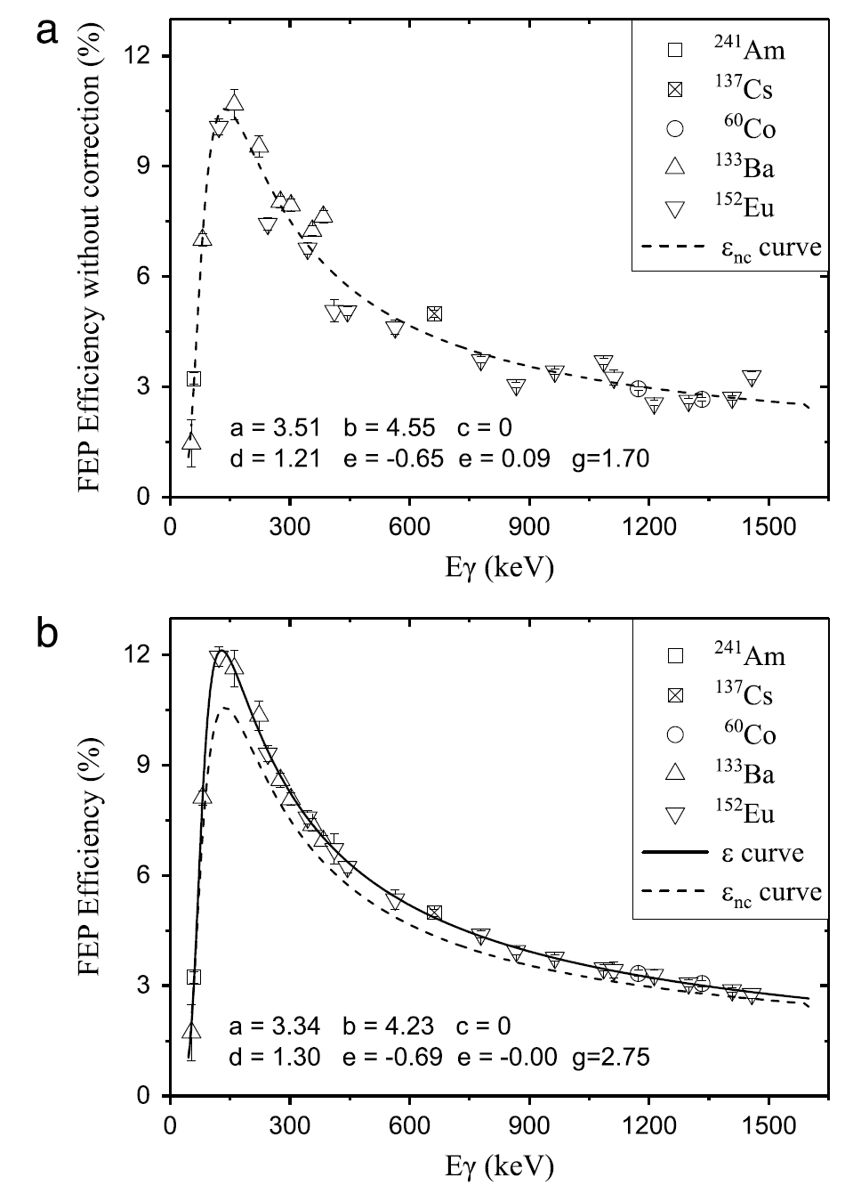
Correction for summing coincidence with Geant4
L.-C. He et al., Nucl. Instrum. Methods Phys. Res. A 880 (2018) 22–27

Slide 13
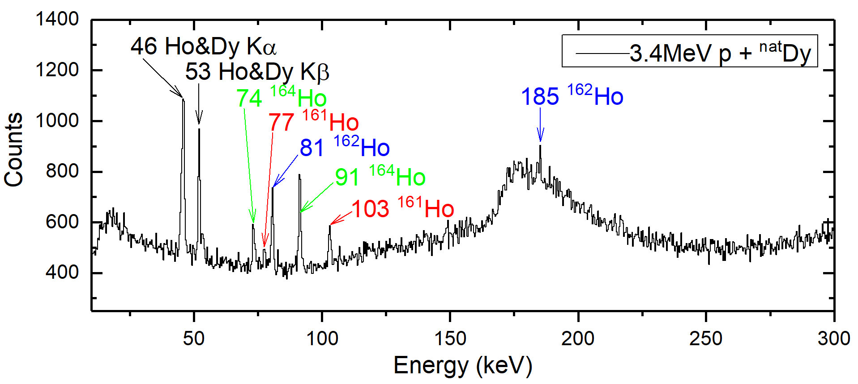
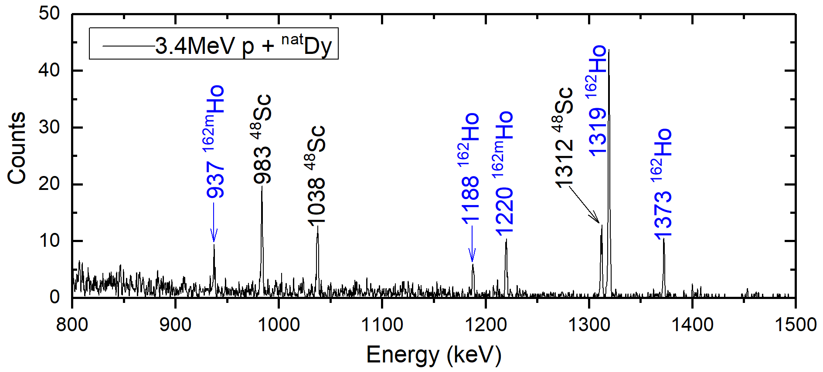
Spectrum: p + ^{nat}Dy
Element abundance：
¹⁵⁶Dy (0.06%)
¹⁵⁸Dy (0.1%)
¹⁶⁰Dy (2.34%)
¹⁶¹Dy (18.91%)
¹⁶²Dy (25.51%)
¹⁶³Dy (24.90%)
¹⁶⁴Dy (28.18%)
Lifetime of production：
¹⁶¹Ho 2.48 (5) h
^{161m}Ho 6.76 (7) s
¹⁶²Ho 15.0 (10) m
^{162m}Ho 67.0 (7) m
¹⁶³Ho 4570 (25) y
^{163m}Ho 1.09 (3) s
¹⁶⁴Ho 29 (1) m
^{164m}Ho 37.5 (15) m

Slide 14
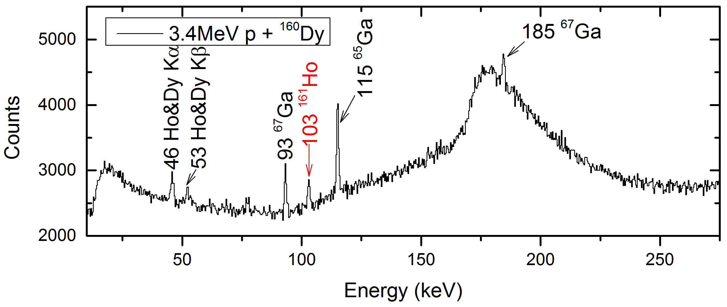
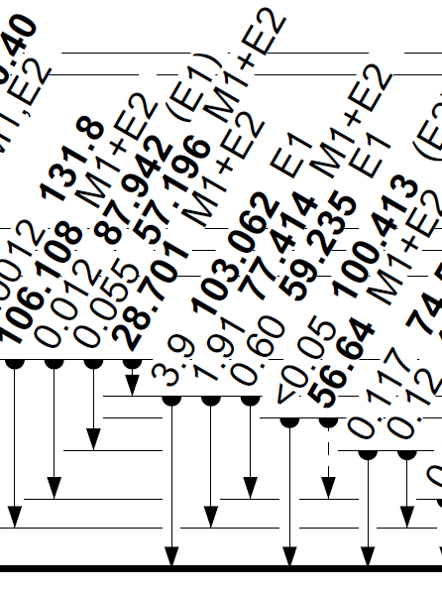
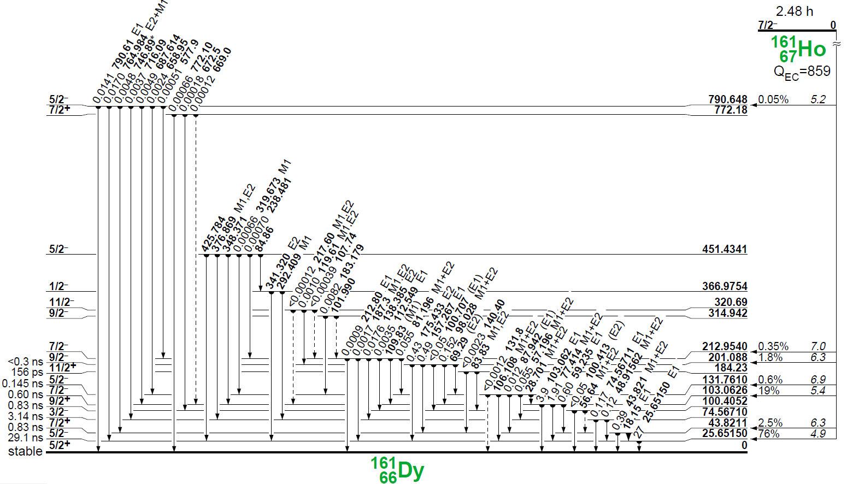
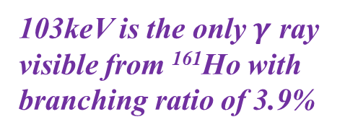
Spectrum: p + ¹⁶⁰Dy
103keV is the only $γ$ ray visible from ¹⁶¹Ho with branching ratio of 3.9%
Element abundance：
¹⁶⁰Dy(51.82%), ¹⁶¹Dy(13.87%),
¹⁶²Dy(5.79%), ¹⁶³Dy(3.05%),
¹⁶⁴Dy(1.68%), O(17.6%).

Slide 15
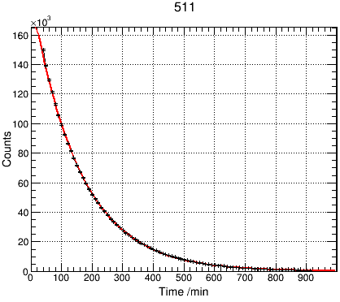
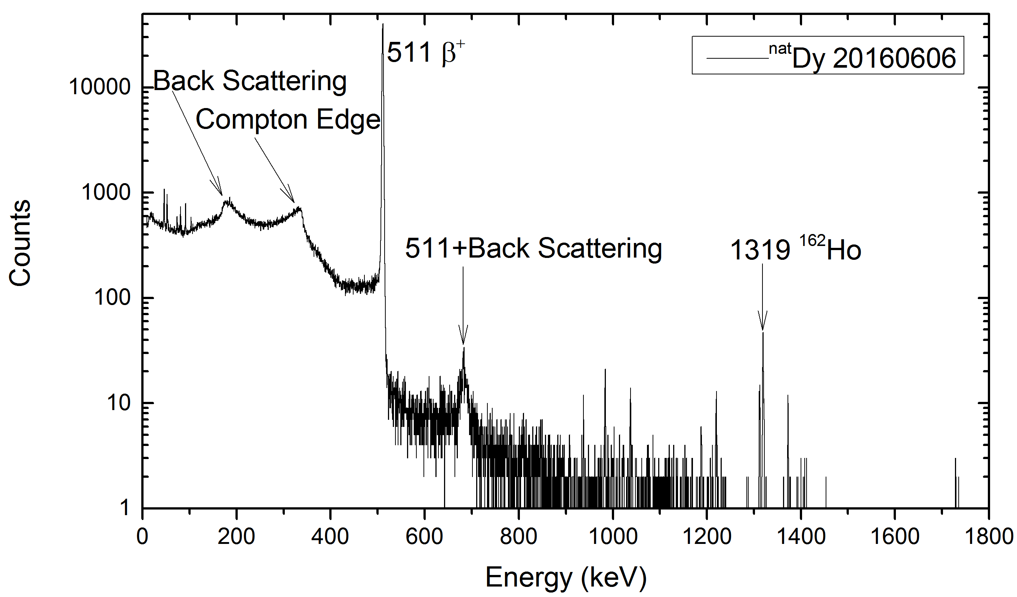
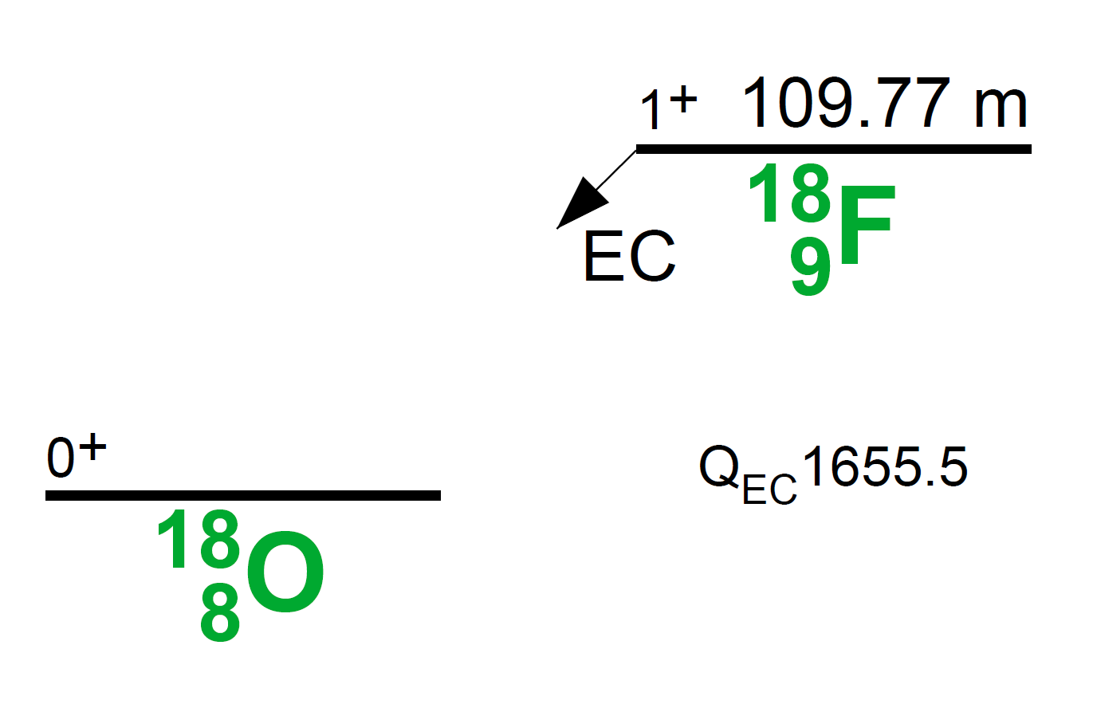
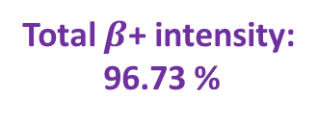
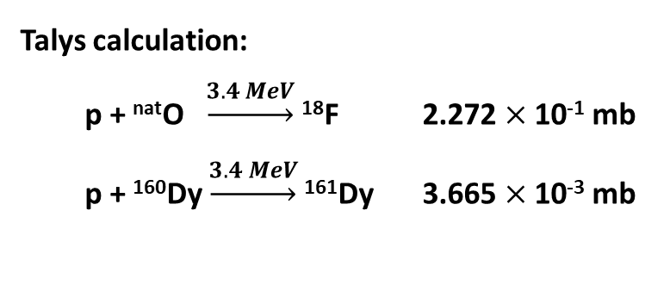
Contaminations in target
p + ^{nat}Dy
Lifetime of 511keV: 109.71 min
Talys calculation:
p + ^{nat}O $\underset{→}{3.4 MeV}$ ¹⁸F 2.272 $×$ 10⁻¹ mb
p + ¹⁶⁰Dy $\underset{→}{3.4 MeV}$ ¹⁶¹Dy 3.665 $×$ 10⁻³ mb
Total $β$+ intensity:
96.73 %

Slide 16
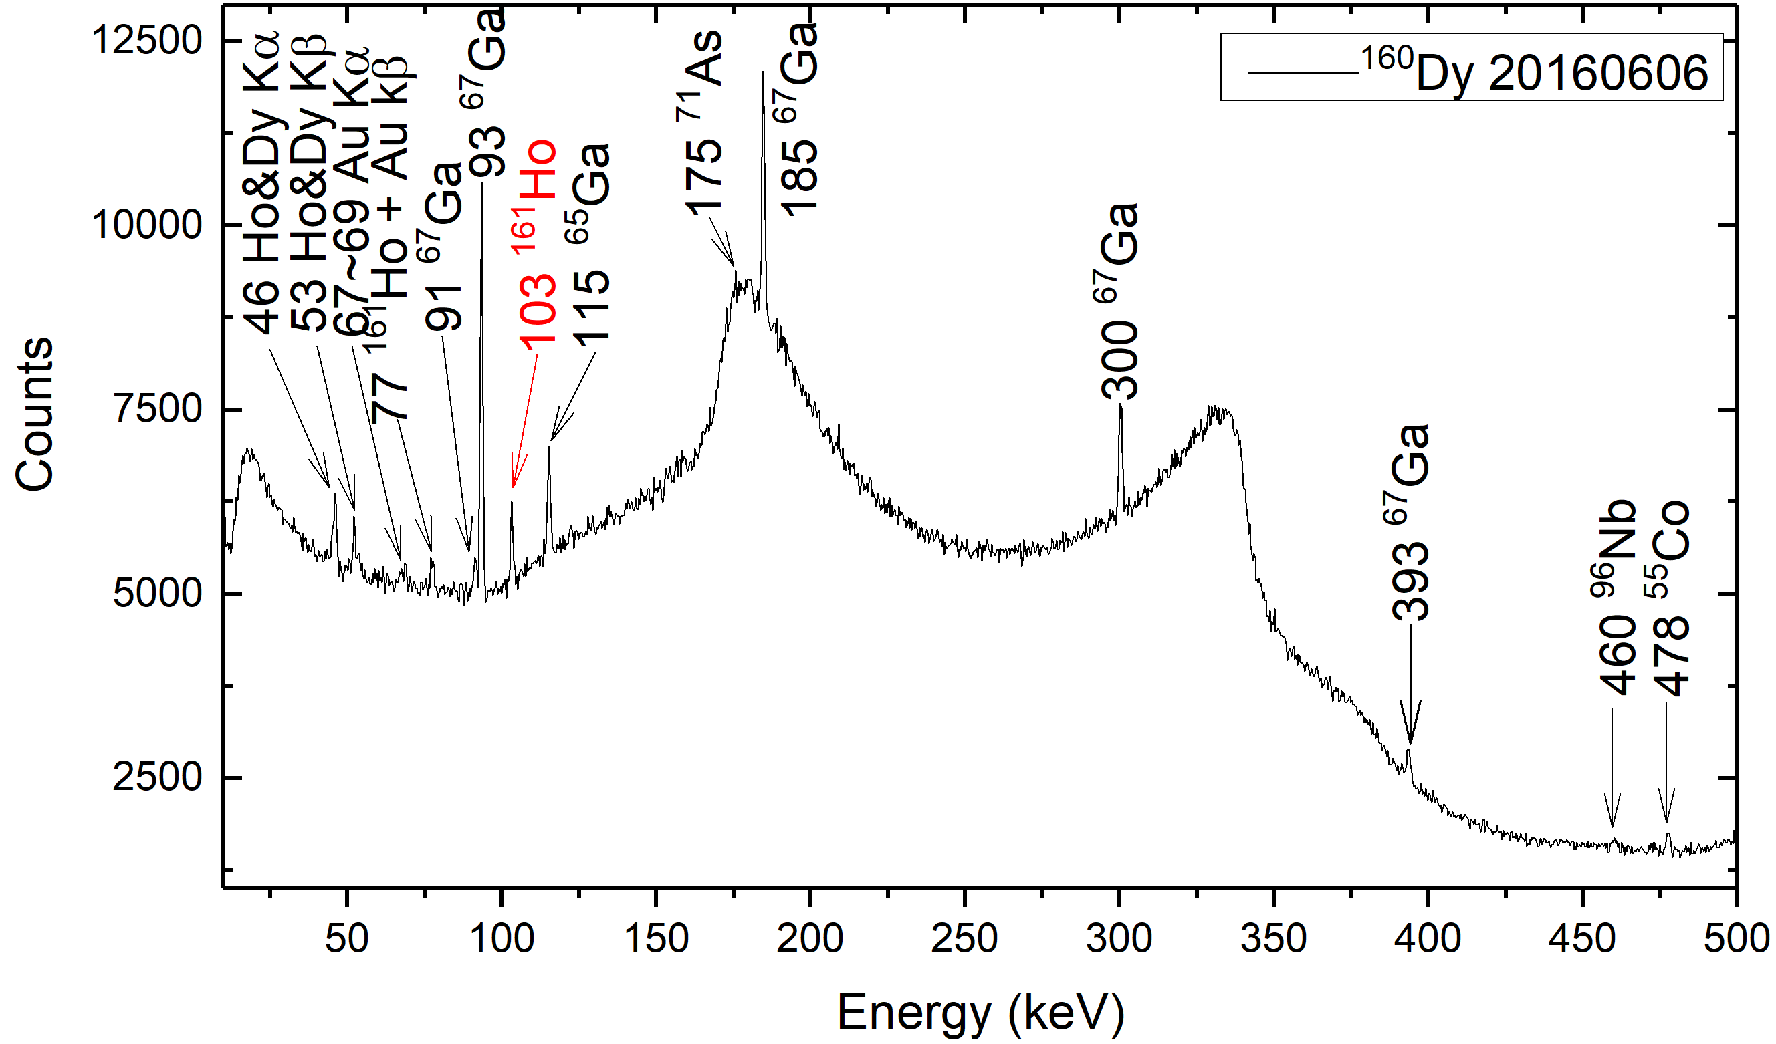
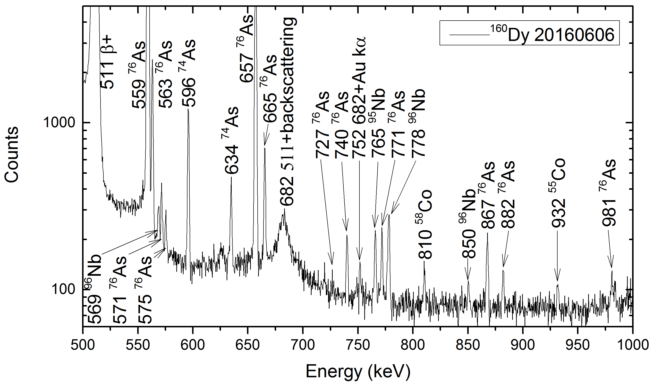
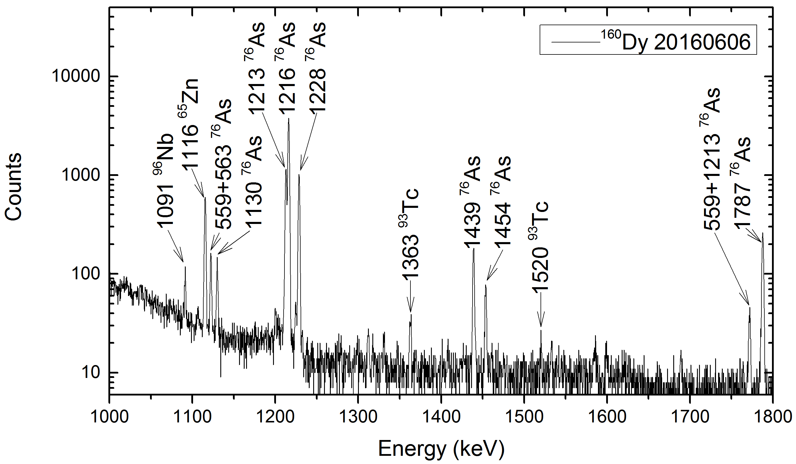
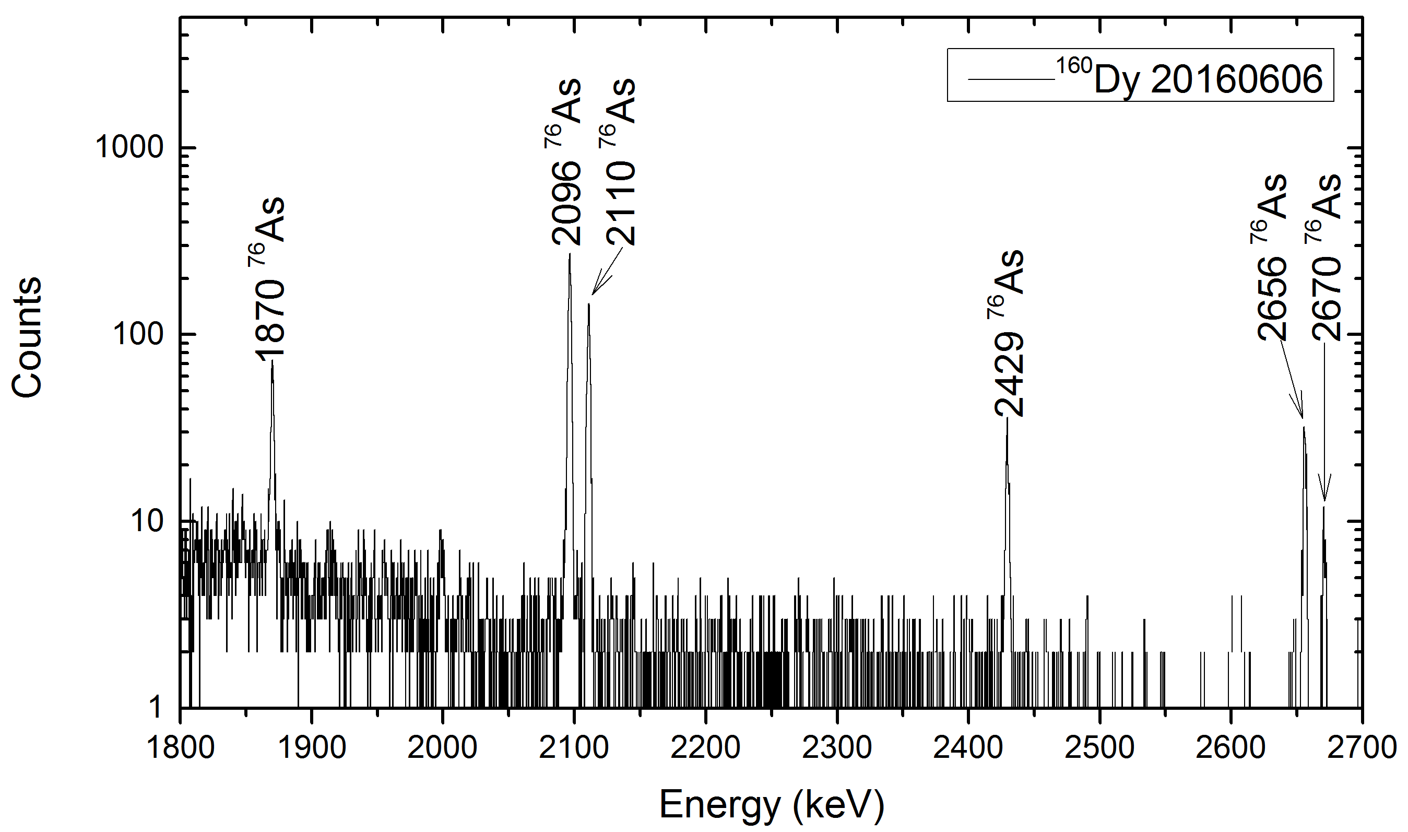
Contaminations in target
p + ¹⁶⁰Dy

Slide 17
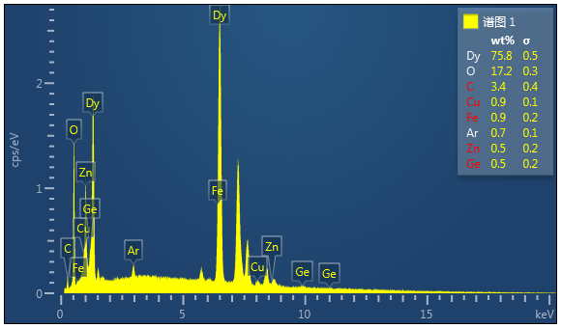
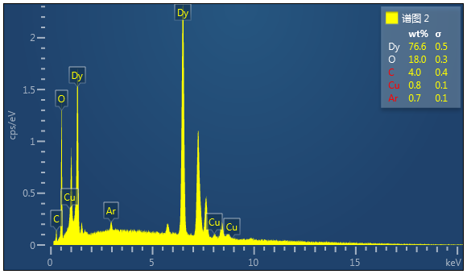
Contaminations in target
Energy-dispersive X-ray spectroscopy
O → ¹⁸F
Ca → ⁴⁸Sc
Fe → ⁵⁵Co
⁵⁸Co
Cu → ⁶⁵Zn
Zn → ⁶⁵Ga
⁷⁰Ga
Ge → ⁷¹As
⁷³As
⁷⁴As
⁷⁶As
Zr → ⁹⁵Nb
⁹⁶Nb
⁹⁷Nb
Mo → ⁹³Tc
⁹⁵Tc
The abundances of contamination elements are < 1% except O.

Slide 18
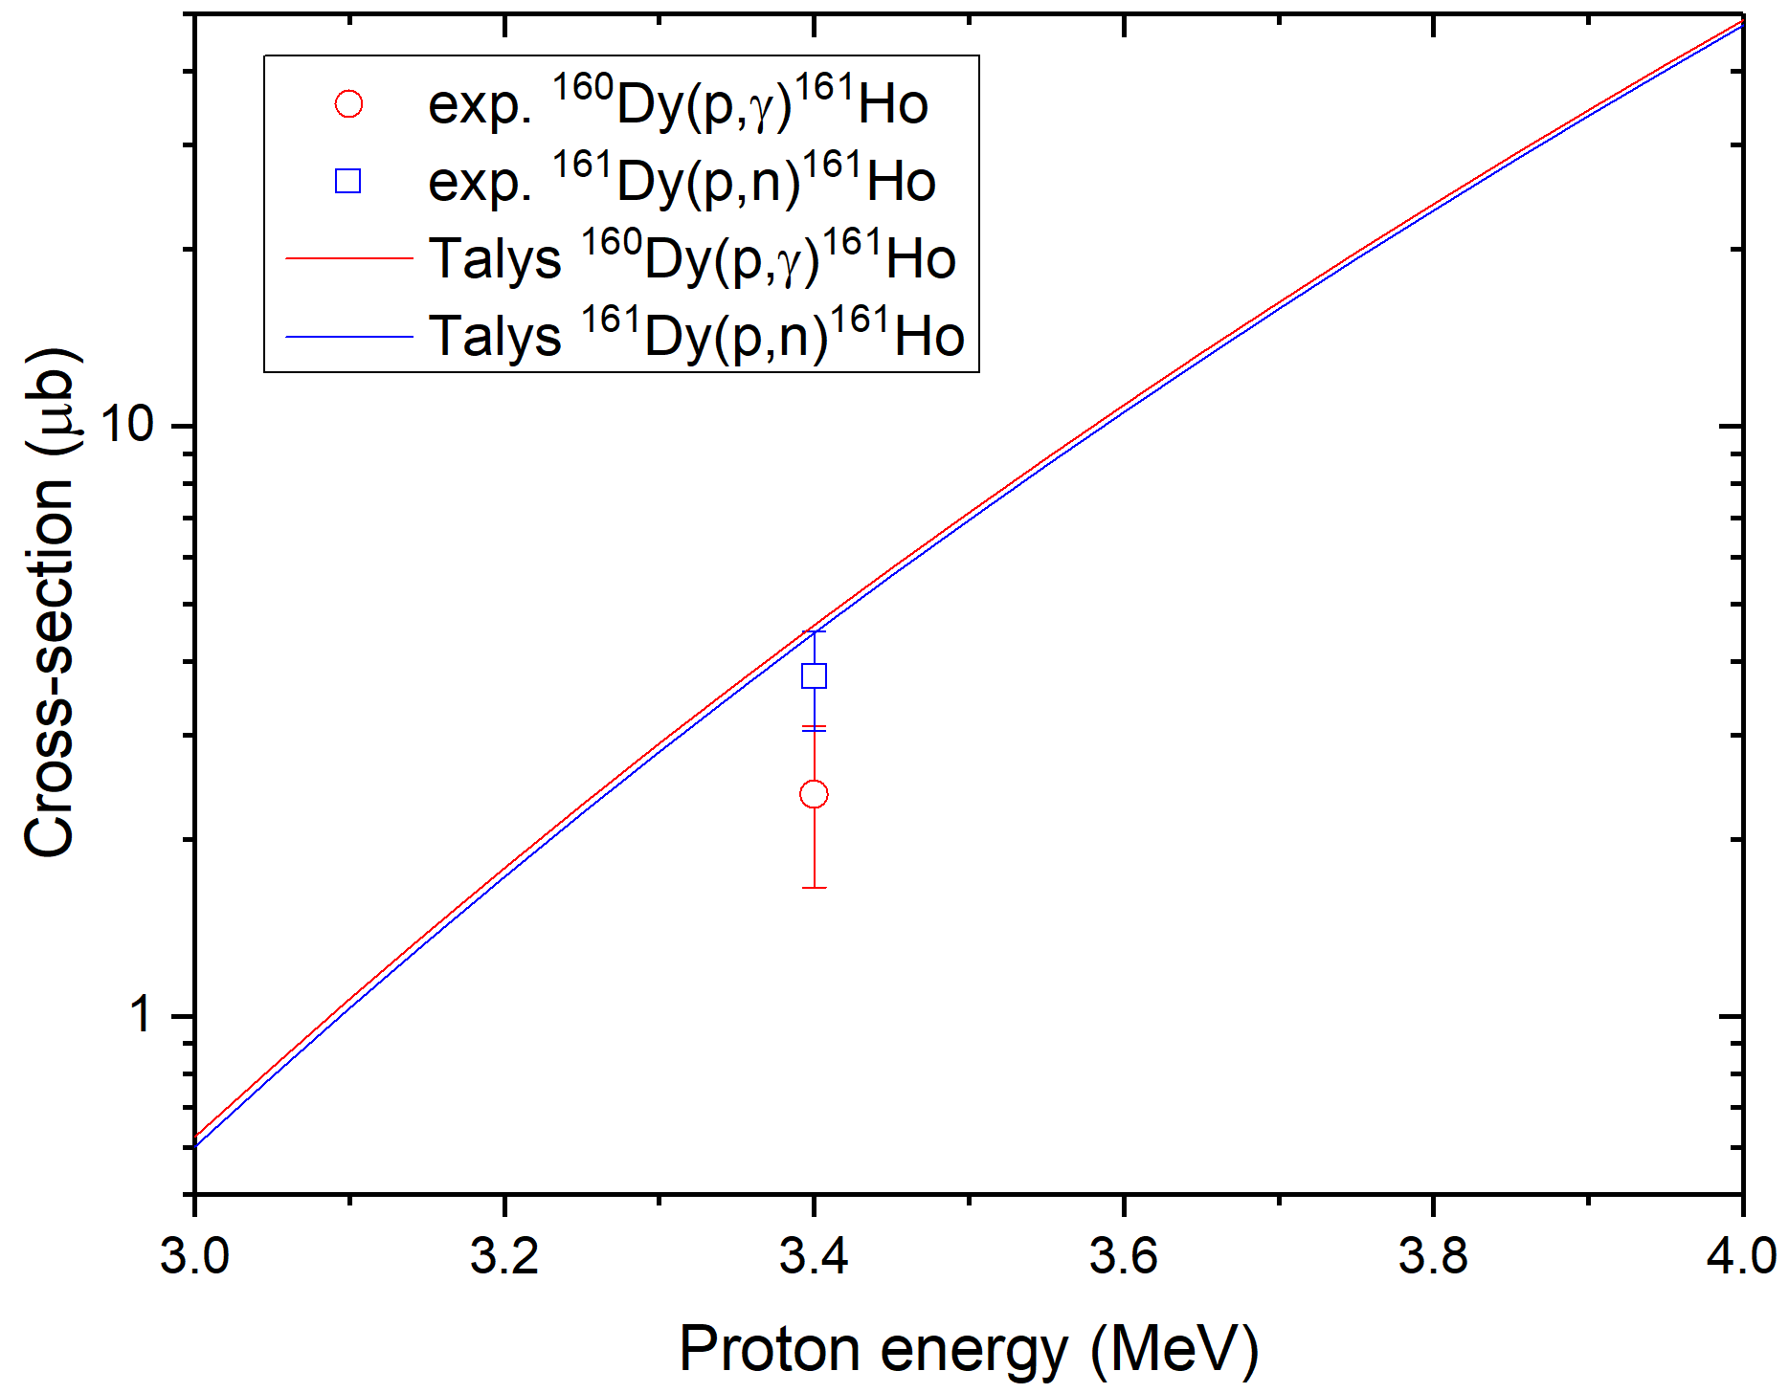




Preliminary result
Present work
N. Özkan, et al., Phys. Rev. C 96, 045805 (2017)
$$162Er\left(p,n\right)162Tm$$
$$162Er\left(p,γ\right)163Tm$$
Preliminary
Prospect: Obtain more experimental data to cover the Gamow window ($4±1$ MeV) for Dy isotopes!

Slide 19
Thanks for your attention

