Slide 1

Beam Optics design for CEPC collider ring
Yiwei Wang, Yuan Zhang, Yuanyuan Wei, Sha Bai, Dou Wang,
Huiping Geng, Chenghui Yu, Jie Gao
IHEP, Beijing
1st workshop on applications of high energy Circular Electron-Positron Collider（CEPC） synchrotron radiation source
6-8 Dec 2017

Slide 2
Outline
Introduction
Optics of Collider ring (linear optics, nonlinearity correction)
  Interaction region
  Arc region
  RF region
  Straight section region
  Whole ring
Summary

Slide 3
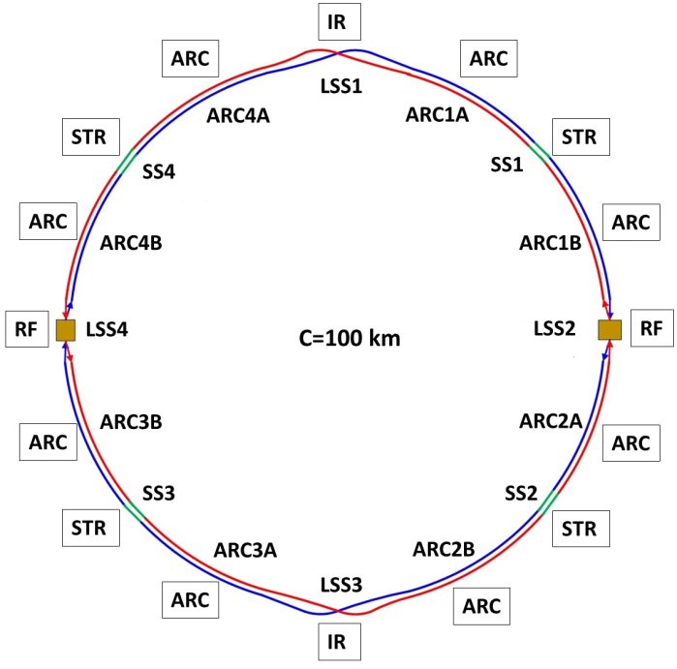
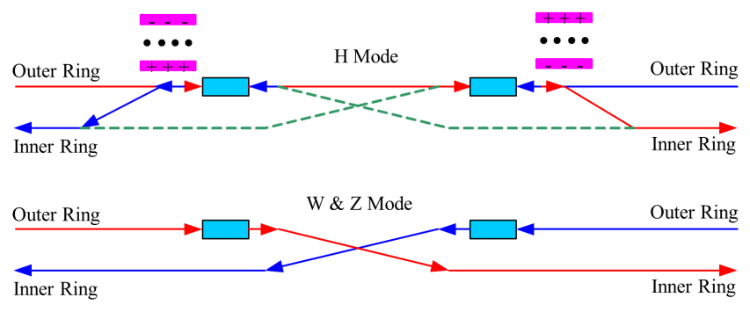
Introduction
The circumference of CEPC collider ring is 100 km.
In the RF region, the RF cavities are shared by two ring for H mode.
Twin-aperture of dipoles and quadrupoles is adopt in the arc region to reduce the their power. The distance between two beams is 0.35m.
Compatible optics for H, W and Z modes
  For the W and Z mode, the optics except RF region is got by scaling down the magnet strength with energy.
  For H mode, all the cavities will be used and bunches will be filled in half ring.
  For W & Z modes, half number of cavities will be used and bunches can be filled in full ring.
Notes:
2 fold symmetry

Slide 4
Parameters of CEPC collider ring
 | Higgs | W | Z
Number of IPs | 2
Energy (GeV) | 120 | 80 | 45.5
Circumference (km) | 100
SR loss/turn (GeV) | 1.68 | 0.33 | 0.035
Half crossing angle (mrad) | 16.5
Piwinski angle | 2.75 | 4.39 | 10.8
N_{e}/bunch (10¹⁰) | 12.9 | 3.6 | 1.6
Bunch number | 286 | 5220 | 10900
Beam current (mA) | 17.7 | 90.3 | 83.8
SR power /beam (MW) | 30 | 30 | 2.9
Bending radius (km) | 10.9
Momentum compaction (10⁻⁵) | 1.14
β_{IP} x/y (m) | 0.36/0.002
Emittance x/y (nm) | 1.21/0.0036 | 0.54/0.0018 | 0.17/0.0029
Transverse σ_{IP} (um) | 20.9/0.086 | 13.9/0.060 | 7.91/0.076
ξ_{x}/ξ_{y}/IP | 0.024/0.094 | 0.009/0.055 | 0.005/0.0165
RF Phase (degree) | 128 | 134.4 | 138.6
V_{RF} (GV) | 2.14 | 0.465 | 0.053
f _{RF} (MHz) (harmonic) | 650
Nature bunch length σ_{z} (mm) | 2.72 | 2.98 | 3.67
Bunch length σ_{z} (mm) | 3.48 | 3.7 | 5.18
HOM power/cavity (kw) | 0.46 (2cell) | 0.32(2cell) | 0.11(2cell)
Energy spread (%) | 0.098 | 0.066 | 0.037
Energy acceptance requirement (%) | 1.21
Energy acceptance by RF (%) | 2.06 | 1.48 | 0.75
Photon number due to beamstrahlung | 0.25 | 0.11 | 0.08
Lifetime due to beamstrahlung (hour) | 1.0
F (hour glass) | 0.93 | 0.96 | 0.986
L_{max}/IP (10³⁴cm⁻²s⁻¹) | 2.0 | 4.1 | 1.0
D. Wang
Notes:
Time structure

Slide 5
Parameters of CEPC collider ring
D. Wang
20171127
 | Higgs | W | Z
Number of IPs | 2
Energy (GeV) | 120 | 80 | 45.5
Circumference (km) | 100
SR loss/turn (GeV) | 1.68 | 0.33 | 0.035
Half crossing angle (mrad) | 16.5
Piwinski angle | 2.58 | 4.39 | 12.8 | 9.03
N_{e}/bunch (10¹⁰) | 15 | 3.6 | 4.8
Bunch number | 248 | 5220 | 8334
Beam current (mA) | 17.9 | 90.3 | 192.3
SR power /beam (MW) | 30 | 30 | 6.7
Bending radius (km) | 10.9
Momentum compaction (10⁻⁵) | 1.14
β_{IP} x/y (m) | 0.36/0.002
Emittance x/y (nm) | 1.21/0.0037 | 0.54/0.0018 | 0.17/0.0029
Transverse σ_{IP} (um) | 20.9/0.086 | 13.9/0.060 | 7.91/0.076
ξ_{x}/ξ_{y}/IP | 0.031/0.116 | 0.009/0.055 | 0.0084/0.062 | 0.017/0.088
V_{RF} (GV) | 2.14 | 0.465 | 0.053 | 0.1
f _{RF} (MHz) (harmonic) | 650 (217500)
Nature bunch length σ_{z} (mm) | 2.72 | 2.98 | 3.67 | 2.38
Bunch length σ_{z} (mm) | 3.26 | 3.7 | 6.16 | 4.33
HOM power/cavity (kw) | 0.56 (2cell) | 0.32(2cell) | 0.7(2cell)
Energy spread (%) | 0.098 | 0.066 | 0.037
Energy acceptance requirement (%) | 1.52
Energy acceptance by RF (%) | 2.06 | 1.48 | 0.75 | 1.7
Photon number due to beamstrahlung | 0.29 | 0.11 | 0.25
Lifetime due to beamstrahlung (hour) | 1.0
Lifetime (hour) | 0.33 (20 min) | 3.5 | 7.4
F (hour glass) | 0.93 | 0.96 | 0.986
L_{max}/IP (10³⁴cm⁻²s⁻¹) | 2.49 | 4.1 | 5.83 | 8.26
Notes:
Time structure

Slide 6
Time structure
Top-up injection
X. Cui, T. Bian
 | Higgs | W | Z
Injection Energy (GeV) | 120 | 80 | 45.5
Bunch number | 286 | 5220 | 8334
Bunch distance (ns) | 583 | 64 | 31
Ne/bunch (10^10) | 12.9 | 3.6 | 1.6
Beam current (mA) | 17.7 | 90.3 | 83.8
Number of Injection Cycles | 1 | 5 | 5
Current decay | 3% | 3% | 3%
Ramping Cycle (sec) | 10 | 6 | 2
Filling time (sec) | 27 | 160 | 272
Collider Lifetime (hour) | 0.33 | 3.5 | 7.4
Injection frequency (sec) | 37 | 383 | 811
Transfer efficiency is 92% if the emmitance of LINAC is 300nm while beam lifetime is 14min.

Slide 7
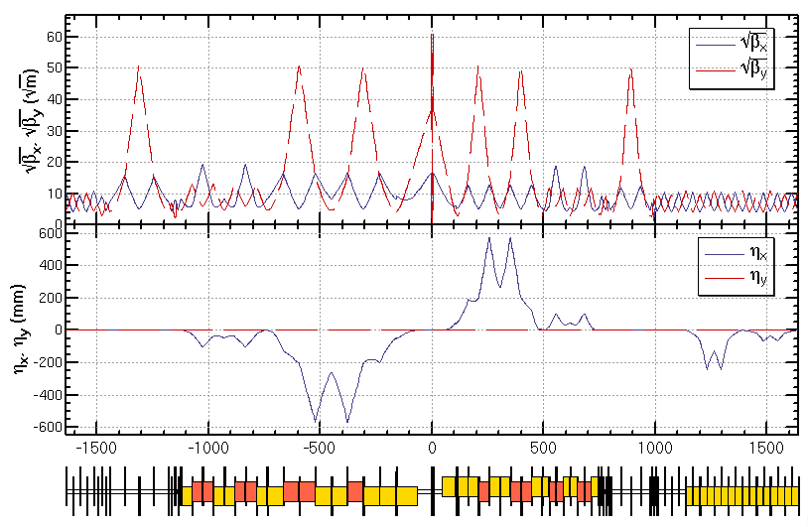
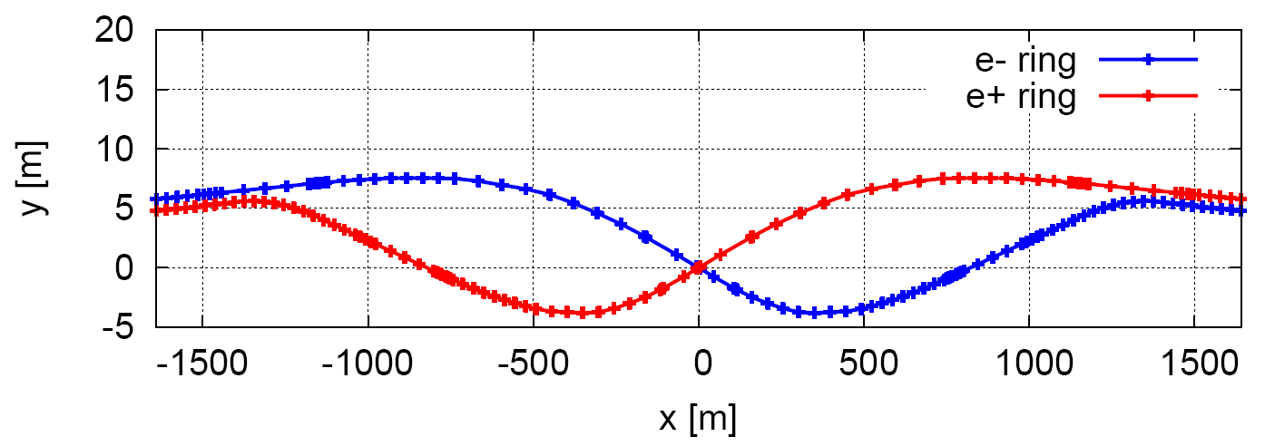
Linear optics of Interaction region
Provide local chromaticity correction of both plane
L*=2.2m, θc=33mrad, GQD0=151T/m, GQF1=102T/m
IP upstream of IR: Ec < 100 keV within 400m, last bend Ec = 47 keV
IP downstream of IR: Ec < 300 keV within 250m, last bend Ec = 95 keV
The vertical emittance growth due to solenoid coupling is less than 4%.
Relaxed optics for injection can be re-matched easily as the modular design.
CW
CCX
CCY
FT
L*= 2.2m
βx*= 0.36mm
βy*= 2mm
GQD0≅-151T/m
GQF1≅102T/m
LQD0=1.73m
LQF1=1.48m
max deviation between two beamlines 9.7m
Notes:
New IR bends

Slide 8
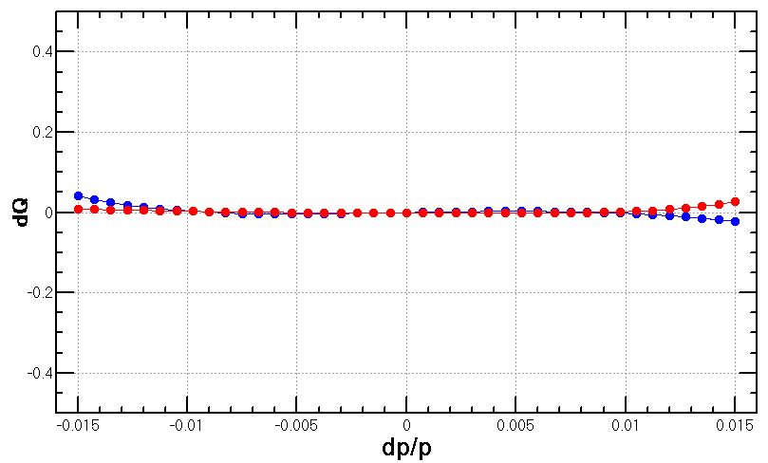
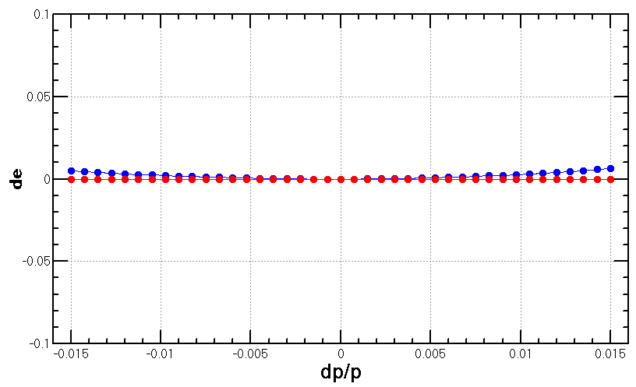
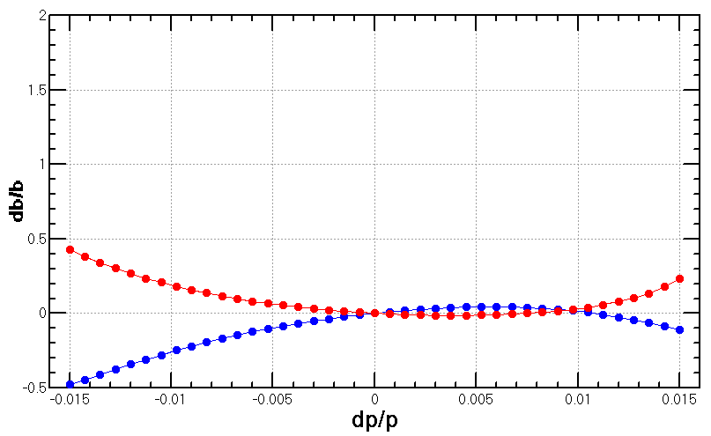
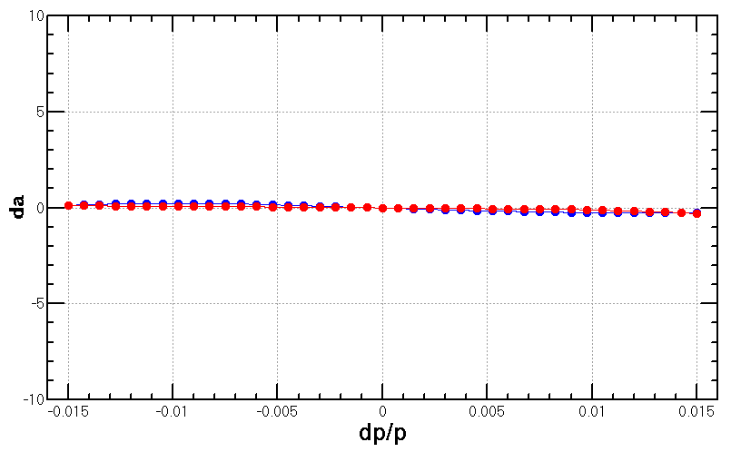
Nonlinearity correction of Interaction region
  Local chromaticity correction with sextupoles pairs separated by –I transportation
  up to 3rd order chromaticity corrected with main sextupoles, phase tuning and additional sextupole pair 2,3)
Ref: 2) Brinkmann 3) Y. Cai

Slide 9
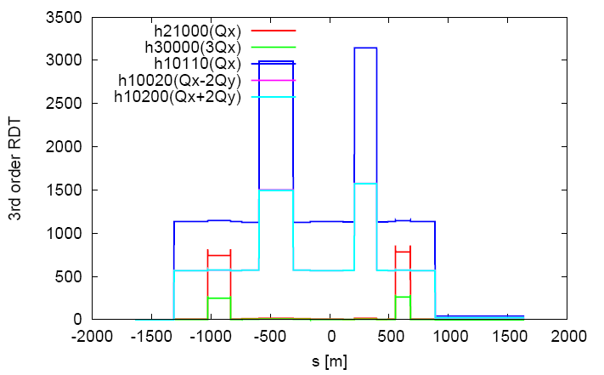
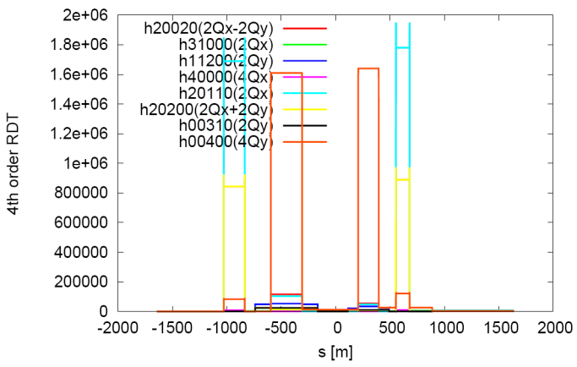
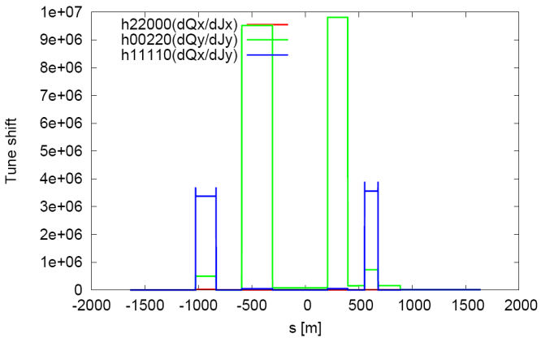
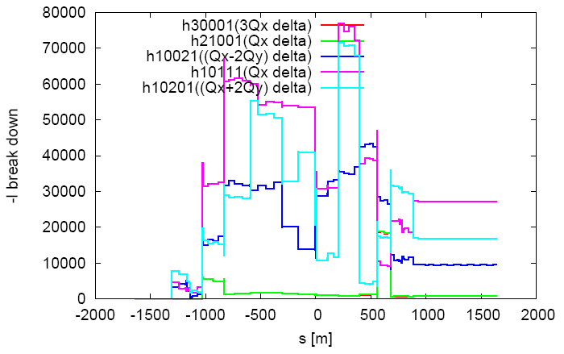
Nonlinearity correction of Interaction region
  Local chromaticity correction with sextupoles pairs separated by –I transportation
  all 3rd and 4th RDT due to sextupoles almost cancelled 1)
  tune shift dQ(Jx, Jy) due to finite length of main sextupoles corrected with additional weak sextupoles 3,4)
  Break down of -I due to energy deviation corrected with ARC sextupoles
    could be further optimized with odd dispersion scheme 5),
    Brinkmann sextupoles 2) or pair of decapoles 3)
Ref:
1) K. Brown
2) Brinkmann
3) Y. Cai
4) Anton
5) K. Oide
6) J. Bengttson’s

Slide 10
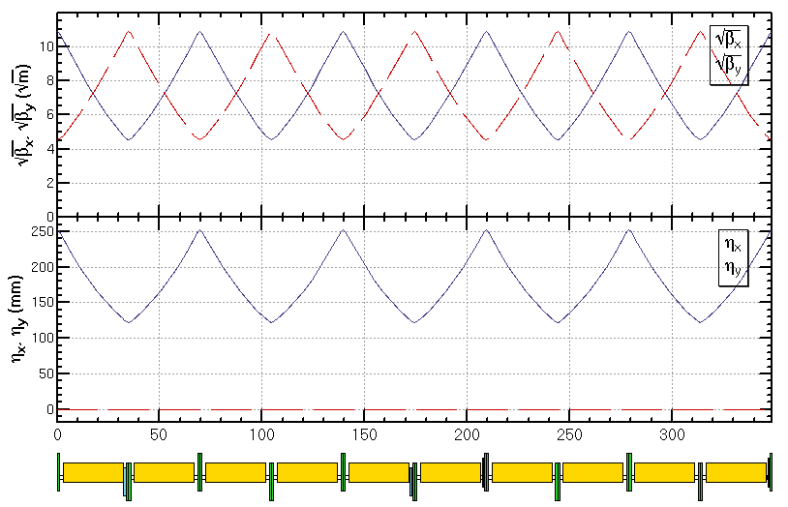
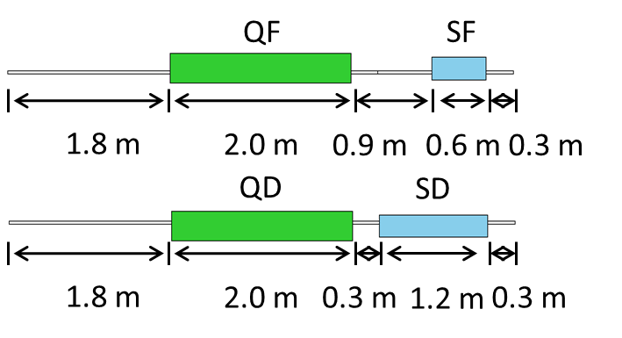
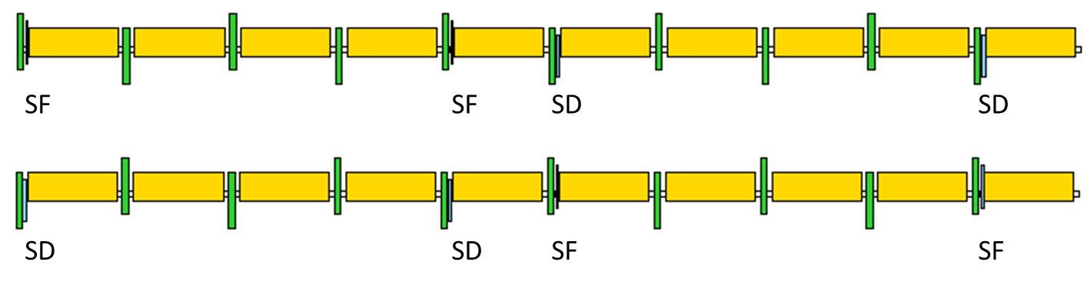
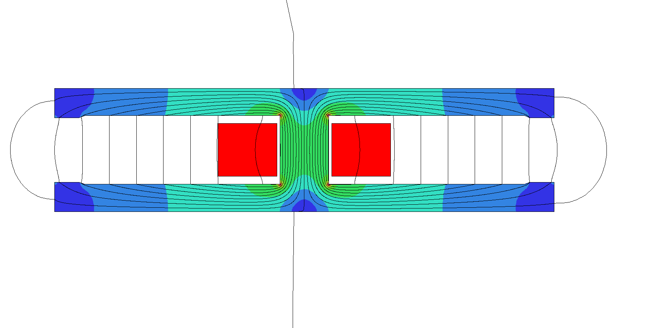
Linear optics design of ARC region
  FODO cell, 90°/90°, non-interleaved sextupole scheme, period =5cells
-I
-I
SD
SD
SF
SF
Twin-aperture of dipoles and quadrupoles is adopt in the arc region to reduce the their power. The distance between two beams is 0.35m.
Ec=351keV, Power=435 W/m
Notes:
Should be 5 cells

Slide 11
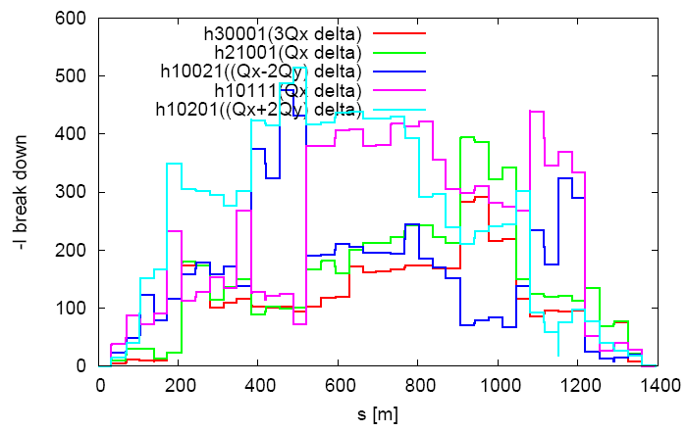
Nonlinearity correction of ARC region
  FODO cell, 90°/90°, non-interleaved sextupole scheme, period =5 cells
  tune shift dQ(Jx, Jy) is very small
    DA on momentum: large
  Chromaticity dQ(δ) need to be corrected with many families
    DA off momentum: with many families to correct dQ(δ)
  With 2 families of sextupoles in each 4 periods i.e. 20 cells
    all 3rd and 4th resonance driving terms (RDT) due to sextupoles cancelled, except small 4Qx, 2Qx+2Qy, 4Qy, 2Qx-2Qy
    break down of -I due to energy deviation cancelled
    thus cells numbers equal to 20*N in each ARC region
Notes:
Should be 5 cells

Slide 12
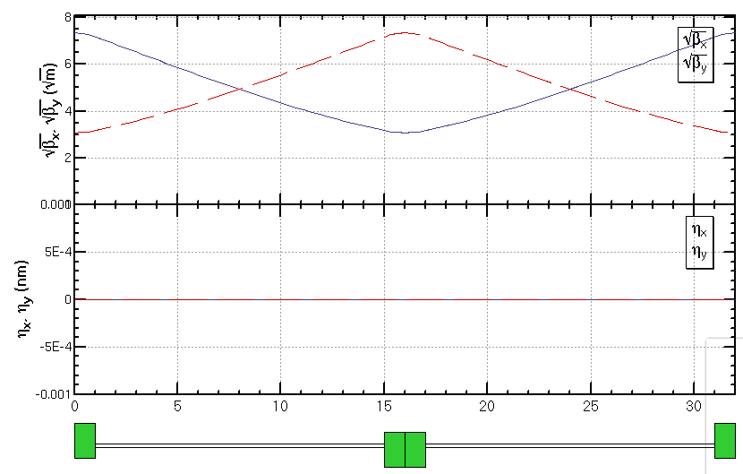
FODO cell for cryo-module
336 / 6 / 2RF stations / 2 sections / 2= 7 cells in each section
get a smallest average beta function to reduce the multi-bunch instability caused by RF cavities
  90/90 degree phase advance
  as short as possible distance between quadrupoles, but should be larger than a module length (12m)
90/90 deg
Half cell: 14m+2m
βmax: 53.8 m
βmin: 9.5 m
cryo-module
quadrupole

Slide 13
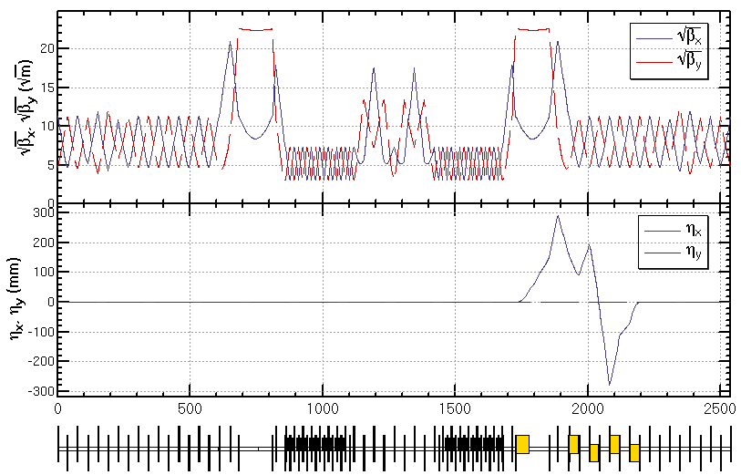
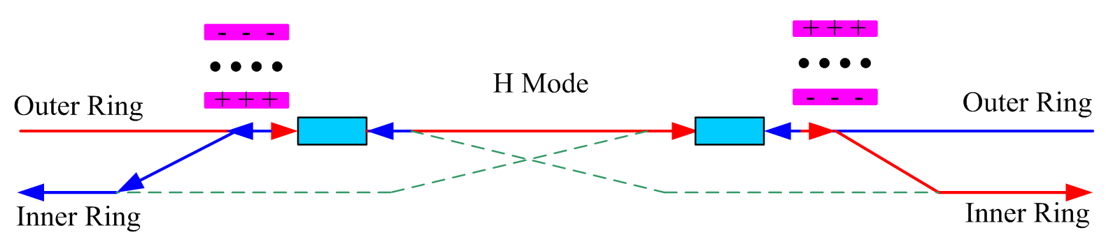
Optics design of RF region
Common RF cavities for e- and e+ ring (Higgs)
An electrostatic separator combined with a dipole magnet to avoid bending of incoming beam(ref: K. Oide, ICHEP16)
RF region divided into two sections for bypassing half numbers of cavities in Z mode
Phase tuning
Phase tuning
common RF cavities
combined magnet
Esep=1.8 MV/m
Lsep=50m
Ldrift=75m
Δx=10cm at entrance of quad

Slide 14
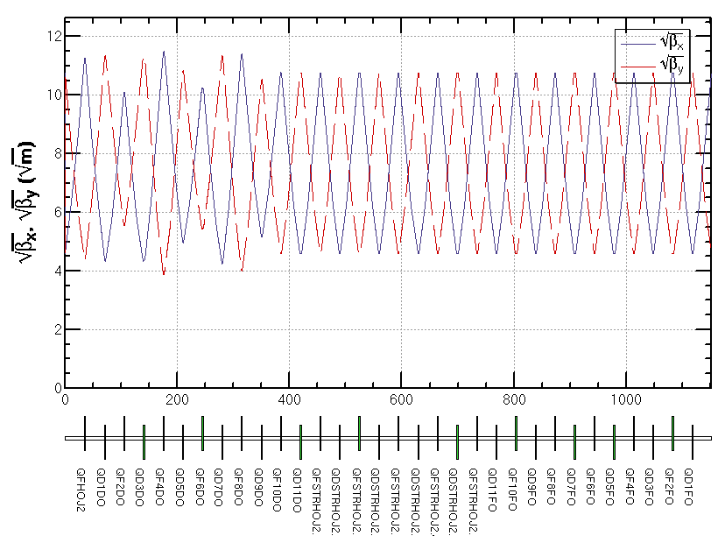
Optics design of Straight section region
The function of the straight section is phase advance tuning and injection.
  Independent magnets for two rings
  0.3m between two quadrupoles of two rings allows a larger size of quadrupoles
Phase tuning
Injection
Phase tuning

Slide 15
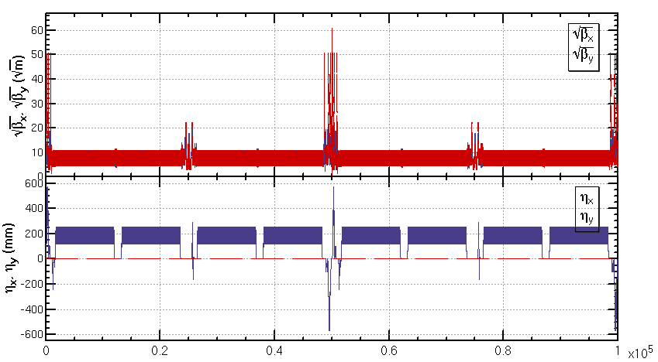
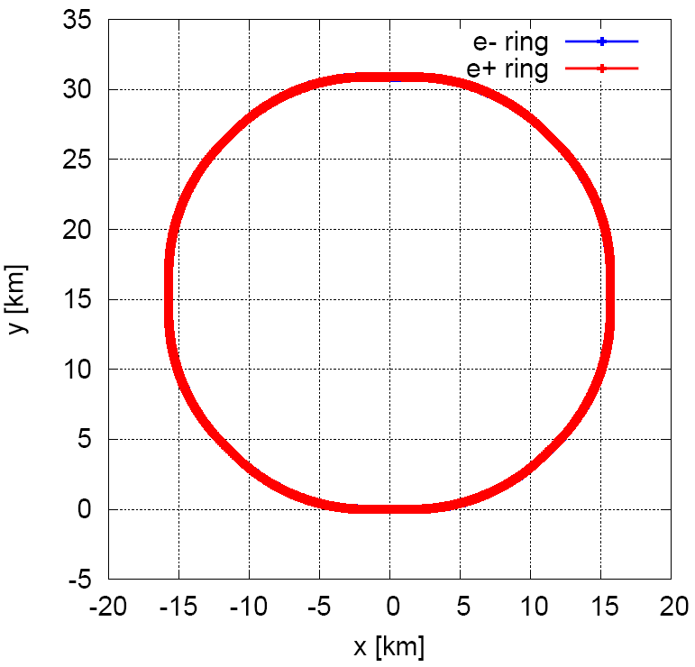
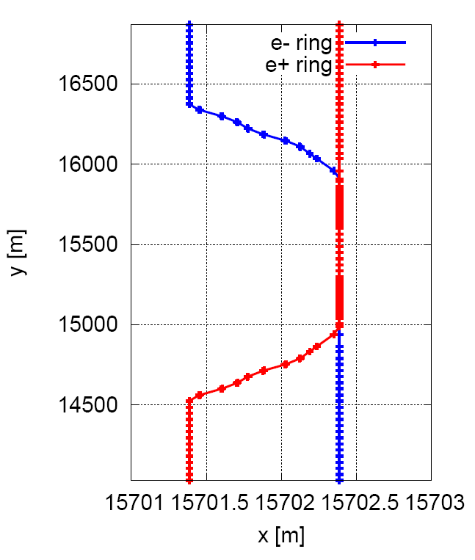
Linear optics of the collider ring
  An optics fulfilling requirements of the parameters list, geometry, photon background and key hardware.

Slide 16
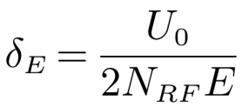
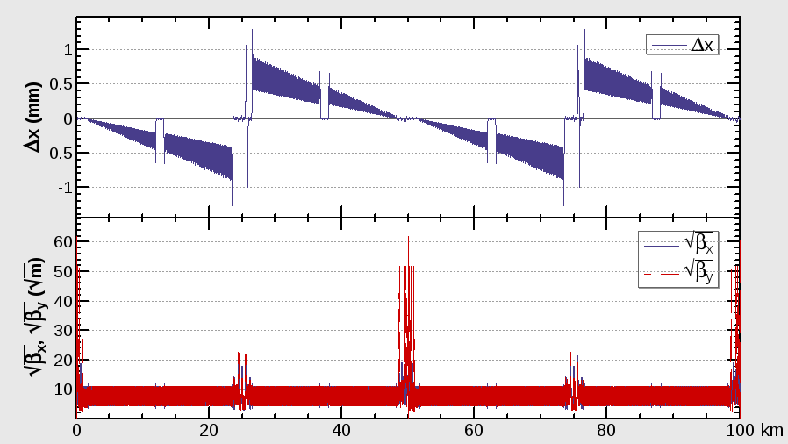
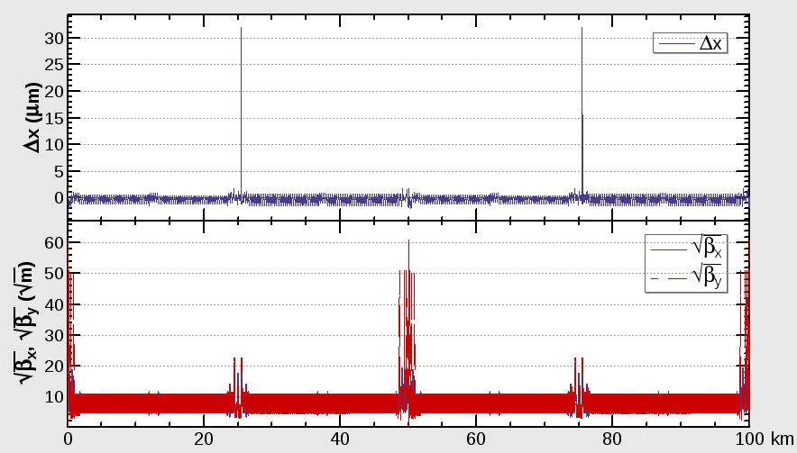
Sawtooth orbit correction
With only two RF stations, the sawtooth orbit in CEPC collider ring around 1mm for H and becomes 1um after tapering the magnet strength with beam energy.
=0.35%

Slide 17
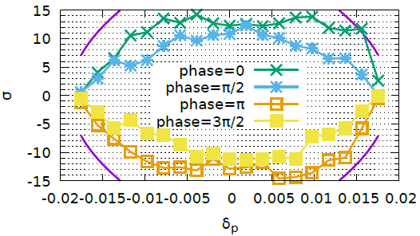
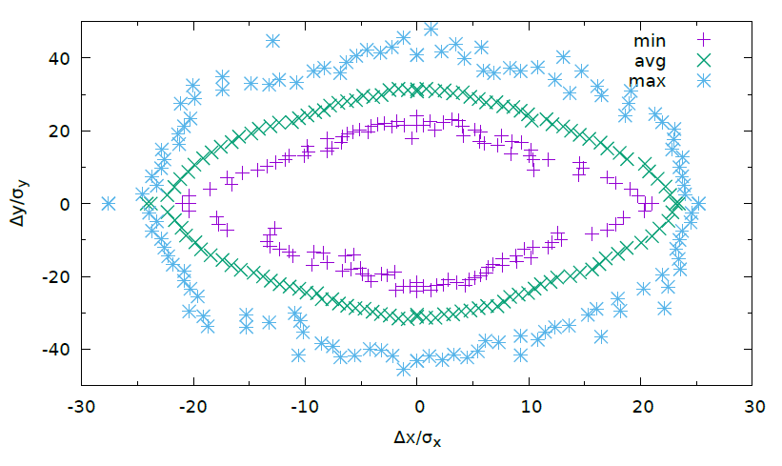


Dynamic aperture optimization
Y. Zhang
SAD is used
200 turns tracked
100 samples
IR sextupoles + 32 arc sextupoles
(Max. free various=254)
Damping at each element
RF ON
Radiation fluctuation ON
Sawtooth on with tapering
The requirements
Minimum DA of 100 samples.
0.3% coupling. 200 turns.
$$16σ_{x}×16σ_{y} \& 0.015$$
$20σ_{x}×20σ_{y} \& 0.017$@ Higgs
without errors
Dynamic Aperture of on-momentum particles

Slide 18
Summary
  Linear optics of the CEPC collider ring designed fulfilling requirements of the parameters list, geometry, photon background and key hardware.
Nonlinearity correction made to give a good start point of dynamic aperture optimization.
Optimized DA fulfill requirement from beam-beam and injection.
Study with errors and correction is undergoing.

Slide 19
Backup

Slide 20
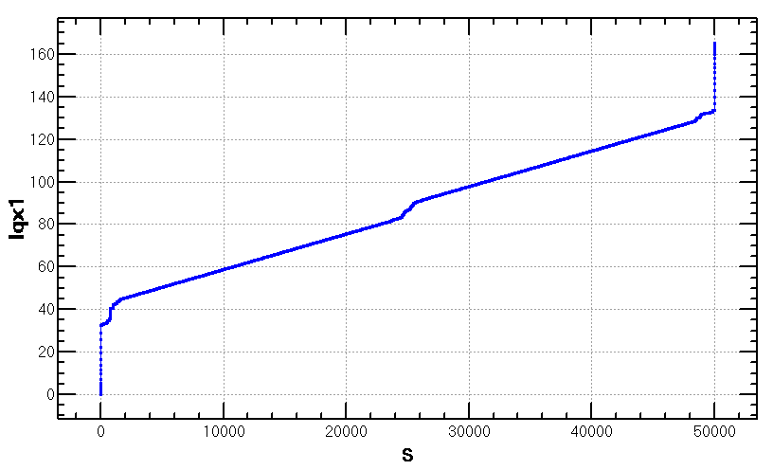
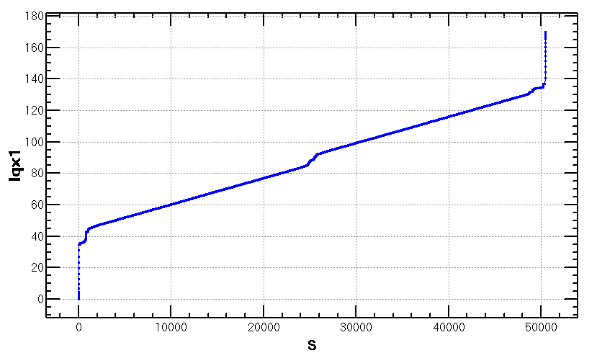
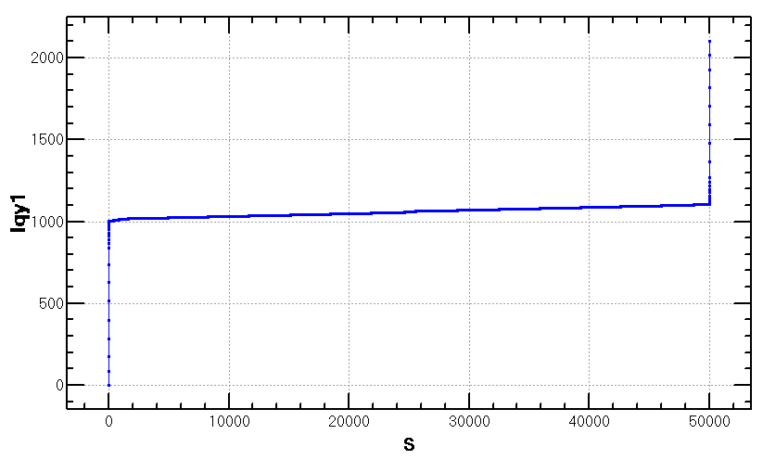
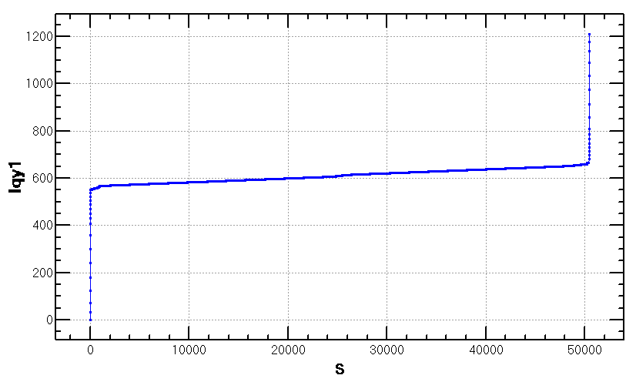
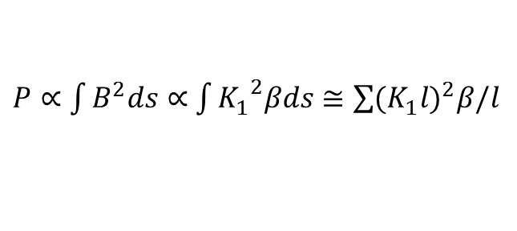
Damping vs damping+fluctuation
Radiation power due to quadrupoles:
$P∝\int{B^{2}ds}∝$ $\int{{K_{1}^{}}^{2}βds≅\sum{{(K_{1}^{}l)}^{2}β/l}}$
LQF=LQD=2.0 m
LQD0=1.73 m, LQF1=1.48m
LQF=LQD=2.0 m
LQD0=1.73 m × 2.0, LQF1=1.48m
small
contribution of QF1 and ARC
quadrupole comparative
lager
contribution of QD0 dominant

Slide 21
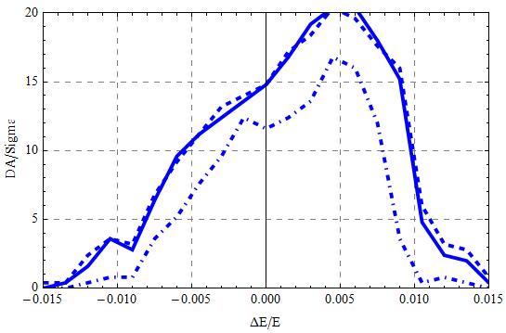
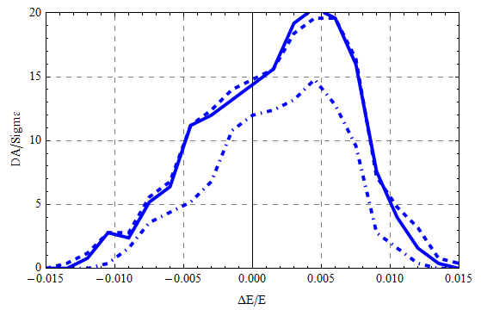
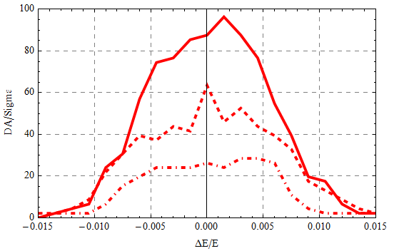
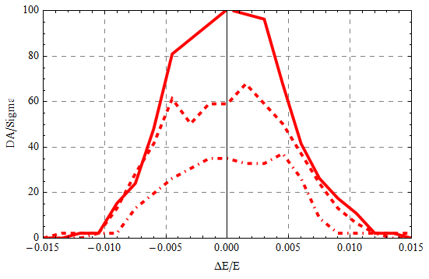
Damping vs damping+fluctuation
LQF=LQD=2.0 m
LQD0=1.73 m, LQF1=1.48m
LQF=LQD=2.0 m
LQD0=1.73 m × 2.0, LQF1=1.48m
x
y
Hard line: w/ damping only
Dashed line: w/ damping and fluctuation (20 samples, maximum)
Dot-dashed line: w/ damping and fluctuation (20 samples, minimum)
Further optimization with longer QD0
by MODE is undergoing.

Slide 22
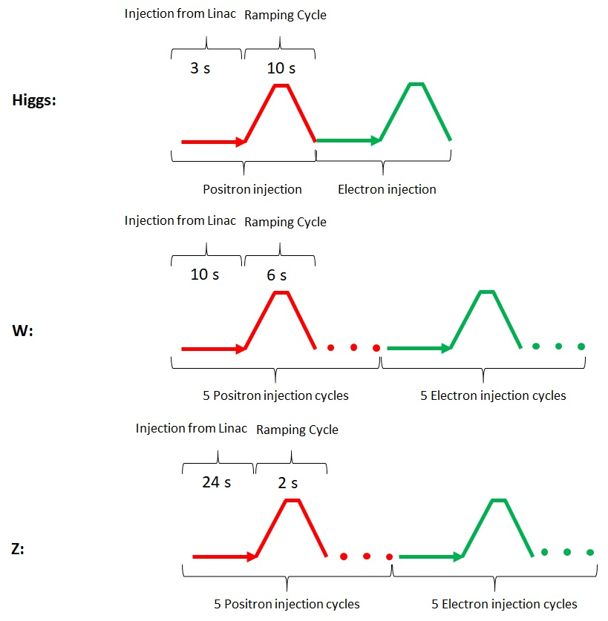
Injection time structure
X. Cui, T. Bian
Top-up injection
27s
160s
272s

