Slide 1
The impact of vibration on BPM measurement
Wang Zhizhuo*, Ma Huizhou, Cao Jianshe
Accelerator BI group , IHEP
2017/12/12
*wangzz@ihep.ac.cn
Notes:
Hello, everyone.
My topic is ‘The impact of vibration on BPM measuring

Slide 2
Outline
scheme
Back Ground
BEPCII vibration sources
Vibration affects BPM
Independent support for BPM
BPM calibration system
Notes:
This report is divided into five parts.

Slide 3
Background
Beam Position Monitor (BPM) works for measuring the position of the beam and plays important roles in improving beam quality.
The general requirement of beam orbit stability is 10% of the beam size and divergence.
$$\begin{matrix}△x≤0.1 σ_{x} △x^{′}≤0.1 σ_{x^{′}} \\ △y≤0.1 σ_{y} △y^{′}≤0.1 σ_{y^{′}}\end{matrix}$$
For HEPS, the minimum size of the bunch in the storage ring is about 1μm, so the resolution of the BPM system is required to reach 0.1μm.
Notes:
In various Beam diagnose Instruments, the BPM ,which works for measuring the position of the Beam,
In modern synchrotron radiation source, beam orbit stability is a key indicator of the high quality operation.

Slide 4
Background
The influence of Vibration on BPM reading
FeedBack
Vibration
？
BPM fast acquisition (FA) data: (from Libera Brilliance+)
The output data stream of FA is approximately 10 kS/s with 2 kHz bandwidth. Usually, the resolution of BPM can be estimated with the FA data.
Notes:
Vibration affects BPM data via two ways. On the one hand, vibration has influence on the beam via the lattice structure. On the other hand, the mechanical vibration transmits to BPM button.
BPM data is used by Feedback system to suppress the vibration of the beam, which is the guarantee of beam orbit stability.
The vibration of BPM button may make errors in the feedback process.
To meet this requirement, it’s necessary for the BPM system to take the mechanical vibration of BPM button into consideration.
For analysis, the BPM FA data is used.

Slide 5
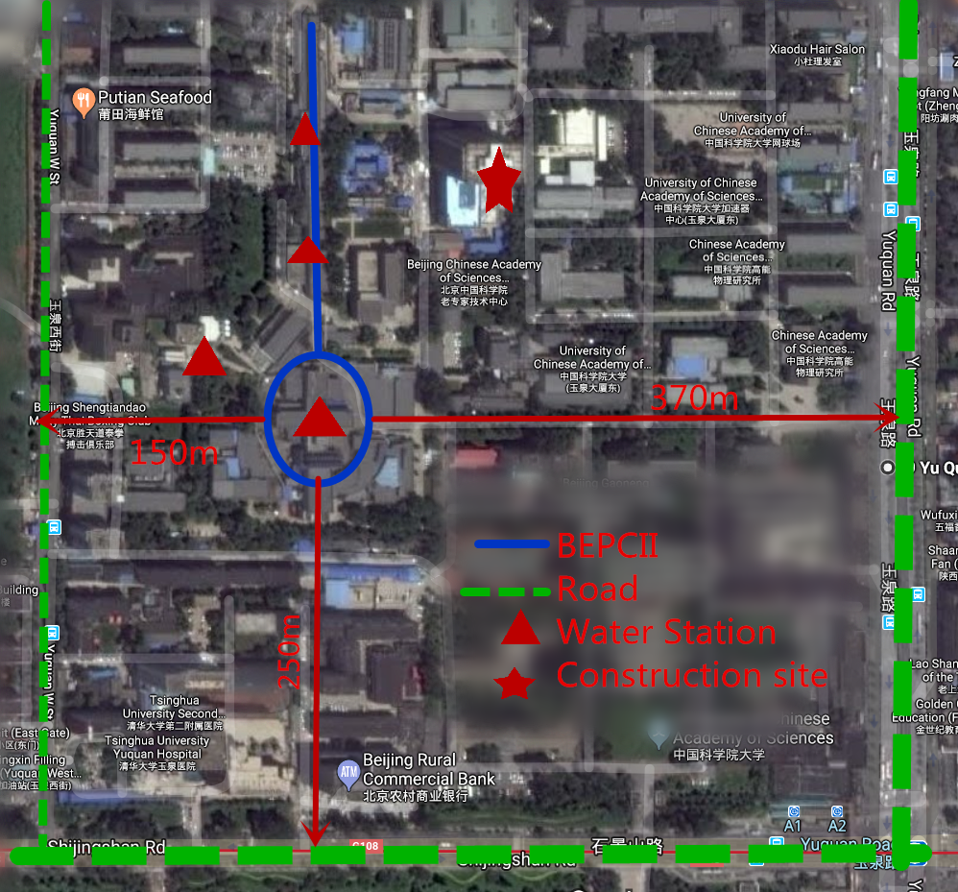
BEPCII vibration sources
Noise around the BEPCII
Constructed in 1988 on the ground surface
Three roads
Four water stations
Construction site
Notes:
For the research of the BPM system for HEPS, some studies has be done on the BPECII. There are about 250 BPMs working with the vibration in the storage ring.
First , there are introduction for the vibration sources around the ring.
The road to the west of BEPCII is 150m away, the east is 360m away, and the subway to the south is 250m away.
Especially, nearby construction site produce loud noise at night.
In its interior, there are four water stations, the largest and nearest is the central water station.

Slide 6
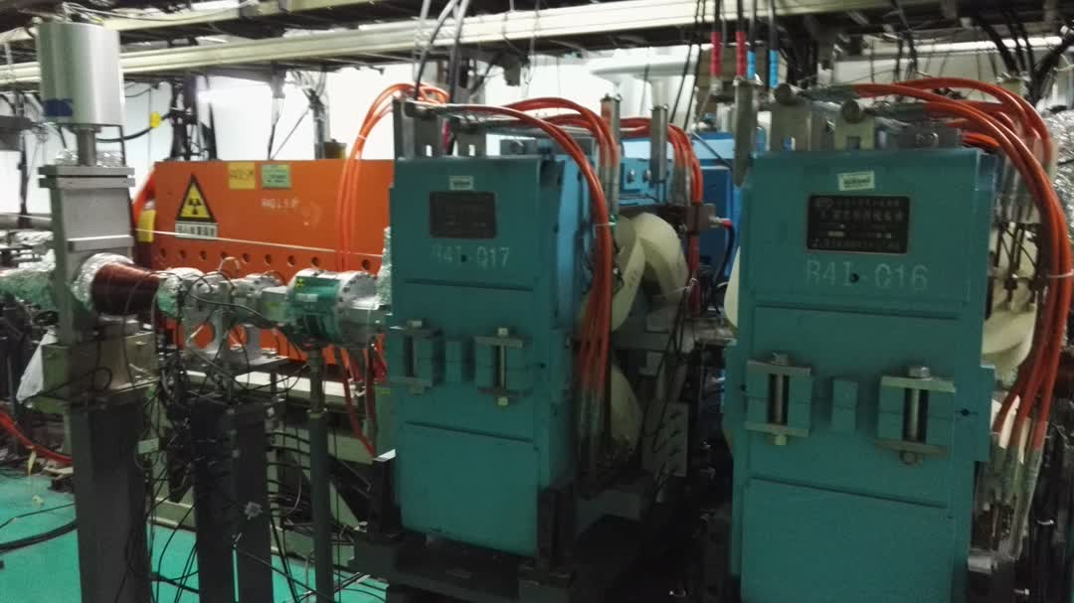
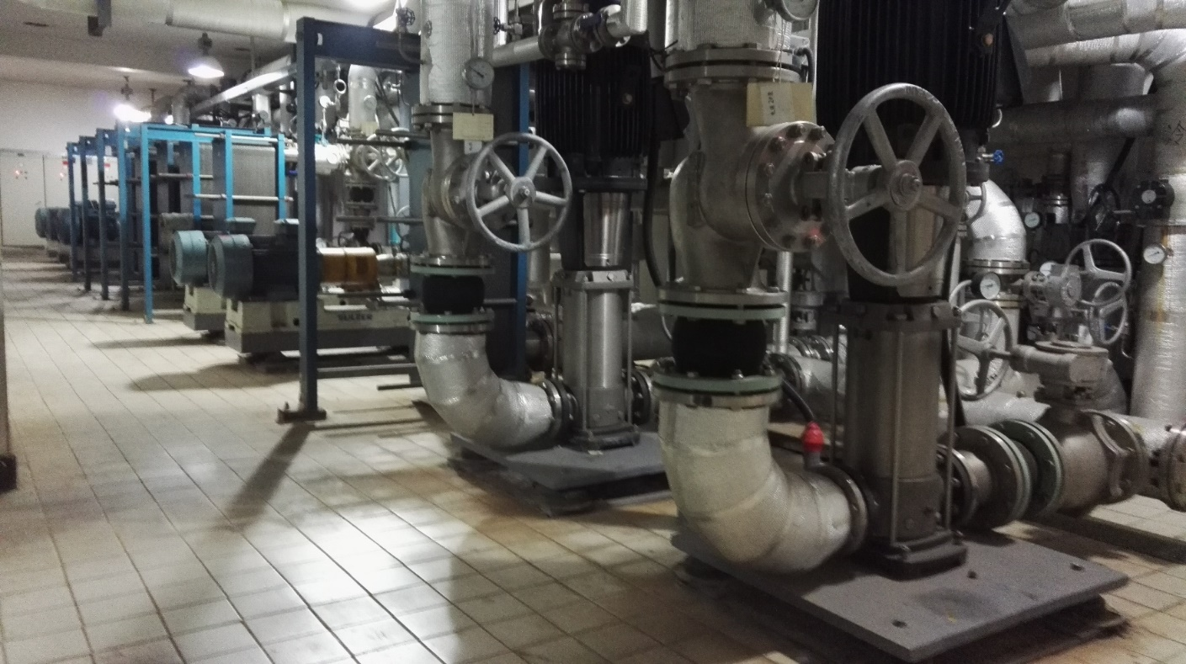
BEPCII vibration sources
Center Water Station
Cool Water flow in Magnet
Vibration spread
Ground : work or turn off ,the difference is less than 5 nm in the ring ground.
Huge vibration caused by cool water when it flow in magnet and vacuum chamber.
Notes:
Vibration from the center water station spreads to the ring with two method.
The former is via the ground. But the difference made by this is less than 5nm.
While, the other method is the vibration caused by water flows. When they flows in magnet and vacuum chamber, some huge vibration .

Slide 7
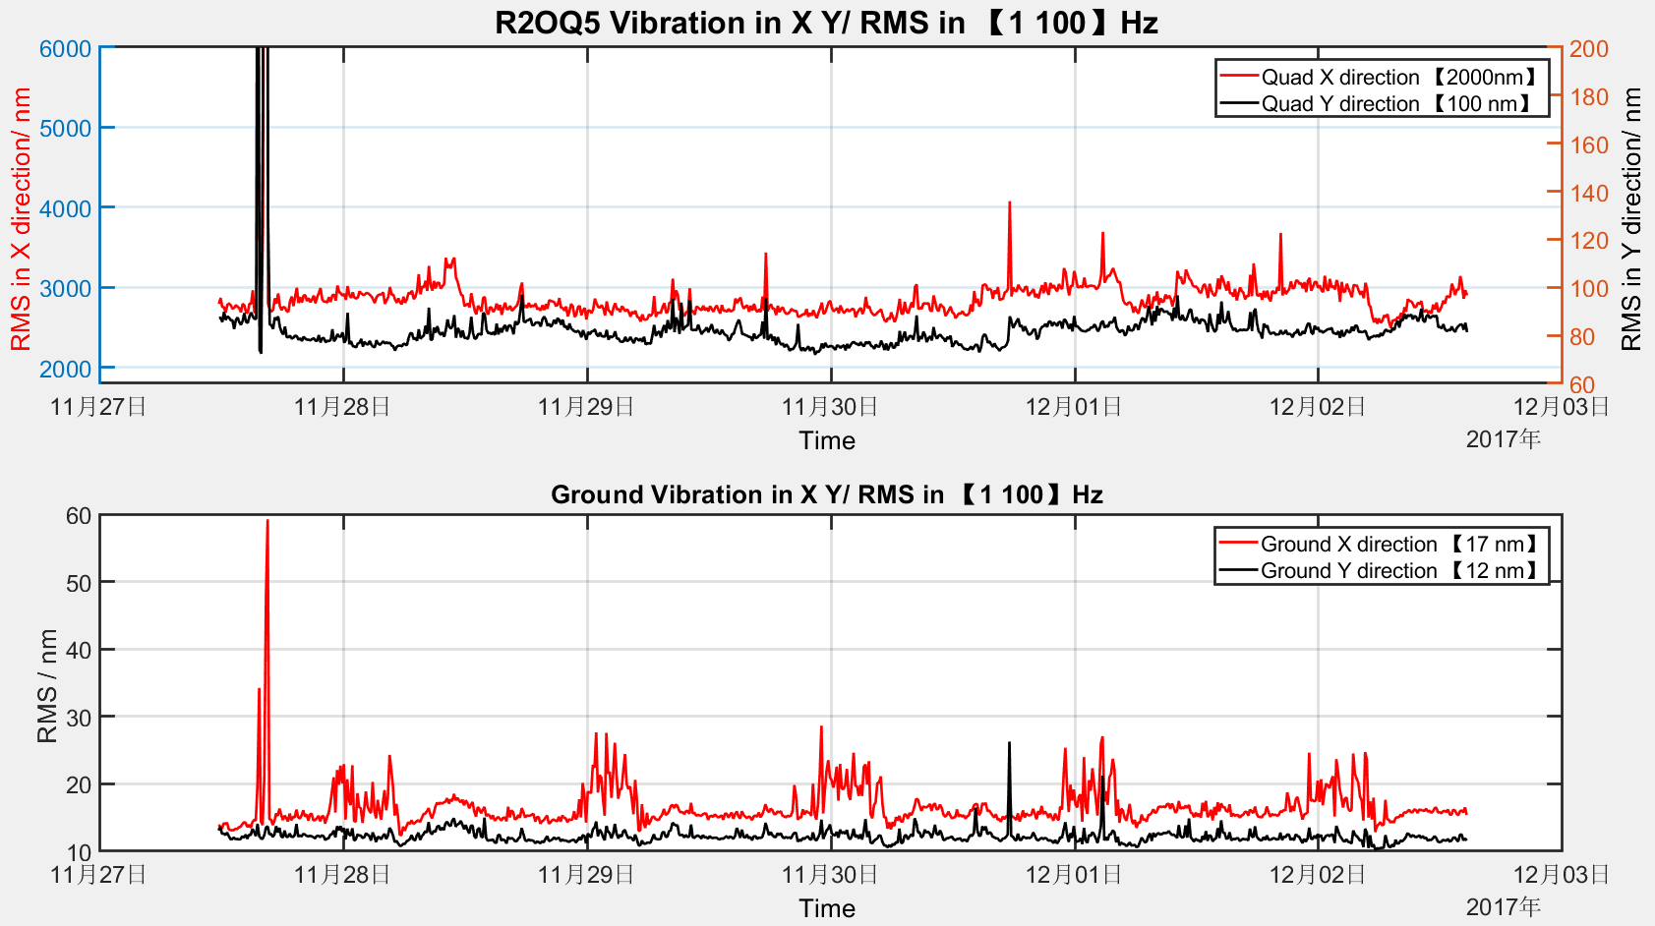
Ground Vibration varies with the time
BEPCII vibration in Ground and Quadrupole
Ground vibration in BEPCII is under 20 nm
The noise appears from the construction site at night.
Vibration in Quadrupole is big, especially in the X direction
Notes:
In order to compare the vibration level between the ground and magnet, as well its periodicity, the vibration of both is measured simultaneously from November 27 to December 2.
From the figure in the below, we can see the level of ground vibrations in the storage ring is under 20 nm and less affected by the surrounding environment at day. Some noise appears periodically in the night which is from the construction site.
While the main attention should be paid on the magnet vibration, especially in the X direction, which reaches 2000nm.

Slide 8
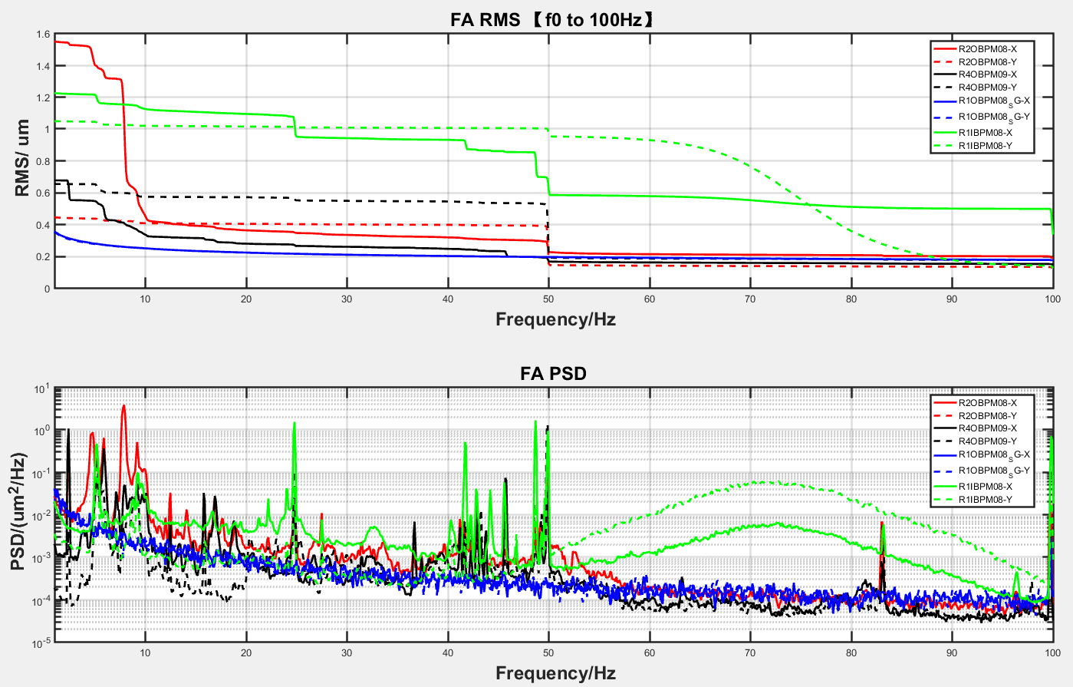
BPM resolution of FA data
Some BPMs FA resolution ~ RMS intgrate in [1 100] Hz of PSD
Result
RMS > 0.4 um
Growth band
X：
6—10Hz,50Hz
Y：
50Hz
Notes:
Some BPMs’ FA data acquires and transmits to PSD.
For comparison, here, we use the integrate of PSD from one to one hundred Hz to estimate BPMs’ resolution.
In the figure of RMS above, their resolutions are all greater than 0.4 um.
Together with the figures of PSD below, the growth band in X direction is in the band from six to ten Hz and the point at the fifty Hz.
While in Y direction ,it is concentrates on the fifty Hz.

Slide 9
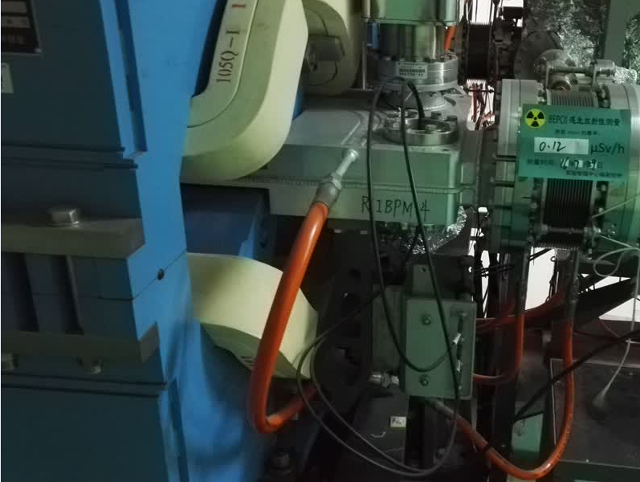
Vibration around BPM and BPM FA data
BPM button
weld
Vacuum chamber
fix
Magnet
Cool water
BPM in BEPCII Storage ring
Notes:
In the BEPCII storage ring, the BPM button is welded into the vacuum chamber and then fixed with the magnet.
In order to analyze the relation of BPM data and its vibration, it is necessary to measure BPM vibration data and BPM FA data.
******************************
Here mainly seismometer and displacement sensor.
Seismometers are easy to use, but bulky and susceptible to strong magnetic fields. They can only be used to measure the vibrations of a magnet attached to a BPM.
As a supplement, the displacement detector measures the vibration of the BPM but lacks a strong support, so the data is not reliable and the spectrum can only be predicted.
******************************

Slide 10
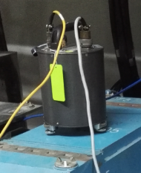
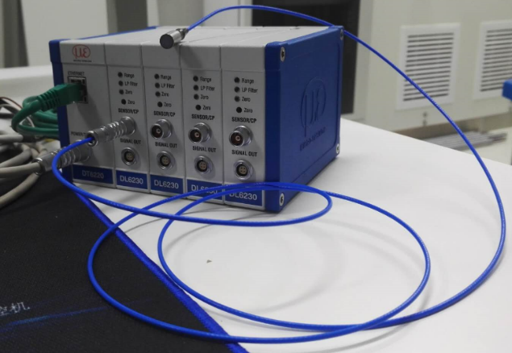
Vibration measurement sensor
Seismometer and Displacement sensor
 | Seismometer | Displacement sensor
measurement range | 0.02~80 Hz | > 120 Hz
Sampling rate | 500 Hz | 520.833Hz
Advantage | Operate easily | Small Anti-interference
Disadvantage | Big Sensitive to magnetic field | Hard to fix Hard for robust support
Notes:
As for measuring the vibration around the BPM button, seismometer and displacement sensor are used.
The table above shows their parameters.
Seismometers are easy to operate, but bulky and sensitive to strong magnetic field.
Displacement sensor is small and Anti-interference, but it is hard to fix and lacks strong support. So the data is not reliable and only used for PSD comparison.

Slide 11
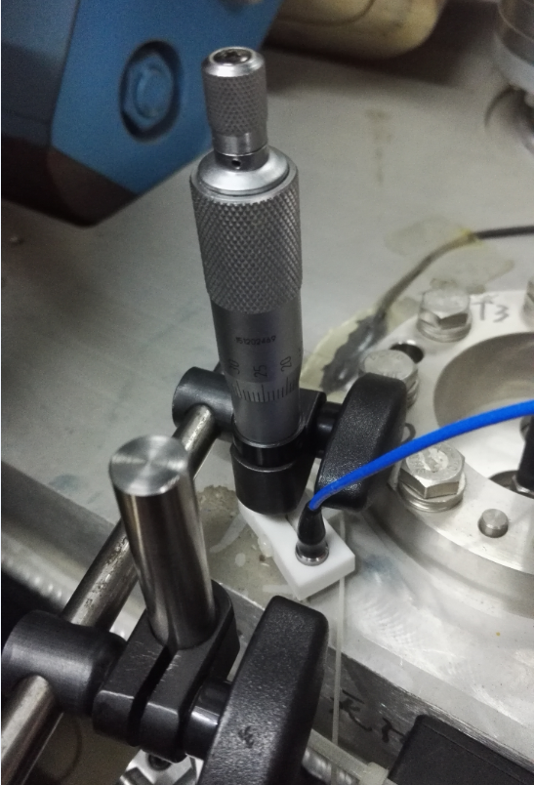
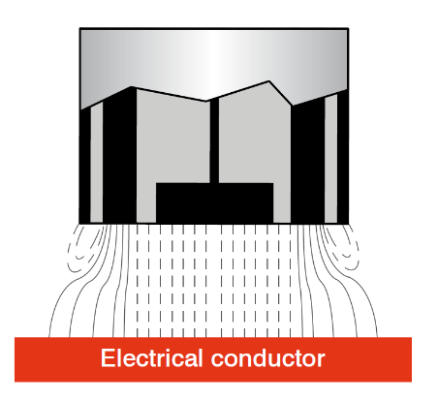
Vibration around BPM and BPM FA data
Seismometer and Displacement sensor around the BPM
Notes:
The seismometer is placed on the quadrupole.
The displacement sensor is attached to the vacuum chamber near the BPM button.
At the same time , BPM FA data is acquired.
Then these data is transfer in PSD for comparative analysis.

Slide 12
Vibration of Quadrupole(Seismometer) and BPM FA PSD
Consistency : 10—20Hz; 40-50Hz;
around 100Hz
Notes:
Here are some initial results.
This figure shows the comparison between Quadrupole vibration and BPM FA data in PSD.
The obvious consistency is in two bands. They are the band from ten to twenty Hz and the band from forty to fifty Hz.
They both has peaks at the point of one hundred Hz.

Slide 13
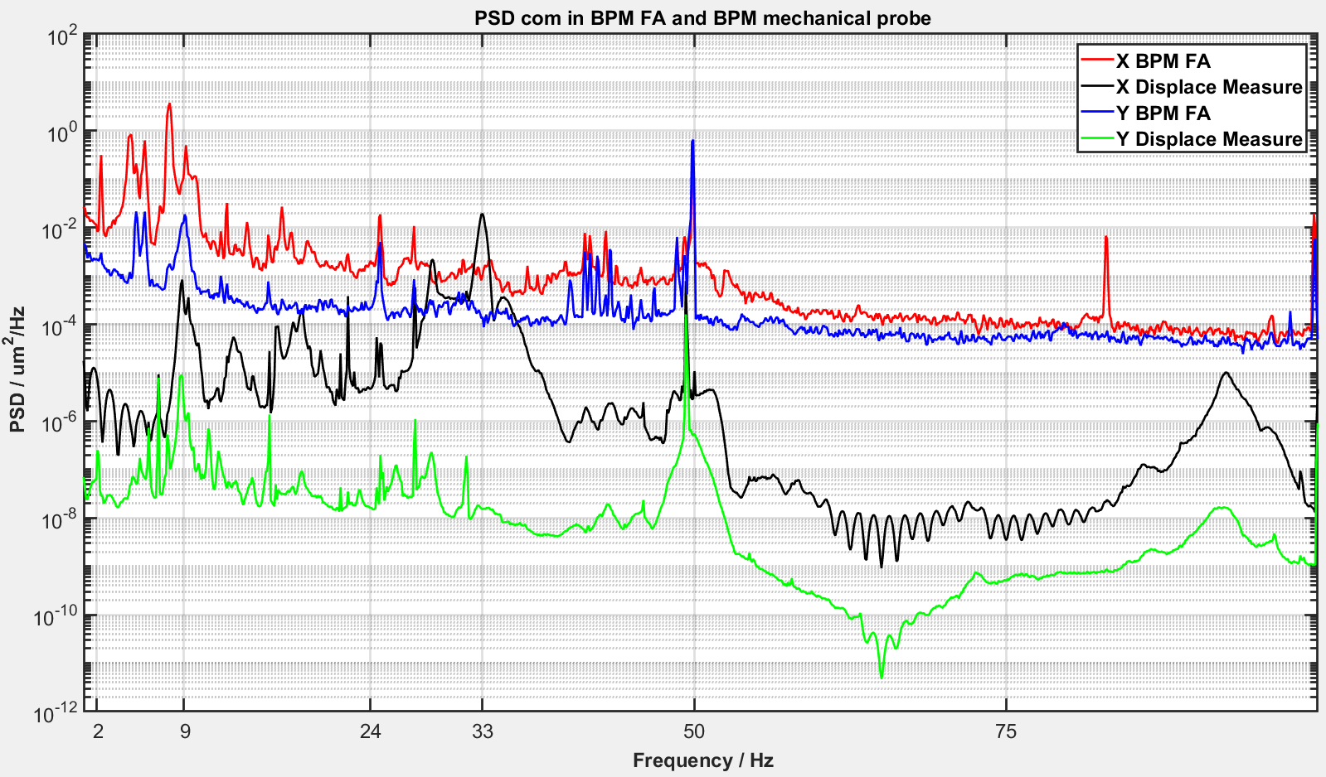
Vibration of BPM vacuum chamber (Displacement sensor) and BPM FA PSD
Consistency in 9Hz, 50Hz
The vibration and FA data in X direction in 9Hz is much greater than those in Y direction.
Notes:
And this figure shows the comparison between vacuum chamber vibration and BPM FA data in PSD.
The obvious consistency is in two points, that is around nine Hz and fifty Hz.
We can also find that around nine Hz, the vibration and FA data in X direction is much greater than those in Y direction. This may be the reason that BPM resolution in X direction has an increase around ten Hz.

Slide 14
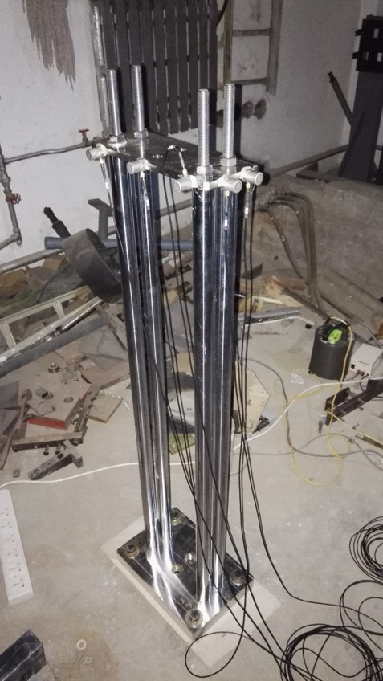
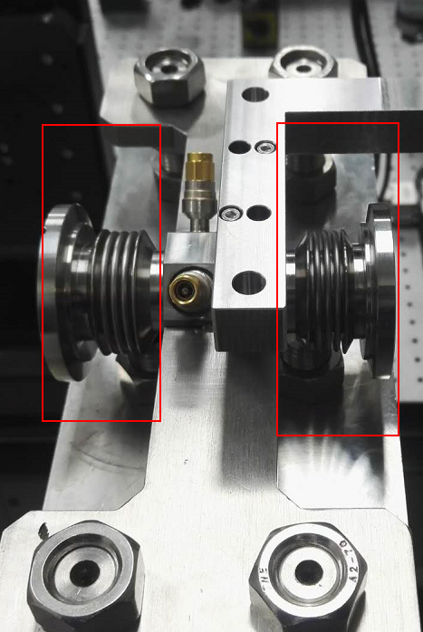
Independent support for BPM
In view of the complicated vibrations of the magnet and other components, it is necessary to install an independent and stable support for the special BPMs.
The BPM is isolated from others with bellows.
Requirements:
Height: 1.2m
Longitudinal length: < 100 mm
Eigenfrequency in X:> 50Hz
Vibration in Y: < 50nm
Design and simulation(refer to other laboratory )
Notes:
The requirements of the support is that :
It has the height of 1.2m and longitudinal length in Z direction less than 100 millimeters.
But its Eigenfrequency should be greater than fifty Hz and the vibration of its top in Y direction should less than fifty nanometers
Then the support is designed and simulated with the references from other laboratory.
The first version has already been processed for test.

Slide 15
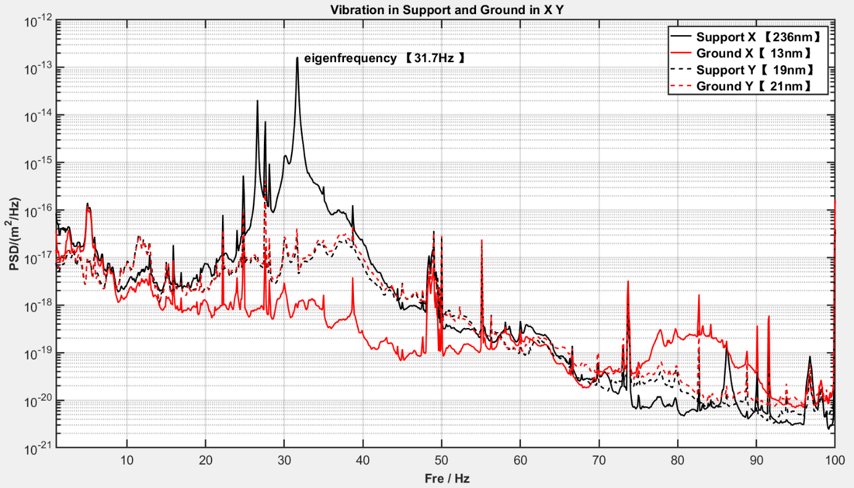
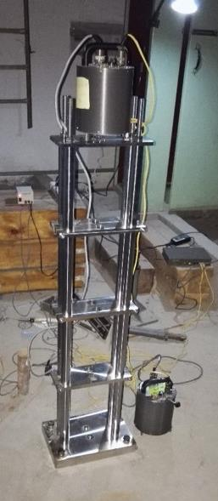
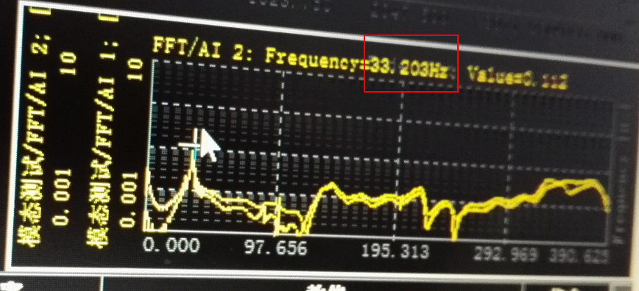
Measure eigenfrequency and vibration PSD
Model Measure
Result：fixed with Ground Bolt easily，
In Y ,the RMS is under 25 nm and amplification factor is about 1.
in X ,first Eigenfrequency reaches 33Hz .
In X, the RMS is terrible
Notes:
The support is fixed to the ground with the ground bolts easily.
With the model measurement, the first eigenfrequency in X is 33 Hz
With the vibration measurement, the RMS in Y direction is under 25nm, but in X direction , it terrible.

Slide 16
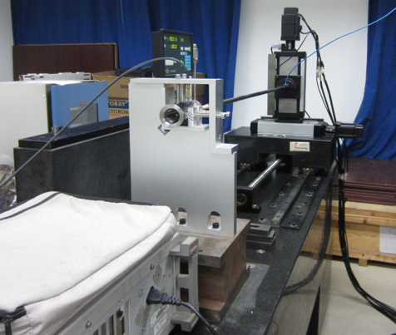
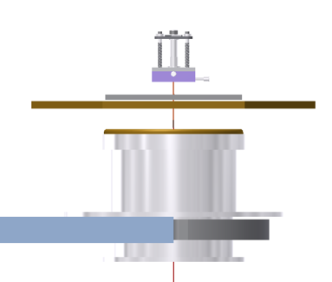
BPM Calibration System
RF Singal loading on the antenna to act as beam for BPM calibration. Antenna rod moves step by step .
 | Tradition | Modern
Platform | Marble | Active isolation platform
Antenna | Rod in Horizontal | Tense wire in Vertical
Way of movement | Antenna rod | BPM
Notes:
BPM calibration in laboratory is necessary.
Traditional calibration system shown in the left figure.
RF Singal loading on the antenna acts as beam. Antenna rod moves step by step .
Antenna rod is easy to vibrate.
When the precision of BPM increases, the vibration of the rod will lead to calibration failure.
So some changes in the table will be done.

Slide 17
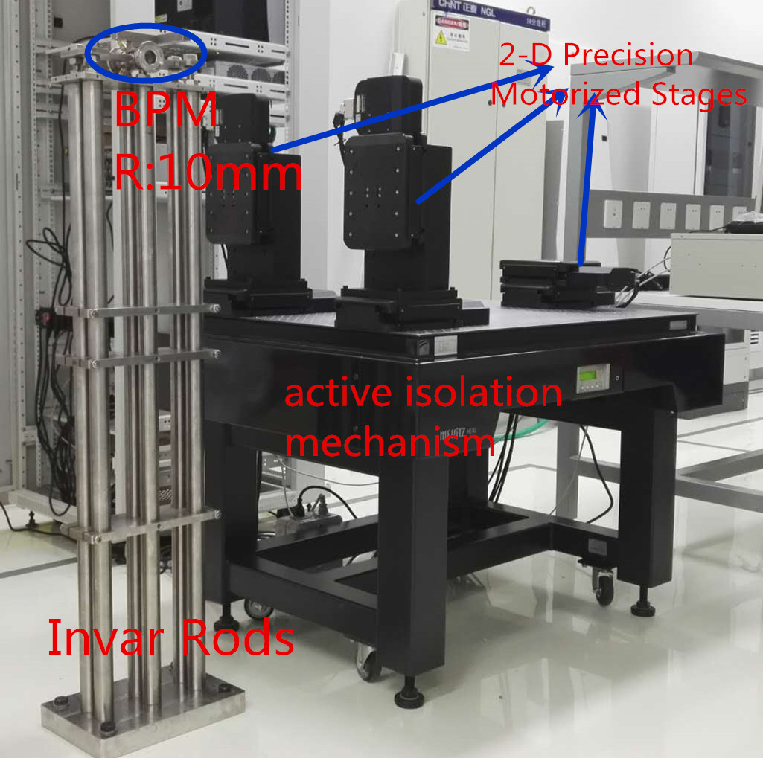
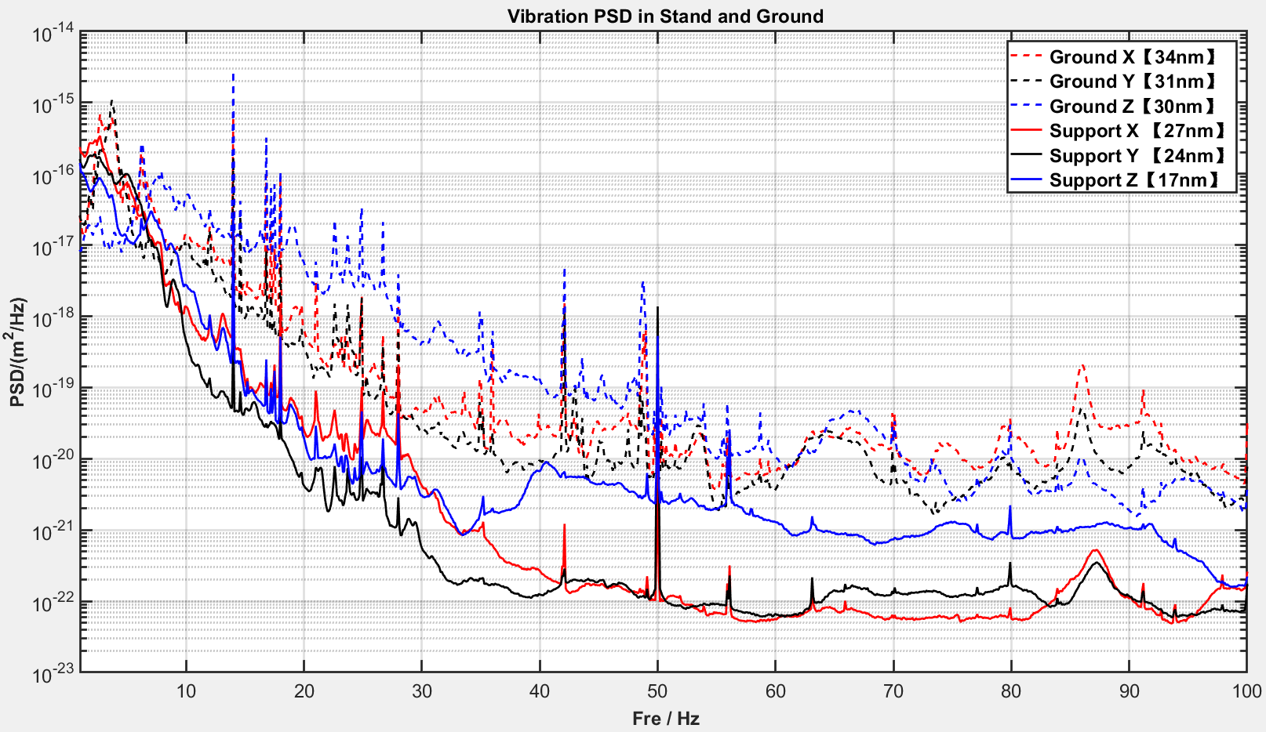
Passive isolation Platform
Performance of the isolation Platform
Another wire simulating as Beam is for the BPM fixed in the independent support. This design will test the effect of vibration on BPM.
Notes:
Active isolation platform has been installed and test.
Its performance of vibration isolation shows in the figure . We can see that in all three directions, the vibrations are suppressed compared with the ground.

Slide 18
Plans in future
More BPMs will be tested for analysis of the effect of vibration on BPM data to quantify the level.
Independent support should be fixed with full grout to suppress the vibration in X direction
BPM calibration system need to develop the mechanical struct for wire and BPM
……
That’s all
Thanks for attention

