Slide 1
Beam Orbit Stability Issues at the SPring-8 Storage Ring
Masaru TAKAO
JASRI
Notes:
I am Masaru Takao of JASRI.
I will talk about the status of beam orbit stability of the SPring-8 storage ring.

Slide 2
Outline
Sources of beam orbit fluctuation and the suppression.
  Fast orbit fluctuation.
  Slow orbit fluctuation.
  Circumference fluctuation.
Improvement of orbit feedback system
  Upgrade of signal processor circuits of COD BPM.
  High accurate corrector steering magnets.
Notes:
Firstly, I will review the sources of beam orbit fluctuation at the SPring-8 storage ring and the suppression.
Orbit fluctuation is classified by these three.
Then, the improvement of the orbit feedback system is reviewed.
One is the upgrade of signal processor circuits of COD BPM.
And the other is the introduction of high accurate corrector steering magnets.
The status of the feedback system is also reviewed.

Slide 3
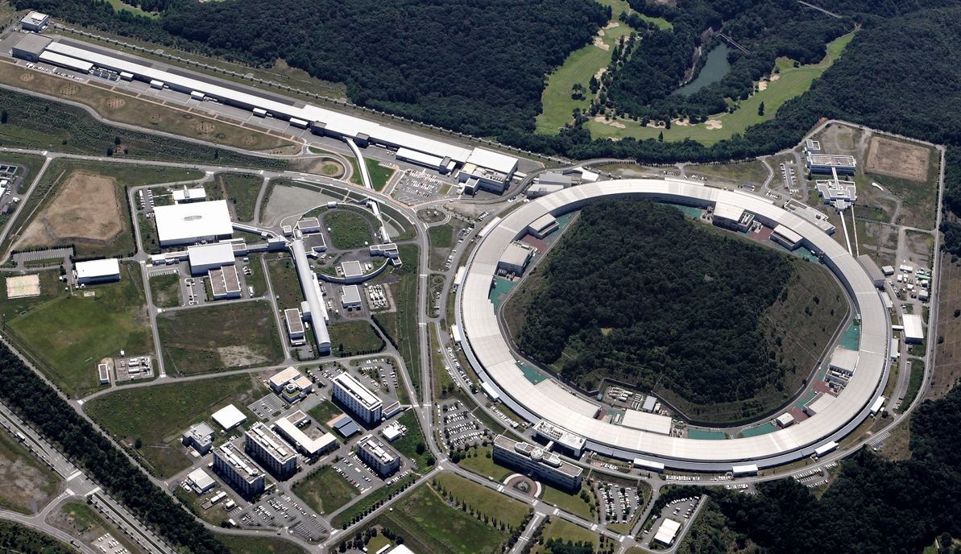
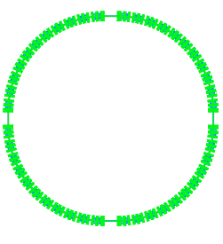
SPring-8 Overview
SPring-8: light source facility for hard X-ray
SACLA (XFEL, 8 GeV)
8 GeV Booster
Synchrotron
1 GeV Linac
8 GeV Storage Ring
©RIKEN/JASRI
Notes:
SPring-8 is the 3rd generation light source facility for hard x-ray.
It consists of 1 GeV linac, 8 GeV booster synchrotron, and 8 GeV storage ring.
Here is 8 GeV XFEL, SACLA.

Slide 4
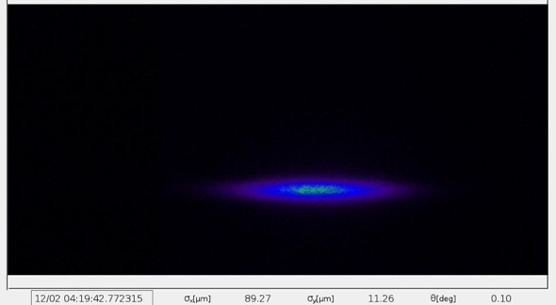
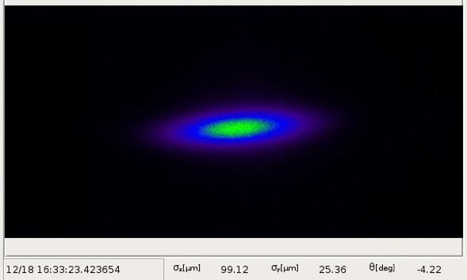
SPring-8 Storage Ring Parameters
Stored Electron Beam Energy | 8 GeV
Circumference | 1436 m
Total Stored Current | 100 mA
Natural Emittance | 2.4 nm•rad
Emittance Coupling Ratio κ | ~ 0.2 %
Beam Profile @ X-ray Pin-Hole Camera
σ_{x}: 89.3μm
σ_{y}: 11.3μm
θ: 0.1deg
σ_{x}: 99.1μm
σ_{y}: 25.4μm
θ: -4.2deg
w/ Coupling Correction (κ: 0.2%)
w/o Coupling Correction (κ: 1%)
Notes:
Here are main parameters of the SPring-8 storage ring.
Stored beam energy is 8GeV.
Circumference is 1436m.
The stored current is 100 mA.
This is kept constant by the top-up injection with the current stability 0.05 %.
Natural emittance is 2.4 nm•rad.
Emittance coupling ratio is 0.2%.
These figures are beam profile images measured by x-ray pin-hole camera.
The left is the beam profile with correcting the coupling,
and the right without the correction.
Without the correction, the coupling ratio 1%,
and the beam profile tilts by -4.2 degree.
By the coupling correction, the coupling ratio is 0.2%,
the beam tilt is almost flat, 0.1 degree.

Slide 5
Sources of Beam Orbit Fluctuation
Fast (>>1Hz)
  Coherent synchrotron oscillation caused by ripple of klystron PS.
  Vacuum chamber vibration caused by water flow of photon absorber.
  That in quad. magnet induces Eddy current.
  Current ripple of quad. magnet PS.
  Kick field of Eddy current induced due to asymmetric cross section of vacuum chamber.
  Ground vibration by cooling system (pumps for cooling water and air conditioner).
Slow (< 1Hz)
  Temperature fluctuation of cooling water for bending magnet.
  Air temperature fluctuation in storage ring tunnel.
    Receiving voltage fluctuation of electric power.
  Change of stored current.
  Earth tide.
  Seasonal change of outdoor temperature.
  Atmospheric pressure.
  Earthquake.
Talk by Matsui.
Talk by Matsui.
Circumference change.
Horizontal orbit shift
at dispersive section,
i.e. beam energy change.
Cured by RF frequency FB.
Notes:
Here are major sources of beam orbit fluctuation of the SPring-8 storage ring.
For fast orbit fluctuation over 1 Hz,
coherent synchrotron oscillation caused by klystron power ripple,
vacuum chamber vibration cased by water flow of photon absorber,
vibration in quadrupole magnet induces Eddy current, and kick the beam,
detail is given in Matsui’s talk,
current ripple of quadrupole magnet power supply,
this also induces kick field of Eddy current due to the asymmetric cross section of vacuum chamber.
ground vibration by cooling system for water and air conditioner,
this is also given by Matsui.
For slow orbit fluctuation under 1 Hz,
temperature fluctuation of cooling water for bending magnet,
air temperature fluctuation caused by receiving voltage fluctuation of electric power,
change of stored current, this is cured by top-up injection,
astronomical and meteorological phenomena,
earth tide, outdoor temperature, atmospheric pressure, earthquake.
These induce circumference change,
so horizontal orbit shift at dispersive section,
i.e. beam energy change.
Then they are cured by RF frequency feedback.

Slide 6
Suppression of Coherent Synchrotron Oscillation
Coherent synchrotron oscillation (~2kHz) observed in horizontal orbit fluctuation at dispersive section.
Suppressed by FB to the RF reference signal.
T. Ohshima and N. Kumagai, PAC’01, Chicago, 2001, p.1975.
Power spectrum of beam position fluctuation measured at arc section.
Notes:
Coherent synchrotron oscillation induced by Klystron power ripple is observed in horizontal orbit fluctuation at dispersive section.
This figure shows the power spectrum of beam position fluctuation measured at dispersive section.
This blue line indicates the synchrotron oscillation.
This peak is suppressed by feedback to the RF reference signal.

Slide 7
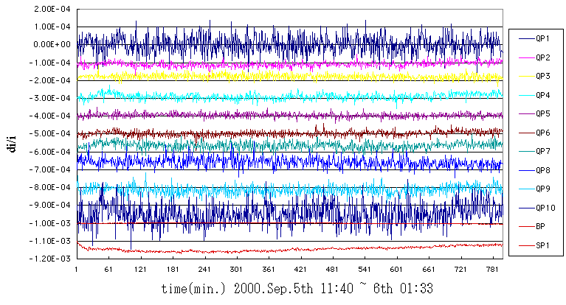
Current Fluctuation of Q-Mag PS
Common PS for each of 10 families of Q-mag.
Current fluctuation of Q-mag PS
Orbit fluctuation by kick of Eddy current on asymmetric cross section
False COD measurement
Wrong COD correction
Current Fluctuation of Q-mag PS: 50ppm @ Sep. 2000
Notes:
The most effective one to suppress the orbit fluctuation is the improvement of the power supply of the quadrupole magnets.
There are 10 families of quadrupole magnets, and each family has own power supply.
At September 2000 the current fluctuation of the quadrupole magnet power supplies was 50 ppm.
The current fluctuation of the quadrupole magnet power supply induced the orbit fluctuation due to asymmetric cross section of vacuum chamber,
In addition, the orbit fluctuation gives the false COD measurement.
This led to the wrong COD correction., so the orbit fluctuation is enhanced.

Slide 8
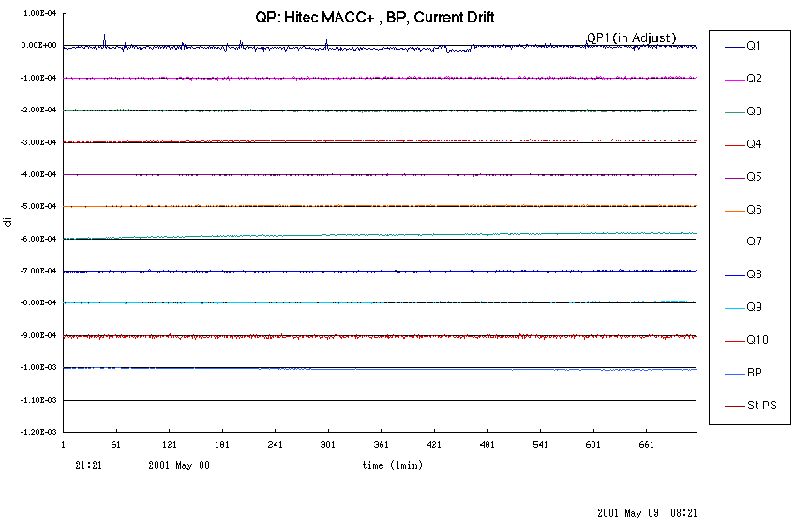
Improvement of Q-Mag PS
Replacement of DCCT for current control of Q-mag PS with high precision one.
Modification of control circuit of Q-mag PS.
Current fluctuation of Q-mag PS: 50ppm 3ppm
Current Fluctuation of Q-mag PS: 3ppm @ May 2001
Notes:
We improved the current stability of the quadrupole magnet power supply by the following methods.
One is the replacement of DCCT for current control of the quadrupole magnet power supply with the high precision one.
And the other is the modification of the control circuit.
These modifications reduce the current fluctuation from 50 ppm to 3 ppm.

Slide 9
Change of Orbit Oscillation by Q-PS Modification
Spectrum of beam orbit oscillation
Notes:
Then the orbit oscillation is reduced as follows, especially that in horizontal direction.
This graphs show the spectrum of the beam orbit fluctuation.
The horizontal oscillation from 0.1 Hz to 10 Hz is drastically reduced.

Slide 10
Effect of Q-PS Modification on Orbit Stability
R.m.s. orbit fluctuation
(difference between 2 successive COD measurements)
Before Q-PS Modification
After Q-PS Modification
Improvement of r.m.s. orbit fluctuation
H: 2.5μm 1.2μm
V: 1.5μm 1.2μm
Notes:
r.m.s orbit fluctuations are improved as follows.
Before the quadrupole magnet power supply modification,
horizontal 2.5 micro meter r.m.s., and vertical 1.5 micro meter.
After the modification, these are reduced to same 1.2 micro meter.

Slide 11
Sources of Slow Orbit Fluctuation
Temperature fluctuation of magnet cooling water.
Receiving voltage fluctuation of electric power.
Variation of stored current.
Notes:
Now, I review the sources of slow orbit fluctuation, as follows;
temperature fluctuation of magnet cooling water,
receiving voltage fluctuation of electric power,
And variation of stored current.

Slide 12
Temperature Fluctuation of Magnet Cooling Water
Temperature fluctuation (a few tens minutes period) of machine (magnet) cooling water reduced by improving control sequence:
+/- 1ºC +/- 0.3ºC @1998 (+/-0.1ºC @present)
C type BM
Temperature fluctuation of cooling water
Deformation of C-type BM
Change of B-field
due to distance change between poles
Horizontal orbit distortion
Notes:
1998, to suppress the orbit drift,
temperature fluctuation of machine cooling water is reduced
from +/- 1ºC to +/- 0.3ºC
by improving the control sequence.
At present, this is further improved to +/- 0.1ºC.
The mechanism of leading to orbit drift is as follows;
Our bending magnet is C-type,
so temperature fluctuation of cooling water deforms it like this.
Then b-field changes due to the distance change between poles.
As the result, horizontal orbit is distorted.
This figure shows the horizontal COD fluctuation over 4 hours, red line,
and the temperature fluctuation of cooling water, blue line.
Clear correlation is observed.
At present, orbit fluctuation like this is not observed.

Slide 13
Receiving Voltage Fluctuation of Electric Power
Fluctuation of thermal condition in SR tunnel brings orbit drift kicked at place structurally weak, e.g. above beam transport, underpass, etc..
Receiving voltage fluctuation is one of the sources of fluctuating thermal condition.
Fan
Beam transport from booster to SR
Notes:
Receiving voltage fluctuation is one of the examples.

Slide 14
Receiving Voltage Fluctuation of Electric Power
Voltage fluctuation
of wall plug power
①
②
①
③
②
Fluctuation of air flow from fan
Fan
③
Change of wall temperature
Tilt change of base plate
(Deformation of tunnel)
④
⑤
⑤
Position shift (H) of Q-mag
④
Horizontal COD induced
Beam transport from booster to SR
Notes:
Voltage fluctuation of electric power brings fluctuation of air flow from fan.
Then, wall temperature changes,
so that the wall stretches.
As the result, tunnel floor, i.e. base plate for magnet girder inclines due to the weak structure.
Hence quadrupole magnet shifts in horizontal direction.
So, the beam orbit kicked horizontally.

Slide 15
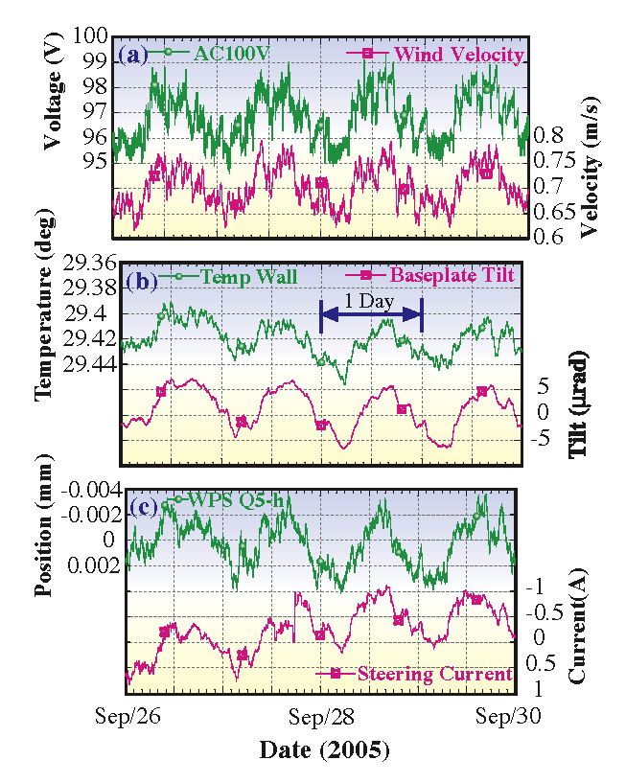
Receiving Voltage Fluctuation of Electric Power
Voltage fluctuation
of wall plug power
①
①
②
Fluctuation of air flow from fan
②
③
Change of wall temperature
③
Tilt change of base plate
(Deformation of tunnel)
④
④
⑤
Position shift (H) of Q-mag
⑤
Horizontal COD induced
⑥
⑥
Current fluctuation of ST-mag
Notes:
These figures show voltage fluctuation of electric power,
velocity of air flow, temperature of wall,
tilt of base plate for magnet girder,
position of quadrupole magnet,
and current of corrector steering magnet close to the beam transport.
All of them change in phase.

Slide 16
Effect of Top-up Operation on Orbit Stability
Top-up Operation stabilizing current/thermal condition.
  Non top-up operation: 2 refills / day
  Top-up operation: 100 mA constant storage current
Current dependent orbit drift disappeared
in top-up operation.
w/o Top-up Injection
w/ Top-up Injection
Notes:
Since May 2004, we start the top-up operation in the user time.
In non-top-up operation, we had two refills per day.
In the worst case, the stored current decreases to half between refills.
According to the decrease of the stored current, the orbit drifts grow in the both directions.
After the introduction of the top-up operation, the current dependent orbit drift disappeared.
R.m.s. orbit drifts over one week stay in 2 or 3 micro meter.

Slide 17
Improvements of Orbit Feedback System
Upgrade of signal processor circuits for COD BPM.
High accurate corrector steering magnet.
Notes:
Lastly, the improvement of orbit feedback system are reviewed.
One is the upgrade of signal processor circuits for COD BPM.
Another is the introduction of high accurate corrector steering magnet.

Slide 18
Orbit Feedback System
Beam Position Monitor (BPM)
12 (COD BPM: 11, turn-by-turn BPM: 1) / 2 Cell
256 COD BPMs in total
Steering Magnet
Horizontal: 6 (High-Definition (21bit) PS: 2) / 1 Cell
100 HD-STs for feedback in total
Vertical: 6 (HD PS: 3) / 1 Cell
142 HD-STs for feedback in total
Algorism of COD correction
to 2016 MICADO
from 2016 SVD.
Notes:
We have 12 BPM per 2 cells.
One of the 12 is used for turn-by-turn measurement,
and the other 11 for COD measurement.
In total we have 256 COD BPMs.
We have 6 steering magnets per one cell for horizontal and vertical direction, respectively.
Two of 6 horizontal steering magnets and 3 of vertical have the power supply with high precision 21bit.
We use these high precision steering magnets for slow orbit feedback.
In total, we have 100 high definition steering magnets for horizontal, and 142 for vertical.
COD correction algorism is best corrector method.
In slow orbit feedback routine, for horizontal and vertical direction, 12 steering magnets are selected
from 100 and 142 high definition steering magnets, respectively.

Slide 19
COD BPMs
Signal processor circuits replaced in Sep. 2006.
  Optimized to stored current 100 mA.
  No attenuator before RF-Amp.
  (Attenuators were used for beam tuning at low beam current at the expense of S/N.)
  Faster ADC.
  Digital processor.
 | New Circuits | Old Circuits
Resolution | 0.1 μm | 0.3 μm
Measurement Cycle in user operation | 7 s (1 s @present) | 30 s
Notes:
Signal processor circuits of COD BPM ware replaced in September 2006.
This is optimized to the storage current 100mA.
There is no attenuator before rf-amplifier.
The attenuators were used for beam tuning at low beam current at the expense of S/N.
The new processor circuit is digital one with faster ADC.
The spec of the COD measurement system is as follows.
The resolution is 0.1 micro meter, and the time for measurement is 3 seconds.

Slide 20
Performance of COD BPM
Estimation of resolution of BPM:
r.m.s. of difference between 2 successive measurements of 100 times.
Notes:
The resolution of BPM is estimated from r.m.s of difference between 2 successive measurements of 100 times.
These figures show the measurement result over the quarter of the SR..
The blue lines indicate the root of betatron function.
The sigma of the measurement consists of the one inherent to the circuit and the beam oscillation.
So the measurement result clearly reflects the lattice functions.

Slide 21
Performance of COD BPM
Estimation of BPM resolution:
r.m.s. of difference between 2 successive measurements of 100 times.
Notes:
Plotting the square of the r.m.s. against the beta function, we have these figures.
The zero cross by the linear fit gives the resolution of the circuit.
The estimated resolution is 0.1 micro meter for both the direction.

Slide 22
Effect of BPM Circuit Replacement
Signal processor circuits of BPM replaced in Sep. 2006.
 | New Circuits | Old Circuits
Resolution | 0.1 μm | 0.3 μm
Correction Period | 7 s (1 s @ present) | 30 s
r.m.s. Orbit Fluctuation | H: 0.5 μm / V: 0.3 μm | H: 1.1 μm / V: 1.3 μm
New Circuit
Old Circuit
Notes:
The signal processor circuit of the COD BPM is replaced in September 2006.
By replacing the signal processor circuit, we could shorten the correction period by 1 fourth.
As the result, the r.m.s. orbit fluctuation is reduced by half in horizontal direction, and by quarter in vertical direction.
Thus orbit fluctuation is well suppressed under 1 micro meter, i.e. sub-micron stability.

Slide 23
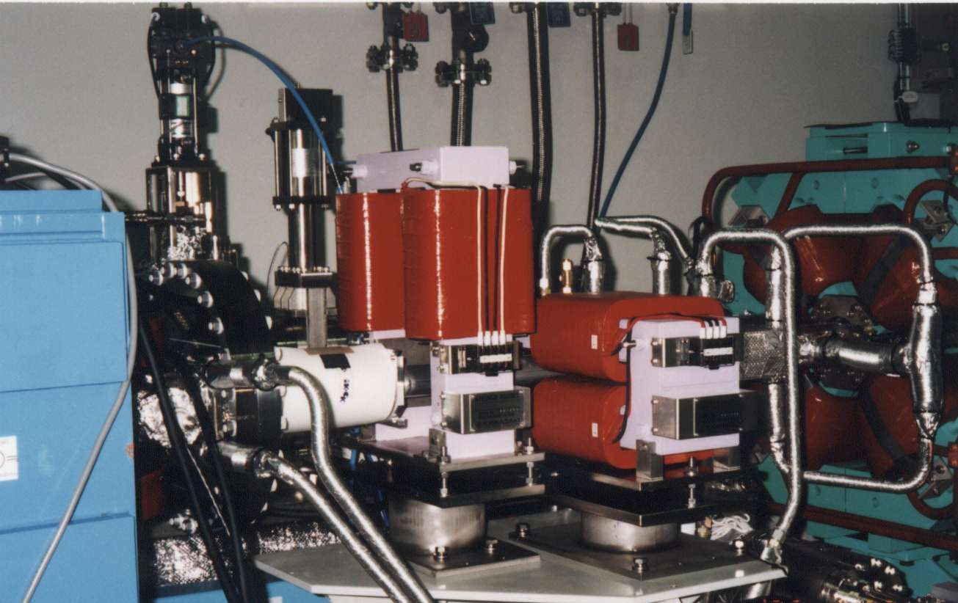
Corrector Steering Magnets
Normal ST: 16bit PS
  Too coarse for orbit feedback.
  Some STs in feedback frequently unchanged.
  A few μm orbit jump at correction period occurred.
 | Max. Kick Angle | Min. Step
H | 1 mrad | 30 nrad
V | 0.5 mrad | 15 nrad
V
H
Notes:
Normal steering magnets have the power supply of 16bit.
Maximum kick angle of horizontal steering magnet is 1 mrad, and the minimum setting step is 30 nrad.
For vertical maximum kick is 0.5 mrad, and minimum step 15 nrad.
In early stage of orbit feedback, we had used these steering magnets.
These setting precisions are too coarse for orbit feedback.
In the feedback routine some steering magnets frequently unchanged.
Then, at correction period, a few micro meter orbit jump occurred.

Slide 24
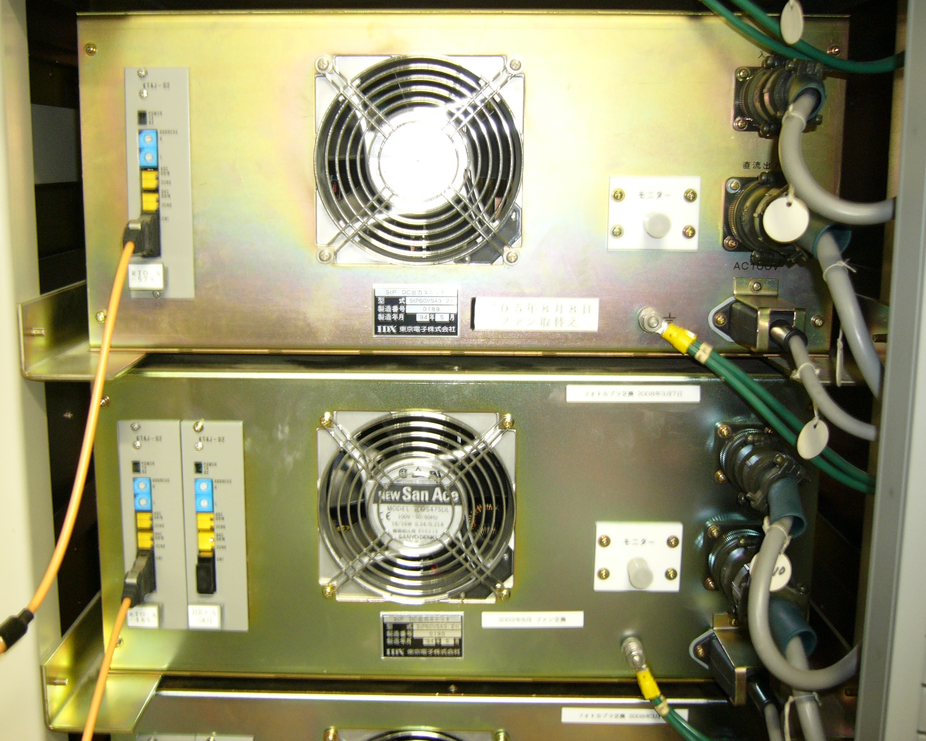
Corrector Steering Magnets
Normal ST: 16bit PS
High Definition (HD) ST: 16bit + 16bit/32 = “21bit” PS
 | Max. Kick Angle | Min. Step
H | 1 mrad | 30 nrad
V | 0.5 mrad | 15 nrad
 | Max. Kick Angle | Min. Step
H | 31 μrad | 1 nrad
V | 16 μrad | 0.5 nrad
Normal ST PS
PS
VME
16bit DAC
Sum
Mag
16bit DAC
Att
HD ST PS
1/32
Notes:
To overcome this issue, we developed the high definition power supply of 21bit.
Doubling the DAC, attenuating the output of one of them by one thirty second, and summing up all,
we practically realize the 21biｔ power supply.
The maximum kick angle of this part is 31 micro rad for horizontal, and 16 micro rad for vertical.
The minimum step is 1 nrad for horizontal, and 0.5 nrad for vertical.
These minimum steps are enough fine for feedback.
This photo shows the rear view of the power supplies.
You can see the double DAC in the high definition power supply.

Slide 25
Orbit Stability Before the Improvements
1 day change of COD
@ 2000/11/04
(after SR reconstruction
for long straight section)
H, V: ~ 4,5 μm r.m.s.
x / μm
y / μm
Circumference
1 day
Notes:
Orbit stability just after the storage ring reconstruction for long straight section is like these.
One day change of COD is 4 or 5 micoro meter in both the directions.
This figure shows the drift of horizontal COD from the origin for one day.
This figure show the vertical orbit drift.
This axis shows the time, this BPM serial number over the SR.
This axis the beam position.

Slide 26
Present Status of Orbit Stability (Slow)
1 day change of COD
@ 2009/07/11
H, V: ~ 1 μm r.m.s.
x / μm
y / μm
Circumference
1 day
Notes:
The present status of slow orbit stability is as follows.
This figure shows ｔｈｅ drift of the r.m.s. orbit in one day.
So, at present, the one day changes of COD are 1 micro meter r.m.s. for the both directions.

Slide 27
Remarks
Sources of beam orbit fluctuation at the SPring-8 SR:
  Fluctuation of RF PS, magnet PS.
  Vibration of vacuum chamber.
  Fluctuation of cooling water temperature, air temperature in SR tunnel.
  Stored current.
It is essential for beam orbit stability to suppress these sources.
Impact of ambient noise appears at the place structurally weak, tough structure is preferable for orbit stability.
Fast and fine COD BPMs and accurate corrector steering magnets are indispensable for precise orbit feedback.

Slide 28
Sources of Circumference Fluctuation
Earth tide.
Atmospheric temperature.
Atmospheric pressure.
Earthquake.
Notes:
At the SPring-8 storage ring, long term variation of the circumference is observed.
Various astronomical and meteorological phenomena,
earth tide, atmospheric temperature, atmospheric pressure, earthquake, and so on.

Slide 29
Circumference Change by Earth Tide
Ground surface expands and contracts by tidal force, so circumference of SR fluctuates accordingly.
Revolution period (length) is fixed by RF frequency, so beam energy changes to fit the period.
As the result, horizontal position shift is observed at dispersive section.
To keep beam energy, feed back on RF frequency.
Orbit length fits to circumference.
Circumference fluctuation over 10 days
Notes:
Ground surface expands and contracts by tidal force, so circumference of SR fluctuates accordingly.
Revolution period (length) is fixed by RF frequency, so beam energy changes to fit the period.
As the result, horizontal position shift is observed at dispersive section.
To keep beam energy, feed back on RF frequency.
Orbit length fits to circumference.
This figure shows the circumference fluctuation over 10 days.
The blue line is measured circumference fluctuation,
and the red one calculated from tidal force.
They show very similar trend.
The upward tendency is the effect of atmospheric temperature.

Slide 30
Circumference Change by Atmospheric Temperature
Circumference shows the seasonal fluctuation as ground surface stretches according to atmospheric temperature with a few month delay.
Circumference stretches in phase to 5m under ground temperature.
Circumference fluctuation over 1 year
+2.5 month
Notes:
Circumference shows the typical seasonal fluctuation as red line in this figure,
as ground surface stretches according to atmospheric temperature.
Phase of circumference fluctuation is delayed by a few month to the atmospheric temperature.
Circumference stretches rather in phase to 5m under ground temperature.

Slide 31
Circumference Change by Atmospheric Pressure
Ground surface is pulled up by low atmospheric pressure, so it stretches as same as earth tide.
Circumference stretches as following ground surface.
Circumference fluctuation over 1 week
Notes:
Circumference fluctuates due to the atmospheric pressure.
Ground surface is pulled up by low atmospheric pressure, so it stretches as same as earth tide.
Circumference stretches as following ground surface.
This figure shows the circumference fluctuation over 1 week,
Circumference stretches in low pressure period.

Slide 32
Circumference Change by Earthquake
Circumference stretches following ground surface expand and contract by far and large earthquake.
Clear dispersion orbit is observed in horizontal COD.
Circumference fluctuation over 30 min.
Horizontal COD fluctuation over 1 hour
Vertical COD fluctuation over 1 hour
1 hour
1/4 Circumference
Notes:
Earthquake induces the circumference fluctuation.
Though, for near earthquake beam tripped due to the betatron oscillation excitation,
for far earthquake beam survives, and the circumference fluctuation is observed.
This figure shows the circumference fluctuation observed in Sinchuan earthquake of Magnitude 8 in 2008 May twelve.
Maximum 300 micrometer, circumference stretched.
These figure show the COD over the quarter of ring at that time.
Clear dispersion orbit is observed in horizontal COD.

