Slide 1
Outline of CEPC Calorimeters CDR
General introduction of Calorimetry system
PFA calorimeters (Tao Hu, Jianbei Liu, Haijun Yang)
Technology options for ECAL
Silicon + tungsten (Vincent Boudry)
Scintillator + tungsten (Zhigang Wang, Yunlong Zhang)
Technology options for HCAL
RPC (Imad Laktineh, Haijun Yang)
GEM (Jianbei Liu)
Scintillator (Boxiang Yu)
Performance of ECAL+HCAL with TB data (Vincent + Imad)
Dual Readout calorimeter (Roberto Ferrari )
General design and performance (Roberto Ferrari)
Deadline for collecting input documents from subgroups: September 30
Deadline for merging and writing up a draft of CDR: October 31

Slide 2
Contact Information
Vincent Boudry, Vincent.Boudry@in2p3.fr
Roberto Ferrari, roberto.ferrari@cern.ch
Tao Hu, hut@ihep.ac.cn
Imad Laktineh, laktineh@ipnl.in2p3.fr
Jianbei Liu, liujianb@ustc.edu.cn
Zhigang Wang, wangzhg@ihep.ac.cn
Haijun Yang, Haijun.yang@sjtu.edu.cn
Boxiang Yu, yubx@ihep.ac.cn
Yunlong Zhang, ylzhang@ustc.edu.cn

Slide 3
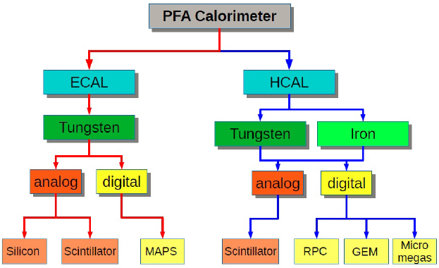
Calorimeters Options
ECAL with Silicon and Tungsten (LLR, France)
ECAL with Scintillator+SiPM and Tungsten (IHEP + USTC)
SDHCAL with RPC and Stainless Steel (SJTU + IPNL, France)
HCAL with ThGEM/GEM and Stainless Steel (IHEP + UCAS + USTC)
HCAL with Scintillator+SiPM and Stainless Steel (IHEP)
Dual readout calorimeters (INFN, Italy)
https://twiki.cern.ch/twiki/bin/view/CALICE/CalicePapers

