Slide 1
Status report on H->μ⁻+μ⁺ at CEPC
Zhenwei Cui
2017/9/10
Notes:
I will report current progress about Higgs decay to di-moun’s study at CEPC.

Slide 2
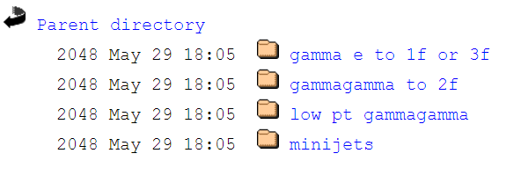
Gammagamma BKG
We didn't include $γ+γ→μ+μ$background in previous study. However, when I added this BKG, the cross section had some problem. We have contacted the Whizard authors and found ILC setting for producing this kind of bkg.
http://ilcsoft.desy.de/dbd/generated/250/gammagamma.html
Thanks to the help from MoXin. He gave me the whizard1.9.5 card to generate gammagamma BKG.
cross_section_in_fb=32629.6

Slide 3
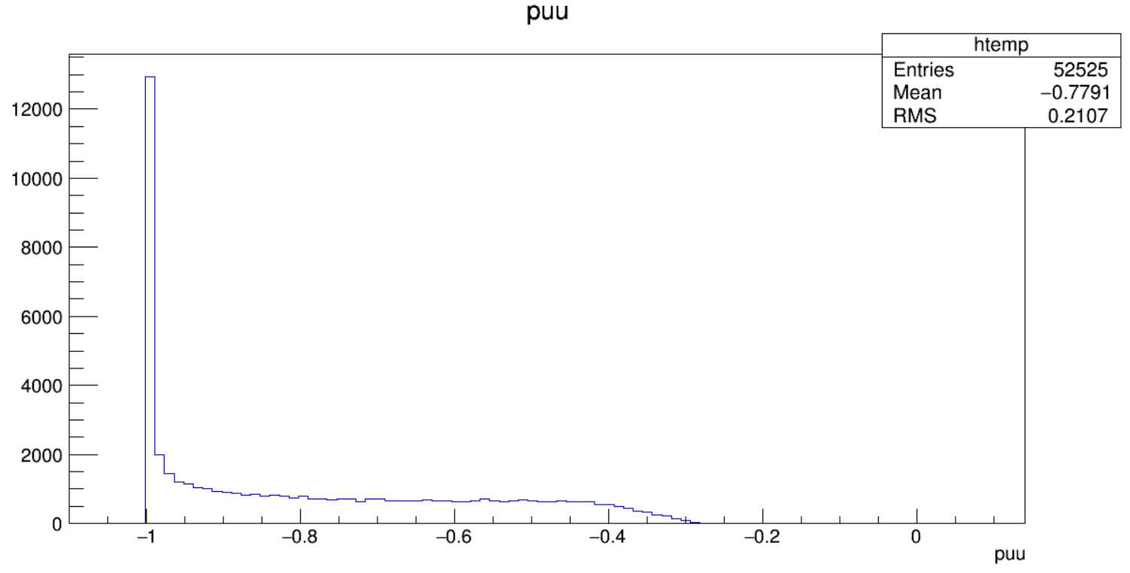
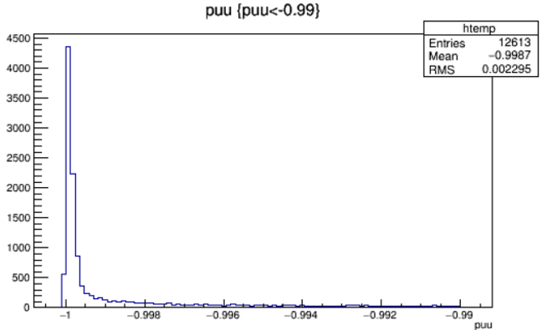
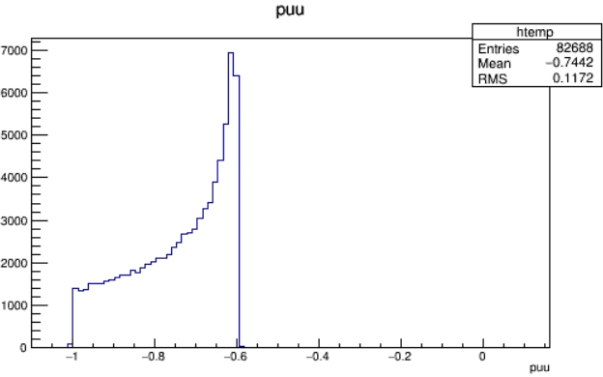
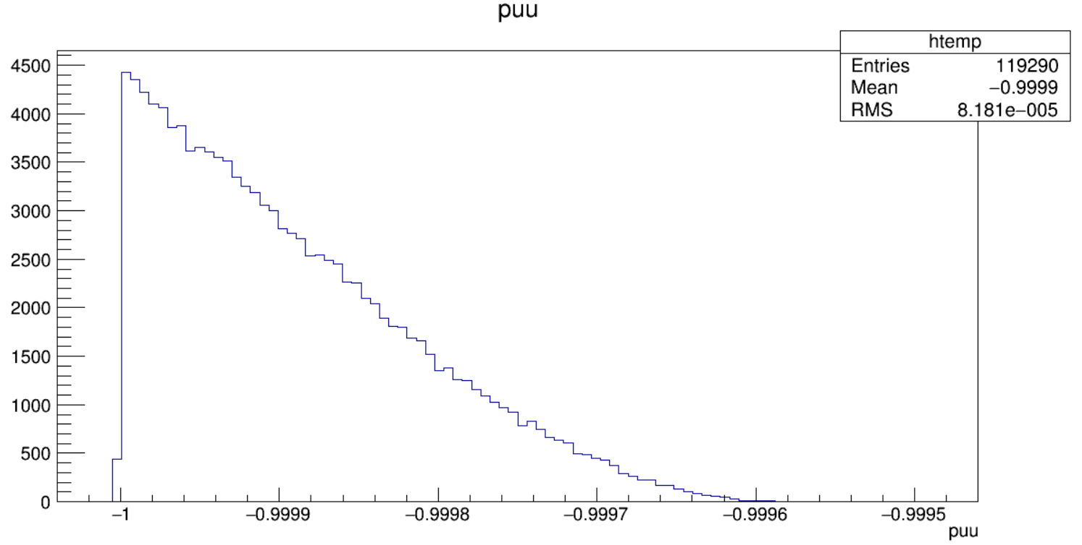
Gammagamma BKG
2f
2f
Cut:
puu>-0.996
gamma
signal

Slide 4
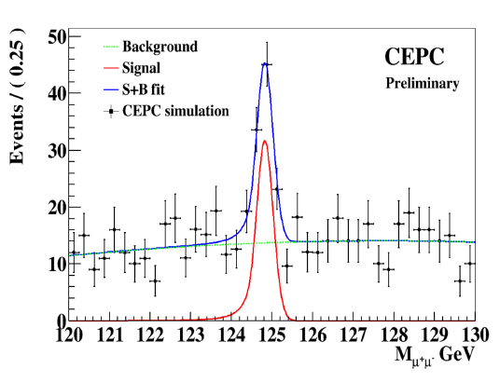
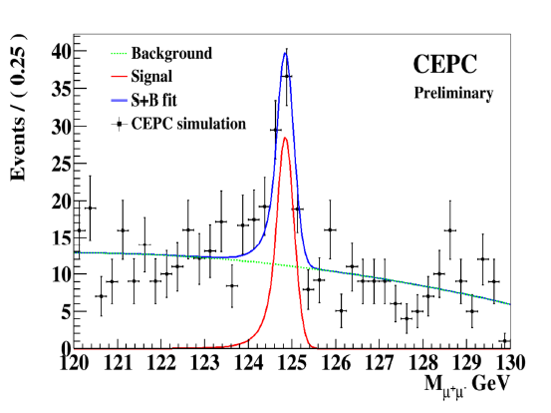
Analysis result
Zqq_MVA :
Strength=1.13
Significance=8.01
Inclusive_MVA:
Strength=1.16
Significance=7.63
In previous studies, we set pseudo-data simply as mixture of S+B events, which however, may suffer to low statistic and more importantly, the results signal strength uncertainty may be wrongly estimated. Hence we refer to a CLIC report （CLIC dp-Note-2014-005 23 October 2014)， by producing MC toys.

Slide 5
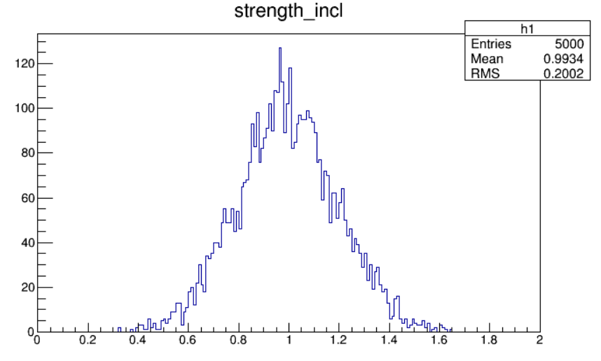
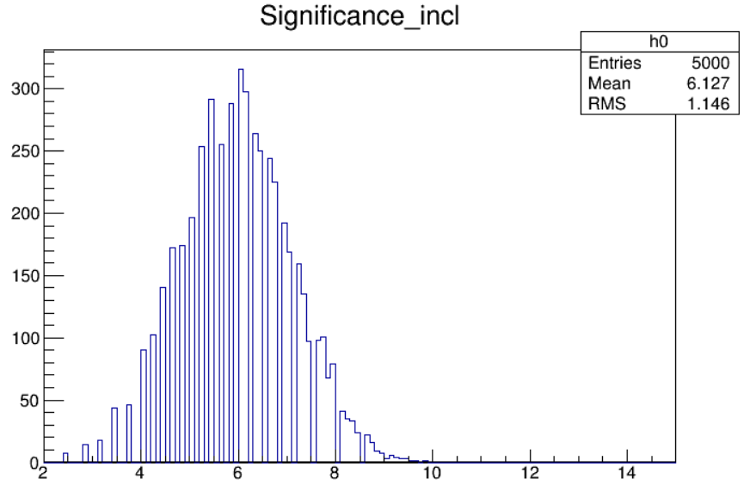
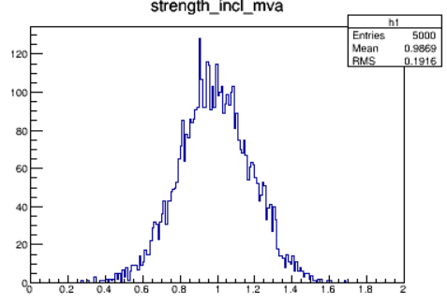
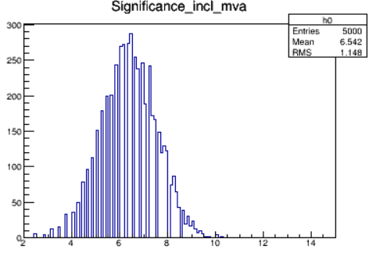
Inclusive analysis
Cut-base
In order to estimate the statistical uncertainty, 5000 Toy Monte-Carlo (MC) experiments were performed where pseudo-data were obtained by randomly picking signal and background M_{µµ} values were randomly generated from the PDF.
MVA

Slide 6
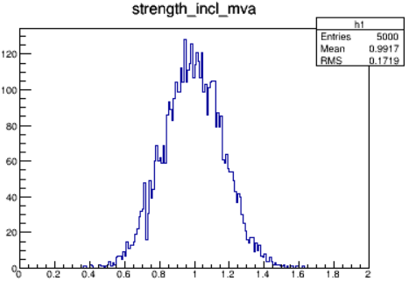
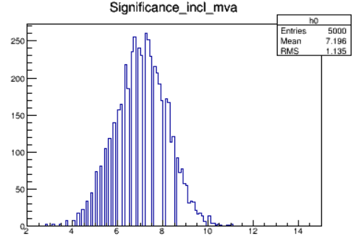
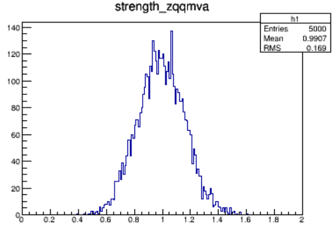
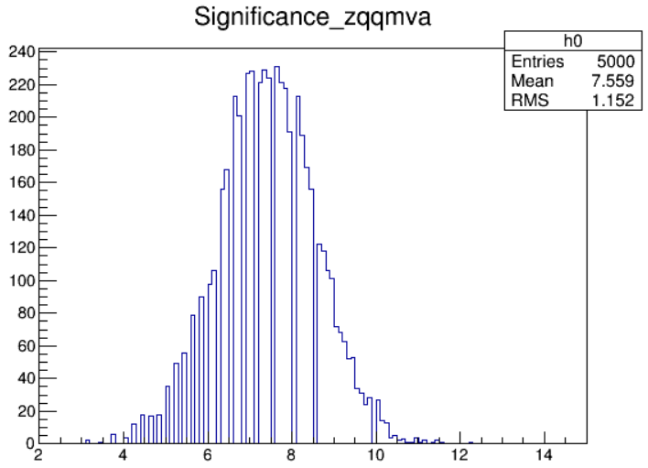
ZqqHuu analysis
MVA results are performed better than Cut-base.
Cut-base
 | strength | significance
incl_cut | 1.3(1) | 7.94(6.1)
incl_mva | 1.16(1) | 7.63(6.2)
zqq_cut | 1.1(1) | 8.12(7.2)
zqq_mva | 1.13(1) | 8.01(7.5)
MVA
Better division，
better approximation

