Slide 1
Introduction
Yaquan Fang

Slide 2
Workshop in November
Physics/simulations will have separated (parallel sections) under detector section.
Hope Physics section a joint one with theory (which will not occupy space in theory sections):
HL-LHC and CEPC challenge for EWK
HL-LHC and CEPC challenge for Higgs
1 kappa framework results
1 EFT (including EWK) + combination
new physics perspectives at CEPC
Whizard Generator towards CEPC
Fast simulation for CEPC
If these two talks can be taken
by theory section, we can more
time for discussion

Slide 3
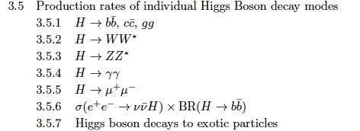
List
combination and kappa analysis: Jin, Kaili, Yaquan and Liu Zheng
- EFT: Jiayin, Liantao et al.,
- implications: Liantao Shufang, et al.,
- simulations: Manqi, Li Gang et al.,
- collider and detector: Joao, Manqi et al.,
- introduction: Liantao et al.,
Not so clear ones are:
- higgs recoiling tagging, mass and XS measurements
- decays: need name list for each channel;
Globally: Jianming
Volunteers are more than welcome
Chunhui, Zhijun
Nikos, Jianming, Lianliang
Zhuoni Qian, Tao Han
Jin Wang, Yaquan
H->tautau Xin Chen
Haifeng
H->Zy Weiming

Slide 4
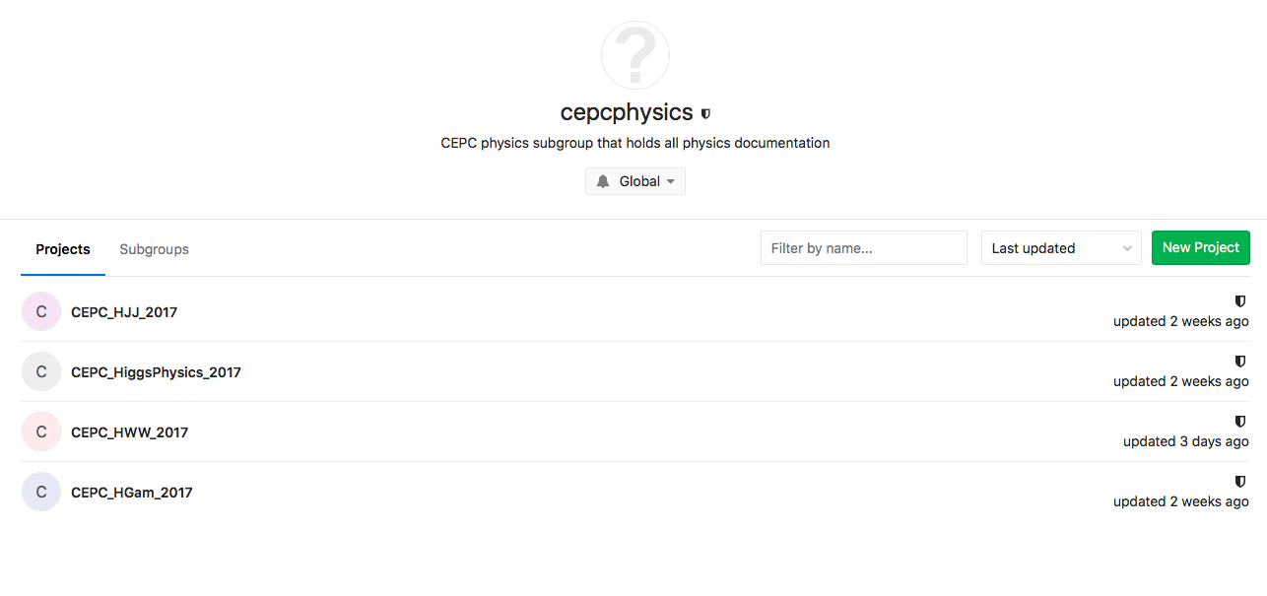
Git for physics white paper
http://cepcgit.ihep.ac.cn/cepcdoc/cepcphysics
Follow Jin’s slides to apply an account :
http://indico.ihep.ac.cn/event/6923/contribution/1/material/slides/0.pdf

Slide 5
How to use it (similar as svn)
git clone http://cepcgit.ihep.ac.cn/cepcdoc/cepcphysics/CEPC_HiggsPhysics_2017

